Slide 1
Supernova neutrino detection with XLZD and the limitations therein
Workshop on Xenon Detector 0νββ Searches: Step Towards the Kilotonne Scale.
SLAC, 25-27 October, 2023
Sayan Ghosh
ghosh116@purdue.edu

Slide 2
Outline
Supernova CEνNS detection sensitivity with XLZD.
Limitations due to charged current interaction of supernova neutrinos.
Implications of this interaction on future detector design.

Slide 3
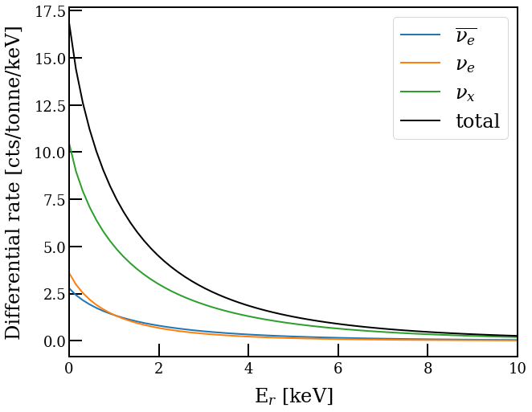
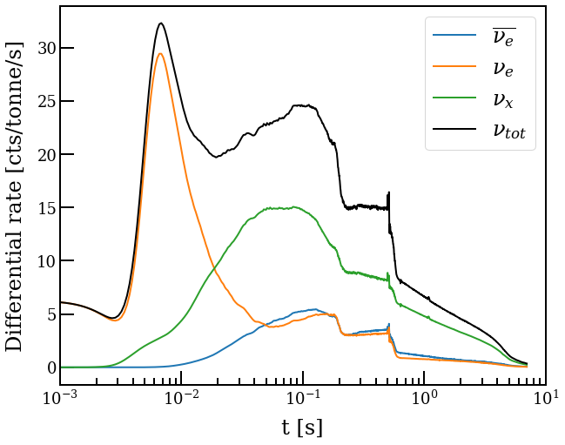
CEνNS
CEνNS process has an $A^{2}$ enhancement Xe a suitable target (A~131.2).
Reference supernova model :- 11 M⊙ at a distance of 10 kpc
(Bollig 2016, Mirizzi, et. al., arXiv:1508.00785)
At a distance of 10 kpc, a typical SN can generate ~700 CEνNS interactions in a target of $\sim 40$ tons of liquid xenon.
SNAX
snewpy

Slide 4
Analysis pathways
Supernova neutrino CEνNS
S1s & S2s
Ionization only
S1 - S2 paired signal
Low threshold
Almost no Z-information
Cleaner Signal
Higher threshold
High signal rate
Delayed electron emission
Low rate from other sources
Accidental Coincidences

Slide 5
Signal and background in detector
Signals and background without cuts
Signals and background after cuts
We put cuts on S2 features like
S2 area, width, rise time, x-y position, etc.
Background-only
Background-only
SN Signals (Simulated)
SN Signals (Simulated)

Slide 6
Detection Significance
Background and signal counts before and after cuts
Integration time = $\sim 7−10$ sec
Melih Kara
(SNvD 2023@LNGS: International Conference on Supernova Neutrino Detection)

Slide 7
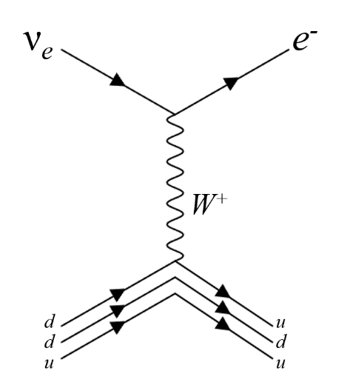
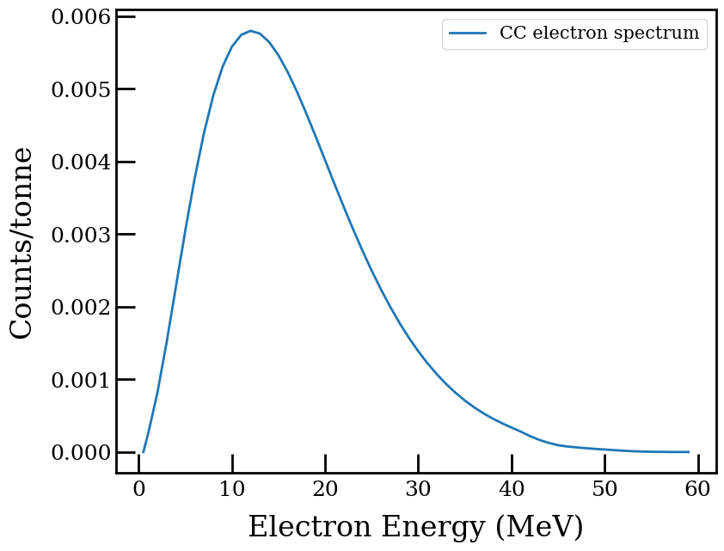
CC interactions of SN neutrinos (a limitation?)
The CC interactions lead to emission of electrons and a daughter nucleus in an excited state (¹³²Cs* in case of ¹³²Xe).
Time integrated spectrum of electrons from CC interaction of SN neutrinos for the entire supernova burst.
P. Bhattacharjee, A. Bandopadhyay, S. Chakroborty, S. Ghosh, et. al., Phys.Rev.D 106 (2022) 4, 043029.
For 11 M⊙ model : $\sim$4 electrons at 10 kpc are expected in XLZD (40 t).

Slide 8
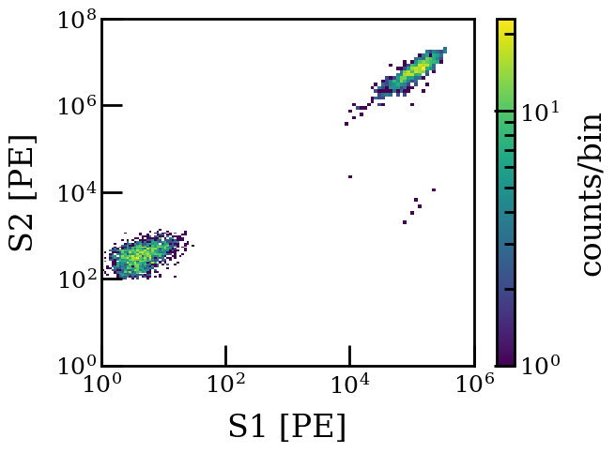
Signal sizes for CC electrons
For 11 M⊙ model, we will have 1 CC electron at a distance of $\sim$21 kpc.
CC e⁻s
CEνNS

Slide 9
Limitations to CEνNS detection
Saturation in PMTs and dead times in DAQ systems (~ms).
Enhanced photo-ionization rate due to large S2s.
Enhanced delayed few electron signal rate.
Effective dead time for muon signals is ~ seconds
Effective dead/high-background time

Slide 10
Limitations to CEνNS detection
Saturation in PMTs and dead times in DAQ systems (~ms).
Enhanced photo-ionization rate due to large S2s.
Enhanced delayed few electron signal rate.
Effective dead time for muon signals is ~ seconds
ν_{e}s dominate the first $\sim$20 ms
Bulk of CEνNS within 1s
The first CC interaction may submerge the later CEνNS upto the next ~1s

Slide 11
Implications on future detectors
Lower bound on the supernova distance due to the CC electrons?
Implications on design of future generation detectors like DARWIN/XLZD.
Enable detection of signals from O(1 keV) – O(100 MeV)
Methods to suppress enhanced photoionization.
Understanding the origin and suppression of delayed few electrons signals
Lower bound
from CC interactions
Lower bound from CC interactions

Slide 12
What if we managed to implement the design?
These implementations help us in lowering Dark Matter search thresholds with S2-only analysis.
Lowering delayed electron emission significantly lowers AC rates for XLZD.
XLZD
Discriminate/ Constrain SN models?
CEνNS
(Total SN neutrino flux)
CC Interactions (Only ν_{e} flux)
Neutrino physics?
Sensitivity to flavor composition of SN

Slide 13
Summary
XLZD will have high detection sensitivity towards supernova neutrinos.
Custom cuts need to be optimized.
CC interactions may pose an issue to CEνNS detection depending on the size of the detector.
Lower bound on the supernova distance.
Dynamic signal acceptance region.
Need to drastically reduce dead time by suppressing delayed electron emission.
Lower bound
from CC interactions
Lower bound from CC interactions

