Slide 1
FACET-II Addresses Key Needs for a Plasma-Based Collider
P5 Town Hall
Doug Storey/ Associate Staff Scientist / FACET-II
May 4, 2022

Slide 2
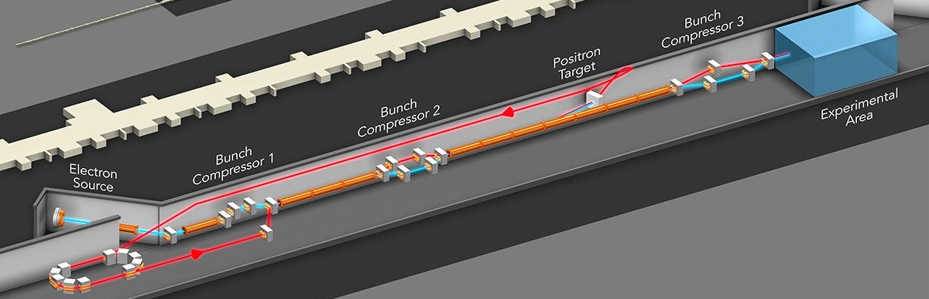
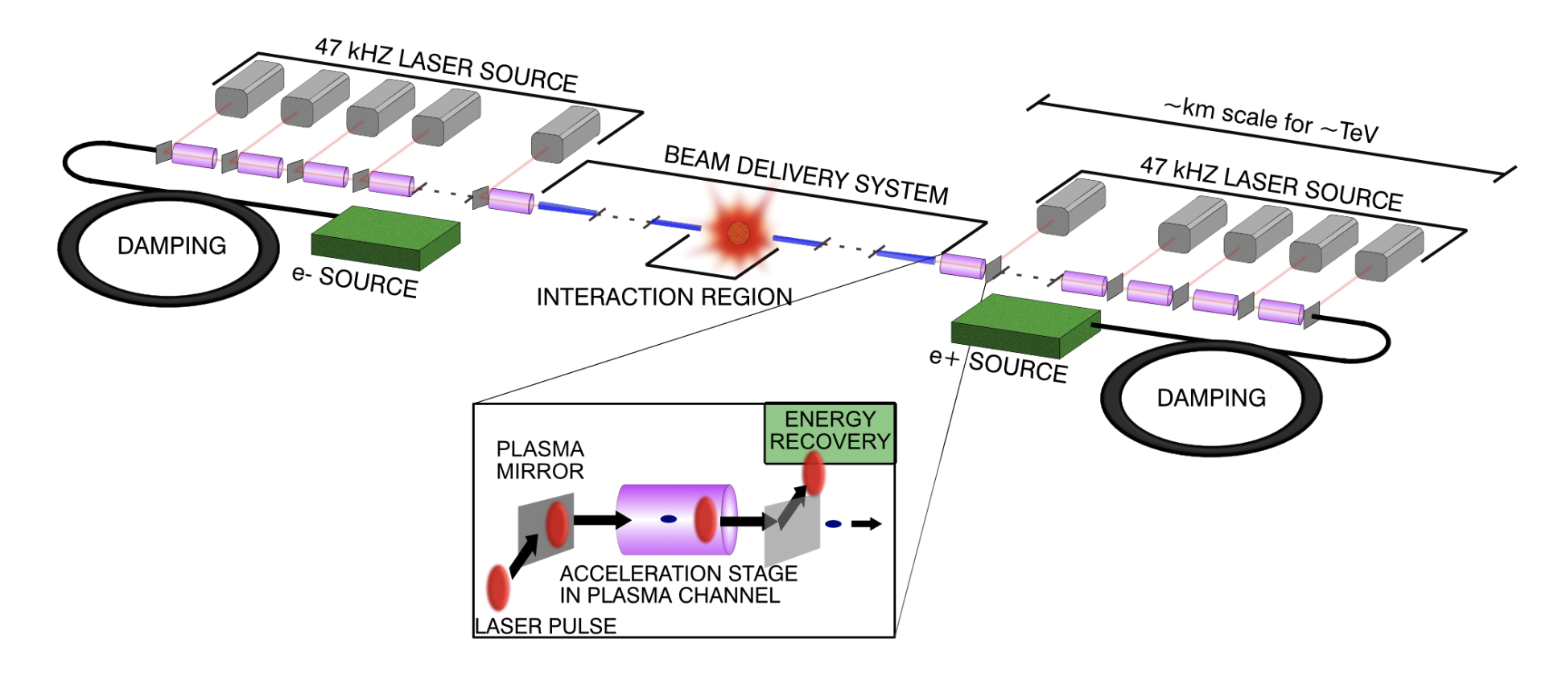
FACET-II National User Facility
FACET-II provides uniquely high intensity, multi-GeV electron beams for investigations into:
High gradient, efficient acceleration through plasma wakefield acceleration
Decreased length of the beam delivery system via plasma lenses
γ-γ collider physics through non-linear Compton scattering experiments
Positron plasma wakefield acceleration (with upgrade)
Positron Damping Ring & Injector
Drive e-beam
Drive e-beam
Laser driven plasma collider: Replace drive lasers with e-beams for beam driven PWFA
Notes:
FACET-II is the only facility in the world with multi-GeV e-beams
And is compatible with a future upgrade to add a positron damping ring and hardware to regain positron capabilities

Slide 3
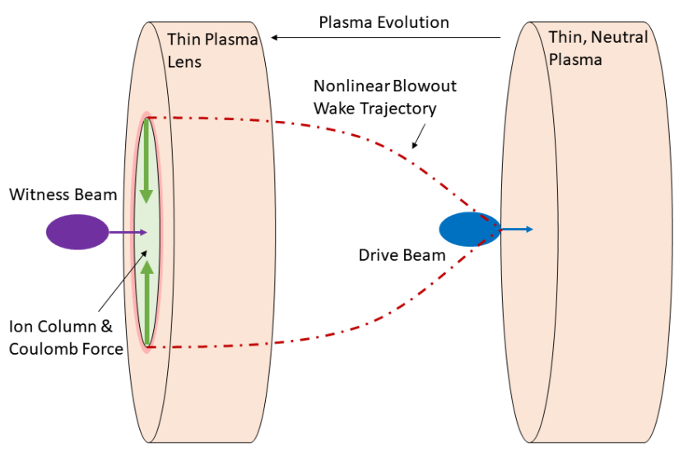
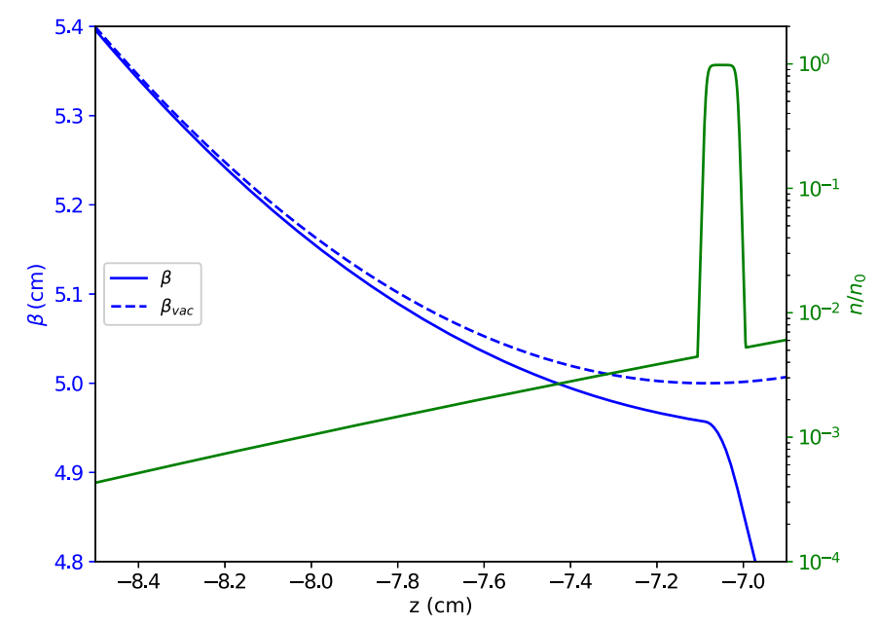
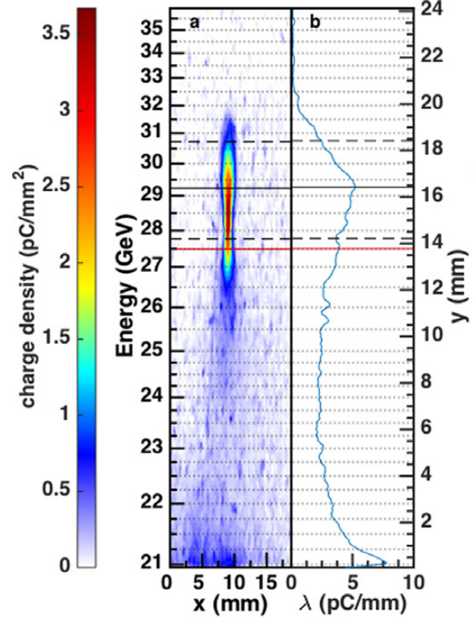
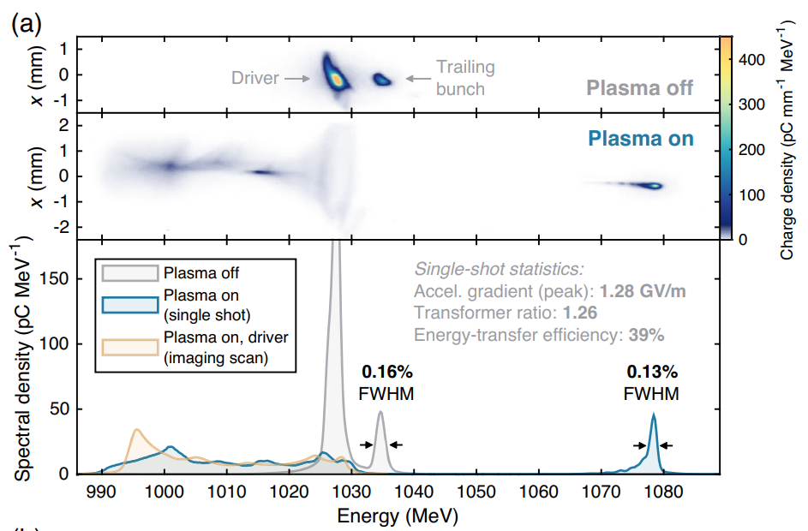
FACET-II addresses key research topics for linear colliders
E300 will demonstrate a single stage of a plasma linear collider with:
Multi-GeV/m acceleration
Low energy spread
Minimal emittance growth
>40% energy transfer efficiency with full energy depletion of driver
E308 is investigating the Underdense Passive Plasma Lens for application in a compact BDS
Traditional optics
Plasma lens
FACET
FLASH-Forward
G. White, et al., JoI (2022)
C. Doss, et al., PRAB (2019)
E320 probes strong field QED through boosted electron-photon collisions
FACET-II IP
e-beam
M. Litos, et al., PPCF (2017)
C. Lindstrom, et al., PRL (2021)
Notes:
E300 – high grad, high effic, low emittance
E308 – BDS plasma lens
Positron upgrade
E320 – example of compton IP for a gamma-gamma collider

Slide 4
FACET-II addresses key research topics for linear colliders
E300 will demonstrate a single stage of a plasma linear collider with:
Multi-GeV/m acceleration
Low energy spread
Minimal emittance growth
>40% energy transfer efficiency with full energy depletion of driver
E308 is investigating the Underdense Passive Plasma Lens for application in a compact BDS
Compact Beam Delivery System
Traditional optics
Plasma lens
Single stage of PWFA accelerator
FACET
FLASH-Forward
FLASH-Forward
G. White, et al., JoI (2022)
C. Doss, et al., PRAB (2019)
E320 probes strong field QED through boosted electron-photon collisions
FACET-II IP
Positron PWFA possible with facility upgrades
Gamma-gamma collider physics
e-beam
M. Litos, et al., PPCF (2017)
C. Lindstrom, et al., PRL (2021)
Notes:
E300 – high grad, high effic, low emittance
E308 – BDS plasma lens
Positron upgrade
E320 – example of compton IP for a gamma-gamma collider

