Slide 1
Dielectric Laser Accelerators
Joel England / Lead Scientist / FACET & Test Facilities
Co-authors: Robert Byer (Stanford), Peter Hommelhoff (Friedrich-Alexander-University)

Slide 2
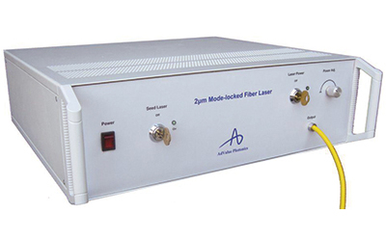
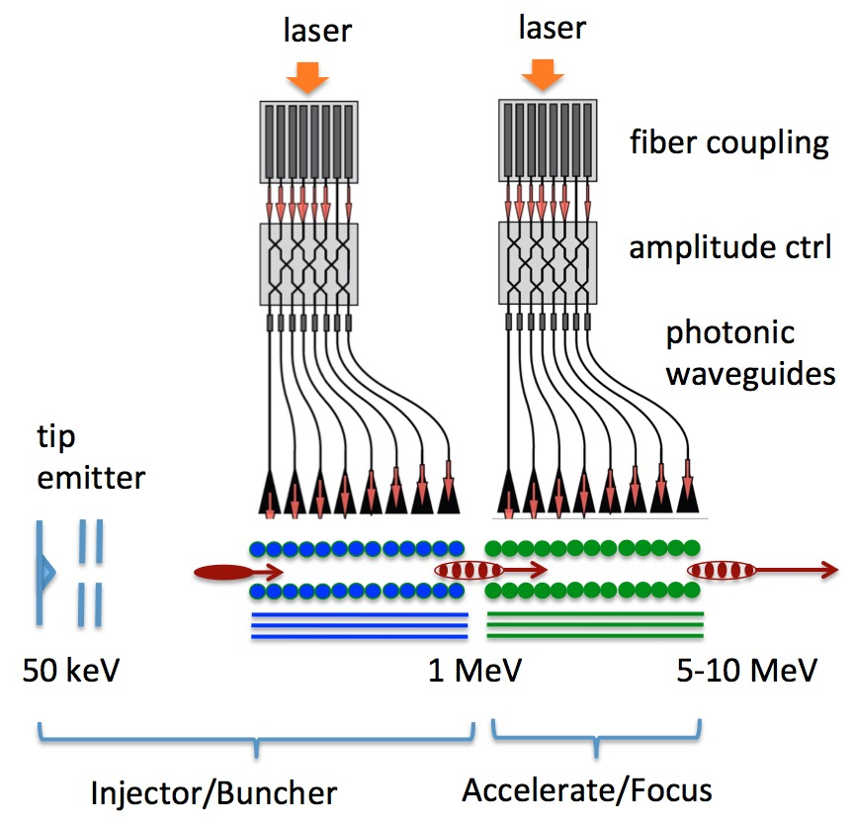
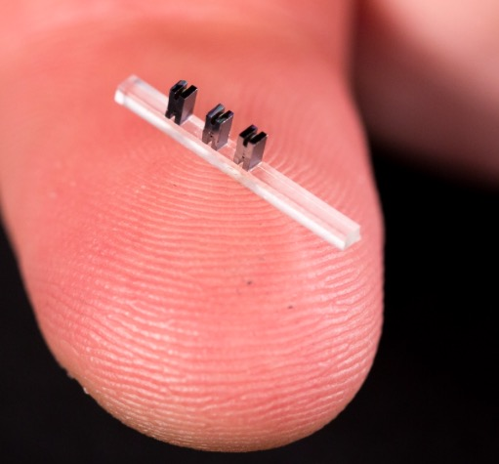
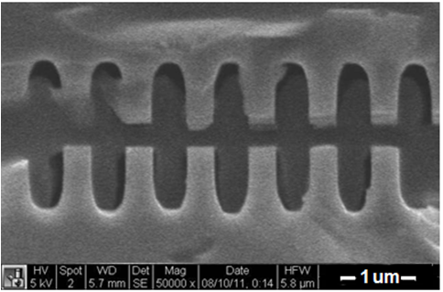
DLA Concept
Modelocked Thulium Fiber Laser (λ = 2µm, 10µJ, 10 MHz, $300k)
Required lasers are MHz rep rate, low pulse energy, wallplug efficiency ~ 30%
Dielectric materials can withstand GV/m
fields and kilowatts of average power
Can be mass produced using techniques of the integrated circuit industy.
Moore Foundation “Accelerator on a Chip” Program (2015-2023)*
Available now
“off the shelf”
gradient
SEM images of DLA prototypes tested at SLAC
$19.5M / 8 years
6 universities, 3 partner labs
2 industry partners
3 cm
fused silica
silicon
DLA research aims to produce ultracompact nanofabricated devices for particle acceleration. SLAC effort initiated under prior DOE support (pre-2015). Current Moore Program effort will end in 2023.

Slide 3
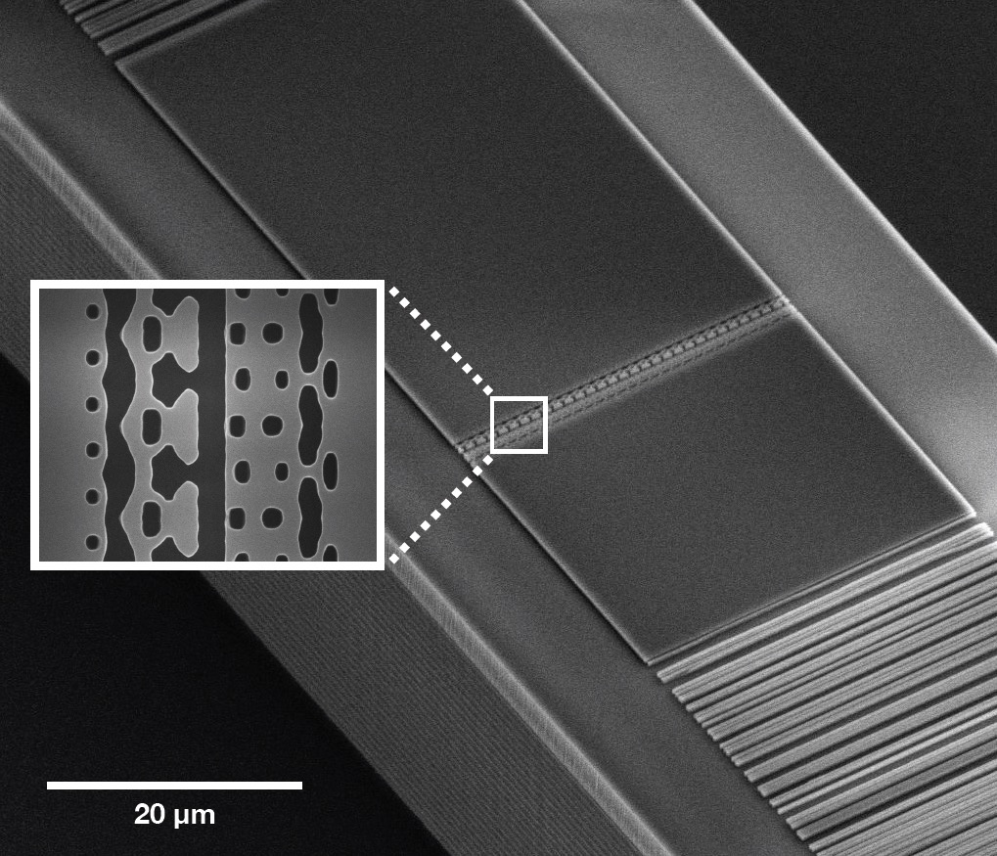
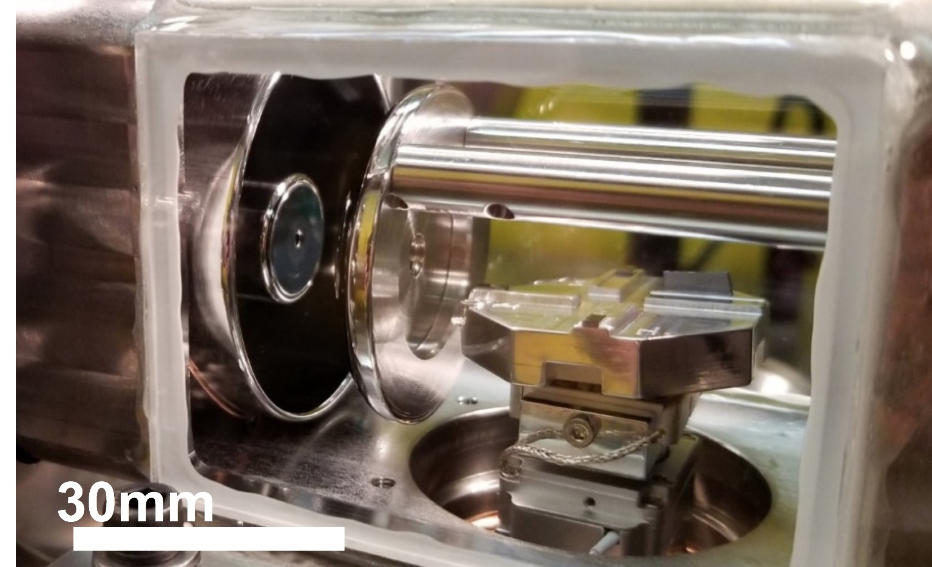
Milestones toward a real-world DLA device
→ Optical microbunching. (SLAC, Sears 2008)¹
Single-staged DLA with high gradient. (SLAC, Peralta 2013)²
GeV/m gradient and 0.3 MeV energy gain. (SLAC/UCLA, Cesar 2018) ^{3,4}
Develop a compatible laser-triggered source. (Stanford, Ceballos 2019) ⁵
Demonstrate laser-driven focusing and deflection. (Stanford/FAU, 2020) ⁶
Demonstration of waveguide-coupled DLA acceleration. (Stanford, Sapra 2020) ⁷
Sub-relativistic bunching, staging, and net acceleration. (Stanford/FAU, 2020) ^{8,9}
Demonstrate DLA net acceleration to 1 MeV. (in progress)
Integrate electron source/injector, couplers, and DLA accelerator on one wafer.
T. Hirano, et al., Appl. Phys. Lett. 116, 161106 (2020)
✔
waveguide coupled DLA
compact e- gun
✔
✔
✔
e-
30mm
✔
N. Sapra, et al., Science 367, 79-83 (2020)
✔
Stanford “glassbox”
✔
96keV
Enormous progress in DLA from theoretical concept to promising technology in 10 years. Further development needed to reach beam energy/quality suitable for most demanding applications.

Slide 4
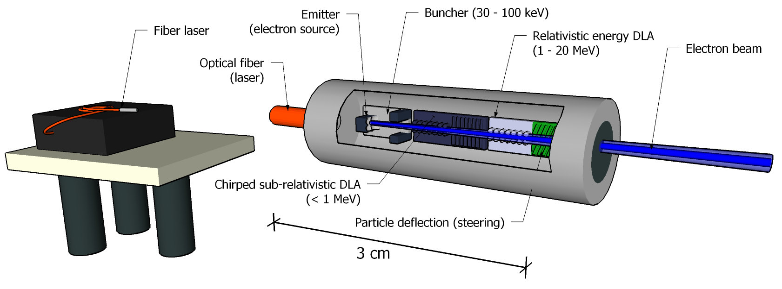
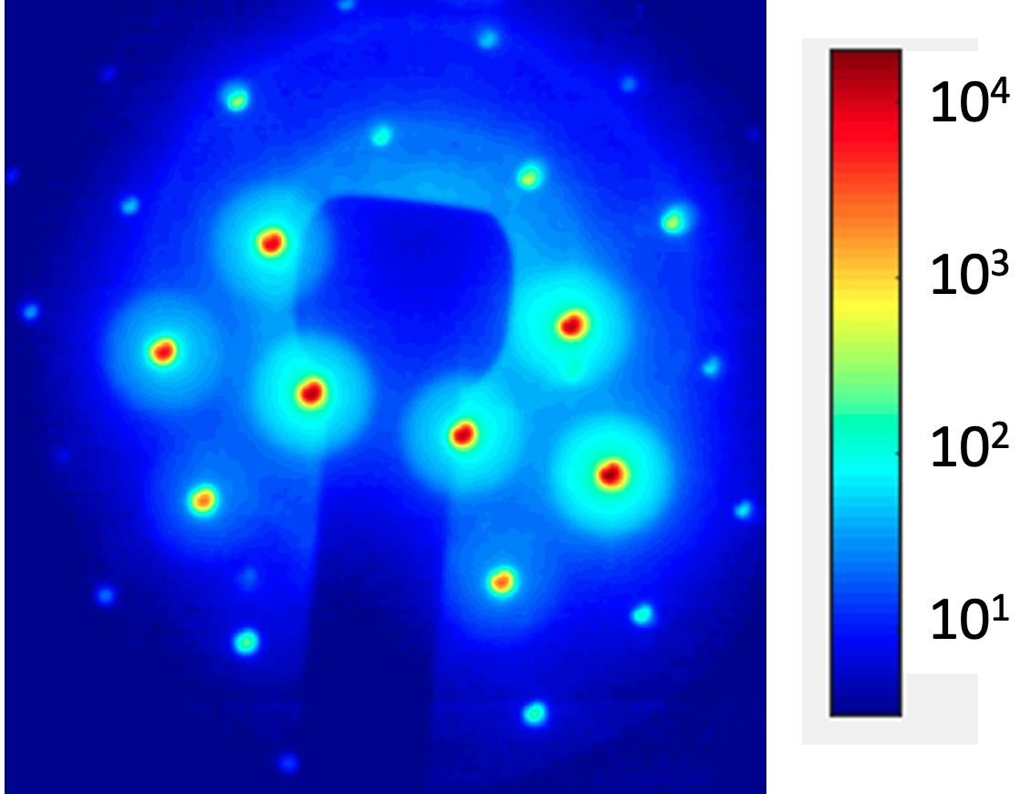
Applications
Application | Field | Time-Scale | Kinetic Energy | Species | Beam Power
Radiobiology, Endoscopic RT | Medical | 5 yrs | 100 keV to 10 MeV | e- | 1-5 mW
UED/UEM, QIS, and Attosecond Science | Science | 5 yrs | 1-5 MeV | e- | 10 to 50 µW
Radiation Sources (EUV, IR, THz) | Industry | 5-10 yrs | 10 to 100 MeV | e- | 0.5 W
Compton X-ray Source | Medical | 5-10 yrs | 10 to 60 MeV | e- | 20 to 60 mW
Fixed Target Dark Matter | HEP | 10-20 yrs | 1-20 GeV | e- | 5 to 120 mW
Proton/Hadron Therapy | Medical | 10-20 yrs | 70 to 250 MeV | p+ | 3-400 mW
Compact XFEL | Science | 10-20 yrs | 1 GeV | e- | 1.5 kW
Multi-Axis Tomography | Science | 10-20 yrs | 1 GeV | e- | 1.5 kW
Colliding Beam Fusion | Industry | 20+ yrs | 15 keV to 1 MeV | p+ | 1 MW
Linear Collider | HEP | 20+ yrs | 1 to 10 TeV | e-/e+ | 10 to 200 MW
compact medical devices
ultrafast electron diffraction
UED time-resolved (20 ps) measurement of
h-BN lattice heating using ACHIP beam line
With guidance from its advisory board, ACHIP has targeted near-term applications for follow-on funding. DOE support would provide a stepping stone to more demanding HEP requirements.

Slide 5
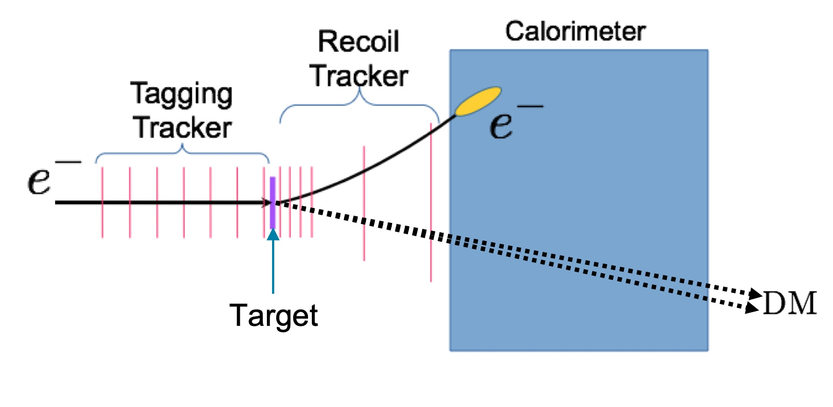
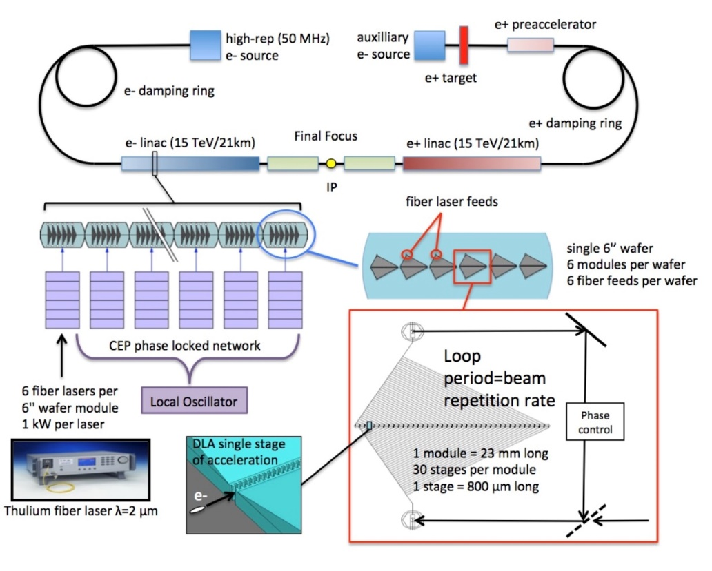
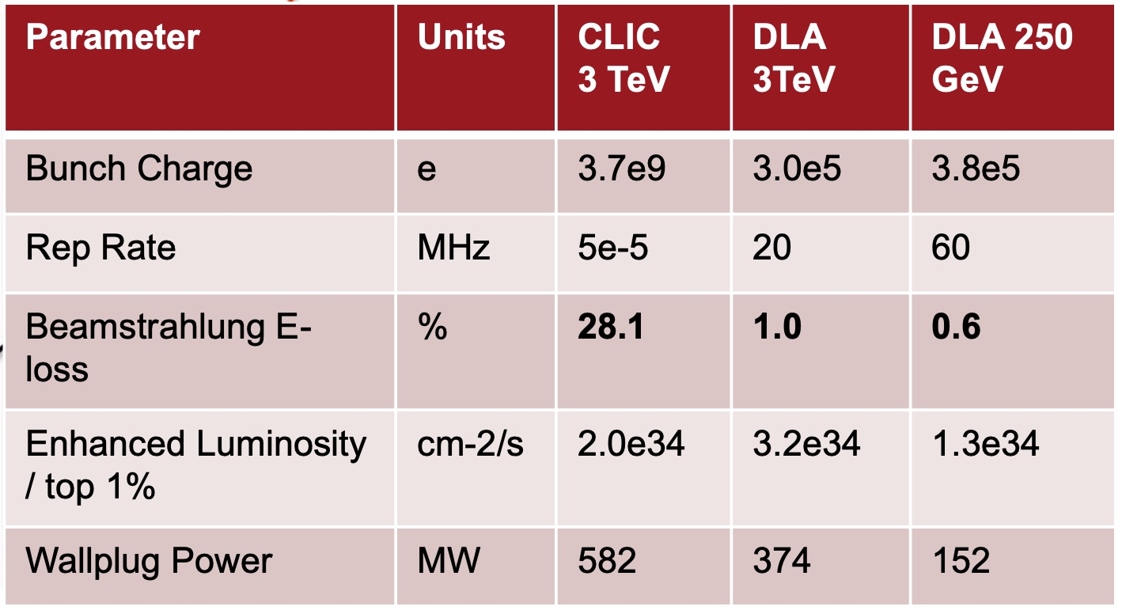
HEP Considerations
HEP 30 TeV e+e- Collider
Indirect Dark Matter Search (Missing Energy/Momentum)¹⁰
Snowmass Contribution, March 15, 2022
Example: proposed LDMX @ SLAC (courtesy T. Nelson)
Search for missing momentum in production of weakly interacting particles using LCLS-II drive beam
energies up to 20 GeV are beneficial
need a clean initial state (single electrons at high rep rate)
possibility to use a DLA → need to bring DLA to GeV scale
A DLA TeV collider has unique advantages (efficiency, cost, low beamstrahlung loss), but long time scale. Indirect fixed target DM search provides a promising intermediate scale application.

Slide 6
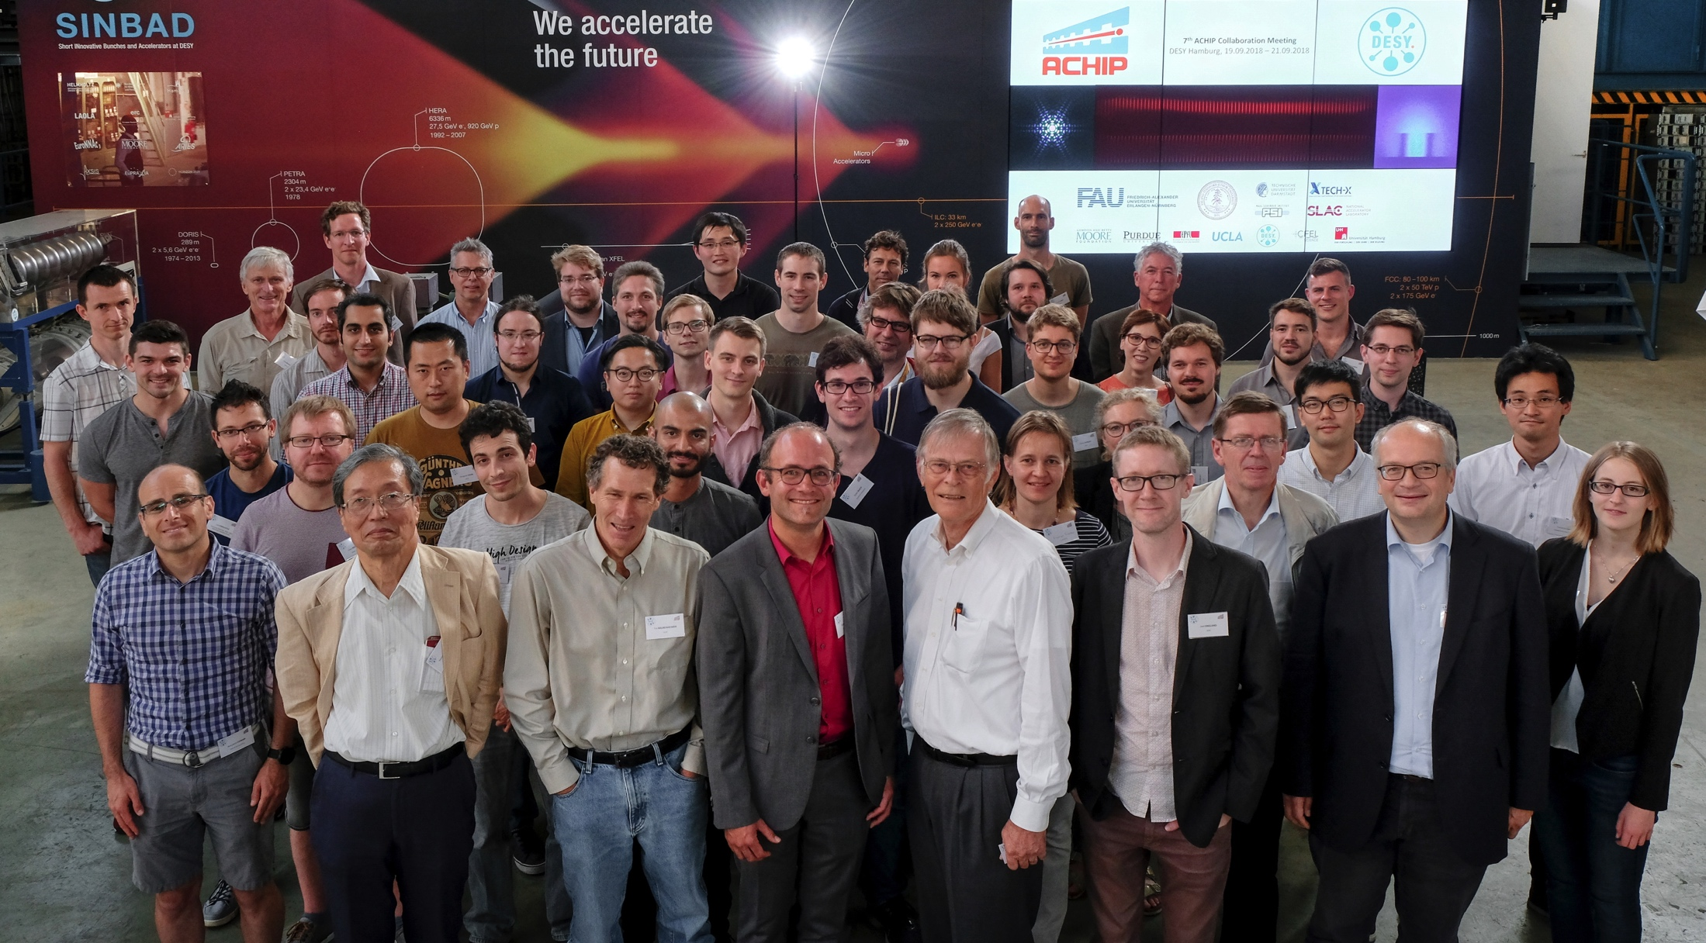
Thank you!
Group photo, ACHIP collaboration meeting in Hamburg, Germany, September 2018.
contact: england@slac.stanford.edu
http://achip.stanford.edu http://slac.stanford.edu/dla
Special thanks to K. Leedle, Z. Huang, Y-C. Huang, T. Hirano, U. Niedermayer for contributions of slides and to the U.S. Dept. Energy, European Research Council, and Gordon and Betty Moore Foundation for support.

Slide 7
References
C. M. S. Sears, E. Colby, R. J. England, et al., “Phase stable net acceleration of electrons from a two-stage optical accelerator,” Phys. Rev. ST-AB, 11, 101301 (2008).
E. A. Peralta, K. Soong, R. J. England, et al., “Demonstration of electron acceleration in a laser-driven dielectric microstructure,” Nature 503, 91-94 (2013).
D. Cesar, S. Custodio, P. Musumeci, et al., “High-field nonlinear optical response and phase control in a dielectric laser accelerator,” Comm. Phys. 1(4), 1-7 (2018).
D. Cesar, et al., “Enhanced energy gain in a dielectric laser accelerator using a tilted pulse front laser, “Opt. Exp. 26 (22), 29216 (2018)
T. Hirano, et al, “A compact electron source for hte dielectric laser acceleratior,” Appl. Phys. Lett. 116, 161106 (2020).
R. Shiloh, et al., “Electron phase-space control in photonic chip-based particle acceleration,” Nature 597, 498-502 (2021).
N. Sapra, et al., “On-chip integrated laser-driven particle accelerator,” Science 367, 79-83 (2020).
D. S. Black, et al., “Net acceleration and direct measurement of attosecond electron pulses in a silicon dielectric laser accelerator,” Phys. Rev. Lett. 123, 264802 (2019).
N. Shoenenberger, et al., “Generation and characterization of attosecond microbunched electron pulse trains via dielectric laser acceleration,” Phys. Rev. Lett. 123, 264803 (2019).
A. Berlin, et al., “Dark matter, millicharges, axion and scalar particles, gauge bosons, and other new physics with LDMX,” Fermilab-PUB-18-310-A, SLAC-PUB-17297 [https://arxiv.org/pdf/1807.01730.pdf]

