Slide 1
The Importance of Pure Theory
Juan Maldacena
P5 Town Hall
SLAC 2023

Slide 2
Physics is an experimental science

Slide 3
Why do theory?

Slide 4
Because we are not smart enough!

Slide 5
Because we are not smart enough!
If we were, then we would derive immediately the consequences of experimental results.
Or we would immediately derive the consequences of our fundamental theories.

Slide 6
already a long time ago it was said…

Slide 7
The book of nature is written in the language of mathematics
Kepler, Galileo 1620s

Slide 8
Fundamental physics is described in the language of quantum field theory
20th century

Slide 9
This language is hard!

Slide 10
We need to understand it! We need people who are fluent…

Slide 11
Interpreting experiments takes a vibrant theoretical physics community!

Slide 12
Theory can motivate new experiments

Slide 13
Grand goal of high energy particle physics
Find the quantum field theory describing nature
Particles and their interactions (presumes weak coupling, which is the case in the SM)

Slide 14
Understanding quantum field theory
Generate possible of QFTs.
Doing computations in a given QFT.

Slide 15
Our basic laws are a bit like riddles: If you solve this mathematical problem→ you can figure out what will happen in your experiment.

Slide 16
Basic tools
Mathematical constraints → Unitarity, positivity, causality, (UV completion).
Physical and phenomenological constraints → match experiments and observations.

Slide 17
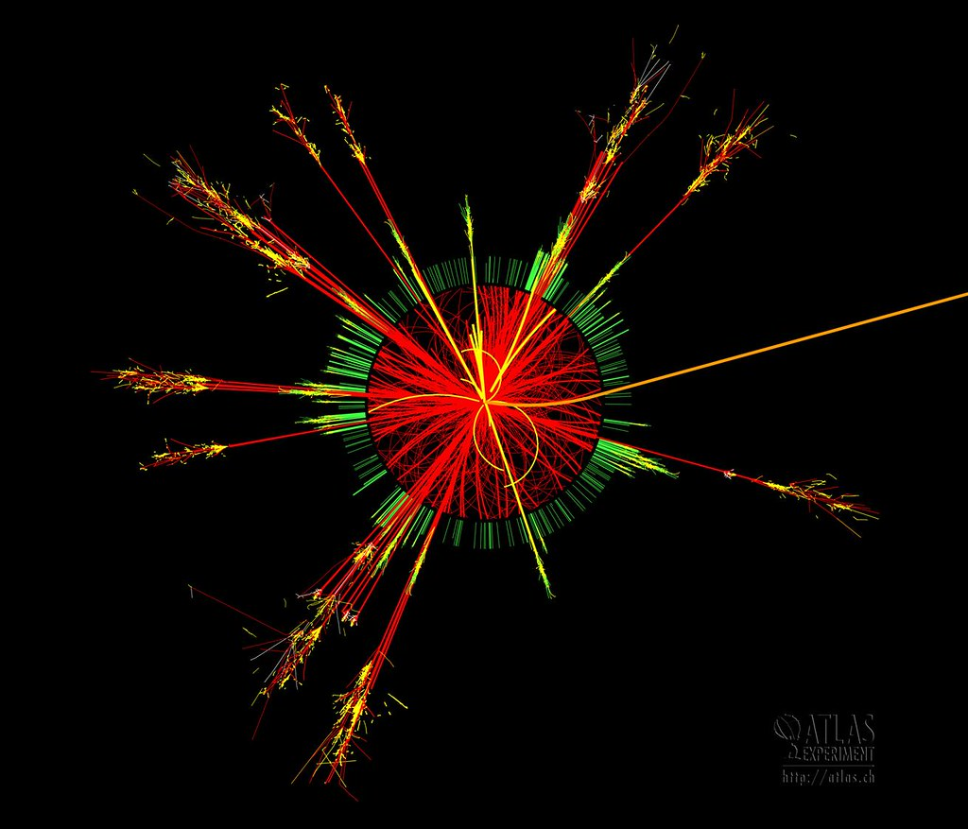
Symmetries
Scaling
Bootstrap
Quantum field theory
Topology
Quantum information
Numerics,
lattice
Dualities
Perturbation theory
Different pieces of the puzzle

Slide 18
A few comments on some of them

Slide 19
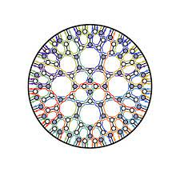
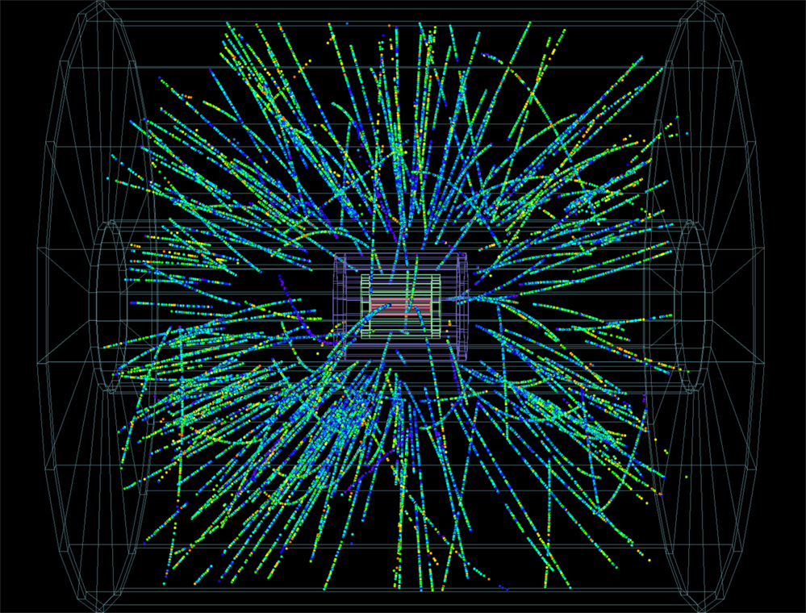
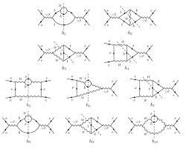
Diving deep into perturbation theory
Sophisticated mathematical ideas are turning into practical computational techniques for colliders.
Twistors, Grassmanians, etc.

Slide 20
The strong coupling frontier
How do we treat or analyze strongly coupled field theories?
We are lucky that the SM is weakly coupled.
But new physics could be strongly coupled. How do we explore it?
QCD becomes strongly coupled at low energies.

Slide 21
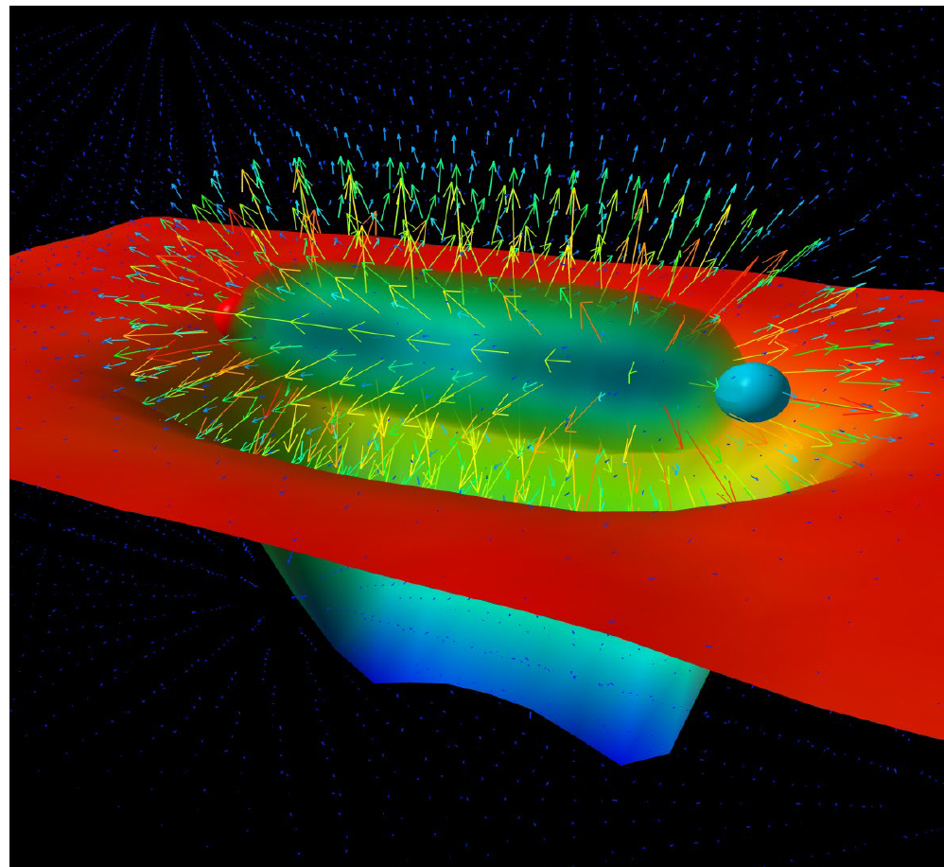
Confinement
Confinement is essential for describing the real world.
Can we understand it better? Conceptually and practically?
Lattice, quantum computers
Toy models (different dimensions, different matter contents, supersymmetry, large N)

Slide 22
A very basic tool..

Slide 23
Symmetries
Conservation laws, selection rules.
Spontaneous symmetry breaking.
Anomalies
Topology
Larger gauge symmetries → GUT theories, etc.
Supersymmetry.
Emergent accidental symmetries.
Proton decay?
Higher form symmetry.
Integrability (in two dimensions, or in large N (planar) theories)

Slide 24
One symmetry plays a crucial role in QFT

Slide 25
Scaling symmetries
Scaling is an important symmetry, or approximate symmetry.
Renormalization group.

Slide 26
Bootstrap ideas
Exploiting mathematical consistency conditions to constrain theories strongly enough to get some predictions.

Slide 27
The conformal bootstrap
=
Well established results in d=2
Very interesting new tool to study CFTs in d>2. Concrete results in 2+1 and 3+1 dimensions.

Slide 28
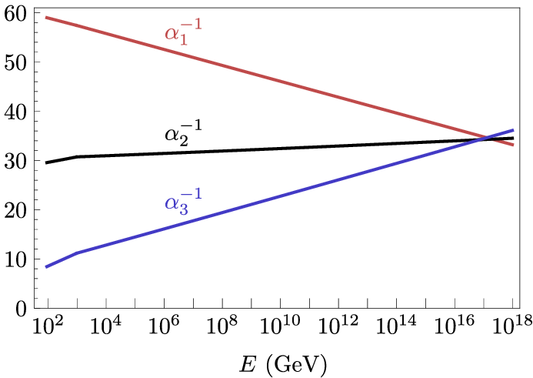
Supersymmetry?
Solvable models
Leads to exact solutions. Window to strong coupling.
Useful for the exploration of many aspects of quantum field theory, confinement, dualities, amplitudes, collider physics, etc.
Is it the ultimate explanation of the electroweak hierarchy?

Slide 29
Dualities in quantum field theory
Strong coupling → weak coupling.
Complicated → Simple.
Connections with condensed matter physics.

Slide 30
Tools from quantum information
beyond quantum simulations…

Slide 31
Quantum field theory through the lens of quantum information
How does quantum information constrain QFT?
Puts some order in the renormalization group flows.
Subtle positive energy conditions.

Slide 32
Let’s pause for a comment…

Slide 33
...but theorists have their heads in clouds..

Slide 34
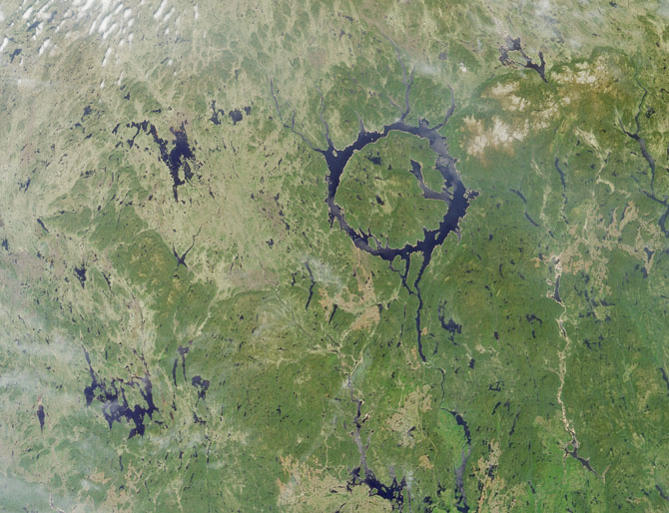
Satellite view : connecting different ideas

Slide 35
An interesting example is the following

Slide 36
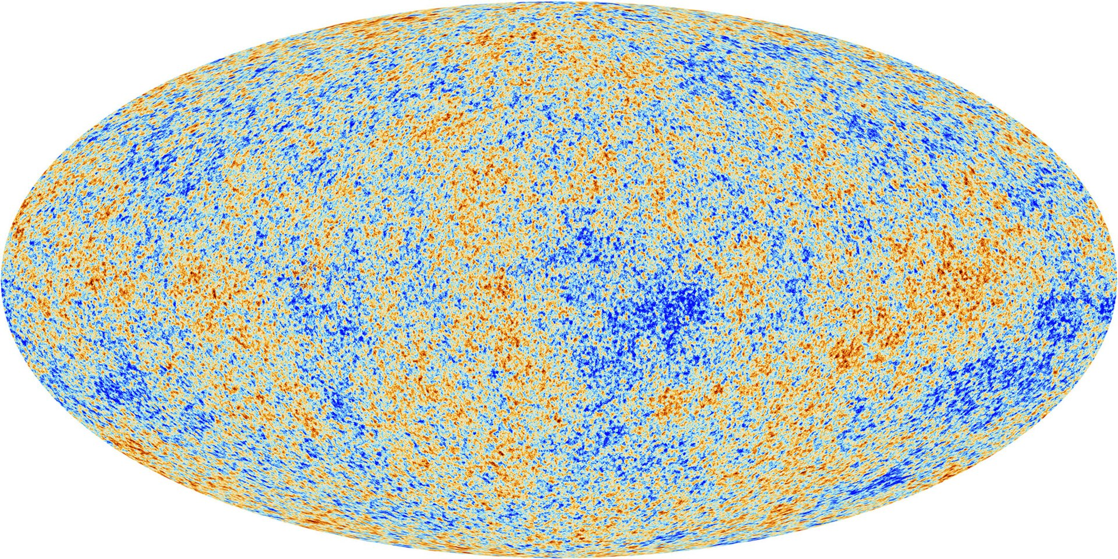
Primordial density fluctuations in cosmology
Theory of inflation developed in the 80’s

Slide 37
Primordial density fluctuations in cosmology
The shape of the universe is a snapshot of a quantum field !

Slide 38
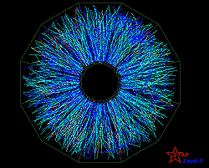
Inflationary primordial fluctuations
Quantum field theory techniques → tools for computing subtle signals.
Similar to

Slide 39
Beyond quantum field theory into Quantum Gravity

Slide 40
Why do we care about quantum gravity?
Mystery of the initial cosmological singularity.
Clarify mysteries around the Standard Model: gauge groups, coupling constants, details of inflation, etc.

Slide 41
String theory as a candidate theory of quantum gravity
It is a theory under construction.
At least, it is a very useful toy model.
It involves involve deep mathematical structures that are intimately connected to various aspects of quantum field theory.

Slide 42
A rich problem to study in quantum gravity

Slide 43
The black hole information problem
How do black holes work in the quantum theory?

Slide 44
A hypothesis

Slide 45
Black holes as quantum systems
A black hole seen from the outside can be described as a quantum system with S degrees of freedom (qubits). S = Area/4 (l_{p} =1)
=
Hawking argued that it is not true…

Slide 46
Gravitational holography
Quantum systems with boundary = quantum theory on the boundary.
AdS/CFT.

Slide 47
Unexpected connections to other fields of physics
Quark gluon plasma
Condensed matter
Quantum chaos.
…

Slide 48
Constraints on effective field theories from quantum gravity
We suspect that not all effective field theories can be embedded in a full theory of quantum gravity.
Some properties are rule out by quantum gravity.
With (hopefully) possible implications for inflation, proton decay, etc.

Slide 49
Conceptual questions in cosmology
Initial singularity?
Measure problem?
Was there anything “before” the singularity?

Slide 50
I would like to end with some comments

Slide 51
The importance of diversity of approaches
It is important to follow a diversity of approaches and theoretical methodologies.
From more phenomenologically oriented.
To in depth studies of idealized models.
I only highlighted a sample of the diverse theoretical ideas that are being studied.

Slide 52
Case study Anomalies and the chiral magnetic effect
j
B
Heavy Ions collisions
Hydrodynamics and black holes
Hydrodynamics and anomalies
Weyl metals

Slide 53
Many other cases
Superconductivity → Higgs boson
Hawking radiation → Cosmological fluctuations.
Topology → Instantons, theta term, anyons, quantum computing…
…

Slide 54
Creating Human capital
Nurturing the rising talent
This area attracts outstanding young people
Supporting junior faculty and postdocs doing high risk/high return research.
Versatile theorists can contribute in many fields of physics, technology and industry.

Slide 55
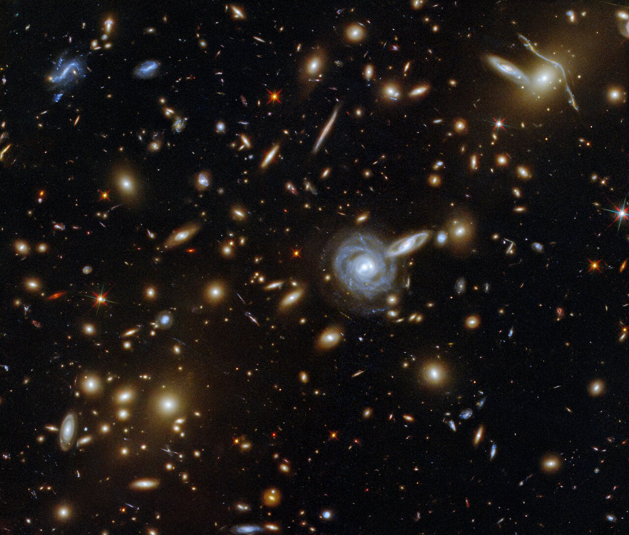
What lies beyond the Standard Model?
We have many exciting opportunities in the road ahead for theoretical discoveries!

Slide 56
We all look forward to the exciting experimental projects that will come out of the P5 process!
Thank you!

