Slide 1
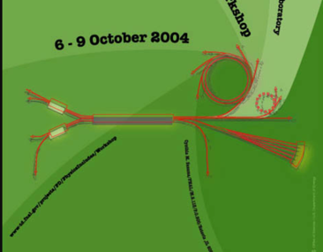
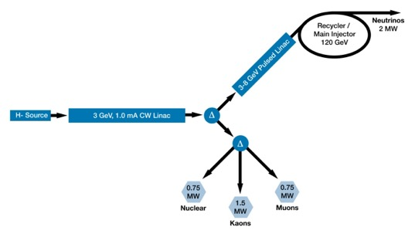
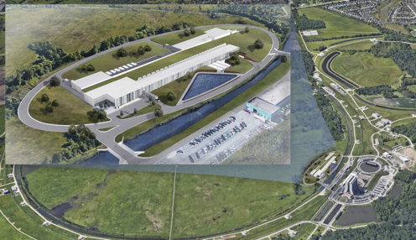
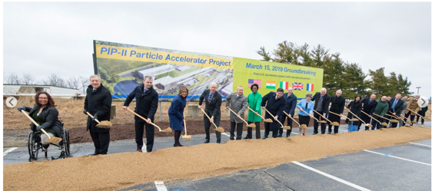
Proton Driver 2004
Project X 2011
PIP-II Today
ECAs at the Intensity Frontier, an example
Brendan Casey, Fermilab
June 9, 2023

Slide 2
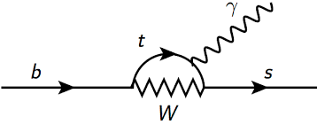
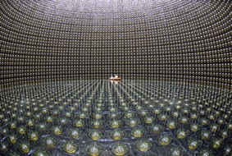
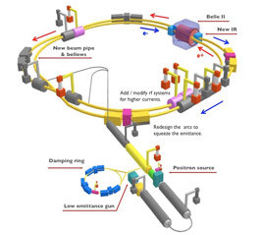
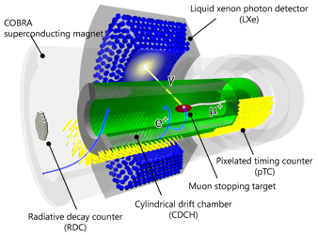
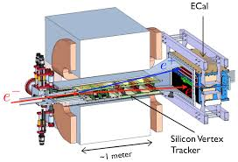
What is the Intensity Frontier?
Many attempts to try and write this down in a sentence, usually focusing on loops and indirect access to energy scales beyond the Energy Frontier
In reality, it is more of a ‘none of the above’ frontier
No one really liked it
Low energy accelerator based searches for dark sectors
neutrinos
Heavy quarks
Charged leptons
Neutrinos just want to be neutrinos
Really consider themselves the cosmic frontier
Collider people have more synergies with EF
Low energy people prefer ‘precision frontier’
But we all like to have fun parties,
and our differences make us more interesting and keep us on our toes

Slide 3
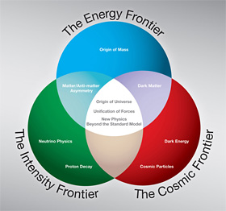
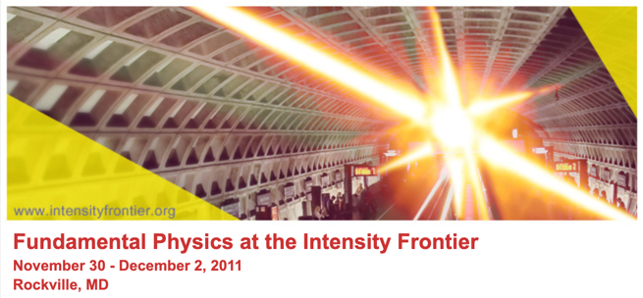
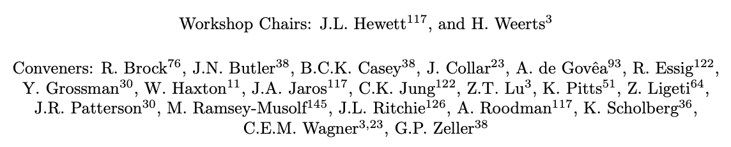
Where did it come from?
Not really any new ideas but we were all brought together by the opportunity created when the ILC cost exercise completed in ~2007 and came in higher than the funding agencies could handle at that time.
DOE charged several community members with defining the intensity frontier (Rockville pre-snowmass process)
2008 P5 defined the 3 frontiers
The 3 early career members on the organizing committee all got ECAs in 2012
Lesson 1: Community involvement is a lot of work, but it pays off

Slide 4
Getting an early career award
I was shopping for something to do after the Tevatron
2008 P5 strongly endorsed Mu2e and said don’t do g-2 in the US
Fermilab Director asked me to work on Mu2e, so I decided to do g-2
  (I did say yes two Directors later)
The muon g-2 detectors were all calorimeter based at Brookhaven. People wanted a tracker but no one thought you really needed one to do the experiment
  It didn’t make it into the project’s scope
ECA program started so I submitted an ECA to fund a tracker for g-2
Lesson 2: Take risks.

Slide 5
Thank you for 3 strikes!
First submission for 2010: mostly hardware based
  Reviewer: “Why would I trust this PI to do an ultra precision measurement like g-2 if he can’t even figure out how to run a spell checker?”
Second submission for 2011: Muon EDM based (i.e. a stand-alone parasitic measurement separate from the g-2 measurement)
  Reviewer: “Why would I give $2.5M to do a poor muon EDM measurement when $2.5M would make an enormous difference in a table-top electron EDM measurement?”
Third submission for 2012: Figured out how the tracker enables the main g-2 measurement. ECA physics case = entire g-2 physics case
  Success
Lesson 3: Poor packaging is sufficient to kill a good idea
Lesson 4: Your ECA’s physics case has to be at least as strong as your experiment’s physics case

Slide 6
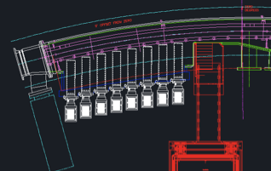
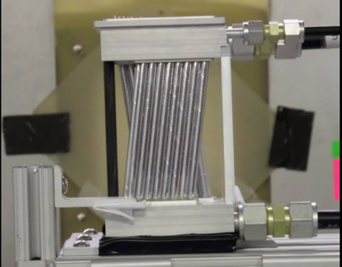
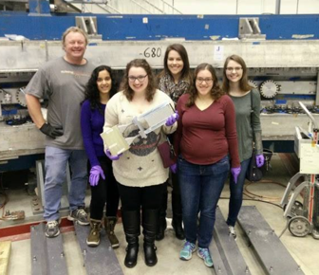
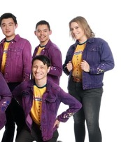
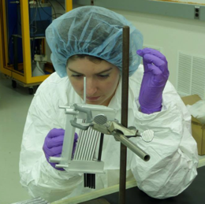
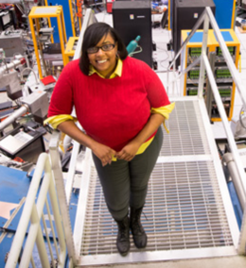
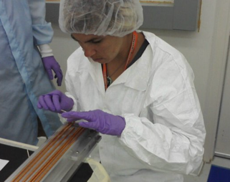

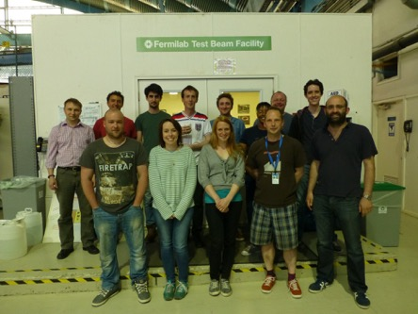








The payoff
Got to design and build something!
Got to hire an awesome team!
Alicia
Emily
Nerione
Emma
Laura
Mandy Rominsky
Leah Welty-Reiger
Tammy Walton
An army of high school students
Got to build an amazing collaboration!

Slide 7
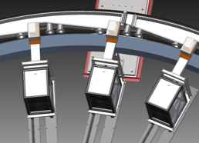
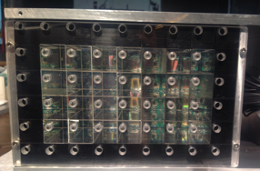
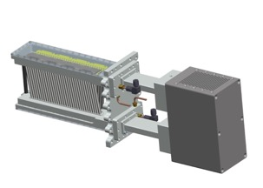
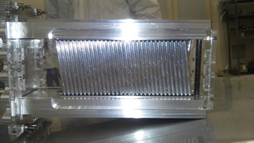
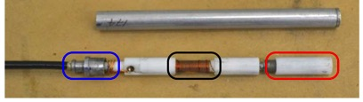
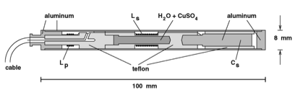
The impact
PbF₂ crystal calorimeters for measuring positron energy and time
In-vacuo straw trackers to measure positron trajectories, extrapolate back to measure beam profile
Muon precession frequency
(NSF MRI Award 2013)
g-2
Proton precession frequency
Beam dynamics
NMR probes fixed in place and on a trolley to tune and map the field
(DOE Early Career Award 2012)
(DOE Early Career Award 2014)

Slide 8
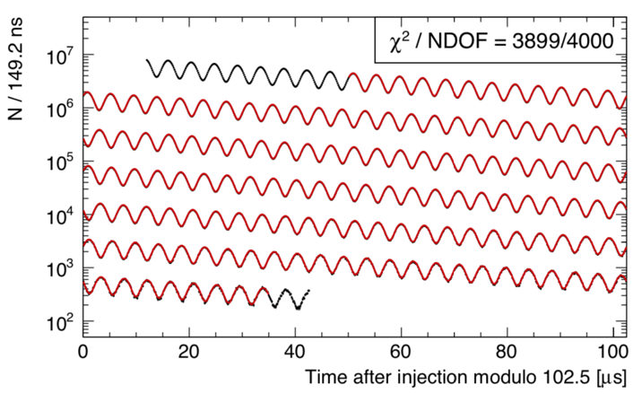
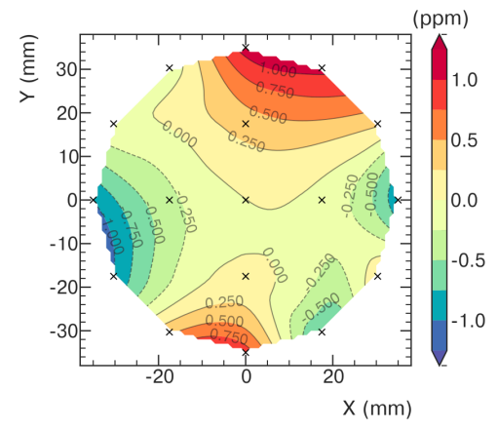
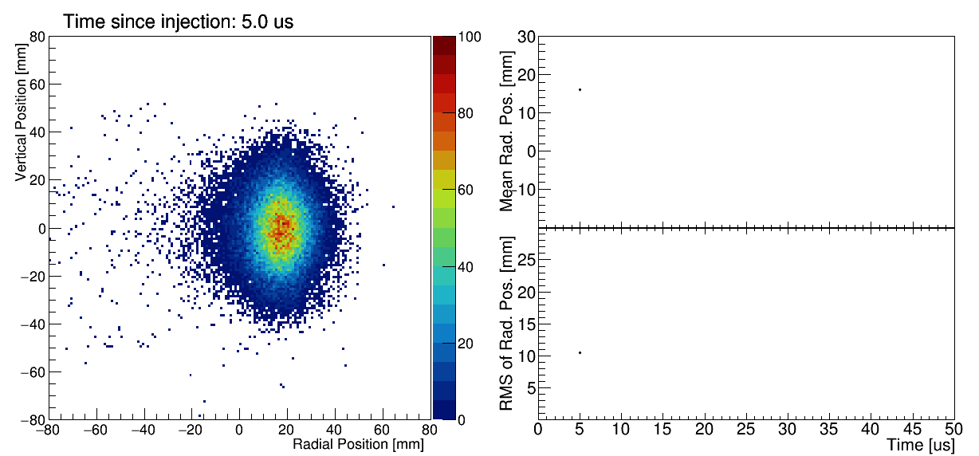
g_{μ}= 2.00233184122(82)
Muon precession frequency
Proton precession frequency
One request:
PLEASE FUND MORE EARLY CAREER AWARDS TO UNDERSTAND THE PREDICTED VALUE OF MUON G-2!
This will greatly increase the return on the DOE’s significant investment!
Beam Dynamics

Slide 9


Where is the intensity frontier now?
Superseded by the last P5
  Neutrinos always wanted to be their own thing
  Everyone else was finally lumped into an appropriately named category: The Unknown!
But we are still funded together so lifting up neutrinos still floats all boats!
More importantly, the 2008 vision has become a reality.
  Multiple sub-fields trying their best to answer intertwined fundamental questions with mutual respect for the challenges each face and the accomplishments each achieve.
  Every victory is a reason to party!
We can start a betting pool for what the next P5 decides to name us!
  (If it’s not too late, my favorite color is purple)

