Slide 1
HEP Early Career Awards in Accelerator R&D
HEP Early Career Award Network Summer 2023 Workshop
Accelerator Frontier Lightning Talk
Xueying Lu
Northern Illinois University (NIU) & Argonne National Laboratory (ANL)
June 9, 2023
@ Texas A&M University

Slide 2
Outline
Research Thrusts in General Accelerator R&D
HEP Early Career Awards (ECAs) in Accelerator R&D
Disclaimer #1: Not including ECAs related to accelerators funded by other offices than OHEP
Disclaimer #2: List in this talk may be incomplete
My own program (since 2021)
“Innovative High-Frequency Structures for High-Gradient Wakefield Acceleration”

Slide 3
Research Thrusts in General Accelerator R&D
Accelerator and Beam Physics (ABP)¹
Beam intensity, quality, control, and prediction
Advanced Accelerator Concepts (AAC)²
Direct Laser Accelerator / Laser Plasma Acceleration / Plasma Wakefield Acceleration / Structure Wakefield Acceleration
Radiofrequency (RF) Acceleration Technology³
Normal-conducting RF / Superconducting RF / RF sources / Auxiliary RF systems
Superconducting Magnets and Materials⁴
Particle Sources and Targets⁵
ABP Roadmap: https://science.osti.gov/hep/-/media/hep/pdf/2022/ABP_Roadmap_2023_final.pdf
AAC Roadmap: https://www.osti.gov/biblio/1358081
RF Roadmap: https://www.osti.gov/biblio/1631119
Magnet Roadmap: https://usmdp.lbl.gov/wp-content/uploads/sites/7/2022/08/USMDP-2020-Plan-Update-web.pdf
Target and Sources Roadmap Workshop held in April 2023
Roadmaps

Slide 4
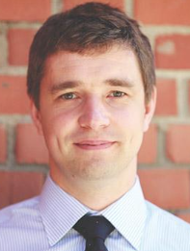
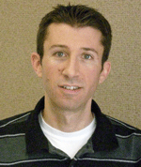
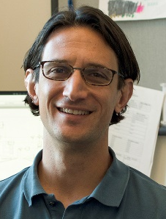
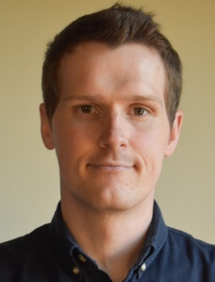
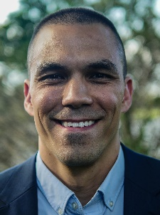
HEP ECAs in Accelerator and Beam Physics
ABP topics: beam modeling, beam dynamics (space charge, instability, cooling…), low-level RF systems, beam diagnostics…
Snopok (IIT)
2012
Mitchell (LBNL)
2016
Mastoridis (CalPoly)
2018
Ainsworth (FNAL)
2020
Jarvis (FNAL)
2020
Ruisard (ORNL)
2022
Advanced Simulation Tools for Muon‐Based Accelerators
Compensation of Nonlinear Space Charge Effects for Intense Beams in Accelerator Lattices
Optimal Design of Radio Frequency Algorithms and Models for Next Generation Accelerators
Ensuring Bunch Stability in Multi-MW Beams
Next-Generation Beam Cooling and Control with Optical Stochastic Cooling
Advancing accelerator beam modeling via high-dimensional phase space diagnostics at a high-intensity injector test stand

Slide 5
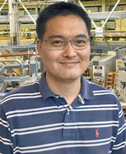
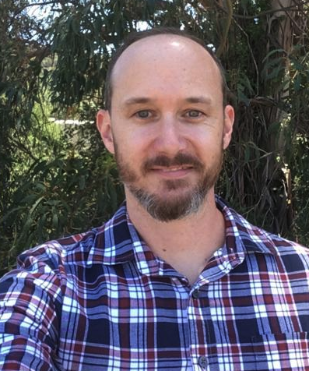
HEP ECAs in Advanced Accelerator Concepts
Advanced accelerators for future TeV colliders
More compact and cost-effective machines, higher repetition rates, reduced environmental impact, better AI-assisted diagnostics…
Du (LBNL)
2017
Zhou (LBNL)
2020
O’Shea (SLAC)
2020
Lu (NIU & ANL)
2021
Turner (LBNL)
2022
Scalable Control of Multidimensional Coherent Pulse Addition for High Average Power Ultrafast Lasers
Multi-kHz Laser-plasma Accelerator Driven by Spectrally Combined Fiber Laser
Improving Accelerators with Diagnostics Optimized for Artificial Intelligence
Innovative
High-Frequency Structures for
High-Gradient Wakefield Acceleration
Energy Recycling for a Green Plasma-Based Collider

Slide 6
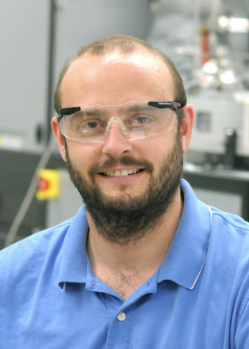
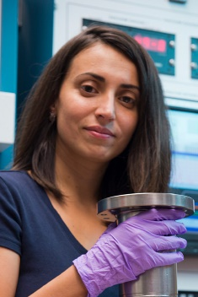
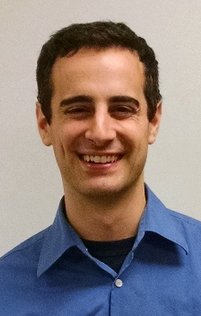
HEP ECAs in RF Acceleration Technology (1)
Superconducting RF
Prolier (ANL)
2011
Grassellino (FNAL)
2014
Posen (FNAL)
2016
Atomic Layer Deposition of Superconductors, an Innovative Approach to Improve the Performance of High Energy Physic Accelerators
Impurity Doping of Niobium for Ultra‐Efficient Superconducting RF Cavities
Developing the Next Generation of Superconducting RF Cavities with Nb3Sn

Slide 7
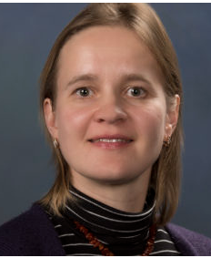
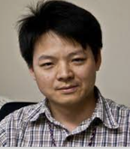
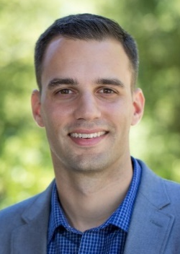
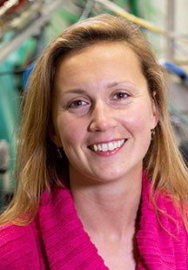
HEP ECAs in RF Acceleration Technology (2)
Normal-conducting RF
High-gradient acceleration, advanced manufacturing technologies…
Simakov (FNAL)
2010
Wang (SLAC)
2011
Nanni (SLAC)
2017
Gamzina (SLAC)
2019
Advancing our Understanding of Photonic Band Gap Structures for Accelerators
RF Breakdown Dependence on Electric and Magnetic Fields and Pulsed Heating
High‐Gradient Accelerators at THz Frequencies
Mechanics of Materials’ Interaction with Electromagnetic Waves in Accelerator Cavities

Slide 8
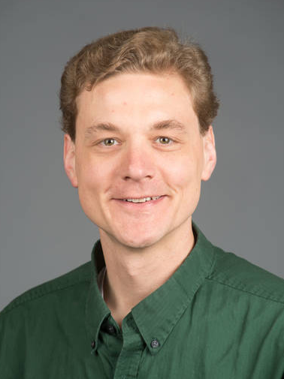
HEP ECAs in:
Superconducting magnets & materials
Particle sources & targets
Shen (LBNL)
2012
Jewell (UW-EC)
2013
Xu (FNAL)
2019
Ammigan (FNAL)
2022
Engineering High Field Superconducting Materials for Frontier Accelerator Technology
Mechanical Performance of HTS Superconductors for HEP Applications
Development of Next-Generation Nb₃Sn Superconductors for Energy-Frontier Circular Colliders
Advanced Materials to Enable Next-Generation High-Power Accelerators

Slide 9
My ECA Program:
Innovative High-Frequency Structures
for High-Gradient Wakefield Acceleration

Slide 10
Compact Linear Accelerators
Energy = Length × Gradient
High gradient $→$ Compact linear colliders
Stanford Linear Collider
2 miles
100 GeV collision energy

Slide 11
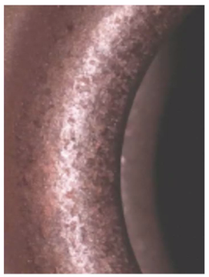
What limits the gradient: RF Breakdown
RF breakdown is the fundamental limiting factor in achieving high gradient
Accelerating gradient currently limited to 10-100 MV/m in conventional RF accelerators
RF breakdown is unwanted
Mechanism not fully understood
Breakdown-induced
pitting in a copper structure

Slide 12
Exciting Time for Accelerator Communities
Towards compact accelerators, we need to:
Develop physics understanding of RF breakdown
High-gradient and breakdown science community
Dedicated breakdown test stands at National Labs and universities
Explore novel accelerator concepts to mitigate RF breakdown
Advanced Accelerator Concepts (AACs) community
Plasma-based accelerators
Laser-based accelerators
Accelerators on a chip
Terahertz (THz) accelerators
Structure wakefield acceleration: short pulse => high gradient
…

Slide 13
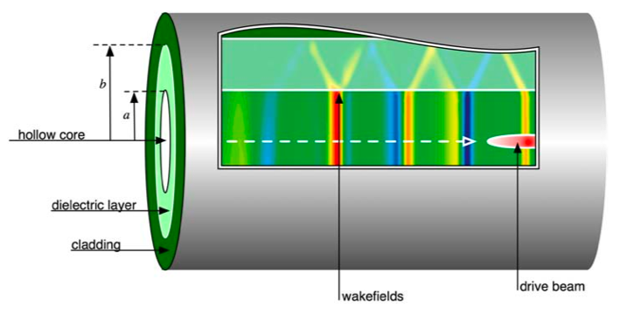
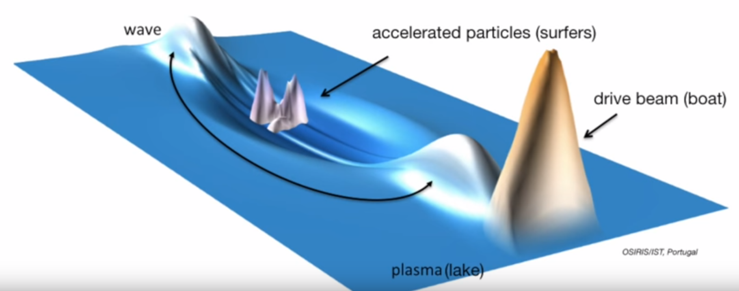
Wakefield & Wakefield Acceleration
Wake of a boat on water
Wakefield of a charged particle beam inside a dielectric tube in vacuum

Slide 14
Structure Wakefield Acceleration (SWFA)
One promising AAC scheme: SWFA
Extract wakefield from a “drive” beam to accelerate a “witness” beam
Happens in accelerator structures in vacuum
Collinear Acceleration
Two-Beam Acceleration
An equivalent short-pulse RF source
14

Slide 15
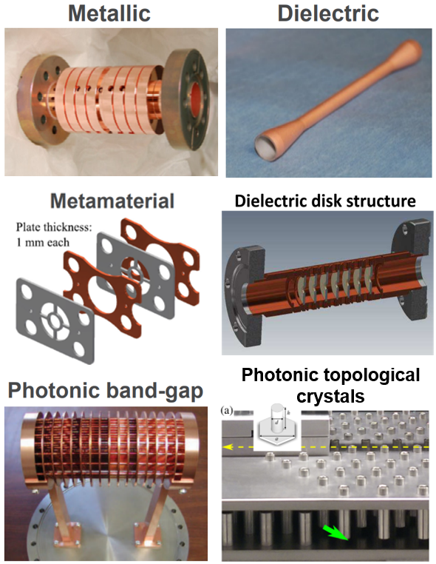
Advanced Wakefield Structures
SWFA with short RF pulses requires advanced structures to achieve high gradient and high efficiency
Recent progress:
High-power wakefield extraction (>500 MW peak power)
High-gradient with SWFA
(>300 MV/m)

Slide 16
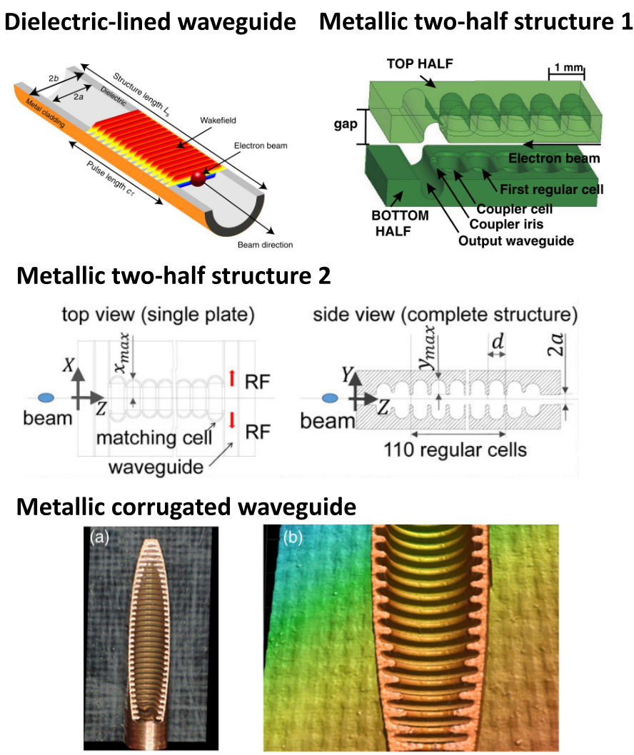
Terahertz (THz) Structures
Advantages of THz and sub-THz wakefield structures
Strong beam-structure interaction (high gradient)
Small transverse size
(compact and cost-effective)
High efficiency when combined with bunch shaping

Slide 17
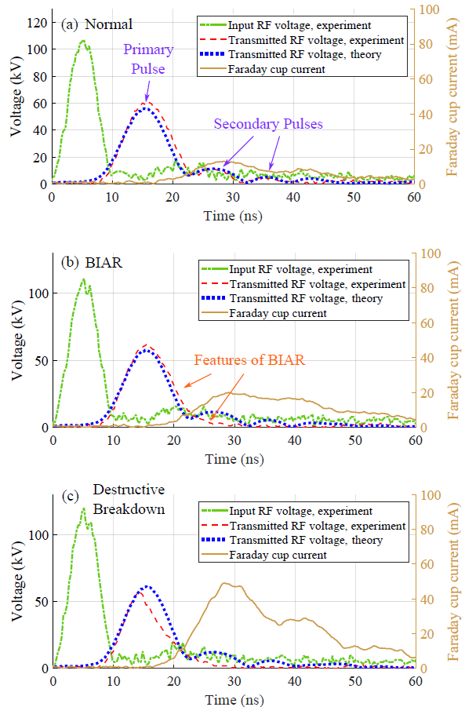
RF Breakdown Physics
Short-pulse operation (a few ns) has the potential to dramatically increase the accelerating gradient by mitigating breakdown risks
Newly discovered “Breakdown Insensitive Acceleration Regime” (BIAR)
RF breakdown happens but doesn’t quite matter

Slide 18
Accelerator Science & Engineering Education
Building a strong workforce in Accelerator Science & Engineering (ASE) is critical to the future of HEP
Ongoing US programs and opportunities
US Particle Accelerator School (USPAS)
DOE Traineeships in ASE
ASET at MSU
CAST at IIT/NIU
Courant at SUNY
VITA at ODU/NSU/HU
Research and outreach opportunities at:
Test facilities and user facilities at National Labs
Local university facilities
* M. Bai, et al, “Strategies in Education, Outreach, and Inclusion to Enhance the US Workforce in Accelerator Science and Engineering”, White Paper to Snowmass 2021 Accelerator Frontier, Topical Group AF1: Beam Physics and Accelerator Education

