Slide 1
HEP Budget
HEP Early Career Network Summer 2023 Workshop
Alan Stone Office of High Energy Physics
8 June 2023

Slide 2
Office of High Energy Physics at a Glance FY 2023 Enacted: $1.166B
Over 1,175 Ph.D. Scientists and 525 Grad Students Supported
Largest Supporter (~85%) of Particle Physics in the U.S.
Over 2,325 Users at 2 SC Scientific Facilities
Funding at >160 Institutions, including 12 DOE Labs
Facility Operations:
29.7%, $346.6M
~30% of Research to Universities
Research:
39.8%, $464.4M
Projects:
30.4%, $355M

Slide 3
HEP Budget ($K): Research, Facilities/Ops, Projects FY 2014 – FY 2023
FY 2022 IRA
$303.6M to Projects
Congress supports P5
Projects to Operations
Strategic Plan for U.S. Particle Physics next 10 years
Particle physics is global
Community made difficult choices
Increase investment in construction
Research Growth in RENEW, FAIR
Research Growth in QIS, AI/ML
 | FY 2014 | FY 2015 | FY 2016 | FY 2017 | FY 2018 | FY 2019 | FY 2020 | FY 2021 | FY 2022 | FY 2023
Research | 48% | 46% | 43% | 42% | 41% | 39% | 37% | 38% | 30% | 40%
Facilities/Operations | 35% | 35% | 32% | 31% | 29% | 27% | 30% | 30% | 22% | 30%
Projects | 17% | 19% | 25% | 27% | 31% | 35% | 32% | 32% | 48% | 30%
Total Budget ($k) | 796,521 | 766,000 | 795,000 | 825,000 | 908,000 | 980,000 | 1,045,000 | 1,046,000 | 1,381,630 | 1,166,000

Slide 4
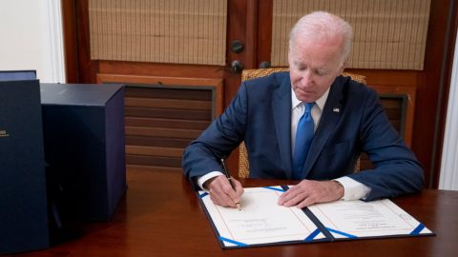
FY 2023 Appropriations: SC and HEP
Office of Science budget increased 8% to $8.1B
While well short of the $8.9B CHIPS and Science Act target, did significantly exceed $7.8B Request
In addition, SC just received a one-time $1.55B boost through the IRA to advance portfolio of major projects
HEP budget increased 8.2% to $1.166B
Slightly above the $1.160B CHIPS and Science Act target, and significantly exceeds $1.121B Request
Congressional guidance to HEP:
LIC: $176M LBNF/DUNE; $120M PIP-II; 2M Mu2e
$35M SURF; no more than $10M CMB-S4
Congressional guidance to SC impacting HEP:
AI/ML – not less than $135M
EPSCoR – $35M across all SC programs
RENEW/FAIR – not less than $60M
QIS – not less than $245M total (>$120M QIS, >$125M Centers)
On Dec. 29, 2022, Pres. Biden signed H.R. 2617 Consolidated Appropriations Act, 2023 into law
$1.7 trillion in FY 2023 discretionary government funding for all 12 annual spending bills
Senate passed the omnibus on Dec. 22, 2022, by a vote of 68-29
House passed the package on Dec. 23, 2022, by a vote of 225-201

Slide 5
HEP FY 2023 Appropriations at $1.166B
FY 2022 IRA supplement funding carried into FY 2023
SBIR/STTR
Beginning FY 2023, all Facilities & Operations exempt from SBIR/STTR. Reduced cost from $25.3M in FY 2022 to $15.9M in FY 2023
Research
Core funding is up about 8% over FY 2022
New $7.8M funding for FAIR, Accelerate, and EPSCoR
Increase SC initiatives +$17M for RENEW, Advanced Computing, QIS, and AI/ML
Projects
LBNF/DUNE and PIP-II at $176M and $120M respectively
HL-LHC ATLAS and CMS at $10M each
Final funding for Mu2e and HL-LHC Accelerator Upgrade Projects at $36M and $30M respectively
ACORN at $2M for Other Project Costs
CMB-S4 at $1M for Other Project Costs
Facilities/Ops
Overall funding increased 10.1% over FY 2022, including
+$7M to Vera Rubin Ops
+$5M SURF (per Congressional guidance)
+$4M to LHC Ops
+$1M to DUNE Collaboration Support
Research Fraction | 39.74%
Facilities/Operations Fraction | 29.81%
Projects Fraction | 30.45%
LIC Fraction | 25.56%
MIE Fraction | 4.89%
Year to Year Fraction Increase | 8.16%
Small Business Innovation Research (SBIR) and Small Business Technology Transfer (STTR), intended to help certain small businesses conduct R&D. Funding takes the form of grants, funded by a 3.65% tax, applied only to Research from FY 2023

Slide 6
HEP Participation in SC Initiatives and DOE Crosscutting Activities
Quantum Information Science
HEP QUANTISED program
MAGIS-100
Diversity, Equity, Inclusion
Broadening Engagement: Engages and increases pathways for physics and engineering students
RENEW: Build research capacity at MSIs
FAIR: Invests in S&T infrastructure at MSIs
EPSCoR: Expands DOE research opportunities to a broad and diverse scientific community
Artificial Intelligence and Machine Learning
ML-enhanced fast simulation; R&D on embedded & real-time AI; and Uncertainty Quantification
Superconducting Quantum Materials and Systems QIS Research Center
Develop beyond-the-state-of-the-art quantum computers and sensors applying technologies developed for the world’s most advanced particle accelerators
Advanced Computing
Maximize US investment in Exascale Computing
Microelectronics
HEP requirements and expertise drive development of advanced devices
Accelerate
Supports the SC-wide Accelerate initiative that promotes scientific research to accelerate the transition of science advances to energy technologies.
Accelerator Science & Technology Initiative
Supports mid- to long-term R&D to maintain a leading position in key accelerator technologies that define SC’s competitive advantage.
* New funding starts in FY 2023
Notes:
QIS: The HEP QuantISED program has leveraged "HEP for QIS" (e.g., Quantum Field Theory --> information theory; and high-Q systems for qubit coherence) as well as "QIS for HEP" (e.g., advanced quantum sensors for dark matter detection)
STEM: Reaching a New Energy Sciences Workforce (RENEW): Leverages SC’s unique national laboratories, user facilities, and other research infrastructures to provide undergraduate and graduate training opportunities for students and academic institutions not currently well represented in the U.S. S&T ecosystem.
AI/ML: The goals of the AI/ML initiative are well aligned with the HEP research program
HEP has made use of AI/ML techniques for 5+ decades. Currently 10 (of ~60) active HEP Early Career winners are strongly employing AI/ML in their research programs.
Many current programmatic AI/ML topics cross HEP frontiers: ML-enhanced fast simulation; R&D on embedded/real-time AI; and Uncertainty Quantification
Superconducting Quantum Materials and Systems (SQMS) Center: Fermilab Hosted
The center is leading the way in extending coherence time of superconducting quantum systems thanks to world-class materials science and through the development of superconducting quantum cavities integrated with industry-designed and -fabricated computer chips
Advanced Computing: This initiative will maximize the Nation’s investment in Exascale Computing to ensure that researchers will have the ability to intuitively meld and orchestrate AI-enabled advanced computing, instruments, and data to accelerate discovery and innovation. To ensure broad access to exascale computing resources, HEP along with the other SC programs, will work with the national laboratories to create an integrated system of scientific user facilities, connected together via advanced networks and enabling software, accessible to U.S. researchers via the internet and remote virtual platforms, to join as equal partners in DOE’s team science model to solve the Nation’s toughest problems.
Microelectronics: HEP has ~unique requirements for real-time data processing. to create higher-level information from streaming raw data as close to the source as possible , typically at very high rates. HEP requirements and expertise help drive development of advanced devices that can handle noisy real-world environments.
DOE Green Energy Initiatives: HEP believes our main contribution to Green Energy Initiatives is through the highly trained personnel we generate, and some technology directions originating from our science. Other ideas on how we can contribute welcome.

Slide 7
HEP Major Laboratory Investments
$1.182B Total to DOE Laboratories (FY 2022)
Argonne National Laboratory
$17.5M Total
Quantum Information Science
Artificial Intelligence and Machine Learning
Energy, Intensity, and Cosmic Frontier particle physics research
Theoretical and Computational Physics
Advanced Technology R&D
LHC Operations
Cosmic Frontier Experimental Operations
Brookhaven National Laboratory
$127.9M Total ($32.785 IRA)
Quantum Information Science
Artificial Intelligence and Machine Learning
Energy, Intensity, and Cosmic Frontier particle physics research
Theoretical and Computational Physics
Advanced Technology R&D and Microelectronics
LHC Operations
Intensity Experimental Operations (Belle-II)
Cosmic Frontier Experimental Operations, including Vera C. Rubin Observatory
LBNF/DUNE Construction Project
HL-LHC Accelerator and ATLAS Detector Upgrade MIEs
Lunar Surface Electromagnetic Experiment (LuSEE)-Night MIE
Fermi National Accelerator Laboratory
$843.5M Total ($257.834 IRA)
Quantum Information Science
Superconducting Quantum Materials and Systems Center
Artificial Intelligence and Machine Learning
Energy, Intensity, and Cosmic Frontier particle physics research
Theoretical and Computational Physics
Advanced Technology R&D and Microelectronics
Fermilab Accelerator Complex (SC User Facility)
LHC Operations
Cosmic Frontier Experimental Operations
Acc. and Det. Infrastructure and Test Facilities
LBNF/DUNE, PIP-II, Mu2e Construction Projects
HL-LHC Accelerator, CMS Detector Upgrade, and ACORN MIE
Lawrence Berkeley National Laboratory
$95.7M Total ($10M IRA)
Quantum Information Science
Artificial Intelligence and Machine Learning
Energy, Intensity, and Cosmic Frontier particle physics research
Theoretical and Computational Physics
Advanced Technology R&D and Microelectronics
LHC Operations
Cosmic Frontier Experimental Operations, including DESI and LZ
Accelerator and Detector Infrastructure and Test Facilities (BELLA)
CMB-S4 MIE (lead lab)
HL-LHC Accelerator and ATLAS Detector Upgrade MIEs
SLAC National Accelerator Laboratory
$83.8M Total
Quantum Information Science
Artificial Intelligence and Machine Learning
Energy, Intensity, and Cosmic Frontier particle physics research
Theoretical and Computational Physics
Advanced Technology R&D and Microelectronics
FACET Operations (Scientific User Facility)
Cosmic Frontier Experimental Operations, including Vera C. Rubin Observatory, SuperCDMS-SNOLAB
Accelerator Infrastructure and Test Facilities
AMES | $1.618M
LANL | $2.438M
LLNL | $3.454M
ORNL | $2.423M
PNNL | $3.249M
SNL | $0.102M
TJNAF | $0.089M
All Labs, in $k | FY 2017 | FY 2018 | FY 2019 | FY 2020 | FY 2021 | FY 2022
Research | 217,892 | 213,454 | 230,489 | 244,535 | 254,642 | 249,735
Fac/Operations | 250,611 | 260,761 | 261,188 | 282,299 | 270,666 | 265,465
Projects | 218,586 | 278,335 | 337,350 | 338,044 | 333,500 | 669,620
Total | 687,089 | 752,550 | 829,027 | 864,878 | 858,808 | 1,181,820

Slide 8
HEP University Research Grants
Does not include SURF Cooperative Agreement
University Grant funding has been stable
Cyclical effects between New/Renewal and Continuations
Renewals do typically get priority, as they support core, ongoing research efforts
Note: The full-funding effect to average Renewal grant funding not unfolded in histogram
But total grant funding growth has been anemic, far below inflation, programmatic need, or P5 guidance
Grant funding numbers include awards in SC initiatives (QIS, AI/ML) and Accelerator Stewardship
Office of High Energy Physics | # of Procurement Requests |  |  |  |  |  | Funds Awarded
 | FY 2017 | FY 2018 | FY 2019 | FY 2020 | FY 2021 | FY 2022 | FY 2017 | FY 2018 | FY 2019 | FY 2020 | FY 2021 | FY 2022
Award Revision | 5 | 6 | 8 | 8 | 11 | 6 | -$74,424 | $33,468 | -$200,950 | -$961,264 | $0 | $702,050
Continuation | 134 | 155 | 180 | 163 | 152 | 180 | $53,377,000 | $72,350,000 | $71,705,000 | $54,277,242 | $77,819,970 | $81,869,209
Incr. Funding* | 0 | 0 | 0 | 1 | 1 | 1 | $0 | $0 | $0 | $235,000 | $240,000 | $250,000
New | 69 | 92 | 54 | 33 | 48 | 48 | $21,333,000 | $26,463,429 | $16,063,816 | $12,913,000 | $17,150,986 | $15,370,950
No Cost Extension | 34 | 48 | 58 | 74 | 85 | 55 | $0 | $0 | $0 | $0 | $0 | $0
Renewal | 45 | 36 | 56 | 66 | 60 | 49 | $36,859,000 | $26,210,000 | $32,635,500 | $50,547,000 | $33,082,000 | $33,921,000
Supplemental | 9 | 12 | 7 | 11 | 13 | 12 | $610,603 | $1,951,000 | $417,000 | $1,200,638 | $1,097,384 | $1,323,749
Total | 296 | 349 | 363 | 356 | 370 | 364 | $112,105,179 | $127,007,897 | $120,620,366 | $118,211,616 | $129,390,340 | $133,436,958
*Does not include SURF Cooperative Agreement.

Slide 9
Increasing Investments to Early Career Research Program https://science.osti.gov/early-career
146 total HEP awards to date: 86 University and 60 National Labs.
In FY 2022, 11 awards (6 Univ, 5 Lab) including first-time HEP awards to U. Wisconsin and U. Tennessee
4 HEP awards funded by Established Program to Stimulate Competitive Research (EPSCoR)
FY 2011 (Theory), FY 2013 (Intensity), FY 2020 (Cosmic), and FY 2021 (Cosmic)

Slide 10
Impacts from Increase ECA Investments
University Awards are effectively “one-shots”, fully funded in the year the award is made
Laboratory Awards require four additional years of funding at ~500k each
The number of awards made per year has increased from the FY15 nadir of 5 (and SC scolding) to a peak of 15 in FY 20 and FY 21
Total active awards as of August 2022 was 70
22 Lab ECAs carried into FY 2023 with a 10.875M commitment
Takeaway: Robust ECA program represents a non-negligible amount of the core Research funding to Labs and University Grants
Start Date | FY10 | FY11 | FY12 | FY13 | FY14 | FY15 | FY16 | FY17 | FY18 | FY19 | FY20 | FY21 | FY22
Current FY Funding ($k) | 16,000 | 3,717 | 3,251 | 2,012 | 3,750 | 3,500 | 4,250 | 6,500 | 8,750 | 8,675 | 9,400 | 8,550 | 6,500
Total FY Funding ($k) | 16,000 | 3,717 | 6,966 | 8,993 | 14,253 | 13,866 | 11,458 | 12,497 | 16,250 | 18,175 | 22,100 | 21,950 | 18,500
CY Awards | 14 | 13 | 12 | 9 | 6 | 5 | 7 | 11 | 14 | 14 | 15 | 15 | 11
Total Active Awards | 14 | 27 | 39 | 48 | 54 | 45 | 39 | 38 | 43 | 51 | 61 | 70 | 70
Total Awards | 14 | 27 | 39 | 48 | 54 | 59 | 66 | 77 | 91 | 105 | 120 | 135 | 146

Slide 11
HEP Support: More Than Labs and Universities
With FY 2023, SURF increases from 30M to 35M, while SBIR/STTR decreases from 25.3M to 15.9M
Program Support includes:
HEP and the community has benefited from a skilled and dedicated group of individuals working at DOE on a term basis (8 detailees as of Feb 2023)
HEP relies on a regular and robust review of Research, Facilities and Projects. Much of this is subcontracted to Oak Ridge Institute for Science and Education (ORISE)
There are many DOE/SC organizational programs, services and initiatives that are funded pro rata. HEP currently contributes 17% to these costs
For FY 2023, the estimated subtotal for Program Support is 12.5M, or 1.1% of HEP budget
FY 2022 has anomaly of 303.6M IRA supplement to projects, and cannot provide FY 2023 grant statistics until end of the fiscal year

Slide 12
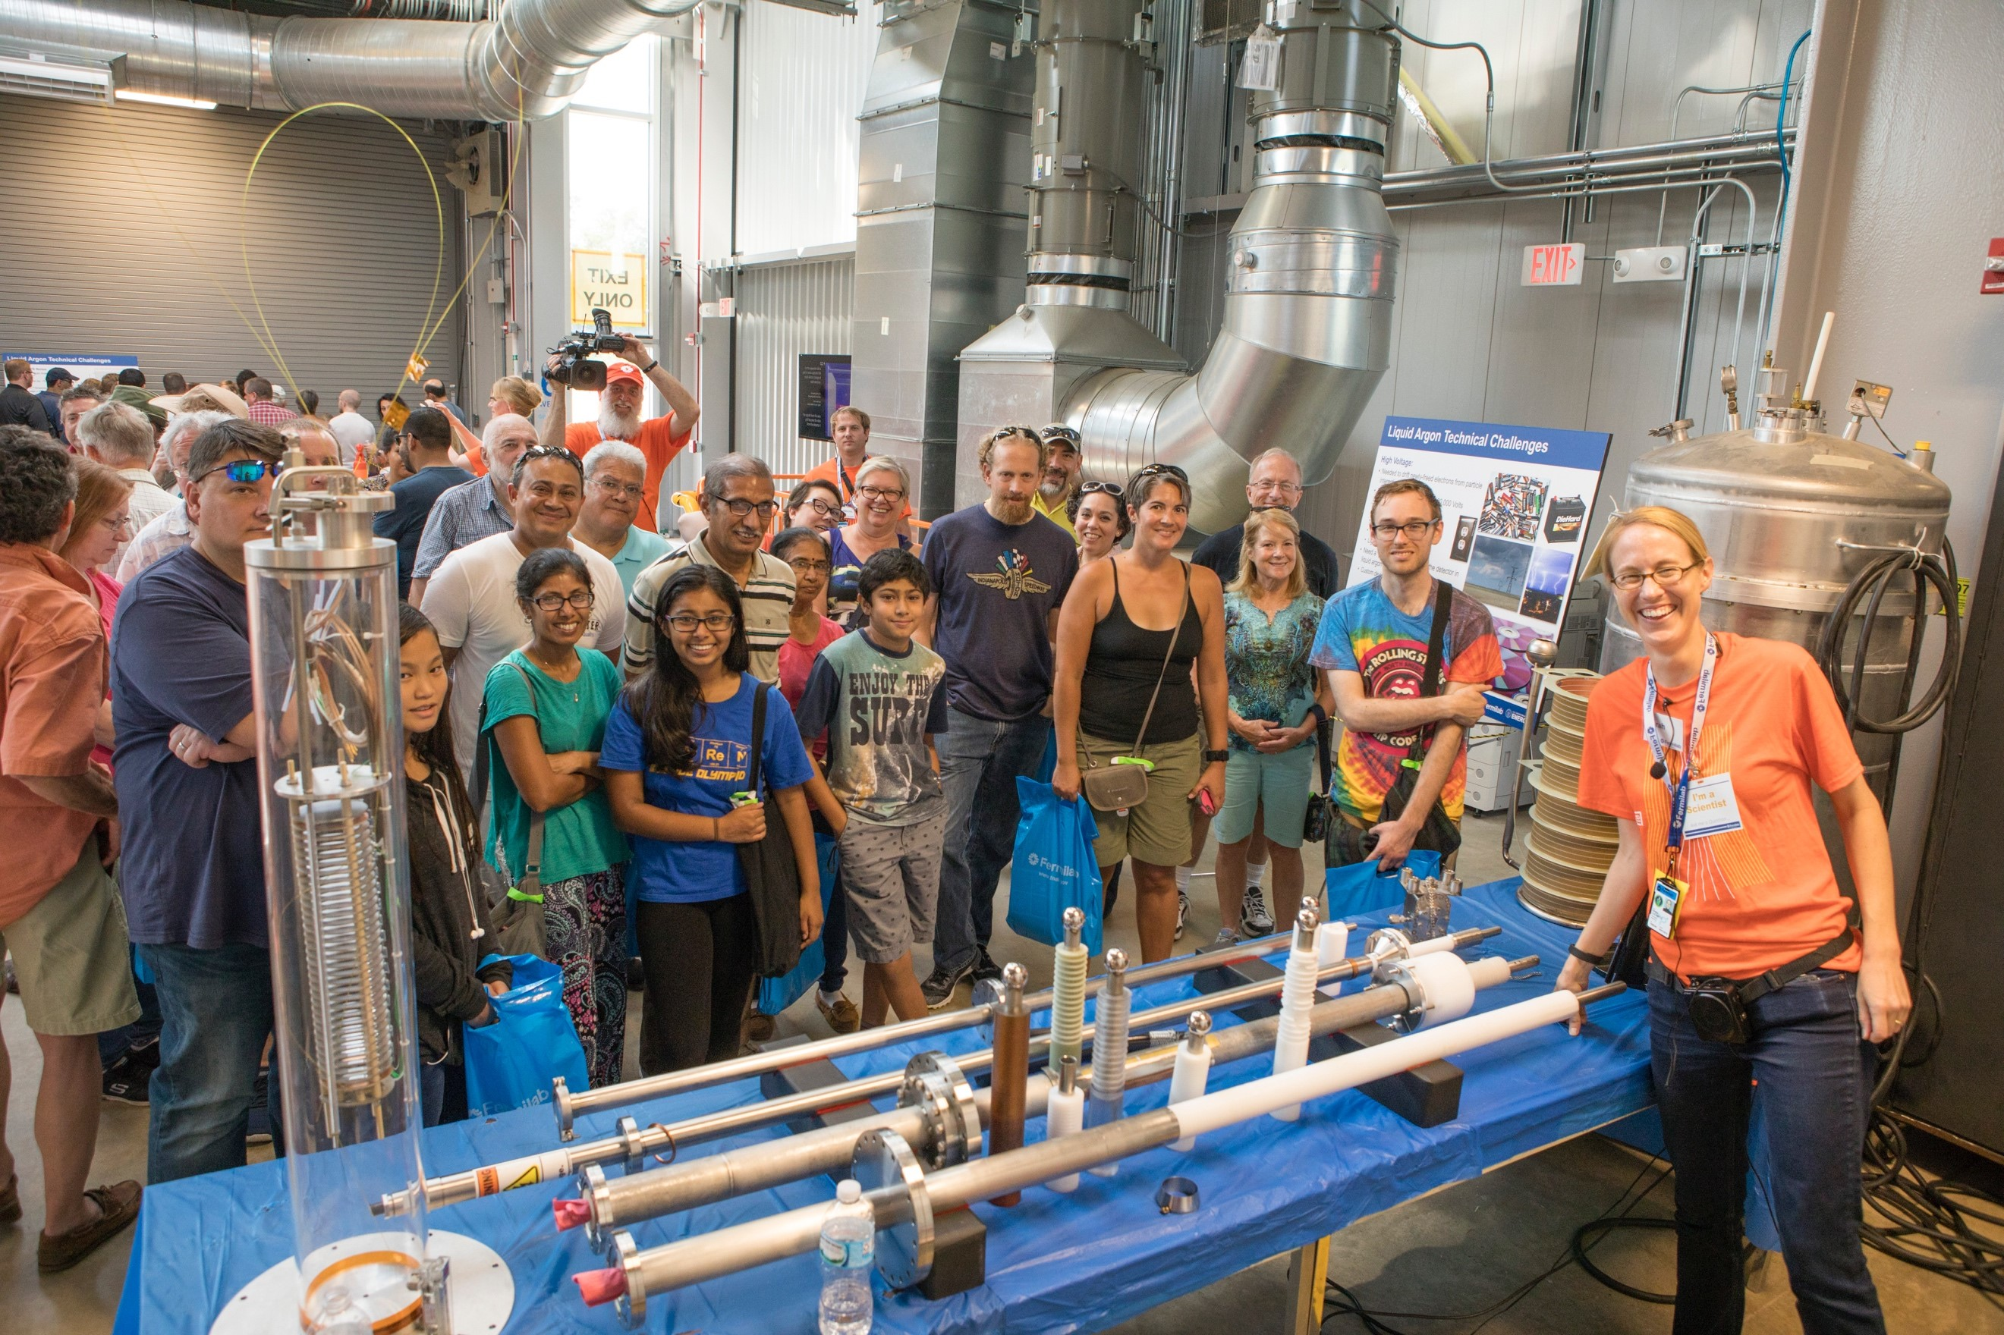
Ongoing HEP Budget Challenges & Opportunities
Inflation
FY 2022 IRA funding to HEP projects enabled the flexibility to mitigate inflationary impacts to core research, access to facilities, and infrastructure investments. HEP increased FY 2023 research and facilities/operations funding by ~8% over FY 2022. Inflation remains a risk for the foreseeable future
Supply Chain
Reliable supply of highly specialized components, materials, and techniques. How to mitigate risk from sole source vendors (cost and schedule), early industry obsolescence (techniques and components), and supply chain economics
Core Research
Our recent Committee of Visitors report encouraged HEP to increase research effort and broaden workforce engagement to better match needs for operation of the new experiments and support ongoing construction activities
.

Slide 13
HEP FY 2024 President's Request Highlights
FY 2024 President's Request of $1,226.3M is an increase of $60.3M, or 5.2%, above the FY 2023 Enacted level
No new starts or initiatives are anticipated
Non-LIC funding $850.3M (-$15.7M decrease)
Report from next P5 strategic plan expected in early 2024
First budget impact likely to be guidance for FY 2025 Execution
Research
+$5.5M increase to RENEW and FAIR
-$21.3M decrease to Core Research
Facilities Operations
+$4M for Vera Rubin to prepare for FY 2025 survey start
-$5M for SURF infrastructure
Projects
+$75M to $255M (TPC) to support the 5 LBNF/DUNE subprojects
+$8M for CMB-S4 MIE to prepare for CD-1
+$5M to support baseline profile of PIP-II
-$14.3M overall for the HL-LHC Upgrades
+$15.7M for the ATLAS and CMS Detector Upgrades per the planned profiles
-$30M as the HL-LHC Accelerator Upgrade received final funding in FY 2023

Slide 14
HEP FY 2024 President’s Request - Communication Strategy
The President is required to submit a budget request to Congress early in the legislative session
The President’s budget is only a request to Congress, but it establishes the President’s wishes regarding the direction of national policies and priorities and often influences the direction of congressional revenue and spending decisions
Agencies usually invited to brief Congress on budget request
Opportunity to reinforce overall strategy. Highlight key elements of request
Informational request for additional detail
Respond to requests regarding impact of alternative funding decisions
SC and HEP await Congressional Appropriation subcommittees (HEWD, SEWD) to designate funding levels for programs and projects
Typically, before August recess
Bottom line: Request ≠ Appropriations
Inflation Reduction Act of 2022 provided supplemental funding of +303.6M for HEP projects
+400M
Post-P5
(+52% in
8 years)

Slide 15
2014 P5 Analysis: High-Level Takeaways Particle Physics Project Priority Panel: Focus on Building for Discovery
We all agree that P5 has been extremely successful. HEP budget has increased by >40% since FY 2015.
While the P5 subcommittee did an excellent job in balancing the new and proposed projects, as well as Research & Facilities – this effort was designed with incomplete HEP budget input
In many cases, the new projects are at least an order of magnitude larger than previous generation experiments
The growth for Research and Facilities associated with the P5 experiments was significantly underestimated
By FY 2022, the imbalance with Projects had outpaced by 100M the optimal support to both core Research and long-term R&D; modernization of SC User Facilities; and Operations of new experiments
Consider for the 2023 P5 subcommittee: Particle Physics Projects Program Priority Panel
What is the right-size of Research to design, build, install, commission, and deliver science on new projects? How best to incorporate the scientific enterprise into the overall planning for projects?
Has the design and development of new projects include robust planning for transition to Operations, lifecycle, and decommissioning?
In which ongoing and emerging R&D areas of national priority does particle physics lead and/or partner?
Incorporate diversity, equity, inclusion, and accessibility into all decision making. Not as an add-on.

Slide 16
2014 P5* Analysis: HEP Projects
2014 P5 report provided a roadmap for agencies to implement
Total Project Costs increased for all approved MIEs (from HL-LHC Upgrades to DESI to LZ to SuperCDMS-SNOLAB to Muon g-2) offset by:
Delayed/reduced funding for ILC, DM G3, Small Projects, CMB-S4 (~$200M)
FY 2022 IRA (~$130M)
Also to mitigate COVID impacts
Recommend applying additional risk contingency to 2023 P5 MIE funding estimates to better
Establish project timelines
Increase implementation flexibility
Manage stakeholder expectations
Current P5
18 Projects: 3 LIC & 15 MIEs
HEP funded $3B in projects from FY 2014-2023 (31% of total budget)
FY 2022 IRA provided $303.6M for projects
* ACORN and LuSEE-Night not in 2014 Report

Slide 17
2014 P5 Analysis: HEP Facilities & Operations FY 2014-2023 ($k)
Increase demands on SC User Facilities
Provide higher beam intensity
Manage increasing data processing and storage
Support a growing user population
SURF refurbishment
Lab Infrastructure
Cosmic Projects Transition to Experimental Operations
Interagency coordination
International agreements
MIE Transition to Experimental Ops: DESI, LZ, Belle II
SURF refurbishment
Increase to SC User Facilities: Fermilab GPPs, SLAC FACET-II
2014 P5 report reflected relatively flat funding profile for facilities (~$250M/year)
P5 implementation demanded much greater resources for both MIE transition to experimental operations, and upgrades and modernization to SC User Facilities
Notes:
Left box are the drivers of 2019 to 2020 $ increases

Slide 18
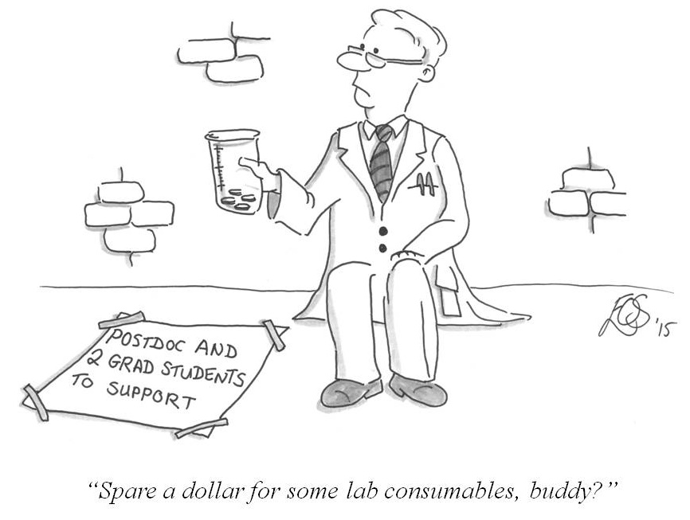
2014 P5 Analysis: Research
High Energy Physics | FY 2014 | FY 2015 | FY 2016 | FY 2017 | FY 2018 | FY 2019 | FY 2020 | FY 2021 | FY 2022 | FY 2023
Research | 360,932 | 334,225 | 320,816 | 321,892 | 334,750 | 348,534 | 364,434 | 383,419 | 386,974 | 448,506
SBIR/STTR | 21,601 | 20,768 | 20,847 | 22,151 | 24,427 | 24,095 | 25,212 | 25,465 | 25,298 | 15,867
Facilities/Ops | 278,683 | 264,634 | 258,236 | 258,696 | 270,488 | 266,556 | 317,310 | 303,616 | 299,728 | 346,627
MIE Projects | 84,305 | 109,373 | 129,001 | 128,761 | 137,935 | 144,815 | 107,044 | 81,500 | 98,000 | 57,000
Total “Discretionary” | 745,521 | 729,000 | 728,900 | 731,500 | 767,600 | 784,000 | 814,000 | 794,000 | 810,000 | 868,000
Research has increased steadily from FY 2016. New peak funding in FY 2023
However, many factors created a cumulative effect adversely impacting the Core Research program
Cost of doing business has increased significantly, year by year, reducing the buying power of research dollars
University Research community continues to grow
Administrative & SC Research Initiatives not considered in 2014 P5 strategy
QIS, AI/ML, Microelectronics, etc. have grown from $18M in FY 2018 to >$110M in FY 2023
Research Initiative alignment with Core Research: high (50%), medium (25%), low (25%)

Slide 19
Charge to a 2023 P5 Subcommittee
HEP is a global field
Preserve essential roles of Universities and National Labs
Support decisions to retain US leadership as a global partner
Diverse workforce results in improved science
Balanced core research budget is paramount to producing science
Assess science case for on-going projects
Address synergies with broad national initiatives
Remember costs of R&D, commissioning, and operations for future projects

Slide 20
2023 P5 Budget Scenarios
Inflation Reduction Act of 2022 provided supplemental funding of +303.6M for HEP projects

Slide 21
FY 2024: High ($1.290B) vs. Low ($1.226B) Scenarios Notable variances and impacts
Projects
LBNF/DUNE ramps +$75M to $255M
Follows CD-1RR project funding profile
PIP-II @$125M; CMB-S4 @25M
HL-LHC ATLAS & CMS Upgrades, ACORN continue
Assume no new mission needs
Facilities/Ops
2-3% increase across the board
$4.9M Fermilab Accelerator Improvement Project (AIP)
Ramp up DUNE Collaboration Support
Research
Constant level of effort (assume 5% inflation)
New lines for Directed R&D and P5 Research Hub
Former might be magnets, horns/targets
Latter might be university collaborative proposal
Projects
CMB-S4: -$16M, delay CD-1
Facilities/Ops
Hold most costs flat from FY 2023
Research
-$48M (-10%) below High Scenario, and -$26M (-6%) below FY 2023 funding levels
With 5% year-to-year inflation (FY 2023 to FY 2024), resulting impact is a reduction of up to -11% on constant level of effort
Limited options to mitigate Reduction in workforce
No discretionary resources to start any new efforts
High
Low
 | High | Low
Research Fraction | 37.44% | 35.70%
Facilities/Operations Fraction | 27.93% | 29.16%
Projects Fraction | 34.63% | 35.14%
LIC Fraction | 29.14% | 30.99%
MIE Fraction | 5.49% | 4.15%
Year to Year Fraction Increase | 10.68% | 5.17%

Slide 22
Developing the Budget
The budget information being provided is a general plan, based on an actual appropriation, different scenarios, and considering:
Administration and SC R&D Priorities
Strategic plan for program (P5, AAAC Decadal Survey)
Support for Projects
Stewardship of DOE National Labs (SC User Facilities)
Available funding vehicles (Grants, Contracts, Coop. Agreement)
Coordination with partners (International, Other Federal, Universities)
Broadening Engagement
Project Support
The further along a project is in the DOE Critical Decision process, the more cemented their budget needs are and less room to change funding profiles
DOE is committed to the successful execution of projects that have reached CD-2 and aims to provide the baseline funding profile
Large Construction projects (LBNF/DUNE, PIP-II) also require line-item approval from Congress
Lab and University support
Laboratory stewardship is an important part of the DOE mission
Most labs are funded through many sources, but Fermilab receives ~95% of its funding from HEP
Need to maintain strong and consistent university support to keep research field healthy and productive
Each Fiscal Year HEP must set aside about 7% of the total HEP budget for Mandatory Spending, Management Reserves, and HEP Program Support
Connections & new initiatives

Slide 23
Comments on Research, Operations, and Projects
Research
Seeding new ideas, pre-project R&D, curiosity driven
Public-private partnerships
Collaborative hubs across frontiers, labs, and SC
What is the right size? Number of students and post-docs per year or five years?
Facilities and Operations
Much are core costs for User Facilities and experimental operations for the next 15+ years
Unknowns are costs to operate new experiments, support for new capabilities, upgrades, or facilities
Will anything close or conclude to offset new costs?
Projects
Some from the previous P5 will extend into the next one by several years
PIP-II, LBNF/DUNE, CMB-S4, HL-LHC Detectors
In the Low and High Scenarios, different approaches were taken with respect to total project funding
Low: Small incremental year-to-year increases, bringing down fraction to 33.1% by FY 2035
High: Capping projects to ~$550M, bringing down fraction to 29.8% by FY 2033

Slide 24
Budget Takeaway and Summary
Program prioritization will benefit from enhanced budget planning principles
Add Contingency for “known unknowns”, e.g., MIE pre-CD-0 project cost estimates
Include Reserve for the “unknown unknowns”, e.g., COVID-19 pandemic (before March 2020), Russian invasion of Ukraine
Upgrades and modernization to SC User Facilities
Plan for projects as part of a comprehensive plan, with targeted R&D prior to CD-0, transition to Operations, and Science exploitation
Credible estimate of lifecycle costs of project to experimental operations (M&S & Labor)
Research efforts necessary to support P5 projects that are increasing due to the size, sensitivity, and complexity compared to previous experiments
2014 P5 implementation continues
Even with the optimistic “High” budget scenario (2022 Chips and Science Act), discretionary resources to start new projects and R&D is likely to be very limited (less than 1% of budget) through at least FY 2025

Slide 26
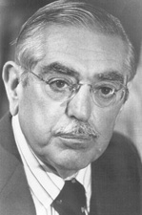
April 17, 1969, Robert R. Wilson testified in front of Congress' Joint Committee on Atomic Energy
DR. WILSON. Because of the kind of research that we are now starting, men will eventually be able to enjoy a richer life, in an intellectual and spiritual sense certainly, but also in their physical well-being.
SENATOR PASTORE. Is there anything connected in the hopes of this accelerator that in any way involves the security of the country?
DR. WILSON. No, sir; I do not believe so.
SENATOR PASTORE. Nothing at all?
DR. WILSON. Nothing at all.
SENATOR PASTORE. It has no value in that respect?
DR. WILSON. It only has to do with the respect with which we regard one another, the dignity of men, our love of culture. It has to do with those things. It has nothing to do with the military. I am sorry.
SENATOR PASTORE. Don't be sorry for it.
DR. WILSON. I am not, but I cannot in honesty say it has any such application.
SENATOR PASTORE. Is there anything here that projects us in a position of being competitive with the Russians, with regard to this race?
DR. WILSON. Only from a long-range point of view, of a developing technology. Otherwise, it has to do with: Are we good painters, good sculptors, great poets? I mean all the things that we really venerate and honor in our country and are patriotic about. In that sense, this new knowledge has all to do with honor and country but it has nothing to do directly with defending our country except to help make it worth defending.
Dr. Robert Wilson (Director, National Accelerator Laboratory)
Senator John Pastore (R.I., Dem., co-chairman, Joint Committee on Atomic Energy)

Slide 27
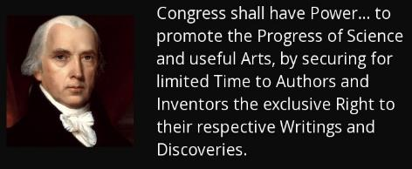
Federal Support of Science and Engineering
The Founders understood the importance of science and technology in the long-term future of the United States. Without science and engineering advancement, in the face of advancement by others, the US could not compete with ideological and economic challengers.
Scientific and technological advancement funded by the Federal Government has a strong constitutional foundation in the Preamble’s mandated promotion of the “common Defence and general Welfare.”
Congress enumerated powers in Article I, Section 8. Implementation of those powers requires federal involvement in science and engineering research, for example:
Clause 5: fixing of “the Standard of Weights and Measures.”
Clause 6: detection and prevention “of counterfeiting.”
Clause 7: establishment and implied improvement of “post Roads” … more modern means of delivering communications.
Clause 8: evaluation of “Discoveries” in “Science and the useful Arts” for the purpose of “securing…exclusive rights” for “Inventors.”
Clauses 12 and 13: “support” of “Armies” and maintenance of “a Navy” … future forces necessary to “common Defence.”
Clauses 15 and 16: support of the “Militia” and their use to “repel Invasions.”
Clause 18: gives Congress the power “to make all laws necessary and proper for carrying into Execution the foregoing Powers, and all other Powers vested by this Constitution in the Government of the United States, or in any Department or Officer thereof.”

Slide 28
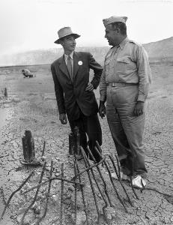
Science Policy and the Constitution
Under Clause 2 of Article II, Section 2, Presidents have the power to appoint “…by and with Advice and Consent of the Senate…all other Officers of the United States…” including individuals responsible for federally supported research in science and technology
The President has significant discretion in assigning science and technology research duties to federal Departments and Agencies so long as Congress can constitutionally fund their implementation.
Since the nation’s founding, federally supported or managed big science and engineering efforts have contributed to national defense or to treaty enforcement.
Canals, locks, dams, and levees beginning in the early 1800s;
Agricultural research through Land Grant academic institutions (1860s-90s);
Transcontinental Railroad in the late 1860s;
Aeronautical research that began early in the 1910s;
The Manhattan Project of the 1940s;
Nuclear Navy and related power systems, and communication satellites in the 1950s;
The Apollo Moon-landing Program of the 1960s.
The constitutional rationale for selective support of pure scientific research lies primarily in the stimulation of educational initiatives that train the scientists and engineers that serve constitutional functions, particularly national security.
https://www.americasuncommonsense.com/
Dr. Robert Oppenheimer and General Leslie Groves

Slide 29
Money for Scientific Research
Historically, finding the money for scientific research was straightforward: people got it from people they knew
Alexander Graham Bell got much of the money to develop his “harmonic telegraph,” from the wealthy father of one of his students (and future wife), 16-year-old Mabel Hubbard
Bell, who was at the time a professor of vocal physiology and elocution at BU’s School of Oratory, even borrowed money from his (famous) assistant, Thomas Watson.
Science has moved forward with boosts from patrons & sponsors: from monarchs to millionaires
Galileo’s heretical revelation that the Earth revolved around the sun would have been unlikely if not for his education at the University of Pisa, which was founded by Pope Clement VI, a devoted patron of the arts & learning
Four centuries after Clement, German universities adopted the notion that it was the academy’s responsibility to advance the understanding of science, a conviction that we take for granted today

Slide 30
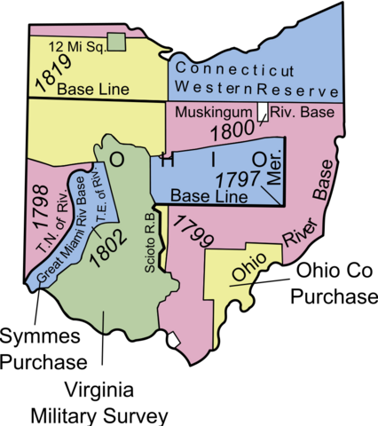
Brief History of Land Grants
At its origins, the US was land rich, and cash poor
First Federal grants, of land west of the Appalachians, were awarded in 1785 to Revolutionary War veterans
Federal government provided bounty land for those who served in the Revolutionary War, the War of 1812, the Mexican War, and Indian wars between 1775 and 1855. It was first offered as an incentive to serve in the military and later as a reward for service.
All federal grants were land grants until 1879, when small amounts of money were awarded to produce braille books for the blind
Three huge land grant programs were signed into law by President Lincoln in 1862 (450,000 sq miles, more than California and Texas, combined)
Morrill Land Grant College Act provided land for colleges in most states, including land located in the Midwest for Eastern states, which then sold the land to provide funds for developing colleges back home (Next Slide)
Homestead Act gave 0.25 square mile tracts to families to settle in western states and territories
Railroad Act paid, in land, for the construction of a railroad from Omaha to Sacramento

Slide 31
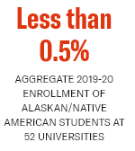
Dark History Behind Land Grant Universities
The Morrill Act promised states between 90,000 and 990,000 acres, depending on the size of their congressional delegations.
Eastern states that had no public land, as well as Southern and some Midwestern states, received vouchers — known at the time as scrip — for the selection of parcels anywhere on the surveyed public domain.
Western states chose land parcels inside their borders, as did territories when they achieved statehood.
Text of the Morrill Act left out something important: the fact that these grants depended on dispossession.
Land-grant universities were built not just on Indigenous land, but with Indigenous land. The grants were as big or bigger than major cities, and were often located hundreds of miles away from their beneficiaries
Nearly 11 million acres of Indigenous land. Approximately 250 tribes, bands and communities. Over 160 violence-backed treaties and land seizures. Fifty-two universities.
https://www.landgrabu.org/

Slide 32
Early Federal Funding for University Research
Before World War I, government money for research was rare, and was mostly aimed at aeronautics and agriculture studies
Industry received little government R&D money and looked to universities for technically trained staff and faculty consultants
Universities rarely sought federal funds for R&D, and many leading U.S. scientists obtained their advanced training in European universities
Science and technology research at American universities was historically funded by local industry, philanthropy, and universities themselves
That model leaped toward industry after WWI, as universities launched industrial cooperation and research programs, essentially inviting corporations to pay for academic research.
All was good until the stock market crashed, and with it, 60 percent of the budgets for some departments
The crash also stanched the flow of funding from foundations
In 1931, total grants from American foundations amounted to $52.5 million, falling to $34 million in 1934.
The devastation was lasting; in 1940 funding was $10 million less 1931 funding

Slide 33
Early Federal Support for Basic Research
When the United States entered WWII on Dec 8, 1941, the country faced severe military and logistical challenges. Over the next three years, American forces needed to fight in a variety of severe conditions and still triumph
Ice and hard stone of the mountains of Italy and malaria-infected mosquitoes of the Pacific
Breathe in submarines three hundred feet below the ocean surface and in bombers tens of thousands of feet above
US government created the Office of Scientific Research and Development (OSRD) to engage the brightest scientific minds and the great machinery of industry in the pursuit of victory. OSRD was created formally by Executive Order 8807 on June 28, 1941, was given almost unlimited access to funding and resources, and was directed by Vannevar Bush, who reported only to President Roosevelt
Research included projects devoted to new and more accurate bombs, reliable detonators, work on the proximity fuse, guided missiles, radar and early-warning systems, more effective medical treatments, more versatile vehicles, the S-1 Section, which later became the Manhattan Project and developed the first atomic weapons.
Office of Naval Research was the first federal agency with statuary authority to contract for basic research
President Truman signed Public Law 588, on Aug 1, 1946.
ONR invented the machinery that still largely governs the research partnership between government & universities
President Truman signed the McMahon/Atomic Energy Act of 1946, transferring the control of atomic energy from military to civilian hands, effective on Jan 1, 1947
Supported investigations of nuclear structure & reactions critical to design of advanced fission weapons and energy systems, and research to reveal new frontiers of physics.
ACTIVITY/AGENCY | YEARS | AUTHORIZATION
Manhattan Project | 1942 – 1946 | none
Atomic Energy Commission | 1946 – 1974 | P.L. 79-585
Energy Research and Development Administration | 1974 – 1977 | P.L. 93-438
Office of Energy Research | 1977 – 1998 | P.L. 95-91
Office of Science | 1998 – Now | P.L. 105-245

Slide 34
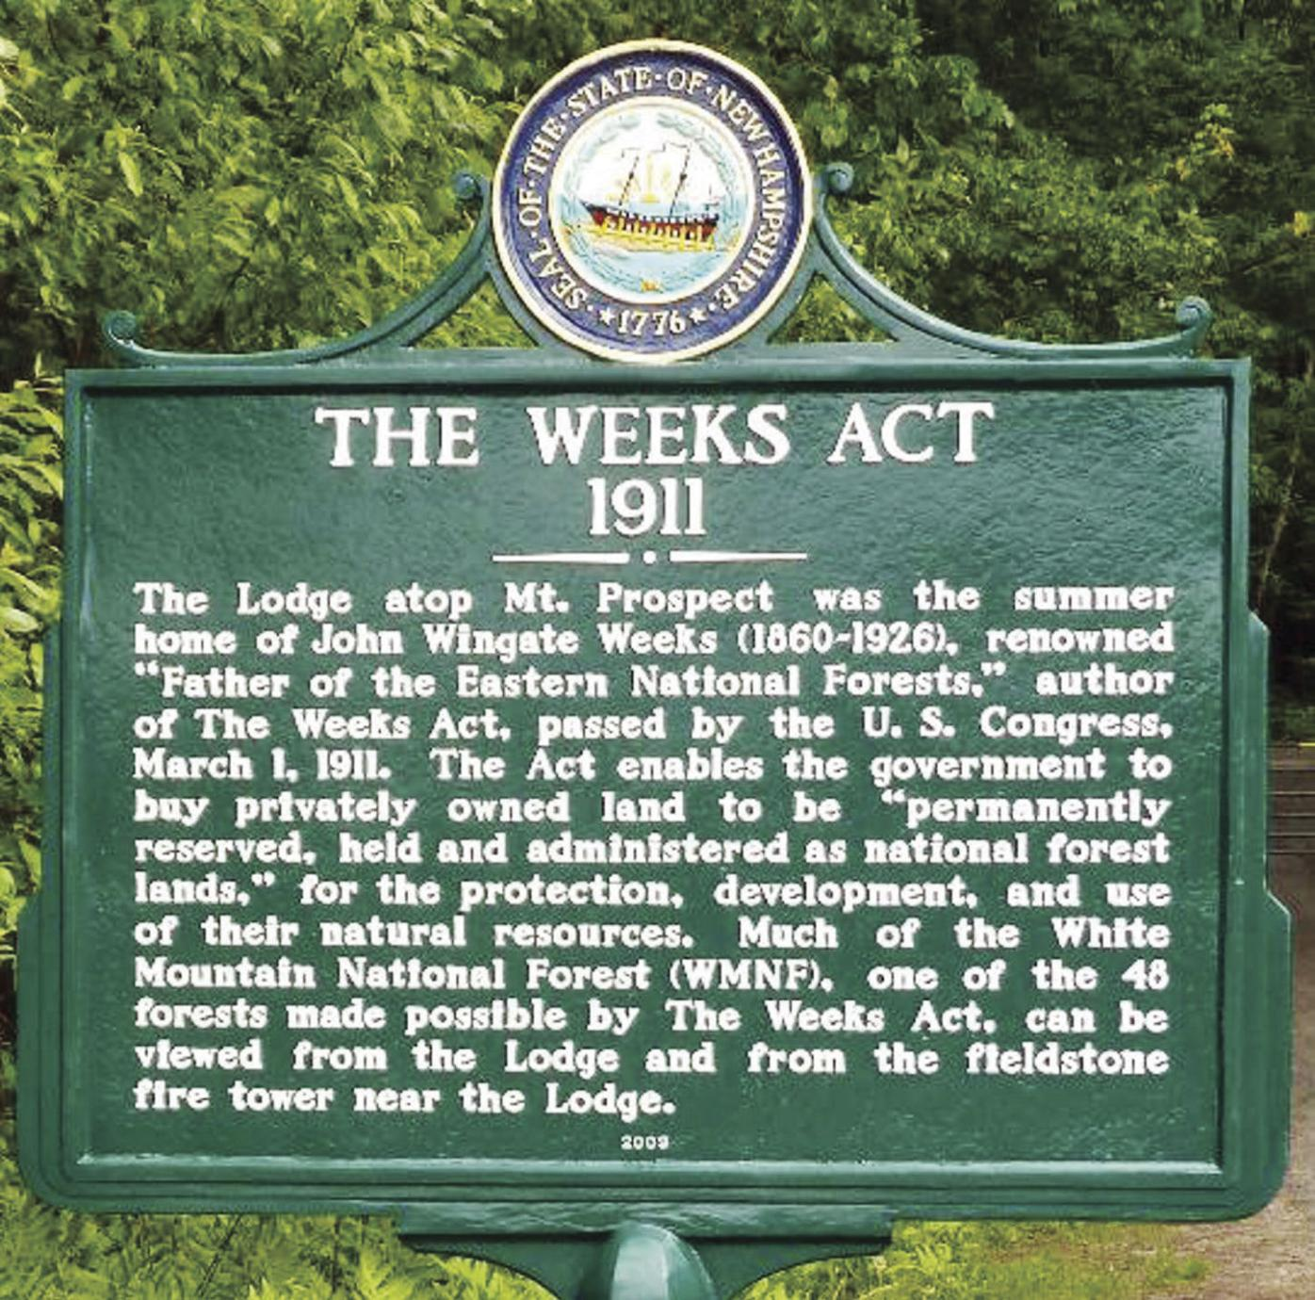
Other Milestones in History of Specific Grant Programs
Hatch Act of 1887, awarding annual sums for agricultural research to states with land grant colleges, the first continuing grant program (continuing to this day)
Weeks Act of 1911, state grants for fire protection on navigable waterways, the first law to require state plans and matching funds
Hatch Act of 1939, restricting political activity of Federal employees and employees of state and local government who are paid with Federal grant funds
First of national policy requirements applicable to all grant programs
Forerunner of our civil rights, environmental, human subject protection, and many, many other "crosscutting" national requirements

Slide 35
Second Liberty Bond Act of 1917
Congress has always placed restrictions on federal debt. Limitations on federal debt have helped Congress assert its constitutional powers of the purse, of taxation, and of the initiation of war.
Between 1788 and 1917, Congress would authorize each bond issue by the United States Treasury by passing a legislative act that approved the issue and the amount. When loans were repaid, the government could not borrow again without asking Congress for approval.
January 1835 was the first and only time all the government’s interest-bearing debt was paid off. President Andrew Jackson, who was suspicious of banks and did not trust the paper money they issued, liquidated the Second Bank of the United States, returning the government’s original investment plus a profit. Congress divided the huge surplus of $17.9 million among the states, which were bogged down with debt.
The Second Liberty Bond Act of 1917, which created the debt ceiling, changed this. It allowed a continual rollover of debt without congressional approval.
Congress enacted this measure to let then-President Woodrow Wilson spend the money he deemed necessary to fight World War I without waiting for often-absent lawmakers to act. Congress, however, did not want to write the president a blank check, so it limited borrowing to $11.5 billion and required legislation for any increase.
The U.S. began accumulating more debt as it got involved in wars abroad. After entering World War II, the U.S. raised the debt limit every year to accommodate increased borrowing.
In June 1946, the debt limit was lowered to $275 billion as war costs dissipated and the federal government began to run three years of surpluses. The federal debt limit remained unchanged at this level for eight consecutive years.
In the last two decades, the U.S. has added $25 trillion in debt, spending nearly $1 trillion more than it receives in taxes and other revenue every year since 2001—in large part due to financing wars, tax cuts, emergency responses, and expanded federal spending. To make up the difference, the government must borrow money to continue to finance payments that Congress has already authorized.
Since 1960, Congress has raised, extended, or revised the debt limit 78 separate times, of which 49 were under Republican presidents and 29 were under Democratic presidents, according to the Department of Treasury. In each of those instances, Congress acted on the debt limit before the nation defaulted.
In recent years, raising the cap has become an increasingly political issue, particularly when power in DC is divided. Since the debt ceiling is one of the few must-pass bills, both parties have tried to use the vote as an opportunity to take a political stand and exact concessions.
There are only two countries that maintain a debt ceiling: the U.S. and Denmark. But the debt ceiling in Denmark does not regularly threaten economic disruption since it is set much higher than the country’s spending. In 2021, Denmark’s debt was about 14% of its ceiling.

Slide 37
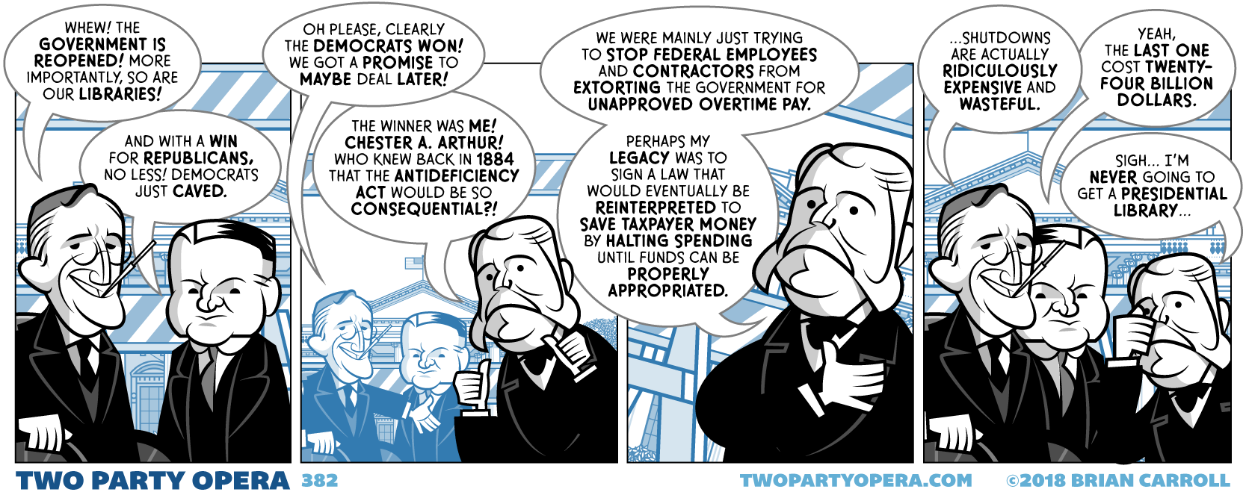
Antideficiency Act (ADA) of 1884 Current version enacted on September 12, 1982
It shall not be lawful for any department of the government to expend in any one fiscal year any sum in excess of appropriations made by Congress for that fiscal year, or to involve the government in any contract for the future payment of money in excess of such appropriations
ADA has its roots in post-Civil War.
Many agencies, particularly the military, would intentionally run out of money, obligating Congress to provide additional funds to avoid breaching contracts.
Some agencies went so far as to spend their entire budget in the first few months of the fiscal year, funding the rest of the year after the fact with additional appropriations from Congress.
To some extent, but not entirely, it implements the provisions of Article 1, Section 9, Clause 7 of the Constitution (the "power of the purse"): "No money shall be drawn from the treasury, but in consequence of appropriations made by law."
The Government Accountability Office, inspectors general, and individual agencies investigate potential violations of the ADA every year. The act has ramifications for agencies and individual employees alike.
Although no one has ever been convicted or indicted for ADA violation, punitive administrative actions are routinely taken against government employees.
The ADA is cited as the reason for a government shutdown when Congress misses a deadline for passing an interim or full-year appropriations bill.

Slide 38
Government Shutdown
Until 1980, there was no such thing as a “government shutdown.” When presidents didn’t have cash, they spent on credit. If Congress failed to pass a budget on time, federal agencies just carried on with work until appropriated funding was authorized retroactively.
Benjamin Civiletti, Pres. Carter’s attorney general, was asked for a legal opinion on what exactly the federal bureaucracy is supposed to do when Congress doesn’t pass a budget by deadline, as they did every fiscal year of Pres. Carter’s presidency.
On April 25, 1980, he wrote to Pres. Carter “My Dear Mr. President; It is my opinion that, during periods of ‘lapsed appropriations,’ no funds may be expended except as necessary to bring about the orderly termination of an agency’s functions.”
Expenditure of additional funds without congressional approval would violate the Antideficiency Act
The law’s language was “plain and unambiguous,” and that it barred agencies from “incurring pay obligations once its authority to expend appropriations lapses.” The only legitimate use for funds once a budget deadline has passed is to facilitate an “orderly termination”, the reason federal employees get to go into work for a few hours to batten down the proverbial hatches on the first day of a shutdown.
In a second legal opinion on the matter, Civiletti carved out exemptions to his austere, “either exists or it does not” rule. The Executive has the constitutional “leeway to perform essential functions and make the government ‘workable’”—this is the reason “essential” air traffic controllers still go to work while most of “nonessential” NASA stays home.

Slide 39
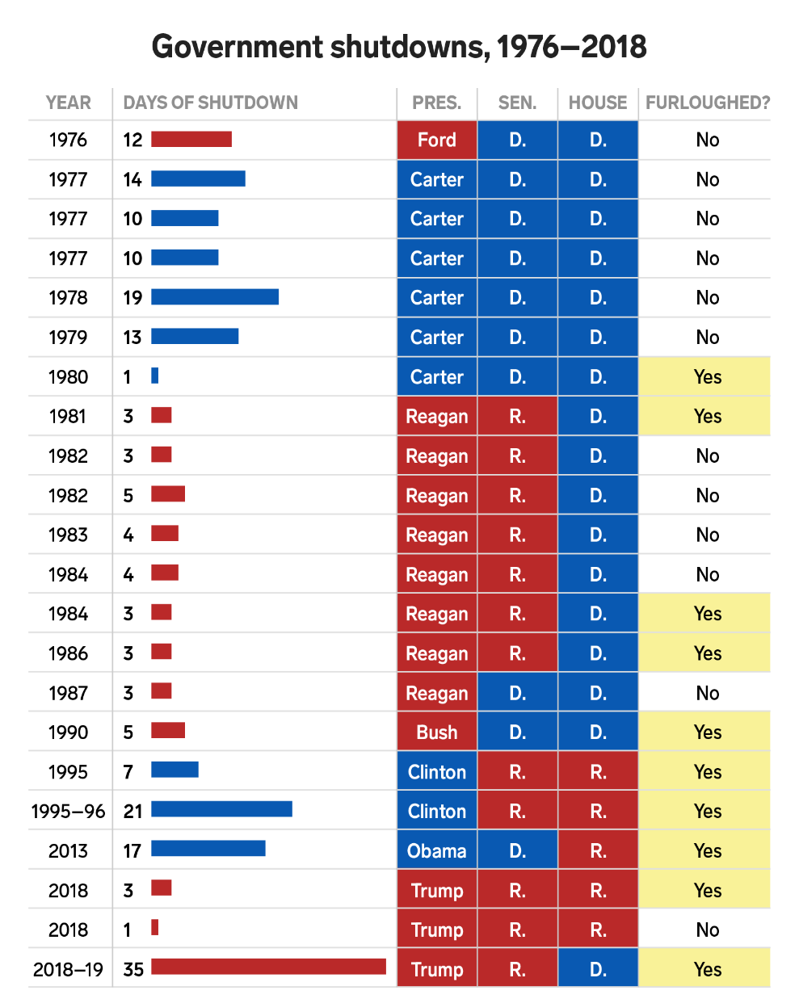
How Many Times Has the Government Shutdown?
Since the passage of the Congressional Budget and Impoundment Act of 1974, there have been 22 gaps in budget funding
Before 1980, the government did not shut down but rather continued normal operations through six funding gaps.
Since 1981, ten funding gaps of three days or less have occurred, mostly over a weekend when government operations were only minimally affected.
There have been 4 “true” shutdowns where operations were affected for more than one business day.
The first two happened in the winter of 1995-1996, when President Bill Clinton and the Republican Congress were unable to agree on spending levels and shut down the government twice, for a total of 26 days.
The third was in 2013 when the House and Senate standoff on funding the Affordable Care Act resulted in a 16-day shutdown.
The fourth (partial) shutdown, starting Dec 22, 2018 and lasted 35 days, centered on a dispute over border wall funding.

Slide 40
Few Minutes on the U.S. Budget Process

Slide 41
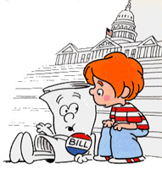
Budget and Accounting Act of 1921
Before the Budgeting & Accounting Act of 1921, no single government entity oversaw the entire budget
Departments submitted budget requests directly to Congress
After WWI, the Act was passed to provide more control over government expenditures
Budgeting debates hinge on powers given to Congress and President in this Act
Restrictions keep either branch from dominating budget decisions
The Act requires the President to submit a budget to Congress every year
The act created:
Bureau of the Budget (BoB), giving President control over individual departments, evaluating competing requests
General Accounting Office tells House and Senate what may be necessary to balance the budget
Reorganization Act of 1939 created the Executive Office of the President (EOP), and BoB moved from Dept. of Treasury to EOP
In 1970, BoB reorganized by Executive Order (Nixon) as the Office of Management and Budget
OMB is the largest agency within the Executive Office of the President

Slide 42
Three Phases of Budget Process
Formulation: Executive branch prepares the President's Budget Request
White House Office of Management and Budget (OMB) controls this process, providing guidance to Executive branch agencies
Congressional: Enacts laws that control spending and receipts
Congress considers the President's Budget proposals, passes a budget resolution, and enacts the regular appropriations acts and other laws that control spending and receipts
Execution: Executive branch agencies carry out program
OMB apportions funds to Executive Branch agencies, which obligate and disperse funding to carry out their programs, projects, and activities
Formulation
Congressional
Execution
FY 20XX Budget | DOE Internal Planning with OMB and OSTP Guidance |  |  |  |  |  |  |  |  |  |  |  | OMB Review |  |  |  | Budget Release | Congressional Budget and Appropriations |  |  |  |  |  |  | Spend the Fiscal Year Budget
 | Oct | Nov | Dec | Jan | Feb | Mar | Apr | May | Jun | Jul | Aug | Sep | Oct | Nov | Dec | Jan | Feb | Mar | Apr | May | Jun | Jul | Aug | Sep | Oct | Nov | Dec | Jan | Feb | Mar | Apr | May | Jun | Jul | Aug | Sep
 | CY(XX–3) |  |  | Calendar Year (20XX–2) |  |  |  |  |  |  |  |  |  |  |  | Calendar Year (20XX–1) |  |  |  |  |  |  |  |  |  |  |  | Calendar Year 20XX

Slide 43
The U.S. Federal Budget Cycle
Typically, three budgets are being worked on at any given time
Executing current Fiscal Year (FY; October 1 – September 30).
Aggregating final FY 2020 End of Year requests to determine final distributions of reserves
OMB review and Congressional Appropriation for upcoming FY.
Preparing FY 2021 Initial Funding Plan for DOE Labs and Program Managers annual budgets assuming a 3-month CR
Agency internal planning for the second FY from now
Submitting the FY 2022 HEP narrative draft to SC budget and DOE CFO for review before it goes to OMB for review
Busy time in HEP budget from mid-August through late September. All three collide with inflexible deadlines
FY 2020 Budget | Spend the Fiscal Year Budget
FY 2021 Budget | OMB Review |  |  |  | Budget Release | Congressional Budget and Appropriations |  |  |  |  |  |  | Spend the Fiscal Year Budget
FY 2022 Budget | DOE Internal Planning with OMB and OSTP Guidance |  |  |  |  |  |  |  |  |  |  |  | OMB Review |  |  |  | Budget Release | Congressional Budget and Appropriations |  |  |  |  |  |  | Spend the Fiscal Year Budget
 | Oct | Nov | Dec | Jan | Feb | Mar | Apr | May | Jun | Jul | Aug | Sep | Oct | Nov | Dec | Jan | Feb | Mar | Apr | May | Jun | Jul | Aug | Sep | Oct | Nov | Dec | Jan | Feb | Mar | Apr | May | Jun | Jul | Aug | Sep
 | CY 2019 |  |  | Calendar Year 2020 |  |  |  |  |  |  |  |  |  |  |  | Calendar Year 2021 |  |  |  |  |  |  |  |  |  |  |  | Calendar Year 2022
You are here

Slide 44
Overview of Budget Formulation Process
OMB provides policy guidance for Executive branch agency budget requests
Absent more specific guidance, agencies start with outyear estimates from previous budget
OMB works with agencies
Identify major issues, develop plans for fall review, plan analysis of issues that will require decisions
OMB provides detailed instructions for submitting budget material
Agencies submit budgets to OMB [before Labor Day]
OMB reviews budget proposals
Considers Presidential priorities, program performance, budget constraints
OMB provides recommended budget proposal to President and provides pass back to agencies [after Thanksgiving]
Agencies may appeal to OMB and the President
Agencies prepare and OMB reviews final congressional budget justification materials [early January]
February: President transmits budget to Congress
Spring
Spring & Summer
June
Sept.
Fall
Late Nov.
Dec.
Jan.
…

Slide 45
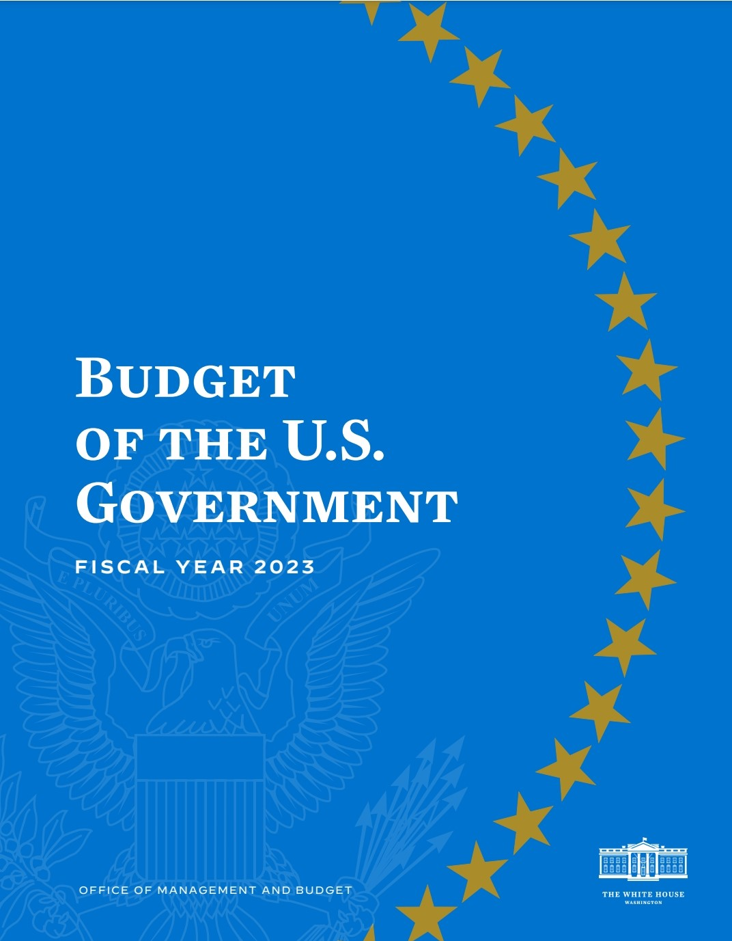
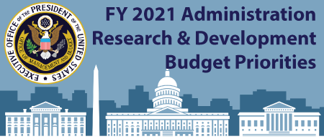
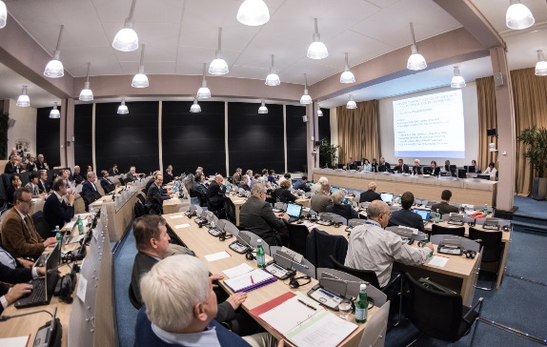
Creating the DOE HEP Budget Request
White House
White House Priorities
OMB Directives
4
Top-down and bottom-up influences to the DOE HEP budget
Advisory Panels (HEPAP, AAAC)
Community-driven Strategic Plans (P5)
Review Committee & Workshop Reports
Project Performance
DOE/SC Management
DOE/HEP Program
Particle Physics Community
Department of Energy

Slide 46
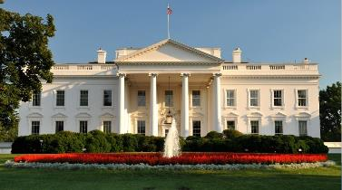
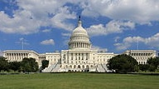
Congressional Budget and Impoundment Control Act of 1974 [aka CBA]
Prior to 1974, Congress had no formal process for establishing a federal budget. The Act was passed in response to feelings in Congress that President Nixon was abusing his power of impoundment by withholding funding of programs he opposed.
CBA created the Congressional Budget Office (CBO), which gained more control of the budget, limiting the power of the OMB.
Established timetable for the budget process, and Committees on the Budget in the House and Senate
The Act passed easily while the administration was embroiled in the Watergate scandal and was unwilling to provoke Congress.
On or Before: | Action to be completed:
1st Mon. in Feb. | President submits his budget
<6 weeks after PBR submitted | Committees submit views and estimates to Budget Committees
April 15 | Congress completes action on the concurrent resolution on the budget
May 15 | Annual appropriation bills may be considered in House
June 10 | House Appropriations Committee reports last annual appropriation bill
June 15 | Congress completes reconciliation
June 30 | House completes action on bills
October 1 | Fiscal year begins

Slide 47
Agriculture, Rural Development, Food and Drug Administration, and Related Agencies
Commerce, Justice, Science, and Related Agencies
NASA and NSF
Defense
Energy & Water Development
Department of Energy
Financial Services and General Government
Homeland Security
Interior, Environment, and Related Agencies
Labor, Health and Human Services, Education, and Related Agencies
Department of Health and Human Services (NIH)
Legislative Branch
Military Construction, Veterans Affairs, and Related Agencies
State, Foreign Operations, and Related Programs
Transportation, Housing and Urban Development, and Related Agencies

Slide 48
HEP Role in Congressional Process
Budget narrative provides the justification for the level of support in the President’s Budget Request
Overview of the HEP program, highlights from the past year, and discussion of:
Line-Item Construction, Major Items of Equipment, New Initiatives or New Starts, Facilities & Experimental Operations, and Research program priorities
Detailed funding of Budget Request vs. Prior Year Request (or Enacted)
“Explanation of Changes”
Additional scope of work (Increase) or Emphasis/Focus/Priority (Decrease)
Focus on what can be done, with priorities
Agencies usually invited to brief Congress on budget request
Opportunity to reinforce overall strategy. Highlight key elements of request
Congress must individually approve each DOE project >$5M
Informational request for additional detail
Respond to requests regarding impact of alternative funding decisions

Slide 49
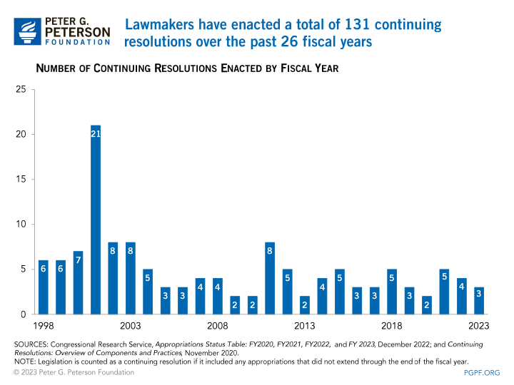
Impacts of a Continuing Resolution (CR)
If U.S. Congress and President have not passed and signed all appropriations bills by September 30, a CR may be passed to avoid a U.S. Government shutdown
Must pass some form of appropriations to have legal authority to spend money!
CRs are now a routine part of the federal budget process
CRs prevent us from making final funding decisions
Increases workload as we must revisit funding decisions
Therefore, a CR may impede the start of new projects
Projects with total cost >$5M must be approved by Congress in an appropriations bill before funding can begin
A CR may also impact the ramp-up of new projects
DOE is committed to the successful execution of projects that have reached CD-2 (aim to meet baseline funding profile)
Projects that have not reached CD-2 are most likely to be impacted under a CR
Mitigation Strategies for University Grants
Moved start dates for University grants back in the Q3 or later in fiscal year
Grant funding decisions have a greater chance to be made after the appropriation is passed
No longer do supplemental awards to fix inadequate award funding made done during a CR
A CR may also impact future-year planning…
Between fiscal year 1977 and fiscal year 2018, Congress only passed all twelve regular appropriations bills on time in four years - fiscal years 1977, 1989, 1995, and 1997.
In fiscal years 2007, 2013, and 2014, Congress enacted an extended CR to provide funding for the remainder of the fiscal year, e.g., full-year CR, (not included in the total number).

Slide 50
Connecting Formulation to Execution
Start from plan laid out in budget formulation, modified by actual appropriation:
Administration and SC R&D Priorities
Strategic plan for program (P5, AAAC Decadal Survey)
Support for Line-item Construction and MIE Projects
Stewardship of DOE National Laboratories (SC User Facilities)
Available funding vehicles (Grants, Contracts, Coop. Agreement)
Coordination with partners (International, Other Federal, Universities)
Diversity, Equity, Inclusion.
Takes time to translate Congressional Appropriation into detailed agency-level budgets:
Appropriations bills are long and detailed. Occasionally there are internal contradictions or errors
If in a CR, agencies must resolve current spending level versus final Appropriation
There may be “rescissions” and/or recovery of prior year balances
Agency CFOs must resolve all this and get agreement with OMB before issuing current Fiscal Year “allotments” of budget authority. This can take a few months. Until this is resolved, agency operates with 30-day spending authority.

Slide 51
Highlights of Budget Execution
Annual Funding Plan sets up a funding plan for the fiscal year based on an Appropriations, or what is more likely, on short-term stop-gap funding, aka Continuing Resolution (CR), extrapolated to the fiscal year
DOE labs develop their annual program funding plan based on the IFP
Plan for the portion of funds available to be released in October will be guided by what is appropriated and apportioned per Congress and OMB, respectively. (Annual Appropriations or CR)
Monthly Approved Funding Plan is a cycle that happens every month thereafter that tracks and records changes in funding including additional allotments, increases, decreases, transfers, funding type changes, etc. Continuing Resolutions make this process much more challenging
Field Work Proposals (FWP) – Received from DOE labs, requesting support for defined scope of work. Budget Managers validate the content and recommend funding.
Lab Transfer Requests – Deobligate and reallocate prior year funds, transfer Project funds, etc.
Just-in-time distribution of funds to Office of Science Service Center for support of Univ. grants
Contingency reserves: SC mandated and HEP programmatic support costs (known unknowns)
Management reserves: Unforeseeable costs (unknown unknowns)

Slide 52
College: Historical Average Cost of Tuition
In 1963, the annual cost of tuition at a 4-year public college was $243, which had the same buying power as $2,349 in September 2022
From 1963 to 2020, the cost of tuition increased 355% after adjusting for inflation
From 2000 to 2020, average postsecondary tuition inflation outpaced wage inflation 111.4%.
In 1963, the cost of a 4-year-degree from a public university was $972.
In 1989, the same degree cost $7,120.
As of the 2020-21 academic year, $102,828 is the price of a bachelor’s degree.
https://educationdata.org/average-cost-of-college

Slide 53
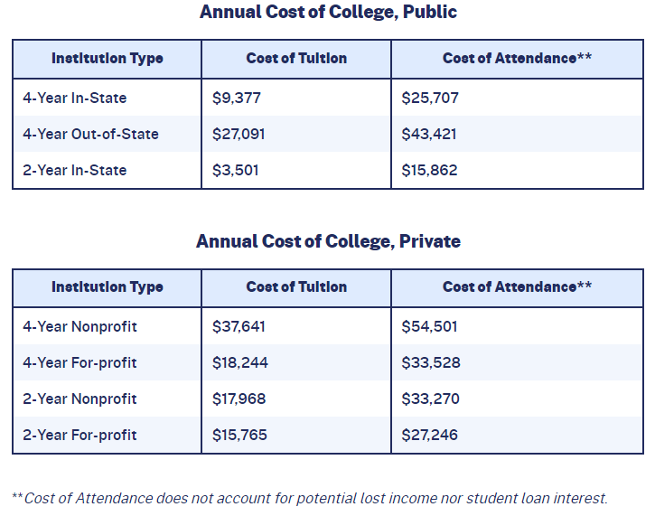
College: Annual and Average Cost
Average cost of college in the United States is $35,551 per student per year, including books, supplies, and daily living expenses.
Average cost of college has more than doubled in the 21st century, with an annual growth rate of 7.1%.
Average private, nonprofit university student spends a total of $54,501 per academic year, $37,641 of it on tuition and fees.
Considering student loan interest and loss of income, the ultimate cost of a bachelor’s degree can exceed $500,000.

Slide 54
College: Food Insecurity, Room & Board, Lost Income
Average Cost of Room & Board
The determining factor in the cost of room and board is whether the student lives on or off campus.
At public 4-year institutions, students living on campus pay an average of $11,557 annually for room and board; off-campus boarders pay $10,941.
At private, nonprofit institutions, on-campus boarders pay an average of $12,857 per academic year; students living off campus pay $10,429.
Average Cost of Lost Income
One of the largest expenses for students enrolled in college may be the loss of potential income in time spent studying instead of working.
Median weekly income for a high school graduate is $809, or $42,068/year.
In 4 years, the average worker with a high school diploma earns $168,272.
The unemployment rate among high school graduates is 6.2%, which is 77.1% higher than the unemployment rate among bachelor’s degree holders.

Slide 55
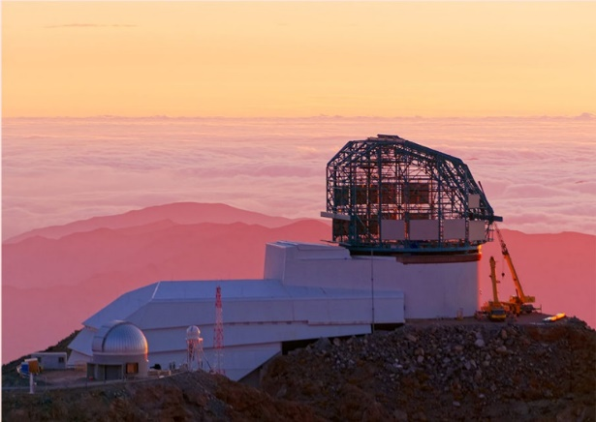
HEP: Supporting Projects, Facilities, and Research to Produce Discovery Science
HEP works proactively with laboratory and university community to carry out a portfolio of facilities, projects & experiments.
Develops and supports a specific portfolio of projects. Emphasis is placed on supporting science collaborations in all stages
Makes significant, coherent contributions to facilities/experiments selected for the program, including project management
Advance the state-of-the-art in particle accelerators & detectors, leading to new, more capable facilities
Enable new and transformative capabilities in QIS, AI/MI, and crosscutting technology areas
HEP strength is our Science Collaboration Model!
Support structured science collaborations that participate in all stages, leading to the best possible results from state-of-the art projects
Scientists are intimately involved: Roles & responsibilities in project design & fabrication (hardware, software), commissioning, exp. operations, science planning & data analysis
Students & postdocs are trained by participation in all phases to gain experience and expertise; opportunities to work at a lab or experimental site
Priority for Research support is for efforts directly in line with HEP roles and responsibilities as well as our science goals
HEP forms partnerships (e.g., NASA, NSF, Int’l) to help deliver our mission

Slide 56
HEP Funding in Historical Context: 1987 to Present
SSC Funding
FY | $M
1987 | 0.0
1988 | 33.0
1989 | 98.1
1990 | 216.9
1991 | 241.5
1992 | 482.6
1993 | 512.9
1994 | 640.0
1995 | 0.0
Adjusting for inflation, based on the Consumer Price Index published by the U.S. Bureau of Labor Statistics, FY 1987 funding $495.4M is about $1,300M in Dec 2022 adjusted dollars. However, over that period, Lab and University cost escalation outpaced CPI.
IRA Funding
FY | $M
2021 | 0.0
2022 | 303.6
2023 | 0.0
ARRA Funding
FY | $M
2008 | 0.0
2009 | 236.5
2010 | 0.0
$ in millions
Students at public 4-year institutions paid $5,423 in tuition & fees, room & board in 1990-91 ($13,648 [or x2.52] in Dec 2022 adjusted dollars). By 2020-21, the cost has risen to $21,337 [or x3.93].

Slide 57
HEP Research ($k) FY 2011-2023
Research Growth
Driven by QIS and AI/ML
-87M: FY11 to FY16 for Research
MIEs: +56M from FY11 ($103M) to FY16 ($159M)
LICs: +66M from FY11 ($0) to FY16
($66M)

Slide 58
HEP Research Breakdown ($k) FY 2014-2023
 | FY 2014 | FY 2015 | FY 2016 | FY 2017 | FY 2018 | FY 2019 | FY 2020 | FY 2021 | FY 2022 | FY 2023
Research Core | 360,932 | 334,225 | 320,816 | 321,892 | 316,750 | 321,034 | 310,934 | 302,856 | 281,307 | 325,930
SBIR/STTR | 21,601 | 20,768 | 20,847 | 22,151 | 24,427 | 24,095 | 25,212 | 25,465 | 25,298 | 15,867
QIS |  |  |  |  | 18,000 | 27,500 | 38,500 | 43,469 | 39,639 | 48,901
AI/ML |  |  |  |  |  |  | 15,000 | 32,269 | 34,308 | 38,539
Microelectronics |  |  |  |  |  |  |  | 4,825 | 6,740 | 6,745
ASTI |  |  |  |  |  |  |  |  | 16,980 | 9,653
Adv. Computing |  |  |  |  |  |  |  |  | 4,000 | 4,957
RENEW |  |  |  |  |  |  |  |  | 4,000 | 8,000
FAIR |  |  |  |  |  |  |  |  |  | 1,927
Accelerate |  |  |  |  |  |  |  |  |  | 3,854
Total Research | 382,533 | 354,993 | 341,663 | 344,043 | 359,177 | 372,629 | 389,646 | 408,884 | 412,272 | 464,373

Slide 59
Historical Chart of HEP Projects FY 1996 – FY 2020
Current P5
61 Projects
HEP funded $2.0B in projects from FY 1996-2015 (14% of total budget)
HEP funded $1.4B in projects from FY 2016-2020 (30% of total budget)

Slide 60
HEP Budget Simulation FY 2024-2035 – High Scenario
 | Research Fraction | 37.53% | 37.44% | 37.81% | 38.80% | 39.62% | 40.50% | 40.69% | 41.47% | 41.45% | 41.97% | 41.48% | 42.29%
 | Facilities/Operations Fraction | 27.82% | 26.04% | 25.77% | 25.83% | 26.27% | 26.36% | 27.13% | 27.10% | 27.72% | 28.19% | 27.99% | 27.71%
 | Projects Fraction | 34.65% | 36.52% | 36.42% | 35.37% | 34.11% | 33.13% | 32.18% | 31.43% | 30.83% | 29.84% | 30.53% | 30.00%
 | LIC Fraction | 29.46% | 30.11% | 27.94% | 26.37% | 22.05% | 20.61% | 19.12% | 21.14% | 25.56% | 25.95% | 27.37% | 26.92%
 | MIE Fraction | 5.19% | 6.41% | 8.49% | 9.00% | 12.05% | 12.53% | 13.06% | 10.29% | 5.28% | 3.89% | 3.16% | 3.08%
 | Year to Year Fraction Increase | 10.63% | 10.73% | 5.01% | 3.67% | 3.00% | 3.03% | 3.03% | 2.94% | 2.86% | 2.78% | 2.70% | 2.63%
 | Activity | FY 2024 Science (1289.891M) | FY 2025 Science (1428.285M) | FY 2026 Science (1499.882M) | FY 2027 Science (1554.875M) | FY 2028 (1601.5M) | FY 2029 (1650M) | FY 2030 (1700M) | FY 2031 (1750M) | FY 2032 (1800M) | FY 2033 (1850M) | FY 2034 (1900M) | FY 2035 (1950M) | Comments
LICs | LBNF/DUNE | 255,000,000 | 305,000,000 | 305,000,000 | 305,000,000 | 305,000,000 | 275,000,000 | 125,000,000
 | PIP-II | 125,000,000 | 125,000,000 | 114,000,000 | 105,000,000 | 42,200,000
 | Booster Upgrade |  |  |  |  | 3,000,000 | 40,000,000 | 120,000,000 | 200,000,000 | 250,000,000 | 250,000,000 | 250,000,000 | 250,000,000 | TPC=1800M
 | Wilson Hall |  |  |  |  | 3,000,000 | 20,000,000 | 60,000,000 | 100,000,000 | 100,000,000 | 70,000,000 | 30,000,000 |  | TPC=400M
 | FCC |  |  |  |  |  | 5,000,000 | 15,000,000 | 50,000,000 | 70,000,000 | 100,000,000 | 150,000,000 | 165,000,000 | TPC=2000M
 | LBNF/DUNE High Flux |  |  |  |  |  |  | 5,000,000 | 20,000,000 | 40,000,000 | 60,000,000 | 90,000,000 | 110,000,000 | TPC=1000M
MIEs and LIC OPC | LBNF/DUNE OPC
 | HL-LHC ATLAS | 16,200,000 | 9,000,000 | 5,000,000 | 5,000,000
 | HL-LHC CMS | 19,500,000 | 8,612,000 | 6,300,000 | 5,000,000
 | CMB-S4 | 25,000,000 | 60,000,000 | 80,000,000 | 80,000,000 | 90,000,000 | 90,000,000 | 80,000,000 | 50,000,000 | 10,000,000 |  |  |  | Adjusted TPC=530M
 | Accelerator Controls | 6,199,000 | 10,000,000 | 25,000,000 | 26,000,000 | 45,000,000 | 10,701,000 |  |  |  |  |  |  | Adjusted TPC=160M
 | DMNI (4 MIEs @20M each) |  | 2,000,000 | 3,000,000 | 5,000,000 | 10,000,000 | 20,000,000 | 20,000,000 | 20,000,000 |  |  |  |  | Project TBD
 | FACET e+ Upgrade (40M) |  | 2,000,000 | 6,000,000 | 10,000,000 | 12,000,000 | 10,000,000 |  |  |  |  |  |  | Project TBD
 | kBELLA (120M) |  |  |  | 2,000,000 | 10,000,000 | 36,000,000 | 42,000,000 | 30,000,000 |  |  |  |  | Project TBD
 | Booster Upgrade (OPC) |  |  | 2,000,000 | 5,000,000 | 15,000,000 | 5,000,000 |  |  |  |  |  |  | Project TBD
 | Wilson Hall (OPC) |  |  |  | 2,000,000 | 5,000,000 | 10,000,000 |  |  |  |  |  |  | Project TBD
 | FCC (OPC) |  |  |  |  | 3,000,000 | 10,000,000 | 25,000,000 | 25,000,000 | 25,000,000 | 12,000,000 |  |  | Project TBD
 | LBNF/DUNE High Flux (OPC) |  |  |  |  | 3,000,000 | 10,000,000 | 20,000,000 | 10,000,000 |  |  |  |  | Project TBD
 | Project Reserve |  |  |  |  |  | 5,000,000 | 35,000,000 | 45,000,000 | 60,000,000 | 60,000,000 | 60,000,000 | 60,000,000 | Project TBD
 | MIE Subtotal | 66,899,000 | 91,612,000 | 127,300,000 | 140,000,000 | 193,000,000 | 206,701,000 | 222,000,000 | 180,000,000 | 95,000,000 | 72,000,000 | 60,000,000 | 60,000,000
 | Project Subtotal | 446,899,000 | 521,612,000 | 546,300,000 | 550,000,000 | 546,200,000 | 546,701,000 | 547,000,000 | 550,000,000 | 555,000,000 | 552,000,000 | 580,000,000 | 585,000,000
Facilities and Operations | Fermilab Accelerator Complex | 157,200,000 | 164,700,000 | 173,000,000 | 181,100,000 | 192,090,000 | 201,500,000 | 226,400,000 | 223,500,000 | 243,500,000 | 259,900,000 | 256,500,000 | 258,900,000
 | SURF | 35,000,000 | 36,100,000 | 37,200,000 | 37,900,000 | 38,700,000 | 39,500,000 | 40,300,000 | 41,100,000 | 41,900,000 | 42,700,000 | 43,600,000 | 44,500,000
 | FACET II | 16,000,000 | 16,500,000 | 17,100,000 | 17,400,000 | 17,700,000 | 18,200,000 | 19,100,000 | 19,700,000 | 20,300,000 | 20,900,000 | 21,900,000 | 22,300,000
 | LHC Operations | 55,600,000 | 58,400,000 | 61,300,000 | 63,800,000 | 65,700,000 | 67,700,000 | 69,700,000 | 71,800,000 | 75,400,000 | 79,200,000 | 83,200,000 | 84,900,000
 | Vera Rubin Obs (aka LSST) | 31,700,000 | 32,000,000 | 32,000,000 | 32,300,000 | 32,600,000 | 32,900,000 | 33,200,000 | 33,500,000 | 33,800,000 | 32,100,000 | 28,900,000 | 26,000,000
 | Other Cosmic Frontier | 25,000,000 | 24,300,000 | 24,100,000 | 25,200,000 | 24,600,000 | 23,000,000 | 24,800,000 | 28,400,000 | 32,300,000 | 37,000,000 | 38,900,000 | 39,700,000
 | FNAL Test Facilities | 23,300,000 | 24,000,000 | 24,800,000 | 25,700,000 | 26,500,000 | 27,300,000 | 28,100,000 | 29,000,000 | 29,900,000 | 30,800,000 | 32,300,000 | 33,100,000
 | Other Operations | 16,070,000 | 18,700,000 | 19,600,000 | 20,600,000 | 25,700,000 | 27,100,000 | 29,000,000 | 32,200,000 | 32,700,000 | 33,800,000 | 35,300,000 | 35,600,000
 | Facility Subtotal | 298,700,000 | 333,700,000 | 348,400,000 | 376,700,000 | 392,000,000 | 416,400,000 | 428,300,000 | 453,900,000 | 462,100,000 | 483,500,000 | 486,800,000 | 509,200,000
Research | Core Research | 298,700,000 | 333,700,000 | 348,400,000 | 376,700,000 | 392,000,000 | 416,400,000 | 428,300,000 | 453,900,000 | 462,100,000 | 483,500,000 | 486,800,000 | 509,200,000
 | SC Initiatives | 129,744,000 | 140,300,000 | 154,800,000 | 159,600,000 | 172,700,000 | 179,300,000 | 188,300,000 | 194,000,000 | 201,800,000 | 209,900,000 | 216,200,000 | 227,000,000
 | Traineeships | 6,000,000 | 6,000,000 | 7,200,000 | 8,000,000 | 9,150,000 | 10,000,000 | 11,000,000 | 11,300,000 | 11,600,000 | 11,700,000 | 12,100,000 | 12,500,000
 | Reserves: Research | 33,378,000 | 37,673,000 | 39,082,000 | 40,875,000 | 41,860,000 | 43,199,000 | 44,200,000 | 46,200,000 | 49,200,000 | 49,500,000 | 50,500,000 | 52,700,000
 | SBIR/STTR | 16,300,000 | 17,100,000 | 17,600,000 | 18,100,000 | 18,800,000 | 19,400,000 | 20,000,000 | 20,400,000 | 21,400,000 | 21,800,000 | 22,500,000 | 23,200,000
 | Research Subtotal | 484,122,000 | 534,773,000 | 567,082,000 | 603,275,000 | 634,510,000 | 668,299,000 | 691,800,000 | 725,800,000 | 746,100,000 | 776,400,000 | 788,100,000 | 824,600,000
 | Total | 1,289,891,000 | 1,428,285,000 | 1,499,882,000 | 1,554,875,000 | 1,601,500,000 | 1,650,000,000 | 1,700,000,000 | 1,750,000,000 | 1,800,000,000 | 1,850,000,000 | 1,900,000,000 | 1,950,000,000

