Slide 1
Welcome & Introductions
HEP Early Career Award Network Summer 2023 Workshop
Rupak Mahapatra, for the organizing group
Gianpaolo Carosi (LLNL) , Rupak Mahapatra (Texas A&M University) , Michael Mooney (Colorado State University), Kazuhiro Terro (SLAC), Faya Wang (SLAC), Peter Winter (ANL)
8-9 June 2023

Slide 2
Background and history
Currently there have been 146 HEP Early Career Awardees from the beginning of the program in FY 2010
58 at National Laboratories & 88 at Universities
The mission of the High Energy Physics (HEP) Early Career Award Network (ECAN) is to organize past and present awardees to make a strong, beneficial impact to the overall DOE HEP program.
We do this by connecting awardees from all areas of HEP science and technology research, by providing networking and career development resources, and by attracting, inspiring, and supporting exceptional STEM talent.

Slide 3
Background and history
This network was first suggested by Program Manager Dr. Alan Stone in 2019 in order to provide a supported resource to connect, collaborate and amplify efforts of Early Career Awardees and to provide more uniform engagement with the broader HEP community and other stakeholders (NSF, NASA, other Office of Science programs).
Several objectives were proposed:
Driven by a sub-group of the community
HEP provides some seed funding to get started
Enable members to have greater role in community planning (P5)
Develop a formal structure
Develop competitive and/or bridge funding for post-docs and grad students
Expand network to adjacent programs (NP, BER, BES, ASCR, etc)
BES recently started a similar effort in Early Career (not just awardees) network

Slide 4
Background and history
The first virtual meeting was held in Oct 2020, to brainstorm what such a ECAN program might look like. This led to a ½ day workshop in March 21, 2021
https://indico.fnal.gov/event/48127/
Also organized through SLACK Channel: http://hep-eca-alumninetwork.slack.com
This 4-hour meeting concluded with the decision to follow up with an in-person meeting that expanded on the topics of interest that were discussed:
Career Development
DEI
Mentoring
Networking
After pausing active work on the network due to the SNOWMASS process we began planning for a hybrid in-person / virtual workshop with the ultimate goal of laying out a more detailed charter for the program.

Slide 5
Current Organizing Committee
Initially this was led by Sam Posen & Jen Raff at Fermilab
After the first ½ day workshop they handed co-lead responsibility to GP Carosi (LLNL) & Kazu Terao (SLAC).
We worked with Missy Miller of ORISE to assist in organizing meetings.
Joined by Rupak Mahapatra (Texas A&M), Peter Winter (ANL), Michael Mooney (Colorado State) and Faya Wang (SLAC) as part of the overall organizing committee.
Meetings were initially bi-weekly (have moved to a weekly format).
Anticipate maintaining a modest sized executive committee (6-8 members?) with rotating leadership / membership in the 1-2 year level of commitment
Would like to maintain a balance between Labs and Universities.
Open to other organizational structures.

Slide 6
Scope
This workshop will focus on establishing the initial setup of working groups for the four major topics so far identified,
Mentoring and Career Development
Scientific Collaboration
DEI / Community Outreach,
Project Management.
and define initial timelines and milestones for the ECAN
The workshop offers several keynote speakers on selected topics and a variety of networking opportunities for ECAN members to get to know each other.
The expected results of this workshop will be essential for defining the structure of the Early Career Awards Network by focusing both the needs of the new ECA members and the experiences of the alumni.

Slide 7
Resources
Initially ORISE (Oak Ridge Institute for Science and Education) was brought in to provide the facilitator (Missy Miller) and services such as web-site hosting.
It was later determined that ORISE’s Scope of Work was limited to temporary programs (operating a review for example) and did not allow for permanent and ongoing programs which the ECAN network aspires to be.
Though we still have access to the ORISE Sharepoint and the currently hosted ECAN website template we have saved the relevant information gathered there to google drives with the aim of transferring to a more permanent home (perhaps hosted by a National Lab).

Slide 8
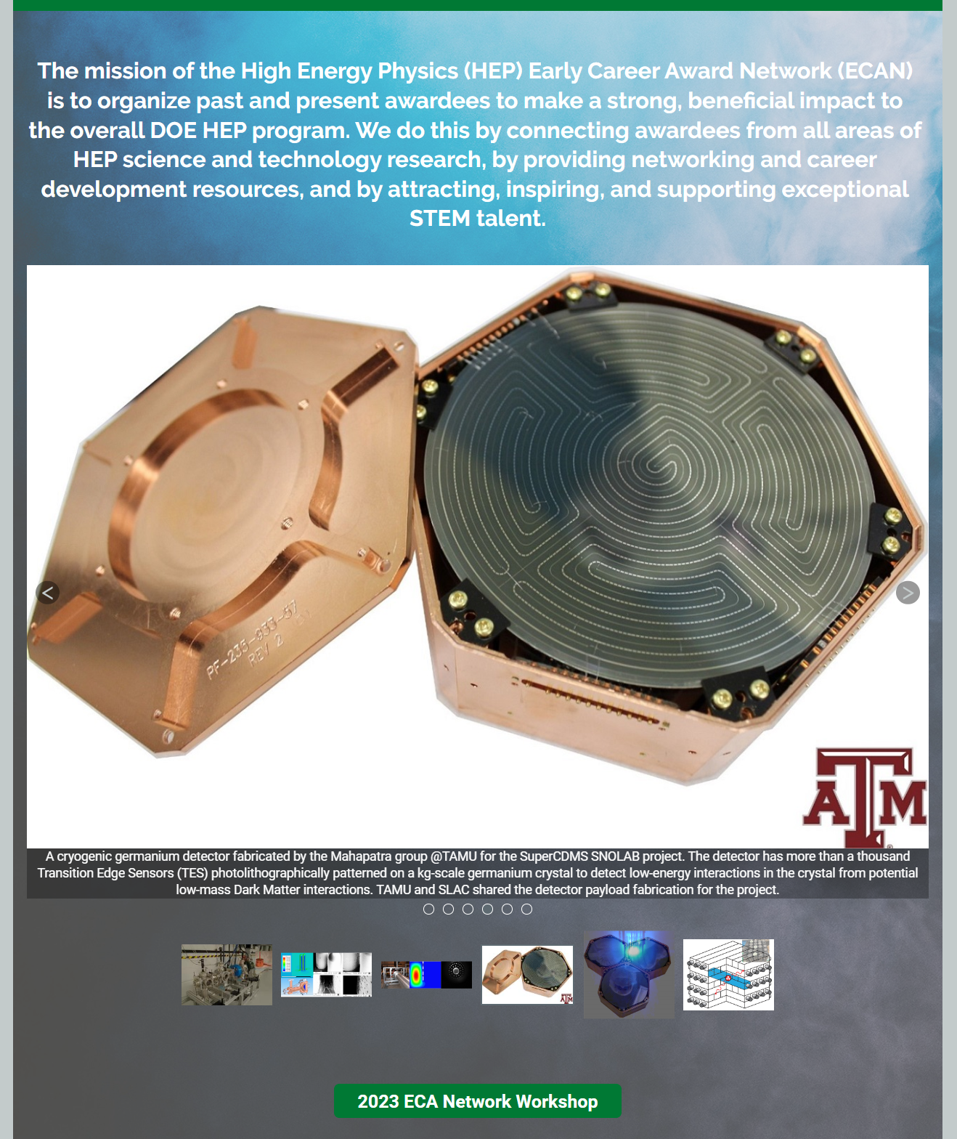
Website Template
Open question on where to permanently host the website
Needs a champion to pull in the material and curate it.
https://cvent.me/qzE7gy

Slide 9
Workshop plan – Presentations
Understand the big picture: HEPAP/P5/Budget/Project Management/Early Career
Presentations are 20 mins + 10 mins Q&A
Lightning talks from each of the HEP frontiers with quick summary and specific research enabled by ECA
Presentations are 12 mins + 3 mins Q&A
We have twice as many virtual attendees as in-person signed up
People will take turns between in-person and virtual participants to ensure equity in discussions.
In-person attendees will use a hand-held microphone to speak, when prompted by the moderator. The moderator will cycle through virtual and in-person participants.

Slide 10
Workshop plan – Discussion Sessions
Questions to consider: google doc
1. Project Management
Can the ECAN provide or point to training in how to work on Projects of various sizes.
What are effective ways for the HEP PIs to engage with Project Controls and Engineering support as they work on projects of various sizes?
Is there feedback that ECAN members can provide to DOE to better guide how projects are managed?
How are big projects managed by DOE? How do the National Labs and the Universities collaborate and find optimum balance of project and collaboration needs for medium and large experiments?

Slide 11
Workshop plan – Discussion Sessions
Questions to consider: google doc
2. Scientific Collaboration
How to identify collaborators with complementary skills and expertise?
How can I effectively communicate my research interests and goals to potential collaborators?
How can I establish trust and build relationships with potential collaborators?
How can I ensure that all collaborators are appropriately acknowledged and credited for their contributions?
How can the ECAN facilitate the building of scientific collaborations?
Next steps (do we maintain a working group and what is their specific goal)?

Slide 12
Workshop plan – Discussion Sessions
Questions to consider: google doc
3. Mentoring & Career Development
How does one find a good mentor?
What should I expect as a mentee and how do I get the most out of mentoring sessions?
What skills should I develop to be an effective mentor?
How can I provide mentoring to ECA applicants at my own institution?
How can the ECAN help in guiding members to effective mentoring training material?

Slide 13
Workshop plan – Discussion Sessions
Questions to consider: google doc
4. Diversity, Equity and Inclusion (DEI) & Outreach
How can the ECAN effectively share best practices in DEI and Outreach?
What works and what doesn’t, while developing hiring and retention practices with DEI in mind?
Where are ECAN members current participating in outreach activities and are there ways to expand?
What are barriers to increasing diversity in HEP and how can the ECAN help to rectify it?

Slide 14
Workshop Deliverables
By the end of the day on Friday we’d like to present a summary of the discussions and an actionable plan for the next year to implement including:
Laying out regular meetings, training sessions and information gathering sessions for the various sub-activities
Identify a plan to populate the ECAN website as a resource for the community.
Produce an updated statement of work draft that will be developed for DOE HEP to consider supporting.

Slide 15
Outlook
We appreciate the strong support from our initial survey (approximately 2/3rd response from the Early Career community).
Healthy turnout in-person and virtually during this busy season (thank you!)
We have a solid framework to start with but welcome additional help and suggestions on how to continue to streamline the program!

Slide 16
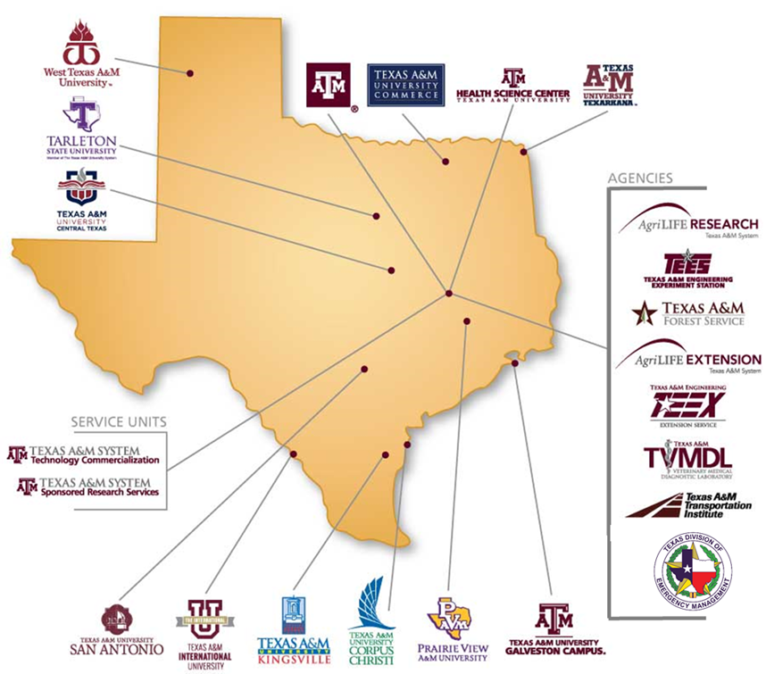
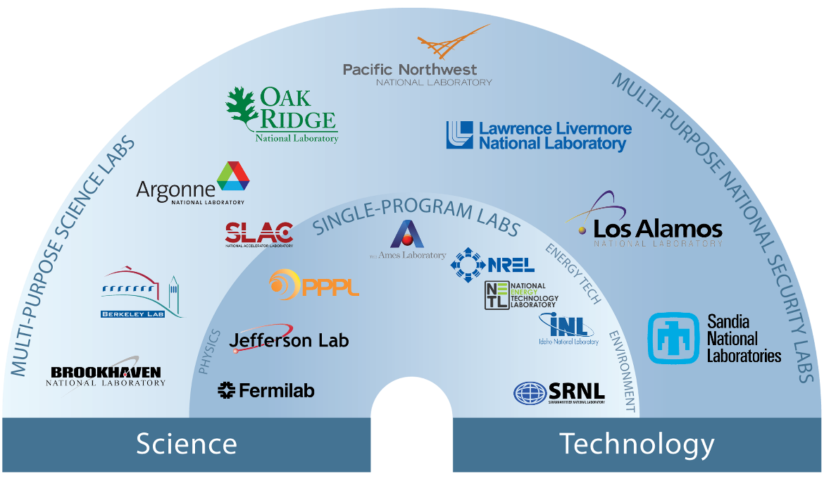
The National Laboratories Office – Thanks for sponsoring this entire event
Create opportunities and lower barriers for The Texas A&M University System researchers and students to engage with National Labs.
Facilitate access for National Labs to engage with Texas A&M System researchers and students.
Ensure Labs are aware the National Laboratories Office is a service available to Texas A&M System researchers and students, and to U.S. Department of Energy National Labs.
A Conduit for Collaborative Research Opportunities

