Slide 1
AI Ethics & Responsible Data Science for Physicists
Savannah Thais, Columbia University

Slide 2
Why are we talking about AI Ethics at a Physics Summer School?
Let’s start with two questions for you…

Slide 3
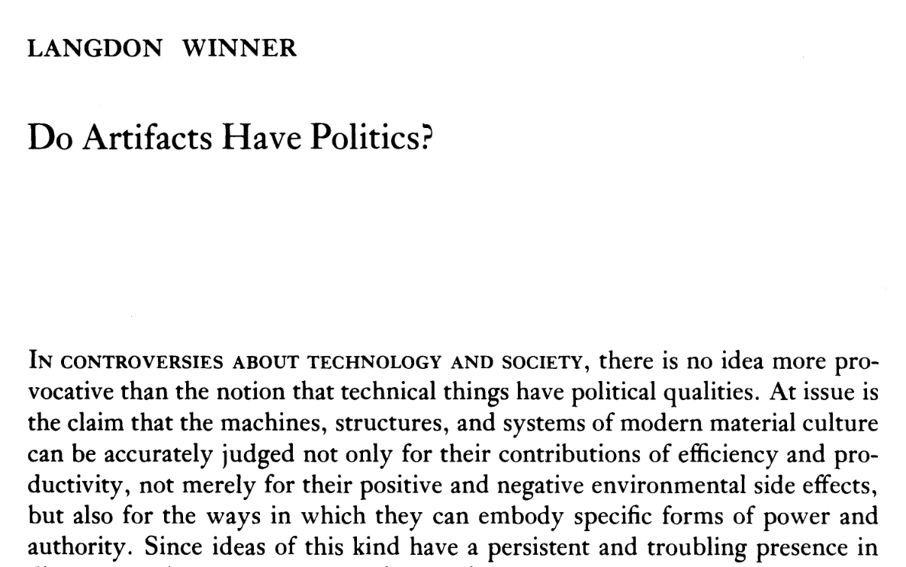
Does AI have politics?
How do we contextualize and interrogate a piece of technology?
Notes:
These system are infrastructure, provide critical functionality (information, access to key services, navigation, normative ideas about society)

Slide 4
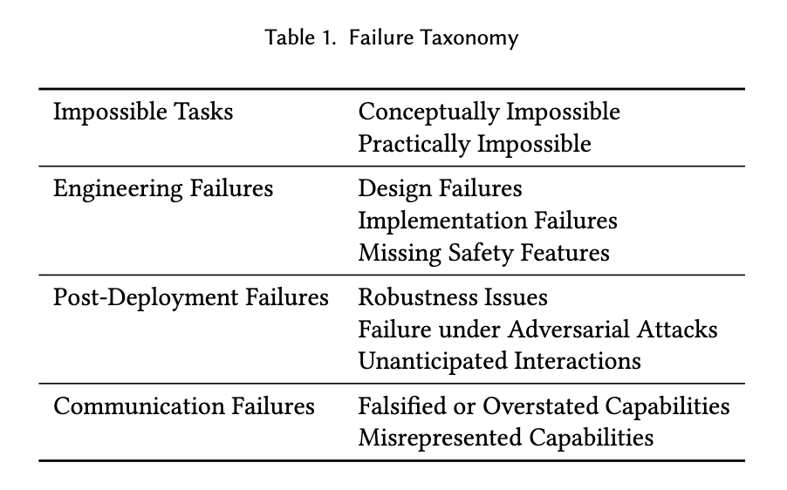
Does AI Function?
What beliefs do we have about the abilities and reliability of AI?
The Fallacy of AI Functionality, Raji et al
Notes:
These system are infrastructure, provide critical functionality (information, access to key services, navigation, normative ideas about society)

Slide 5
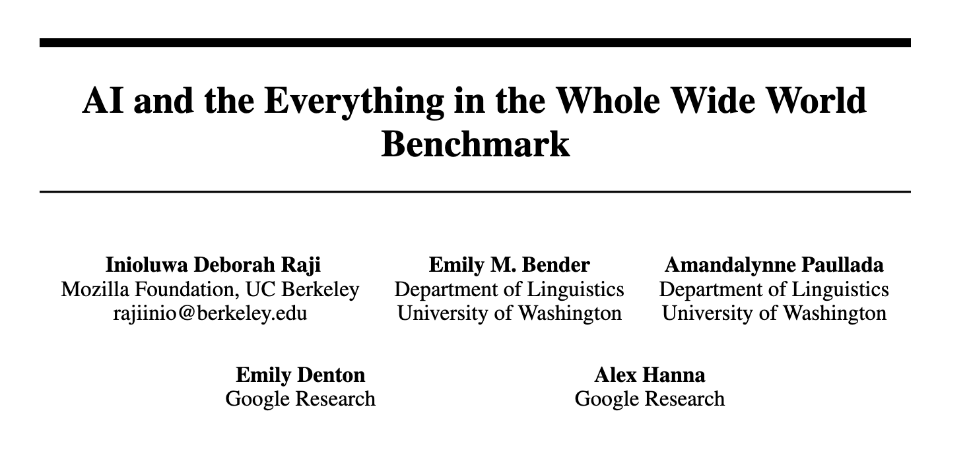
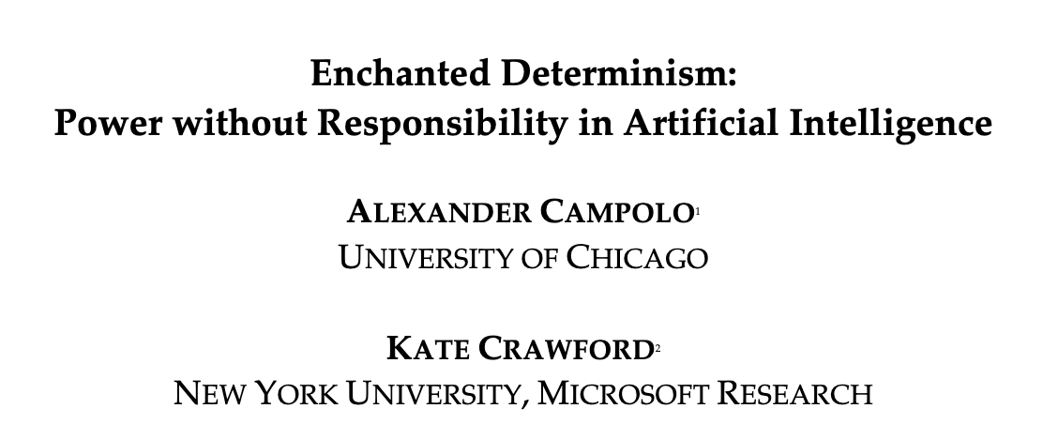
AI Has a Reliability Problem
Focus on constructed tasks and benchmark data sets that may be distant from real world distributions or goals
Application to impossible tasks, robustness issues, misrepresented capabilities, engineering mistakes or failures
Data leakage, incorrect or neglected testing, poor experimental design practices
Acceptance of inherent unknowability of AI systems, willingness to use imprecise or unscientific language
Notes:
Structures in the field have contributed to this

Slide 6
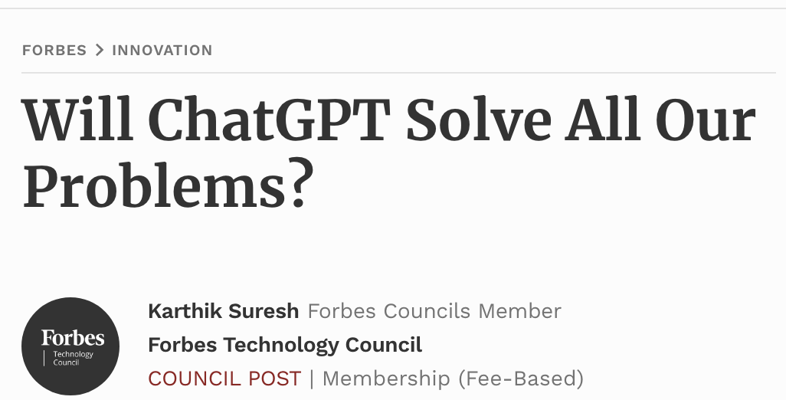
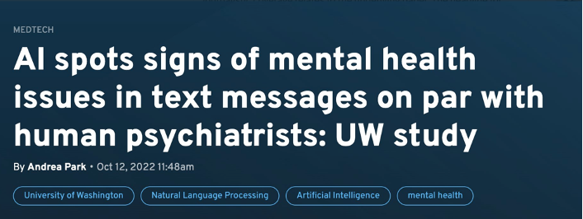
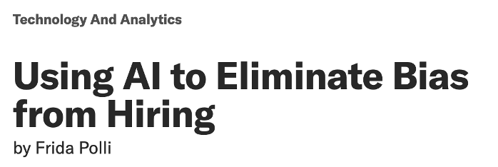
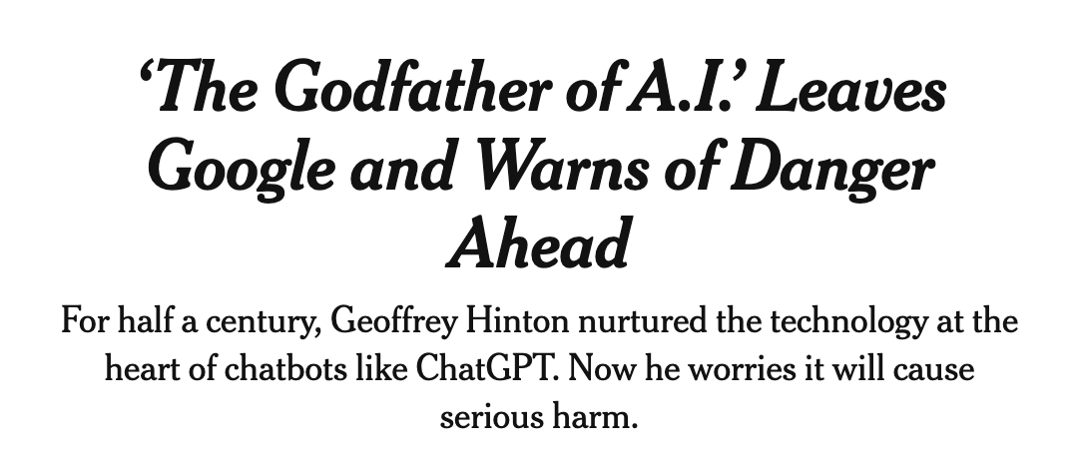
AI Has a Hype Problem

Slide 7
Danger of Treating AI as Magic vs Science
Present Society
Future Society
Research Systems
Allows us to subject people to inaccurate and under-evaluated sociotechnical systems
Can rapidly entrench biases or inequalities
Can push responsibility for harm onto users who inherently have less control
Limits the space of possible solutions we consider
Risks of irrevocably altering information systems or resource infrastructure
Risk of entrenching power in the hands of those who build and ‘test’ these systems
Focuses effort on certain approaches (scale) to the detriment of others
Believe we have solved certain problems we haven’t
Constrains how we think about explainability and contestability

Slide 8
How does this manifest in the real world?

Slide 9
Taxonomy of AI Ethics
Data Collection & Storage
Task Design & Learning Incentives
Model Bias & Fairness
Model Robustness & Reliability
Deployment & Outcomes
Downstream & Diffuse Impacts
How, from who, for what, for how long, with what consent?
What do we ask our systems to do, how does this align?
How does performance vary across groups?
In which circumstances can we trust our systems?
Who is subjected to what, how do we understand impact?
What is changed or lost by what we build?

Slide 10
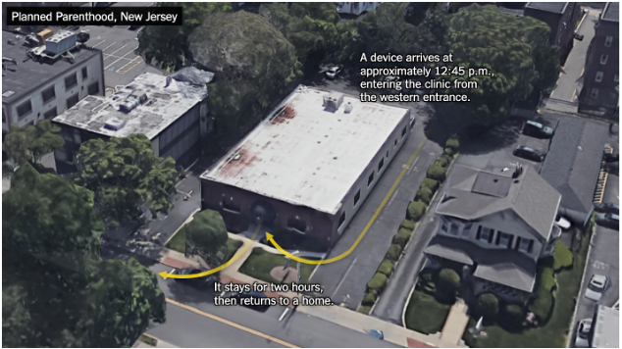
Data Collection & Storage
Data labeling companies exploit workers and political strife in the global south to maximize profits
Non-profit Crisis Text Line shared user conversation data with for-profit spinoff designed to ‘improve customer service’
Data brokerage firms indiscriminately sell aggregated, ‘anonymized’ location datasets
Amazon requires delivery drivers to submit to biometric data tracking
Develops technology to surveil factories for signs of unionization organizing

Slide 11
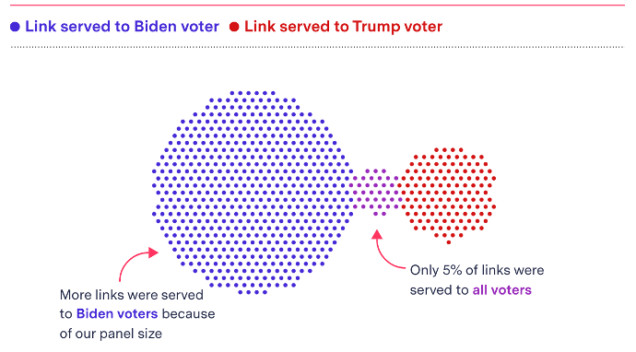
Task Design & Learning Incentives
Recommendation and curation algorithms are designed to maximize retention and click through
Information silos based on click-through rates & shares
Radicalization pipelines through progressive content serving
Viral spread of misinformation accelerated by algorithms
Research on negative impacts of core/profitable technology often suppressed
See Facebook Files, Timnit Gebru firing, prevention of external research
Researchers may pursue conceptually impossible tasks (like trustworthiness detection)

Slide 12
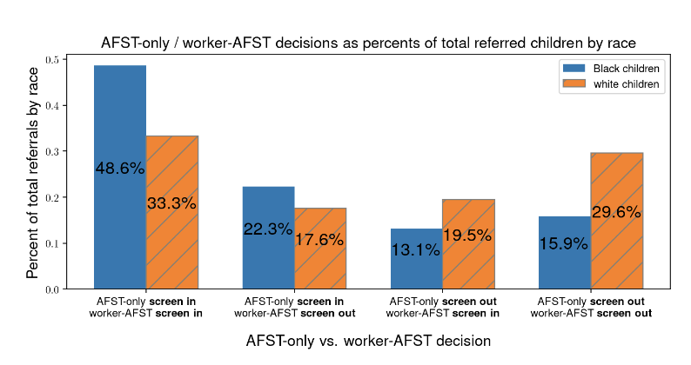
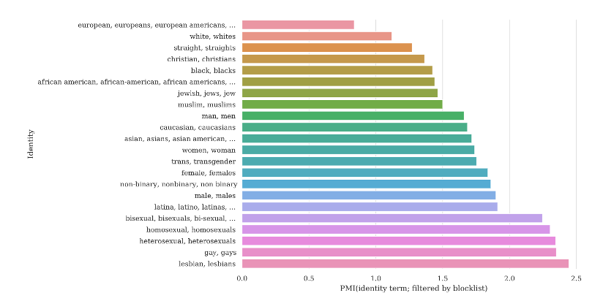
Model Bias & Fairness
Unless explicitly corrected, historical or distribution biases in training datasets are reflected in model performance
E.g. gender bias in hiring for technical roles or racial bias in child welfare screening tools
Particularly an issue for large language models trained on text corpuses collected from web sources
E.g. text completions about Muslims are disproportionately violent or translation tools that demonstrate bias in gender neutral translations
These issues can be trick to resolve
Datasets curated to remove ‘toxic’ and ‘offensive’ content can prevent representation of marginalized groups
Quantitative fairness requirements may not reflect real life expectations or desires
Notes:
Anecdote about nonbinary pronouns in LLMs

Slide 13
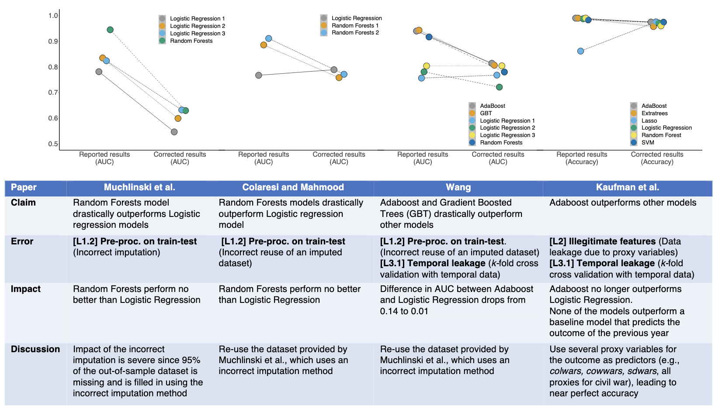
Model Robustness & Reliability
Scientific mistakes in model construction, training, or evaluation yield unreliable or non-generalizable results
E.g. test set not drawn from distribution of interest, illegitimate features, data leakage, sampling bias
Example: a sepsis prediction tool takes antibiotic use as an input feature, inflating performance claims
Models may struggle to generalize to new environments or account for shifts in underlying data distribution
Adversarial examples are poorly understood

Slide 14
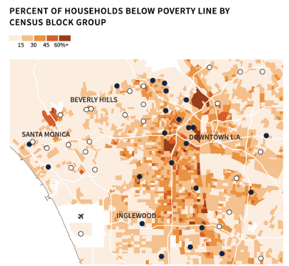
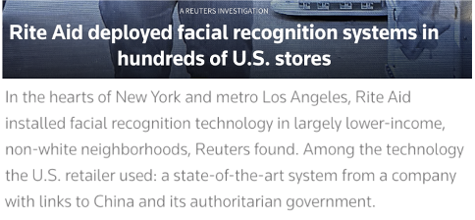
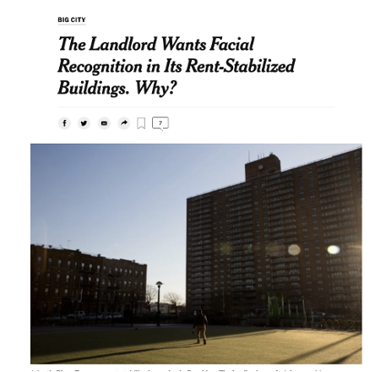
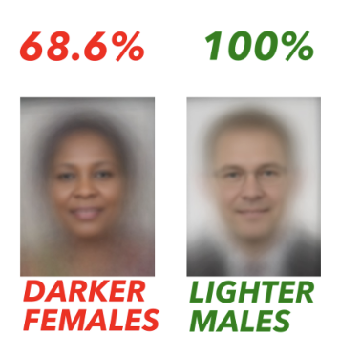
Deployment & Outcomes
Surveillance AI is often disproportionately deployed in low-income and minority neighborhoods
These groups typically have the least influence over AI development and fewest opportunities to dissent
AI systems can be leveraged to support oppression and disenfranchisement
E.g. tracking protestors, profiling religious minorities, deterring asylum seeking
Model predictions may not be the same as real world outcomes
If a societal system is already unfair, a ‘fair’ model may still perpetuate harm

Slide 15
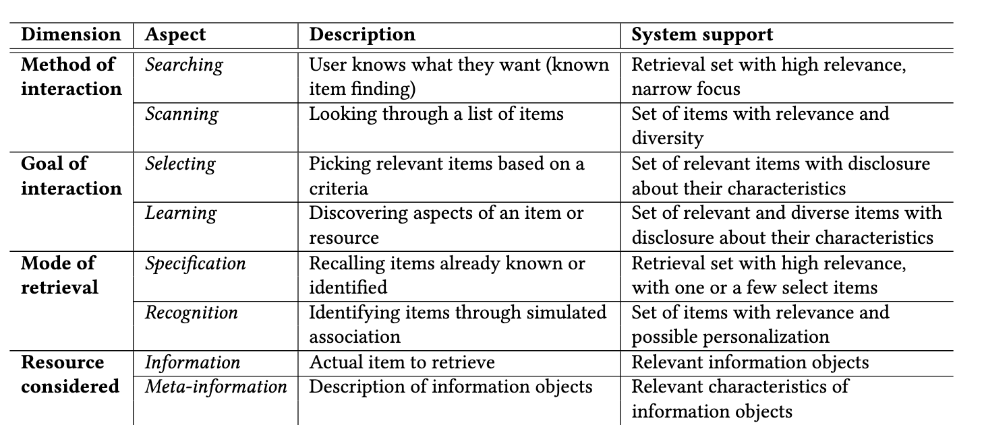
Downstream & Diffuse Impacts
“Technology is neither good nor bad, nor is it neutral”
Technosolutionism defines problems based on the ‘solutions’ offered
E.g. self-driving cars as a solution to the ‘driver problem’
The technology we do or don’t build and the questions we do or don’t ask shape society
E.g. the environmental impact of scale approaches to AI research
It is impossible to separate technology from the financial and political systems that fund and support it
Notes:
Kranzberg’s Laws

Slide 16
What can physicists do to address these issues?

Slide 17
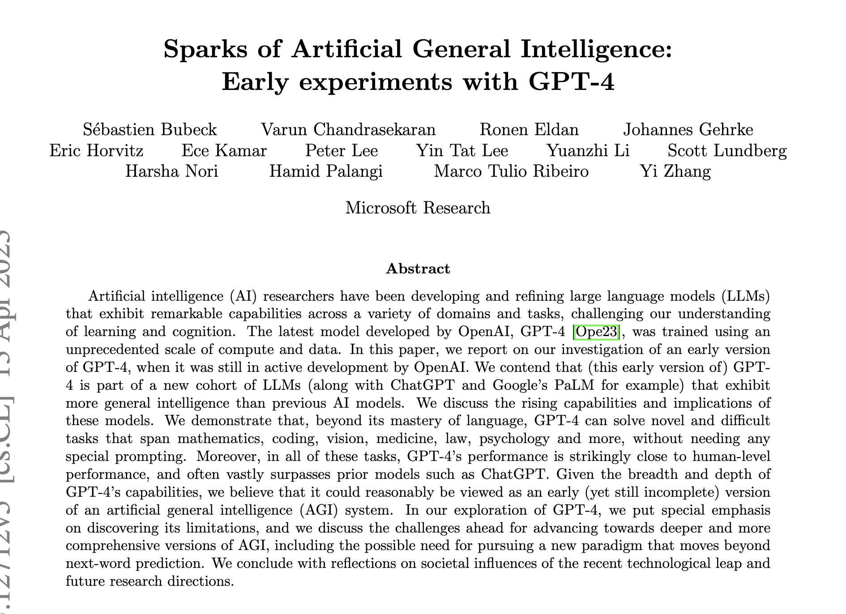
The Empirical Gap
What kind of science is AI/ML? Is it a science?
There is a rich area of research around provable results in ML
E.g. statistical limitations, scaling laws, performance of optimizers, etc
However, recent results in ML/AI tend towards ‘observational science’
E.g. emergernt behaviors, sparks of AGI, theory of mind, etc
An odd paradigm has emerged where we have no real fundamental understanding of something we have built
I believe we can begin to close this gap by changing how we evaluate and contextualize AI/ML
Notes:
SCIENCE IS NOT THE ONLY THING THAT WILL HELP US BUILD BETTER AI

Slide 18
Contextualize your physics ML work…
Is my work well documented and reproducible?
Can this help us understand anything about the foundational principles of ML?
What technology transfer could happen?
And any side projects…
Where is my data coming from? How is it collected and stored?
Is there a more transparent or ‘safe’ way to do this?
Where could bias enter the dataset or model performance?
What guarantees can I provide on model performance?
How will the systems I’m developing be deployed? Will the benefits and harms be equitably distributed?
Notes:
Contextualize your work

Slide 19
Physics to Inform ML
Unlike many ML application domains, with physics we have an (approximately) robust underlying mathematical model
Explainability
De-biasing
Physics of ML
Scientific Principles
We know some information a model should learn and have interpretable bases for some problem classes
We often know true confounding variables and correlations so can meaningfully evaluate debiasing techniques
By studying learning as a stochastic process we can optimize models and training
Core experiment design techniques like uncertainty quantification and blinding can lend robustness

Slide 20
Outreach
Advocacy
Technical Literacy
Legislation
Use your voice, institutional power, and collective action to work against unjust or unsafe uses of AI
Work with your communities to help them develop the knowledge necessary meaningfully consent to sociotechnical systems and understand possible recourse.
Share your scientific expertise with policy makers and champion meaningful regulations

Slide 21
Use your quantitative skills and model building intuition!

Slide 22
A Scientific Framework for AI Experiments
01
02
03
04
05
06
07
Research Goal
I want to identify Higgs bosons at the ATLAS detector
Hypothesis
I think the angle between the decay products is an informative signal
Collect Data
Find a labeled data set with the necessary information (ideally one used before)
Test the Hypothesis
Train one model (that you’ve identified beforehand) using the data
Analyze Results
Is this model better than existing systems (including uncertainty!)
Reach a Conclusion
I should or should not use this model because of X, Y, and Z
Refine + Repeat
Momentum of decay products may be informative OR another architecture may work better

Slide 23
A Scientific Framework for AI Impacts
Even good ML models and systems make errors
Errors and harms distributed differently (though harm usually depends on error)
Understanding these distributions (across different variables) is then key to much of AI ethics and responsible data science work
Additional complexity: like in physics these systems and models are often stacked
The distribution of errors and harms can affect the system being modeled
These errors can cause harms in the real world

Slide 24
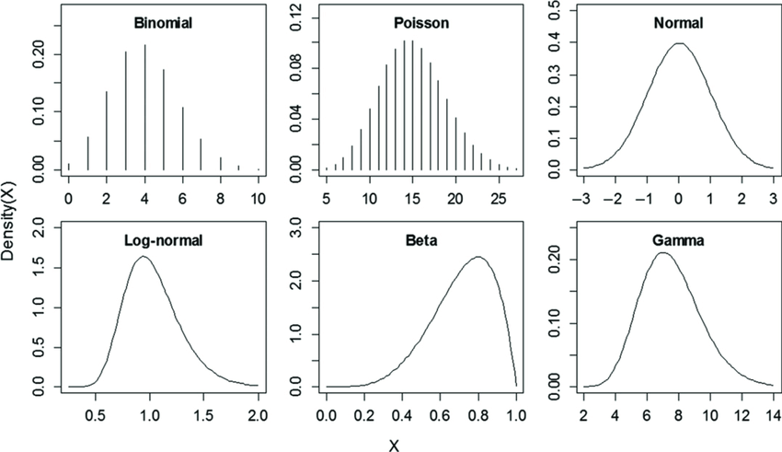
Characterizing the Distributions
So we get similar many similar questions to those we have in a physics analysis:
What data selections or biases contributed to the distribution?
How do we ensure the distribution is modeled correctly? What kinds of tests can we use?
What should the distribution look like (or what do we want it to look like given certain assumptions/goals)?
If anything is incorrect or needs to be changed, what knobs can we turn?
In physics these questions are often hard but answerable in some other applications they may not be!

Slide 25
Consider All Steps of the Pipeline
Model Building
Data Collection
Testing
What population is sampled? How? What format is the data collected in?
What variables are used? How do they related to the outcome? What statistical assumptions underlie the model? What incentive are we considering?
What theory or model of the world are we comparing to?
01
02
03
04
05
Data Processing
Model Evaluation
What cleaning is applied? How does it affect distributions? How are null values handled?
What metrics are used? How do we check for bias? How do we check for robustness?

Slide 26
So let’s take a mindset of system/model auditors
Pretend we’re reviewing a physics paper…we want to make sure that the analysis is rigorous and statistically sound (or understand where it went wrong)

Slide 27
Racial Bias in Healthcare Risk Assessment

Slide 28
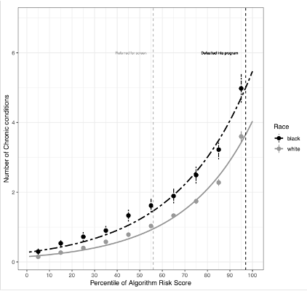
Understanding the Distributions
Determine an appropriate measure of model validity
Check the performance (closure) of the model across all areas where it will be applied (each race)
See that it underperforms in some phase spaces…why could that be?
Interrogate model variables and labels to look for statistical sources of bias
Fix it…in this case by defining a better training label and potentially de-biasing historical data and/or accounting for uncertainty

Slide 29
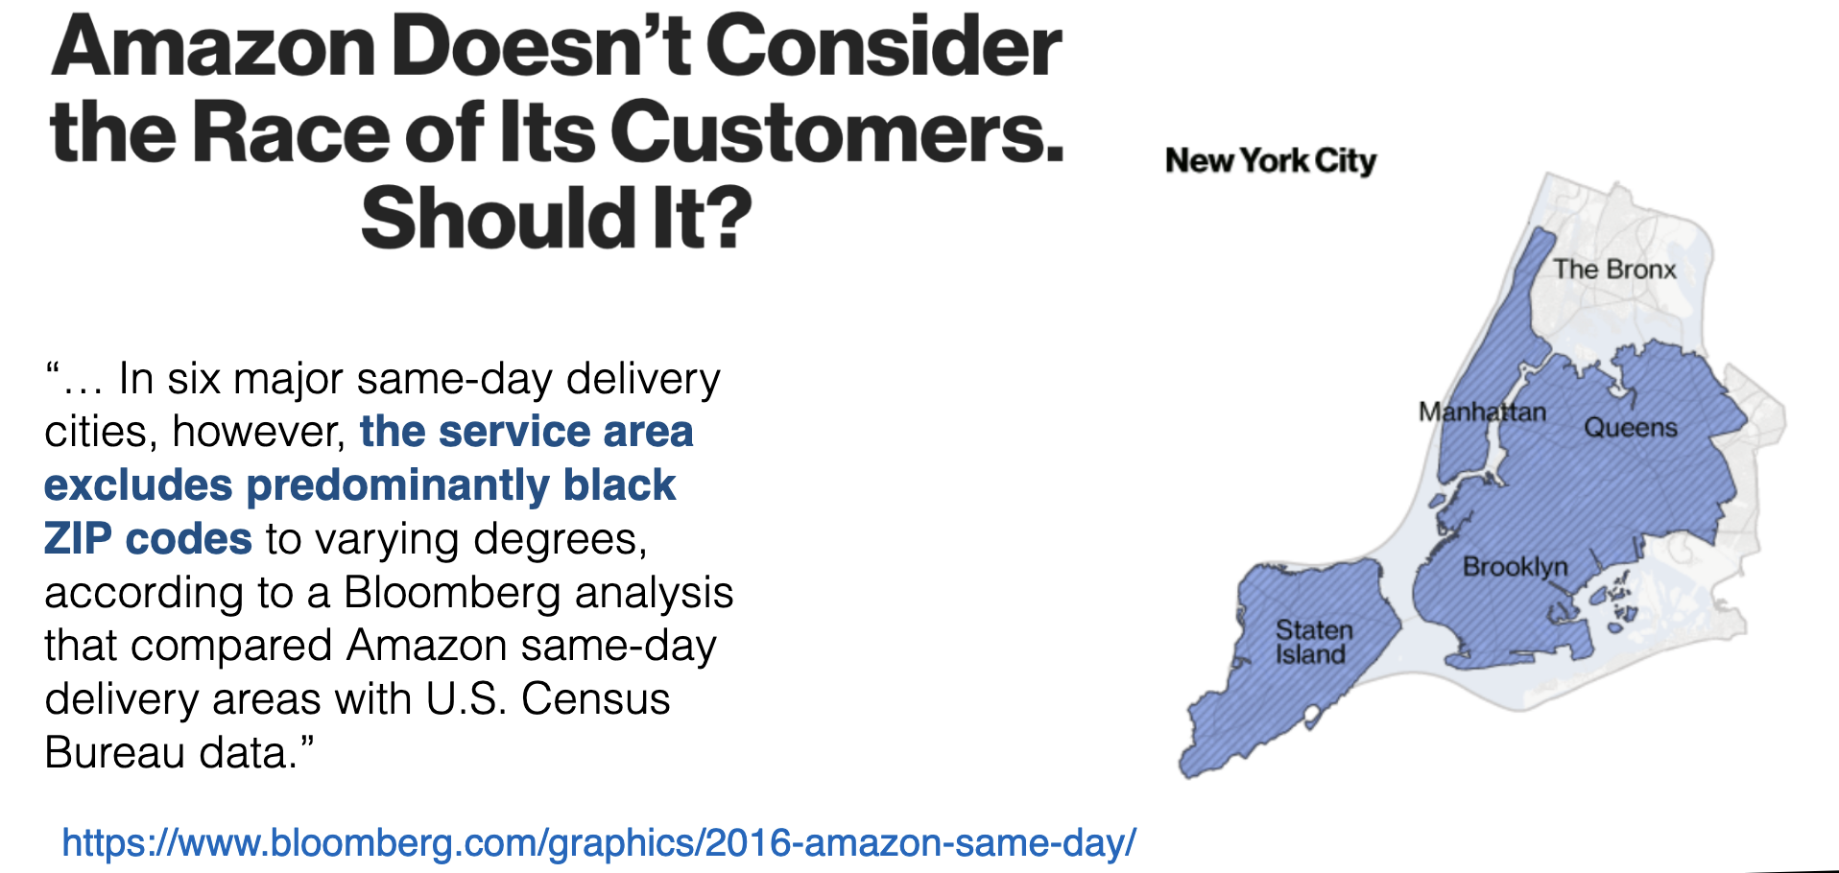
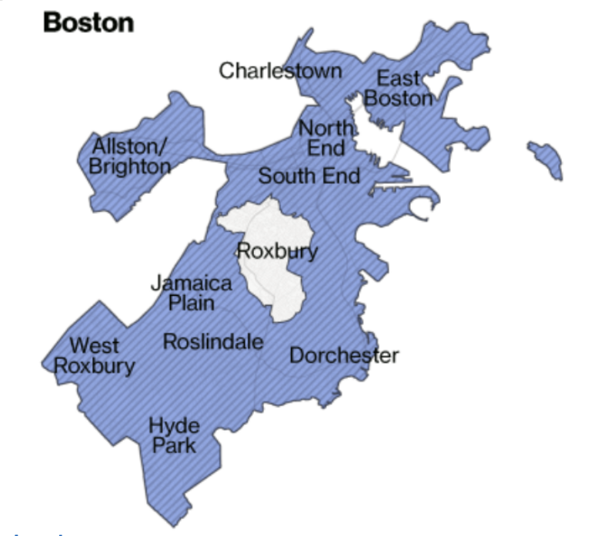
Racial Bias in Same Day Delivery

Slide 30
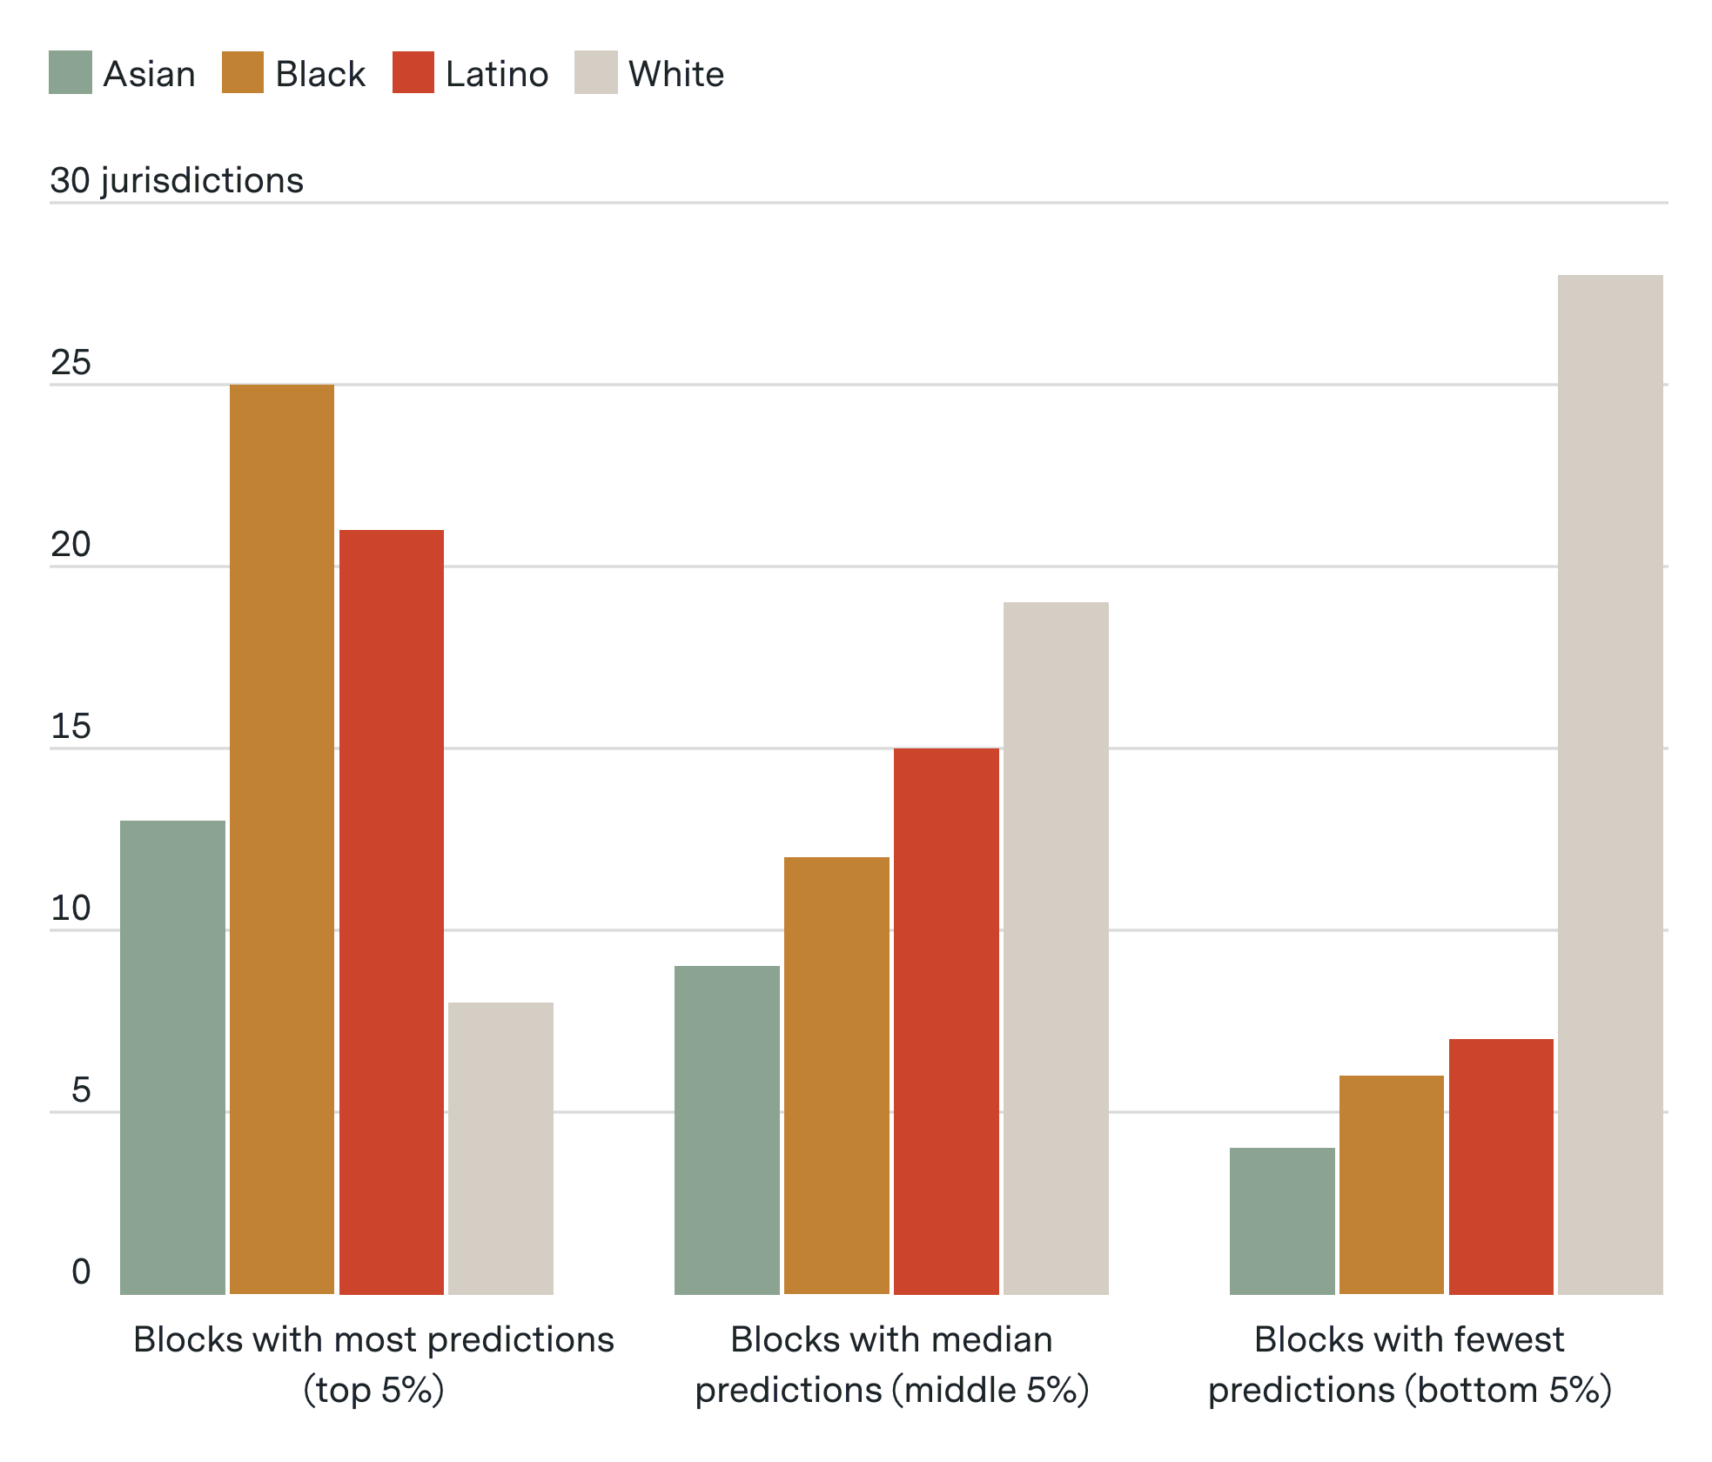
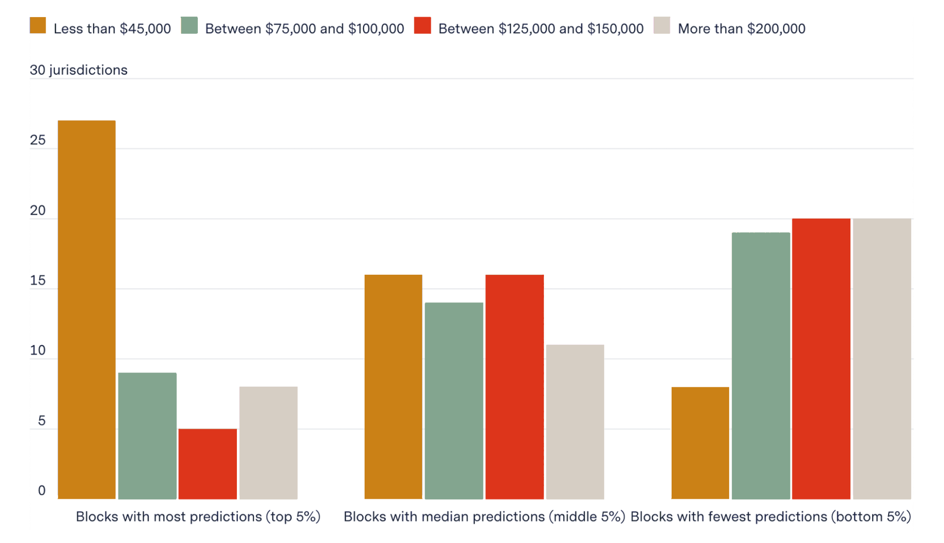
Predictive Policing
From excellent Gizmodo report

Slide 31
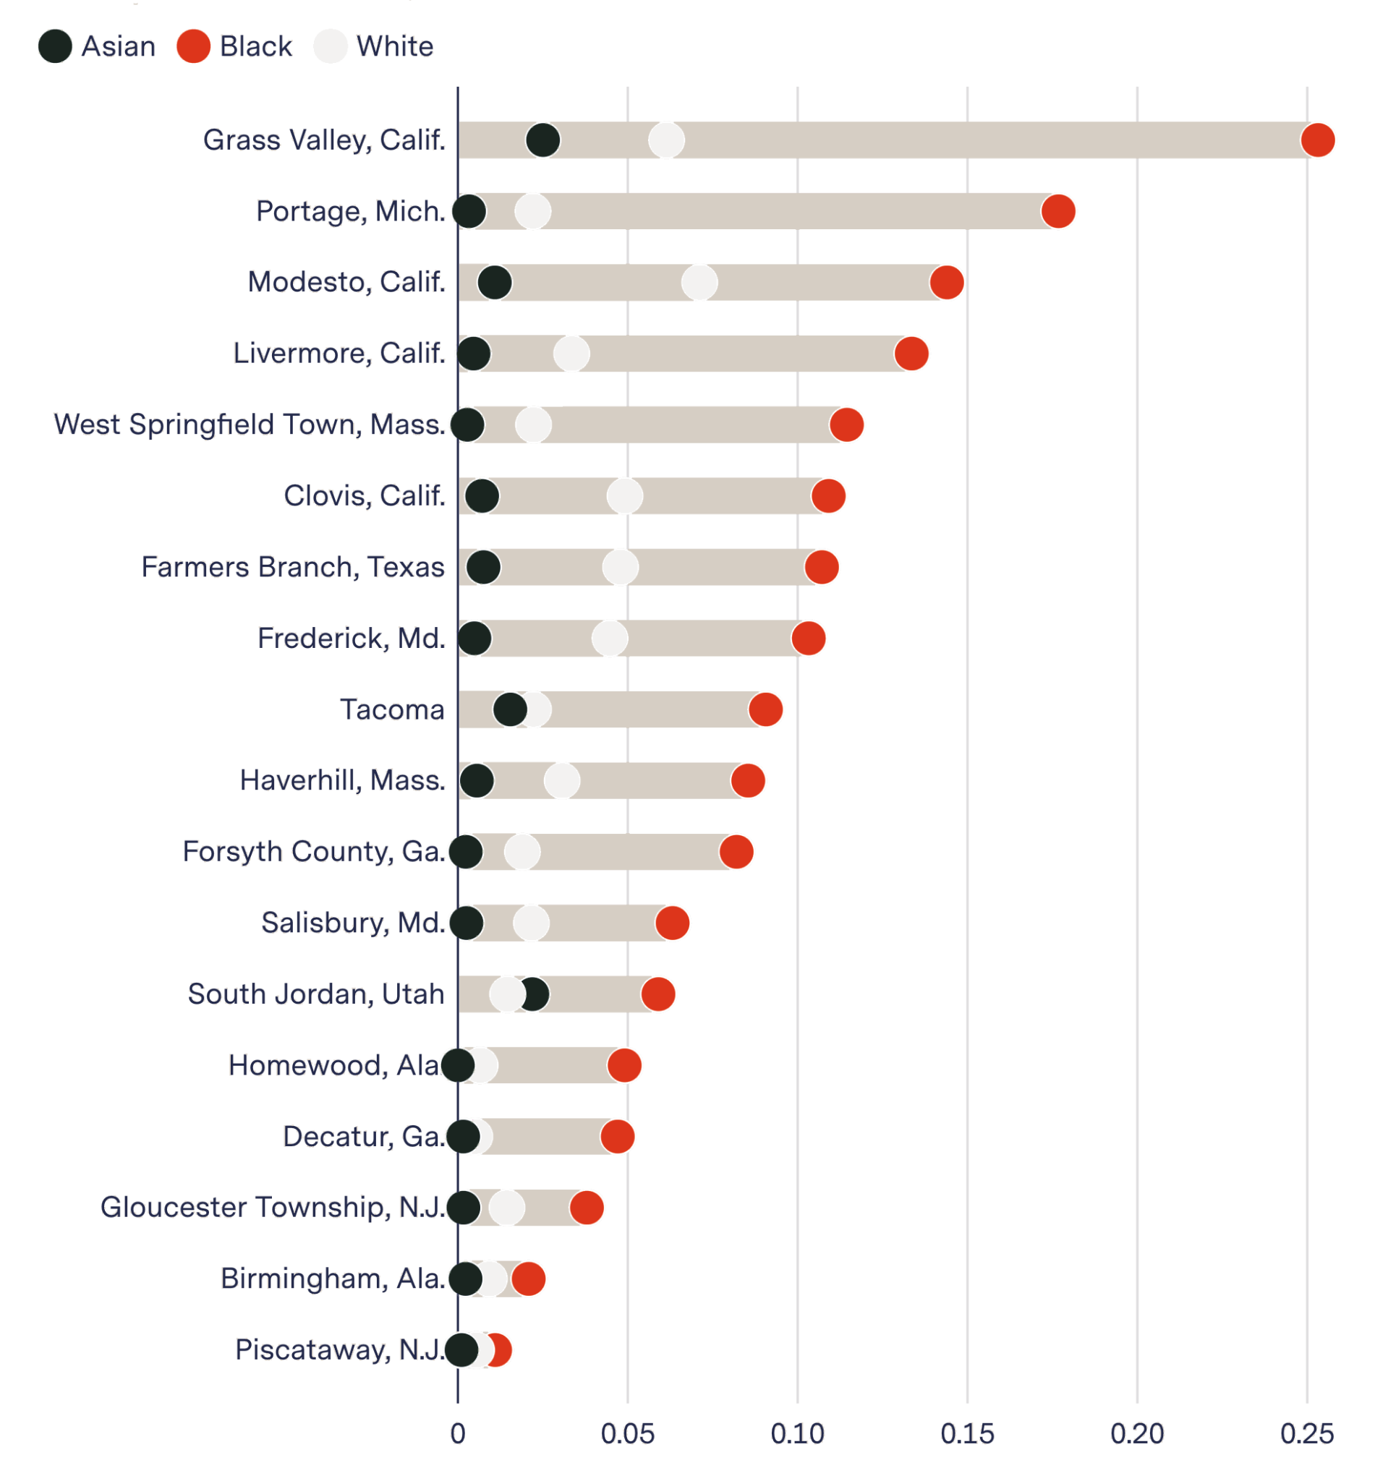
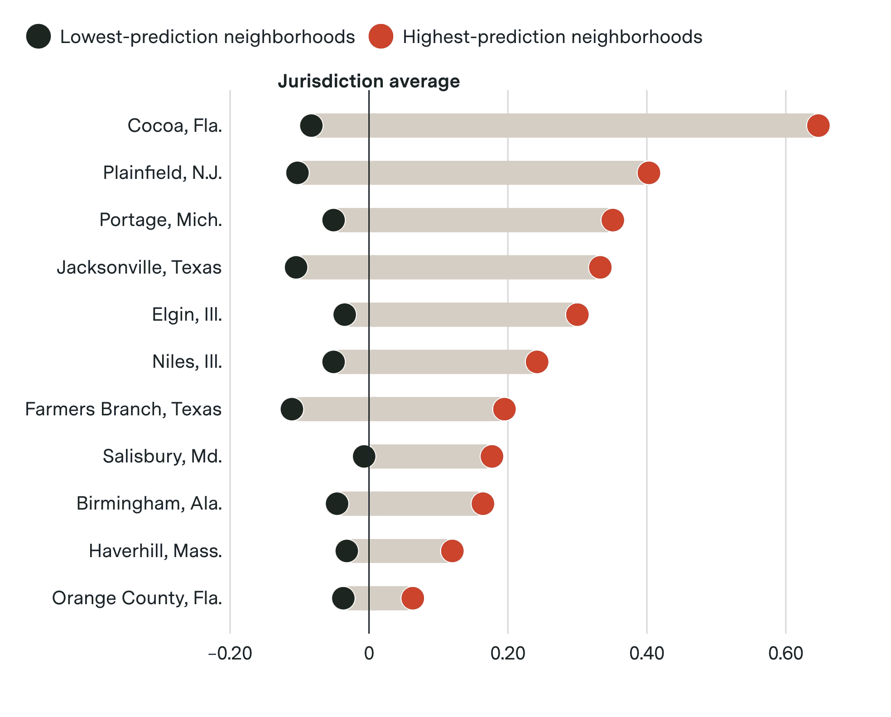
Predictive Policing

Slide 32
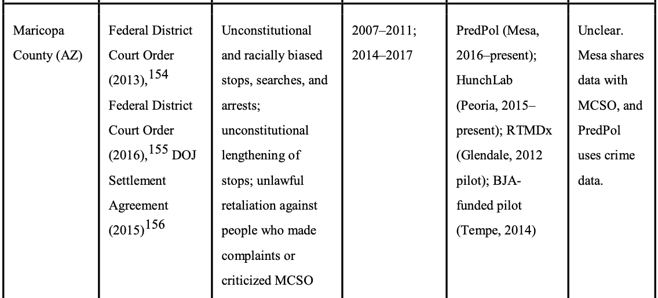
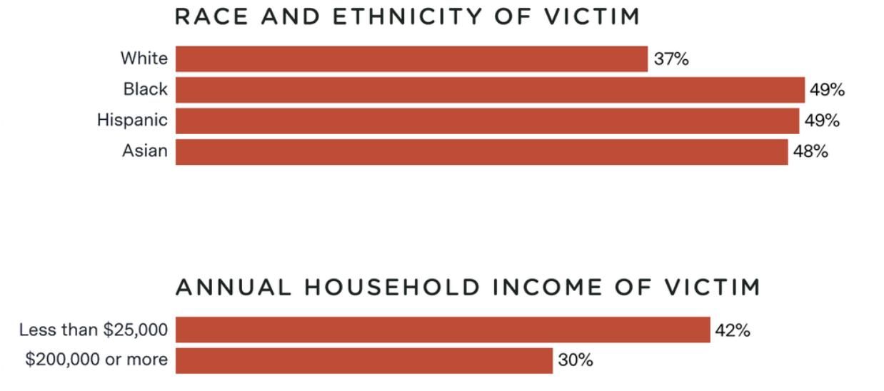
Understanding the Distributions
What is an appropriate measure of performance here? (not all crimes are reported)
Where could the apparent bias in prediction arise from? How could we understand if it’s accurate?
How does the system itself affect the phase space the developers are trying to measure
How could we start to address these concerns?

Slide 33
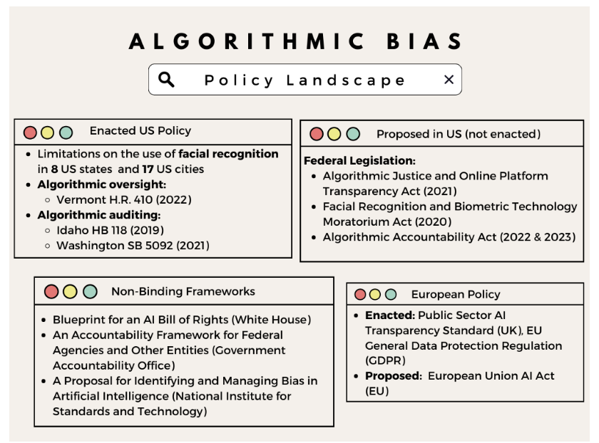
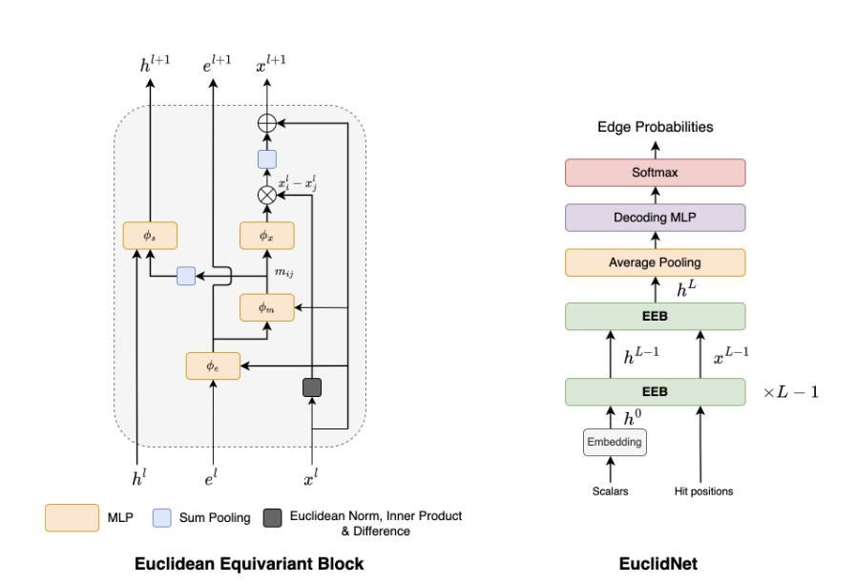
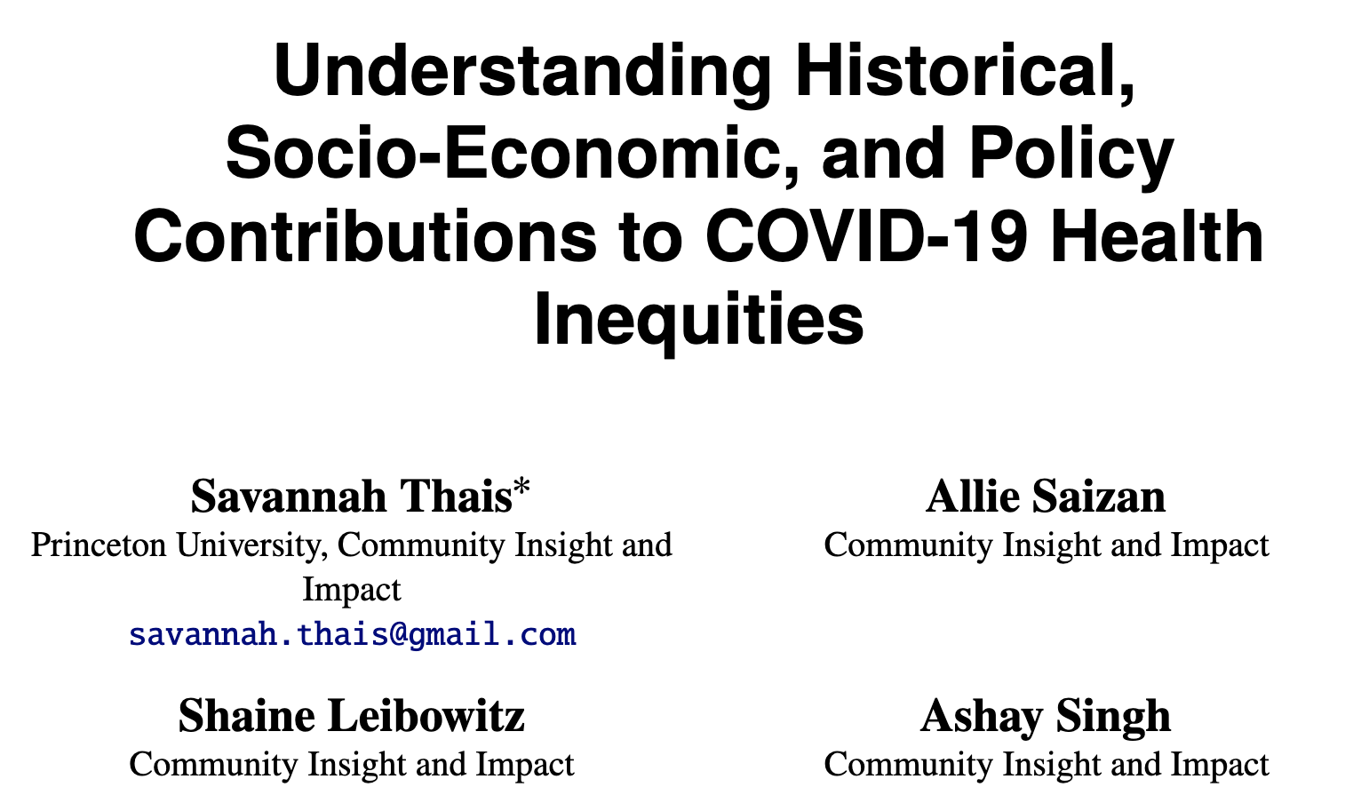
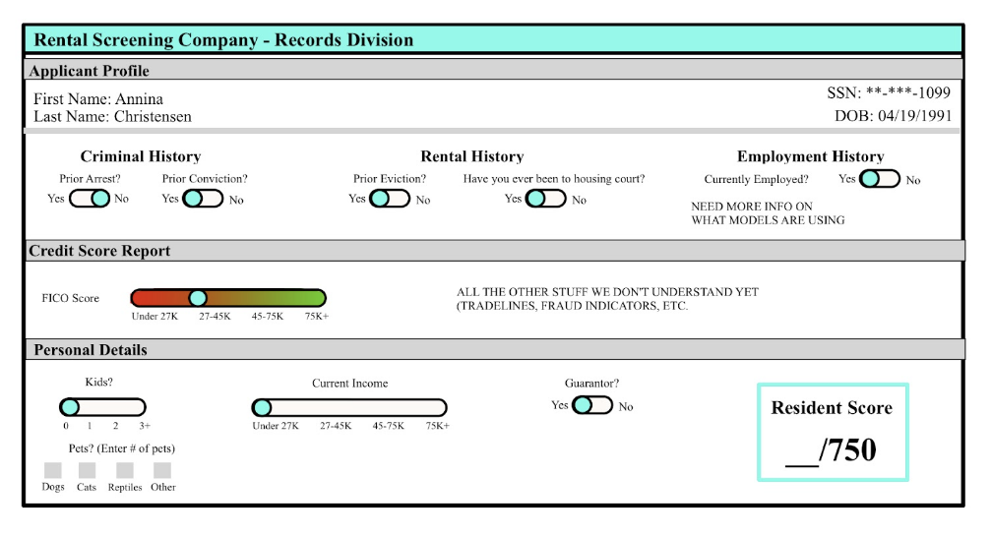
Some of My Current Research

Slide 34
Resources (Physics Related)
“Physicists Must Engage with AI Ethics, Now”, APS.org
“Fighting Algorithmic Bias in Artificial Intelligence”, Physics World
“Artificial Intelligence: The Only Way Forward is Ethics”, CERN News
“To Make AI Fairer, Physicists Peer Inside Its Black Box”, Wired
“The bots are not as fair minded as the seem”, Physics World Podcast
“Developing Algorithms That Might One Day Be Used Against You”, Gizmodo
“AI in the Sky: Implications and Challenges for Artificial Intelligence in Astrophysics and Society”, Brian Nord for NOAO/Steward Observatory Joint Colloquium Series
Ethical implications for computational research and the roles of scientists, Snowmass LOI
LSSTC Data Science Fellowship Session on AI Ethics
Panel on Data Science Education, Physics, and Ethics, APS GDS

Slide 35
Resources (General)
AI Now
Alan Turing Institute
Algorithmic Justice League
Berkman Klein Center
Center for Democracy and Technology
Center for Internet and Technology Policy
Data & Society
Data for Black Lives
Montreal AI Ethics Institute
Stanford Center for Human-Centered AI
The Surveillance Technology Oversight Project
Radical AI Network
Resistance AI

Slide 36
Thank you!
Let’s discuss!
savannah.thais@gmail.com
@basicsciencesav

