Slide 1
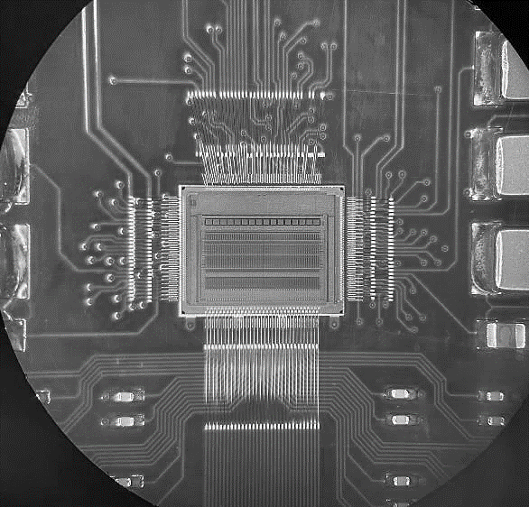

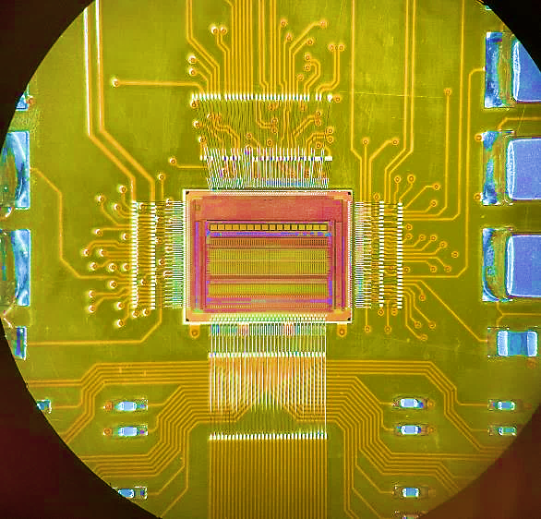


4D Tracking – ASIC
02/03/2023
Bojan Markovic – markovic@slac.stanford.edu

Slide 2
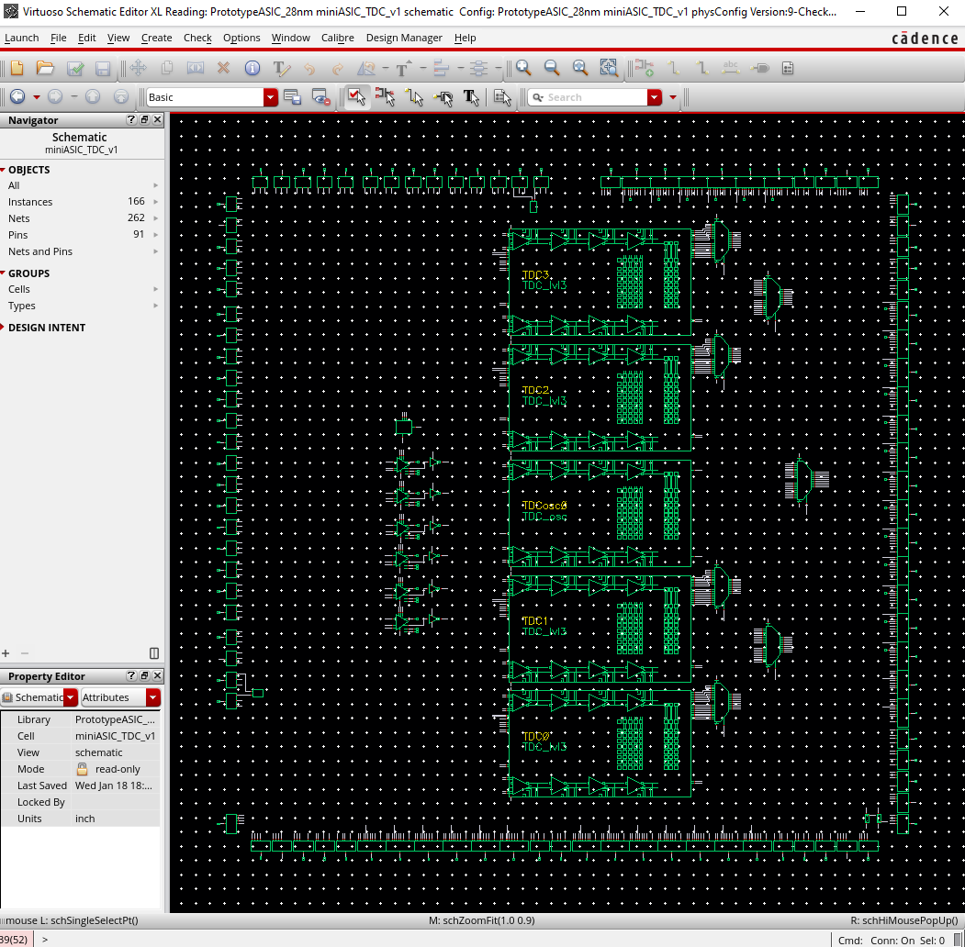
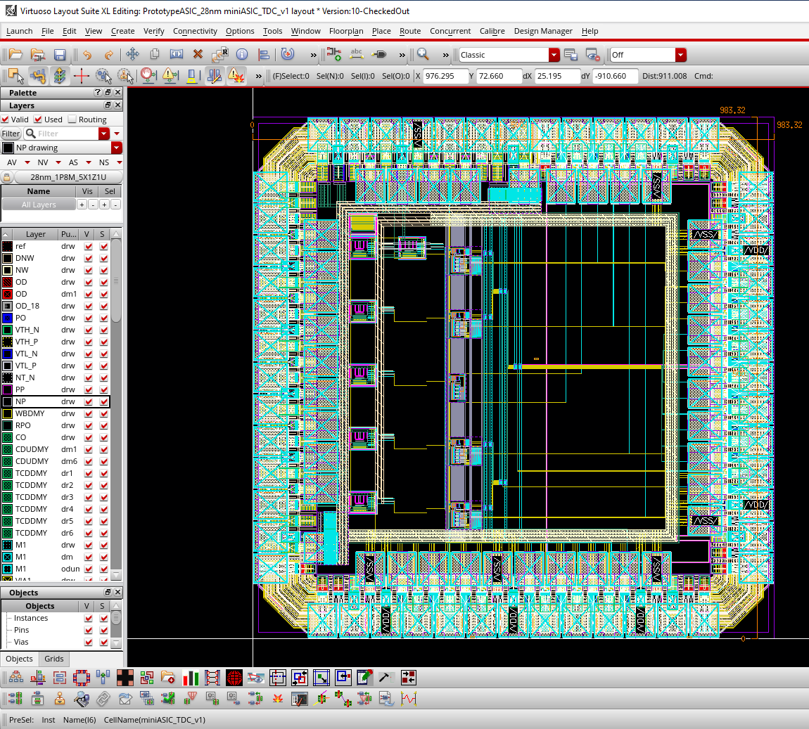
TDC Prototype ASIC
Schematic:
Layout:

Slide 3
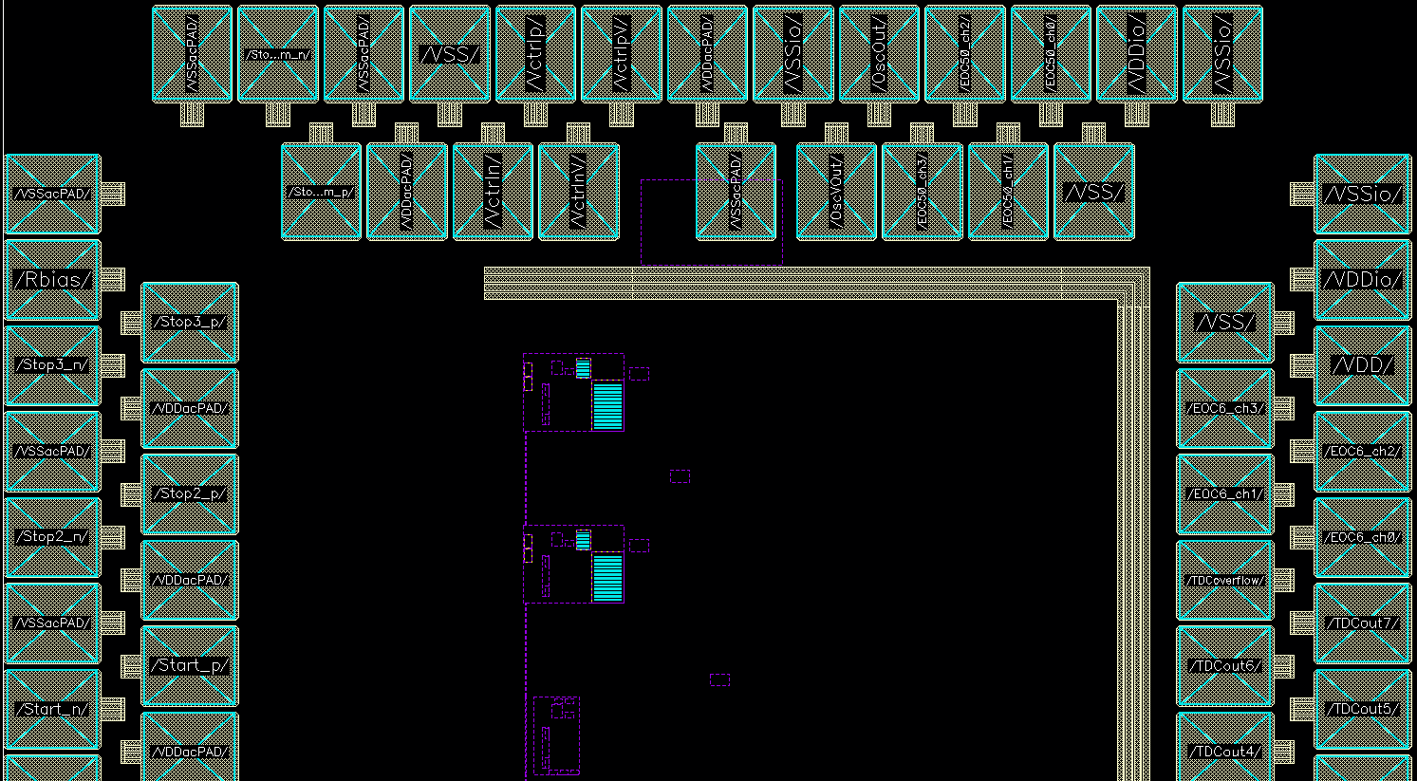
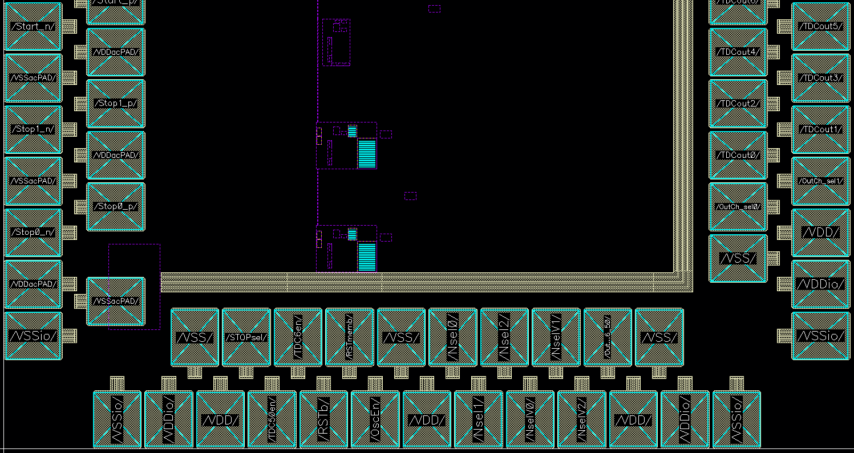
PAD numbering goes counterclockwise starting from bottom left corner
Bottom |  | Right |  | Top |  | Left
PAD No. | PAD Name | PAD No. | PAD Name | PAD No. | PAD Name | PAD No. | PAD Name
0 | VSSio | 23 | VSSio | 46 | VSSio | 68 | VSSacPAD
1 | VDDio | 24 | VDDio | 47 | VDDio | 69 | Rbias
2 | VSS | 25 | VSS | 48 | VSS | 70 | Stop3_p
3 | VDD | 26 | VDD | 49 | EOC50_ch0 | 71 | Stop3_n
4 | STOPsel | 27 | OutCh_sel_0 | 50 | EOC50_ch1 | 72 | VDDacPAD
5 | TDC50en | 28 | OutCh_sel_1 | 51 | EOC50_ch2 | 73 | VSSacPAD
6 | TDC6en | 29 | TDCout0 | 52 | EOC50_ch3 | 74 | Stop2_p
7 | RSTb | 30 | TDCout1 | 53 | OscOut | 75 | Stop2_n
8 | RSTmemb | 31 | TDCout2 | 54 | OscVOut | 76 | VDDacPAD
9 | OscEn | 32 | TDCout3 | 55 | VSSio | 77 | VSSacPAD
10 | VSS | 33 | TDCout4 | 56 | VSSacPAD | 78 | Start_p
11 | VDD | 34 | TDCout5 | 57 | VDDacPAD | 79 | Start_n
12 | Nsel0 | 35 | TDCout6 | 58 | VctrlpV | 80 | VDDacPAD
13 | Nsel1 | 36 | TDCout7 | 59 | VctrlnV | 81 | VSSacPAD
14 | Nsel2 | 37 | TDCoverflow | 60 | Vctrlp | 82 | Stop1_p
15 | NselV0 | 38 | EOC6_ch0 | 61 | Vctrln | 83 | Stop1_n
16 | NselV1 | 39 | EOC6_ch1 | 62 | VSS | 84 | VDDacPAD
17 | NselV2 | 40 | EOC6_ch2 | 63 | VDDacPAD | 85 | VSSacPAD
18 | OutSel_6_50 | 41 | EOC6_ch3 | 64 | VSSacPAD | 86 | Stop0_p
19 | VDD | 42 | VDD | 65 | Stop_comm_p | 87 | Stop0_n
20 | VSS | 43 | VSS | 66 | Stop_comm_n | 88 | VDDacPAD
21 | VDDio | 44 | VDDio | 67 | VSSacPAD | 89 | VSSacPAD
22 | VSSio | 45 | VSSio |  |  | 90 | VSSio

Slide 4
PAD numbering goes counterclockwise starting from bottom left corner
Bottom |  |  | Right |  |  | Top |  |  | Left
PAD No. | PAD Name | Type | PAD No. | PAD Name | Type | PAD No. | PAD Name | Type | PAD No. | PAD Name | Type
0 | VSSio | IO ground | 23 | VSSio | IO ground | 46 | VSSio | IO ground | 68 | VSSacPAD | Analog ground
1 | VDDio | IO 1.8V supply | 24 | VDDio | IO 1.8V supply | 47 | VDDio | IO 1.8V supply | 69 | Rbias | Analog bias (0.9V)
2 | VSS | Core ground | 25 | VSS | Core ground | 48 | VSS | Core ground | 70 | Stop3_p | RX input
3 | VDD | Core 0.9V supply | 26 | VDD | Core 0.9V supply | 49 | EOC50_ch0 | Digital CMOS Out (1.8V) | 71 | Stop3_n | RX input
4 | STOPsel | Digital CMOS In (1.8V) | 27 | OutCh_sel_0 | Digital CMOS In (1.8V) | 50 | EOC50_ch1 | Digital CMOS Out (1.8V) | 72 | VDDacPAD | Analog 0.9V supply
5 | TDC50en | Digital CMOS In (1.8V) | 28 | OutCh_sel_1 | Digital CMOS In (1.8V) | 51 | EOC50_ch2 | Digital CMOS Out (1.8V) | 73 | VSSacPAD | Analog ground
6 | TDC6en | Digital CMOS In (1.8V) | 29 | TDCout0 | Digital CMOS Out (1.8V) | 52 | EOC50_ch3 | Digital CMOS Out (1.8V) | 74 | Stop2_p | RX input
7 | RSTb | Digital CMOS In (1.8V) | 30 | TDCout1 | Digital CMOS Out (1.8V) | 53 | OscOut | Digital CMOS Out (1.8V) | 75 | Stop2_n | RX input
8 | RSTmemb | Digital CMOS In (1.8V) | 31 | TDCout2 | Digital CMOS Out (1.8V) | 54 | OscVOut | Digital CMOS Out (1.8V) | 76 | VDDacPAD | Analog 0.9V supply
9 | OscEn | Digital CMOS In (1.8V) | 32 | TDCout3 | Digital CMOS Out (1.8V) | 55 | VSSio | IO ground | 77 | VSSacPAD | Analog ground
10 | VSS | Core ground | 33 | TDCout4 | Digital CMOS Out (1.8V) | 56 | VSSacPAD | Analog ground | 78 | Start_p | RX input
11 | VDD | Core 0.9V supply | 34 | TDCout5 | Digital CMOS Out (1.8V) | 57 | VDDacPAD | Analog 0.9V supply | 79 | Start_n | RX input
12 | Nsel0 | Digital CMOS In (1.8V) | 35 | TDCout6 | Digital CMOS Out (1.8V) | 58 | VctrlpV | Analog bias (0.9V) | 80 | VDDacPAD | Analog 0.9V supply
13 | Nsel1 | Digital CMOS In (1.8V) | 36 | TDCout7 | Digital CMOS Out (1.8V) | 59 | VctrlnV | Analog bias (0.9V) | 81 | VSSacPAD | Analog ground
14 | Nsel2 | Digital CMOS In (1.8V) | 37 | TDCoverflow | Digital CMOS Out (1.8V) | 60 | Vctrlp | Analog bias (0.9V) | 82 | Stop1_p | RX input
15 | NselV0 | Digital CMOS In (1.8V) | 38 | EOC6_ch0 | Digital CMOS Out (1.8V) | 61 | Vctrln | Analog bias (0.9V) | 83 | Stop1_n | RX input
16 | NselV1 | Digital CMOS In (1.8V) | 39 | EOC6_ch1 | Digital CMOS Out (1.8V) | 62 | VSS | Core ground | 84 | VDDacPAD | Analog 0.9V supply
17 | NselV2 | Digital CMOS In (1.8V) | 40 | EOC6_ch2 | Digital CMOS Out (1.8V) | 63 | VDDacPAD | Analog 0.9V supply | 85 | VSSacPAD | Analog ground
18 | OutSel_6_50 | Digital CMOS In (1.8V) | 41 | EOC6_ch3 | Digital CMOS Out (1.8V) | 64 | VSSacPAD | Analog ground | 86 | Stop0_p | RX input
19 | VDD | Core 0.9V supply | 42 | VDD | Core 0.9V supply | 65 | Stop_comm_p | RX input | 87 | Stop0_n | RX input
20 | VSS | Core ground | 43 | VSS | Core ground | 66 | Stop_comm_n | RX input | 88 | VDDacPAD | Analog 0.9V supply
21 | VDDio | IO 1.8V supply | 44 | VDDio | IO 1.8V supply | 67 | VSSacPAD | Analog ground | 89 | VSSacPAD | Analog ground
22 | VSSio | IO ground | 45 | VSSio | IO ground |  |  |  | 90 | VSSio | IO ground

Slide 5
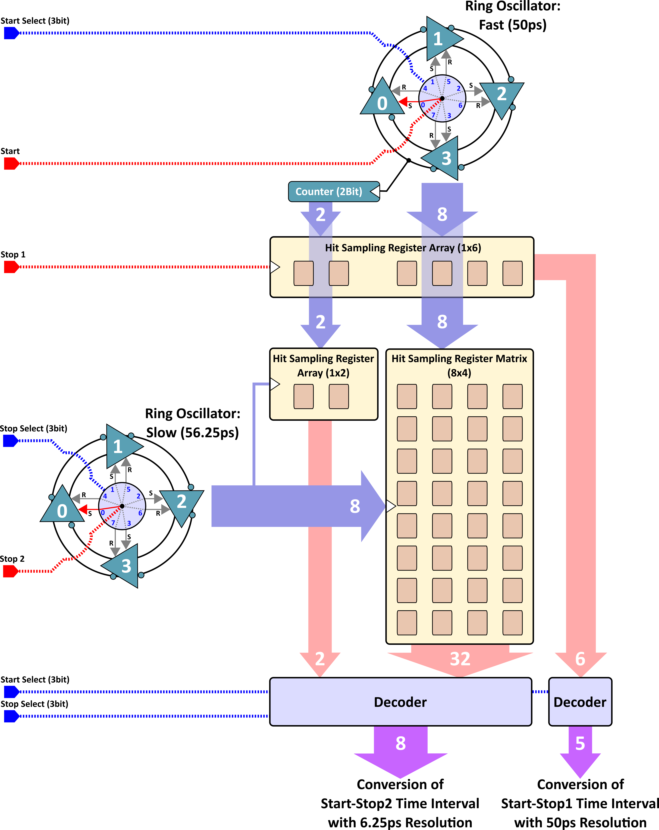
28nm TDC Architecture
2D Vernier Architecture:
  Fast Ring Oscillator with 50ps propagation delay cells;
  Slow Ring Oscillator with 56.25ps propagation delay cells;
START + two STOP signal for simultaneous time-of-arrival (TOA) and time-over-threshold (TOT) measurements;
Coarse time resolution (TOT): 50ps;
Fine time resolution (TOA): 56.25ps - 50ps = 6.25ps;
Sliding scale technique for improvement of conversion linearity:
  Both ring oscillators have programable starting conditions via delay cell set/reset function;
  Starting conditions randomly selected each measurement cycle and corresponding values subtracted from the conversion result;
  Same time intervals converted with different parts/bins of the TDC conversion characteristics;
  Sliding scale transforms the non-linearities into stochastic variable thus effectively improving the conversion linearity at the expense of worsening single-shoot precision.

Slide 6
Prototype I/O
Rbias
(750ohm resistor to ground)
Stop_comm
(Stop_comm_p, Stop_comm_n)
Start
(Start_p, Start_n)
OutSel_6_50
(0->50ps, 1->6.25ps)
OutCh_sel1, OutCh_sel0
(00 -> Ch0, 01->Ch1, 10->Ch2, 11->Ch3)
TDC 3
(50ps & 6.25ps)
(50ps) OUT
0
mux
Stop 50ps
mux
TDC 3 Out
mux
TDCoverflow
TDCout7
TDCout6
TDCout5
TDCout4
TDCout3
TDCout2
TDCout1
TDCout0
(6.25ps) OUT
1
11
Stop3
(Stop3_p, Stop3_n)
Stop 6.25ps
TDC 2
(50ps & 6.25ps)
0
mux
Stop 50ps
mux
TDC 2 Out
1
10
Stop2
(Stop2_p, Stop2_n)
Stop 6.25ps
TDC 1
(50ps & 6.25ps)
0
EOC50_ch3
EOC50_ch2
EOC50_ch1
EOC50_ch0
EOC6_ch3
EOC6_ch2
EOC6_ch1
EOC6_ch0
mux
Stop 50ps
mux
TDC 1 Out
1
01
Stop1
(Stop1_p, Stop1_n)
Stop 6.25ps
TDC 0
(50ps & 6.25ps)
0
mux
Stop 50ps
mux
TDC 0 Out
1
00
Stop0
(Stop0_p, Stop0_n)
Stop 6.25ps
OscEn (0-> Oscillators Enabled, 1-> Oscillators Disabled)
VDDio (1.8V)
VDDacPAD (0.9V)
VDD (0.9V)
VSSio (0V)
VSSacPAD (0V)
VSS (0V)
STOPsel
(0 -> StopN=6.25ps, Stop_comm=50ps, 1 -> StopN=50ps, Stop_comm=6.25ps)
OSC
(50ps & 56.25ps)
Power
Nsel2
Nsel1
Nsel0
OscOut (50ps -> 4.88 MHz)
RSTb (active low)
OscVOut (56.25ps -> 4.34 MHz)
RSTmemb (active low)
NselV2
NselV1
NselV0
TDC50en (1-> 50ps TDC enabled)
Vctrlp. Vctrln, VctrlpV, VctrlnV
(Bias voltages connected to programmable DACs)
TDC6en (1-> 6.25ps TDC enabled)

Slide 7
Prototype I/O – digital CMOS In (1.8V)
Rbias
(750ohm resistor to ground)
Stop_comm
(Stop_comm_p, Stop_comm_n)
Start
(Start_p, Start_n)
OutSel_6_50
(0->50ps, 1->6.25ps)
OutCh_sel1, OutCh_sel0
(00 -> Ch0, 01->Ch1, 10->Ch2, 11->Ch3)
TDC 3
(50ps & 6.25ps)
(50ps) OUT
0
mux
Stop 50ps
mux
TDC 3 Out
mux
TDCoverflow
TDCout7
TDCout6
TDCout5
TDCout4
TDCout3
TDCout2
TDCout1
TDCout0
(6.25ps) OUT
1
11
Stop3
(Stop3_p, Stop3_n)
Stop 6.25ps
TDC 2
(50ps & 6.25ps)
0
mux
Stop 50ps
mux
TDC 2 Out
1
10
Stop2
(Stop2_p, Stop2_n)
Stop 6.25ps
TDC 1
(50ps & 6.25ps)
0
EOC50_ch3
EOC50_ch2
EOC50_ch1
EOC50_ch0
EOC6_ch3
EOC6_ch2
EOC6_ch1
EOC6_ch0
mux
Stop 50ps
mux
TDC 1 Out
1
01
Stop1
(Stop1_p, Stop1_n)
Stop 6.25ps
TDC 0
(50ps & 6.25ps)
0
mux
Stop 50ps
mux
TDC 0 Out
1
00
Stop0
(Stop0_p, Stop0_n)
Stop 6.25ps
OscEn (0-> Oscillators Enabled, 1-> Oscillators Disabled)
VDDio (1.8V)
VDDacPAD (0.9V)
VDD (0.9V)
VSSio (0V)
VSSacPAD (0V)
VSS (0V)
STOPsel
(0 -> StopN=6.25ps, Stop_comm=50ps, 1 -> StopN=50ps, Stop_comm=6.25ps)
OSC
(50ps & 56.25ps)
Power
Nsel2
Nsel1
Nsel0
OscOut (50ps -> 4.88 MHz)
RSTb (active low)
OscVOut (56.25ps -> 4.34 MHz)
RSTmemb (active low)
NselV2
NselV1
NselV0
TDC50en (1-> 50ps TDC enabled)
Vctrlp. Vctrln, VctrlpV, VctrlnV
(Bias voltages connected to programmable DACs)
TDC6en (1-> 6.25ps TDC enabled)

Slide 8
Prototype I/O – digital CMOS Out (1.8V)
Rbias
(750ohm resistor to ground)
Stop_comm
(Stop_comm_p, Stop_comm_n)
Start
(Start_p, Start_n)
OutSel_6_50
(0->50ps, 1->6.25ps)
OutCh_sel1, OutCh_sel0
(00 -> Ch0, 01->Ch1, 10->Ch2, 11->Ch3)
TDC 3
(50ps & 6.25ps)
(50ps) OUT
0
mux
Stop 50ps
mux
TDC 3 Out
mux
TDCoverflow
TDCout7
TDCout6
TDCout5
TDCout4
TDCout3
TDCout2
TDCout1
TDCout0
(6.25ps) OUT
1
11
Stop3
(Stop3_p, Stop3_n)
Stop 6.25ps
TDC 2
(50ps & 6.25ps)
0
mux
Stop 50ps
mux
TDC 2 Out
1
10
Stop2
(Stop2_p, Stop2_n)
Stop 6.25ps
TDC 1
(50ps & 6.25ps)
0
EOC50_ch3
EOC50_ch2
EOC50_ch1
EOC50_ch0
EOC6_ch3
EOC6_ch2
EOC6_ch1
EOC6_ch0
mux
Stop 50ps
mux
TDC 1 Out
1
01
Stop1
(Stop1_p, Stop1_n)
Stop 6.25ps
TDC 0
(50ps & 6.25ps)
0
mux
Stop 50ps
mux
TDC 0 Out
1
00
Stop0
(Stop0_p, Stop0_n)
Stop 6.25ps
OscEn (0-> Oscillators Enabled, 1-> Oscillators Disabled)
VDDio (1.8V)
VDDacPAD (0.9V)
VDD (0.9V)
VSSio (0V)
VSSacPAD (0V)
VSS (0V)
STOPsel
(0 -> StopN=6.25ps, Stop_comm=50ps, 1 -> StopN=50ps, Stop_comm=6.25ps)
OSC
(50ps & 56.25ps)
Power
Nsel2
Nsel1
Nsel0
OscOut (50ps -> 4.88 MHz)
RSTb (active low)
OscVOut (56.25ps -> 4.34 MHz)
RSTmemb (active low)
NselV2
NselV1
NselV0
TDC50en (1-> 50ps TDC enabled)
Vctrlp. Vctrln, VctrlpV, VctrlnV
(Bias voltages connected to programmable DACs)
TDC6en (1-> 6.25ps TDC enabled)

Slide 9
Prototype I/O – Analog Bias (0.9V)
Rbias
(750ohm resistor to ground)
Stop_comm
(Stop_comm_p, Stop_comm_n)
Start
(Start_p, Start_n)
OutSel_6_50
(0->50ps, 1->6.25ps)
OutCh_sel1, OutCh_sel0
(00 -> Ch0, 01->Ch1, 10->Ch2, 11->Ch3)
TDC 3
(50ps & 6.25ps)
(50ps) OUT
0
mux
Stop 50ps
mux
TDC 3 Out
mux
TDCoverflow
TDCout7
TDCout6
TDCout5
TDCout4
TDCout3
TDCout2
TDCout1
TDCout0
(6.25ps) OUT
1
11
Stop3
(Stop3_p, Stop3_n)
Stop 6.25ps
TDC 2
(50ps & 6.25ps)
0
mux
Stop 50ps
mux
TDC 2 Out
1
10
Stop2
(Stop2_p, Stop2_n)
Stop 6.25ps
TDC 1
(50ps & 6.25ps)
0
EOC50_ch3
EOC50_ch2
EOC50_ch1
EOC50_ch0
EOC6_ch3
EOC6_ch2
EOC6_ch1
EOC6_ch0
mux
Stop 50ps
mux
TDC 1 Out
1
01
Stop1
(Stop1_p, Stop1_n)
Stop 6.25ps
TDC 0
(50ps & 6.25ps)
0
mux
Stop 50ps
mux
TDC 0 Out
1
00
Stop0
(Stop0_p, Stop0_n)
Stop 6.25ps
OscEn (0-> Oscillators Enabled, 1-> Oscillators Disabled)
VDDio (1.8V)
VDDacPAD (0.9V)
VDD (0.9V)
VSSio (0V)
VSSacPAD (0V)
VSS (0V)
STOPsel
(0 -> StopN=6.25ps, Stop_comm=50ps, 1 -> StopN=50ps, Stop_comm=6.25ps)
OSC
(50ps & 56.25ps)
Power
Nsel2
Nsel1
Nsel0
OscOut (50ps -> 4.88 MHz)
RSTb (active low)
OscVOut (56.25ps -> 4.34 MHz)
RSTmemb (active low)
NselV2
NselV1
NselV0
TDC50en (1-> 50ps TDC enabled)
Vctrlp. Vctrln, VctrlpV, VctrlnV
(Bias voltages connected to programmable DACs)
TDC6en (1-> 6.25ps TDC enabled)

Slide 10
Prototype I/O – Low-jitter RX (0.9V)
Rbias
(750ohm resistor to ground)
Stop_comm
(Stop_comm_p, Stop_comm_n)
Start
(Start_p, Start_n)
OutSel_6_50
(0->50ps, 1->6.25ps)
OutCh_sel1, OutCh_sel0
(00 -> Ch0, 01->Ch1, 10->Ch2, 11->Ch3)
TDC 3
(50ps & 6.25ps)
(50ps) OUT
0
mux
Stop 50ps
mux
TDC 3 Out
mux
TDCoverflow
TDCout7
TDCout6
TDCout5
TDCout4
TDCout3
TDCout2
TDCout1
TDCout0
(6.25ps) OUT
1
11
Stop3
(Stop3_p, Stop3_n)
Stop 6.25ps
TDC 2
(50ps & 6.25ps)
0
mux
Stop 50ps
mux
TDC 2 Out
1
10
Stop2
(Stop2_p, Stop2_n)
Stop 6.25ps
TDC 1
(50ps & 6.25ps)
0
EOC50_ch3
EOC50_ch2
EOC50_ch1
EOC50_ch0
EOC6_ch3
EOC6_ch2
EOC6_ch1
EOC6_ch0
mux
Stop 50ps
mux
TDC 1 Out
1
01
Stop1
(Stop1_p, Stop1_n)
Stop 6.25ps
TDC 0
(50ps & 6.25ps)
0
mux
Stop 50ps
mux
TDC 0 Out
1
00
Stop0
(Stop0_p, Stop0_n)
Stop 6.25ps
OscEn (0-> Oscillators Enabled, 1-> Oscillators Disabled)
VDDio (1.8V)
VDDacPAD (0.9V)
VDD (0.9V)
VSSio (0V)
VSSacPAD (0V)
VSS (0V)
STOPsel
(0 -> StopN=6.25ps, Stop_comm=50ps, 1 -> StopN=50ps, Stop_comm=6.25ps)
OSC
(50ps & 56.25ps)
Power
Nsel2
Nsel1
Nsel0
OscOut (50ps -> 4.88 MHz)
RSTb (active low)
OscVOut (56.25ps -> 4.34 MHz)
RSTmemb (active low)
NselV2
NselV1
NselV0
TDC50en (1-> 50ps TDC enabled)
Vctrlp. Vctrln, VctrlpV, VctrlnV
(Bias voltages connected to programmable DACs)
TDC6en (1-> 6.25ps TDC enabled)

Slide 11
Prototype I/O – Power
Rbias
(750ohm resistor to ground)
Stop_comm
(Stop_comm_p, Stop_comm_n)
Start
(Start_p, Start_n)
OutSel_6_50
(0->50ps, 1->6.25ps)
OutCh_sel1, OutCh_sel0
(00 -> Ch0, 01->Ch1, 10->Ch2, 11->Ch3)
TDC 3
(50ps & 6.25ps)
(50ps) OUT
0
mux
Stop 50ps
mux
TDC 3 Out
mux
TDCoverflow
TDCout7
TDCout6
TDCout5
TDCout4
TDCout3
TDCout2
TDCout1
TDCout0
(6.25ps) OUT
1
11
Stop3
(Stop3_p, Stop3_n)
Stop 6.25ps
TDC 2
(50ps & 6.25ps)
0
mux
Stop 50ps
mux
TDC 2 Out
1
10
Stop2
(Stop2_p, Stop2_n)
Stop 6.25ps
TDC 1
(50ps & 6.25ps)
0
EOC50_ch3
EOC50_ch2
EOC50_ch1
EOC50_ch0
EOC6_ch3
EOC6_ch2
EOC6_ch1
EOC6_ch0
mux
Stop 50ps
mux
TDC 1 Out
1
01
Stop1
(Stop1_p, Stop1_n)
Stop 6.25ps
TDC 0
(50ps & 6.25ps)
0
mux
Stop 50ps
mux
TDC 0 Out
1
00
Stop0
(Stop0_p, Stop0_n)
Stop 6.25ps
OscEn (0-> Oscillators Enabled, 1-> Oscillators Disabled)
VDDio (1.8V)
VDDacPAD (0.9V)
VDD (0.9V)
VSSio (0V)
VSSacPAD (0V)
VSS (0V)
STOPsel
(0 -> StopN=6.25ps, Stop_comm=50ps, 1 -> StopN=50ps, Stop_comm=6.25ps)
OSC
(50ps & 56.25ps)
Power
Nsel2
Nsel1
Nsel0
OscOut (50ps -> 4.88 MHz)
RSTb (active low)
OscVOut (56.25ps -> 4.34 MHz)
RSTmemb (active low)
NselV2
NselV1
NselV0
TDC50en (1-> 50ps TDC enabled)
Vctrlp. Vctrln, VctrlpV, VctrlnV
(Bias voltages connected to programmable DACs)
TDC6en (1-> 6.25ps TDC enabled)

Slide 12
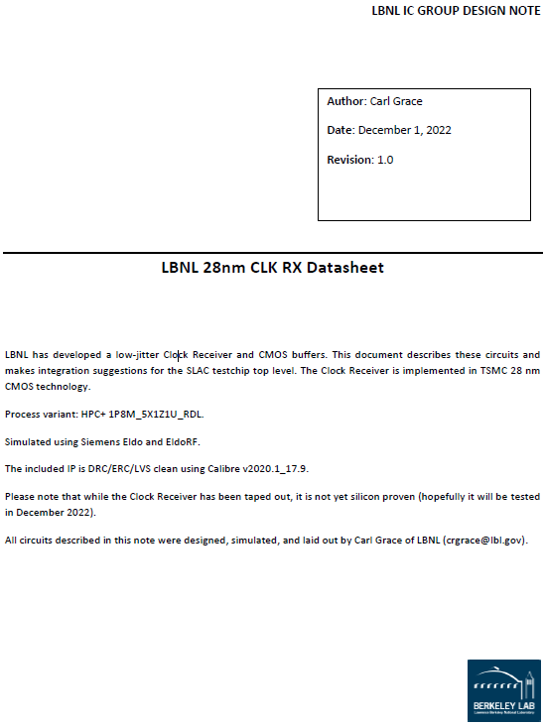
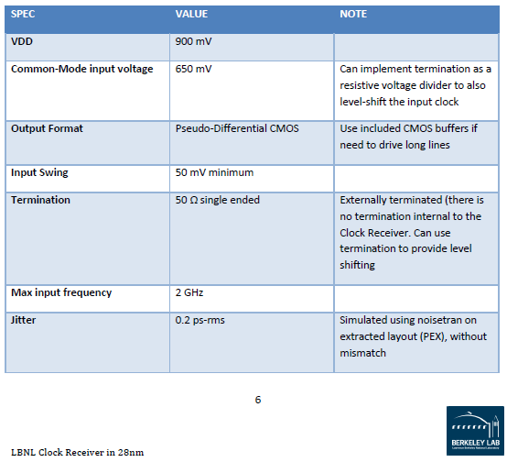
LBNL 28nm CLK RX

Slide 13
Signal Timing
RSTb
RSTmemb
(could be applied only at startup)
Nsel[2:0]
NselV[2:0]
Start
(Timing reference signal / Clock)
StopN / Stop_comm
(Signal from a detection system / delayed version of Start in test setup)
EOC
(End-of-Conversion)
Readout the TDCs by selecting/multiplexing the outputs using OutSel_6_50 and OutCh_sel[1:0] inputs. To the output data TDCoverflow, TDCout[7:0] attach the 50ps/6.25ps and channel identification (OutSel_6_50 and OutCh_sel[1:0]) and Nsel[2:0], NselV[2:0] values used in the measurement cycle
Change Nsel[2:0], NselV[2:0] values before resetting the TDC and starting the next measurement cycle

Slide 14
Backup

Slide 15
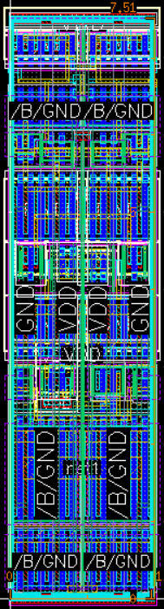
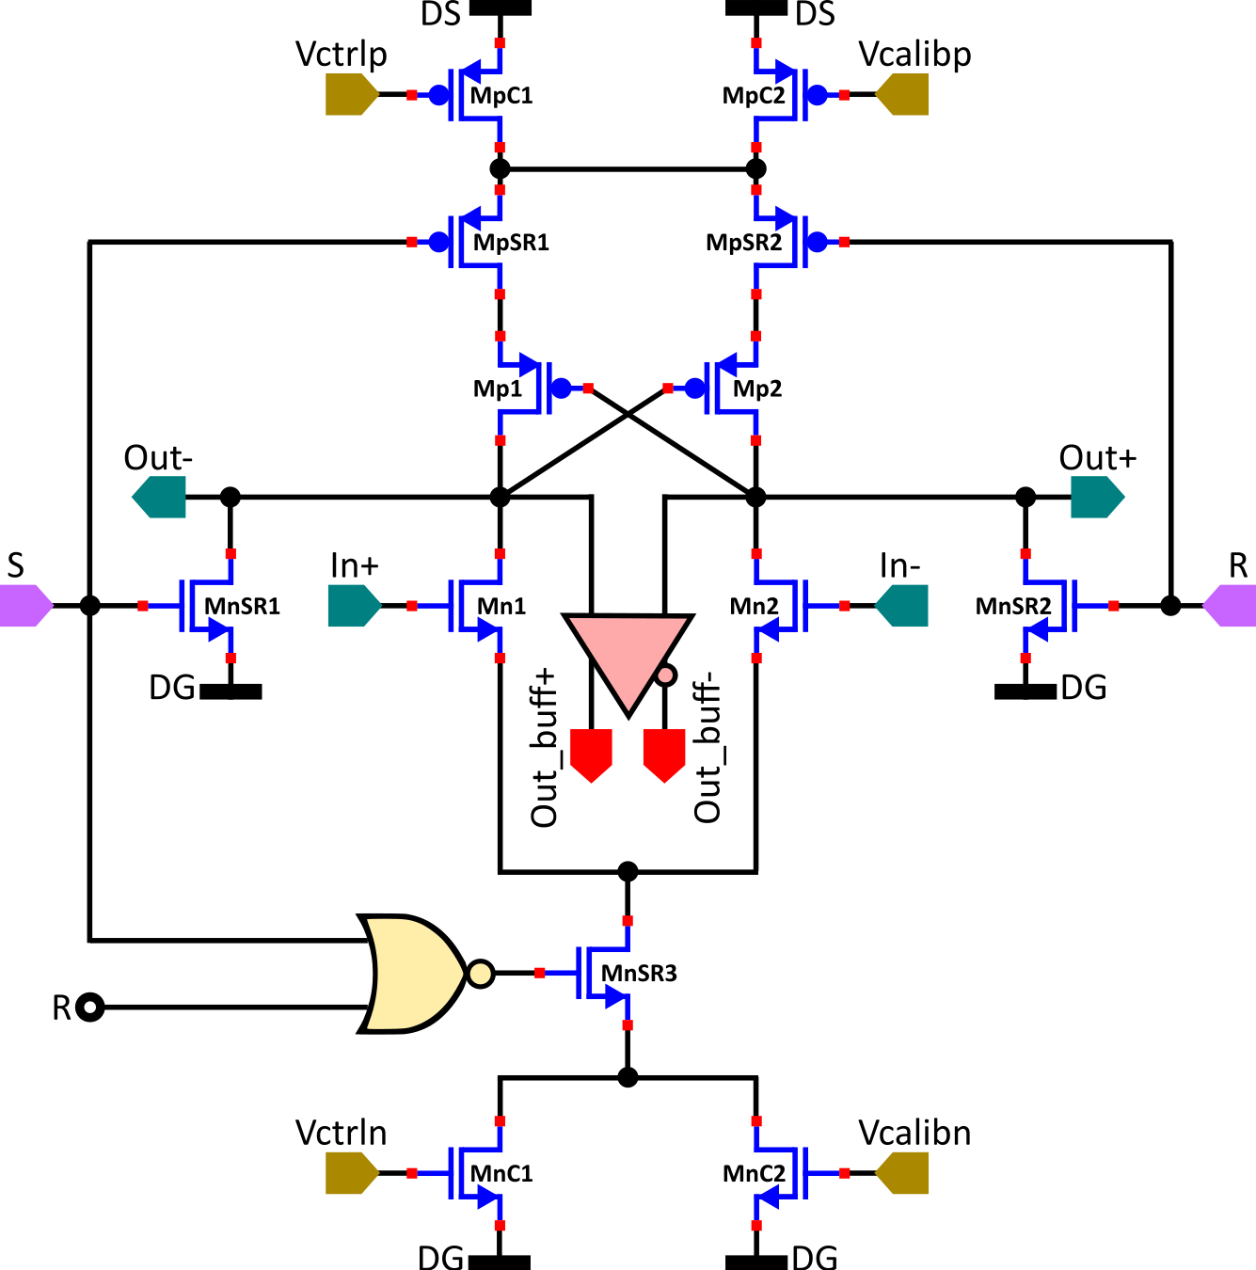
Voltage-Controlled Delay Cell (VCDC)
Differential Cascode Voltage Switch Logic (DCVSL) implementation
Current-starved approach for propagation delay control
Calibration / Trimming
Output buffer for driving the state-sampling registers
Set/Reset logic controls
Leakage reduction:
  Non-minimum length (35nm) used for all transistors
  LVT used for speed-critical transistors with HVT transistors in series between supply and ground
Schematic:
Layout:
LVT
HVT
Core transistors
HVT
HVT
LVT
LVT
HVT
HVT
7.51µm
LVT
LVT
HVT
HVT
HVT
HVT
LVT
1.83µm

Slide 16
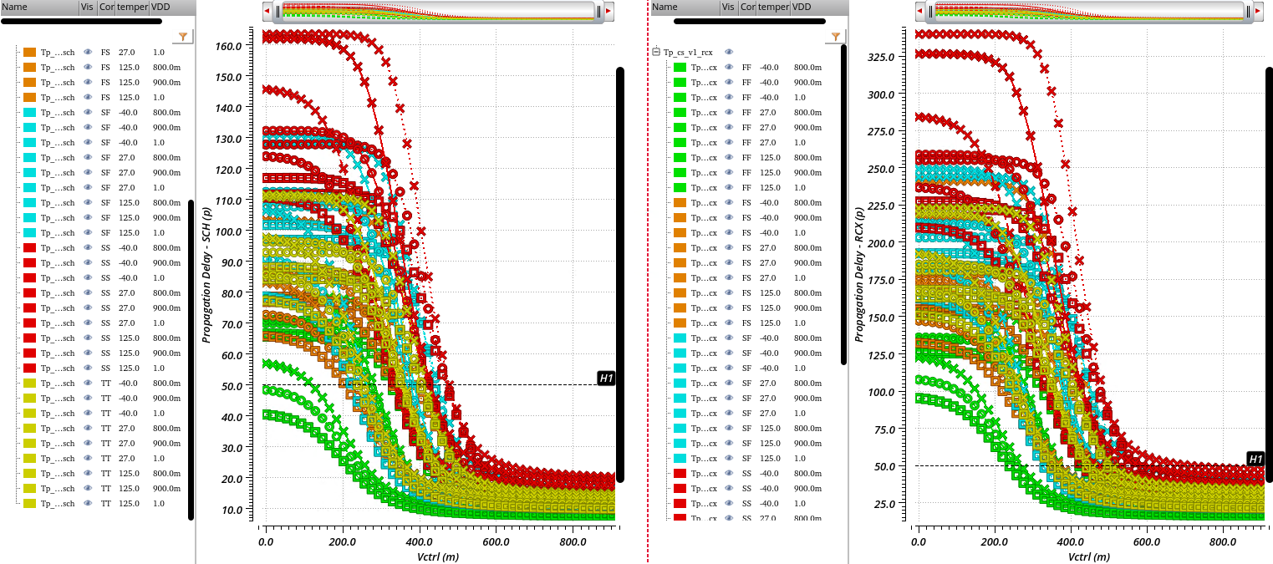

VCDC Delay-Voltage Characteristics: PVT variation
Schematic:
Layout Parasitic Extracted (RCX):
TT
SS
FF
FS
SF
○
27°C
□
125°C
x
-40°C
50ps
―
0.9V
--
1.0V
50ps
...
0.8V
Delay $×\sim 2−2.5$

Slide 17
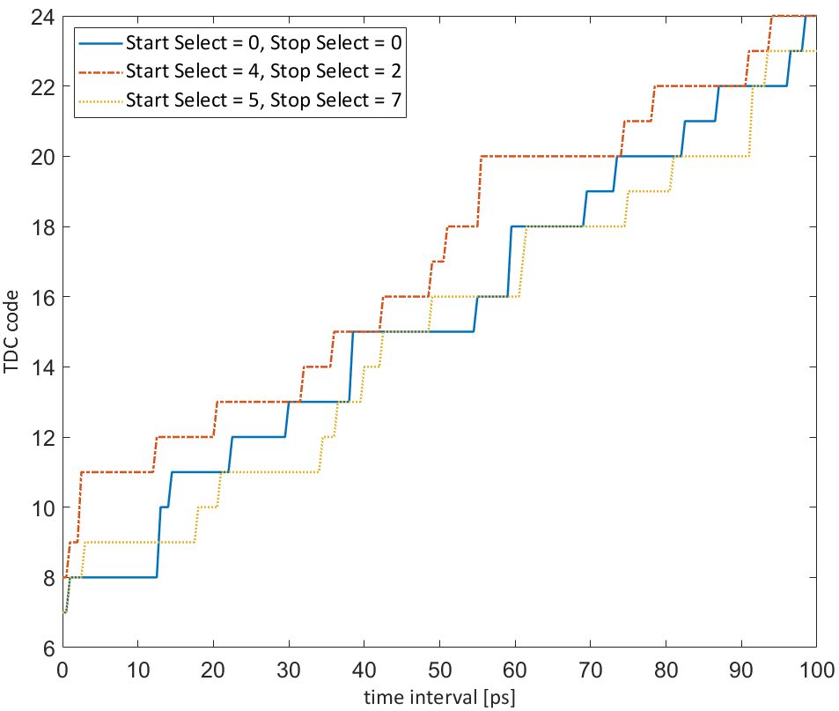
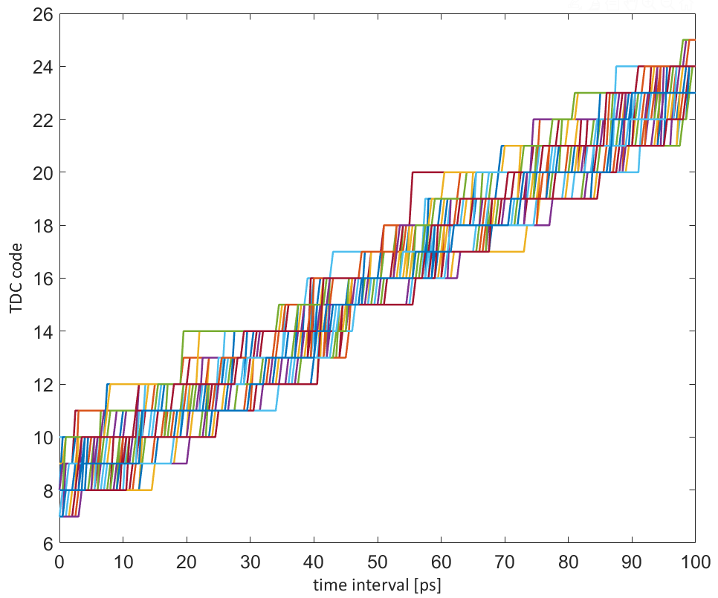
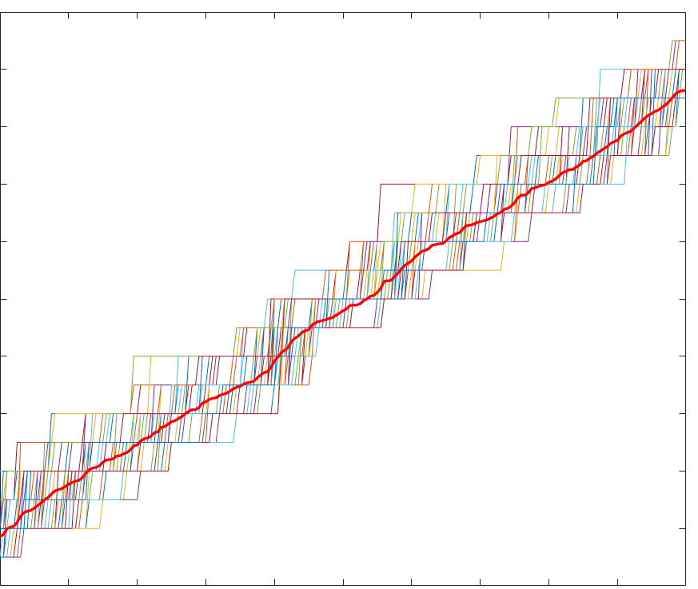
28nm TDC Architecture – Sliding Scale
28nm TDC characteristics with mismatch (Global Corner + Local MC) for:
3 different oscillator pair starting conditions:
All 64 possible oscillator pair starting conditions:

