Slide 1
C³ Community Update
Emilio Nanni
2/6/2023
Early Career Letter (Last Call):
https://sites.google.com/view/ec4c3/home
Please register here to join mailing list or express interest:
https://indico.slac.stanford.edu/event/7155/

Slide 2
Technically…. we arrived on time.

Slide 3
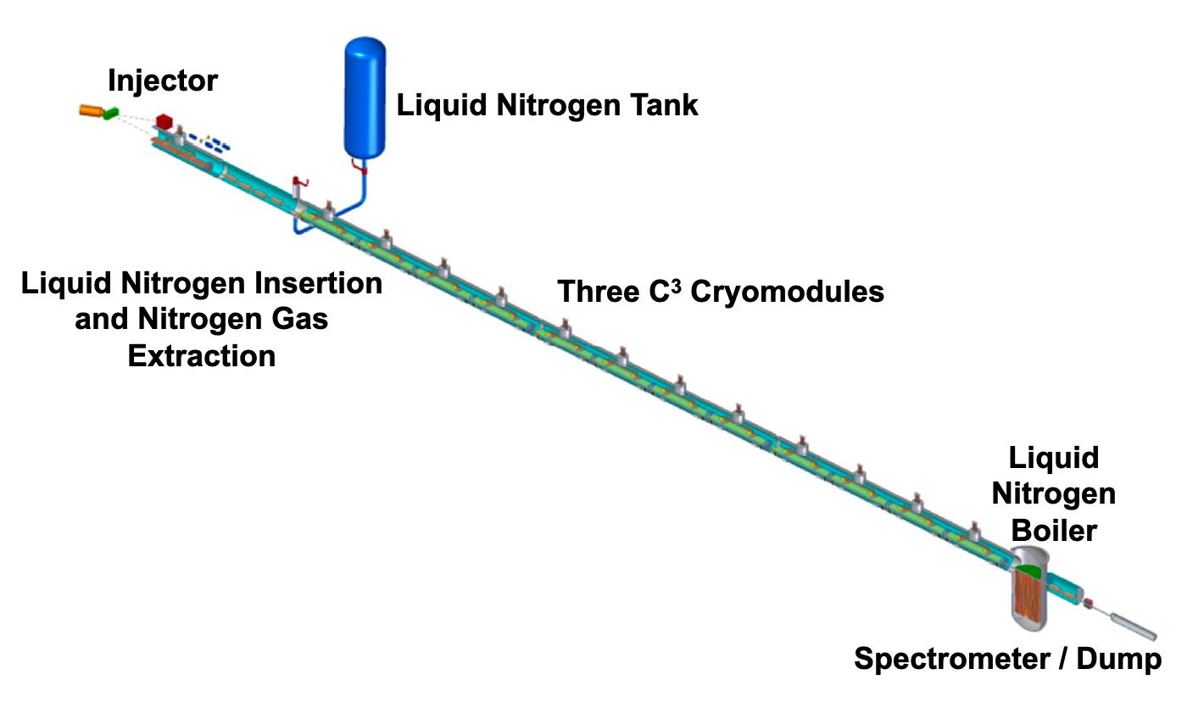
The long road to P5….
P5 Visiting SLAC May 3-5 for Accelerators (and some other topics)….
We hope C³ will be invited, but have not heard anything official
C³, C³ Demonstration R&D
Present P5 Website: http://hitoshi.berkeley.edu/P5/
Snowmass delivered to key messages:
Enthusiasm for Future Higgs Factory
US Interest in Future Colliders
While we wait….
R&D proceeds (components to beam dynamics), studies to inform demonstrator proposal, cost estimates for a demonstrator
Demonstrate fully engineered cryomodule
~50 m scale facility
3 GeV energy reach
Answer technical questions needed for CDR
This is a BIG effort it won’t be realized without broad participation from the community
C3 Feb 2023 Workshop - LANL

Slide 4
Early Career Letter
To highlight early career interest to P5 two letters for P5
EC4C3 Letter
https://sites.google.com/view/ec4c3/home
https://sites.google.com/view/ec-for-future-colliders/home
140 Signatures
160 Signatures
C3 Feb 2023 Workshop - LANL

Slide 5
Sustainability and Luminosity
Sustainability will be a topic for P5
Electrical power budget
Underlying assumptions:
Leverage power estimates from CLIC / ILC
What is different about C3?
Cooling
RF Sources
The biggest challenges for achieving the design luminosity
Emittance, emittance, emittance
Over coming months look at sustainability (beyond electricity, construction, environment, etc)
If interested…. Reach out
Proposal name | C3 - Cool Copper Collider
Beam energy [GeV] | 125
Average beam current [A or mA] | 0.016 mA
SR power [MW] | n/a
Collider cryo power [MW] | 60
Collider RF power [MW] | 40
Collider magnet power [MW] | 15
Cooling & ventilation power [MW] | 10
General services power [MW] | 10
Injector cryo power [MW] | 6
Injector RF power [MW] | 5
Injector magnet power [MW] | 4
Pre-injector power (where applicable) [MW] | n/a
Detector power (if included) [MW] | n/a
Data center power (if included) [MW] | n/a
Total power [MW] | 150
Luminosity [10^(34) /cm^2/s] | 1.3
Total integrated luminosity / year [1/fb/yr] | 0.21 ab-1
Effective physics time per year asumed/needed to achieve integrated annual luminosity [10^7 s] | 1.6
Energy Consumption / year [TWh] | 0.67
C3 Feb 2023 Workshop - LANL

Slide 6
Large Scale Cryogenics
Very high confidence in performance of cryoplants – many commercial examples
We assume 15% plant efficiency; Air liquide quoted 16.4%up to 16.8%
C3 Feb 2023 Workshop - LANL

Slide 7
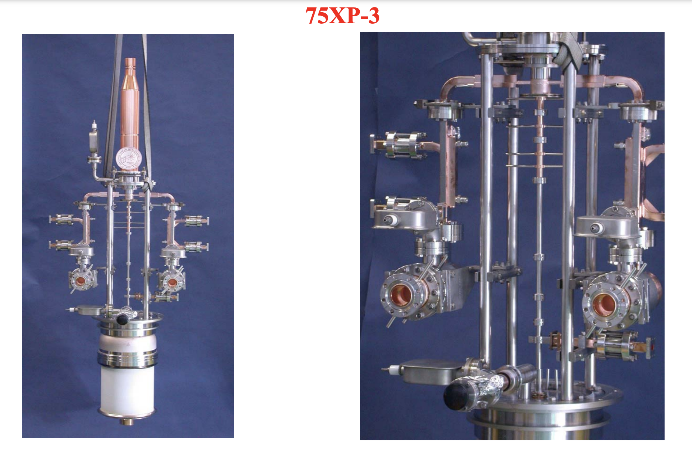
RF Sources
Picture is more nuanced – we assume 65% for the klystron, 50% for the rf source
We assume PPM focusing
These efficiencies and higher have been demonstrated - in particular with expensive depressed collectors
Promising HEIKA work needs to continue
Not in our baseline: RF pulse compression could help a lot by reducing fill time
https://indico.cern.ch/event/39372/contributions/1829827/attachments/787979/1080133/AVlieks-X-Band_Klystron_Development_at_SLAC-final.pdf
C3 Feb 2023 Workshop - LANL

Slide 8
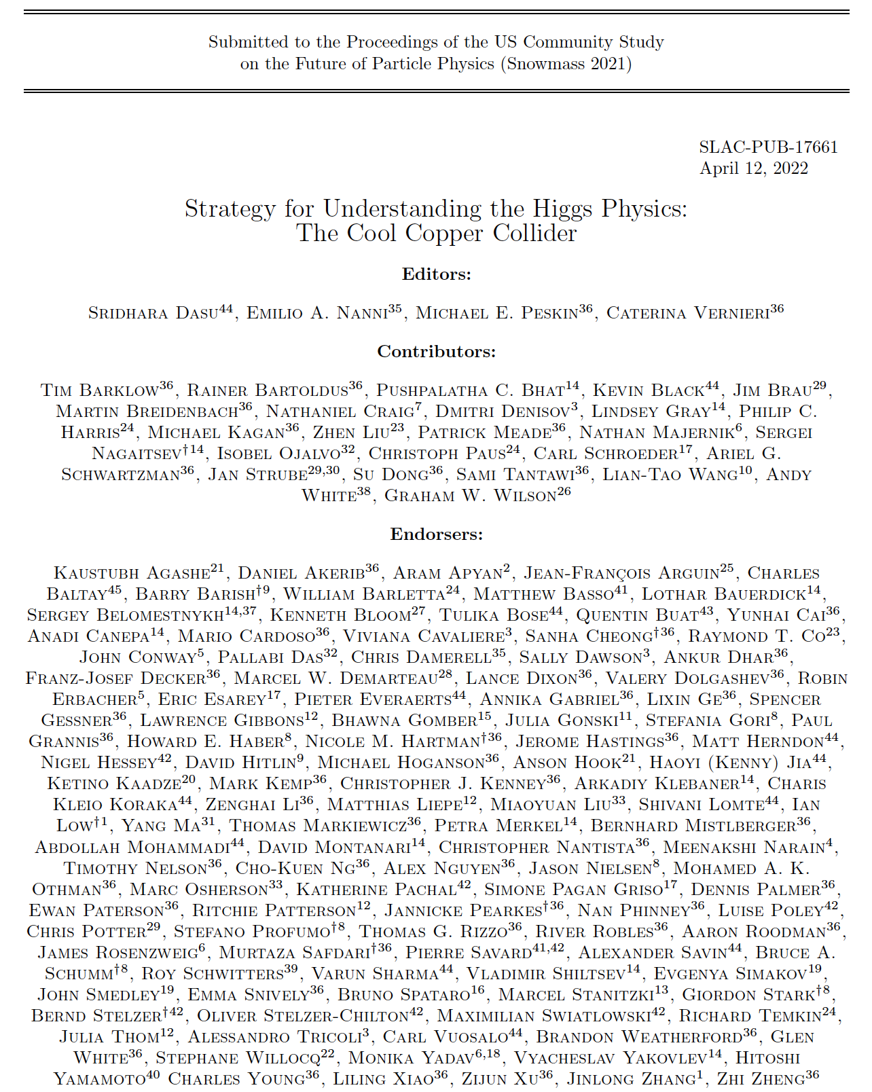
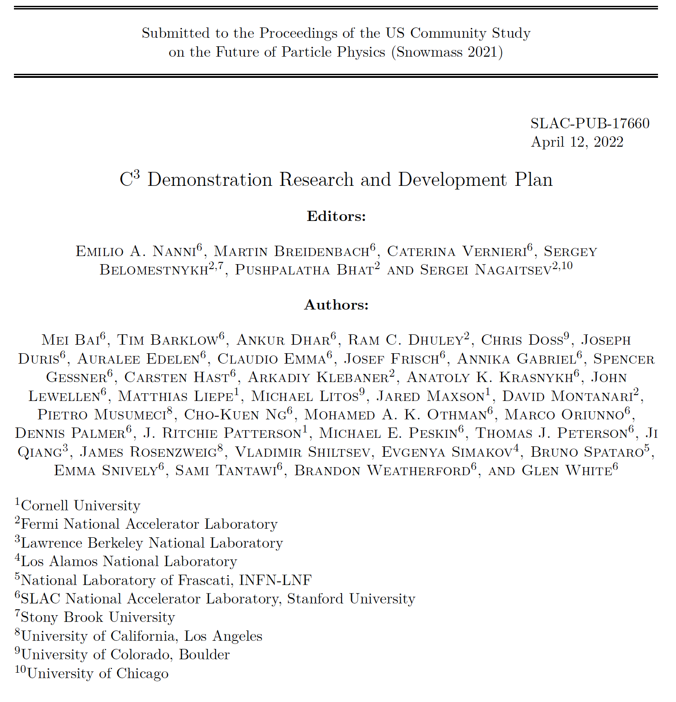
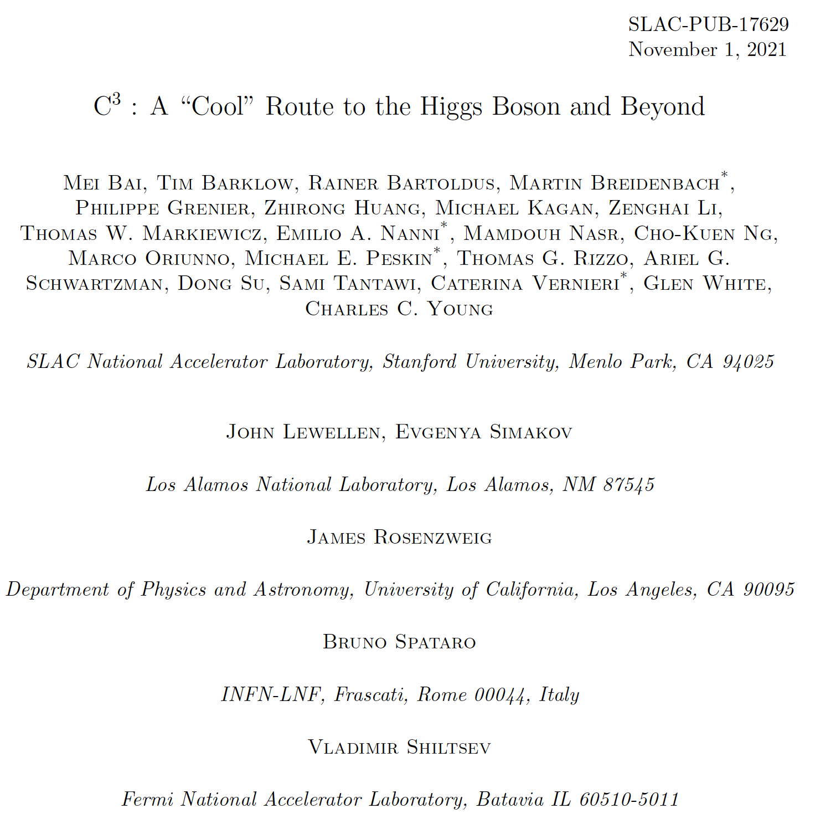
Acknowledgements
Opportunity to Turn Snowmass Submission into JINST Special Issue – Target End of March
Additional Contributors
Mitchell Schneider
Charlotte Whener
Gordon Bowden
Andy Haase
Julian Merrick
Bob Conley
Radiabeam
Cici Hanna
More Details Here (Follow, Endorse, Collaborate):
https://indico.slac.stanford.edu/event/7155/
C3 Feb 2023 Workshop - LANL

Slide 9
Questions?

