Slide 1
Photocathode Trends
& High Gradient Hopes
John Smedley

Slide 2
Overview
Cathode Overview
Semiconductor Cathodes
Principle of operation, Roughness, in situ x-ray analysis
Major Trends in Cathode Research
Epitaxy, Heterostructuring, Optical etalons, Sealed photocathode
What would a high gradient cathode look like?
The electron source determines the initial volume of phase space – and it is hard to make it better

Slide 3
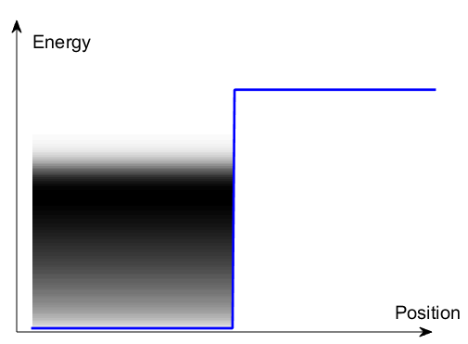
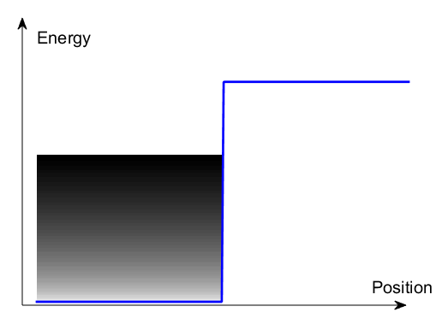





The means to generate electron beams
$$φ$$
Solid
$$φ$$
Vacuum
$$E_{F}$$
Solid
Vacuum
$$E_{F}$$
$$kT$$
T = 0
T >0
Thanks to Jared Maxson, Cornell
Notes:
So how do you get an electron beam? Start with a electrons in a box as a simple model of a metal.
Turn the temperature up, you get a tail of electrons extending above the fermi level.

Slide 4
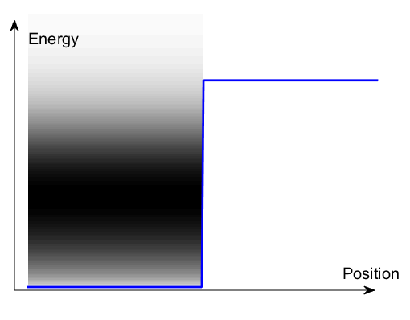
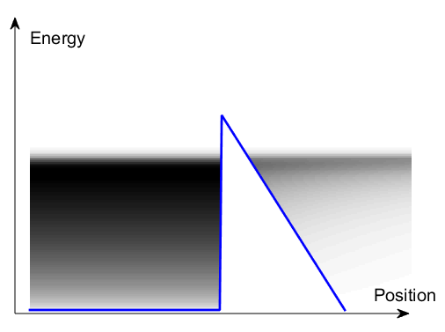





The means to generate electron beams
Thermionic Emission
Field emission
$$e^{−}$$
$$E_{acc}$$
$$E_{acc}$$
Solid
$$φ$$
Solid
$$φ_{0}$$
Vacuum
Vacuum
$$e^{−}$$
T >> 0
T >0

Slide 5
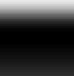








The means to generate electron beams
Photoemission
$$E_{acc}$$
$$E_{acc}$$
Photon energy $hν,$
$$φ$$
Scattering loss
$$φ$$
Solid
Vacuum
Vacuum
time
$$kT$$
$$kT$$
$$hν$$
$$hν$$
T >0
T >0

Slide 6
Semiconductor Photocathodes
The primary path to high average current in photoinjectors
The good points:
  QE can be >10%
  Many use visible light
  Polarized cathodes possible
Common types:
Cs₂Te – QE ~7% @ 262 nm, Lifetime ~1yr
K₂CsSb – QE >4% @ 532 nm, Lifetime ~weeks
Cs:GaAs – QE ~0.5% @ 800 nm (polarized), >6% @ 527 nm
However:
  Require UHV (<0.1 nTorr)
  Limited Lifetime
  Response time
  Complicated
  W.E. Spicer & A. Herrera-Gomez, Modern Theory and Applications of Photocathodes, SLAC-PUB-6306 (1993)

Slide 7
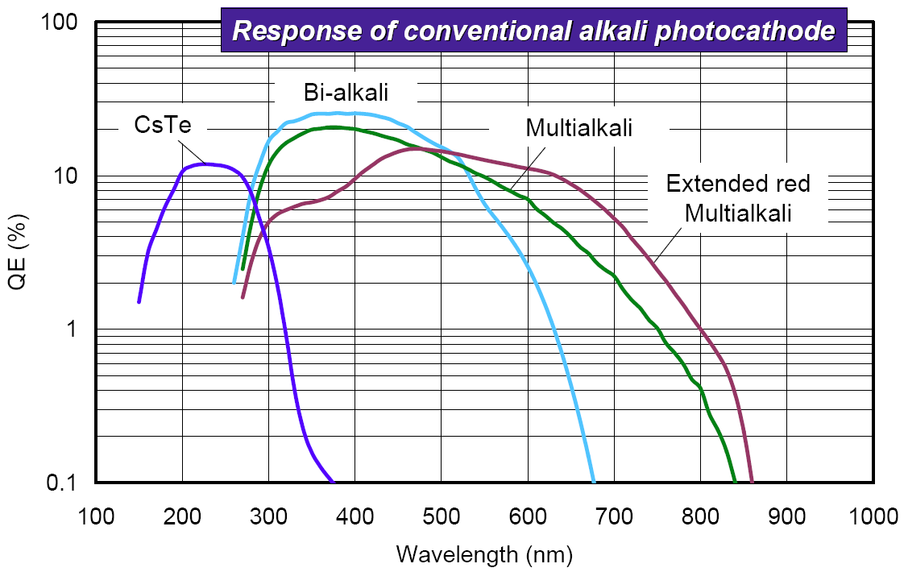

Slide 8

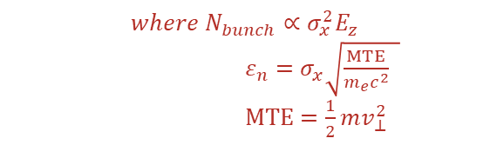



Maximum Achievable Brightness
E_{z} (5-100+ MV/m)
I. Bazarov et al., Phys. Rev. Lett. 102, 104801 (2009)
Child-Langmuir law
$$B_{4D}∝\frac{N_{bunch}}{ε_{n}^{2}}$$
$$∝\frac{E_{z}}{MTE}$$
Electron Bunch
$${{where N}_{bunch}∝σ_{x}^{2}E}_{z}$$
$ε_{n}=σ_{x}\sqrt{\frac{MTE}{m_{e}c^{2}} }$
$MTE=\frac{1}{2}mv_{⊥}^{2}$
Photocathode
$$σ_{x}$$
Laser pulse
Increase $E_{z}$
Brightness limited by photocathode MTE

Slide 9
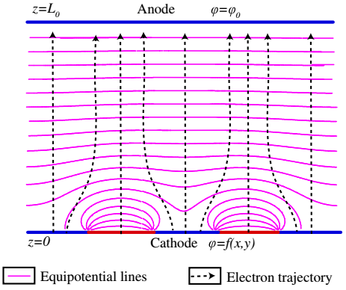
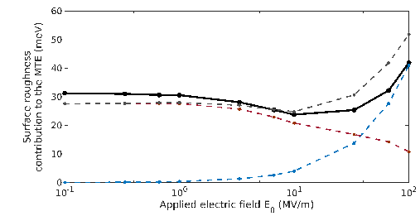
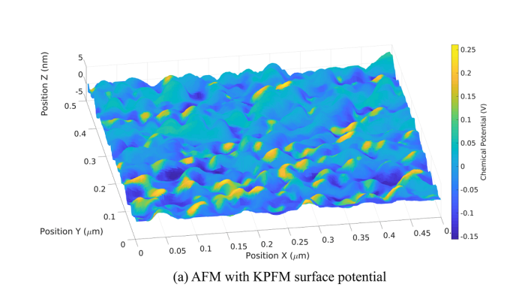


MTE limiting factors -Surface non-uniformities
Physical Roughness
Chemical Roughness
$${MTE}_{field}=\frac{π^{2}a^{2}E_{0}e}{2λ}$$
$$MTE_{wf}=\frac{π^{2}h^{2}e}{4\sqrt{2}aE_{0}}$$
$$2a$$
$$λ$$
J. Feng, S. Karkare et al, J. Appl. Phys. 121, 044904 (2017)
Combined Physical and Chemical Roughness
S. Karkare and I. Bazarov, Phys. Rev Applied, 4, 024015 (2015)
Need single crystal ordered surfaces to get sub-10 meV scale MTE
G. Gevorkyan et al. Phys. Rev. ST- Accel and Beams, 21, 093401(2018)

Slide 10
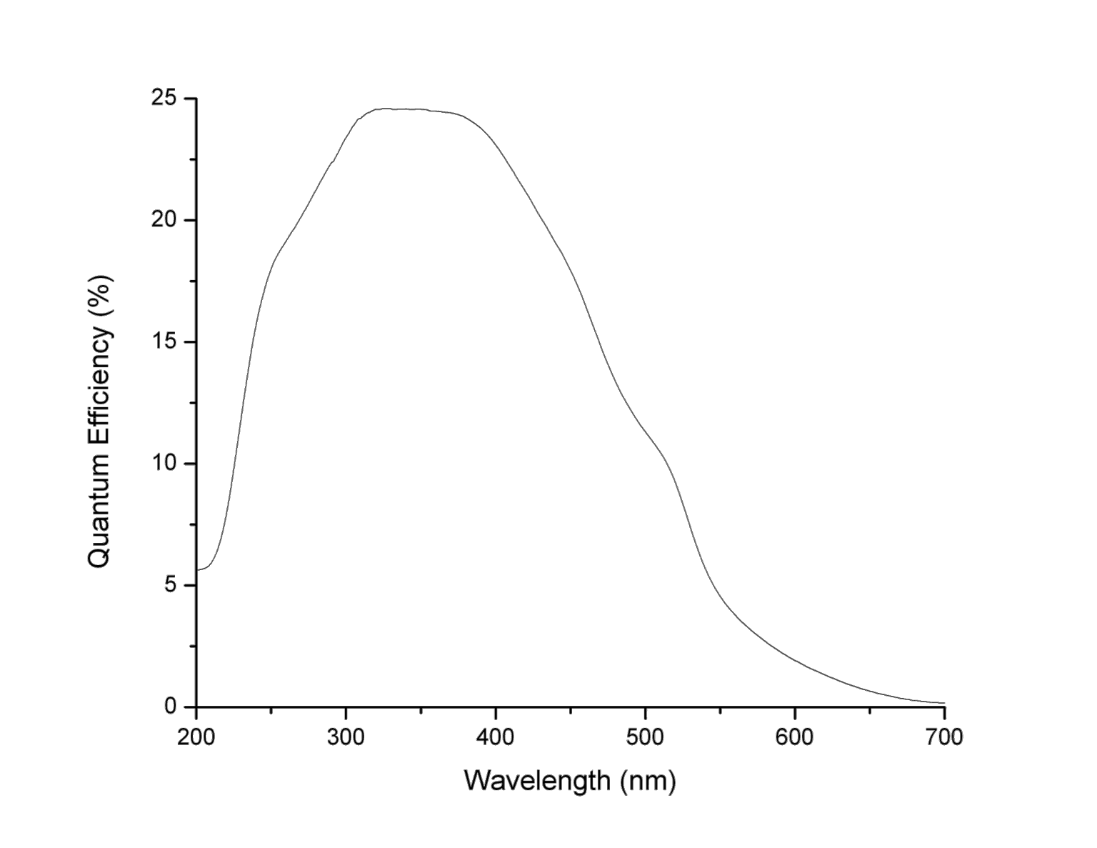
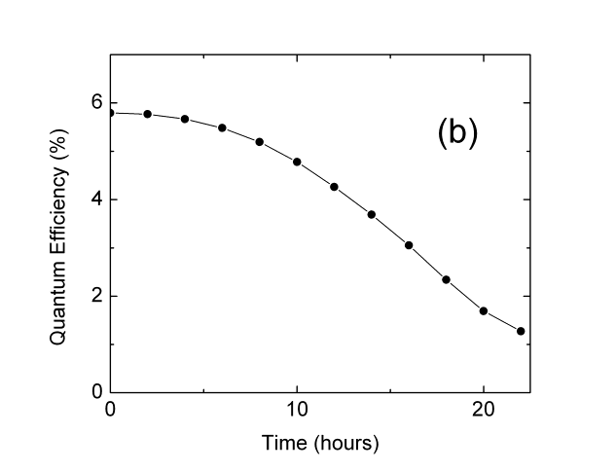
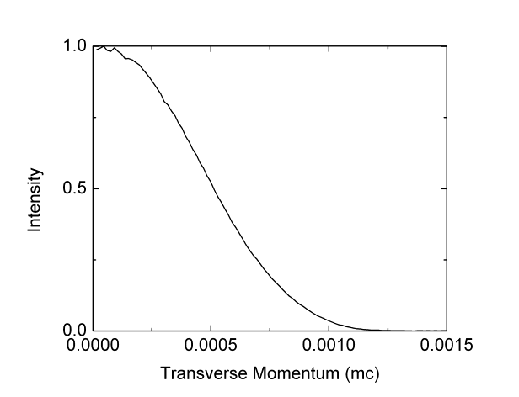
K₂CsSb: A Good Candidate
Good Lifetime 1e-9 mBar
In “magic window”
Caveats: Reflection mode Green light QE
Low transverse Momentum (543 nm)
0.36 µm/mm
Onset of e-e scattering
Unproductive absorption
T. Vecchione et al., Appl. Phys. Lett. 99, 034103 (2011)

Slide 11
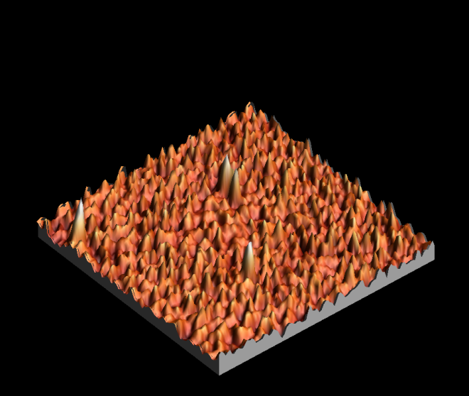
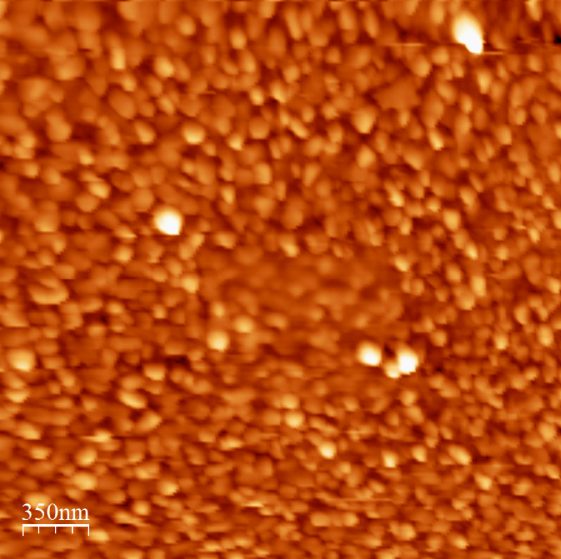
Traditional Sequential Deposition of K₂CsSb
High QE and Rough Surface
  25 nm roughness, 100 nm spatial period
  S. Schubert et al., APL Materials 1, 032119 (2013)
  Emittance vs field measured with Momentatron, 532 nm light
  T. Vecchione, et al, Proc. of IPAC12, 655 (2012)

Slide 12
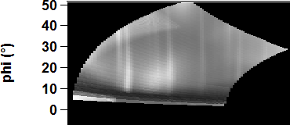
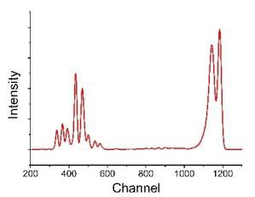
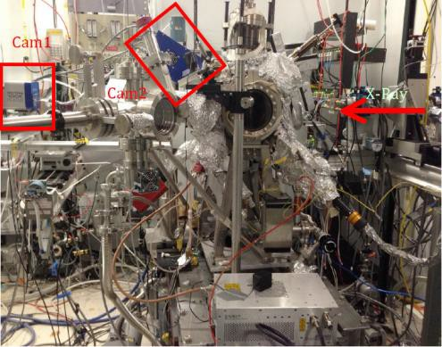
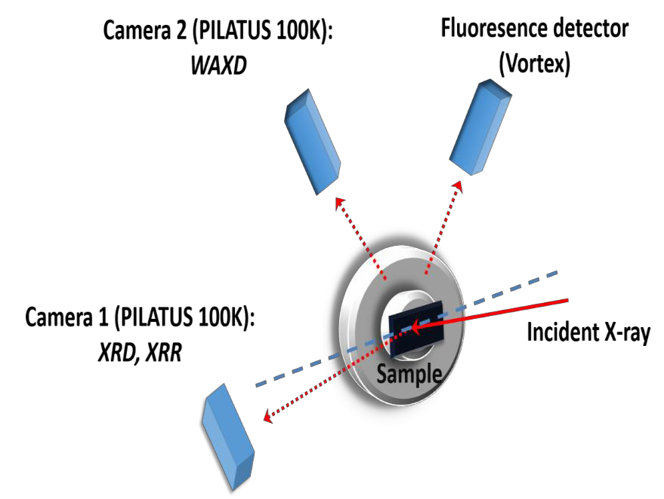

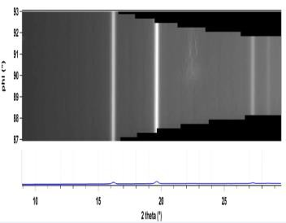

In operando analysis during growth
(setup at NSLS/X21 & CHESS G3 & NSLS-II/ISR)
Wide angle X-ray diffraction
X-ray fluorescence
Growth and characterization system
❸
25 30 35 40 45 50 55
2θ
XRF
Synchrotron Radiation
+ : high brilliance, …
- : limited beamtime
❶
1/2/3: Evaporators
9
3
Reflective spot
In-situ UHV growth system (10⁻¹⁰ ~ 10⁻¹¹Torr)
installed at G3, CHESS
Phi
9
0
8
7
10
15 20 25
2 theta
X-ray diffraction
X-ray reflectivity
15

Slide 13

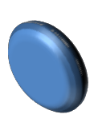

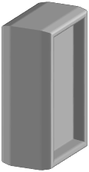

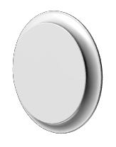






Experimental set up: K₂CsSb cathode growth
Horizontal evaporation of three sources:
P=1x10-10 mbar
FTM
Cs K
X-rays
Sb
Recipe:
QE during growth (532 nm laser)
Cs
QE(%)
K
T(C)
140
K
Cs
100
Sb
25
t
t
16

Slide 14
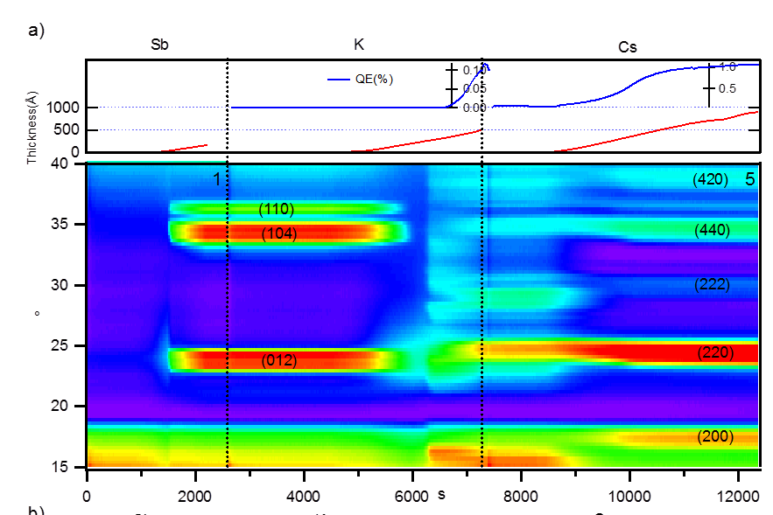
Reaction Dynamics
Antimony evaporated on Si, 0.2 Å/s; crystallize at 4nm
K deposition dissolves Sb layer - This is where roughening occurs!
QE increase corresponds with K_{x}Sb crystallization Cs increases lattice constant and reduces defects
M. Ruiz-Osés et al., APL Mat. 2, 121101 (2014)

Slide 15
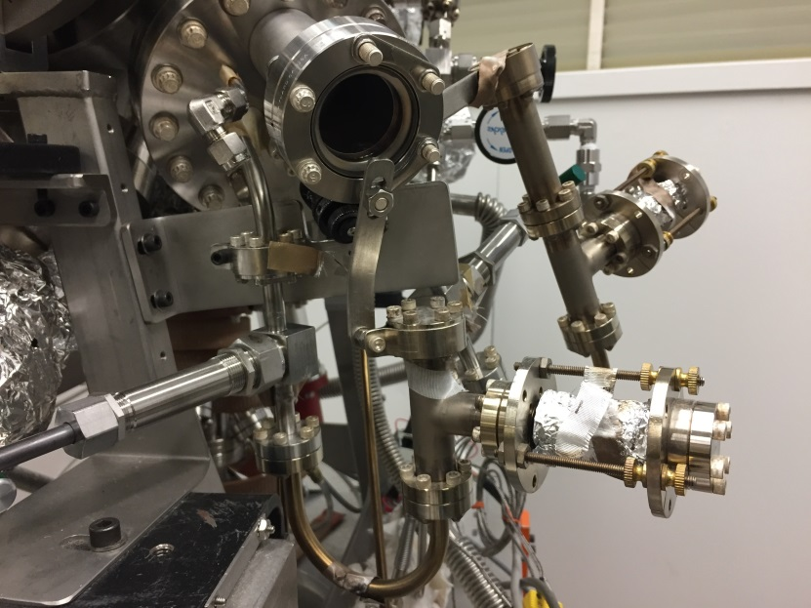
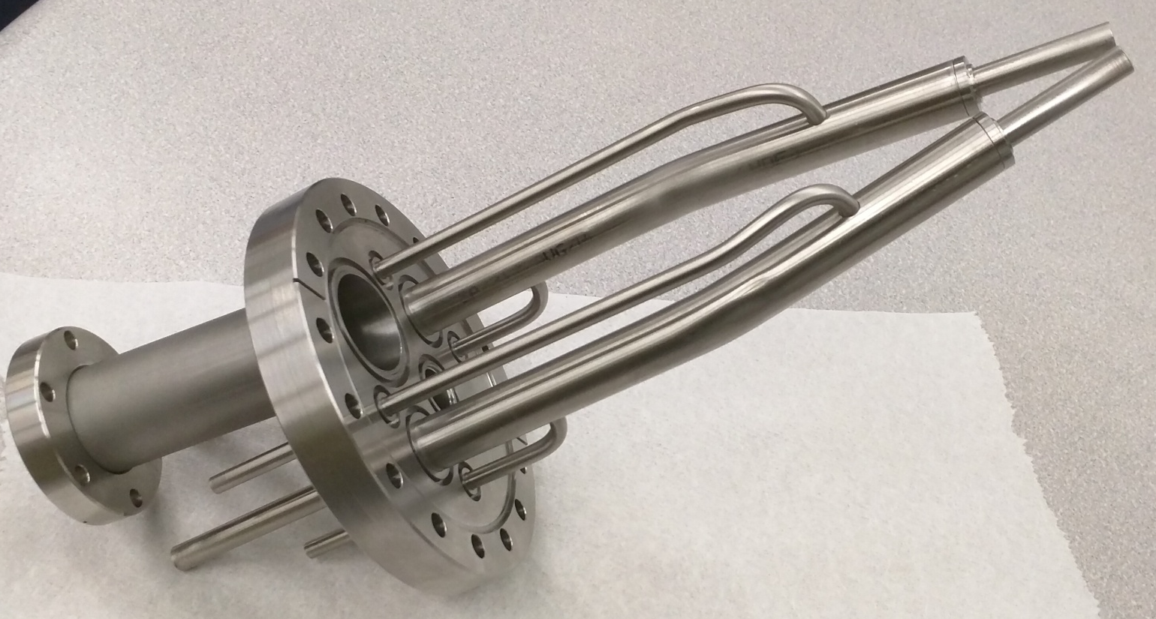
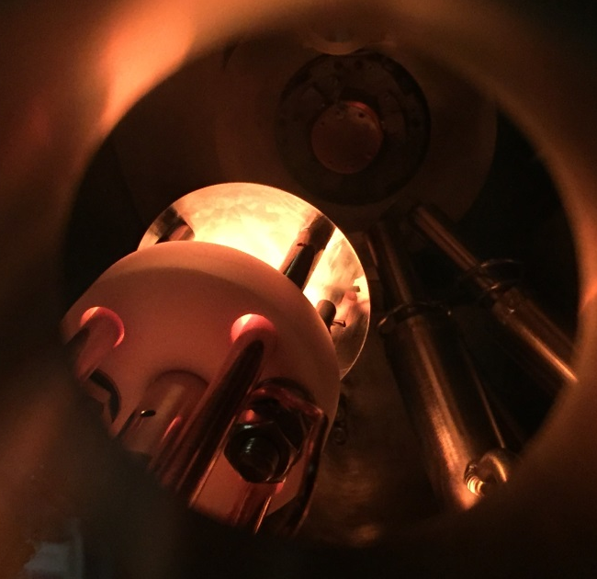
Ternary Co-evaporation
Simultaneously evaporate from Sb evaporator and K,Cs effusion cells
Cs Cell
J tube
K capsule
Growth rate are controlled by J tube temperature, valve and shutter
Stoichiometry controlled by real time XRF

Slide 16
Thickness
~10nm
(440)
Real time
XRD
(422)
(420)
(222)
Real time
Fluorescence
QE

Slide 17
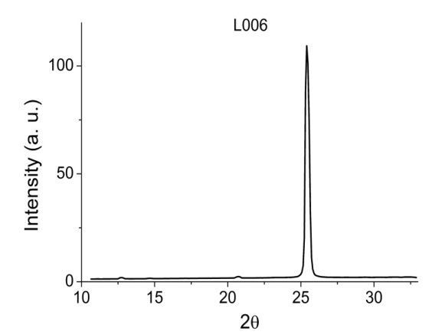
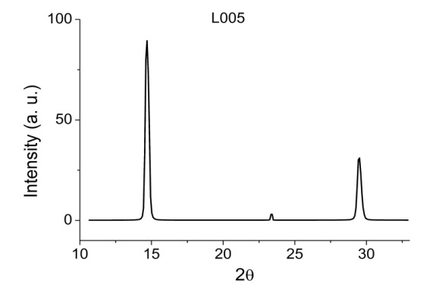
Stoichiometry & Structural Analysis
Camera 1
(200)
Grain size 27.7nm
Grain size 20.2nm
(222)
(400)
(111)
(220)
Camera 2
Highly textured
K₂CsSb phase!
mm size lateral grains
 | K | Sb | Cs
L004 Si | 2.50 | 1.00 | 1.16
L005 Si | 2.37 | 1.00 | 0.91
L006 Si | 2.21 | 1.00 | 0.95
L011 Si | 2.07 | 1.00 | 0.94
L012 MgO | 1.98 | 1.00 | 0.88
Good K/Cs/Sb ratio!
This works for the entire Alkali antimonide family – we’ve created pseudo single crystals with a wide range of stoichiometries

Slide 18
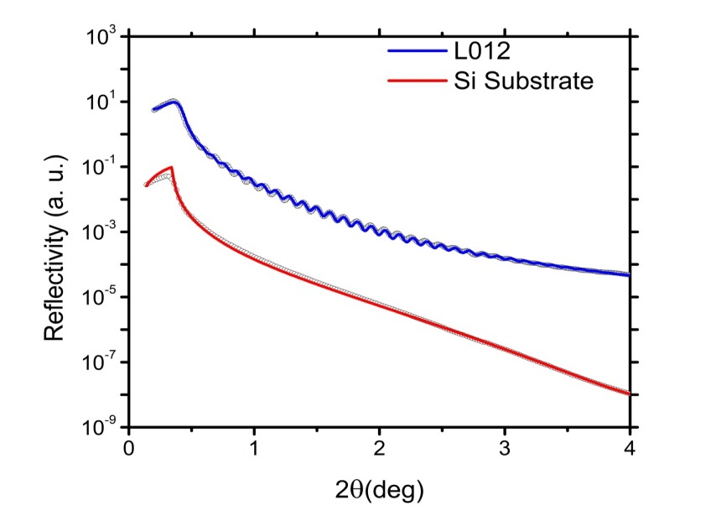
Surface Roughness & QE
 | QE@532nm(%) | Roughness(A) | Thickness (A) | Grain size (A)
L004 Si | 4.9 | 3.5 | 234 | 155
L005 Si | 5.8 | 11.5 | 815.3 | 277
L006 Si | 5.4 | 13.8 | 757.5 | 202
Simultaneous evaporation of all constituents results in no crystal phase transformation
Smooth, reproducible and ultra-high QE. Highly Crystalline!

Slide 19
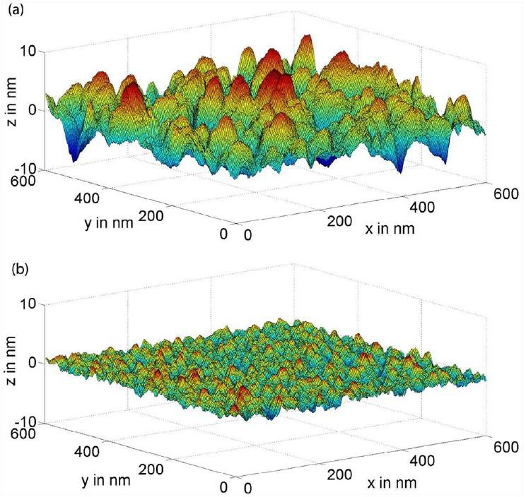
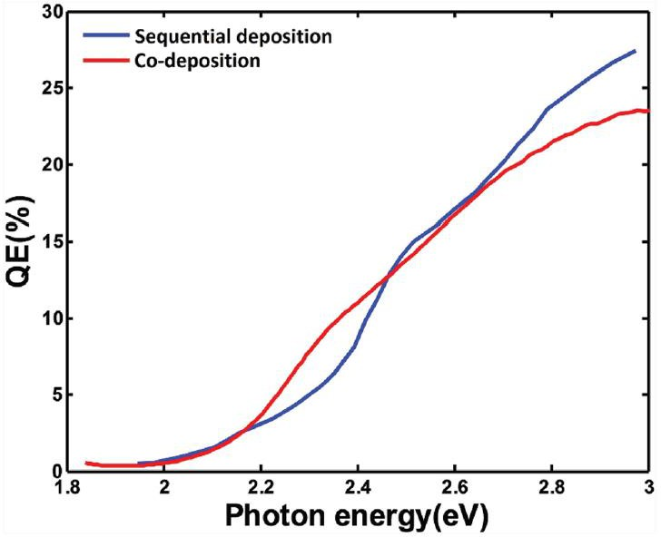
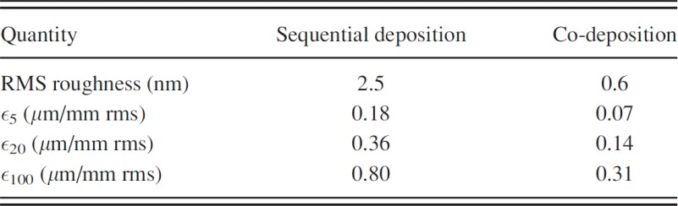
Co-deposition leads to efficient and ultra-smooth cathodes
Co-deposited K2CsSb yield spectrum
Sequential deposition
Co-deposition
20 MV/m
5 MV/m
- significant emittance degradation for sequential method
- no practical degradation with co-deposition
20 MV/m
100 MV/m
LN2 threshold emission
  significant degradation, even with co-deposition
  we need films smoother than 0.6 nm!!
J. Feng et al., J. Appl. Phys., 121(4) 044904, 2017

Slide 20
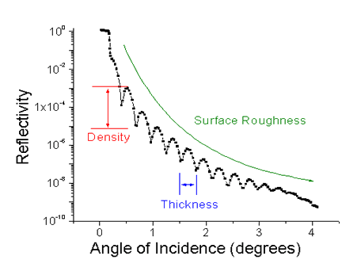
Experimental set-up: Cs-Te cathode growth
Cs
Lα
Cs
Lβ
Te
Lβ
Te
Lα
Cam2:
XRD
Cam1:
XRD, XRR
Substrate
Cam3:
XRF
X-ray: 13 keV
LDLS Lamp source
Te
source
Cs cell

Slide 21
Sequential vs Co-dep CsTe -- XRF
Cs
Lα
Cs
Lβ
Si substrate
Te
Lβ
Te
Lα
Te deposition
@ 120 °C
Cs Te Co-deposition
@ 120 °C
Sample | Te | Cs (+/-0.05)
R008 Sequential | 1.00 | 1.75
R009 Co-dep | 1.00 | 1.98
Cs deposition
@ 120 °C
Leave Cs on for a while
@ 120 °C
At same substrate temperature; co-dep method incorporates more Cs.

Slide 22
Realtime analysis : Sequential growth
Te rate : 0.05 ~ 0.07 A/s
23.5nm
Cs rate : 0.2 ~ 0.6 A /s
~150 nm
~2nm
< 10nm
In less than 10 nm of Cs deposition, at least 2 intermediate phases appeared and disappeared, then a stable product of CsTe forms.

Slide 23
Realtime analysis : Co-deposition
~230nm
CsTe rate : 0.2 ~ 0.6 A /s
~25nm
Starts to crystalize ~ 25 nm of total thickness.
Same phase throughout the growth.

Slide 24
CsTe cathode Quantum efficiency
QE
Co-dep can result in much higher QE than sequential
over cesiation might lead to Cs build-up on the cathode surface and lower the QE
QE can be recovered by removing the access Cs
Wavelength (nm)
M. Gaowei, J. Sinsheimer, D. Strom, J. Xie, J. Cen, J. Walsh, E. Muller, and J. Smedley
Phys. Rev. Accel. Beams 22, 073401 – Published 23 July 2019

Slide 25
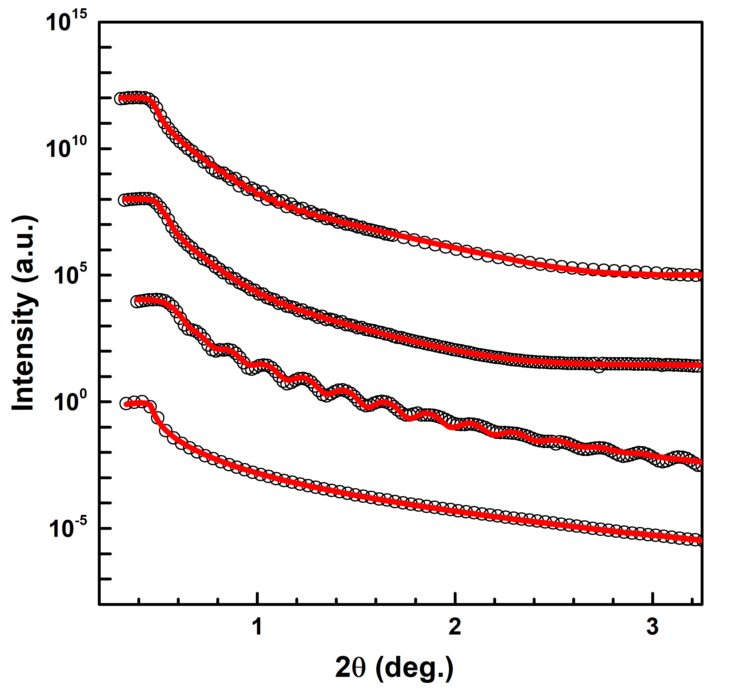
CsTe cathode surface roughness: XRR analysis
R008 Sequential - CsTe on Si
R009 Co-dep - CsTe on Si
Too rough to fit roughness
Final Cs₂Te/Si
Cs₂Te/Si
After Loadlock
Cs₂Te/Cs₂Te/Si
After growth
Cs₂Te/Si
Te/Si
Stopped growth temporarily
Si
 | Thickness (Å) | Roughness (Å)
FINAL Cs2Te/Cs2Te | 968.3 ± 2.9 (total Cs₂Te) | 19.1 ± 0.2
Cs2Te/Cs2Te | 1026.1 ± 1.6 (total Cs₂Te) | 19.10 ± 0.07
Cs2Te | 245.5 ± 1.7 | 9.55 ± 0.14
Si Substrate | - | 3.75 ± 0.02

Slide 26
Trends and observations
Modern photocathode development is focused in two areas:
High average current (e⁻ cooling, CW FEL – FLASH, EuXFEL, LCLS-II)
Ultra high brightness (UED/UEM)
These are driving development of semiconductor cathodes
Spatial uniformity (better than 0.6nm RMS), Single crystal
Ultra thin/optical etalon
Sealed photocathode systems for commercial delivery
Graphene or HBN covered cathodes
Galdi et al., Appl. Phys. Lett. 118, 244101 (2021)
M. Gaowei, et al., Phys. Rev. Accel. Beams 22, 073401 (2019)
A. Alexander, et al., AIP Advances 11, 065325 (2021)
J. Smedley, et al., Alkali Antimonide Photocathodes for Everyone, PAC 2013, 1178
J. Biswas, et al., APL Materials 10, 111115 (2022)
H. Yamaguchi, et al., npj 2D Materials and Applications, 12, (2017)

Slide 27
Concerns at Ultrahigh gradient
Practical/Engineering – How to bring the cathode into the cavity?
Joints allow separation of problems, often at the cost of field emission
Cathode Field Emission – How to limit?
Higher work function or band gap, spatially smooth and uniform
Compromise on UV light?
Cesium migration? Will cathode poison the gun?
Requires R&D, but surface layers may help
Maintaining MTE at high gradient
Requires ultra smooth, possibly single crystal
1 nm RMS @ 250 MV/m, 1 nC bunch at CL limit: .06 um emittance from field

Slide 28
What would optimal high field cathode look like?
“Smooth” layer
potentially graphene
High Band Layer
Ideally p-doped
Alkali telluride
Laser
e⁻
Photoemissive layer
Visible sensitive
Alkali antimonide
Conducting layer
for charge resupply
at cryo
Ultrasmooth – may need specialized growing surface with RA below 0.5 nm
Semi-epitaxial – limit boundary scattering and nonuniformity.
Evidence of epitaxy of Alkali antimonides on graphene is promising
Need defect control to allow doping of semiconductors to shift fermi level

