Slide 1
C³ Structure Development Updates
Ankur Dhar
02/07/2023

Slide 2
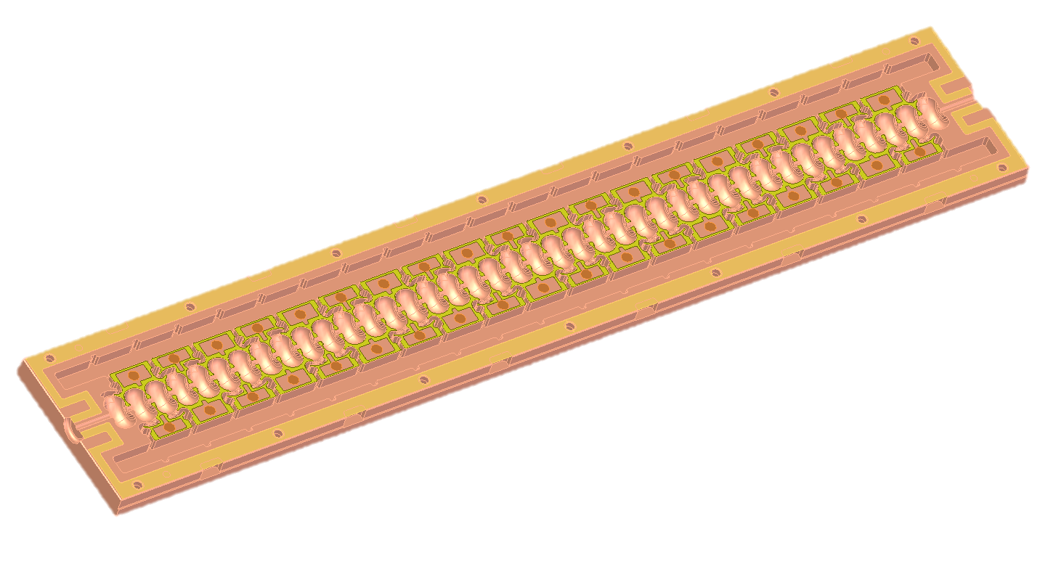
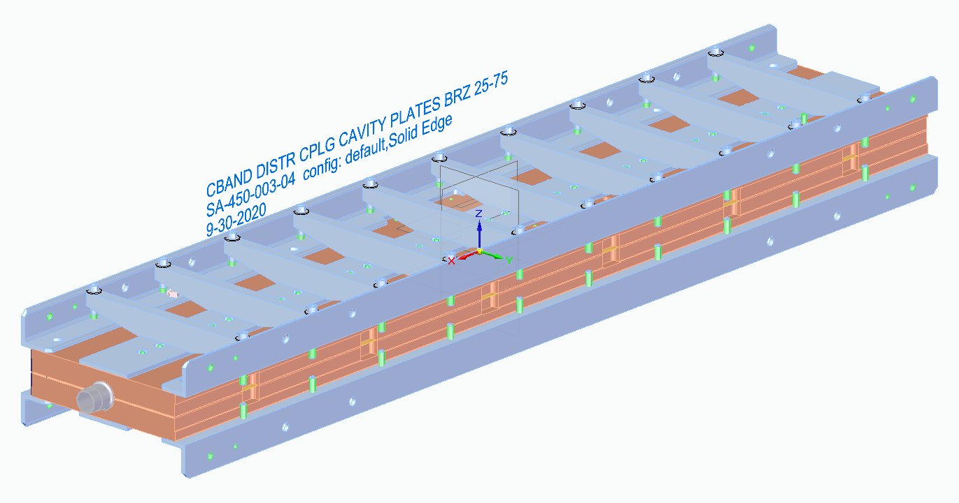
Main Linac Structure Update
Point of Contact: Valery Borzenets valeryv@slac.stanford.edu
Next iteration of main linac module is undergoing design
Main goals are to address poor surface bonding along the irises and post-machining warping
This is being addressed through the addition of an additional strongback along the center of the structure
Braze alloy will also be applied inside the structure close to the irises, with copper spacer to ensure braze material flow

Slide 3
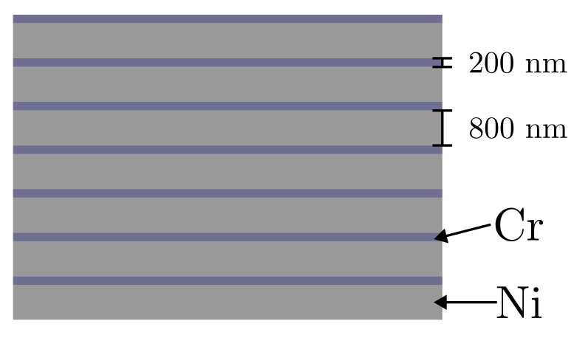
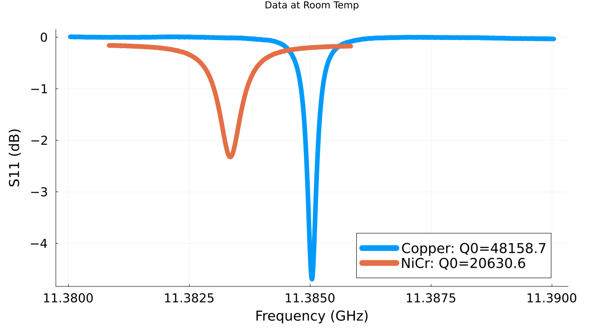
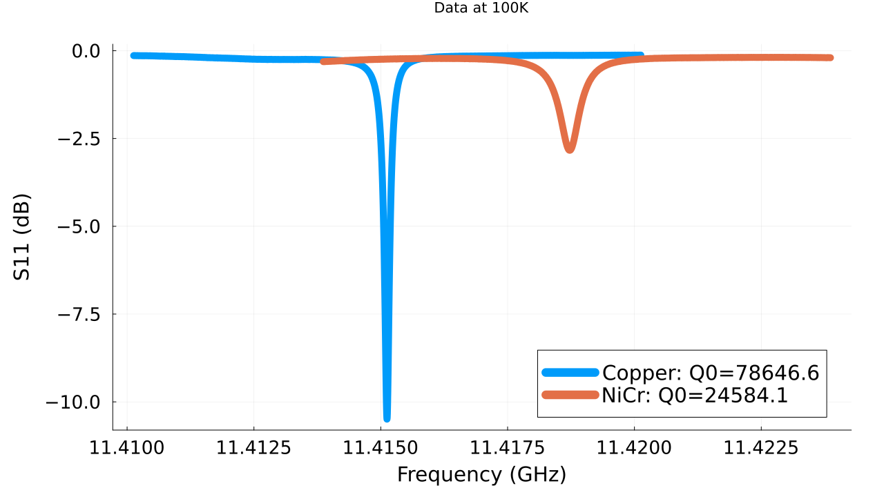
NiCr Deposition Method
Point of Contact: Valery Borzenets valeryv@slac.stanford.edu
NiCr is typically sputtered for thin film applications
This is not viable for coating large damping slits
Potential solution is to electroplate layers of Ni and Cr and then use a hydrogen furnace to form NiCr
The RF loss of this fired sample was verified through S11 measurements of a resonant cavity

Slide 4
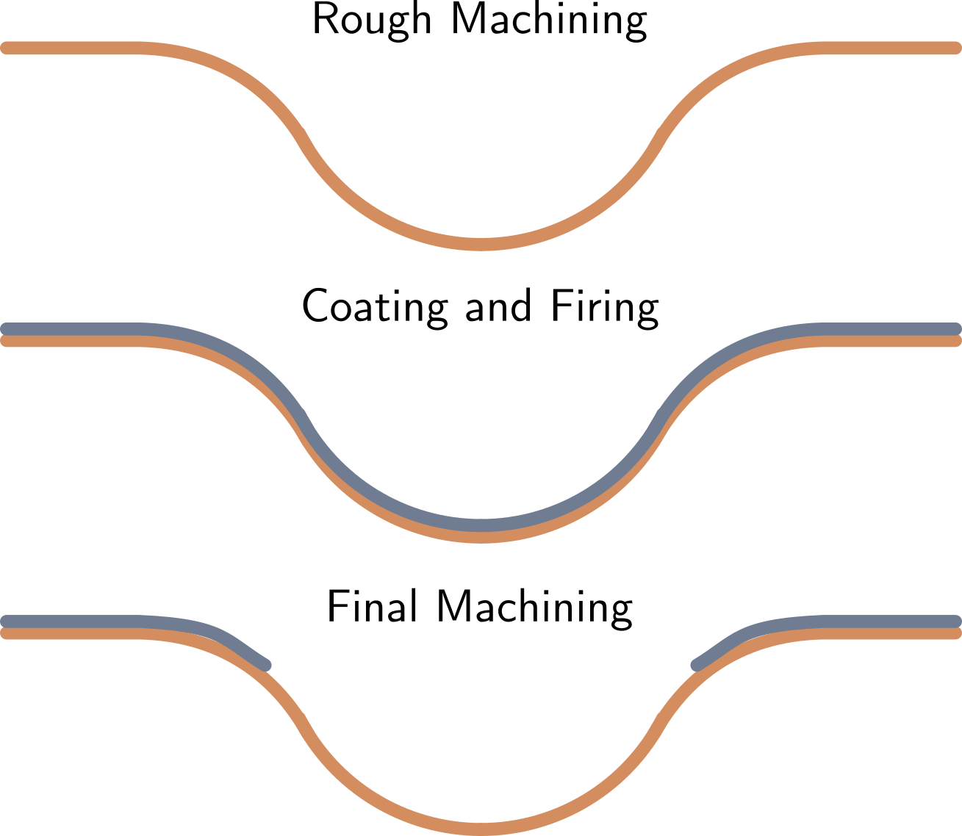
NiCr Application to Main Linac
Point of Contact: Valery Borzenets valeryv@slac.stanford.edu
This electroplating method provides a scalable solution for depositing NiCr on damping slits
Linac cavities would be rough machined along with slits, waveguides, etc
Electroplating would cover entire linac
Final machining removes NiCr layer from unwanted areas, leaving coated slits

Slide 5
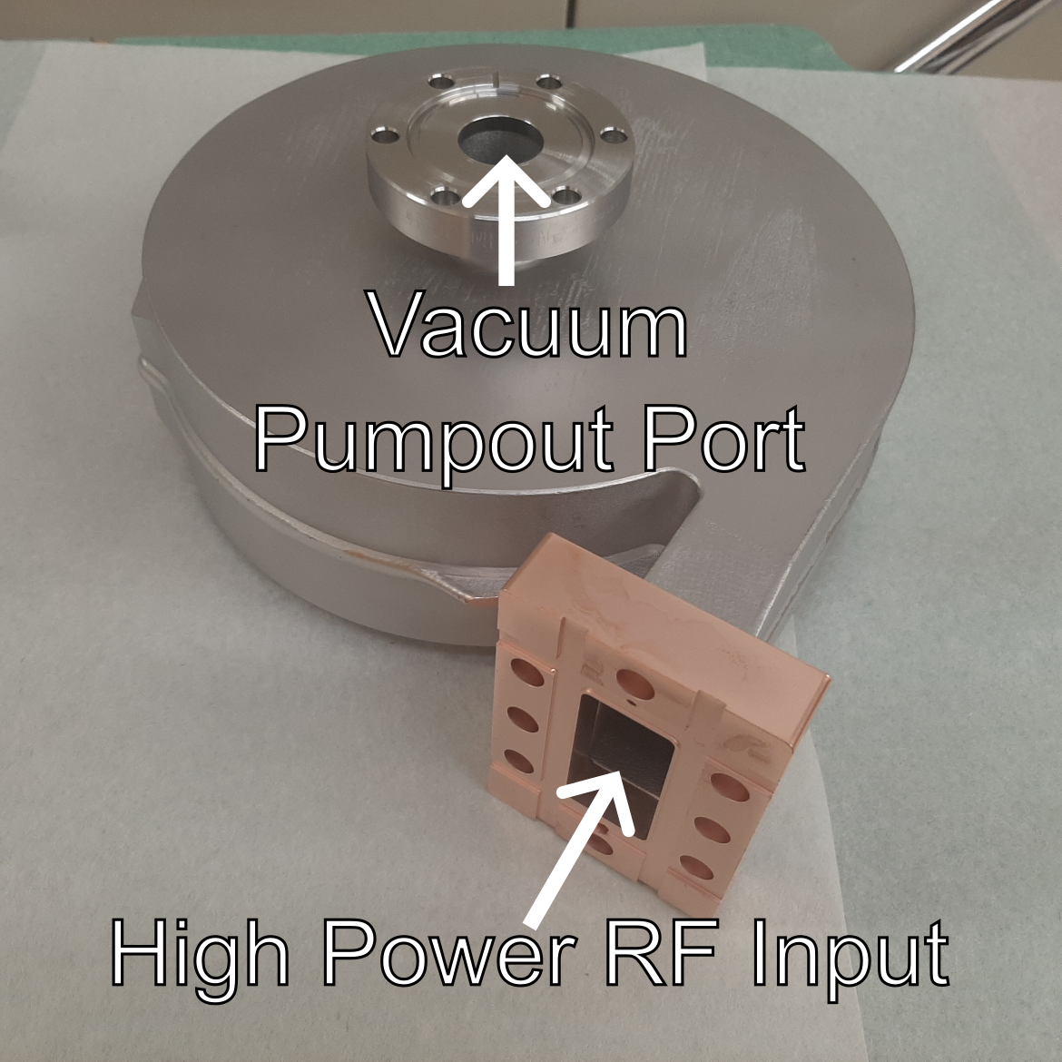
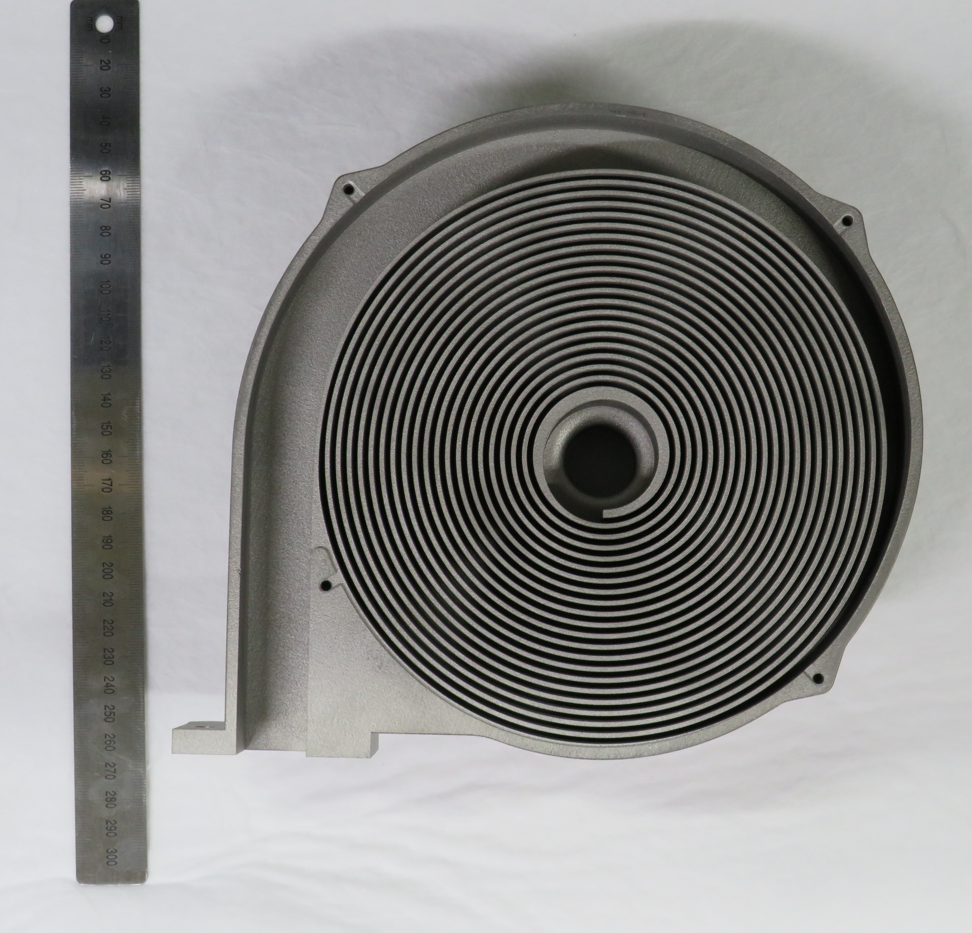
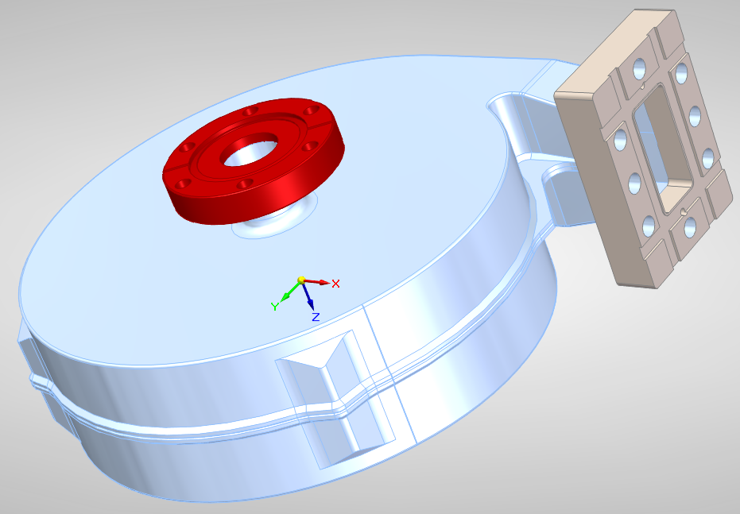
Additive Manufactured C-Band Load: Escargload
Point of Contact: Julian Merrick julianm@slac.stanford.edu
Inspired by CERN’s efforts on designing an additively manufactured load for X-band
General design was to create a spiral load formed from a taper lossy waveguide with a pump-out port at the center

Slide 6
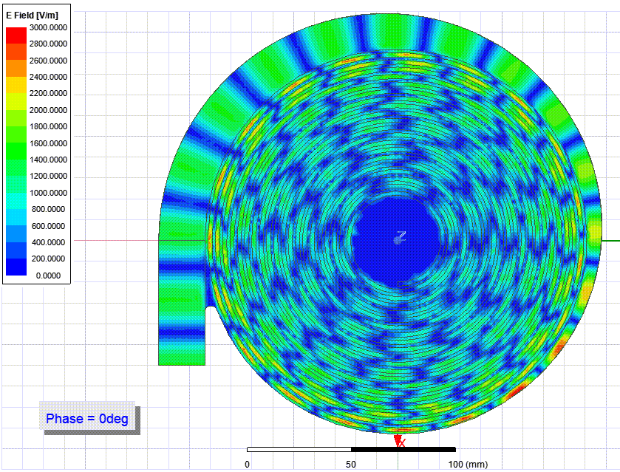
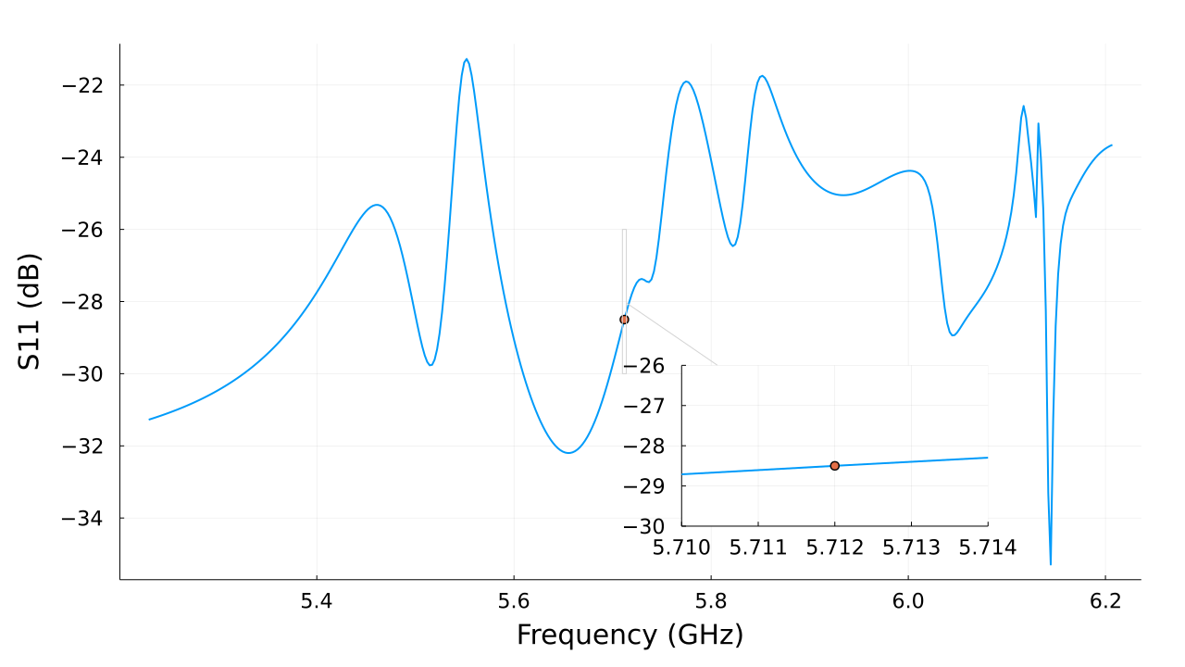
Additive Manufactured C-Band Load: Escargload
Point of Contact: Julian Merrick julianm@slac.stanford.edu
Initial designs were iterated within HFSS, before being sent to Protolabs for manufacturing
Target loss was -20dB at 5.712 GHz
Simulations estimated -28dB

Slide 7
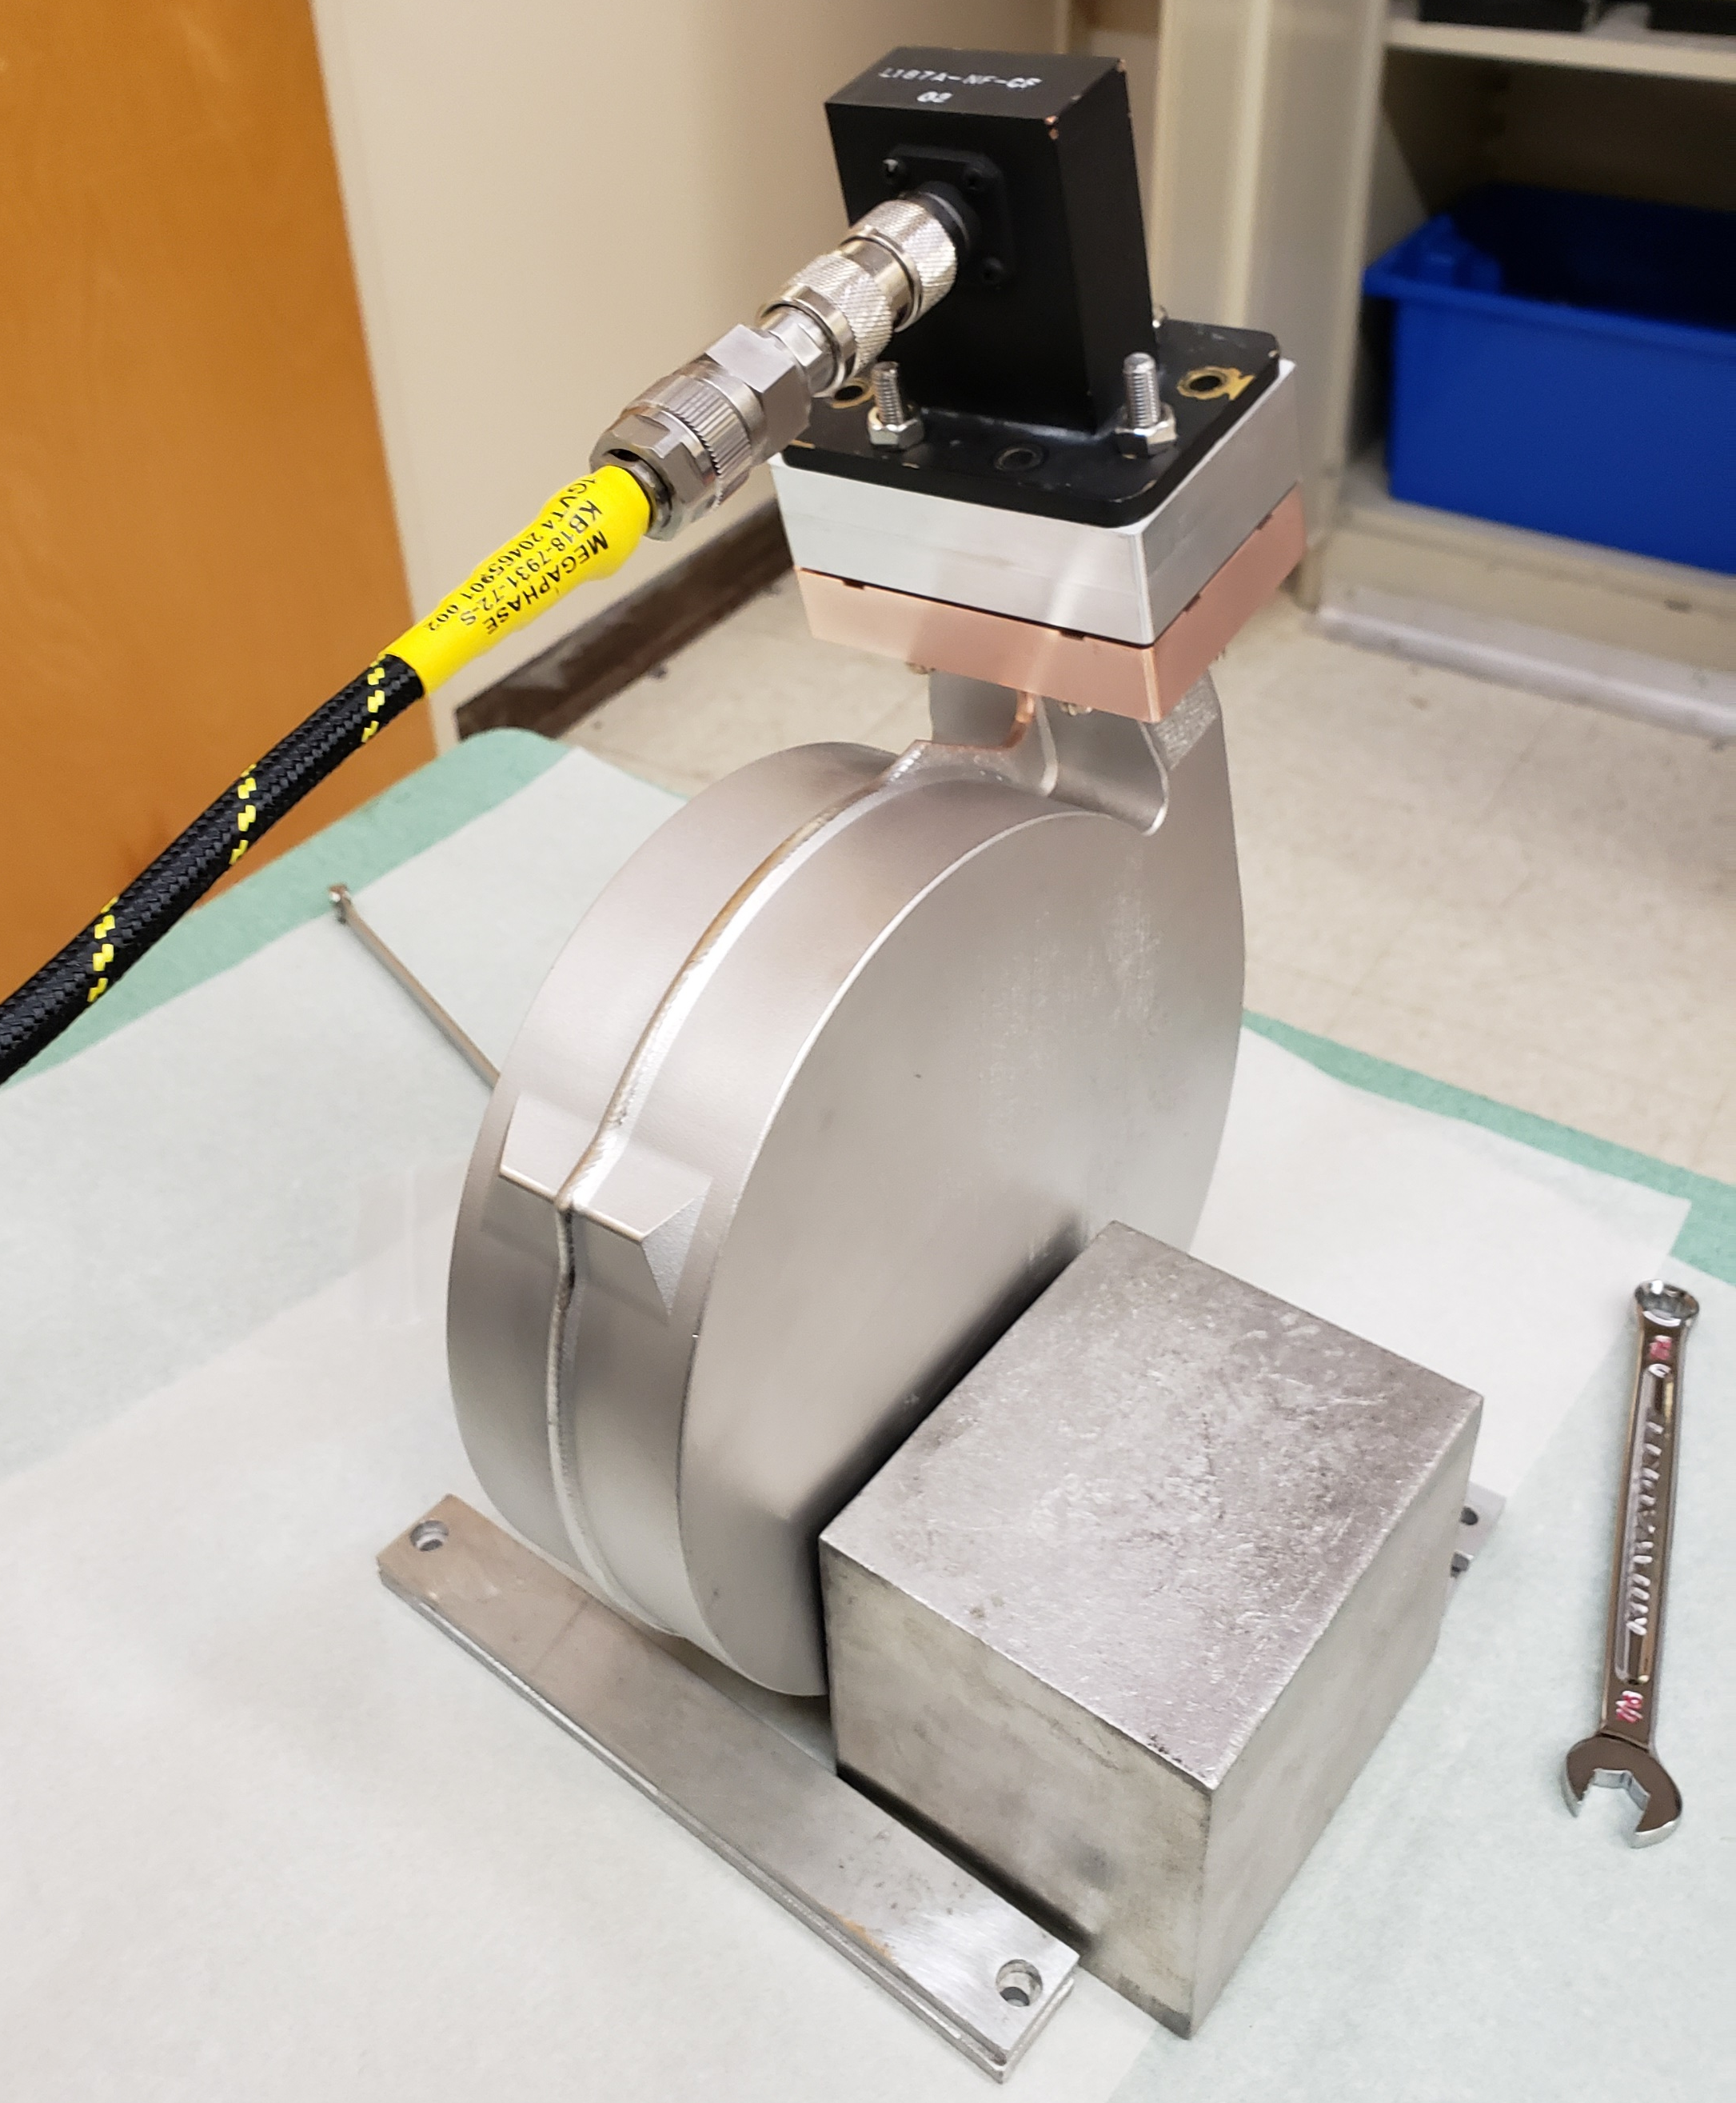
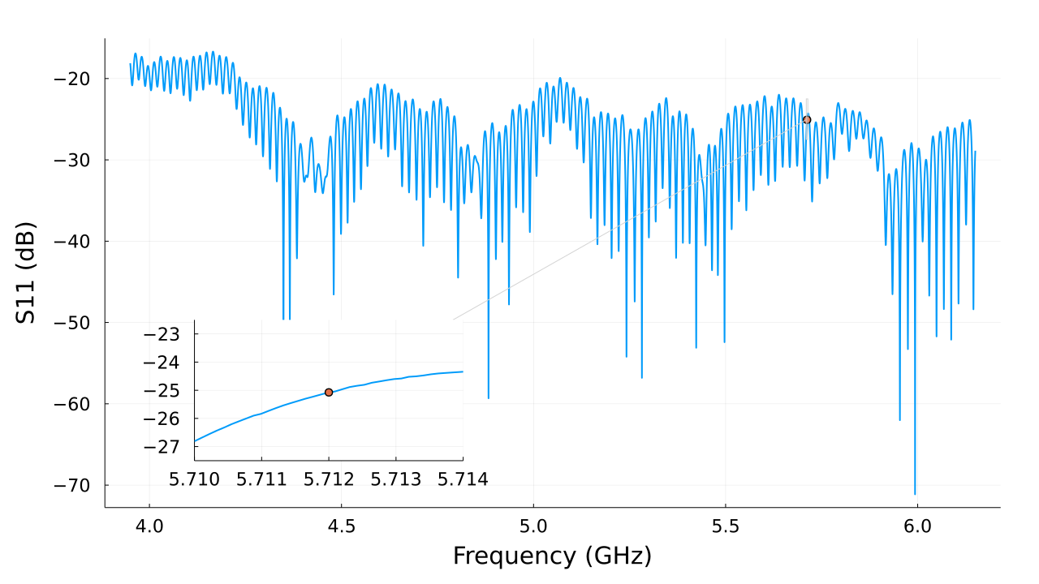
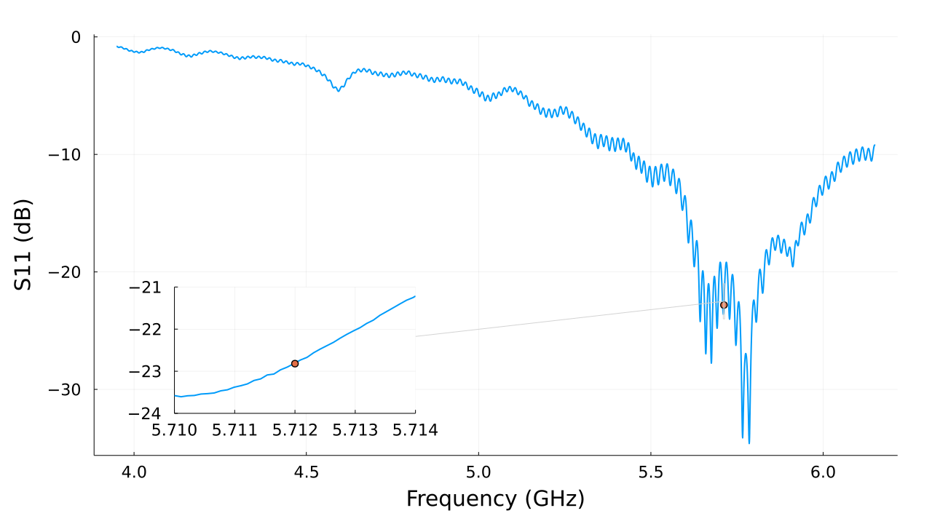
Testing the Escargload
Point of Contact: Julian Merrick julianm@slac.stanford.edu
Cold tests were conducted at SLAC before being sent to Radiabeam for high power tests
Measured loss at 5.712 GHz was -22.8dB in vacuum
High power testing at Radiabeam was conducted with 8 MW max power
Tests were paused for reasons unrelated to load performance
In Air
In Vacuum

Slide 8
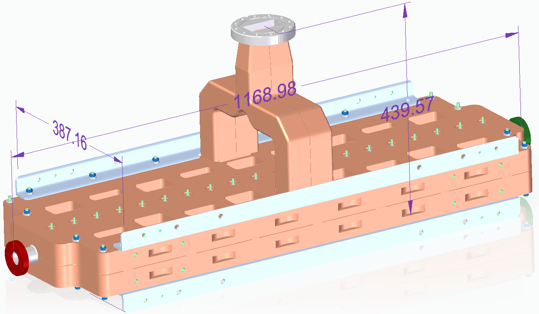
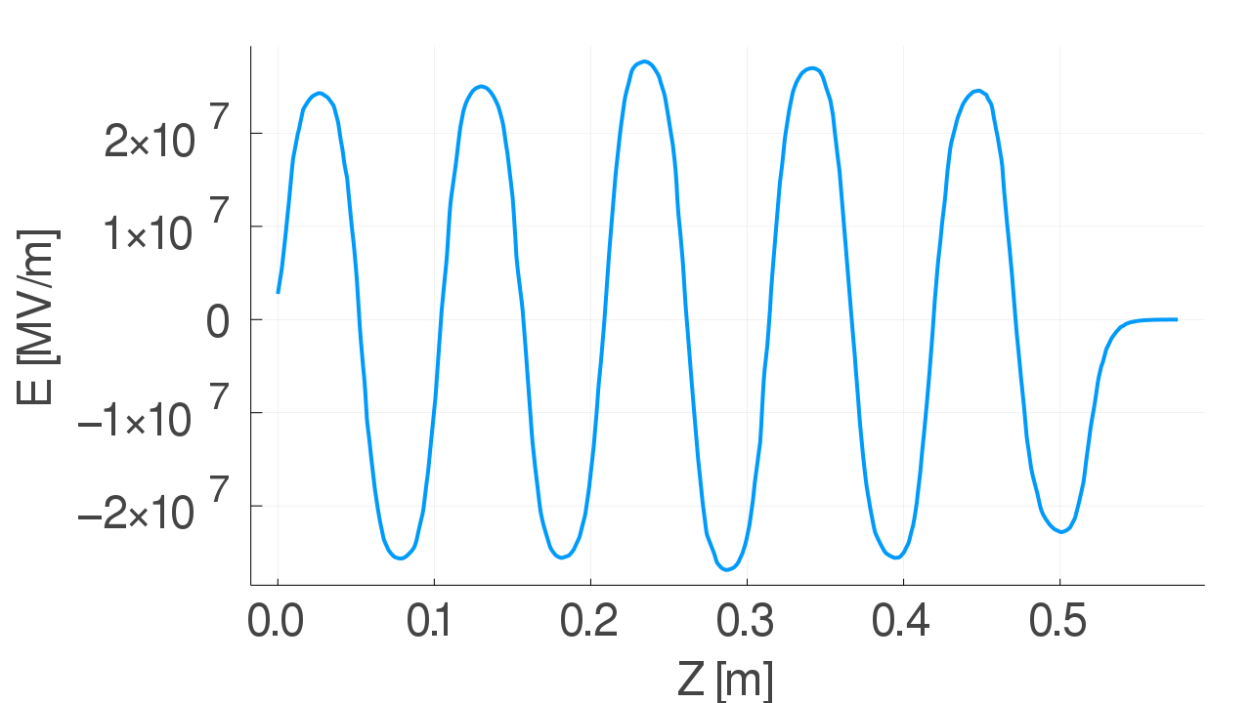
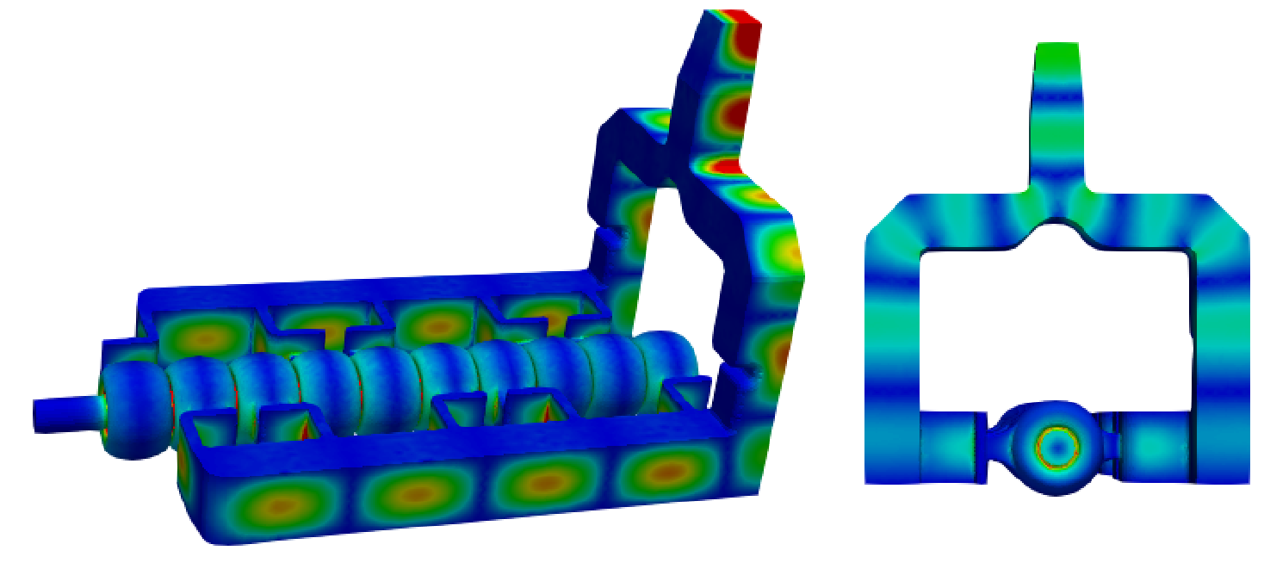
Characterizing Large Aperture Injector Linac
Point of Contact: Ankur Dhar adhar@slac.stanford.edu
Large apertures introduce coupling between cavities
This cross coupling means tuning needs to account for collective behavior within the structure
These adjustments were verified with extensive simulation in HFSS and ACE3P
Bead pulls were conducted to measure field flatness as tuning was conducted

Slide 9
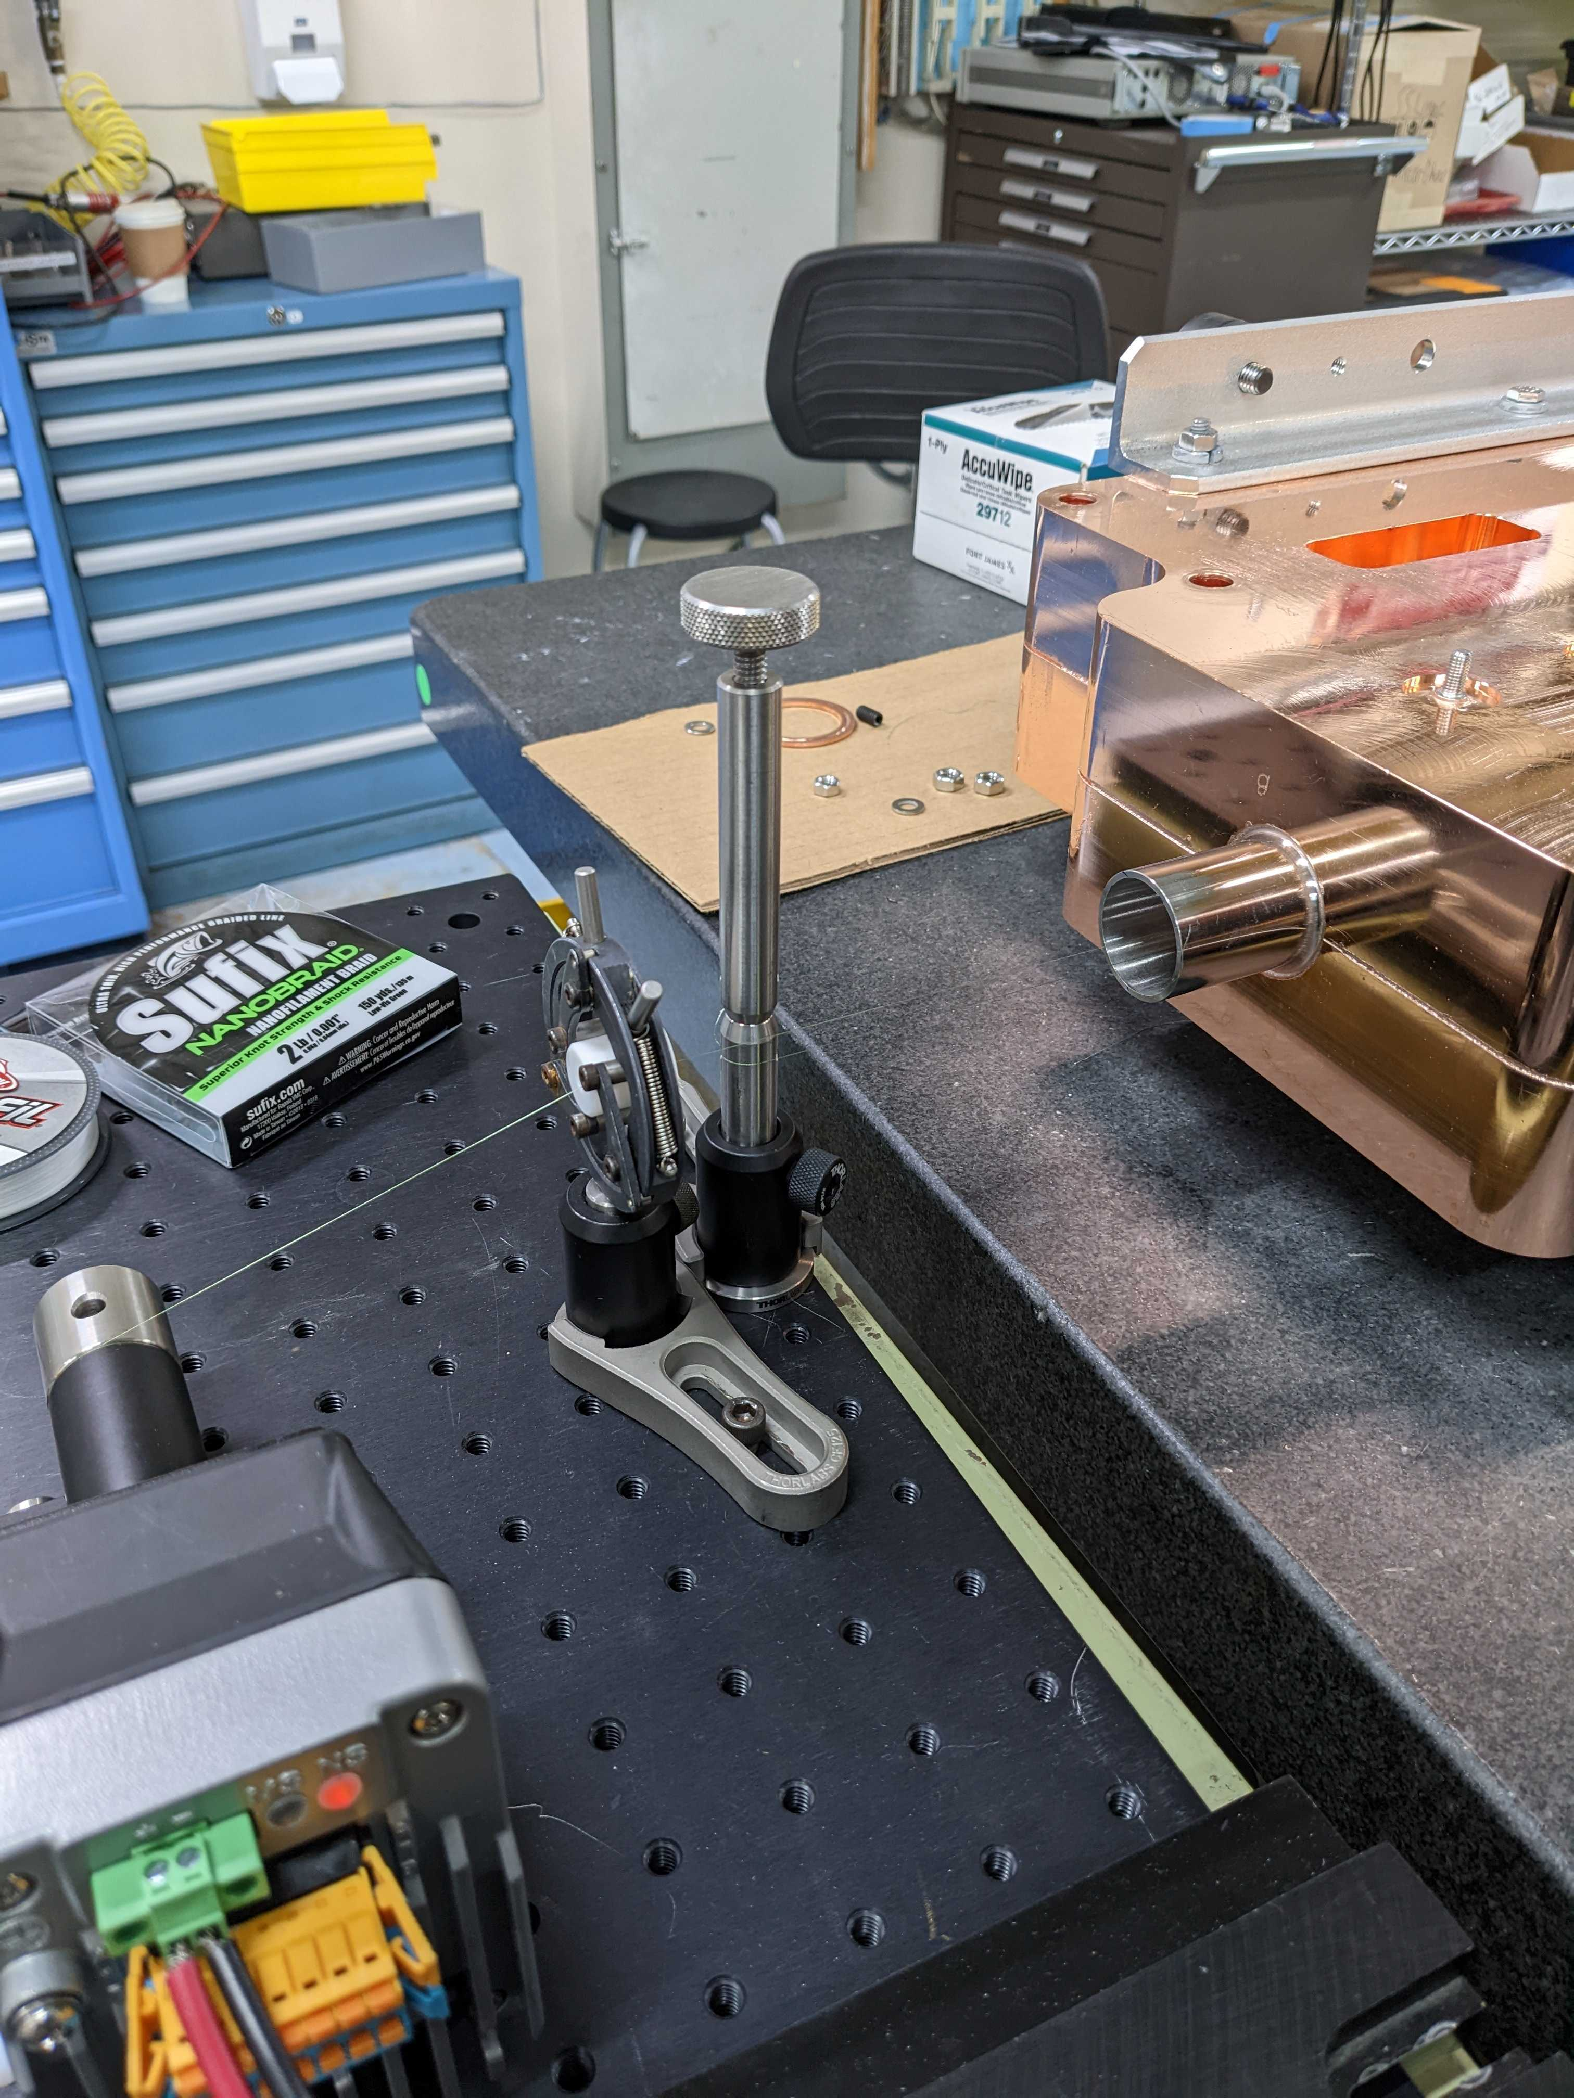
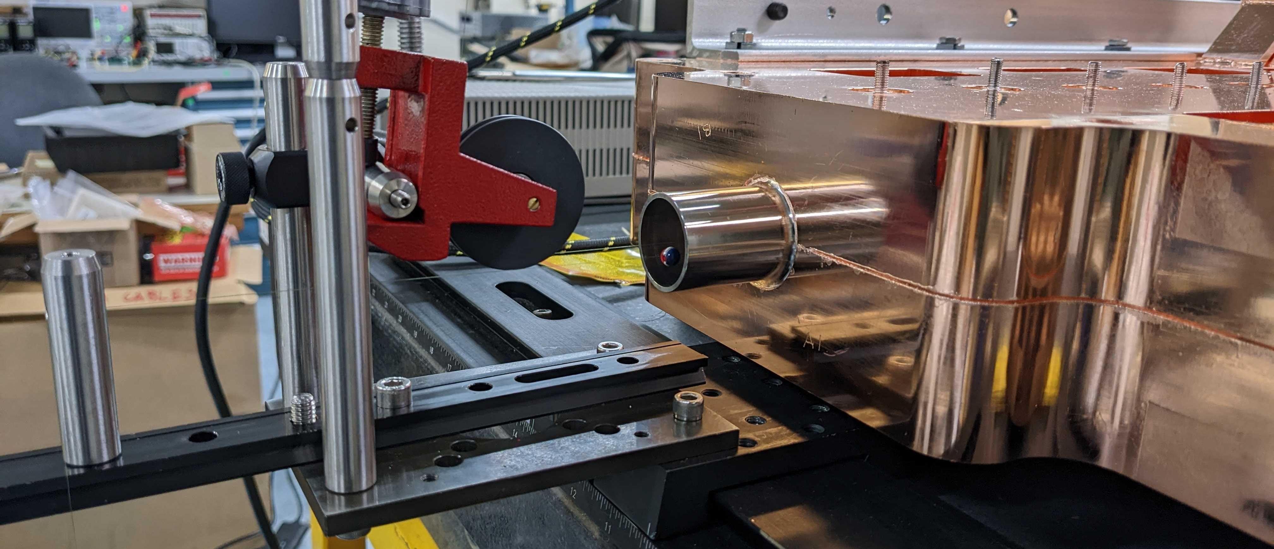
Bead Pull Characterization
Point of Contact: Ankur Dhar adhar@slac.stanford.edu
In order to better characterize the contribution of each cavity on the collective π mode, a second larger bead was used as a static perturbation
Crank
First Line
Second Line
First Line
Second Line

Slide 10
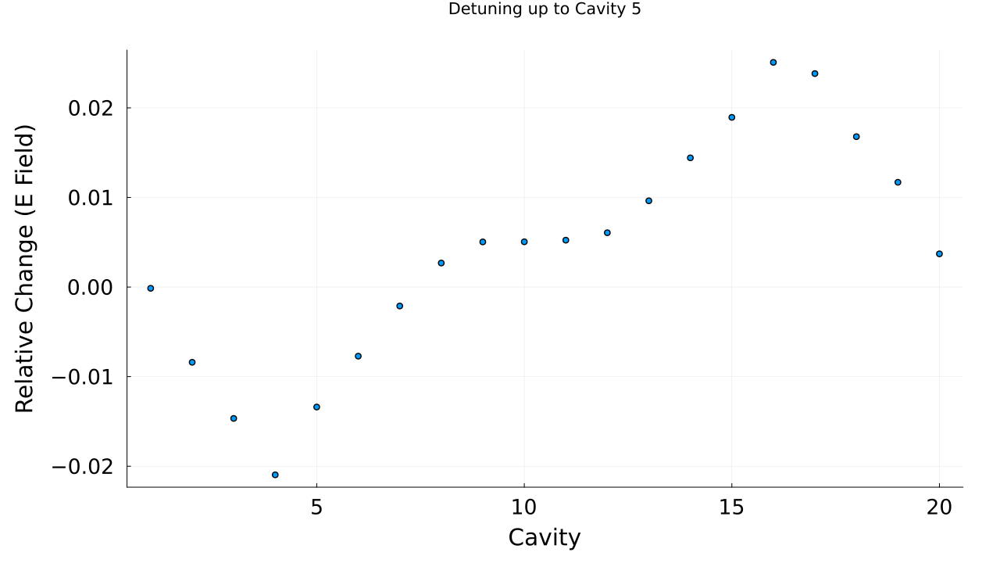
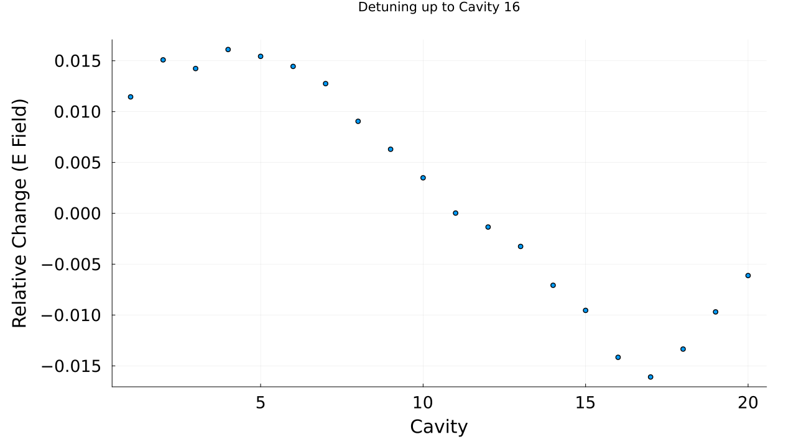
Measuring Perturbation Effects on Bead Pull
Point of Contact: Ankur Dhar adhar@slac.stanford.edu
Cavities 5 and 16 are mirrored across the structure, and have reciprocal effects on the overall field structure
Tuning cavities based on these differential measurements allows us to tune the cavities relative to each other to restore field flatness

Slide 11
Modeling Perturbation using ACE3P
Point of Contact: Mohamed Othman mothman@slac.stanford.edu
Each cavity has a dielectric bead with a relative permittivity to induce tuning
Each bead can be turned ON or OFF in simulation
ϵ₁₀
ϵ₁
ϵ₂
ϵ₃
ϵ_{i=1,2,,..20,i≠10} =1, ϵ ₁₀ = 3.5 → Overall pi mode shift of -15 kHz
S11 [dB]
Only Cell 10 perturbed
No perturbation
Frequency [GHz]

Slide 12
Perturbation Approach
Point of Contact: Mohamed Othman mothman@slac.stanford.edu
First, calculate derivatives of π mode frequency of each cell versus change in dielectric constant ε_{i}
$$F_{i}=\frac{{∂f}_{i}}{{∂ε}_{i}},i=1,2,…,20$$
Calculate derivatives of field amplitude of each cell versus change in dielectric constant ε_{i}
$$E_{ij}=\frac{{∂E}_{i}}{{∂ε}_{j}},i,j=1,2,…,20$$
Calculate derivatives of field amplitude of each cell versus against frequency shift
$$E_{ij}^{′}=\frac{{∂E}_{i}}{{∂ε}_{j}}×{\left(\frac{{∂f}_{j}}{{∂ε}_{j}}\right)}^{−1}=\frac{{∂E}_{i}}{{∂f}_{j}},i,j=1,2,…,20$$
Symmetric matrix

Slide 13
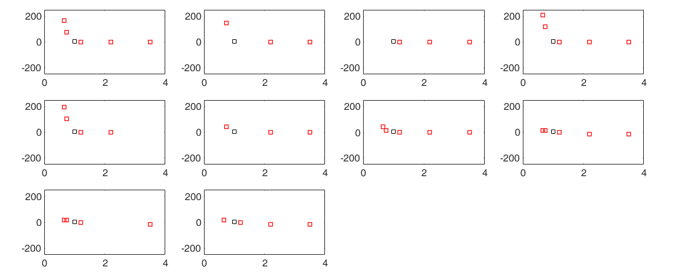
π mode Frequency Perturbation
Point of Contact: Mohamed Othman mothman@slac.stanford.edu
ϵ₁₀
ϵ₁
ϵ₂
ϵ₃
ϵ₄
Frequency Shift [kHz]
ϵ₅
ϵ₆
ϵ₇
ϵ₈
End cells affect the π mode more strongly than inner cells
This allows for tuning each cavity by tracking π mode only
ϵ₉
ϵ₁₀

Slide 14
Field Profile Perturbation: Varying ϵ₁
Point of Contact: Mohamed Othman mothman@slac.stanford.edu
only changing ϵ₁
ϵ₁ =0.5
ϵ₁ =0.9
ϵ₁ =1.8
E Field [V/m]
ϵ₁ =2.2
ϵ₁ =3.5
z [m]
This is repeated for all other cells and values of ϵ₁

Slide 15
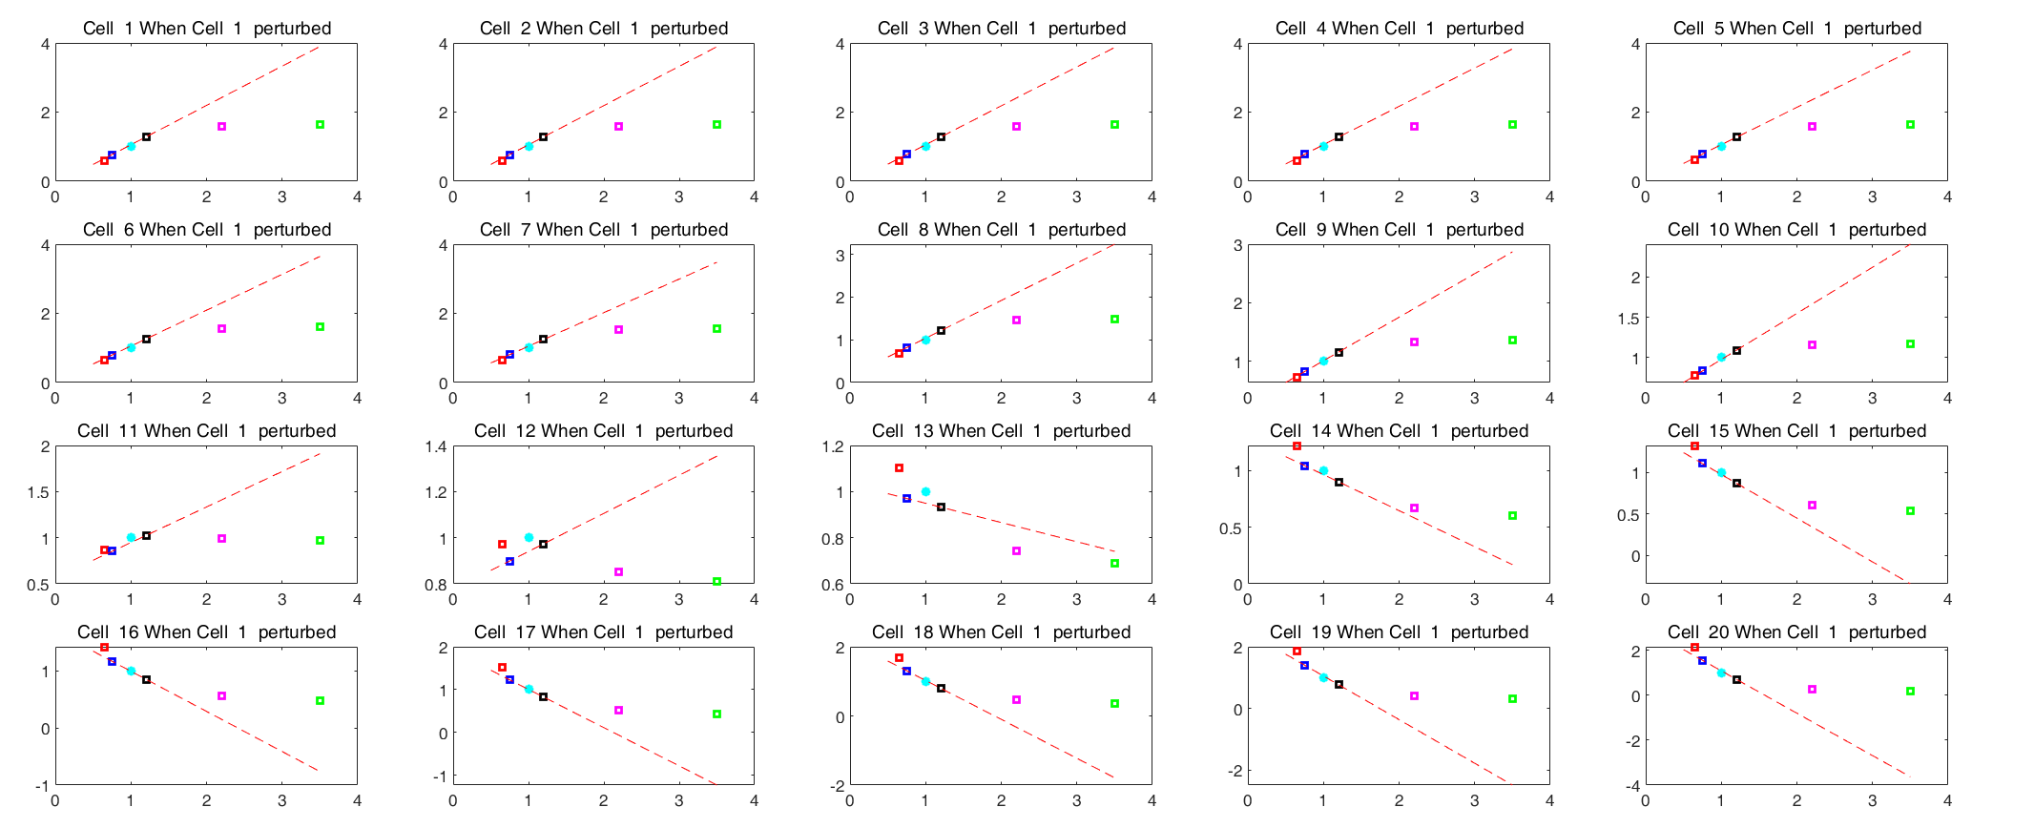
Field Profile Perturbation : Varying ϵ₁
Point of Contact: Mohamed Othman mothman@slac.stanford.edu
% E Field change
ϵ₁
This is repeated for all other cells

Slide 16
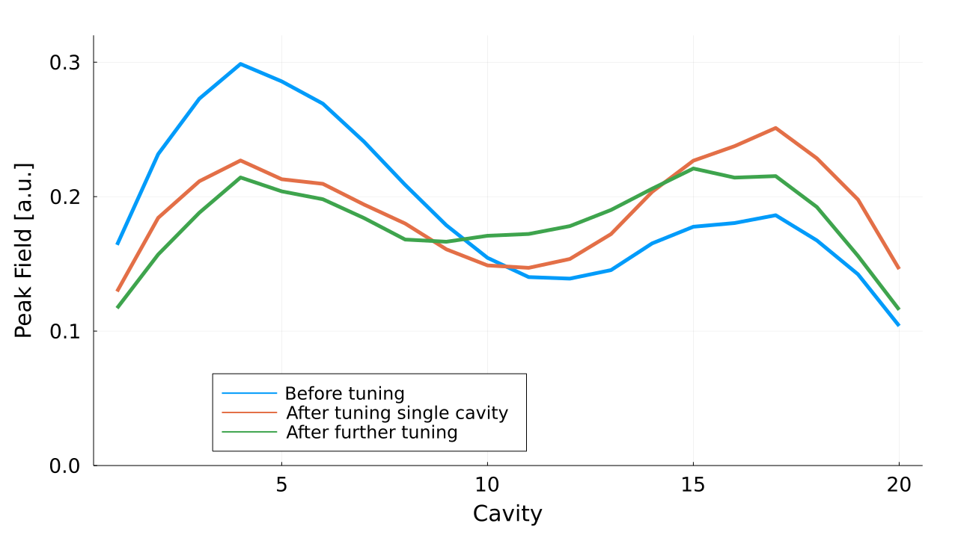
Preliminary Tuning Results
With this information, the first pass of tuning has been successful in improving field flatness
Structure will be brazed one more time to fix leaks before final tuning to 2.856 GHz

Slide 17
Questions?

Slide 18
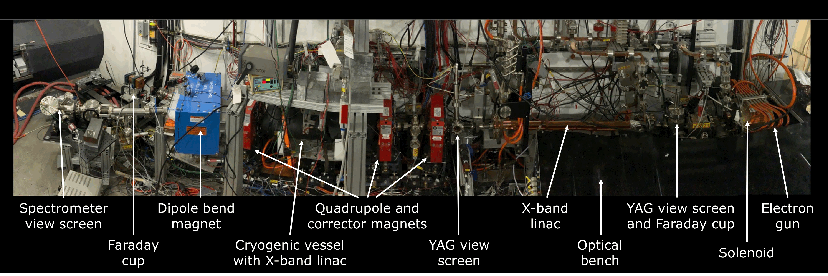
Future Test Plans
Once tuned, various proposals to testing the structure are in preparation:
High power test measuring breakdown rate with 35 MW klystron at Station S-band at NLCTA
ASSET-style wakefield measurement without high power at FACET-II
Also potentially at XTA within NLCTA
Full power + beam tests at CLEAR and/or APS
Open to further suggestions for test sites

Slide 19
Comparison of Technologies for EIC pre-injector e⁻ linac
 | SLAC Linac 3 m structure | PSI Linac 4 m structure | Distributed Coupling 1 m structure | Cryo-Distributed Coupling [77 K] 1 m structure
Shunt Impedance [M/m] a/ [radius/wavelength] | 51* 0.15-0.11 | 45-56⁺ 0.135-0.095 | 58 0.125 | 210 0.125
Power / Length @ 16 MeV/m [MW/m] / Power for 400 MeV [MW] in 25 m Min. 65 MW 5045 Klystron | 8.3 / 210 4 klystrons | 6.2 / 156 3 klystrons | 4.4 / 110 2 klystrons | 1.8 / 44 1 klystron
Achievable Gradient [MeV/m] Constant BDR Scaled from Pulsed Heating | 50 | 60 | 74 | 118
Power for 400 MeV in 8 m [MW] Corresponds to 50 MeV/m Min. 65 MW 5045 Klystron | 645 10 klystrons | 488 8 klystrons | 344 6 klystrons | 138 3 klystrons

