Slide 1
Study of HOM Couplers for the C-band Accelerating Structure
Dongsung Kim (LANL)
Evgenya I. Simakov (LANL)
Zenghai Li (SLAC)
February 7th, 2023
LA-UR

Slide 2
Outline
Introduction
Q-factor and shunt impedance for monopole/dipole modes
Study for HOM suppression using waveguide slots and damping loads
20-cell cavity with many shapes of waveguide slots (straight, 50 μm tapered, 0.5 μm tapered )
Summary / Future plans

Slide 3
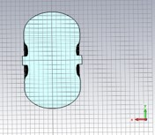
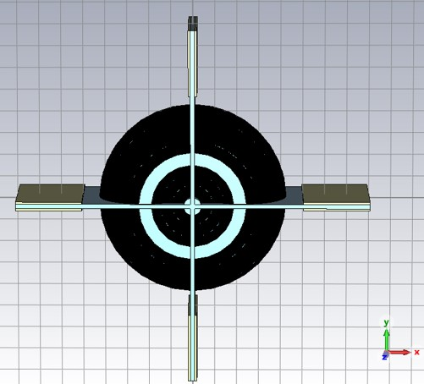
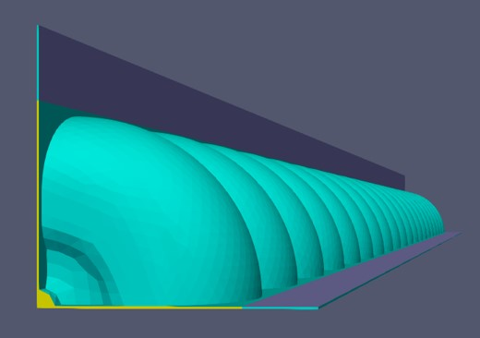
Workflow
Single cell with periodic boundary
20-cell structure
Find all monopole and dipole modes from 5 - 40 GHz
Compute Wall loss Q-factor, Shunt impedance, kick-factor
Waveguide slot with 0.5 mm lossy material
Loaded Q
Q-factor x kick-factor
Waveguide slot with Impedance boundary
Damped Q
Q-factor x kick-factor

Slide 4
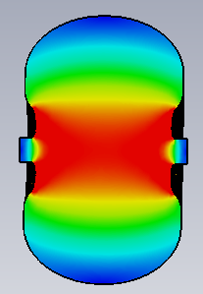
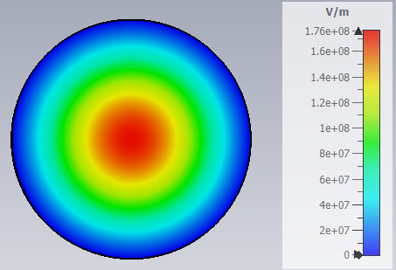
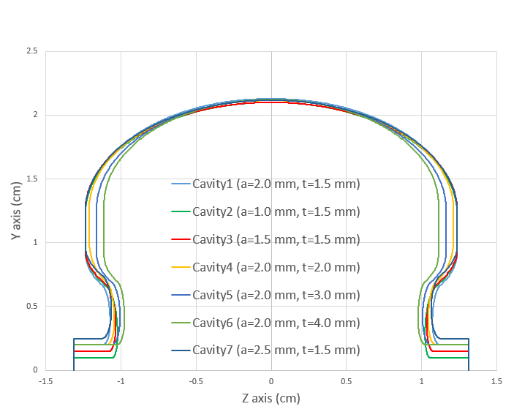
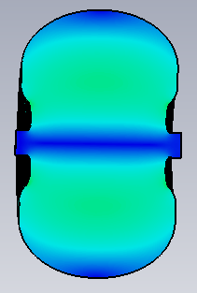
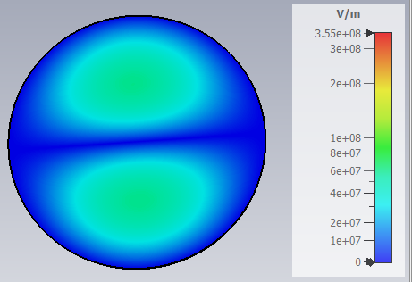
TM₀₁₀ monopole mode at 5.712 GHz
SLAC’s 7 cavities.
y-z plane
x-y plane
TM₁₁₀ dipole mode at 9.247 GHz
y-z plane
x-y plane

Slide 5



Shunt impedance calculation
1) Panofsky-Wenzel theorem
R_{s} → Gives Longitudinal Shunt Impedance. (unit: Ohm)
$$k_{x}=\frac{{\left|I_{s}\left(ω_{s}\right)\right|}^{2}}{4W_{s}}$$
→ Gives Longitudinal kick factor (unit: V/C/cell)
$$R_{s, y}=\frac{c}{ωd^{2}} R_{s}(ω,d)$$
→ Gives Transverse Shunt Impedance. (unit: Ohm/m)
2) Direct integration of magnetic and electric field.
→ Gives Transverse Shunt Impedance. (unit: Ohm/m)
We compare two R_{s,y} values.
References: From AOT-AE_19-007_Scorp_test_cav.pdf

Slide 6
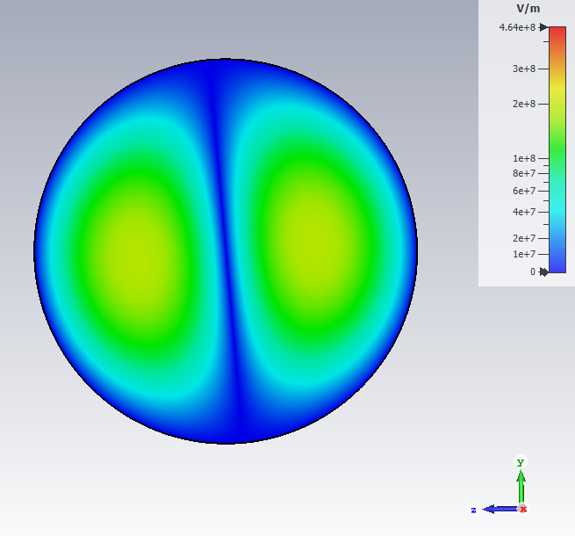
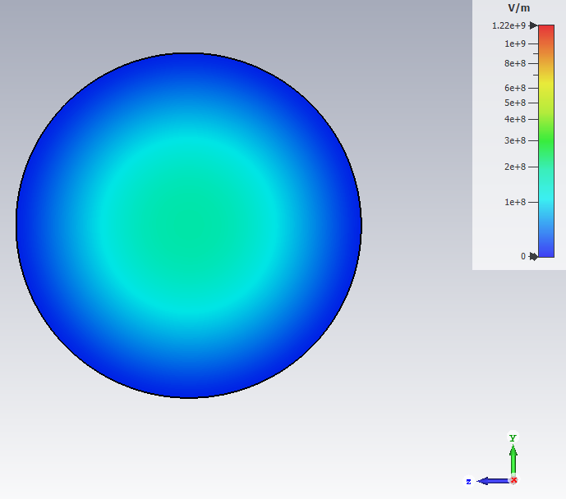
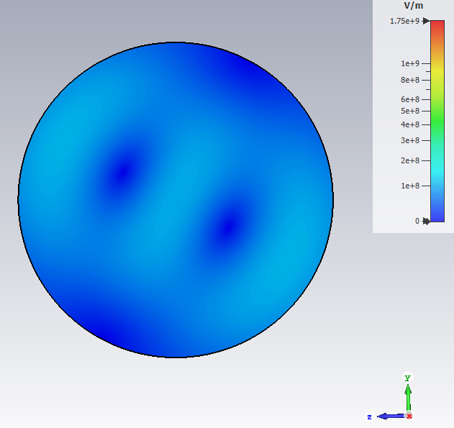
Mode Characterization
Mode 5 (9.249 GHz, TM₁₁₀)
Mode 1 (5.712 GHz, TM₀₁₀)
 | Offset (mm) |  | Transverse Shunt Imp. (Ohm/m) | Transverse kick factor (V/C/m/cell) | Q factor
 | y | x
CST | 0 | 0.4 |  | 8.275E+13 | 1.815E+04
Matlab | 0 | 0.4 | 6.805E+06 | 8.274E+13
 | Offset (mm) |  | Longitudinal Shunt Imp. (Ohm) | Longitudinal kick factor (V/C/cell) | Q factor
 | y | x
CST | 0 | 0 | 3.179E+06 | 2.044E+12 | 1.396E+04
Matlab | 0 | 0 | 1.556E+06 | 2.001E+12
Mode 15 (12.20 GHz, TM₁₁₁)
 | Offset (mm) |  | Transverse Shunt Imp. (Ohm/m) | Transverse kick factor (V/C/m/cell) | Q factor
 | y | x
CST | 0 | 0.4 |  | 1.902E+14 | 1.487E+04
Matlab | 0 | 0.4 | 7.47E+07 | 1.900E+14

Slide 7
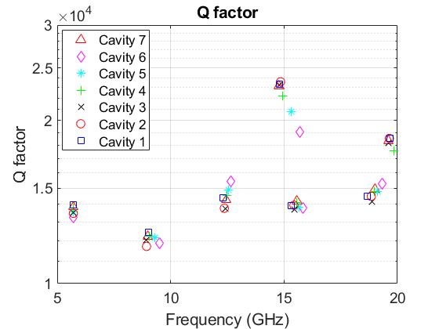
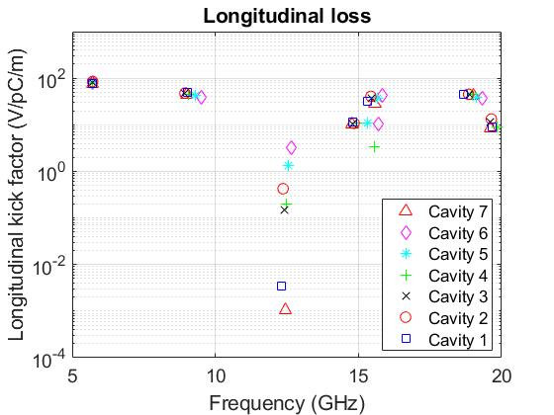
Monopole modes: Q-factor and Longitudinal loss
Q-factor: 13000 – 24000
k_{z}: 0.003 – 100 V/pC/m

Slide 8
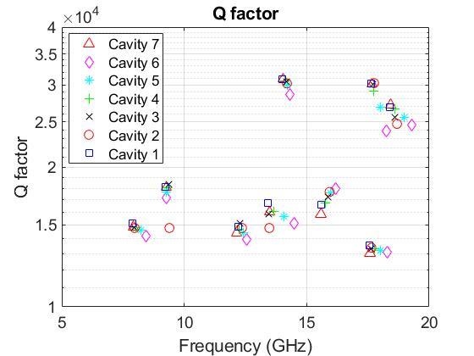
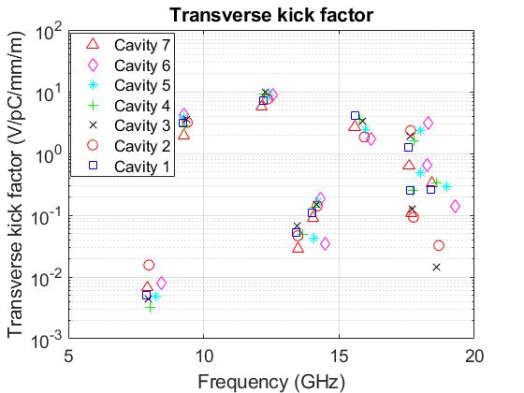
Dipole modes: Q-factor and Transverse kick-factor
Q-factor: 13000 – 30200
k_{z}: 0.003 – 10 V/pC/mm/m

Slide 9
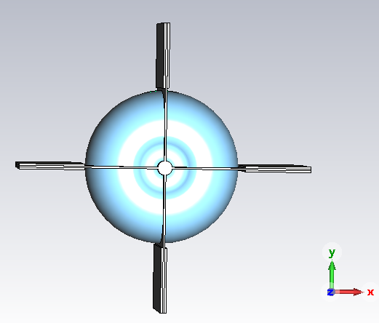
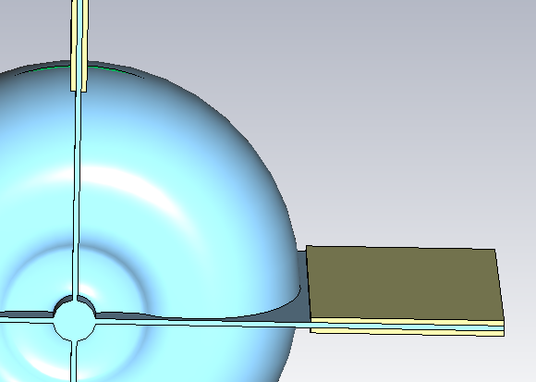
Design of waveguide slots and HOM damping load
Damping load
t
L
Parameter (mm) | Value
Length of waveguide slot (L) | 30 to 50 mm
Thickness of damping load | 0.5 mm (fixed)
Thickness of waveguide (t) | 0.5 to 2.0 mm
Focus on TM dipole modes from 5 to 40 GHz in cavity 1.
Electrical conductivity of damping loads: 100 S/m.

Slide 10
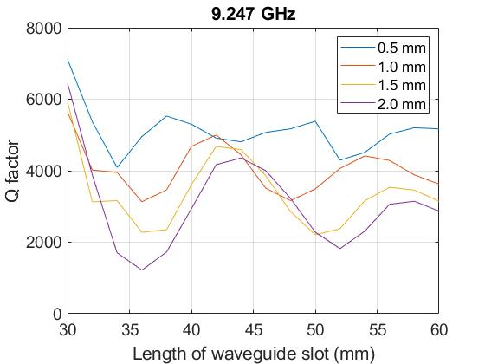
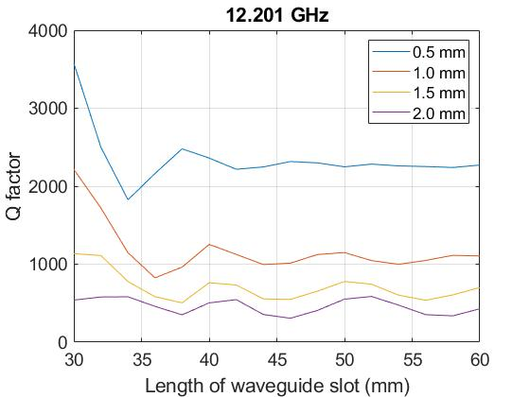
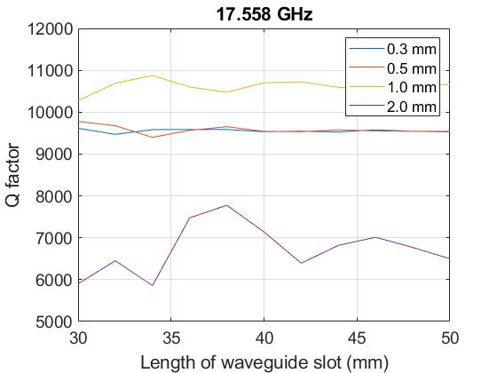
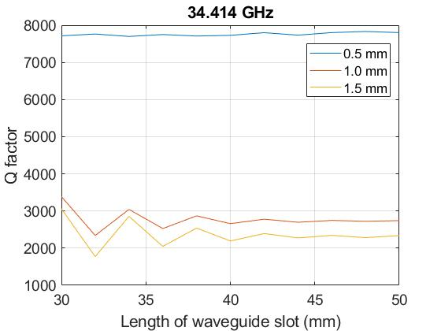
Dependence of Q on thickness and length of waveguides
With 2.0 mm thickness of waveguide, Q-factor was below 2000 except the frequency at 17.558 GHz.

Slide 11
Comparison of (kick-factor x Q₀) vs kick-factor x damped Q
0.5 mm thickness of the straight waveguide with 50 mm length.
Some dipole modes do not couple well with damping loads and show still high Q values (> 5000) at 9.25, 12.20, 17.56, and 34.41 GHz.

Slide 12
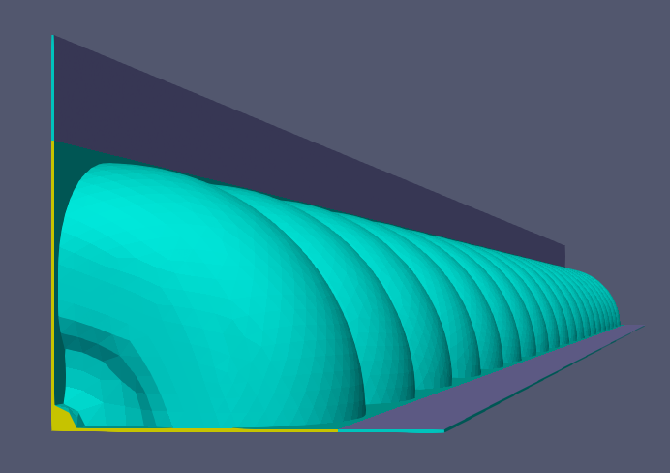
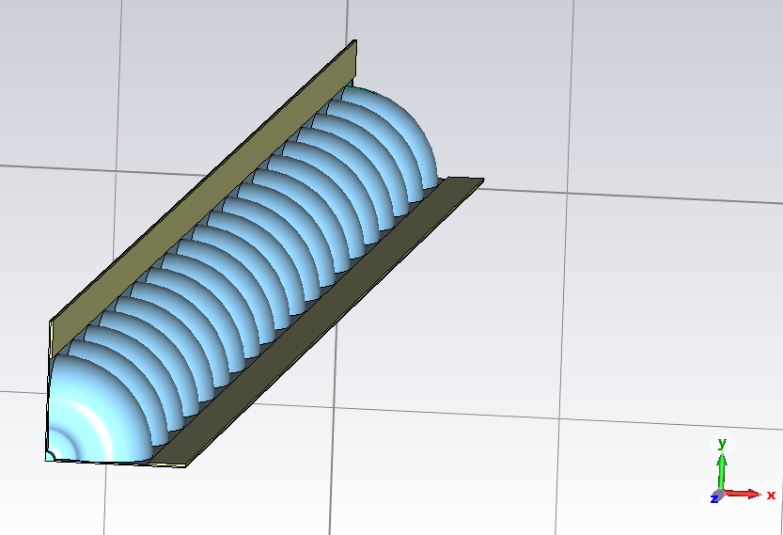
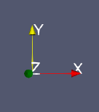
20-cell C-band Accelerating Structure in CST and Omega3P
In CST
In Omega3P
Lossy material
Impedance boundary
0.5 mm thick of waveguide
Lossy metal sheet (yellow): 0.5 mm thick.
Electrical conductivity: 100.0 S/m.
Mesh
- 12 Cells per wavelength
- 6 Cells per max model box edge
Mesh
- volume all sizing function type skeleton scale 7 time_accuracy_level 2 min_size auto max_size 1.5 max_gradient 1.5
(mm)
35 Cells per wavelength

Slide 13
Comparison of 20 cell structure in between CST and Omega3P
Both have 30 mm waveguide length and 100 S/m

Slide 14

20-cell Structure with Straight waveguide
Impedance boundary
c: 250 um
d: 250 um
Straight waveguide
Impedance boundary: 100 or 1E+6 S/m
Length variation: 30 - 50 mm
a: 22 mm
b: 8 - 28 mm
Total length of waveguide varies from 30 mm to 50 mm

Slide 15
Straight waveguide with 30 mm – 50 mm (100 S/m)
 | Waveguide length (mm)
Frequency (GHz) | Minimum Q | Minimum Kick x Q
9.22 | 34, 36 | 34, 36
12.2 | 34, 36 | 34, 36
17.5 | 34 | 50

Slide 16
Kick x Q with Straight Waveguide (100 S/m and 1E+6 S/m)

Slide 17

20-cell Cavity Structure with tapered waveguide
Impedance boundary
(1E+6 S/m)
d: 50 um or 0.5 um
Two different cases of tapered waveguide
- 50 um end
- 0.5 um end
a: 22 mm
b: 8 mm and 28 mm
→ Total length is 30 mm and 50 mm

Slide 18
Q-factor
50 mm tapered waveguide case provide lower damped Q

Slide 19
Summary of Q-factor
Lowest value at each frequency
 | Q-factor |  |  |  | Q-factor x kick factor (V/pC/m/mm)
Frequency (GHz) | 30 mm Straight (250 um) | 30 mm Tapered (50 um) | 30 mm Tapered (0.5 um) | 34 mm Straight (250 um) | 50 mm Straight (250 um) | 50 mm Tapered (50 um) | 50 mm Tapered (0.5 um)
9.27 | 1.27E+06 | 1.20E+06 | 1.08E+06 | 1.02E+06 | 8.86E+05 | 8.71E+05 | 8.54E+05
12.37 | 4.14E+05 | 7.46E+04 | 3.41E+05 | 1.27E+06 | 9.05E+05 | 5.32E+05 | 2.36E+05
17.47 | 2.18E+05 | 8.44E+05 | 1.22E+06 | 2.76E+05 | 1.79E+05 | 1.03E+05 | 5.34E+04
20.67 | 2.48E+06 | 2.65E+06 | 1.27E+06 | 2.68E+05 | 8.84E+04 | 1.91E+05 | 6.43E+05
23.65 | 1.67E+05 | 3.10E+04 | 5.35E+05 | 3.01E+05 | 2.19E+05 | 1.27E+05 | 6.60E+04
34.00 | 7.34E+04 | 2.65E+04 | 2.44E+04 | 3.54E+04 | 1.74E+04 | 9.15E+03 | 5.82E+03
34.75 | 1.00E+05 | 5.35E+04 | 2.19E+04 | 2.88E+04 | 2.44E+04 | 2.56E+04 | 3.34E+04

Slide 20
Q-factor x kick-factor
50 mm length with tapered waveguide case provide lower Kick-factor x Q-factor except at 9.27 GHz and 34.75 GHz

Slide 21
Summary of Kick-factor x Q-factor (V/pC/m/mm)
Lowest value at each frequency
 | Q-factor x kick factor (V/pC/m/mm) |  |  |  | Q-factor x kick factor (V/pC/m/mm)
Frequency (GHz) | 30 mm Straight (250 um) | 30 mm Tapered (50 um) | 30 mm Tapered (0.5 um) | 34 mm Straight (250 um) | 50 mm Straight (250 um) | 50 mm Tapered (50 um) | 50 mm Tapered (0.5 um)
9.27 | 3.11E+05 | 3.74E+04 | 1.23E+04 | 2.54E+05 | 8.77E+04 | 6.36E+04 | 2.70E+04
12.37 | 3.72E+04 | 8.10E+03 | 3.10E+04 | 2.32E+05 | 2.94E+04 | 2.74E+04 | 2.71E+04
17.47 | 1.07E+05 | 3.65E+05 | 4.17E+04 | 1.37E+05 | 3.68E+04 | 1.96E+04 | 5.30E+03
20.67 | 6.90E+04 | 3.17E+04 | 2.60E+04 | 1.57E+04 | 8.72E+03 | 6.93E+03 | 7.83E+03
23.65 | 5.97E+03 | 1.09E+03 | 8.78E+03 | 1.26E+04 | 9.15E+03 | 4.32E+03 | 1.06E+03
34.00 | 1.57E+04 | 2.64E+04 | 2.41E+04 | 1.94E+04 | Below 1000 | Below 1000 | 3.17E+03
34.75 | 8.61E+04 | 2.69E+04 | 6.30E+03 | 4.82E+03 | 2.57E+04 | 2.45E+04 | 3.25E+04

Slide 22
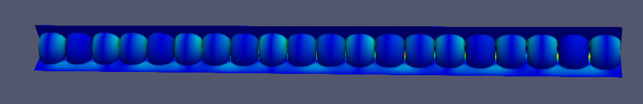
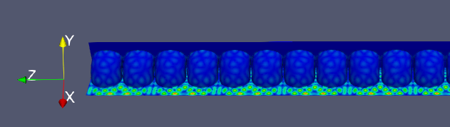
Summary
  Simulated a C-band accelerating structures to calculate Q-factors and kick-factors from monopole and dipole modes (5 – 40 GHz) in CST
  Designed and computed damping loads for higher order mode suppression using CST and ACE3P
  50 mm waveguide length with tapered section provides lower Q-factors and kick-factor x Q-factors
9.27 GHz
39.00 GHz

Slide 23
Future Plans
  To reduce Kick-factor x Q-factor (Below 1.0 E+4 V/pC/m/mm) at certain frequencies (9.27 GHz and 12.37 GHz), we plan to…
  Adapt a mixture of two tapered sections in one waveguide slot (ex, from 250 um to 100 um and 100 um to 5 um)
  Give an individual tapered waveguide in +/- axis
  34 mm length of the tapered waveguide

Slide 24
Backup slides

Slide 25
Mode (M: monopole, D: dipole) | Frequency (GHz)
 | Cavity1 (a=2mm, t= 1.5mm) | Cavity2 (a=1mm, t=1.5mm) | Cavity3 (a=1.5mm, t=1.5 mm) | Cavity4 (a=2mm, t=2 mm) | Cavity5 (a=2mm, t=3 mm) | Cavity6 (a=2mm, t=4 mm) | Cavity7 (a=2.5mm, t=1.5 mm)
TM₀₁₀ (M) | 5.714 | 5.712 | 5.712 | 5.712 | 5.712 | 5.712 | 5.711
TE₁₁₁ (D) | 7.882 | 7.977 | 7.957 | 8.017 | 8.231 | 8.454 | 7.924
TM₀₁₁ (M) | 9.015 | 8.939 | 8.931 | 9.075 | 9.297 | 9.518 | 8.994
TM₁₁₀ (D) | 9.249 | 9.395 | 9.372 | 9.288 | 9.275 | 9.258 | 9.271
TE₀₁₁ (M) * | 10.942 | 11.069 | 11.055 | 11.061 | 11.197 | 11.347 | 11.009
TM₁₁₁ (D) | 12.201 | 12.358 | 12.288 | 12.253 | 12.420 | 12.541 | 12.145
TM₀₂₀ (M) | 12.317 | 12.367 | 12.409 | 12.478 | 12.539 | 12.646 | 12.441
TE₁₁₂ (D) | 13.434 | 13.475 | 13.465 | 13.666 | 14.072 | 14.330 | 13.479
TE₁₂₁ (D) | 13.990 | 14.194 | 14.162 | 14.109 | 14.215 | 14.502 | 14.041
TM₀₂₁ (M) | 14.814 | 14.845 | 14.796 | 14.926 | 15.309 | 15.692 | 14.780
TM₀₂₁ (M) | 15.333 | 15.436 | 15.466 | 15.553 | 15.671 | 15.821 | 15.571
TM₁₂₀ (D) | 15.595 | 15.935 | 15.863 | 15.771 | 15.965 | 16.168 | 15.581
TE₀₁₁ (M) * | 15.709 | 15.863 | 15.836 | 15.962 | 16.360 | 16.780 | 15.822
TE₀₂₁ (M) * | 17.511 | 17.763 | 17.742 | 17.659 | 17.734 | 17.826 | 17.619
TM₁₂₁ (D) | 17.558 | 17.646 | 17.641 | 17.738 | 18.006 | 18.266 | 17.582
TM₁₂₁ (D) | 17.616 | 17.751 | 17.704 | 17.780 | 18.006 | 18.278 | 17.656
TE₁₁₂ (D) | 18.391 | 18.689 | 18.612 | 18.617 | 18.966 | 19.301 | 18.439
TM₀₃₀ (M) | 18.683 | 18.847 | 18.887 | 18.970 | 19.118 | 19.315 | 19.000
TM₀₃₁ (M) | 19.670 | 19.642 | 19.600 | 19.859 | 20.441 | 20.965 | 19.591
* TE mode of the monopole has been removed due to its small shunt impedance.
Frequency slightly varies (+/- 0.2 GHz)

Slide 26
Advanced Computational Electromagnetics 3D Parallel
ACE3P is a comprehensive set of parallel multi-physics codes
Supported by SLAC and DOE’s High Performance Computing Initiatives
Based on high-order curved finite elements for high-fidelity modeling
Implemented on massively parallel computers for increased problem size and speed
Frequency Domain: Omega3P – Eigensolver (damping)
S3P – S-Parameter
Time Domain: T3P – Wakefields and Transients
Particle Tracking: Track3P – Multipacting and Dark Current
EM Particle-in-cell: Pic3P – RF guns & space charge effects
Multi-physics: TEM3P – EM, Thermal & Mechanical analysis
ACE3P workshop material

Slide 27
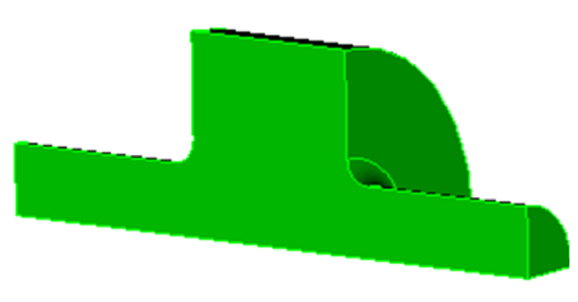
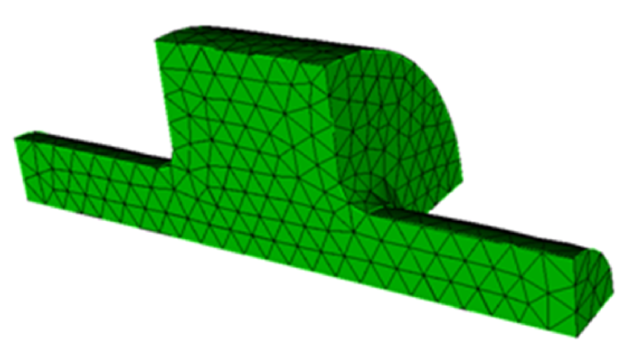
ACE3P Simulation Workflow
Nonlinear Eigensolver in Omega3P for HOM damping calculation.
Cubit
Geometry and Mesh Generation
On desktop computer
Mesh
ACE3P Modules
Omega3P Eigensolver (for damping)
On supercomputer or cluster at NERSC
Results
Paraview
Data Visualization and Postprocessing
On desktop computer
ACE3P workshop material

Slide 28
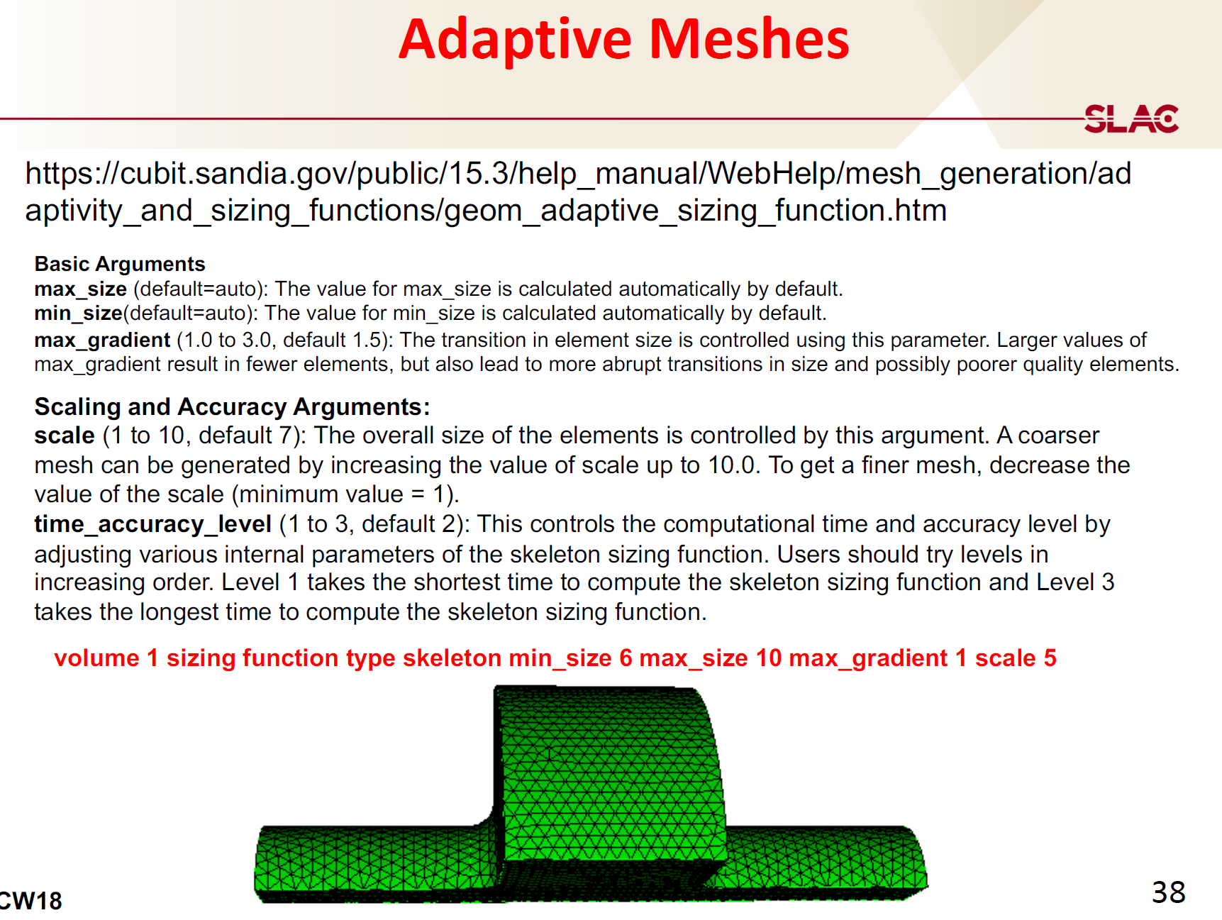

Slide 29
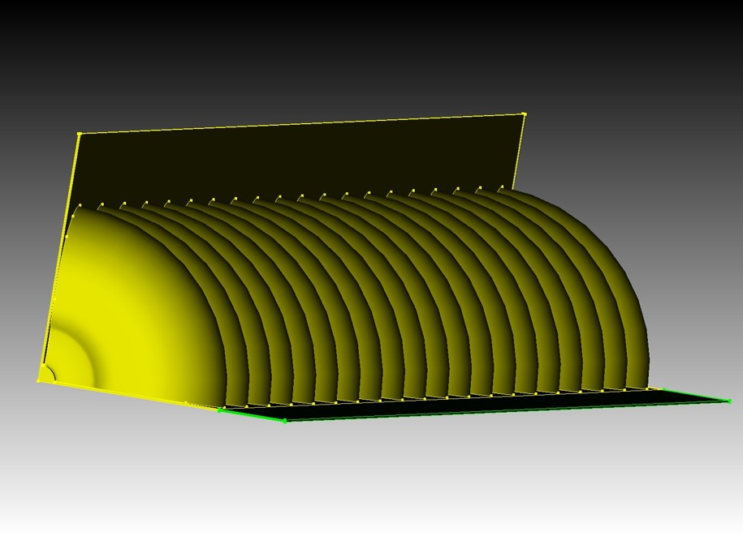
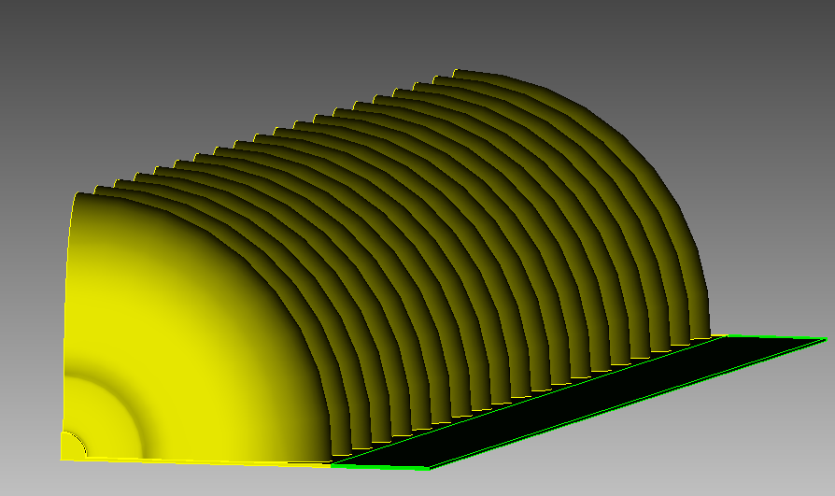
Work progress on 9/2/2022
Two different geometries show different results in frequency regime.
Both have Impedance boundary in one waveguide slot.
Case 1 (Two slots)
Case 2 (One slots)
Impedance boundary
Impedance boundary

Slide 31
Summary
 | Frequency (GHz) |  |  |  |  |  | Thickness of the w/g slot (mm) | Lossy metal (Thick x length, mm) | Note
# of Simulation | TM₀₁₀ (Monopole) | Q (Perturb) | TM₁₁₀ (Dipole) | Q (Perturb) | TM₀₁₁ (Monopole) | Q (Perturb)
12 | 5.71475 | 1.410E+04 | 9.22308 | 1.019E+04 | 9.01953 | 1.246E+04 | 0.3 | 0.5 x 15 | Lossy material: 356 S/m
32 | 5.72019 | 1.428E+04 | 9.16816 | 8013.50 | 9.01924 | 1.251E+04 | 1.0 | 0.5 x 17.5
38 | 5.72033 | 1.4223E+04 | 9.16742 | 6433.62 | 9.01953 | 1.2476E+04 | 1.0 | 0.5 x 18 | Lossy material: 50 S/m
39 | 5.71975 | 1.4052E+04 | 9.31872 | 2186.80 | 9.01997 | 1.2369E+04 | 1.0 | 0.5 x 18 | Lossy material: 100 S/m, φ=288.86°
40 |  |  |  |  |  |  | 1.0 | 0.5 x 18.2 | Error (accuracy didn’t get to 1e-6)
41 | 5.71959 | 1.4067E+04 | 9.31630 | 1583.79 | 9.01973 | 1.2386E+04 | 1.0 | 0.5 x 28 | Lossy material: 100 S/m, φ=288.86°
42 | 5.71945 | 1.4005E+04 | 9.31647 | 1914.05 | 9.02010 | 1.2234E+04 | 1.0 | 0.5 x 38 | Lossy material: 100 S/m, φ=288.86°
43 | 5.71933 | 1.4030E+04 | 9.31623 | 1166.57 | 9.02007 | 1.2282E+04 | 1.0 | 0.5 x 30 | Lossy material: 100 S/m, φ=288.86°
44 | 5.72057 | 1.4126E+04 | 9.30317 | 1547.88 | 9.02031 | 1.2489E+04 | 1.0 | 0.5 x 30 | Lossy material: 100 S/m, φ=293.55°
45 | 5.72007 | 1.4021E+04 | 9.55486 | 527.39 | 9.02103 | 1.2629E+04 | 1.0 | 0.5 x 30 | Lossy material: 100 S/m, φ=180.00°
46 | Error (accuracy didn’t get to 1e-6) |  |  |  |  |  |  | 0.5 x 18 | Lossy material: 100 S/m, φ=293.55°
47 | 5.719725 | 1.4101E+04 | 9.30258 | 3650.83 | 9.01947 | 1.243E+04 | 1.0 | 0.5 x 20 | Lossy material: 100 S/m, φ=293.55°
48 | 5.719955 | 1.4139E+04 | 9.302229 | 3773.5 | 9.020341 | 1.245E+04 | 1.0 | 0.5 x 22 | Lossy material: 100 S/m, φ=293.55°
49 | 5.71999 | 1.411E+04 | 9.302318 | 3488.13 | 9.019604 | 1.2489E+04 | 1.0 | 0.5 x 24 | Lossy material: 100 S/m, φ=293.55°
50 | 5.719297 | 1.4046E+04 | 9.300304 | 2476.16 | 9.152312 | 1.228E+04 | 1.0 | 0.5 x 26 | Lossy material: 100 S/m, φ=293.55°
51 | 5.71974 | 1.410E+04 | 9.30155 | 1957.93 | 9.019395 | 1.244E+04 | 1.0 | 0.5 x 28 | Lossy material: 100 S/m, φ=293.55°
52 | 5.720376 | 1.4127E+04 | 9.304582 | 1505.95 | 9.020367 | 1.2483E+04 | 1.0 | 0.5 x 30 | Lossy material: 100 S/m, φ=293.0°
53 | 5.720122 | 1.4143E+04 | 9.304872 | 2024.87 | 9.01984 | 1.2514E+04 | 1.0 | 0.5 x 32 | Lossy material: 100 S/m, φ=293.0°
54 | 5.719496 | 1.4065E+04 | 9.303035 | 2440.14 | 9.020524 | 1.2326E+04 | 1.0 | 0.5 x 34 | Lossy material: 100 S/m, φ=293.0°
55 | Error (accuracy didn’t get to 1e-6) |  |  |  |  |  | 1.0 | 0.5 x 36 | Lossy material: 100 S/m, φ=293.0°
56 | 5.720223 | 1.4103E+04 | 9.304296 | 2461.20 | 9.019795 | 1.2463E+04 | 1.0 | 0.5 x 38 | Lossy material: 100 S/m, φ=293.0°
 |  |  |  |  |  |  | 1.0 | 0.5 x 40 | Lossy material: 100 S/m, φ=293.0°
 |  |  |  |  |  |  | 1.0 | 0.5 x 42 | Lossy material: 100 S/m, φ=293.0°

Slide 32
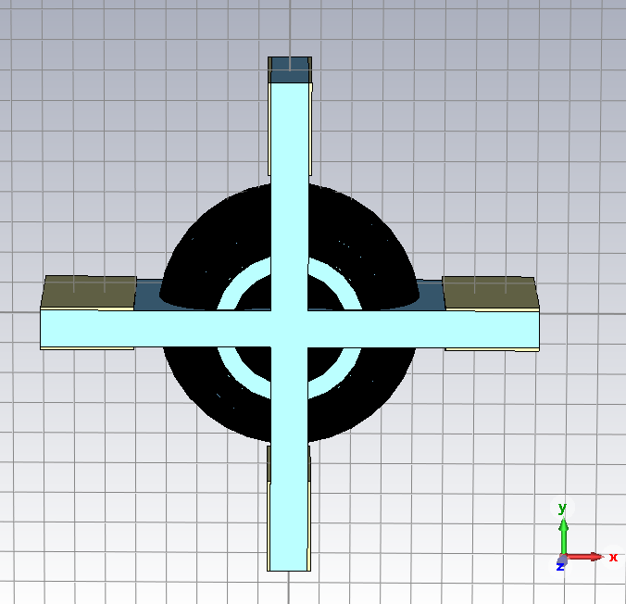
Cavity with metal sheet (Metalsheet_test15_WholeCavity): each thin slot (3.0 mm thick) with 0.5 mm lossy metal sheet.
# of Mode | Mode type | Frequency (GHz) | Q (Perturbation)
1 |  | 5.13784 | 80.875
2 |  | 5.13795 | 80.911
3 |  | 5.59584 | 89.888
4 | TM₀₁₀ (Monopole) | 5.77427 | 1.449E+04
5 |  | 8.25869 | 58.686
6 |  | 8.63834 | 2205.8
7 |  | 8.63843 | 2212.5
8 | TM₁₁₀ (Dipole) | 9.02848 | 1.233E+04
9 | TM₁₁₀ (Dipole) | 9.02857 | 1.234E+04
10 | TM₀₁₁ (Monopole) | 9.08898 | 1.129E+04
11 |  | 9.18092 | 51.944
12 |  | 9.32623 | 38.532
13 |  | 9.32651 | 38.561
14 |  | 9.62050 | 1.549E+04
15 |  |  | -
6.0 mm
15 mm (25 – 40 mm)
3.0 mm thick of blue slot.
Lossy metal sheet (yellow): 0.5 mm thick from 3.0 – 3.5 mm of the lossy metal sheet.
Electrical conductivity: 3.56e+02 S/m.
Mesh
- Cells per wavelength& Cells per max model box edge
12 for model and 12 for background.
Frequency: 5 – 10 GHz
Boundary conditions
- Electric (Et=0) in X and Y.
- Periodic in Z.
- background: PEC

Slide 33
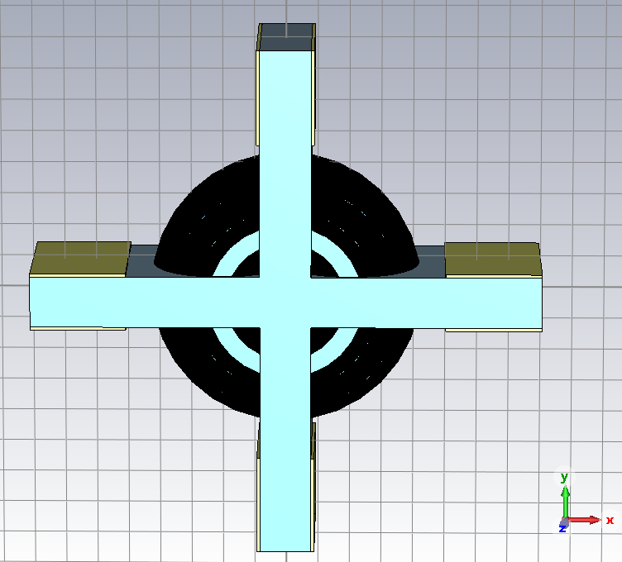
Cavity with metal sheet (Metalsheet_test17_WholeCavity): each thin slot (4.0 mm thick) with 0.5 mm lossy metal sheet.
# of Mode | Mode type | Frequency (GHz) | Q (Perturbation)
1 |  | 5.33393 | 104.44
2 |  | 5.33420 | 104.48
3 | TM₀₁₀ (Monopole) | 5.78630 | 1.313E+04
4 |  | 5.96426 | 109.63
5 |  | 8.27870 | 73.797
6 |  | 8.84324 | 2744.8
7 |  | 8.84378 | 2739.6
8 | TM₁₁₀ (Dipole) | 8.97496 | 9998.6
9 | TM₁₁₀ (Dipole) | 8.97524 | 9994.7
10 | TM₀₁₁ (Monopole) | 9.27018 | 1.030E+04
11 |  | 9.34999 | 51.613
12 |  | 9.35021 | 51.666
13 |  | 9.36063 | 69.929
14 |  | 9.46614 | 1.272E+04
15 | -
15 mm (25 – 40 mm)
8.0 mm
4.0 mm thick of blue slot.
Lossy metal sheet (yellow): 0.5 mm thick from 4.0 – 4.5 mm of the lossy metal sheet.
Electrical conductivity: 3.56e+02 S/m.
Mesh
- Cells per wavelength& Cells per max model box edge
12 for model and 12 for background.
Frequency: 5 – 10 GHz
Boundary conditions
- Electric (Et=0) in X and Y.
- Periodic in Z.
- background: PEC

Slide 34
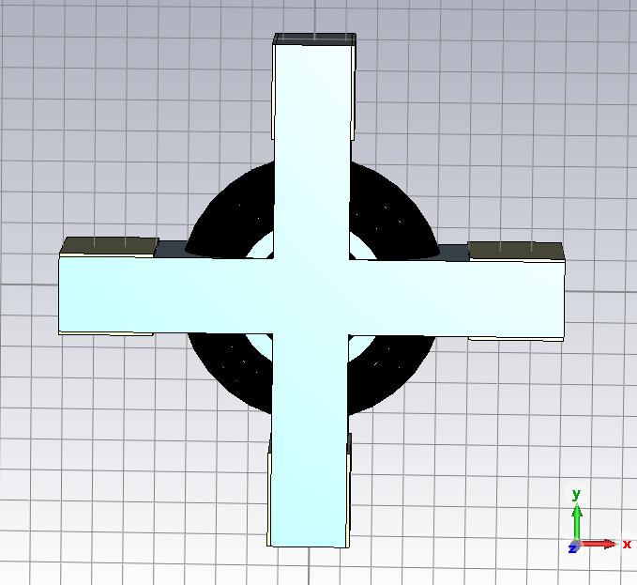
Cavity with metal sheet (Metalsheet_test19_WholeCavity): each thin slot (6.0 mm thick) with 0.5 mm lossy metal sheet.
# of Mode | Mode type | Frequency (GHz) | Q (Perturbation)
1 |  | 5.60359 | 149.50
2 |  | 5.60373 | 149.58
3 | TM₀₁₀ (Monopole) | 5.68765 | 7025.8
4 |  | 6.57598 | 130.72
5 |  | 8.30790 | 104.97
6 | TM₁₁₀ (Dipole) | 8.77357 | 2554.6
7 | TM₁₁₀ (Dipole) | 8.77382 | 2557.4
8 | TM₀₁₁ (Monopole) | 9.01912 | 2825.6
9 |  | 9.04656 | 152.88
10 |  | 9.04704 | 152.66
11 |  | 9.83368 | 143.69
12 |  | 9.83392 | 143.57
13 |  | 9.97267 | 2324.1
14 |  | 9.99744 | 107.06
15 | - | - | -
15 mm (25 – 40 mm)
12.0 mm
6.0 mm thick of blue slot.
Lossy metal sheet (yellow): 0.5 mm thick from 6.0 – 6.5 mm of the lossy metal sheet.
Electrical conductivity: 3.56e+02 S/m.
Mesh
- Cells per wavelength& Cells per max model box edge
12 for model and 12 for background.
Frequency: 5 – 10 GHz
Boundary conditions
- Electric (Et=0) in X and Y.
- Periodic in Z.
- background: PEC

Slide 35
Q with Straight Waveguide (100 S/m and 1E+6 S/m)
Graph should be fixed.
Q value: 34 mm (1E+6) > 50 mm (1E+6) > 34 mm (1E+2) > 50 mm (1E+2)

