Slide 1
C³ Main Linac
Glen White / AD-ARD-Beam Physics

Slide 2
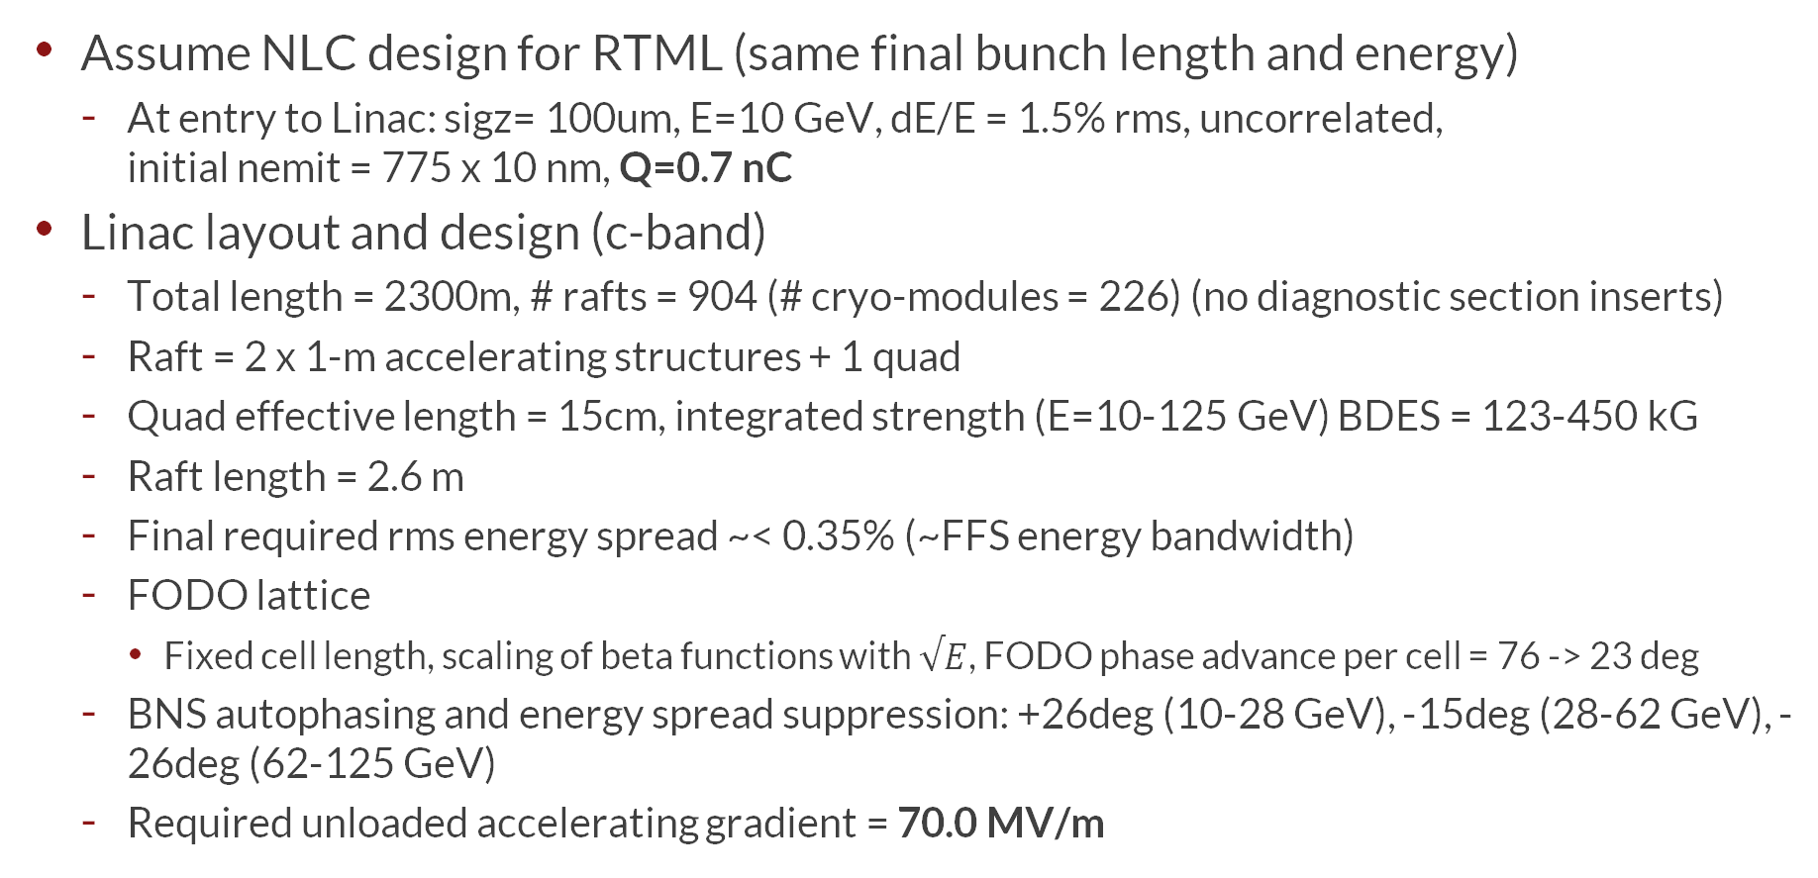
Overview and Assumptions
(Tracking Simulations performed with Lucretia)
Assume NLC design for RTML (same final bunch length and energy)
  At entry to Linac: sigz= 100um, E=10 GeV, dE/E = 1.5% rms, uncorrelated,
  initial nemit = 775 x 10 nm, Q=0.7 nC
Linac layout and design (c-band)
  Total length = 2300m, # rafts = 904 (# cryo-modules = 226) (no diagnostic section inserts)
  Raft = 2 x 1-m accelerating structures + 1 quad
  Quad effective length = 15cm, integrated strength (E=10-125 GeV) BDES = 123-450 kG
  Raft length = 2.6 m
  Final required rms energy spread ~< 0.35% (~FFS energy bandwidth)
  FODO lattice
    Fixed cell length, scaling of beta functions with $√E$, FODO phase advance per cell = 76 -> 23 deg
  BNS autophasing and energy spread suppression: +26deg (10-28 GeV), -15deg (28-62 GeV), -26deg (62-125 GeV)
  Required unloaded accelerating gradient = 70.0 MV/m

Slide 3
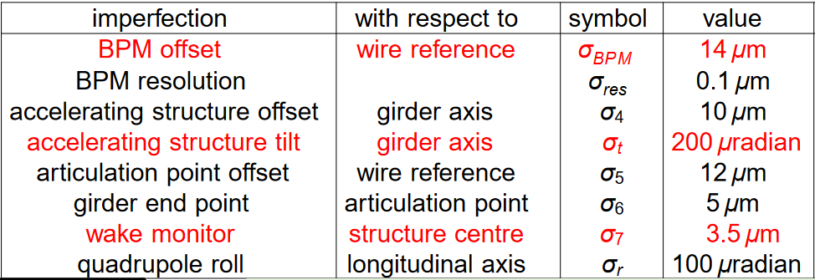
Linac Beam Parameters
Parameter | Symbol | CCC | CLIC (PIP)
Beam Energy | [GeV] | 125 | 190
Luminosity | L [10³⁴ cm⁻²s⁻¹] | 1.35 | 1.5
Train rate | [Hz] | 120 | 50
# Particles / bch , Bunch Charge | N [x 1e9] , Q_{b} [nC] | 4.4, 0.7 | 5.7, 0.83
Bunch Length | σ_{z} [μm] | 100 | 70
Initial emittance | γε_{x,y} [nm-rad] | 775, 10 | 850, 10
Final emittance | γε_{x,y} [nm-rad] | 775, 15 | 900, 15
# Bunches | n_{b} | 200 | 352
Bunch Spacing | Δt [ns] | 3.5 | 0.5
Energy Spread | δ_{E} [%] (initial) | 0.15 | 0.2
Energy Spread | δ_{E} [%] (final) | 0.36 | 0.35
Imperfection | With Respect to… | Symbol | Value
BPM Resolution | Reference | σ_{BPM} | 0.1 μm
Offsets internal to CCC | Raft axis | σ_{SCAV} | 5 μm
CCC & Quad roll | Raft axis | σ_{RCAV} | 200 μrad
BPM -> Quad center alignment | Raft axis | σ_{QBPM} | 2 μm
Quad strength | Raft axis | Δk_{Q} | 0.1 %
CLIC

Slide 4
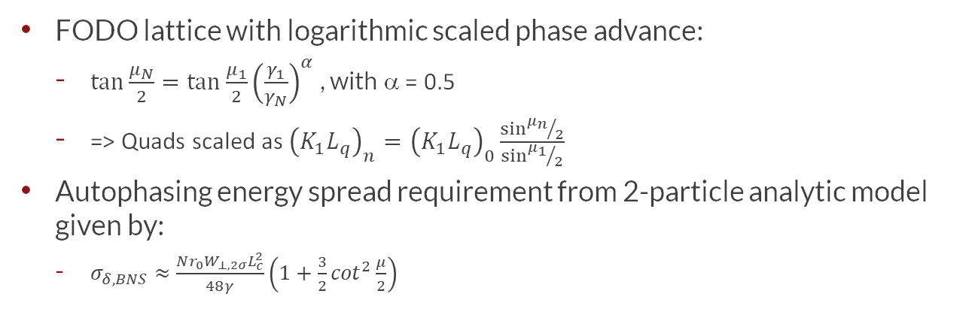
Linac Optics
10 GeV
125 GeV
FODO lattice with logarithmic scaled phase advance:
  $\tan{\frac{μ_{N}}{2}=\tan{\frac{μ_{1}}{2}{\left(\frac{γ_{1}}{γ_{N}}\right)}^{α}}}$ , with α = 0.5
  => Quads scaled as ${\left(K_{1}L_{q}\right)}_{n}={\left(K_{1}L_{q}\right)}_{0}\frac{\sin{{μ_{n}}/2}}{\sin{{μ_{1}}/2}}$
Autophasing energy spread requirement from 2-particle analytic model given by:
  $σ_{δ,BNS}≈\frac{Nr_{0}W_{⊥,2σ}L_{c}^{2}}{48γ}\left(1+\frac{3}{2}\cot^{2}\frac{μ}{2}\right)$

Slide 5
Quadrupole Field Strengths
Quad aperture = cavity aperture
Quad effective length = 15 cm

Slide 6
Structure Short-Range Wakefields
Wakefields (short-range longitudinal and transverse) applied to each structure
Note CCC wakes ~3X stronger than NLC for comparison

Slide 7
Particle Tracking - Longitudinal Wakes
No initial energy spread
Initial centroid offset = 0.1 sigma_y
Transverse wakes OFF
No BNS damping
Longitudinal wakes ON
  Generates ~0.6% final energy spread

Slide 8
Particle Tracking – Transverse Wakes + BNS Damping
Initial energy spread=1.5%
Initial centroid offset = 0.1 sigma_y
Transverse wakes ON
Longitudinal wakes ON
BNS damping + energy spread suppression
  10% emittance growth
  0.36% final energy spread

Slide 9
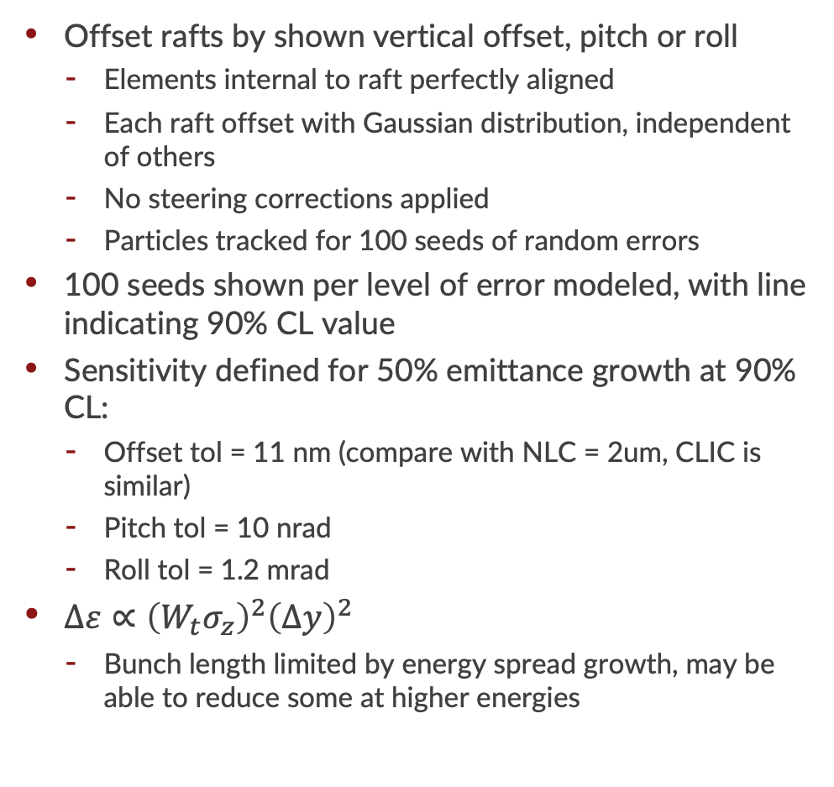
Raft Misalignment Sensitivity
Offset rafts by shown vertical offset, pitch or roll
  Elements internal to raft perfectly aligned
  Each raft offset with Gaussian distribution, independent of others
  No steering corrections applied
  Particles tracked for 100 seeds of random errors
100 seeds shown per level of error modeled, with line indicating 90% CL value
Sensitivity defined for 50% emittance growth at 90% CL:
  Offset tol = 11 nm (compare with NLC = 2um, CLIC is similar)
  Pitch tol = 10 nrad
  Roll tol = 1.2 mrad
$∆ε∝{\left(W_{t}σ_{z}\right)}^{2}{\left(∆y\right)}^{2}$
  Bunch length limited by energy spread growth, may be able to reduce some at higher energies

Slide 10
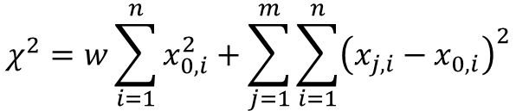
Beam-Based Alignment (BBA)
Three BBA techniques simulated
  1-1 steering
  Dispersion Free Steering (DFS)
  Wakefield bumps
Correction mechanism is horizontal & vertical motion of quadrupole magnets
Measurements are BPMs located adjacent to each Quadrupole
1-1 steering minimizes BPM readings, DFS further minimizes absolute beam orbit (minimizes dispersion)
(Wakefield) bumps use 4 x 100-m motorized sections of Linac
$$χ^{2}=w\sum_{i=1}^{n}{x_{0,i}^{2}+\sum_{j=1}^{m}{\sum_{i=1}^{n}{{\left(x_{j,i}−x_{0,i}\right)}^{2}}}}$$
DFS: BPMS (i) minimized for on-energy (0) and off-energy beams (j),
with weighting factor (w) tuned for best emittance preservation

Slide 11
Tuning Performance
100 random seeds
  Errors are with respect to reference system, as shown in table on slide 3
1-1 steering + DFS + bumps shows adequate performance tolerance
  >90% of seeds show <5nm-rad vertical emittance growth
Wake bumps only important in vertical dimension
Require ~650nm initial horizontal emittance

Slide 12
Long-Scale Alignment Tolerance Simulation
λ=10m
λ=500m
λ=1000m
Pre-alignment positions according to random distribution with given wavelength and RMS amplitude (see above examples for λ=10, 500, 1000 m and 2.3 km length linac)
Tolerance simulation steps:
  Generate 100 random alignment seeds with a given RMS amplitude & wavelength
  For each seed, apply BBA
  For each seed, track beamline including wakefields, chromatic emittance dilution effects etc
  Use 90% CL emittance from 100 seeds as emittance estimate
  Increase alignment amplitude
  Continue above steps until 1nm emittance growth calculated, then select next wavelength and repeat

Slide 13
Long-Scale Alignment Tolerances
CLIC Alignment tolerances
C3 Alignment tolerances
DFS+wake bumps shows alignment tolerance required to provide Δε_{y}=5nm (design emittance growth for Linac): 500 μm expected installation tolerance shown
  Expect to need e.g. ballistic alignment to correct for λ<100m errors
Other lines show Δε_{y}=1nm to compare with CLIC
D. Schulte, CLIC Main Linac Beam Dynamics,
ALEGRO Workshop, CERN 2019

Slide 14
Vibration Tolerance
Quadrupoles
Accelerating Cavities
RMS random vertical offsets applied to an otherwise perfectly aligned Linac (separately applied to individual accelerating structures and quadrupoles)
Tolerances for 1 nm vertical emittance growth (RMS)
[90% CL from 100 random seeds]:
  Cavities = 1.5 μm
  Quadrupoles = 5.5 nm
Incoming beam alignment tolerance:
  Δy < 0.08 σ_{y}
Incoming beam position

Slide 15
Summary
Tight offset sensitivities due to transverse wakefield and strong lattice required by BBU mitigation
  ~80X NLC & similar to CLIC sensitives
  Requisite emittance growth (<5 μm-rad @ 90% CL) demonstrated with inter-raft alignment tolerances
Alignment tolerances ~CLIC,
  Longer-range alignment tolerances maybe somewhat more relaxed but need to design alignment system:
  ~30 um at short wavelengths, mms at km wavelengths.
Vibration tolerance: 1.5 μm structure, 5.5 nm quadrupole,
0.08σ injection error
Tuning simulation demonstrates ~3 nm emittance growth at
90% CL

Slide 16
Q = 0.6 nC

Slide 17
Linac Optics
10 GeV
125 GeV
FODO lattice with logarithmic scaled phase advance:
  $\tan{\frac{μ_{N}}{2}=\tan{\frac{μ_{1}}{2}{\left(\frac{γ_{1}}{γ_{N}}\right)}^{α}}}$ , with α = 0.5
  => Quads scaled as ${\left(K_{1}L_{q}\right)}_{n}={\left(K_{1}L_{q}\right)}_{0}\frac{\sin{{μ_{n}}/2}}{\sin{{μ_{1}}/2}}$
Autophasing energy spread requirement from 2-particle analytic model given by:
  $σ_{δ,BNS}≈\frac{Nr_{0}W_{⊥,2σ}L_{c}^{2}}{48γ}\left(1+\frac{3}{2}\cot^{2}\frac{μ}{2}\right)$

Slide 18
Quadrupole Field Strengths
Set quad aperture = cavity aperture
Quad effective length = 15 cm

Slide 19
Particle Tracking – Transverse Wakes + BNS Damping
Initial energy spread=1.5%
Initial centroid offset = 0.1 sigma_y
Transverse wakes ON
Longitudinal wakes ON
BNS damping + energy spread suppression
  0 emittance growth
  0.3% final energy spread

Slide 20
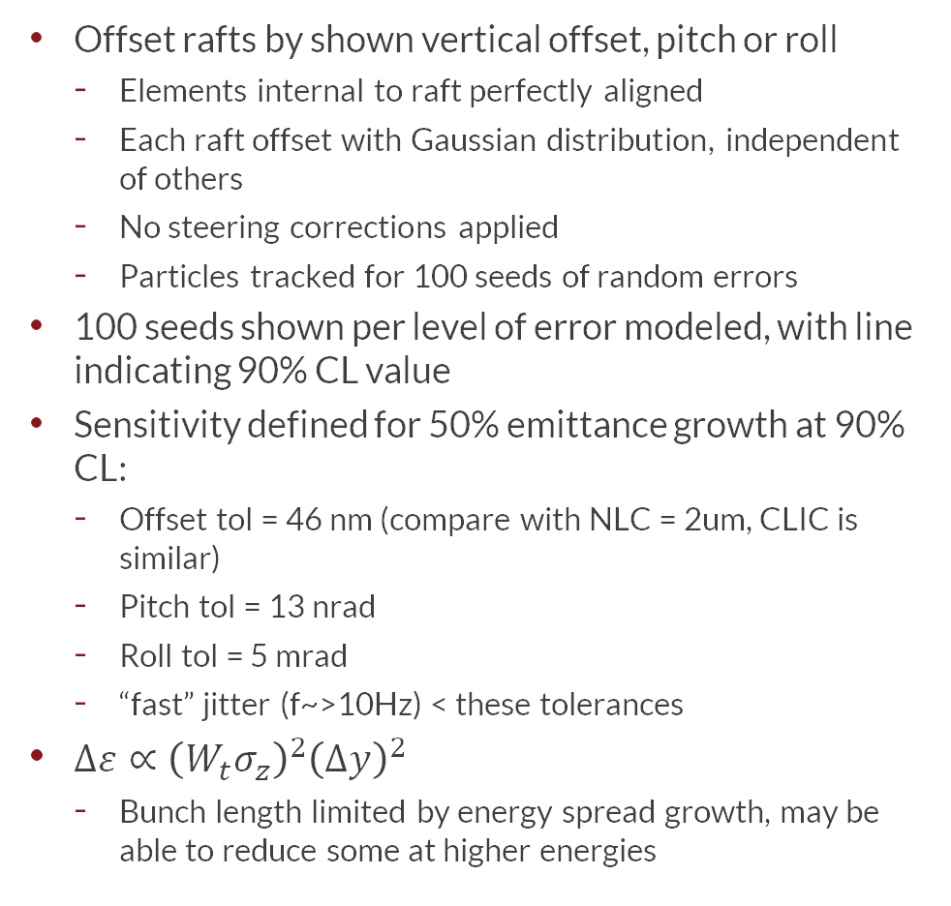
Raft Misalignment Sensitivity
Offset rafts by shown vertical offset, pitch or roll
  Elements internal to raft perfectly aligned
  Each raft offset with Gaussian distribution, independent of others
  No steering corrections applied
  Particles tracked for 100 seeds of random errors
100 seeds shown per level of error modeled, with line indicating 90% CL value
Sensitivity defined for 50% emittance growth at 90% CL:
  Offset tol = 46 nm (compare with NLC = 2um, CLIC is similar)
  Pitch tol = 13 nrad
  Roll tol = 5 mrad
  “fast” jitter (f~>10Hz) < these tolerances
$∆ε∝{\left(W_{t}σ_{z}\right)}^{2}{\left(∆y\right)}^{2}$
  Bunch length limited by energy spread growth, may be able to reduce some at higher energies

Slide 21
Tuning Performance
100 random seeds
  Errors are with respect to reference system, as shown in table on slide 3
1-1 steering + DFS + bumps shows adequate performance tolerance
  >90% of seeds show <5nm-rad emittance growth

Slide 22
Vibration Tolerance
Accelerating Cavities
Quadrupoles
RMS random vertical offsets applied to an otherwise perfectly aligned Linac (separately applied to individual accelerating structures and quadrupoles)
Tolerances for 1 nm vertical emittance growth (RMS)
[90% CL from 100 random seeds]:
  Cavities = 3.8 μm
  Quadrupoles = 7.9 nm
Incoming beam alignment tolerance:
  Δy < 0.1 σ_{y}
Incoming beam position

