Slide 1
Opportunities for cryo-rf studies at Cornell Jared Maxson CLASSE, Cornell University Assistant Professor of Physics

Slide 2
Overview
Cornell is interested in normal conducting cryo-RF for several applications, which I’ll describe in detail.
We’re also interested in the fundamental physics of high-field RF surfaces.
Upshot of this talk:
We would like to generate a proposal to NSF to establish a cryo-RF test bunker with beam generation capability at Cornell.
We would like to interface closely with the C3 community to generate this proposal.
Specifically: How could a Cornell facility be maximally collaborative and complementary to existing test facilities @ SLAC, UCLA, RadiaBeam, LANL, and beyond?

Slide 3
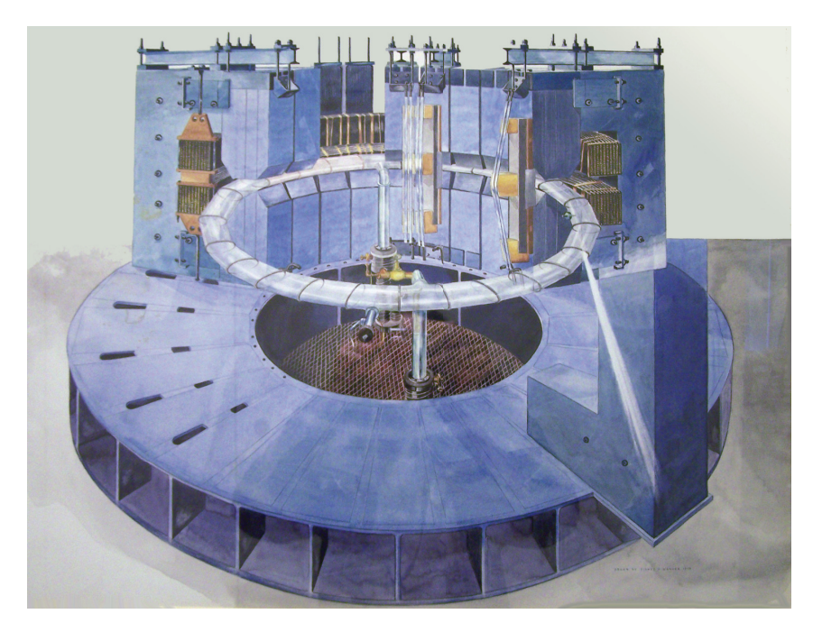
A quick Cornell accelerator overview
History:
300 MeV Synchrotron,
1949

Slide 4
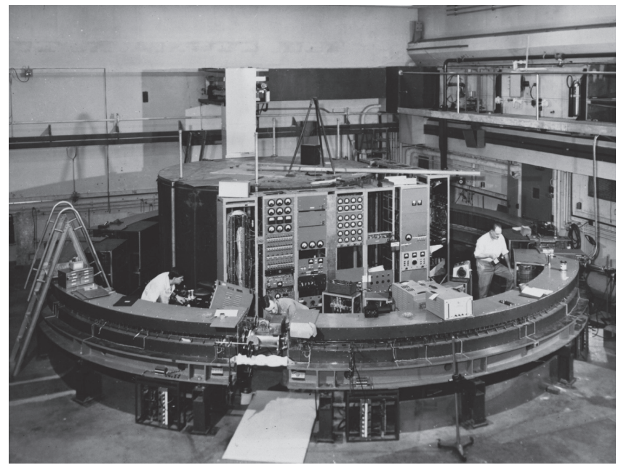
A quick Cornell accelerator overview
History:
1952:
1.3 GeV, The first strong focusing synchrotron
“Wilsonian” design:
300 MeV sychtrotron used as a choke in the power circuit!

Slide 5
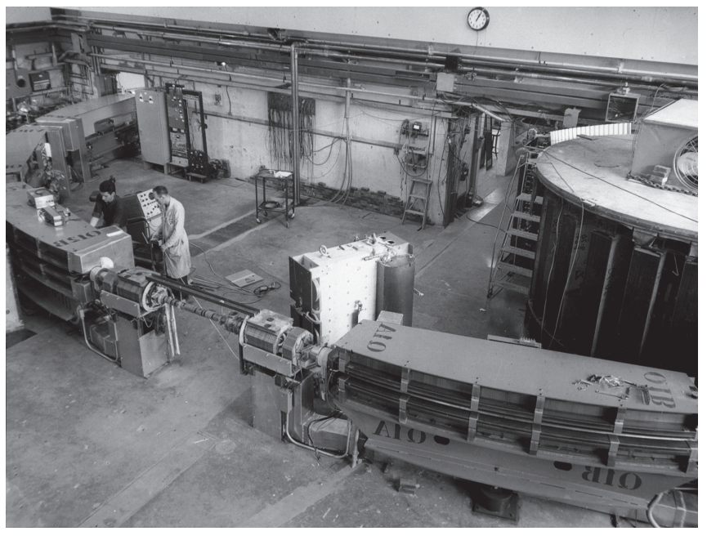
A quick Cornell accelerator overview
History:
Expanding to fill the space…
1963: 2.2 GeV

Slide 6
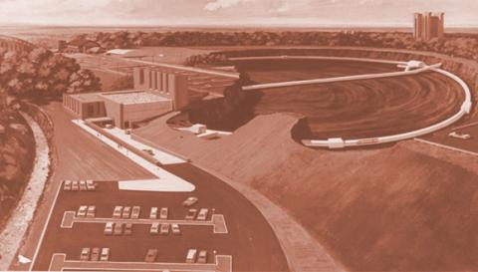
A quick Cornell accelerator overview
History:
Outgrowing the Newman Laboratory:
1967: 12 GeV Synchrotron

Slide 7
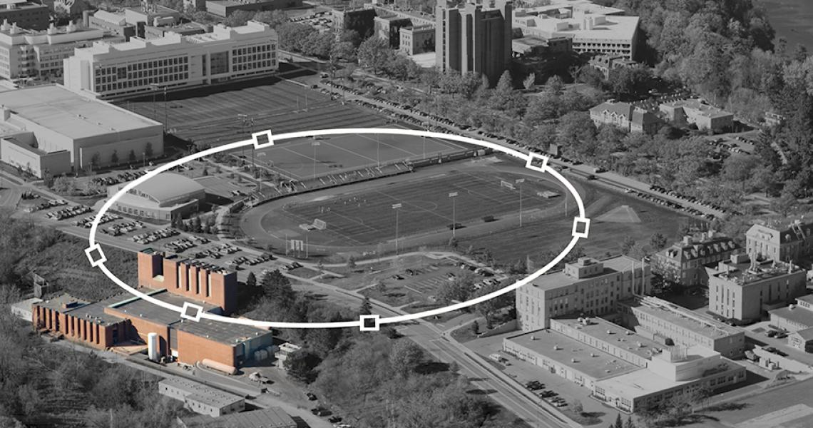
A quick Cornell accelerator overview
History:
Outgrowing the Newman Laboratory:
1967: 12 GeV Synchrotron

Slide 8
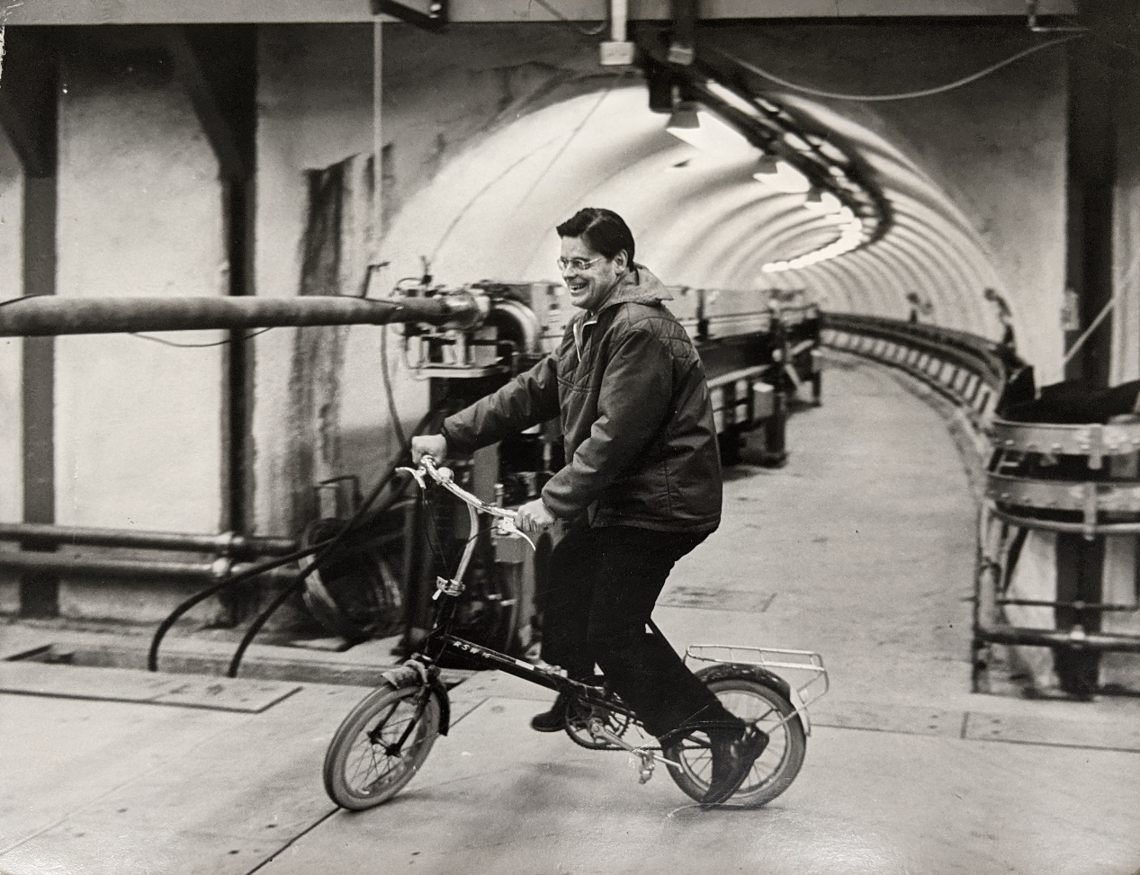
A quick Cornell accelerator overview
History:
Outgrowing the Newman Laboratory:
1967: 12 GeV Synchrotron
Robert Wilson in the tunnel, 1968

Slide 9
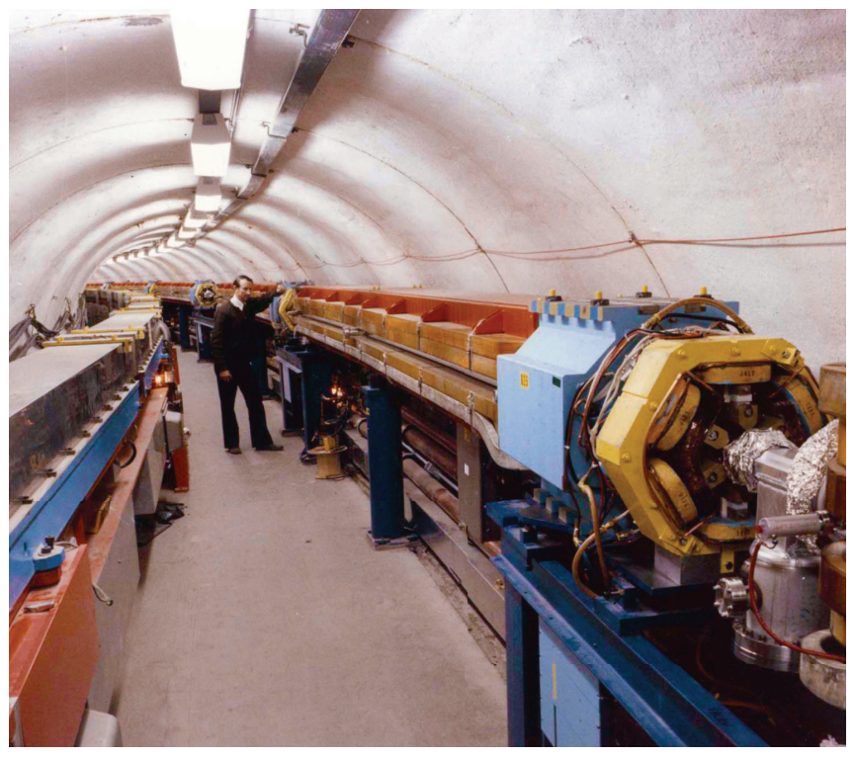
A quick Cornell accelerator overview
History:
1979: Cornell Electron Storage ring, CESR
Electron-positron collisions,
And more than 2 decades of elementary particle physics.
Since inception, CESR has also driven CHESS, running concurrently with the particle physics program.
Funded by NSF
Wilsonian synchrotron:
In-vacuum magnets
Remains the booster
for CESR to this day.
Boyce McDaniel with CESR

Slide 10
CESR for CHESS
Particle physics at CESR concluded in 2008.
Since that time, CESR has mainly served to provide x-rays for CHESS.
CHESS has continued to grow. In 2018 the ring and hutches were revamped for:
Single species operation (positrons, for now)
Double bend achromat replacement for 1/6 of the ring
New undulators (CCUs) feeding beamlines.
High brightness and flux at high photon energy

Slide 11
CHESS Today
NSF investment in CHESS remains strong, but a new partner model has expanded the funding agency portfolio.
DoD, NIH, NYSTAR, industry, and more.
~1,200 users/year, 30% new users each year, large majority is non-Cornell.
Next slides: a zoom-in on CHESS and its facilities.

Slide 12
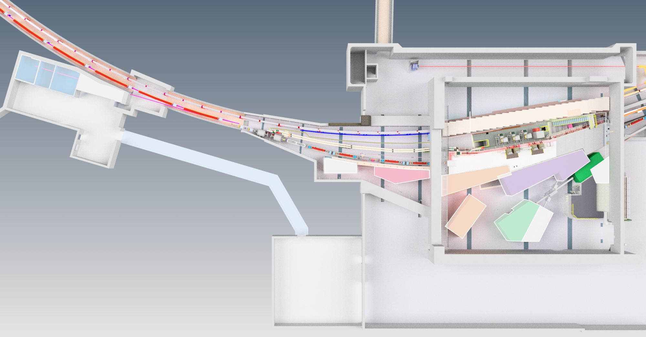
CHEXS @ CHESS
The NSF beamlines of CHESS. CHEXS = Center for High-Energy X-ray Sciences at CHESS (CHEXS @ CHESS)

Slide 13
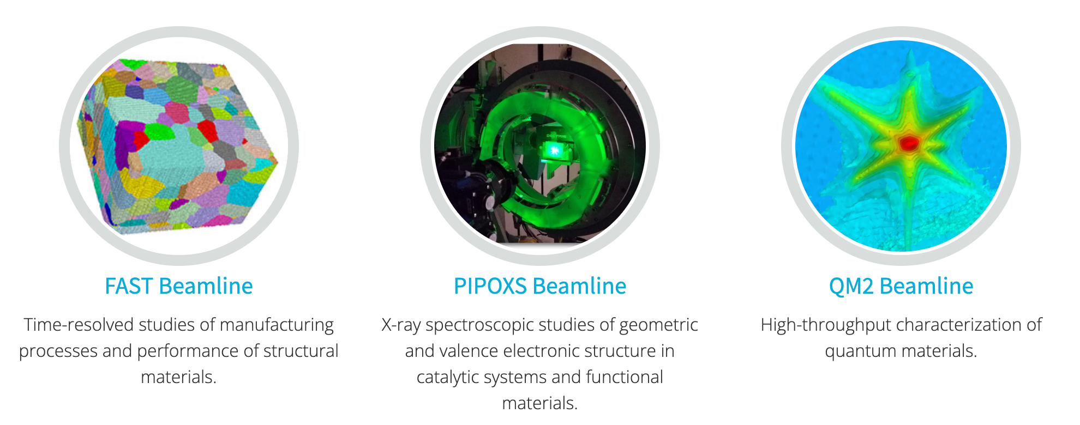
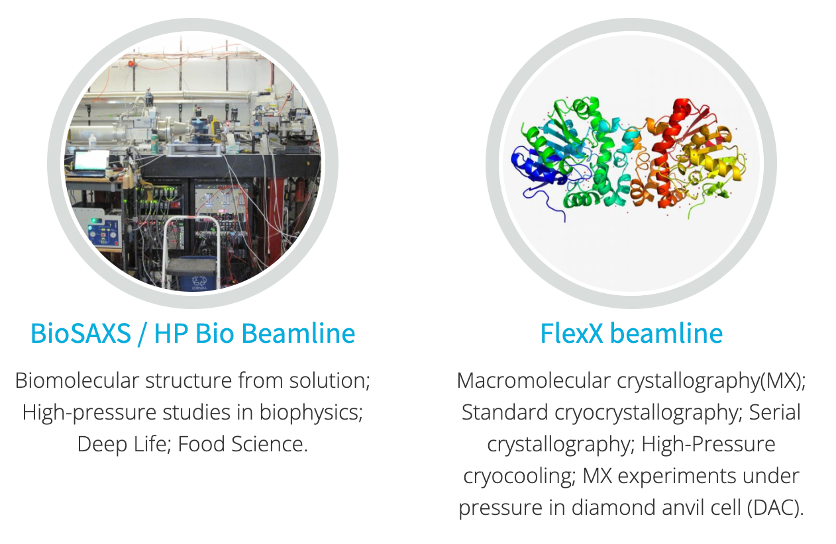
CHEXS @ CHESS
The NSF beamlines of CHESS. CHEXS = Center for High-Energy X-ray Sciences at CHESS (CHEXS @ CHESS)

Slide 14
MacCHESS
Macromolecular X-ray science at CHESS
Funded by NSF, NIH/NIGMS

Slide 15
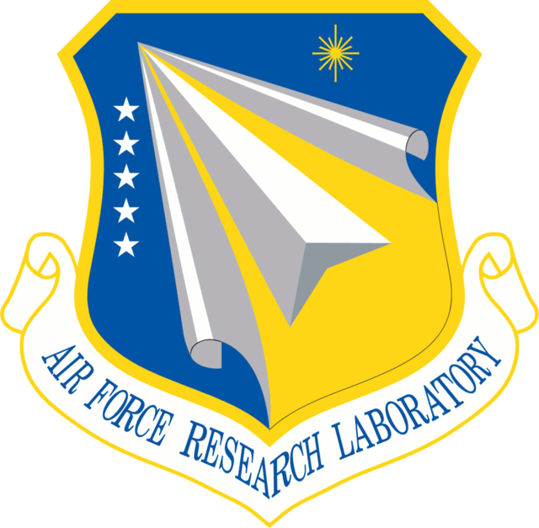
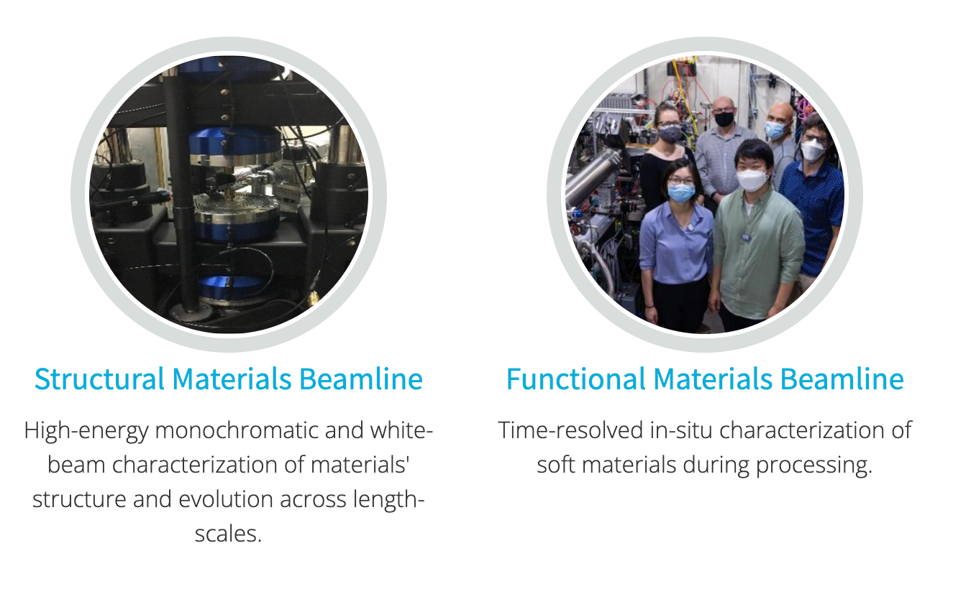
MSN-C @ CHESS
Materials Solutions Network at CHESS (MSN-C).
A partnership between CHESS, DoD and their collaborators

Slide 16
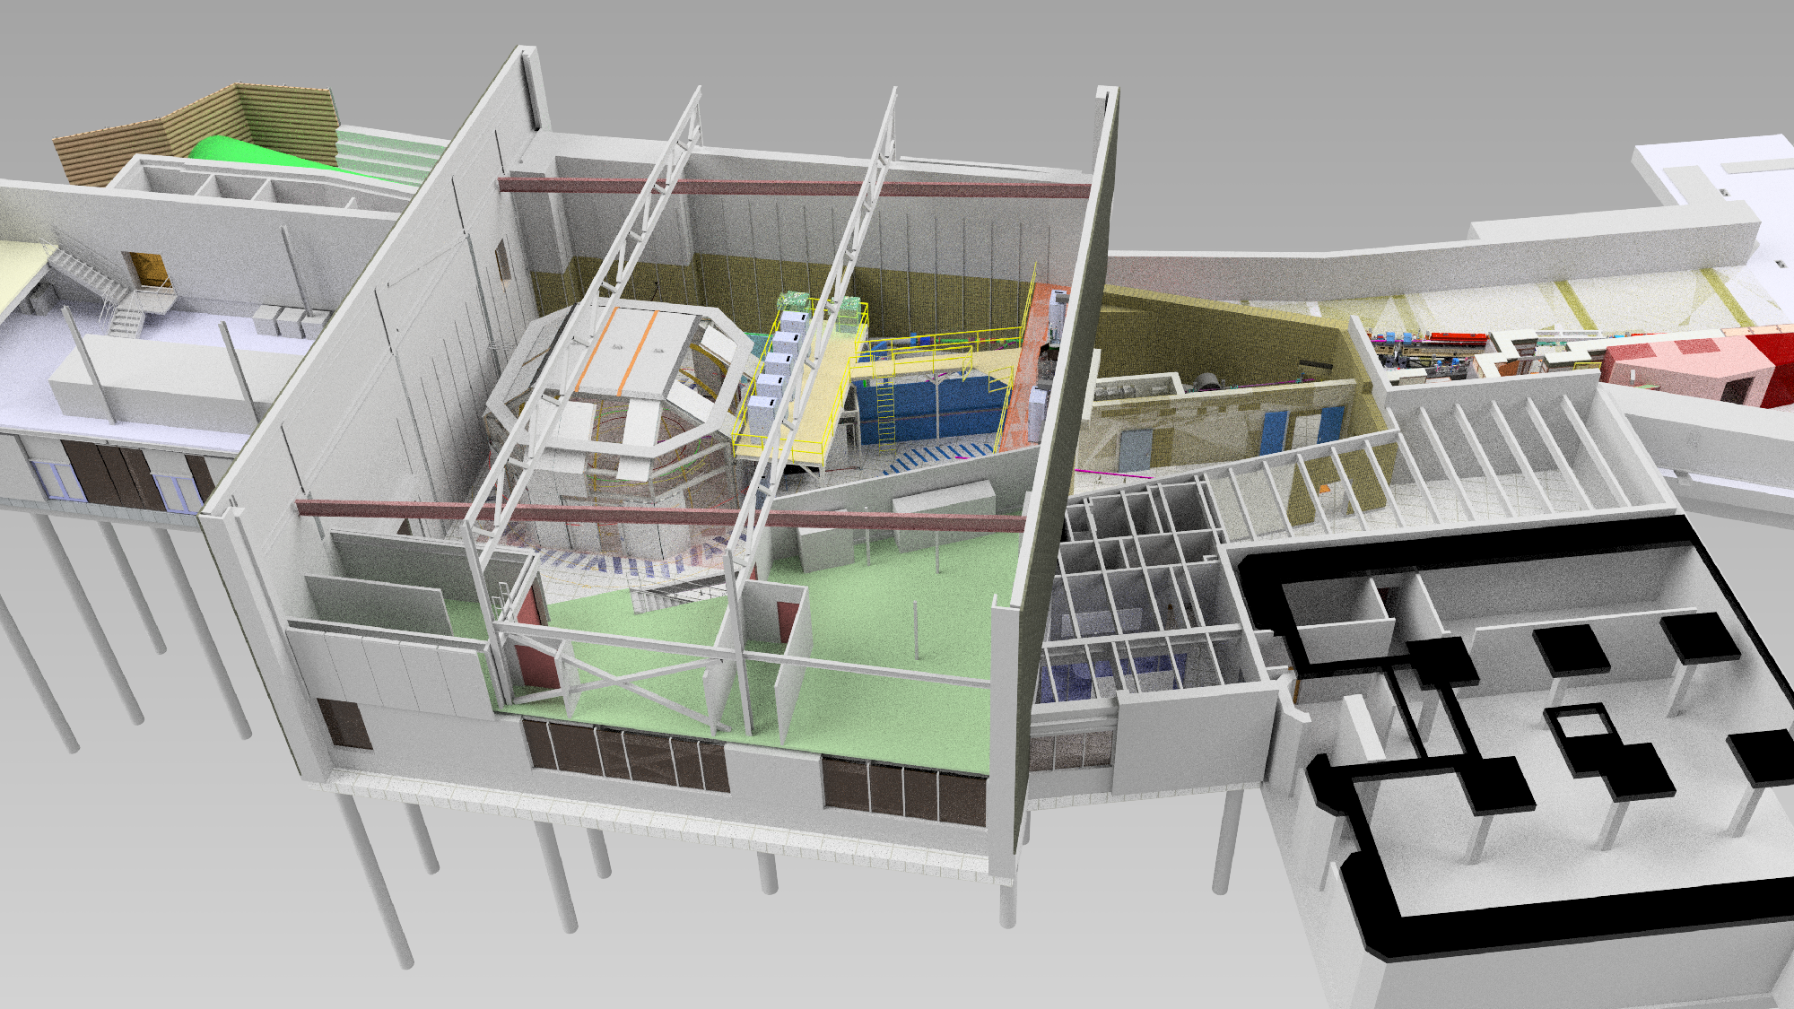
New: High Magnetic Field Beamline
Funded via NSF’s Mid-scale research infrastructure, $32.6M to install a high field magnet (20T) on a new CHESS beamline.
Partnership with Florida’s MagLab and UPR.

Slide 17
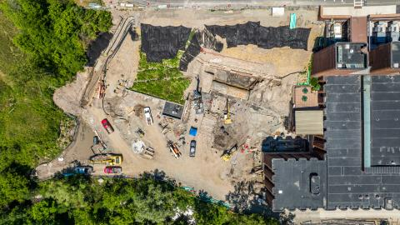
New: High Magnetic Field Beamline
Funded via NSF’s Mid-scale research infrastructure, $32.6M to install a high field magnet (20T) on a new CHESS beamline.
Partnership with Florida’s MagLab and UPR.
The new experimental
Hall for the HMF beamline.

Slide 18
Future-proofing Cornell’s accelerators
We are now planning for the next decades of beam running at CESR and CHESS.
The age of our linac source and booster synchrotron is a vulnerability.
(Though it has been a marvel-–on nearly all the time for 56 years and counting!)
We are excited about cold copper RF technology as it may provide a route to full energy (6 GeV) linac injection into CESR.
Not just a replacement—a linac could do much more.

Slide 19
Our facility layout

Slide 20
Our facility layout
CBETA
CBETA: The Cornell BNL ERL Test
Accelerator. A great example of Cornell/DOE
Partnership.

Slide 21
Our facility layout
S-band 60 Hz Linac, up to 350 MeV
L0E Hall
Hosts CBETA
40 meters across
Not unreasonable to consider a 6 GeV cold copper linac
housed in L0E in the 2030’s.

Slide 22
Not just a booster replacement
A linac of course could do more than replacing the aging synchrotron.
Short pulse x-rays. A linac-driven undulator parasitic to CESR filling could feed into the CHESS experimental hall.
UED – high brightness few MeV electron beams based on cold copper technology.

Slide 23
Where to start
As a first step in this vision, we would like to build a proposal to NSF to build a cryo-RF test bunker in Wilson lab.
Our target is NSF Major Research instrumentation, up to $4M total project cost. Also considering shorter fuse options.
Features:
High power rf installation, possibly at multiple frequencies
Cryo capability down to LHe temperature (lots of existing SRF infrastructure already)
Beam generation capability–photocathode drive laser for single bunch and bunch train generation.

Slide 24
Our facility layout
S-band 60 Hz Linac, up to 350 MeV
L0E Hall
Hosts CBETA
40 meters across
Not unreasonable to consider a ~10 meter scale bunker.

Slide 25
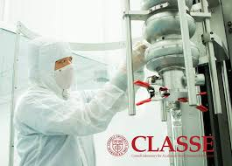
Interfacing with C3
We want to interface with existing efforts at LANL, SLAC, UCLA, and RadiaBeam and to be complimentary to them.
Lots of existing infrastructure for SRF that can be brought to bear on cold copper.

Slide 26
Our interests and capabilities
The accelerator group and lab leadership are supportive of this concept.
We want to get input on the details from you.
Some of the physics we are interested in studying:
Ultimate gradient limits
Dark current as a function of surface prep
HOM damping, beam break-up, wakes
Surface coatings via CVD
High brightness production with photocathodes (we also want to provide cathode support to other high gradient programs at UCLA, LANL, and more)
Can consider doing an application demo with UED (existing infrastructure)

Slide 27
Your input
What properties of a new testbed facility be most useful to the C3 community?
Standout items that this facility might focus on for C3?
We’re open to input on specs, too
We have lots of infrastructure at 2.856 GHz. We are considering a facility that can do high-power S and C band.
Baseline: Scandinova K-series, ~50 MW RF.
Desires for photocathode drive laser? Pulse pattern, etc…
We envision this facility could work with LHe, LN2, and cryocooler-based cryomodules.

Slide 28
Summary
Our goal is to build high power cryo-rf test station at Cornell.
We envision this might lead to new capabilities for CHESS
At this stage, we would like to write a proposal that points to this possibility and callout direct benefits to HEP, XFELs, etc, too.
We would like this setup to be explicitly useful to this group.
Our target is NSF, which can help expand the cold-copper funding agency stakeholders.

