Slide 1

Update on the status of the C-band high gradient program at LANL
Evgenya Simakov, Anna Alexander, Petr Anisimov, Walter C. Barkley, W. Brian Haynes, Deepak Rai, Tsuyoshi Tajima, Haoran Xu, Muhammed Zuboraj
Los Alamos National Laboratory
2/6/2023
Managed by Triad National Security, LLC., for the U.S. Department of Energy’s NNSA.

Slide 2
Outline of this talk
Introduction and LANL C-band project overview
Experimental activities
  CERF-NM: High gradient C-band test stand
  CARIE: new high gradient RF injector test facility
Summary and near-term plans

Slide 3
Introduction: why Los Alamos
Achieving high-gradient performance (low breakdown rates, low field emission, new materials for HOM absorption, cathodes at high gradient etc.) is a materials science problem.
Los Alamos is, at core, a materials science laboratory with particular expertise and interest in metallurgy.
Los Alamos also considers itself the steward of accelerator science for the NNSA part of the DOE complex.
Thus, Los Alamos has both an institutional interest in, and capability to address, this problem space.
High gradient C-band work directly aligns with future NNSA and LANL missions.

Slide 4
LANL must develop accelerators for various national security needs
LANSCE accelerator upgrades:
Applications such as pRad desire higher proton beam energy
→ add a booster to current LANSCE linac to increase beam energy to 3-5 GeV
New capabilities: improve accessibility
Material science at LANL will benefit from powerful directional high repetition rate X-ray sources
43 keV photons can be produced with 42 MeV electron beam
43 keV photons are DMMSC relevant
Compact Accelerators: enabling feasibility
Achieving high gradient performance (low breakdown rates, low field emission, new materials for HOM absorption, etc.) is a material science problem.
LANL is, at core, a material science laboratory

Slide 5
LANL High Gradient C-band research
The goals for LANL’s high gradient project are
To build a C-band (5.712 GHz) high gradient rf breakdown study facility (2019-2022).
To build a C-band cryo-cooled photoinjector study facility (2022-2025).
To conduct material studies.
To develop C-band compact accelerator facility for X-ray production or UED (future).
This work was funded by Los Alamos National Laboratory (LANL) Laboratory Directed Research and Development (LDRD) program and Technology Evaluation and Development (TED) funds.

Slide 6
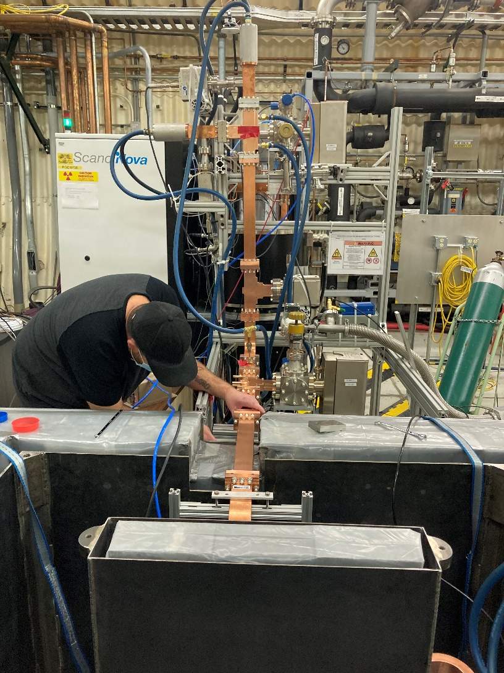
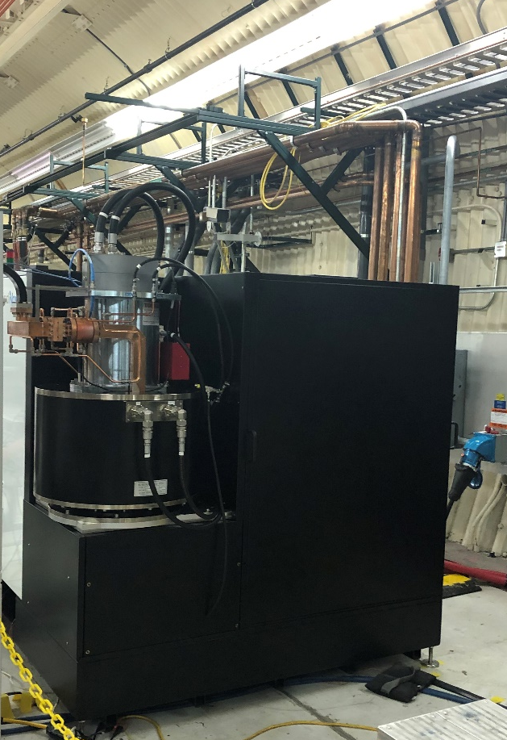
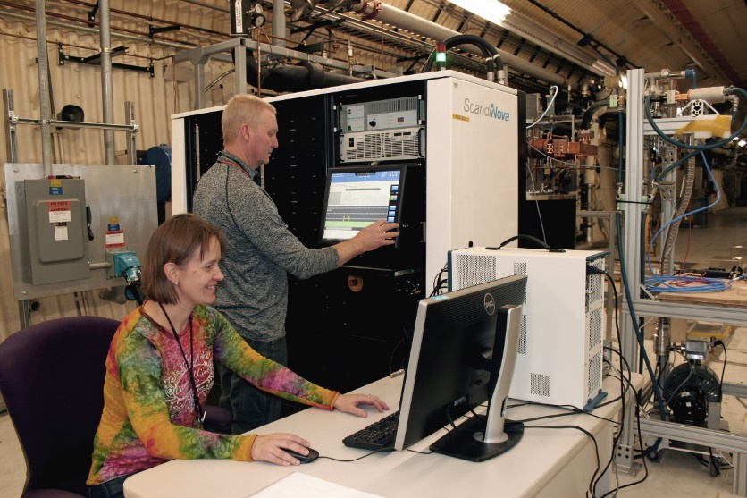
LANL C-band Engineering Research Facility (CERF-NM)
CERF-NM was built with $3M of LANL’s internal infrastructure investment.
Powered with a C-band Canon klystron
Conditioned to 50 MW
Frequency 5.712 GHz
300 ns – 1 µs pulse length
Rep rate up to 200 Hz (typical 100 Hz)
Nominal bandwidth 5.707-5.717 GHz

Slide 7
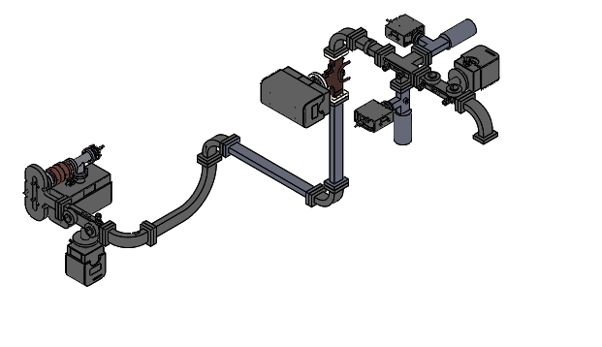
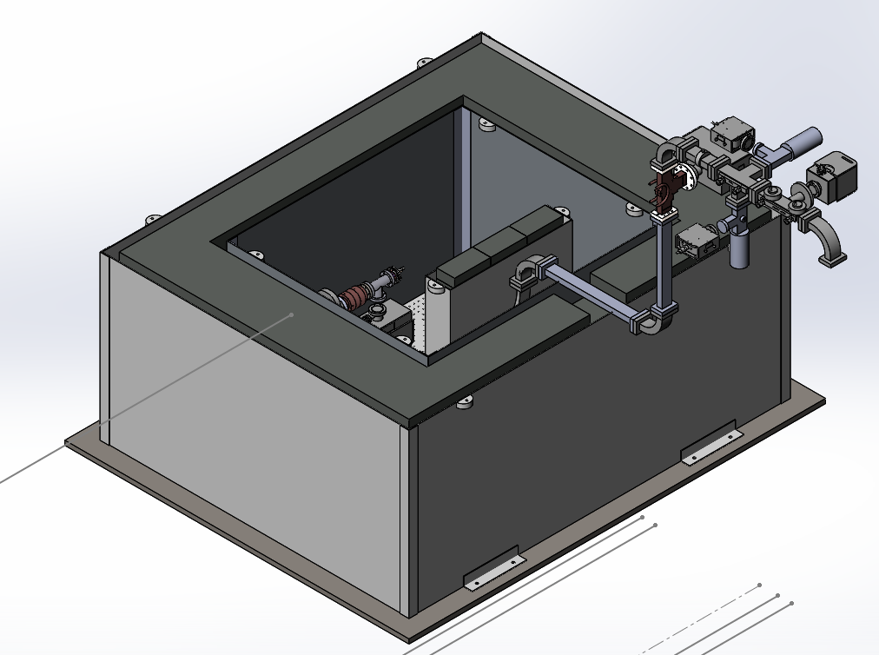
Schematic of the C-band test stand
Radiologically certified for dark currents up to 5 MeV and 10 μA.
Ion pump and ion gauge
Cavity
FC1
Mode launcher
FC2
Dir coupler (FWD, REV)

Slide 8
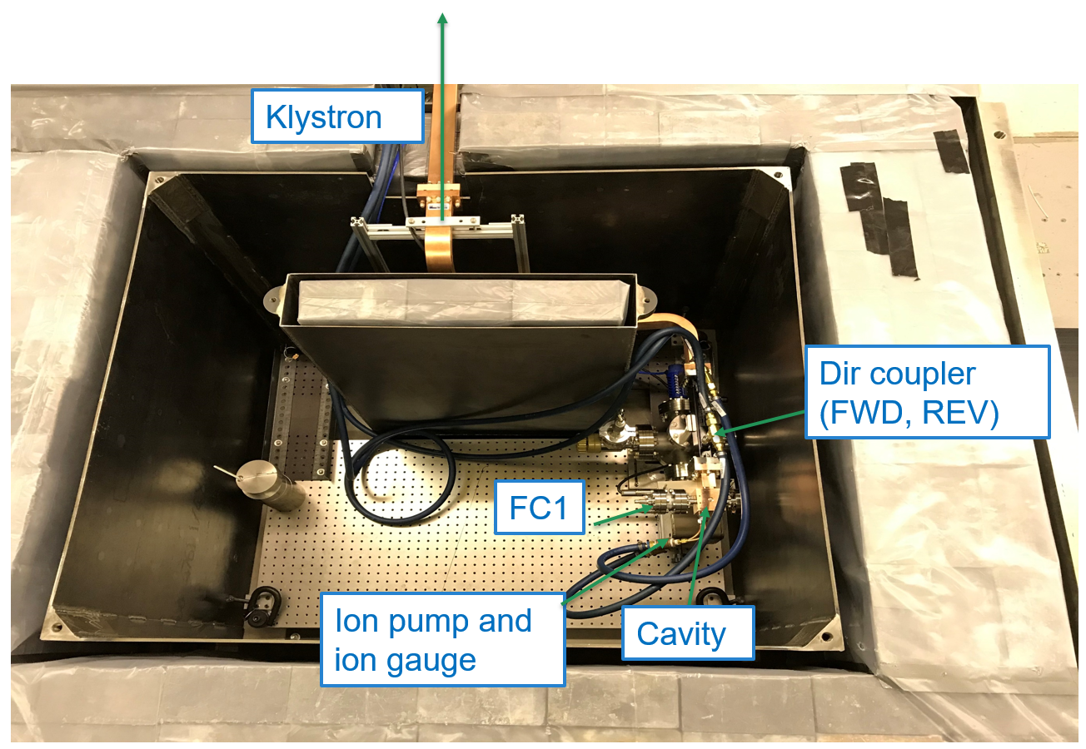
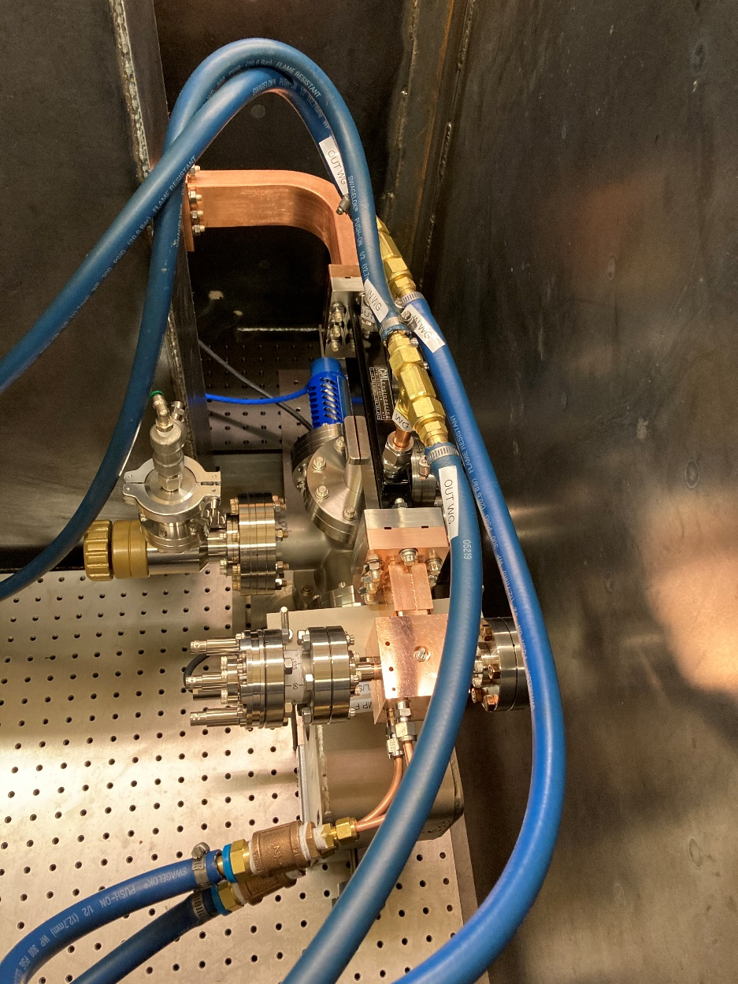
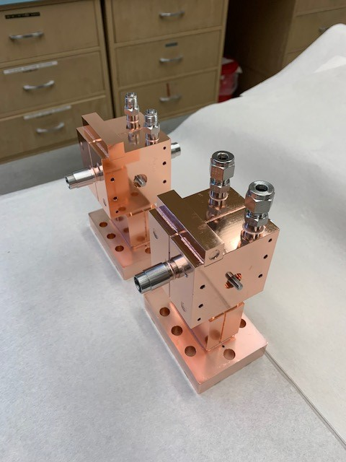
The first two high gradient cavities were tested at CERF-NM in FY21
This C-band high gradient test facility is nationally unique. The first cavities tested at CERF-NM were manufactured at SLAC.

Slide 9
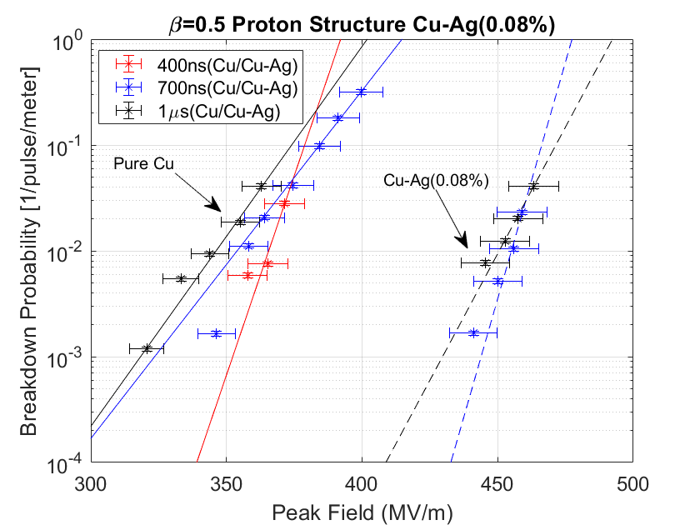
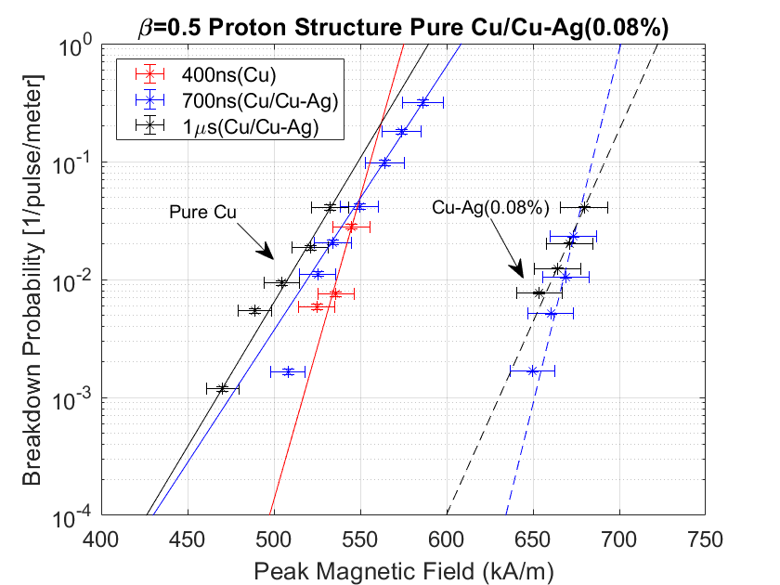
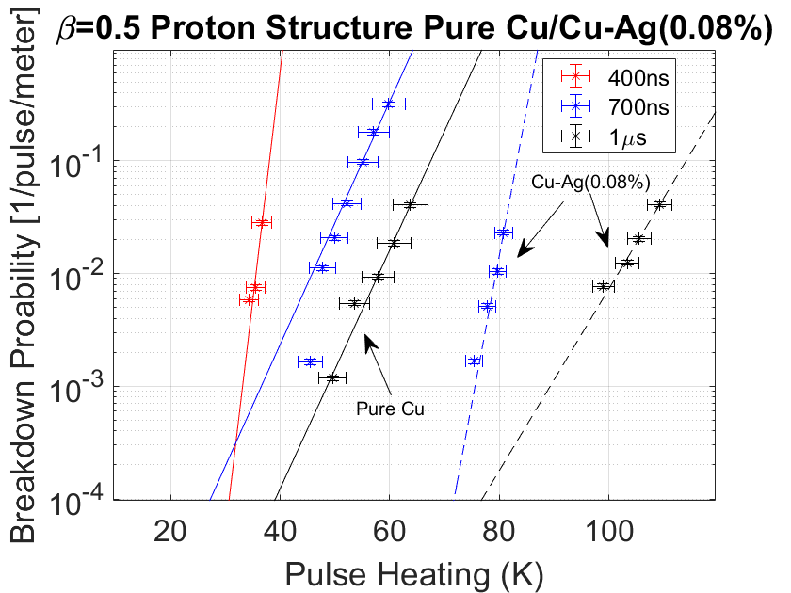
Peak surface electric fields in excess of 300 MV/m demonstrated in high gradient tests
Breakdown probabilities were recorded for three different pulse lengths for copper and copper-silver cavities.

Slide 10
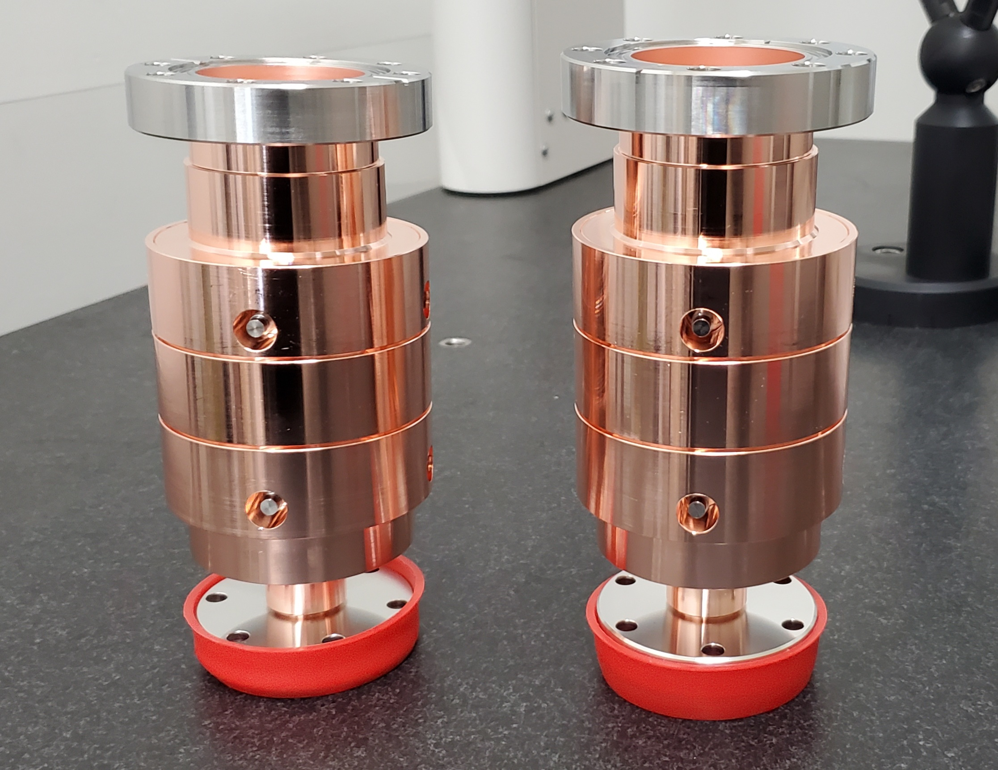
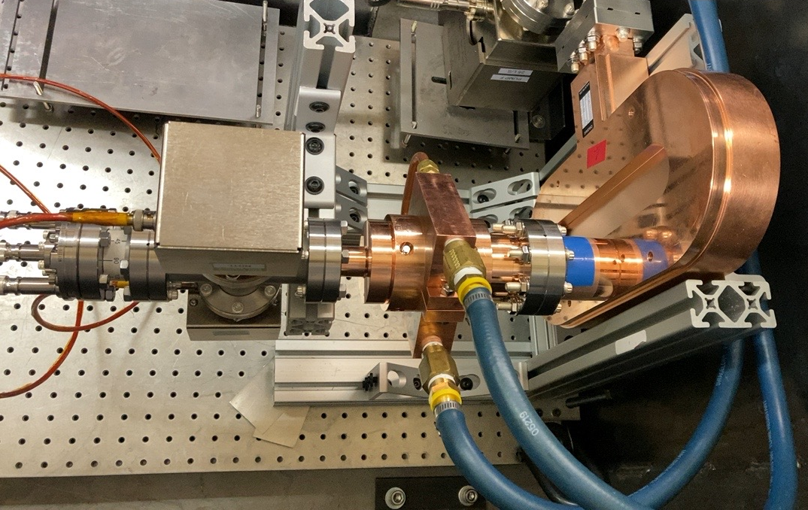
Two a/λ=0.105 cavities were fabricated and tested at high gradients
cavity
mode launcher

Slide 11
The cavities were conditioned up to the maximum available power at the test stand
The cavities were conditioned at 1 μs pulse length.
Cavity #1:
Maximum coupled power: 14 MW.
Peak surface electric field: 255 MV/m.
Peak surface magnetic field: 373 kA/m.
Cavity #2:
Maximum coupled power: 15 MW.
Peak surface electric field: 308 MV/m.
Peak surface magnetic field: 449 kA/m.

Slide 12
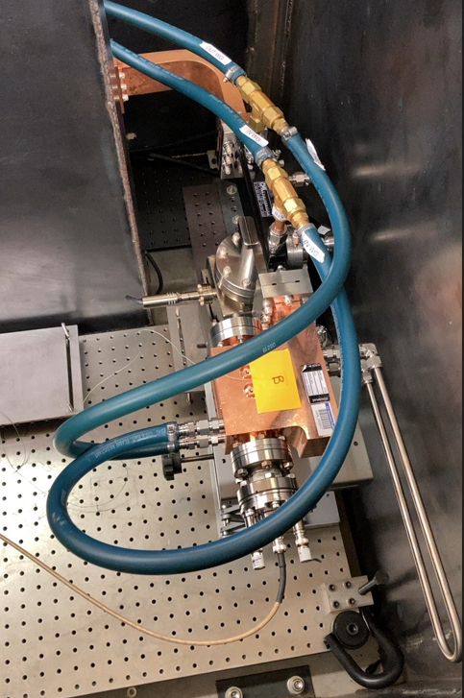
Prototype booster cell for LANSCE upgrade
The goal of this experiment is to measure the breakdown rates at accelerating gradients of 40 MV/m and 80 MV/m.

Slide 13
Summary and test plans for CERF-NM
LANL C-band high gradient test stand is currently operational
Testing of the SLAC copper beta=0.5 cavities and two a/λ = 0.105 cavities is finished.
Right now, we test the optimized proton booster cell.
We are talking to Euclid about a possibility to test their design of a pulse compressor.
The test stand is open to collaborators.
We consider adding capability to cool cavities under test to cryogenic temperatures.

Slide 14
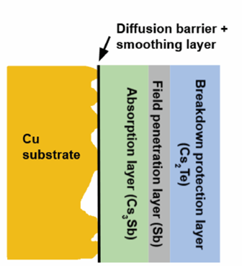
CARIE: Cathodes And Rf Interactions in Extremes
A new three-year project was funded at LANL to demonstrate operation of high-quantum-efficiency cathodes in a high-gradient RF injector.
Project builds upon LANL’s expertise in high-gradient C-band and high-QE photocathodes.
The proposed heterostructured cathode will include multiple layers to ensure atomic flatness of the surface, high QE, and the ability to withstand high electric fields with no breakdown.
Target beam parameters: 250 pC, 0.1 μm*rad, B_{5D} = 10¹⁶ A/m².
The project started in October of 2022.

Slide 15
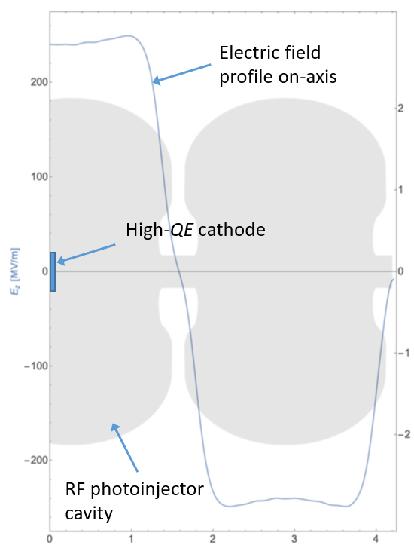
RF photoinjector considerations
We will fabricate 1.6 cell gun design by UCLA/SLAC.
Questions we are trying to address:
The cathode: there is an idea to grow the cathode straight on the copper wall. This is an engineering challenge. Current design: INFN plug.
RF coupler design: must take into account integration with the cryo-cooling and the solenoid.
Solenoid: must take into account integration with the cryo-cooling.
Cryo-cooling: cryo-cooler and low rep rate or liquid nitrogen?

Slide 16
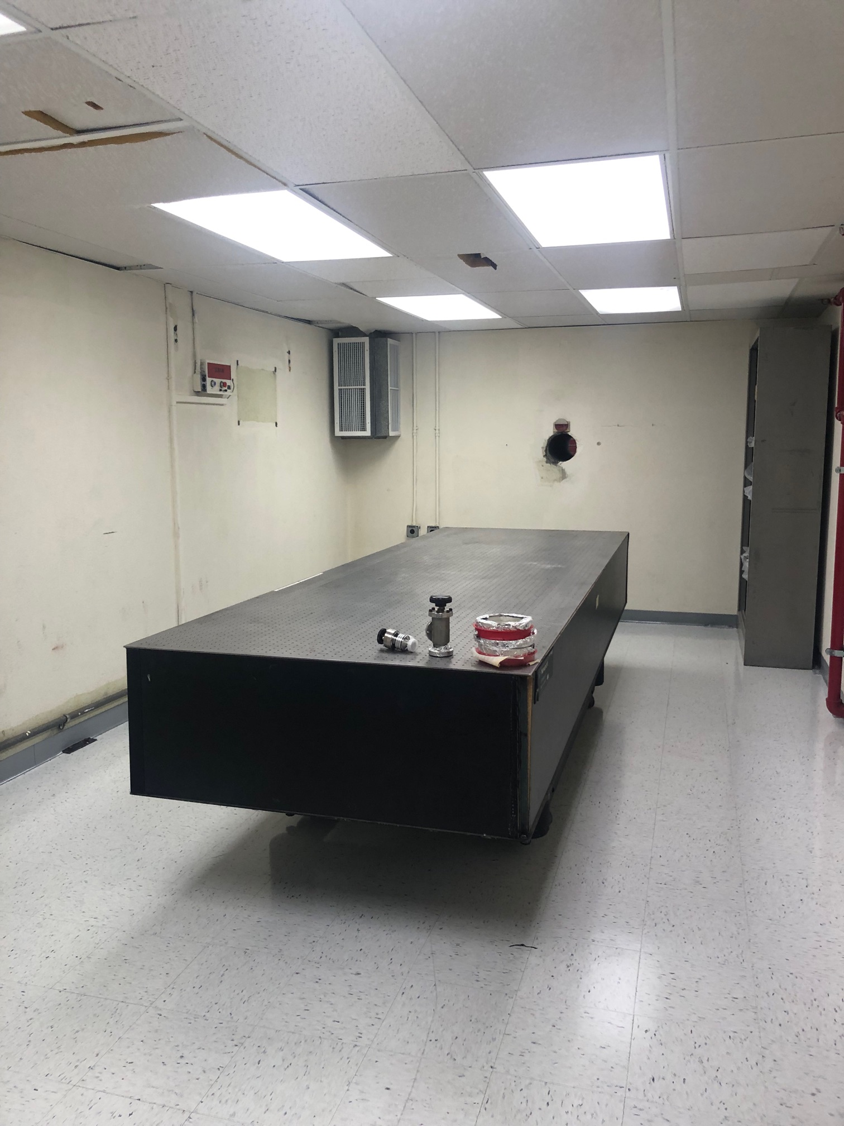
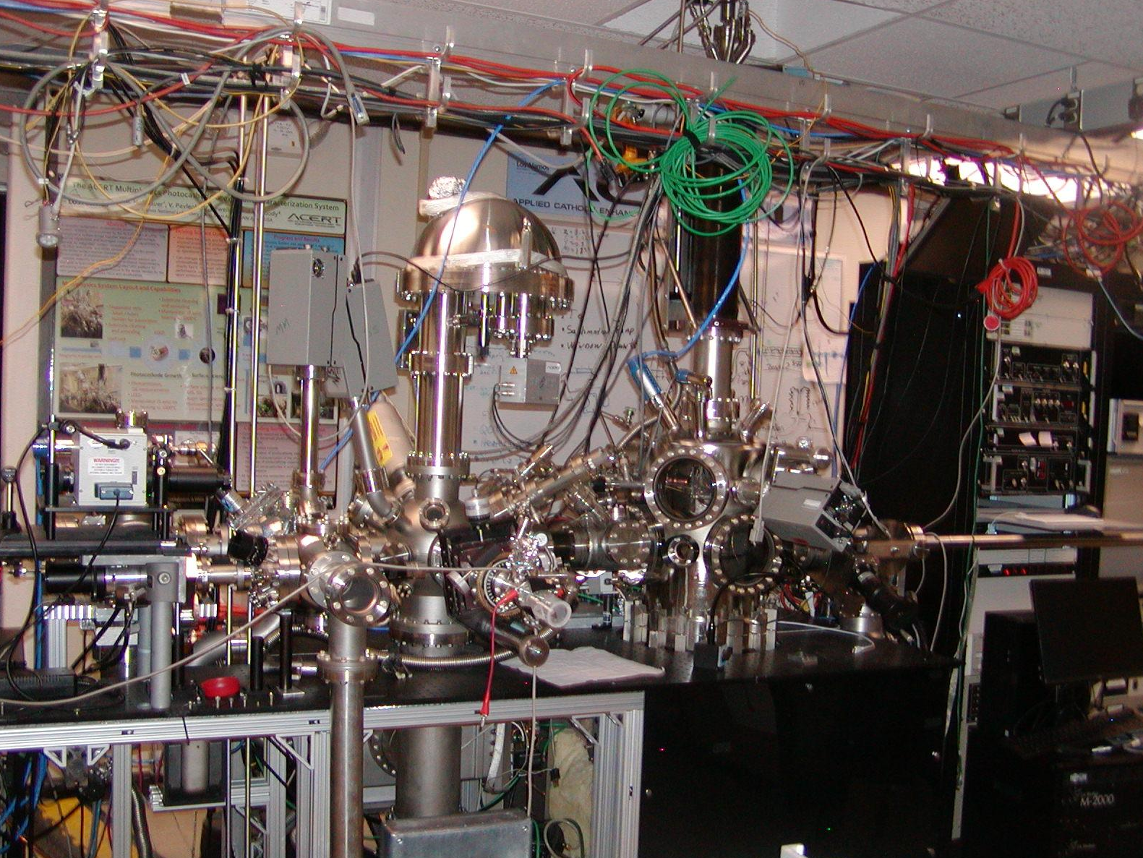
CARIE vault
A location was identified on LANSCE mesa that can accommodate a 20 kW electron beam.
Co-located with a cathode fabrication and characterization facility (ACERT).
The vault was cleaned for the new experiment.
A modulator for the 50 MW C-band klystron is in the final stages of procurement.

Slide 17
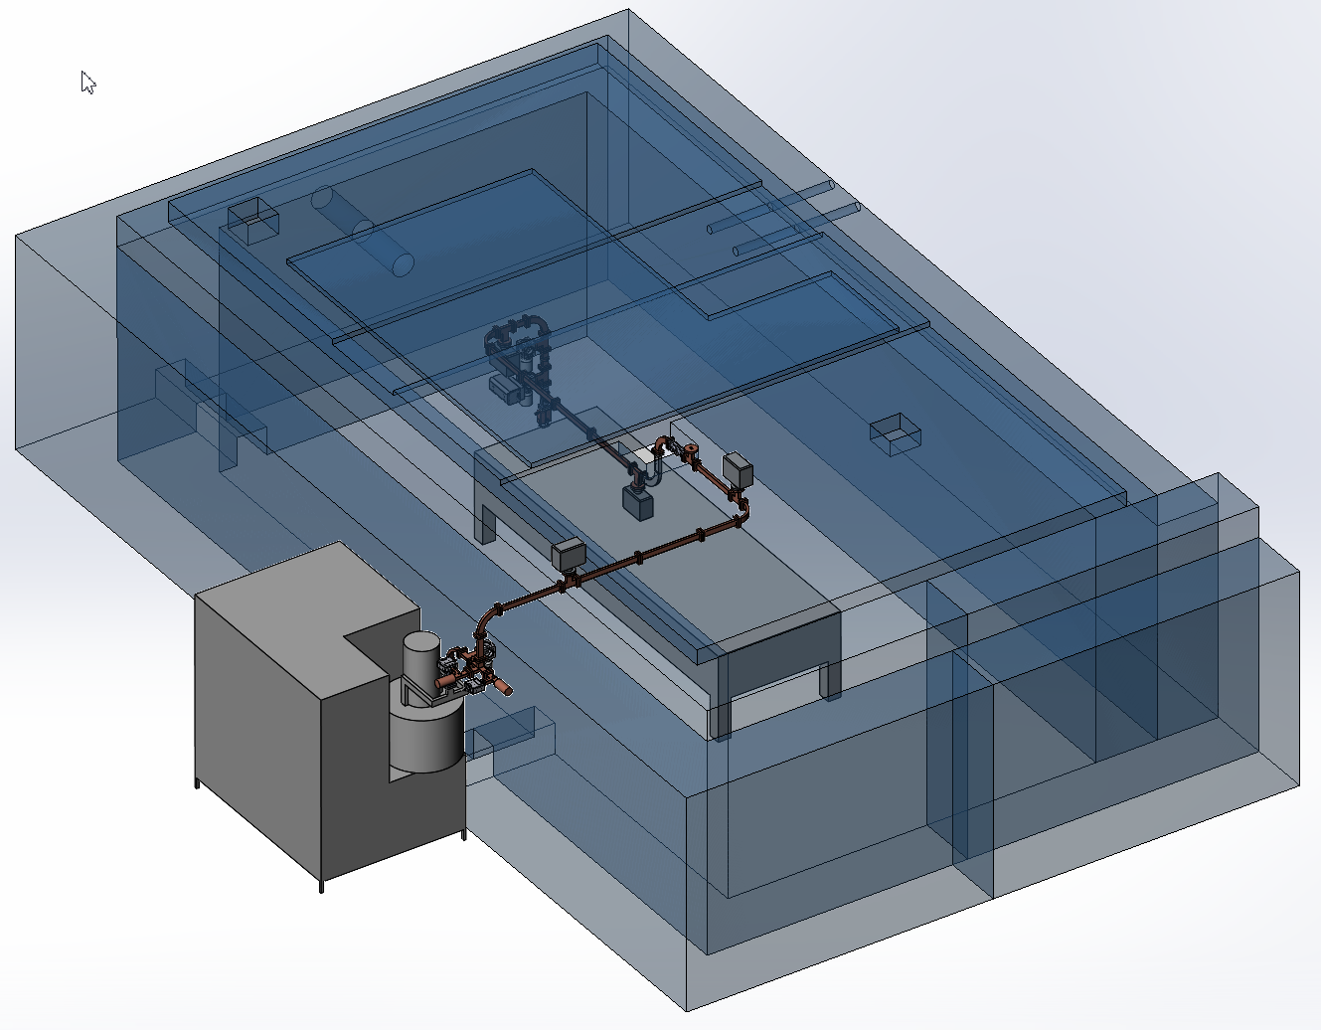
CARIE vault facility lineout

Slide 18
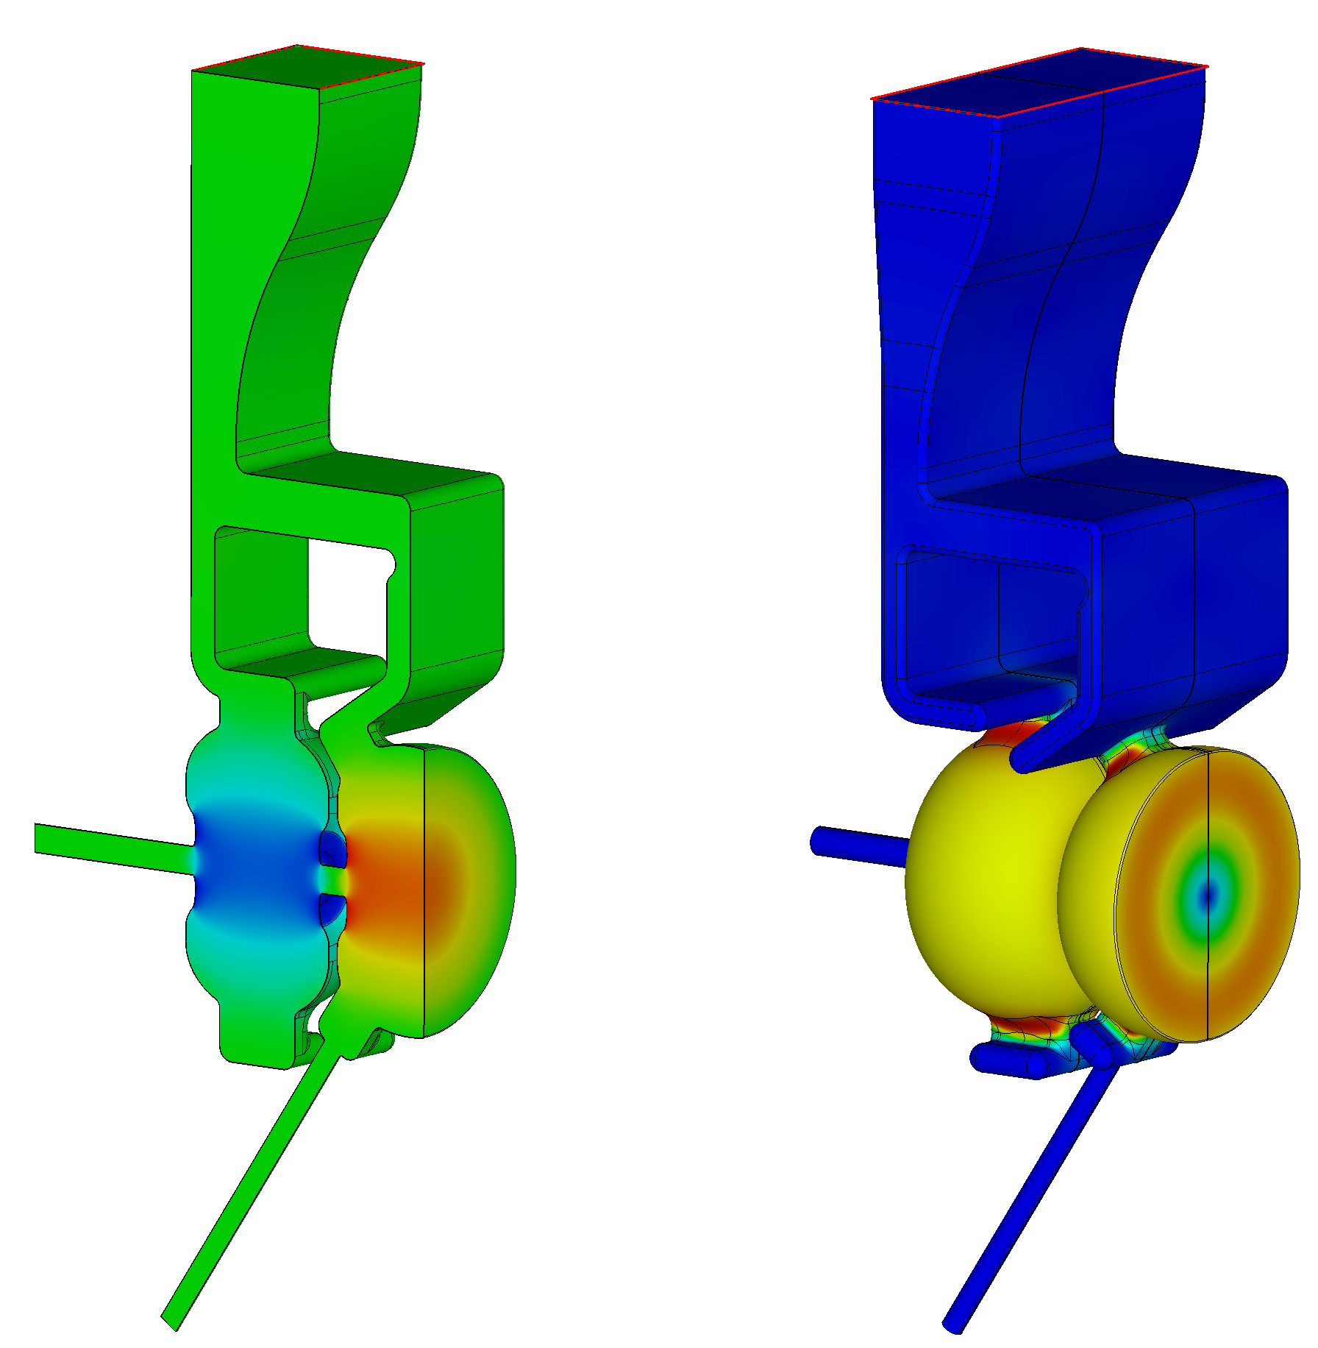


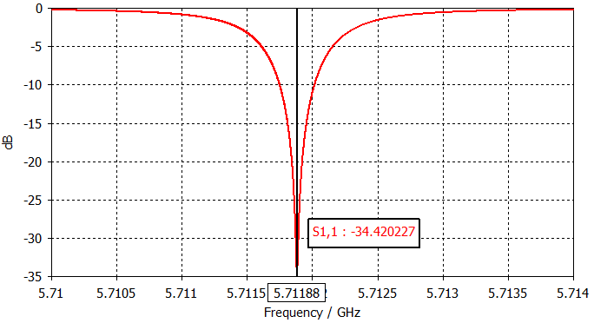
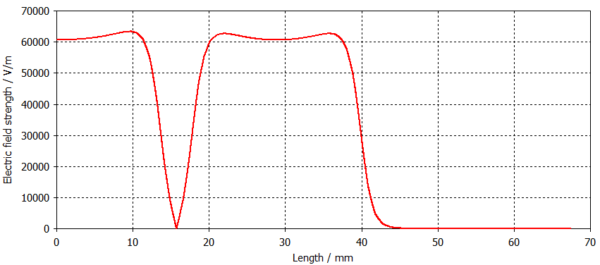
RF photoinjector electromagnetic design
RF design for the all-copper photoinjector is complete.
1.6 cell injector
Two waveguides couple the half-cell and the full cell with 180⁰ phase advance.
E_{surf}/E_{cath}=1.28, H_{surf}Z₀/E_{cath}=0.64.
Power for E_{cath}= 240 MV/m is about 8 MW.
E_{m}

Slide 19
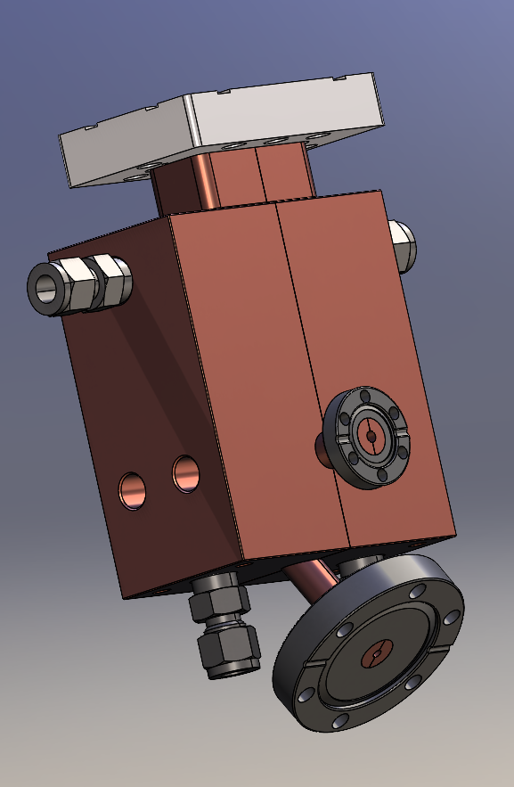
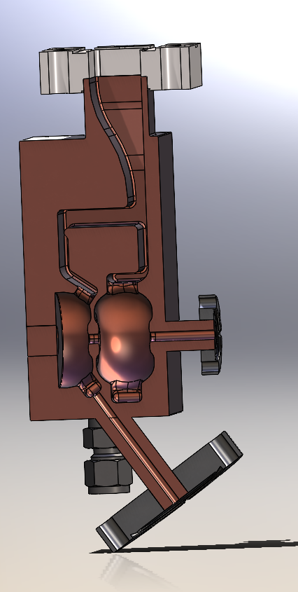
RF photoinjector fabrication
We will first fabricate and test an all-copper injector with no cathode plug.
CAD design for the all-copper photoinjector is complete.
Purchase order is in procurement.
Estimated delivery time is 15 weeks.

Slide 20
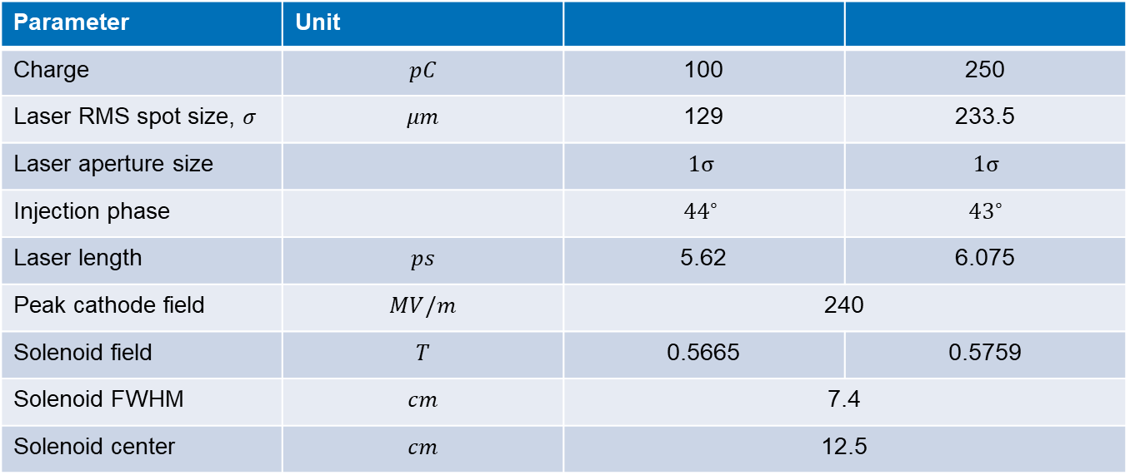
RF injector beamline design (and comparison to 100 pC case)
Parameter | Unit
Charge | $$pC$$ | 100 | 250
Laser RMS spot size, $σ$ | $$μm$$ | 129 | 233.5
Laser aperture size |  | $$1σ$$ | $$1σ$$
Injection phase |  | $${44}^{∘}$$ | $${43}^{∘}$$
Laser length | $$ps$$ | 5.62 | 6.075
Peak cathode field | $$MV/m$$ | 240 | 240
Solenoid field | $$T$$ | 0.5665 | 0.5759
Solenoid FWHM | $$cm$$ | 7.4 | 7.4
Solenoid center | $$cm$$ | 12.5 | 12.5

Slide 21
GPT simulations: beam emittance and spot size
100 pC case
250 pC case
Notes:
GPT output in GDF to SDDS to Python for plotting.

Slide 22
GPT simulations: beam current and slice emittance at beam waist
100 pC
250 pC

Slide 23
GPT simulations: beam brightness
100 pC
250 pC

Slide 24
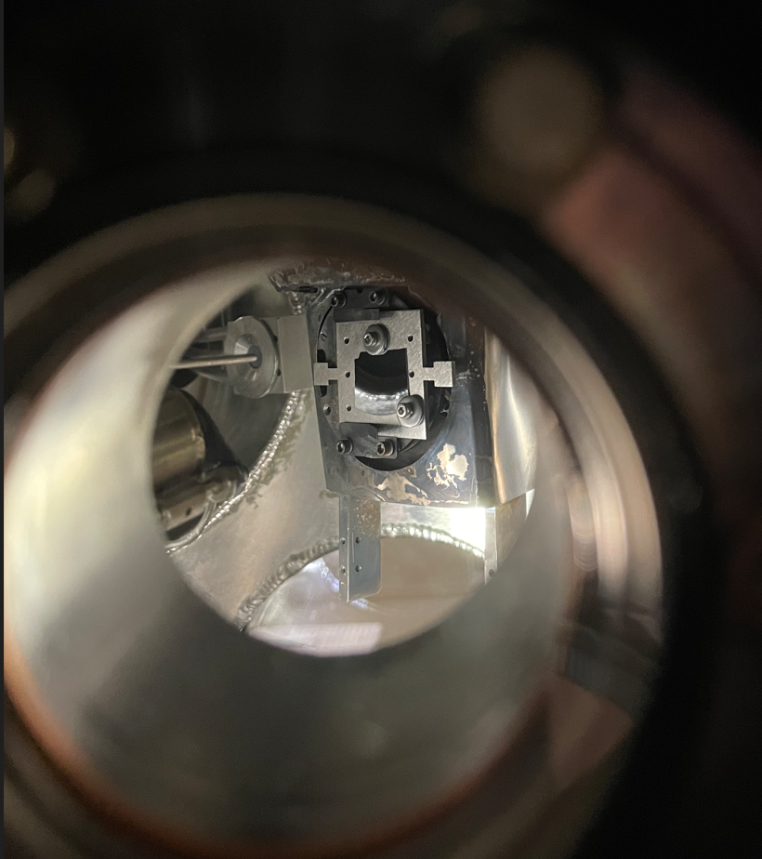
Cathode production at ACERT
Cathode growing chamber recommissioned.
CsTe cathode growing starts this week.

Slide 25
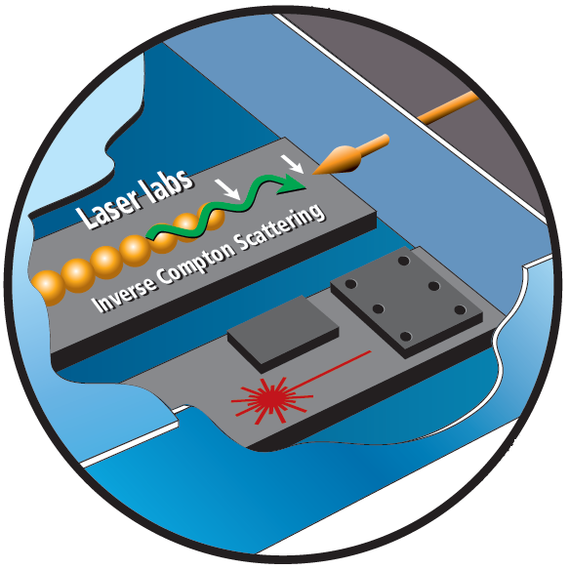
LANL has plans for further developing its C-band accelerator capabilities
Director Initiative money were allocated in FY22 to jump start this facility.
5-year goal: build operational C-band cryo-cooled copper accelerator.
Ultimate goal: provide 43 keV and 100 keV photon bursts for material studies with Inverse Compton Scattering
Another project idea under development – MeV Ultrafast Electron Diffraction facility.

