Slide 1
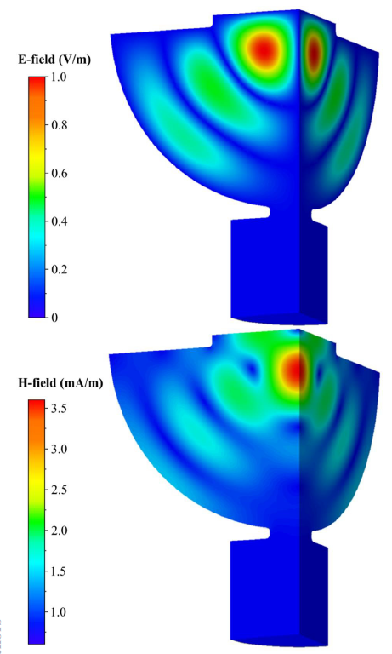
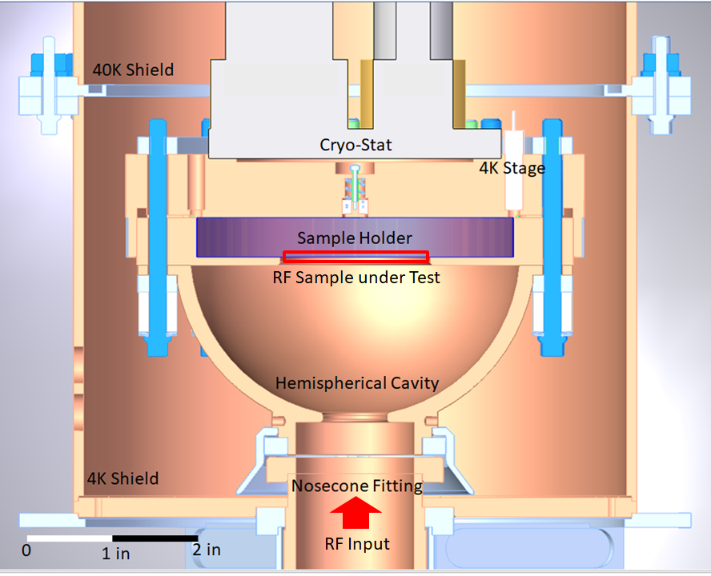
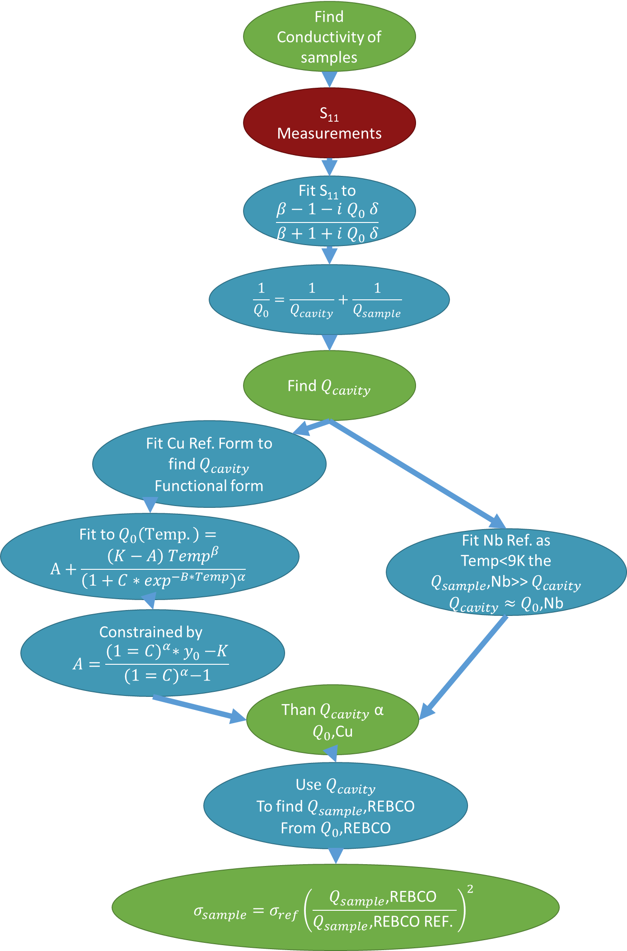
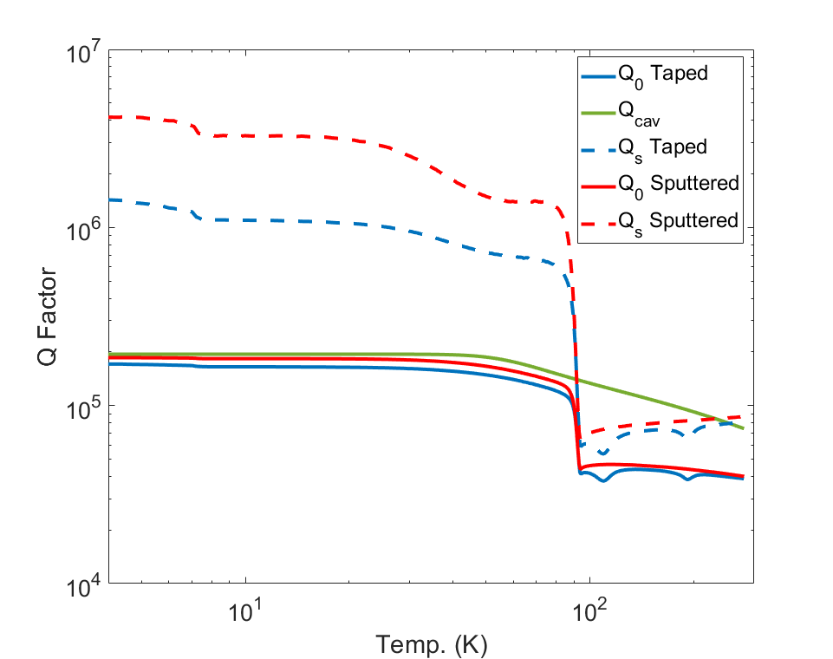
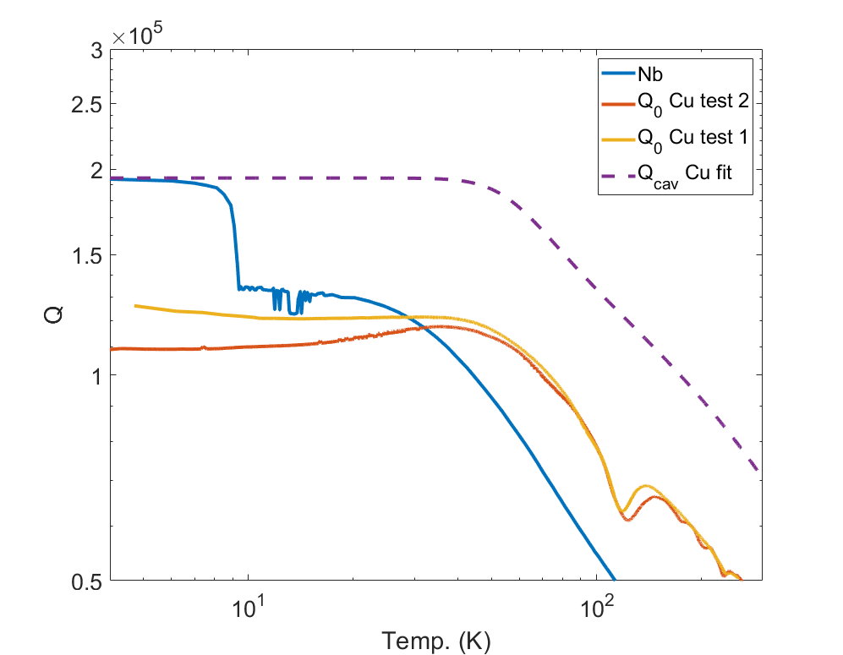
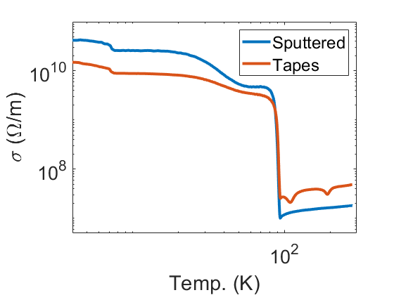
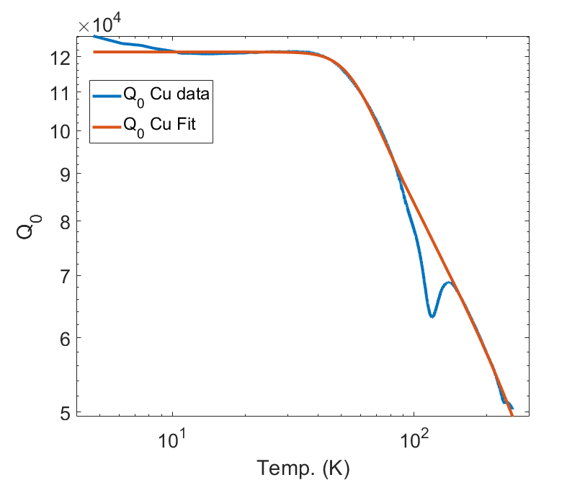
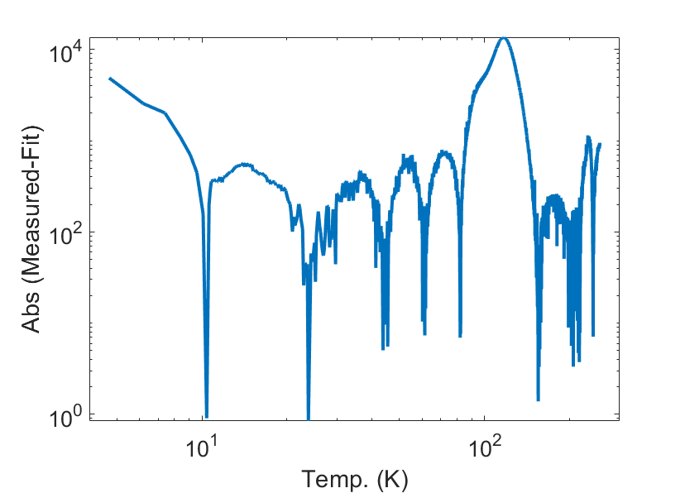
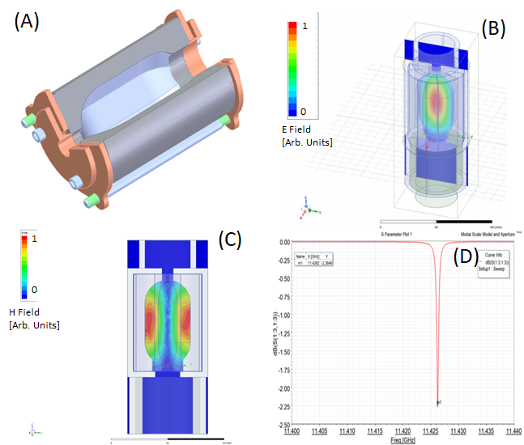
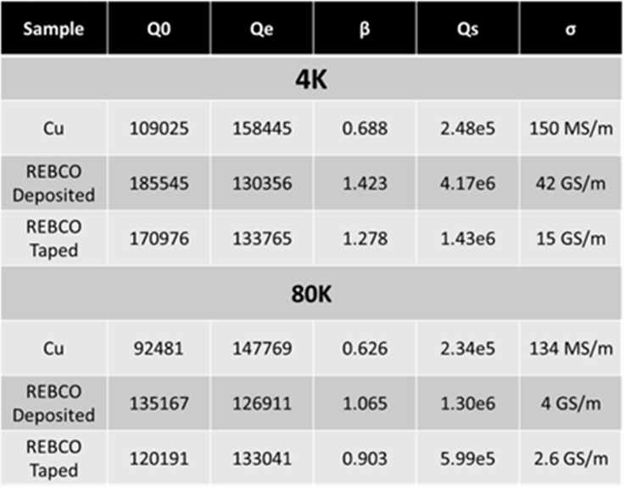
REBCO Sample Testing for a HTS High Q Cavity
Mitchell E. Schneider†, Gregory. P. Le Sage, Ankur Dhar, Emilio A. Nanni;
SLAC National Accelerator Laboratory, Menlo Park,California,USA
Jessica Golm, Patrick KrKotić,Walter Wuensch, Sergio Calatroni;
CERN, Geneva, Switzerland
Joffre Gutierrez; ICMAB-CSIC, Barcelona, Spain
†mitchs@slac.stanford.edu
Abstract
REBCO
FABRICATION PROCESS
HIGH POWER CRYOGENIC TESTSTAND
Nb LINAC have's low gradient <20 MV/m but CW
Cu LINAC in >> 100 MV/m but τ< 1μs
Conductivity (σ) of Nb>>Cu => the Q of Nb>> CU cavities
Cryogenic copper is the happy middle ground
High Q need for Devices like pulse compressors for cryogenic copper
High temperature superconductors (HTS) provide this Avenue Like REBCO that Tc
Two REBCO on Cu sputtered tapes
Coding used 2G CC Fujikura
buffer layer of MgO Films were 600 nm, tapes were 12 mm wide
Tapes Investigated as deposition be use on curvilinear surfaces.
Pmax 1MW
$τ_{max}⁡$=1μs
Temp Resolution 0.1 K
Dynamic range
4-300 K
Hemispherical cavity max H field on sample min E field
CONDUCTIVITY FROM
Q-FACTOR MEASUREMENTS
Low Power Testing of REBCO
Q0 for REBCO Dominated by cavity
REBC Ref. is 43GS/m
Qs Ref. for sputtered 4.2e6 and tapes 2.4e6
Measured for sputtered
within 1% reference
Tape samples factor for less sputtered
Dips and Cu not due to superposition of
WG+Cavity mode
Tc of 88K
Design of HTS Cavity
REBCO 80 K used for design parameters of a HTS cavity
Cavity will be used as an RF pulse compressor for future collider's
fill time 1 µs requires Q external to be 71,000
Constraining beam iris 5.7 mm
Q0 for REBCO walls is 201,000 =>β=39.55
Conclusions
HTS Cavities provide exciting high Q cavity options that can provide high gradients at LN temperatures
As well as applications for pulse compressors and other High Q devices
Acknowledgement: This research has been supported by the U.S. Department of Energy (DOE) under Contract No. DE-AC02-76SF00515.

