Slide 1
Commercialization and fundamental research of waste heat recovery technology from ILC using ‘HASClay’
LCWS2023 in SLAC
Sustainability Session
Higashi-nihon KidenKaihatsu Co.,Ltd.(HKK)
Goh Mitoya

Slide 2
Contents
Corporate Introduction
ILC Candidate Sites and Green ILC
Off-line Waste Heat Circulation Model
What is ‘HASClay’?
Fundamental research
Demonstration tests to achieve commercialization
Summary

Slide 3
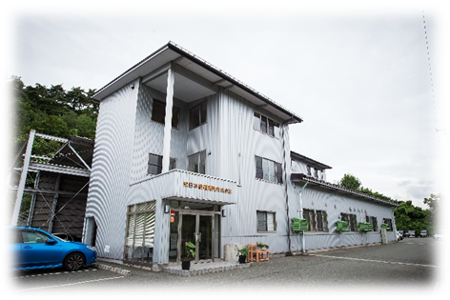
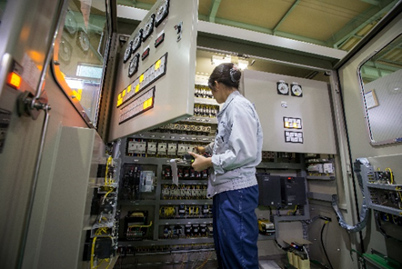
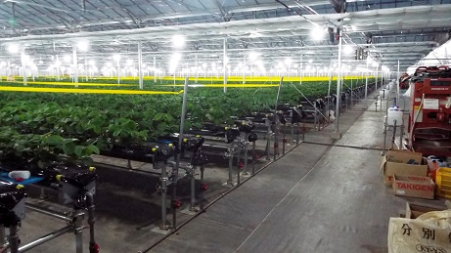
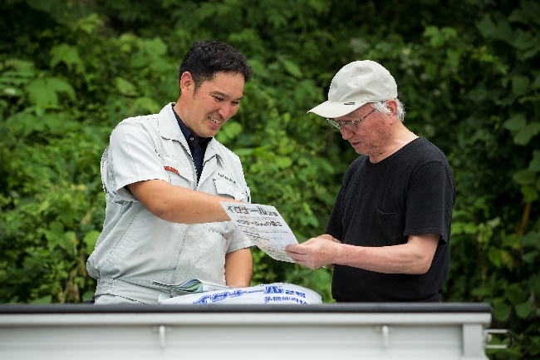
Corporate Introduction
Higashi-nihon KidenKaihatsu Co,.Ltd. (HKK)
Established in | January 22, 1971
Numbers of employees | 53
Business | Electromechanical business Design and fabrication of control and instrumentation systems for various plants. Environmental business (Agricultural-related) Sales of special fertilizers and agricultural materials. Design and construction of closed-type elevated cultivation systems for strawberries.

Slide 4
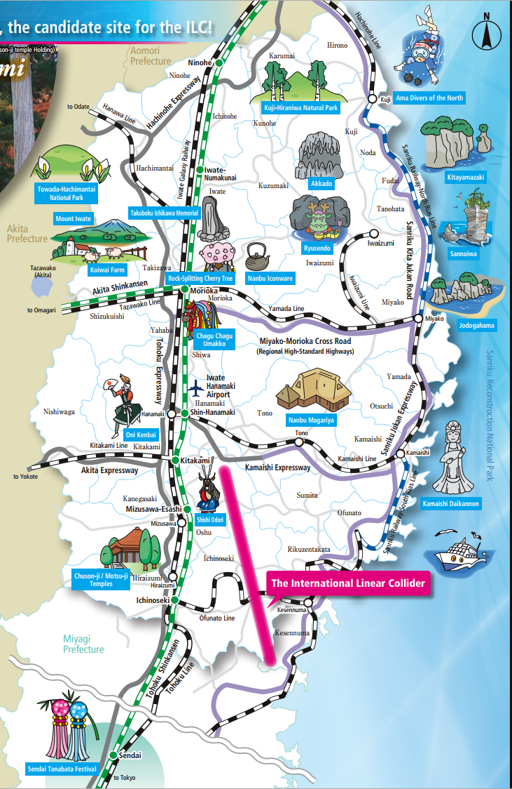
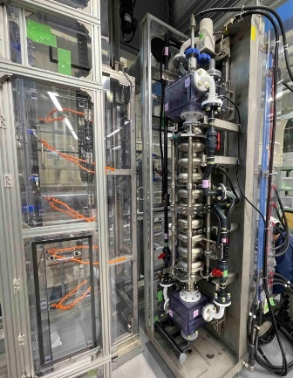
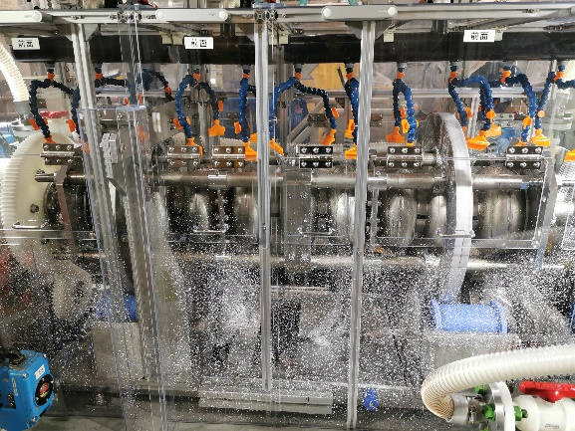
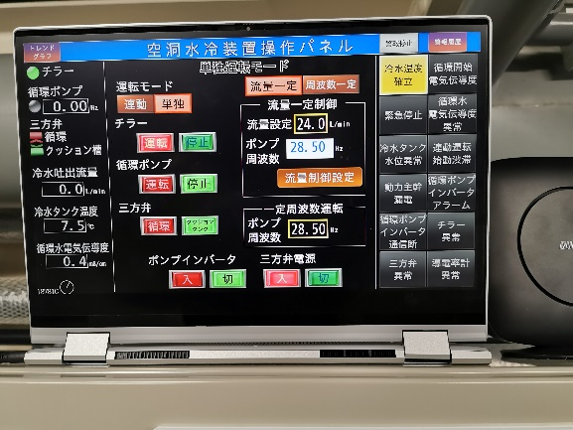
Corporate Introduction
Morioka-shi
The capital of Iwate Prefecture.
HKK is located here.
Distance: about 100 km
By car: about 1.5 hour
Candidate site for the ILC construction

Slide 5
ILC Candidate Sites and Green ILC
‘Green ILC Concept’
Utilizing clean energy supplied from the local region.
Thorough efficiency optimization to minimize energy consumption.
Utilizing waste heat and applying it to local industries.
Creating an attractive living environment in the Tohoku and Kitakami areas.
Advanced urban development
Local revitalization and community activation
Reconstruction from the Great East Japan Earthquake

Slide 6
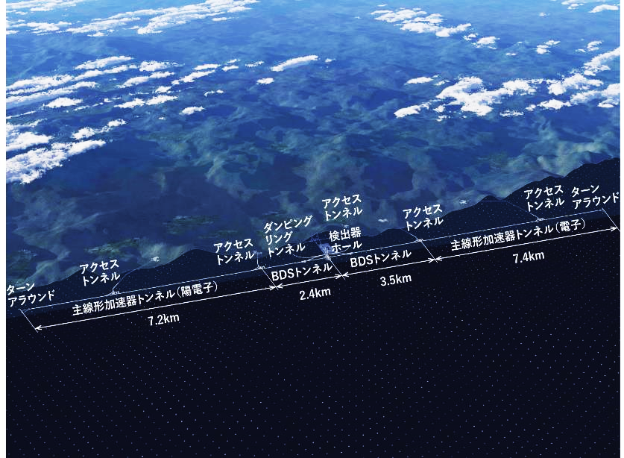
ILC Candidate Sites and Green ILC
Features of Iwate Prefecture
There are many exhaust heat sources such as factories, hot springs, and geothermal power plants.
Since there are many mountainous areas , it is difficult to place facilities that generate heat energy and those that use it effectively close to each other.
©Rey.Hori/KEK
Image of ILC at Kitakami site.
It is suitable to use heat circulation
by non-piping (off-line) transportation using a car, etc.,
instead of piping (on-line) transportation.

Slide 7
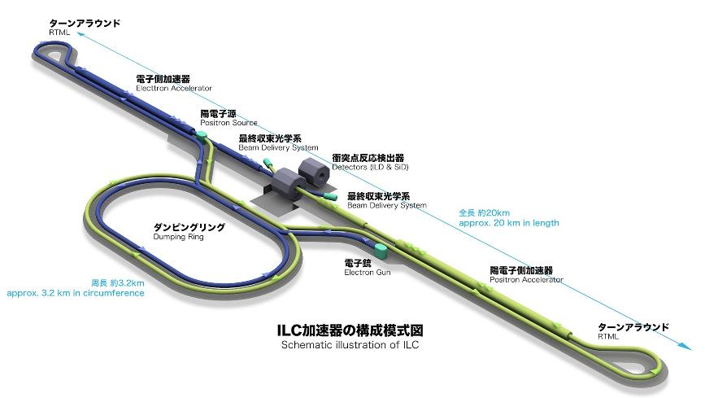
ILC Candidate Sites and Green ILC
70% of the exhaust thermal energy is less than 200℃ .
Most of them are not reused and thrown away.
ILC annual power consumption
~about 700 million kWh
Released as low-grade heat of about 60 ˚C
Schematic illustration of ILC
Source: KEK Homepage
Total annual heat exhaust at the factory in Japan.
Source: Tomohiro Akiyama, Journal of the Japan Institute energy，86，101-187(2007)

Slide 8
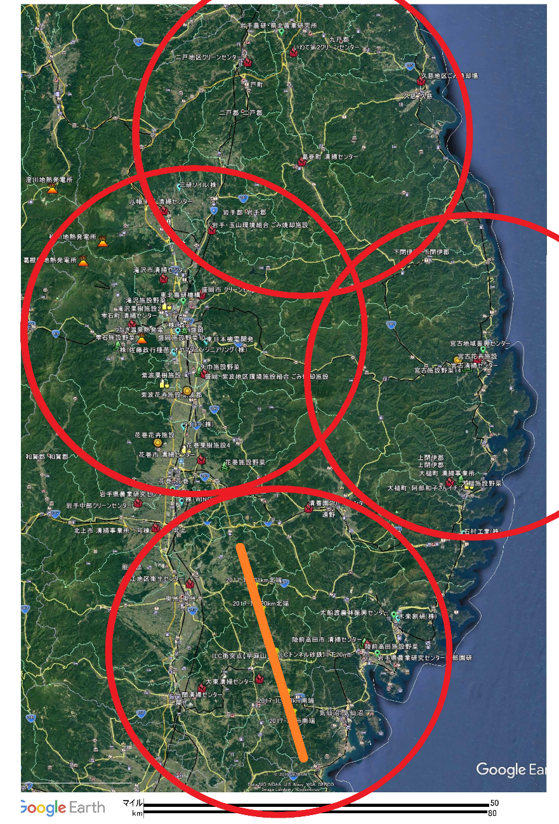
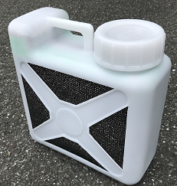
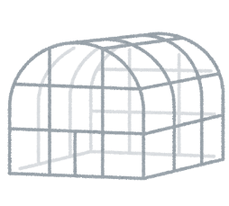
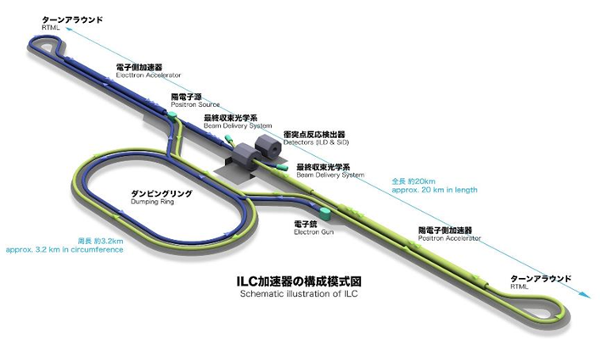
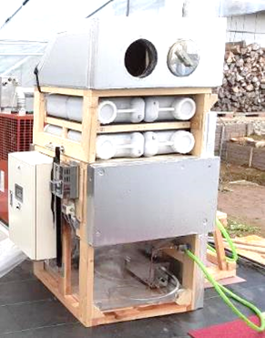
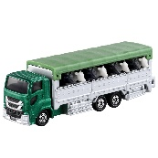
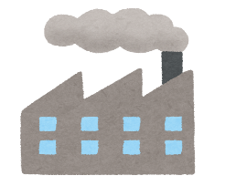
Off-line Waste Heat Circulation Model
Heat storage process
Heat reuse process
Portable Hasclay container
Exhaust heat from ILC
(50~100 ˚C)
Greenhouse
for agriculture
Containers delivery
Containers delivery
Containers delivery
Energy
management
Containers delivery
Heat release device
Demand and supply
Energy pricing and billing
Building a system that networks the facilities with small-scale and decentralized demand and supply, making it accessible to many people.
Heat reuse process
Heat storage process
Greenhouse for agriculture
Exhaust heat from Factory (50~100 ˚C)

Slide 9
What’s HASClay ?
HASClay® is an inorganic adsorbent material composed of a composite of amorphous hydroxyl aluminum silicate (HAS) and low-crystallinity clay.
HASClay® has the ability to store heat with the principle of energy transfer by water vapor desorption.
In particular, it has an excellent storage capacity for low-grade heat (<100 ˚C).
It is capable of repeating the heat storage and dissipation cycle over and over again.
By sealing the container and blocking moisture, the heat energy can be stored semi-permanently and will not ignite or deteriorate, making it safe to store.
Off-line transport allows exhaust heat from ILC and factories to be used effectively in a wide range of fields.
The appearance of HASClay®
Performance of various adsorbents
Adsorbent | Heat storage ability | Heat storage capacity(kJ/L)
HASclay | 40 ˚C or more | 567
Modified zeolite | 80 ˚C or more | 439

Slide 10
Fundamental research
The aim of research.
Understanding the microstructure of the HASClay using a synchrotron radiation facility.
During the demonstration tests until May 2022, HASClay was only able to exhibit an average heat dissipation performance of approximately 46.9%.
It is necessary to stably extract the heat storage and dissipation performance of HASClay.
We want to utilize a synchrotron radiation facility to elucidate the structural changes in HASClay during water adsorption and desorption, and improve the heat dissipation performance.
"X-ray imaging (SAGA Light Source, BL07)“
We will perform X-ray imaging measurements on both unused and repeatedly used HASClay samples in various stages of drying (4 stages), and observe the internal state of each HASClay sample to obtain information on the changes that may occur in the material structure. This will allow us to investigate the optimization of the thermal storage environment.
"SAXS・USAXS(SPring-8,BL19B2) “
・Measurement using an automatic measurement robot
Small-angle scattering measurements will be conducted on unused and multiple-used HASClay samples that have been pre-absorbed with water to three levels. The purpose is to investigate the effect of pore size differences.
・Time-resolved (in-situ) measurements
A self-made temperature-controlled stage will be used to continuously dry the same sample in a wet state. The process of water molecule detachment and drying will be observed in situ using small-angle scattering to obtain insights.
Implemented in December 2022.

Slide 11
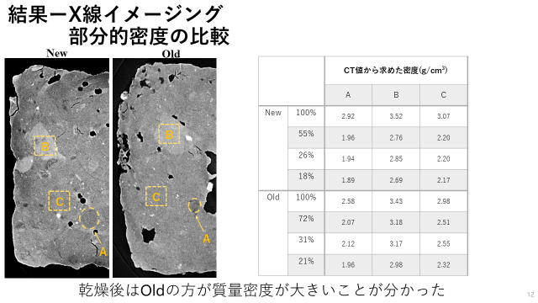
Fundamental research
"X-ray imaging (SAGA Light Source, BL07)“
We were able to observe three regions with different densities and the density changes that occur during each drying process.
After drying, it was revealed that the sample which had been used multiple times had a higher mass density compared to the unused sample, and the amount of density change during drying was smaller.

Slide 12
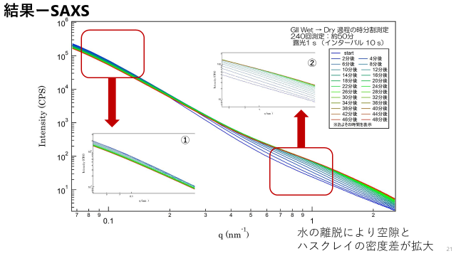
Fundamental research
"SAXS・USAXS(SPring-8,BL19B2) “
It was found that the density difference between the pore and the HASClay increases due to water evaporation.
By one-dimensionally converting SAXS and USAXS data, scattering profiles of unused and multiple-used samples could be compared.
The phenomenon of decreasing scattering intensity in the low-wave number region and increasing in the high-wave number region was observed.

Slide 13
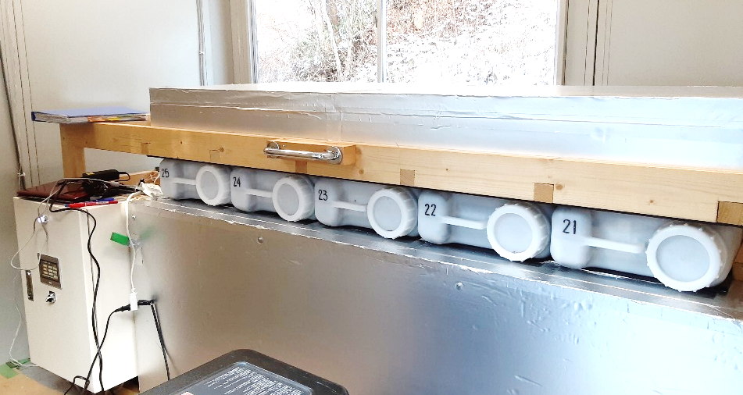
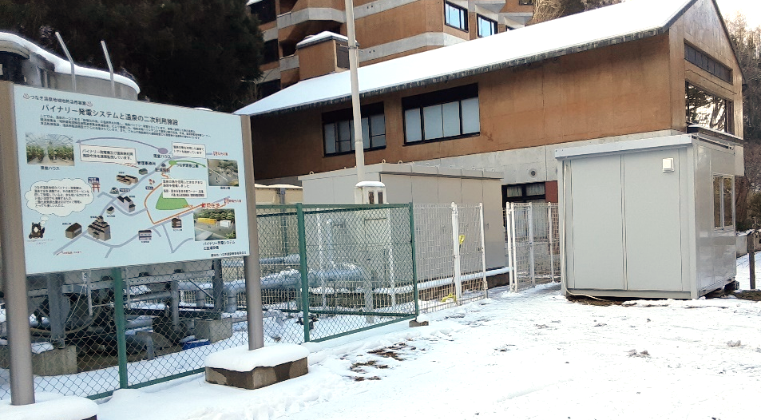
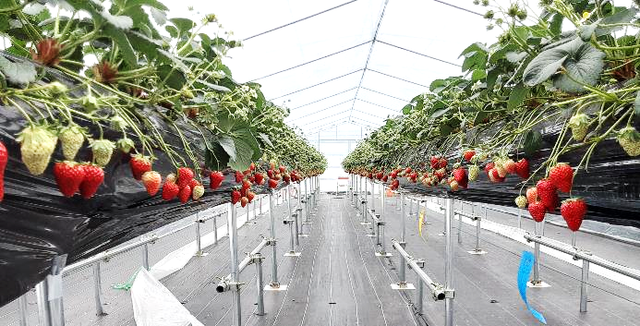
Demonstration tests to achieve commercialization
Thermal storage process: Hot spring
Heat dissipation process: Greenhouse
Utilizing the heat of hot spring water to store (dry) HASClay
Utilizing HASClay for heat dissipation and using it for nighttime heating
Delivery after heat storage
Heat storage device
inside
Heat dissipation device
Recovery and Recharging after Heat Dissipation
Panoramic view of the heat storage facility
Strawberry cultivation greenhouse

Slide 14
Demonstration tests to achieve commercialization
Thermal storage site --- Heat dissipation site : Distance 12 km / Delivery time 20 minites by car
Heat dissipation site:
Greenhouse ‘Takahashi Farm’
Thermal storage site: Hot spring
‘Morioka-tsunagi Onsen’

Slide 15
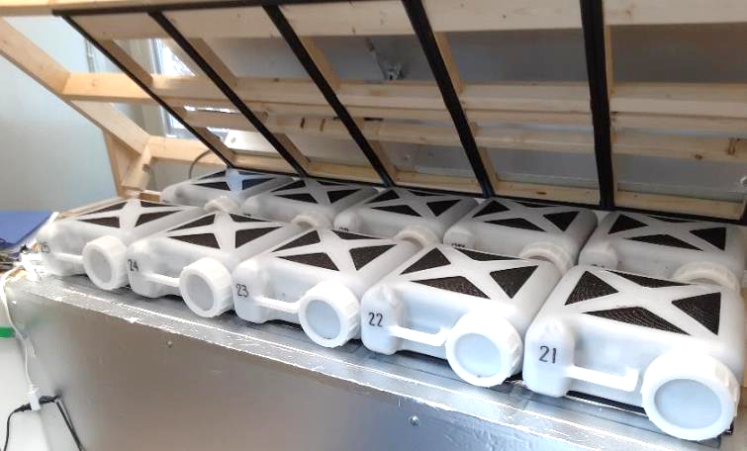
Demonstration tests to achieve commercialization
Thermal storage process
Tsunagi-Onsen(Morioka-shi)
Using hot spring water after binary power generation (60 ˚C)
Heat is exchanged in the hot spring water tank, and the heat is stored in HASClay using a fan coil unit
Store 10 small cases per cycle for heat storage
Dry approximately 10.5 kg of water adsorbed by releasing heat for an average of 14 hours
Thermal storage unit in open state
F
Heat Storage House
binary power generation
Hot sprig
water tank
30 m³
HAS
HAS
Fun coil
unit
P

Slide 16
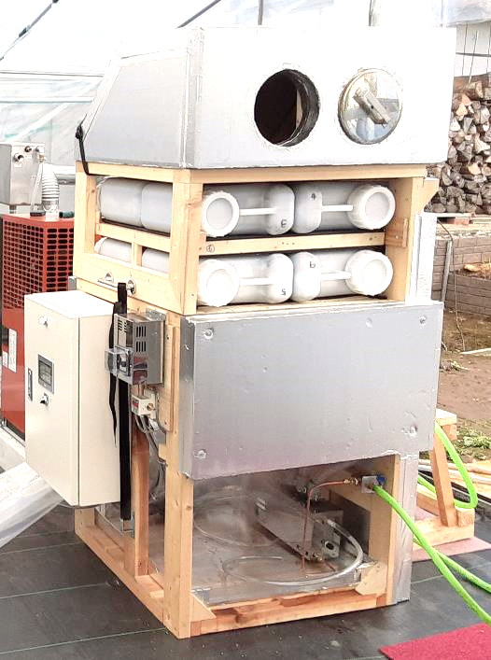
Demonstration tests to achieve commercialization
Heat dissipation process
178 m³ greenhouse located in agricultural fields in Morioka-shi
High-elevation cultivation of strawberries using localized heating methods (made by HKK)
Heating equipment:
Main = Wood stove / ‘Goron-ta’ 23 kW
(operates around 23:00)
Auxiliary = A kerosene-fueled air heater 22 kW
(operates at 10 ˚C or below)
We aim to use HASClay to heat during the night and before sunrise to reduce the consumption of kerosene used by the air heater
Heat dissipation device
8 small cases are released per cycle.
Water vapor is supplied from the bottom of the cases and adsorbed onto the HASClay, which then releases heat from the top of the device.

Slide 17
Demonstration tests to achieve commercialization
The result of a demonstration test.
The period from 2021 to 2022.
The heat dissipation performance in this experiment was approximately 46.9% output of the original performance of 9.03 MJ/10kg for the husk ash.
It is considered that 4.20 liters of kerosene were saved per day, and a total of 643 liters of kerosene were saved during 153 days.
→CO2 emissions reduction equivalent to 1.6 t-CO2/L
The period from 2022 to 2023.
The heat dissipation performance in this experiment was approximately 70.4% output of the original performance of 9.03 MJ/10kg for the husk ash.
It is considered that 6.4 liters of kerosene were saved per day, and a total of 680 liters of kerosene were saved during 107 days.
→CO2 emissions reduction equivalent to 1.69 t-CO2/L
By improving the heat dissipation performance, it is possible to reduce kerosene consumption even more.

Slide 18
Summary
Under the concept of the Green ILC, we are conducting research to recover and circulate the thermal energy discharged from the ILC facility within the region, and aim to commercialize it.
We are utilizing synchrotron radiation facilities to understand the state changes in water molecule adsorption and desorption within the fine pore structure of HASClay.
We are conducting parallel demonstration tests to achieve higher heat dissipation performance of HASClay.
We will collaborate with various organizations to achieve commercialization and aim for regional revitalization.

