Slide 1
My mission is to be based in Iwate Prefecture, where the ILC candidate site is located, and to work with the community to do what is necessary for the community to accept the ILC.
For this purpose, we are willing to make efforts in cooperation with many colleagues in Japan and abroad.
In particular, we would like to strengthen cooperation between the region and KEK and AAA in Japan.

Slide 2
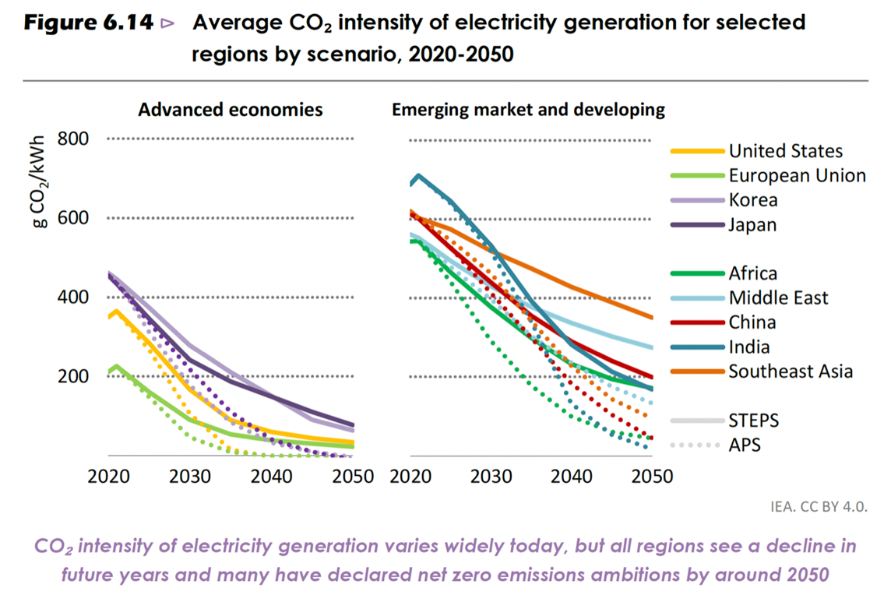
My presentation will be limited to the operational phase of ILC (not life cycle).
Thank you Benno–san for providing this valuable information!
This is my starting point of the today’s presentation.
Currently, CO₂ emission factor in Japan is twice as high as in Europe.
However, I will show a scenario in line with the national policy of achieving carbon neutrality by 2050 in my talk.

Slide 3
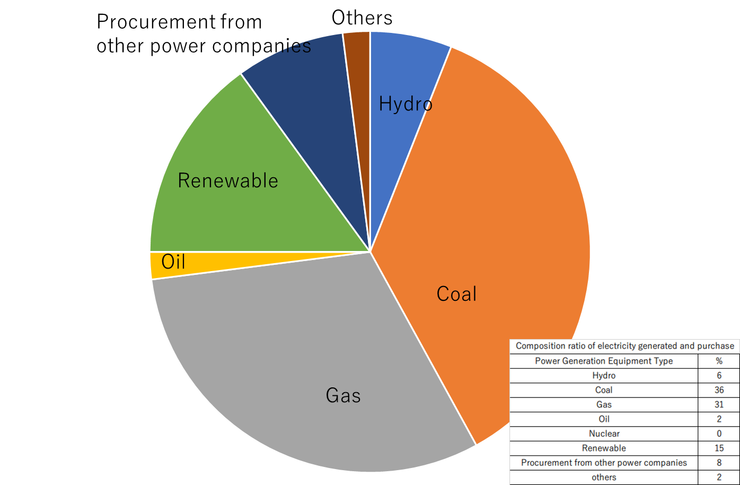
Tohoku Electric Power's Electricity Sales Results for 2021
The reason for the large CO₂ emission factor,
483g-CO₂/kWh, is simple:
70% fossil fuels
No Nuclear

Slide 4
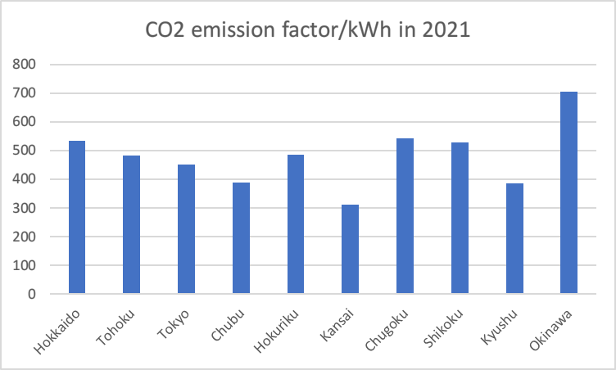
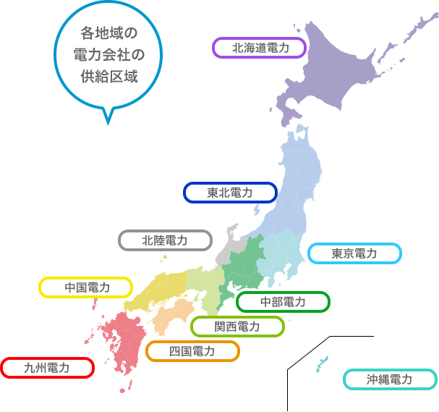
480
for each power company (g/kWh)
300(63% of Tohoku)
Hokkaido
ILC
Candidate site
Tohoku
Japan's power generation business is covered by 10 regional companies.
CO₂ emission factor depends on the power generation facility configuration of the company.
Hokuriku
Tokyo
Chugoku
Chubu
Kansai
Shikoku
Kyushu
Okinawa
Compare the electricity facility composition ratio of Kansai Electric Power Company, which has the lowest CO₂ emission factor, with that of Tohoku Electric Power Company, where the ILC candidate site is located. The factor of Kansai is 63% of Tohoku.

Slide 5
Comparison of electricity sales by generation facility between Kansai Electric Power and Tohoku Electric Power Company.
483g/kWh depends on large amounts of fossil fuels
No Nuclear
in
Tohoku

Slide 6
The Japanese government's policy until 2050 is to reduce fossil fuels and increase renewable energy while utilizing nuclear power to some extent.
Kansai Electric Power's power generation capacity ratio is close to the government's 2030 interim target if renewable energy is increased.

Slide 7
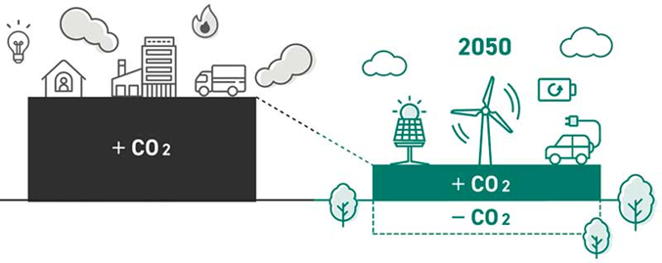
Japanese Government Policy for Achieving Carbon Neutrality by 2050.
Reduce CO₂ emissions and offset by increasing CO₂ absorption.
ILC also follows this Policy.
So what absorbs CO₂ sustainably?
For this purpose, I am working with the agriculture, forestry, and fisheries industries in the Tohoku region.

Slide 8
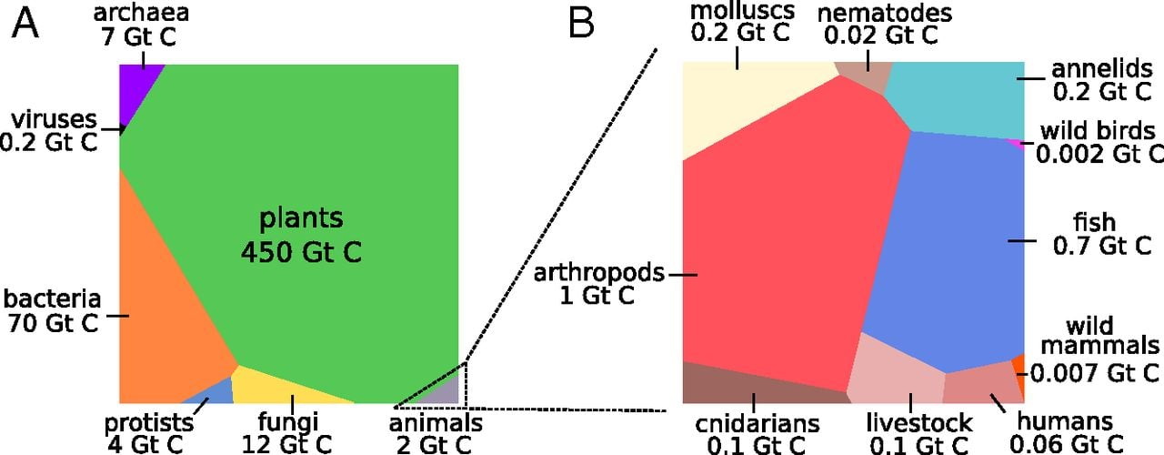
Why I am working with the agriculture, forestry, and fisheries industries in the Tohoku region ?
The reasons for this are shown in the figure below.
Main sustainable carbon stores are plants, which can store 450 Gt carbon.
Reference: ”The biomass distribution on Earth”, Y.M. Bar-On, R. Phillips, R. Milo,
https://www.google.com/search?client=firefox-b-d&q=The+biomas+distribution+on+earth

Slide 9
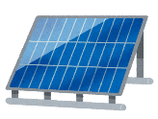
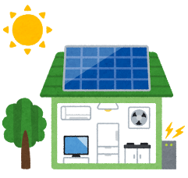
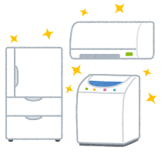
Using the Miyako-city (51,000 people, 1,259 km², Largest in area in Iwate) on the coast of Iwate as a case study, future projections were made in line with government policy.
Goal: Achieve carbon neutrality by 2050 !
To achieve this, emissions will be gradually reduced and increase green carbon (Forest) and blue carbon (Coastal Seaweed).
［k-ton］
emission
Increasing targets by renewable energy type.
500
Industry
14％reduction
46％
reduction
＜scenario＞
Business
Maintaining the Status Quo
250
Energy Saving Efforts
Home
Increase Renewable Energy and Energy Saving Efforts
Mobility
0
absorption
Forest
Increase absorption
to offset emissions
Final amount that must be emitted
Blue Carbon
Green Carbon
2013
（Base year）
①2018
②2030
interim target
③2050
Aiming to achieve carbon neutral
This slide is from Hiroaki Terasawa-san of Asia Air Survey CO., LTD.
Part of joint research between AAA and Tohoku ILC Project Promotion Center

Slide 10
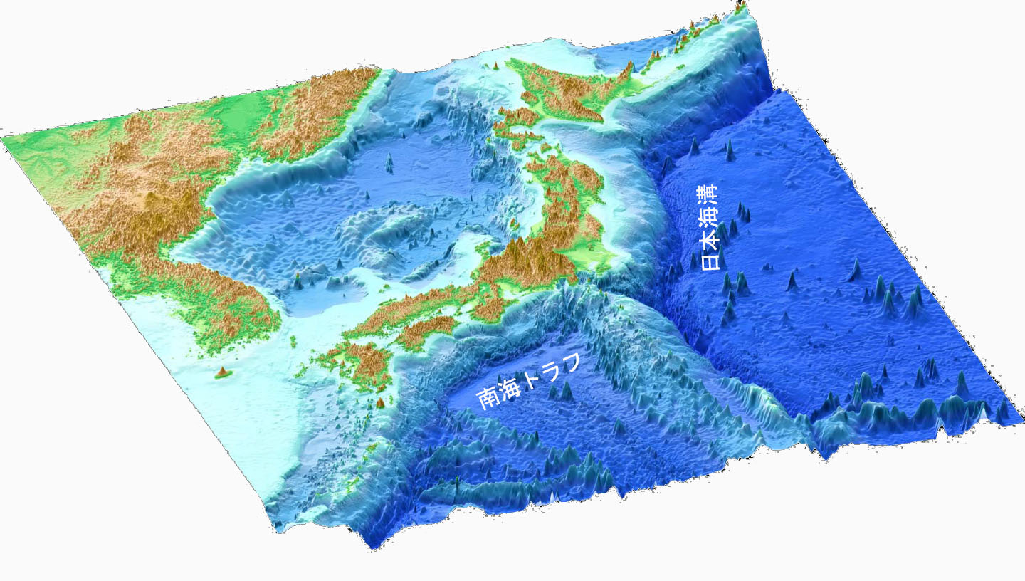
Japan has abundant sustainable plant resources
“Prevailing wind + water from Sea of Japan + backbone (e.g. of a mountain ridge)”
➔Bringing a bounty of 1,700 mm of average annual precipitation.
➔Japan is not blessed with fossil fuel production, but it has an abundance of sustainable biomass.
➔Properly managed biomass can be expected to absorb more than 5 tons of CO₂ per hectare annually.
Prevailing wind
Sea of Japan
Japan Trench
Nankai Trough

Slide 11
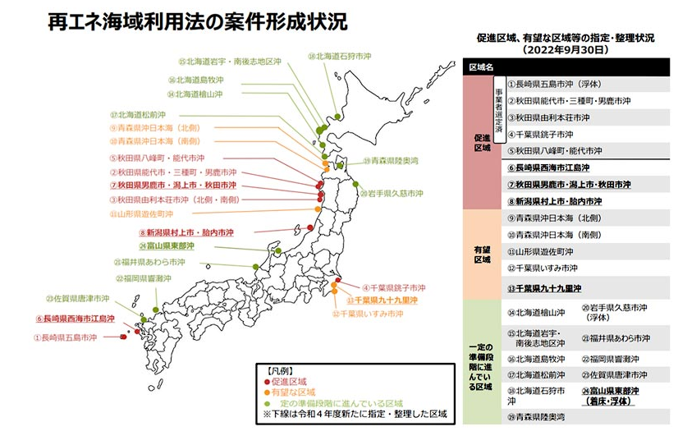
1. Distribution of wind conditions along the coast of Japan, where are suitable for wind power generation
This figure is from “Sustainable energy Sea Area Utilization Act, Case Formation Status”.
Tohoku region has particularly high potential for wind power generation.

Slide 12
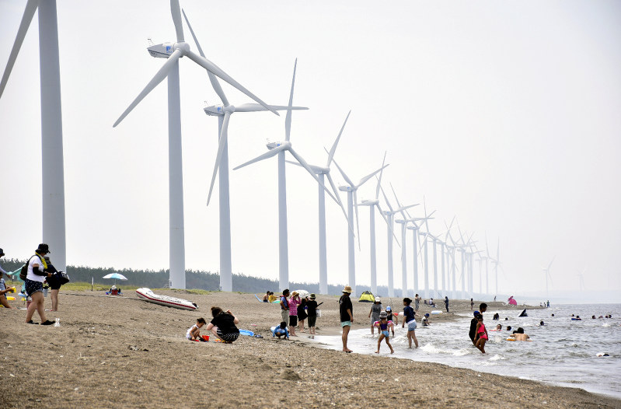
The Japanese government has a policy of increasing wind power generation capacity, and construction has been progressing rapidly recently.
One example: Situation on the Akita Prefecture coast facing the Sea of Japan

Slide 13
2. Forestry
Wood-based community development ➔ Shin-ich Takizawa’s presentation, this session
Here, I will show CO₂ absorption potential by forests in Ichinoseki City, where the ILC candidate site is located.
Forest Analysis in Ichinoseki City (ha)
Cedar in planted forests and various broadleaf trees in natural forests predominate.
Since CO₂ absorption by trees is highest during the growing season, understanding tree species and management conditions is the basis for calculating the amount of CO₂ absorption.

Slide 14
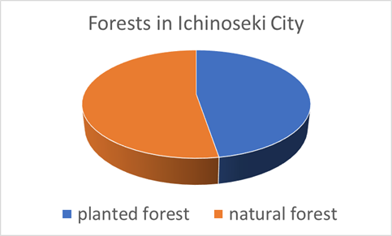
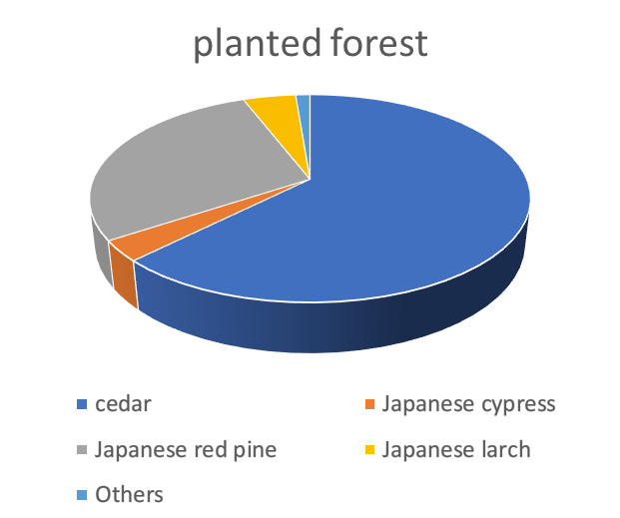
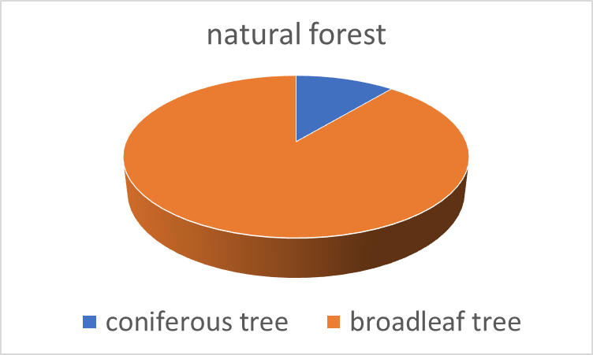
47% Planted Forest: 31465 ha
53% Natural Forest: 34895 ha
Total 66363 ha
Natural forests are mostly broadleaf tree.
In planted forests, cedar is the most abundant species, followed by red pine.
Estimation by Hiroshi Kikuchi-san, advisor to the Ichinoseki City Agricultural Land and Forestry Department:
The entire Ichinoseki forest absorbs 303.53 kilotons of CO₂ per year.
The average annual CO₂ absorption per unit area is 4.57 t/year/ha.
Japan's Forestry Agency estimates that an ideally managed artificial cedar forest can absorb 8.8 t CO₂ per hectare each year. Ichinoseki forest management has room for improvement.
This amount, 303.53 kilotons of CO₂ per year is already sufficient to cover the total emissions of the ILC by the CO₂ emission factor, which should be so around 2040.
Of course, it is necessary to consider the CO₂ balance of Ichinoseki City as a whole.
Therefore, it is important to try to further reduce emissions and increase absorption.

Slide 15
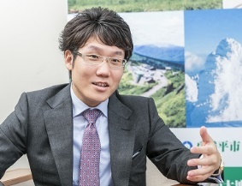
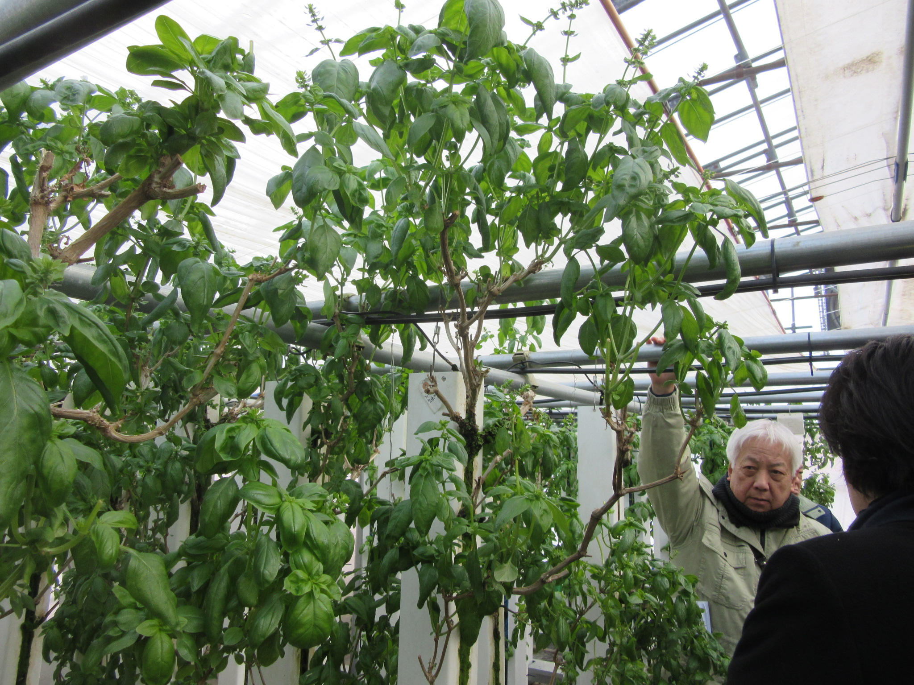
3. Agriculture
Greenhouse agriculture using ILC waste heat recovery (low-grade waste heat recovery)➔Goh Mitoya’s presentation, this session
Greenhouse agriculture using heat from hot springs and unused biomass.
Key person, president N. KODAMA of MOVIMAS Inc. (IT
Company).
Business in Hachimantai City, northern Iwate Prefecture.
3-D high-density hydroponic cultivation of Basil.
Heat source is a hot spring.

Slide 16
Technology
Thorough management through IoT that allows even inexperienced farmers to enter the farming industry.
Ventilation fan control
循環扇制御
換気扇制御
Suppresses pest infestation by regulating humidity and stabilize shipping quantity and quality
Circulating fan control
Reduction of disease risk through year-round air conditioning management
AI-based image evaluation
AI画像判定
ミスト制御
Mist control
Support for low-skilled farmers
Hot spring flow control
温泉流量制御
Nutrient Circulation control
Year-round cultivation through the use of hot spring heat ➔ Significant reduction of fossil fuels.
養液循環制御
Improved yield by optimizing fertilizer concentration/amount and acidity

Slide 17
4. Blue Carbon (CO₂ absorption by seaweed in coastal areas in the town of Hirono, northern Iwate Prefecture)
CO₂ absorption by seaweed is very promising because it is slightly better than that of forests.
Creating artificial tidal pools (4m wide and 1m deep ditches, total length 17.5 km) to create a flow of fresh seawater due to the difference in tidal range, which encourages the growth of wakame (seaweed) and kelp.
Seaweed is eventually anchored to the seafloor as flow algae.
3106.5 t (CO2 equivalent) certified as J Blue Credit.
Sea urchins (very tasty) are now abundant as a byproduct.
J Blue Credits are blue carbon credits issued and sold by JBE (Japan Business and Economy Technology Research Association).
JBE is composed of the National Maritime, Port and Aviation Research Institute, the Sasakawa Peace Foundation, and individual university professors.

Slide 18
Summary
ILC Lab (will be established in near future, hopefully) should make further effort to advance energy-saving technologies.
On the other hand, as a region with a candidate site, we will continue our efforts to realize a sustainable society by the time construction of the “ILC in Japan” begins.
To this end, we will make efforts to deepen cooperation between the ILC and local primary industries (agriculture, forestry, and fisheries).
Furthermore, we will use the technology of the ILC waste heat recovery project to build a regional thermal energy circulation system.
Thank you for your attention

