Slide 1
U.S. Department of Energy
Office of Science
Office of Accelerator R&D and Production
Camille M. Ginsburg
Deputy Director, Office of Accelerator R&D and Production
International Workshop on Future Linear Colliders
Industry Forum
May 16, 2023

Slide 2

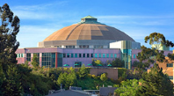
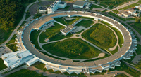
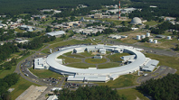
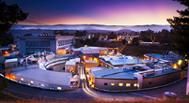
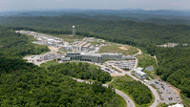
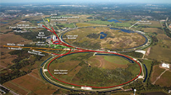
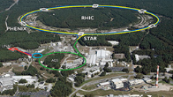

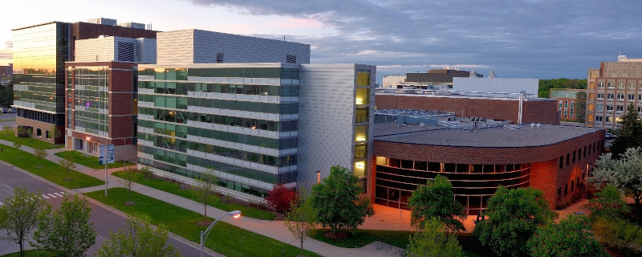
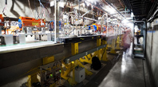
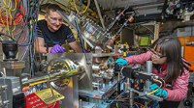
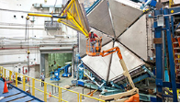

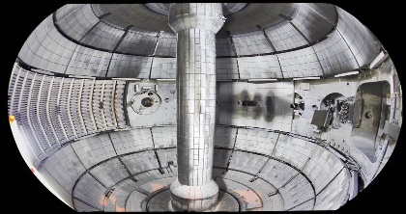
Nearly half of SC’s more than 38,500 users perform research at an accelerator-based facility
light sources
Linac Coherent Light Source
Advanced Light Source
Advanced Photon Source
National Synchrotron Light Source II
Stanford Synchrotron Radiation Light Source
hadrons
ions
Spallation Neutron Source
Fermilab Accelerator Complex
Relativistic Heavy Ion Collider
ATLAS
Facility for Rare Isotope Beams
ARDAP funded
test facilities
plasma
FACET-II Beam Test Facility
BNL Accelerator Test Facility
Continuous Electron Beam Accelerator Facility
DIII-D
NSTX-U
Accelerators and related technologies are the foundation of these world-leading scientific instruments
FY 2019: 19,337 users (54% of 35,771 total SC users) were at accelerator-based SC facilities.
FY 2020-2021 substantial drop due to COVID pandemic
FY 2022: 17,738 users (46% of 38,558 total SC users) were at accelerator-based SC facilities
Notes:
These facilities cost ~$1.5B to operate in FY 2022, with a further ~$0.5B in new accelerator facility construction.
In FY 2022, Long-term
AS&T investments total $96M (i.e., 4.8%).
Mention that SC’s large facilities are scattered across CA, IL, NY, VA, TN, NJ
Additional DOE facilities in NM, MO, WA

Slide 3
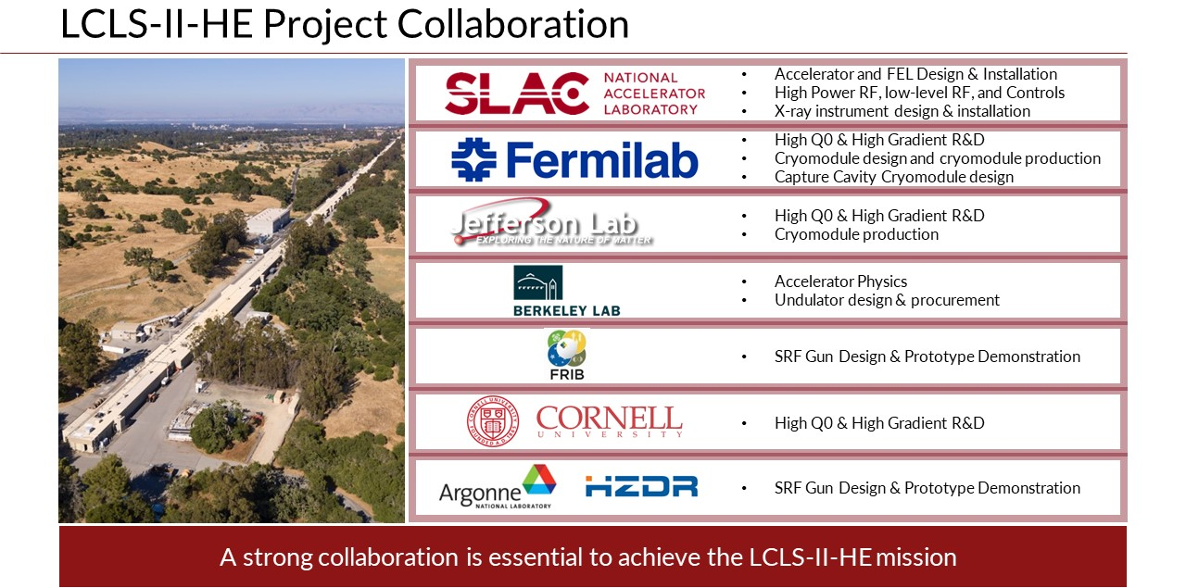
Next generation facilities will continue to need the close collaboration of institutions and funding sources
Notes:
Example in which close collaboration of institutions across funding offices is critical; drives the need for cross-cutting initiatives

Slide 4
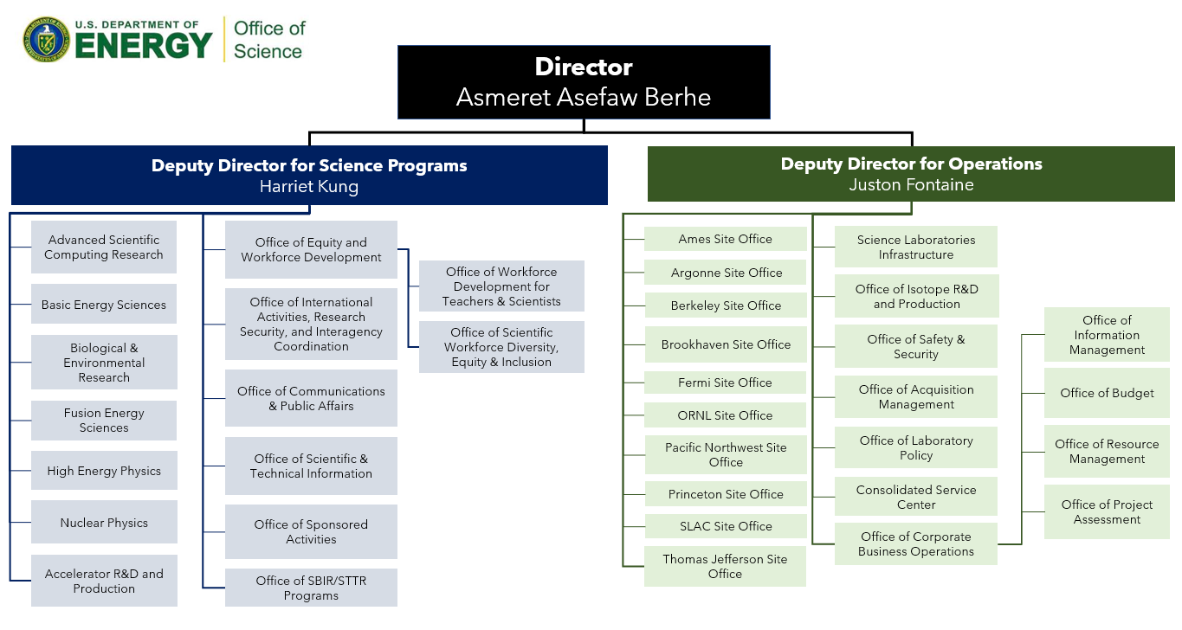
Establishment of ARDAP (SC-25)
Spun-off from HEP in 2020 in recognition of the central importance of accelerators and related technologies to the current and future scientific capabilities stewarded by SC programs.
Activities tightly integrated with those in BES, FES, HEP, and NP.
and Laser
* ARDAP = Office of Accelerator R&D and Production
Organization chart 5 Apr 2023

Slide 5
ARDAP People
Office Director and Program Manager for Accelerator Stewardship
Eric R. Colby
Email: Eric.Colby@science.doe.gov
Deputy Office Director and Program Manager for Accelerator Development
Camille M. Ginsburg
Email: Camille.Ginsburg@science.doe.gov
Program Manager (detailee) for Workforce Development
Marion M. White
Email: Marion.White@science.doe.gov
Program Manager (detailee)
Roark A. Marsh
Email: Roark.Marsh@science.doe.gov
Program Manager (detailee)
Christine I. Clarke
Email: Christine.Clarke@science.doe.gov
We welcome your input and feedback

Slide 6
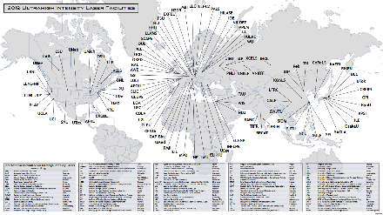
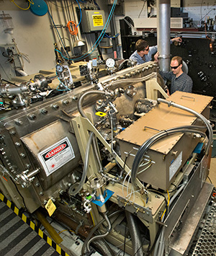
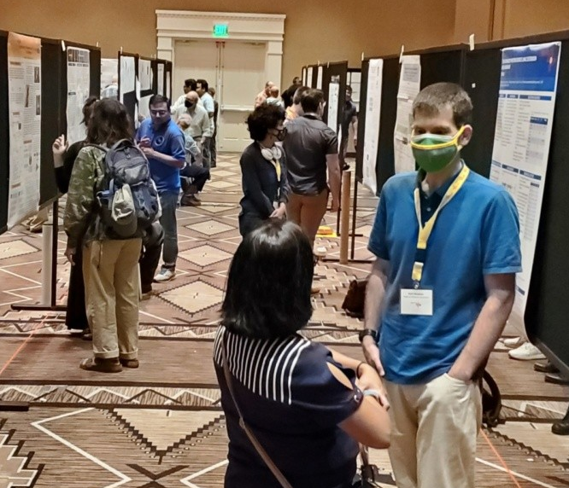
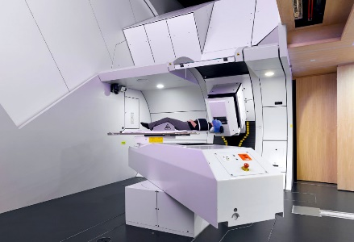
ARDAP Mission
…coordinate and make accelerator R&D and production investments aimed at addressing Accelerator Science & technology (AS&T) gaps to ensure new/emerging accelerator technology available for future discovery science, medicine, industry, and national security needs, by
  Facilitating coordination of Programmatic AS&T R&D investments across SC;
  Maintaining strategic picture of U.S. AS&T needs and worldwide competition;
  Investing in selected cross-cutting AS&T areas;
  Supporting workforce development;
  Maturing key AS&T technologies and developing capable U.S. vendors;
  Transitioning accelerator technology to broader uses beyond fundamental R&D.
Ultrahigh intensity laser facilities (2019)
BNL ATF CO2 laser
NAPAC 2022
Varian proton gantry w/HTS magnets @PSI
Notes:
Figures:
ICUIL.org map of ultrahigh intensity laser facilities, as of 2019.
BNL ATF picosecond- and terawatt-class CO2 Laser, the only in the world in the chirped pulse amplification regime
Proton gantry at PSI, Switzerland. Varian Medical Systems, LBNL, and PSI have teamed up to make a 3rd generation ultracompact fast-scan proton gantry from HTS magnets.
2022 NAPAC poster session

Slide 7

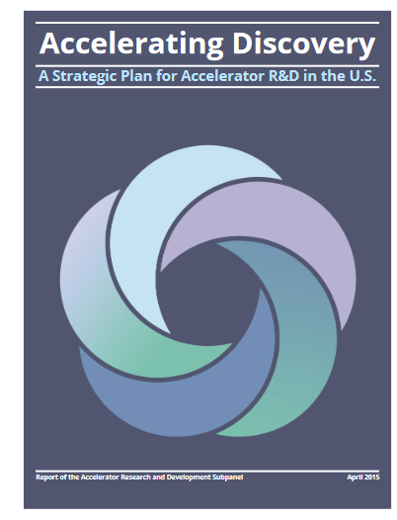
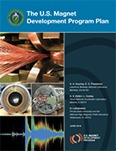
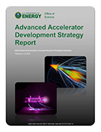
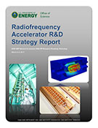
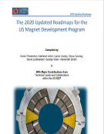
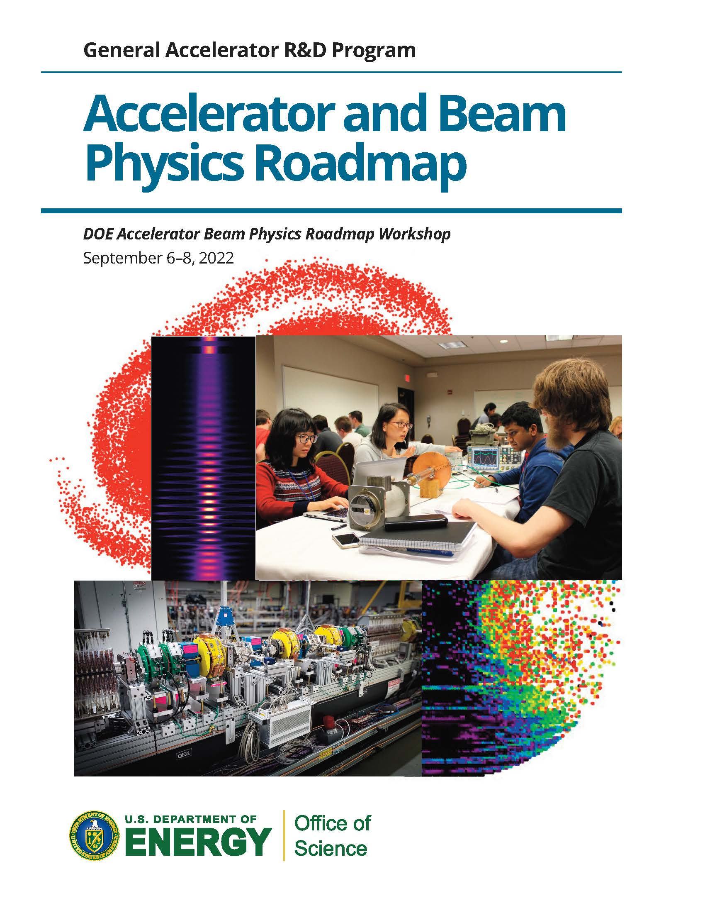
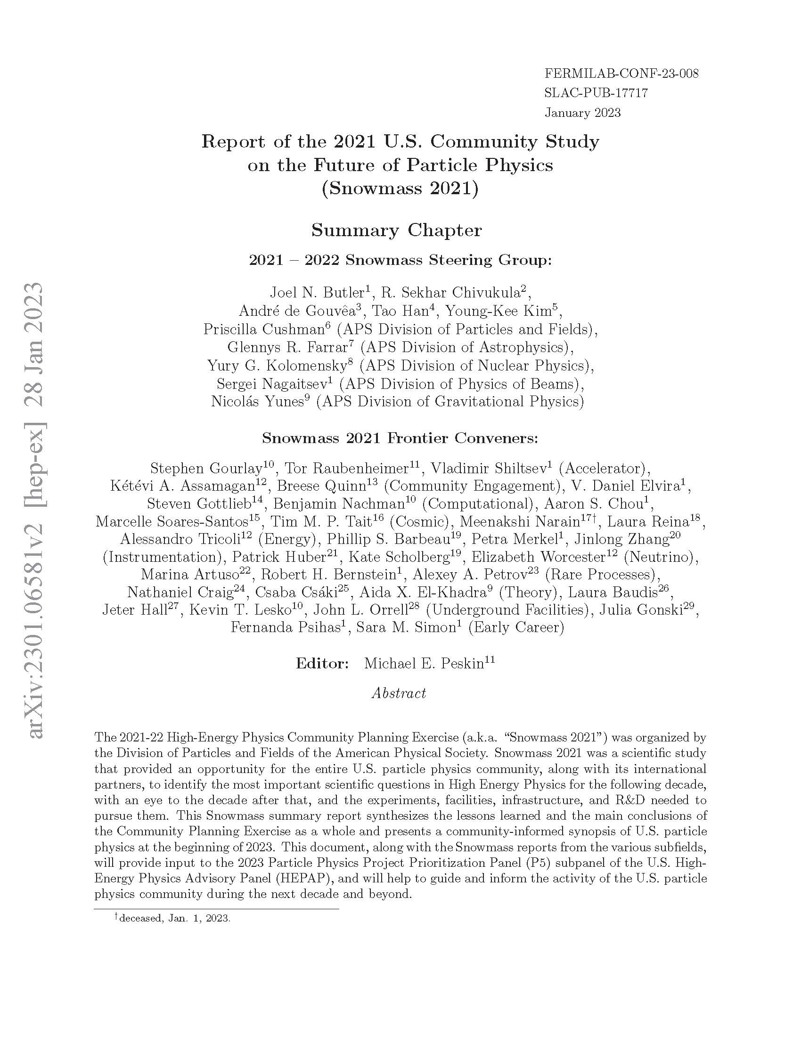
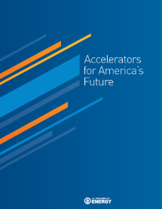
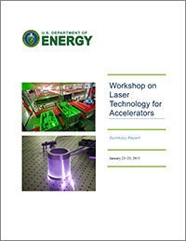
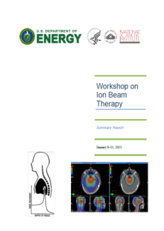
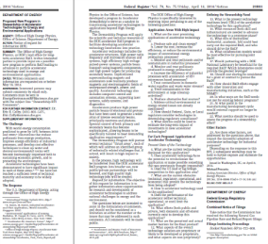
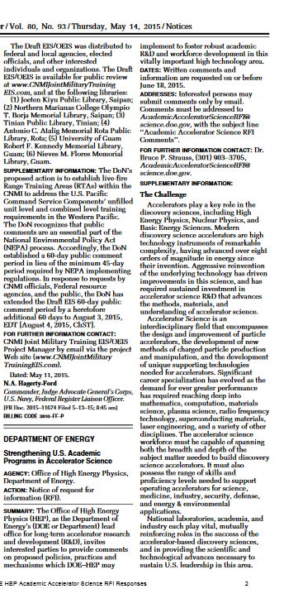
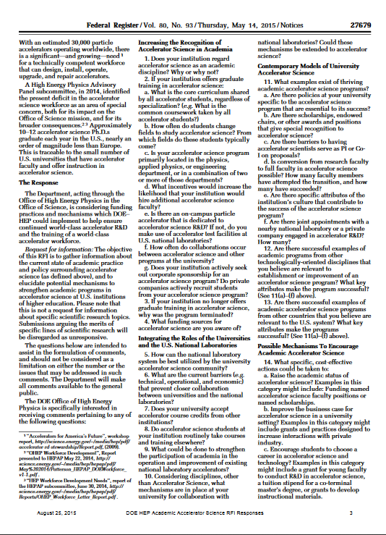
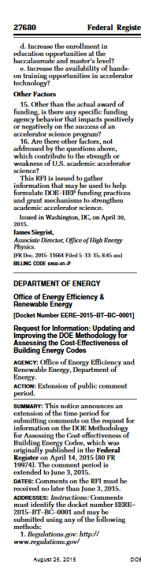
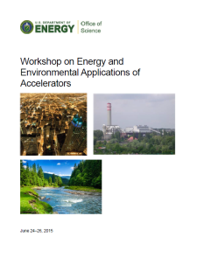
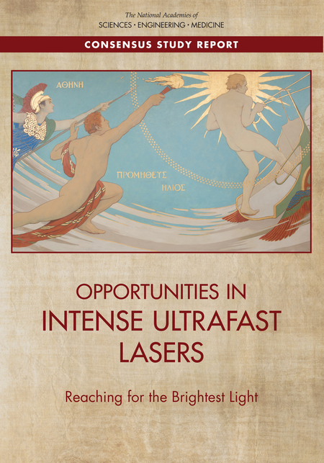
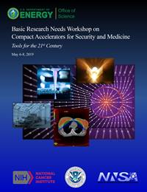
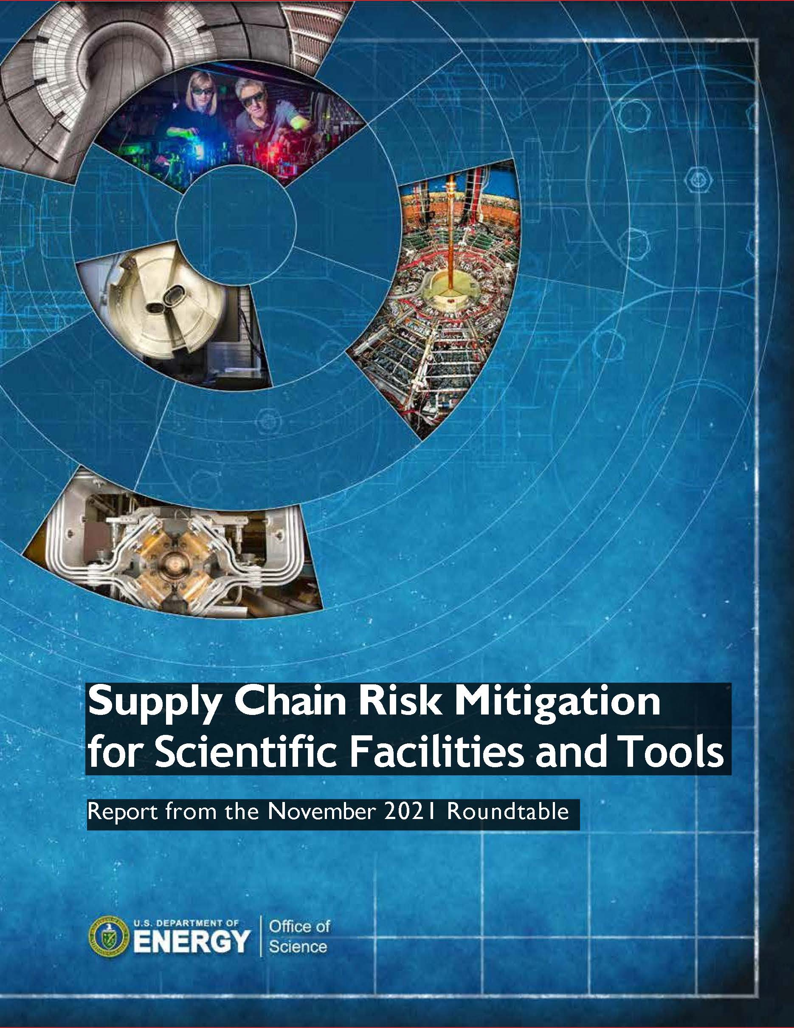
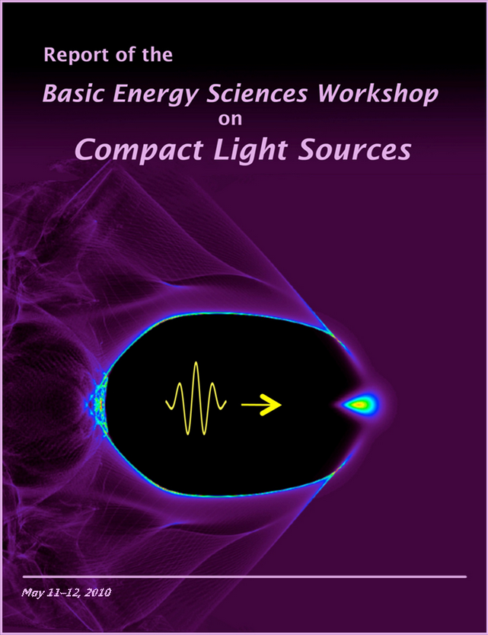
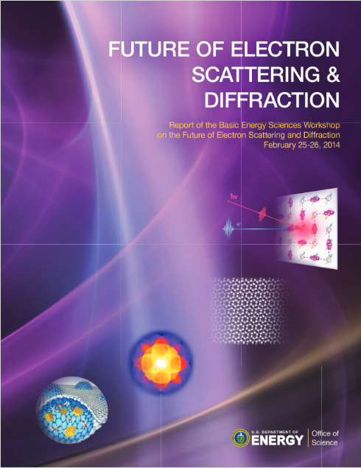
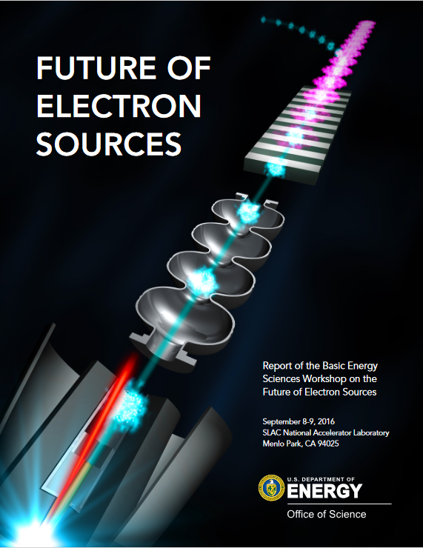
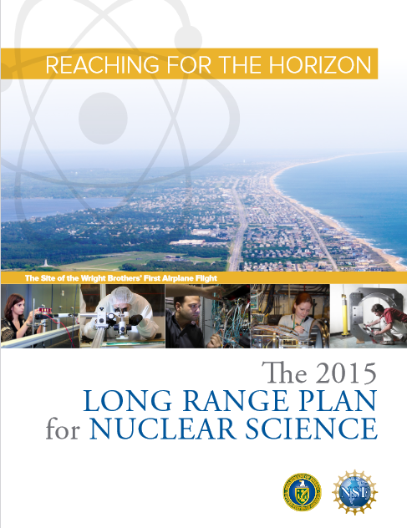
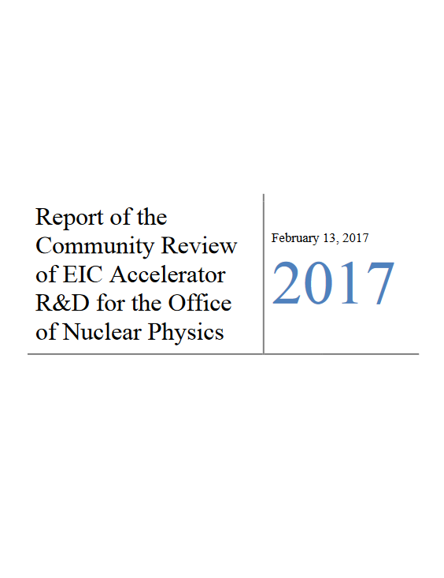


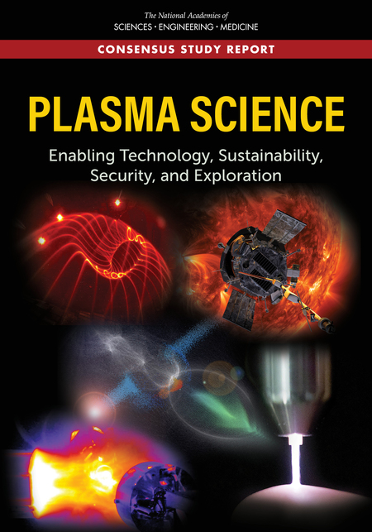
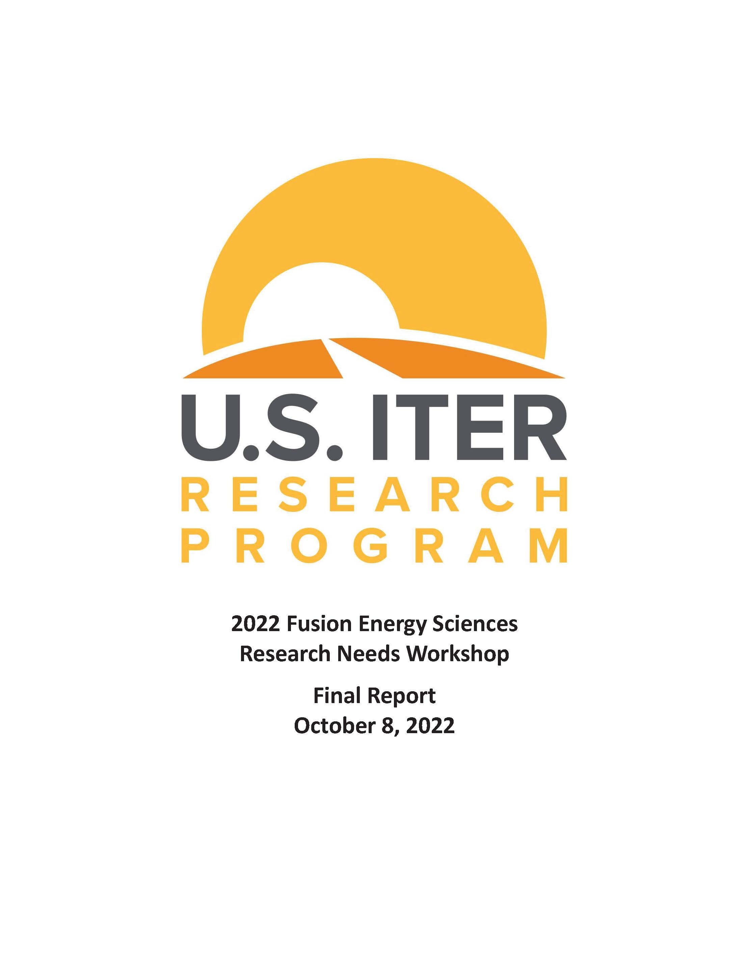
Community input guides ARDAP priorities
High Energy Physics
  P5, GARD Panels, Roadmaps; Snowmass
Accelerator Stewardship
  BRNs, RFIs, NAS
Basic Energy Sciences
  BRNs and Workshops
Nuclear Physics
  LRP and Panel reports
Fusion Energy Sciences
  Panel reports, NAS report
2014
2015
2016
2016
2017
2020
2022
2023
2010
2013
2013
2014
2015
2015
2017
2019
2019
2010
2014
2016
2015
2017
2015
2020
2021
2022
Notes:
Community input guides our work (left-to-right)
HEP: 2014 P5 report; 2015 P5 subpanel report; 2016 HEP magnet development program roadmap; 2016 AAC workshop report; 2017 RF research roadmap workshop report; 2020 updated magnet development roadmap; 2022 GARD roadmap; 2023 Snowmass report
Accelerators: 2010 (HEP) symposium/workshop summary industry/science/defense; 2013 laser technology for accelerators; workshop summary; 2013 ion beam therapy workshop summary; 2014 RFI: proposed new program in stewardship of accelerator technologies for energy and environmental applications; 2015 RFI: strengthening U.S. academic programs in accelerator science; 2015 Workshop on energy and environmental applications of accelerators; 2017 NAS Opportunities in Intense Ultrafast Lasers; 2019 BRN workshop on compact accelerators for security and medicine; 2019 Supply Chain Risk Mitigation roundtable
BES: 2010 Workshop on compact light sources; 2014 Future of electron scattering and diffraction; 2016 Future of electron sources
NP: 2015 Long-range plan for nuclear science; 2017 Community review of EIC accelerator R&D report
FES: 2015 Plasma at the frontier of scientific discovery; 2020 Powering the Future: Fusion & Plasmas; 2021 NAS Plasma Science

Slide 8
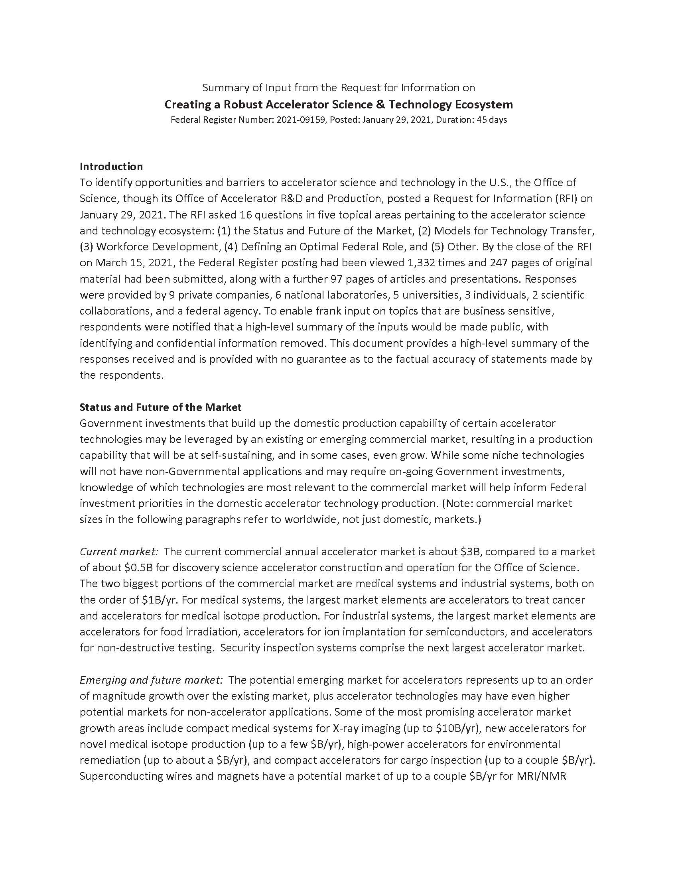
Charting a future for accelerator technology
Inventory of R&D Needs for DOE Facilities
  Completed in 2018, refreshed in 2020
AS&T Supplier Survey
  December 2020
Request for Information on Creating a Robust AS&T Ecosystem
  January 2021
  Status and Future of the Market; Workforce Development; Models for Technology Transfer; Defining an Optimal Federal Role
Supply Chain Risk Mitigation Roundtable for Scientific Facilities and Tools
  November 2021 (organized by SC-3)
Laser Basic Research Needs (BRN) workshop
  Tentatively August 2023
  Scientific challenges needing laser technology, largest impact areas
  Laser technology needs, current gaps
  Areas of strong mutual interest across federal agencies, industry
  Areas of largest impact
  Workforce needs
Notes:
Supplier survey:
What critical AS&T was purchased, from whom, and how much?
Covered current projects and recent operations
What are critical dependencies?
RFI for creating robust AS&T ecosystem

Slide 9
Funding calls
ARDAP Funding Opportunity Announcement
  Annual call for proposals
  Four topic tracks (see next…)
SBIR/STTR program
  ARDAP participates in this program which supports U.S. small businesses
  Nominally annual FOA – ARDAP is switching back to release 1 this year
  Two phases:
    Establish technical merit, feasibility and commercial potential
    Continue efforts initiated in phase 1
  Application should be commercializable within 3-5 years
Notes:
SBIR=Small business innovation research
STTR=Small business technology transfer

Slide 10
FY 2023 Research Opportunities in Accelerator Stewardship and Accelerator Development (DE-FOA-0002951)
$19.5M in funding for new and renewal awards in two main areas:
Accelerator Stewardship
  Track 1: Use-Inspired Basic R&D – aimed at transitioning accelerator technology into medical, security, environmental, and industrial applications
  Track 2: Cross-cutting Basic Accelerator R&D – aimed at developing the foundations and new concepts of next-generation accelerator technology
  Track 3: Accelerator Test Facility Program – providing support for non-DOE institutions to use a DOE SC accelerator R&D capability
TRL≤4
Accelerator Development
  Track 4a: Accelerator Technology Sector Business Plans – funded studies of specific sectors of the accelerator technology ecosystem
  Track 4b: Accelerator Technology Partnerships – public-private partnerships to strengthen domestic suppliers of accelerator technology
TRL≤6, MRL≤7

Slide 11
Track 1.3: High-power electron accelerator technology for industrial applications
Topic informed by Workshop on Energy and Environmental Applications of Accelerators (2015)
  https://science.osti.gov/-/media/hep/pdf/accelerator-rd-stewardship/Energy_Environment_Report_Final.pdf
Successful awards for energy & environment studies, efficient high-power RF, MW accelerating structures - $10.3M since 2015
Efficient HPRF: IOT, and magnetron
E&E: 1-10 MeV e- accelerators, NCRF and SRF
Example: G. Ciovati et al., PRAB 26, 044701 (2023) [E&E+MW]
Conceptual design of CW SRF 750 MHz, 1 MeV, 1 MW, conduction-cooled e- accelerator for environmental remediation
  Commercial magnetrons, commercial cryocoolers
Prototype Nb3Sn cavity at 915 MHz
  Horizontal test cryostat
  Conductively cooled with cryocoolers to 4.3K (no He!) at industrial partner
  Surface magnetic field 50 mT reached, 1 MeV energy gain
Ciovati et al.
Notes:
G. Ciovati had two awards: the accelerator design, and the cavity prototyping

Slide 12
SC Workforce Development Programs
RENEW: Reaching a New Energy Sciences Workforce
  https://science.osti.gov/Initiatives/RENEW
  Provide training opportunities at institutions historically underrepresented in SC
FAIR: Funding for Accelerated, Inclusive Research
  https://science.osti.gov/Initiatives/RENEW
  Build research capacity, infrastructure, and expertise and institutions historically underrepresented in SC, especially minority-serving institutions (MSI’s) and emerging research institutions (ERI’s)
EPSCor: Established Program to Stimulate Competitive Research
  https://science.osti.gov/bnes/epscor
  Build research capability in designated US States without substantial infrastructure
Energy I-Corps:
  https://www.energy.gov/technologytransitions/energy-i-corps
  Technical business skills training
LEEP: Lab-embedded entrepreneurship Program
  https://www.energy.gov/eere/ammto/lab-embedded-entrepreneurship-program
  Embed startups at national labs, where mentored by lab scientist
HEP Traineeship in Accelerator Science & Engineering (HEP)
  https://science.osti.gov/hep/-/media/grants/pdf/foas/2023/SC_FOA_0003025.pdf
  For universities to train scientists and engineers in accelerators
Early Career Research Awards
  https://science.osti.gov/early-career
  For junior faculty or lab staff within 10 years of PhD

Slide 13
Conclusion
U.S. Accelerator R&D and Production (ARDAP) program helps ensure that new and emerging accelerator technology will be available for future discovery science, medicine, industry, and national security needs
ARDAP develops and coordinates accelerator science/technology topics within the Office of Science
ARDAP makes its own investments in fundamental accelerator technology R&D and in the commercialization of these technologies
ARDAP is guided by community input and serves the U.S. public

Slide 14
Backup slides

Slide 15
Resources from greater accelerator community
HEP:
  2014 HEPAP P5 report;
  2015 HEPAP P5 subpanel report;
  2016 HEP magnet development program roadmap;
  2016 AAC workshop report;
  2017 RF research roadmap workshop report;
  2020 Updated magnet development roadmap;
  2022 GARD roadmap;
  2023 Snowmass report
Accelerators:
  2010 Accelerators for America’s Future symposium/workshop summary industry/science/defense
  2013 Laser technology for accelerators workshop summary;
  2013 Ion beam therapy workshop summary;
  2014 RFI: energy and environmental applications of accelerators;
  2015 RFI: strengthening U.S. academic programs in accelerator science;
  2015 Workshop on energy and environmental applications of accelerators;
  2017 NAS Opportunities in Intense Ultrafast Lasers;
  2019 BRN workshop on compact accelerators for security and medicine;
  2019 Supply Chain Risk Mitigation roundtable
BES:
  2010 Workshop on compact light sources;
  2014 Future of electron scattering and diffraction;
  2016 Future of electron sources
NP:
  2015 NSAC Long-range plan for nuclear science;
  2017 Community review of EIC accelerator R&D report
FES:
  2015 Plasma at the frontier of scientific discovery;
  2020 Long-range plan Powering the Future: Fusion & Plasmas;
  2021 NAS Plasma Science

Slide 16
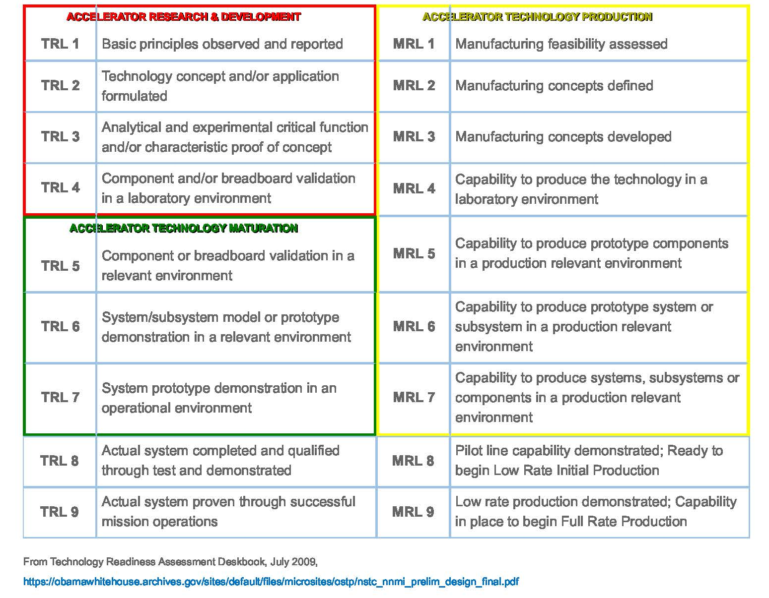
Technical Readiness & Manufacturing Readiness

Slide 17
Broad Office of Science goals
Biden-Harris Administration FY23 priorities:
  …require continued investments in R&D; science, technology, engineering, and mathematics (STEM) education and engagement; STEM workforce development; technology transfer and commercialization; and research infrastructure, with emphasis on Historically Black Colleges and Universities, other Minority Serving Institutions, and disadvantaged communities who have been historically underserved, marginalized, and adversely affected by persistent poverty and inequality
Topics include:
  Pandemic readiness and prevention
  Tackling climate change
  Catalyze research and innovation in critical and emerging technologies
  Innovation for equity
  National security and economic resilience

