Slide 1
Overview of the AAA activities
~update since ILCX2021~
Tohru Takahashi
Hiroshima University/AAA
May 16, 2023

Slide 2
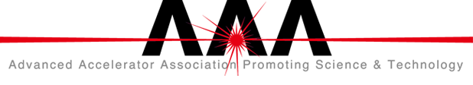
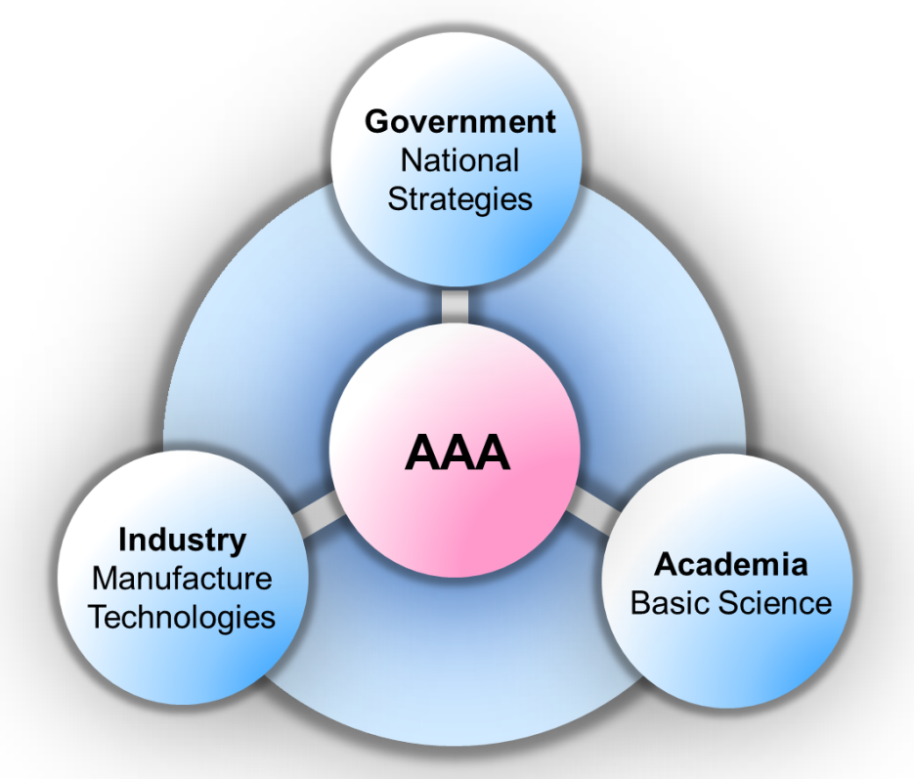
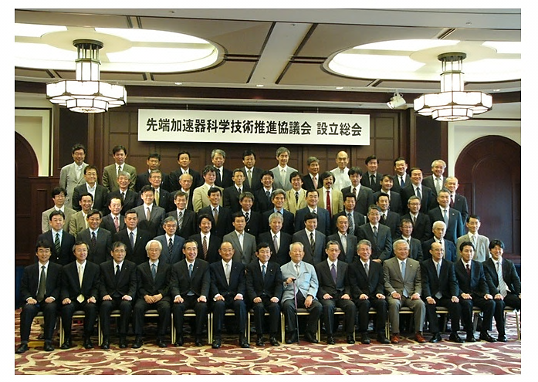
Advanced Accelerator Association
Promoting Science and Technology
To promote inter-sectoral collaboration
in accelerator technology
Organized 2008

Slide 3
The central model
of the collaboration
as of July 9, 2022
97 Companies
41 Institutions
Notes:
To promote inter-sectoral collaboration, we set the ILC as the central model of the collaboration
as of July 20, 2021, the membership is
102 companies
41 research institutions

Slide 4
Organization
Eternity Supreme Advisor
Late Kaoru Yosano
Honorary Chair
Late Masatoshi Koshiba
Supreme Advisor:
Takeo Kawamura
Special Advisors:
Hiroya Masuda
Hiroaki Takahashi
Senior Advisors:
Yoichi Tao
Junichi Nishiyama
Masao Ninomiya
Toshiyuki Sakamoto
Chair: Shunichi Miyanaga
Board of Directors
Representative Director
Shunichi Miyanaga (MHI)
Directors
Masanori Yamauchi (KEK)
Yuzo Ohnishi (Kyoto Univ.)
Masahiro Inagaki (Kyocera)
Tadasu Yotsuyanagi (Toshiba)
Hidetoshi Takehara (Hitachi)
Noriyuki Takazawa (MELCO)
Kunihisa Yamura (Iwate Chambers of Commerce)
Auditor
Sachio Komamiya (Waseda Univ.)
Shoji Asai (Univ. of Tokyo)
General Meeting
Corporate Organizations
and Institutional Organizations
Secretariat
Secretary General
Masanori Matsuoka
Technology Study Group
Chair: Hitoshi Hayano
Project Promotion Study Group
Chair: Satoru Yamashita
Outreach Group
Chair: Tohru Takahashi

Slide 5
Working groups
Technology study group
Promoting industry-academia collaboration
  sharing accelerator (ILC) technology
Stimulating application/innovation of accelerator technology
Project promotion study group
Comprehensive actions to realize ILC
  International relations
  Regional Revitalization and Community Development
  Safety and Disaster Prevention
Outreach group
Getting public understanding accelerator science by
  transmitting information of impact on society/industries

Slide 6
Technology Study Group
Sustainability
  To reduce environmental impact, we address technical challenges in efficiently using electricity, incorporating renewable energy, recovering energy from spent beams, and ensuring safety in large accelerators like the ILC, through industry-academia collaboration.
Engineering Design
  We identify technical challenges for the detailed design of ILC accelerator and tunnel attachment, conducting focused industry-academia collaboration to address them..
Technology Transfer
  Advancing research on cutting-edge technologies related to accelerators, and expanding the potential for their applications though seminar with industry sector
Notes:
The one of the main activities of Technology study group is to have seminars to introduce the state of art technology in accelerator science, to company menbers
Unfortunately, we have not have face-to-face meeting since January 2020 but have remote seminars regularly.

Slide 7
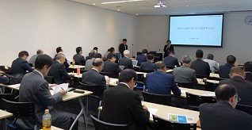
Seminars
 | date | theme | Speakers
70 | 2022-07-07 | CFS status and issues for transportation and assembling Status of ILC CFS ILD Solenoid: transportation Transportation of big heavy materials. | N. Terunuma Y. Yokota. D. Kato
71 | 2022-10-06 | Latest technology of advanced acc. IFMIF accelerator Nanotelas: new SRF Activity of Tokin corp. | K. Masuda T. Ysudumi. K. Otaga
72 | 2022-12-08 | SuperKEKB nano beam Status of SuperKEKB R&D of SC FF magnet Kudo denki corp. | M. Masuzawa N. Ouchi H. Matsu
73 | 2023-02-09 | ILC beam dump and Laser acc. Mutifacited Use of ILC beam dump Laser driven electron acc. B & A technology | Y. Sakaki T. Hosogai K. Ozeki
74 | 2023-04-13 | Accelerator cavity SRF cavity R&D in KEK NRF high field technology and subTHz Metal corp. | T. Michimae T. Abe Y. Nagasawa
Notes:
The one of the main activities of Technology study group is to have seminars to introduce the state of art technology in accelerator science, to company menbers
Unfortunately, we have not have face-to-face meeting since January 2020 but have remote seminars regularly.

Slide 8
Project Promotion Study Group
Board member in charge
Yuzo Onishi
Academia
Industry
Leader
S. Yamashita(IPU)
Vice Leader
N. Terunuma(KEK)
Advisor
Yoshioka(PSG), Nishiyama(IFG), Sakamoto(IEEJ)
Core Members
Kawagoe(secretary/Kyushu), Takeuchi(Rep. Secretary/Obayashi), Yshio(Obayasi)
Ishikawa(KEK), Otani(Tokyo), Narita(Iwate), Yoshioka(Kyushu), Sanuki(Tohoku)
Matsuoka(MHI), Yoshizumi(Kyocera), Ushiyama(Toshiba), Nakamura(Hitachi)
Hata(Melco), Fukuda(Shimizu), Shimokochi(Takenaka), Suzuki(TEPSCO), Sekina(Toda)
Oyama(Kashima), Kawabata(Asuka), Kataoka(Taisei)
Working Groups
Oversee relations,
Project Management
Town Development
Regional Development
Safety,
Disaster prevention
Notes:
Project promotion group has various kind of activities
These are an example of recent topics.
In addition to the regular meeting, tow working group report was published this year
Regional Revitalization and Community Development WG Report, which descries studies of utilization of waste hear and new mobility society
Safety and Disaster Prevention WG Report has published outcome of their more than 10 years of activity
Single-tunnel design, Siting issues, Facility construction, Safety/Disaster Prevention
let me introduce some topics from the report

Slide 9
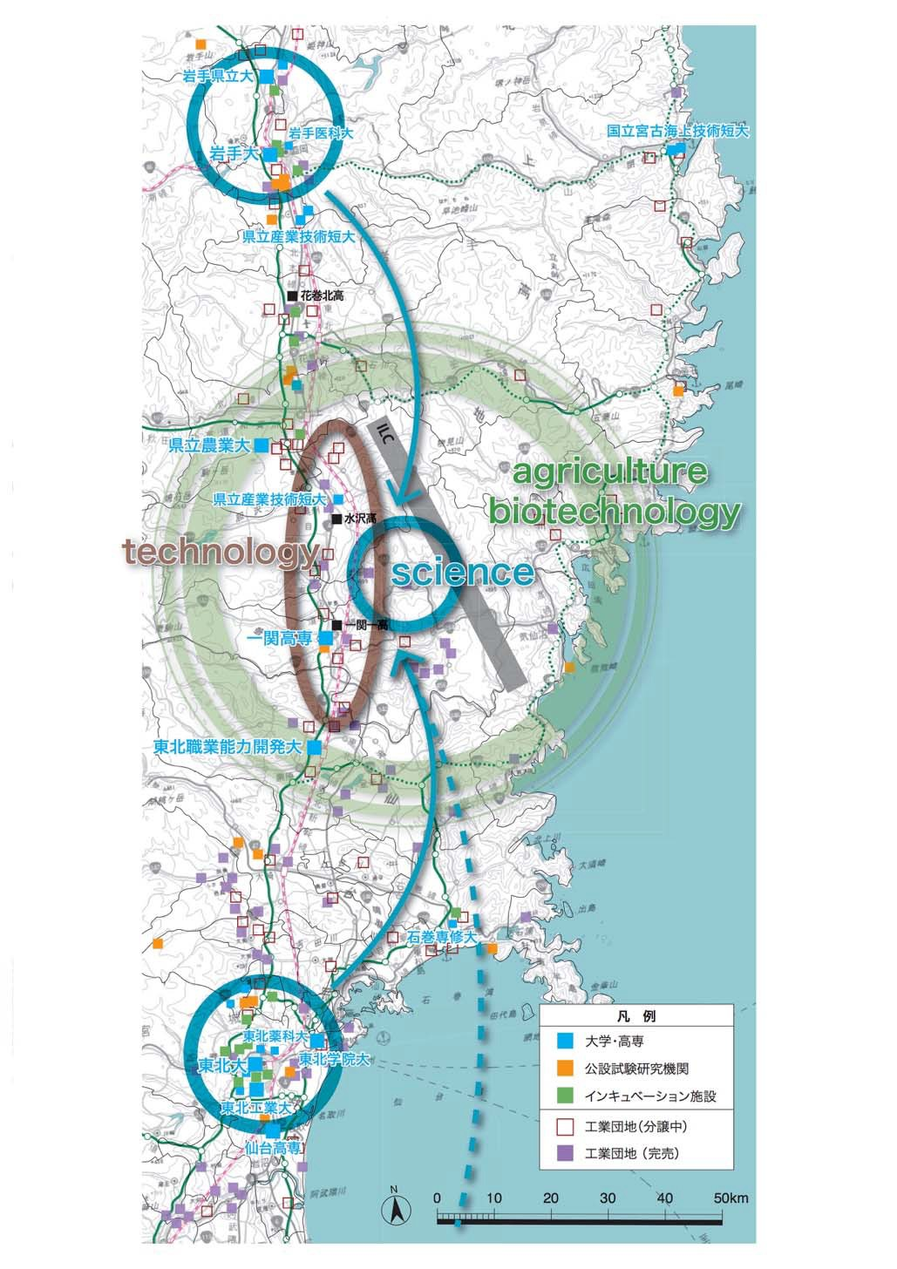

Creating a field where the world's most advanced knowledge can be utilized at the hub of the ILC
Morioka
Glocalization
QOL of reseacher
  Short/long term residences
  accommodation/residence and sight seeing
  Helthcare/Educational facilities
    Internationalization and ICT
IP Campus
Eco-town
utilizing ILC waste heat
Innovation
Main Campus
Logistics base
Distribution base
Industry creation/Knowledge transfer
  management/center
  Tohoku ILC eco-system
Community Area
eVTOL flight base
Highway
Sustainability
Green ILC / Energy Sustainability
Agricultural, forestry, fisheries bases
utilizing waste heat and other
sustainable energy sources
Sendai
Shinkansen
Airport
Reference Information: "Tohoku and Kitakami Area Grand Design with ILC"
Notes:
(next generation town)
The ILC is expected to be built in the area of Iwate and Miyagi prefecture. The main campus will be located almost middle of two large cities, Morioka and Sendai. Both cities have the airport and advanced industrial accumulation base including science facilities, universities and private companies. Researchers and their families can choose the variety of accommodation using convenient transportation such as Shinkansen or highway driving. We believe that the area around the ILC will be attractive not only for researchers but for other people by means of area management and installing new technologies such as eVTOL. Old houses in Tohoku area will be also attractive for accommodation and residence.

Slide 10
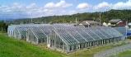







next generation of sustainable communities that people around the world aspire to live in
・ All wooden
●Innovation
Creative town developing toward the next generation
・ Waste hear utilization
Greenbelt and Agricultural complex
Large scale heat storage
■Next generation mobility area
Fully automatic operation (Level 4 or more)
eVTOL takeoff and landing
・ Seamless transportation and logistics
・ People flow / logistics interlocking service
Central
green park
ILC researchers and local residents
●Providing demonstration site for:
・Healthcare ・Mobility
・Robot service / guidance
Notes:
(Basic model of the ILC community )
Basic model of the ILC community is shown this slide. One of the important concept is sustainable community development that coexists with forests and nature. I
t has some design codes of all wooden, green garden, local production and local consumption of energy, etc. On the other hand, this town will be evolving with the next generation technology in the field of healthcare, mobility, robotics and so on.

Slide 11

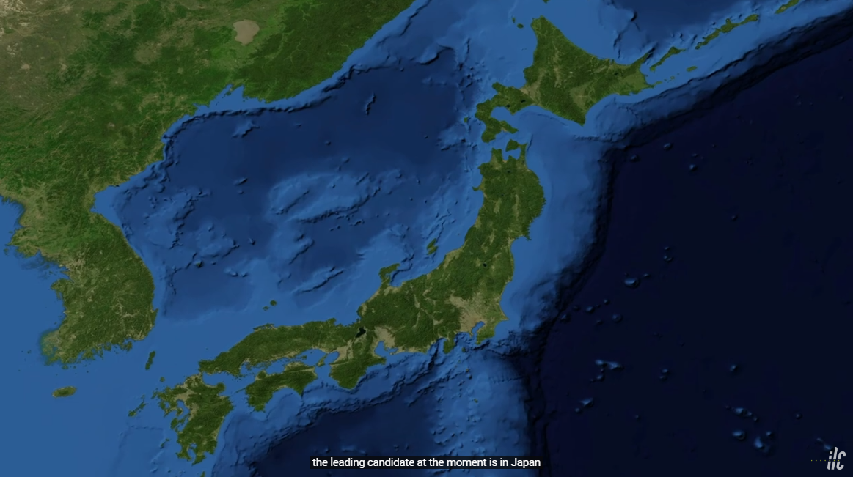

Outreach Working Group
Community in Tohoku

Slide 12
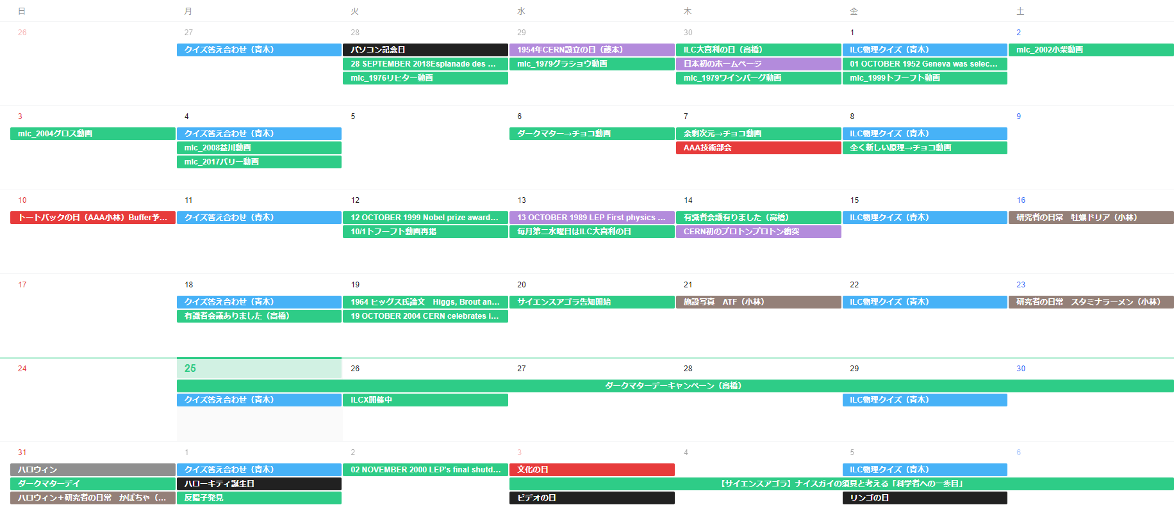
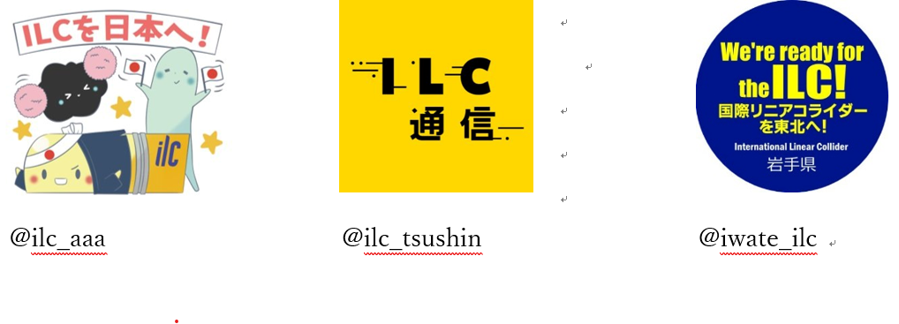
KEK-AAA-Tohoku meeting for social media(twitter) use
CERN birthday
First Web site in Japan
Nobel Prize in Physics
First Proton Collision at CERN
Higgs’s Paper on PRL
ILCX2021

Slide 13
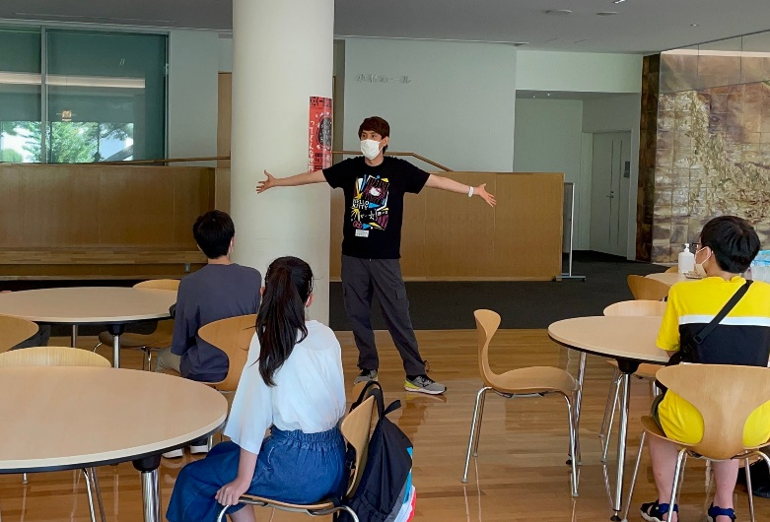
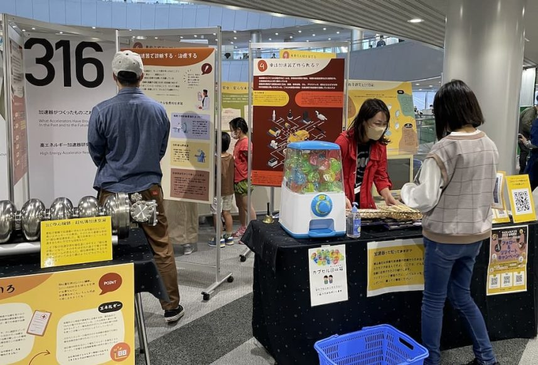
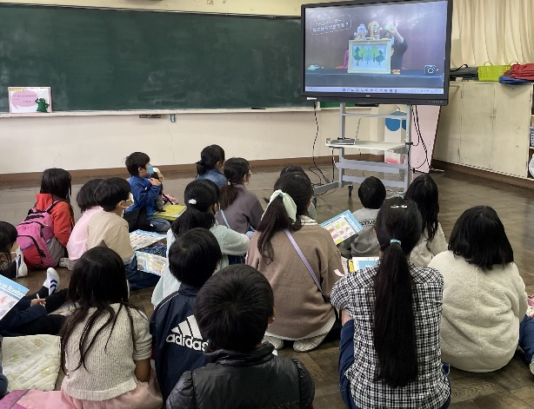
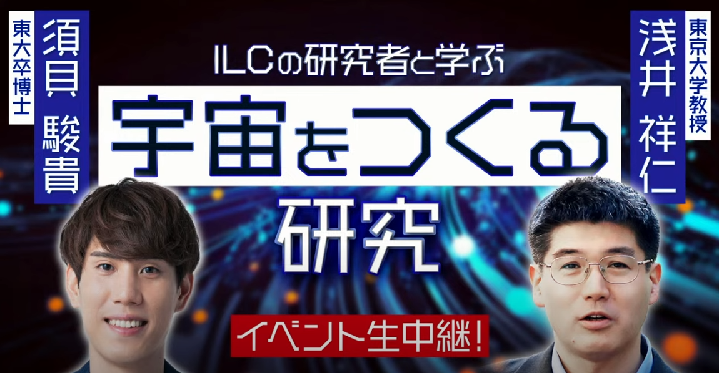
Collaborated with KEK-Iwate for outreach events
2022/7/30
KEK-QuizKnock
2022/11/5，6
Science Agora 2022
2022/11/5
KEK Caravan
2023/3/19
KEKーILC-Japan ILC Science Cafe

Slide 14
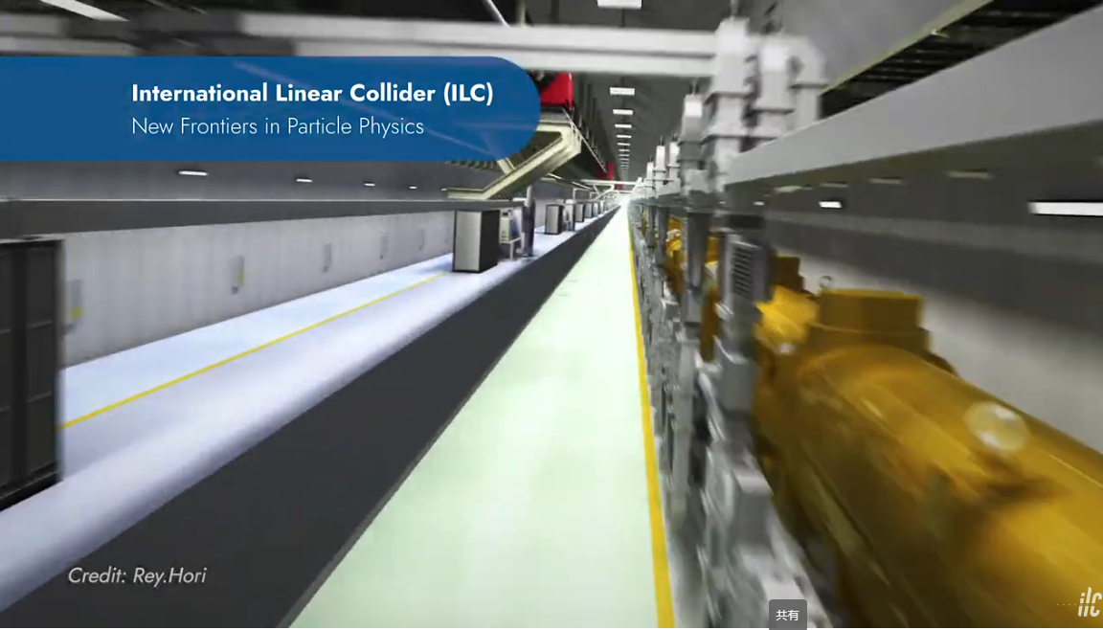
ILC Promotion film
KEK-IDT-AAA
Avairiable on YouTne
https://youtu.be/2AHEgNjBqx0

Slide 15
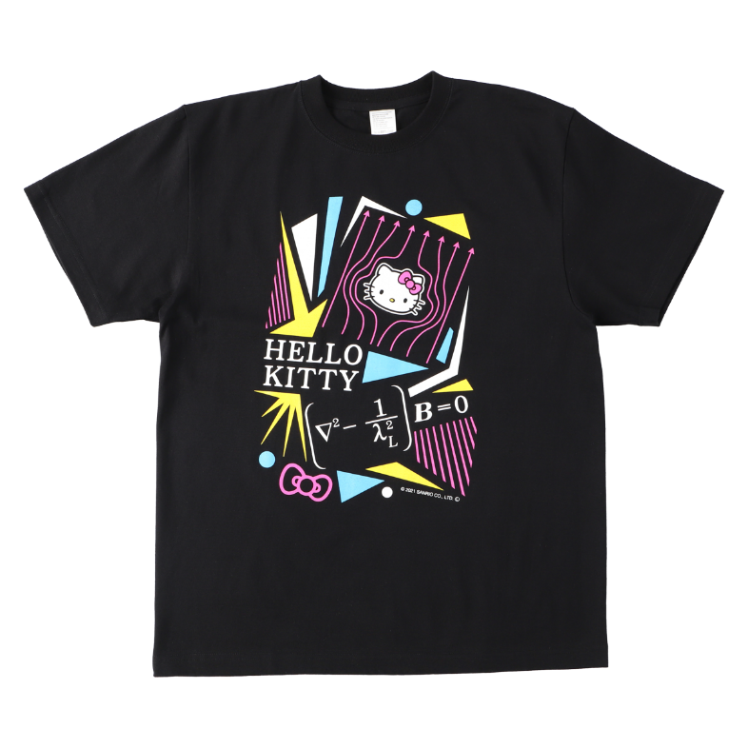
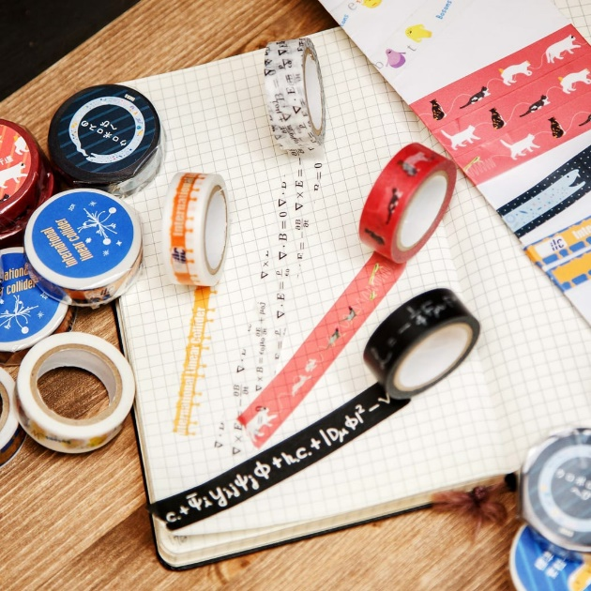
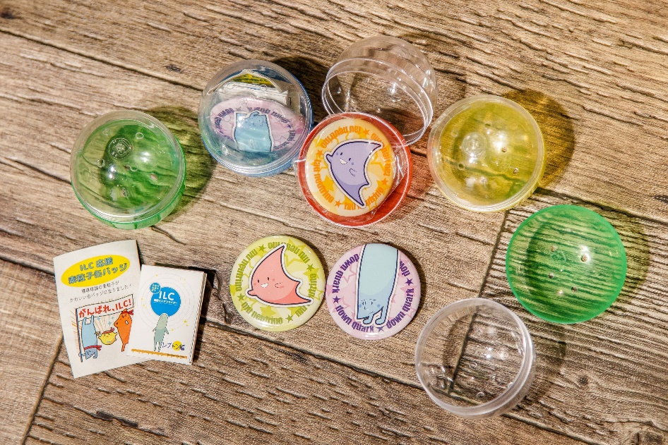
Goods
T-Shrits
Decorative tapes
Badges
Sales
JPY 761,353 in 2022

Slide 16

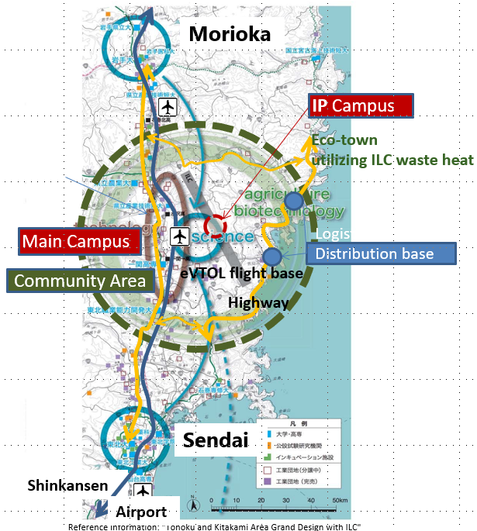
Technology transfer
Project Promotion
Public outreach
15 years of activity
to promote ILC in Japan

