Slide 1
APS cavity study
KEK M. Fukuda

Slide 2
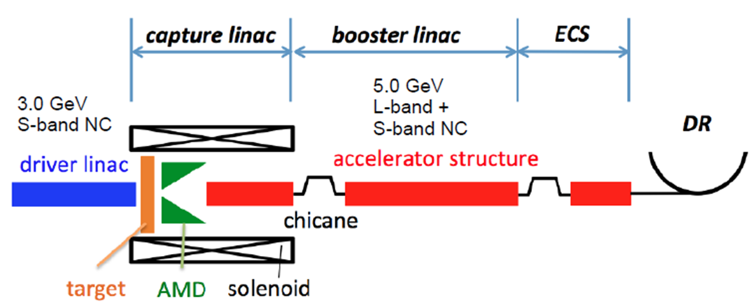
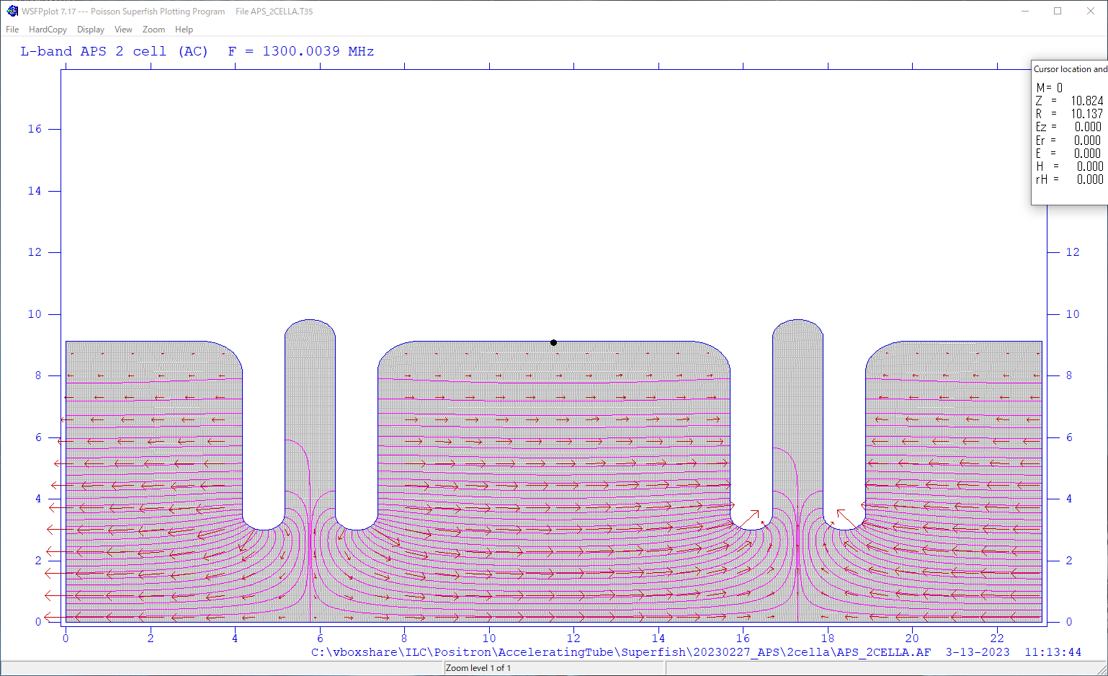
Development of APS cavity for Capture linac
L-band APS cavities
We have developed the L-band Alternative Periodic structure(APS) cavity for the capture linac in the E-driven positron source for ILC.
Challenges
Beam loading compensation
Very high heat load due to electromagnetic shower from the target → Powerful cooling system is required.
Remote beam flange connection
Connection point is surrounded by solenoid coils
APS cavity
Bi-periodic structure
π/2 mode → High group velocity
Contents
Heat load test using L-band 9cell APS cavity.
Design of the 21cell APS cavity by SUPERFISH.
ILC-TDR
Coupling cell
Accelerating cell

Slide 3
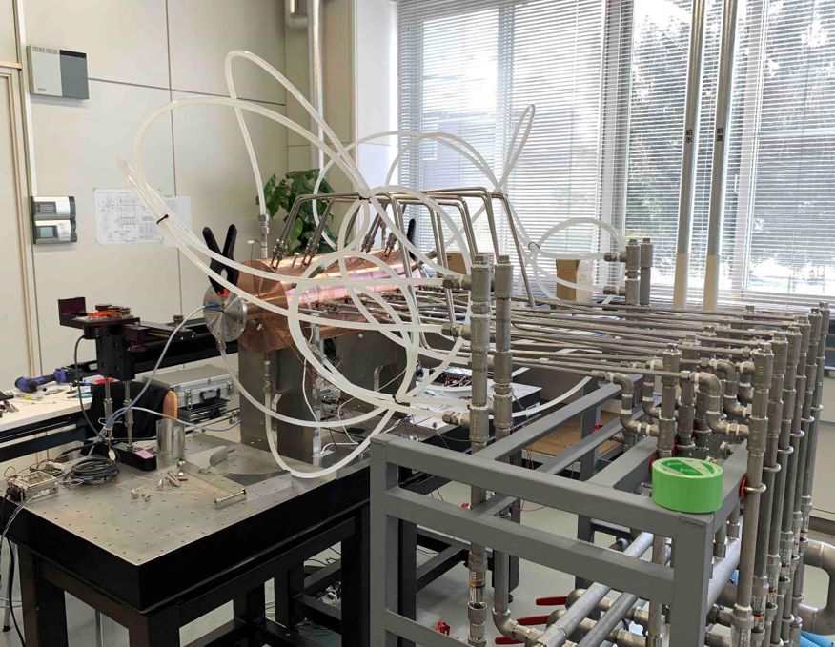
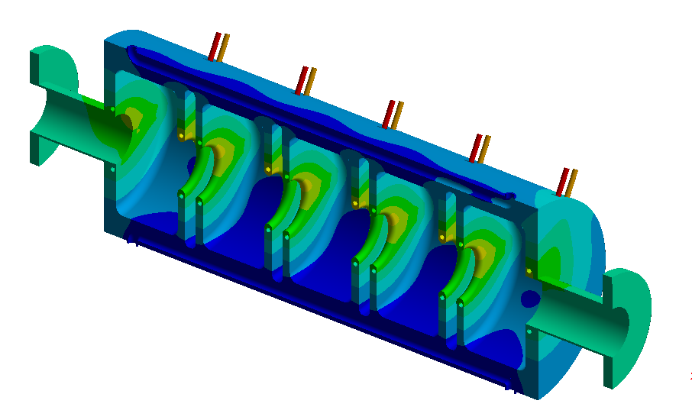
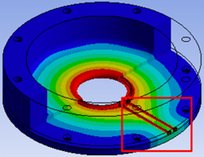
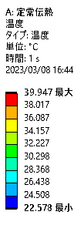
9cell APS cavity for the heat load test
The 9cell APS cavity has been fabricated to study the detuning by heat load due to electromagnetic showers.
The cavity has two cooling lines: Body(cooling), Iris(heating).
Reproduce temperature distribution when the electromagnetic showers hit irises.
A heat load test is planned after this summer.
Measure the temperature, the resonant frequency, field flatness.
テスト空洞を作って、この時のCavity distortionによって、周波数やField balanceがどう変わるか
テストを予定している。
熱分布のシミュレーション結果。
テスト空洞は作成され、周波数測定は行われた。
温度を変えて試験するのはこれから。

Slide 4
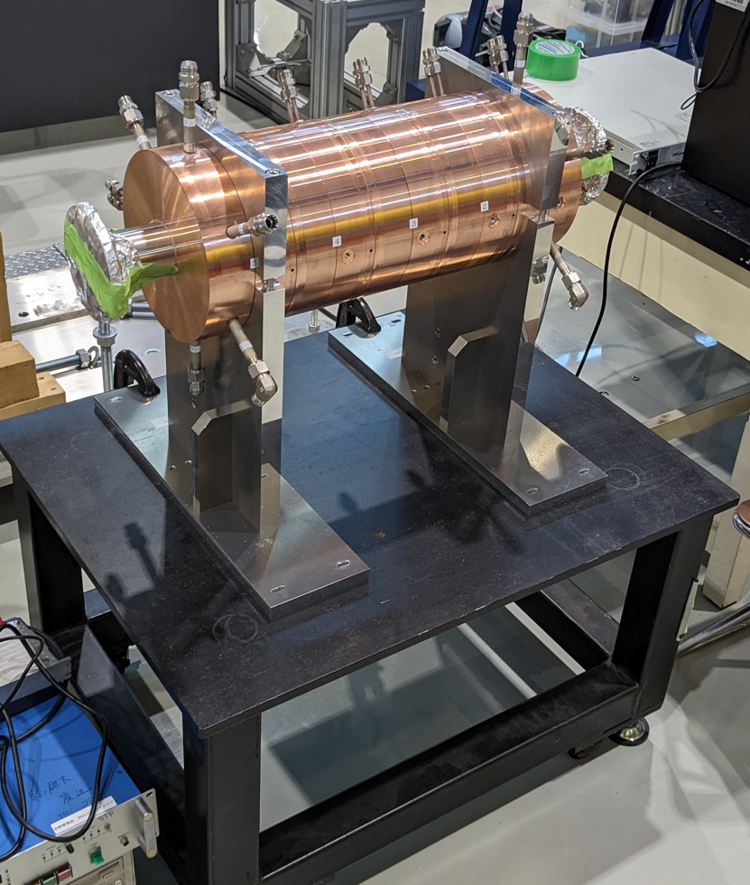
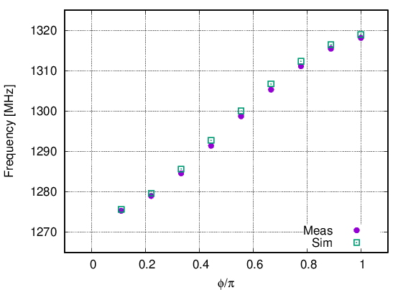
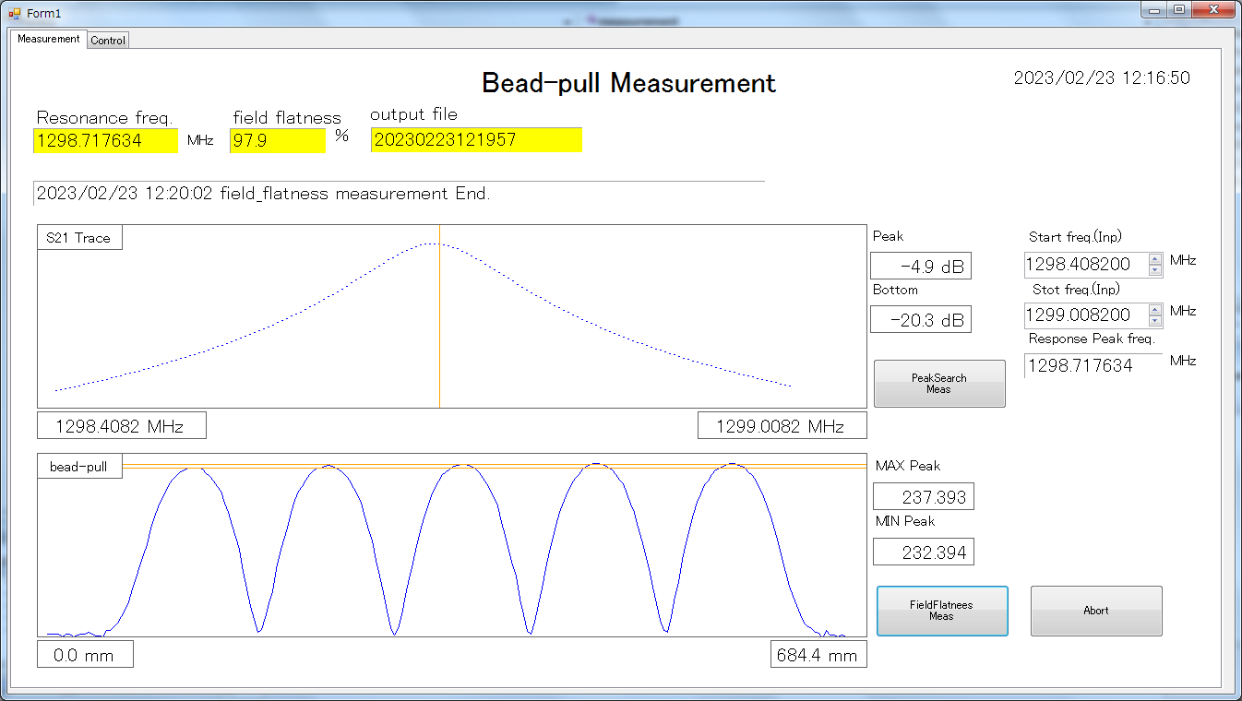
Resonant frequency measurement
Frequency is slightly lower than the 1.3GHz. But dispersion curve is good.
Field flatness obtained by bead-pull measurements is so good.
Operation point
1298.7MHz
T: 21.6degC

Slide 5
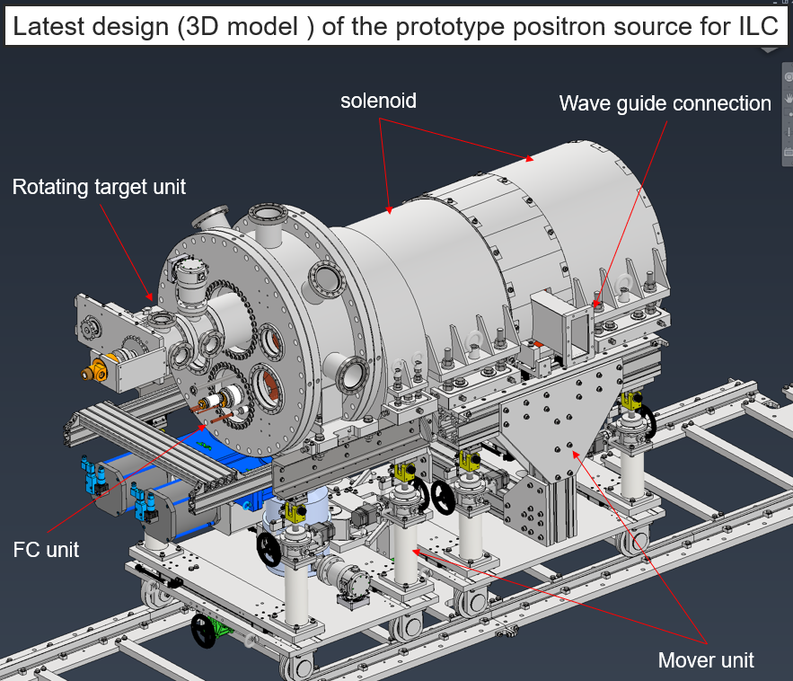
Design of a 21cell APS cavity for capture linac
We have started the design of 21cell APS cavity this year.
11 accelerating cells and 10 coupling cells
Design of cavity structure
Rsh, Field flatness, Group velocity, input coupler, pickup for rf power monitor
Outer dimension
Cooling channel、Tuner、Waveguide、Beam pipe flange…
Simulation
Multi-bunch beam acceleration with beam loading
Effect of Heat load and Cooling system
Finally, It is planned to fabricate the APS cavity and install it on the test bench for checking installation space, Cooling, RF test and so on.

Slide 6
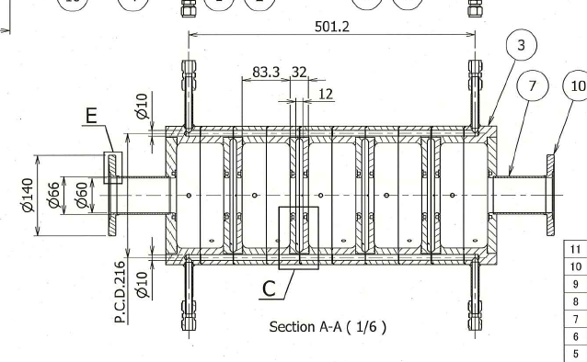
Design of a 21cell APS cavity for the capture linac
The 21cell APS cavity is designed by SUPERFISH now.
The cavity structure is based on the 9cell APS cavity for the heat load test.
Drawing of the 9cell APS cavity

Slide 7
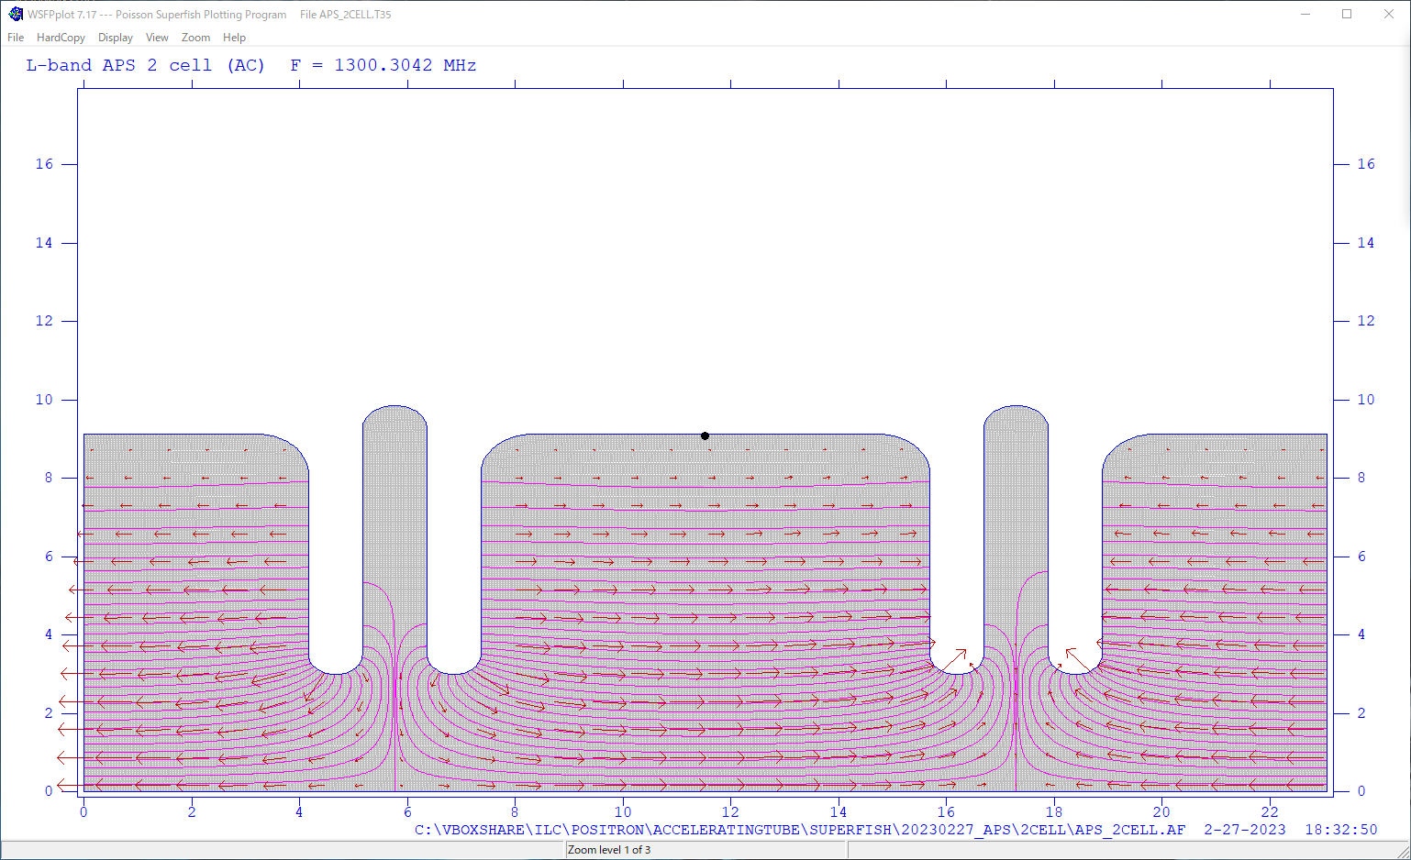
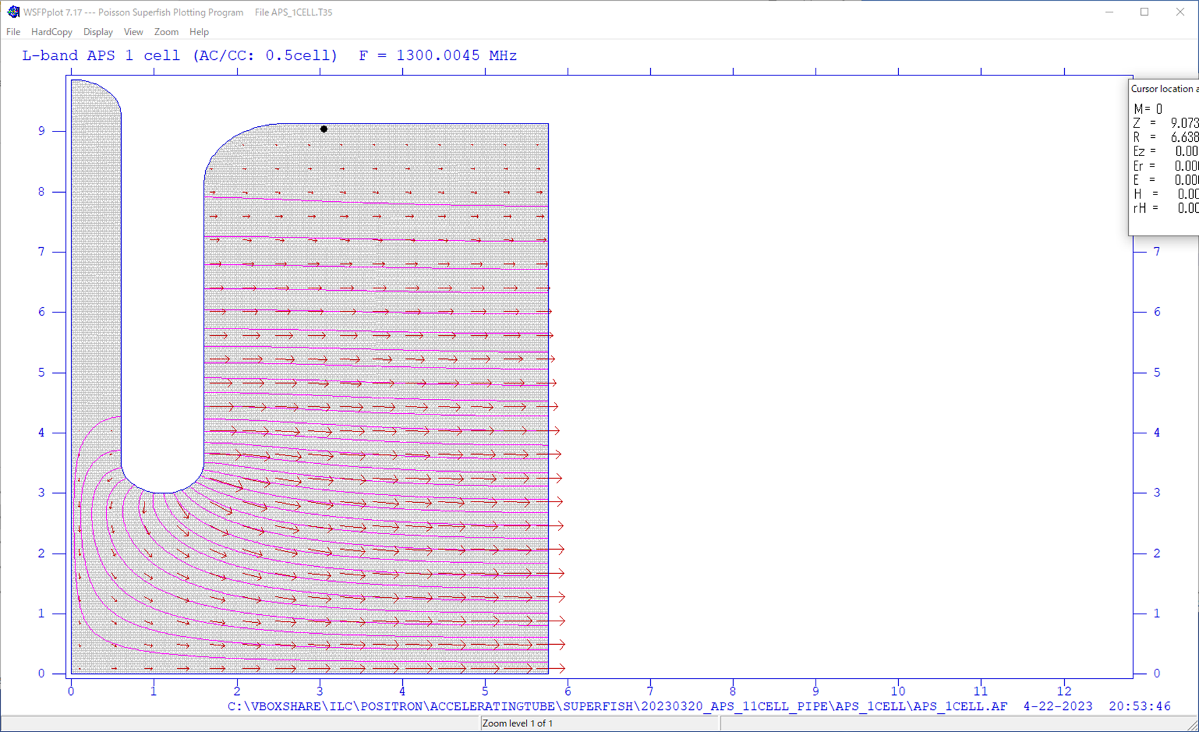
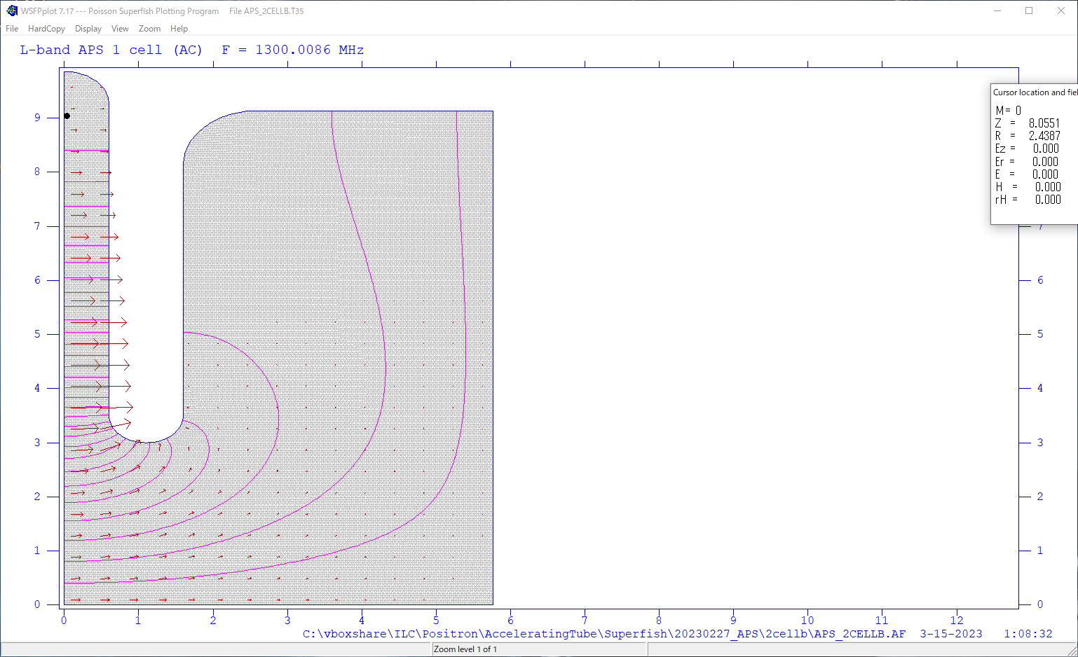
Resonant frequency adjustment
2a: 60.0 mm
2b: 182.74mm
2c: 197.245mm
Radii of both an accelerating cell and a coupling cell are adjusted to match the resonant frequency of 1300MHz.
b
a
c
Accelerating cell
Coupling cell
Resonant frequency
1300.0045MHz
Resonant frequency
1300.0086MHz
2b: 182.74mm
2c: 197.245mm
b
C

Slide 8
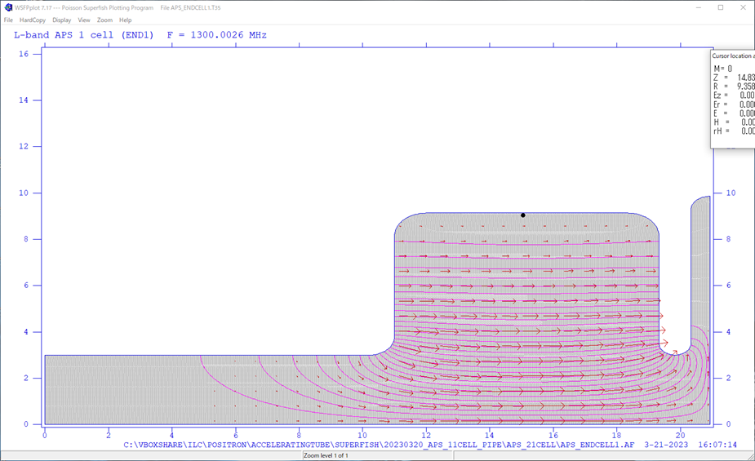
Resonant frequency adjustment (End cell)
The round chamfering of an end cell are adjusted to match the resonant frequency of 1300MHz.
1300.0026MHz
2b: 182.74mm
R: 7.913mm
R: 7.913mm
b

Slide 9
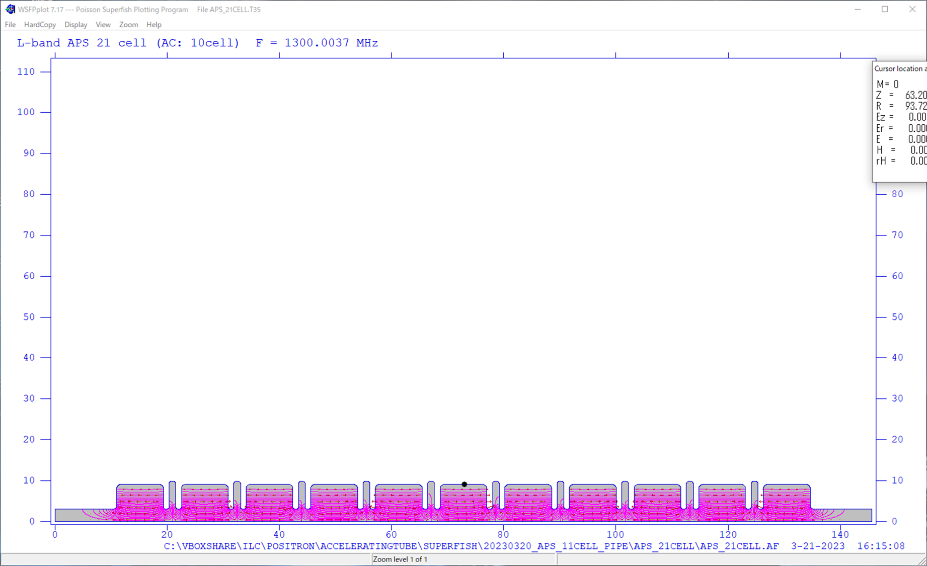
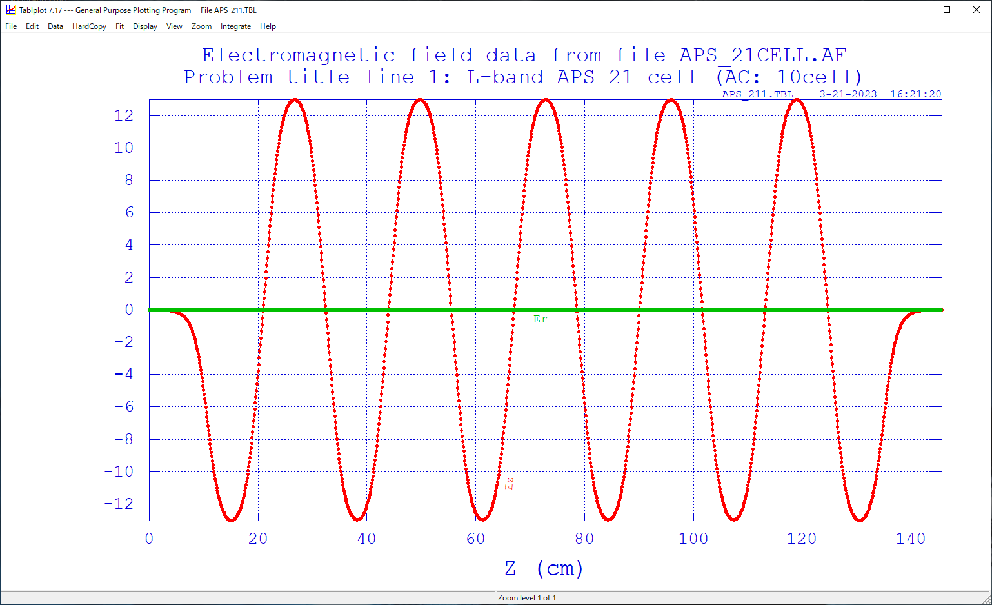
Electric field calculated by SUPERFISH
The 21cell APS cavity was constructed by combining these accelerating cells, coupling cells and end cells.
The resonant frequency calculated by SUPERFISH is 1300 MHz.
Good field flatness is obtained.
Ez on the z-axis
Resonant frequency:
1300.0037MHz

Slide 10
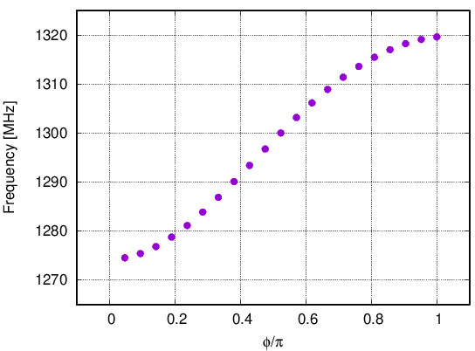
Dispersion curve and parameters
Parameters
Shunt impedance [MΩ/m] | 54.6
Transit-time factor | 0.635
Q0 | 24977
r/Q [Ω] | 1120
Group velocity: Vg | 0.0269c
Cavity length[mm] | 1268
Operation point
19.6MHz
25.5MHz
Calculated by SUPERFISH
Group velocity: vg = 0.027c
→ 2.7% of the speed of light

Slide 11
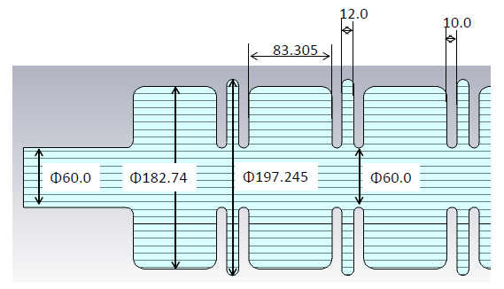
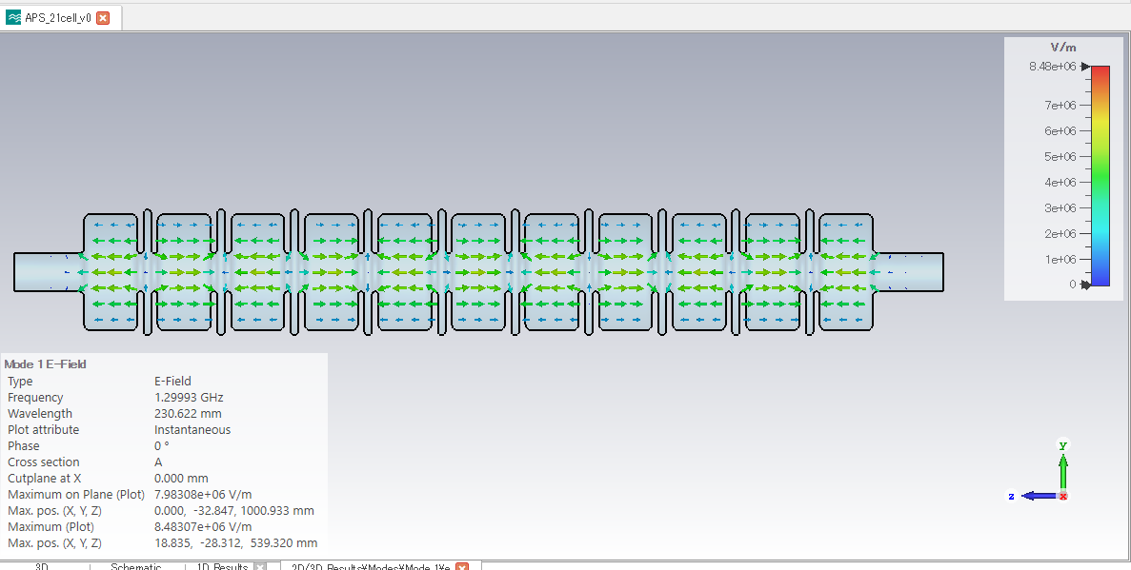
Summary
The 21cell APS cavity is designed by SUPERFISH now.
Heat load test is planned using 9cell APS cavity.
Next steps
Modification of the cavity structure to make the space of thick cooling channel to get larger flow rate.
Design of an input coupler cavity by CST studio
Design of cooling channel
Heat load study with 9cell test APS cavity after this summer.

