Slide 1
Positron Capture Simulation in ILC E- Drive Positron Source
Hiroshima University
Masao KURIKI on behalf of Hiroki Tajino

Slide 2
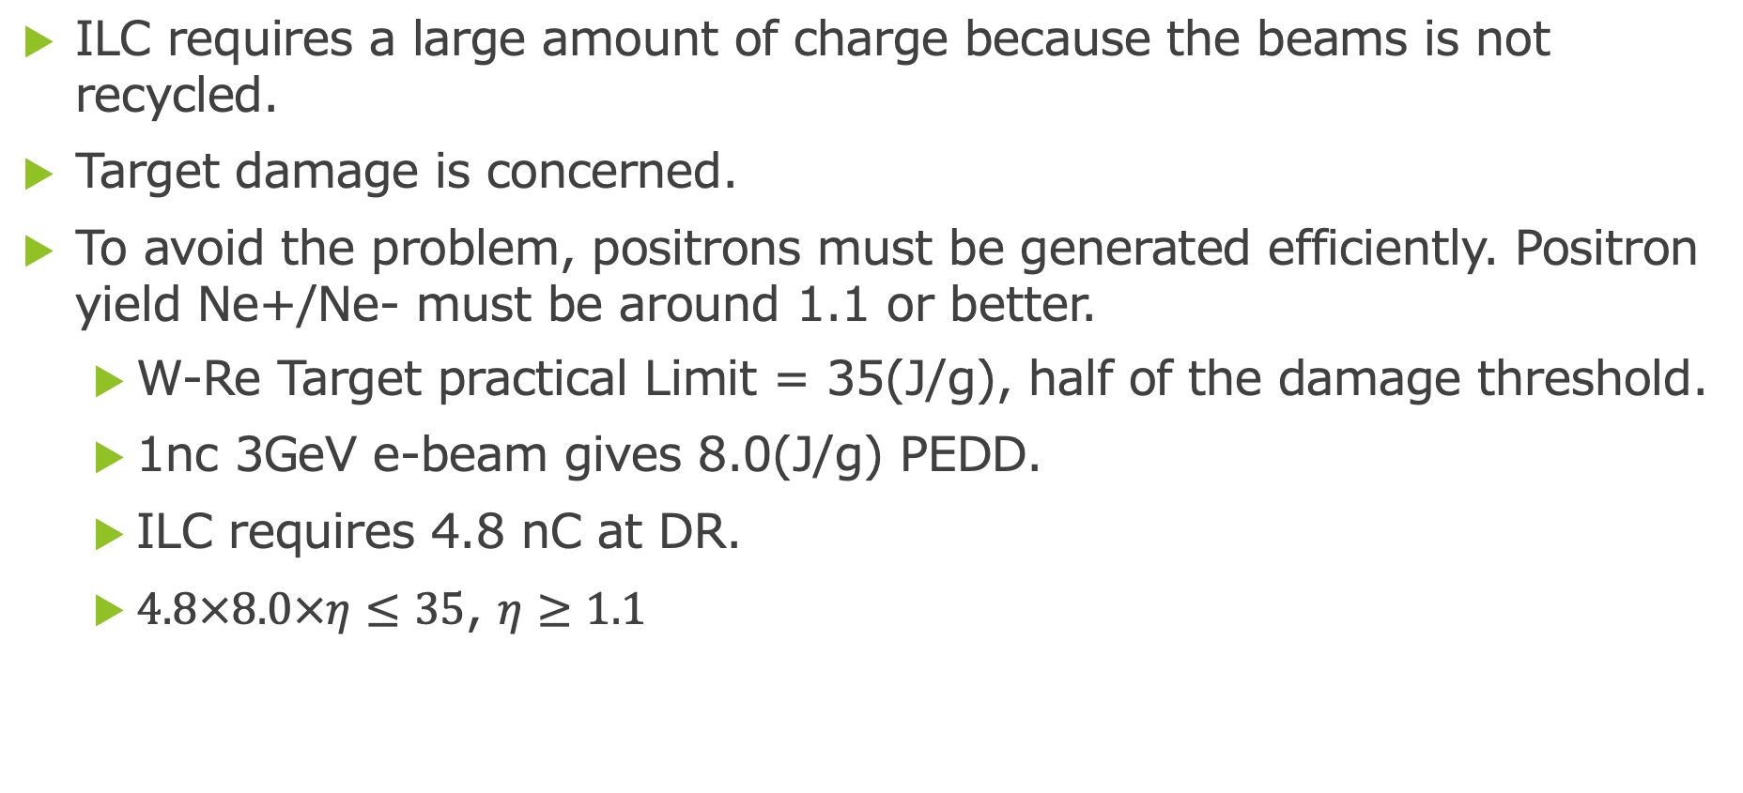
Research purpose
ILC requires a large amount of charge because the beams is not recycled.
Target damage is concerned.
To avoid the problem, positrons must be generated efficiently. Positron yield Ne+/Ne- must be around 1.1 or better.
  W-Re Target practical Limit = 35(J/g), half of the damage threshold.
  1nc 3GeV e-beam gives 8.0(J/g) PEDD.
  ILC requires 4.8 nC at DR.
  $4.8×8.0×η≤35$, $η≥1.1$

Slide 3
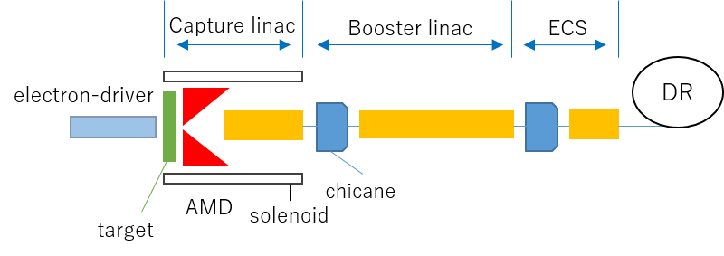
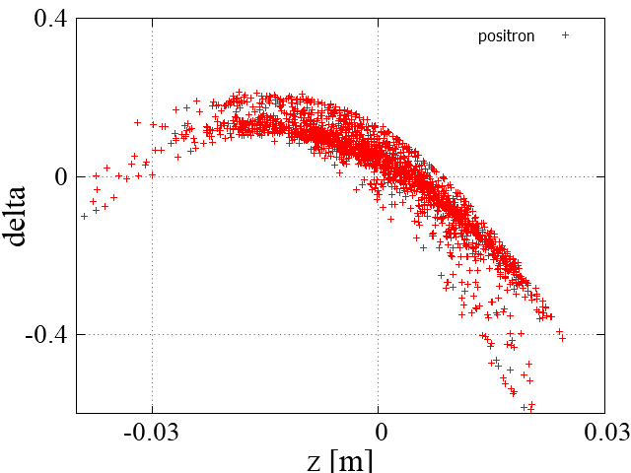
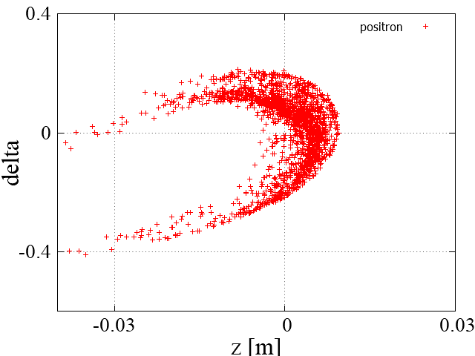
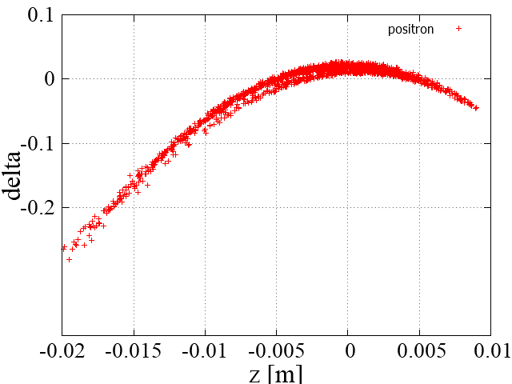
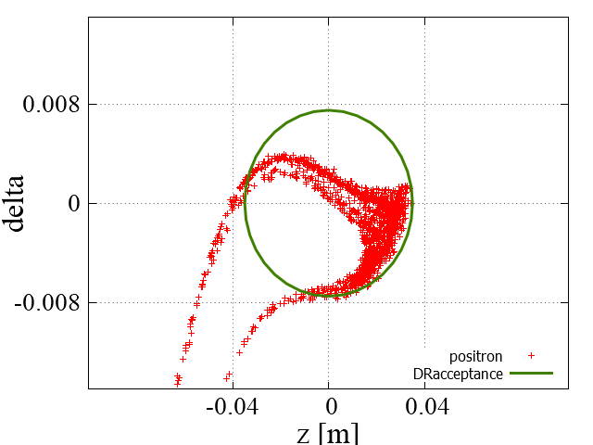
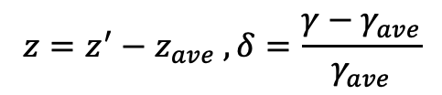
Electron Drive ILC Positron Source
GEANT
GPT
SAD
phase space distribution
$$z=z^{′}−z_{ave} , δ=\frac{γ−γ_{ave}}{γ_{ave}}$$
Capture linac exit
Chicane exit
Booster linac exit
ECS exit

Slide 4
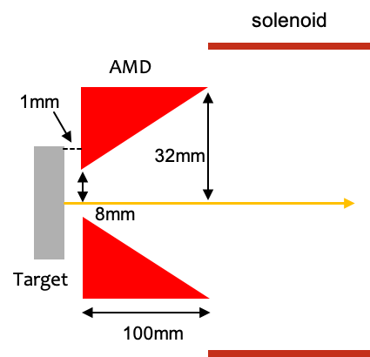
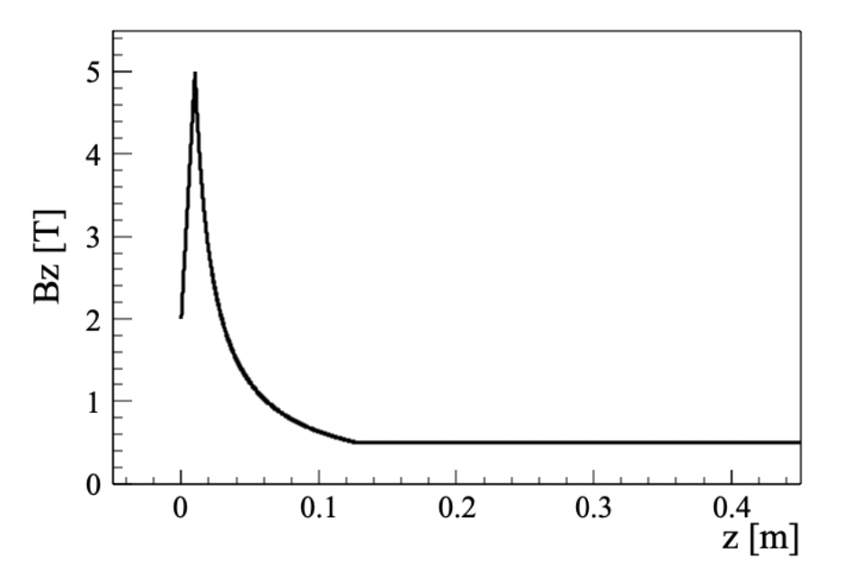
Target・AMD
Target
W-Re alloy (26% of Re) for large tensile strength
AMD (Adiabatic Matching Device)
Suppresses transverse momentum
5 T B_{z} peak field smoothly connected to 0.5 T solenoid field.
AMD magnetic field profile

Slide 5
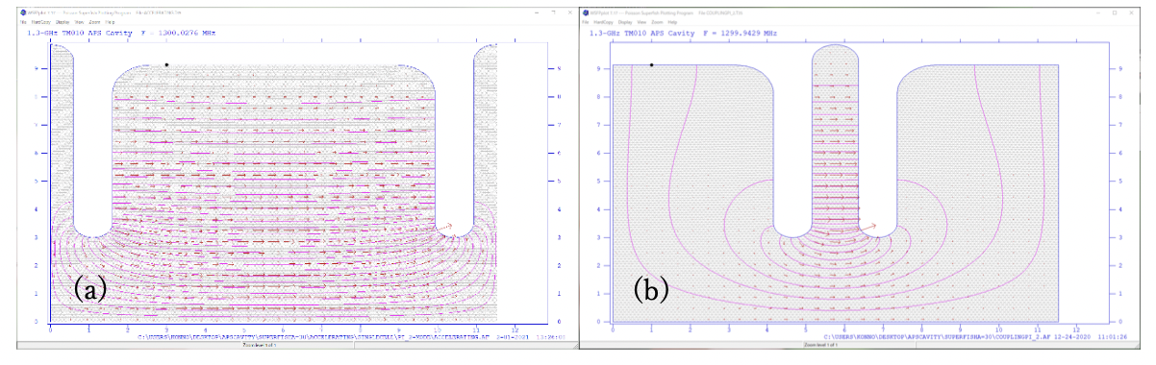
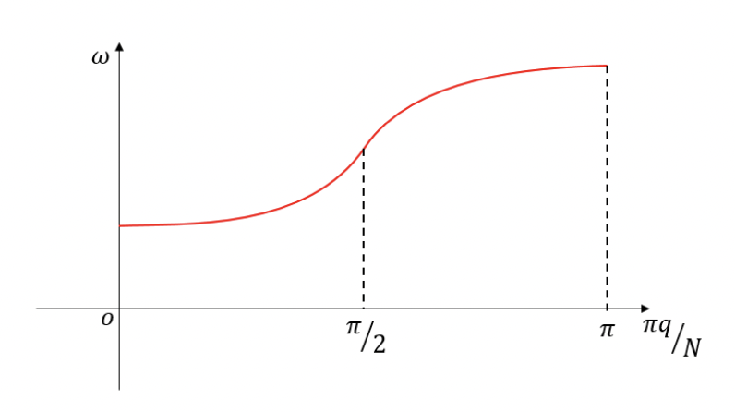
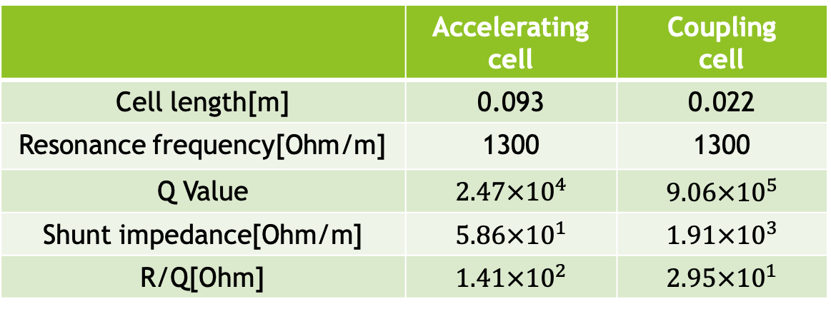
Capture Linac
The capture linac “captures” the generated positron in a RF bucket by bunching and acceleration.
The capture linac is composed from 36 APS (Alternate Periodic Structure) cavities for the large aperture 2a=60mm.
APS is a standing wave cavity operated in π/2 mode.
Cells with field (acceleration cells) and without field (coupling cells) are alternated.
Acceleration cell is longer for better shunt impedance.
(a)Accelerating cell
(b)Coupling cell

Slide 6


Deceleration capture method
If positrons are placed at the deceleration phase initially, the positrons are bunched at the acceleration phase by phase slipping: Deceleration capture.
In case of acceleration phase, positrons that fall into the deceleration phase due to phase slippage caused by the large transverse momentum will overflow into the next RF bucket.
t=5nsec
Deceleration phase for e+
Acceleration phase for e-
$$e^{−}$$
$$e^{+}$$
t=198nsec

Slide 7
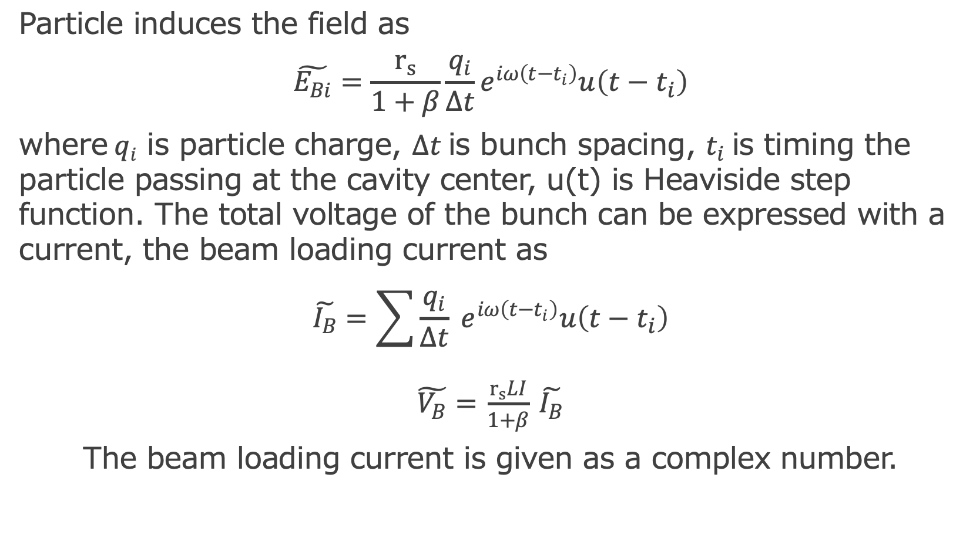
Beam field and the beam loading current
Particle induces the field as
$$\tilde{E_{Bi}}=\frac{r_{s}}{1+β}\frac{q_{i}}{∆t}e^{iω\left(t−t_{i}\right)}u\left(t−t_{i}\right)$$
where$qi$ is particle charge, $∆t$is bunch spacing, $t_{i}$is timing the particle passing at the cavity center, u(t) is Heaviside step function. The total voltage of the bunch can be expressed with a current, the beam loading current as
$$\tilde{I_{B}}=\sum{\frac{q_{i}}{∆t} e^{iω\left(t−t_{i}\right)}u\left(t−t_{i}\right)}$$
$\tilde{V_{B}}=$ $\frac{r_{s}LI}{1+β}$ $\tilde{I_{B}}$
The beam loading current is given as a complex number.

Slide 8
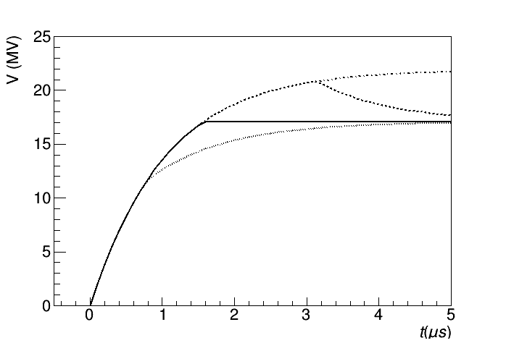
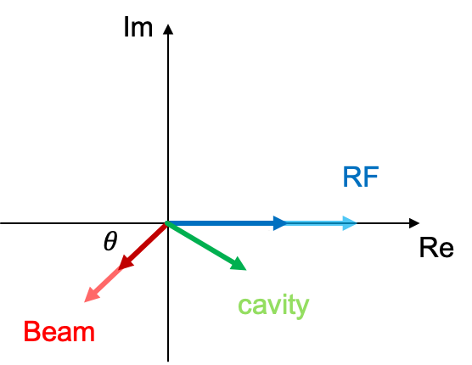
Beam loading compensation (1)
When a beam passes through the cavity, field is induced. In the multi-bunch acceleration, the cavity field is varied in time causing the non-uniform acceleration in the pulse.
A conventional beam loading compensation for SW cavity is delta-T method; The electric field of the RF, which increases with time, cancels out the electric field due to the beam.
It works well if we can treat the beam loading current as a real number.
Unfortunately, it does not work if the beam is off-crest, because the beam loading current becomes a complex number.

Slide 9
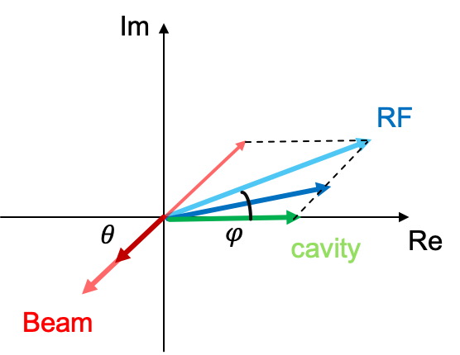
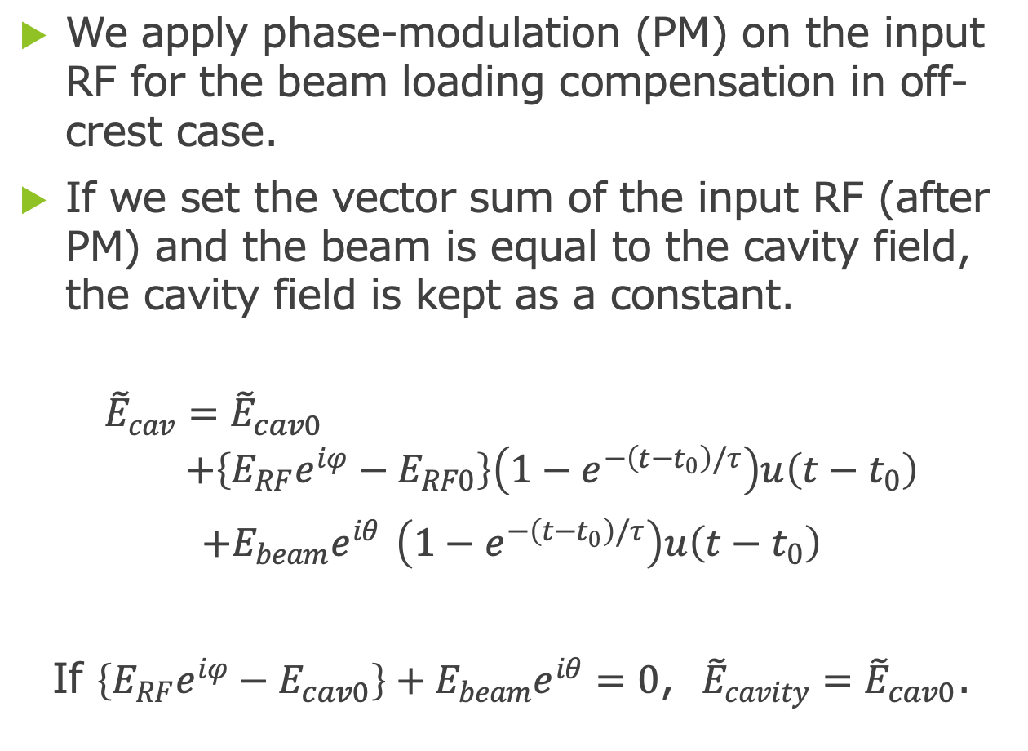
Beam loading compensation (2)
We apply phase-modulation (PM) on the input RF for the beam loading compensation in off-crest case.
If we set the vector sum of the input RF (after PM) and the beam is equal to the cavity field, the cavity field is kept as a constant.
$${\tilde{E}}_{cav}={\tilde{E}}_{cav0} \\ +\left\{{E_{RF}e}^{iφ}−E_{RF0}\right\}\left(1−e^{−\left(t−t_{0}\right)/τ}\right)u\left(t−t_{0}\right)$$
$+E_{beam}e^{iθ}$ $\left(1−e^{−\left(t−t_{0}\right)/τ}\right)u\left(t−t_{0}\right)$
If $\left\{{E_{RF}e}^{iφ}−E_{cav0}\right\}+E_{beam}e^{iθ}=0$, ${\tilde{E}}_{cavity}={\tilde{E}}_{cav0}$.

Slide 10
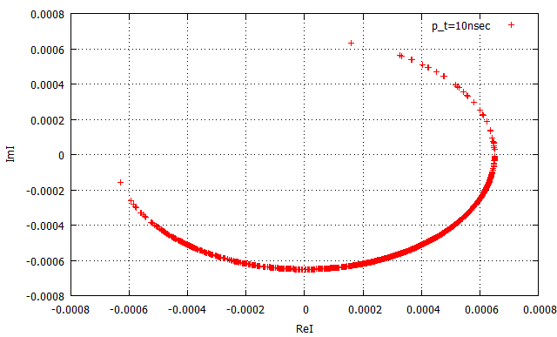
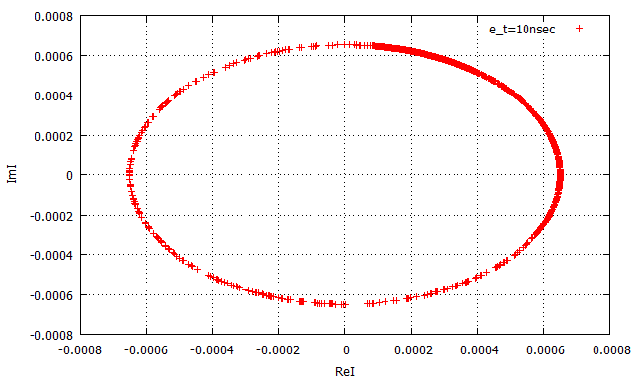
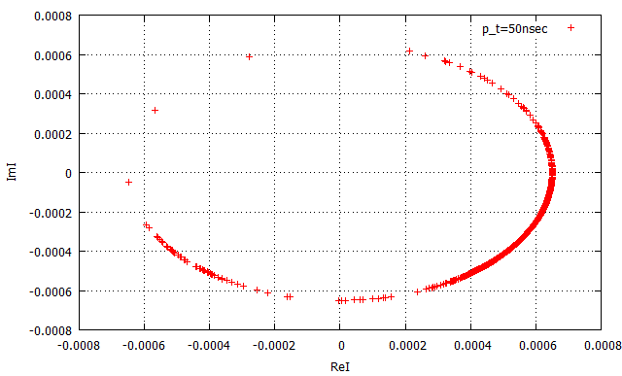
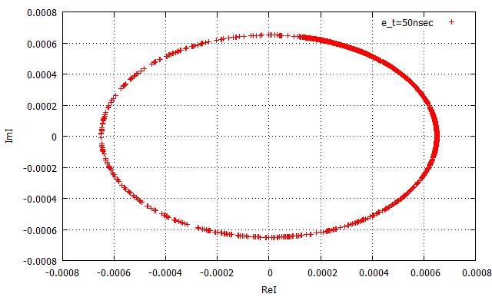
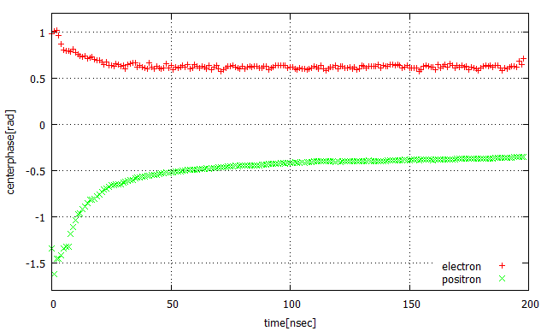
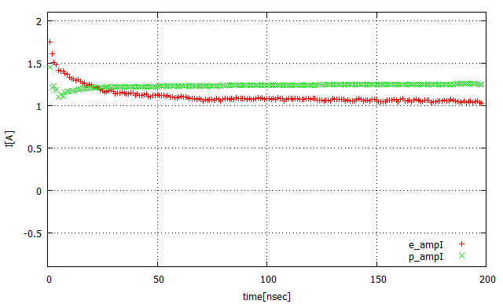
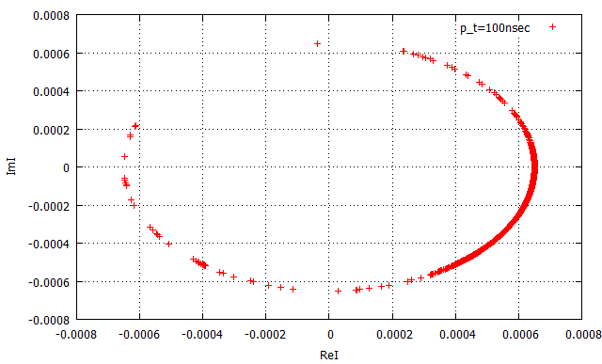
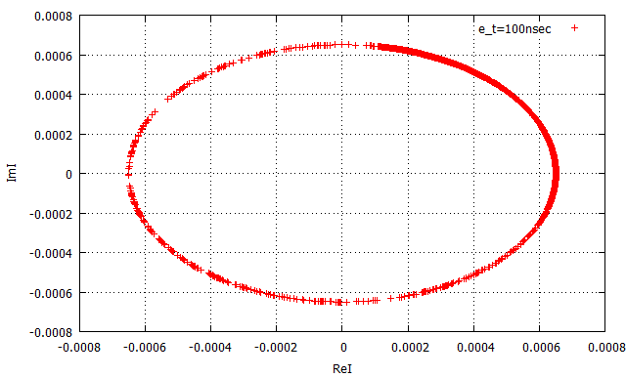

Beam loading current
Positron
Electron
10ns
10ns
The beam loading current by particles
$$\tilde{I_{Bi}}=\frac{q_{i}}{∆t} e^{iω\left(t−t_{i}\right)+φ_{0}}$$
50ns
50ns
Average phase (rad)
Abs(I) (A)
100ns
100ns

Slide 11
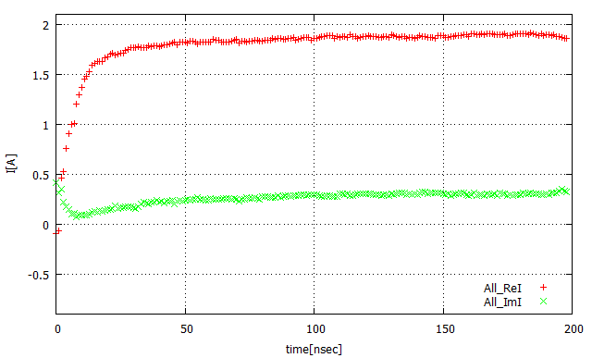
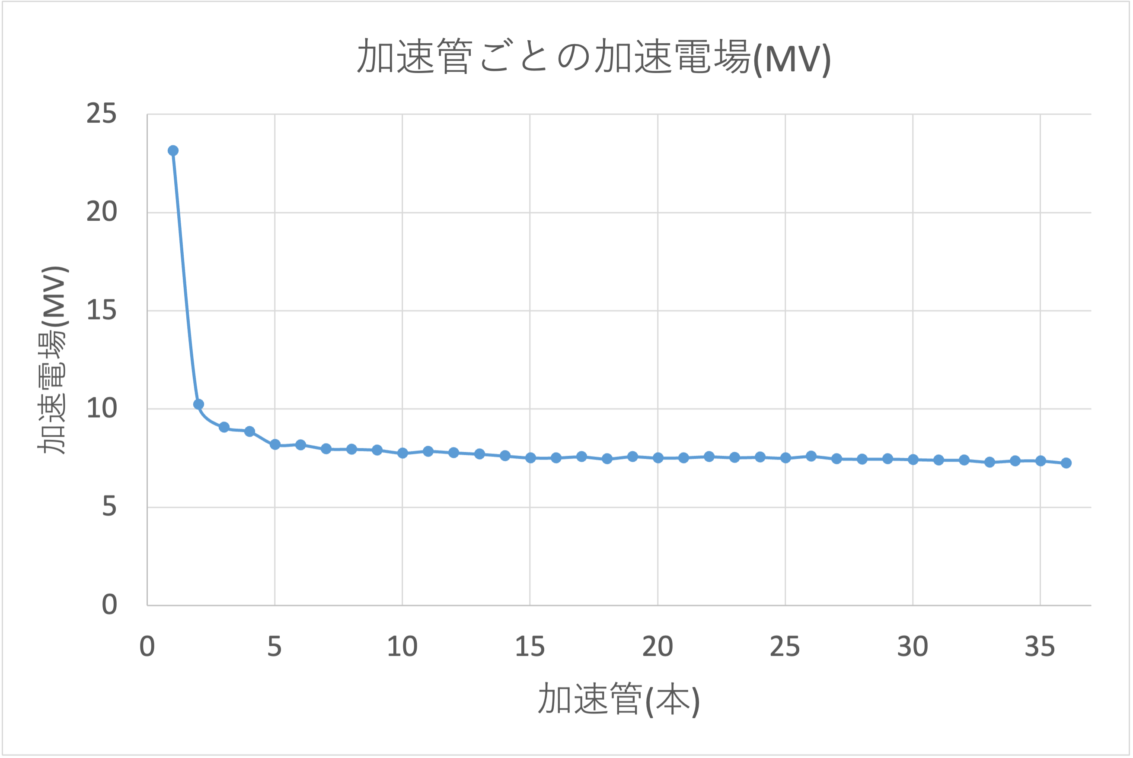

Beam loaded cavity voltage
We evaluated the total beam loading current as a vector sum of the positron and electron currents.
The cavity voltage is determined as
$$E_{RF}\sin{φ}−E_{beam}\sin{θ}=0$$
$$E_{cav0}={E_{RF}\cos{φ}+E}_{beam}\cos{θ}$$
I(A)
Acc. V (MV)
Acc. index

Slide 12
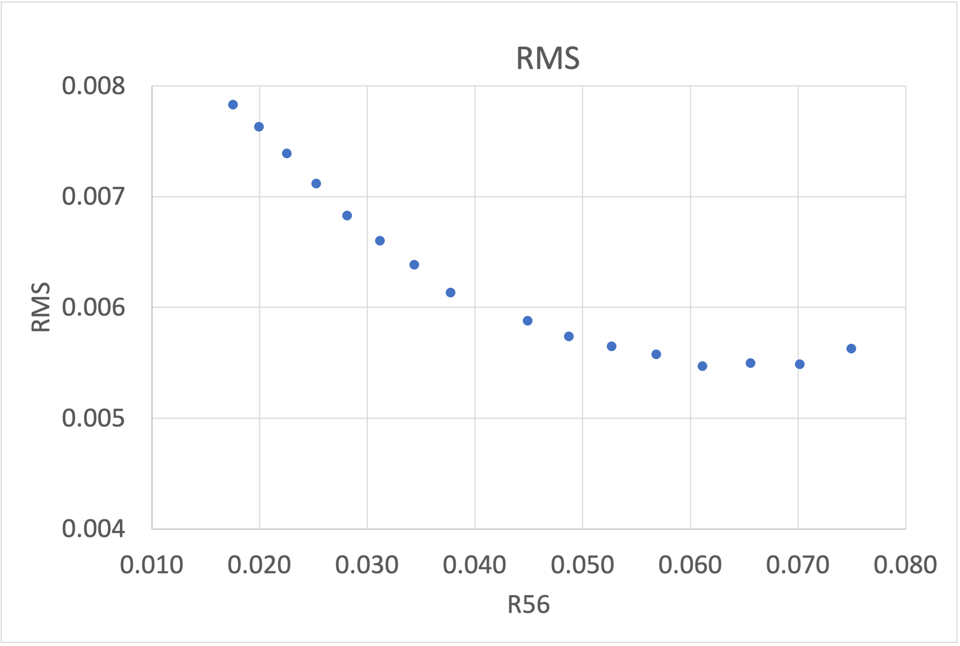
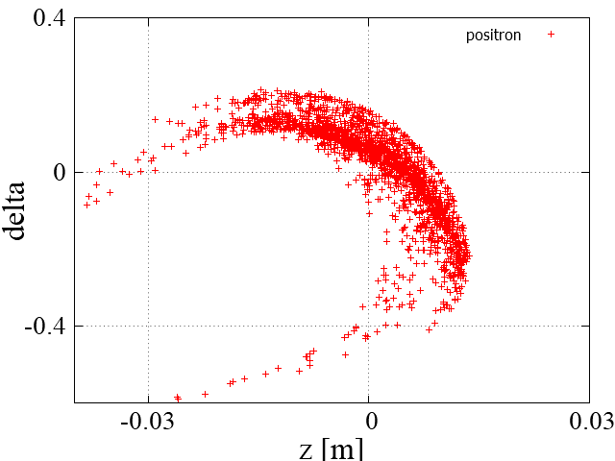
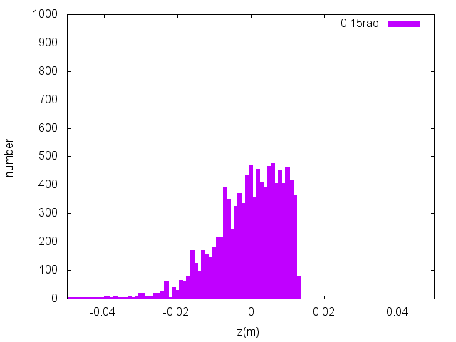
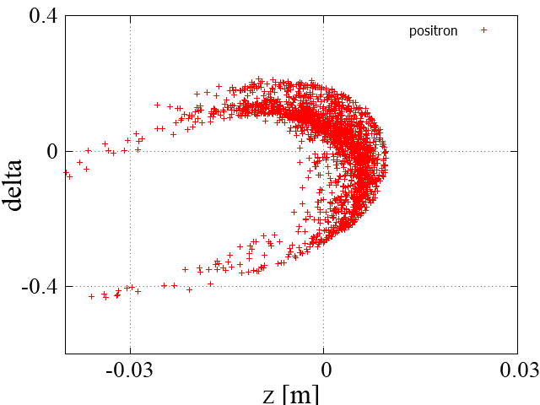
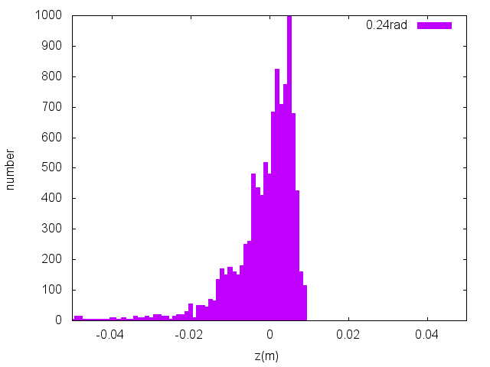

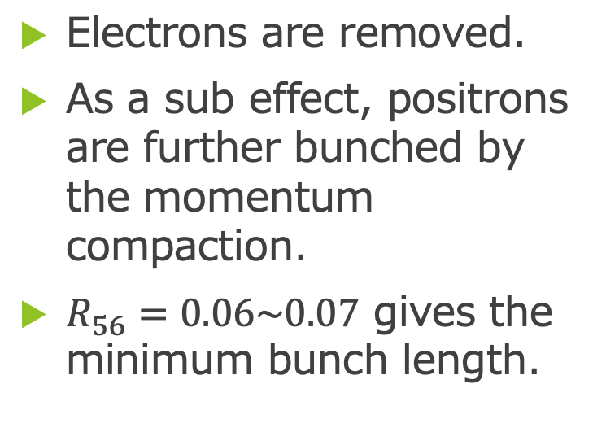


Chicane
Electrons are removed.
As a sub effect, positrons are further bunched by the momentum compaction.
$R_{56}=0.06\sim 0.07$ gives the minimum bunch length.
Capture linac exit
BM length${ L}_{B}=0.36m$、spacing $L=0.15m$
$$R_{56}=0.018$$
After chicane
$$R_{56}=0.045$$

Slide 13
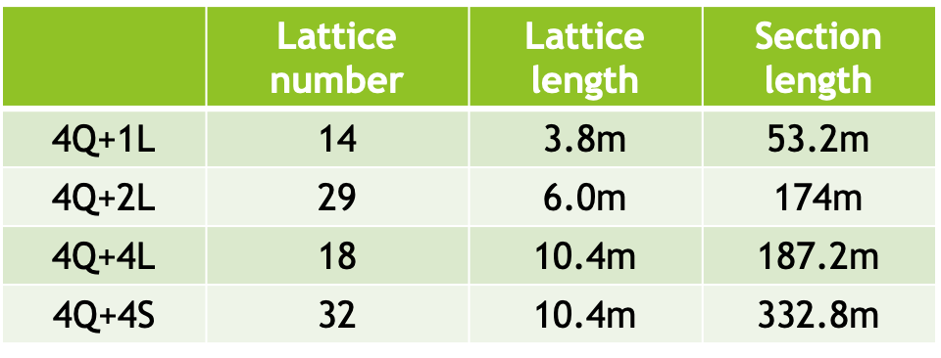
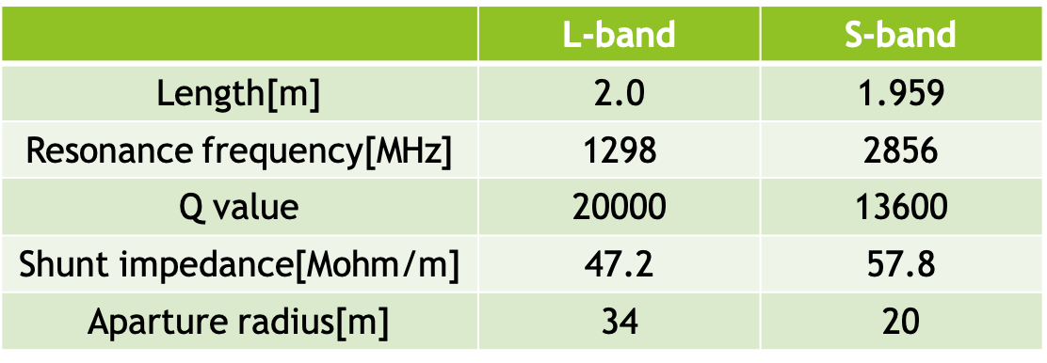
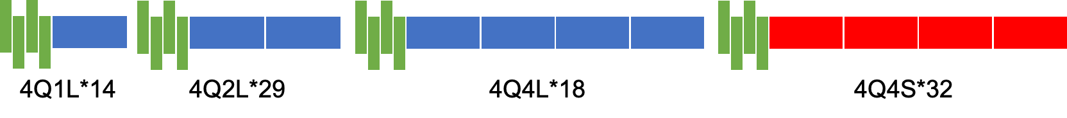
Booster Linac
Positron is accelerated up to 5 GeV.
L-band cavities with large aperture in the first half.
S-band cavity with high acceleration efficiency in the second half.
Beam loading compensation will be discussed by Kuroguchi.

Slide 14
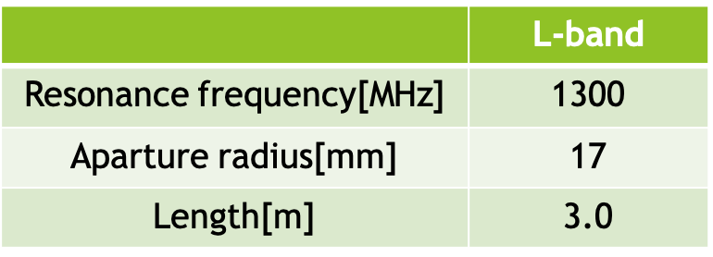

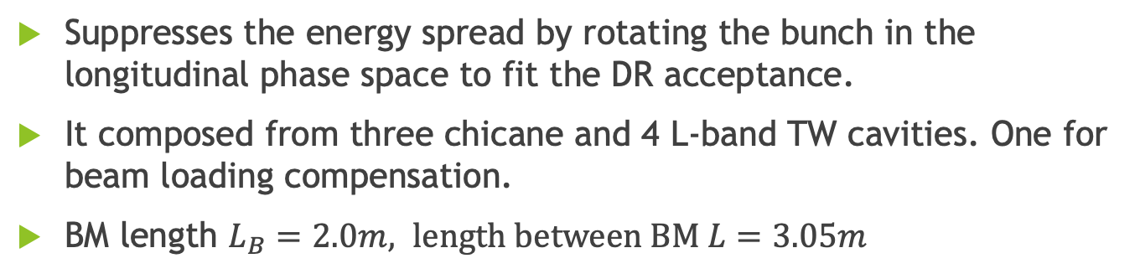


ECS
$$δ$$
Suppresses the energy spread by rotating the bunch in the longitudinal phase space to fit the DR acceptance.
It composed from three chicane and 4 L-band TW cavities. One for beam loading compensation.
BM length $L_{B}=2.0m, length between BM L=3.05m$
Z
$$δ$$
Z
Chicane part
Chicane part
Chicane part
L-band Cavity
QM
QM
QM
QM
$$δ$$
Z

Slide 15
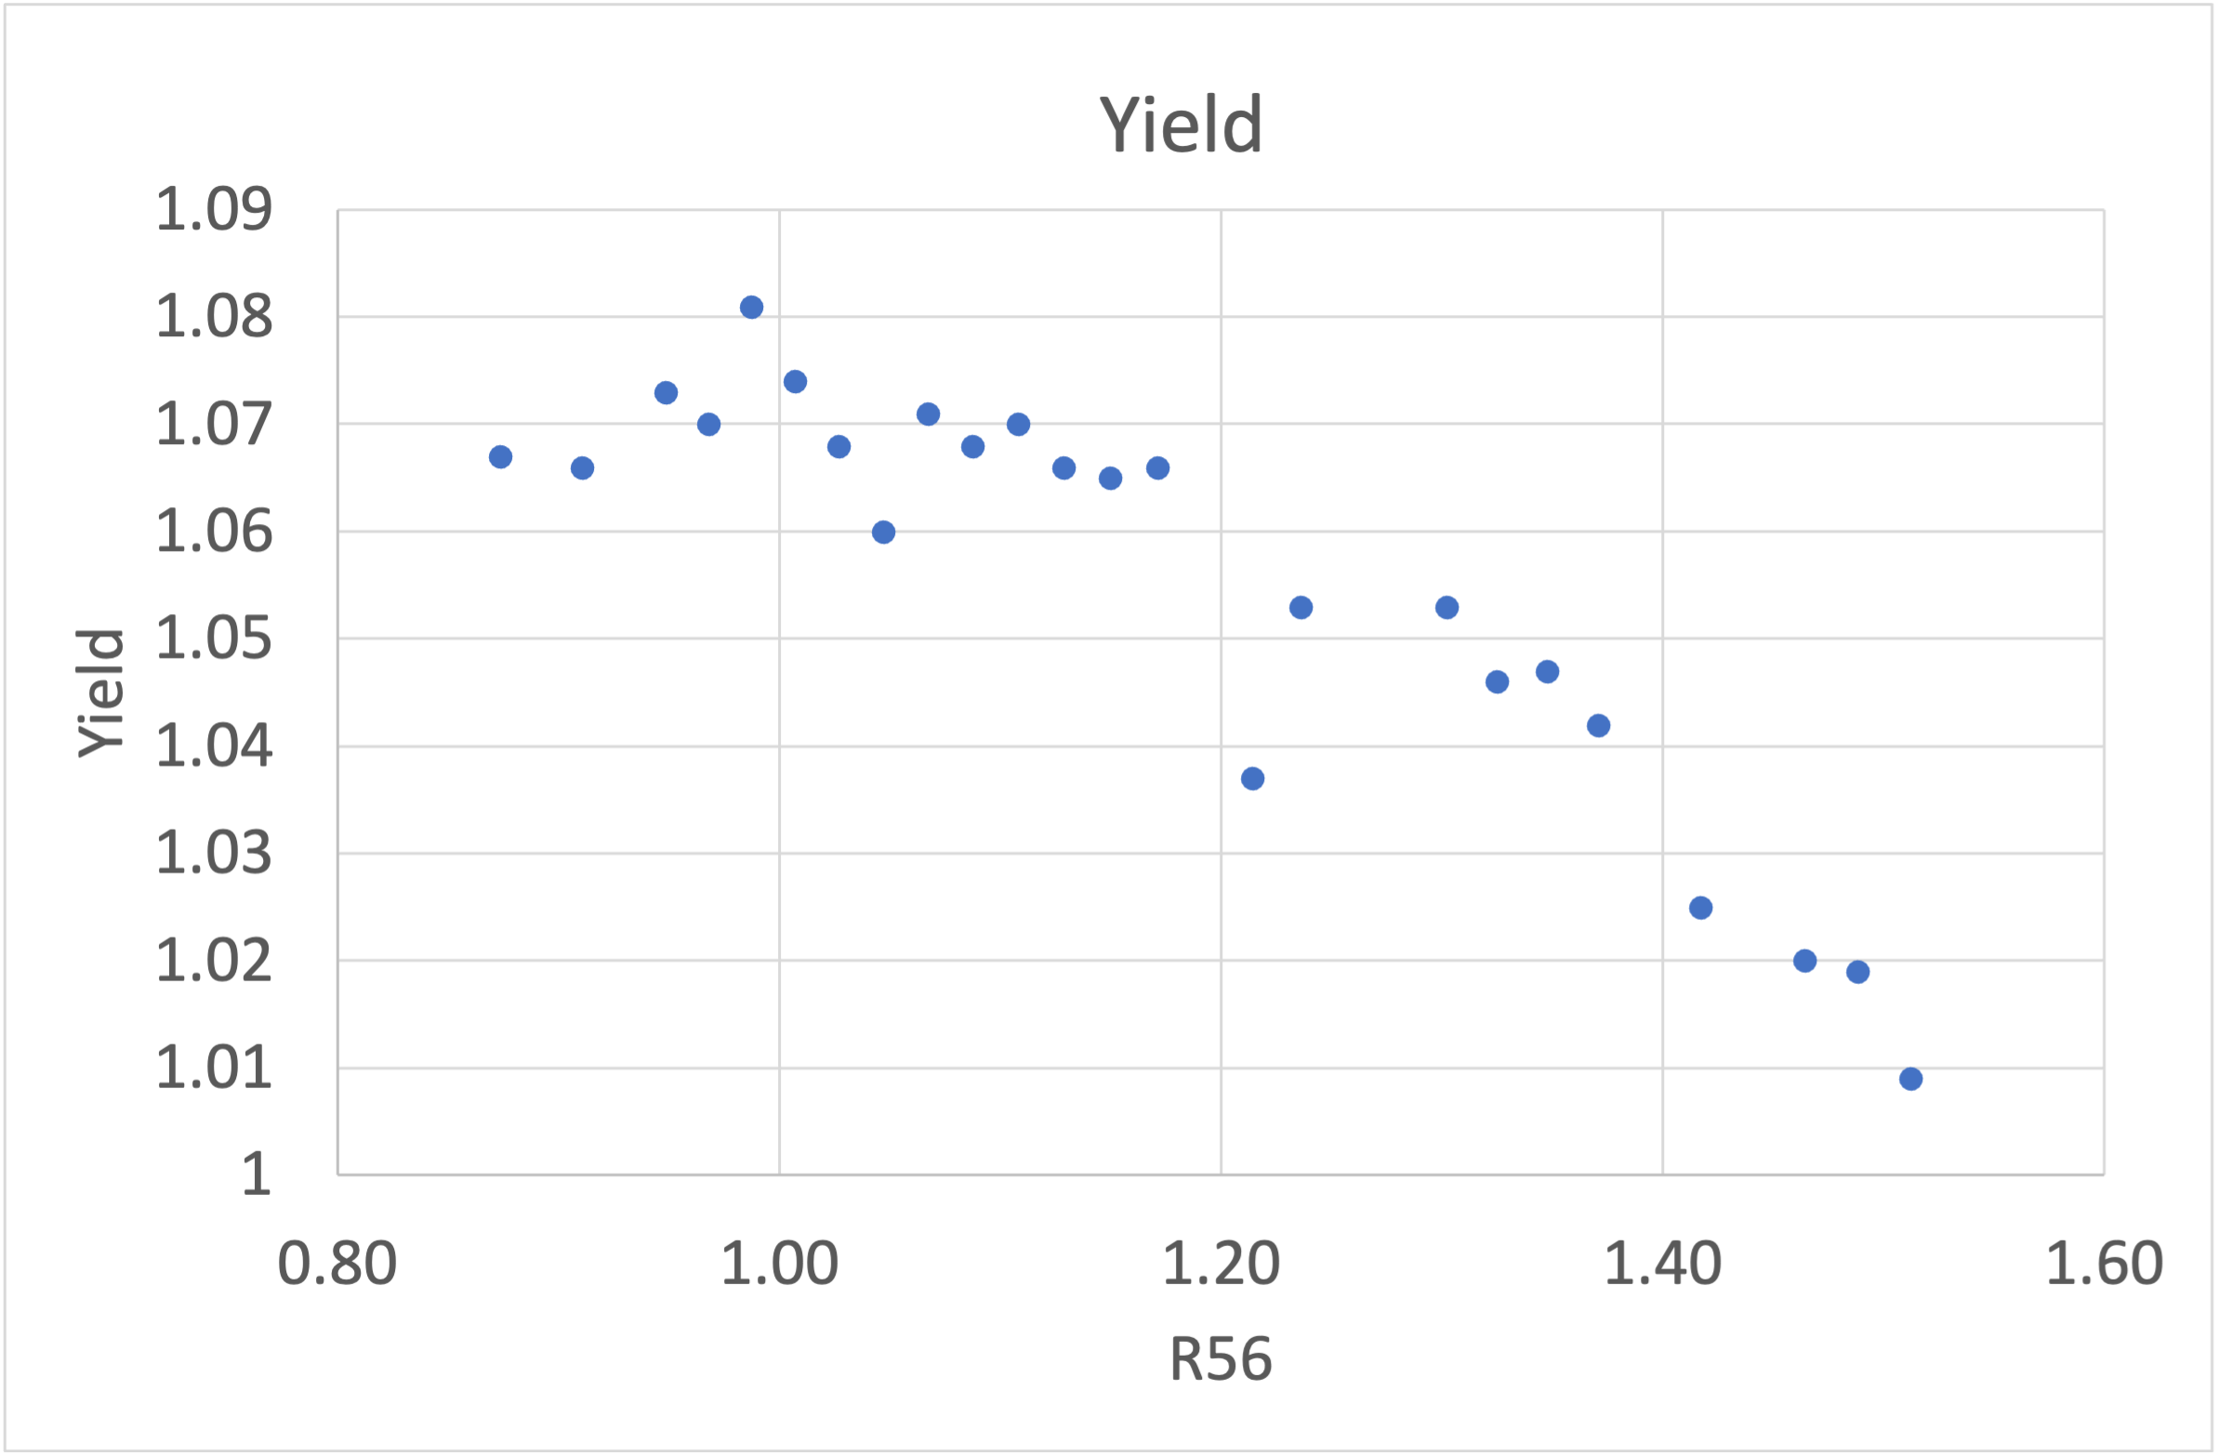
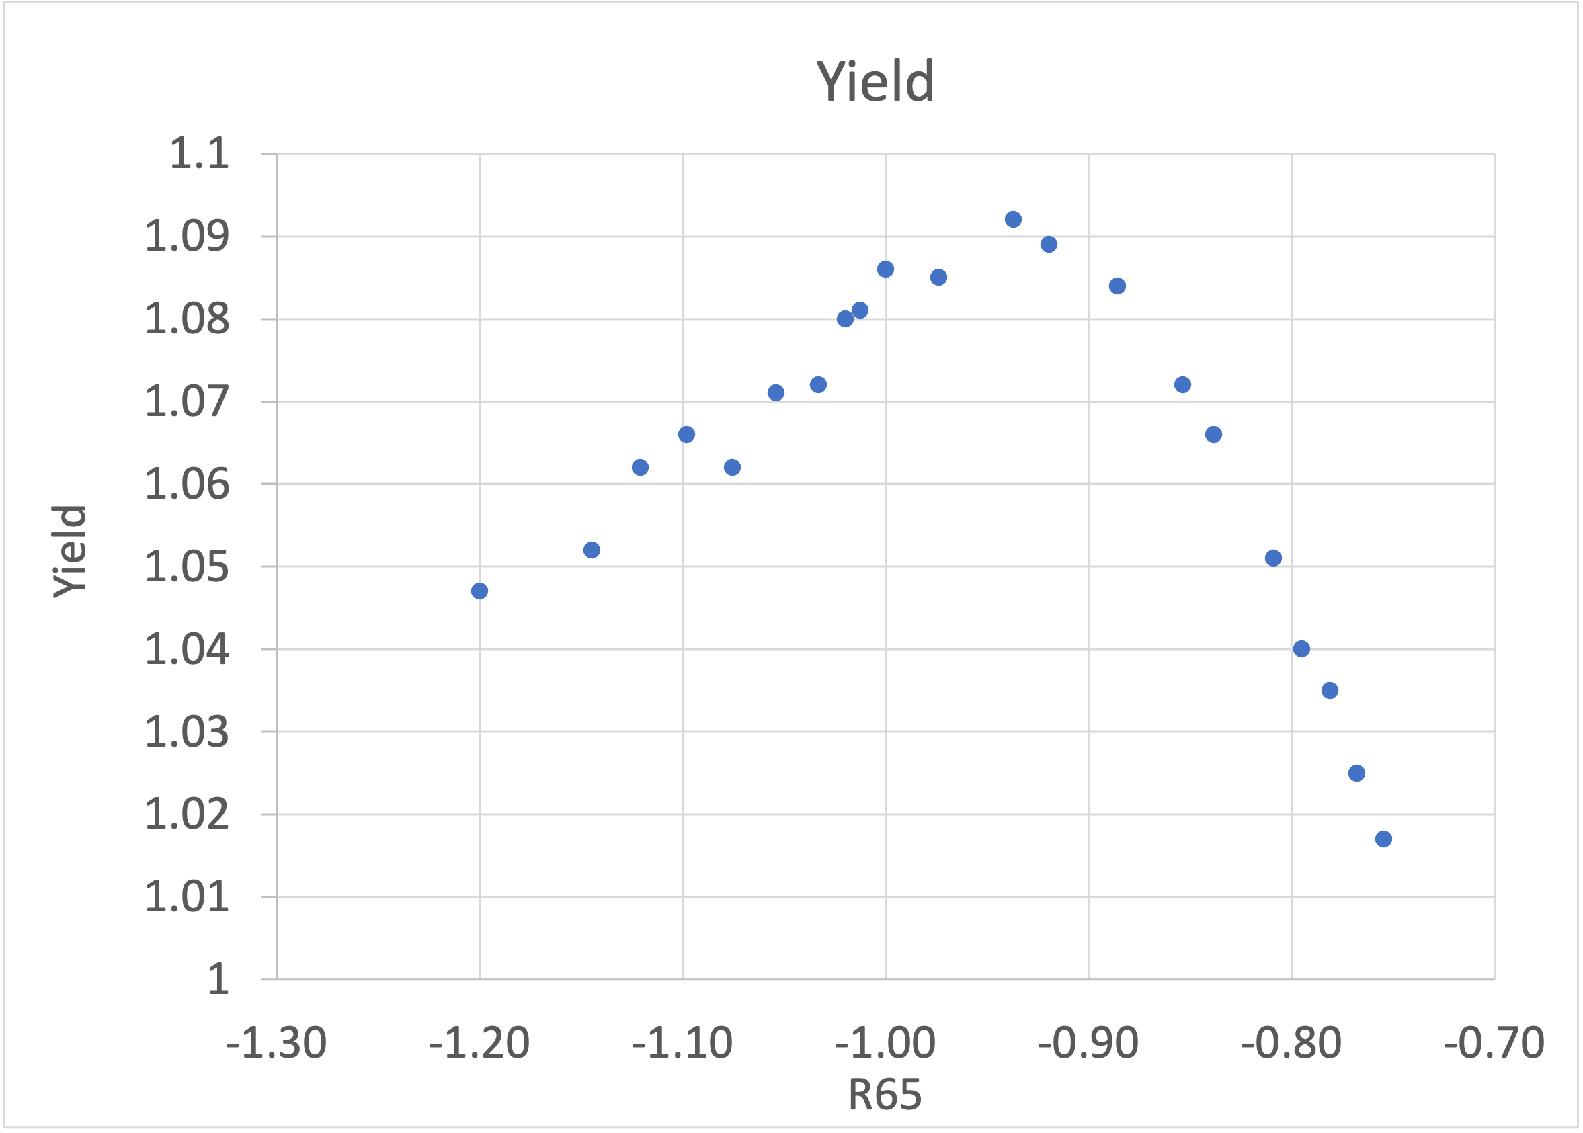




Optimization of R₅₆ and R₆₅ in ECS
Optimization of ECS is performed in two steps.
$R_{56}$ and $R_{65}$ are optimized with $R_{56}R_{65}+1=0$ (linear regime).
$R_{56}$ is optimized with a fixed $R_{65}$.
The maximum yield was 1.09 giving 35.3 J/g on Target.
PEDD is on the practical limit where the system can be operated safely.
$R56$=0.987
$$R_{56}R_{65}+1=0$$
$$R_{56}$$

Slide 16
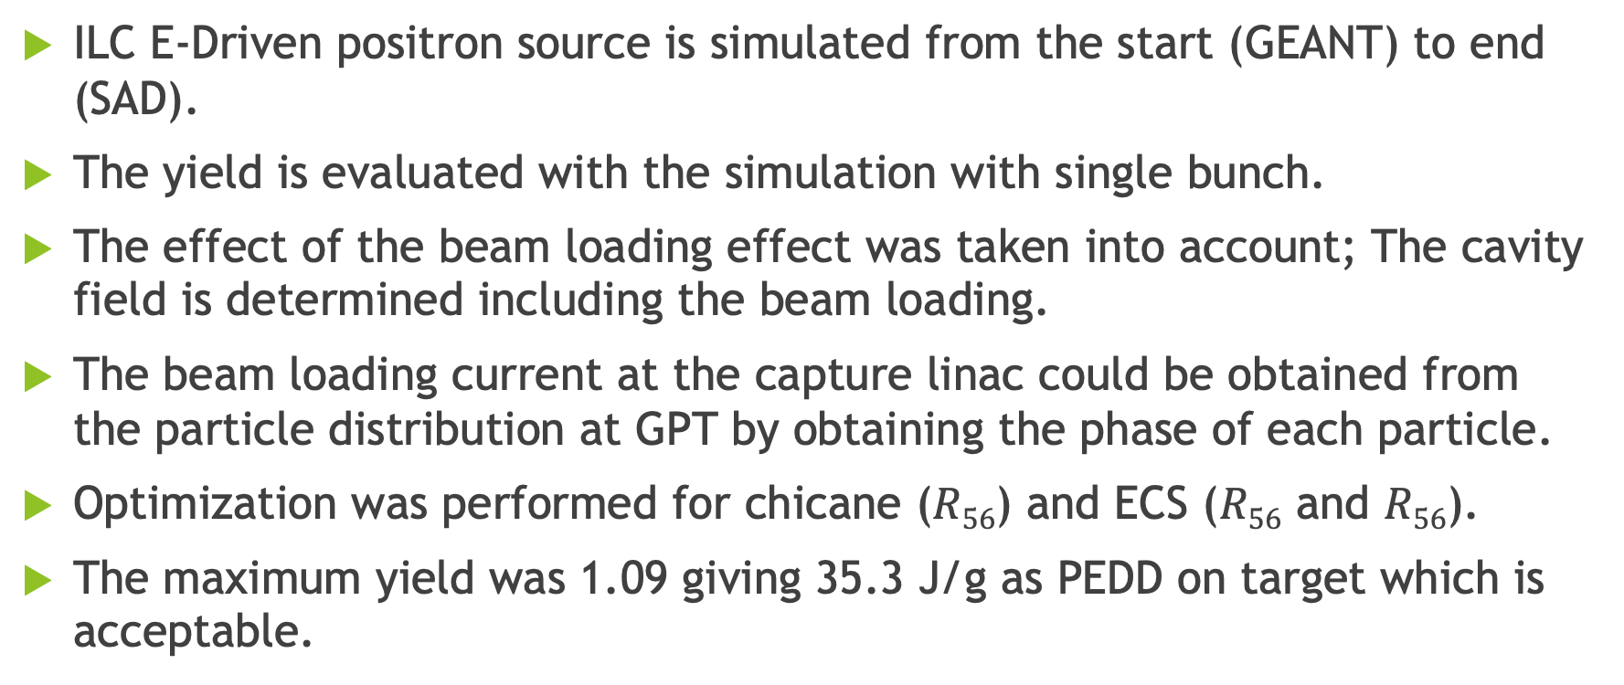
Summary
ILC E-Driven positron source is simulated from the start (GEANT) to end (SAD).
The yield is evaluated with the simulation with single bunch.
The effect of the beam loading effect was taken into account; The cavity field is determined including the beam loading.
The beam loading current at the capture linac could be obtained from the particle distribution at GPT by obtaining the phase of each particle.
Optimization was performed for chicane ($R56$) and ECS ($R56$ and $R56$).
The maximum yield was 1.09 giving 35.3 J/g as PEDD on target which is acceptable.

