Slide 1


C³ Alignment with Rasnik
…the alignment of the C3 accellerator structures…
Harry van der Graaf, Joris van Heijningen, Anoop Nagesh Koushik
LCWS 2023, SLAC, Stanford, CA

Slide 2
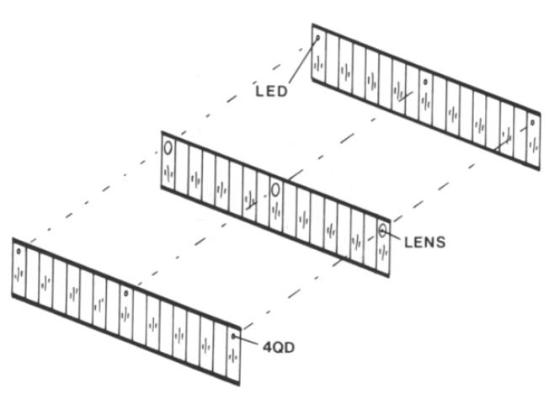
1983: Alignment of the Muon Spectrometer of the L₃ experiment at CERN
…..original idea was from Draper Lab/MIT, Cambridge, Mass
Muon chambers in L₃
First Rasnik design: 4QD
Red Alignment System NIKhef

Slide 3
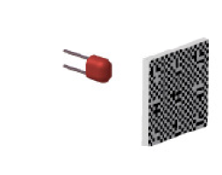
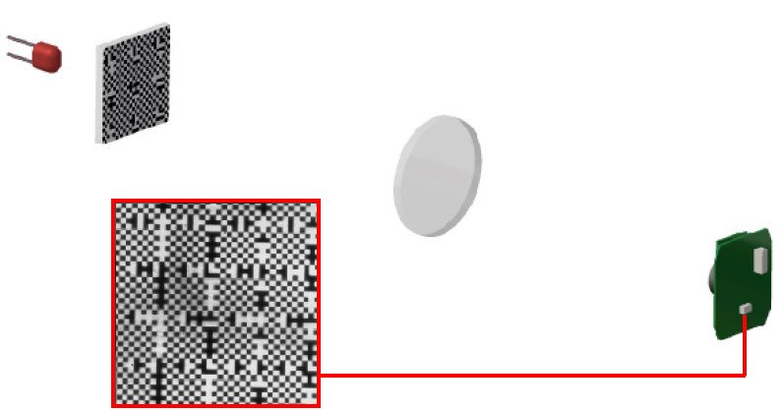

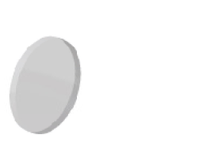
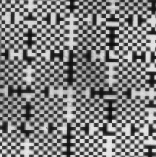
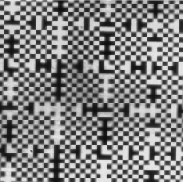
1993: CCD-Rasnik Three Point Alignment system for ATLAS
Coded mask is projected via lens on pixel sensor;;
In principle, all 6 DoFs of mask & pixel sensor + x,y,z of lens can be determined;
x,y,z and rotZ (θ_{z}, not for lens) are measured
z
M. Beker et al., “The Rasnik 3-point alignment system”, JINST 14 P08010 (2019)

Slide 4
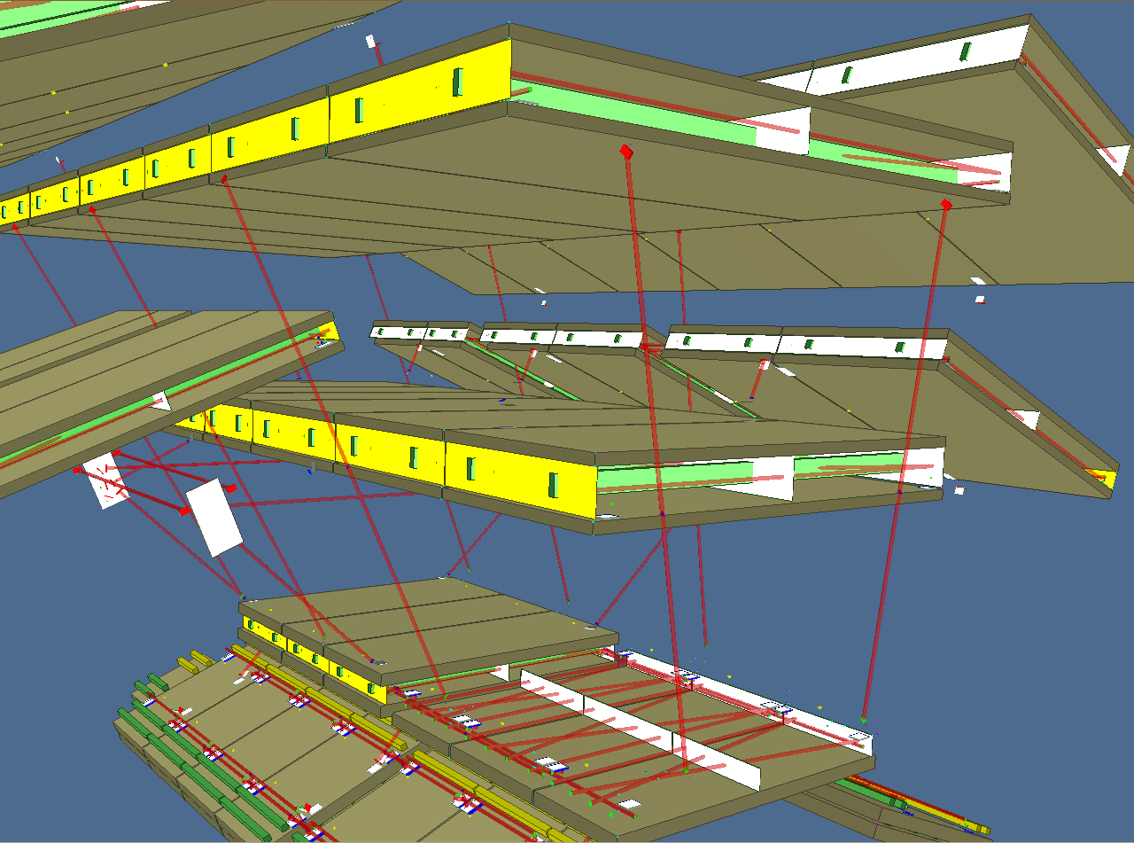
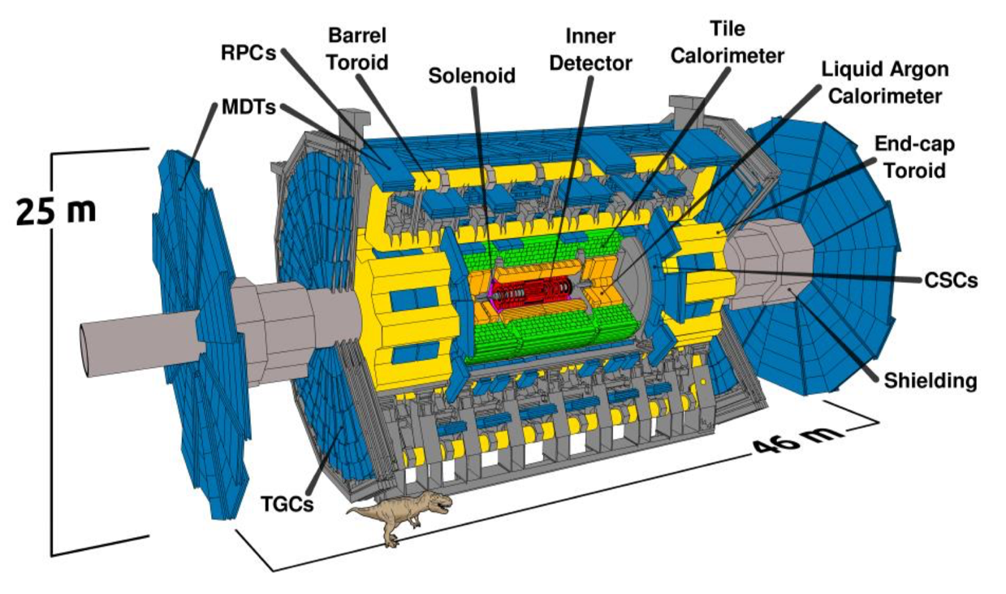
ATLAS experiment: 8000 Rasniks, none fails since start
In order to properly
reconstruct vertices…
… we need to know where
our detectors are!

Slide 5
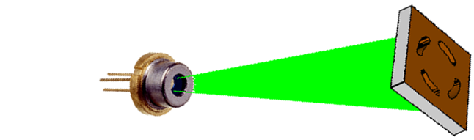

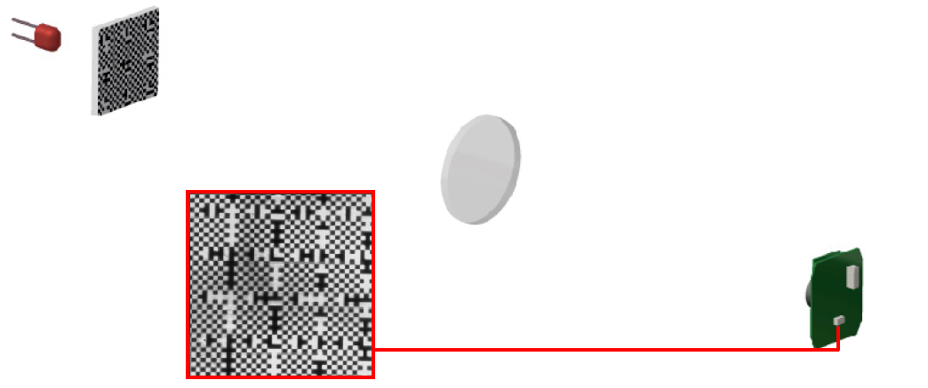
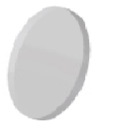
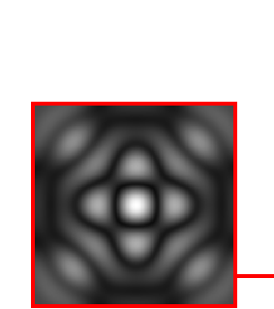
Long distance Rasniks: RasDif

Slide 6
Alignment over long distance ( > 100 m): RasClic, later RasDif:
replace lens by zone plate
replace coded mask by monochromatic spherical-wave light source (1 $ laser diode)
140 m
Pioneered by A. Seryi, SLAC:
Investigation of slow motions of the SLAC linac tunnel, SLAC-PUB-8597 8597 (1) (2000) P06034, arXiv:physics/0008195.

Slide 7
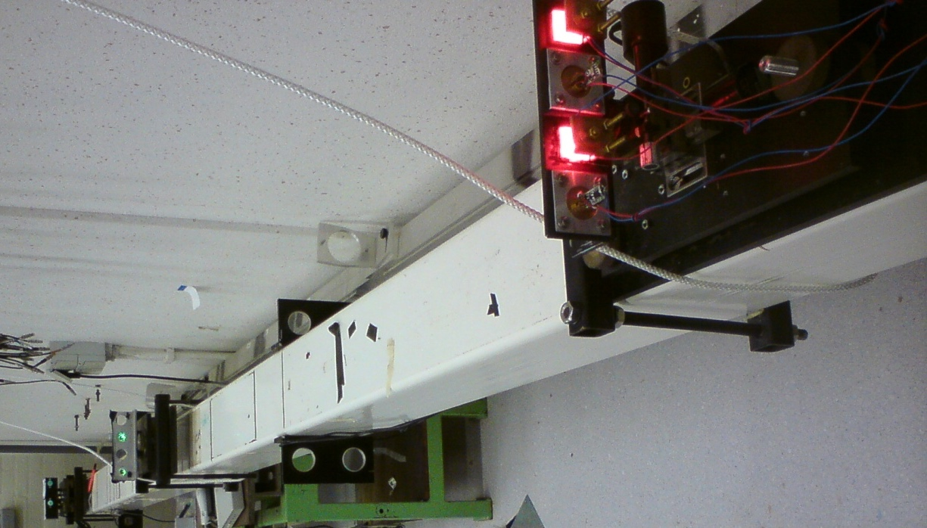
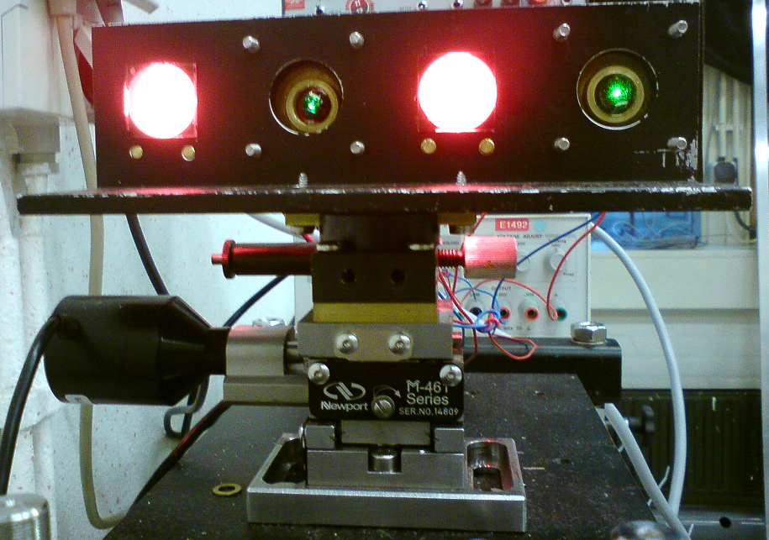
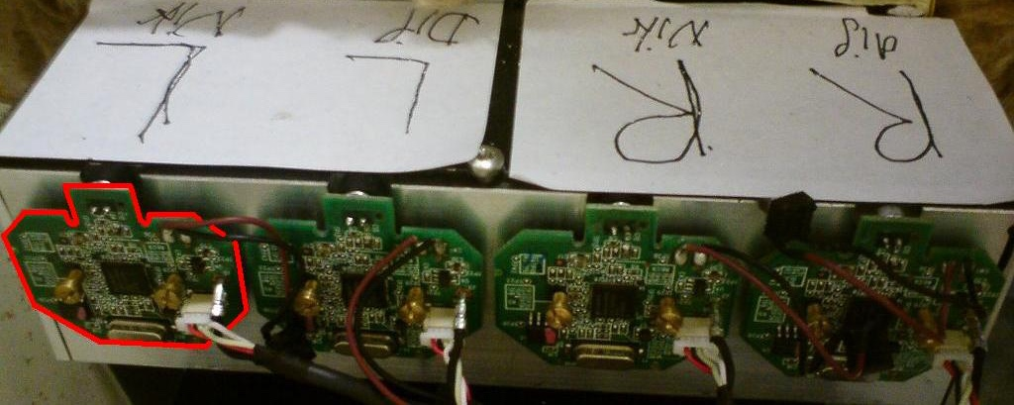
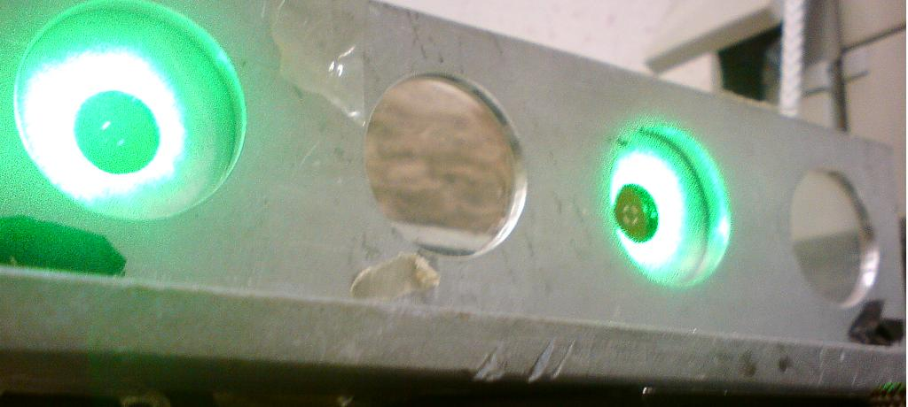
RasCLIC: 4 m set-up at Nikhef
2 Rasniks and 2 Rasdifs in parallel operation
2 masks and 2 lasers on actuator
JvH, “Precision Improvement in Optical Alignment Systems of Linear Colliders ”, M.Sc. Thesis, Delft University of Technology (2012)
2 lenses and 2 diffraction plates
4 pixel image sensors of a Logitech C300

Slide 8
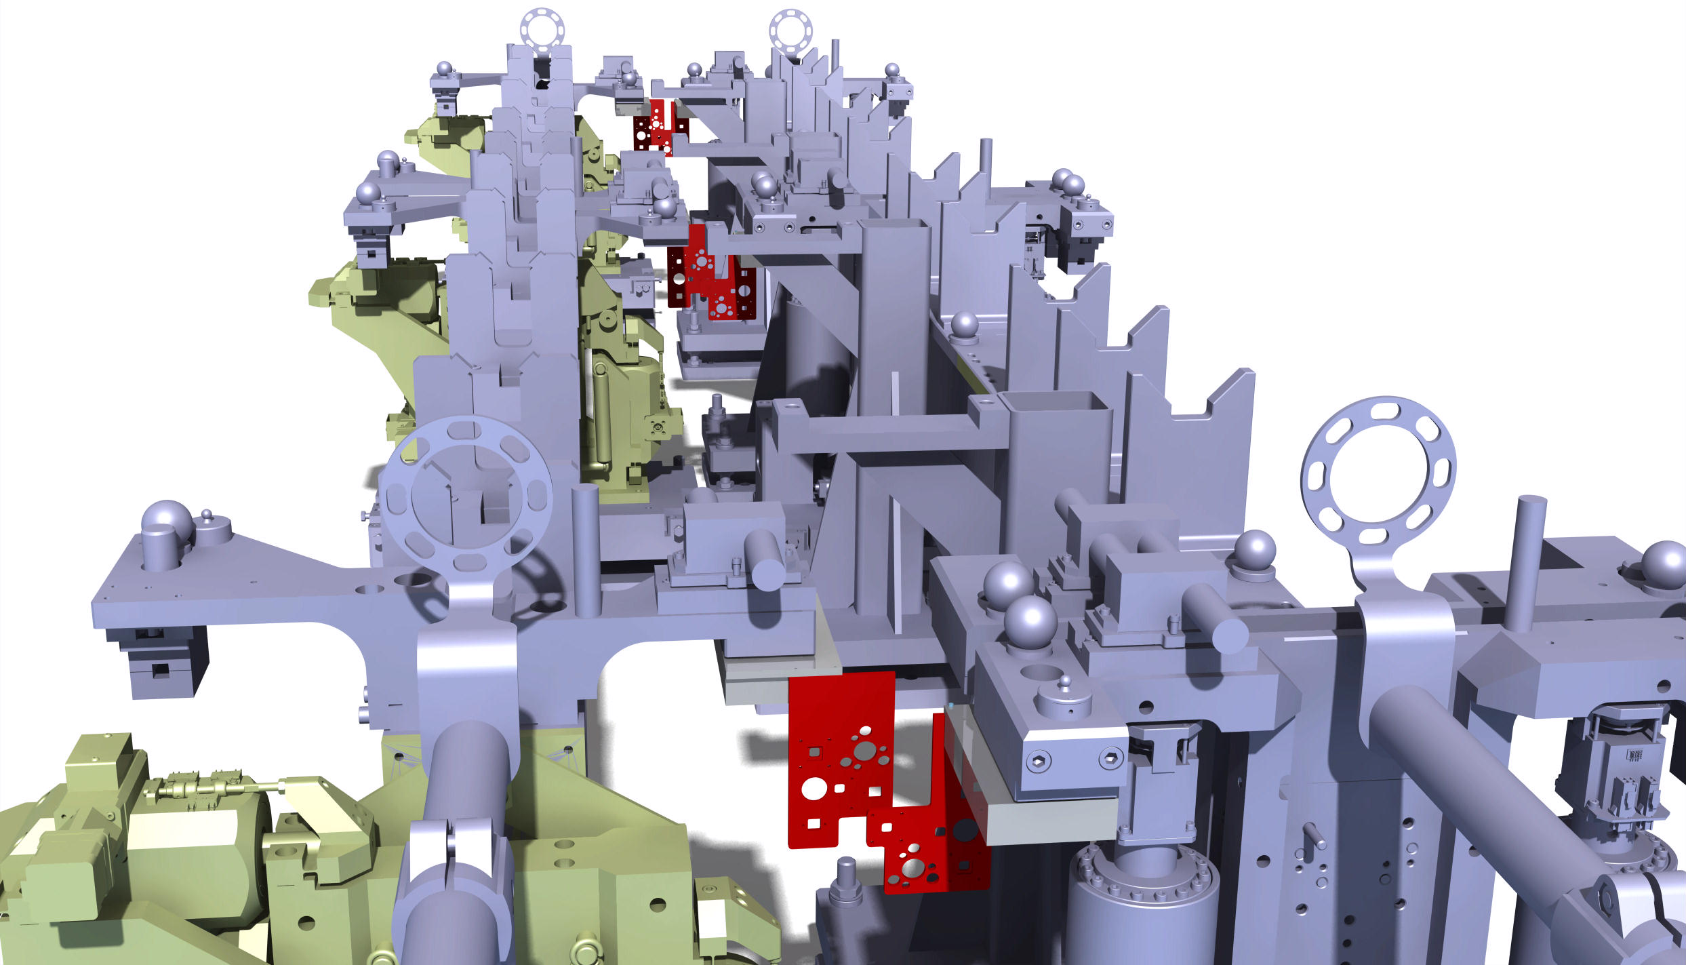
RasChain: interconnected “leapfrog” Rasnik systems for basic CLIC units of 2010 mm

Slide 9
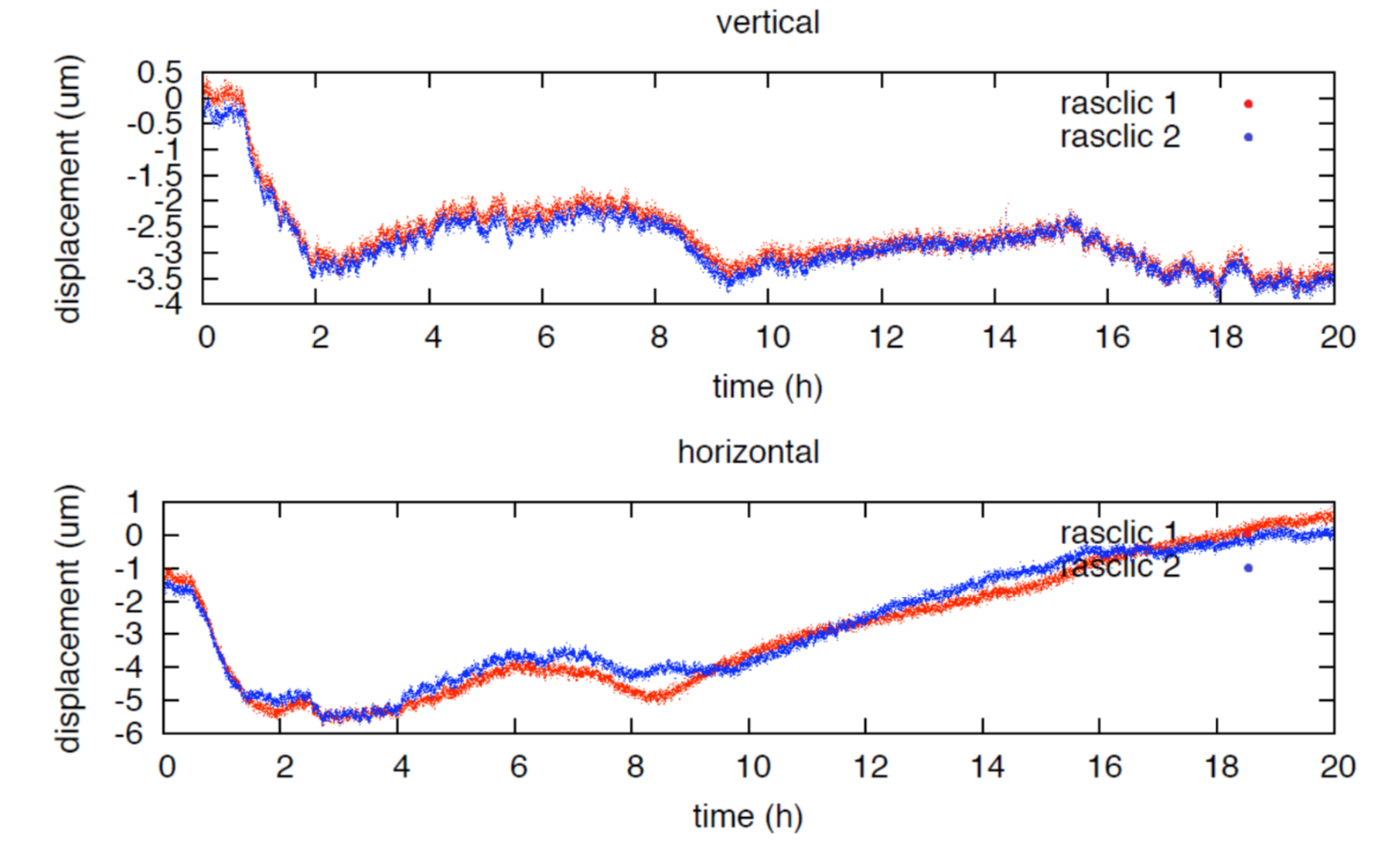
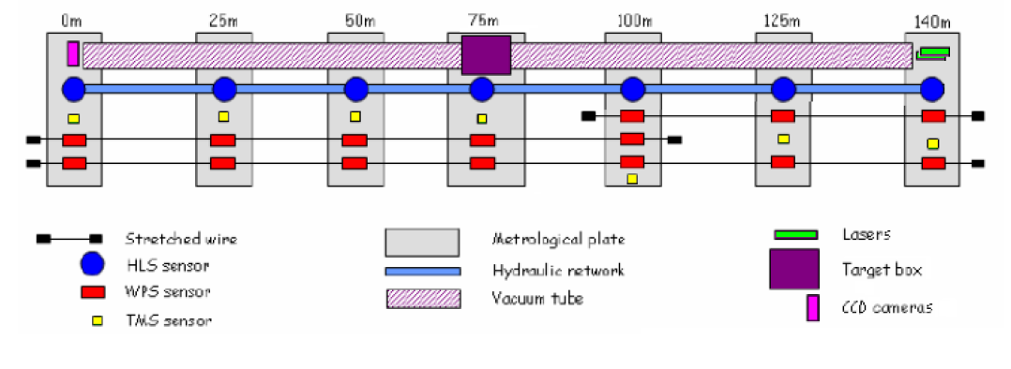
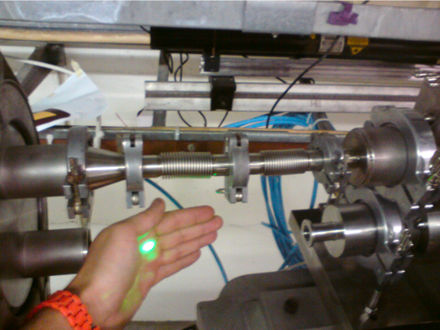
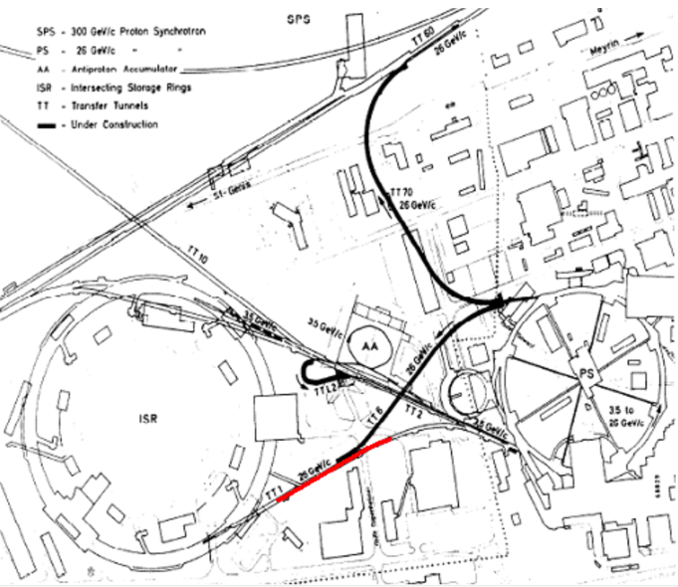
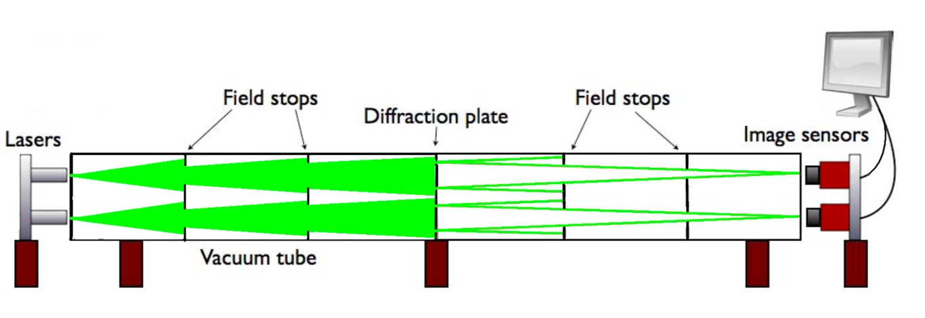
140 m test set-up (TT1 @ CERN)
in vacuum: 100 nm RMS over 140 m
JvH, “Precision Improvement in Optical Alignment Systems of Linear
Colliders ”, M.Sc. Thesis, Delft University of Technology (2012)

Slide 10
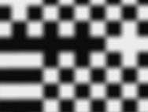
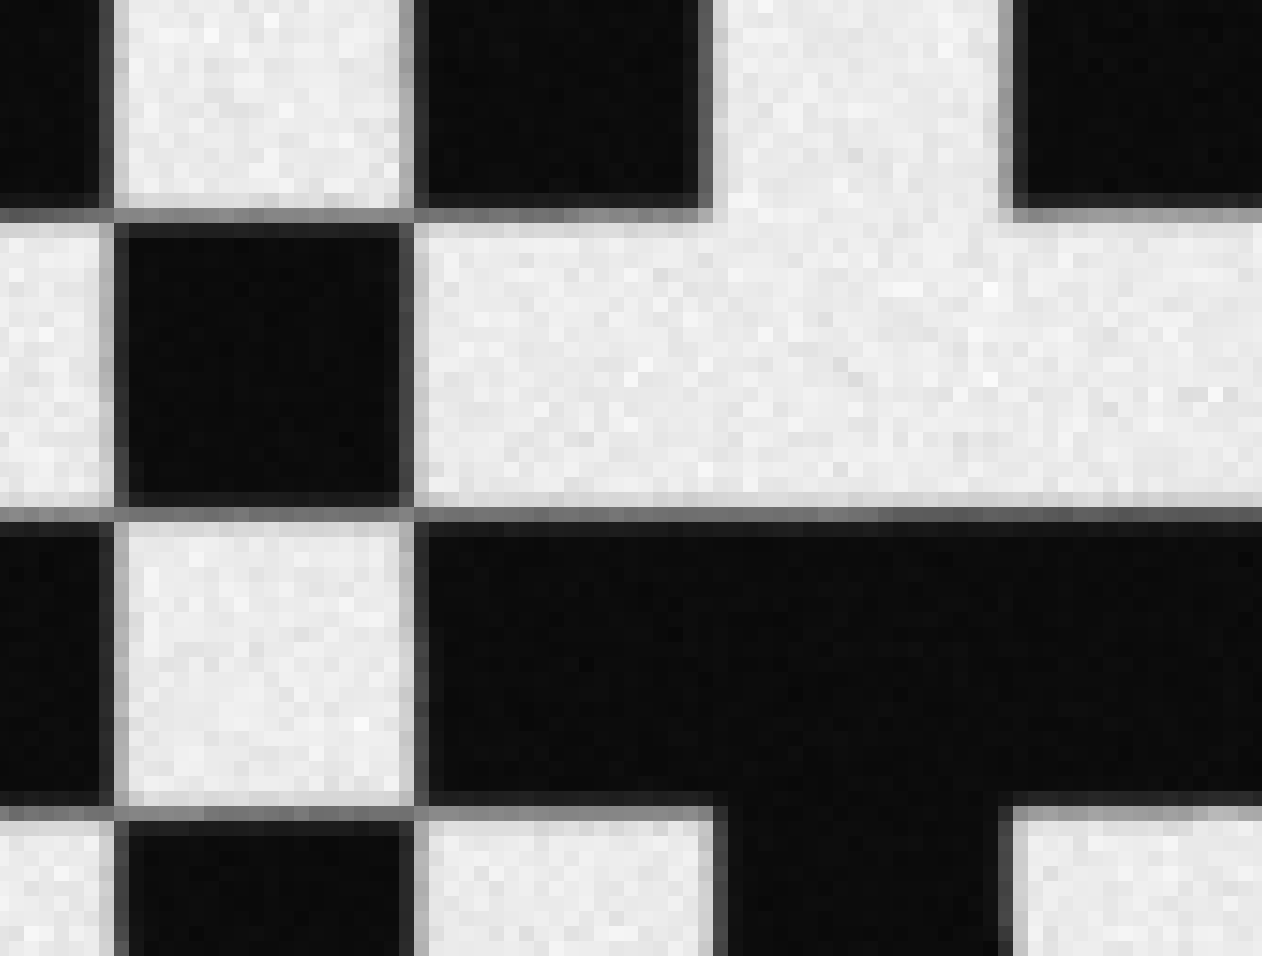



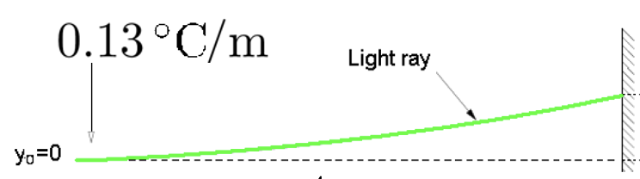

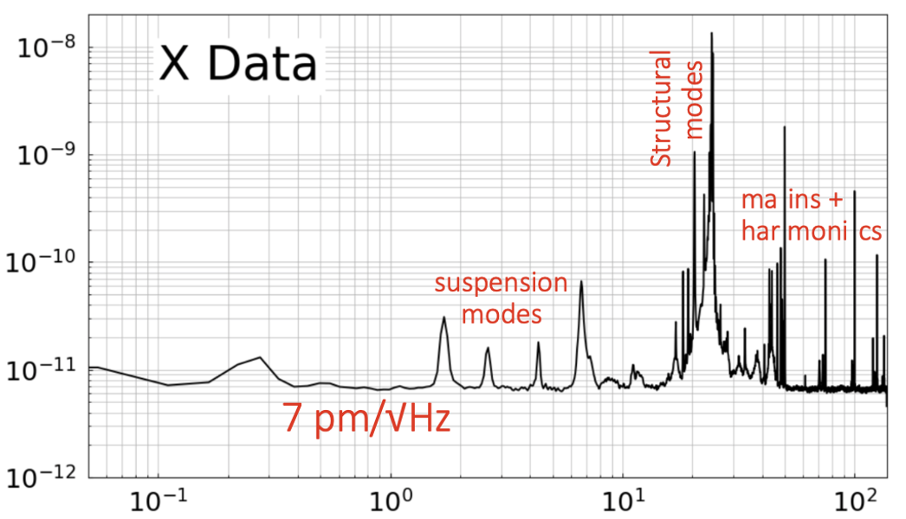

Limits and sources of noise
Image wobble by varying
refractive index along optical path
Blurring by diffraction
Quantum noise =
√(electronic noise² + photon noise²)
constant $∝$# photons
H. van der Graaf et al., “The ultimate performance of the Rasnik 3-point alignment system”, Nuclear Inst. and Methods in Physics Research, A 1050 (2023) 168160

Slide 11
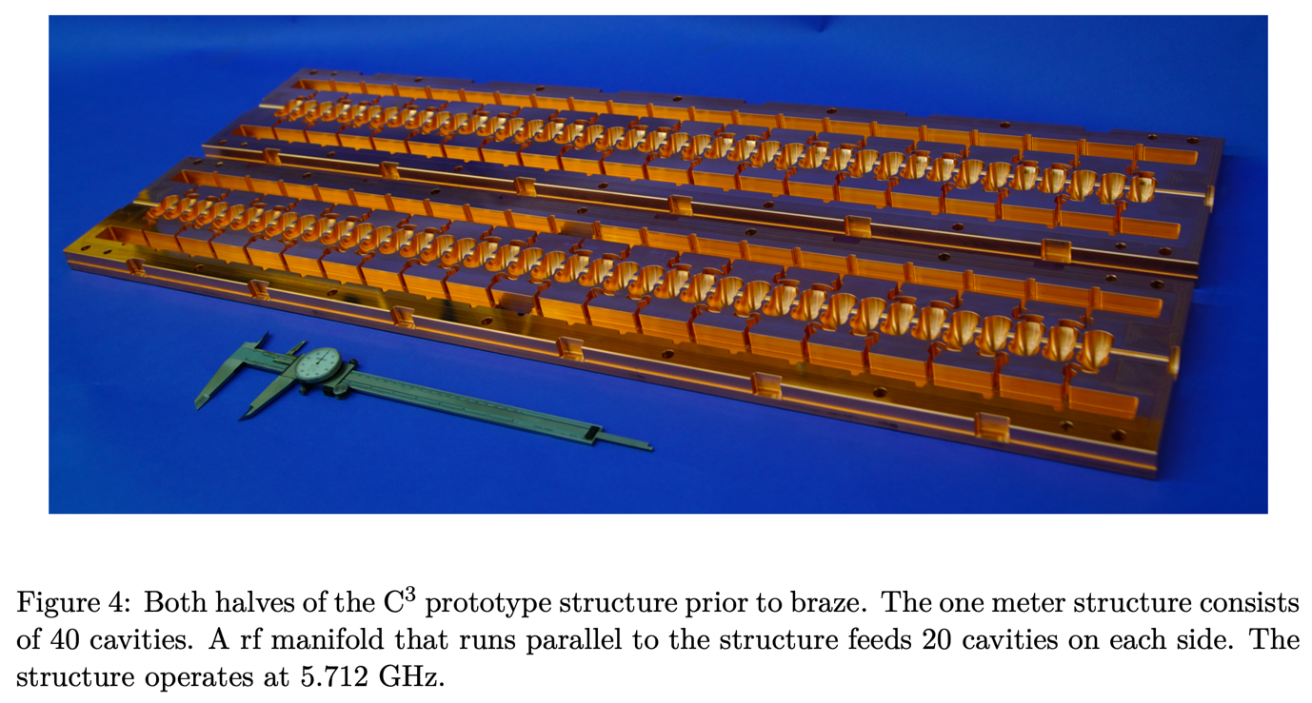
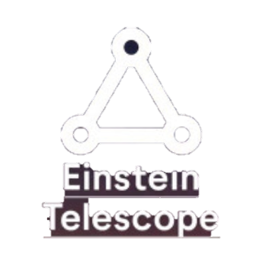
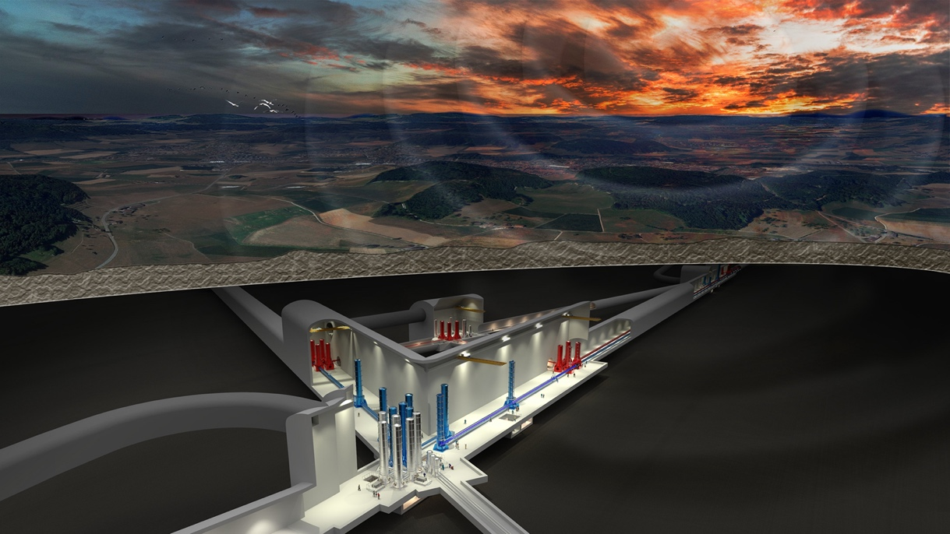
Future Rasnik developments
Particle colliders and gravitational-wave detectors are going cryogenic
C³ cool copper collider
Einstein Telescope
77 K
10 K
Need for cryogenic CMOS pixel sensors and diode laser (e.g. VCSEL)

Slide 12
From 3-point alignment system to n-point alignment system:
chainplates
image pixel sensor
zone plate
VCSEL laser diode

Slide 13
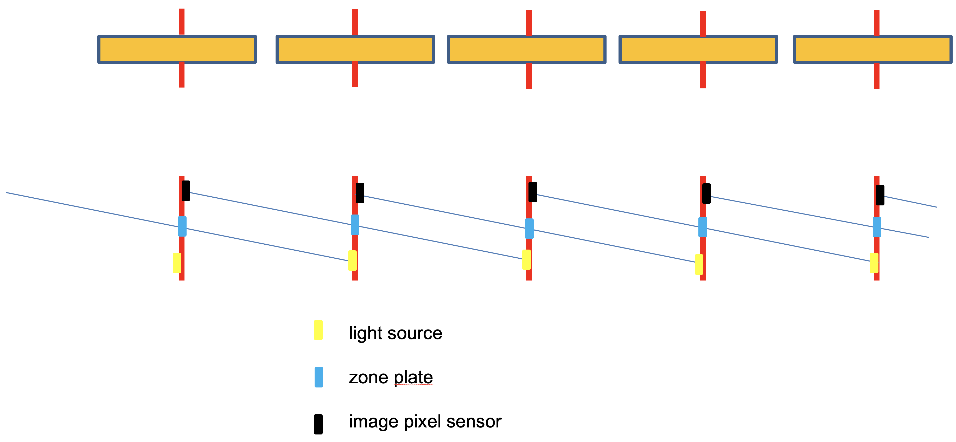
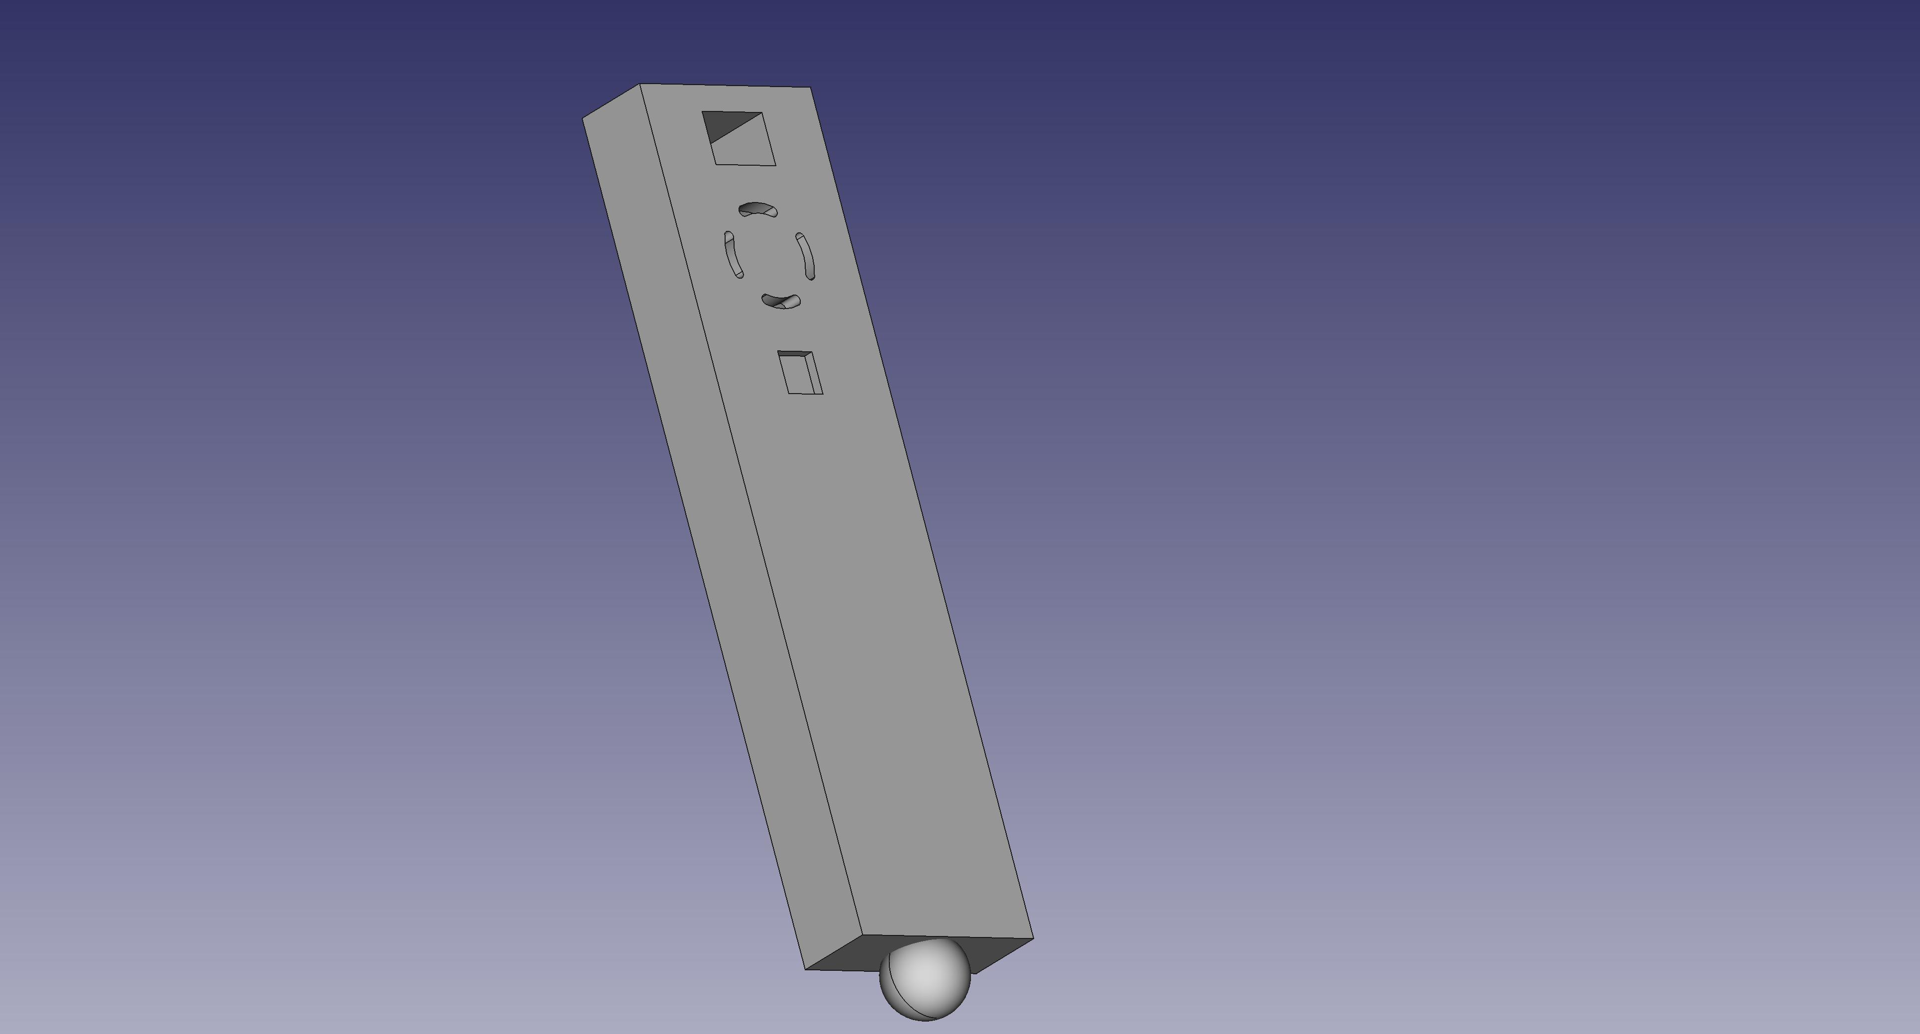
C3: alignment of ~2100 accelerator structures
accelerator structure
stick
Stick

Slide 14
Front view into accelerator structure
Alignment fits in two optical paths, adjascent and along to accelerator structures,
of 5 mm x 18 mm.

Slide 15
cryo module n
cryo module n+1
raft unit
acc structure
↺
Structure can rotate around Y axis left unnoticed by Rasnik!
8x RasDif chainplates
Each structure is 6D defined in space, with redundancy

Slide 16
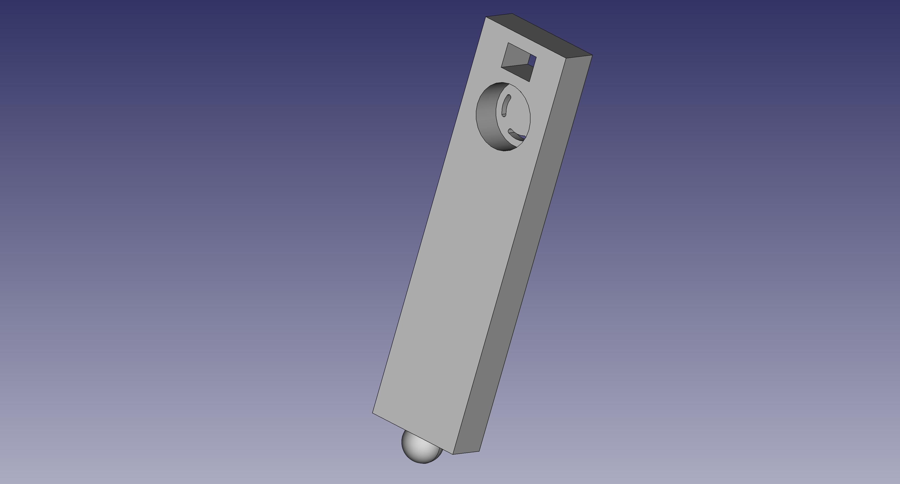
image sensor mount
zone lens
laser diode mount
YZ ref fixation
X ref fixation
The Stick
A Stick includes 4 items:
a CMOS image sensor chip
a transparent pattern forming a zone lens
a laser diode
a mounting interface

Slide 17
Rasnik for Quarter Cryogenic Module QCM
Sticks: fully submerged in LN₂:
➔ Laser diode and cam (image sensor on pcb) should be able to operate in LN₂ (77 K)!
Laser diode: tested 4 different types, worked allright simply submerged 😊
our favorite cam (Daheng VEN-134) fails at 90 K 🙁

Slide 18
CCDs operating at 4 K exist (Webb telescope)
Commercially available: Teledyne CCD201-20. Too sophisticated, need to develop readout system
N. McConkey (Univ of Sheffield): tested, in 2016, many simple webcams at 77 K and found the Floureon Car Rear View cam working at 77 K. This cam is not anymore available.
Alternatives:
  1 place cam in mini-cryostat: complicated, expensive
  2 place Rasnik in gaseous N₂ space: very unpractical
Nicola McConkey, Neil Spooner, Matthew Thiesse, Michael Wallbank, Thomas Karl Warburton:
Cryogenic CMOS Cameras for High Voltage Monitoring in Liquid Argon arXiv:1612.06124

Slide 19
Alternative 1: place cam in insulating container (dewar)
mirror
cam in dewar

Slide 20
Alternative 2: bring Rasnik into gaseous volume
gaseous N₂
LN₂

Slide 21
Conclusions & plans
The continues alignment of all accelerator structures using Rasnik seems feasable
Priority 1: find 77 K-proof cam [including (warm) readout & control system]
Design Stick (and possible aux mechanics): produce 8 sticks for QCM, ready end 2023
Set up 3-stick calibration station: QCM is to be equipped with pre-calibrated Sticks.
QCM: Quarter Cryogenic Module

