Slide 1
Overview of Low Emittance Transport and Beam Dynamics Studies of ILC Linac
Arun Saini
Presenter: Nikolay Solyak
LCWS Meeting
05/17/2023

Slide 2
Outline
Introduction
ILC Main Linac
Review of Emittance Dilution Mechanisms
  Baseline Optics
  Static Misalignments
  Coupler RF and Wake Kick
Failure modes
Summary

Slide 3
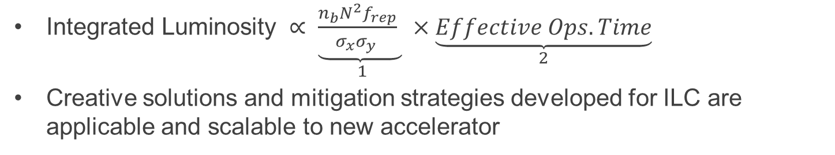
Linear Colliders for Higgs Factory
Snowmass’21 Accelerator Frontier group listed four promising traditional electron-positron collider projects for Higgs Factories.
Table I5 - ITF Report – T.Roser, et al, arXiv:2208.06030
 | CME (TeV) | Lumi per IP @ Higgs (10^34) | Pre-Project R&D Years | Years to 1st Physics | Cost Range (2021 $B) | Electric Power MW
ILC | 0.25 | 2.7 | 0-2 | < 12 | 7-12 | 140
CLIC | 0.38 | 2.3 | 0-2 | 13-18 | 7-12 | 110
CCC | 0.25 | 1.3 | 3-5 | 13-18 | 7-12 | 150
HELEN | 0.25 | 1.4 | 5-10 | 13-18 | 7-12 | 110
$\text{Integrated} \text{Luminosity} ∝ \underset{1}{\underbrace{\frac{n_{b}N^{2}f_{rep}}{σ_{x}σ_{y }} }}×\underset{2}{\underbrace{Effective Ops.Time}}$
Creative solutions and mitigation strategies developed for ILC are applicable and scalable to new accelerator

Slide 4
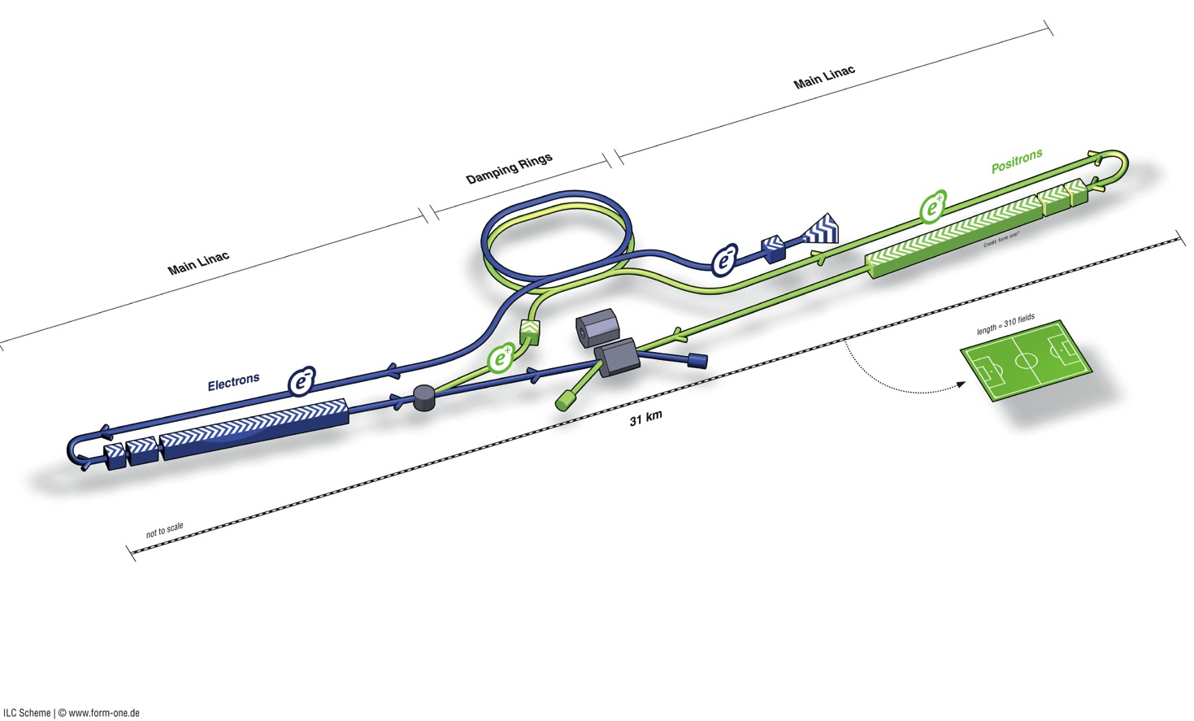
ILC Schematic
Damping Rings
Polarised positron
source
Polarised electron source
Ring to Main Linac (RTML)
e+ Main Linac (incl. bunch compressor)
Beam dump
Beam Delivery System (BDS) & physics detectors
Total length (500 GeV) | 30.5 km
SCRF ML (RTML) | 22.2 km
RTML_BC | 2.8 km
Positron source | 1.1 km
BDS / IR | 4.5 km
Damping Rings | 3.2 km
e- Main Linac (incl. bunch compressor)

Slide 5
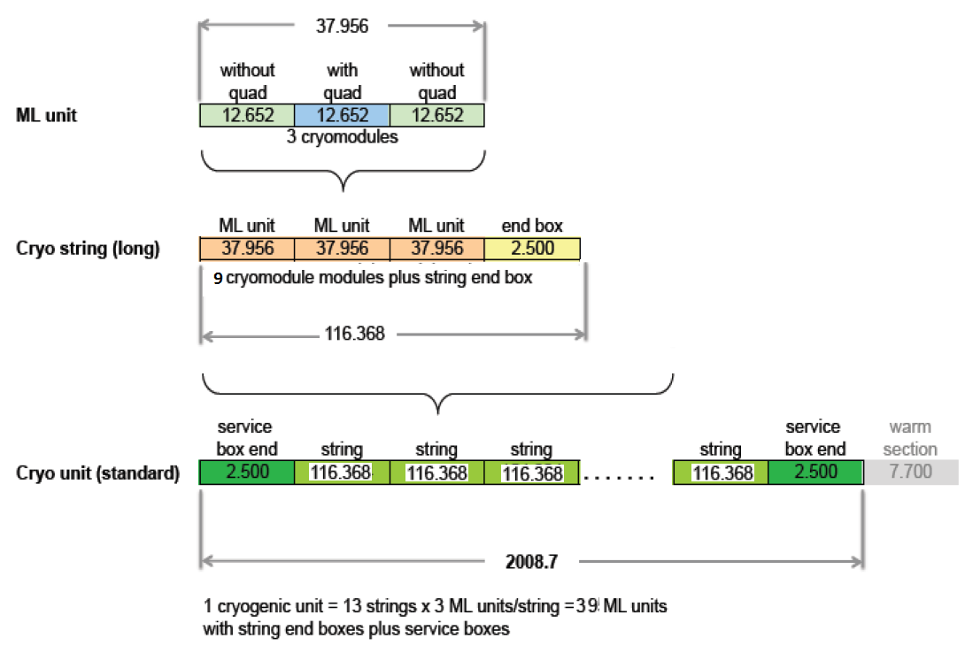
Main Linac Architecture
ILC utilizes two types of CMs. Type A comprise nine, 1.3 GHz, 9-cell SRF cavities while Type B includes 8 cavities and a quadrupole magnet package at the center.
Arrangement of CMs in configuration of A-B-A makes an RF/ML unit. A total of 285 (282) units for e-linac (e+ linac).
Three ML units with cold box makes a cryo-string.
Periodic arrangement of cryo-string is interrupted by insertion of 7.7 m warm section.
Number of cryo strings between successive warm section makes a cryo-unit.

Slide 6
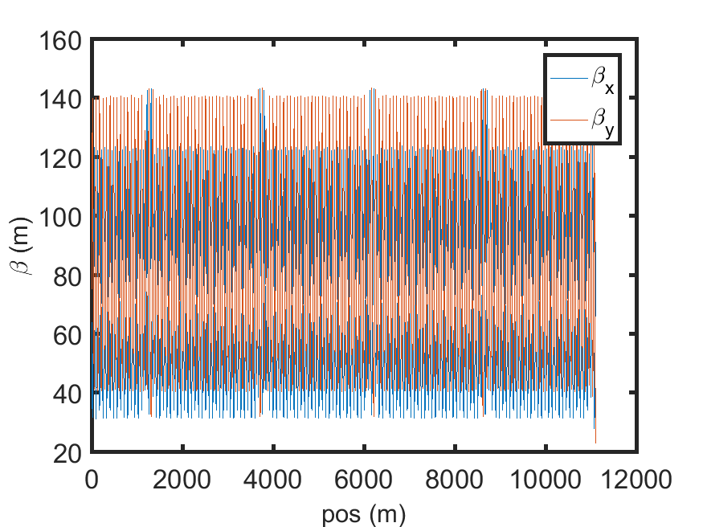
ILC Main Linac Optics
ILC2016x (Dec. 2016)
https://bitbucket.org/whitegr/ilc-lattices/downloads/
https://accelconf.web.cern.ch/linac2016/papers/moplr008.pdf
Zoomed View
Beta Functions in First Cryo-Unit
Maximum periodic Twiss function in horizontal and vertical plane are 120 and 140m respectively.
Minimum periodic Twiss function in horizontal and vertical plane are 31 and 40 m respectively.

Slide 7
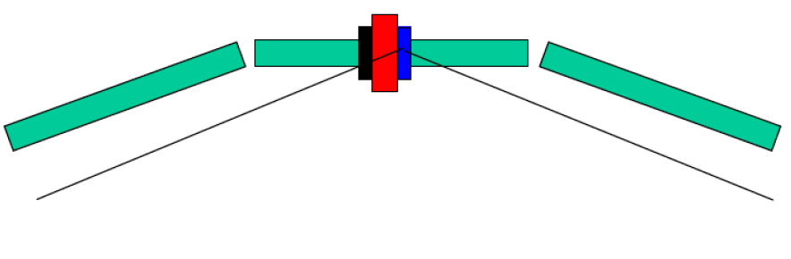
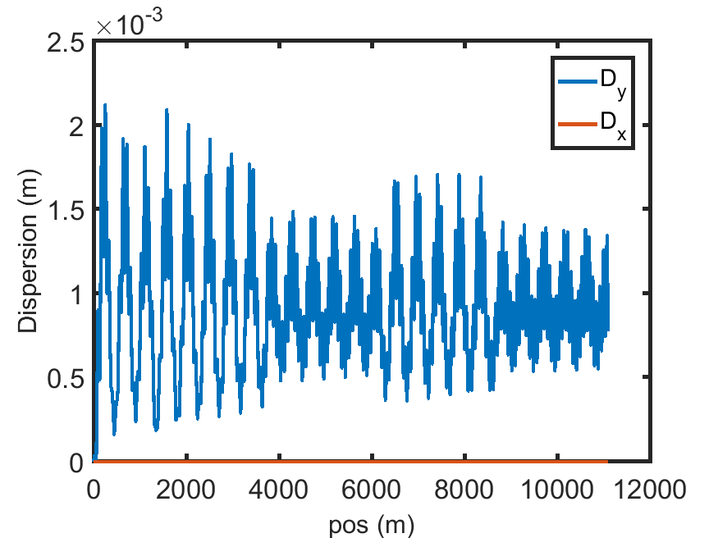
Curved ILC Linac
An essential feature of the ILC Linac is that it follows the earth’s curvature.
Optimized Dispersion function
Vertical dipole correctors are used to steer the beam along Earth’s curvature.
Because there is only one corrector per RF unit (3 cryomodules), beam is steered in such a way that it is passed off-axis through cryomodule but through the center of quadrupoles.

Slide 8
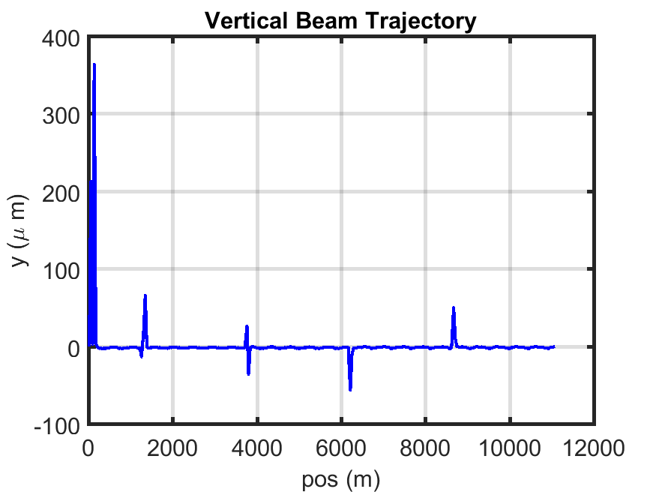
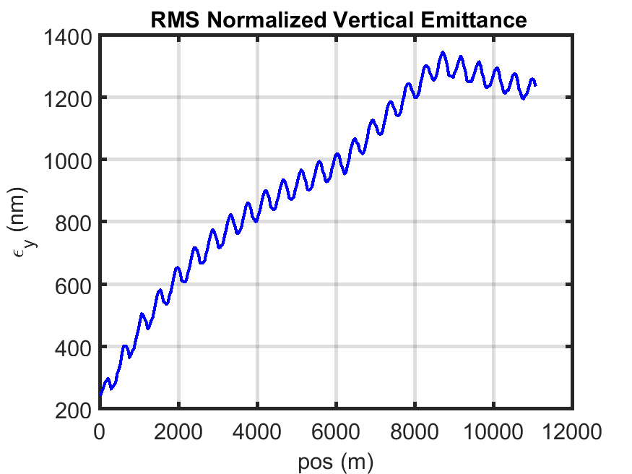
Emittance Growth in Baseline Linac
Beam tracking studies is performed using LUCRETIA
A Gaussian distribution of 10k macro particles distributed in 4σ are tracked through the lattice.
Linac is aligned and wake fields are included
Matching b/w cryo-units
Curved Linac
Unmatched Optics
After matching

Slide 9
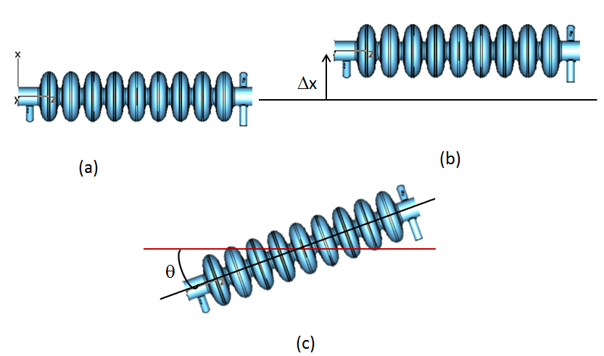
Main Linac Performance with Static misalignments
Nominal Alignment Tolerances for ILC Main Linac
Tolerance | Vertical (y) plane
BPM Offset w.r.t. Cryomodule | 300 μm
Quad offset w.r.t. Cryomodule | 300 μm
Quad Rotation w.r.t. Cryomodule | 300 μrad
Cavity Offset w.r.t. Cryomodule | 300 μm
Cryostat Offset w.r.t. Survey Line | 200 μm
Cavity Pitch w.r.t. Cryomodule | 300 μrad
Cryostat Pitch w.r.t. Survey Line | 20 μrad
BPM Resolution | 1.0 μm
Aligned
Offset
Pitch/ Tilt.
Misalignments were applied only in vertical plane.
Short range wake fields were included in analysis
One to one steering and dispersion free steering were applied in tandem.

Slide 10
Misalignment Implementation
Random misalignments of individual beamline elements were introduced within the range of +/- 3σ
Study was performed with 50 machines.
Distribution of quadrupole, cavity and BPMs offset.

Slide 11
Low Emittance Transport Studies for Curved Linac (1)
Emittance growth without and with correction
Maximum normalized RMS Emittance without correction is ~2E+06 nm.
After applying correction, max. emittance dilution is limited to 12 nm.
Mean emittance growth after applying correction is 3.3nm.

Slide 12
Low Emittance Transport Studies for Curved Linac (2)
Distribution of emittance dilution after applying one to one and dispersion free steering.
Δε = ε_{f} - ε_{i}
50 machines are used.
Initial emittance is 24 nm.
Mean emittance growth after applying correction is 3.3 nm while 90% emittance is 6.7 nm.

Slide 13
Low Emittance Transport Studies for Curved Linac (3)
Beam trajectories without and with correction
Golden trajectories after applying correction
Maximum excursion of beam trajectory without correction is 30mm.
Superconducting cavity aperture limitation is 35 mm.
After applying one to one and DFS correction, excursion of beam trajectories are limited in +/- 3 σ of BPMs offset.

Slide 14
Low Emittance Transport Studies for Curved Linac (4)
Mean Emittance Growth for 50 seeds
After One to One
After One to One +DFS
Emittance dilution in curved linac and straight linac after applying correction is within budget of 4 nm dilution (Specification of 20 % emittance growth in main linac).
  Dilution in curved linac is ~2nm higher in comparison to straight linac.

Slide 15
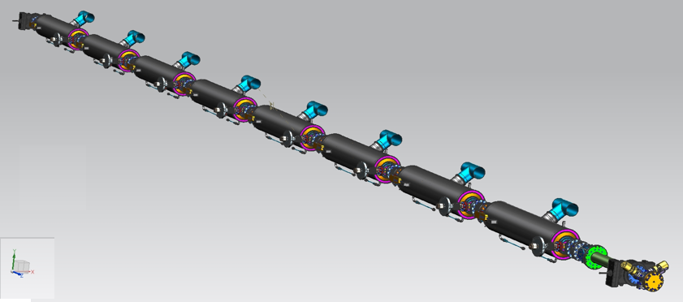
New Realistic Model for Static Misalignment Studies
Different stages of assembly, installation and commissioning introduce a kind of systematic correlated misalignments among beamline elements in comparison to random misalignments of individual elements.
Installation of SRF cavities on a string introduces independent random misalignments of the cavity.
Installation of the string on cryomodule would introduce the string misalignments instead of individual cavity. All cavity on the string would acquire a common offset.

Slide 16

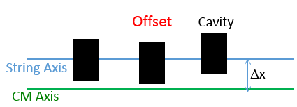
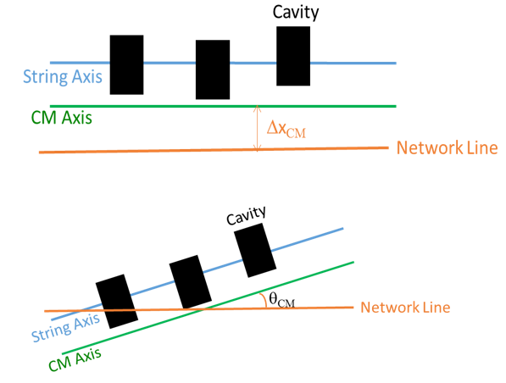
Correlated Misalignment Model
Cavities misalignment on string
String misalignment on CM
CM misalignment on Network Line
Implications of Correlated misalignments are more sever
Detailed discussion of the model is presented elsewhere
A. Saini et al, IPAC 2016, WEPMR012

Slide 17
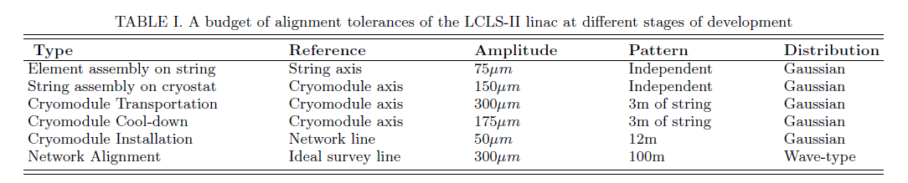
Misalignment Budget for LCLS-II SRF Linac
Correlated Misalignments Budget
LCLS-II Independent Random Misalignments Budget
Tolerance | Vertical (y) plane
BPM Offset w.r.t. Cryomodule | 500 μm
Quad offset w.r.t. Cryomodule | 500 μm
Cavity Offset w.r.t. Cryomodule | 500 μm
Cryostat Offset w.r.t. Survey Line | 500 μm
Cavity Pitch w.r.t. Cryomodule | 500 μrad
Cryostat Pitch w.r.t. Survey Line | 50 μrad
BPM Resolution | 10.0 μm

Slide 18
Emittance growth comparison
Mean emittance growth
Mean emittance growth after one to one steering
Case Study: Correlated Misalignments- Mean Emittance dilutions are ~55% and ~ 2.7% without and with 1-1 correction respectively
Case Study: Uncorrelated Misalignments- Mean Emittance dilutions are 19% and 1.0 % without and with correction respectively.
Realistic correlated misalignment model results in a higher emittance growth

Slide 19
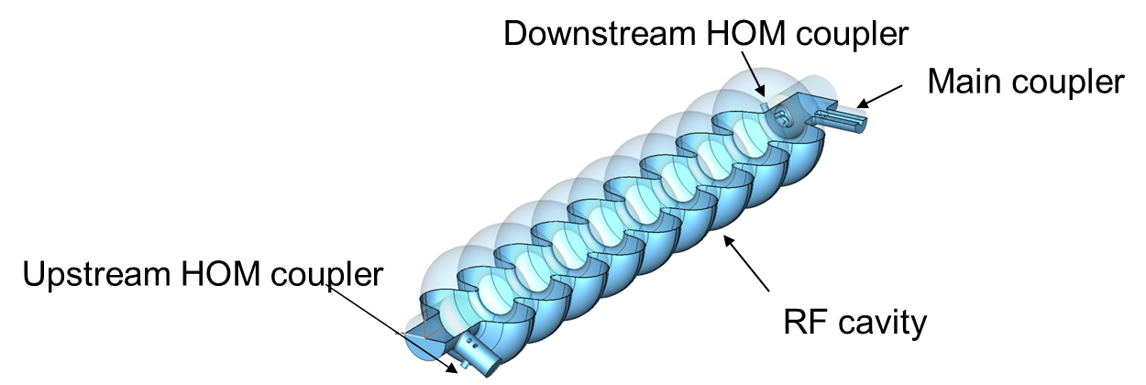
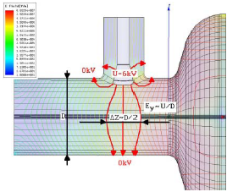
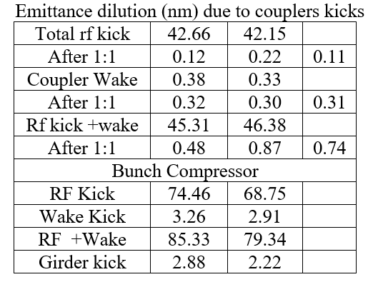
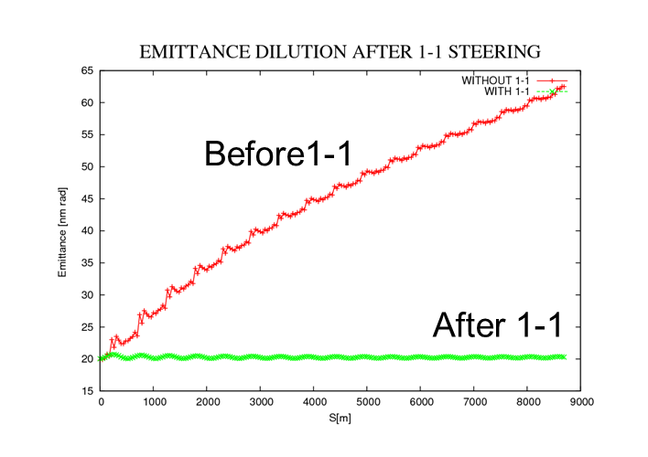
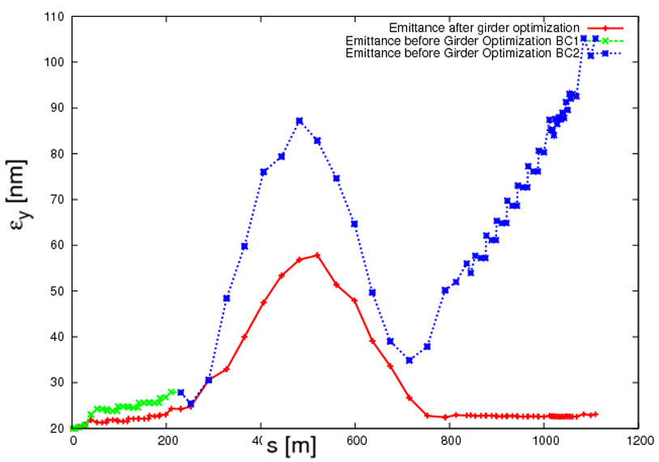
Coupler RF kick and Wake Kick
The coupler generates RF and wake kicks
  Even beam passing through axis experience its kicks
  Study of Coupler's effect in ILC like lattice, IPAC10, THPD088, A.Saini et al
The kick is dependent on the particle position in bunch.
Longer bunch has larger impact. One to one steering is not enough for compensation.

Slide 20
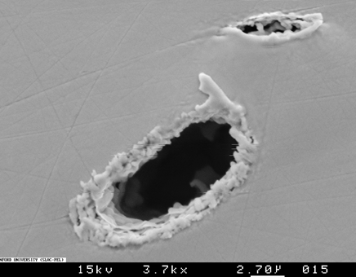
Fault Scenarios in ILC Linac
A large number of beamline elements in the linac increases likelihood of a beamline element failure during operation.
These failures might degrade beam quality, as well as, results in beam loss. Beam loss can be segmented in two categories:
Unlocalized beam loss: Fractional particle losses over a length for a period of time. Implications are
  Additional heat load in cryogenic environment
  Radioactivation
Localized beam loss: A full bunch or a complete beam pulse is lost on a localized surface.
  Sever beam induced thermal damage.
Single pulse damage in 1.4mm Cu: NLC studies
M. Ross http://indico.cern.ch/conferenceDisplay.py?confId=185561

Slide 21
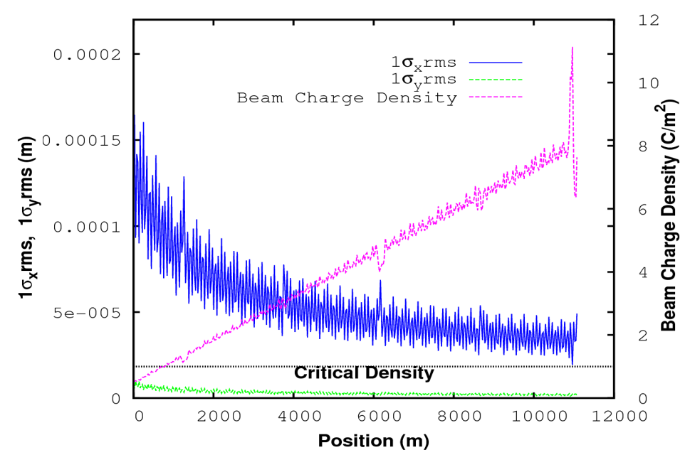
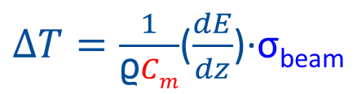
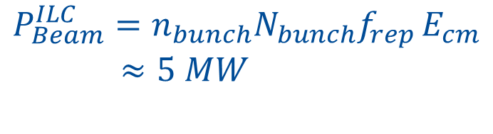
Risk of Thermal Damage in ILC main Linac
Beam induced thermal damage depends on beam density at impact location
If critical charge density above ~1pC/µm² there is substantial risk of beam induced damage.
Localized beam loss could result in significant damage in main linac.
$∆T=\frac{1}{\text{ϱ}Cm}$($\frac{dE}{dz}$)·σ_{beam}
$$P_{Beam}^{ILC}=n_{bunch}N_{bunch}f_{rep }E_{cm}$$
$≈5 MW$
  Understanding of Impact of component failures at vulnerable locations is important to devise appropriate mitigation scheme and Machine protection system

Slide 22
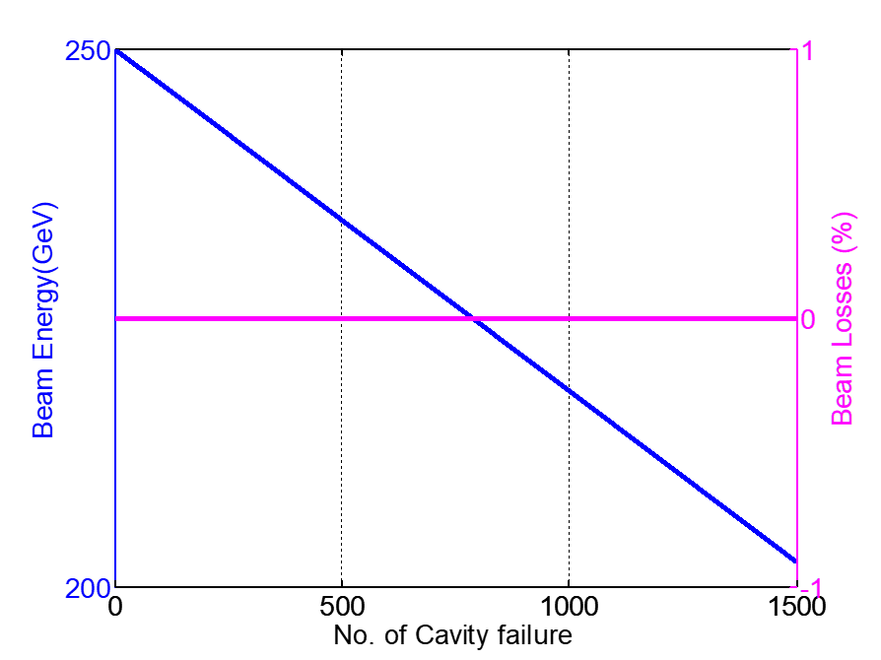
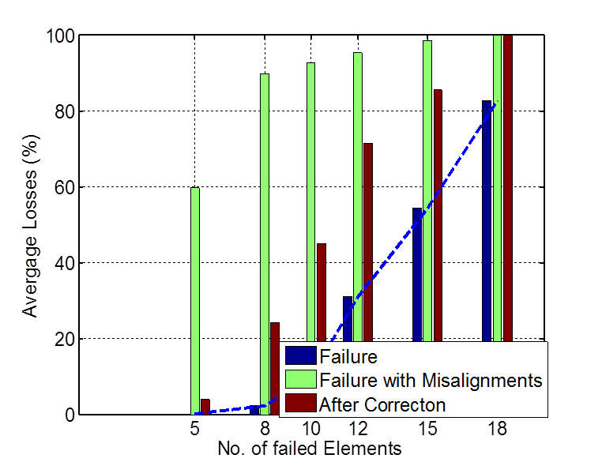
Failure Mode Studies for ILC Main Linac
An extensive study was performed to understand beam sensitivity against a variety of fault scenarios. A. Saini et al, THPMR003, IPAC16
The main linac is robust against SRF cavity failure.
Random 5 quadrupole failures in main linac would start generating beam loss.
SRF Cavity Failures
Quadrupole Failures

Slide 23
Quadrupole Failure in Main Linac
Quadrupole failures alter transverse focusing period and results in large amplitude beam oscillation.
  Resulting increase in beam sizes reduces beam density at impact location.
Vertical Trajectory distribution for all seeds for a case study for 100% beam loss
Loss Particle Energy Distribution

Slide 24
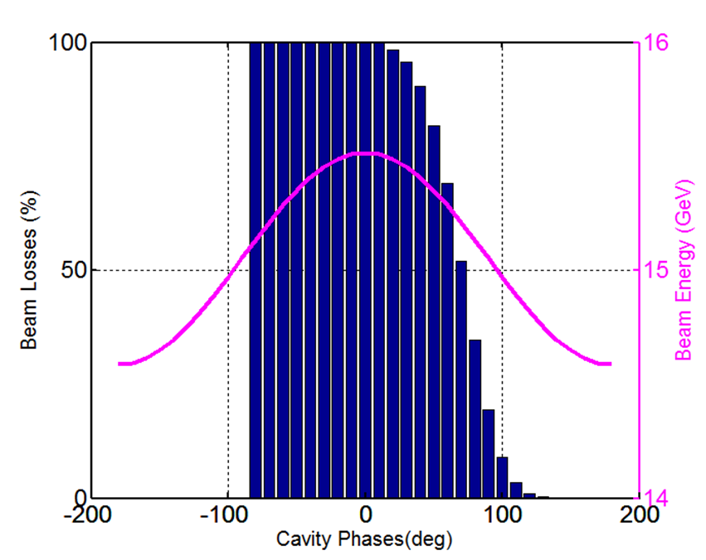
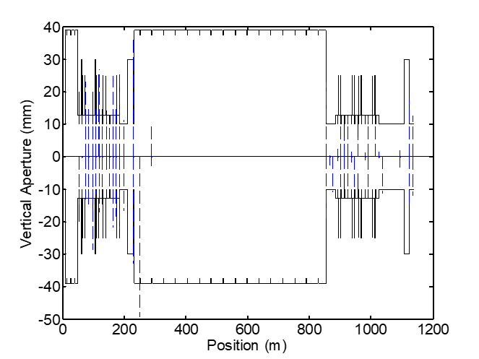
Failure Modes in Bunch Compressor
Fault scenarios were also studied in bunch compressors.
Beam is relatively more sensitive to component failure in bunch compressor.
  In comparison to main linac, RF phase acceptance in BC1 is lower.
  Collimators imposes limiting aperture in bunch compressors.
Beam loss with RF phase shift in BC1
Loss Particle in Bunch Compressor

Slide 25
Machine Availability and Reliability
Availability and reliability engineering aspects need to be incorporate in the design of modern accelerator facilities.
  Identify potential vulnerable components and develop potential mitigation strategies.
  Reduce unscheduled beam interruptions
  Minimize maintenance and operation cost of the machine
ILC needs an updated machine availability analysis
  Expertise and experience gained with modern accelerators (XFEL, LCLS-II) needs to be utilize.
  Availability for complete facility needs to be evaluated instead of individual system
Lately published Assessment of PIP-II operational availability for PIP-II SRF facility, A.Saini et al, This model can be adapted and scaled for ILC.

Slide 26
Summary
A lot of studies had been performed for ILC Linac and that can be adapted for new linear collider proposals.
Some studies need to be updated
  Realistic misalignments
  Availability Analyses.
Fermilab have expertise and resources. We are happy to contribute and collaborate on similar studies.

Slide 27
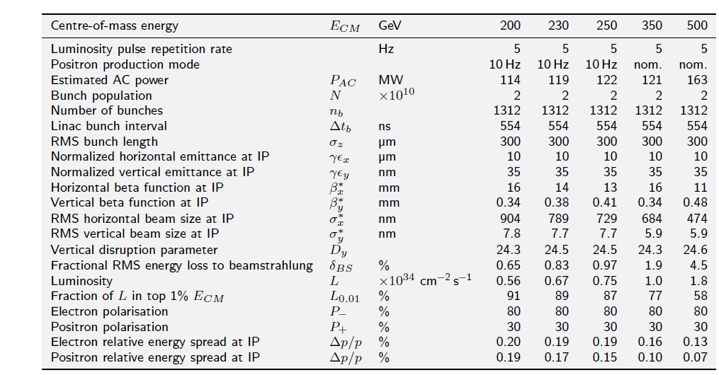
ILC: Basic Parameters
TDR Parameter Lists

Slide 28
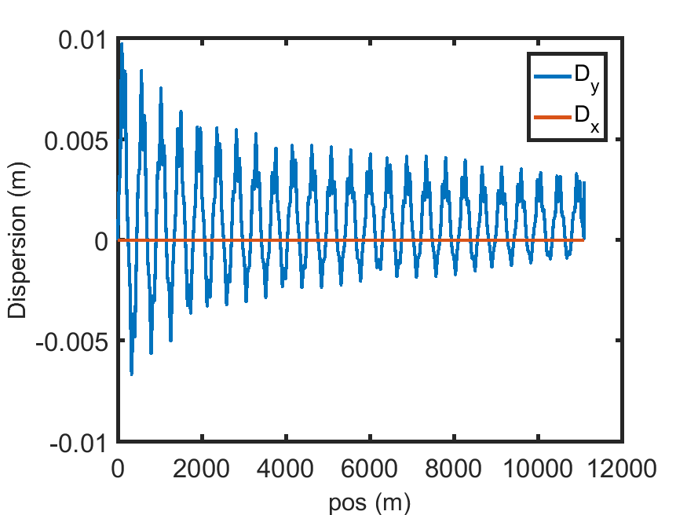
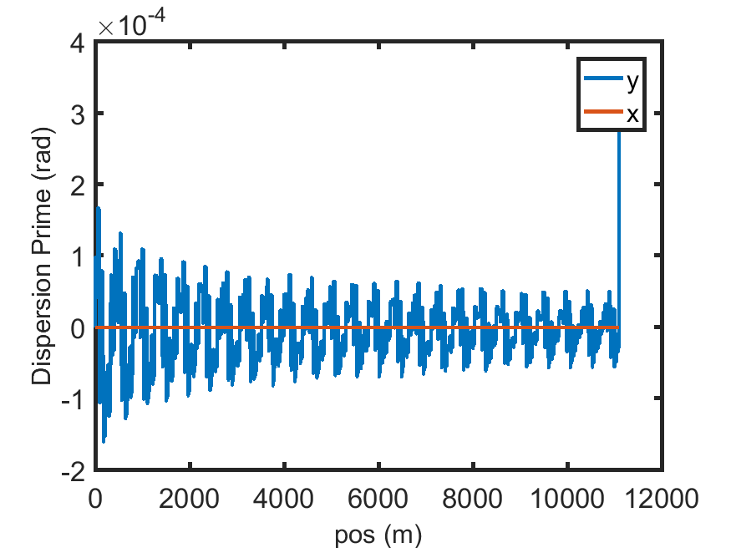
Dispersion Functions along the Linac
Dispersion Function along the Linac
Dispersion Prime along the Linac
Maximum vertical dispersion in the linac is ~1x10⁻² (m).
Horizontal dispersion is zero in the linac.

