Slide 1
MAD-NG for Final Focus Design
Enrico Manosperti, Laurent Deniau, Joshua Gray,
Rogelio Tomás and Andrii Pastushenko
17/05/2023

Slide 2
Table of contents
MAD-X and MAD-NG
Twiss command
Match command
Tracking performance
Execution time
Results accuracy
Summary
2
Enrico Manosperti LCWS 2023 17/05/2023

Slide 3
MAD-X and MAD-NG
MAD-X and MAD-NG are simulation codes for beam dynamics and optics used for particle accelerator design and optimization.
MAD-X was released in 2002 and it is based on the programming languages C, C++, Fortan77, and Fortran90.
MAD-NG has been developed since 2016 in parallel to MAD-X, and is based on the Lua programming language with few extensions.
Physics is based on the symplectic integration of differential maps made out of Generalized Truncated Power Series Algebra (GTPSA).
MAD-X 5.8.1 and MAD-NG 0.9.6, to achieve the best performance for the CLIC FFS design for an energy of 7 TeV in the center-of-mass.
3
Enrico Manosperti LCWS 2023 17/05/2023

Slide 4
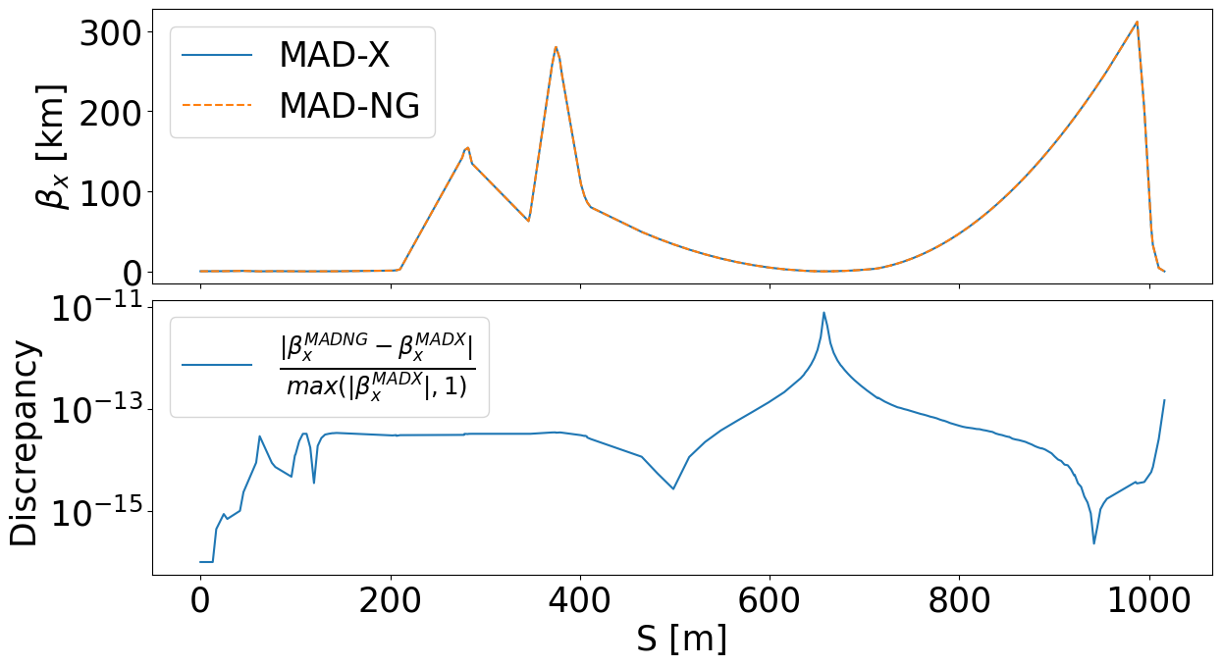
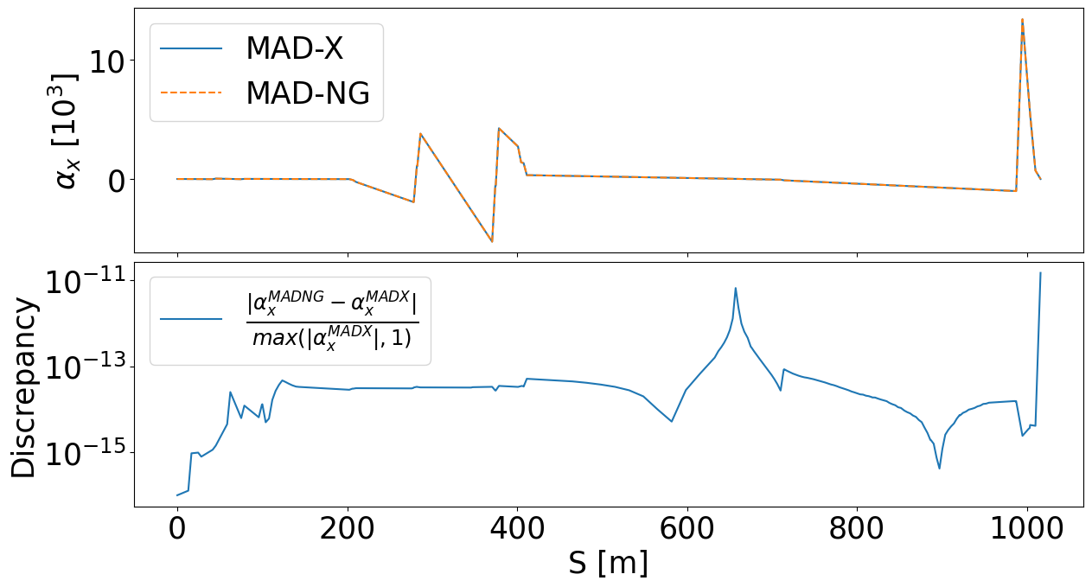
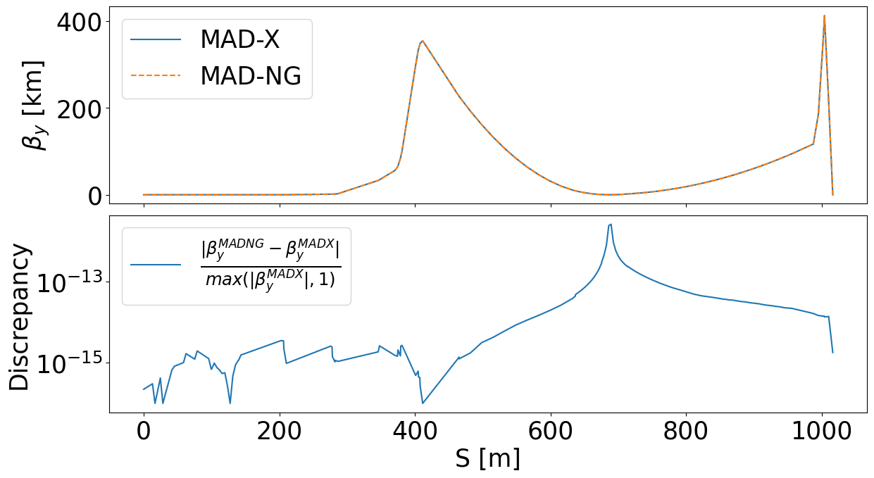
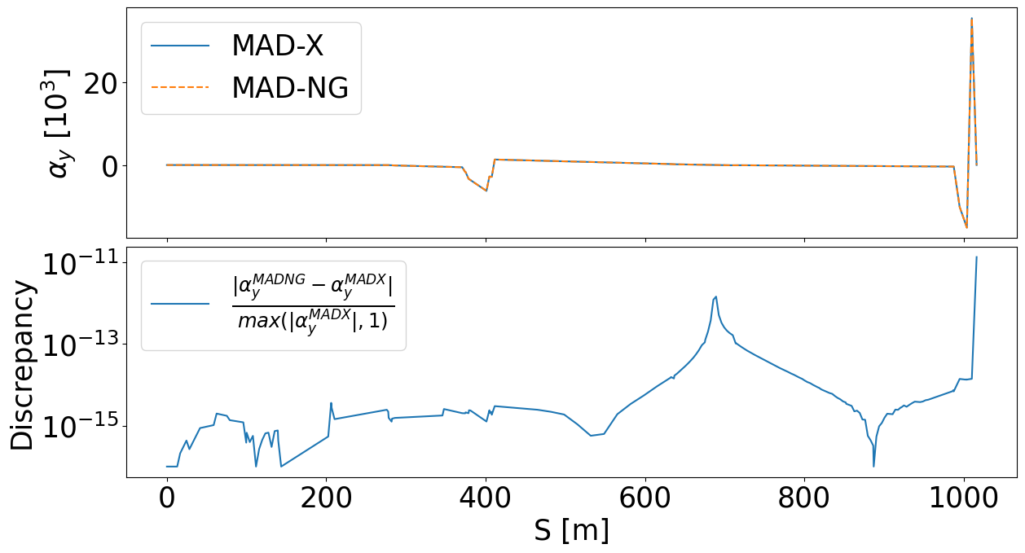
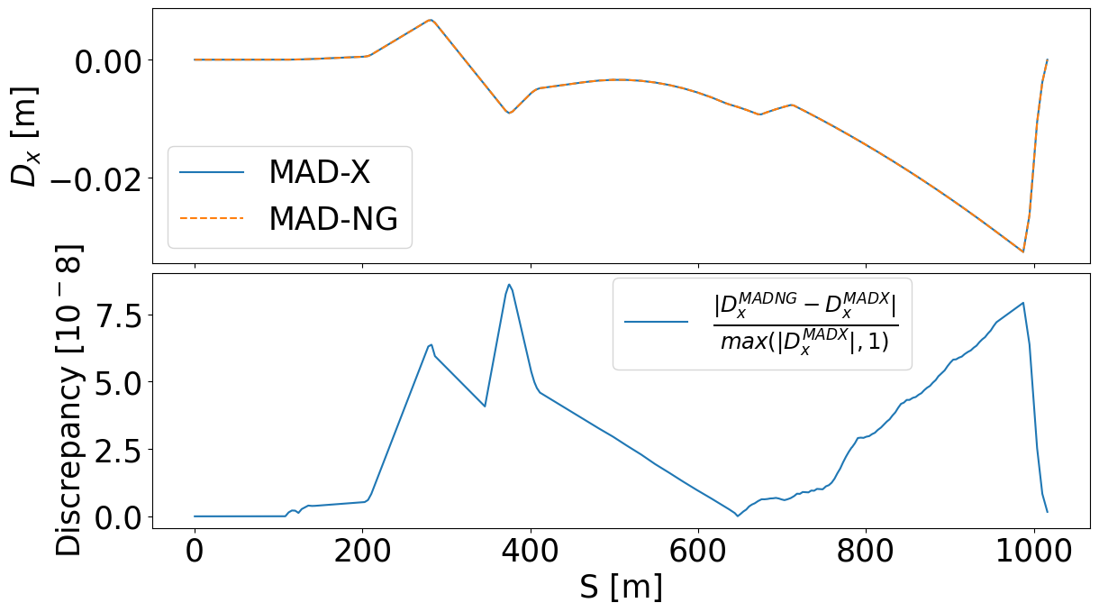
Twiss command
The Twiss command provides a single interface to calculate the linear lattice functions.
Stable comparison over a large dynamic range of variables values
$Discrepancy=\frac{|X_{MADNG}−X_{MADX}|}{max(|X_{MADX}|,1)}$
where 𝑋 is the value to be compared between the two codes.
The Twiss command has been initialized with the values $β_{x}=\text{104.3 }\text{m}, β_{y}=28.9 m, α_{x}=α_{y}=0 and D_{x}=0 m.$
The largest discrepancy between the two codes is reached for the dispersion which remains slightly below $ΔD_{x}<{10}^{−7}$.
For $β and α$, the maximum discrepancy remains below ${10}^{−11}$.
4
Enrico Manosperti LCWS 2023 17/05/2023

Slide 5
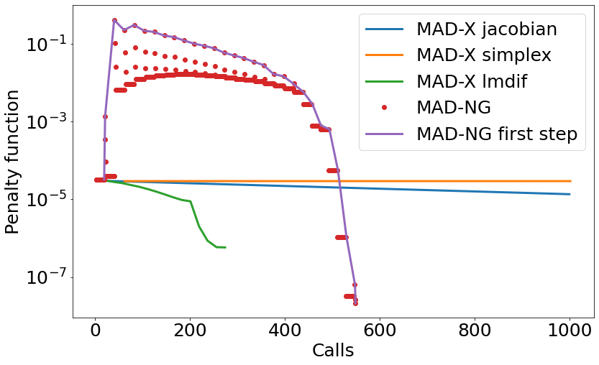
Match command
The Match command is used for matching the optics parameters at any part of the machine.
Variation of the strengths of the quadrupoles in the FFS (17 quadrupoles).
$$Penalty function \left(P\right)=\sqrt{\frac{\sum_{i}{w_{i}^{2}{\left(x_{i}−c_{i}\right)}^{2}}}{\sum_{i}{w_{i}^{2}}}}$$
where $x_{i}$ and $c_{i}$ are respectively the values and targets of the constraints, and the $w_{i}$ are the weights associated with the constraints.
Optimization steps:
Computation of the Jacobian by finite differences in the variables (small plateaus of dots).
Jacobian application to the first new step (upper line).
Line-search bisection (single dots stepping down) to decrease the penalty function. Maximum number of attempts is controlled by the bisec option (here bisec=3).
Number of calls for each stage:
$$N_{i}=number of variables+1+N_{best bisec}$$
MAD-X considers one call for each $N_{i}$, varying the variables in small steps, whereas MAD-NG looks for a global solution with larger initial steps.
5
Enrico Manosperti LCWS 2023 17/05/2023

Slide 6
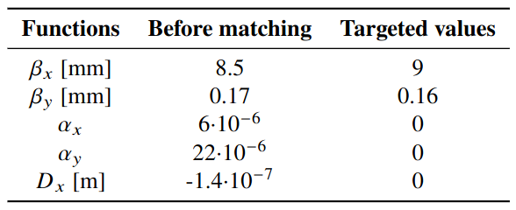
Match command
SIMPLEX and LMDIF are other matching methods available in MAD-X.
MAD-NG reaches the best result of all.
6
Enrico Manosperti LCWS 2023 17/05/2023

Slide 7
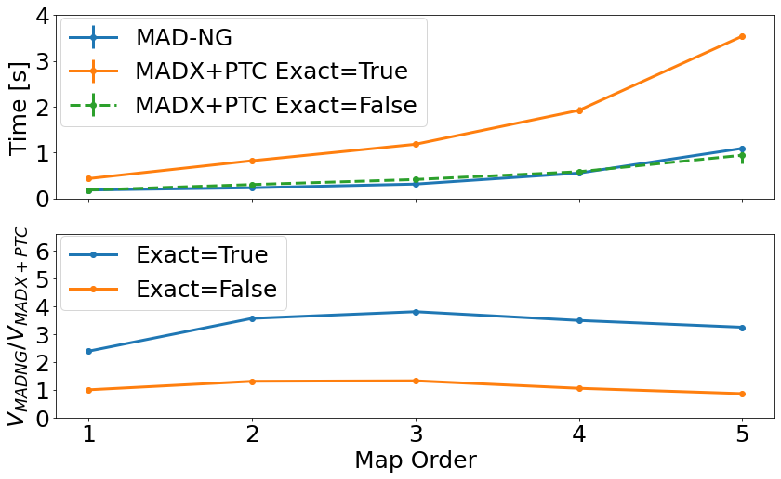
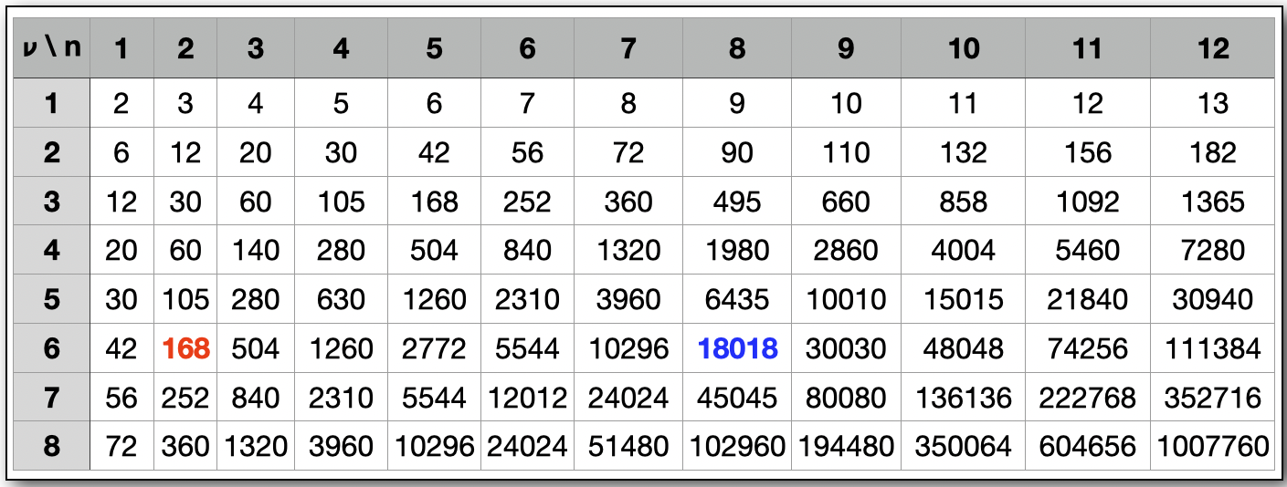
Performance – Execution time
The Polymorphic Tracking Code (PTC) is a Fortran 90 library included in MAD-X that provides symplectic integration of the equations of motion through all accelerator elements.
MAD-NG and PTC are polymorphic tracking codes based on the principle of tracking differential maps.
In PTC it is possible to select the kind of Hamiltonian, exact (exact = true ) or expanded (exact = true), to be used for the elements maps.
The number of coefficients in the TPSAs of a differential map with $ν$ variables at order $n$ is $ν\left({n+ν \atop v}\right)=\frac{\left(n+ν\right)!}{n!(ν−1)!}$
MAD-NG performs the map computation between two and four times faster than MADX-PTC for exact=true and at the same speed for exact=false.
7
Enrico Manosperti LCWS 2023 17/05/2023

Slide 8
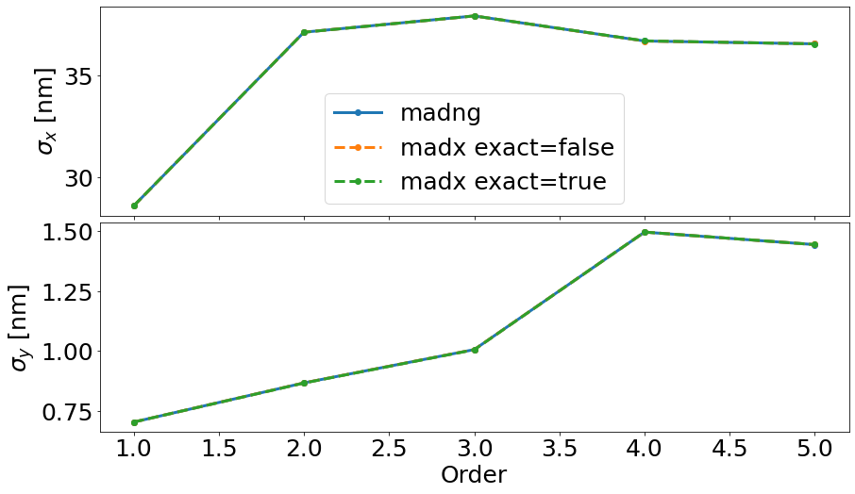
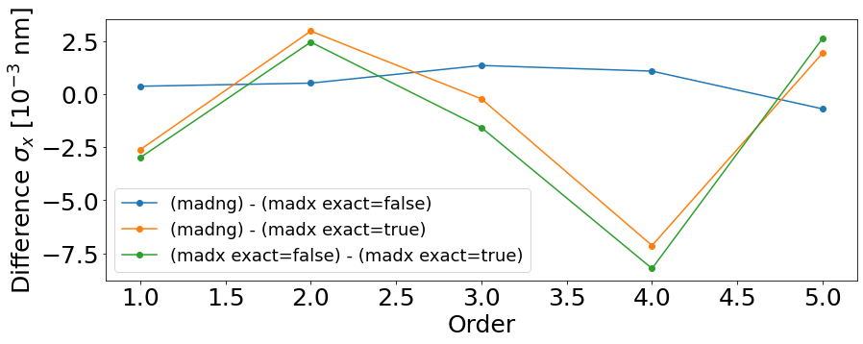
Performance – Results accuracy
The maps generated by MAD-NG and MADX-PTC are used as input by Mapclass to compute the higher order beam size at the Interaction Point.
The beam size computed from the maps generated by the two codes, with both exact = false and exact = true, are the same within a tolerance below ${10}^{−2}$ nm.
Beam size delivered by Mapclass with MAD-NG and MADX-PTC maps as input, computed here with a rms relative momentum spread of $Δp/p=0.3\%$.
8
Enrico Manosperti LCWS 2023 17/05/2023

Slide 9
Summary​
The comparison between MAD-X and the new code MAD-NG was carried out for the three main commands offered by these codes, track, twiss, and match.
The evolution of the penalty functions and the delivered results obtained for different optimization methods have been analyzed to compare the overall performance of these codes.
For the particular example shown here MAD-NG achieved a smaller penalty function.
The speed performance and the accuracy of the maps have been cross-checked between these codes for different setups
Better runtime performances for MAD-NG when considering the best available physics model exact=true.
9
Enrico Manosperti LCWS 2023 17/05/2023

