Slide 1


Design of CLIC
Beam Delivey System
at 7 TeV
Enrico Manosperti, Rogelio Tomás and Andrii Pastushenko
17/05/2023

Slide 2
Table of contents
Luminosity extrapolation
Issues and challenges of the 7 TeV design
Collimation section design and optimization
Final Focus System design and optimization
Full Beam Delivery System
Summary
2
Enrico Manosperti LCWS 2023 17/05/2023

Slide 3
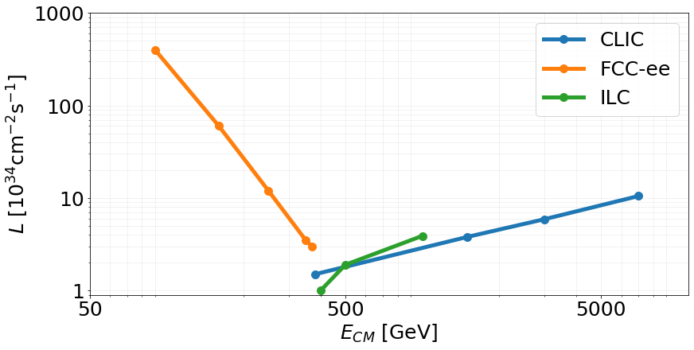

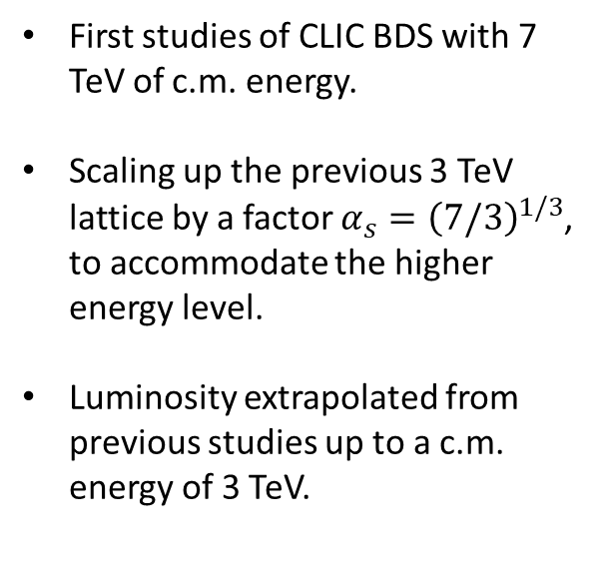
Luminosity extrapolation
First studies of CLIC BDS with 7 TeV of c.m. energy.
Scaling up the previous 3 TeV lattice by a factor $α_{s}={\left(7/3\right)}^{1/3}$, to accommodate the higher energy level.
Luminosity extrapolated from previous studies up to a c.m. energy of 3 TeV.
$$ℒ_{pred}≈{10}^{35}cm^{−2}s^{−1}$$
Enrico Manosperti LCWS 2023 17/05/2023
3

Slide 4
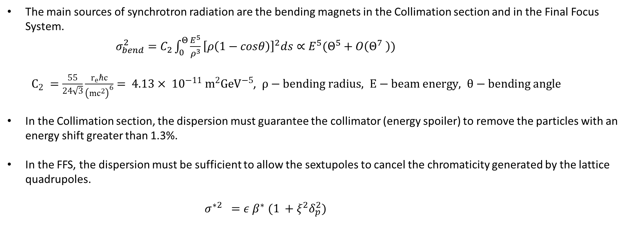
Issue of the new design
The main sources of synchrotron radiation are the bending magnets in the Collimation section and in the Final Focus System.
$σ_{bend}^{2}=C_{2}\int_{0}^{Θ}{\frac{E^{5}}{ρ^{3}}{\left[ρ\left(1−cosθ\right)\right]}^{2}ds∝E^{5}(Θ^{5}+O\left(Θ^{7} \right))}$
  $C_{2} =\frac{55}{24\sqrt{3}}\frac{r_{e}ℏc}{{\left(mc^{2}\right)}^{6}}= 4.13× {10}^{−11} m^{2}GeV^{−5}$, $ρ−bending radius, E−beam energy, θ−bending angle$
In the Collimation section, the dispersion must guarantee the collimator (energy spoiler) to remove the particles with an energy shift greater than 1.3%.
In the FFS, the dispersion must be sufficient to allow the sextupoles to cancel the chromaticity generated by the lattice quadrupoles.
        $$σ^{∗2} =ε β^{∗} (1 +ξ^{2}δ_{p}^{2})$$
4
Enrico Manosperti LCWS 2023 17/05/2023

Slide 5
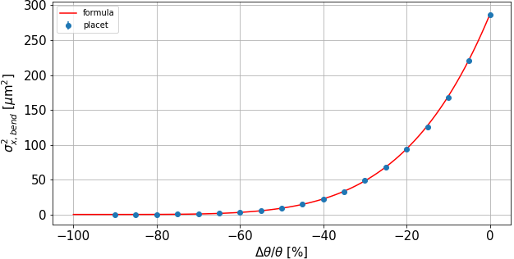
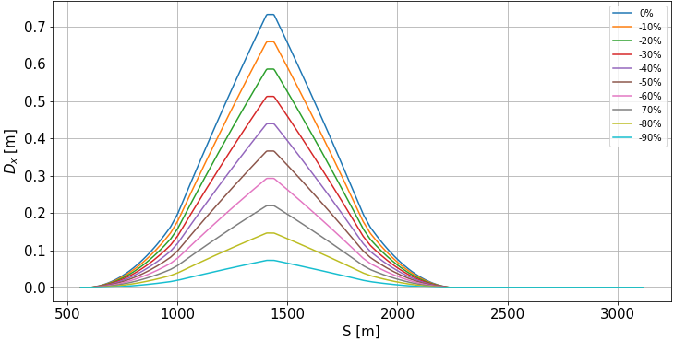
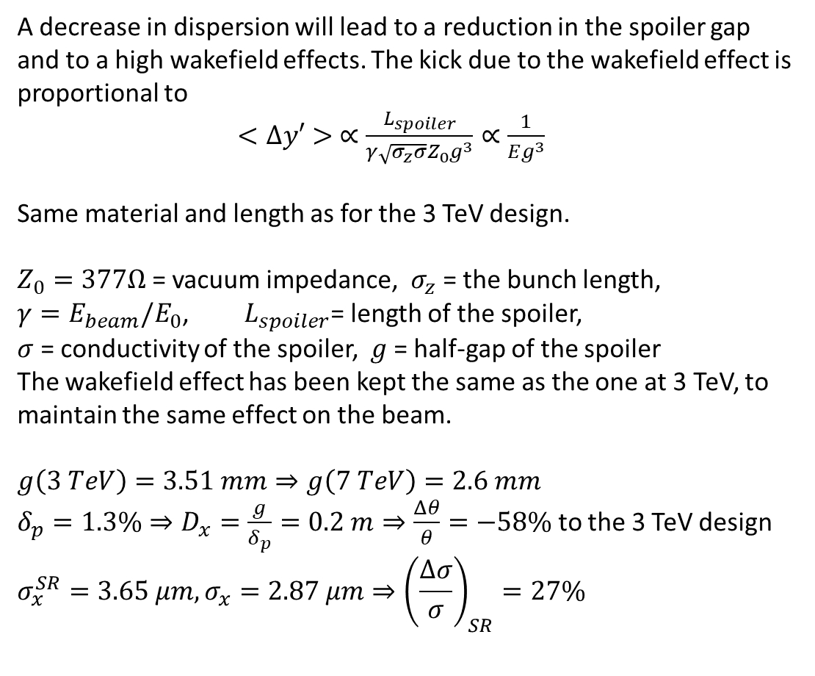
Scaling of Collimation angles
A decrease in dispersion will lead to a reduction in the spoiler gap and to a high wakefield effects. The kick due to the wakefield effect is proportional to
$<Δy′> ∝\frac{L_{spoiler}}{γ\sqrt{σ_{z}σ}Z_{0}g^{3}}∝\frac{1}{Eg^{3}}$
Same material and length as for the 3 TeV design.
$Z_{0}=377Ω$ = vacuum impedance, $σ_{z}$ = the bunch length,
$γ=E_{beam}/E_{0}$, $L_{spoiler}$= length of the spoiler,
$σ$ = conductivity of the spoiler, $g$ = half-gap of the spoiler
The wakefield effect has been kept the same as the one at 3 TeV, to maintain the same effect on the beam.
$$g\left(3 TeV\right)=3.51 mm⇒g\left(7 TeV\right)=2.6 mm$$
$δ_{p}=1.3\%⇒D_{x}=\frac{g}{δ_{p}}=0.2 m⇒\frac{Δθ}{θ}=−58\%$ to the 3 TeV design
$$σ_{x}^{SR}=3.65 μm, σ_{x}=2.87 μm⇒{\left(\frac{Δσ}{σ}\right)}_{SR}=27\%$$
5
Enrico Manosperti LCWS 2023 17/05/2023

Slide 6
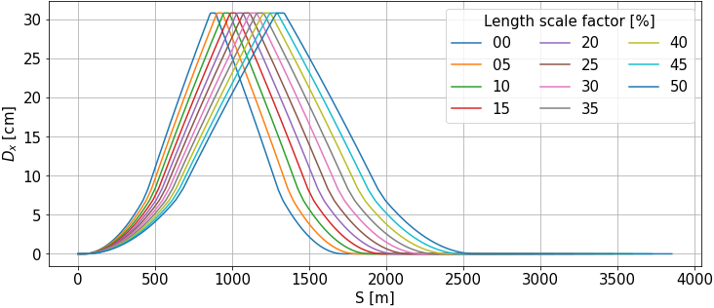
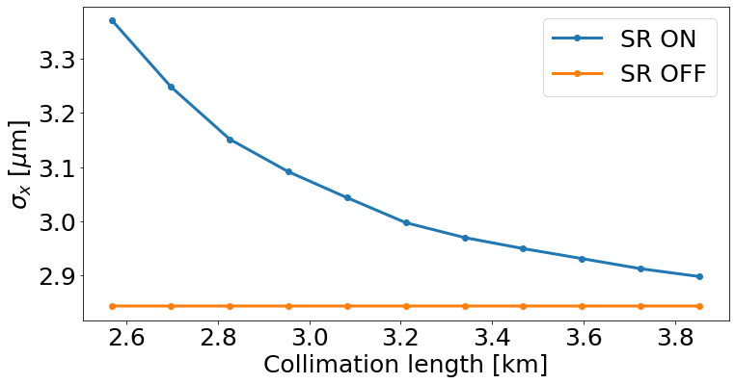
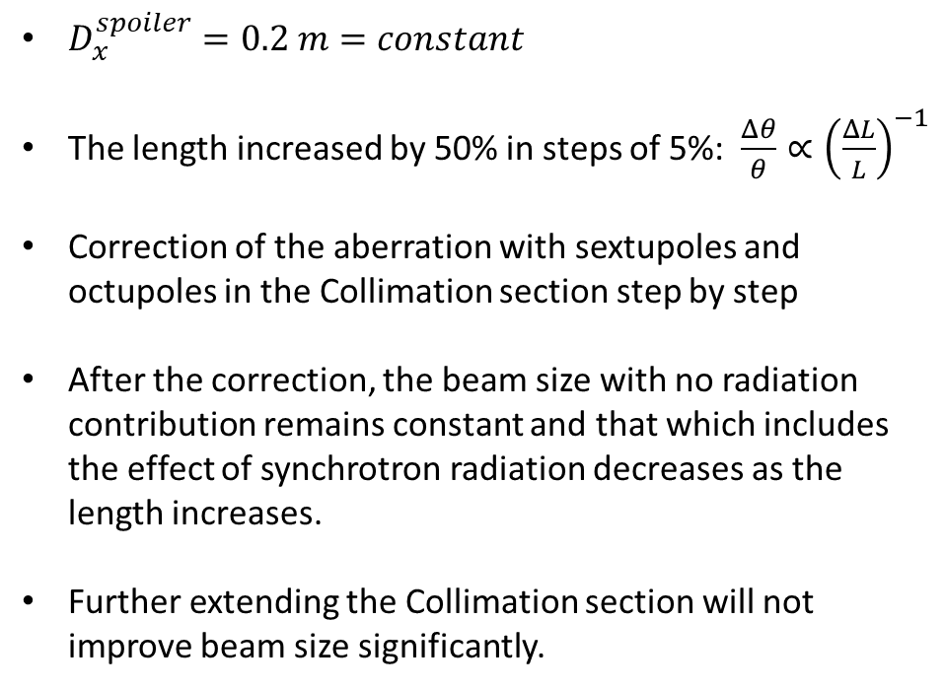
Scaling of Collimation length
$D_{x}^{spoiler}=0.2 m=constant$
The length increased by 50% in steps of 5%: $\frac{Δθ}{θ}∝{\left(\frac{ΔL}{L}\right)}^{−1}$
Correction of the aberration with sextupoles and octupoles in the Collimation section step by step
After the correction, the beam size with no radiation contribution remains constant and that which includes the effect of synchrotron radiation decreases as the length increases.
Further extending the Collimation section will not improve beam size significantly.
6
Enrico Manosperti LCWS 2023 17/05/2023

Slide 7
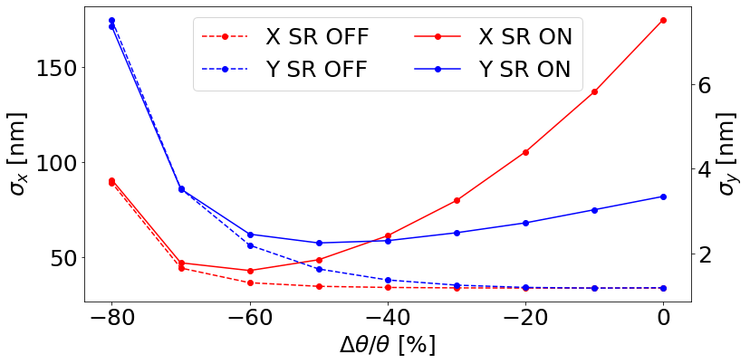
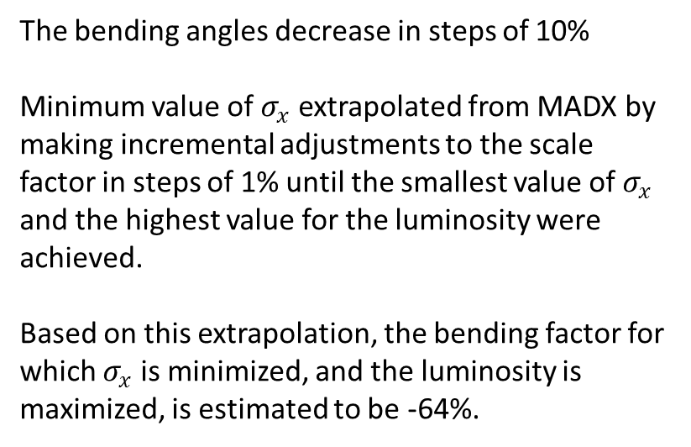
Synchrotron Radiation in FFS
Lower bending angles $⇒$ Lower dispersion at sextupoles $⇒$ the relevant sources of beam size growth are aberrations
The bending angles decrease in steps of 10%
Minimum value of $σ_{x}$ extrapolated from MADX by making incremental adjustments to the scale factor in steps of 1% until the smallest value of $σ_{x}$ and the highest value for the luminosity were achieved.
Based on this extrapolation, the bending factor for which $σ_{x}$is minimized, and the luminosity is maximized, is estimated to be -64%.
The minimum value of $σ_{y}$was not taken into consideration, as the bending magnets only act in the horizontal plane and therefore it was necessary to focus on reducing the effects of SR in that plane.
7
Enrico Manosperti LCWS 2023 17/05/2023

Slide 8
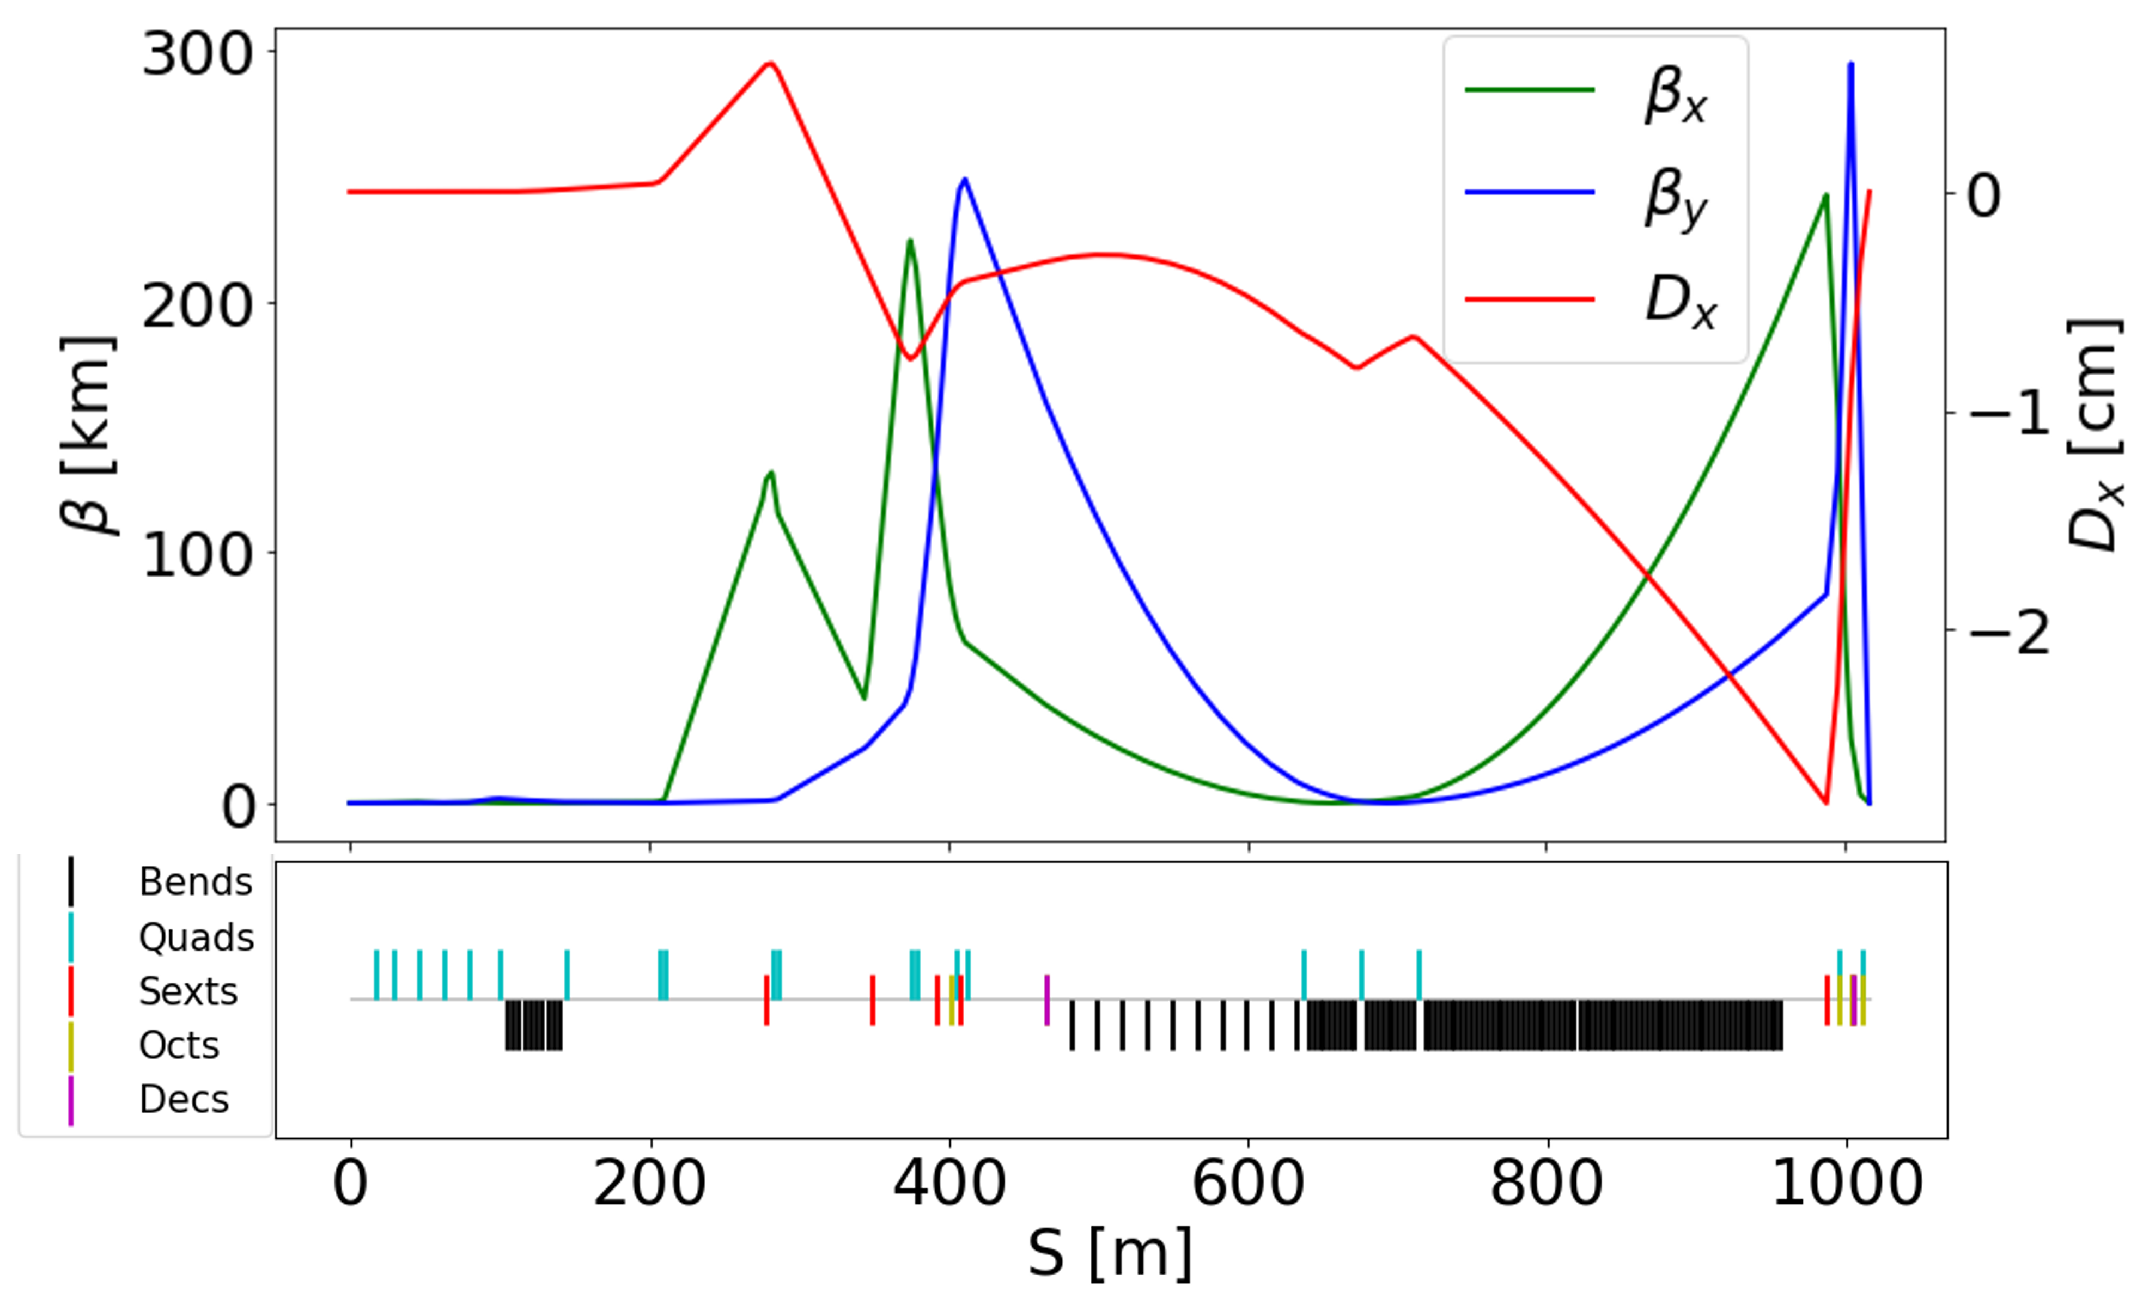
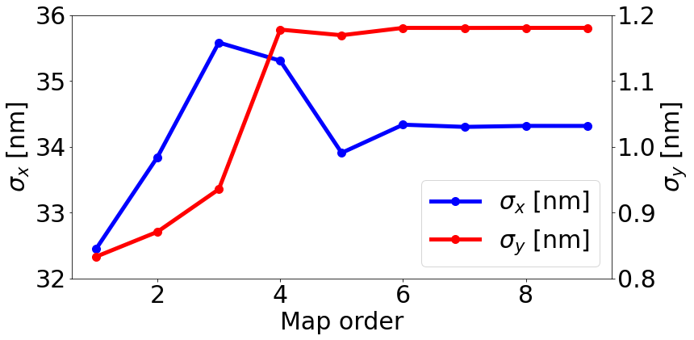
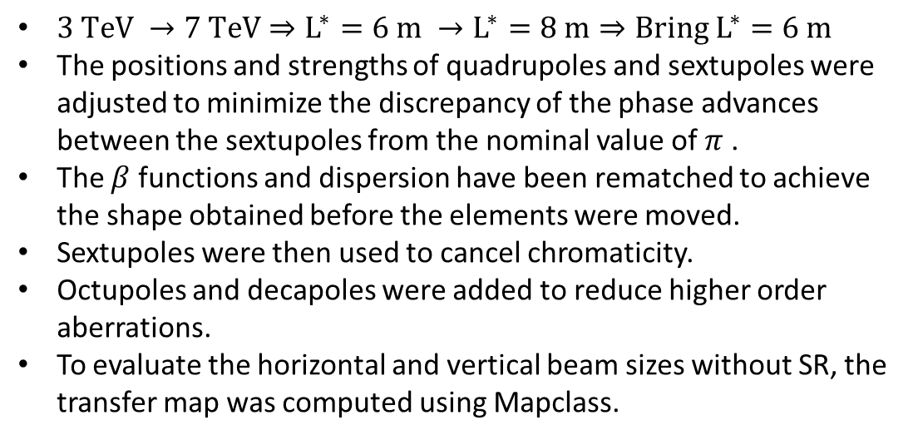
FFS Optimization
$3 TeV →7 TeV⇒L^{∗}=6 m →L^{∗}=8 m⇒Bring L^{∗}=6 m$
The positions and strengths of quadrupoles and sextupoles were adjusted to minimize the discrepancy of the phase advances between the sextupoles from the nominal value of $π$ .
The $β$ functions and dispersion have been rematched to achieve the shape obtained before the elements were moved.
Sextupoles were then used to cancel chromaticity.
Octupoles and decapoles were added to reduce higher order aberrations.
To evaluate the horizontal and vertical beam sizes without SR, the transfer map was computed using Mapclass.
8
Enrico Manosperti LCWS 2023 17/05/2023

Slide 9
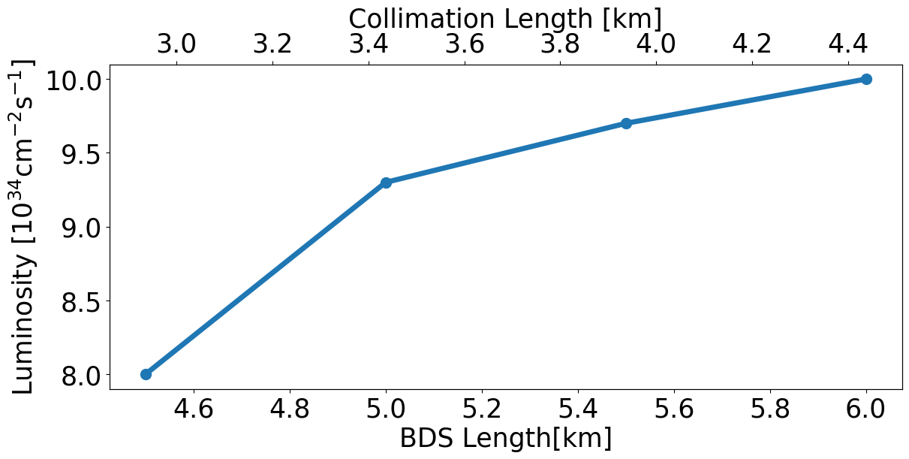
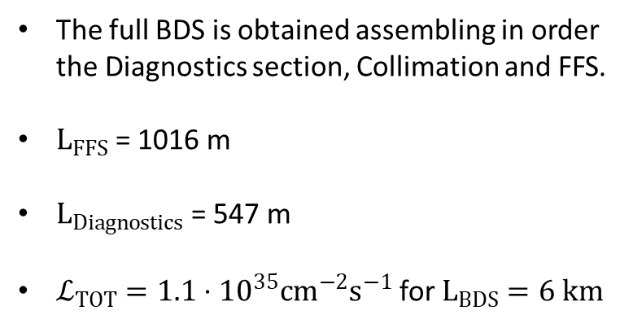
Full BDS
The full BDS is obtained assembling in order the Diagnostics section, Collimation and FFS.
$L_{FFS}$ = 1016 m
$L_{Diagnostics}$ = 547 m
$ℒ_{TOT}=1.1⋅{10}^{35}cm^{−2}s^{−1}$for $L_{BDS}=6 km$
9
Enrico Manosperti LCWS 2023 17/05/2023

Slide 10
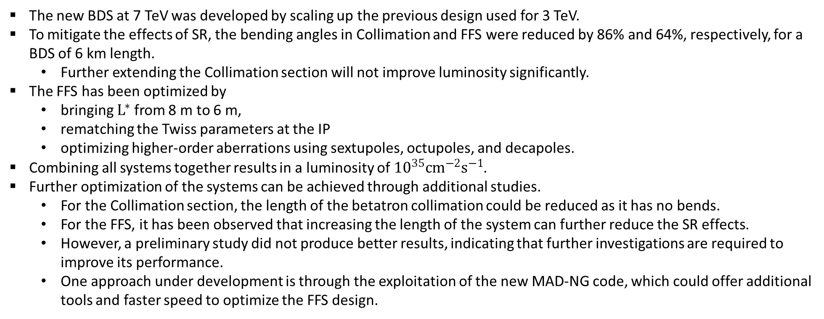
Summary
The new BDS at 7 TeV was developed by scaling up the previous design used for 3 TeV.
To mitigate the effects of SR, the bending angles in Collimation and FFS were reduced by 86% and 64%, respectively, for a BDS of 6 km length.
  Further extending the Collimation section will not improve luminosity significantly.
The FFS has been optimized by
  bringing $L^{∗}$ from 8 m to 6 m,
  rematching the Twiss parameters at the IP
  optimizing higher-order aberrations using sextupoles, octupoles, and decapoles.
Combining all systems together results in a luminosity of ${10}^{35}cm^{−2}s^{−1}$.
Further optimization of the systems can be achieved through additional studies.
  For the Collimation section, the length of the betatron collimation could be reduced as it has no bends.
  For the FFS, it has been observed that increasing the length of the system can further reduce the SR effects.
  However, a preliminary study did not produce better results, indicating that further investigations are required to improve its performance.
  One approach under development is through the exploitation of the new MAD-NG code, which could offer additional tools and faster speed to optimize the FFS design.
10
Enrico Manosperti LCWS 2023 17/05/2023

