Slide 1
BEAM BREAKUP STUDIES FOR THE $C^{3}$ LINEAR COLLIDER
International Workshop on Future Linear Collider – May 15-19 2023
Speaker: F. Bosco^{1,2,3*}
Co-authors: M. Behtouei⁴, O. Camacho¹, M. Carillo^{1,2,3}, E. Chiadroni^{2,4},
L. Faillace⁴, L. Ficcadenti³, D. Francescone^{2,3}, A. Fukasawa¹, A. Giribono⁴,L. Giuliano^{2,3},
G. Lawler¹, Z. Li⁵, N. Majernik^{5,1}, M. Migliorati^{2,3}, A. Mostacci^{2,3}, L. Palumbo^{2,3},
J. Rosenzweig^{1,2}, G. J. Silvi^{2,3}, B. Spataro⁴, S. Tantawi⁵
¹UCLA, Los Angeles, 90095 CA, USA
²La Sapienza University of Rome, 00161 Rome, Italy
³INFN-Sez. Roma1, 00161 Rome, Italy
⁴INFN-LNF, 00044 Frascati, Italy
⁵SLAC, Menlo Park, 94025, CA, USA
* fbosco@physics.ucla.edu
This work is supported by DARPA under Contract N.HR001120C0072, by DOE Contract DE-SC0009914 and DE-SC0020409, by the National Science Foundation Grant N.PHY-1549132 and by INFN through the project ARYA.
Notes:
Good morning – Thanks for the opportunity of giving this talk – Thanks the committee for the possibility of remote participation
Today I will talk about BBU studies in the C3 linear collider and other machines utilizing the same type of accelerating structures
Such studies were performed in the last couple of years in the framework of a larger collaboration as you can see from the list of co-authors

Slide 2
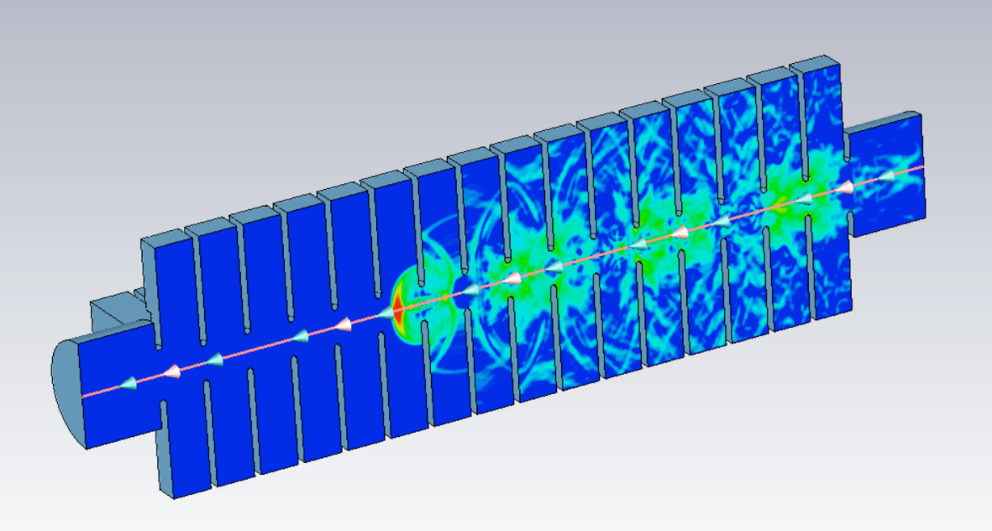
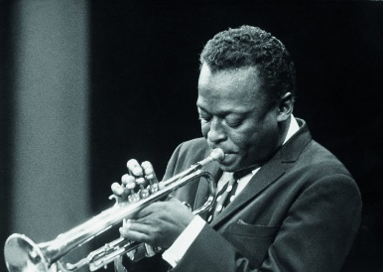
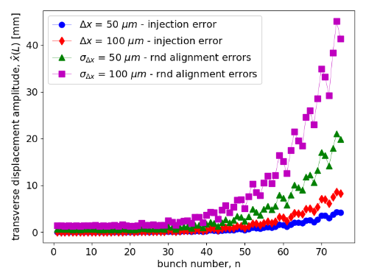
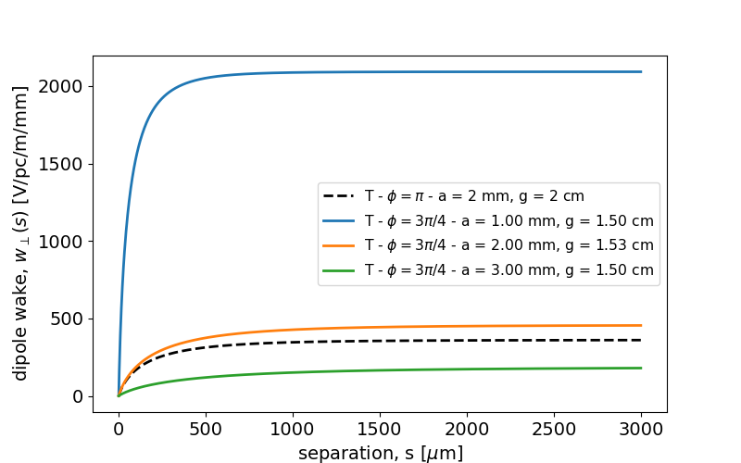
Contents
Initiatives utilizing distributed coupling linacs and our experience with such structures
Sources of wakefields in RF linacs and BBU effects
Modeling of the wakefield interaction: the code MILES
BBU studies for the TeV-scale working point of the $C^{3}$ linear collider
Investigation of phase advances alternative to the $π$-mode: SRWFs in $3π/4$ mode distributed coupling linac
Notes:
Here’s an overview of the contents of my presentation
I will start by giving you some framework by summarizing our experience with activities involving distributed coupling linacs
Next I will give a simple introduction to the BBU effects in rf linacs in order to identify the kind of issues we aim to describe and I will also spend a few words about the modeling that we adopt for such analyses
Then I will show some results concerning the LR BBU effects in the C3 LC
And, finally, discuss the ongoing activities aimed at studying the same type of effects in DCLs exploiting phase advances alternative to the conventional pi mode

Slide 3
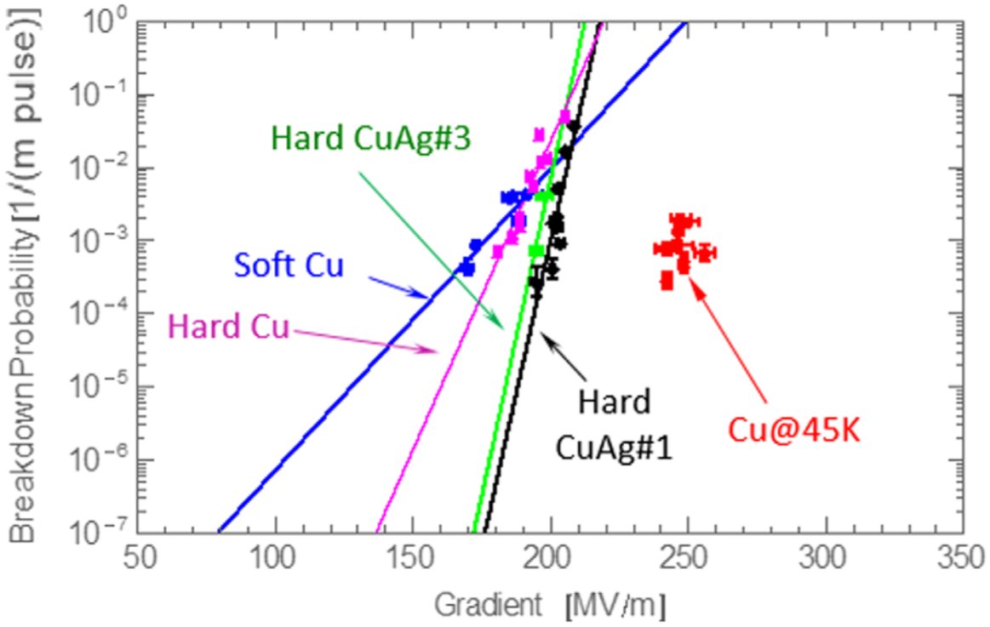
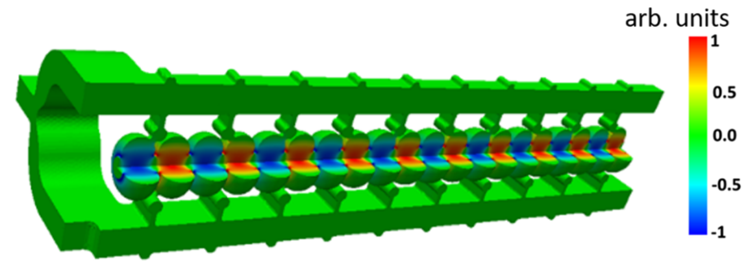
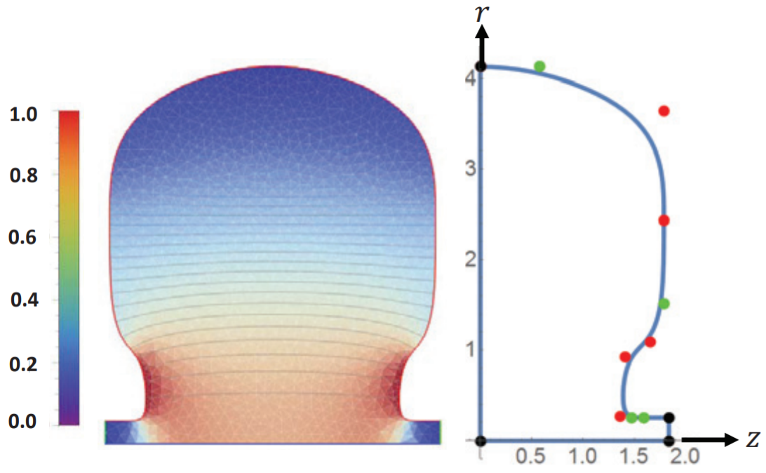
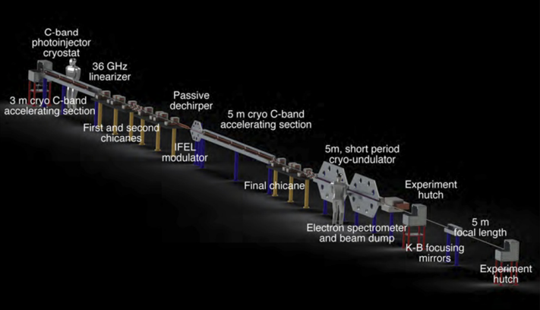
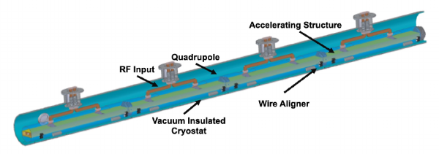
Our Experience with Dist. Coupling Linacs
A novel NCRF concept for high gradient acceleration:
Distributed coupling linac (DCL) scheme
Optimized cavity topology
Cryogenic operation of Cu structures (e.g. 45-77 K)
UC-XFEL
DARPA-GRIT ICS Source
$C^{3}$: a ‘‘Cool Copper Collider’’
Notes:
Distributed coupling linacs have been discussed a few times during the workshop. They represent a clever concept for high gradient operation in periodic radio-frequency accelerating structures
The peculiarity of this design consists in the use of a manifold guiding structure to distribute the rf power in each cell. As a consequence, the irises are no longer constrained to coupling requirements meaning that the entire unit-cell cavity shape can be optimized to enhance the acceleration process
In addition, the operation at cryogenic temperatures allows to reduce the surface fields mitigating the breakdown rate probability
Distributed coupling linacs, both in the cryo-cooled and room temperature versions, are widely present in the initiatives investigated by our collaboration and allow applications ranging from UCXFEL, ICS G-rays sources and lepton collider
Before moving on, I want to show some of the unique concepts for the high gradient acceleration that characterize the activities of the collaboration
This structure is a distributed coupling linac which uses a manifold waveguide to individually distribute the rf power in each cell of the periodic accelerating structure
As a consequence, the irises dimensions are no longer constrained to coupling requirements meaning that the entire unit-cell cavity shape can be optimized to improve the acceleration process
In addition, it has been observed that operation of copper cavities at cryogenic temperatures, below 77 K, mitigates the breakdown limit meaning that for a given BDR probability it is possible to operate at higher gradients
Also, the combination of optimized cavity design at cryogenic temperatures, enables ultra high field photoinjectors which improves the beam brightness at the source
------
Here I am showing some of the unique concepts for the high gradient acceleration that characterize the activities of the collaboration

Slide 4
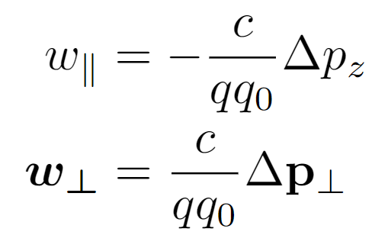
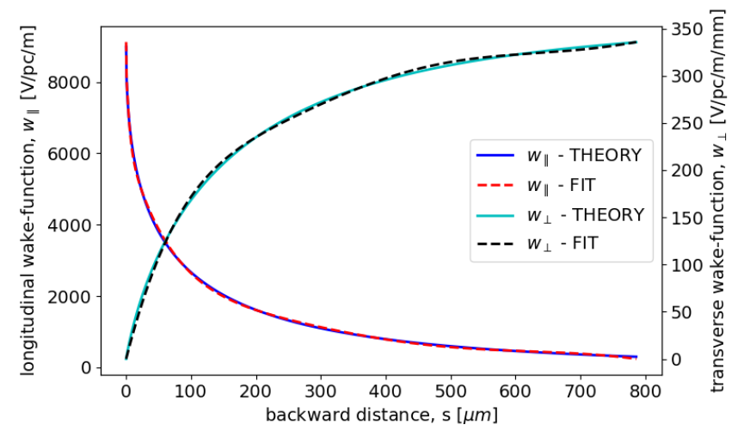
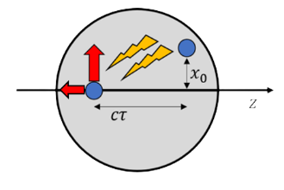
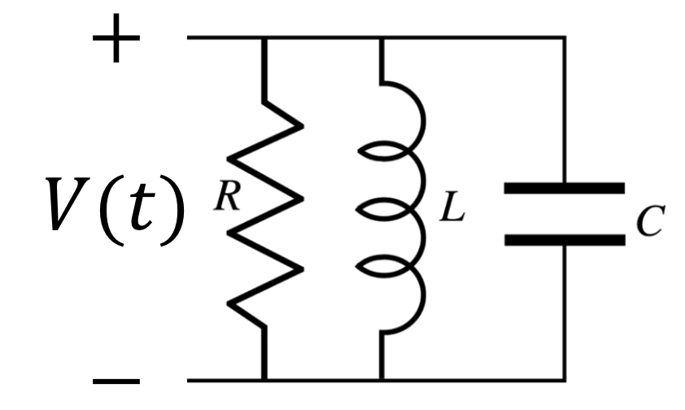
Sources of Wakefields in Linacs
Field generated by the beam, diffracted by the surrounding environment and acting back on the beam
Responsible for energy spread and transverse deflection
Modes in resonant cavities
Periodic accelerating structures
Longitudinal monopole and transverse dipole higher order modes (HOMs) in the accelerating cavities
Responsible for the long-range wakefield (LRWF) interaction ($ω_{n}=ω_{0}\sqrt{1−{\left(2Q\right)}^{−2}}$ and $α=ω_{0}/2Q$)
Longitudinal monopole and transverse dipole impedance from diffraction theory
Responsible for the short-range wakefield (SRWF) interaction in periodic accelerating structures
$ω_{0}$, $Q$, $R$
Notes:
So far we have only focused on the benefits associated with this type of structures but we should also say that high shunt impedance structures are accompanied by stronger wakefields
Wakefields are self-induced EM fields produced by the beam and diffracted by the discontinuity of in the surrounding geometry
Such parasitic fields act back on the beam introducing energy spread and transverse deflection that are described by a dedicated formalism that makes use of the wake-functions
In rf linacs the main contribution of wakefields is introduced by the interaction with the accelerating structures themselves
Depending on the time scale of the separation among the particles, two types of effects are observed: a long range interaction due to the excitation of HOMs introduces coupling among different bunches whereas a short range interaction due to the cell irises introduces intra-beam coupling described by diffraction theory

Slide 5
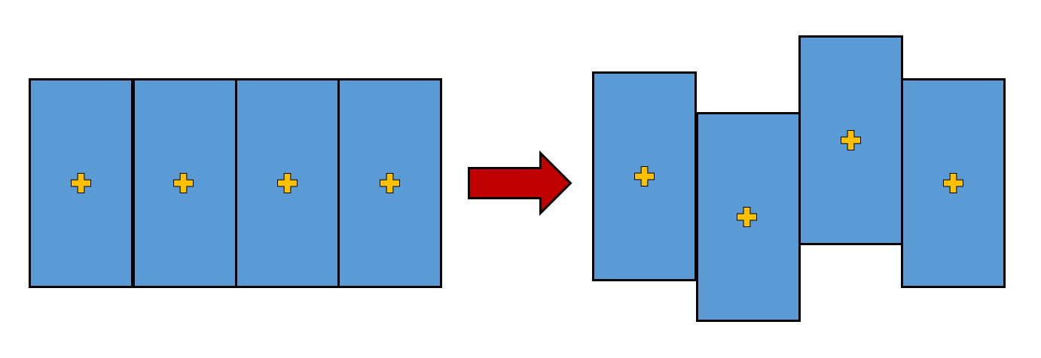
Beam Breakup Effects
Long-range transverse interaction
Short-range transverse interaction
Off-axis bunches
Excitation of dipole HOMs
Transverse deflection
!
Instability: the amplitude of the center of mass oscillation grows
!
Phase space dilution: the correlation between the planes is a cause of emittance growth
Notes:
These two types of interaction in the transverse plane are responsible for BBU effects
In particular, in the LR time-scale bunches traveling off-axis will excite dipole HOMs which causes deflection of the trailing bunches. Eventually, this process repeats itself in a cycle leading to an instability: the amplitude of the transverse oscillation grows without control
In the short-range time-scale the slice-dependent deflection induced by the SRWF introduces a correlation between the longitudinal and transverse planes leading to a growth of the projected emittance

Slide 6
The Code MILES
Dedicated tracking code
Motivation to investigate wakefields effects in linacs in presence of non-negligible space charge endangering the nominal beam quality
Use of simple semi-analytical models: flexible and time-efficient tool (factors $∼$1/30-1/10) with acceptable reduction of the accuracy
Main applications: investigation of misalignment effects and design of possible correction schemes
Miles Davis (May 26, 1926 – September 28, 1991)
MILES = Modeling Instabilities in Linacs with Ellipsoidal Space charge
Modeling overview and comparison with other codes
 | MILES approach | Commonly utilized approaches
Space Charge | Equivalelent ellipsoid or Multi-slice superposition | Particle in cell (PIC)
Wakefields | Algebraic formalism | Convolution integral or FFT equivalent
Notes:
The urge to performing customized studies on BBU effects in advanced linacs has motivated us to develop MILES: a dedicated tracking code investigating wakefield effects in linacs while also including simple models for space charge forces
The code uses semi-analytical approaches that yield a flexible and time-efficient tool at the expenses of an acceptable reduction of the accuracy
The primary goal conceived for MILES is the investigation of misalignment effects and the design of mitigation schemes for such imperfections
For the sake of time today I will not focus on the models adopted by this code however if anyone is curious to know more I encourage you to ask me about it later or even offline
In addition, MILES gave us the opportunity to compare different approaches identifying possible advantages and limits also in comparison with standard approaches.
Indeed, as the action of self-induced fields depend on the beam distribution, most codes utilize particle in cell methods for space charge and an integral convolution with the beam slices for wakefields
Such methods can be time consuming for large particle sets and thus the combination of space charge and wakefield is not trivial

Slide 7
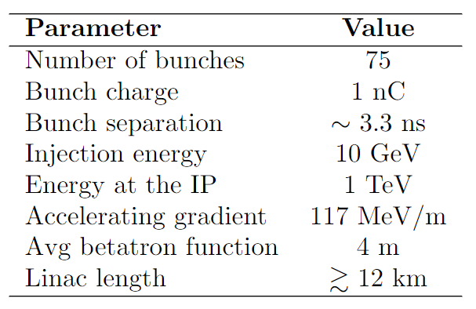
Long-range BBU in the $C^{3}$ Linac
BBU studies for the TeV scale working point of the $C^{3}$ linear collider
Center of mass oscillations in multi-bunch operation: sequence of point-like, structureless macro-particles carrying the whole bunch charge
$C^{3}$ working point at TeV-scale
Injection error:
Linac sections are perfectly aligned (ideal)
Injection with a transverse offset $Δx$ for all bunches
Random alignment errors:
On-axis injection
Linac sections exhibit gaussian transverse offsets with std dev $σ_{Δx}$
+ knowledge of dipole HOMs parameters ($ω_{0}$, $Q$, $R_{⊥}$) for $5<ω_{0}/2π<20 GHz$
Amplitude of the transverse oscillation of the bunches at the interaction point
$C^{3}$ parameters
D. Kim et. al, Design Study of HOM Coupler for the C-band Accelerating Structure, doi:10.18429/JACoW-IPAC2022-TUPOMS057
Notes:
In the next two slides I will show an application where I have used MILES to study the mutual LRWF interaction for the TeV-scale working point of the C3 linear collider
The main parameters for this example are taken from a reference paper and reported in the table
The additional information for this analysis is the knowledge of the
here and we investigate injection and alignment errors in absence of mitigation techniques
The plot shows the amplitude of the transverse oscillation for each of the 75 bunches in the rf-macro pulse at the end of the linac. Clearly, mitigation techniques are necessary since, due to the HOMs, alignment errors in the order of a few tens of microns produce oscillations in the millimeter scale

Slide 8
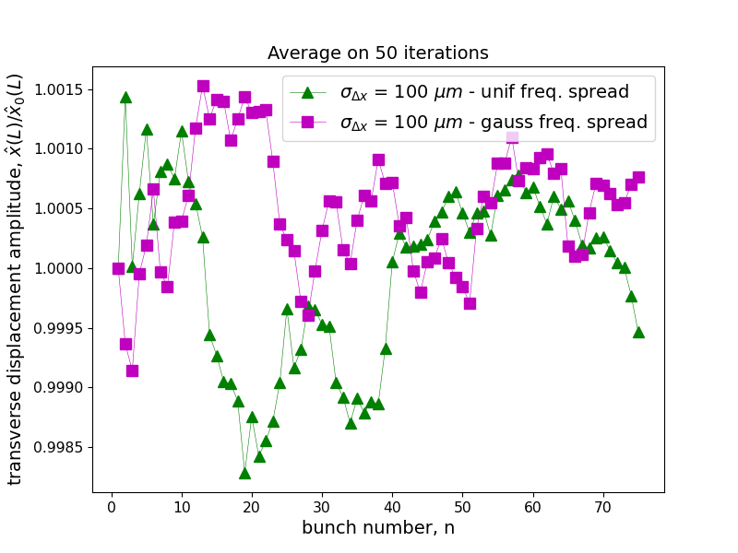
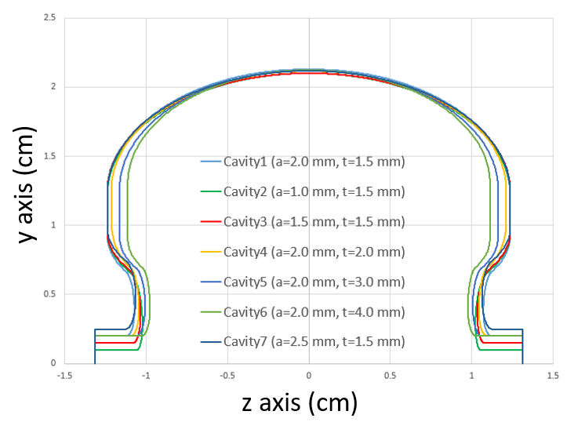
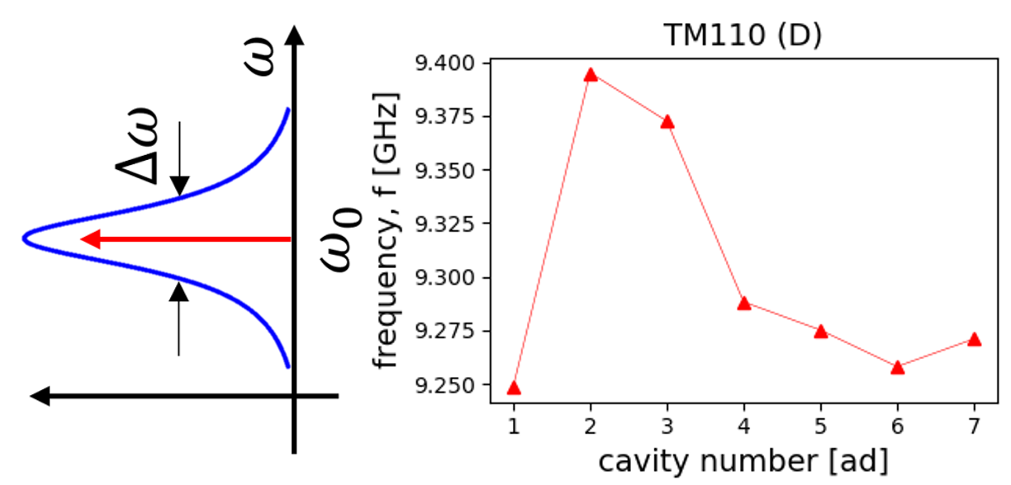
Long-range BBU in the $C^{3}$ Linac (2)
Detuning of the HOMs
Unstable motion if the ratio $f_{HOM}/f_{b}$ is close to an integer (see Mosnier)
Mitigation through frequency spread (or detuning)
Seven cavity-designs from small variations of the original geometry
HOMs exhibit different, i.e. random, frequencies through subsequent linac sections
Worst case scenario from previous plot:
Random misalignments with $σ_{Δx}=100 μm$
Courtesy of D. Kim
$C^{3}$ parameters
Amplitude of the transverse oscillation for each bunch in the rf-pulse at the interaction point normalized to the first bunch’s amplitude
Notes:
It is possible to demonstrate that the motion becomes highly unstable when the ratio of the HOM frequency and the bunch repetition rate is close to an integer as the mode and the pulsed beam fulfill a resonant condition
A possible mitigation scheme, known as frequency spread, consists in applying small changes to the nominal geometry of the cavity so that the mode will appear with different frequencies in subsequent linac sections
Such fluctuations break the coherent interplay of the pulsed beam with the mode
Now we focus on the worst case from the previous simulation but we introduce a frequency spread of the HOMs in our tracking code. The transverse oscillations of the bunches are now normalized with respect to the first bunch that does not experience dipole wakes. We can observe that, since all the amplitudes are close to 1, breaking the interaction pattern cancels the BBU-effects completely

Slide 9
$3π/4$-mode performance
Phase advances alternative to the conventional $π$-mode

Slide 10
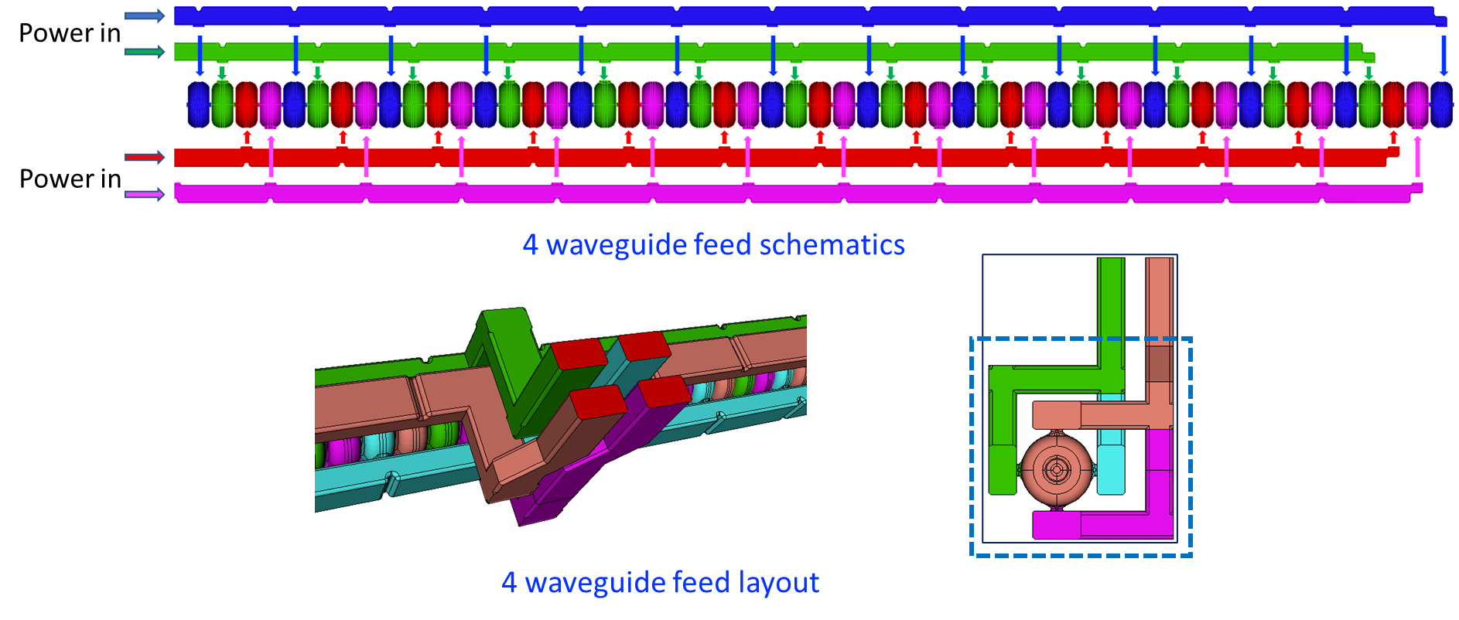
135 degree phase advanced distributed coupling structure
Courtesy of S. Tantawi et. al
If one includes the period as an optimization parameter then the optimal structure with the minimal surface magnetic field, and consequently the highest shunt impedance occurs at ~$132°$ phase advance; a natural choice is$a 135°$ (i.e. $3π/4$ radians) phase advance.
Every 4th cavity has a $π$phase shift (modulo $2π$), hence 4 manifolds are needed to feed the structure.
Every two manifolds need to be fed with a $π/2$ phase shift; naturally fed by a hybrid that isolates the forward signal from the reflected signal.
Cell-to-cell phase advance:
$$φ=\frac{ω}{c}p$$
Shumail, Li, Tantawi
S. Tantawi, Z. Li, M. Shumail, C. Nantista, M. Oriunno, G. Bowden, B. Loo, E. Snively, “Cryogenically Cooled 135 Degree Distributed-Coupling Linear Accelerator and Its Application to Very High Electron Energy Radiation Therapy,” to be published.
Notes:
The rest of the talk is dedicated to the recent investigation we initiated on alternative configurations with respect to the pi-mode sw
Indeed in the distributed coupling scheme the cell-to-cell phase advance is entirely handled by the manifold as there is no cell to cell coupling
Therefore, the period of the unit cell can be chosen aribitrarily and becomes part of the parameter space for the optimization
It has been observed that the optimal phase advance that maximizes the shunt impedance is around 130 deg and thus one can think to work in the 135 or 3pi/4 for which a feasible distribution scheme can be found combining 4 manifolds and 90-degrees hybrid couplers

Slide 11
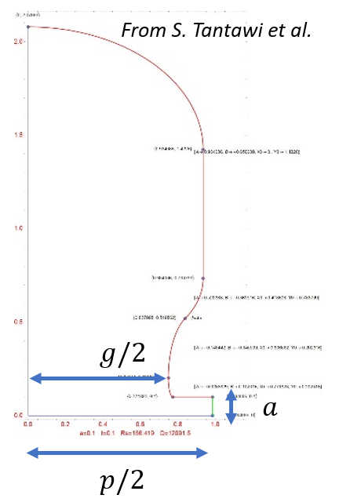
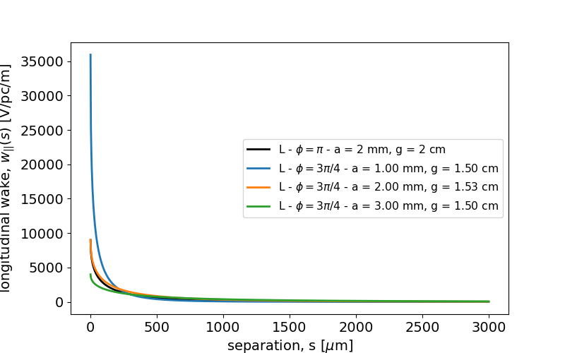
SRWF in the $3π/4$ Structures
Change of the geometrical dimensions implies changes in the wakefields
$$φ=3π/4$$ | $φ=π$ (original)
Iris $a$ [mm] = 1,2,3 | Iris $a\left[mm\right]=2$
Gap $g\left[cm\right]=1.496, 1.534, 1.501$ | Gap $g\left[cm\right]=2$
Period $p\left[mm\right]=19.682$ ($3λ/8$) | Period $p\left[mm\right]=26.242$ ($λ/2$)
Longitudinal Monopole SR wake-function
Transverse dipole SR wake-function
Notes:
With this motivation we aim to perform equivalent studies for the BBU effects in this type of structure starting from SRWF
The SR wakefunction for periodic linacs is described by a well-known formula which depends on the geometric parameters of the unit-cell cavity
Changing the phase advance and, thus, the geometry will change the WF as we can see here
In particular this is shown for three different irises that are to be considered to allow frequency spread of the HOMs
For comparison the original pi mode 2mm iris is shown and we notice that the WF for the same iris is only slightly higher for the 3pi/4 case

Slide 12
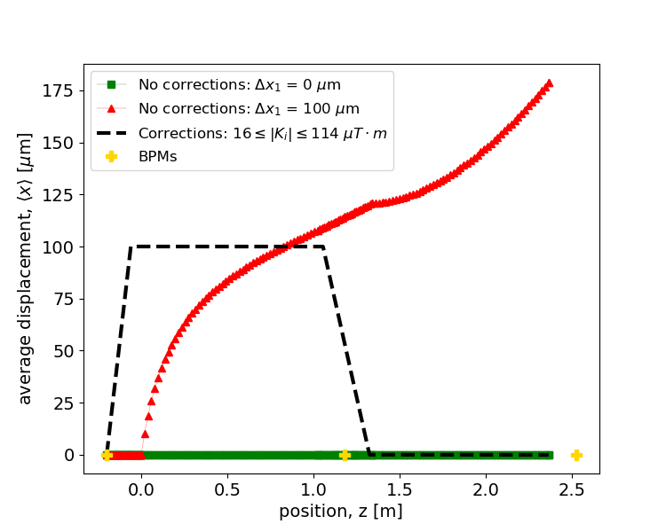
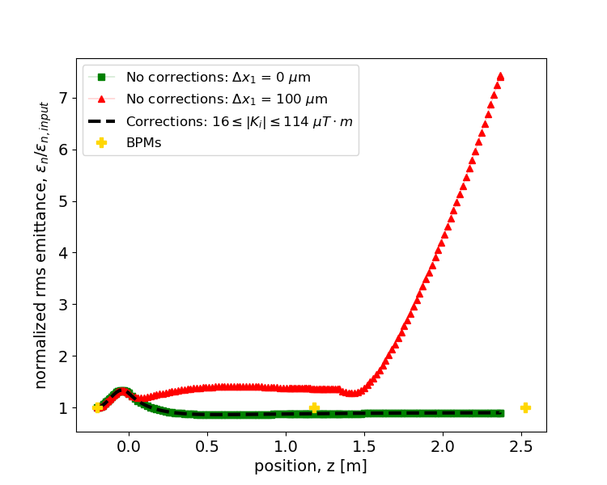
Mitigation by Trajectory Steering
Reference case
UC-XFEL scenario (100 pC, 0.5 mm rms beam, ~100 nm emittance at injection)
2 linac sections: $6.9 MeV<γmc^{2}<150 MeV$ with the 1st section is 100 um off-axis
Demonstration for the worst case scenario of 1 mm iris (two correctors upstream each linac section)
Centroid trajectory
Emittance growth
UC-XFEL parameters
Notes:
In order to quantify these effects we investigate a reference case with two distributed coupling linac sections the first one being 100 um off-axis
As emittance dynamics induced by wakefields are more relevant at low energies, we consider beam and linac parameters taken from the UCXFEL case
In absence of corrections, the beam propagates off-axis in the misaligned linac exciting strong dipole wakefields that induce, in turn, a significant emittance growth: a factor 7 with respect to the nominal value
Nevertheless we can still handle this type of alignment errors by controlling the trajectory with moderate strength dipole steering magnets
Here we utilize two correctors upstream each linac section to force the beam to travel always on the axis of the linac regardless of the misalignments: in this case the excitation of dipole wakes is negligible and the emittance can be preserved

Slide 13
Conclusions and Outlook
International Workshop on Future Linear Collider – May 15-19 2023
Cryo-cooled distributed coupling linacs are expected to play a crucial role for advanced and diverse applications ($e^{−}e^{+}$ colliders, FELs, ICS, FLASH RT,…)
The development of MILES for an efficient description of BBU (and other) effects
BBU effects and their mitigation in the $C^{3}$ linear collider
Possible benefits in the operation with $3π/4$ phase advance structures
Ongoing work on long-range BBU
Electromagnetic simulation: eigenmode analysis of the structure finding frequencies, quality factors and shunt impedances for monopole and dipole
BBU studies with the $3π/4$ structure: multi-bunch simulations with MILES to estimate the center-of-mass oscillations as well as multi-bunch with intra-beam effects (SC + SRWF) for simultaneous description of short-range and long range wakefields
Thank you for your attention
(Questions are welcome)
fbosco@physics.ucla.edu
Notes:
To summarize:
Cryo-cooled DCLs represent an efficient instrument for high gradient acceleration and they are envisioned for large scale and small-scale facilities such as colliders, particle driven radiation sources and electron FLASH radio-theraphy
Beam breakup effects endanger the beam quality and stability so their study and mitigation is extremely important
The 3pi/4 mode is promising alternative to fully exploit the optimized cavity shape and we should definitely continue this analysis
In particular here’s the plan for our next steps concerning long range BBU effcts: characterization of the HOM for the modified structure (eigenmode sims) multi bunch simulations with miles

Slide 14
Additional Material
International Workshop on Future Linear Collider – May 15-19 2023

Slide 15
The Code MILES
Dedicated tracking code
Motivation to investigate wakefields effects in linacs in presence of non-negligible space charge endangering the nominal beam quality
Use of simple semi-analytical models: flexible and time-efficient tool (factors $∼$1/30-1/10) with acceptable reduction of the accuracy
Main applications: investigation of misalignment effects and design of possible correction schemes
Miles Davis (May 26, 1926 – September 28, 1991)
MILES = Modeling Instabilities in Linacs with Ellipsoidal Space charge
Comparison with other codes utilized in accelerator physics
SPACE CHARGE: Particle in cell, PIC, approach (GPT, ASTRA, PARMELA,TSTEP…)
WAKEFIELDS: Convolution integral with the beam slices, often solved with FFT algorithms (ASTRA, ELEGANT, LUCRETIA…)
SC + WF: Complexity and CPU times increase and, thus, it is not a trivial feature (ASTRA, IMPACT-Z, OCELOT, HOMDYN)
Notes:
This challenging framework has motivated us to develop MILES: a dedicated tracking code investigating wakefield effects in linacs while also including simple models for space charge forces
The code uses semi-analytical approaches that yield a flexible and time-efficient tool at the expenses of an acceptable reduction of the accuracy
The primary goal conceived for MILES is the investigation of misalignment tolerances and the design of mitigation schemes for such imperfections
In addition, MILES gave us the opportunity to compare different approaches identifying possible advantages and limits also in comparison with standard approaches.
Indeed, as the action of self-induced fields depend on the beam distribution, most codes utilize particle in cell methods for space charge and an integral convolution with the beam slices for wakefields
Such methods can be time consuming for large particle sets and thus the combination of space charge and wakefield is not trivial

Slide 16
The Code MILES
Dedicated tracking code
Motivation to investigate wakefields effects in linacs in presence of non-negligible space charge endangering the nominal beam quality
Use of simple semi-analytical models: flexible and time-efficient tool (factors $∼$1/30-1/10) with acceptable reduction of the accuracy
Main applications: investigation of misalignment effects and design of possible correction schemes
Miles Davis (May 26, 1926 – September 28, 1991)
MILES = Modeling Instabilities in Linacs with Ellipsoidal Space charge
Modeling overview and comparison with other codes
SPACE CHARGE: Equivalent ellipsoid or Multi-slice superposition instead of PIC approaches (GPT, ASTRA, PARMELA,TSTEP…)
WAKEFIELDS: Algebraic formalism valid for short and long-range interaction instead of convolution integral with the beam slices (ASTRA, ELEGANT, LUCRETIA…)
SC + WF: Complexity and CPU times increase and, thus, it is not a trivial feature (ASTRA, IMPACT-Z, OCELOT, HOMDYN)
Notes:
This challenging framework has motivated us to develop MILES: a dedicated tracking code investigating wakefield effects in linacs while also including simple models for space charge forces
The code uses semi-analytical approaches that yield a flexible and time-efficient tool at the expenses of an acceptable reduction of the accuracy
The primary goal conceived for MILES is the investigation of misalignment tolerances and the design of mitigation schemes for such imperfections
In addition, MILES gave us the opportunity to compare different approaches identifying possible advantages and limits also in comparison with standard approaches.
Indeed, as the action of self-induced fields depend on the beam distribution, most codes utilize particle in cell methods for space charge and an integral convolution with the beam slices for wakefields
Such methods can be time consuming for large particle sets and thus the combination of space charge and wakefield is not trivial

Slide 17
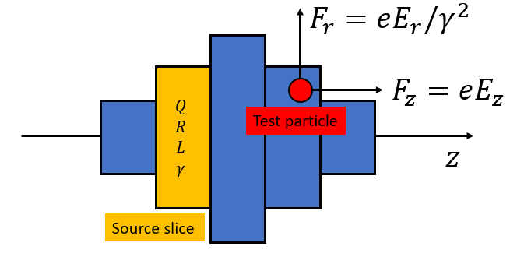
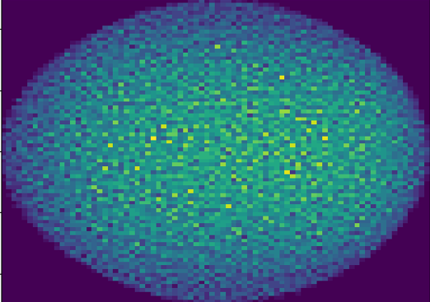
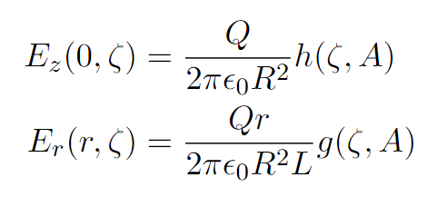
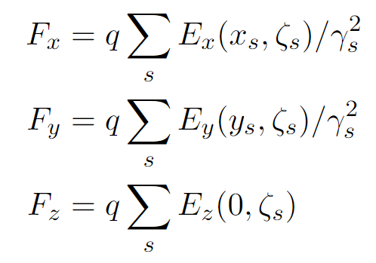
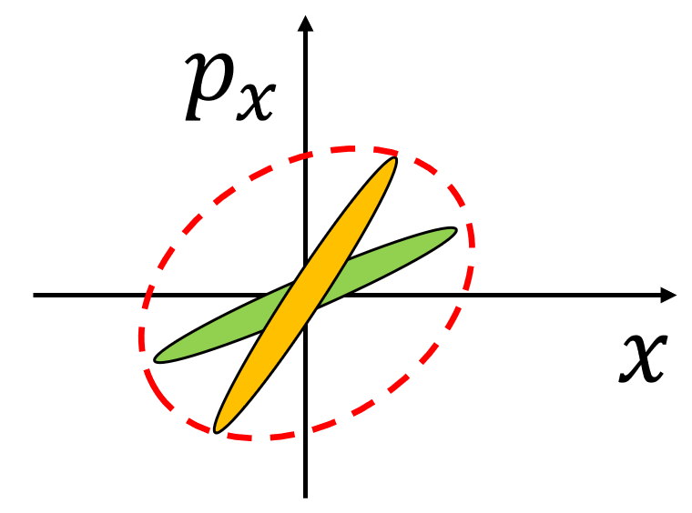
Modeling Space Charge Forces
Equivalent ellipsoid method
Multi-slice superposition method
Ellipsoidal beams arise from the blowout process
An equivalent uniform ellipsoid is associated to the actual beam distribution
Self-induced forces are known analytically
Forces are linear: self consistent model
Divide the beam in cylindrical slices with individual size, energy and aspect ratio
Field produced by each (uniform) slice is known analytically ($∂/∂θ=0$, $∂E_{z}/∂r=0$)
Force on each particle: superposition of the fields produced by all the slices (generalization of “HOMDYN”)
Field form factors
Advantages
Very fast ($∼30$ times than 3D PIC )
Successfully reproduces rms size ($σ_{x},σ_{y},σ_{z}$) and energy spread ($σ_{E}$)
Limitations
Absence of correlation prevents the observation of emittance dynamics
Loss of axial symmetry in presence of strong transverse wakefield
Advantages/Limitations
Correlation between the planes describes the emittance dynamics
Allows description of more arbitrary geometries
More time-consuming but still faster than PIC
Notes:
Let me review briefly two semi-analytical methods we proposed for space charge effects
The first one associates the actual beam distribution to an equivalent uniform ellipsoid which produces well-known self induced forces
In addition, this approach is attractive because ellipsoidal beams appear frequently in modern beamlines as they are naturally produced by the so-called blowout process
The second method can be considered a generalization of the code HOMDYN and divides the beam in cylindrical slices with individual size and energy which produce a field in this form in the surrounding space
The force acting on each particle is then given by the superposition of the EM field produced by all the slices
The ellipsoid method is very fast and in many practical cases reproduces the rms beam dimension and energy spread correctly
However, since the forces are not slice-dependent, the model forbids to observe well-known emittance dynamics that are induced by the independent evolution of the beam slices
In addition, in presence of wakefields, the deflection introduced by the transverse wake will displace the centroid of each slice breaking the symmetry that is implied in the ellipsoidal model meaning that the model is not valid in strong-BBU regime unless correction schemes for the trajectories are introduced
The multi-slice approach overcomes both these limitations: it exhibits a correlation between the planes and allows description of more arbitrary shapes. The drawback is that this method become more time consuming but remains faster than a PIC
---
For what concerns SC forces, the strength of such effects depends on the shape and the size of the distribution, and therefore their description utilizes PIC methods
Here I am showing two alternative semi-analytical methods:

Slide 18
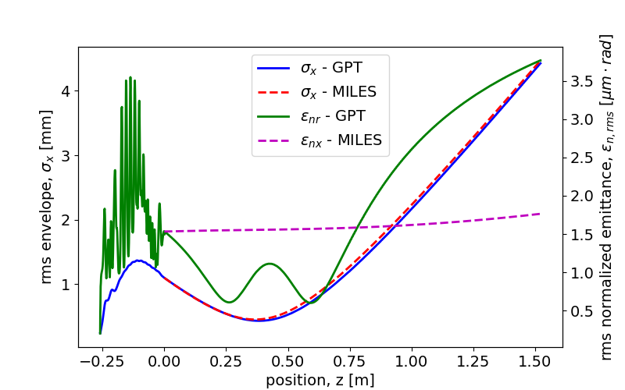
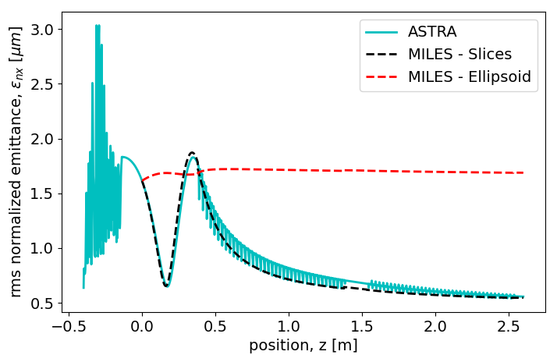
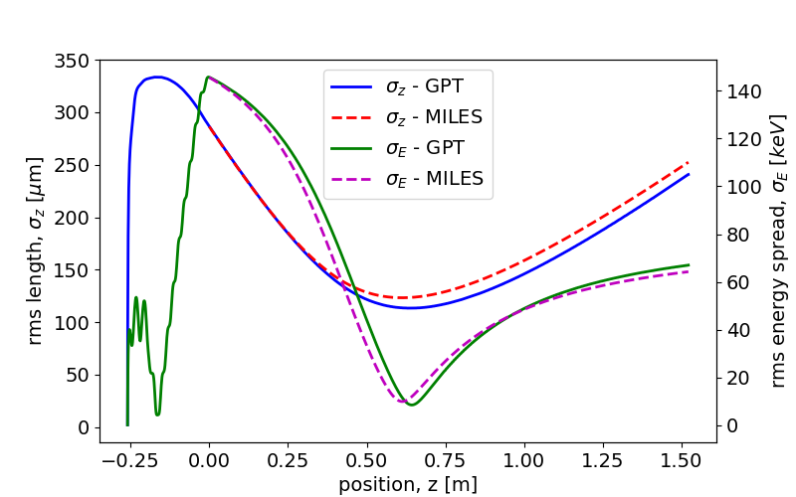
Modeling Space Charge Forces (2)
Equivalent ellipsoid method
Multi-slice superposition method
$250 pC$ $e^{−}$ beam from the C-band hybrid gun
Evolution in a field-free (drift) region with GPT (solid lines) and with the ellipsoidal model in MILES (dashed lines)
$250 pC$ $e^{−}$ beam produced by the hybrid gun and matched to its invariant envelope in a booster linac
Emittance dynamics: oscillations in the drift and compensation in the linac
Transverse plane: $σ_{x}$, $ε_{nx }$
Injection in the booster
Longitudinal plane: $σ_{z}$, $σ_{E}$
DARPA parameters
DARPA parameters
Relative error within 3% with $∼$1/6 execution time
Relative error within 4% (except emittance) with $∼$1/40 execution time
M. Ferrario et al., Direct measurement of the double emittance minimum in the beam dynamics of the Sparc high-brightness photoinjector, Phys. Rev. Lett. 99, 234801 (2007).
Notes:
Here we can see some examples where our approach is compared to codes like GPT and ASTRA, both using PIC
In both cases we consider the beam produced by the hybrid photoinjector that, on the left, propagates in a long drift space and on the right is injected in a booster linac receiving emittance compensation
On the LHS MILES is using the Ellipsoidal model which, as anticipated, describes the transverse and the longitudinal dimensions as well as the energy spread correctly but it fails to reproduce the emittance oscillation
On the RHS the ellipsoidal model still fails in describing the evolution of the rms emittance however the multi-slice approach reproduces successfully both the oscillation in the drift and the compensation process

Slide 19
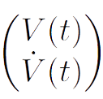
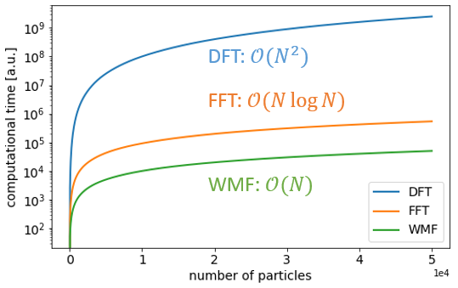
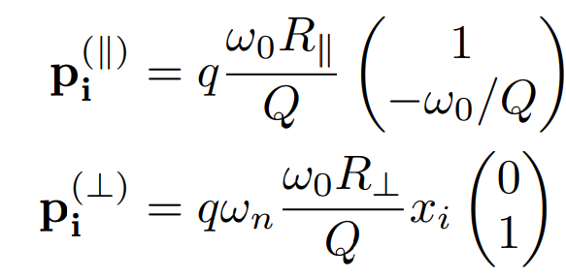
Modeling Wakefield Effects
Interaction of a particle with a cavity resonant mode
The change in momentum (energy/deflection) is described by the equivalent shunt circuit voltage
Evolution of the voltage state
Recursive formula
State after the $n$ charges have passed
$N$ particles $⇒$ $N−1$ operations
Perturbation:
Kick induced by the passing charges
Free-evolution:
Homogenous 2nd order differential equation
Notes:
Here I want to introduce the algebraic formalism that we developed in order to describe the effects of both longitudinal and transverse wakefields
The fundamental idea upon which the formalism relies is the interaction of a charged particle with a resonant cavity mode
Such modes can be used to represent the actual higher order modes excited in the accelerating structures as well as arbitrary wakefunctions
It can be shown that the energy variation as well as the deflection of a particle interacting with a resonant mode can be described in terms of the voltage across the equivalent RLC circuit representing the mode. Therefore, all is needed is to keep track of the evolution of the voltage continuously excited by the passing charges
The evolution of the voltage state, consisting of the voltage and its derivative, is described by this operator where the matrix M accounts for the free-evolution according to the usual homogeneous differential equation whereas the perturbation vector p modifies the state after the passage of a new charge
The voltage state after the transit of n charges is obtained by the composition of operators of such kind and provides a recursive formula which significantly reduces the number of operations with respect to the convolution integral approach

Slide 20
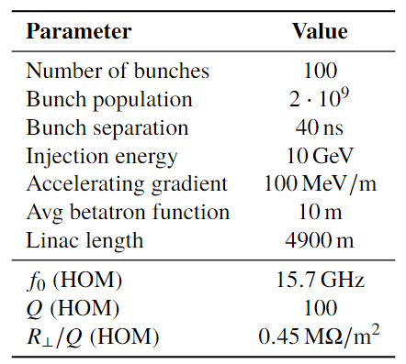
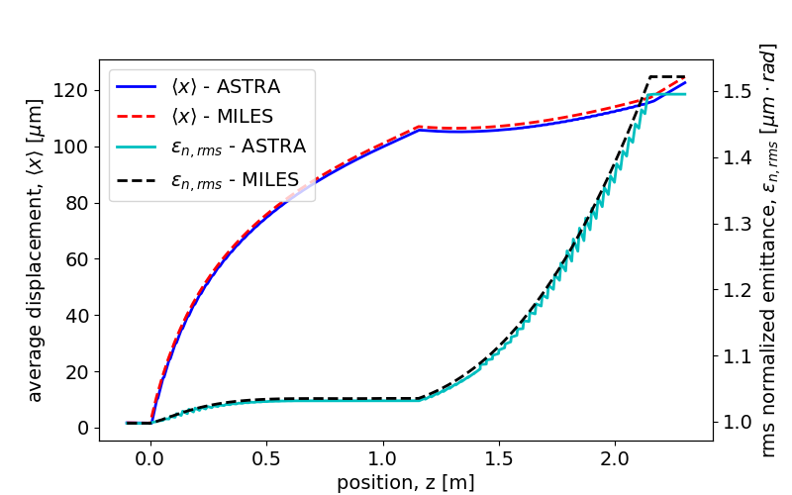
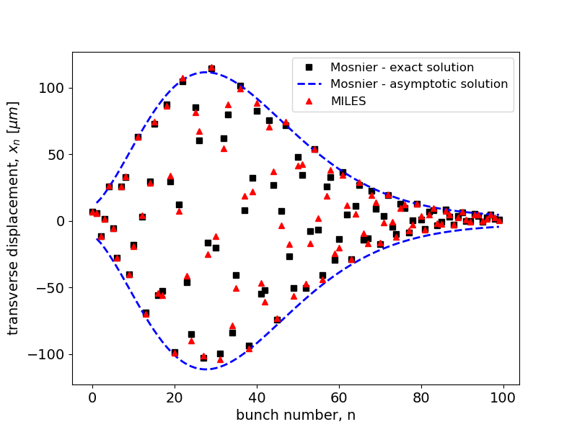
Modeling Wakefield Effects (2)
Short-range WF interaction
Long-range WF interaction
5 MeV rectangular beam propagating in two linac sections with $Δx_{1}=100 μm$ and $Δx_{2}=0$
Wakes from diffraction theory in periodic linacs
100 bunches injected off-axis in a linear collider
Wakes from a single HOM
DARPA-like parameters
Misaligned linac section: the beam propagates off axis exciting dipole wakes which cause emittance growth
Transverse bunch oscillations induced by a dipole HOM responsible for LRWF interaction
Notes:
Finally we can show some validation tests where this formalism is employed and compared with pre-existent codes or analytical models.
In the first example a monochromatic beam is affected by the longitudinal wakefields within a linac section which introduce a spread in energy
In the second example a misaligned linac section causes the beam centroid to travel off-axis where dipole wakefields are excited causing a growth of the rms emittance
In the last example a train of charged bunches is injected off axis in a linac exciting a dipole mode which induces transverse oscillations of the bunches
In all cases our model reproduces the expected behavior

Slide 21
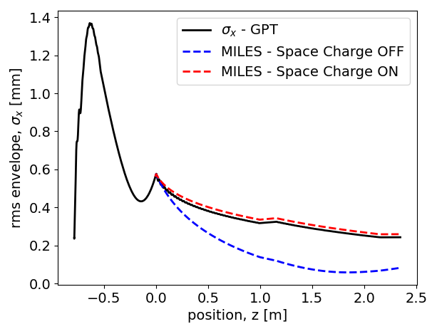
Motivation: Unique Beam Physics
Enhanced radial focusing in rf linacs
Strong wakefield interaction
Space-charge sensitivity
High accelerating gradient: $∼$50 MeV/m (room temp) and $∼$125 MeV/m (cryo-cooled)
1st - order focusing: transitions from field-free to non-zero field regions (a)
2nd - order focusing: non-synchronous space harmonics in the accelerating cells (b)
Small irises cause stronger wakefield interaction: C-band structures with $∼2mm$ iris radius ($∼0.038⋅λ_{rf}$)
Field diffracted in periodic accelerating structures (K. Bane’s theory) (c)
HOMs parasitically excited in the linac (d)
Beams produced by rf photoinjectors are in the 3-5 MeV energy range
Highly space charge-dominated nearby the injection in linac boosters
Nominal focusing anomalously strong in absence of SC forces (overfocusing)
(a)
SRWF
(c)
(b)
Injection in the booster
Note: $ν=η/8\cos\left(Δφ\right)$ with $η=1.12−0.5\cos\left(2Δφ\right)$
(d)
LRWF
Notes:
The motivation for such studies arises from the combination of photoinjectors and linac boosters with the properties described earlier which defines a unique and challenging scenario from the beam physics perspective
The optimized cell geometry of distributed coupling linacs enhances the accelerating gradient which is responsible for inherent radial focusing mechanisms introduced by the linac itself
Conversely, the small irises increase the impedance of the structures causing strong wakefields acting both within the same bunch or among different bunches
In addition to that, nearby the injection region our beams are highly space charge dominated so we need to take such effects into account. Such forces act against the external focusing which, as shown by this simple example with photoinjector + booster, results anomalously strong in absence of SC causing overfocusing and loss of laminarity
------
I want to focus on the challenging beam physics characteristics of the machines we aim to describe

Slide 22
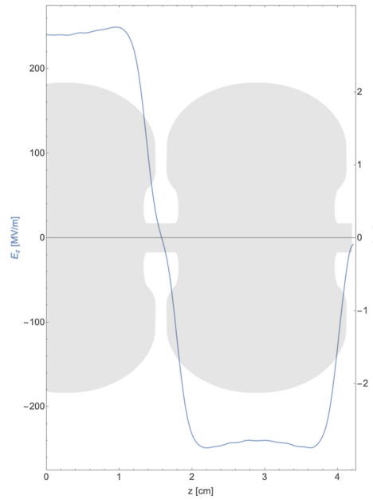
The Initiatives of the Collaboration (2)
Innovative RF-concepts for high gradient acceleration:
(a)
(b)
Distributed coupling scheme: cells receive the RF power individually from a guiding manifold structure (a)
Optimized cavity topology (b) enhances the efficiency in acceleration of charged particles (cell irises not subjected to coupling constraints)
Cryogenic operation: copper structures in the 45-77 K range support higher electromagnetic fields for a given breakdown rate (c)
Combination of such techniques enables also next-generation, very high field RF photoinjectors (d)
(c)
(d)
Notes:
Before moving on, I want to show some of the unique concepts for the high gradient acceleration that characterize the activities of the collaboration
This structure is a distributed coupling linac which uses a manifold waveguide to individually distribute the rf power in each cell of the periodic accelerating structure
As a consequence, the irises dimensions are no longer constrained to coupling requirements meaning that the entire unit-cell cavity shape can be optimized to improve the acceleration process
In addition, it has been observed that operation of copper cavities at cryogenic temperatures, below 77 K, mitigates the breakdown limit meaning that for a given BDR probability it is possible to operate at higher gradients
Also, the combination of optimized cavity design at cryogenic temperatures, enables ultra high field photoinjectors which improves the beam brightness at the source
------
Here I am showing some of the unique concepts for the high gradient acceleration that characterize the activities of the collaboration

Slide 23
The Initiatives of the Collaboration (3)
UC-XFEL
New paradigm for university-scale facilities ($∼40 m$ footprint, $<40M\$$ costs)
Next generation rf gun: high peak field (240 MV/m at C-band*)
Distributed coupling, cryogenic rf linac structures (up to $125 MV/m$, C-band)
Short-period ($∼mm$) cryogenic undulators
DARPA-GRIT ICS Source
Compact $γ$-rays source: high flux, tunable, narrow bandwidth
Novel electron source: C-band hybrid photo-injector
Room temperature, distributed coupling rf linac structures (C-band)
$C^{3}$: a ‘‘Cool Copper Collider’’
250 GeV (extendible to TeV-scale) Higgs factory: high luminosity $e^{−}e^{+}$ linear collider
Modularized C-band cryo-cooled, distributed coupling linac structures ($∼125 MV/m$)
Near future ($∼$2030-2040) HEP frontiers
(*C-band = $5.712 GHz$)
Notes:
All such concepts are widely present in the main projects proposed by the collaboration and summarized here
The UC-XFEL is an ambitious design for the realization of university-scale facilities: despite the reduced footprint and cost, the expected photon flux per pulse is equal to several percent of the existing full-scale XFELs
The DARPA-GRIT machine is an ICS gamma ray source for which the driving electron beam is produced by a novel hybrid photoinjector. I will talk about this device later
The cool copper collider is a proposal for a high luminosity Higgs factory that is conceived as a modular facility made by the repetition of this 9 m long cryomodule unit. It represents a promising candidate for the near term future of HEP

Slide 24
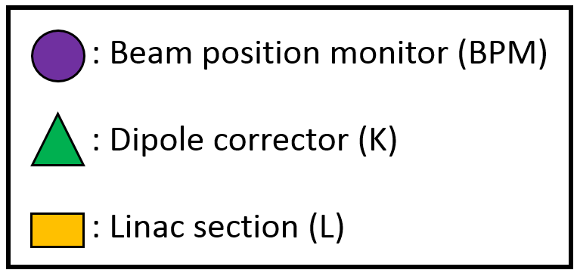
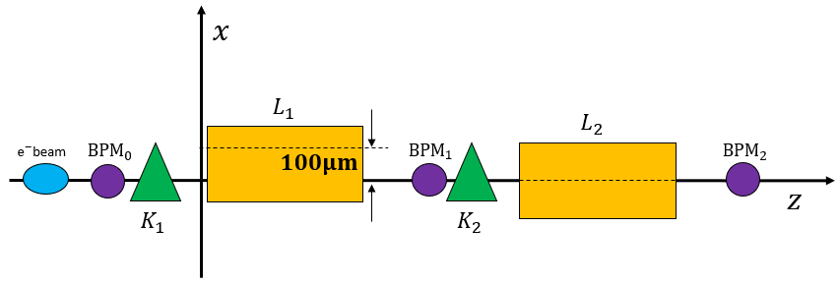
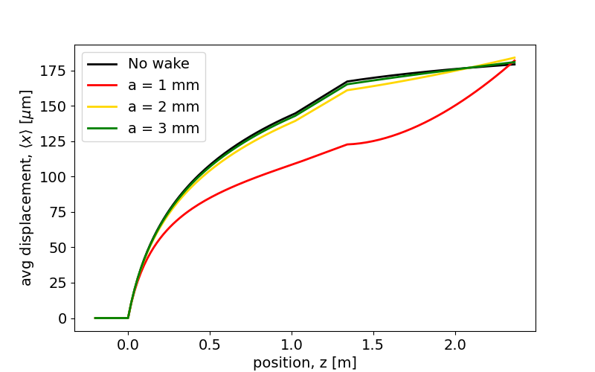
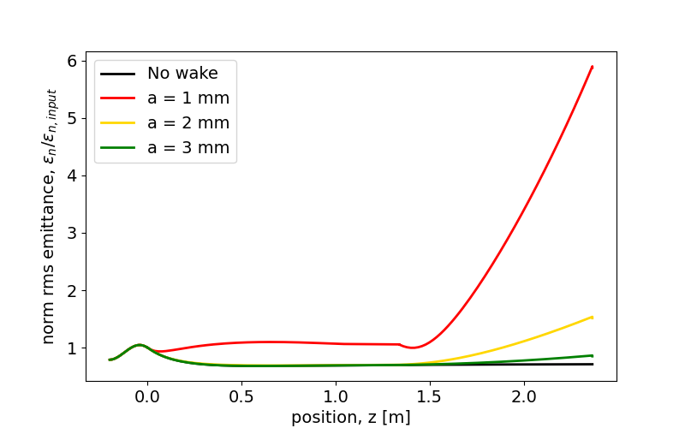
SRWF in the $3π/4$ Structures (2)
Reference case
UC-XFEL scenario (100 pC, 0.5 mm rms beam, ~100 nm emittance at injection)
2 linac sections: $6.9 MeV<γmc^{2}<150 MeV$ with the 1st section is 100 um off-axis
Reference case from the UC-XFEL
Two section linac ($∼2 m$)
Section 1 is 100 $μm$ off-axis
Centroid trajectory
Emittance growth
UCXFEL-like parameters

Slide 25
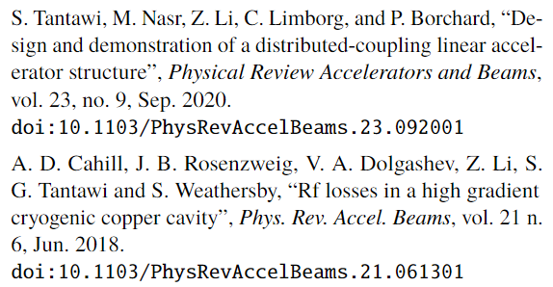
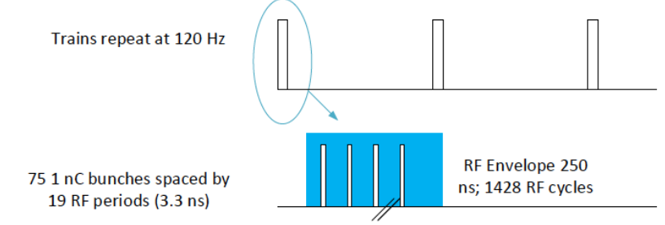
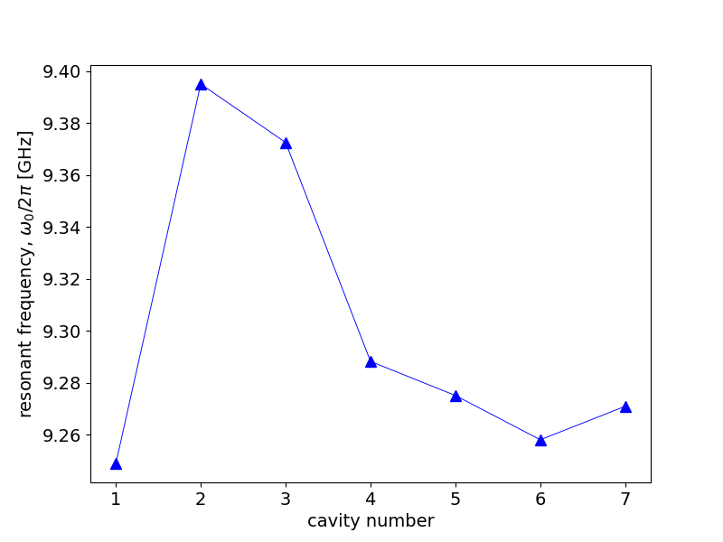
The “Cool Copper Collider” or $C^{3}$ in Numbers
Working point
A total charge of 75 nC is delivered within a 250 ns long macro-pulse (1428 rf-bucket in C-band, i.e. 5.712 GHz)
75 electron bunches (1 nC each) with a separation of 19 rf periods (3.3 ns)
The electrons are injected at 10 GeV and accelerated up 1 TeV with an average gradient of 117 MeV/m -exploiting distributed coupling and cryo-cooling - (i.e., overall length $≳$12 km)
Alternate gradient FODO lattice with $⟨β_{x}⟩=4$ m provides focusing in the transverse plane
$TM_{110}$-like Mode
Higher order modes
CST Studio Suite: 20 HOMs (excluding degeneracy) in the range 5<$f$<20 GHz
9 of them are dipole modes responsible for BBU effects
Mitigation through frequency spread for each dipole mode (unstable motion if the ratio $f_{HOM}/f_{b}$ is close to an integer)
Courtesy of D. Kim
Notes:
Recap of the main machine parameters from the reference paper
LRWF exist in the form of HOMs: EM study of the unit-cell -> 9 main dipole modes excited by bunch traveling off-axis and causing the parasitic interaction
Variations of the original geometry introduce detuning of the res freq of the HOM (example TM110-like): frequ-spread technique
Unstable motion if the ratio fHOM/fb is close to an integer

Slide 26
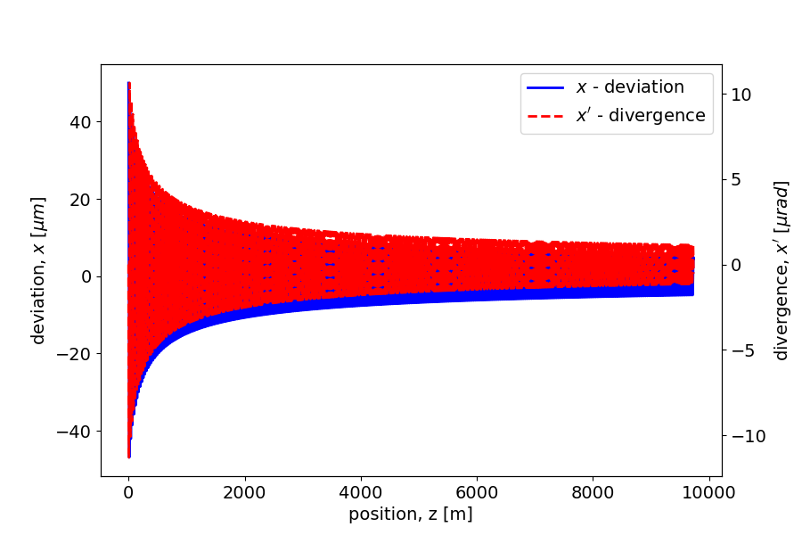
Multi-bunch beam dynamics
Basic modeling
Bunches within the rf-pulse: sequence of rigid macro-particles with no internal structure
Bunches perform transverse oscillations in presence of an external focusing optics (alternating gradient FODO lattice with average beta function $β_{x}$)
Bunches are accelerated as they propagate within the linac (average accelerating gradient $γ^{′}$)
If $γ^{′}L_{c}/γ≪1$
Adiabatic damping of the transverse oscillations in absence of collective effects
Notes:
Mention the basic concepts behind our model
The dynamics in absence of collective effects is very simple: since, in general, we are interested in the transverse oscillation of the center of mass of the bunches induced by the mutual interaction, it is sufficient to describe the bunch train as a sequence of rigid MP neglecting their internal structure
The combination of acceleration and external focusing results in the classic adiabatic damping of the oscillations as the bunches propagate inside the machine

Slide 27
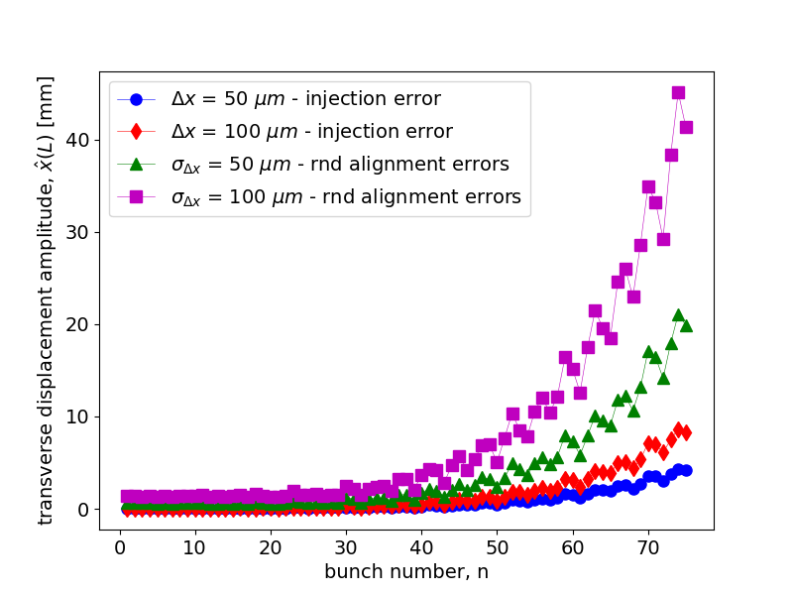
Injection and Alignment Errors
Injection error:
Linac sections are perfectly aligned
Injection of all bunches occurs with a transverse shift $Δx$
Random alignment errors:
Injection occurs on-axis
Linac sections are shifted transversely with gaussian offsets with std dev $σ_{Δx}$
NO DETUNING
All cavities are equal
Each mode exhibits the same frequency in all cavities
Amplitude of the transverse oscillation for each bunch in the rf-pulse at the interaction point
Notes:
In the next two slides I will show some examples concerning the C3 linac
Injection and Alignment errors in absence of mitigation techniques
Amplitude of the transverse oscillation for each of the 75 bunches at the end of the linac: notice the scale in mm (interaction takes place in a very long machine)
Larger oscillations in case of alignment errors: dipole modes are continuously excited regardless of the adiabatic damping

Slide 28
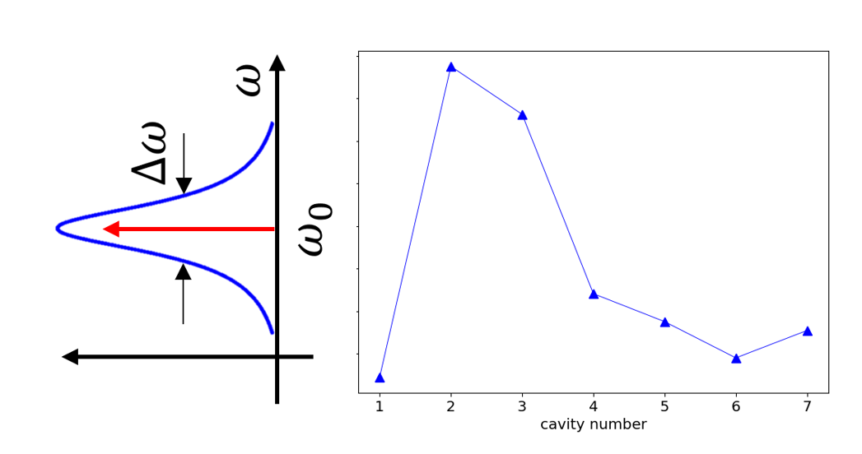
Frequency Spread of the HOMs
Worst case scenario from previous plot:
Random misalignments with $σ_{Δx}=100 μm$
WITH DETUNING
Variations are applied section-by-section
Each HOM exhibits a different (random) frequency through the subsequent linac sections
The range of variations for the resonant frequencies is established by CST data
(section-by-section)
(cell-by-cell)
Amplitude of the transverse oscillation for each bunch in the rf-pulse at the interaction point normalized to the first bunch’s amplitude
Notes:
Now we focus on the worst case from the previous simulation, random errors with std 100, but we introduce a frequency spread
The variations of the geometry that change the resonant frequencies are applied section by section rather than cell by cell

Slide 29
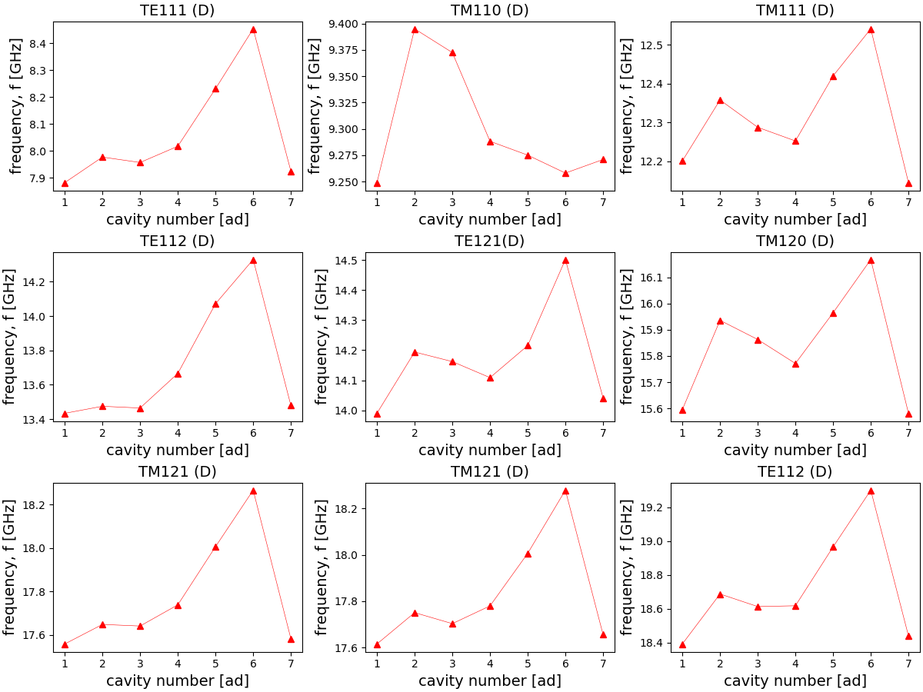
SLAC 7 Cavities
Courtesy of D. Kim
y axis (cm)
z axis (cm)
List of 20 HOMs
9 of which are dipole modes -> BBU effects
(Realistic) frequency spread for each dipole mode

Slide 30
Ongoing Work on Long-range BBU
International Workshop on Future Linear Collider – May 15-19 2023
To do list
Electromagnetic simulations
CAD drawing of the $3π/4$ phase advance cell (input received from S. Tantawi et al.)
Eigenmode analysis of the structure finding frequencies, quality factors and shunt impedances for monopole and dipole
BBU studies with the $3π/4$ structure
Multi-bunch simulations with MILES to estimate the center-of-mass oscillations
Investigate multi-bunch with intra-beam effects (SC + SRWF): simultaneous description of short-range and long range wakefields
Thank you for your attention
(Questions are welcome)
fbosco@physics.ucla.edu

Slide 31
135 degree phase advanced distributed coupling structure
Courtesy of S. Tantawi et. al
If one includes the period as an optimization parameter then the optimal structure with the minimal surface magnetic field, and consequently the highest shunt impedance occurs at ~$132°$ phase advance; a natural choice is$a 135°$ (i.e. $3π/4$) phase advance.
Every 4th cavity has a $π$phase shift (modulo $2π$), hence 4 manifolds are needed to feed the structure.
Every two manifolds need to be fed with a $π/2$ phase shift; naturally fed by a hybrid that isolates the forward signal from the reflected signal.
$$π$$
Cell-to-cell phase advance:
$$φ=\frac{ω}{c}p$$
$$π/2$$
$$π/2$$
Shumail, Li, Tantawi
S. Tantawi, Z. Li, M. Shumail, C. Nantista, M. Oriunno, G. Bowden, B. Loo, E. Snively, “Cryogenically Cooled 135 Degree Distributed-Coupling Linear Accelerator and Its Application to Very High Electron Energy Radiation Therapy,” to be published.

