Slide 1
A Nanosecond Pulse Technology for Injection/Extraction Systems
Anatoly Krasnykh
TID/RFARED
LCLW2023, SLAC, May 2023

Slide 2
Outline
ILC DR Baseline and Result of the ATF Injection/Extraction Experiments
R&D of fast solid-state pulse technology at SLAC
TEM kickers on the LCLS-I beamline
Ultra-fast kickers for two color experiments at LCLS-II
A 256 kHz CW nanosecond pulser
SLAC advantage TEM kicker Structure
Conclusion

Slide 3
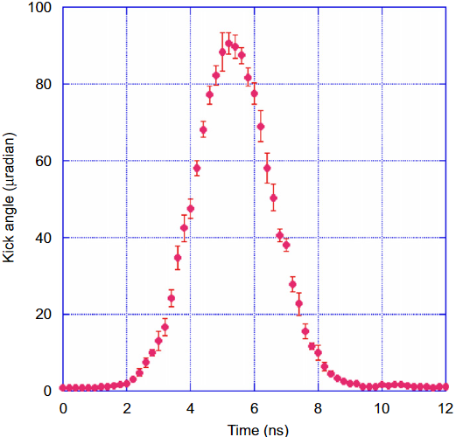
“The realistically achievable kicker pulse rise-fall times is an important problem for many accelerator projects where the fast manipulation of the individual bunch orbit is desired. “
ILC DR baseline
ATF, in 2007, 2010, and 2011
DR Energy | GeV | 5
DR RF period | ns | 1.538 | 650 MHz
Bunch Length | mm | 6
Bunch separation *) | ns | 3-9
Rise/Fall | ns | ~2
Length | mm | 300 | 2 ns
Aperture | mm | 30
Number bunches |  | 1320/2625
Rep Rate | MHz | 2-6 | Burst
Nk/Np | ea. | 42/84
Required Kick | mrad | 0.6
The FID pulser with +_5 kVp,
Rise/Fall ~ 3.2/4.0 ns
Rep Rate 3.3 MHz
Burst Mode ~ 30 pulses, 0.5 Hz
Technology
Components
Availability
Notes:
Only FID (German, LLC) technology can deliver the pulsers with the spec that is close to the ILC DR pulser spec.
What is the FID technology? What kind components are used? Are they available from national industry?

Slide 4
R&D at SLAC
https://indico.psi.ch/event/6972/contributions/16597/
https://indico.cern.ch/e/pulpoks23
The pulse power rate on all ON high power switches commercially available off-the-shelf switches (thyratrons, MOSFETs) is reduced with the rise of a switching power.
Limitations are < 1 MW /ns because the switching processes from the OFF to ON stage take rather long time to form the carriers in the large anode-cathode volume.
A few examples are shown on the next sides.
Notes:
This Workshop is continuing the series devoted to the study of accelerator issues relating to the high-energy linear electron-positron colliders.
DR is one key element of any e-e+ collider.
The emittances of the injected and extracted beams, the structure of the bunch train, and the repetition rate are critical parameters of the damping ring, which indirectly determine the luminosity of future colliders.
The presentation will discuss the advanced technology that is used in the control of the bunch orbit.

Slide 5
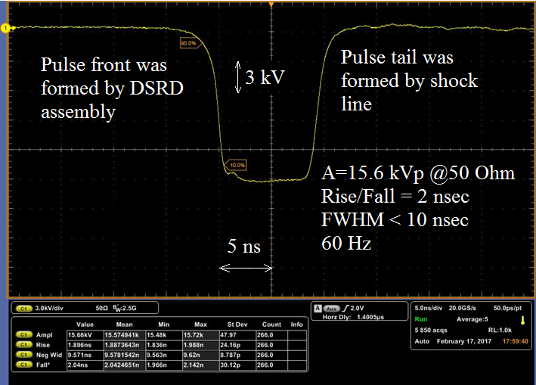
A Nanosecond Pulser for Injection/Extraction Kicker with a 3 MeV Transverse Kick
These pulse parameters meet spec for the typical injection/extraction kickers.
Kicker aperture: 30 mm
Length: 1200 mm
Kicker filling time: 4 ns
Transvers kick: 2.6 MeV
$$Power_Rate≅\left(5÷10\right)\frac{MW}{ns}$$
DSRD and Shock Line technologies are employed to form the waveform.
Notes:
Here is the waveform demonstrate a 10 ns pulse where the special components are employed.

Slide 6
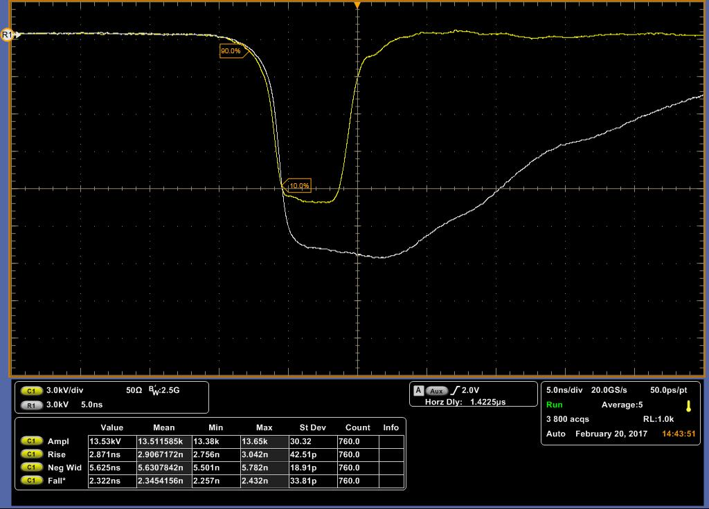
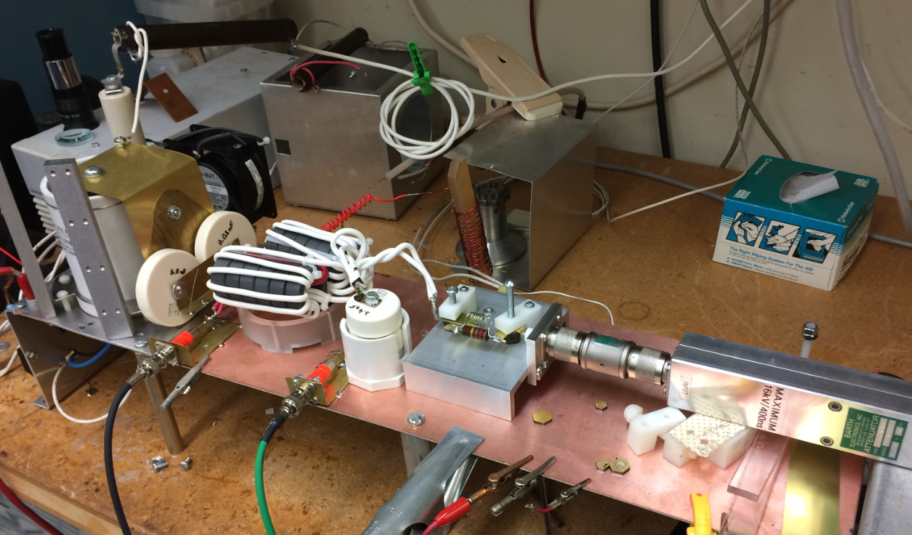
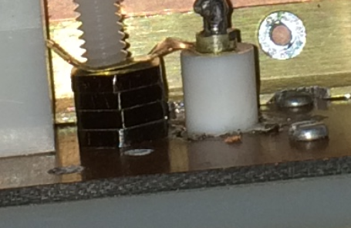
Pulser Prototype Details
No NLTL case:
A=24.7 kV (I=494A)
NLTL cores: OD=0.16”, ID=0.088”
With NLTL:
H_{FWD}~124 A/cm, H_{sw}~55 A/cm
H_{RE} ~240 A/cm
S_{sw}~0.66 uC/cm
t_{sw}= S_{sw}/ H_{RE} ~2.7 nsec
HY3189, C1=16 nF, C2=1.7 nF
x-fmr: w1=2, w2=7, 6 ea. NiZn, OD=1.4”
There are several practical physical effects that can overcome the power rate limitation for commercially available off-the-shelf switches. For example, electromagnetic effects in
nonlinear ferromagnetic media
semiconductor media
can overcome the power rate limitation.
DSRD
In both cases, the nonlinear characteristic of a switching media (ferromagnetic and solid-state plasma in semiconductors) are employed in the final stage to create multi- MW level nanosecond pulses.
Notes:
Another words: several physical effects can assist the primarily switch to overcome the switching power rate.

Slide 7
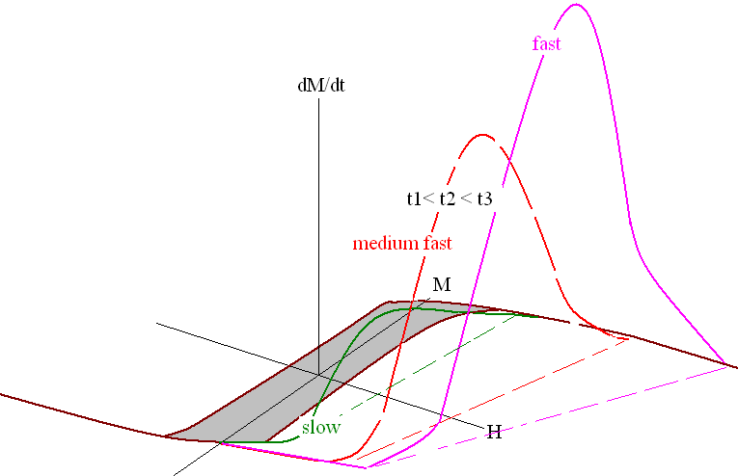
An Assistance of the Main Turn ON Switch
Dynamics of magnetization in strong magnetic fields
Space charge effects, carrier lifetimes, mobilities in the semiconductors
$$\frac{d\vec{M}}{dt}=γ\left[\vec{M} \vec{H}\right]−α\left[\frac{d\vec{M}}{dt} \vec{H}\right]$$
$$\frac{dM}{dt}=λH\left\{1−\frac{M^{2}}{M_{s}^{2}}\right\}$$
$$t_{r}∝\frac{S_{sw}}{H_{sw}}$$
Issues:
Optimization of doping levels, gradients of concentration, semiconductor materials, technology of fabrication, pumping modes, etc.
S_{sw} ? λ ?, BD? BDM?…
Materials and technology fabrication relates the switching rates, efficiency, etc.
A proper engineering design of the injection/extraction system requires the knowledge of these parameters.
Notes:
A base of the switching technology is shown.

Slide 8
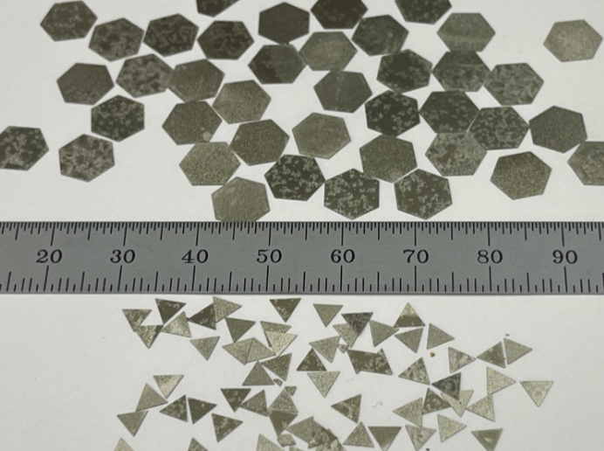
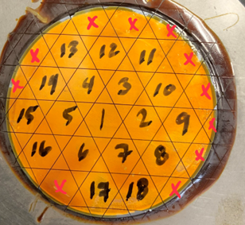
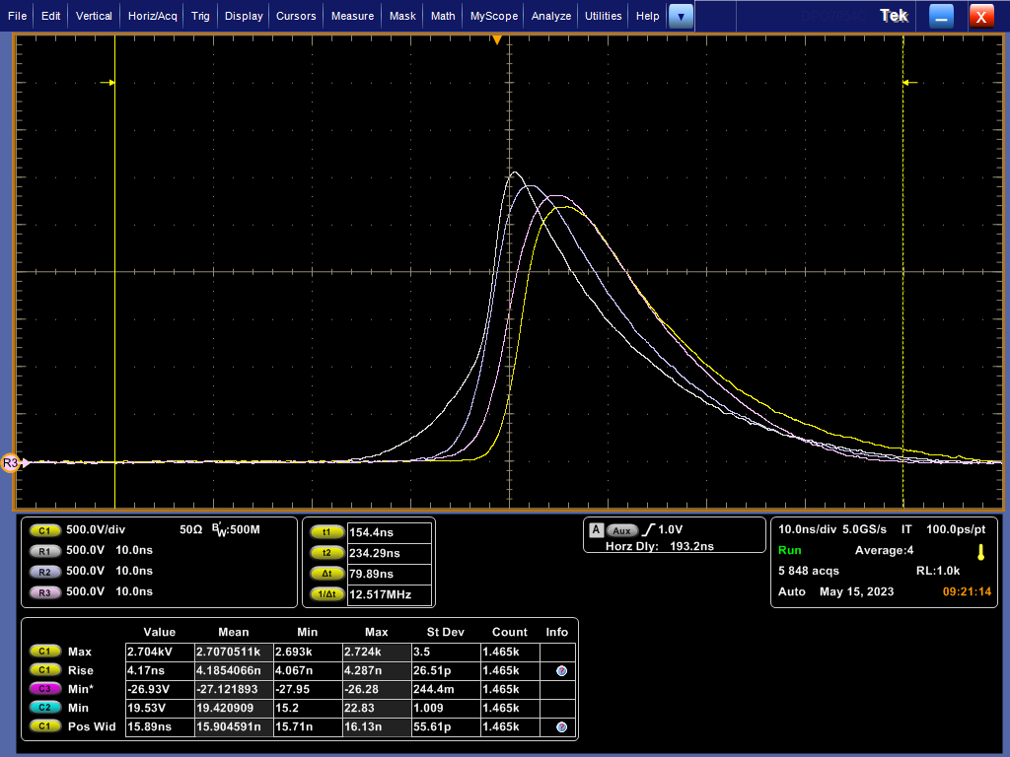
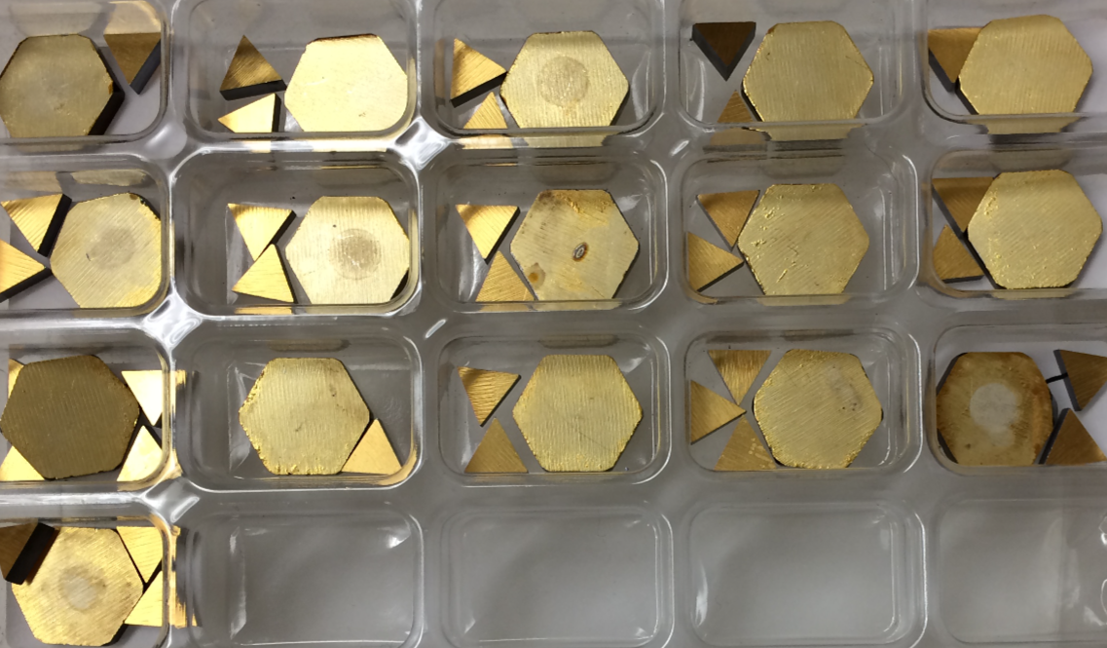
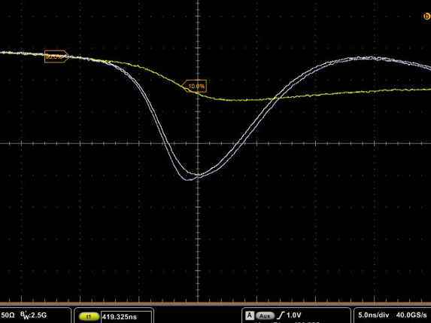
A DSRD Fabrication Process with Our Industrial Partner
3” Si Wafers
Deep diffusion of dopants
Metallization
Brazing of stacked assembly
However, there are chips which work in DSRD, SOS, and other modes.
A selection of chips before their stack in series would be one important technological step in future.
Notes:
However even this no optimal technology could be useful for a rise of the switching rate.

Slide 9
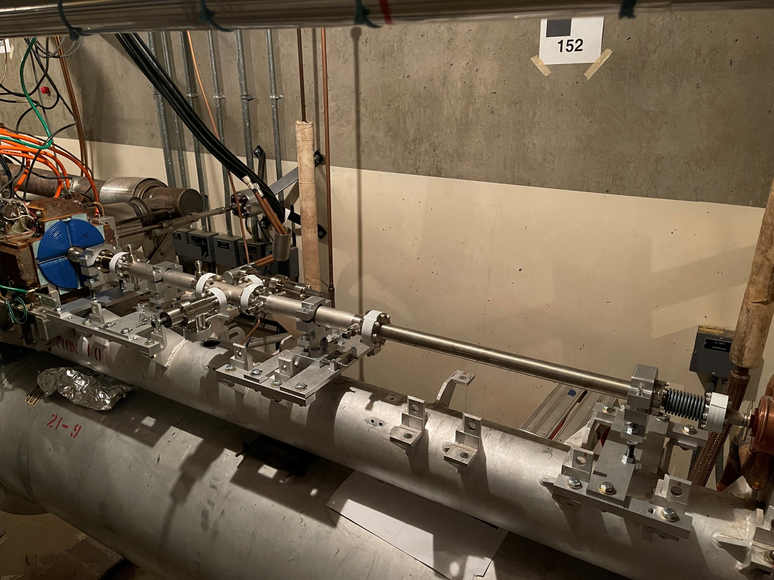
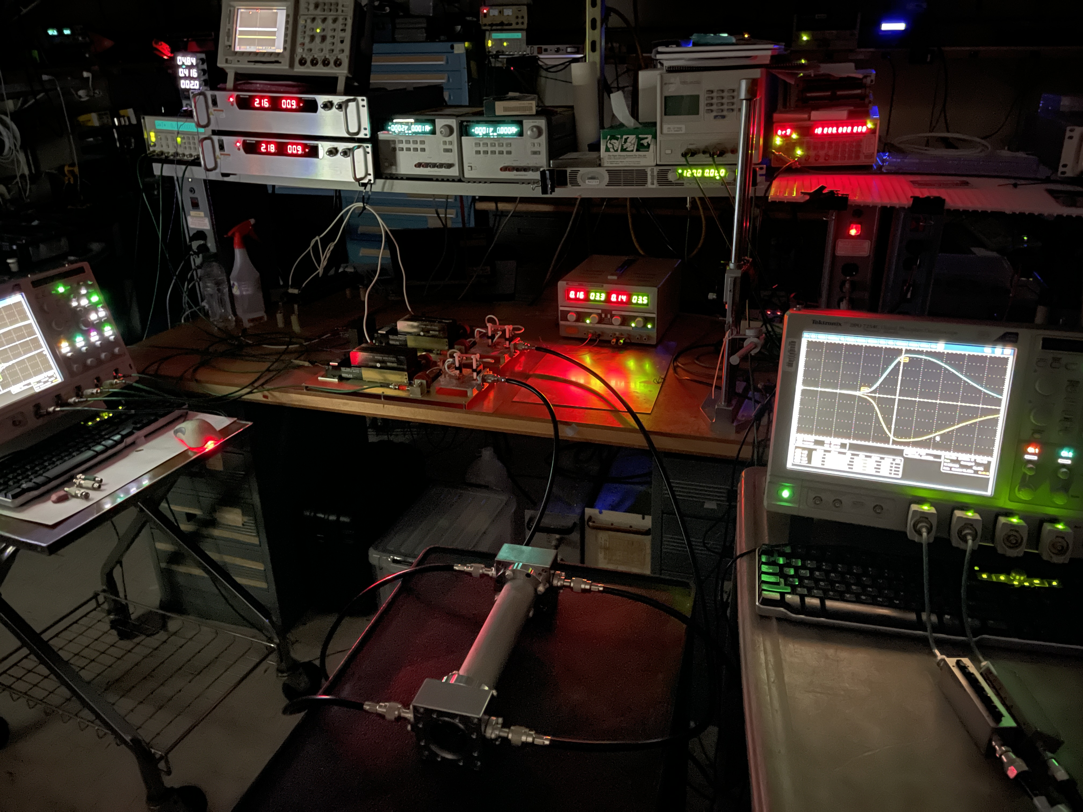
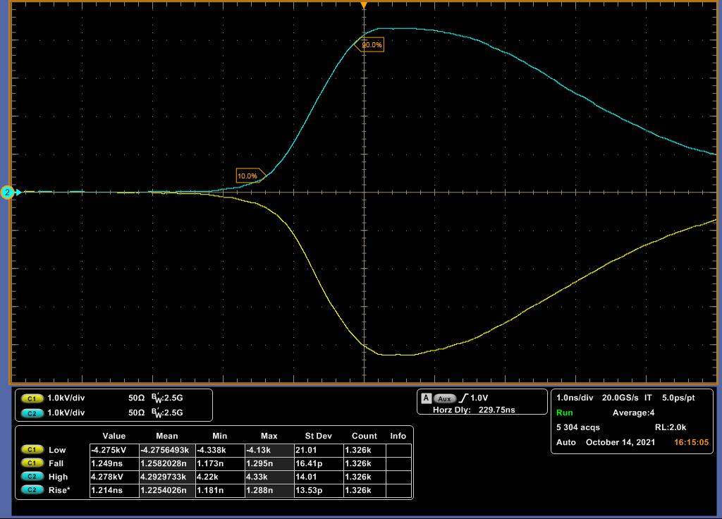
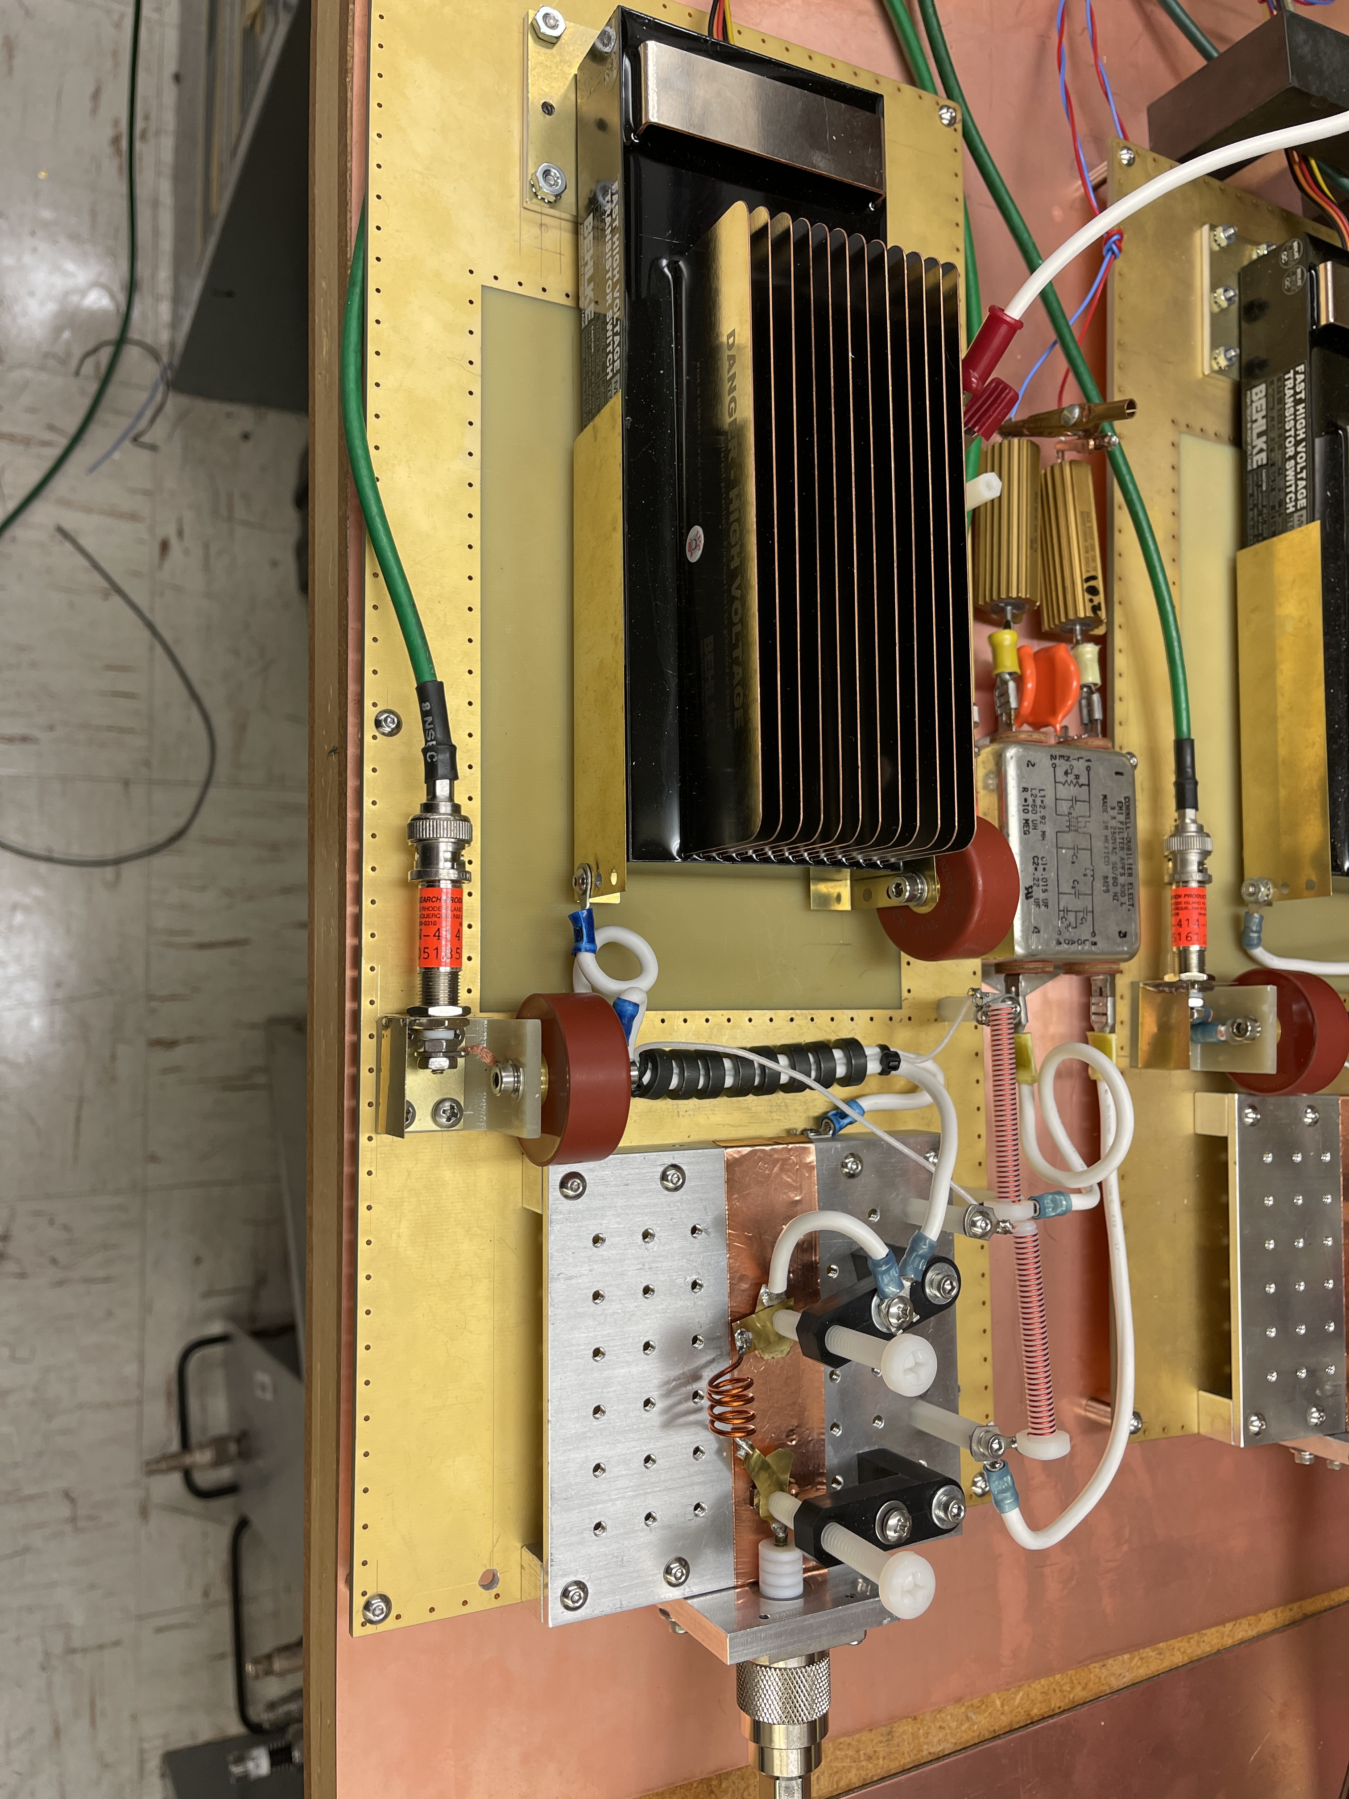
Example: A control of the individual bunch orbit on the LCLS-I multi-bunch mode operation
Bellows
V-kicker
4-way cross with components
H-kicker
Drift
Bellows
2 ns
Kicker aperture: 20 mm
Length: 300 mm
Kicker filling time: 1 ns
Transvers kick: 307 keV
Notes:
Here is the example where the solid-state technology creates a 0.4 MW per nanosecond power rate continuously with 120 Hz repetition rate. The initial commercial switch with assistance of the semiconductor OFF switch forms a 0.5 MW power swing during nanosecond.
Output pulser amplitude is 4.3 kV peak at 50 Ohm. Rep rate: 120 Hz.

Slide 10
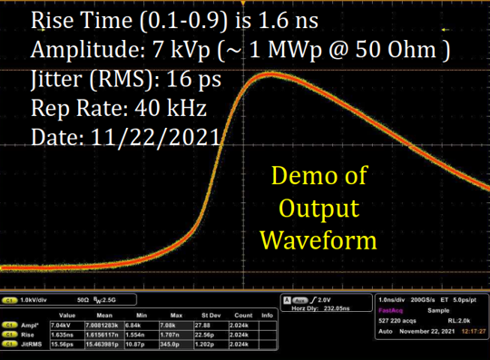
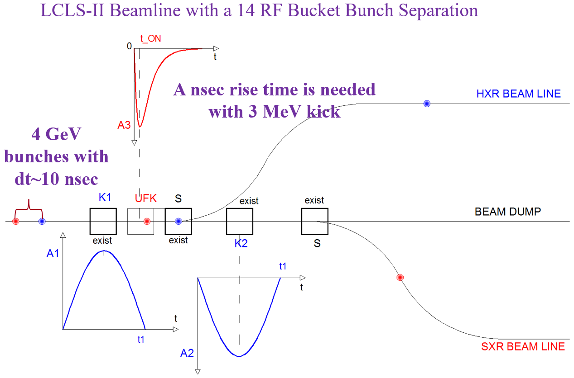
An Ultra-fast Kicker Farm at an 8 GeV LCLS-II Beam Switch Yard
$$W_{tr}^{require}=8∙{10}^{9}∙0.31∙{10}^{−3}≅2.48 MeV$$
$$W_{tr}^{require}=8∙{10}^{9}∙0.434∙{10}^{−3}≅3.47 MeV$$
$$W_{tr}^{demo}=7∙{10}^{3}∙4.8∙30∙4≅4 MeV$$
$$W_{tr}^{demo}=7∙{10}^{3}∙<2.9>∙30∙7≅4.26 MeV$$
The ultra-fast kicker system can deliver the required transverse kick for an 8 GeV beam at a 40 kHz repetition rate.
Notes:
An array of 11 ea. kickers with 22 pulsers is going to be use for two-color experiments.

Slide 11
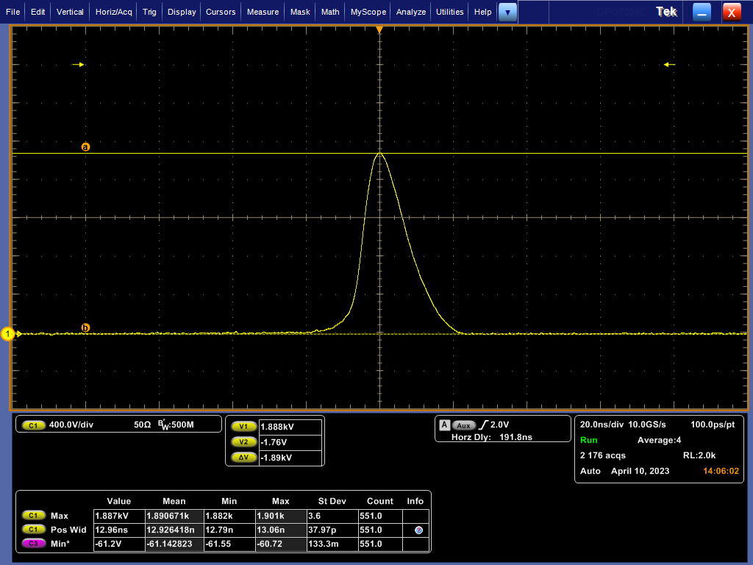
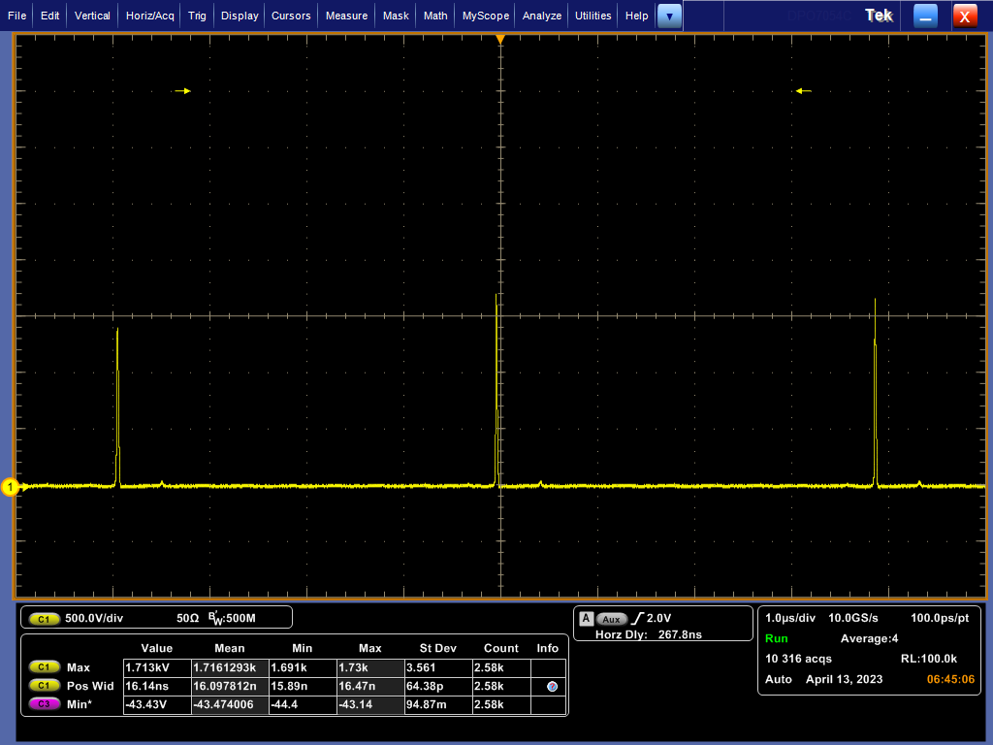
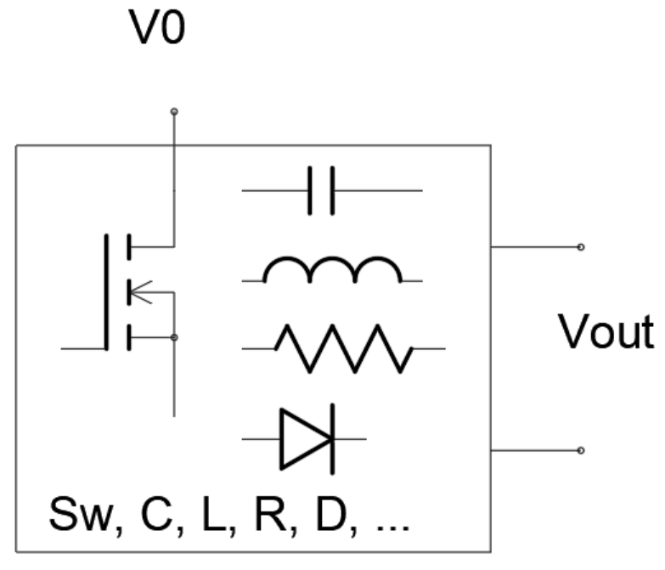
A 256 kHz Pulser for the Camshaft Bunch in Storage Ring
Amplitude: 1.8 kV @50 Ohm
FWHM: ~ 15 ns
Rep. Rate: 256 kHz
CW mode continuously
Courteously C. Sun, LBNL, Physical Review Letters, 2012
Pulser: V0=350 VDC, ~0.9A
Output: one DSRD cell at 50 Ohm
Pulser Efficiency: ~70%

Slide 12
Kicker Structure with TEM-Mode for ILC DR in beginning of 2000th
2003-2005 Design
In 2003

Slide 13
The proposed SLAC kicker structure

Slide 14
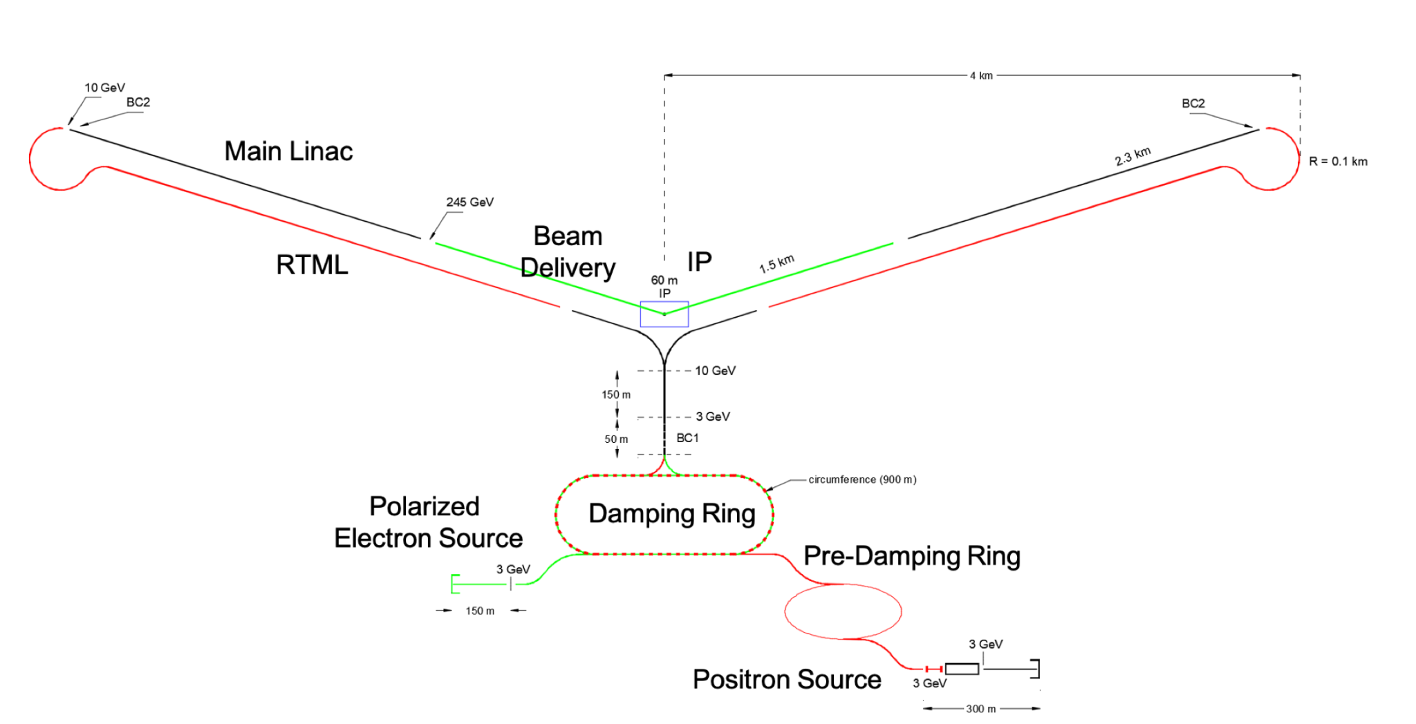
An Injection Extraction System for the C³ DR (a preliminary consideration)
Bunch train pattern:
Four ~700 ns bunch trains with a ~100 ns separation and
~5.25 ns bunch separation of 133 bunches inside of each train.
Revolution time: ~ 3.2 us ( 312.5 kHz).
Injection/Extraction of the 700 ns-long bunch train with a 120 Hz repetition rate.
Swap/Replace a 700 ns-long bunch train simultaneously.
These are modest initial parameters for the injection/extraction system.

Slide 15
Conclusion
A cost-effective technology for the TEM kicker structures and their power systems were discussed.
An operation in the multi-bunch mode at our FEL facilities is the main “supporter” of the development of high-power solid-state nanosecond technology at SLAC.
We have a successful demonstration of this technology on generators of our own production, where stable pulse power swing is tens of MW per nanosecond with picosecond pulse-to-pulse jitter.
We are currently working on a design of high average power pulse generators with a repetition rate in the megahertz range.
Work supported by US Department of Energy contract DE‐AC02‐76SF00515

