Slide 1
FCC-ee Accelerator
LCWS Workshop
May 18, 2023
Tor Raubenheimer on behalf of FCC collaboration & FCCIS DS team particular thanks to Michael Benedikt, Manuela Boscolo, Tom Browder, Paolo Craievich, Fabiola Gianotti, Johannes Gutleber, Patrycja Laidouni, Mika Masuzawa, Katsunobu Oide, Dmitry Shatilov, Vladimir Shiltsev and Frank Zimmermann
SPACE FOR ADDITIONAL LOGOS

Slide 2

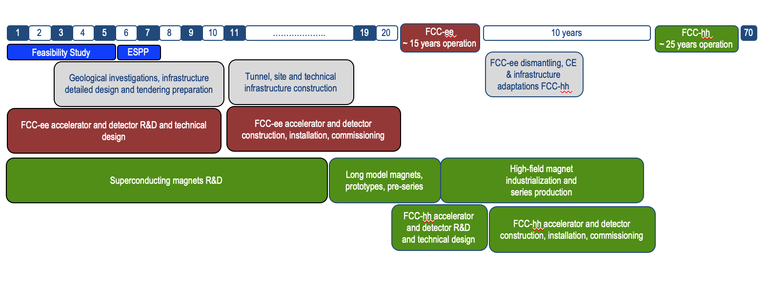
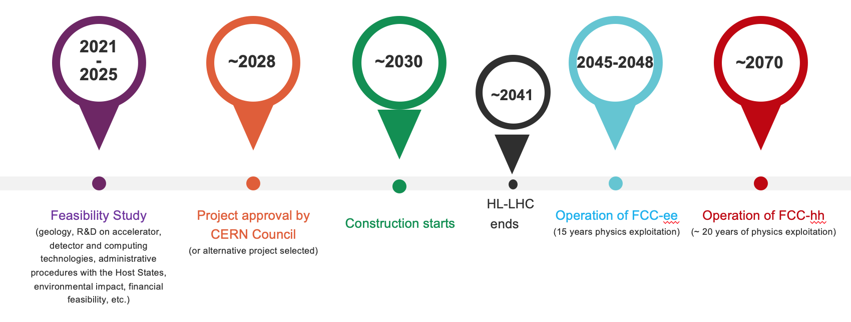
FCC timeline
Note: FCC Conceptual Design Study
started in 2014 leading to CDR
in 2018
Technical schedule:
FCC-ee could start
operation in 2040 or earlier
Realistic schedule takes into account:
CERN Council approval timeline
past experience in building colliders at CERN
that HL-LHC will run until ~ 2041
ANY future collider at CERN cannot
start physics operation before 2045-2048
(but construction will proceed in parallel to
HL-LHC operation)
F. Gianotti

Slide 3
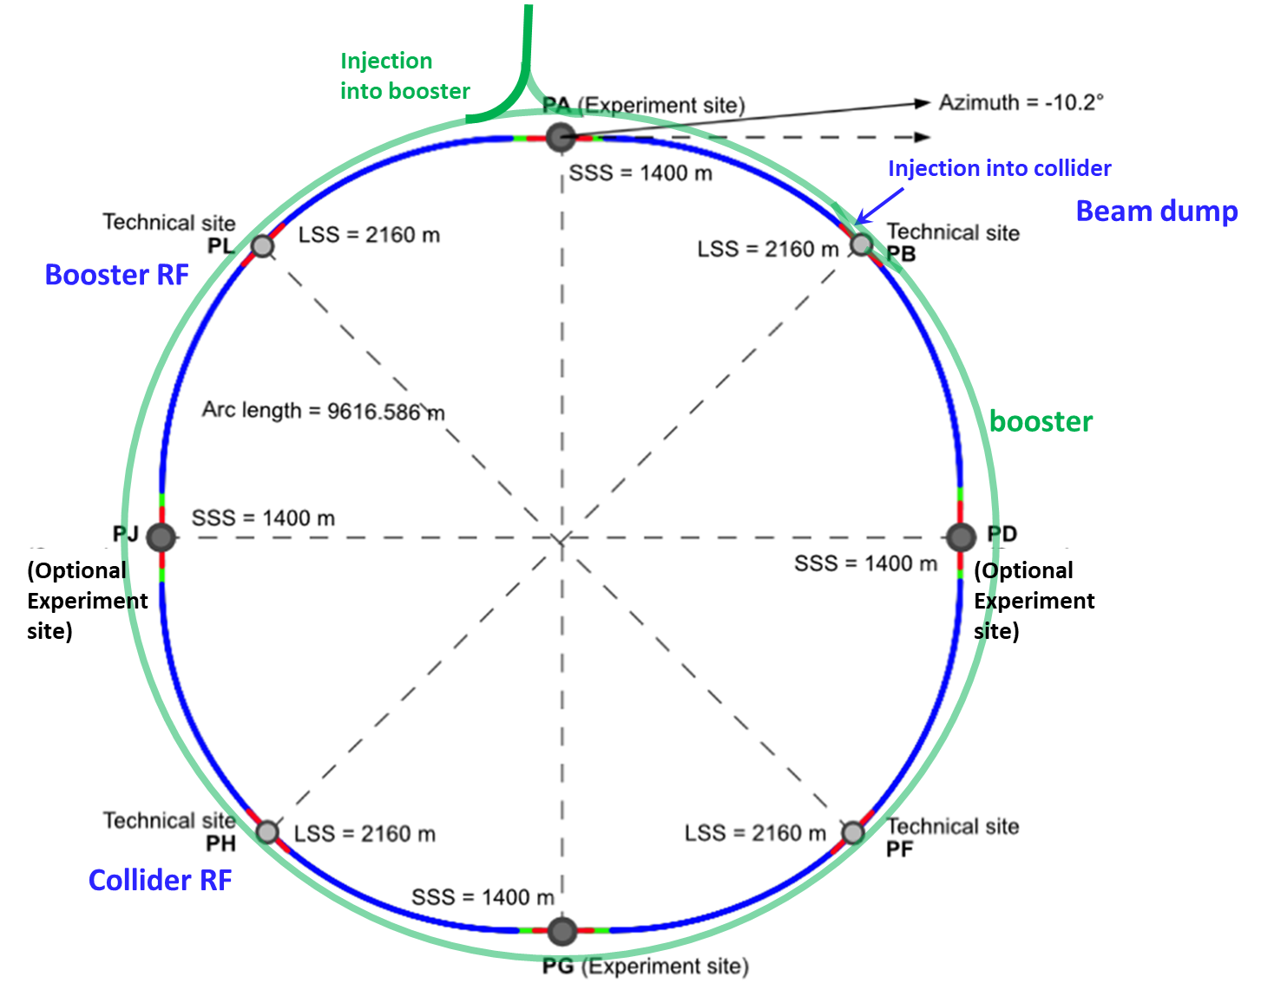
FCC-ee layout
Double ring e+e- collider with 91 km circ.
Common footprint with FCC-hh, except around IPs
Perfect 4-fold super-periodicity allowing 2 or 4 IPs; large horizontal crossing angle 30 mrad, crab-waist collision optics
Synchrotron radiation power 50 MW/beam at all beam energies
Top-up injection scheme for high luminosity Requires booster synchrotron in collider tunnel and 20 GeV e+/e- source and linac

Slide 4
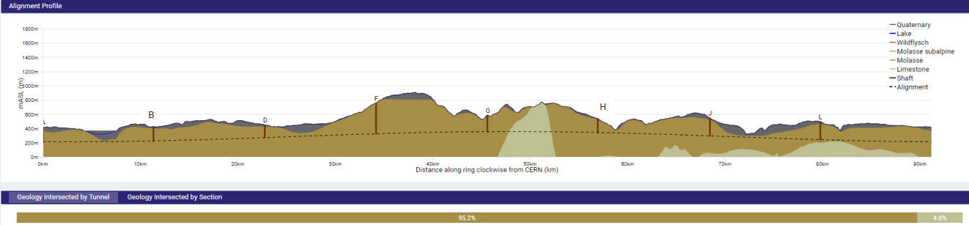
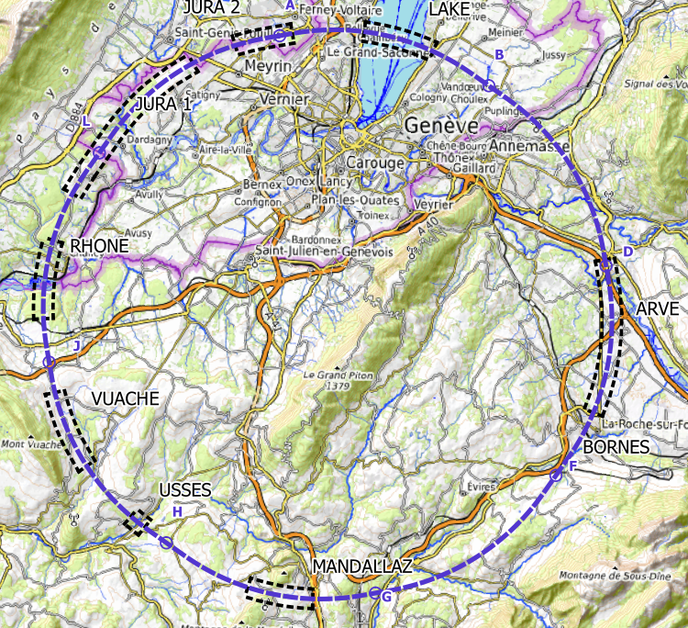
Optimized placement and layout
present baseline implementation
Layout chosen out of ~ 50 initial variants
95% in molasse geology for minimising tunnel construction risk
8 surface sites with ~5 ha area each
<5 km of new roads in total to be built to connect the surface sites to existing roads and other networks
site investigations planned for 2024 and 2025 to verify geological conditions:
limestone-molasse border, karstification, water pressure, moraine properties, water bearing layers, etc.
~40-50 drillings, 100 km of seismic lines

Slide 5
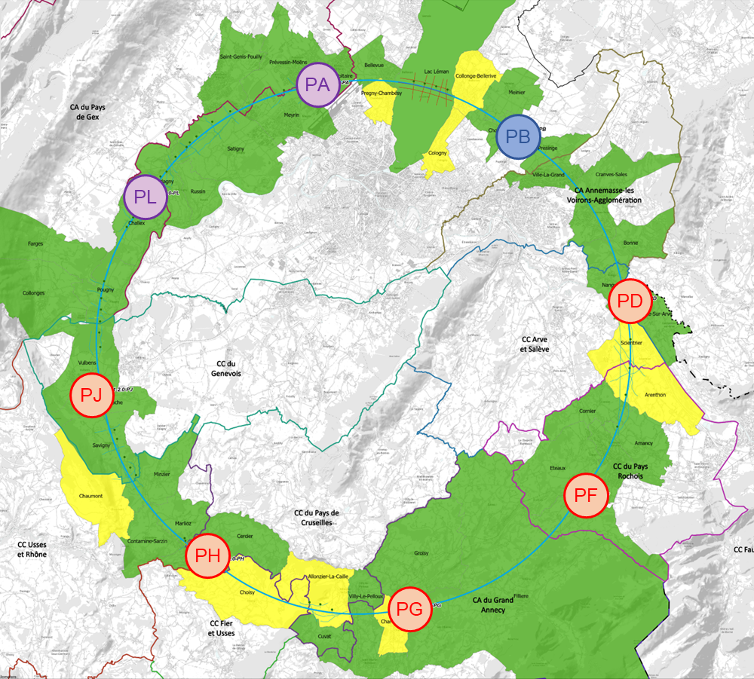
implementation baseline PA31-3.0 91 km
status as of 20 March 2023
M. Benedikt, F. Eder, J. Gutleber, P. Laidouni
Layout chosen out of ~ 50 initial variants, based on geology and surface constraints (land availability, access to roads, etc.), environment (protected zones), infrastructure (water, electricity, transport), etc.
Meetings with municipalities concerned in France (31) and Switzerland (10)
Following “Éviter, reduire, compenser”
(Avoid, Reduce, Compensate)
principle of EU and French regulations
Rencontrée
Rendez-vous proposé / programmé

Slide 6
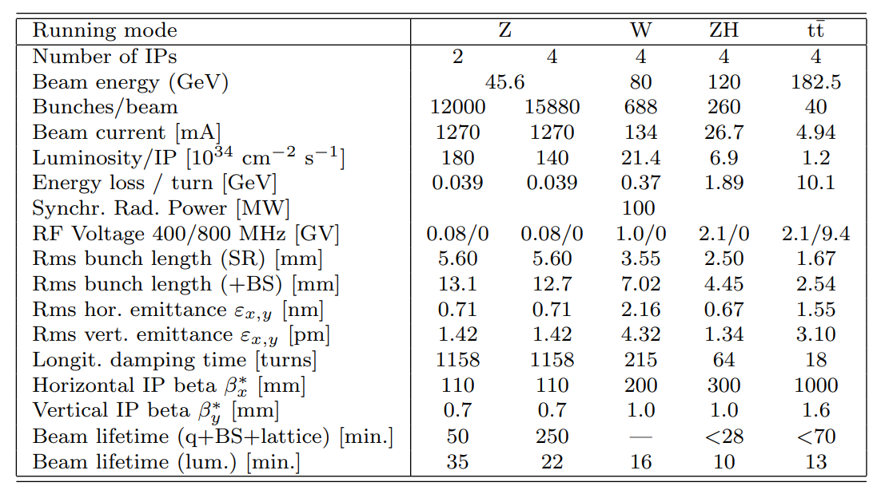
FCC-ee: main machine parameters and run plan
4 years
5 x 10¹² Z
LEP x 10⁵
2 years
>2x10⁸ WW
LEP x 10⁴
3 years
2 x 10⁶ H
5 years
2 x 10⁶ tt pairs
Very high luminosity at Z, W, and Higgs
Accumulate > luminosity in 1st 10 years at Higgs, W, and Z than ILC at Higgs
Accommodates up to 4 experiments → robustness, statistics, specialized detectors, engage community
Run plan naturally starts at low energy with the Z and ramps but can be adjusted with modest RF Bypass to start at Higgs

Slide 7
Accelerator Design
Design is not as developed as ILC …. That’s a good thing!
Design benefits from LEP, LHC, DAFNE, and B-factory experience as well as LC, EIC and CEPC development
Have detailed lattices for collider rings and booster
Full simulations of beam-beam effects
Working on alignment and correction strategies
Like ILC, much of the accelerator is highly repetitive with challenging IRs
→ Develop prototype of half arc-cell
→ Develop IR mock-up
Most R&D is focused on optimizing systems for power efficiency & cost

Slide 8
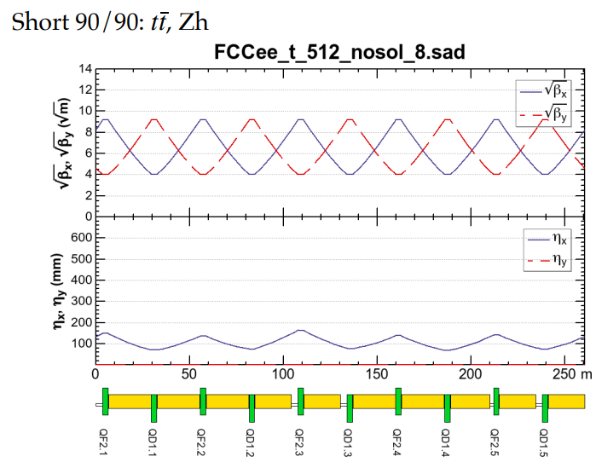
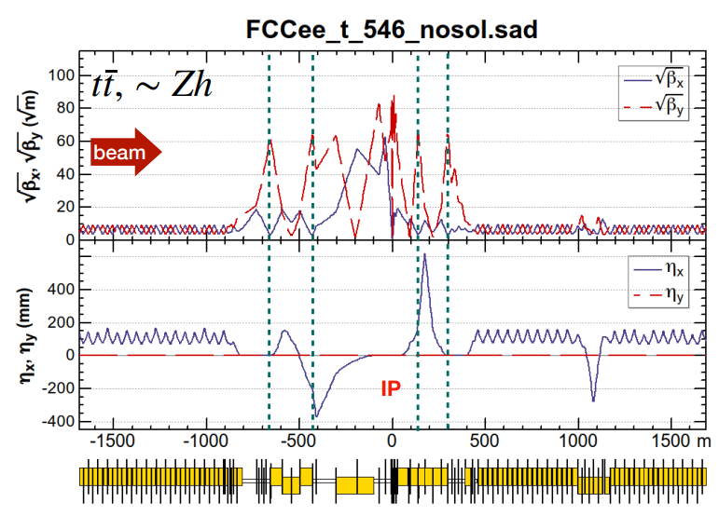
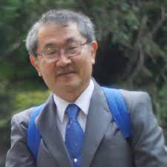
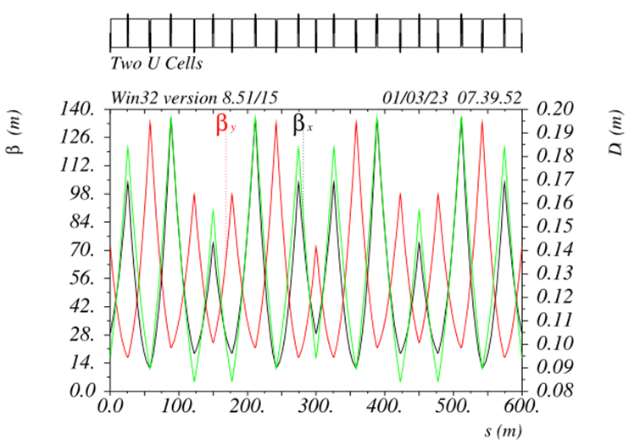
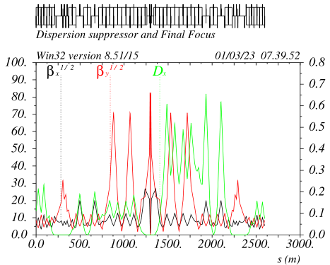
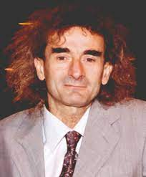
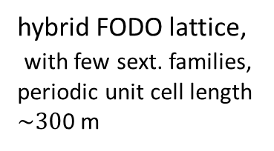
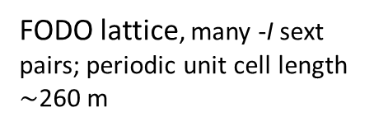
FCC-ee collider optics development: 2 options
arc
interaction region
K. Oide, 2023 EPS
Rolf Wideroe award winner
Phys. Rev. Accel. Beams 19, 111005
FODO lattice, many -I sext pairs; periodic unit cell length $\sim$260 m
baseline for 2023 FCC “mid-term” review
“1.5” sext.s per final focus,
asymmetric
P. Raimondi, 2017 EPS Gersh Budker award winner
design in progress -
further relaxed tolerances,
reduced power consumption,
larger momentum acceptance
5 sext.s per final focus, modular
hybrid FODO lattice,
with few sext. families,
periodic unit cell length
$\sim 30$0 m
Phys. Rev. Accel. Beams 26, 021601

Slide 9




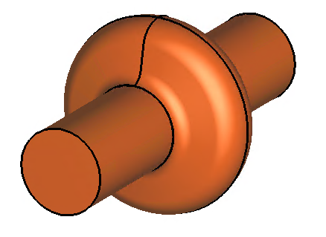
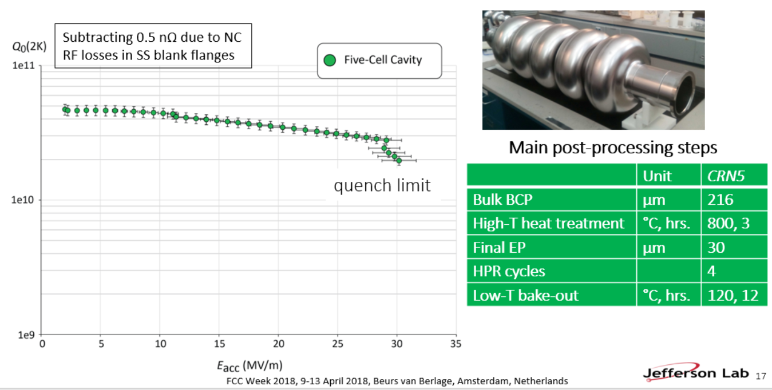
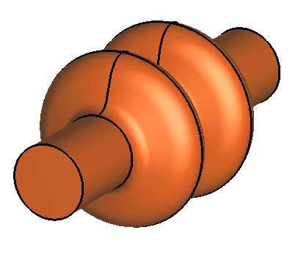
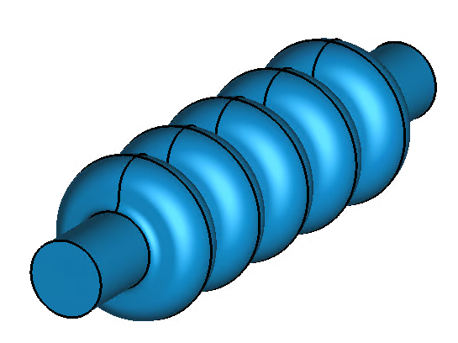
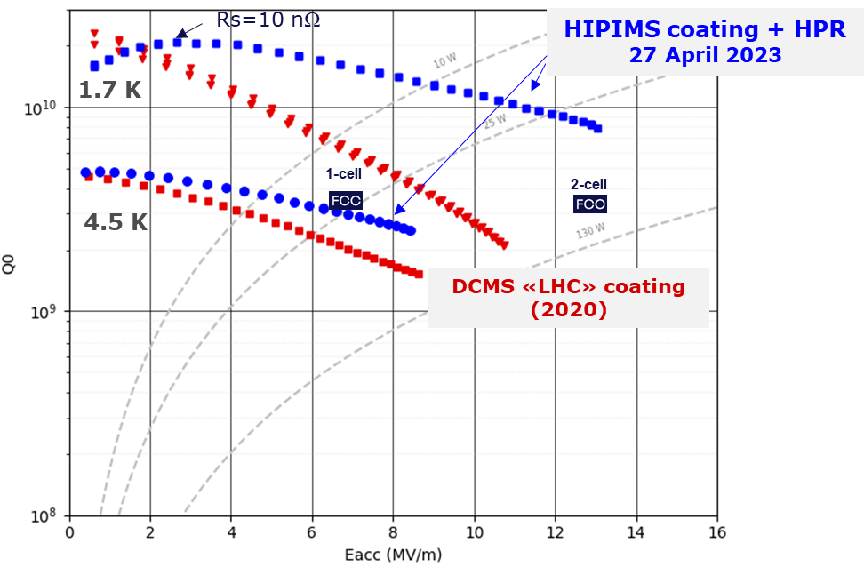
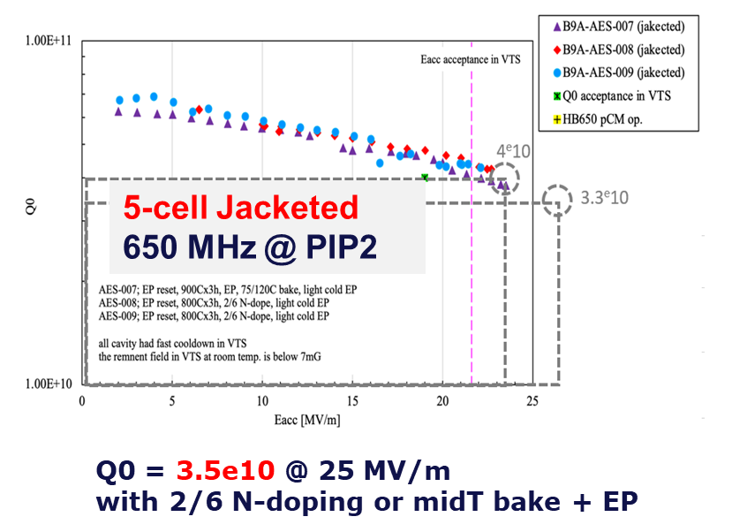
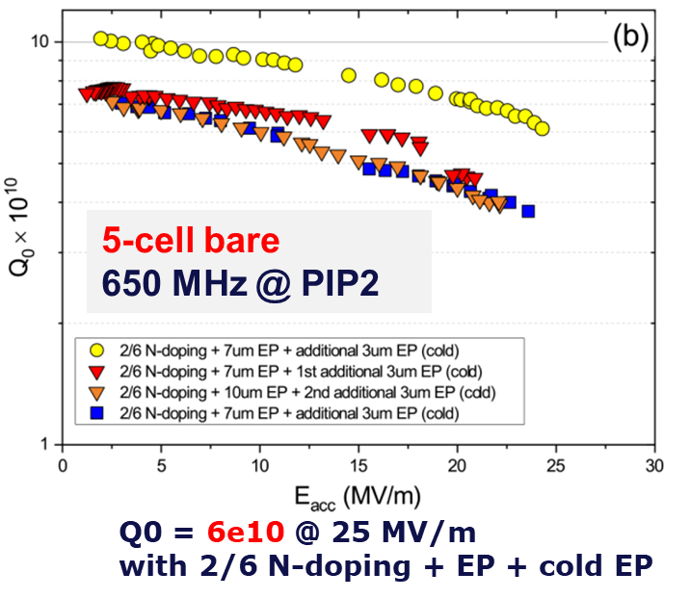
FCC-ee SRF system
Z
low R/Q, HOM damping, powered by 1 MW RF coupler and high efficiency klystron
F. Peauger,
O. Brunner
5-cell cavity development (2018), successful collaboration with JLAB
  1-cell
  400 MHz,
  Nb/Cu
W, H
moderate gradient and HOM damping requirements; 500 kW / cavity, allowing reuse of klystrons already installed for Z
  2-cell
  400 MHz,
  Nb/Cu
ttbar,
booster
high RF voltage and limited footprint thanks to multicell cavities and higher RF frequency; 200 kW/ cavity
  5-cell
  800 MHz,
  bulk Nb
F. Marhauser
Promising R&D towards ultra-high Q₀. Collaboration with FNAL
First attempt of HiPIMS* niobium coating on a 400 MHz Cu cavity
*High-power impulse magnetron sputtering

Slide 10





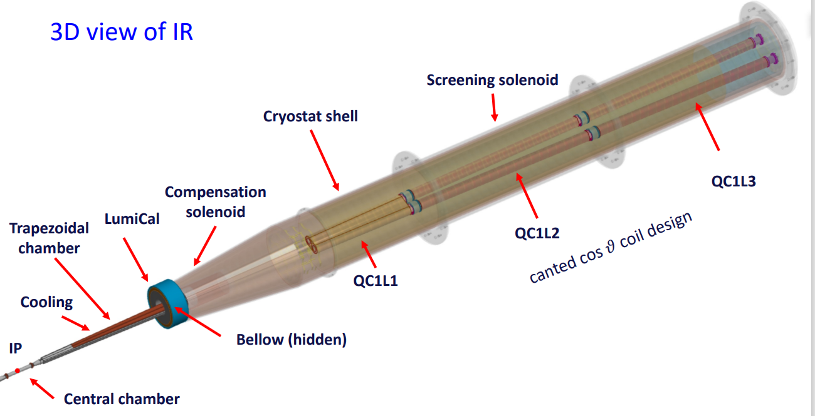
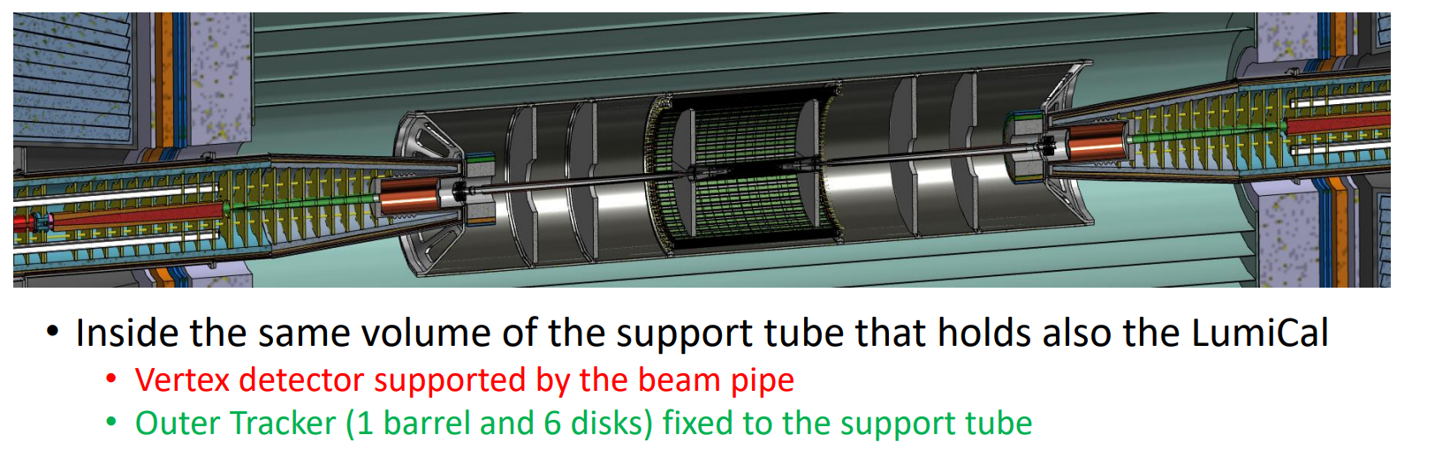
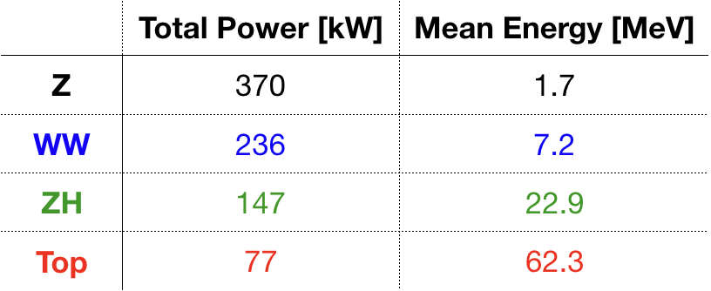
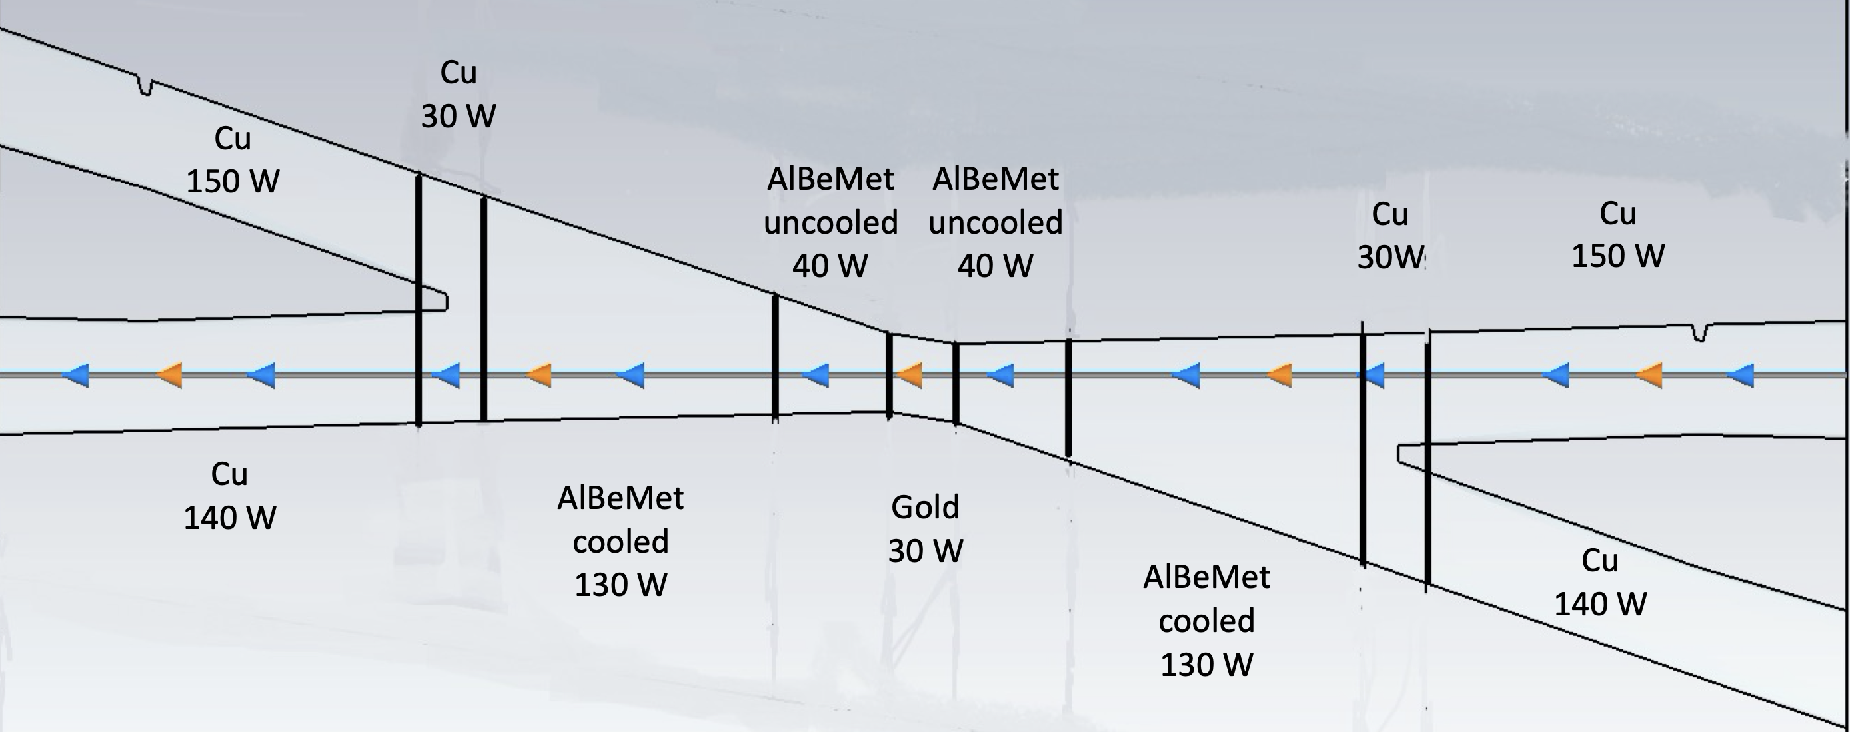
FCC-ee MDI
Novel outer support tube for central beam pipe and vertex detector
Manuela Boscolo, Fabrizio Palla,
Filippo Bosi
Mike Koratzinos,
Brett Parker,
Arnaud Foussat
IR magnets
IR SR
masks
Mike Sullivan,
Helmut Burkhardt,
Kevin Andre
IR heat load distribution
Alexander Novokhatski
Andrea Ciarma,
Anton Lechner,
Helmut Burkhardt,
Manuela Boscolo
Beamstrahlung dump

Slide 11






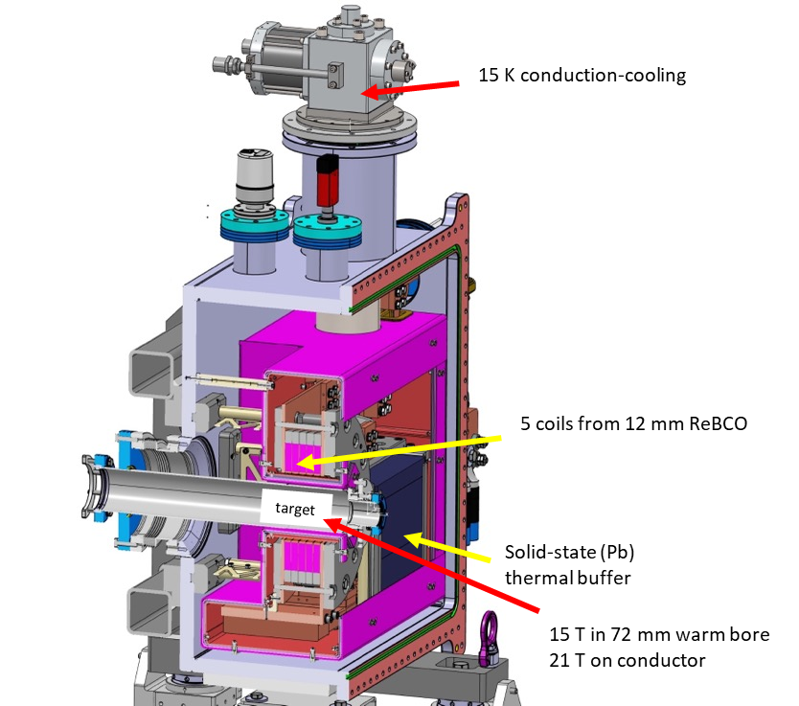
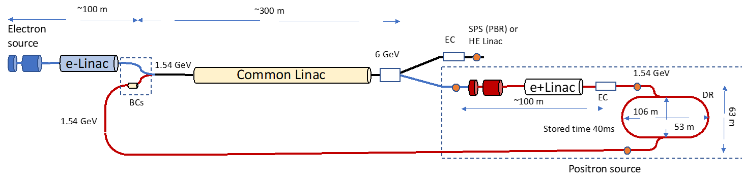
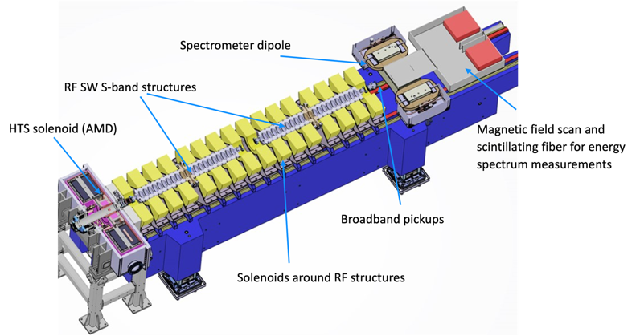
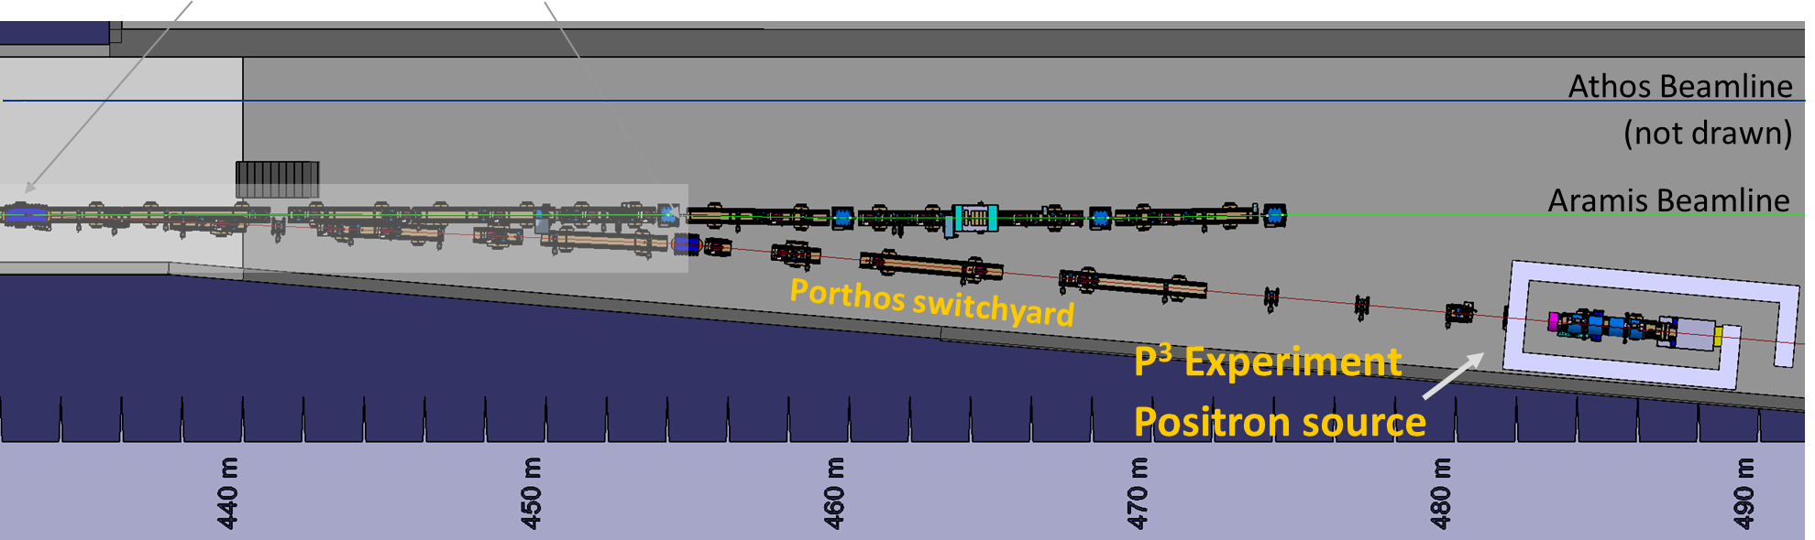
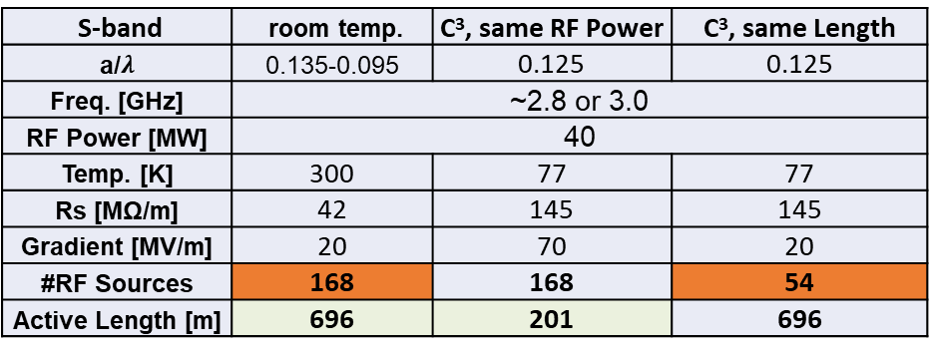
injector, P³ exp., HTS solenoid, C³?
CHART collaboration PSI & CERN with partners IJCLab (Orsay), INFN-LNF (Frascati), KEK/SuperKEKB as observer, INFN-Ferrara – radiation from crystal, CEA (FCCIS, booster)
FCC-ee pre-injector layout
P. Craievich, I. Chaikovska, A. Grudiev, C. Milardi, et al.
HTS NI target solenoid,
e⁺ rate within a factor x2 of rate shown by SLC;
an order magnitude lower than LC designs
Options for HE injector linac
(6→20 GeV)
Ankur Dhar, Emilio Nanni, Glen White
J. Kosse, T. Michlmayr, H. Rodrigues
S-band | room temp. | C³, same RF Power | C³, same Length
a/$λ$ | 0.135-0.095 | 0.125 | 0.125
Freq. [GHz] | ~2.8 or 3.0
RF Power [MW] | 40
Temp. [K] | 300 | 77 | 77
Rs [MΩ/m] | 42 | 145 | 145
Gradient [MV/m] | 20 | 70 | 20
#RF Sources | 168 | 168 | 54
Active Length [m] | 696 | 201 | 696
Goal: demonstrate high-yield positron source concept
“P³ Experiment” at PSI’s SwissFEL, beam tests from 2025/26

Slide 12
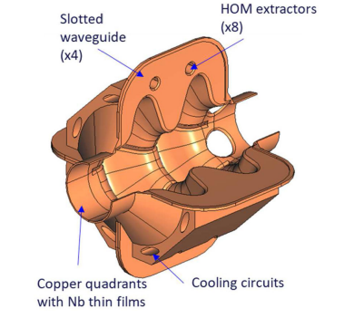
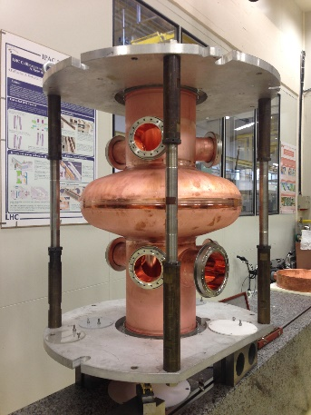
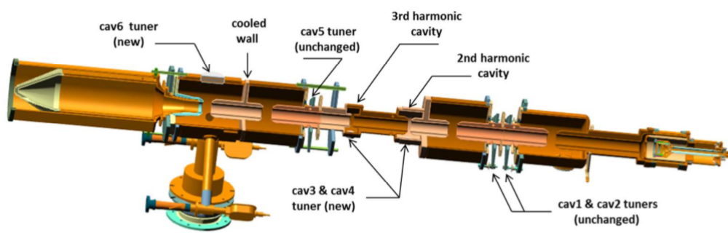
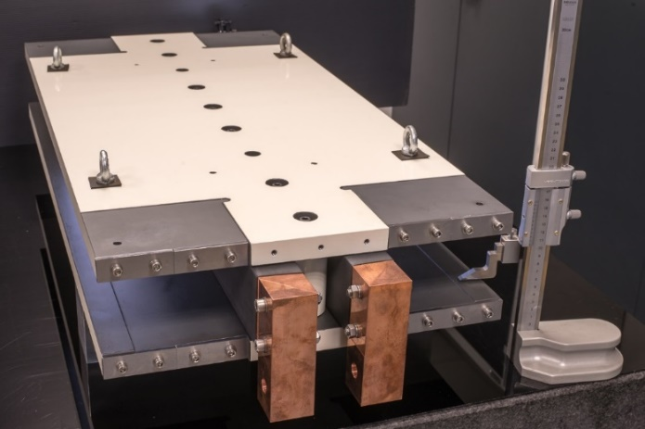
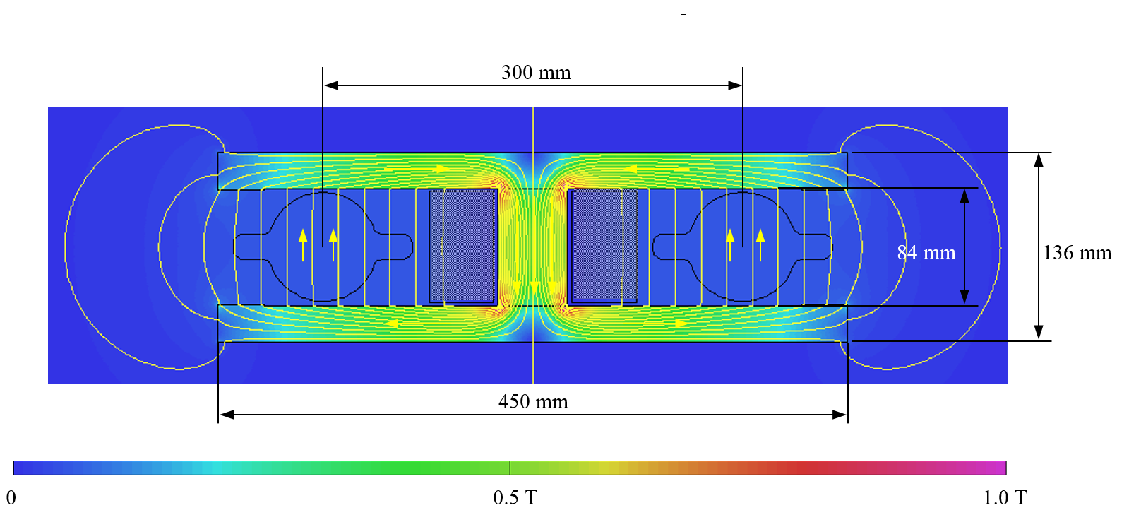

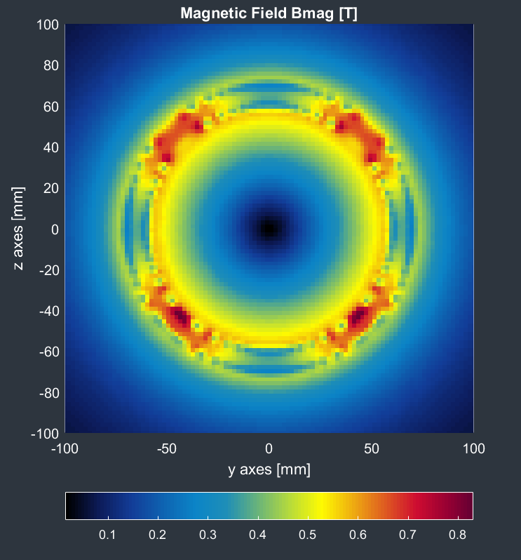
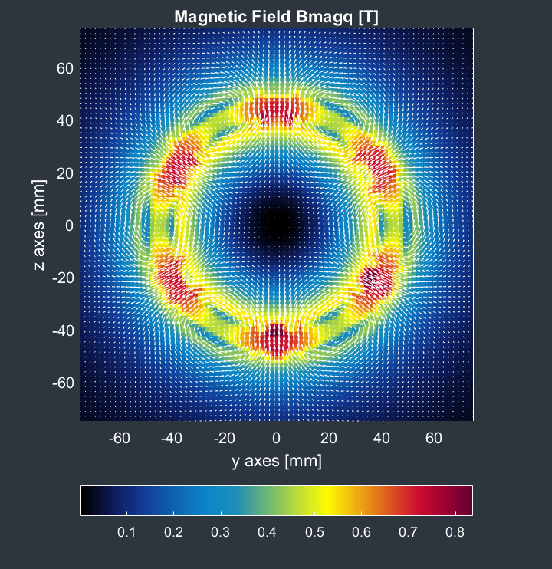
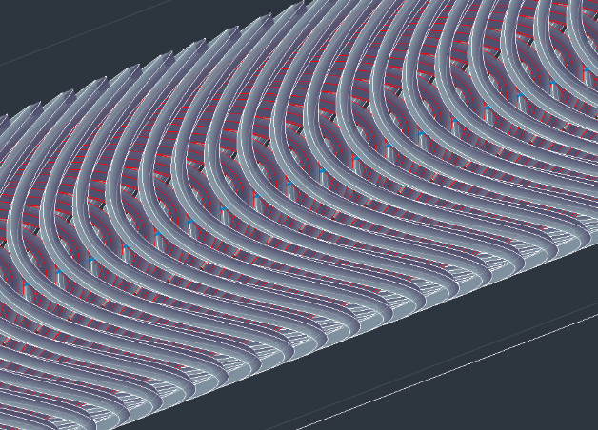

FCC-ee accelerator R&D - examples
efficient RF power sources
(400 & 800 MHz)
efficient high-Q SC cavities
Slotted Waveguide Elliptical cavity (SWELL) for high beam current & for high gradient, seamless by nature – links to past work at ANL (Liu & Nassiri, PRAB 13, 012001)
I. Syratchev
400 MHz 1- & 2-cell Nb/Cu, 4.5 K
high efficiency klystrons
& scalable solid-state amplifiers
FPC & HOM coupler, cryomodule,
thin-film coatings
I. Syratchev
under study: CCT HTS quad’s & sext’s for arcs
reduce energy consumption by O(50 MW)
energy efficient twin aperture arc dipoles
M. Koratzinos,
B. Auchmann
A. Milanese

Slide 13





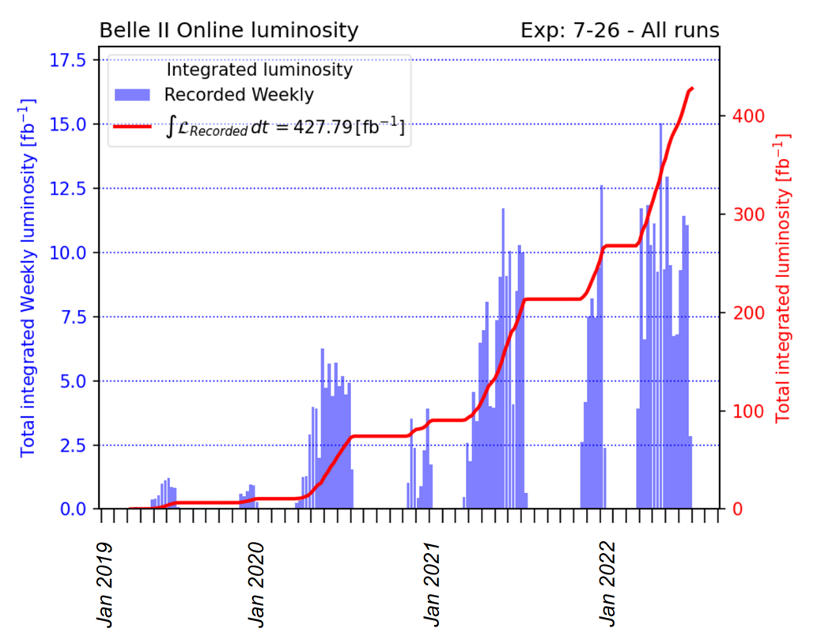

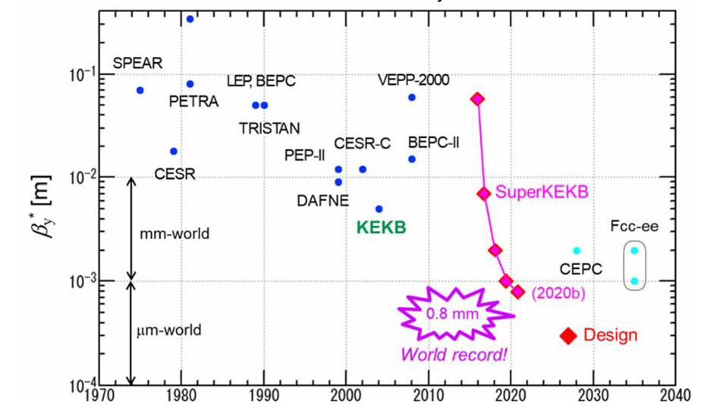
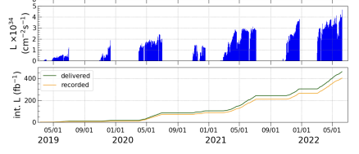
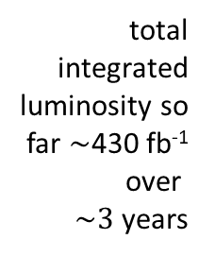
SuperKEKB*
world’s highest luminosity & lowest β* e⁺e⁻ collider
total integrated luminosity so far $\sim$430 fb⁻¹ over
$\sim 3$ years
3 km double ring,
top-up injection
world record luminosity of 4.7x10³⁴ cm⁻²s⁻¹,
β_{y}* = 1.0 mm (= FCC), also β_{y}* = 0.8 mm shown – with “virtual” crab-waist collision scheme originally developed for FCC-ee (K. Oide)
DAFNE and SuperKEKB have demonstrated the crab-waist optics and highlighted some of the operational challenges

Slide 14
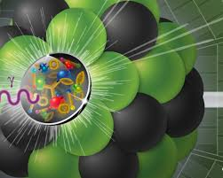
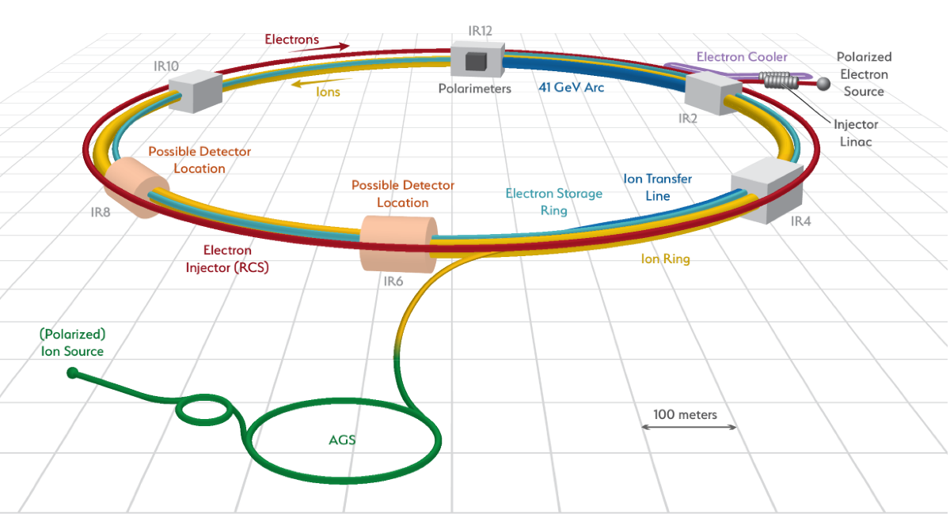
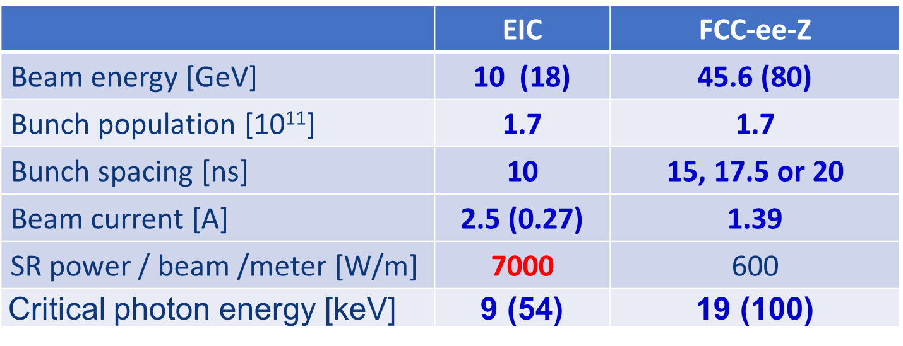
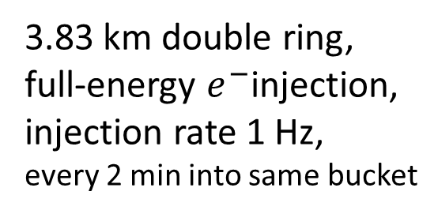
US Electron Ion Collider (EIC)
US EIC Electron Storage Ring similar to, but more challenging than, FCC-ee
beam parameters almost identical, but twice the maximum electron beam current, or half the bunch spacing, and lower beam energy
>10 areas of common interest identified by the FCC and EIC design teams, addressed through joint EIC-FCC working groups, still evolving
EIC will start beam operation about a decade prior to FCC-ee
The EIC will provide an invaluable opportunity to train next generation of accelerator physicists on an operating collider as well as testing hardware prototypes, beam control schemes, etc.
3.83 km double ring,
full-energy $e^{−}$injection,
injection rate 1 Hz,
every 2 min into same bucket

Slide 15
Mid-Term Review & Cost Review, autumn ‘23
Mid-term review report, supported by additional documentation on each deliverable, will be submitted to review committees and to Council and its subordinate bodies, as input for the review.
Results of both general mid-term review and the cost review should indicate the main directions and areas of attention for the second part of the Feasibility Study
Infrastructure & placement
Preferred placement and progress with host states (territorial matters, initial states, dialogue, etc.)
Updated civil engineering design (layout, cost, excavation)
Preparations for site investigations
Technical Infrastructure
Requirements on large technical infrastructure systems
System designs, layouts, resource needs, cost estimates
Accelerator design FCC-ee and FCC-hh
FCC-ee overall layout with injector
Impact of operation sequence: Z, W, ZH, $\text{t}\overline{\text{t}}$ vs start at ZH
Comparison of the SPS as pre-booster with a 10-20 GeV linac
Key technologies and status of technology R&D program
FCC-hh overall layout & injection lines from LHC and SC-SPS
Physics, experiments, detectors:
Documentation of FCC-ee and FCC-hh physics cases
Plans for improved theoretical calculations to reduce theoretical uncertainties towards matching FCC-ee statistical precision for the most important measurements.
First documentation of main detector requirements to fully exploit the FCC-ee physics opportunities
Organisation and financing:
Overall cost estimate & spending profile for stage 1 project
Environmental impact, socio-economic impact:
Initial state analysis, carbon footprint, management of excavated materials, etc.
Socio-economic impact and sustainability studies

Slide 16
Start of FCC-ee physics run
2047 –
2046 –
2045 –
2044 –
2043 –
2042 –
2041 –
2040 –
2039 –
2038 –
2037 –
2036 –
2035 –
2034 –
2033 –
2032 –
2031 –
2030 –
2029 –
2028 –
2027 –
2026 –
2025 –
– 2047
– 2046
– 2045
– 2044
– 2043
– 2042
– 2041
– 2040
– 2039
– 2038
– 2037
– 2036
– 2035
– 2034
– 2033
– 2032
– 2031
– 2030
– 2029
– 2028
– 2027
– 2026
– 2025
Start accelerator commissioning
Start detector commissioning
End of HL-LHC operation
Start detector installation
Start accelerator installation
Start accelerators component production
Technical design & prototyping completed
Start of detector component production
Four detector TDRs completed
Ground-breaking and start of civil engineering
Start of engineering design
Detector CDRs (>4) submitted to FC³
Completion of HL-LHC: more ATS personnel available
Completion of HL-LHC upgrade: more detector experts available
FCC Approval, R&D, start prototyping
FC³ formation, call for CDRs, collaboration forming
European Strategy Update
FCC Feasibility Study Report
Detector EoI submission by community
FCC-ee Accelerator
Key dates
FCC-ee Detectors

Slide 17
Summary
FCC-ee fills the need for a highest precision EW/Higgs factory
Provides highest luminosity at Z, W and H@240 GeV of all proposed factories
Based on 60 years of experience with circular e⁺e⁻ colliders, some of which currently in operation, hence no need for a large demonstrator facility
  R&D on components focused on improved performance, increased efficiency, industrialization, cost aspects, sustainability and minimizing environmental impact
  R&D timelines are consistent with construction in 2030’s
FCC uses current CERN infrastructure; FCC-hh will reuse FCC-ee infrastructure
FCC integrated program offers long-term vision for global HEP at precision and energy frontiers, interlinked with large-scale advanced technology R&D programs
  FCC-ee, FCC-hh hadron collider (100 TeV pp, AA), FCC-eh option, …
Many opportunities to engage in the program!

Slide 18
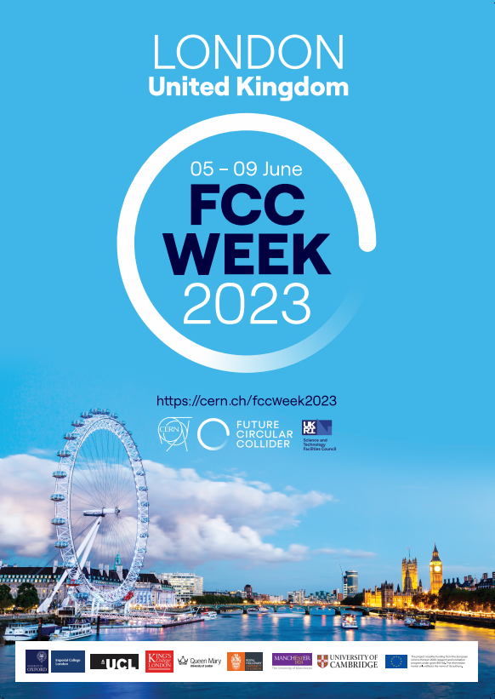
FCC Week 2023
thank you !
Future Circular Collider (FCC) Week 2023, at the Millennium Conference Centre in London, United Kingdom from Monday 5 June to Friday 9 June 2023.
Organised with the support of the UK Research and Innovation Science and Technologies Facilities Council (STFC) and the EU-funded Horizon 2020 FCCIS project
Local partners : STFC, the University of Cambridge, Imperial College London, King’s College London, the University of Manchester, the University of Oxford, Queen Mary University of London, Royal Holloway University of London and University College London
Registration is open !
We look forward to welcoming you to London for what promises to be an exciting and informative event!
https://cern.ch/fccweek2023

Slide 19
spare slides

Slide 20
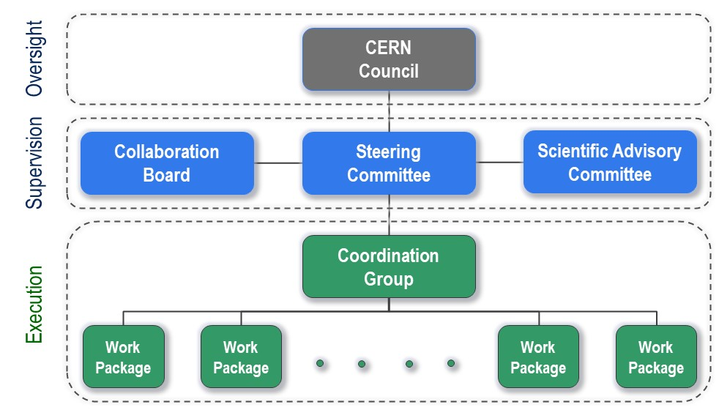
FCC Feasibility Study - organisational structure
Key contributors from US:
L. Merminga / FNAL
Steering Committee
M. Minty / BNL
Scientific Advisory Committee
A. Lankford / UCI
Collaboration Board Co Chair
T. Raubenheimer / SLAC
Accelerator WP coordinator
T. Lundin / FNAL
Surface building designs WP
M. Sullivan / SLAC
MDI WP coordinator

Slide 21

FCC Feasibility Study – Organigram, April 2023
EU Projects
NN
Collaboration building
Emmanuel Tsesmelis
Study Support and Coordination
Study Leader: Michael Benedikt
Deputy Study Leader: Frank Zimmermann
Study Support Unit
IT: Sylvain Girod
Procurement: Adam Horridge
Quality management: Beatriz Arias
Resources: Sylvie Prodon
Secretariat: Julie Hadre
Communications
Panagiotis Charitos, James Gillies
Physics, Experiments and Detectors
Patrick Janot, Christophe Grojean
Physics programme
Matthew McCullough, Frank Simon
Accelerators
Tor Raubenheimer
Frank Zimmermann
Project organisation model
NN
Technical Infrastructures
Jean-Paul Burnet, Klaus Hanke
Host State processes and civil engineering
Timothy Watson
Organisation and financing models
Florian Sonnemann
FCC-ee collider design
Katsunobu Oide
FCC-hh design
Massimo Giovannozzi
Technology R&D
Roberto Losito
FCC-ee booster design
Antoine Chancé
FCC-ee injector
Paolo Craievich, Alexej Grudiev
FCC-ee energy calibration polarization
Alain Blondel, Jorg Wenninger
FCC-ee MDI
Manuela Boscolo, Mike Sullivan
Integration
Jean-Pierre Corso
Geodesy & survey
Hélène Mainaud Durand
Electricity and energy management
Jean-Paul Burnet
Cooling and ventilation
Guillermo Peon
Cryogenics systems
Laurent Delprat
Computing and controls infrastructure, communication and network
Pablo Saiz
Safety
Thomas Otto
Operation, maintenance, availability, reliability
Jesper Nielsen
Transport, installation concepts
Roberto Rinaldesi
Administrative processes
Friedemann Eder
Placement studies
Johannes Gutleber, Volker Mertens
Environmental evaluation
Johannes Gutleber
Tunnel, subsurface design
John Osborne
Surface sites layout, access and building design
A. Mayoux
Detector concept
Mogens Dam
Physics performance
Patrizia Azzi, Emmanuel Perez
Software and computing
Gerardo Ganis, NN
Financing model
Florian Sonnemann
Procurement strategy and rules
NN
In-kind contributions
NN
Operation model
Paul Collier, Jorg Wenninger
FCC transfer lines
Wolfgang Bartmann

Slide 22
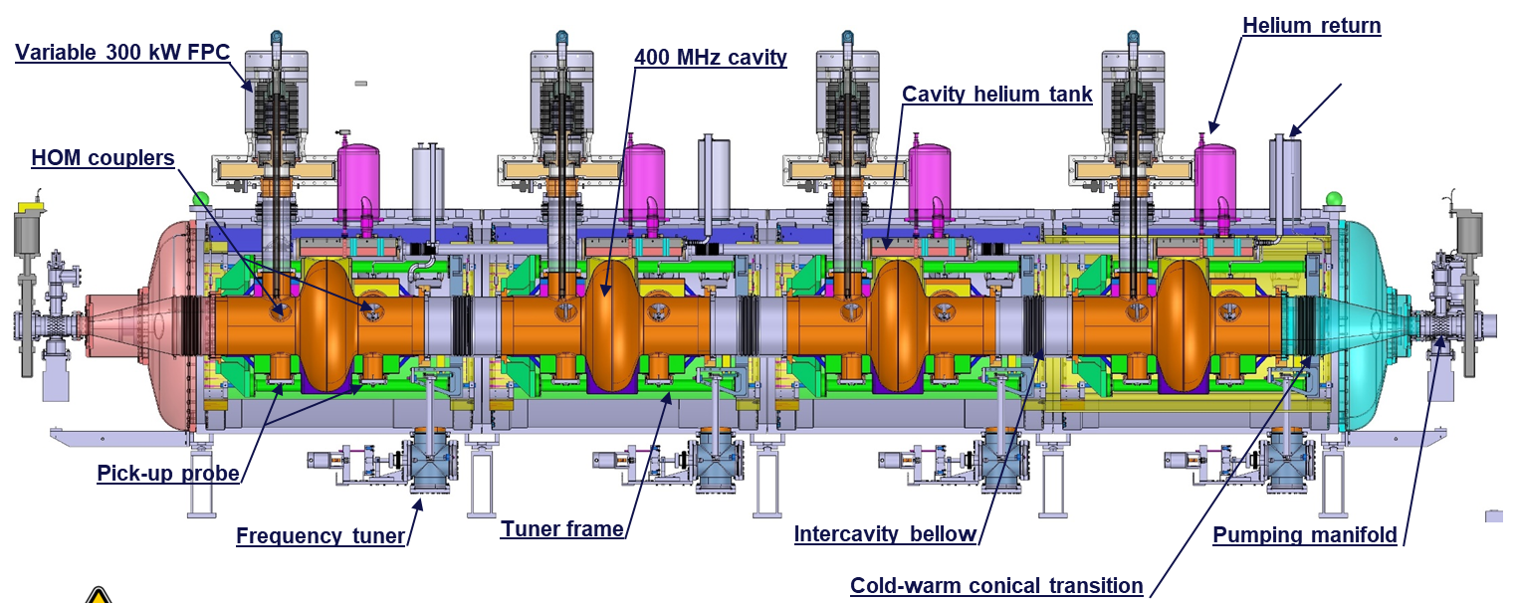

Cryomodule length
FCC-ee Cryomodules
V. Parma
1-cell 400 MHz | 10 m
2-cell 400 MHz | 10 m
5-cell 800 MHz | 7.2 m
Hypothesis for the 1-cell and 2-cell 400 MHz cavities is to group them into four cavity cryomodules of about 10 to 11 meters long each, with identical controls, vacuum, waveguide and cryogenics interfaces for ‘plug play replacement
Example of the LHC cryomodule (400 MHz, 4.5 K)
For the 5-cell cavities, the minimum number of cavities is four but could be extended to 6 or more
Example of the SPL cryomodule (704 MHz, 2 K)

Slide 23

FCC-ee
pre-injector complex on the CERN Prévessin site
6 GeV
20 GeV
W. Bartmann

Slide 24
FCC Feasibility Study (2021-2025): high-level objectives
Demonstration of the geological, technical, environmental and administrative feasibility of the tunnel and surface areas
and optimisation of placement and layout of the ring and related infrastructure
Pursuit, together with the Host States, of the preparatory administrative processes required for a potential project approval
Optimisation of the design of FCC-ee and FCC-hh colliders and their injector chains, supported by R&D to develop
the needed key technologies
Elaboration of a sustainable operational model for the machine and experiments in terms of human and financial resource needs,
as well as environmental aspects and energy efficiency
Development of a consolidated cost estimate, as well as the funding and organisational models needed to enable the project’s technical design completion, implementation and operation (emphasis on FCC-ee)
Identification of substantial resources from outside CERN’s budget for the implementation of first stage project (tunnel and FCC-ee)
Consolidation of the physics case and detector concepts and technologies
Feasibility Study funded from CERN budget (~ 35 MCHF/year over 5 years, including high-field magnet R&D).
Additional funding from the European Commission and collaborating institutes (e.g. CHART collaboration with Switzerland)
Mid-term review end of 2023 → final results in Feasibility Study Report by end of 2025
F. Gianotti

Slide 25

FCC-hh: main machine parameters
F. Gianotti
Formidable challenges:
high-field superconducting magnets: 14 - 20 T
power load in arcs from synchrotron radiation: 5 MW → cryogenics, vacuum
stored beam energy: 8 GJ → machine protection
pile-up in the detectors: ~1000 events/xing
energy consumption: 4 TWh/year → R&D on cryo, HTS, beam current, …
Formidable physics reach, including:
Direct discovery potential up to ~ 40 TeV
Measurement of Higgs self to ~ 5% and ttH to ~ 1%
High-precision and model-indep (with FCC-ee input)
measurements of rare Higgs decays (𝛄𝛄, Z𝛄, µµ)
Final word about WIMP dark matter

Slide 26



Stage 1: FCC-ee – highest-luminosity lepton collider
double ring e⁺e⁻ collider, with full-energy booster
2 or 4 interaction points
efficient L from Z to 𝑡𝑡 ̅
  thanks to twin-aperture magnets, high-Q SRF, efficient RF power sources, top-up injection, etc.
>2.5 ab⁻¹ / IP with $\sim$0.5x10⁶ H / IP (3y)
>75 ab⁻¹ / IP with $\sim$2x10¹² Z / IP (4y)
luminosity vs. electricity consumption
collects LEP data statistics in few minutes
highest lumi/power of all H fact. proposals
Nature Physics 16, 402–407 (2020)

Slide 27

Status of Global FCC Collaboration
12 US universities and DOE laboratories contributing so far
(and counting ! ☺)
147
Institutes
30
Companies
34
Countries
EC
H2020
further increasing US involvement in physics, detectors, accelerator and technologies is essential for preparing FCC implementation

