Slide 1
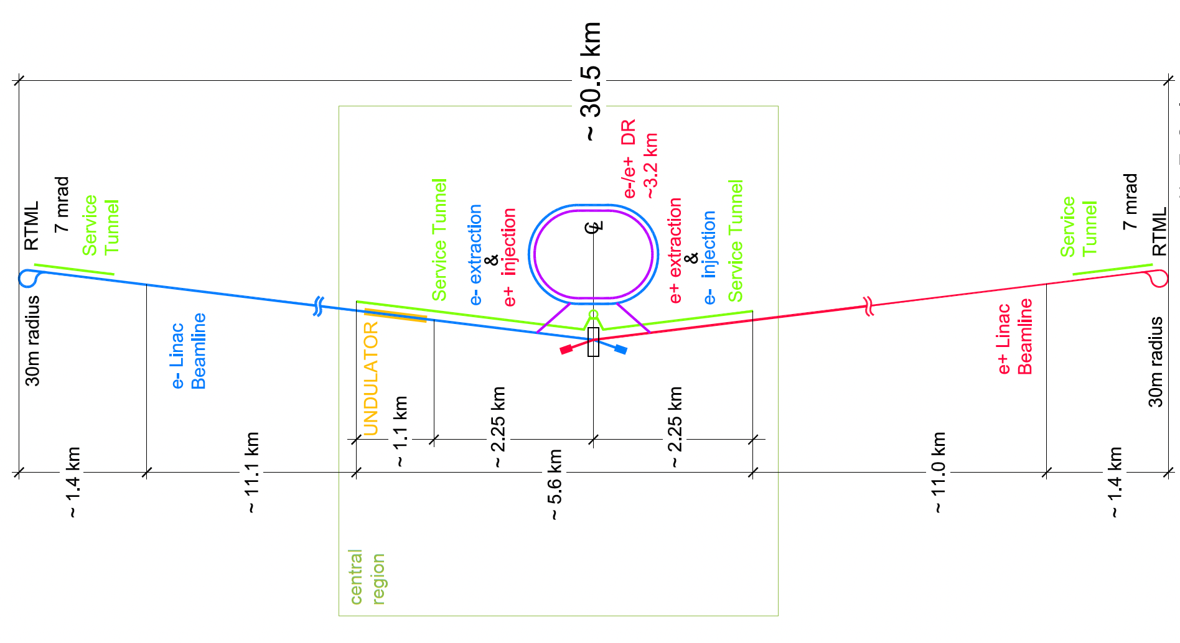
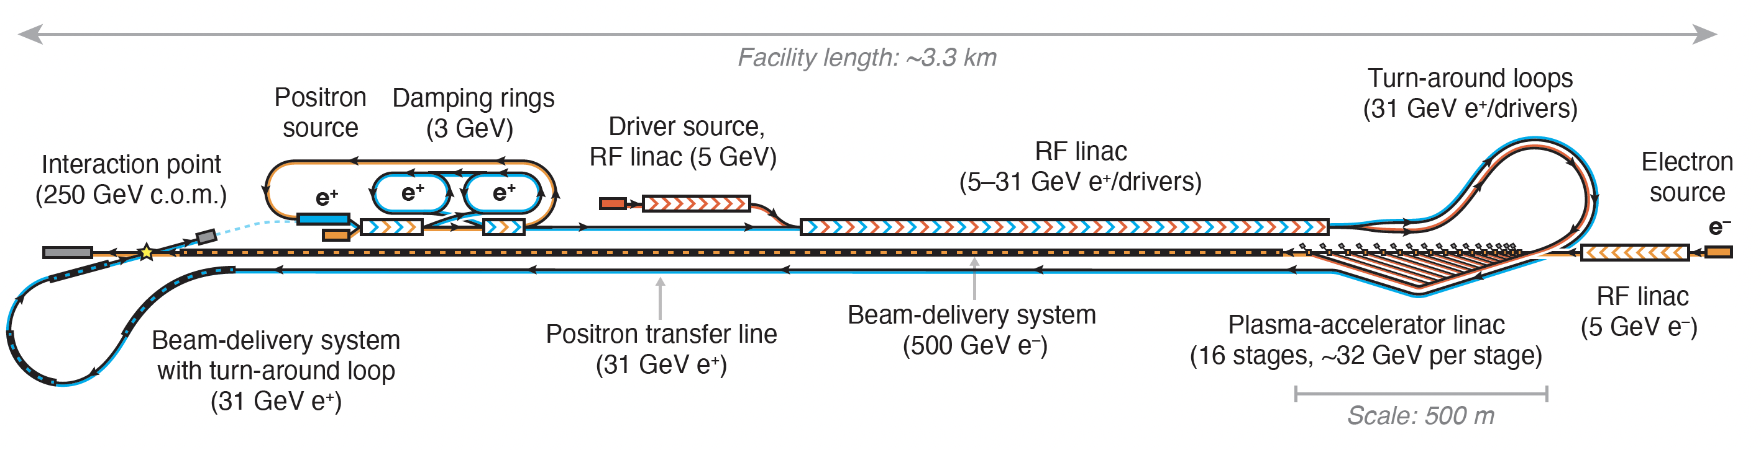
Hybrid Asymmetric Linear Higgs
Factory (HALHF)
https://arxiv.org/2303.10150

Slide 2
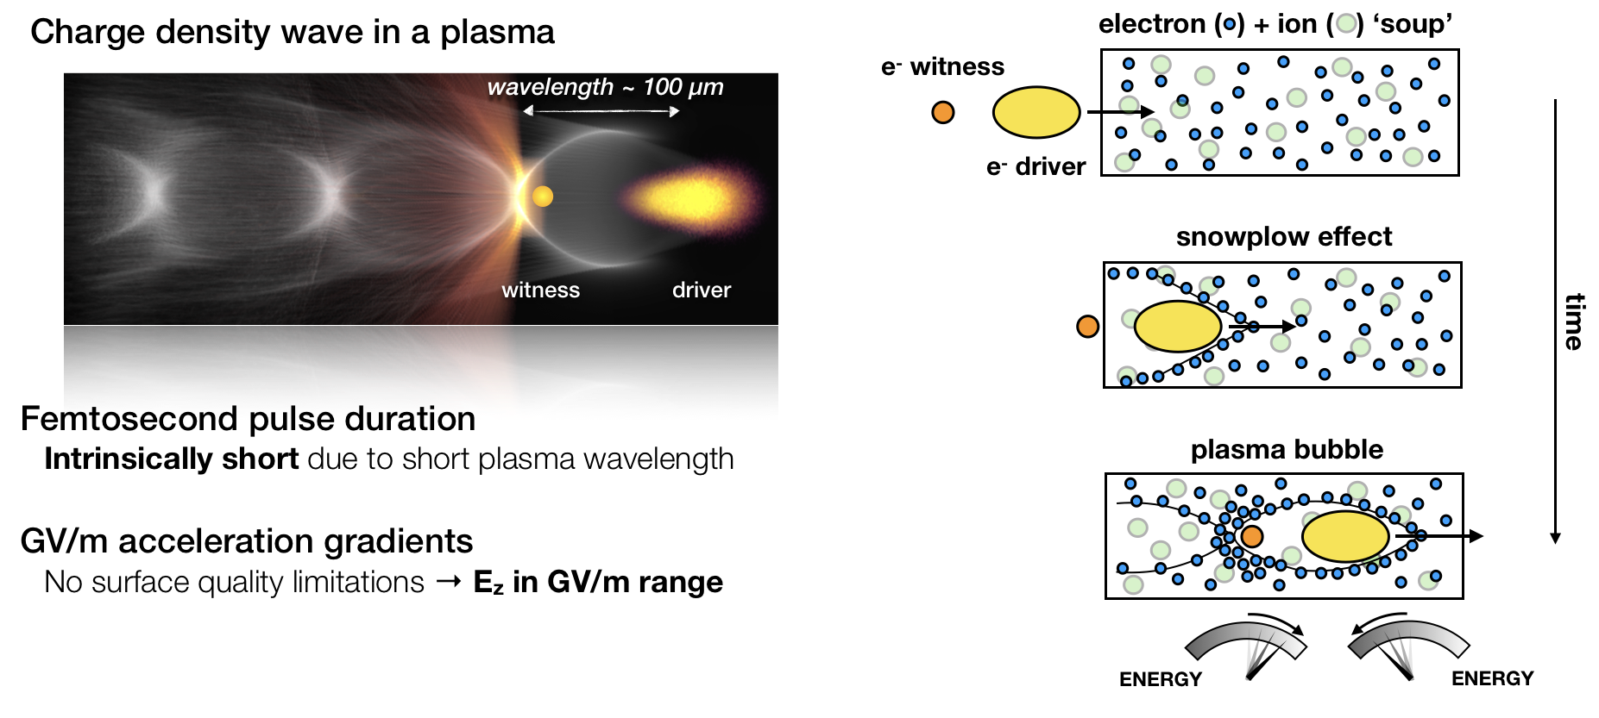
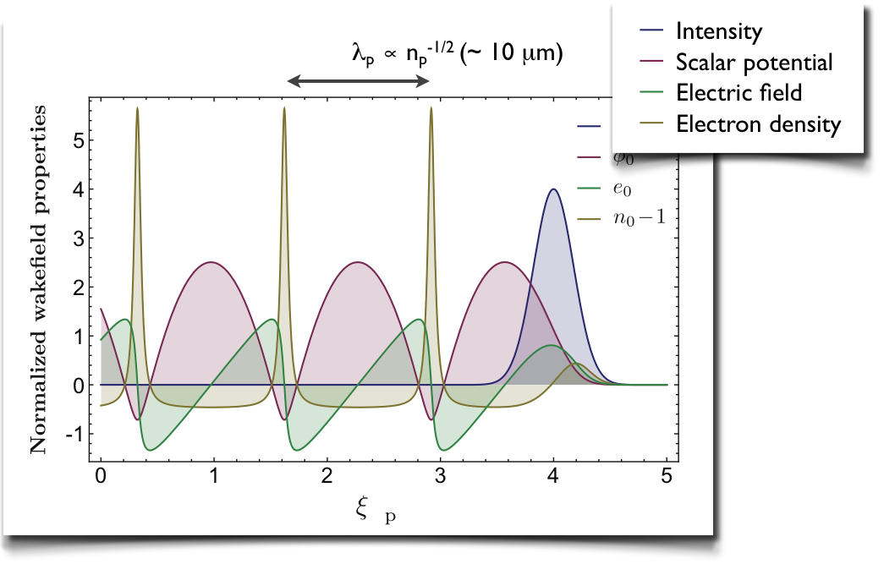
Plasma Wave Acceleration

Slide 3
Hybrid Asymmetric Linear Higgs
Factory (HALHF)
The basic idea is – there are enough problems with a PWFA e⁻ accelerator; e⁺ is even more difficult. Bypass this for e⁺e⁻ collider by using conventional linac for e⁺.
For this to be attractive financially, conventional linac must be low energy => asymmetric energy machine.
This requirement led to (at least for us) unexpected directions – the more asymmetric the machine became, the better!

Slide 4
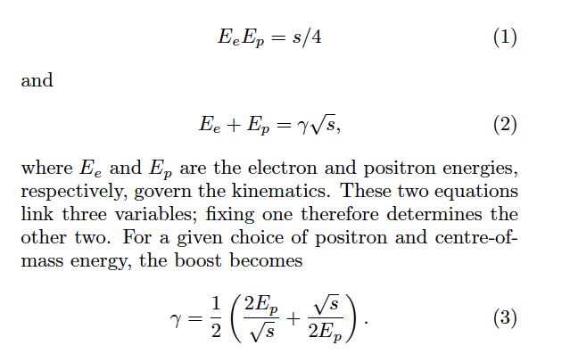
Relativistic Refresher
It turns out that the optimum (see below) for E_{cm} = 250 GeV is to pick E_{e} = 500 GeV, E_{p}= 31 GeV, which gives a boost in the electron direction of γ ~ 2.13.

Slide 5
HALHF Layout
e-
e+
e+ BDS
e- BDS
Overall facility length ~ 3.3 km – which will fit on ~ any of the major (or even ex-major) pp labs. (NB. There is
a service tunnel a la ILC (not shown))

Slide 6
Energy Efficiency
Asymmetric machines less energy efficient than symmetric – energy lost “in accelerating the C.o.M.” For equal bunch charges => 2.5 times more energy required for same C.o.M. energy.
Can be reduced by introducing asymmetry into beam charges – increase charge of low-energy beam and decrease high-energy s.t. N² = N_{e}N_{p} constant => L conserved.
P/P₀ = (N_{e}E_{e}+N_{p}E_{p})/(N*sqrt(s))
Optimum is to scale e⁺ charge by sqrt(s)/(2E_{p}), i.e. factor ~ 4.
Producing so many e⁺ problematic – compromise by scaling by factor 2 (2*e⁺, ½* e⁻).
Reduces energy increase to 1.25. Also reduces bunch charge in PWFA arm.

Slide 7
Emittance reduction
Geometric emittance of bunch scales with 1/E .
Lower-energy e⁺ beam must have smaller β function at I.P. – use β_{x} /β_{y} = 3.3/0.1 mm c.f. CLIC 8.0/0.1 mm.
In contrast, high-energy e⁻ beam - β function can be increased, which could reduce complexity of BDS.
More interesting is to increase the e⁻ emittance AND reduce the β function => normalized emittance can be 16 times higher for the same L => increased tolerances in PWFA arm.
Beam-beam focusing effect on L must be simulated with Guinea Pig.

Slide 8
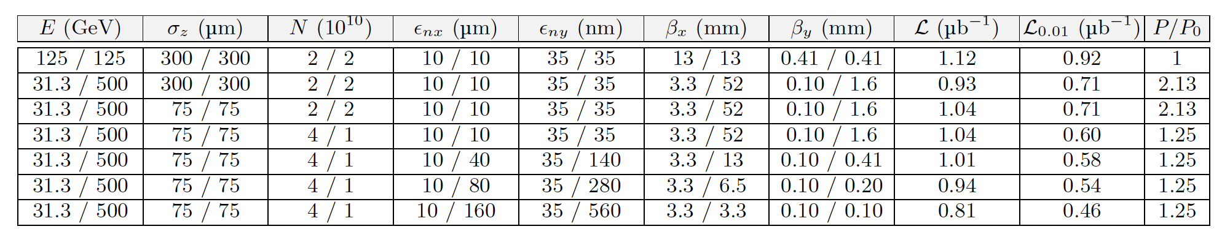
Beam-beam Effects
Guinea-Pig results:
ILC
HALHF
HALHF with reduced emittance for PWFA

Slide 9
Positron Source
“Conventional” e⁺ sources are not trivial – that for ILC, which has relaxed requirements wrt HAHLF, still under development.
e⁻ accelerated to 5 GeV and then collide with target to produce e+ which are accumulated, bunched and accelerated to 3 GeV and then damped in 2 rings (~identical to CLIC but bigger e⁺ bunch charge (4*10¹⁰ e⁺).
May be possible to use spent e⁺ bunch after collision rather than dedicated e⁻ bunch, with cost savings.

Slide 10
Main RF Linac
Split in 2, to accelerate e⁻ PWFA drive beams from 1 – 5 GeV & then
both e⁺ and e⁻ from 5 GeV to 31.3 GeV.
Assume gradient of 25 MV => 1.25 km long.
Delivers total average power of 21.4 MW => including e⁺ power and
ε ∼ 50%, wall-plug 47 MW.
Assume warm L-band linac – if necessary CW SRF could be used but
would increase cost and change bunch pattern.
Before drivers, e⁺ bunch accelerated with 180º phase offset.

Slide 11
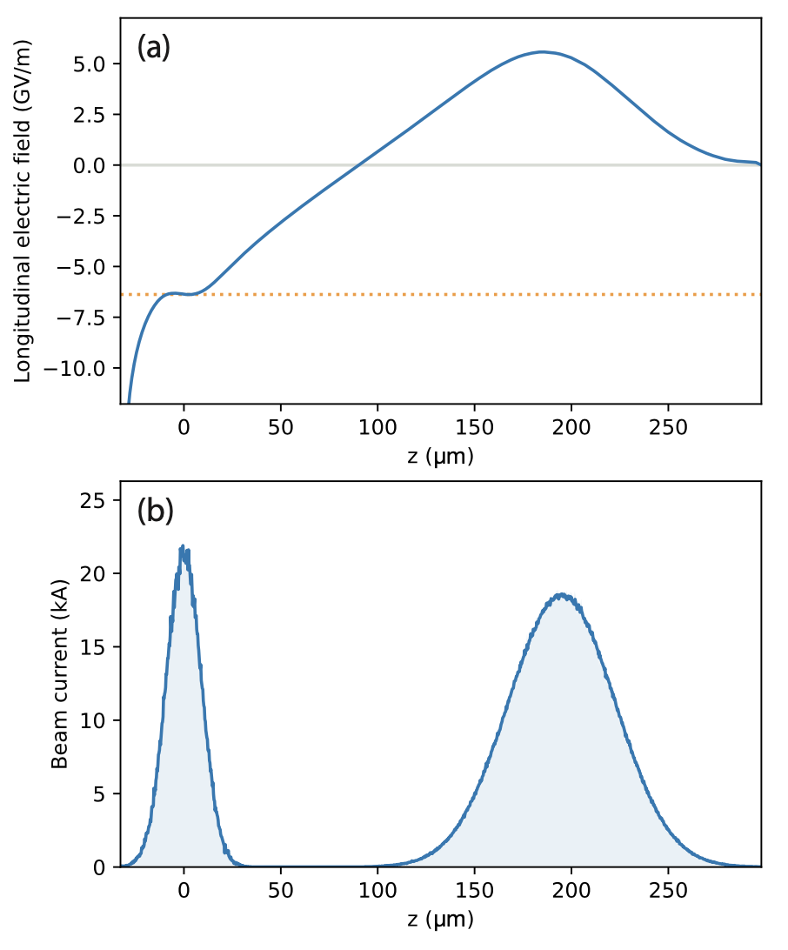
PWFA Linac
Drivers go through turn-around and
then distributed to plasma cells via
undulating delay chicane.
Assuming TR ~ 1, e- bunch accelerated
by 31 GeV/5m stage => 16 stages
with ρ ~ 1.5*10¹⁶ => 6.2 GV/m.
Interstage optics needs ~ <26.5m>
but scales with sqrt(E).
Total length of PWFA linac = 410m.

Slide 12
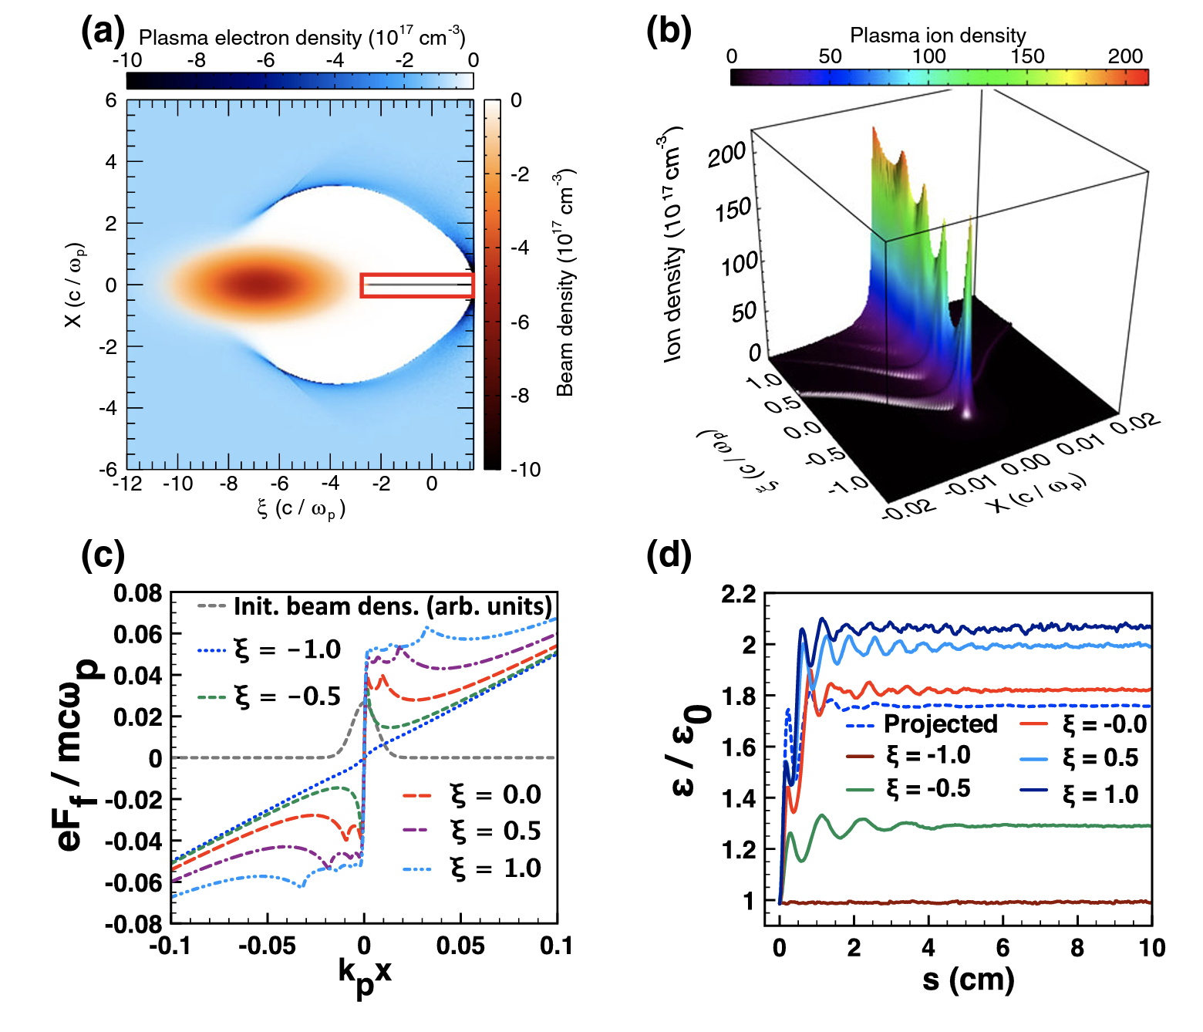
PWFA Linac
Assuming PWFA ε∼37%, 75% driver energy into wake, 50% of which is extracted => 25% of driver energy dumped into 16 beam dumps, 37.5% goes into plasma cell => 100 kW/m.
Utilising emittance asymmetry
eases emittance preservation
problem & mitigates effects of
ion motion – e⁻ beam density
reduced cf symmetric machine
by factor 32 => ions
Δφ ∼ 0.17 (<<π/2)
[J. Rosenzweig et al., PRL 95, 195002 (2005)]
[W. An et al., PRL 118, 244801 (2017)

Slide 13
Bunch-train pattern.
Assuming L-band linac:

Slide 14
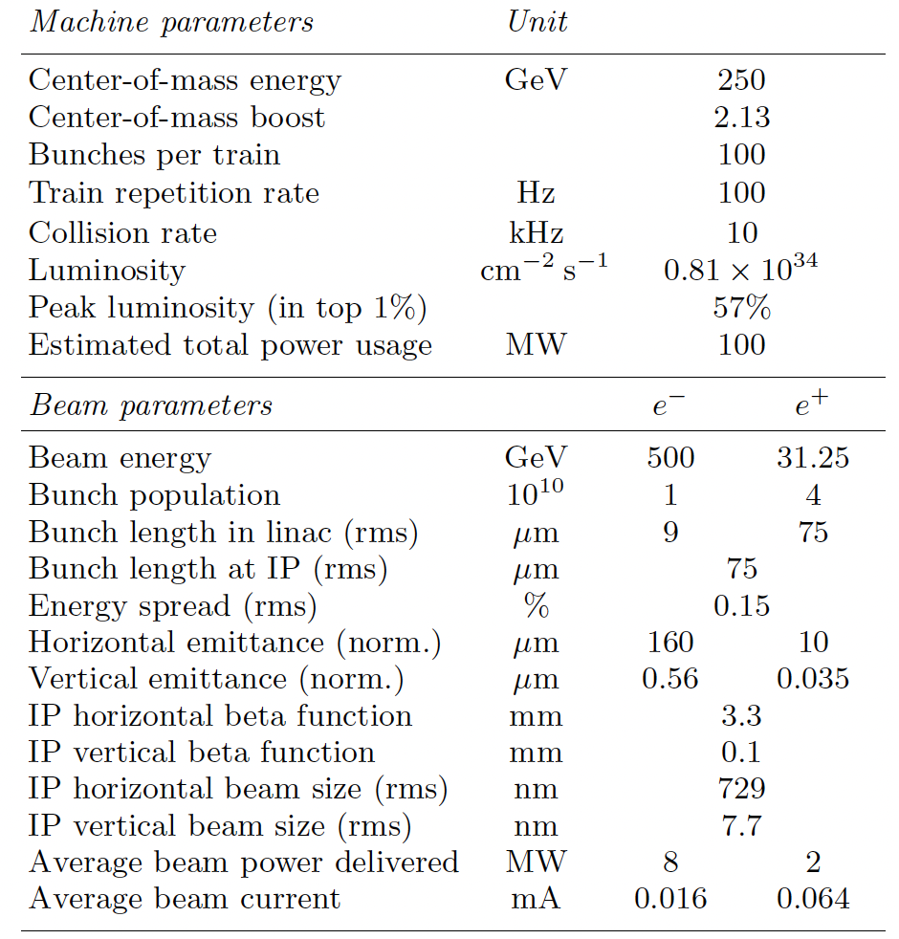
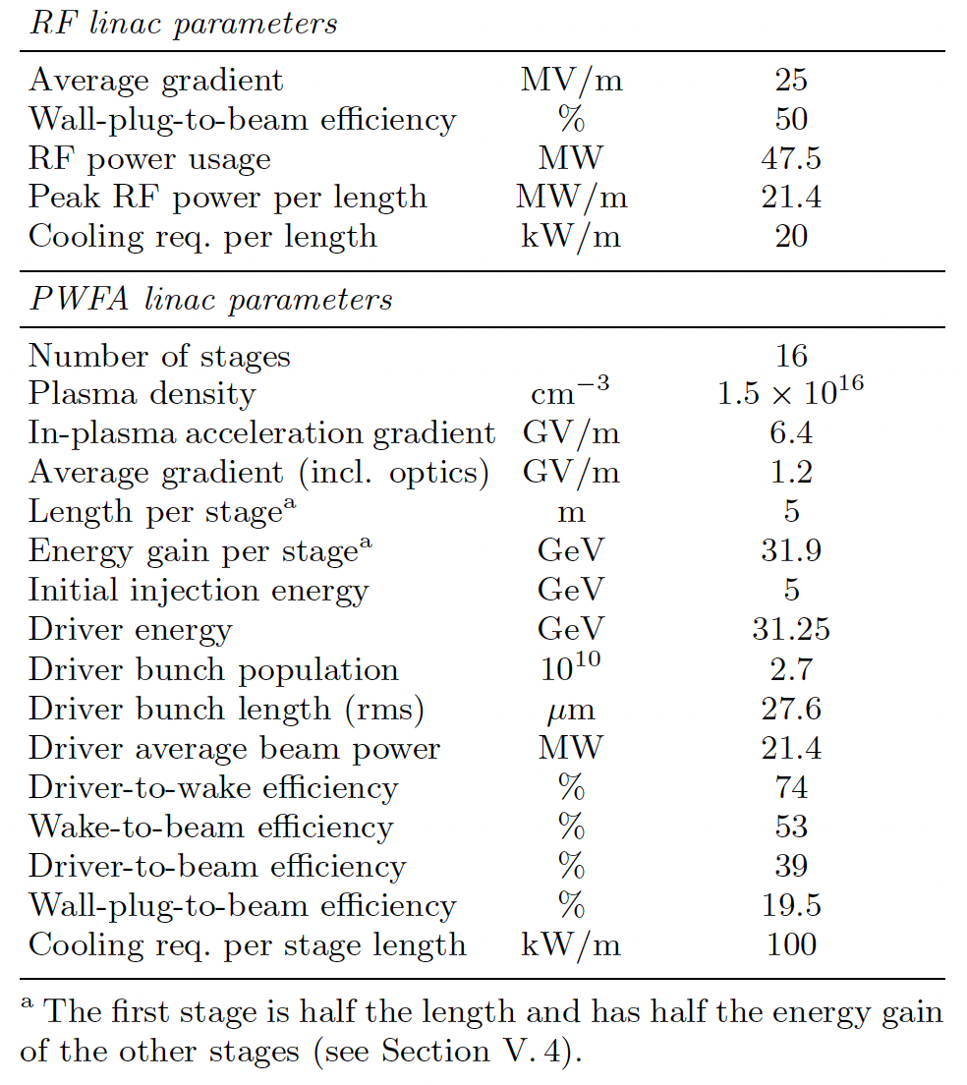
HALHF Parameter Table

Slide 15
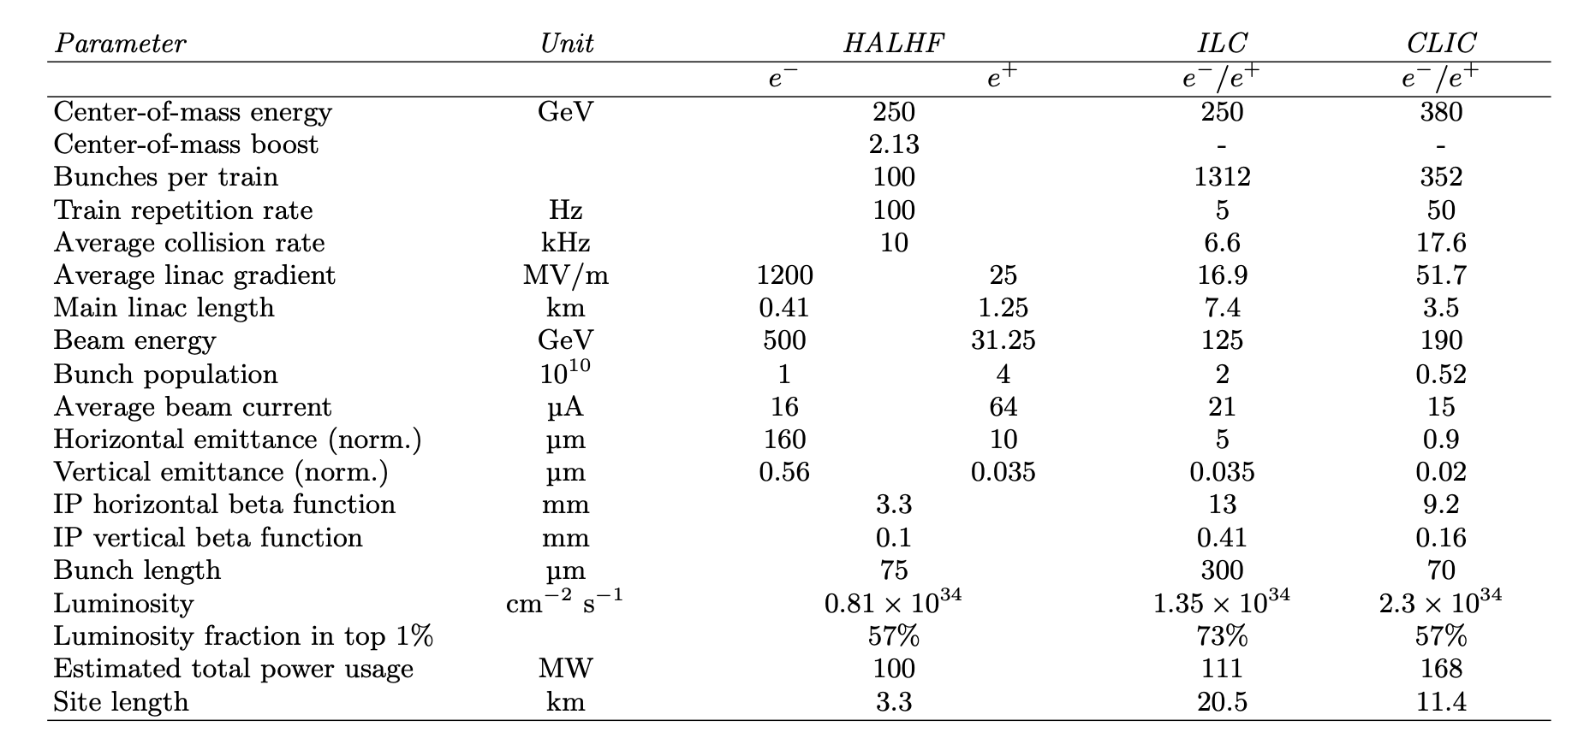
HALHF Parameters cf
ILC & CLIC

Slide 16
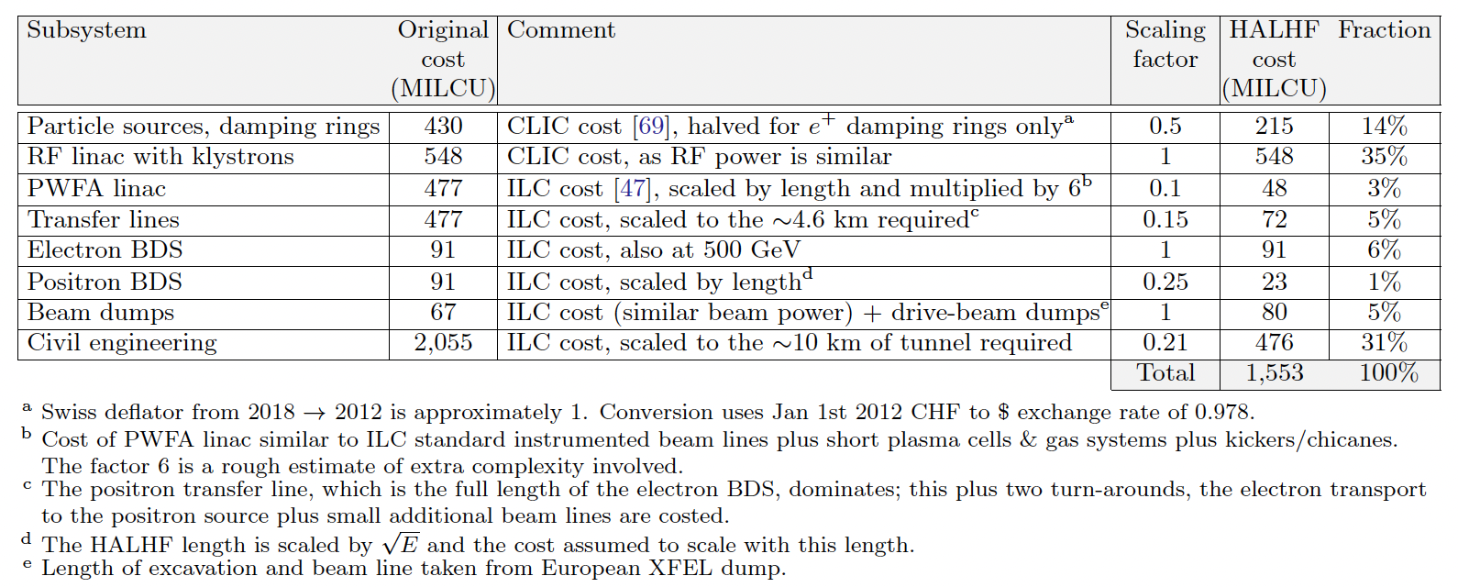
Cost Estimate
Scale from existing costed projects wherever possible – mostly ILC – very rough – not better than 25% accurate.

Slide 17
Cost Estimate
Snowmass study ITF of various accelerator costs gives ILC Higgs Factory Total Project Cost (TPC) (= US accounting) of $7 – 12B (2021 $). Scaling this by the value estimate (~European accounting) of HALHF/ILC@Snowmass gives HAHLF TPC ~ $2.3 – 3.9B: c.f. EIC TPC = ~< $2.8B.

Slide 18
Running Costs
Dominated by power to produce drive beams.
(100*16*4.3nC + 6.4nC)*100 => 47.5 MW@50% eff.
Damping rings: 2*10 MW.
Cooling – assume similar to CLIC => 50% of RF power (corresponds to 20 kW/m).
For magnets and other conventional sources assume ~9 MW.
Gives total power requirement ~ 100 MW – similar to other proposals.

Slide 19
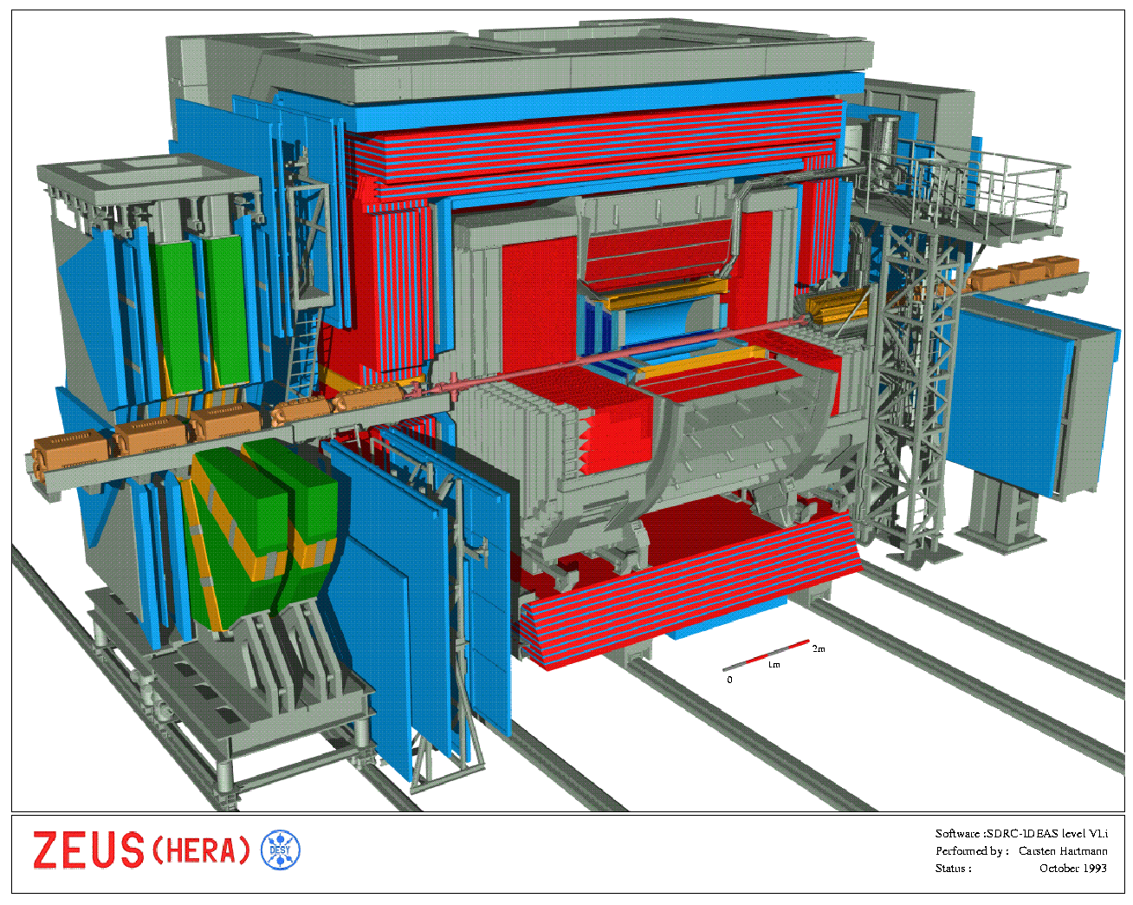
Experimentation at HALHF
Boost is smaller than
HERA - HERA detectors
very similar to those at
symmetric machines.
Preliminary study
(M. Berggren) with long
ILD barrel shows ~ similar
Higgs resolution.
Measurement of L via
Bhabha (e⁺e⁻ -> e⁺e⁻)
- rate reduced by
1/(θγ)² & e⁺ scattered
into barrel – but not a
problem. Singles rate
good for machine
optimisation

Slide 20
Project Staging
Any project of this size and scope needs a ~10% prototype. A few cells producing useful currents of e⁻ at few 100 GeV would be very interesting for SFQED.
Once satisfactory performance demonstrated, remaining elements can be constructed and then running at Z can be used to tune up machine and detector.

Slide 21
Upgrades
Energy upgrade: keep e⁺ energy same increases γ as E increases – experiments more and more difficult; increasing e⁺ energy to keep γ ~ constant gives expensive linac.
However, getting to ttbar threshold with same e⁺ energy => E(e-) ~ 1 TeV and γ ~ 2.9, still less than at HERA and ttbar final state even more spherical. Keeping γ constant by lengthening conventional linac needs E(e⁺) ~ 44 GeV and E(e⁻) ~ 700 GeV. (space allocated and tunnel already built both for linac &BDS).
Produce e⁺ polarization via ILC-like scheme - ideas exist for E(e⁻) 500 GeV.

Slide 22
Summary & Conclusion
HALHF benefits from maximal asymmetry.
Even if e⁺ acceleration not a problem, HALHF could still
be best way forward – but requires > a decade of significant R&D.
Conventional design work needed: DR with high bunch charge;
heavily loaded linac; BDS…
PWFA R&D: higher accelerated charge (x ~10),
higher repetition rate (x ~1000), plasma-cell power dissipation
(x ~1000), beam jitter reduction (x ~10-100).
BUT – if R&D successful, HALHF would be the first e⁺e⁻ Higgs
Factory proposal that costs ~ same as a “national” project.

