Slide 1

ECFA detector R&D roadmap: international DRD collaborations
D. Contardo IP2I, CNRS-IN2P3

Slide 2


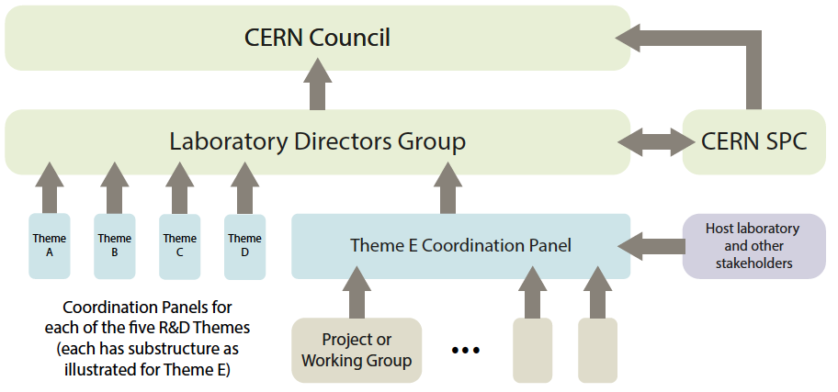

2020 Update of the European Strategy for Particle Physics Physics
under LDG, coordination formed
2021 Accelerator R&D roadmap
High-Field Magnets - Radiofrequency Structures - Muon Beams - Energy Recovery Linacs -
Plasma Acceleration
(Physics Briefing Book)
2021Detector R&D roadmap
2023 DRD collaboration
proposals
under ECFA, on-going this talk
US process : 2022 Snowmass symposium briefing book, P5 strategy update autumn 2023

Slide 3
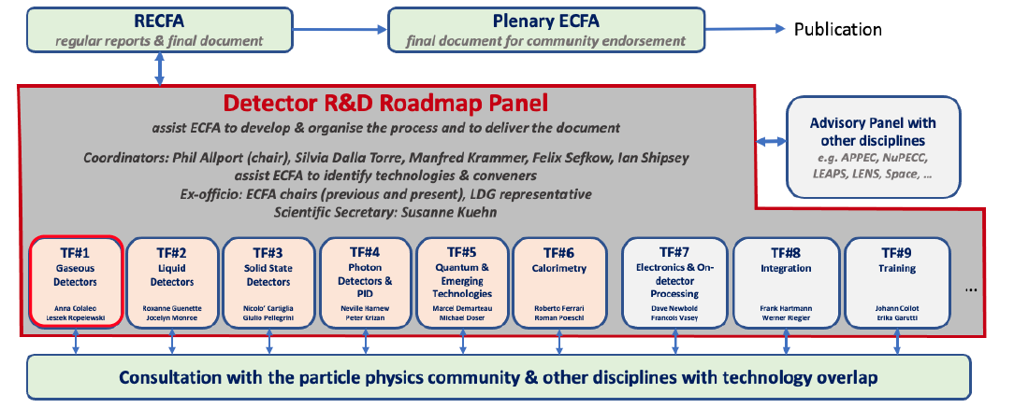
ECFA detector R&D roadmap preparation
9 Task Forces organizing wide consultation of the community* through questionnaires and symposia**
6 areas mapping technologies, detector systems
and strategic programs
3 transverse areas
* Nuclear Physics and AstroParticle (including Gravitational Wave) not considered in the roadmap, but NuPPEC and ApPEC invited to follow the process, also joint ECFA - NuPECC - ApPEC seminars in 2019 - 2022 to develop common instrumental projects
** great source of information on requirements for future experimental programs and State or the Art detector R&D, also US CPAD workshop 2022
4

Slide 4
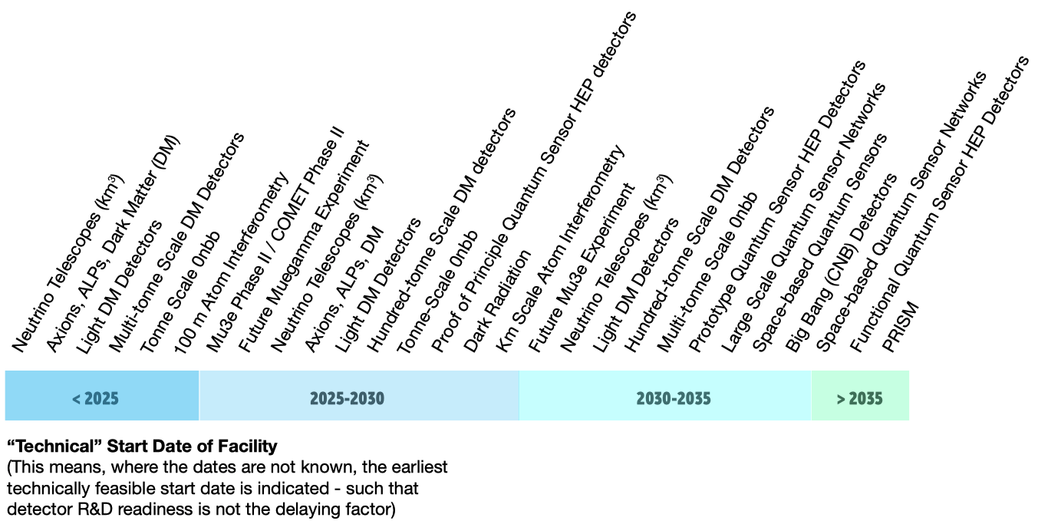
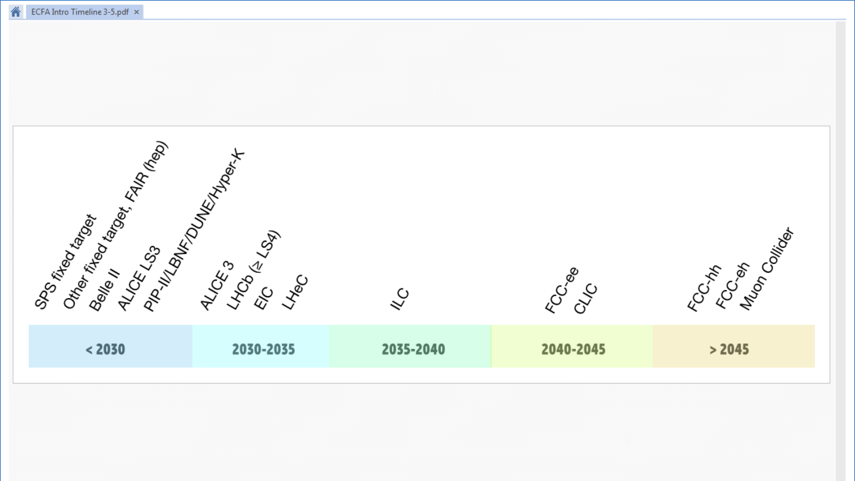
ECFA detector R&D roadmap goal
establish needs to fulfil strategic programs identified by the ESPP update
    future experiments at large accelerator facilities
    future experiments at small accelerators,
    at nuclear reactors and/or with cosmic rays
Dark Matter, Neutrino, 0𝜈ββ mostly related to TF2 liquid detectors and TF5 quantum and emerging sensors
3

Slide 5
ECFA detector R&D roadmap goal
establish needs to fulfil strategic programs identified by the ESPP update
    focus of this presentation
    future collider planning
    préparation – construction - physics - ee, hh, μμ
3

Slide 6
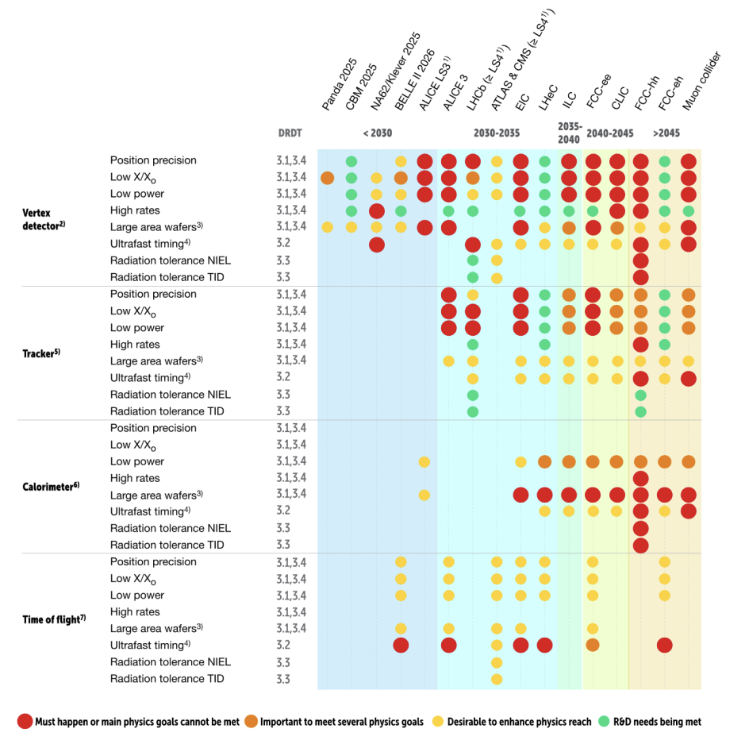
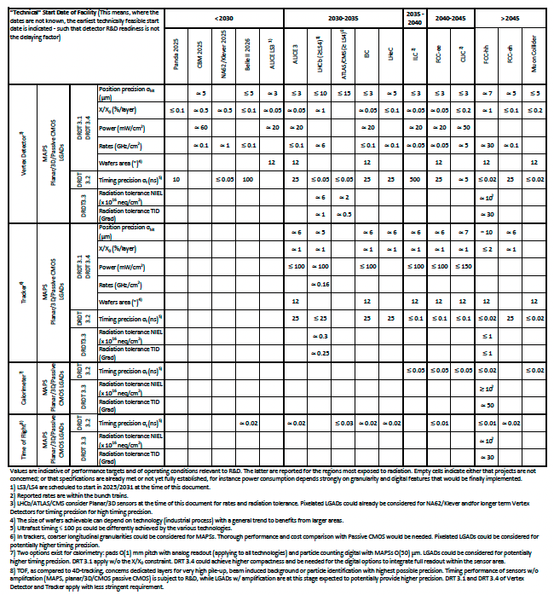
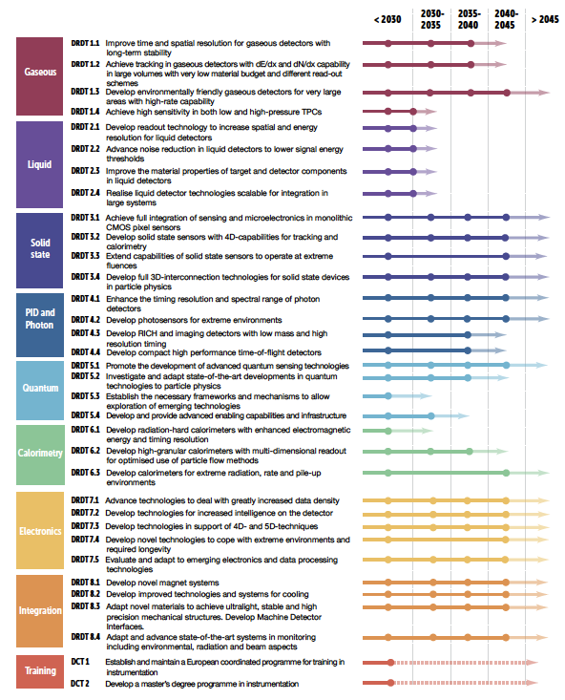
ECFA detector R&D content
Front view of the CMS detector barrel part
ball park performance targets
needs/benefits for physics reach
detector R&D Themes
ex. TF3 Solid State Detector
Systems and technology options
10 General Recommendations to achieve outlined goals, two about execution
GR4: international coordination and organization of R&D activities
ensure red dots are fulfilled and orange achieved to the best by the program need-dates
GR6: establish long term strategic funding program
5

Slide 7
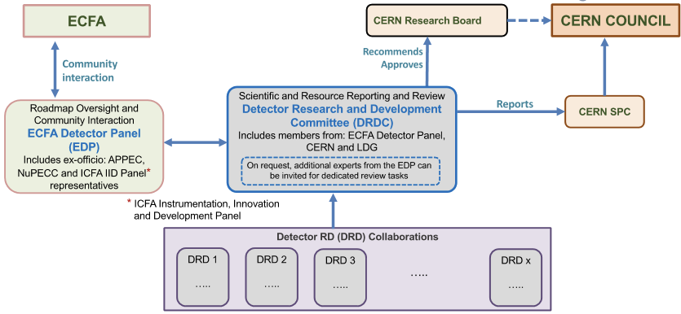
Proposal to implement the roadmap GR4 and GR6 approved by CERN Council Sep. 2022
form DRD international collaborations anchored at CERN with a status similar to experiments:
DRDC scientific review committee*, Funding Agency MoU agreements, Resources Review Board
EDP hosted at DESY : interface to experiments, vetting scope, goals & milestones, acting as expert members in DRDC
DRDC being formed
TFx/DRDx are areas identified by the roadmap
a coordination panel for training (TF9/DRD9)
DRD proposals to DRDC end-July 2023**, collaborations active Jan. 2024, MoUs prepared/signed by FAs in 2024
* Review frequency will de defined by the DRDC, it could typically be every 2 years
** TF7/DRD7 and TF5/DRD5 only LoI in July, full proposal end-2023 /beginning 2024, TF8/DRD8 possibly a forum under discussion
6

Slide 8
Timeline considerations for DRD planning
when technical solutions must be handled to strategic projects*
”Blue sky” low Technology Readines Level continuous R&D process
DRD strategic R&D
Experiment design & system engineering
    Production
    and installation
Physics start
DRD collaborations active Jan. 2024
12 years
3 + 6 + 3 years
CLIC/FCC-ee
Muon Coll.
2037
2048
4 - 5 years
3 + 6 + 3 years
2028
2040
ILC/CCC
3 - 4 years
7 - 8 years
ALICE-3, LHCb-2, ATLAS/CMS, EIC, BELLE-3, stepping stones and also CEPC current planning
2027
2035
7
* ballpark timelines for future colliders, smaller scale projects mostly upgrades of existing experiments with fixed LS4 timeline for HL-LHC

Slide 9
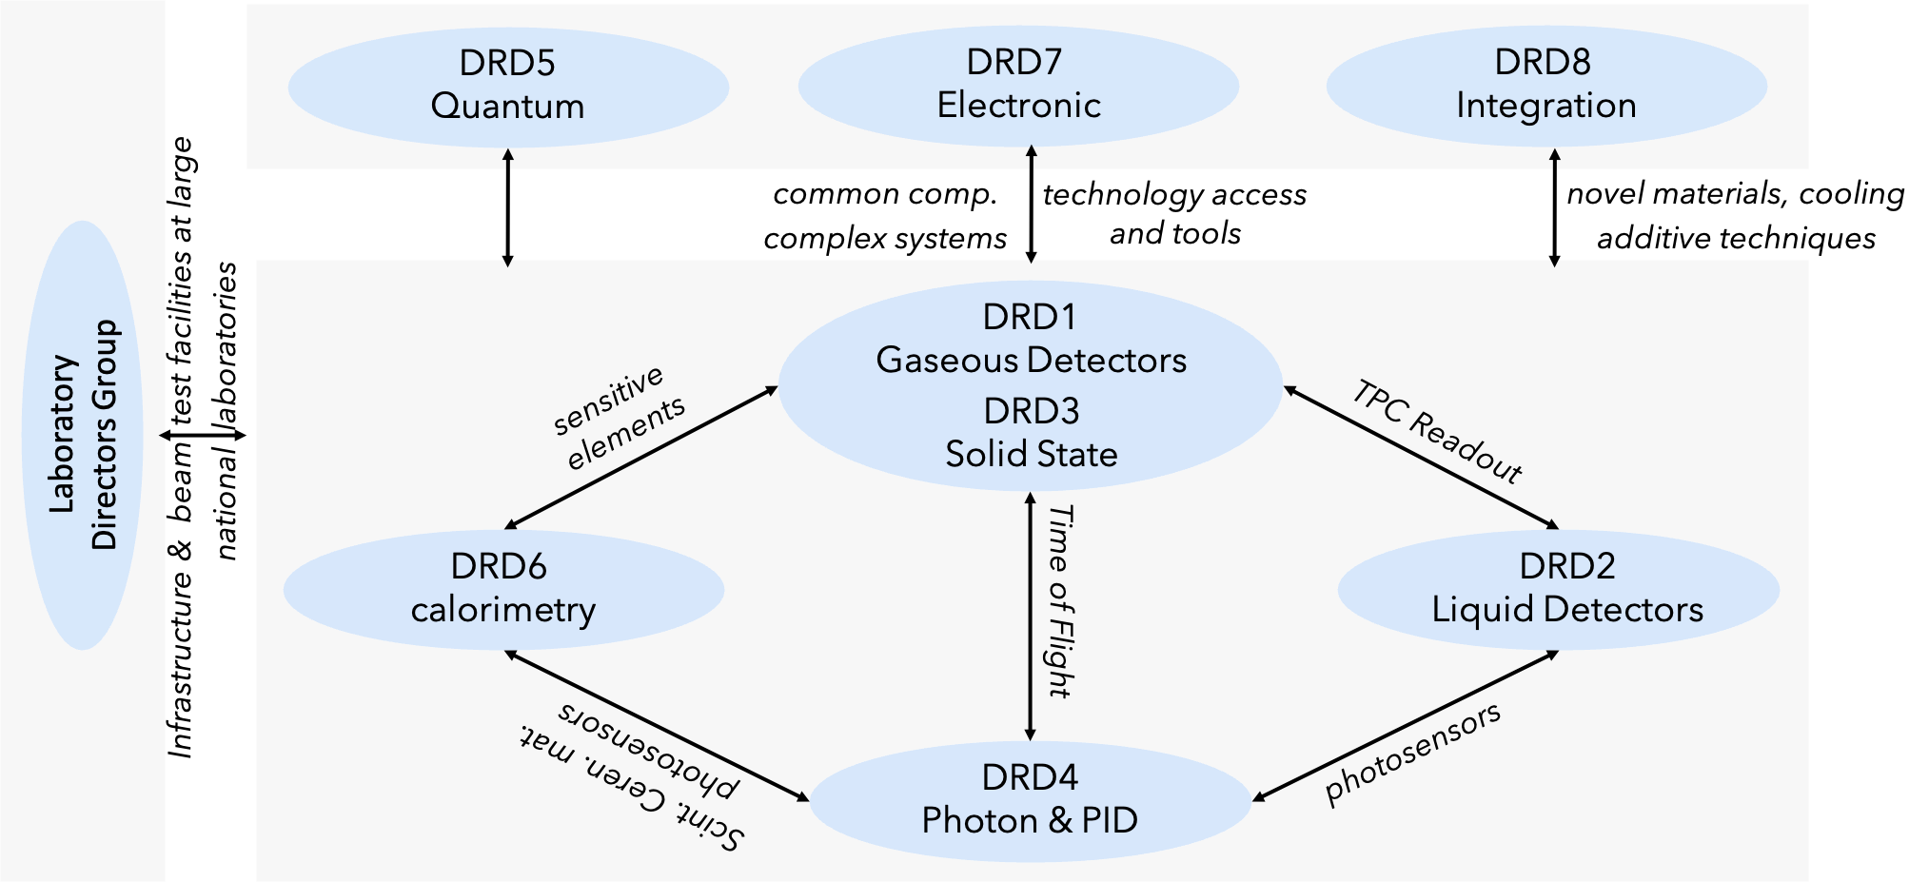
Topical considerations to establish DRD planning
interplay between DRDs
*
direct the community contributions to Work Packages and resources in proper DRD(s)
7
* LNF - Italy, STFC/Daresbury - UK, CIEMAT - DESY, Germany, STFC/RAL - UK , LNGS - Italy, F.CEA/Irfu – France, IJCLab – France, Nikhef - Netherlands, PSI - Switzerland

Slide 10
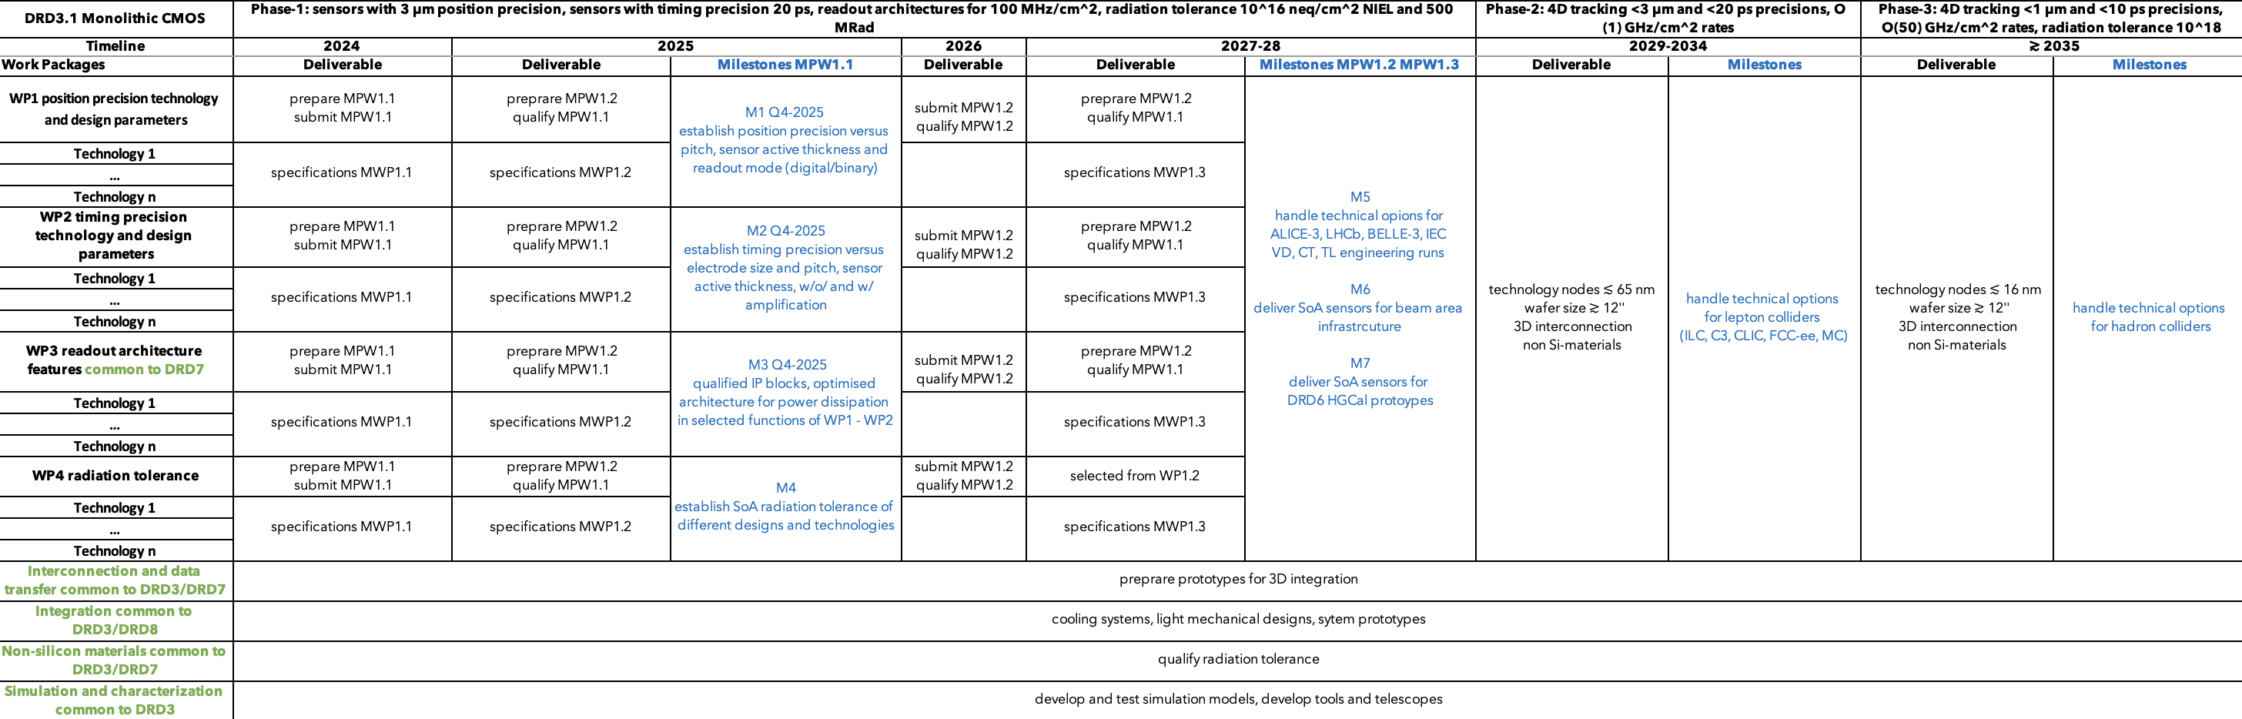
DRD proposals scientific content
technology Work Packages planning
deliverables - milestones
transverse activities planning
simulation/characterization tools, beam test facilities, industrial partnership, dissemination & networking
Work Packages & technology options
not contractual ex. Monolithic CMOS DRD3.1
1st period typically 3-4 years
targeting stepping stone programs (slide 8)
previsions
toward longer term strategic projects
programs will evolve* with experiment requirements & R&D progress including blue sky growing TRL
* In relation with review process cycles
7

Slide 11
DRD proposals resources and organization structure content
demonstrate programs can reasonably be achieved
Public documents will contain:
  list of institutes willing to contribute to each WP
  scale of human and funding resources required to achieve each WP
  management, committees and working group organization
Confidential material on resources in support of programs will be submitted to the DRDC
  sum of resources (HR and funding) currently expected to be available
  sum of new strategic resources sought
  initial money matrix of contributions per Funding Agency
It is expected that institutes will have entered into negotiations with their Funding Agency
to ensure that the assumptions on additional strategic support can be considered
(although not guaranteed before MoU 1st agreements*)
7
* it is foreseen that MoUs will be regularly updated as the R&D programs evolve (with a frequency to be agreed between CERN and FAs)

Slide 12
DRD collaboration proposal preparation
under ECFA roadmap panel (slide 3), with TF experts and existing program conveners*
  TF1/DRD1 Gaseous Detectors https://indico.cern.ch/event/1214405/
  TF2/DRD2 Liquid Detectors https://indico.cern.ch/event/1214404/
  TF3/DRD3 Solid State Detectors https://indico.cern.ch/event/1214410/
  TF4/DRD4 Photon Detectors and PID https://indico.cern.ch/event/1214407/
  TF5/DRD5 Quantum and Emerging Technologies https://indico.cern.ch/event/1214411/
  TF6/DRD6 Calorimetry https://indico.cern.ch/event/1213733/
  TF7/DRD7 Electronics and On-detector Processing https://indico.cern.ch/event/1214423/
  TF8/DRD8 Integration https://indico.cern.ch/event/1214428/
  TF9/DRD9 Training https://indico.cern.ch/event/1214429/
Wide consultation with the community**, workshops & surveys to establish program & contributions
* ex. current CERN RD which mandate end end-2023 and will become part of the new wider scope DRD collaborations:
RD51 (MPGDs) in TF1/DRD1, RD50 (radiation hard semiconductors) & RD42 (diamond) in TF3/DRD3, RD18 (crystals) in TF4/DRD4 and TF6/DRD6
** Subscription to follow the process and to contribute at the links
7

Slide 13
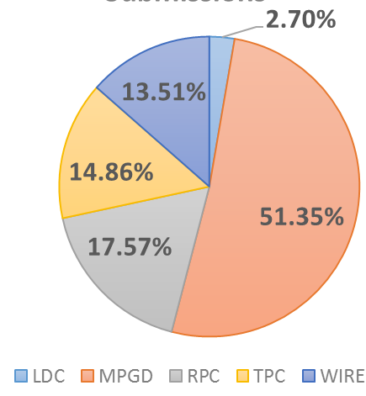
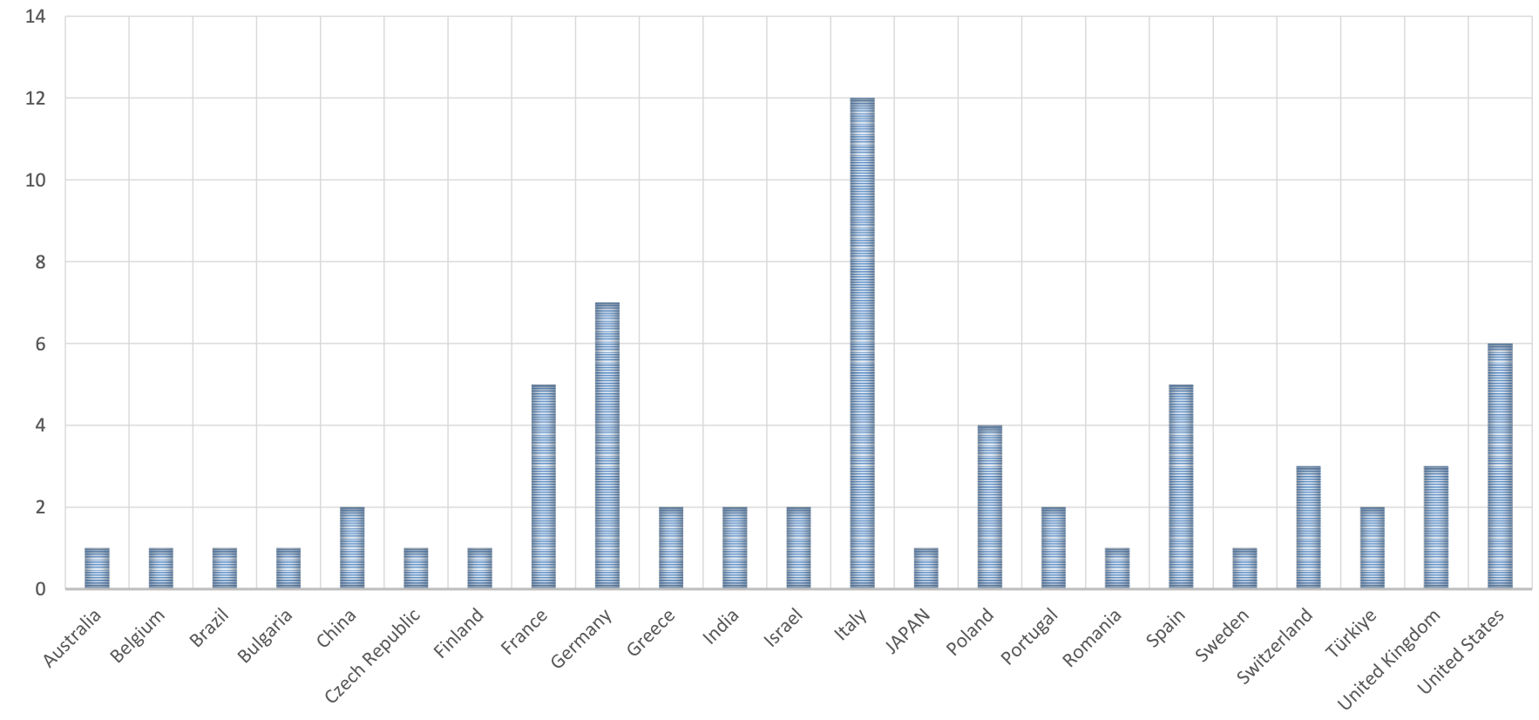
DRD1 Gaseous Detectors program & community building status
conveners: Anna Colaleo, Leszek Ropelewski, 292 people registered
Organized in 8 working groups to develop the R&D program
  WG1 : technologies MPGDs, RPC, Wires, TPC, DCH
  WG2 : applications muon tracking and triggering, Central Tracking with PID, Photon Detection, ToF, High Granularity Calorimetry, TPC for rare event searches
  WG3 : gas and material studies
  WG5 : electronic components
  WG6 : detector production
  WG7 : common test facilities
  WG8 : training and dissemination
Detailed survey in each WG to assess community interests
  74 contributions presented at 1st community meeting
Planning of technology Work Packages (deliverable/milestones)
  on-going mapping of needs and aspirations of the community
Discussion of collaboration structure on-going
  proper arrangement of technology and transverse activities
DRD1 proposal draft at 2nd community meeting
Geographical distribution
Colors indicative of Technology areas versus transverse activities
6

Slide 14
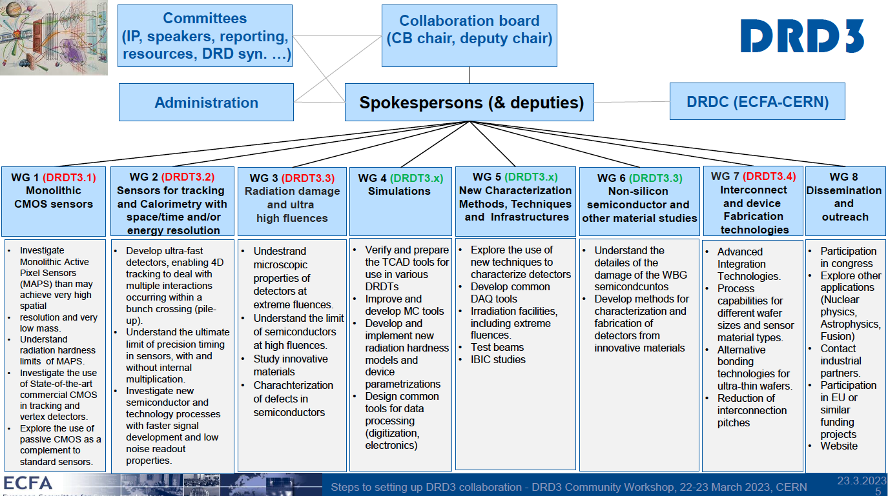
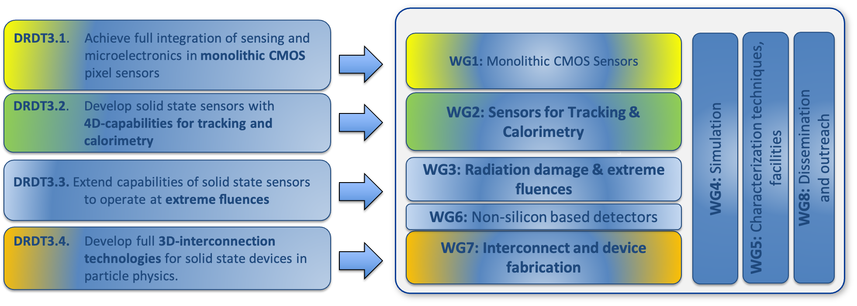
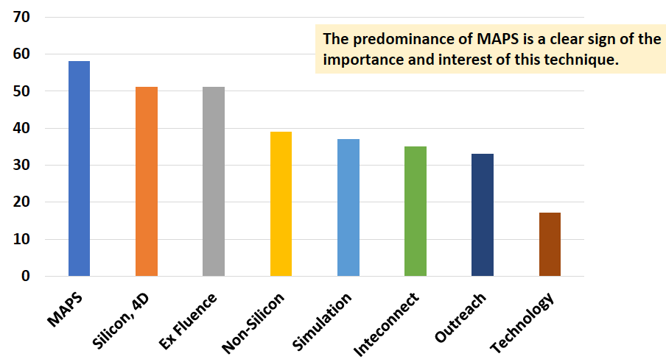
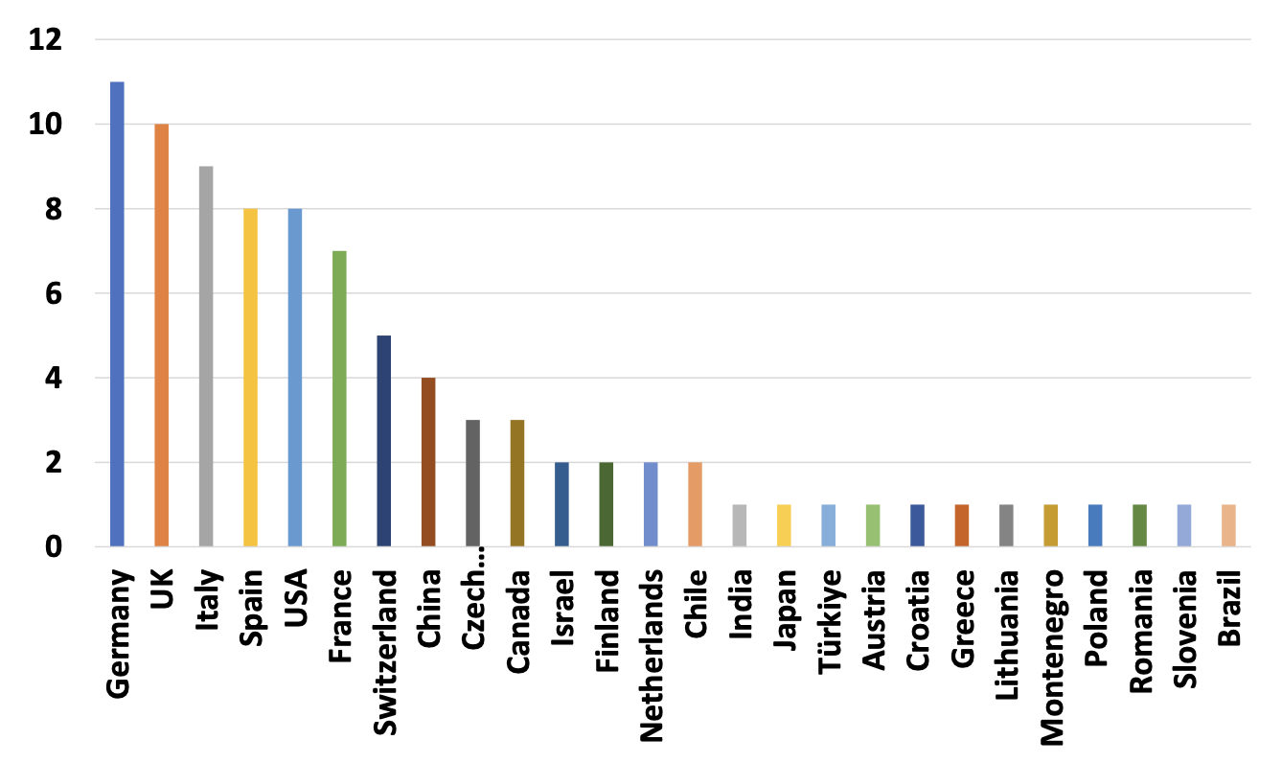
DRD3 Solid State Detectors program & community building status
conveners: Nicolo Cartiglia, Giulio Pellegrini, 484 people registered
Organized in 8 working groups to develop the R&D program
  WG1 : Monolithic CMOS sensors
  WG2 : sensors for tracking and calorimetry (Hybrid, LGADs)
  WG3 : radiation damage and ultrahigh fluence
  WG5 : characterization techniques, facilities
  WG6 : non silicon based detectors
  WG7 : Interconnect and device fabrication
  WG8 : dissemination and outreach
Survey to assess community interests
  88 contributions presented at 1st community meeting
Planning of technology Work Packages (deliverable/milestones)
  on-going mapping of needs and aspirations of the community
DRD3 proposal draft beginning of June
Predominance of CMOS(MAPS)
Geographical distribution
6

Slide 15
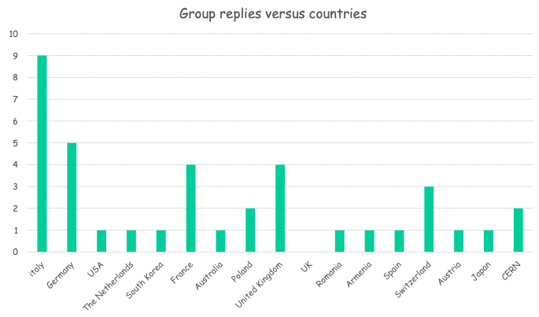
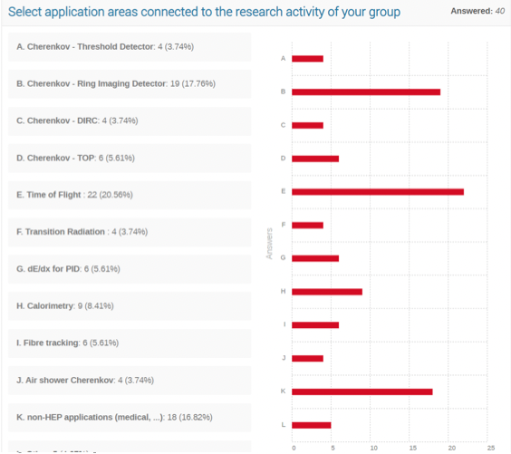
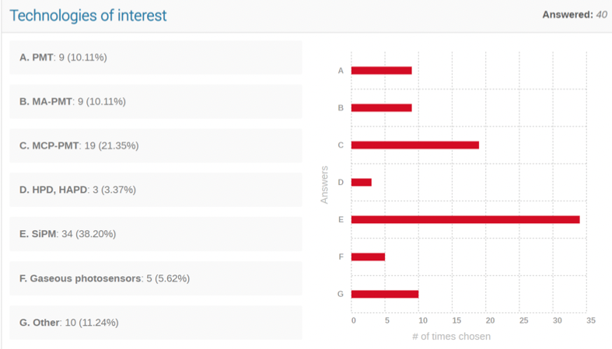
DRD4 Photon Detectors and PID program & community building status
conveners: Peter Krizan, Christian Joram, 217 people registered
4 Technology areas identified in coordination meeting
  WG1 : photodetector (SiPM, SPADs, PMT/MCP-PMT, Gas)
  WG2 : particle ID (RICH/DIRC/TOP,TORCH/ToF)
  WG3 : technologies (radiators, optical elements, readout, cooling, software)
  WG4 : emerging technologies (novel materials and concepts…)
Survey to assess community interests
  40 contributions
Planning of technology Work Packages (deliverable/milestones)
  1st community meeting this week 16 – 17 May
DRD4 proposal draft end-June
WG2
WG1
6

Slide 16
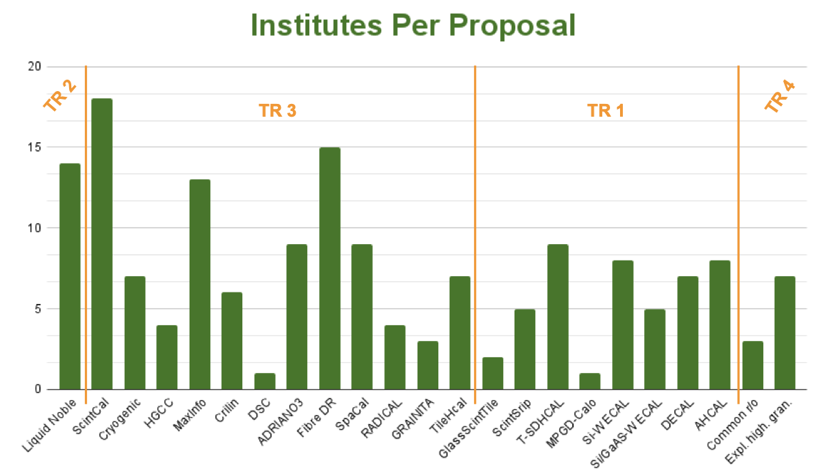
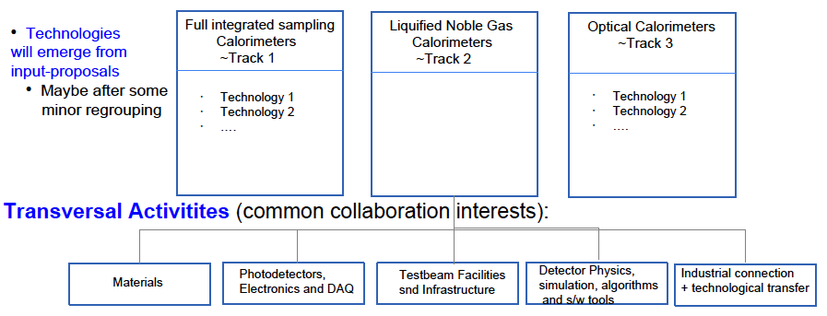
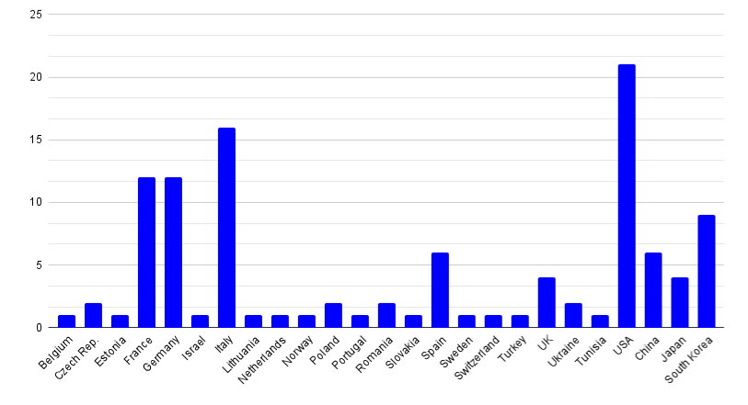
DRD6 Calorimetry program & community building status
conveners: Roberto Ferrari, Roman Pöschl, 232 people registered
Organized in 4 working groups to develop the R&D program (1st community meeting)
  WG1 : full integrated sampling calorimeters
  WG2 : liquified Noble Gas calorimeters
  WG3 : optical calorimeters
  WG4 : transverse activities
Survey to assess community interests
  23 contributions, 110 institutes, presented at 2nd community meeting
Planning of technology Work Packages (deliverable/milestones)
  on-going mapping of needs and aspirations of the community
DRD6 proposal draft beginning of June
Institutes per proposal
WG2
WG3
WG1
WG4
Institutes per country
6

Slide 17
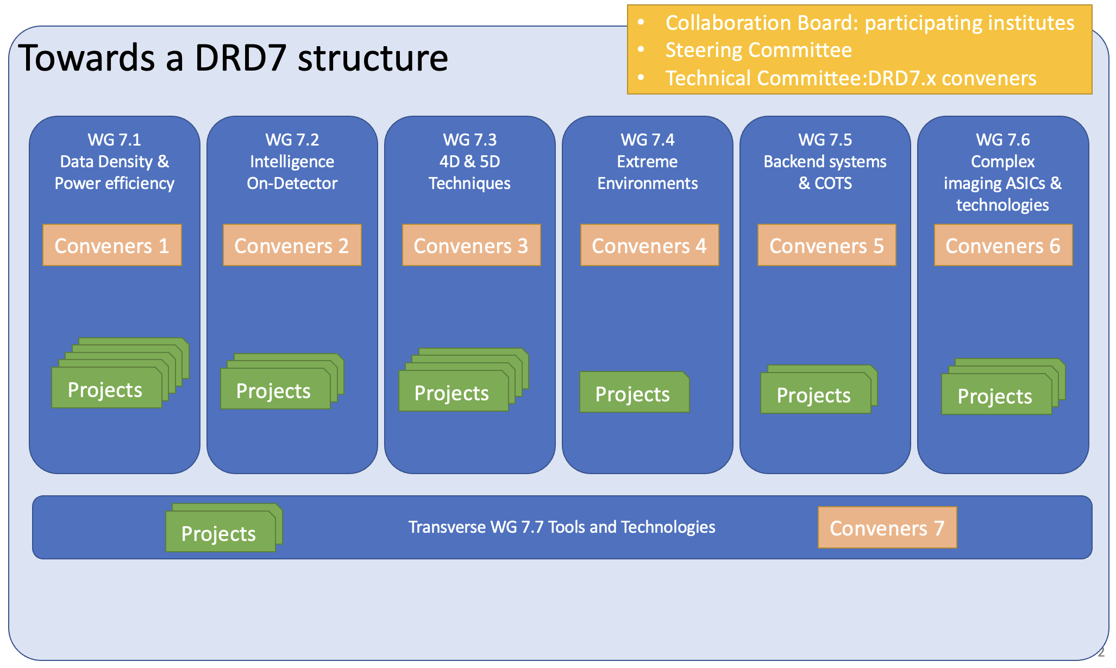
DRD7 electronics and on-detector processing program & community building status
conveners: Francois Vasey, Dave Newbold, 183 people registered
Technology areas identified at 1st community workshop
  WG1 : data density and power efficiency
  WG2 : intelligence on the detector
  WG3 : 4D and 5D techniques
  WG4 : extreme environments
  WG5 : backend systems and cots
  WG6 : complex imaging ASICs and technologies
  WG7 : provision access to tools and technologies (vendors)
Interaction with other DRDs
  DRDs provide specification, planning, production and characterisation of prototypes with relevant RH and funding
  DRD7 review specifications and designs, develop and provision common IP, components, and subsystems, deliver common, generic, complete components / systems, when big or complex
      Work organisation proposal being investigated
        Tiered/platform structure of competences (with appropriate sharing of human resources with other DRDs)
Next steps
  May-June collect expressions of interest in specific projects, define common plans and interface to other DRDs
  July DRD7 LoI indicating broad scope, composition and resource needs scale
  September 2nd community workshop to discuss Work Packages
  December proposal submitted to DRDC including resources
organization proposal
6

Slide 18
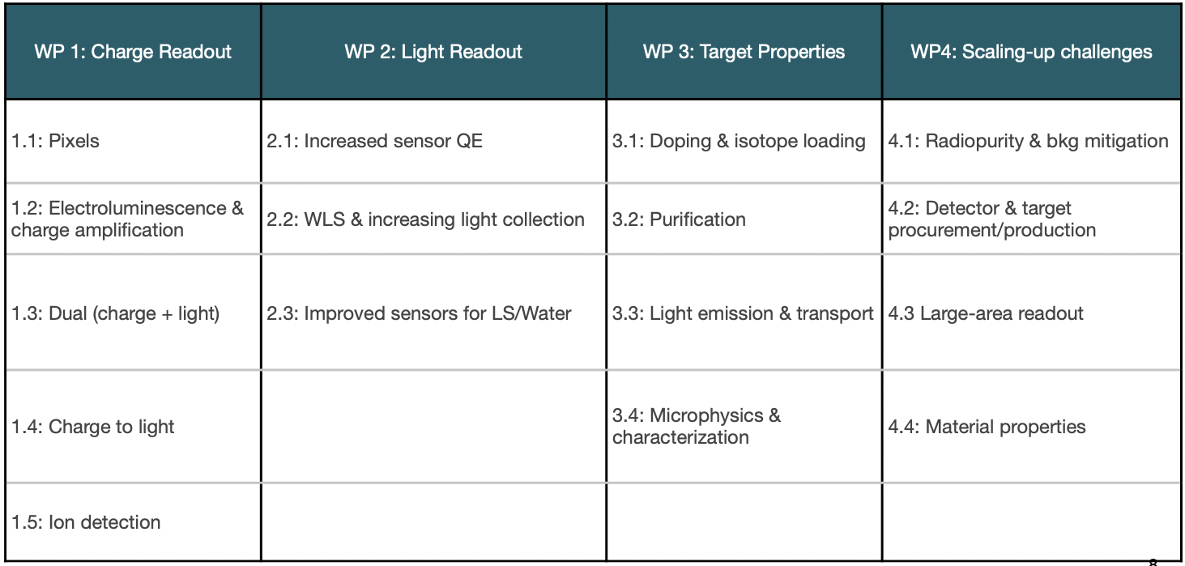
DRD2 Liquid Detectors program & community building status
conveners: Roxanne Guenette, Jocelyn Rebecca Monroe, Ian Shipsey, 168 people registered
Technology areas identified in coordination meeting
  WG1 : charge readout
  WG2 : light readout
  WG3 : target properties
  WG4 : scaling-up
Planning of technology Work Packages
  1st community meeting
Survey to assess community interests and WP deliverables/milestones on-going
DRD2 proposal draft early-June
WG1
WG2
WG3
WG4
WPs
6

Slide 19
DRD5 Quantum and emerging technologies program & community building status
conveners: Michael Doser, Marcel Demarteau, Ian Shipsey, 164 people registered
Proposal to organize WGs define in expert workshop Apr.
  WG1 : clocks, clock networks
  WG2 : kinetic detector
  WG3 : superconducting spin based sensors
  WG4 : optomechanical sensors
  WG5 : atoms, molecules, ions, interferometry
  WG6 : meta materials 0-1-2D materials
Next steps
  circulate minutes of workshop with seeds of Work Package
  circulate white paper to organise WGs
  July submit LoI to DRDC with initial projects and resource needs scale
  September 1st community meeting to tune WP proposal
  January 2024 submit proposal to DRDC
6

Slide 20
Summary
Forming DRD collaborations raises strong international interest
it is a good time to join
Establishing first stage of R&D programs is well underway
These programs will have dynamic evolution
integrating new ideas while handling solutions to strategic programs
Positive feedback from FAs was received through rECFA
DRD programs will value investments with potential to ramp-up resources
6

Slide 21
Additional material
10

Slide 22
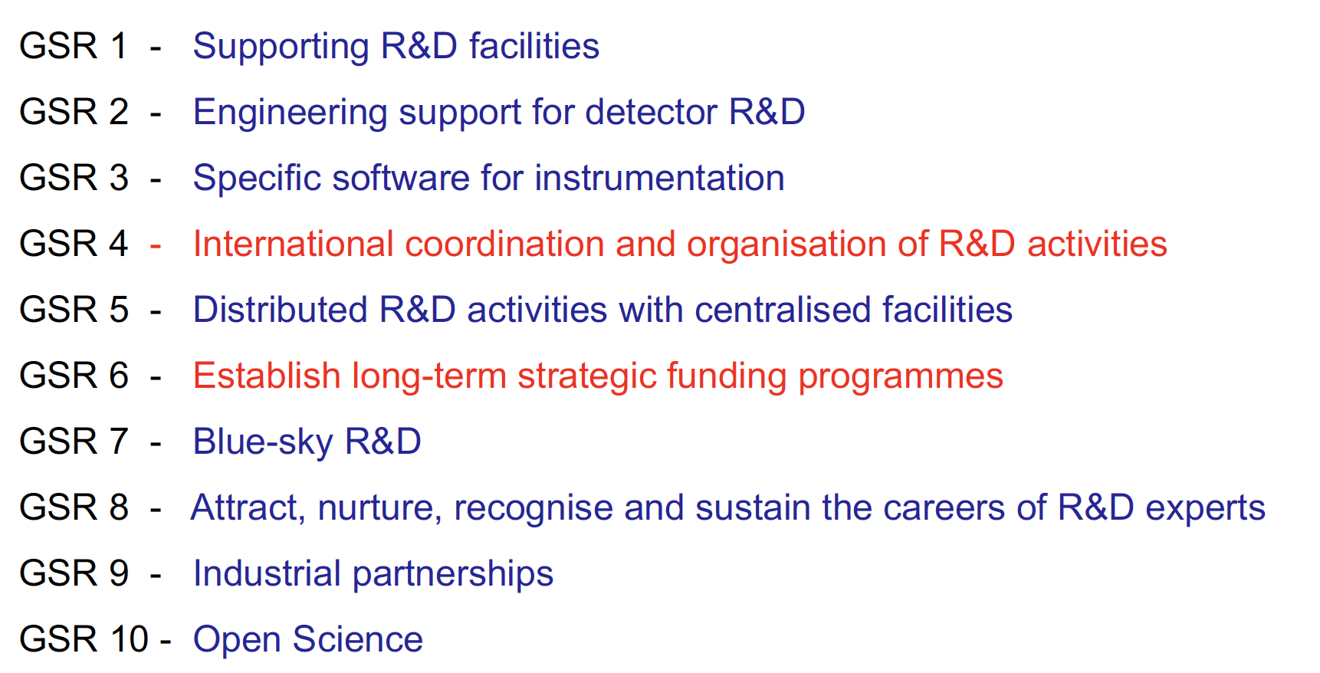
ECFA Detector R&D roadmap recommendations
11

Slide 23
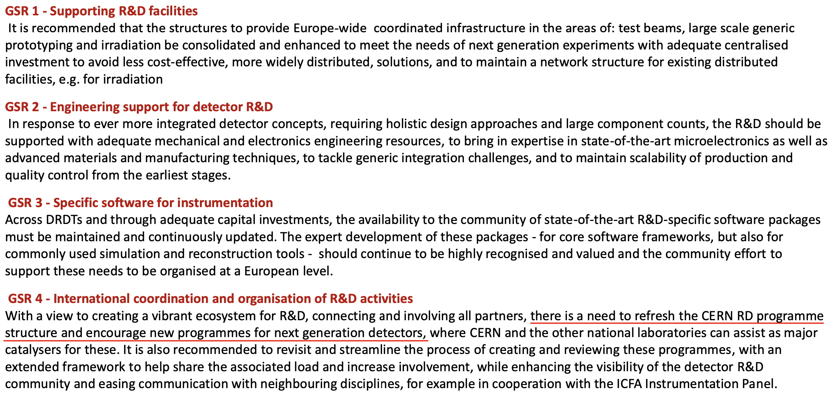
ECFA Detector R&D roadmap recommendations
11

Slide 24
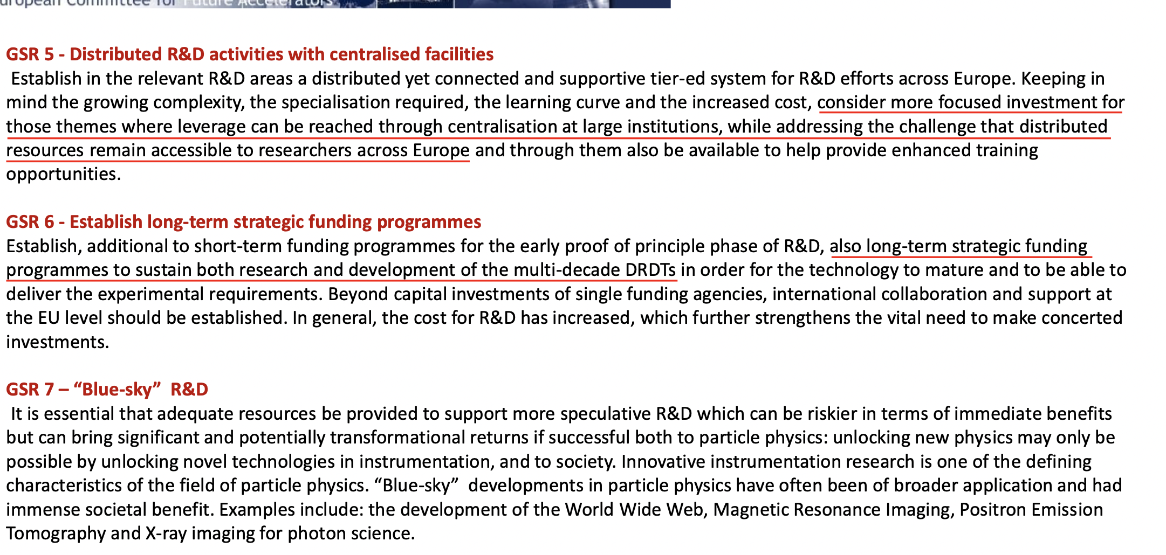
ECFA Detector R&D roadmap recommendations
11

Slide 25
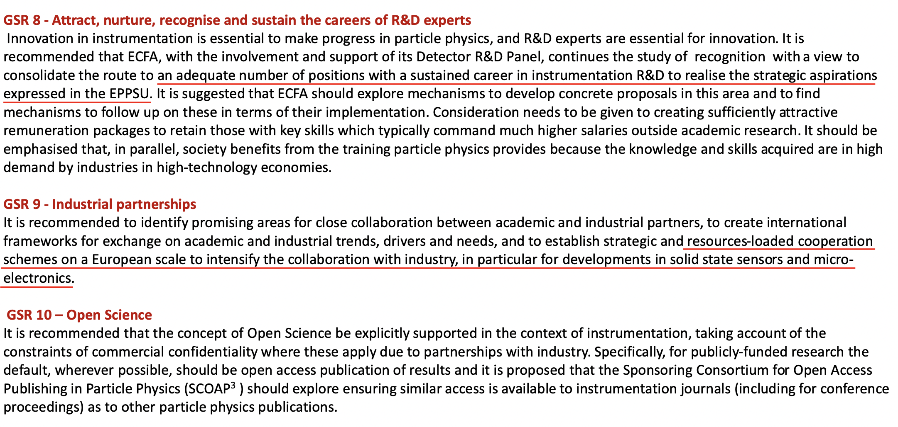
ECFA Detector R&D roadmap recommendations
11

Slide 26
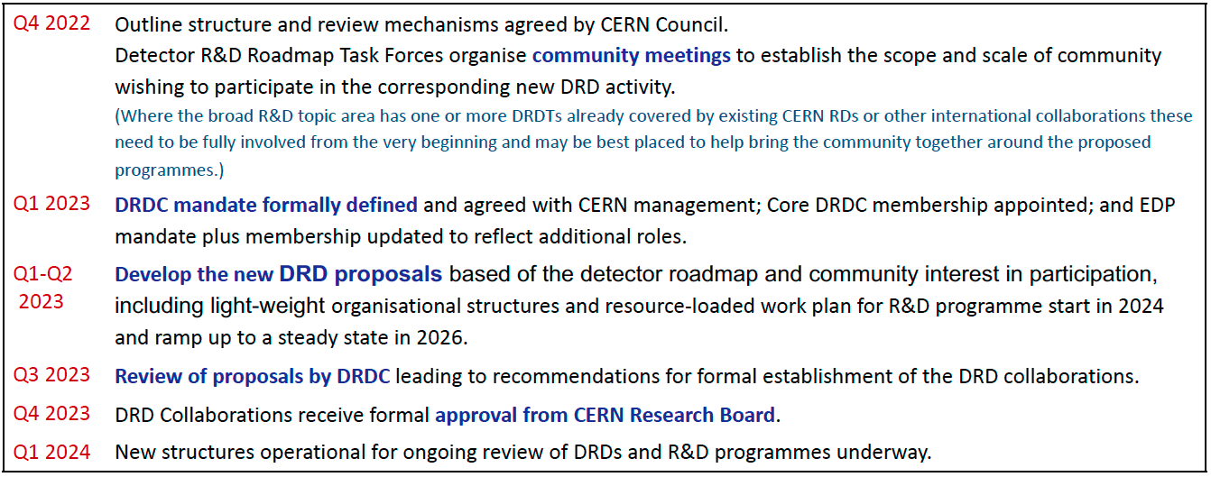
Overall process and timeline to form the DRD collaborations*
7
* Presentation of K. Jakobs at the SPSC on Sept. 27, 2022 (private communication)

Slide 27
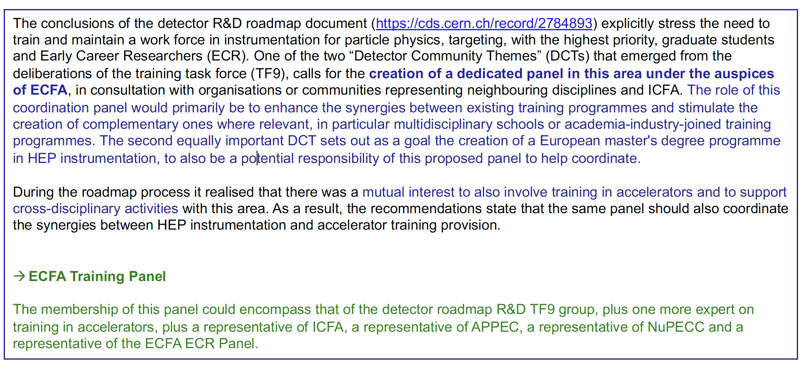
Plans for training (TF9)
* Presentation of K. Jakobs (ECFA Chair) at the SPSC on Sept. 27, 2022 (private communication)
12

Slide 28
Further references
DOE Basic Research Needs Study on High Energy Physics
CERN EP R&D program
AIDAINNOVA European Program (linking research infrastructures in detector development and testing)
Attract European Program (linking to industry on detection and imaging technologies)
ECFA EDP documents (input to ESPP, community survey…)
12

