Slide 1
ECFA Higgs Factories Study: Physics Analysis Tools
Dirk Zerwas
IJCLab and DMLab
May 18, 2023
LCWS
Introduction
ECFA WG2
KEY4HEP
Conclusions and Outlook

Slide 2
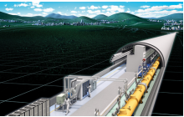
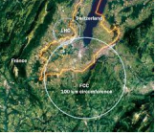
Introduction
Aidan Robson’s talk
ECFA Study on Physics, Experiments and Detectors at a Future e+e- Factory
ECFA recognizes the need for the experimental and theoretical communities involved in physics studies,
experiment designs and detector technologies at future Higgs factories to gather. ECFA supports a series
of workshops with the aim to share challenges and expertise, to explore synergies in their efforts and
to respond coherently to this priority in the European Strategy for Particle Physics (ESPP).
Goal: bring the entire e+e- Higgs factory effort together, foster cooperation across various projects;
collaborative research programmes are to emerge
Multi-year study to conclude in a ECFA report
Until ~2025: before the next European Strategy update

Slide 3
Introduction
WG 1: Physics Potential
Convener: Patrick Koppenburg (NIKHEF Amsterdam), Jenny List (DESY), Fabio Maltoni (UC Louvain / Bologna) and
Jorge de Blas (Granada)
WG 2: Physics Analysis Methods
Convener: Patrizia Azzi (INFN-Padova / CERN), Fulvio Piccinini (INFN Pavia) and Dirk Zerwas (IJCLab / DMLab)
WG 3: Detector R&D
Convener: Marie Cruz Fouz (CIEMAT - Madrid), Giovanni Marchiori (APC Paris) and Felix Sefkow (DESY)
Editors of the ECFA report (2025)
Aidan Robson (Glasgow) and Christos Leonidopoulos (Edinburgh)
ECFA Working Groups are not restricted to Europe!
Meetings:
https://indico.cern.ch/category/14055/
Mailing list (e-group):
ecfa-Workshop-Higgs-factory@cern.ch
One workshop per year:
October 11-13, 2023 Paestum (south of Naples)
https://agenda.infn.it/event/34841/

Slide 4
ECFA WG2
Assignment from ECFA:
Monte Carlo generators for e+e- precision EW, Flavour, Higgs, and top physics,
Luminosity measurements
Software framework
Fast simulation and the limitations of such techniques
Full Simulation
Track and vertex reconstruction algorithms
Jet algorithms / jet reconstruction
Particle-flow reconstruction and global event description
Requirements on particle identification
Flavour tagging algorithms
Importance of timing information
Constrained fit
Translated into concrete Topics:
SOFTWARE ECOSYSTEM
GENERATORS
SIMULATION
RECONSTRUCTION

Slide 5
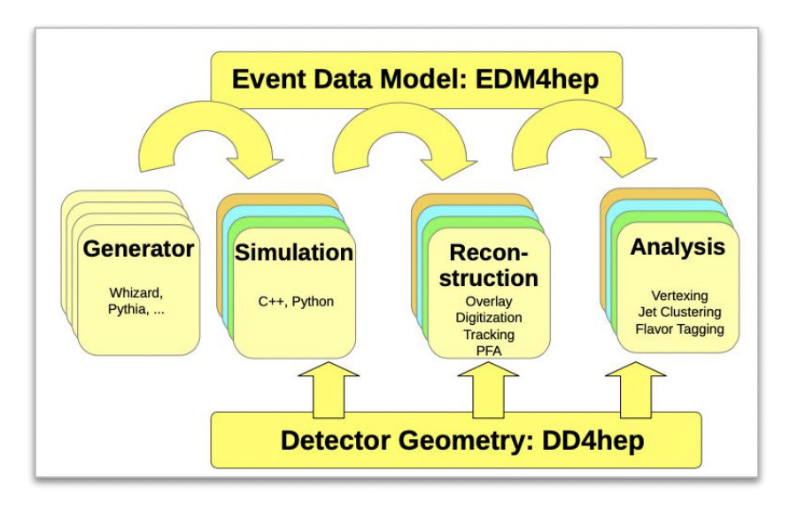
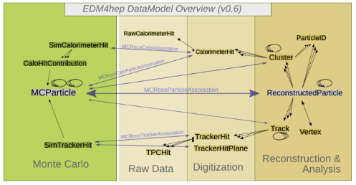
ECFA WG2 and KEY4HEP
Graphically:
Independent steps to the analysis
Linked through geometry
Software framework
Historically, individual solutions chosen:
ILD, SiD, CLIC: ilcsoft with DD4hep, LCIO and Marlin
CEPC: CEPCSW
FCC-ee: FCCSW
C^3: CMS-based/inspired
But common needs
Geometry for simulation and reconstruction
Reconstruction with Particle Flow
ECFA choice: Software ecosystem KEY4HEP

Slide 6
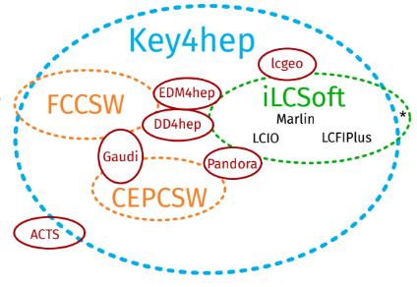
KEY4HEP
Frank Gaede
Gerardo Ganis
Andre Sailer
The ECFA choice: Software ecosystem KEY4HEP
Funded through AIDA-Innova
Adopted by SiD, ILD, CEPC, CLIC, FCC-ee aka fully developing and/or migrating to
Important involvement/contributions from all continents (China, Europe) and all gradients, circular and linear: FCC-ee, CEPC and linear: ILD, SiD, CLIC
Ecosystem (not just a framework):
Geometry: DD4HEP
EDM: EDM4hep
ilcsoft with LCIO, LCFIPlus, lcgeo
CEPCSW
ACTS (ATLAS inspired tracking) in progress

Slide 7
KEY4HEP: Framework
Framework:
Gaudi
LHCb initiated, adopted by ATLAS
Open source and project independent
Active support (HL-LHC)
Data processing framework designed to manage experiment workflows
Separation of data and algorithms; well defined interfaces
Separation of persistent and transient data
Language C++
Configuration: Python
Code:
Algorithm
Tool
Interface
Services
ILD
ilcsoft
Migrated to KEY4HEP by wrappers
Full translator LCIO EDM4hep ready
SiD
Java
ilcsoft
Follow ILD to migrate to KEY4HEP
CEPC:
Started from ILCsoft
Switched to KEY4HEP
Contributions to KEY4HEP
Initiated LCIO2EDM4hep work
FCC:
Started in KEY4HEP

Slide 8
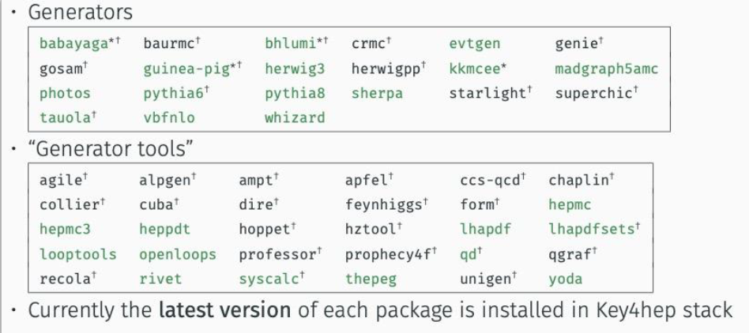
KEY4HEP: Generators
Generators:
Interfaces to many generators
Interfaces to key4hep processing chain (k4Gen)
Readers for relevant data formats
Set of auxiliary tools related to MC particles (filters, smearing, particle guns, …)

Slide 9
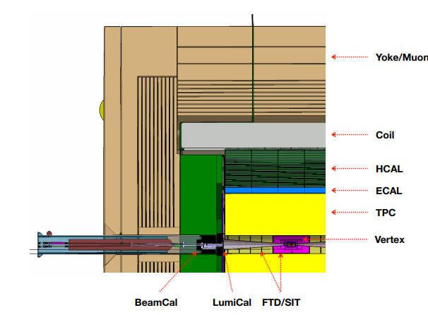
KEY4HEP: Geometry
k4geo:
DD4hep detector models spread in several project repositories
ilcsoft/lcgeo, FCCDetectors, CEPCSW/Detector
k4geo is an attempt to reduce risk of duplications
LOI SiD:
SLIC (C++-based Geant4 wrapper with simplified XML for geometry description)
Mix of SLIC and Marlin Reco for DBD
Moved to DD4hep after DBD
Availability:
ILD
SiD
CLICdet
CLD
IDEA
Noble-Liquid Based
DD4HEP:
Easy transition for SiD, ILD, CLIC: took part in the development
FCC feedback: difficulties even for people with experience in Geant4
FCC engineering baseline designs not fully there yet

Slide 10
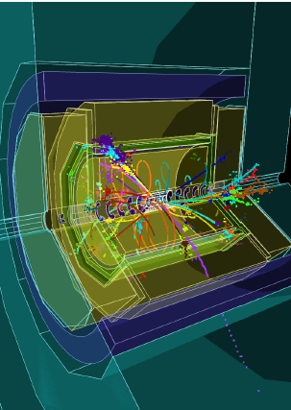
KEY4HEP: Simulation
k4sim:
Fast simulation DELPHES
Full simulation Geant4
KEY4HEP:
The detailed simulations of ILD, SiD, CLD are alive
SiD:
Transition done (extensive work to keep in sync with engineering model
Needs a careful validation
FCC-ee:
Strong reliance on DELPHES (with upgrades for tracking)
Detector models are (mainly) physicists models, engineering in progress and implementation in DD4HEP in progress

Slide 11
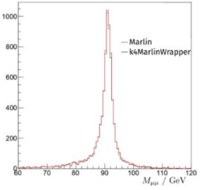
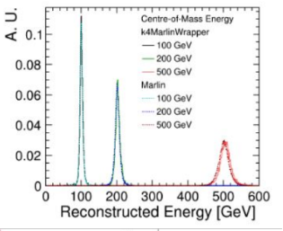
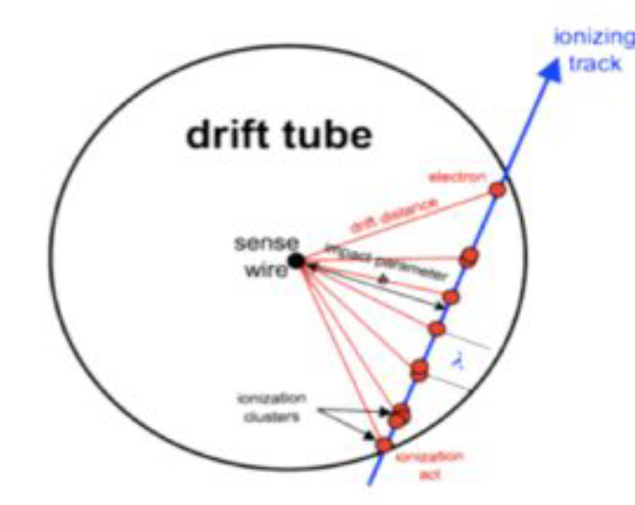
KEY4HEP: Reconstruction
LinearWorld:
Marlin
MarlinWrapper allows smooth transition from LCIO/Marlin to Gaudi/EDM4hep via "mix and match"
SiD:
Org.lcsim
Followed by Java Analysis Studio (JAS) / HEPREP / WIRED for event display and interactive(!) Python-based analysis
Moved to Marlin/PandoraPFA/LCFIPlus
Detector feedback:
CALICE calorimetry: timing
Feeding back into EDM4hep
FCC and CEPC:
Cluster counting in reconstruction
Fed back into EDM4hep

Slide 12
WG2 Activities: Generators
Getting all interested parties together on “neutral” ground:
1st Topical Meeting on Generators
Nov 9-10, 2021 (CERN, hybrid)
Take aways:
Whizard is/has been THE workhorse
New developments in LHC generators: MADGRAPH, SHERPA,…
New developments of old generators: KKMCee, BabaYaga,…
☹ hard to get Monte Carlo groups interested in Polarization, but work and resurrection work (MADGRAPH and SHERPA) started by Alan Price and Stefano Frixione
Focus Meeting on Beamstrahlung
Jan 12, 2022 (zoom)
Follow-up on Topical Meeting:
In-depth discussion of Beamstrahlung
Better understanding of CIRCE
Disagreement on FCC-ee Beamstrahlung (No effect, time dependent effect)
Daniel Schulte+Thorsten Ohl will provide sets for all for the ECFA report
2nd Topical Meeting on Generators
June 21-22, 2023 Brussels
https://indico.cern.ch/event/1266492/
Goals:
Interface to KEY4HEP and intermediate IO issues
Technical Benchmarks for ECFA report (Alan Price in charge)
CPU versus precision
ECFA Topics: Generators
Input Standardization for Benchmarks and ECFA Topics
Production?

Slide 13
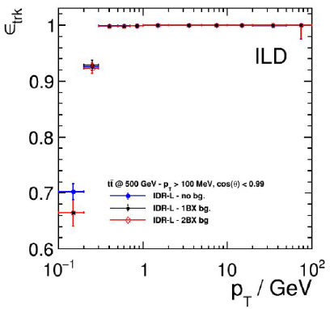
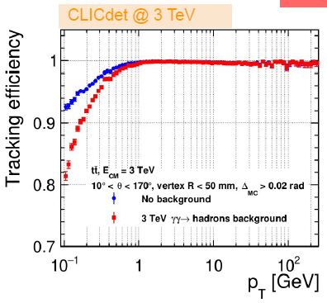
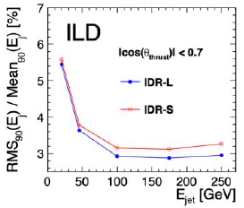
WG2 Activities: Simulation and Reconstruction
1st Topical Meeting on Simulation
Feb 1-2, 2022 (zoom)
Take aways:
DELPHES available in KEY4HEP
SGV produces LCIO
Detailed simulations available for LC world
CEPC contributing
FCC-ee moving towards GEANT4
Being in a common system helps!
1st Topical Meeting on Reconstruction
May 4-5, 2022 (DESY, hybrid)
Take aways:
ILD tracking
CLIC conformal tracking
LHC ACTS
FCC-ee Cluster counting
ParticleFlow is the common basic reconstruction tool/paradigm: PandoraPFA/Arbor
Being in a common system helps!
2nd Topical Meeting on Reconstruction
July 11-12, 2023
Take aways:
High level reconstruction
Particle ID
Cross reconstructions, e.g., ACTS on ILD? Which comparisons make sense?

Slide 14
Questions for the Future
Wishlists:
Event display (Phoenix ready to rise)
Modularity of detector configurations (partially done for FCC)
Machine-Learning: should this be made available? (historic example MVA using root then becoming part of root)
Timescales (my personal take):
FCC-ee: short term production readiness by end of 2023
ILC, CLIC, CEPC: continuous improvement/migration (ecosystem continues to allow for production through ilcsoft)
Full lcio to EDM4hep converter defines switchover readiness: done now
HPC:
Concrete work in ACTS will become available when integrated in KEY4HEP
Gaudi can do MT (athenaMT)
Gaussino integration (work by CEPC)
Support/Person power:
Support at CERN (2 permanent + fellows)
Support at DESY (1permanent + fellow)
Support at CEPC (permanent and postdocs multi-task)

Slide 15
Conclusions and Outlook
ECFA Higgs Factories Study:
Bring together all e+e- communities irrespective of gradient and continent
KEY4HEP:
Excellent collaboration between ILC, CLIC, CEPC, FCC-ee on
Geometry
Generators
Simulation
Reconstruction
Future work:
Join the e-group at CERN: ecfa-Workshop-Higgs-factory@cern.ch
Thank you to:
Thank you to Patrizia Azzi, Frank Gaede, Gerardo Ganis, Weidong Li, Fulvio Piccinini, Andre Sailer, Jan Strube for their input!
En route to ECFA report: Your Participation is welcome
Excellent Team in place: Join them!

