Slide 1
High Temperature Superconducting for RF cavity
Mitchell E. Schneider, Gregory. P. Le Sage, Ankur Dhar, and Emilio A. Nanni;
SLAC National Accelerator Laboratory, Menlo Park,California,USA
Jessica Golm, Patrick KrKotić,Walter Wuensch, Sergio Calatroni;
CERN, Geneva, Switzerland
Neil Lamas and Joffre Gutierrez; ICMAB-CSIC, Barcelona, Spain

Slide 2
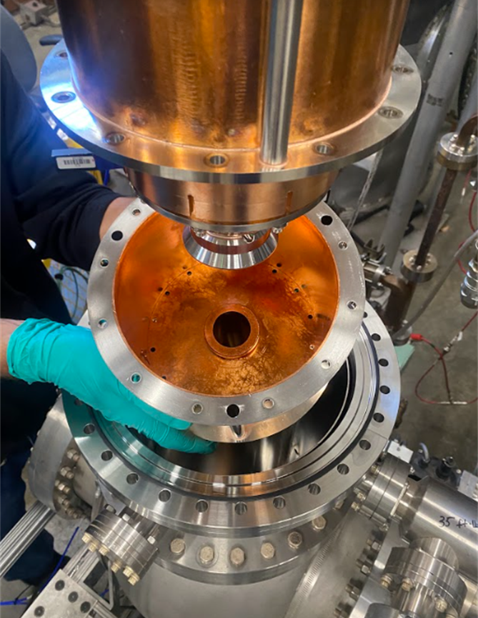
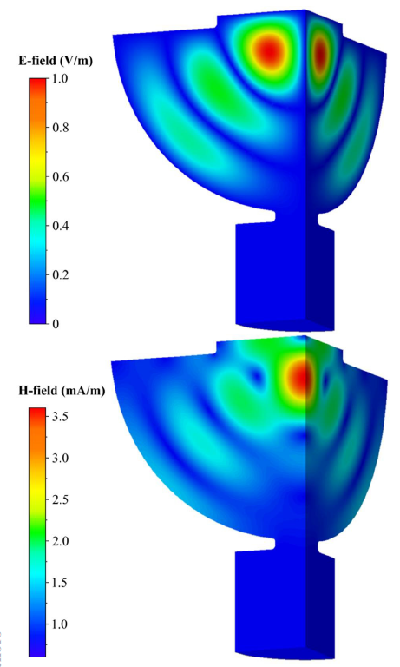
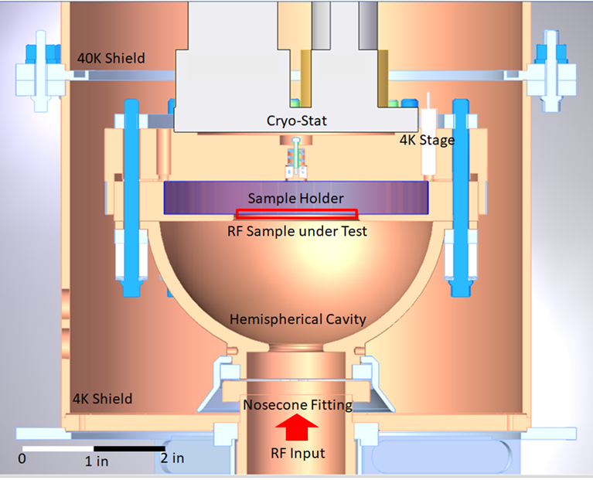
Motivation
TS4 is design to find the low and high-power characteristics for HTS and other materials in SRF in X-band
1. Measured RF conductivity of the sample
W$here σ_{sample}=σ_{Ref}{\left(\frac{Q_{s}}{Q_{s for σ_{Ref} form HFSS}}\right)}^{2}$
Which is a component of the intrinsic quality factor
As $\frac{1}{Q_{0}}=\frac{1}{Q_{cavity}}+\frac{1}{Q_{sample}}$
A TE11 mode hemispherical cavity to min E field on the surface and max H field to determine the quench field
We will use the fond RF conductivity to design RF cavity and accelerating cavity like Pulse compressor

Slide 3
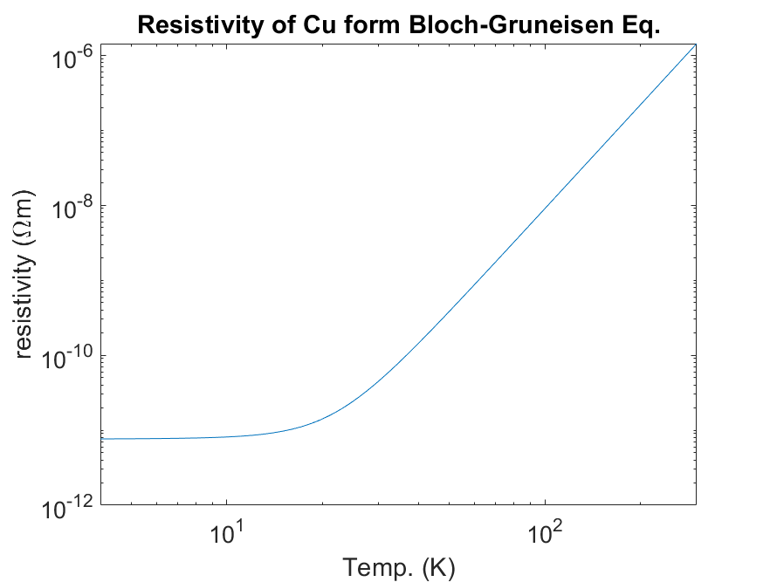
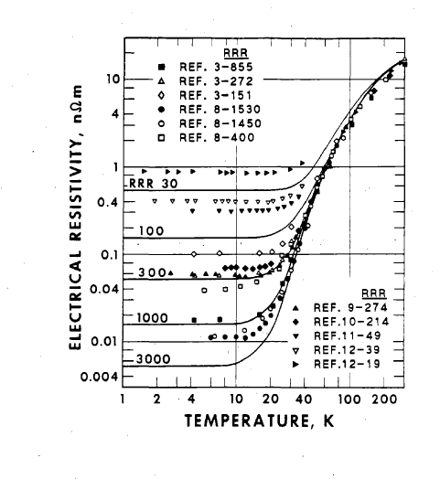
Classical theory of conductivity
To determine the conductivity of the walls of the cavity we find Conductivity(Temp)
Using the density of states Bloch-Gruneisen law for resistivity is
But for low temp we should the form Rphy. Rev. B D. B. Poker and CV. E. Klabunde 26 1270212 (1982)
Which matches with the national Institute of standards data that use a form of

Slide 4
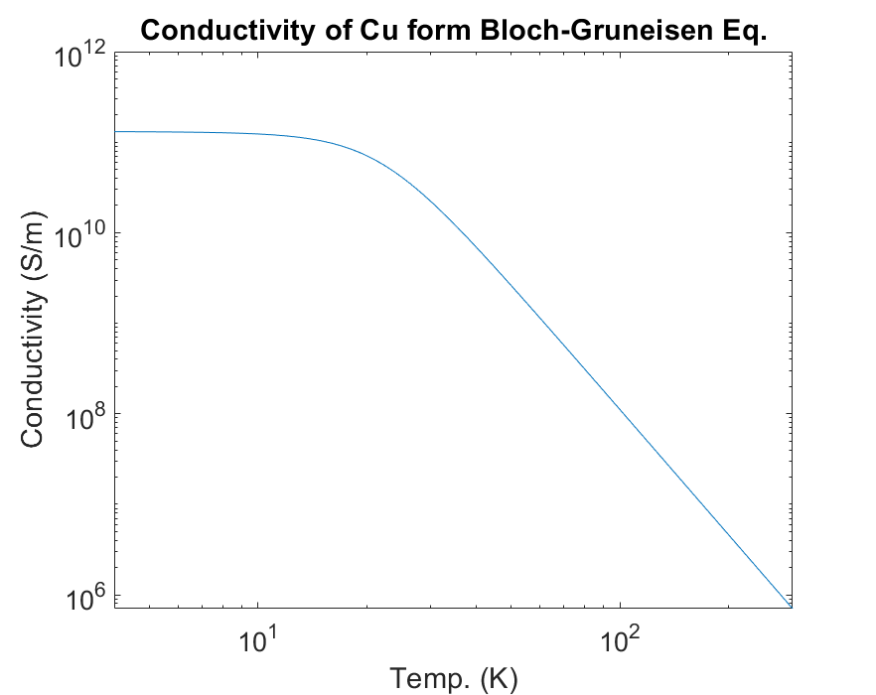
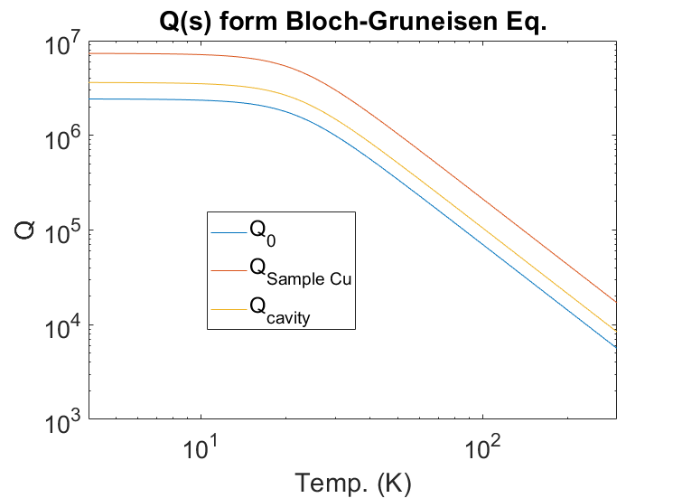
Q(s) form Bloch-Gruneisen law
Use Bloch-Gruneisen conductivity, then we model in HFSS the Q₀ , Q_{cavity ,}Sample Cu assuming that sample walls are equal
Q₀, Q_{sample}, and Q_{cavity} are parallel shifts of each other Assuming the same conductivity at a given temperature

Slide 5
Samples tested to find Q cavity
We then tested the following samples to achieve the functional form of Q cavity
Where for Temp.<9K for Nb We can treat the Nb as a perfect conductor
Then is $Q_{sample}$>>$Q_{cavity}$ than $Q_{cavity}≈Q_{0}$
Then for any Residual resistance value (RRR) the conductivity above 40 K is approximately the same of both samples clean
We can then get the functional form from the copper sample scaled by the linear value we get for the niobium
To Fit VNA data we us to Find Q0:
$$S_{11}=20 log\left|\frac{β−1−j Q_{0} δ}{β+1+j Q_{0} δ}\right|$$
$$δ=\frac{f}{f_{0}}−\frac{f_{0}}{f}$$
$$β=\frac{Q_{0}}{Q_{ext}}$$
The fitting gives us the Q factor
$$\frac{1}{Q_{0}}=\frac{1}{Q_{cavity}}+\frac{1}{Q_{sample}}$$
=>$\frac{1}{Q_{sample}}=\frac{1}{Q_{0}}−\frac{1}{Q_{cavity}}$ => $Q_{cavity}>$ $Q_{0}$

Slide 6
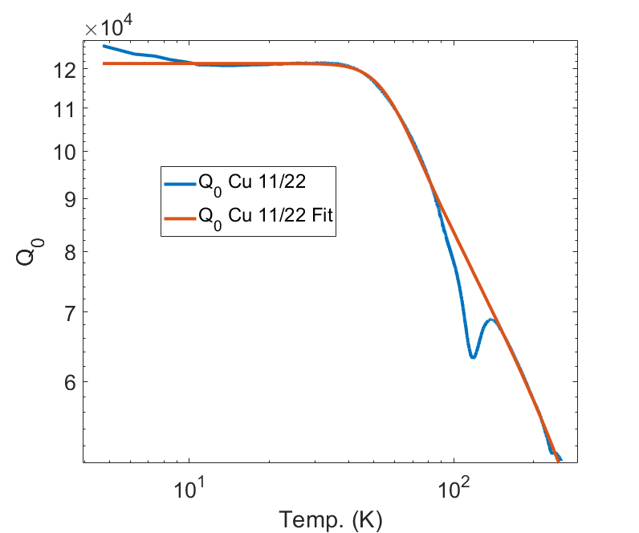
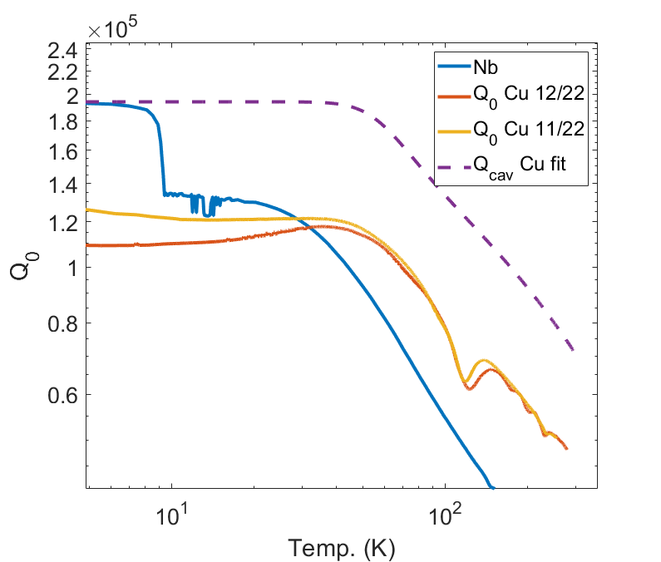
Functional form of Q cavity
Q₀ Q _{cavity} and Q_{sample} can be treated as parallel shifts of one another
The data can now be modeled with Generalized logistics equation multiplied by a power term which is in the same form of the national Institute of standards equation which itself can be taylor expanded into the BG
Q_{cavity} (T)=A+ $\frac{(K−A)T^{β}}{{(1+c∗e^{−B∗T})}^{α}}$
Where K,$y_{0}$,β,c, B and α Our fitting coefficients
And a is confined to the asymptotic limit for low temperatures by
$$A=\frac{{(1+c)}^{α}y_{0}−K}{{(1+c)}^{α}−1}$$
Where $Q amplitude$ was obtained from the niobium results and was found to be 1.942e5

Slide 7
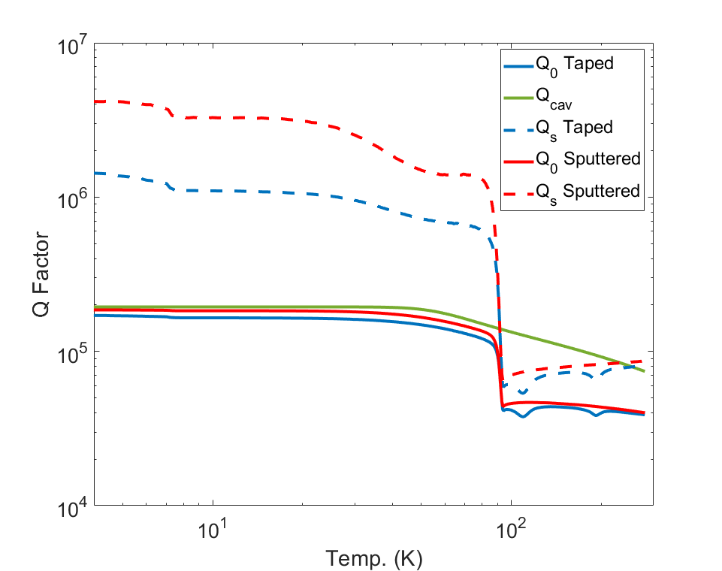
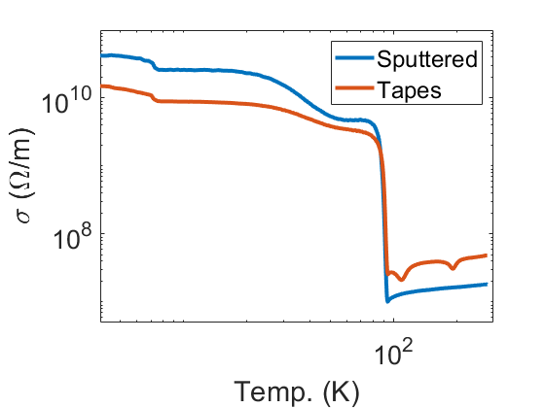
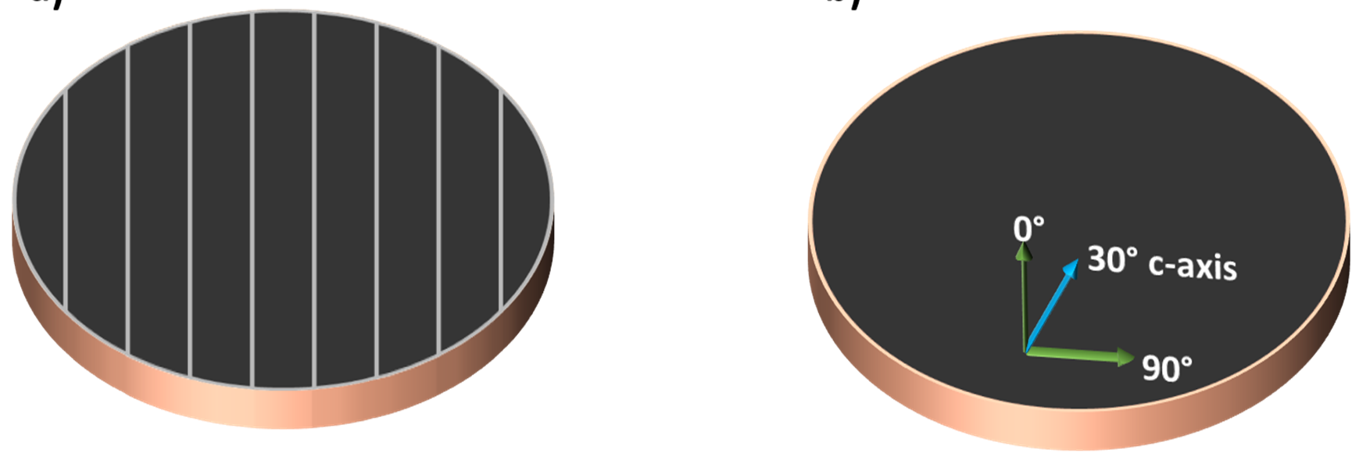
Low Power REBCO Results
Then We find Q cavity, using a combination of the niobium and copper datasets
REBCO results agree with previous experiments
Model is consistent with HFSS simulations and classical theory
We find that the Conductivity for Deposited Sample to be match with 42 GS/m±1GS/m
Tapes Qs ref. of 2.4e6 and conductivity at 4K of 15 GS/m ie 35% of Ideal

Slide 8
Taped YBCO Results 80 K
Sample | Q0 | Qe | β | Qs | σ
4K |  | Sample @ 80K Sample @ 80K | Sample @ 80K | Sample @ 80K
Cu | 109025 | 158445 | 0.688 | 2.48e5 | 150 MS/m
REBCO Deposited | 185545 | 130356 | 1.423 | 4.17e6 | 42 GS/m
REBCO Taped | 170976 | 133765 | 1.278 | 1.43e6 | 15 GS/m
80K
Cu | 92481 | 147769 | 0.626 | 2.34e5 | 134 MS/m
REBCO Deposited | 135167 | 126911 | 1.065 | 1.30e6 | 4 GS/m
REBCO Taped | 120191 | 133041 | 0.903 | 5.99e5 | 2.6 GS/m

Slide 9
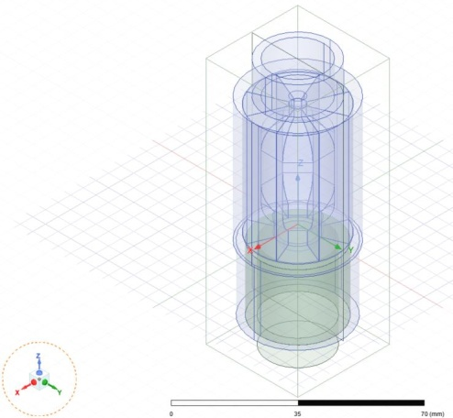
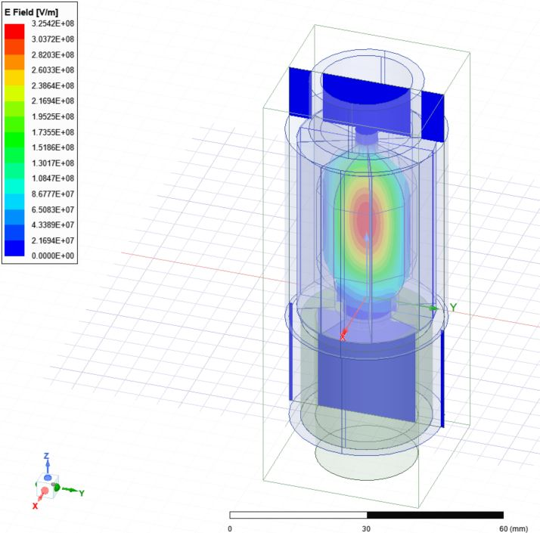
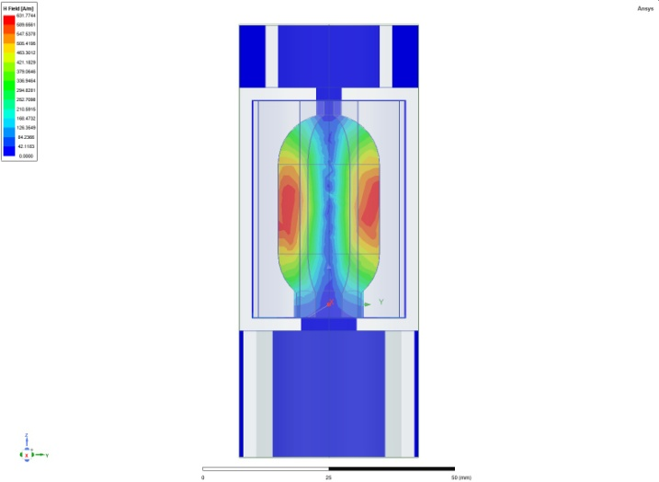
Octagonal HTS Cavity Design
11.426 GHz found in HFSS simulation so far
T_{f} = 2Q_{L}/ω_{RF} = 1 us
Q_{L} = 71,779
Q₀ = 201178
Find Qe using a PEC cavity
Beta = 39.554
HTS conductivity = 190x copper
Octagonal facet width is 8.416 mm
aperture radius around 5.7 mm
TM₀₁₀ – not a pure mode
R = 10.312 mm inner, 11.151 mm outer
F₀₁₀ = c/2p * C₀₁/R = 10.29 – 11.13 GHz
25 MW in TM01 mode
Max field volume 1784 MV/m, 3.278 MA/m
Max field surface 618.9 MV/m, 3.126 MA/m
Complex Mag E Complex Mag H

Slide 10
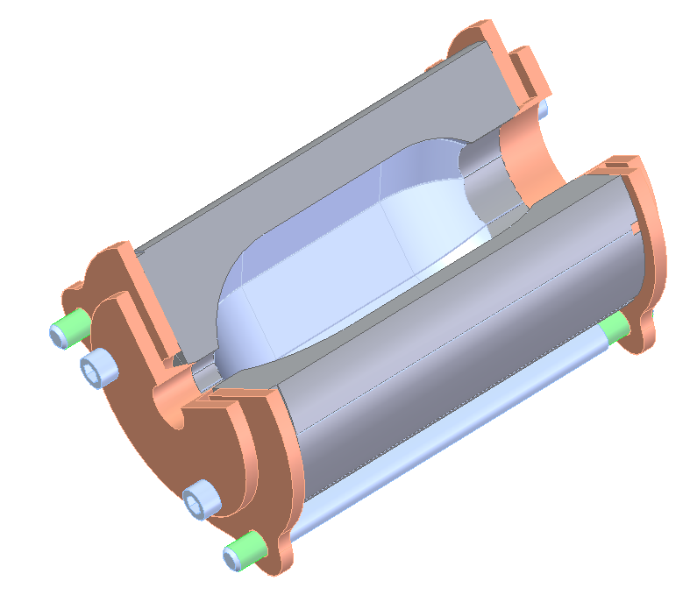
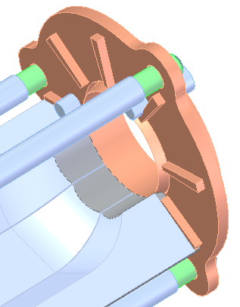
Cavity tuning by separating facets with pressed wedges
Radial guide for each facet.
Frequency adjustment by separating facets using conical actuators on both sides
Current is axial, so small gaps do not affect wall current
All motion will be done against preloading springs
Note that the coupling aperture is changing with tuning, so beta is affected.
HFSS Simulation: Move all facets outward radially
Radial Offset [mm] Frequency [GHz] Q
0 11.4068 35950.2
0.01 11.3960 35722.1
0.02 11.3857 34996.4
0.05 11.3545 34152.9
0.1 11.3016 32911.5

Slide 11
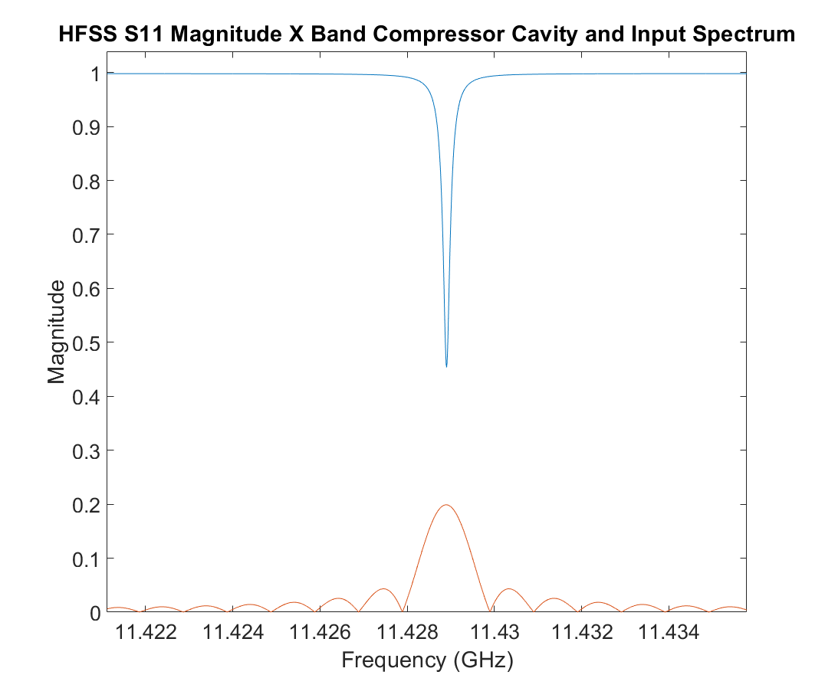
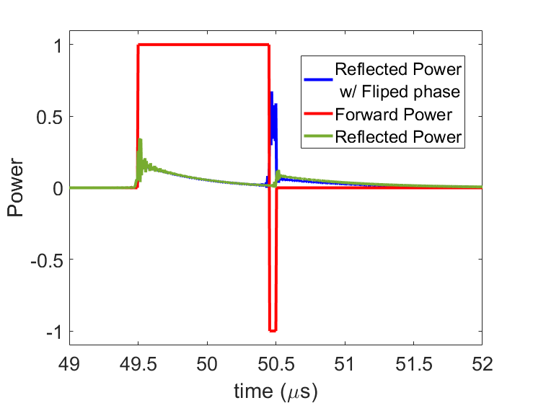
Cavity with Pulse compressing capabilities
Cavity is currently being fabricated
Preliminary simulation shows its ability to work as a high-power pulse compressing cavity
High power testing of REBCO to start immediately with TWT power
More than an order of magnitude pulse compression can occur

Slide 12
Acknowledgments
This research has been supported by the U.S. Department of Energy (DOE) under Contract No. DE-AC02-76SF00515.
Please support C^3

