Slide 1


SRF 5-year Plan in Japan for ILC
Yasuchika Yamamoto (KEK), on behalf of IDT WG2 SRF Group
Kirk

Slide 2
Contents
ILC Technology Network (ITN)
Time-critical WPs related to SRF
Upgrade of SRF facilities at KEK
Production schedule for 5-year plan
Meeting/Discussion for Global Collaboration
Summary

Slide 3
ILC Technology Network (ITN)
Time-critical WPs
ML&SRF
(Main linac &
Superconducting RF)
Sources
DR
(Damping ring)
BDS
(Beam Delivery System)
Dump
WP-prime 1
Cavity production
WP-prime 4
Electron source
WP-prime 12
System design
WP-prime 15
Final focus
WP-prime 17
Main dump
WP-prime 2
Cryomodule design
Undulator positron scheme
WP-13
Collective effect
WP-prime 16
Final doublet
WP-18
Photon dump
WP-5
Undulator
WP-prime 3
Crab cavity
WP-prime 14
Injection/extraction
WP-prime 6
Rotating target
WP-prime 7
Magnetic focusing
SRF is the main part!
E-driven positron scheme
SRF
Sources
Nanobeam
WPP | 1 | Cavity production
WPP | 2 | CM design
WPP | 3 | Crab cavity
WPP | 4 | E- source
WPP | 6 | Undulator target
WPP | 7 | Undulator focusing
WPP | 8 | E-driven target
WPP | 9 | E-driven focusing
WPP | 10 | E-driven capture
WPP | 11 | Target replacement
WPP | 12 | System design
WPP | 14 | Injection/extraction
WPP | 15 | Final focus
WPP | 16 | Final doublet
WPP | 17 | Main dump
with Americas and Europe
WP-prime 8
Rotating target
WP-prime 9
Magnetic focusing
WP-prime 10
Capture cavity
KEK’s main WPs
WP-prime 11
Target replacement
ATF collaboration

Slide 4
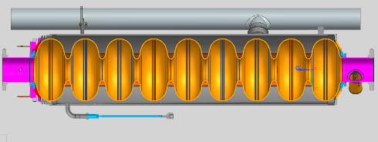
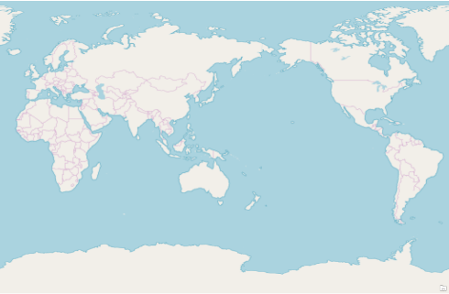
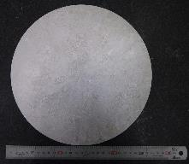
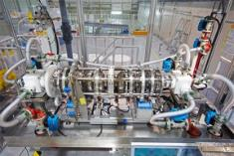
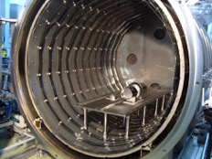
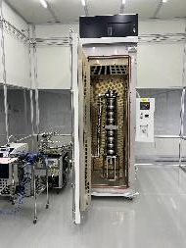
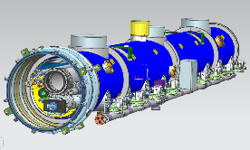
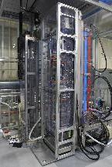
WP-prime 1: SRF Cavity
(Scoping the Industrial-Production Readiness)
Referring European XFEL and LCLS-II experiences
The SRF cavity technology has become matured technology based on TESLA, E-XFEL and LCLS-II experiences. Asia, Americas and EU have attempted R&D for the higher performance with cost-effective production. In WPP-1, the successful production yield will be evaluated.
Industrial-production readiness: 12 cavities produced in JP:
  Evaluate the successful production yield
Cavity performance expected: E_{acc} = <35 MV/m> (+/− 20%), Q₀ = 1.0 x 10¹⁰, Yield = ≥90%
Globally common design applicable to High Pressure Gas Safety (HPGS) regulation in JP
  Plug-compatible design
Production process with higher performance/lower cost (i.e. cost-effective production)
  Advanced Nb sheet production: Clean surface by direct slice + cost reduction
  Advanced surface treatment: High-G and High-Q cavity
    Optimization of best surface treatment
WPP-1: Work flow
Process to be applicable to JP-HPGS
↓
Preparation of material
↓
Cavity production
↓
Surface treatment
↓
Vertical test and Yield evaluation
↓
(WPP-2: assembled to CM)
 | # of cavities to be produced
 | Americas | Europe | JP/Asia
single-cell | 2 | 2 | 6
nine-cell | 8 | 8 | 12
Cavity design based on TESLA/LCLS-II
(globally common design)
Europe
JP/Asia
Americas
①
⑥
①
Nb Sheet
Electro-polish
Heat treatment
Conventional vs cold EP
Horizontal vs Vertical
800℃ vs 900℃
FG vs MG
120℃ vs mid-T baking
8 cavities produced in three regions to be assembled to one CM, and tested
Establishment of best mass-production process for ILC

Slide 5
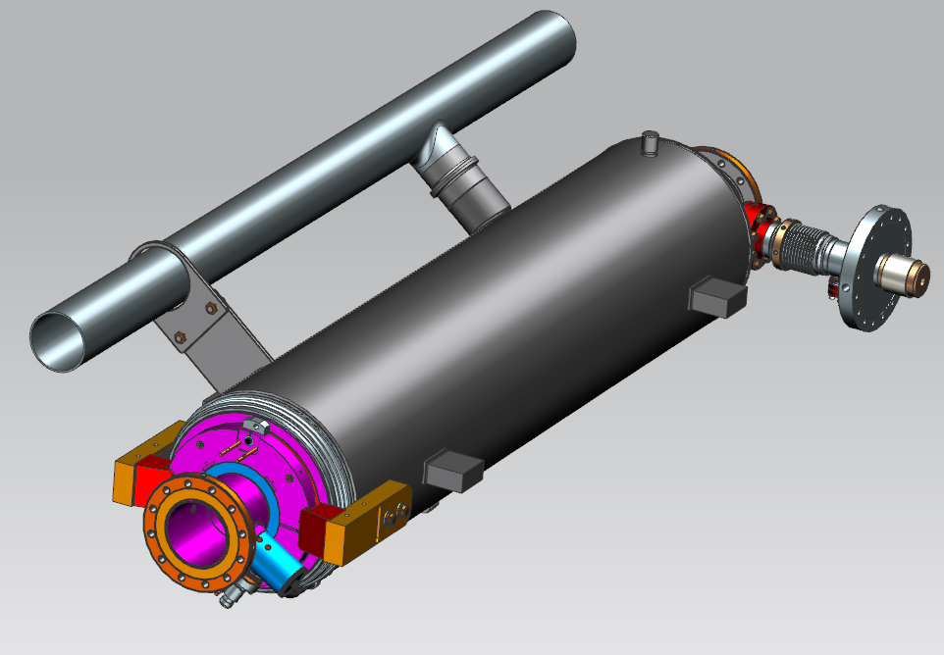
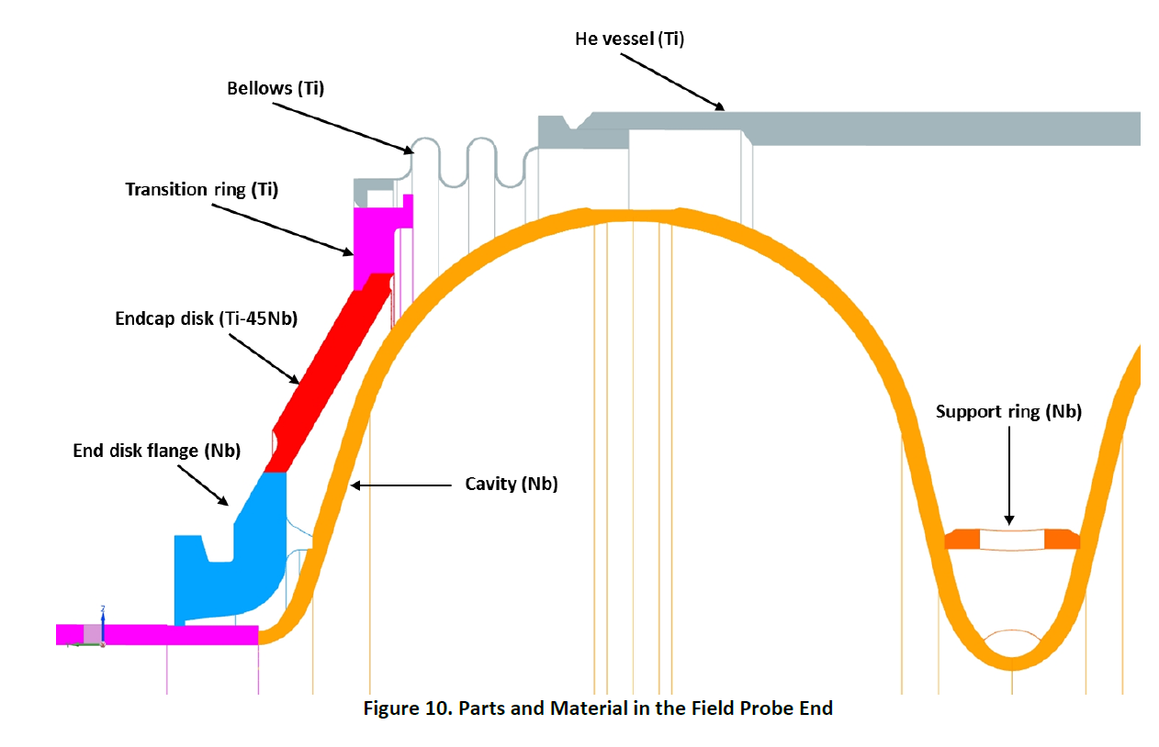
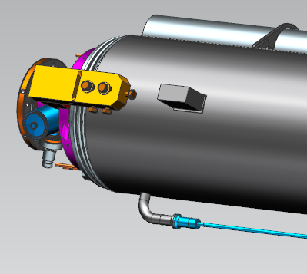
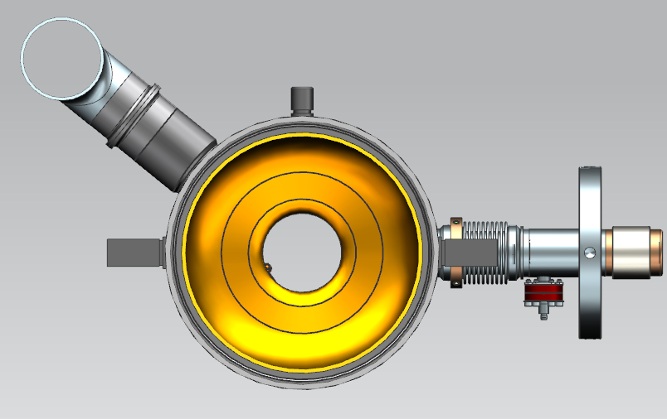
ILC Cavity with short-short beampipes
9-cell cavity, TESLA style
1247.4mm, flange to flange
Support lugs - LCLS-II
He vessel material: Ti Gr2
2-phase pipe material: SS316L
Ti-SS transition joins used:
- warm up nozzle
- 2 phase pipe connection
Ti-SS transition
SS
Ti Gr2
342
Umemori-san is organizing HPGS related to cavity production in Japan.
He will present tomorrow.
24
support lugs
Ti-SS transition
Y. Orlov

Slide 6
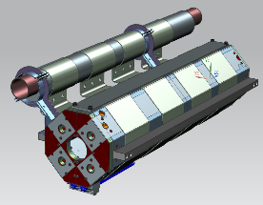
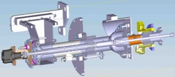
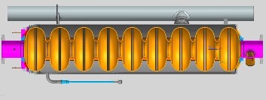
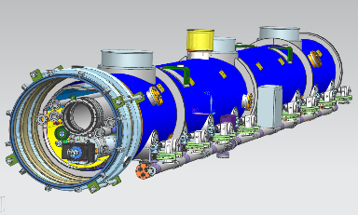
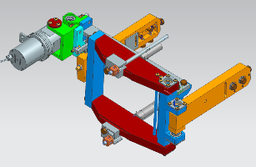
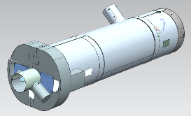
WP-prime 2: Cryomodule (CM) design optimization, construction
(Scoping the CM Global Transfer and Performance Assurance)
The SRF technology based on TESLA has become matured technology after E-XFEL and LCLS-II. In WPP-2, one CM will be designed globally, produced and tested in Japan with some cavities transferred from overseas.
Referring European XFEL and LCLS-II experiences
WPP-2: Work flow
One CM design by global collaboration, production and test in Japan
Cavity performance: E_{acc} = <31.5 MV/m >, Q₀ = 1.0 x 10¹⁰
8 cavities produced/evaluated in WPP-1 to be assembled, including some cavities from overseas
Globally common design applicable to high pressure gas safety (HPGS) regulation
Ancillaries production/evaluation:
  input power coupler, frequency tuner, SCQ+cold BPM, magnetic shield, advanced clean work
Change request after TDR (SCQ current lead port, tuner design, etc.)
  After testing prototype CM, these change requests to be considered
Design of CM and ancillaries
↓
Production of components
↓
Cavity string assembly
↓
CM assembly
↓
CM test
↓
(reflected in the EDR)
Input power coupler
SCQ magnet
Cavity
Frequency tuner
Magnetic shield
Construction of prototype CM for ILC designed globally

Slide 7
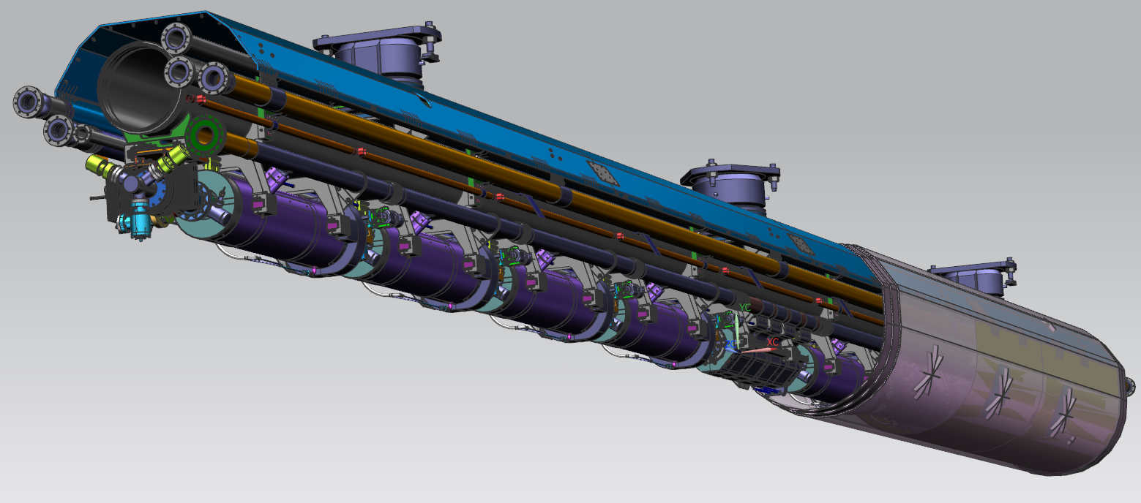
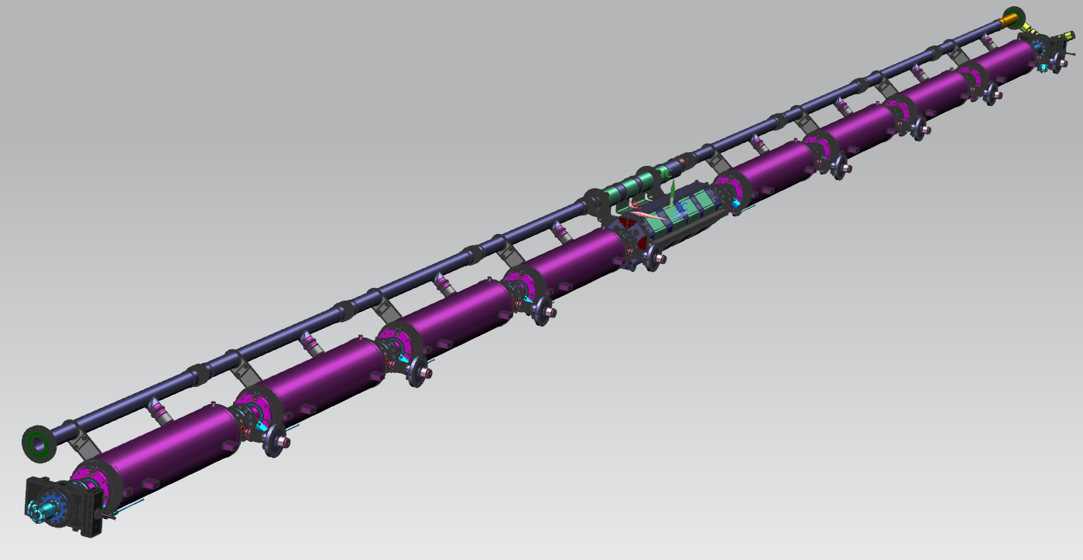
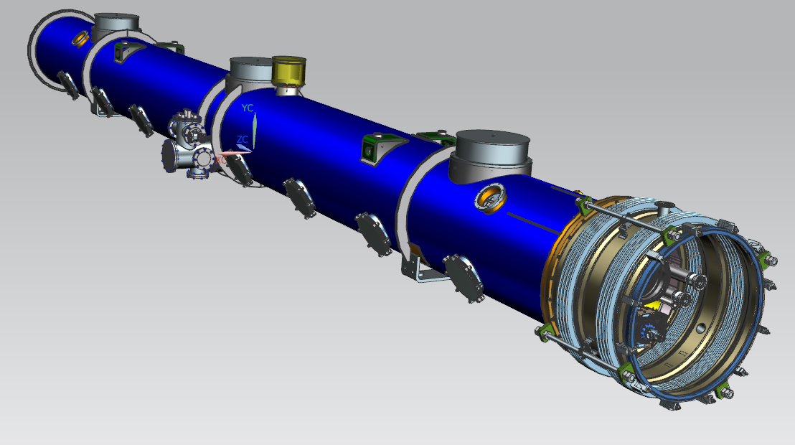
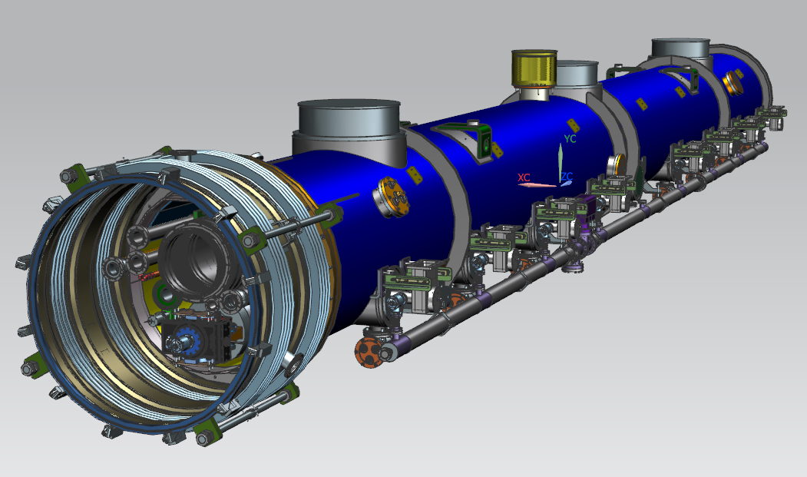
ILC Type-B Cryomodule
Type-B CM has one unit of SCQ+cold BPM at the center position.
This current lead port is moved to power coupler port at the opposite side.
Y. Orlov

Slide 8
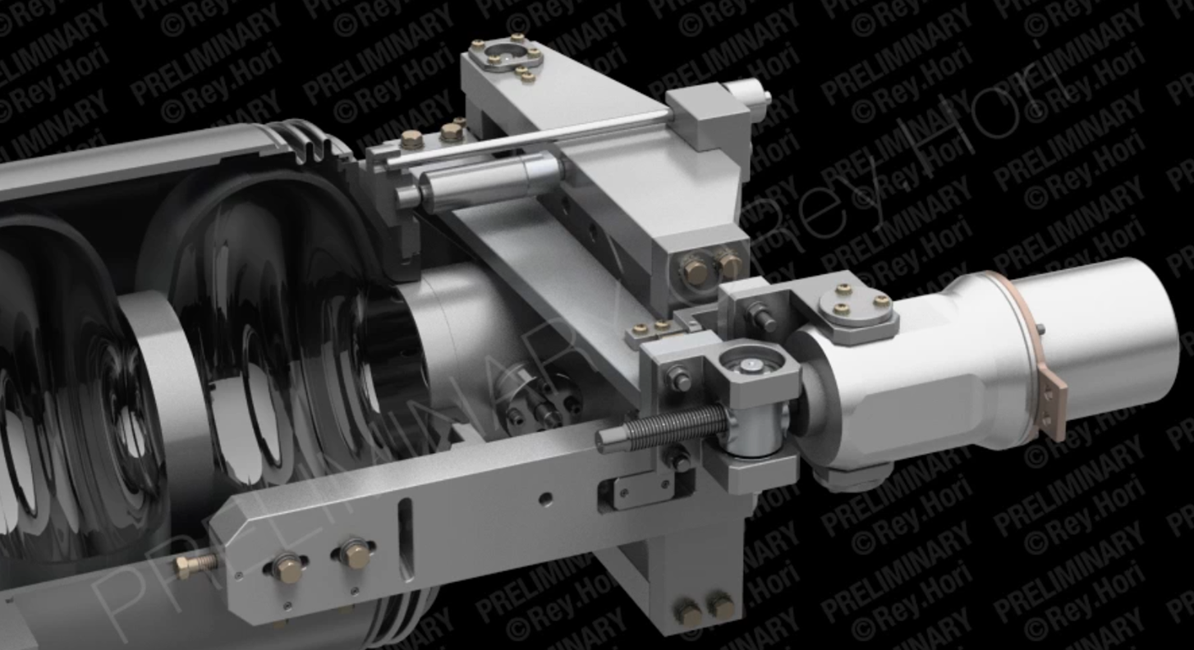
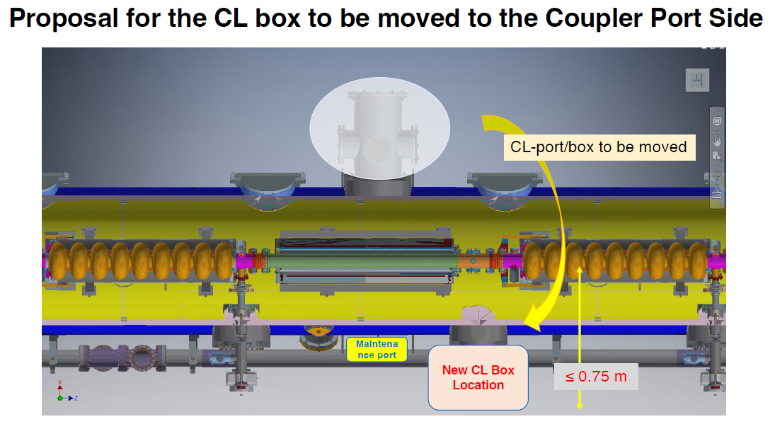
Change requests related to SRF
When we change something after TDR, we have to submit change request, and pass the review.
In this 5-year plan, we have two change requests related to frequency tuner and current lead port.
LCLS-II tuner has worked with high reliability,
but there is no experience in pulsed mode operation.
We need to check this with first CM.
CM design is already completed, but we have to design outside components, that is, waveguide system, pumping system for power coupler, current lead box, etc.
We need more detailed drawing.
LCLS II (HE)/FNAL’s
N=320 units+ 180units
Y. Orlov

Slide 9
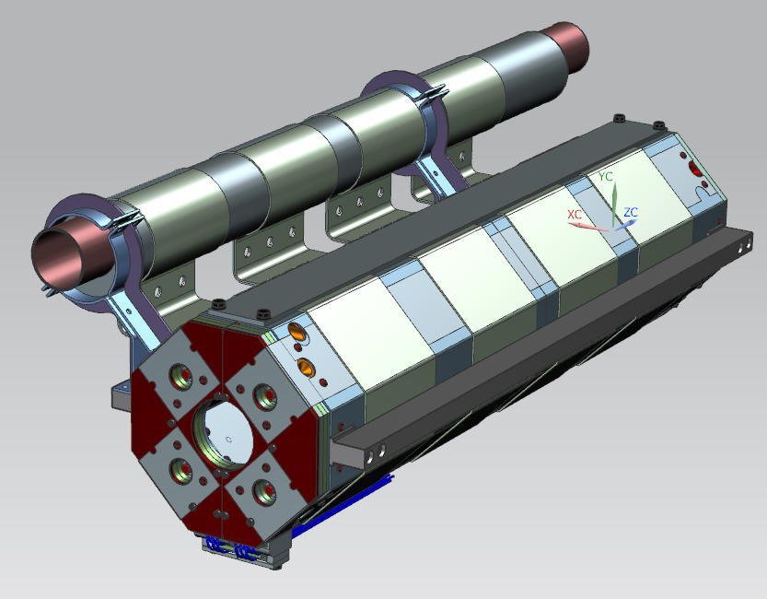
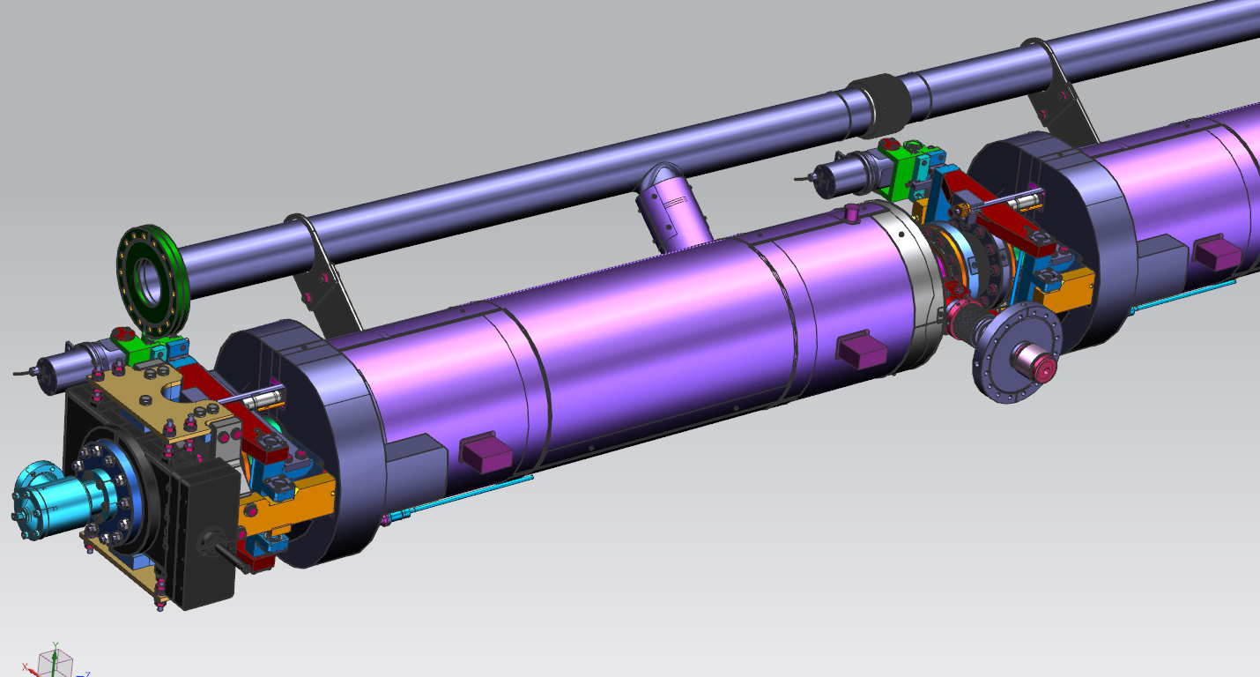
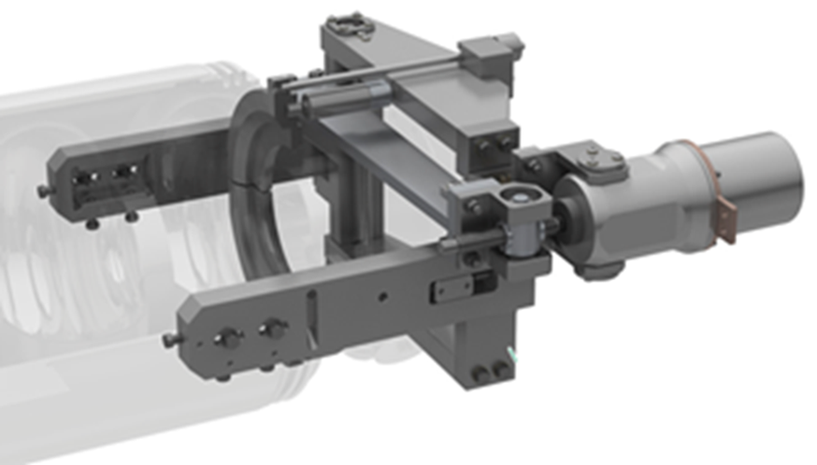
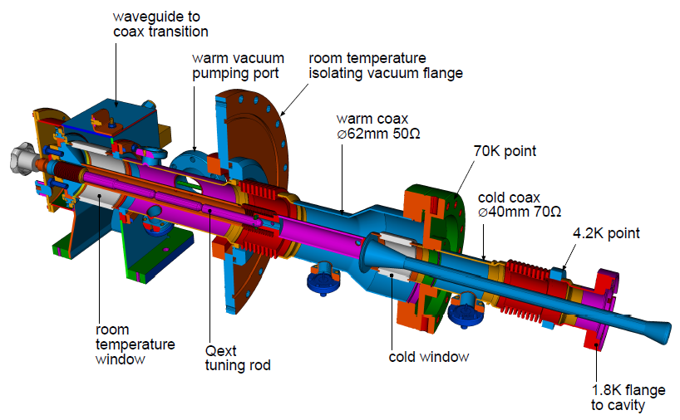
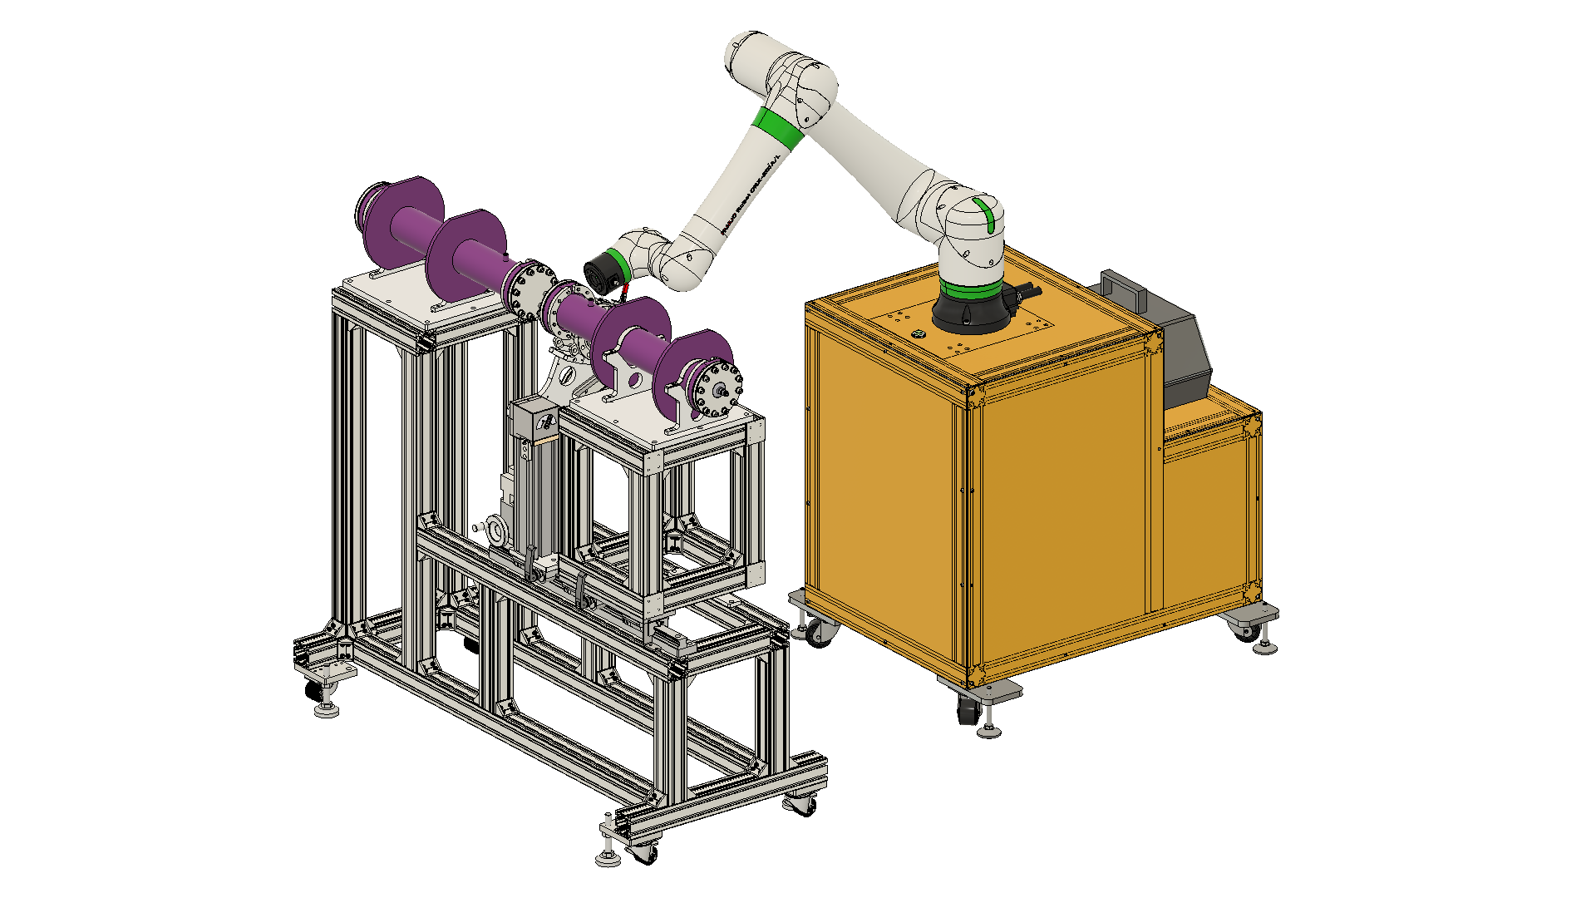
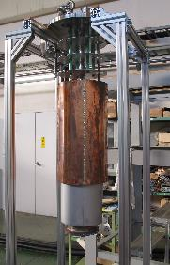
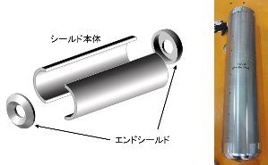
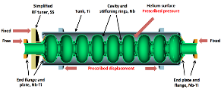
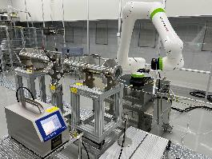
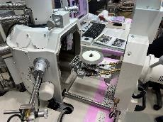
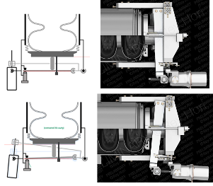
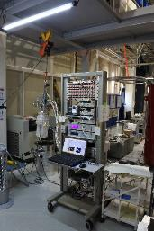
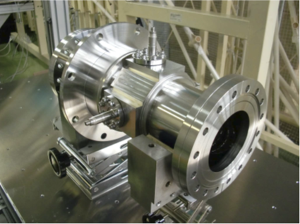
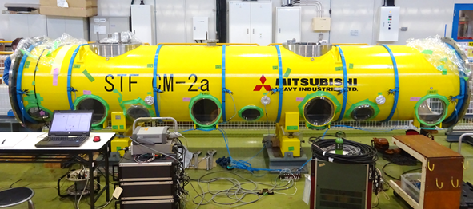
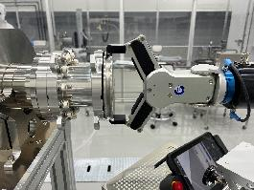
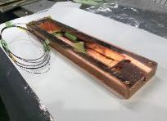
Cryomodule ancillaries, and preparation tool
SCQ+cold BPM | Magnetic shield | Frequency tuner | Power coupler | Clean assembly
NbTi, Nb₃Sn, MgB₂ Conduction cooling | Hermeticity Lower residual magnetic field Demagnetization | Modified LCLS-II tuner Compensation for higher LFD Feed-forward/Feed-back control | E-XFEL type Higher power/Higher duty Reliable materials (ceramics, copper plating, TiN coating) | Auto-cleaning Auto-assembly Perfectly remote operation for no-human/no-dust

Slide 10
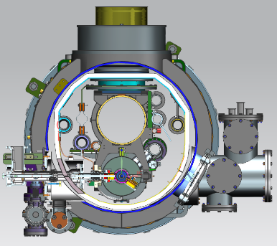
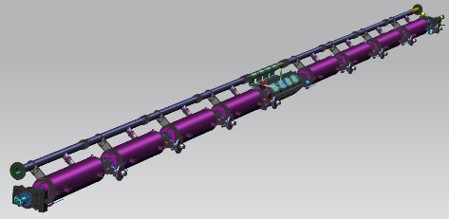
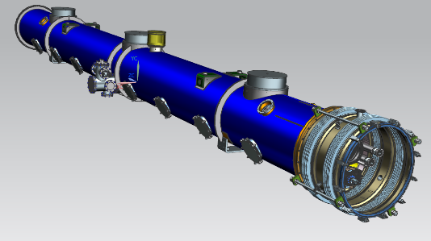
WP-prime 2: Cryomodule (CM) design optimization, construction
(Scoping the CM Global Transfer and Performance Assurance)
Unify cryomodule (CM) design with ancillaries, based on globally common engineering design, drawings & data-base
Establish globally compatible safety design base to be approved/authorized by HPGS regulations individually in each region, most likely referring ASME guidelines to be compatible with Japanese regulations.
Cavity string
Ancillaries:
SC mag., tuners, couplers
CM outlook with vacuum vessel
Y. Orlov
Region Regulation | Americas ASME | Europe Eu-EN, TUV | Japan/Asia JP-HPGS Act
CM tech. design base | LCLS-II | Euro-XFEL | KEK-STF, QST-IFMIF
ILC CM design | Common CM design globally compatible to HPGS regulation in all regions, and most likely ASME guidelines to be compatible with Japanese regulations.

Slide 11
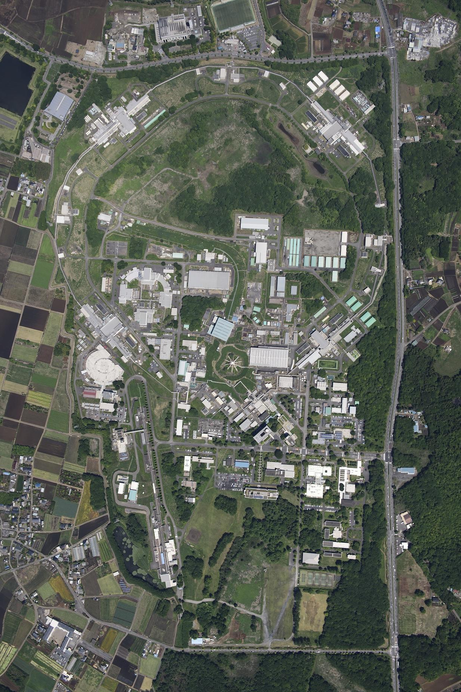
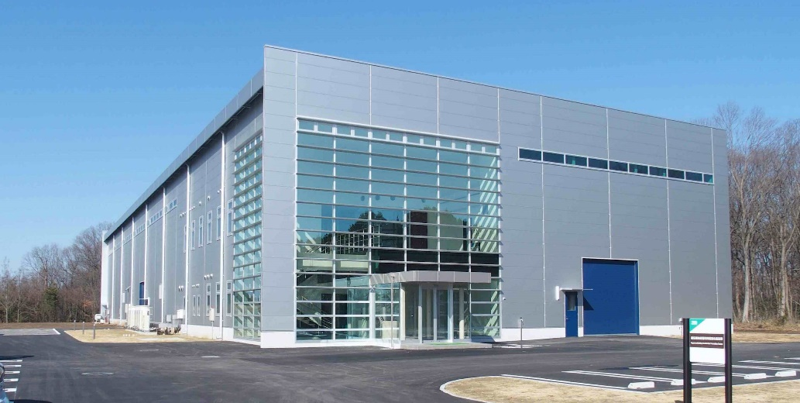
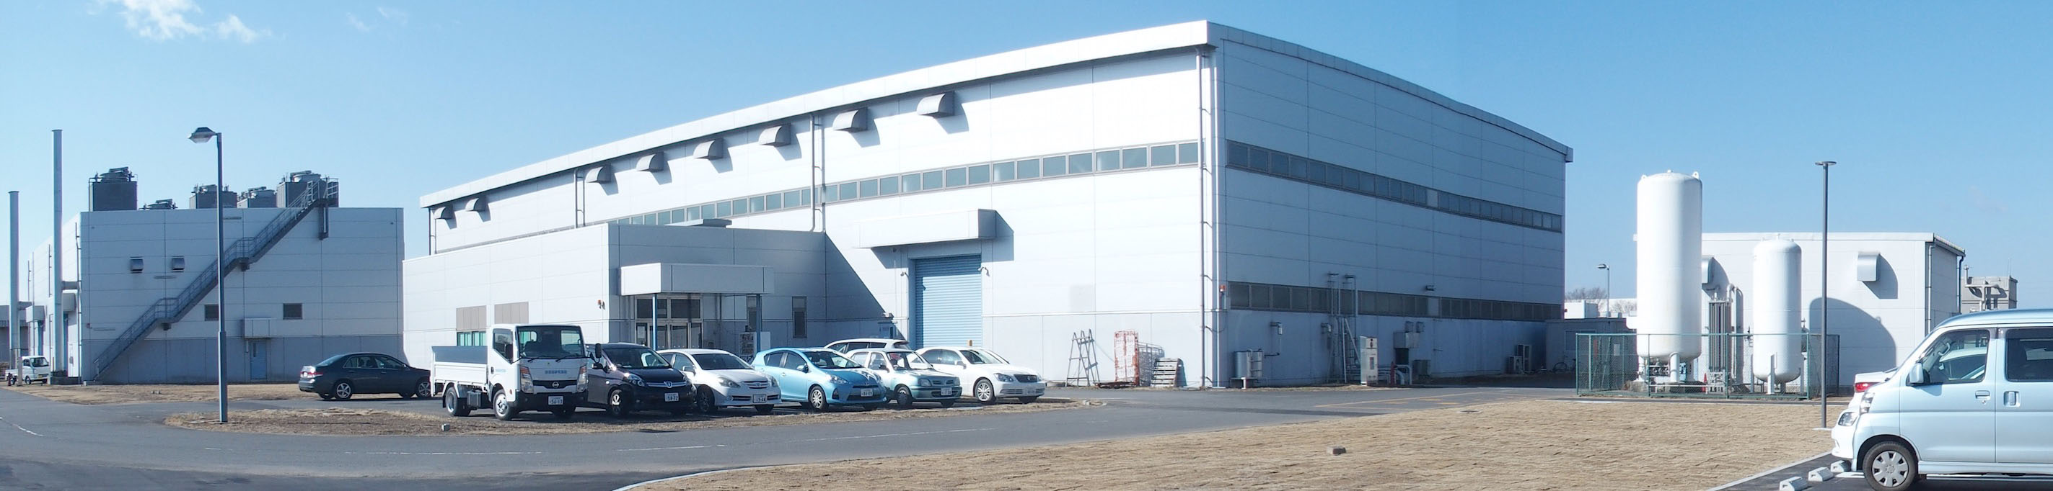
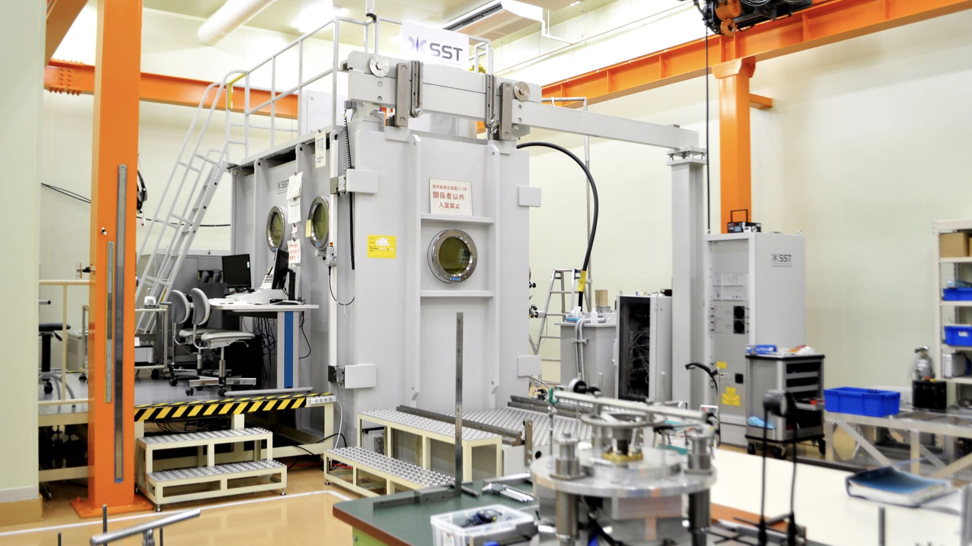
SRF facilities at KEK
COI
(Center of Innovation)
STF
(Superconducting RF Test Facility)
CFF
(Cavity Fabrication Facility)

Slide 12
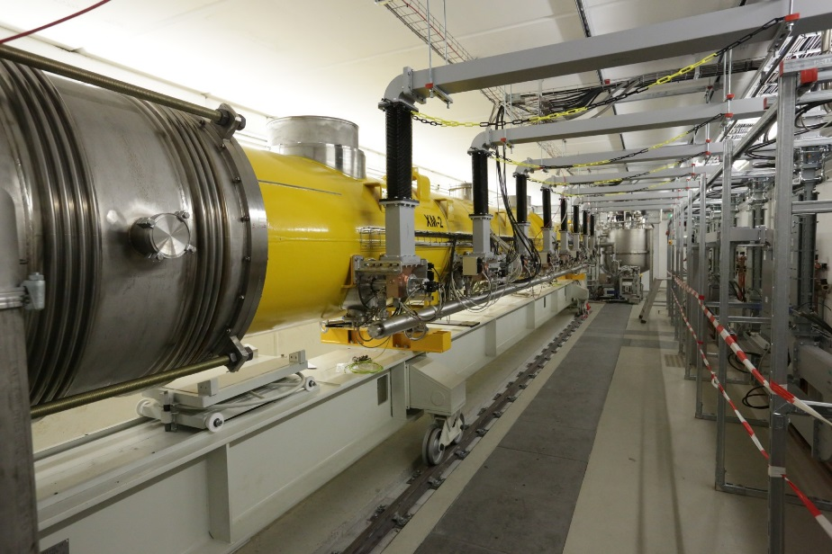
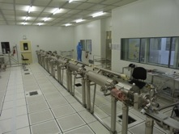
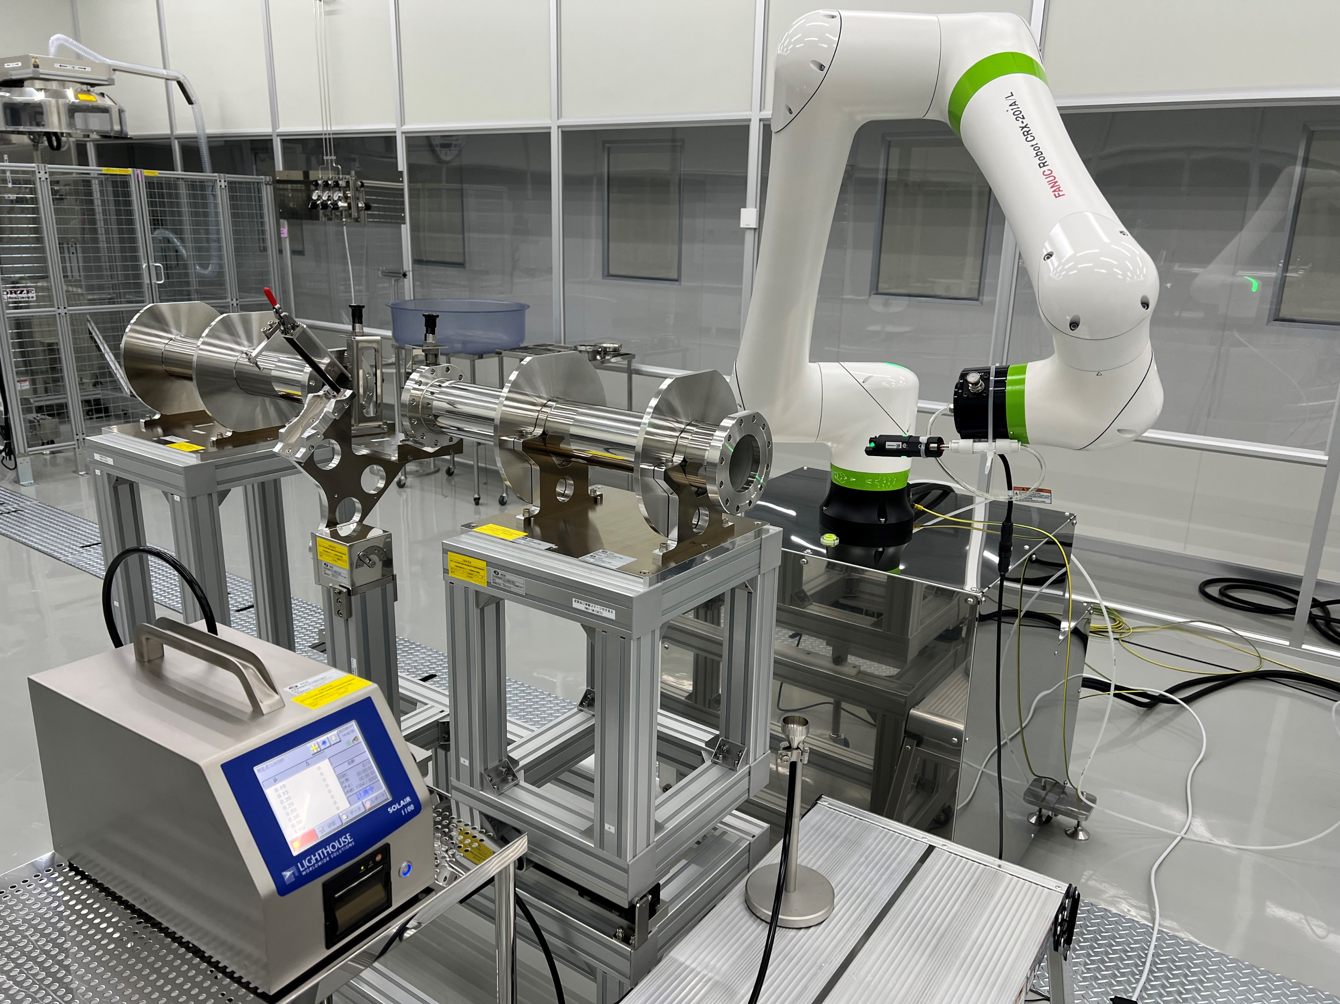








COI infrastructures
Rail system for cavity string
Robot arm for auto cleaning
Cryomodule test cave
High level RF system for CM test
R&D for vertical EP
Hanger and rail system for CM construction
Cryogenics upgrade for CM test
Heat furnace upgrade

Slide 13
Production Schedule of Cavity and Ancillaries for 5-year Plan (FY starts from April in Japan)
 |  | FY2023 |  |  |  | FY2024 |  |  |  | FY2025 |  |  |  | FY2026 |  |  |  | FY2027
 |  | 1 | 2 | 3 | 4 | 1 | 2 | 3 | 4 | 1 | 2 | 3 | 4 | 1 | 2 | 3 | 4 | 1 | 2 | 3 | 4
Japan/Asia | 1-cell FG | 4
 | 1-cell MG | 2
 | 9-cell FG | 1 |  |  |  | 5
 | 9-cell MG | 1 (test) |  |  |  | 1 |  |  |  | 4 |  |  |  | 1
 | Power coupler |  |  |  |  | 2 (test) |  |  |  | 8
 | Frequency tuner |  |  |  |  | 1 (test) |  |  |  | 8
 | SCQ magnet+BPM |  |  |  |  | 1 (test) |  |  |  | 1
 | Magnetic shield |  |  |  |  | 1 (test) |  |  |  | 8
 | Cavity string
 | CM production
 | CM assembly
 | CM test
Americas | 1-cell FG
 | 1-cell MG
 | 9-cell FG |  |  |  |  |  |  | 4
 | 9-cell MG |  |  | 1 |  |  |  | 3
Europe | 1-cell FG |  |  | 1
 | 1-cell MG |  |  | 1
 | 9-cell FG |  |  |  |  |  |  | 4
 | 9-cell MG |  |  | 1 |  |  |  | 3
Deadline:
Delivery of all cavities with helium tank @Sep/2026
(should be satisfied with HPGS of Japan)
CM construction @Sep/2027
First cooldown test completed @Mar/2028
Necessary infrastructure will be also constructed for CM assembly and test at COI.

Slide 14
Meeting/Discussion for Global Collaboration
Americas
  US has done many collaborative works about CM design and HPGS, High-Q/High-G R&D with Japan
    Especially, SCQ, Magnetic shield, Frequency tuner, Power coupler, Clean work are main tasks
    Of course, cavity production is also included
Asia
  Korea has an interest in production and test of 1-cell/9-cell cavity and development of cold BPM
Europe
  France and Italy have a plan to produce and test 1-cell/9-cell cavities, join CM design and HPGS
    An expert from CEA will stay at KEK to discuss these items
  Spain has an interest in development of SCQ magnet and cold BPM systems
Japan hopes more countries and regions will join for this project!
Face-to-face meeting is very important for global collaboration.

Slide 15
Summary
Japan hopes to have global collaboration for ITN
SRF part is cavity production as WPP-1, and CM design and construction as WPP-2
KEK will upgrade some infrastructures at COI facility
There are some important deadlines for CM construction and test

Slide 16

Thank you very much for your attention
Japan hopes that as many countries as possible will participate.
Please join us!!
“Maneki Neko”

Slide 17
Work packages related to SRF ①
Work package | Detailed category | Brief description
1.3 GHz Cavity | High pressure gas safety | Documentation, Sample test, Simulation, Negotiation with KHK and local government
 | Procurement/Production | Documentation, Negotiation with vendors, Production at CFF
 | Quality control/assurance | Nb material evaluation (eddy current scan), RRR measurement, Other material evaluation
 | Preparation | Pre-tuning/Field flatness assurance, clean work, inspection, local grinding, pumping/leak check
 | Surface treatment | Heating, bulk-EP, light-EP, BCP (outer surface), Rinsing, Drying, Baking
 | Vertical test/Yield evaluation | RF measurement, T-/X-ray mapping, 2nd sound, Fluxgate, Demagnetization, Cooling process
 | Helium tank welding | TiG welding, Alignment between cavity and tank
 | HOM coupler | Tuning HOM couplers
Power coupler | Design | Drawing, Simulation, Sample test
 | Procurement/Production | Documentation, Negotiation with vendors
 | Preparation/Assembly | Cleaning, Rinsing, Drying, Assembly for high power test, Pumping
 | Quality control/assurance | Quality evaluation of ceramics with TiN coating, copper plating, brazing
 | High power RF test | RF conditioning with high power, Monitoring temperature/vacuum/electron/arc/luminescence
 | Storage | Design of storage jigs (by cavity string assembly)
Frequency tuner incl. piezo | Design | Drawing, Simulation, Sample test
 | Procurement/Production | Documentation, Negotiation with vendors
 | Preparation/Assembly | Cleaning, Assembly
 | Quality control/assurance | Quality evaluation
 | Performance test | Performance test at cold temperature

Slide 18
Work packages related to SRF ②
Work package | Detailed category | Brief description
SCQ magnet + cold BPM Systems | Design/Study | Drawing, Simulation, quench protection study
 | Procurement/Production | Test coil, Coil/magnet production, Low power test
 | Preparation/Assembly | Assembly process, Alignment
 | Quality control/assurance | Quality evaluation
 | Performance test | Performance test at cold temperature
Magnetic shield | Design/Study | Drawing, Simulation, Study of residual magnetic field inside cryo-vessel, Demagnetization
 | Procurement/Production | Test shield production, Production
 | Preparation/Assembly
 | Quality control/assurance | Quality evaluation
 | Performance test | Performance test using 9-cell cavity at cold temperature
Clean work | Quality control/assurance | Documentation related to work flow in clean room
 | Clean items | Ionized gun, Dust monitor, Slow pumping system, Filter, Cart to lift a cavity, Gasket, Bolt/nut,
 | Robotics | Study of auto cleaning/assembly
 | Preparation | Rinsing cavity outer surface, Drying, Alignment of cavity string
 | Assembly for VT | Development of work process with robot
 | String assembly | Development of work process with robot
Cryomodule | Design/Study | Drawing, Simulation, HPGS
 | Procurement/Production | Documentation, Negotiation with vendor
 | Preparation/Assembly | RF cable/feedthrough, Temperature sensor, Fluxgate, Thermal shield, Insulation material, Support post
 | Quality control/assurance | Documentation related to work flow in clean room
 | Performance test | Cold test at 2K, with low power and high power

Slide 19
Work packages related to SRF ③
Work package | Detailed category | Brief description
Vacuum systems | Pumping system | Beamline, Power coupler, Cryo-vessel, Slow pumping system
 | Vacuum gauge | Beamline, Power coupler, Cryo-vessel,
 | Gate valve | Development of dust-free GV, Cleaning, Assembly
HOM damper |  | Not necessary, but under consideration
Alignment |  | Cavity-to-cavity, Cavity-to-CM
High Level RF System |  | Klystron, modulator, waveguide, dummy load, variable hybrid, phase shifter, circulator, Magic-T
Low Level RF System |  | Construction of control systems incl. feed-forward/feed-back (open/closed-loop operation)
Cryogenics | Construction | Upgrade work, Connection of transfer line to CM for cold test
 | Pumping system | Pumping system for 2K helium
 | Control | Control system
 | High pressure gas safety | Negotiation with local government
Installation |  | CM installed into cave
Machine protection (?) |  | Performance degradation, dark current, radiation security, quench detection for SCQ-magnet, etc.
Once the MOU is contracted, KEK expects these tasks to be carried out in global collaboration.
It may take several months to half a year before the MOU is contracted.
Note also that KEK must adhere to the schedule related to 5-year plan.

