Slide 1
Surface Engineering Research for High Q and High Gradient CW Accelerators
Daniel Bafia
May 16th, 2023
LCWS’23
FERMILAB-SLIDES-23-067-TD

Slide 2
Overview
Key Material Science Findings: Oxygen Enables High Q and G in LTB Cavities
Role of Diffused Oxygen in Mitigating HFQS
Role of Diffused Oxygen in Tuning Cavity Quench Field
Applying Findings to Cavities of Other Frequencies
What Other impurities?
Conclusion

Slide 3
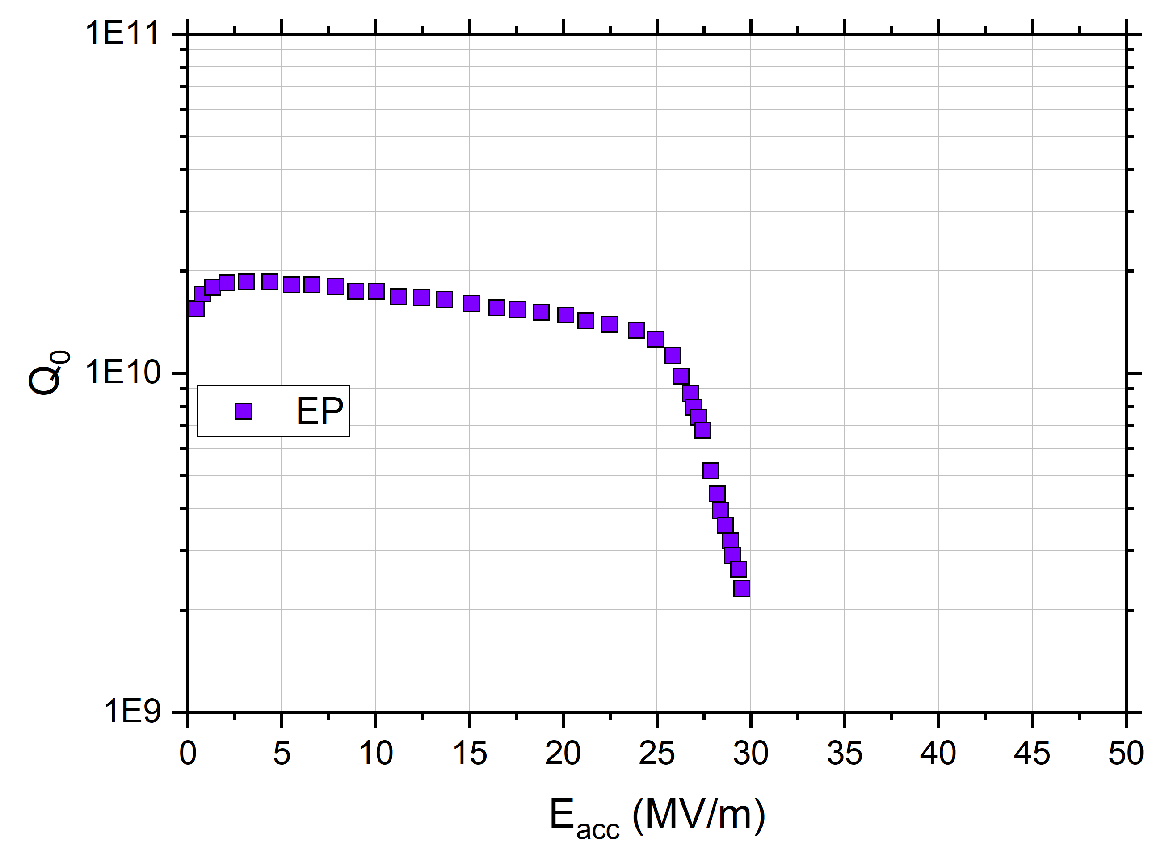
Quest for High Q₀ and Gradient with Impurities
Nb SRF Cavities Post Various Surface Treatments
HFQS
f₀ = 1.3 GHz
T = 2 K

Slide 4
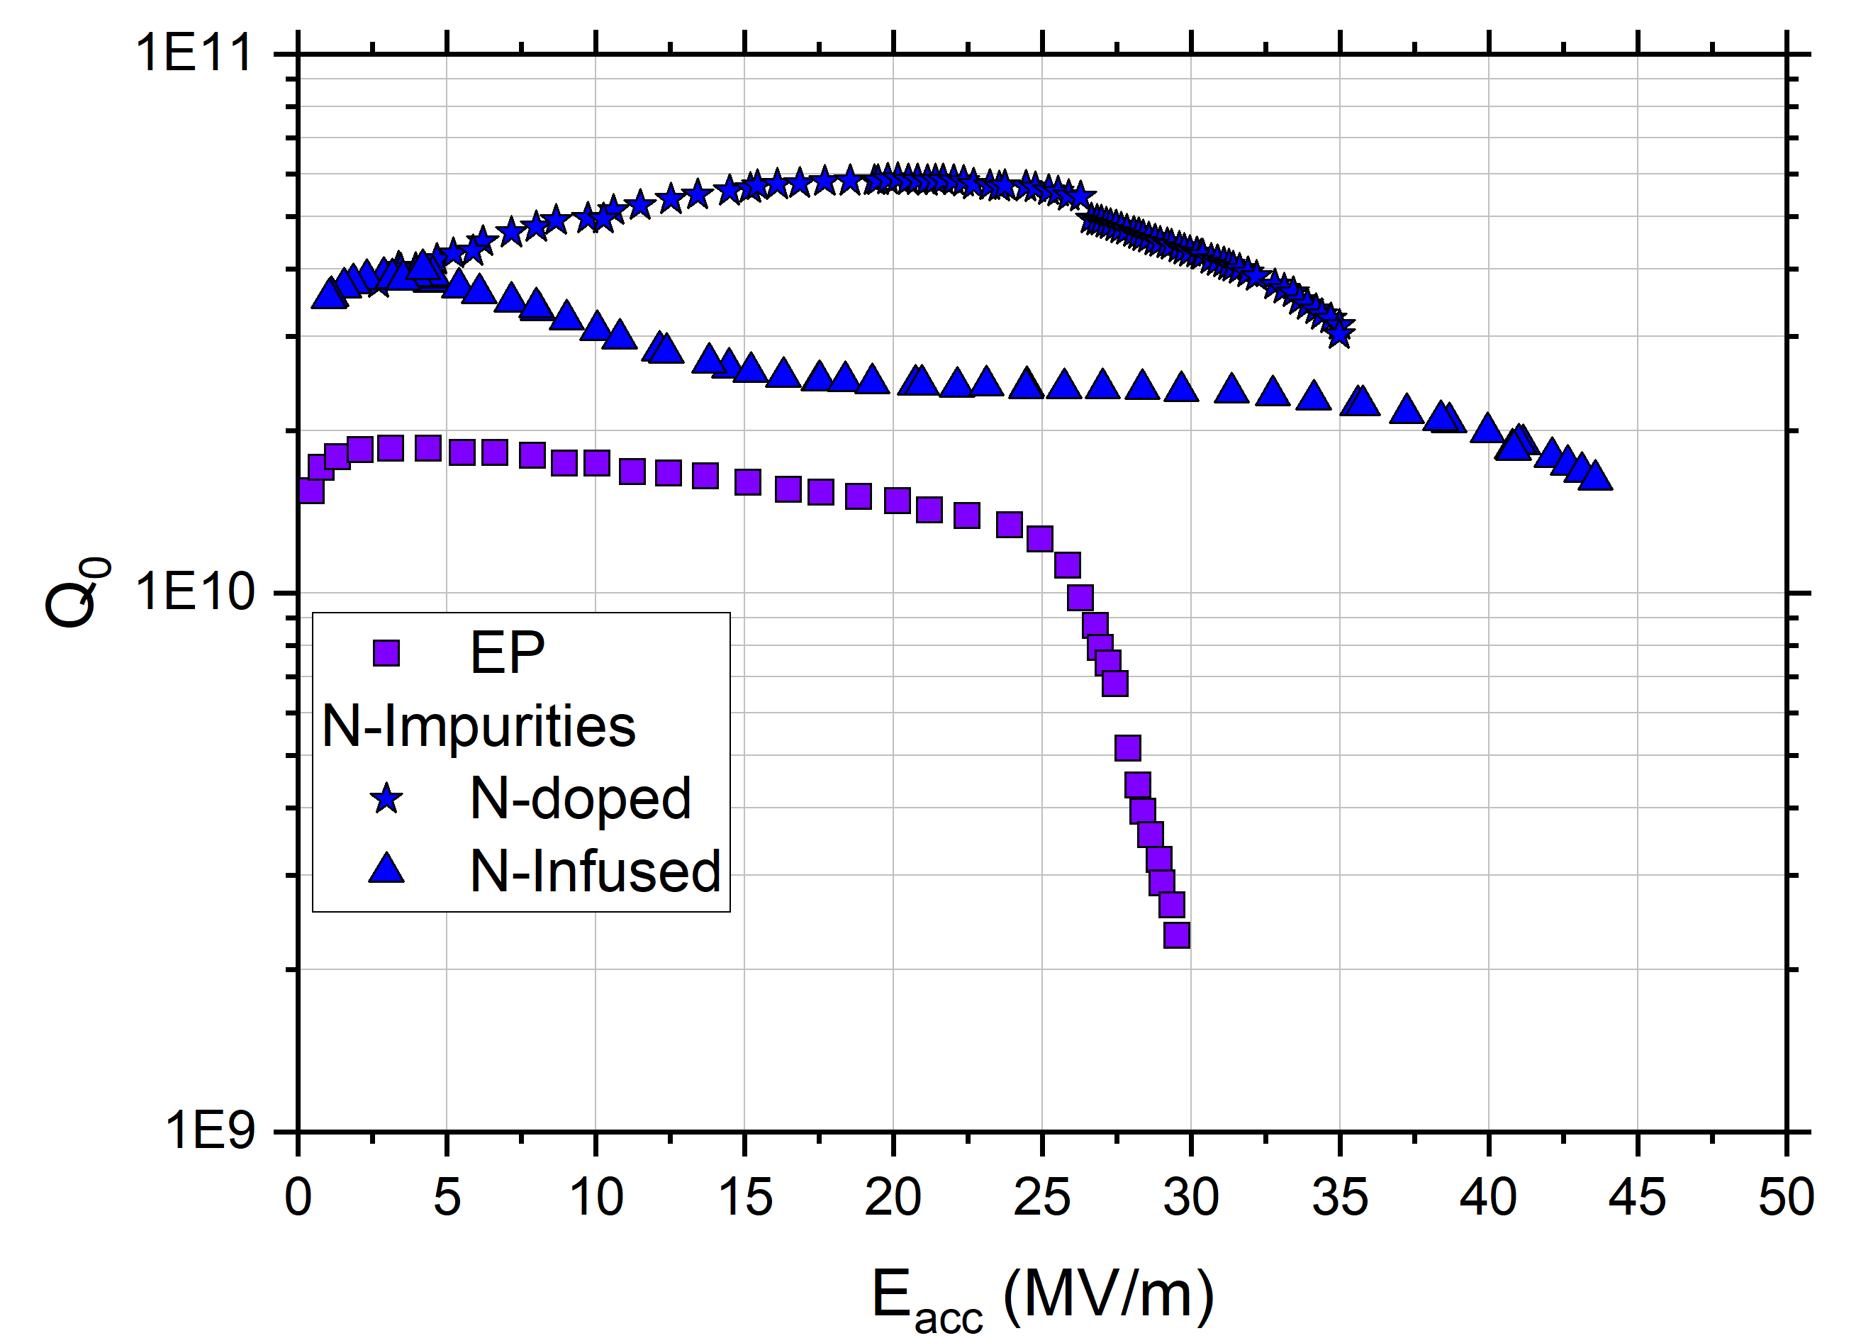
Quest for High Q₀ and Gradient with Impurities
Nb SRF Cavities Post Various Surface Treatments
N impurities
High Q₀: N-doping
High Gradient: N-Infusion
HFQS
f₀ = 1.3 GHz
T = 2 K

Slide 5
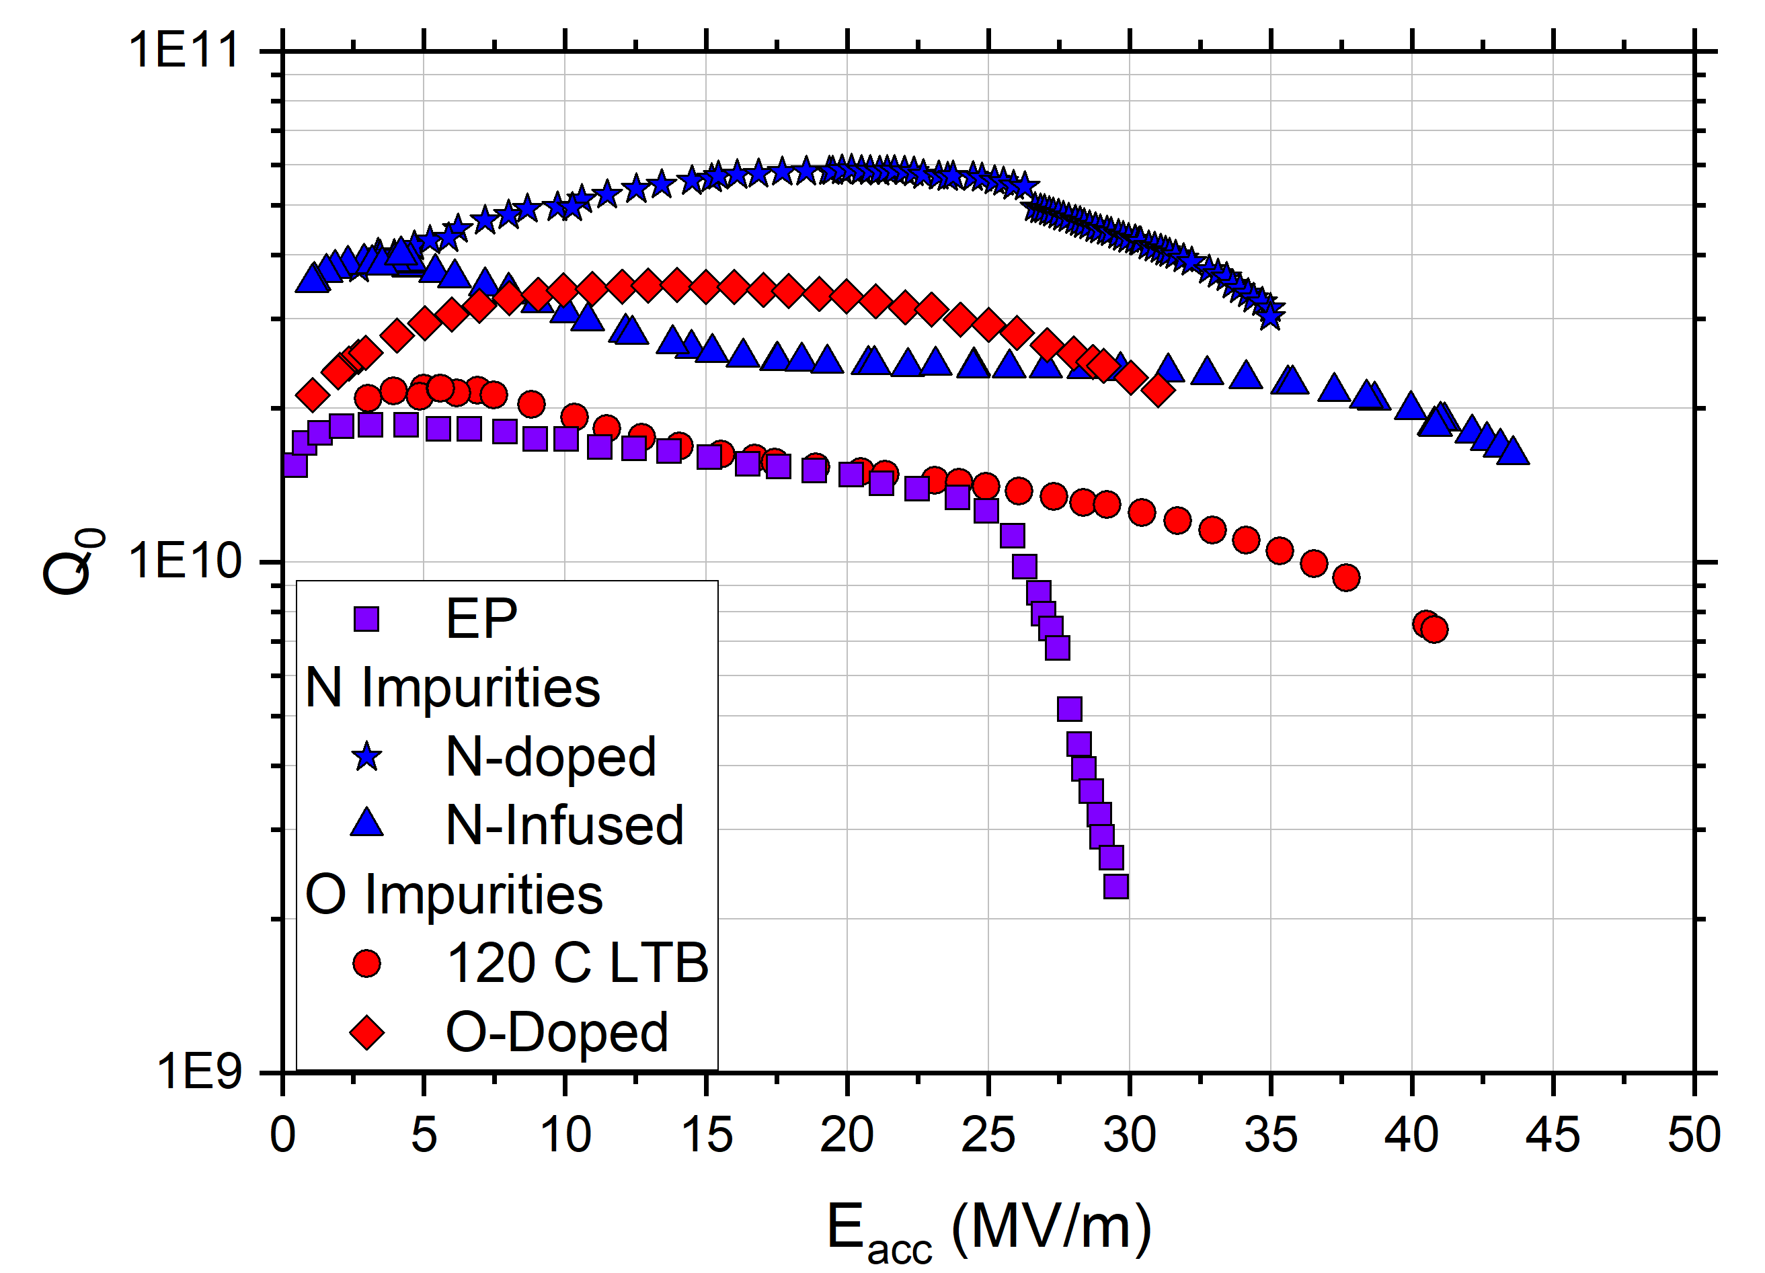
Quest for High Q₀ and Gradient with Impurities
Nb SRF Cavities Post Various Surface Treatments
N impurities
High Q₀: N-doping
High Gradient: N-Infusion
Oxygen impurities:
High Gradient: Low Temp. Bake
High Q₀: O-doping
HFQS
What is the precise role of O impurities in bulk Nb cavity performance and how can we tune performance?
f₀ = 1.3 GHz
T = 2 K
D. Bafia | LCWS 2023

Slide 6
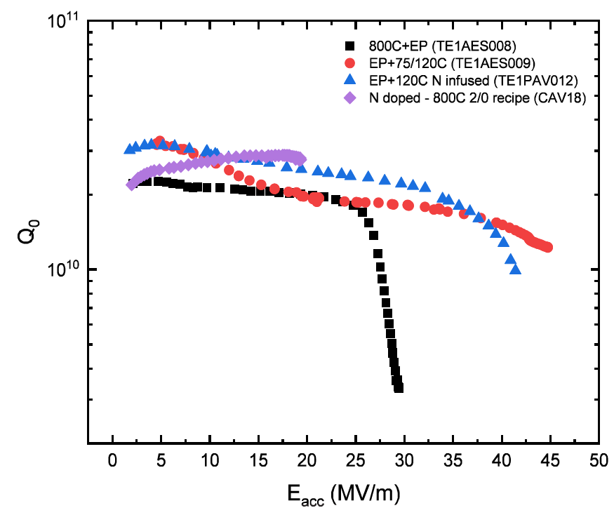
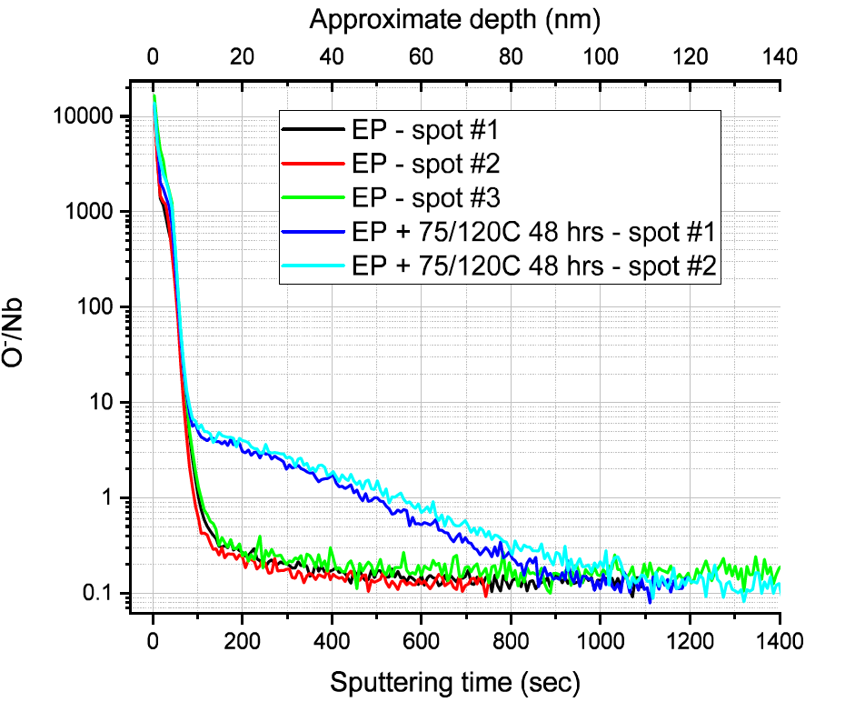
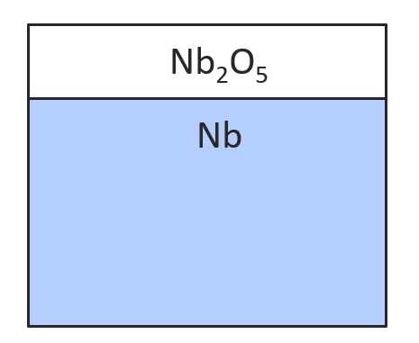
Key Material Science Findings: Diffused O Enables High G in LTB Cavities
RF Data on Variously Processed Cavities to be Cut
TOF-SIMS Data on Cavity Cutouts
What happens to RF performance if we gradually diffuse more oxygen?
LTB
EP
Fick’s law diffusion
A. Romanenko et al, SRF’2019, THP014
A. Romanenko, TTC’2020, CERN

Slide 7
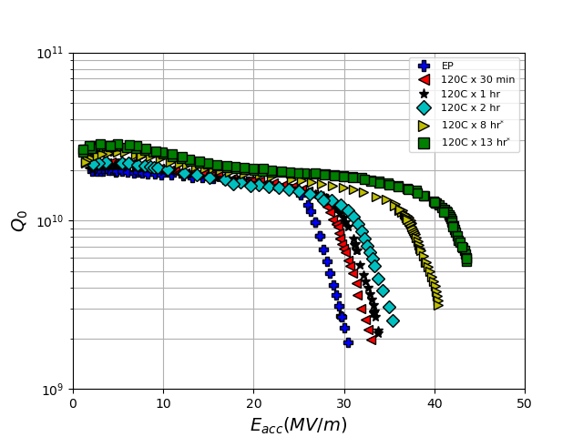
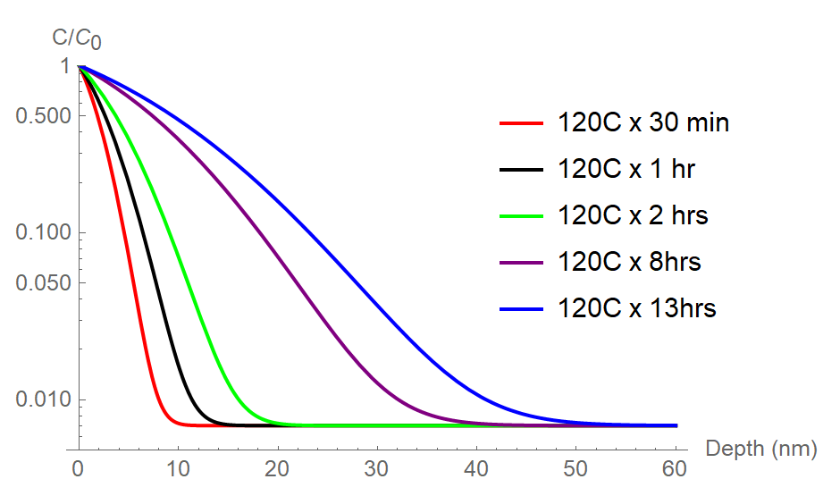
Utilizing Diffused O to Eliminate HFQS & Improve Gradient
TE1RI003 Post Sequential 120C Baking
HFQS onset
Subjected TE1RI003 to sequential rounds of 120 C vacuum baking
As O diffuses deeper:
HFQS onset increases
Quench field improves
Calculated O Depth Profile
2K
1.3 GHz
D. Bafia et al, Proceedings of SRF’2021, THPTEV016

Slide 8
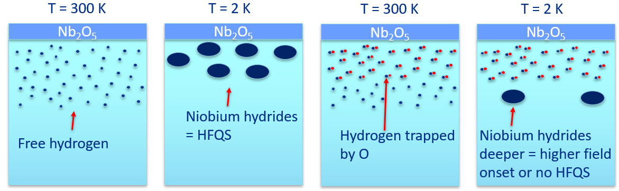
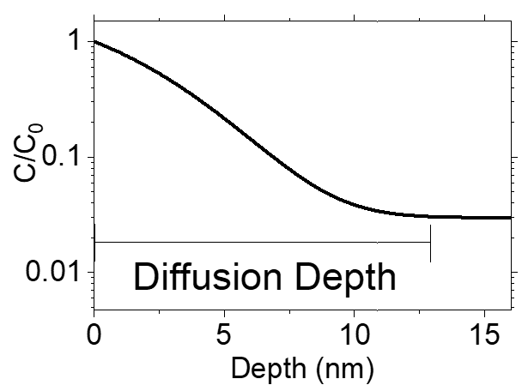
Solidifying the Role of O in the Mitigation of HFQS in 1.3 GHz
Onset of HFQS vs O Diffusion Depth
Before baking
After LTB
33x decrease
Supports Romanenko model of hydrides and shows that diffused oxygen mitigates HFQS
D. Bafia et al, Proceedings of SRF’2021, THPTEV016

Slide 9
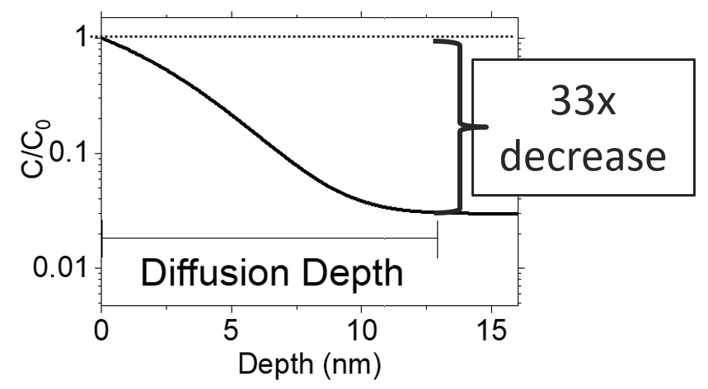
Diffusion Depth vs Quench Field for 1.3 GHz Cavities
Quench Peak
HFQS Regime
HFQS regime: quench due to thermal origins
Quench peak
  When O diffuses 46 nm
  → Achieved via 120 C x 12 hrs
Mid-T Bake data comes from S. Posen et al., PRA 13, 014024 (2020)

Slide 10
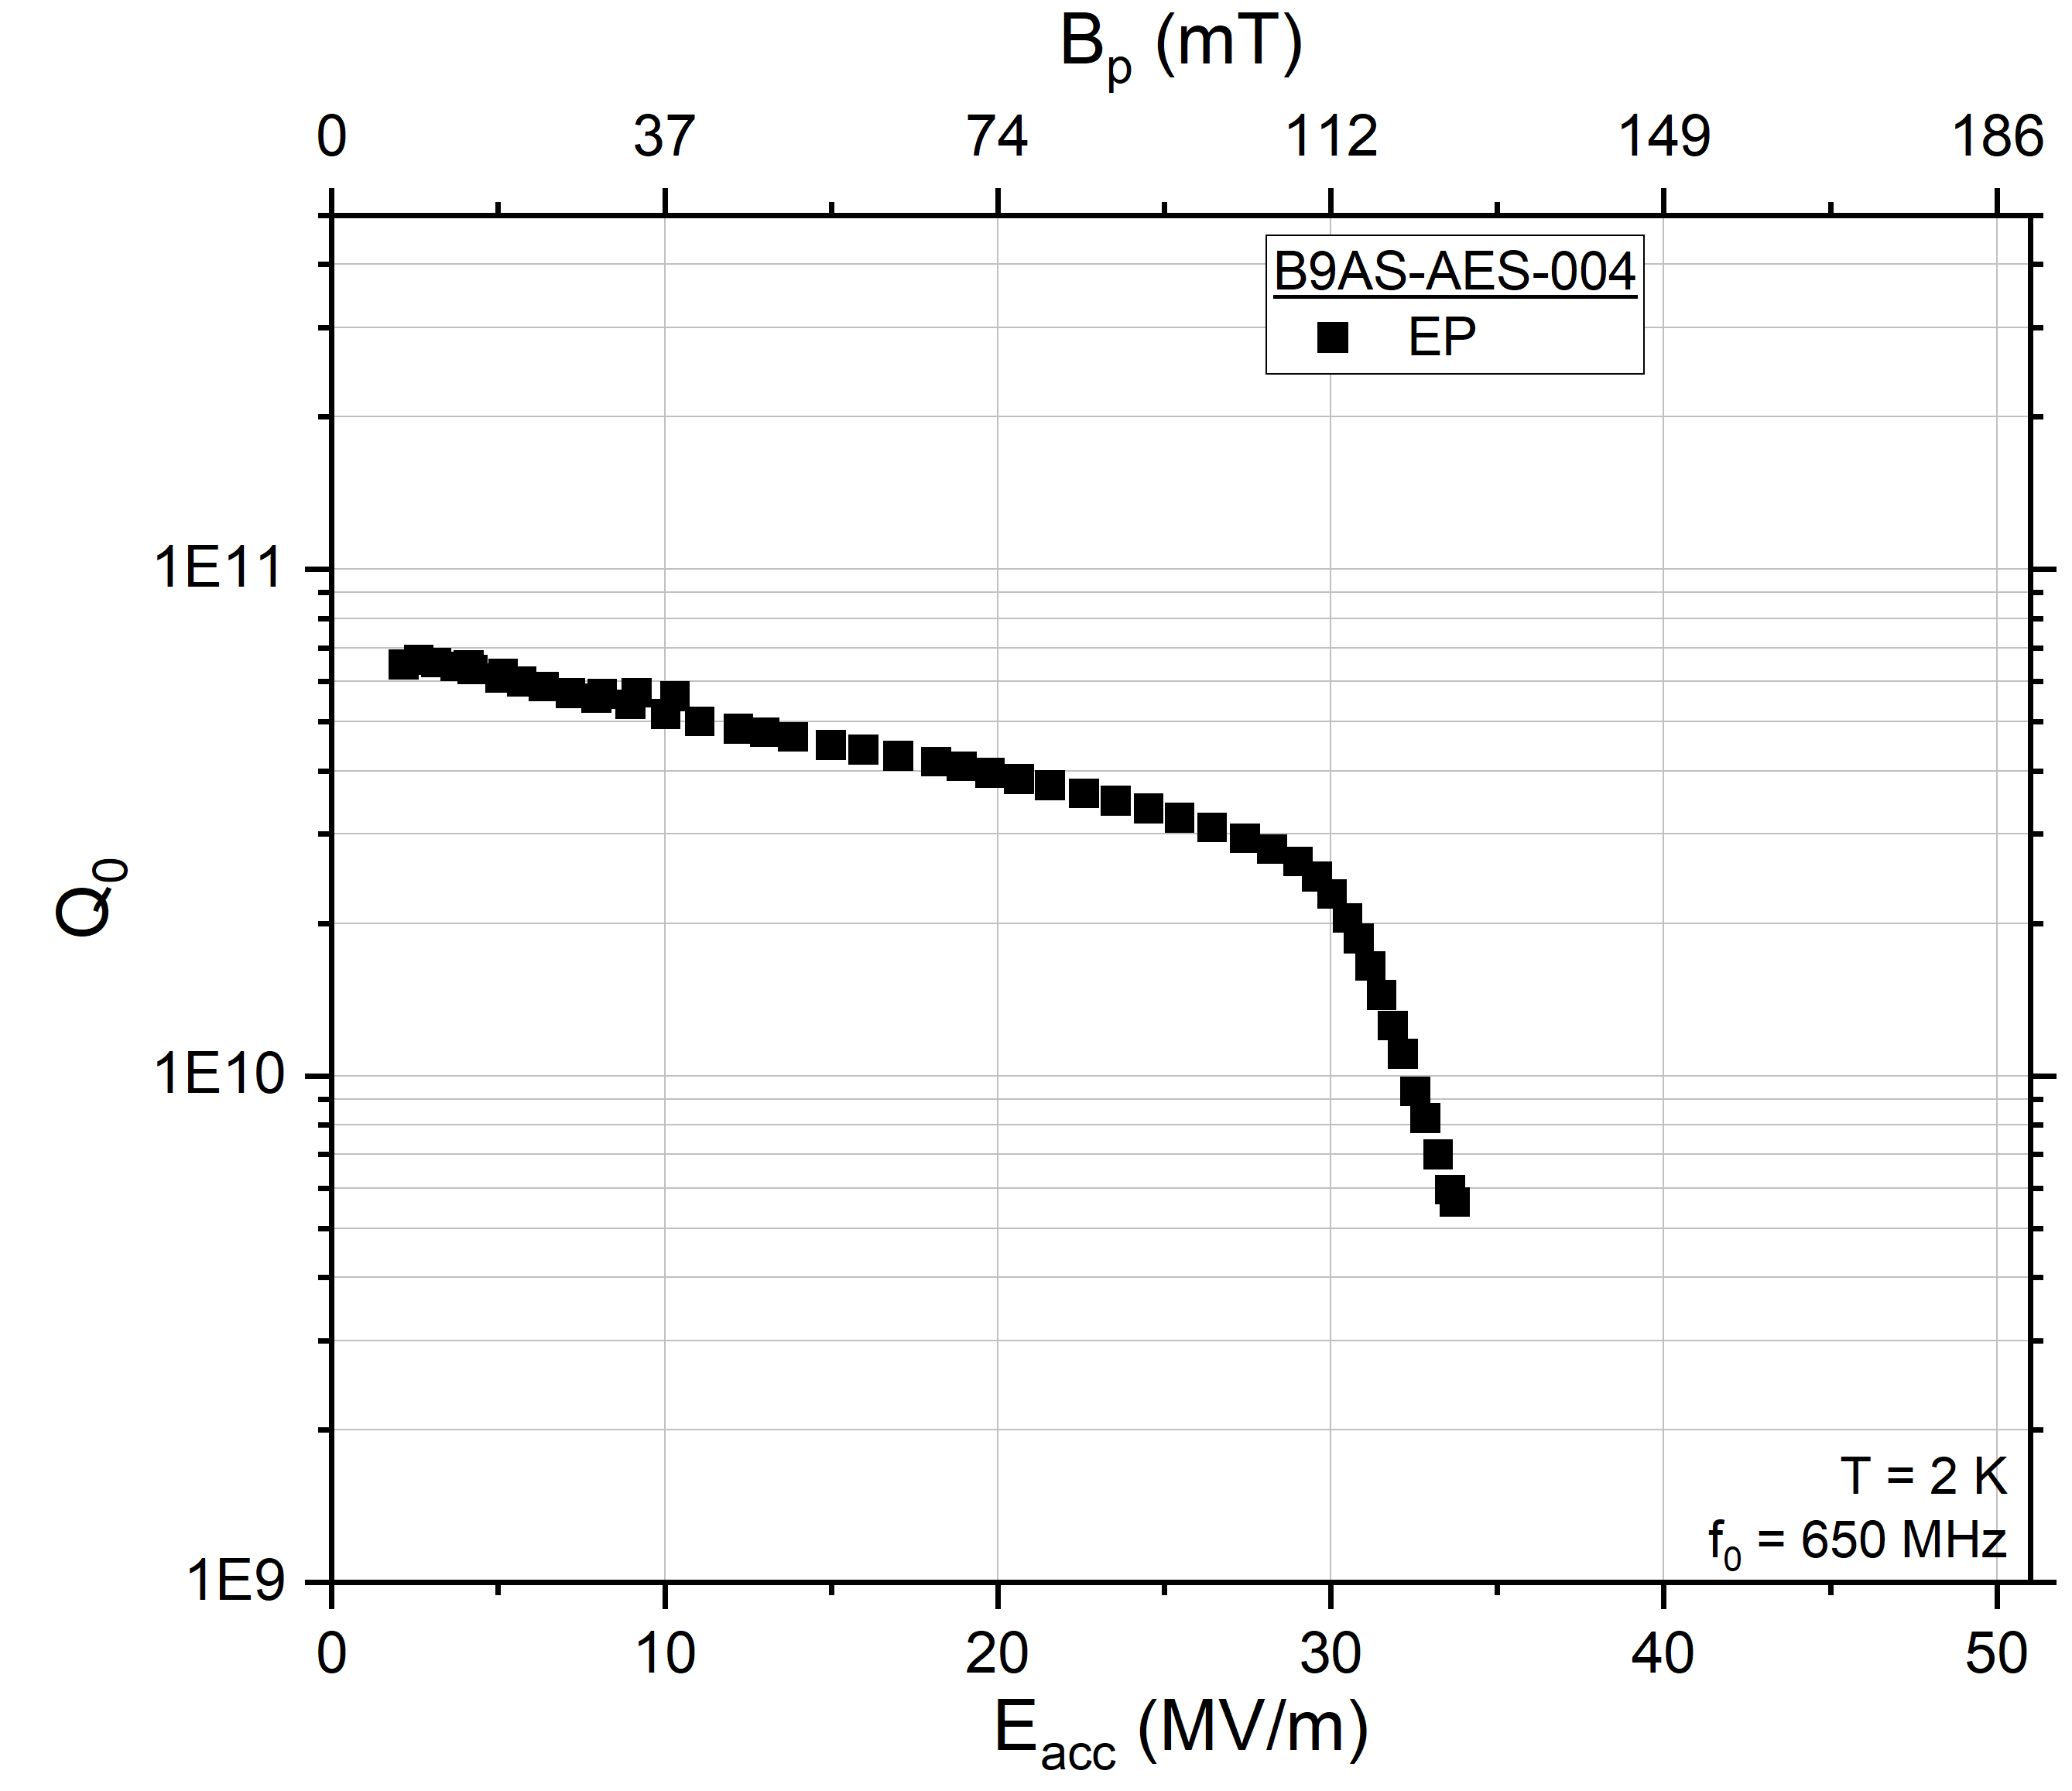
Applying 120 C x 12 hrs LTB to Other Frequencies: 650 MHz
What do we expect after 120 C x 12 hr in situ LTB?
No HFQS up to 161 mT
2) Quench @ 187 mT

Slide 11
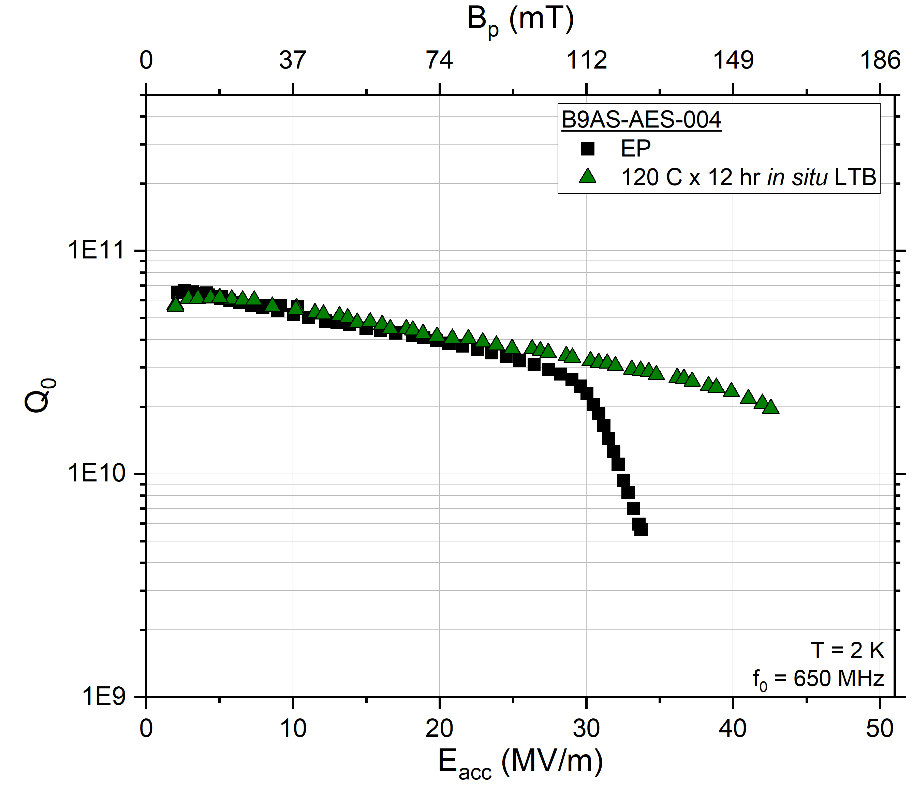
Applying 120 C x 12 hrs LTB to Other Frequencies: 650 MHz
What do we expect after 120 C x 12 hr in situ LTB?
No HFQS up to 161 mT
2) Quench @ 187 mT
  We observe 158 mT
✓
?

Slide 12
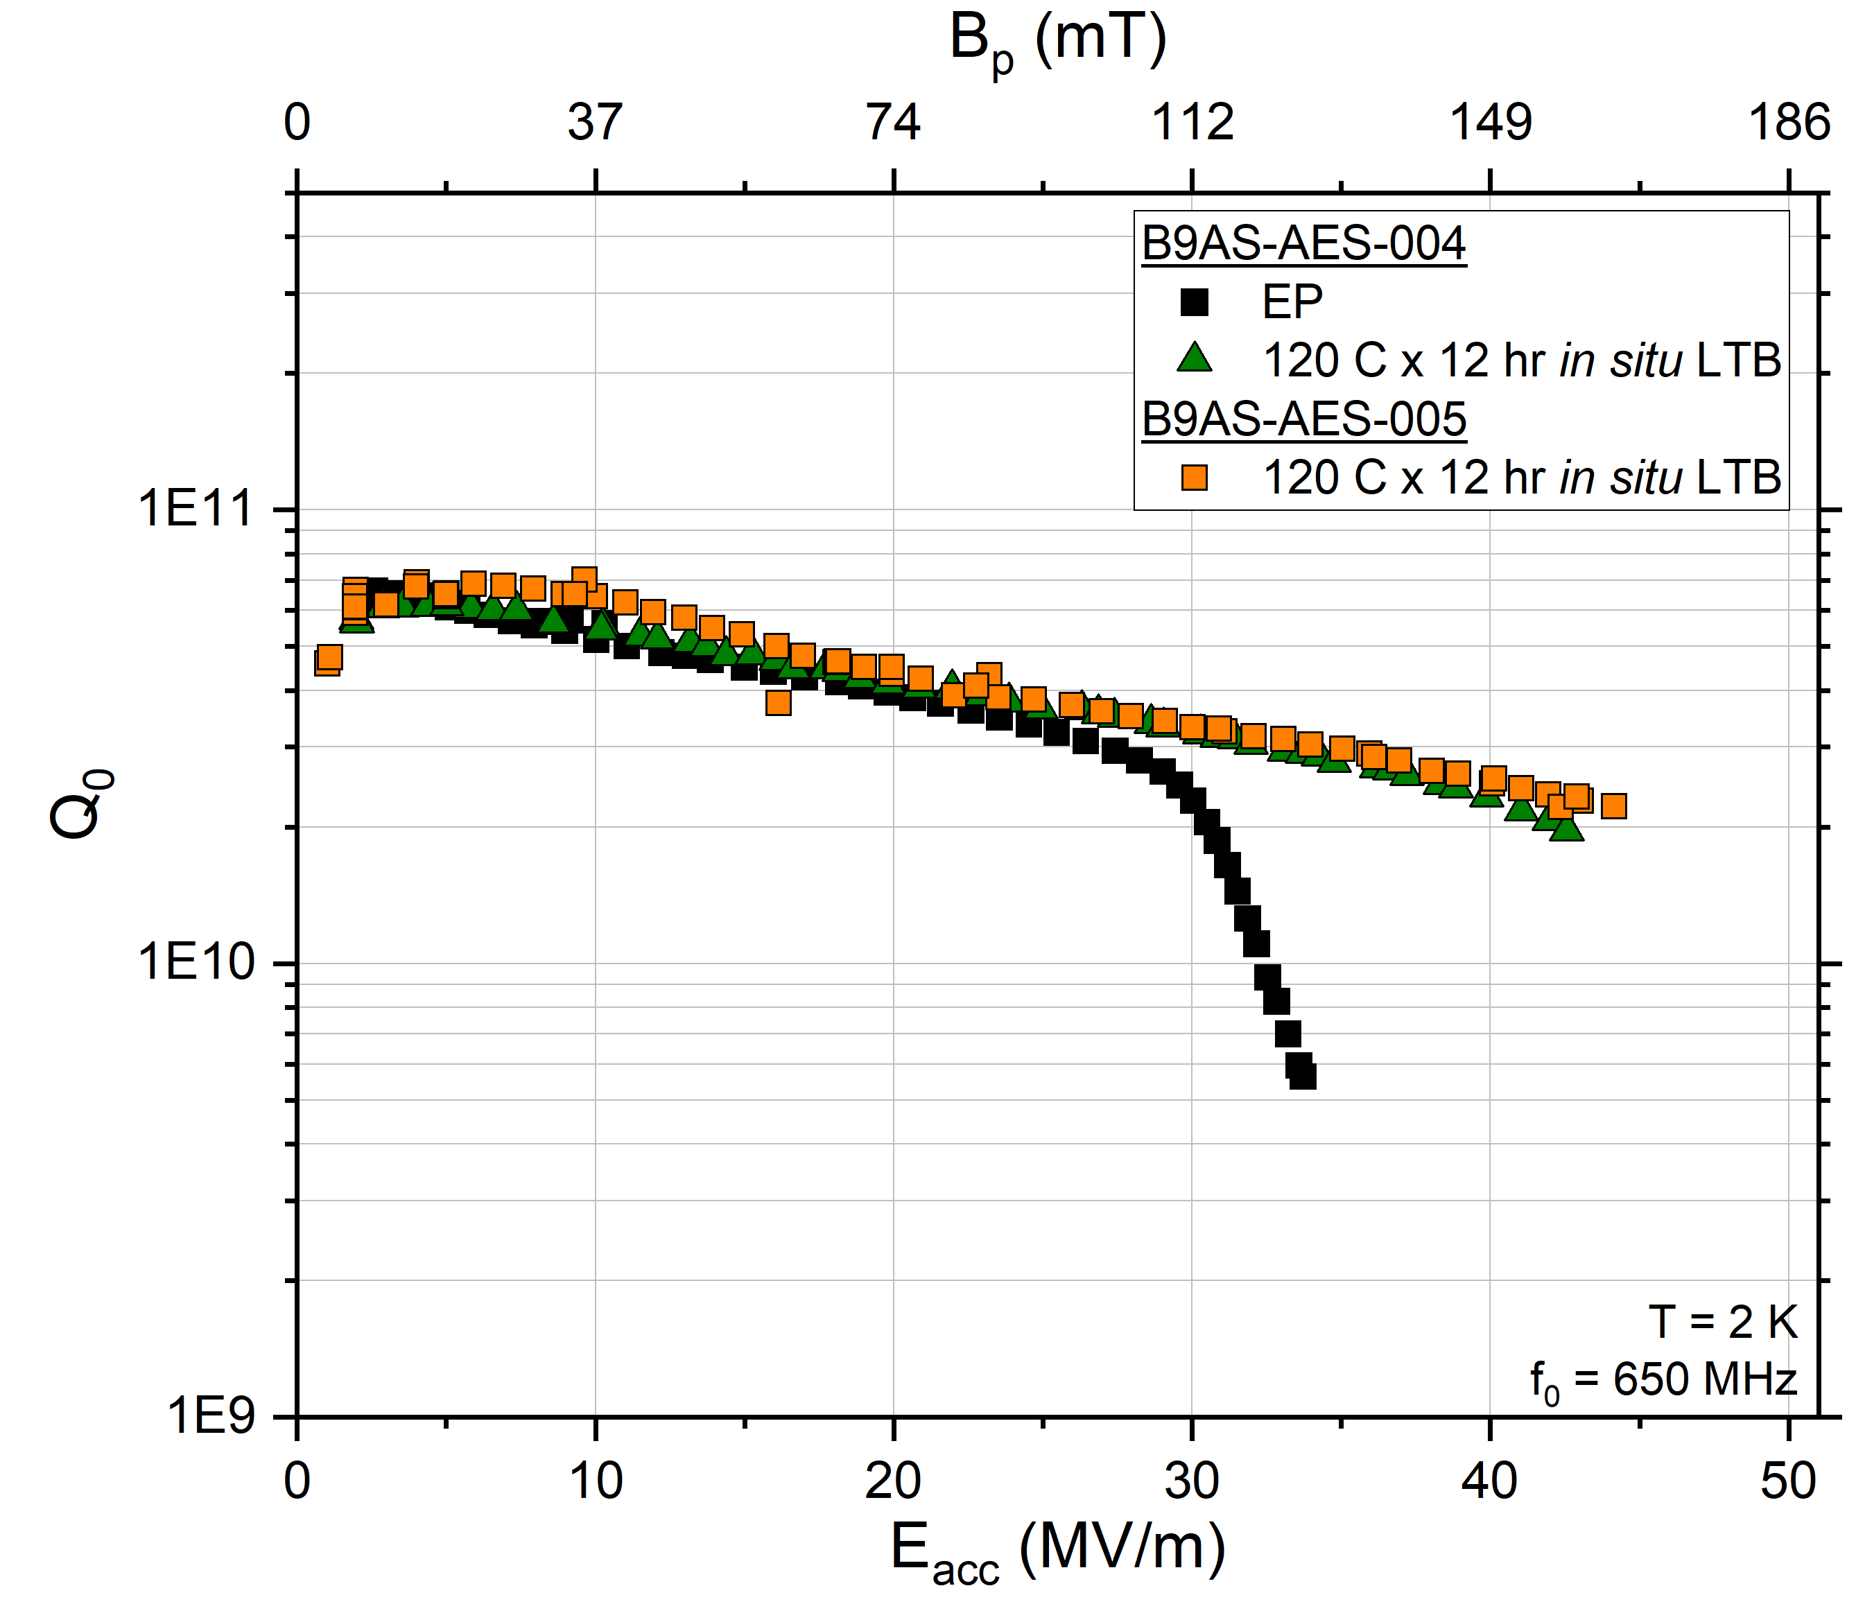
Applying 120 C x 12 hrs LTB to Other Frequencies: 650 MHz
What do we expect after 120 C x 12 hr in situ LTB?
No HFQS up to 161 mT
2) Quench @ 187 mT
  We observe 158 mT
  And again at 164 mT
✓
?
Near record quench in 650 MHz, 164 mT!
Notes:
Current record held by Sha et al. from CEPC with 168 mT at surface (achieved 40 MV/m but with Bp/Eacc = 4.2 mT/MV/m due to larger beam pipe diameter)

Slide 13
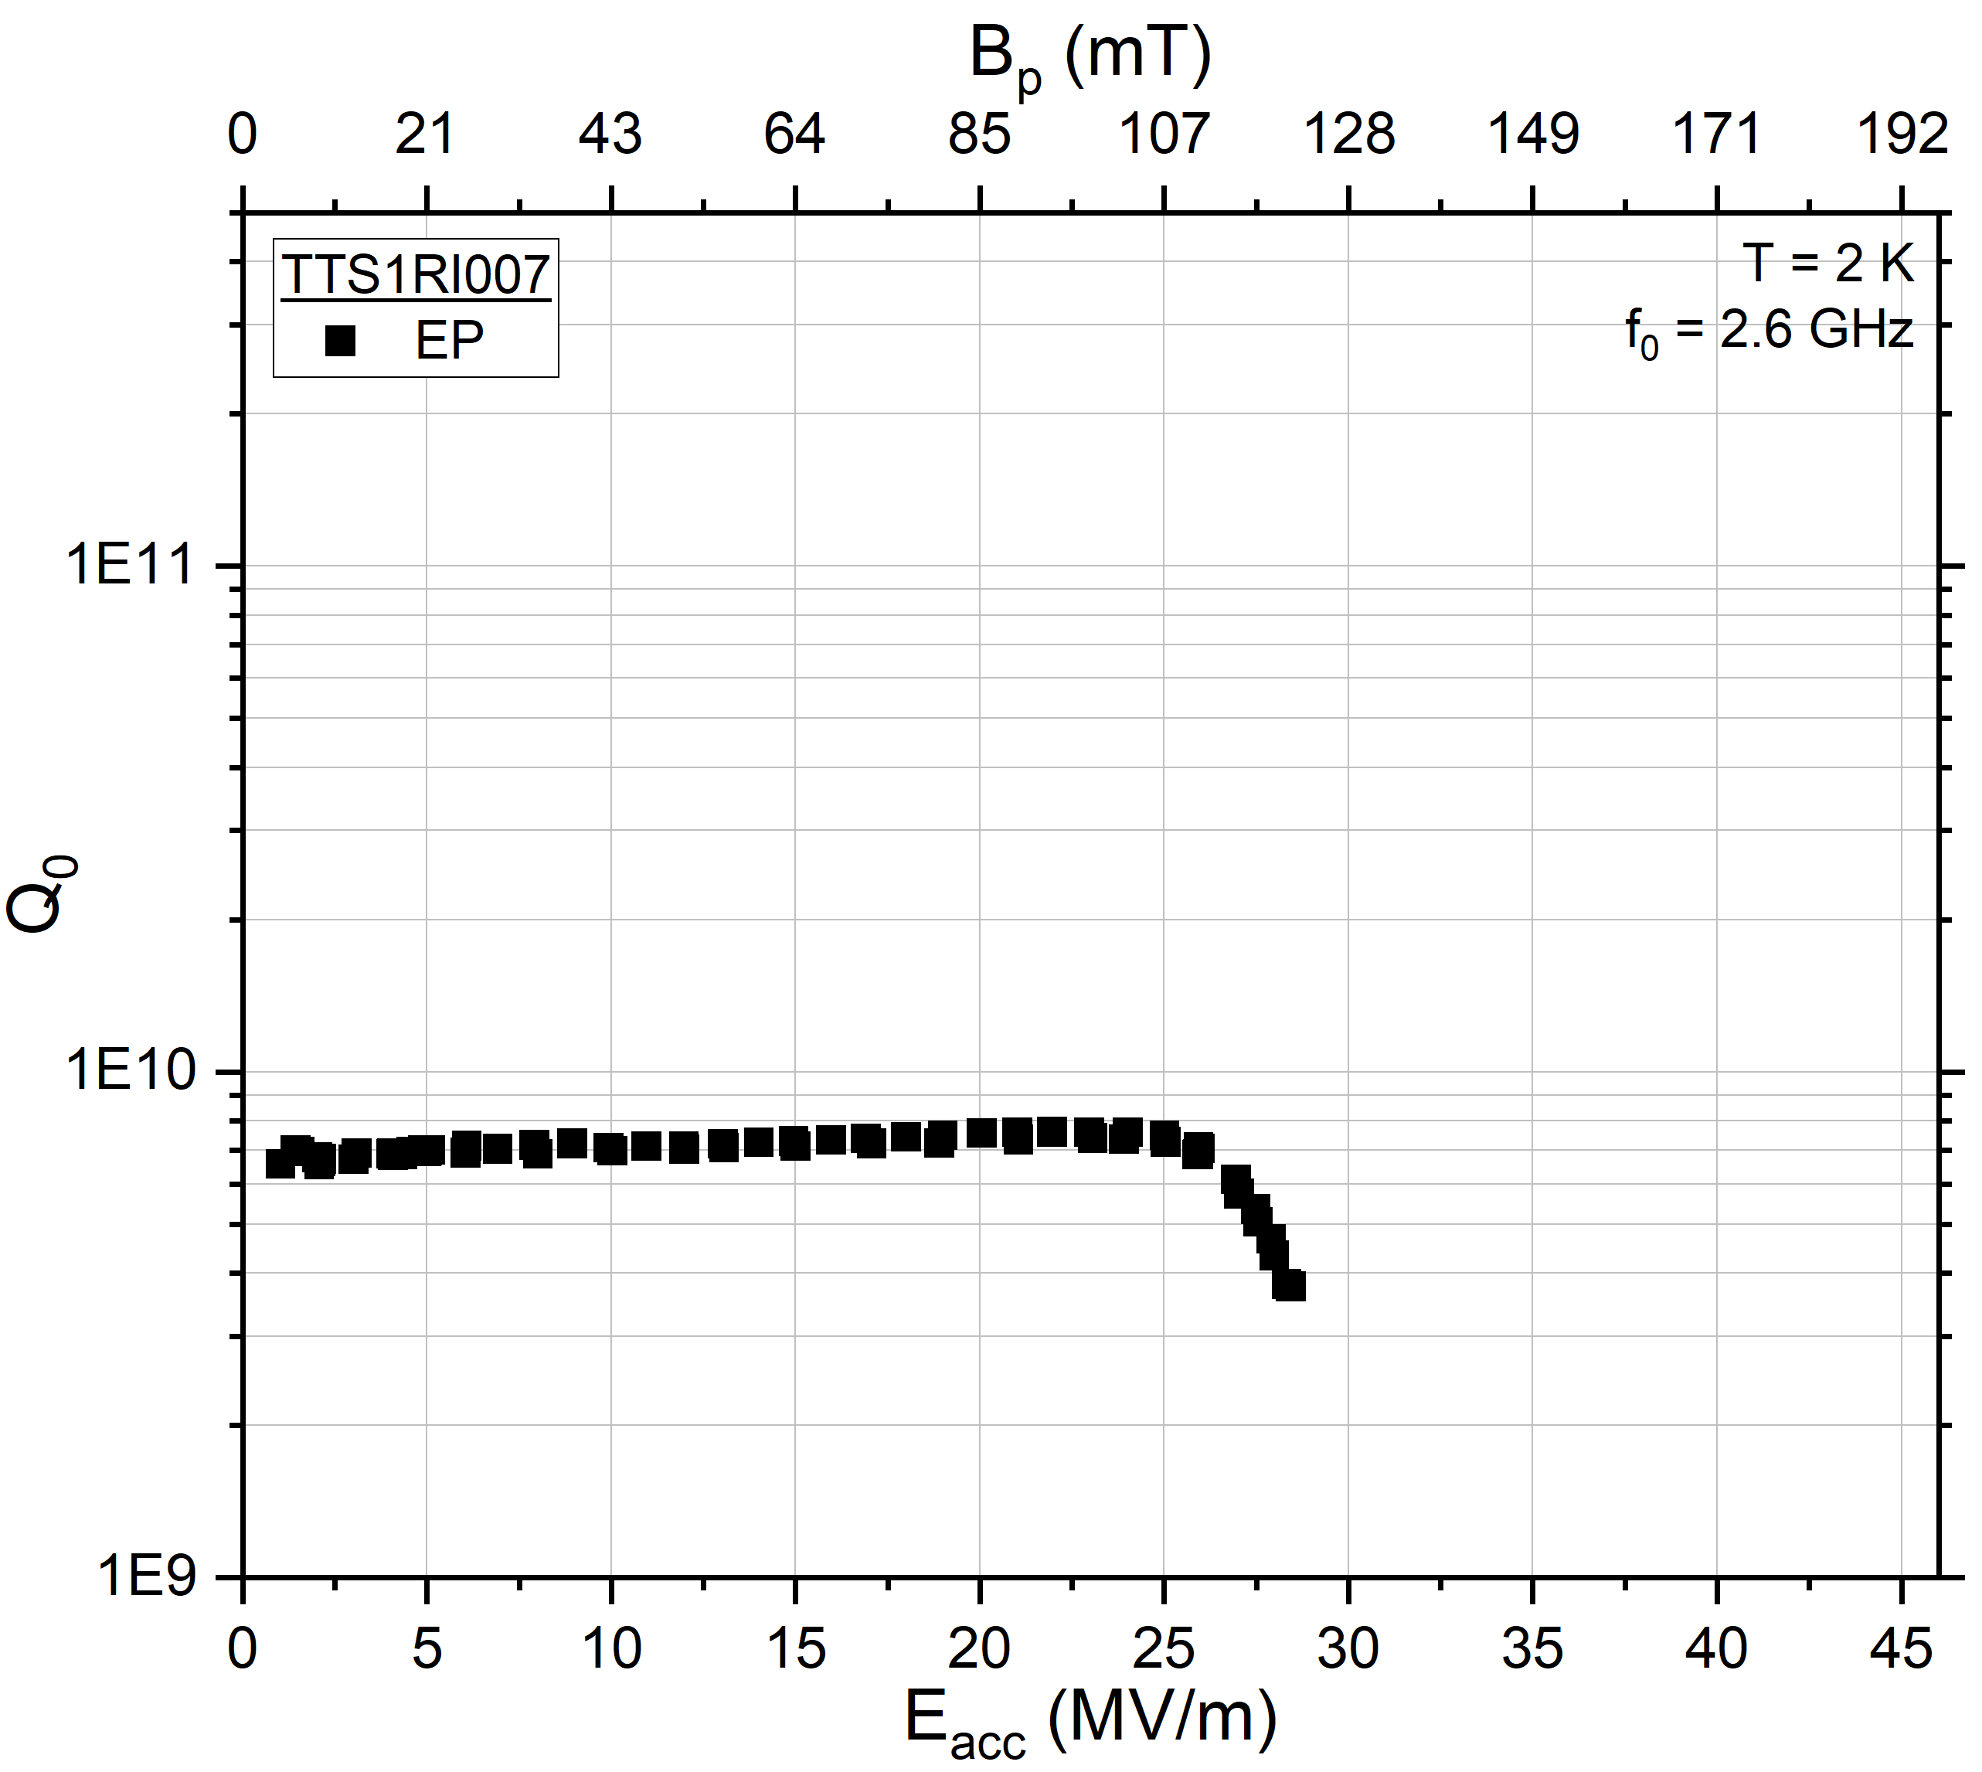
Applying 120 C x 12 hrs LTB to Other Frequencies: 2.6 GHz
What do we expect after 120 C x 12 hr in situ LTB?
No HFQS up to 161 mT
Quench @ 187 mT

Slide 14
Applying 120 C x 12 hrs LTB to Other Frequencies: 2.6 GHz
What do we expect after 120 C x 12 hr in situ LTB?
No HFQS up to 161 mT
Quench @ 187 mT
  We observe 160 mT
✓
?
High quench field achieved in 2.6 GHz, 161 mT!
Preliminary: For same O profile, all cavities exhibit same HFQS and similar quench behavior regardless of frequency

Slide 15
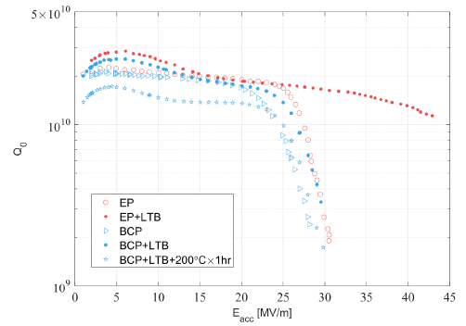
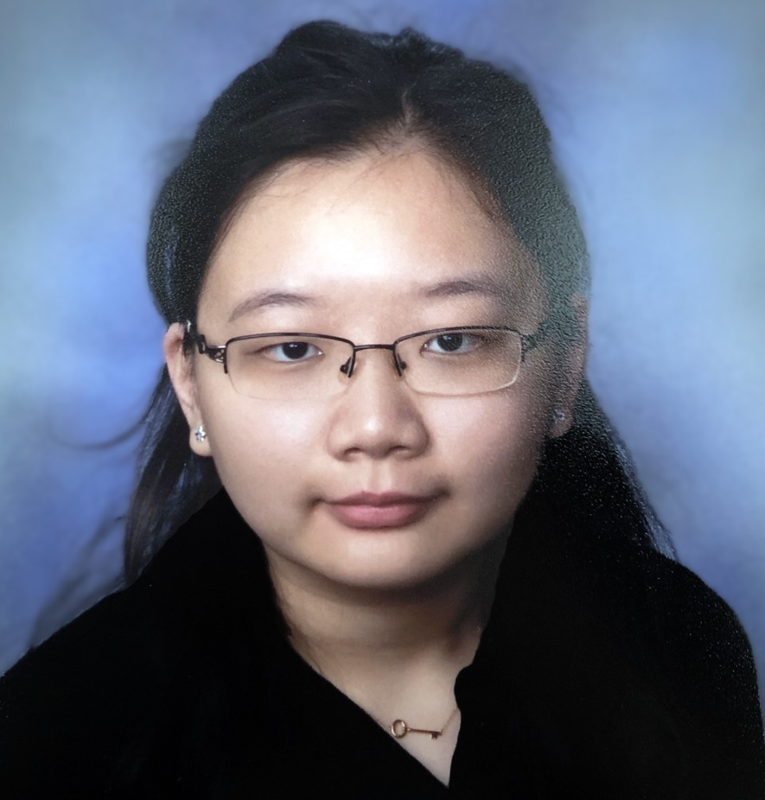
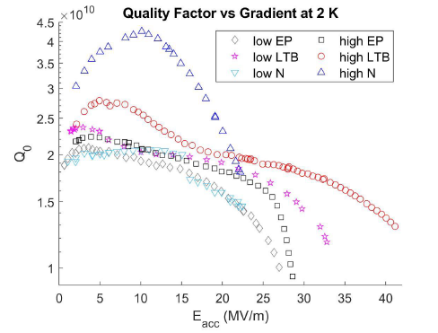
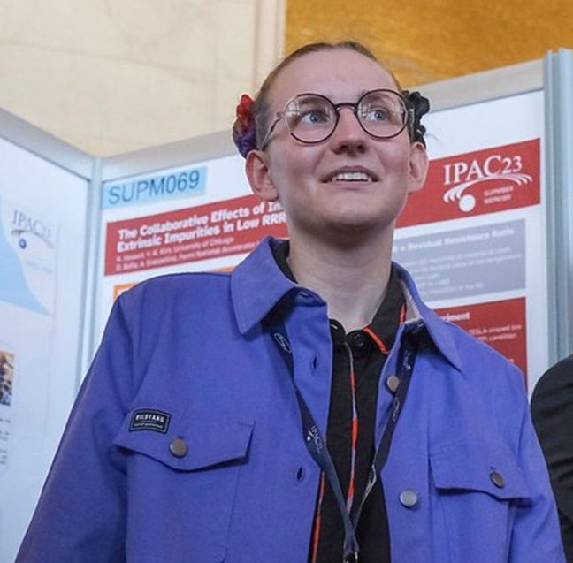
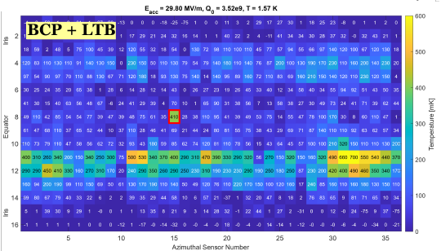
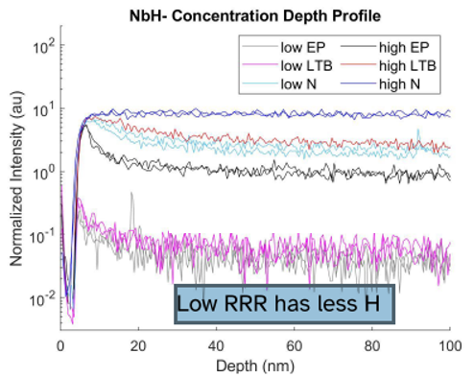
Further Surface Engineering Studies on Cavities
Further Improving Cavity Performance with O
Study on Role of Various Impurities in Cavities
H. Hu
K. Howard
H. Hu et al., Proc. Of IPAC’23, WEPA190
K. Howard et al., Proc. of IPAC’23, WEPA189
Coupling simulation, material science, and RF testing to identify optimal oxygen profile for high Q₀ and G in variously treated cavities
Looking for an enthusiastic postdoc to join our group!
Comparative in-depth study of high and low RRR cavities to identify potential role of intrinsic impurities

Slide 16
Conclusion
Oxygen diffused from the native niobium oxide via vacuum baking responsible for performance variation in cavities
1.3 GHz Cavity studies
HFQS onset scales linearly with the depth to which oxygen diffuses
Nonmonotonic relationship between quench field and O diffusion depth
Applied findings from 1.3 GHz cavities to other design frequencies and achieved near record gradients in 650 MHz and 2.6 GHz cavities
Studies to further improve performance underway:
  Profile tailoring, role of intrinsic impurities, …

Slide 17
Thank Your for Your Attention!

