Slide 1
1.3 GHz RF-Dipole Crabbing Cavity System for International Linear Collider
International Workshop on Future Linear Colliders
15-19 May 2023

Slide 2
Outline
Crabbing System for ILC
ILC Crabbing System Specifications
EM Design
  RF Parameters
  HOM Damping
Mechanical Analysis
  Stress Analysis
  Tuning Sensitivity
Fabrication Plan
Cryomodule Layout
Summary and Next Steps

Slide 3
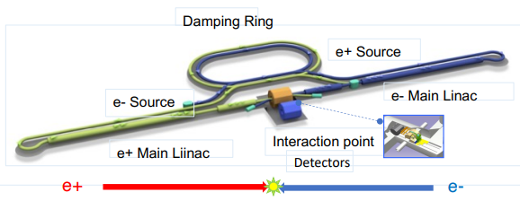
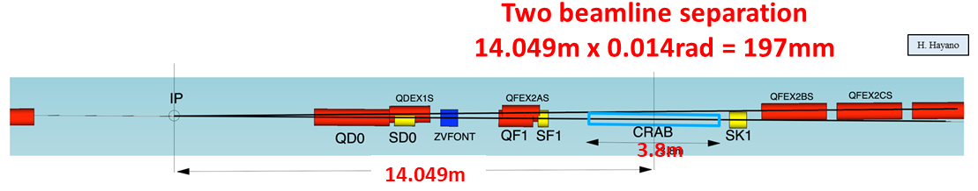
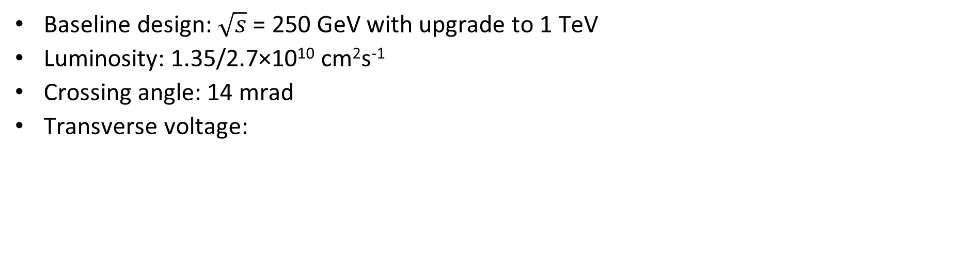
Crabbing System for ILC
ILC Technical Design Report
Baseline design: $\sqrt{s}$= 250 GeV with upgrade to 1 TeV
Luminosity: 1.35/2.7×10¹⁰ cm²s⁻¹
Crossing angle: 14 mrad
Transverse voltage:
Parameter | Value
Center of mass energy [GeV] | 250/1000
Crossing angle [mrad] | 14.0
β_{cc} [m] | 23.2
β_{IP} [mm] | 13.0/22.6
RMS bunch length (σ_{z}) [mm] | 0.3/0.25
RMS horizontal beam size (σ_{x}*) [nm] | 729.0/481.0
Beam Energy | 250 GeV |  |  | 1 TeV
f₀ [GHz] | 1.3 | 2.6 | 3.9 | 1.3 | 2.6 | 3.9
Tot. V_{t} [MV | 1.845 | 0.923 | 0.615 | 7.4 | 3.7 | 2.5

Slide 4
Requirements for ILC 1.3 GHz Crab Cavity
Operating frequency – 1.3 GHz
  Transverse voltage – 1.845 MV (125 GeV) and 7.4 MV (for 500 GeV)
Maximum fields – E_{p} < 45 MV/m and B_{p} < 80 mT
Total impedance threshold:
  Z_{x} = 48.8 MΩ/m and Z_{y} = 61.7 MΩ/m
Transverse kick factors:
  k_{x} < 1.6×10³ V/pc/m and k_{y} < 1.2×10² V/pc/m
Tuning specifications – 100-180 kHz
Dimensional constraints:
  Minimum beam aperture = 25 mm
  Total cryomodule length < 3.8 mm
  Parallel beam pipe separation = 197 mm
ILC Crab Cavity Specifications (V19) – P. McIntosh

Slide 5
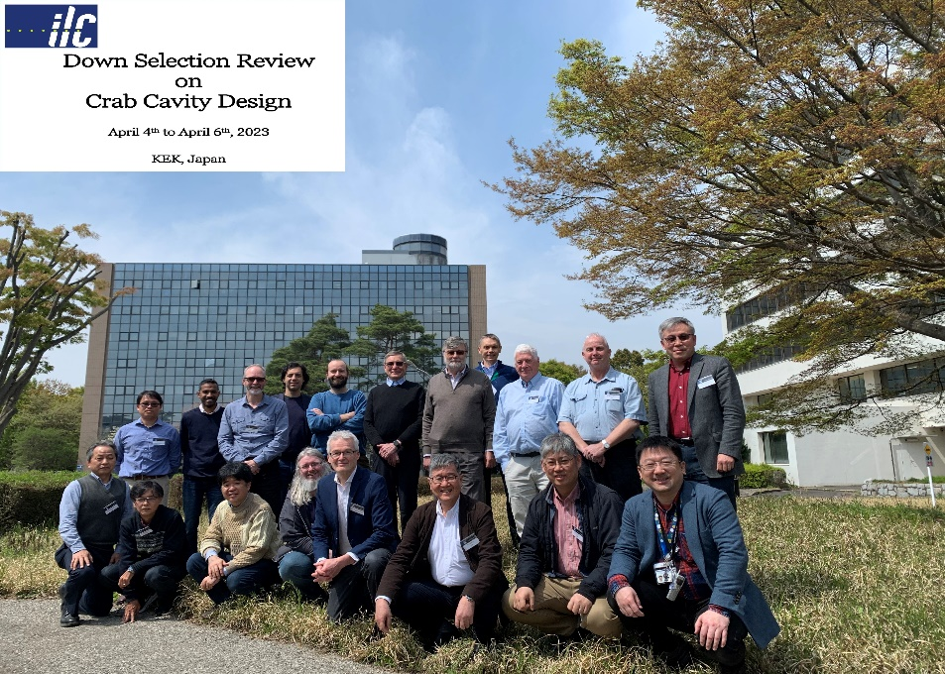
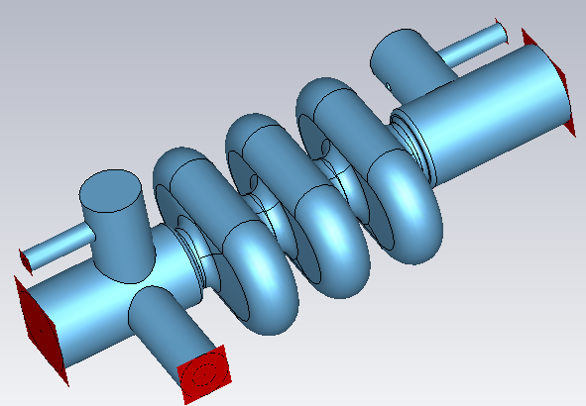
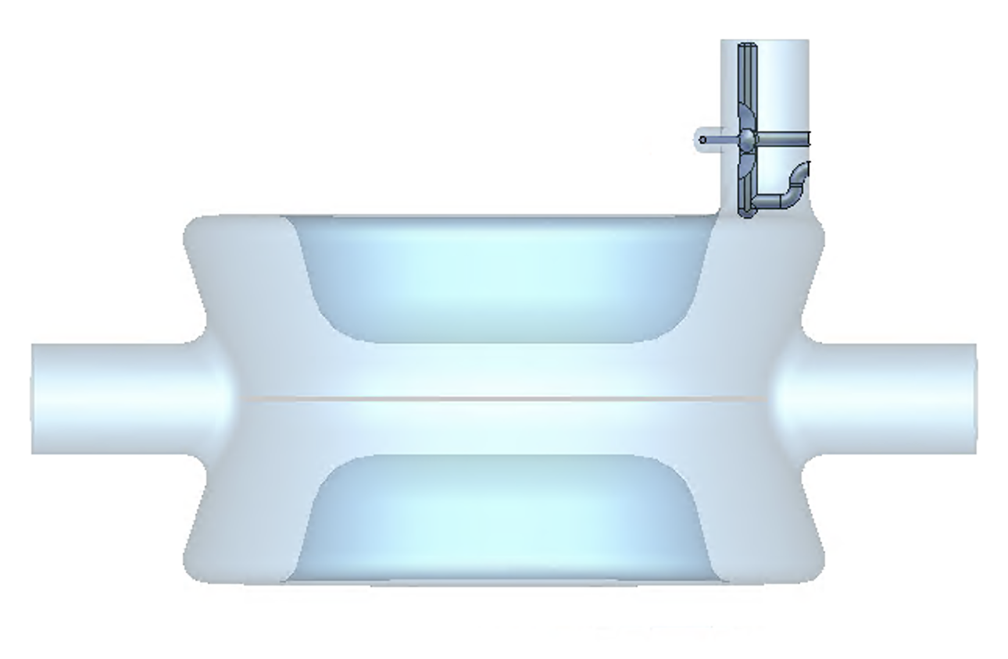
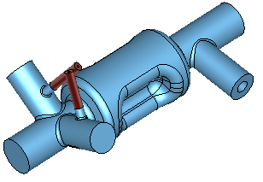
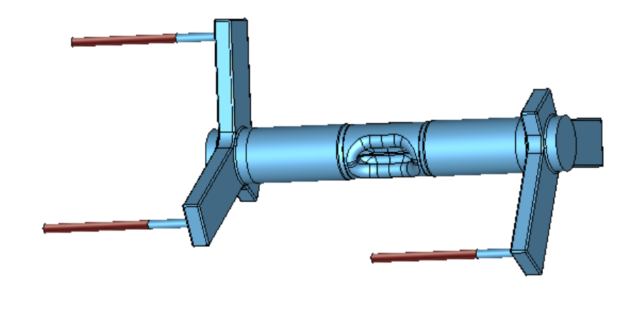
ILC Crab Cavity Designs
Several crab cavity designs have been proposed
Down Selection Review on Crab Cavity Design – April 4-6, 2023 – KEK, Japan
  Two crab cavity designs were down selected
2 Final Designs
  RF-Dipole Cavity (RFD) [1.3 GHz] from ODU/JLab
  Quasi-waveguide Multi-cell Resonator (QMiR) [2.6 GHz] from Fermilab
2 selected designs will go into prototype production in the 18 month Pre-Lab phase
ILC Crab Cavity Development, R. Laxdal
(Thursday, 8.30 am)
RFD 1.3 GHz (ODU/JLAB)
WOW 1.3 GHz
(BNL, CERN)
DQW 1.3 GHz
(BNL, CERN)
RACETRACK 3.9 GHz
(LANCASTER UNIV. /COCKTROFT)
QMIR 2.6 GHz (FERMILAB)

Slide 6
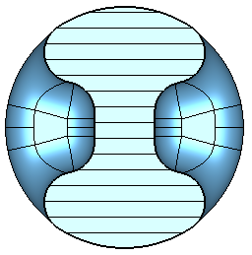
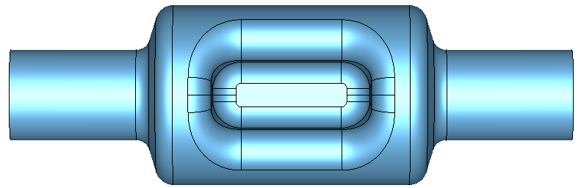
1.3 GHz RFD Cavity Design
Optimized the pole shape (pole height and length):
  To achieve peak surface field requirements of E_{p} < 45 MV/m and B_{p} < 80 mT
Property | Value
Operating frequency [GHz] | 1.3
1st HOM [GHz] | 2.089
E_{p}/E_{t}* | 3.81
B_{p}/E_{t}* [mT/(MV/m)] | 6.78
B_{p}/E_{p} [mT/(MV/m)] | 1.78
G [Ω] | 129.88
R/Q [Ω] (V²/P) | 439.51
R_{t}R_{s} [Ω²] (V²/P) | 5.71×10⁴
*Reference length V/E_{t} = λ/2 [mm] | 115.3
V_{t} max per cavity [MV] | 1.36
E_{p} [MV/m] | 44.94
B_{p} [mT] | 79.96
V_{t} per cavity [MV] (@ 125 GeV) | 0.9225
Stored energy (U) [J] | 0.237
P_{diss} [W] (for R_{s} = 30 nΩ) | 0.45
Q₀ (for R_{s} = 30 nΩ) | 4.33×10⁹
25 mm
310 mm
50 mm
31.5 mm
99.4 mm
130 mm
Cavity Dimensions (rf volume) | Value
Pole separation [mm] | 25
Beam aperture [mm] | 50
Cavity Length [mm] (flange-to-flange) | 310
Cavity Diameter [mm] | 99.4
Pole Length [mm] | 85
Pole Height [mm] | 31.5
Angle [deg] | 22.5
 | 250 GeV | 1 TeV
Max V_{t} per cavity [MV] | 1.36 | 1.36
Total V_{t} [MV] | 1.845 | 7.4
Number of cavities | 2 | 6
V_{t} per cavity [MV] | 0.9225 | 1.234
V_{t,max} / V_{t,operational} | 1.47 | 1.10

Slide 7
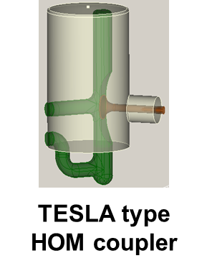
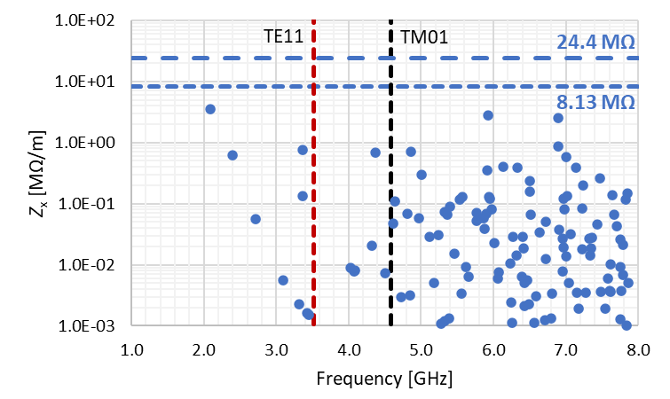
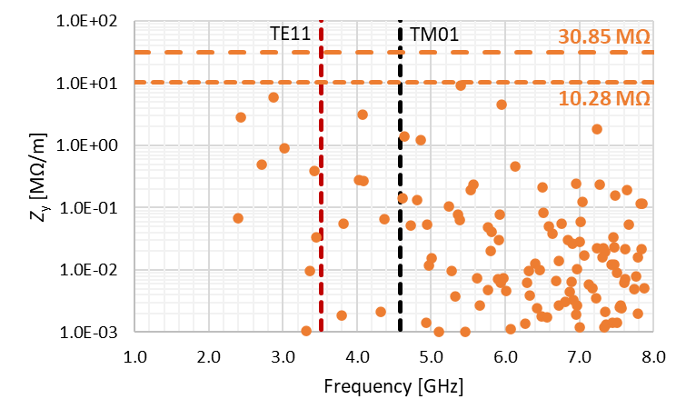
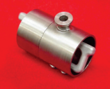
HOM Impedances
Damping using 2 TESLA type HOM couplers
Total impedance threshold (requirements): Z_{x} = 48.8 MΩ/m and Z_{y} = 61.7 MΩ/m
Impedance threshold per cavity: Z_{x} = 8.13 MΩ/m and Z_{y} = 10.28 MΩ/m (6 cavities)
Impedance threshold per cavity: Z_{x} = 24.4 MΩ/m and Z_{y} = 30.85 MΩ/m (2 cavities)
Dampers placed on one end of the cavity: no interference with the FPC
HOM2
FPC
HOM1
Impedances calculated using circuit definition

Slide 8
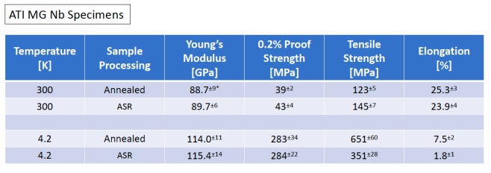
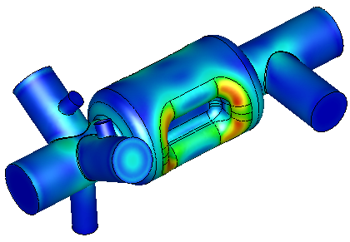
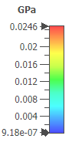
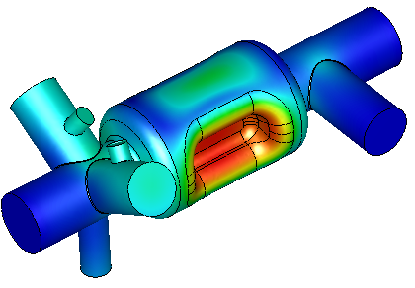

Stress Analysis
Analysis at 2.2 atm external pressure
Nb material properties at room temperature for MG
  Young’s modulus – 88.7 GPa
  Poisson’s ratio – 0.38
Cavity thickness – 3 mm
Allowable stress < 39 MPa (For MG)
  Maximum stress is 24.6 MPa
New Nb Material for Cost Saving, A. Yamamoto
(Tuesday,11.30 am)
Case | Max. Stress [MPa]
Cavity with HOMs | 24.6
+ Tuner – Pull | 23.8
+ Tuner – Push | 29.2

Slide 9
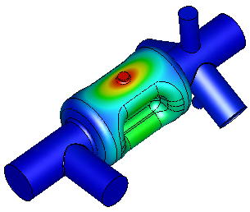

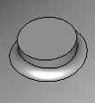
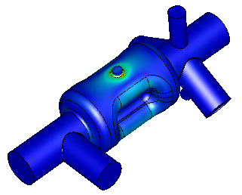
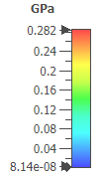
Tuning Sensitivity Analysis
Nb material properties at cryo temperature for annealed MG
  Young’s modulus – 114 GPa (1.65×10⁷ psi)
  Allowable stress < 283 MPa (For MG)
Required tuning range – 100-180 kHz
Tuner Adapter
Ø 1.5 cm
Total Displacement | Tuning Sensitivity | Max. Tuning Range
0.34 mm | 9.5 MHz/mm | ±3.24 MHz
Sensitivity: 9.5 Hz/nm
Tuning range of 200 kHz corresponds to a total displacement of 22 μm
Loaded bandwidth of 87 Hz (Q_{L} = 1.5×10⁷) corresponds to a total displacement of 9.2 nm
Tuning force (for 200 kHz) per side – 175 N
Can be implemented with a piezo tuner

Slide 10
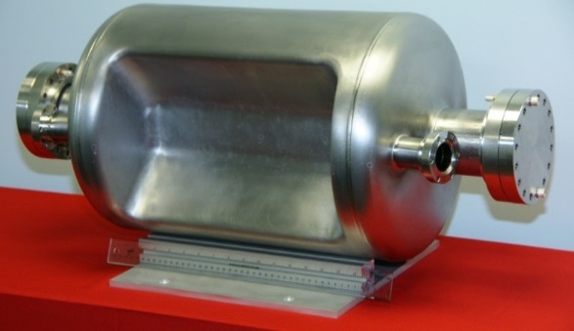
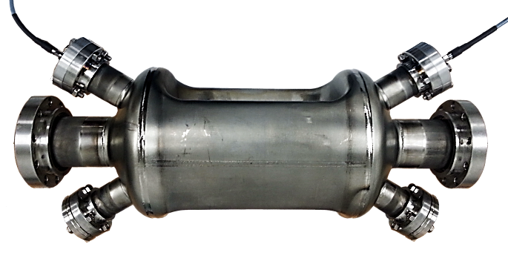
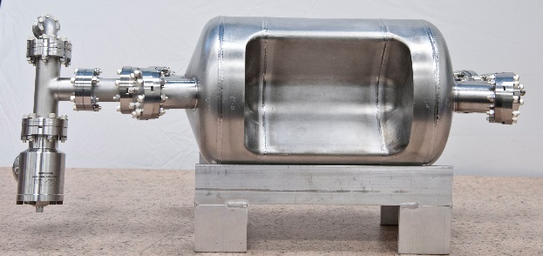
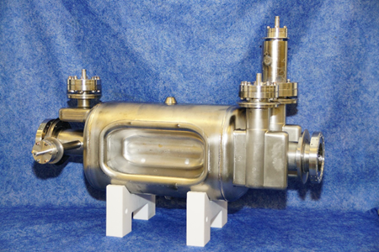
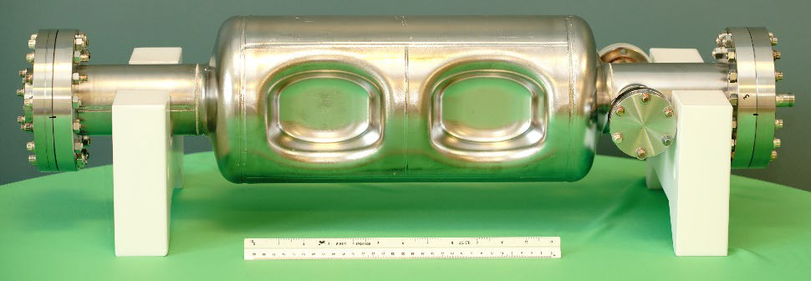
RF-Dipole Crabbing Cavities
499 MHz
750 MHz
400 MHz
960 MHz

Slide 11
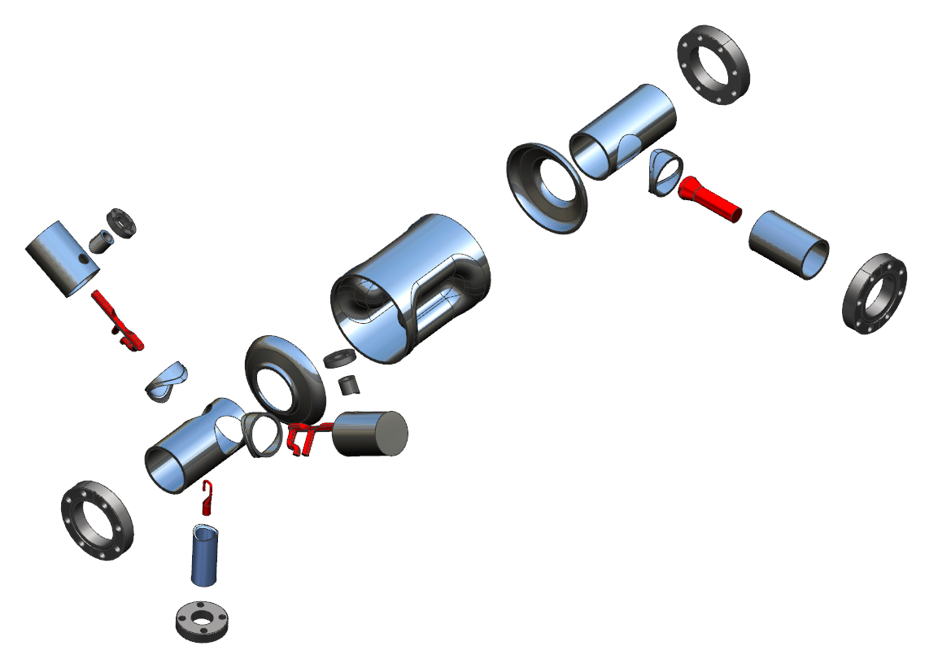
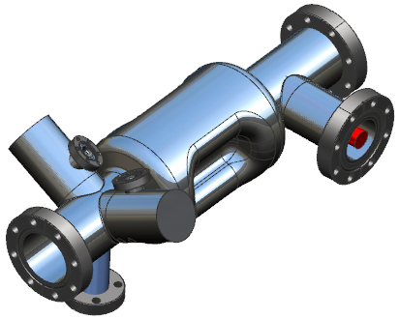
Cavity Fabrication
Cavity body thickness - 3mm
Thickness of beam pipes, HOM cans – 2 mm
HOM hooks and probes – Nb
FPC and FP probes – Cu
Cavity flanges – SS 316LN with Cu gaskets
  Center body will be machined and EDM out of Nb ingot
    Better control over dimensions and tolerances
    Reduced number of welds
    Reduces number of dies and fixturing
    Allows for variable thickness
HOM coupler fabrication
  TESLA HOM couplers used in XFEL, LCLS-II, CEBAF-C100, and ILC
  Well understood fabrication process

Slide 12
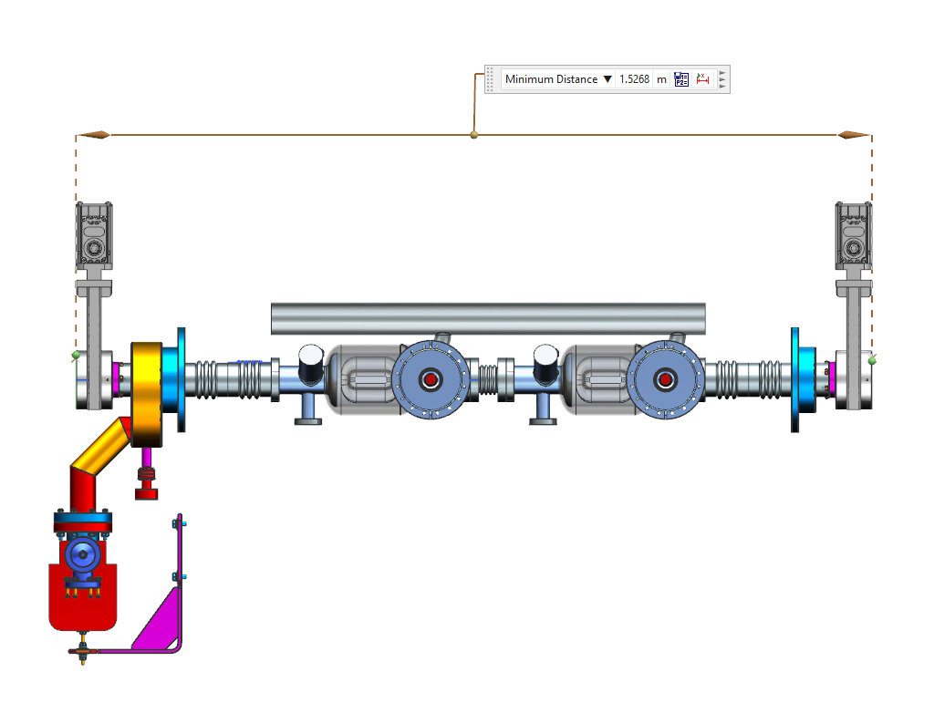
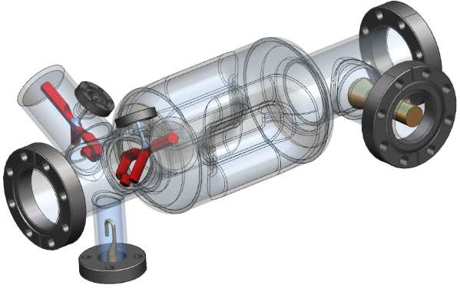
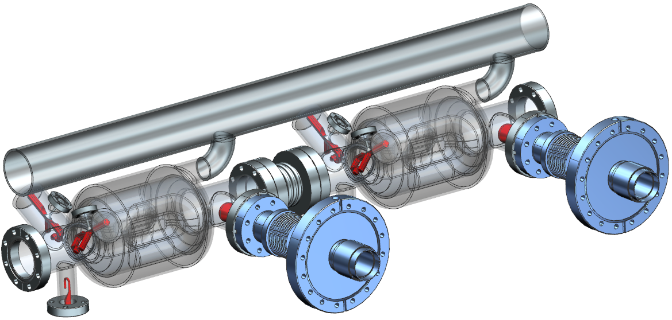
Conceptual He Vessel and Cryomodule Design
2 cavities in a single cryomodule
  Second beam pipe – 20 mm beam pipe
  Total achievable – 2.72 MV (1.36 MV V_{t} per cavity )
Design concept follows JLab C100 cryomodule
FPC, HOM couplers can be placed outside the He vessel
Cryomodule length ~1.5 m and diameter < 1 m

Slide 13
Summary and Next Steps
RFD cavity was down selected as one of the two cavities to be prototyped in the next phase of crabbing cavity development for ILC
Basic design is completed; will do detailed analysis to finalize the cavity dimensions
  Wakefield analysis
  Multipacting analysis with HOM dampers
Full engineering design and develop a detailed fabrication plan
Fabrication of the prototype cavity with HOM dampers
We have had great collaborations with LHC HiLumi and EIC with SLAC, BNL, Fermilab, CERN, TRIUMF
Looking forward to collaborations on developing the ILC crabbing systems

Slide 14
THANK YOU !!!

Slide 15
Features of RF-Dipole Cavities
Compact design
Fundamental deflecting/crabbing mode has the lowest frequency
  No LOMs, no need for notch filter in HOM coupler for LOM
  Nearest HOM widely separated ( > 1.5 fundamental)
Low surface fields and high shunt impedance
Good balance between peak surface electric and magnetic field
Good uniformity of deflecting field due to high degree symmetry
Multipole components can be managed by shaping the geometry of the poles.
HOM couplers located in area of low field in fundamental mode

Slide 16
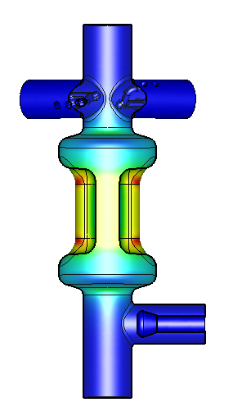
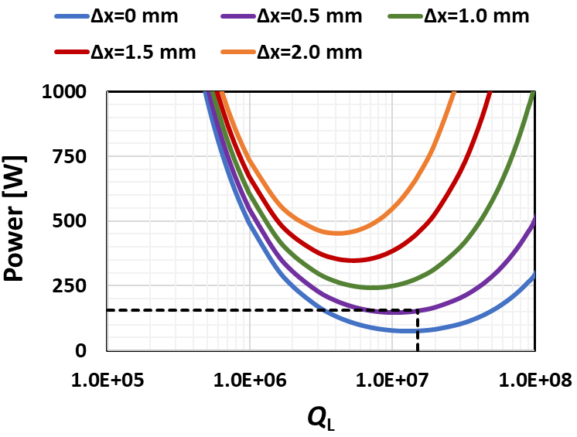
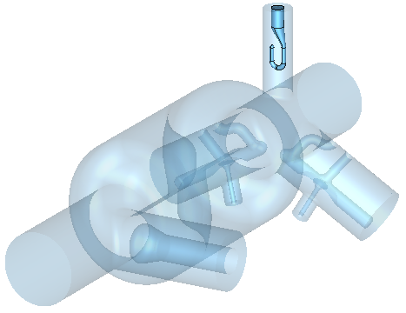

Fundamental Power Coupler
Coupling using coaxial antenna
  Similar to LCLS II power coupler
Beam current: I_{b} = 8.75 mA
Design parameters:
  Beam offset: Δx = 0.5 mm
  Microphonics: δf = 50 Hz
Cavity parameters:
  R/Q (V²/P_{diss})= 444.8 [Ω]
  Total V_{t} for 125 GeV = 1.845 [MV]
  V_{t} per cavity = 0.9225 [MV]
FPC Coupling:
δf = 50 Hz
Field Probe
Coupling using hook coupler
Field probe:
  Q_{ext} < 1.0×10¹⁰
  Extract ~200 mW at 0.9225 MV
Parameter | Value
Q_{ext} | 1.5×10⁷
RF Power at the cavity [W] | 154
RF heating at Cu probe [W] | 0.65

Slide 17
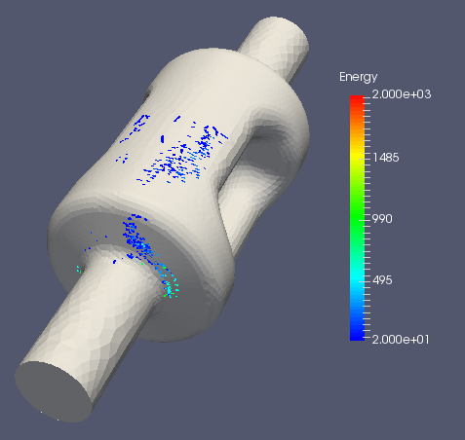
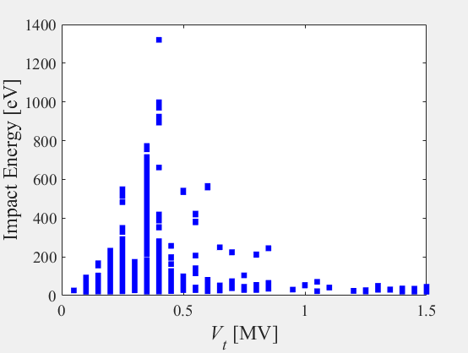
Multipacting Analysis
Resonant particles traced for 50 rf cycles with impact energy 20-2000 eV
Simulated for particles generated at a 1/8th surface area
Multipacting barrier at ~0.35 MV is similar to other barriers seen in other RFD cavities, and is fully processable
  Doesn’t reappear after fully processed
Multipacting analysis including couplers remains to be done
Final location of the resonant particles after 50 rf cycles

Slide 18
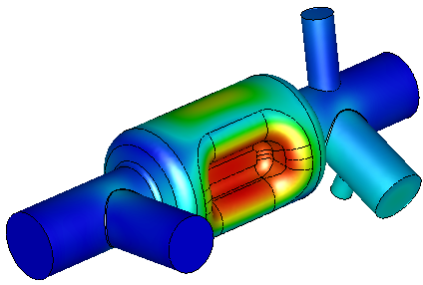
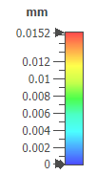
Pressure Sensitivity
Nb material properties at room temperature for MG
  Young’s modulus – 88.7 GPa (1.29×10⁷ psi)
  Poisson’s ratio – 0.38
Cavity thickness – 3mm
Cavity constrained at beam pipe ports and FPC
Stiffening at poles can reduce pressure sensitivity
  Or with variable thickness at the poles
Frequency shift at 2 K (24 torr) = -15.7 kHz
Cavity Type | df/dP [Hz/torr]
1-cell | – 652.45
1 atm

Slide 19
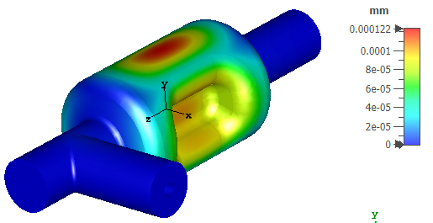
Lorentz Detuning
Nb material properties at cryo temperature for annealed MG
  Young’s modulus – 114 GPa (1.65×10⁷ psi)
  Poisson’s ratio – 0.38
Cavity thickness – 3mm
Cavity constrained at beam pipe ports and FPC
Lorentz detuning can be reduced by tuner
  Tuning by push/pull at top and bottom of the cavity
Cavity Type | k_{L} [kHz/(MV)²] | V_{t} [MV] | Δf [kHz]
1-cell | -3.67 | 1.35 | 6.7

Slide 20
List of Nb Material
Cavity Parts (Nb) | Material Type | Dimensions [mm] | Qty | Weight [kg]
Center body | MG forged ingot | Ø 110 mm × 140 mm | 1 | 11.4
End caps | Disc | Ø 130 mm × 3 mm | 2 | 0.7
Beam tubes | Sheets | 115 mm × 180 mm × 2 mm | 2 | 0.8
HOM cans | Sheets | 65 mm × 148 mm × 2 mm Ø 45 mm × 2 mm | 2 | 0.4
FPC tube | Sheets | 84 mm × 148 mm × 2 mm | 1 | 0.3
FP tube | Rod | Ø 25 mm × 70 mm | 1 | 0.3
FPC & HOM transitions | MG forged ingot | Machined from remaining material of the center body | 3 | 0
HOM hooks and probes | MG forged ingot |  | 2 | 0
Total |  |  |  | 13.9

