Slide 1
LCLS-II-HE Cavity and Cryomodule Testing
LCWS2023
James Maniscalco | SRF Engineer | SLAC National Accelerator Laboratory
17 May 2023

Slide 2
LCLS-II-HE project scope
Slide adapted from G. Hays
Install low-emittance injector and SRF gun for extended hard X-ray performance
Add 23 additional cryomodules (L4 linac) to increase the LCLS-II accelerator energy to 8 GeV.
Install new cryogenic distribution box and transfer line between the cryoplant and the new L4 linac.
New long period Soft X-ray Undulator
Upgrade the LCLS Hard X-ray endstations for MHz beam and data rates

Slide 3
LCLS-II-HE cavity and cryomodule requirements
Bare 1.3 GHz LCLS-II/LCLS-II-HE cavity
Objective: increase beam energy from 4.0 to 8.0 GeV
23 new cryomodules added to existing 35
Quantity | LCLS-II Cavities | LCLS-II Cavities in HE | HE Cavities in HE | Unit
Number of 1.3 GHz cavities | 280 | 280 | 193†
Minimum average cavity Q₀ at nominal E_{acc} | 2.7 | 2.7 | 2.7 | 10¹⁰
Vertical test qualifying gradient | 19 |  | 23 | MV/m
Assumed fraction of failed cavities | 6 | 3 | 6 | %
Nominal average operating gradient | 15.7 in L2-3 | 16.9 in L2-3 | 20.8 | MV/m
Vertical test field emission onset min. | 17.5 |  | No FE allowed | MV/m
Maximum CM captured dark current | 10 | 10 | 30 | nA
† includes injector CM (8) and BCC (1)

Slide 4
High-Q/High-Gradient R&D
R&D program following LCLS-II project to improve nitrogen doping recipe and surface processing (2018-2020)
Research collaboration between SLAC, Fermilab, Jefferson Lab, Cornell University
Increase cavity gradient without degrading Q₀
Improve uniformity of performance with tighter QA
Challenge: long lag between vendor activities and cavity tests (2-3 month minimum)
Incorporating lessons learned from LCLS-II
Furnace contamination: recurring issue that led to significant amount of rework
improved residual gas monitoring needed
EP temperature: lower & more stable temperatures correlated with higher quench fields
more thorough measurement of cavity temperature needed
Flux expulsion: different material batches require different treatment
pre-determine required heat treatment temperatures by single cell flux expulsion testing
In-person vendor oversight: necessary solve issues in a timely manner
be ready to visit cavity supplier on short notice and frequently

Slide 5
LCLS-II-HE recipe
LCLS-II | LCLS-II-HE
Bulk EP High Temperature Furnace Treatment & Doping (2N6) Fine EP | Bulk EP 1 High Temperature Furnace Treatment Bulk EP 2 (last portion cold) Doping (2N0) Fine EP (all cold)
Additional changes:
Require continuous RGA spectrum during furnace runs
Require continuous monitoring of temperatures during electropolishing runs
Sort cavity half-cell material by required heat treatment temperature

Slide 6
LCLS-II-HE cavity scope
10 qualification + 168 main production + 24 additional cryomodule cavities ordered from an industrial vendor in Europe, following competitive bid process
Qualification cavities went into “verification cryomodule” (vCM)
Cavity qualification testing overseen by Cavity Technical Board (CTB)
Manufacture @ vendor
Vertical qual.
@ partner labs
PASS
Cryomodule
assembly
FAIL /
MARGINAL
minor issue: light rework at labs
reporting
oversight
Analysis by cavity technical board
Analysis by cavity technical board
Set aside for possible rework
major
issue
CTB: SME’s from SLAC, JLab, and FNAL

Slide 7
Vertical qualification testing – requirements
Gradient: E_{acc} ≥ 23 MV/m
Quality factor: Q₀(21 MV/m) ≥ 2.5×10¹⁰
VT stainless steel flange R = 0.8 nΩ
HOM coupling: Q_{ext} > 2.7e11
HOM power: P_{HOM}(21 MV/m) < 1.7 W
Field emission: no detectable FE up to quench
Frequency: f = 1300.25±0.10 MHz
Field probe coupling: 2.5×10¹¹ < Q_{ext} < 7.0×10¹¹
Multipacting: fully processed before final Q vs. E
7π/9 mode: avoid mode buildup → quick measurements

Slide 8
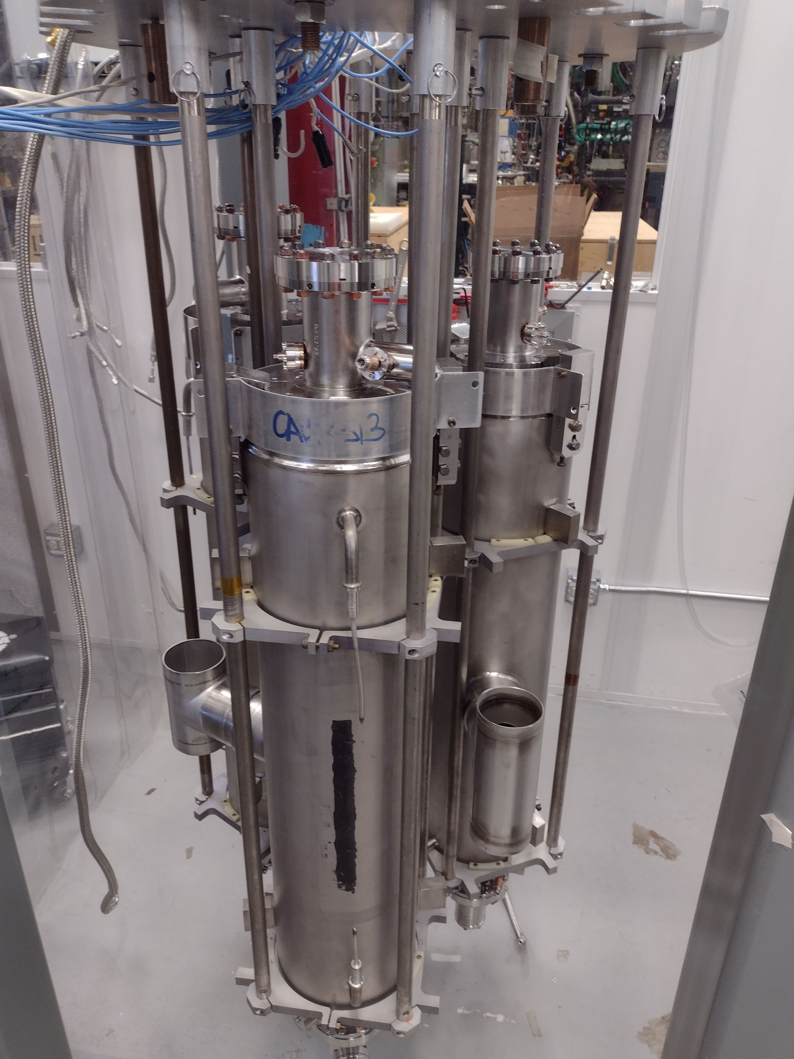
Vertical qualification testing – procedures
Cavities shipped by vendor ready for VT
High-Q coupler: Q_{ext} ≈ 1.5×10¹⁰
Tested at partner labs after receipt
Installed on vertical test stand (up to 3 cavities at same time)
Active pumping at JLab*; not at FNAL
*tests after Dec. 2022 have no active pumping
Instrumentation installed
Radiation monitors
Four thermometers (minimum)
Two fluxgate magnetometers (minimum)
Fast cool to 4.25 K, with B_{amb}(T_{c}) ≤ 5 mG
Cool to testing T = 2.00±0.02 K
Fermilab vertical test system

Slide 9
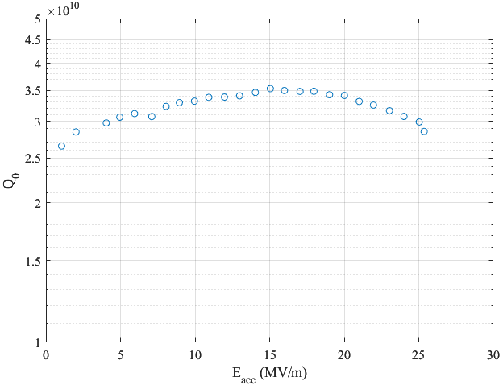
Vertical qualification testing – procedures
Calibrate Q₀ measurements
Average of ≥ 5 decay msmts. @ 6-8 MV/m
Measure Q₀ vs. E_{acc} to quench
1 MV/m increments (or smaller increments as needed)
No administrative limit on gradient
Watch for FE and MP quenches
If Q degradation after MP processing, evaluation by CTB
If FE present and conditions away, final power rise from low field to quench in 1 MV/m increments required for qualification.
Example vertical test data

Slide 10
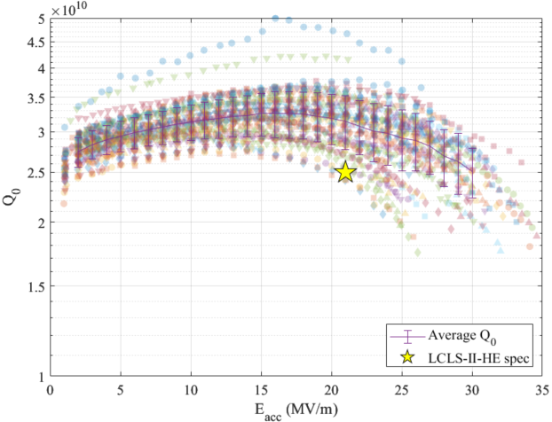
Vertical test performance so far – as of May 10, 2023
145 cavities tested, of which:
103 qualify (71%)
92 as received
8 after 1 rerinse
3 after 2+ rerinses
1 “on hold” for marginal Q₀ (<1%)
9 disqualified (6%)
4 with low Eacc
3 with persistent FE
1 with low Q0
1 with HOM scratch
6 in need of mechanical repair (4%)
26 awaiting re-test after high-pressure rinse to mitigate field emission (18%)
All cavities with no FE

Slide 11
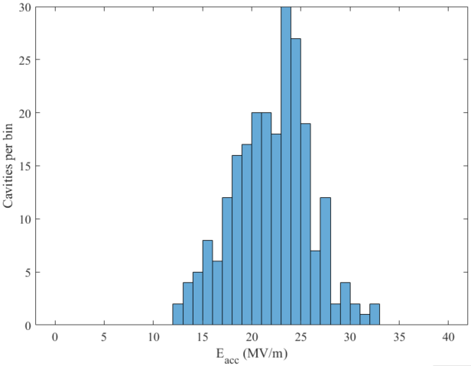
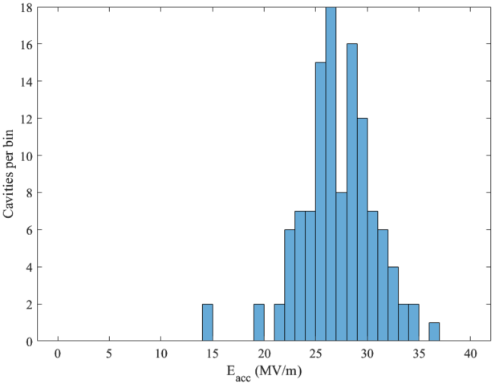
HE cavities vs. LCLS-II: accelerating gradient in VT
LCLS-II
HE vCM + production
Average quench gradient: 22.0±3.9 MV/m
Average quench gradient: 27.2±3.5 MV/m
LCLS-II spec: 19 MV/m
LCLS-II-HE spec: 23 MV/m
>5 MV/m improvement

Slide 12
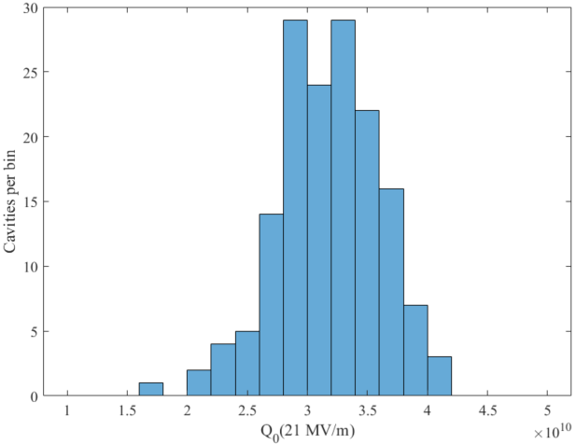
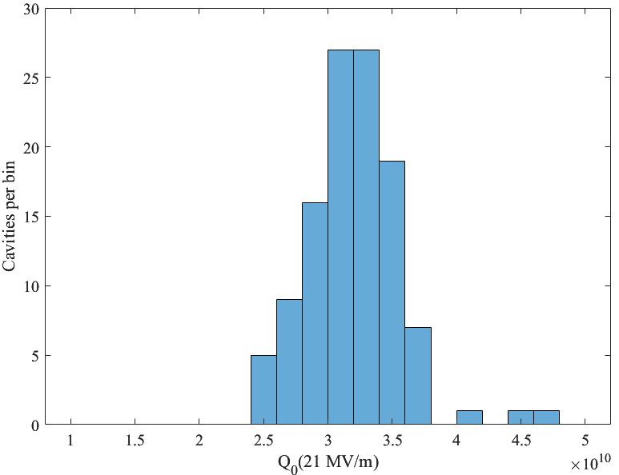
HE cavities vs. LCLS-II: quality factor in VT
LCLS-II
HE vCM + production
Average Q₀:
3.18±0.44×10¹⁰
Average Q₀:
3.20±0.37×10¹⁰
Only considering cavities that reached at least 21 MV/m
Very few cavities below spec

Slide 13
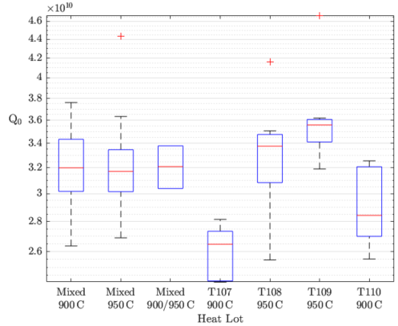
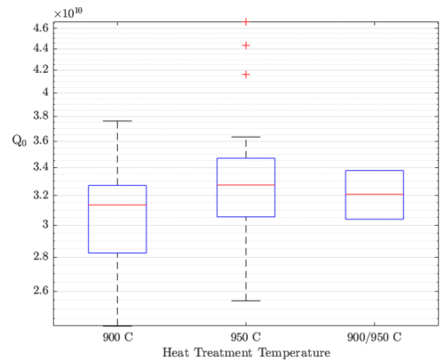
Quality factor by heat lot
Material segregation strategy has been successful
Higher heat treatment lots generally show higher Q₀ (better flux expulsion)
One lot (T107) appears to have been assigned the wrong temperature. Still meets specification (except 1 cavity)
Mixed 900 °C cavities have higher Q₀ than pure cavities at same temp.
High Q₀ also for mixed 900/950 °C cavities with pre-treated subassemblies

Slide 14
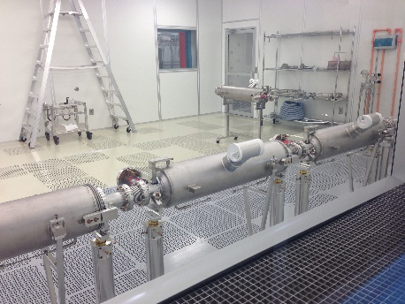
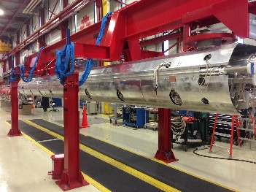
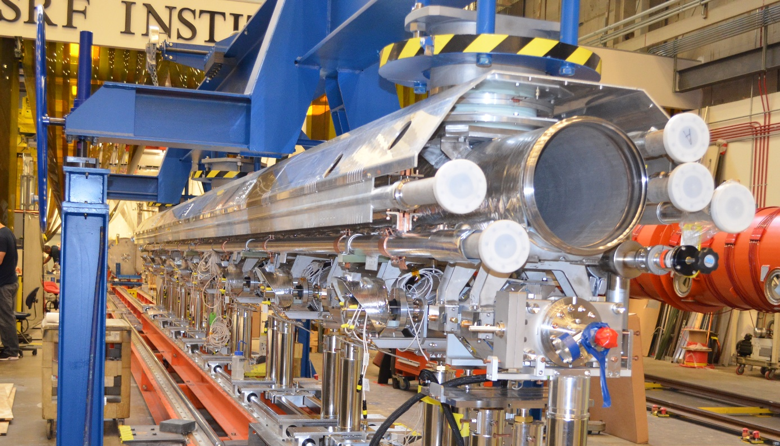
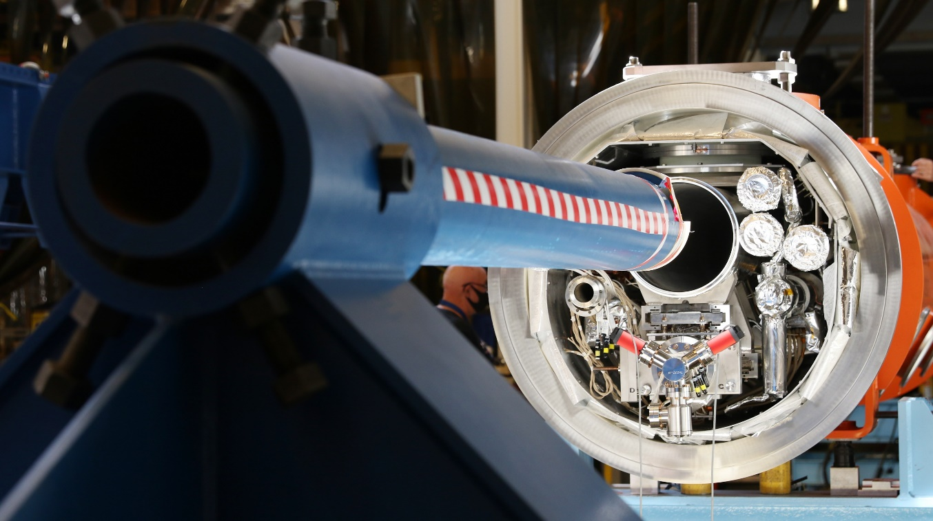
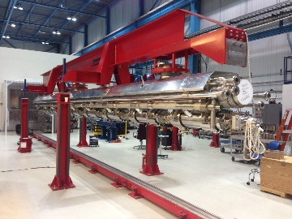
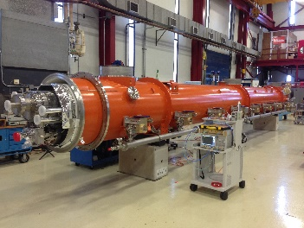
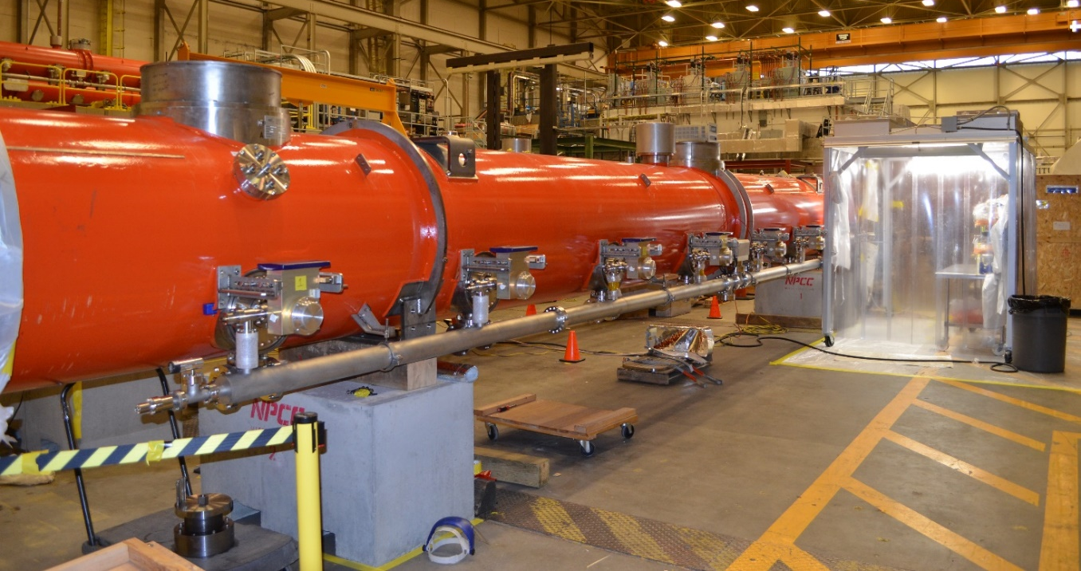
Cryomodule assembly
Cryomodule assembly at partner labs proceeding. So far:
4* modules completed and tested with production LCLS-II-HE cavities at FNAL
1 module has undergone initial testing at JLab
Leveraging assembly lines / test facilities / personnel from LCLS-II assembly
FNAL
JLab
* F1.3-21 built with spare cavities from LCLS-II and 2 spare vCM cavities.

Slide 15
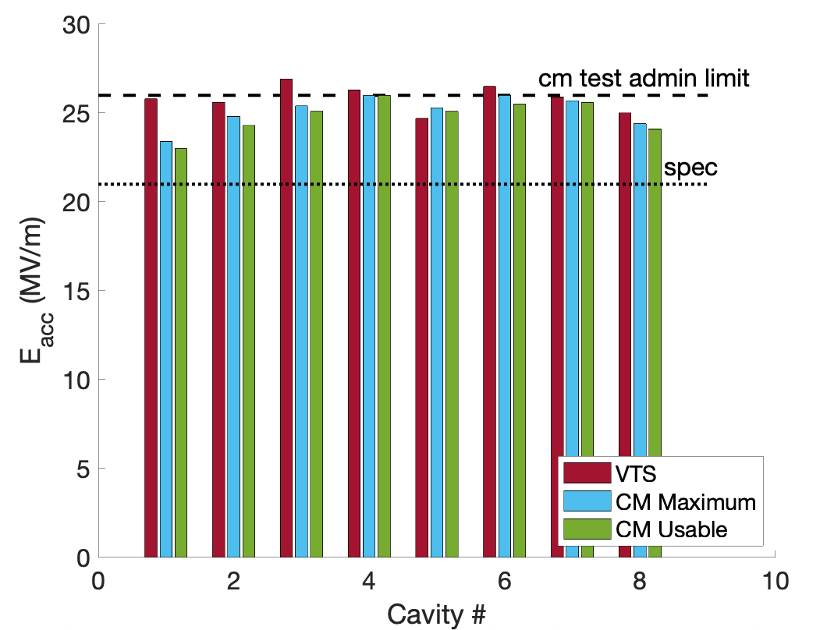
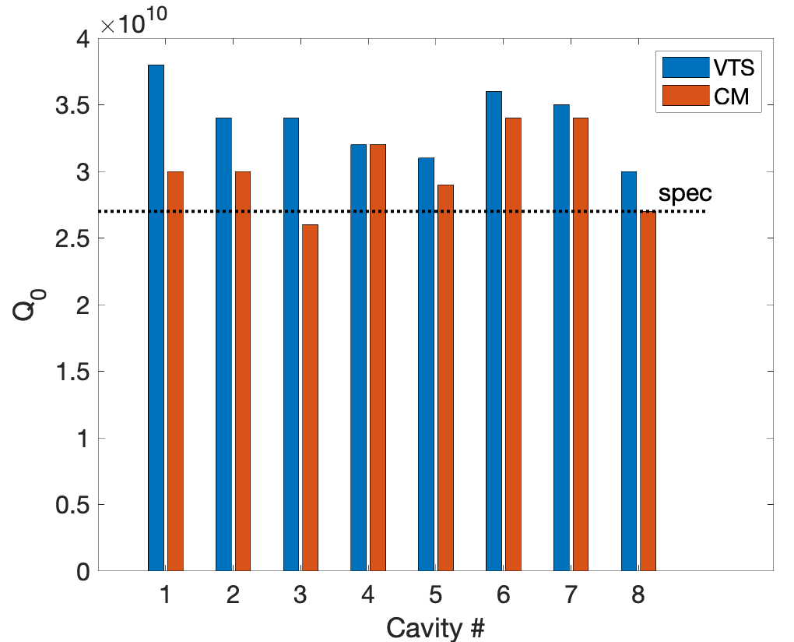
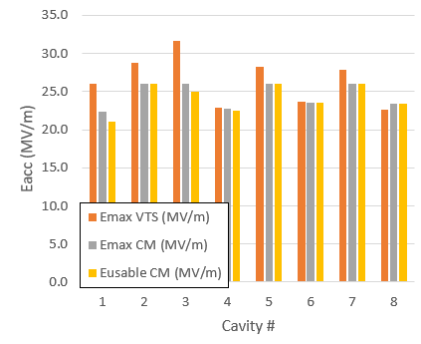
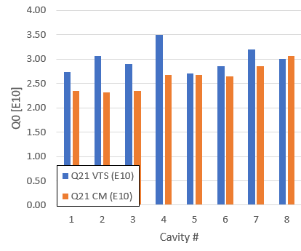
Cavity performance in cryomodules
plots from S. Posen
F1.3-20 (vCM)
Average usable gradient: 24.1 MV/m
Usable voltage: 200 MV
2 K heat load: 119 W (Q_{0,avg}=3.12×10¹⁰)
F1.3-21
Average usable gradient: 25.1 MV/m
Usable voltage: 201 MV
2 K heat load: 141 W (Q_{0,avg}=2.62×10¹⁰)

Slide 16
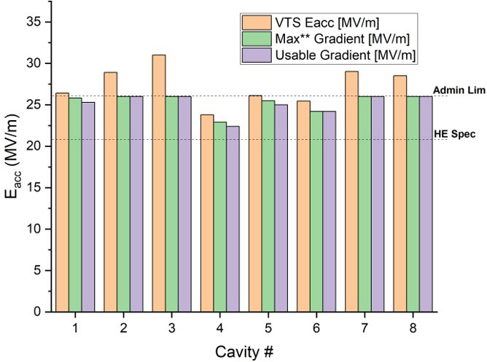
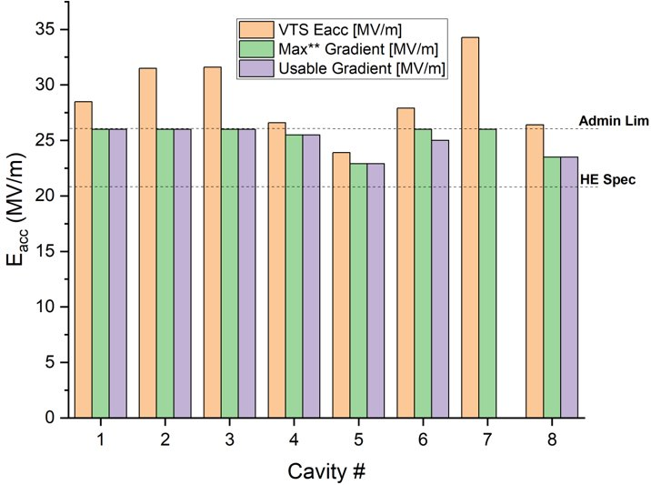
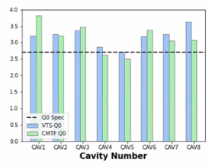
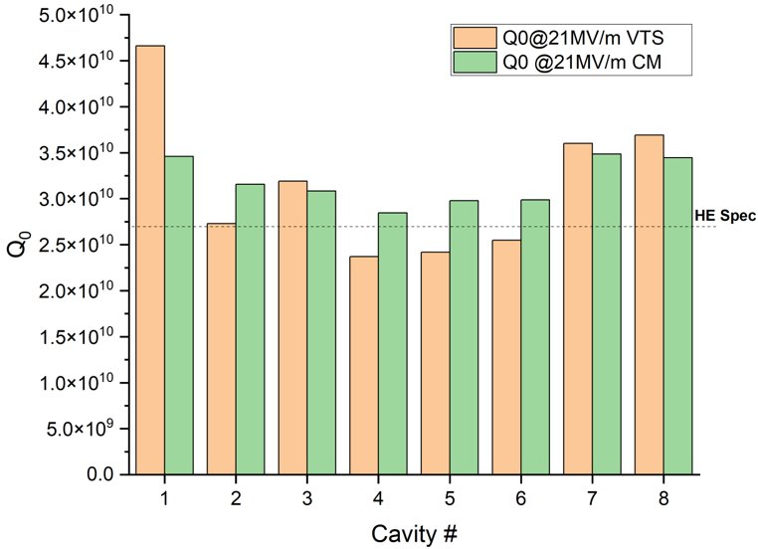
Cavity performance in cryomodules
plots from A. Cravatta
F1.3-22
Average usable gradient: 25.1 MV/m
Usable voltage: 209 MV
2 K heat load: 116 W (Q_{0,avg}=3.18×10¹⁰)
F1.3-23
Average usable gradient: 25.1 MV/m
Usable voltage: 209 MV
2 K heat load: 115 W (Q_{0,avg}=3.14×10¹⁰)

Slide 17
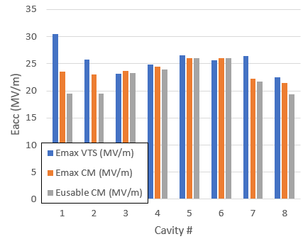
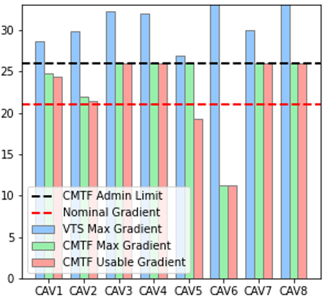
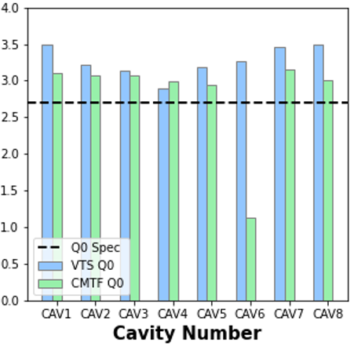
Cavity performance in cryomodules
plots from A. Cravatta
F1.3-24
Average usable gradient: 22.6 MV/m
Usable voltage: 187 MV
2 K heat load: 115 W (Q_{0,avg}=3.27×10¹⁰)
J1.3-22 (preliminary)
Average usable gradient: 22.4 MV/m
Usable voltage: 186.2 MV
Expected to increase after MP processing
Heat load/Q₀ measurements pending restart of testing

Slide 18
Outlook
Cavity deliveries to continue through April-May 2023
Additional 24 cavities to come in batches of 12
Fall 2023
Spring 2024
Cryomodule assembly and test to continue through mid 2025

