Slide 1
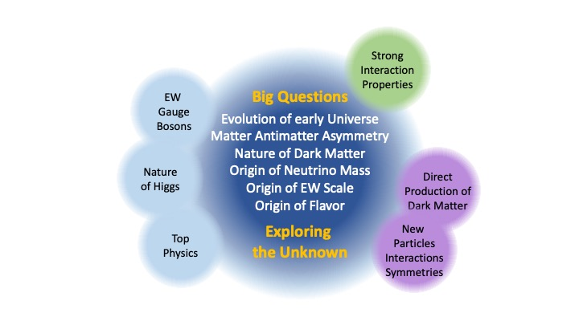
Beyond standard model searches at CMS: Highlights and prospects
Sridhara Dasu University of Wisconsin for CMS Collaboration

Slide 2
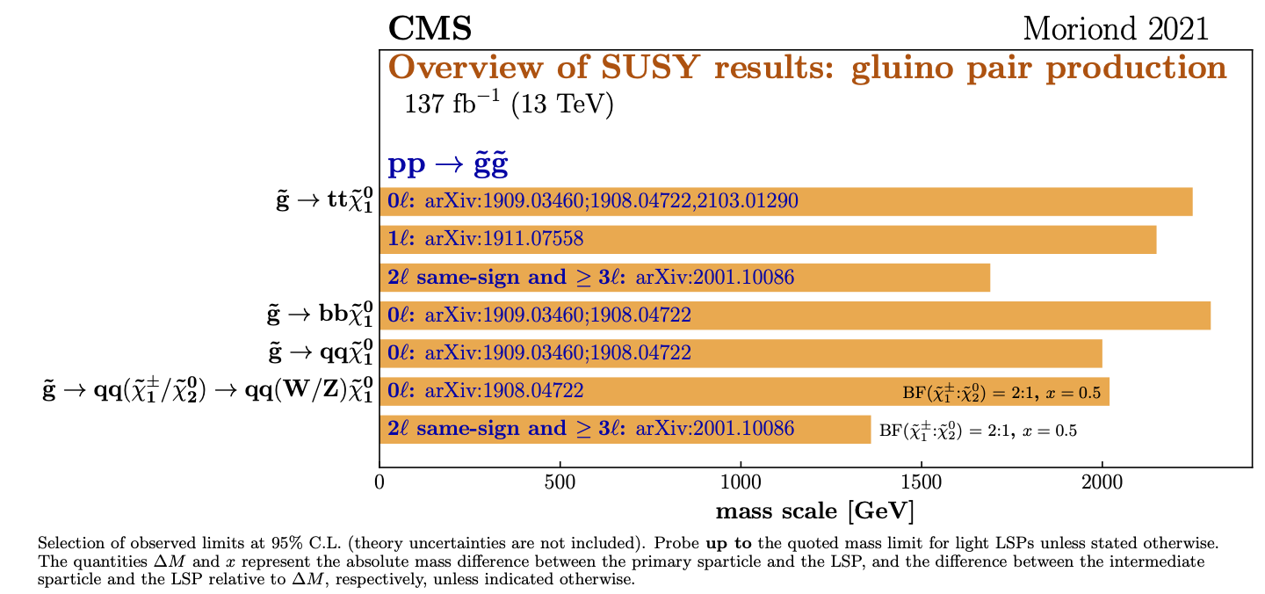
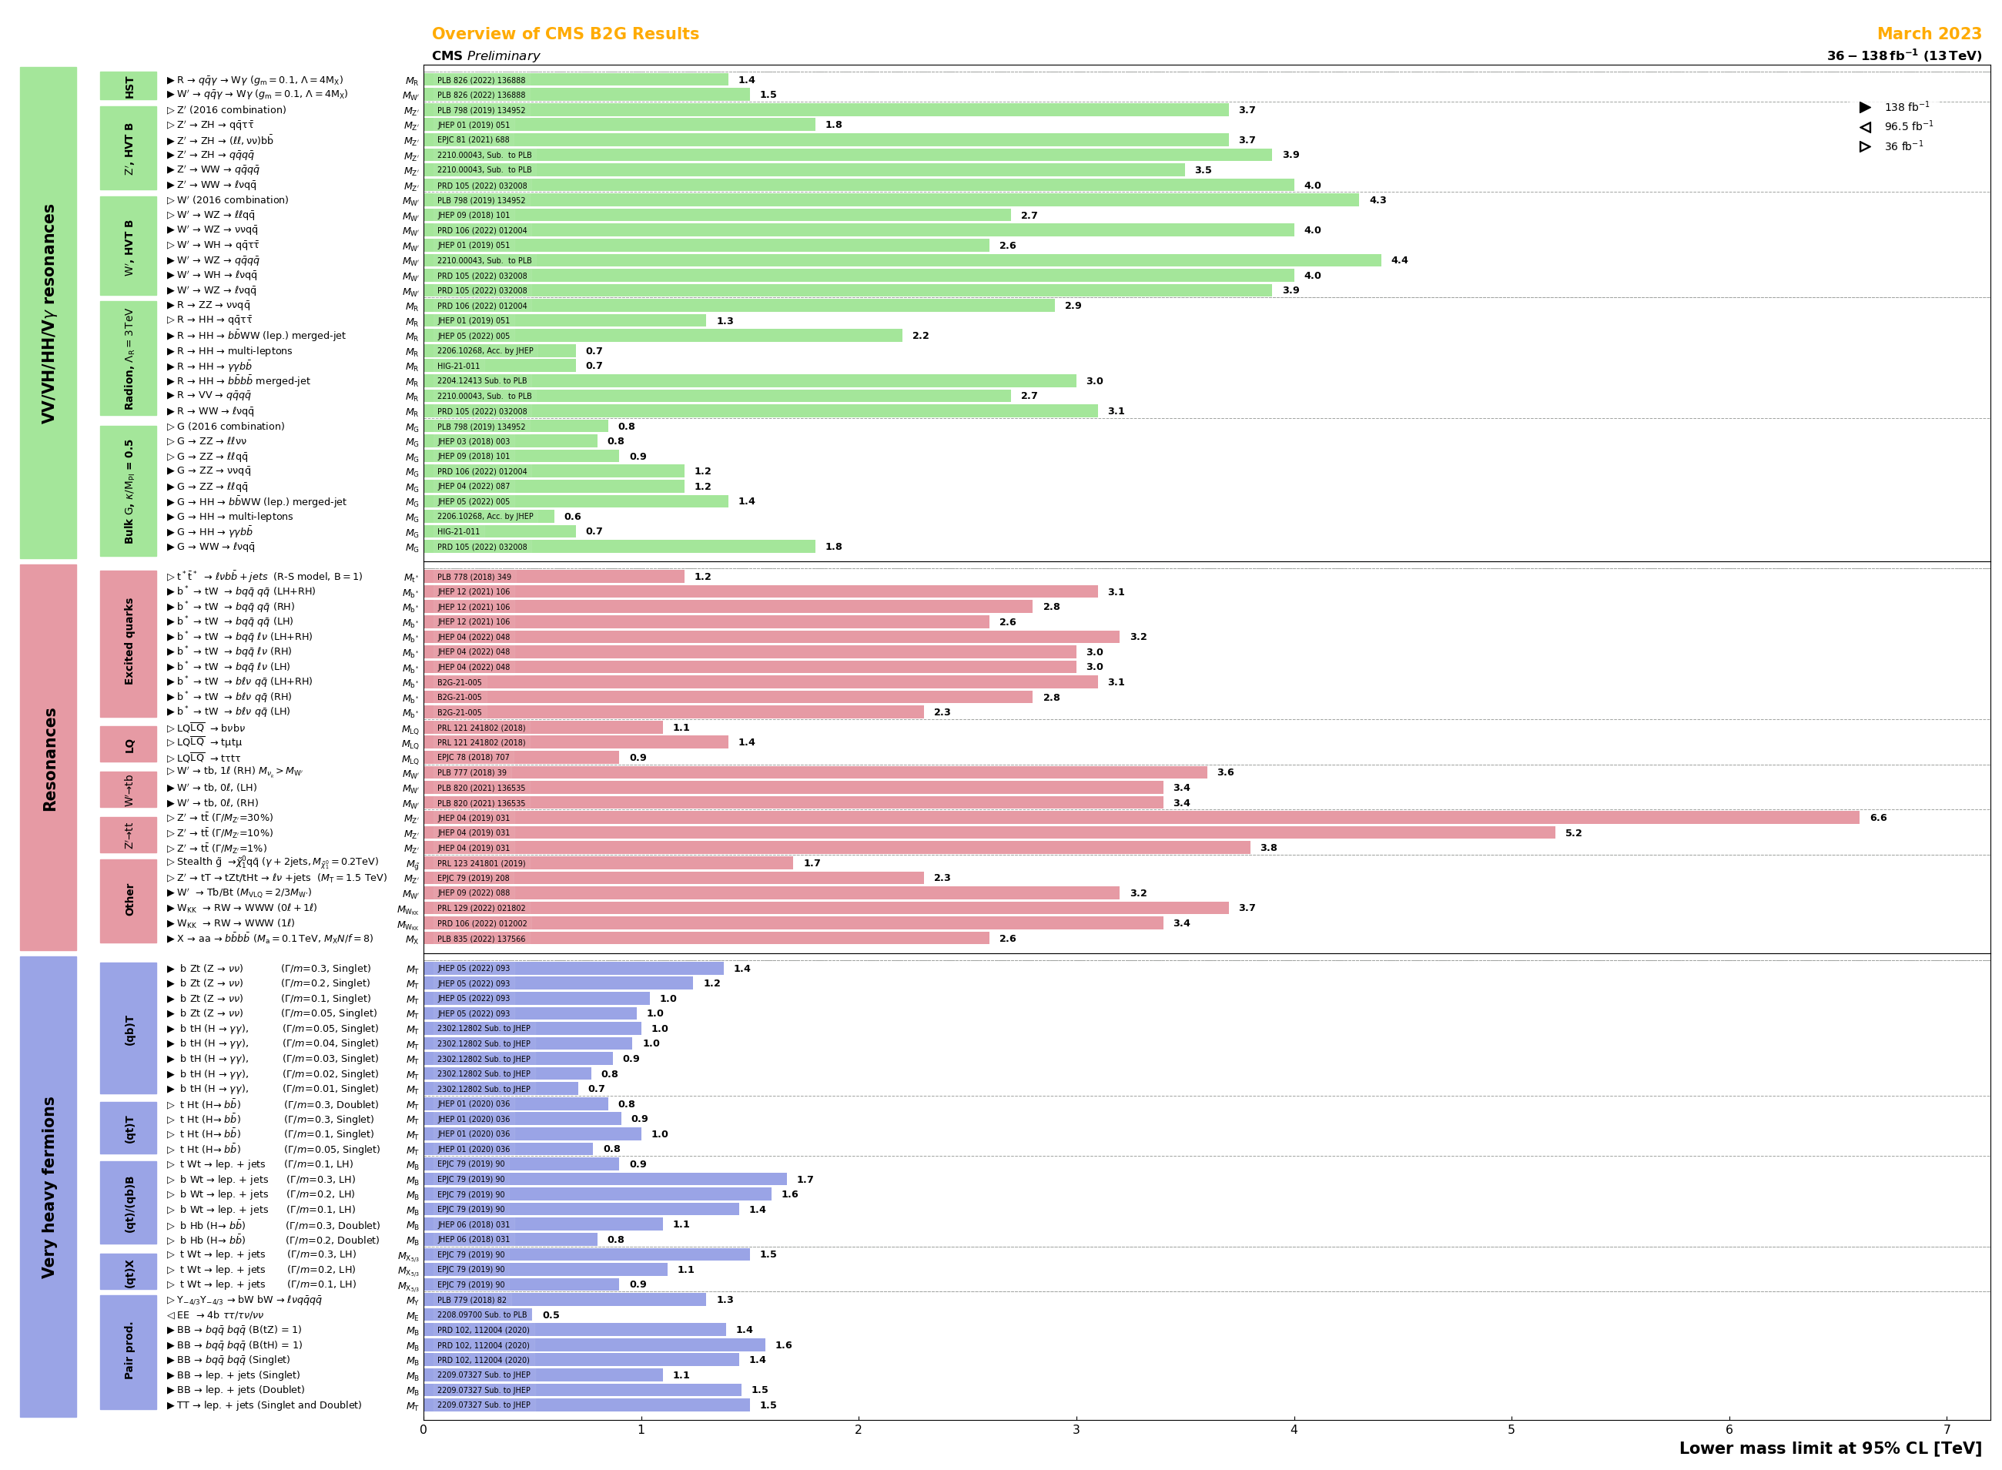
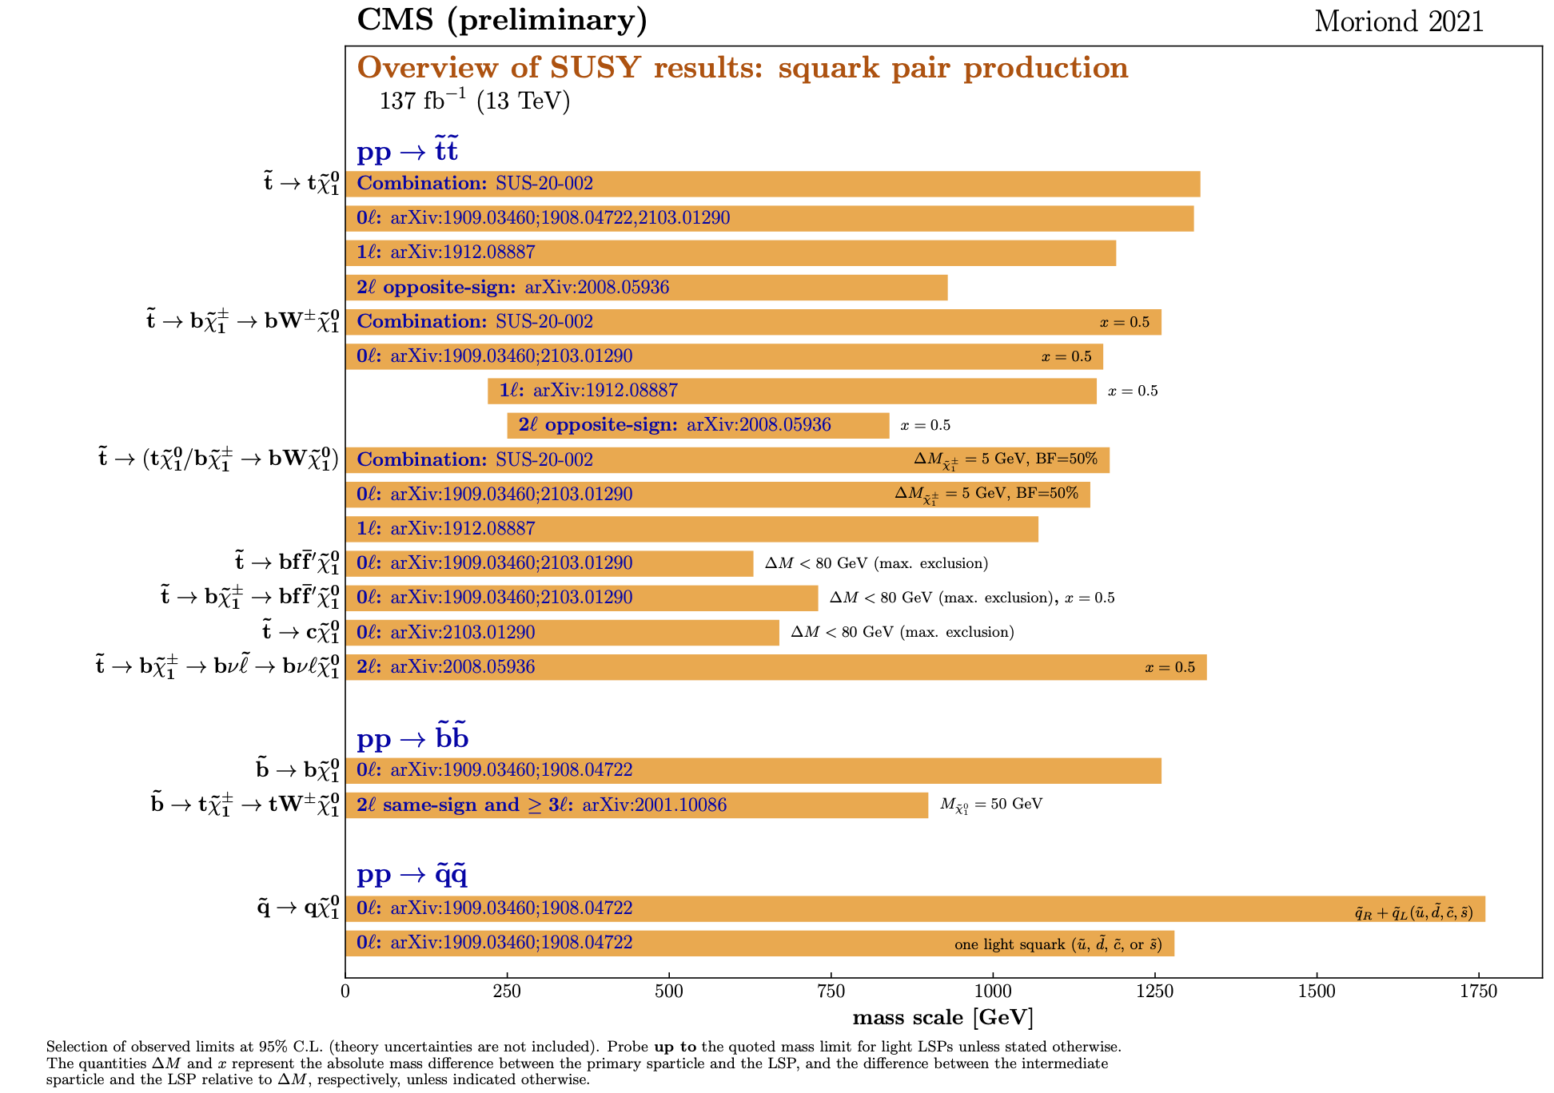
Gluino-pairs, Squark-pairs, Diboson-Resonances, Heavy Fermions
gluinos
Diboson Resonances
Excited quarks
squarks
Lepto quarks
Z’
Heavy Fermions

Slide 3
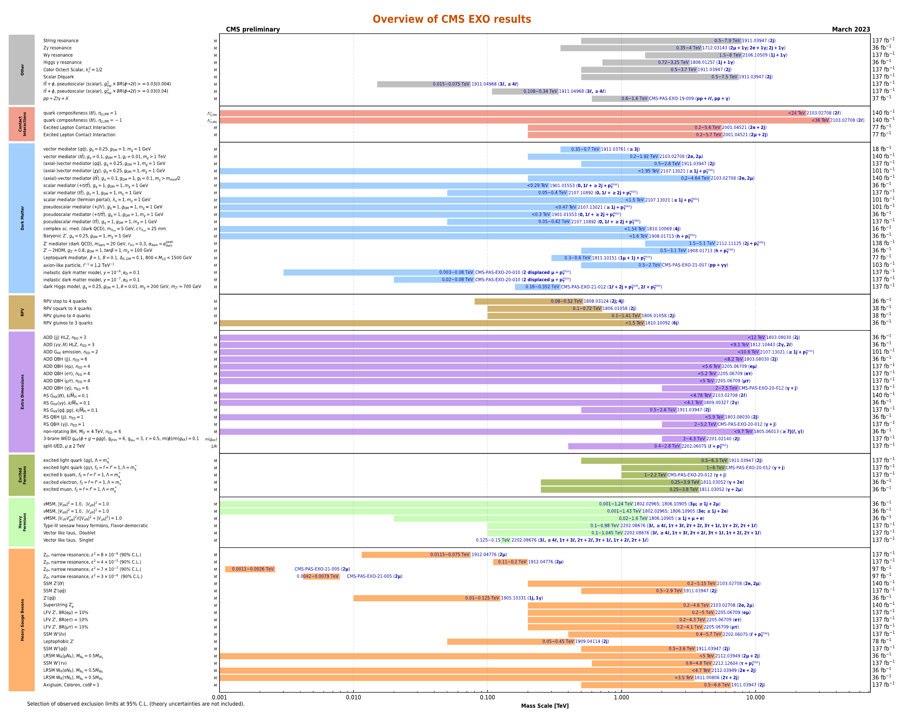
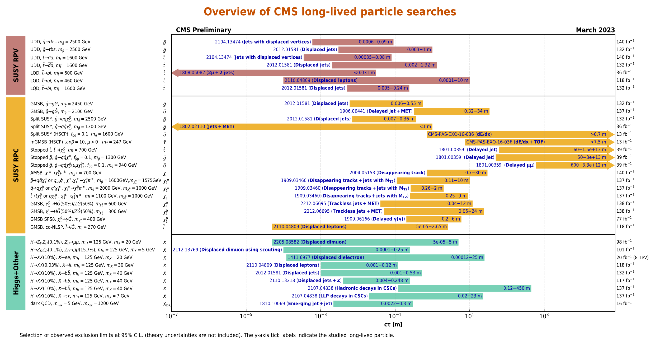
Summary of Exotica From Snowmass
DM
ED
There is a LOT of material to chose from, and fill hours.
Will present an eclectic set of topics relevant for LCs it being LCWS-2023
W’,Z’
TeV
10 TeV

Slide 4
One of Nathaniel’s Seven Questions
Someone asked, how about off-diagonal Yukawas?

Slide 5
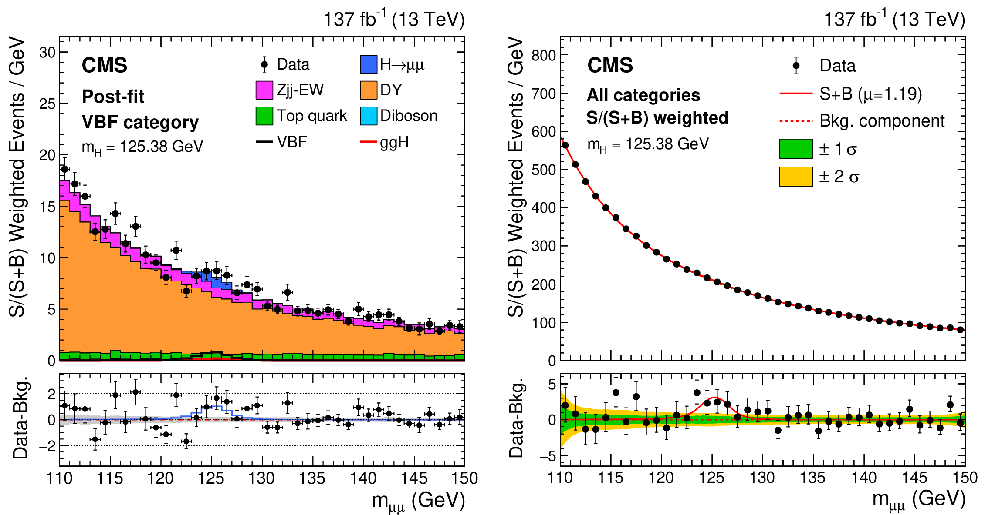
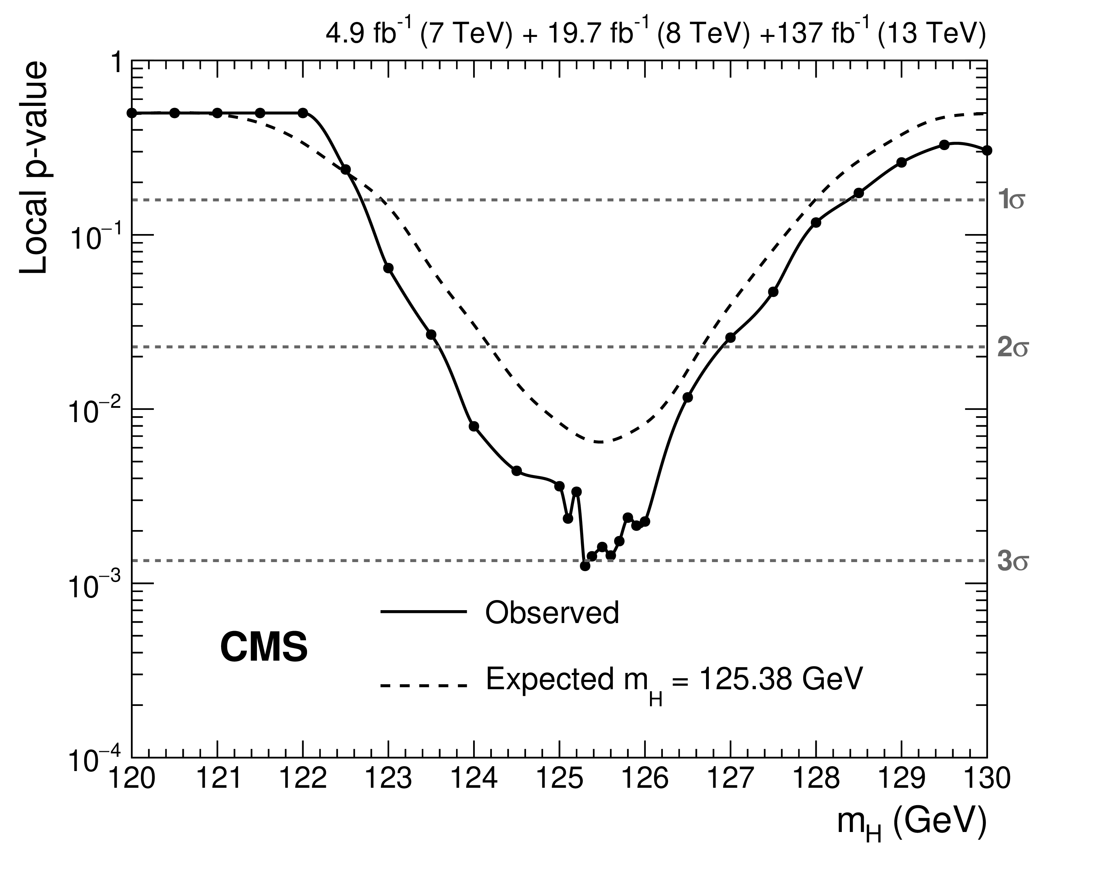
Evidence for Second Generation Yukawa Albeit in the lepton sector
JHEP 01 (2021) 148
Continue to profit from excellent CMS muon resolution
Run-3: >5σ
HLLHC: Δκ_{μ} ~ 5%

Slide 6
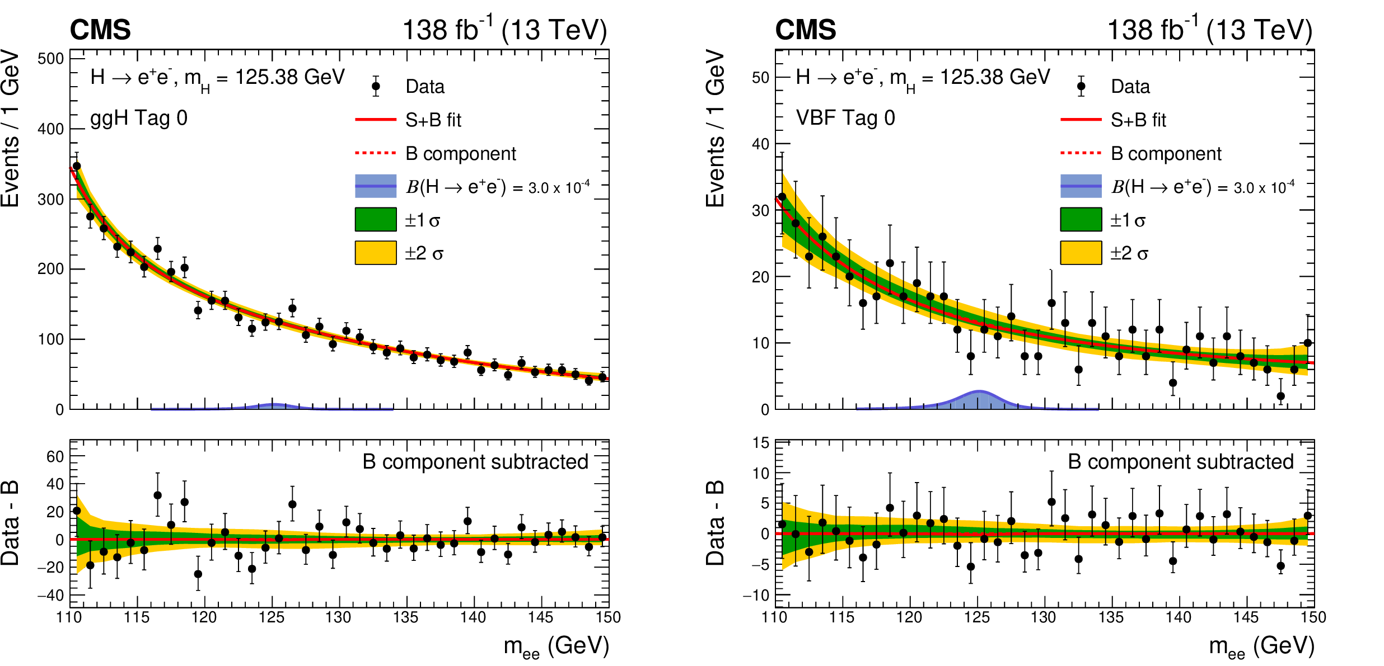
First Generation Yukawa Again in the lepton sector – if we see something it has to be BSM!
arXiv:2208.00265
No one talks about $Ye$ other than FCC-ee special run

Slide 7
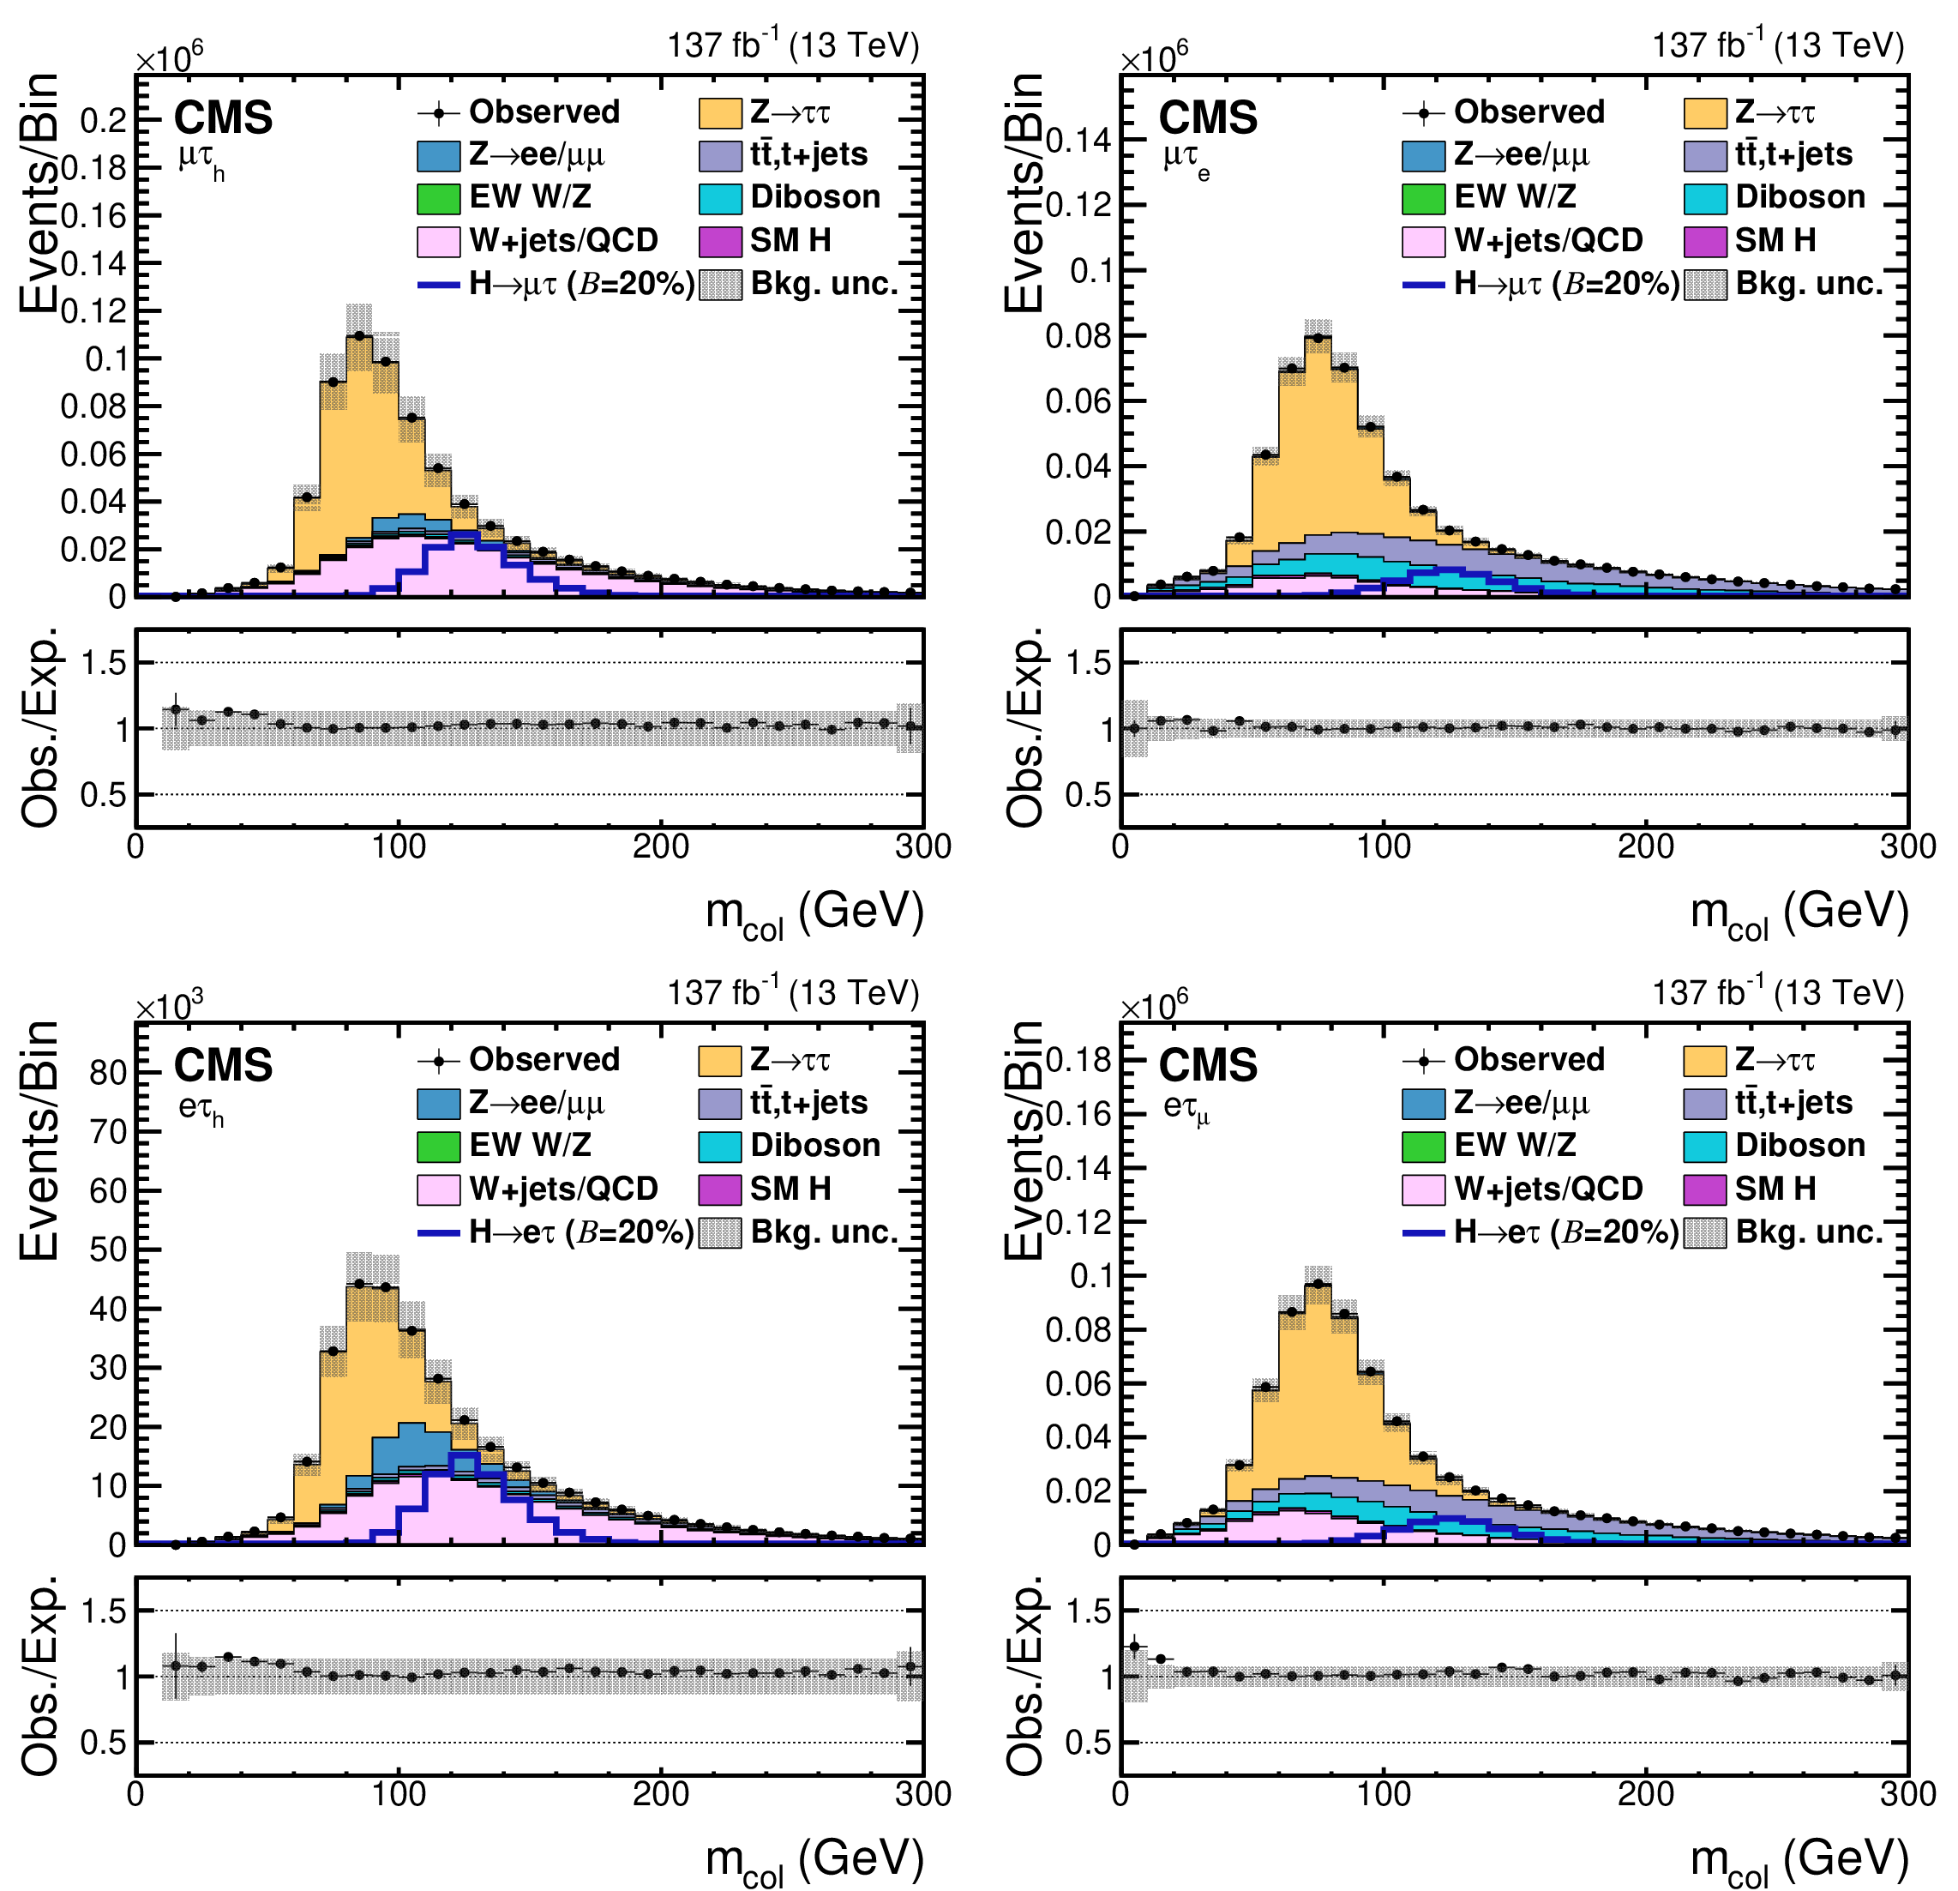
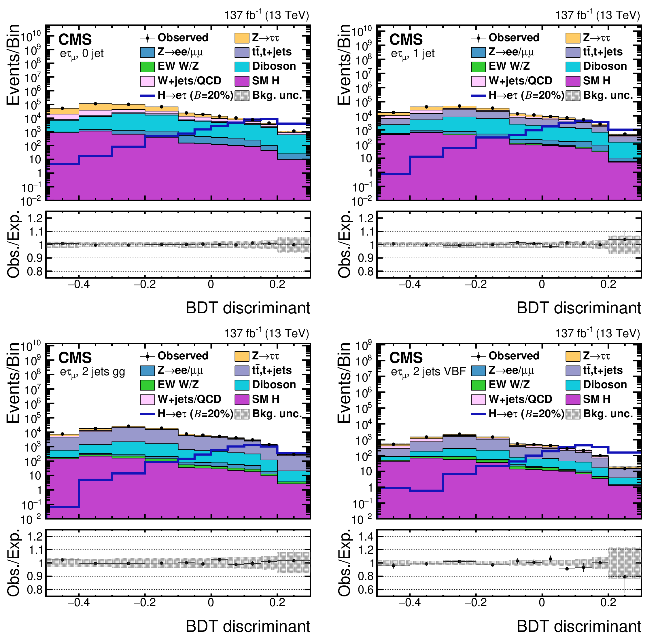
LFV: $H\left(125\right)→μτ,H\left(125\right)→eτ$
Phys. Rev. D 104 (2021) 032013
Challenges:
Significant backgrounds
Single lepton triggers
$$→$$
Embedded samples for $Z→ττ$
ML-based isolation
ML-based discriminators

Slide 8
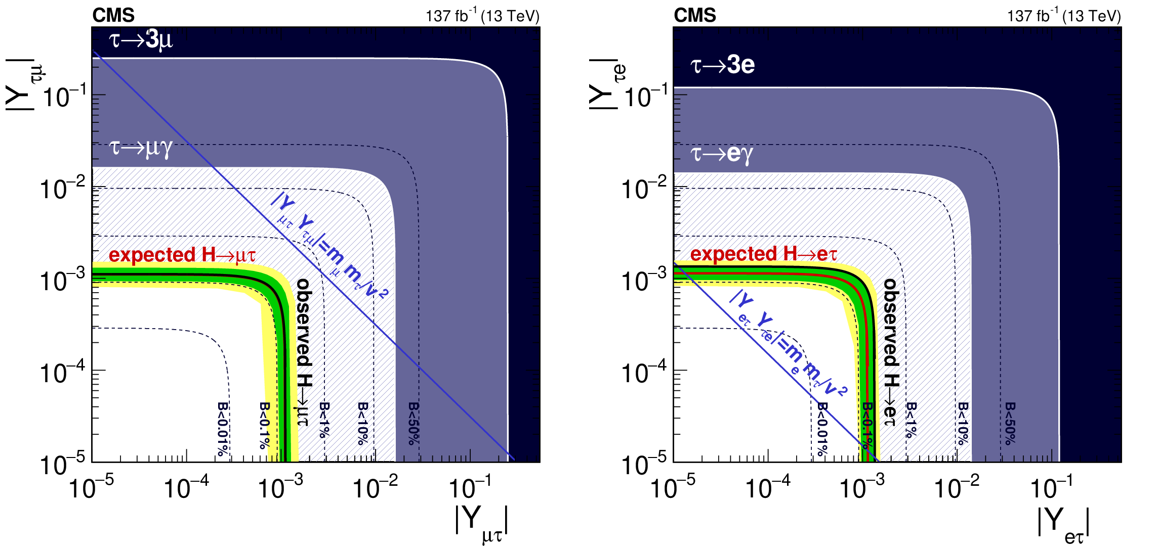
LFV: $H\left(125\right)→μτ,H\left(125\right)→eτ$
Phys. Rev. D 104 (2021) 032013

Slide 9
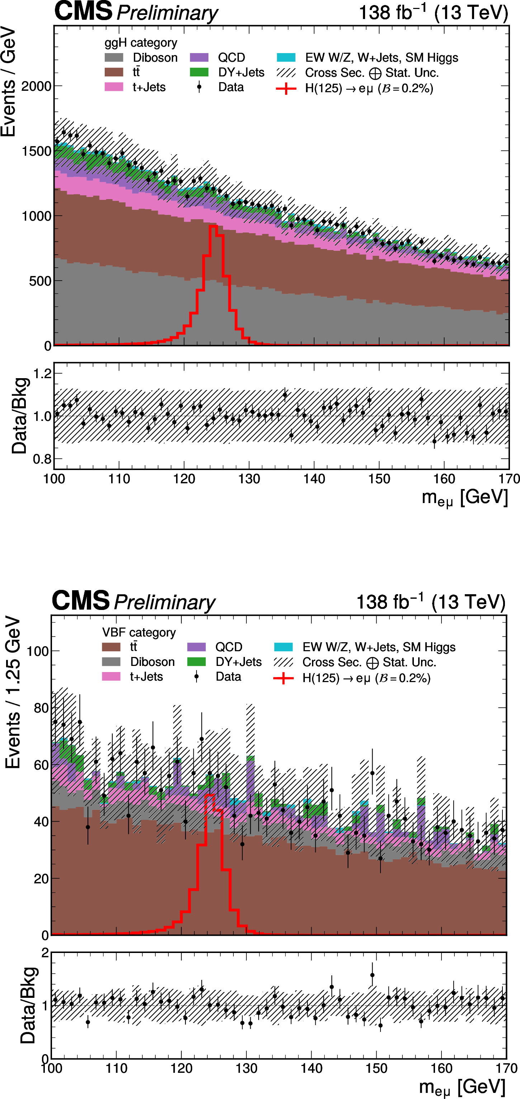
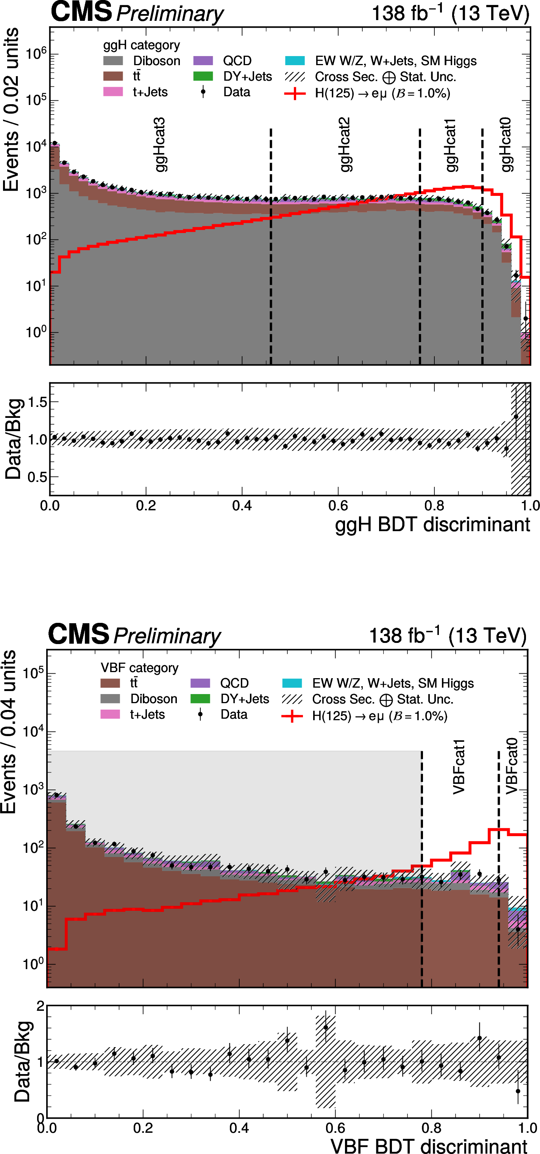
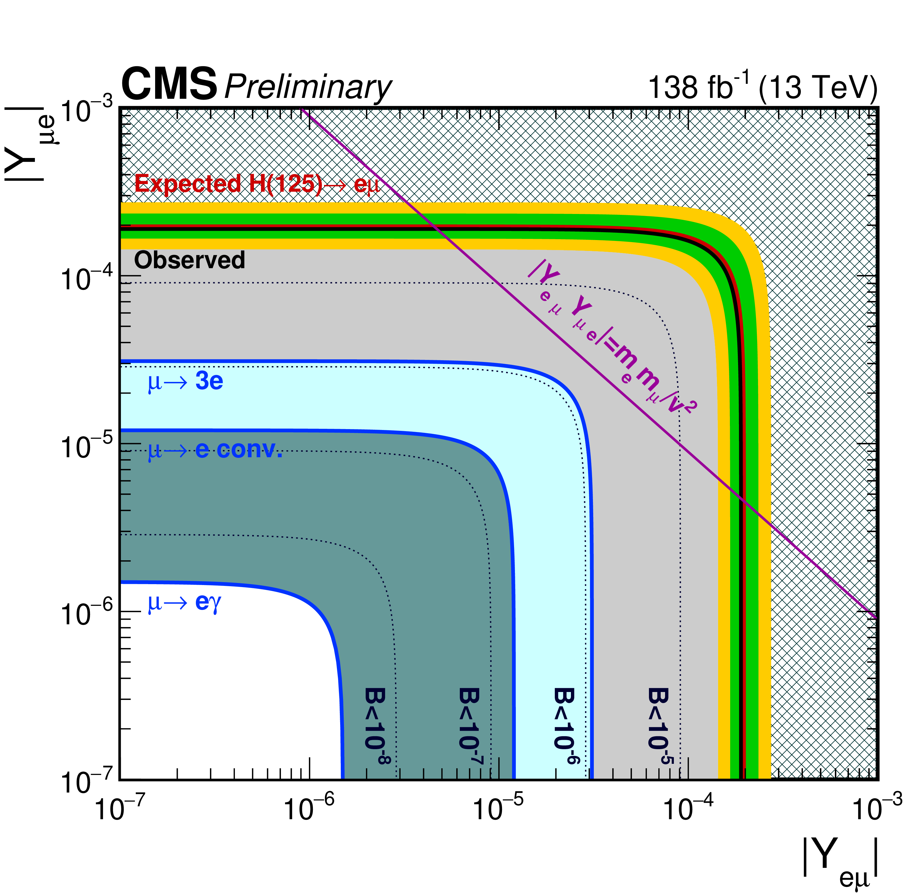
LFV: How about $H(125)→eμ$?
CMS-HIG-22-002
ML Discriminators $→$

Slide 10
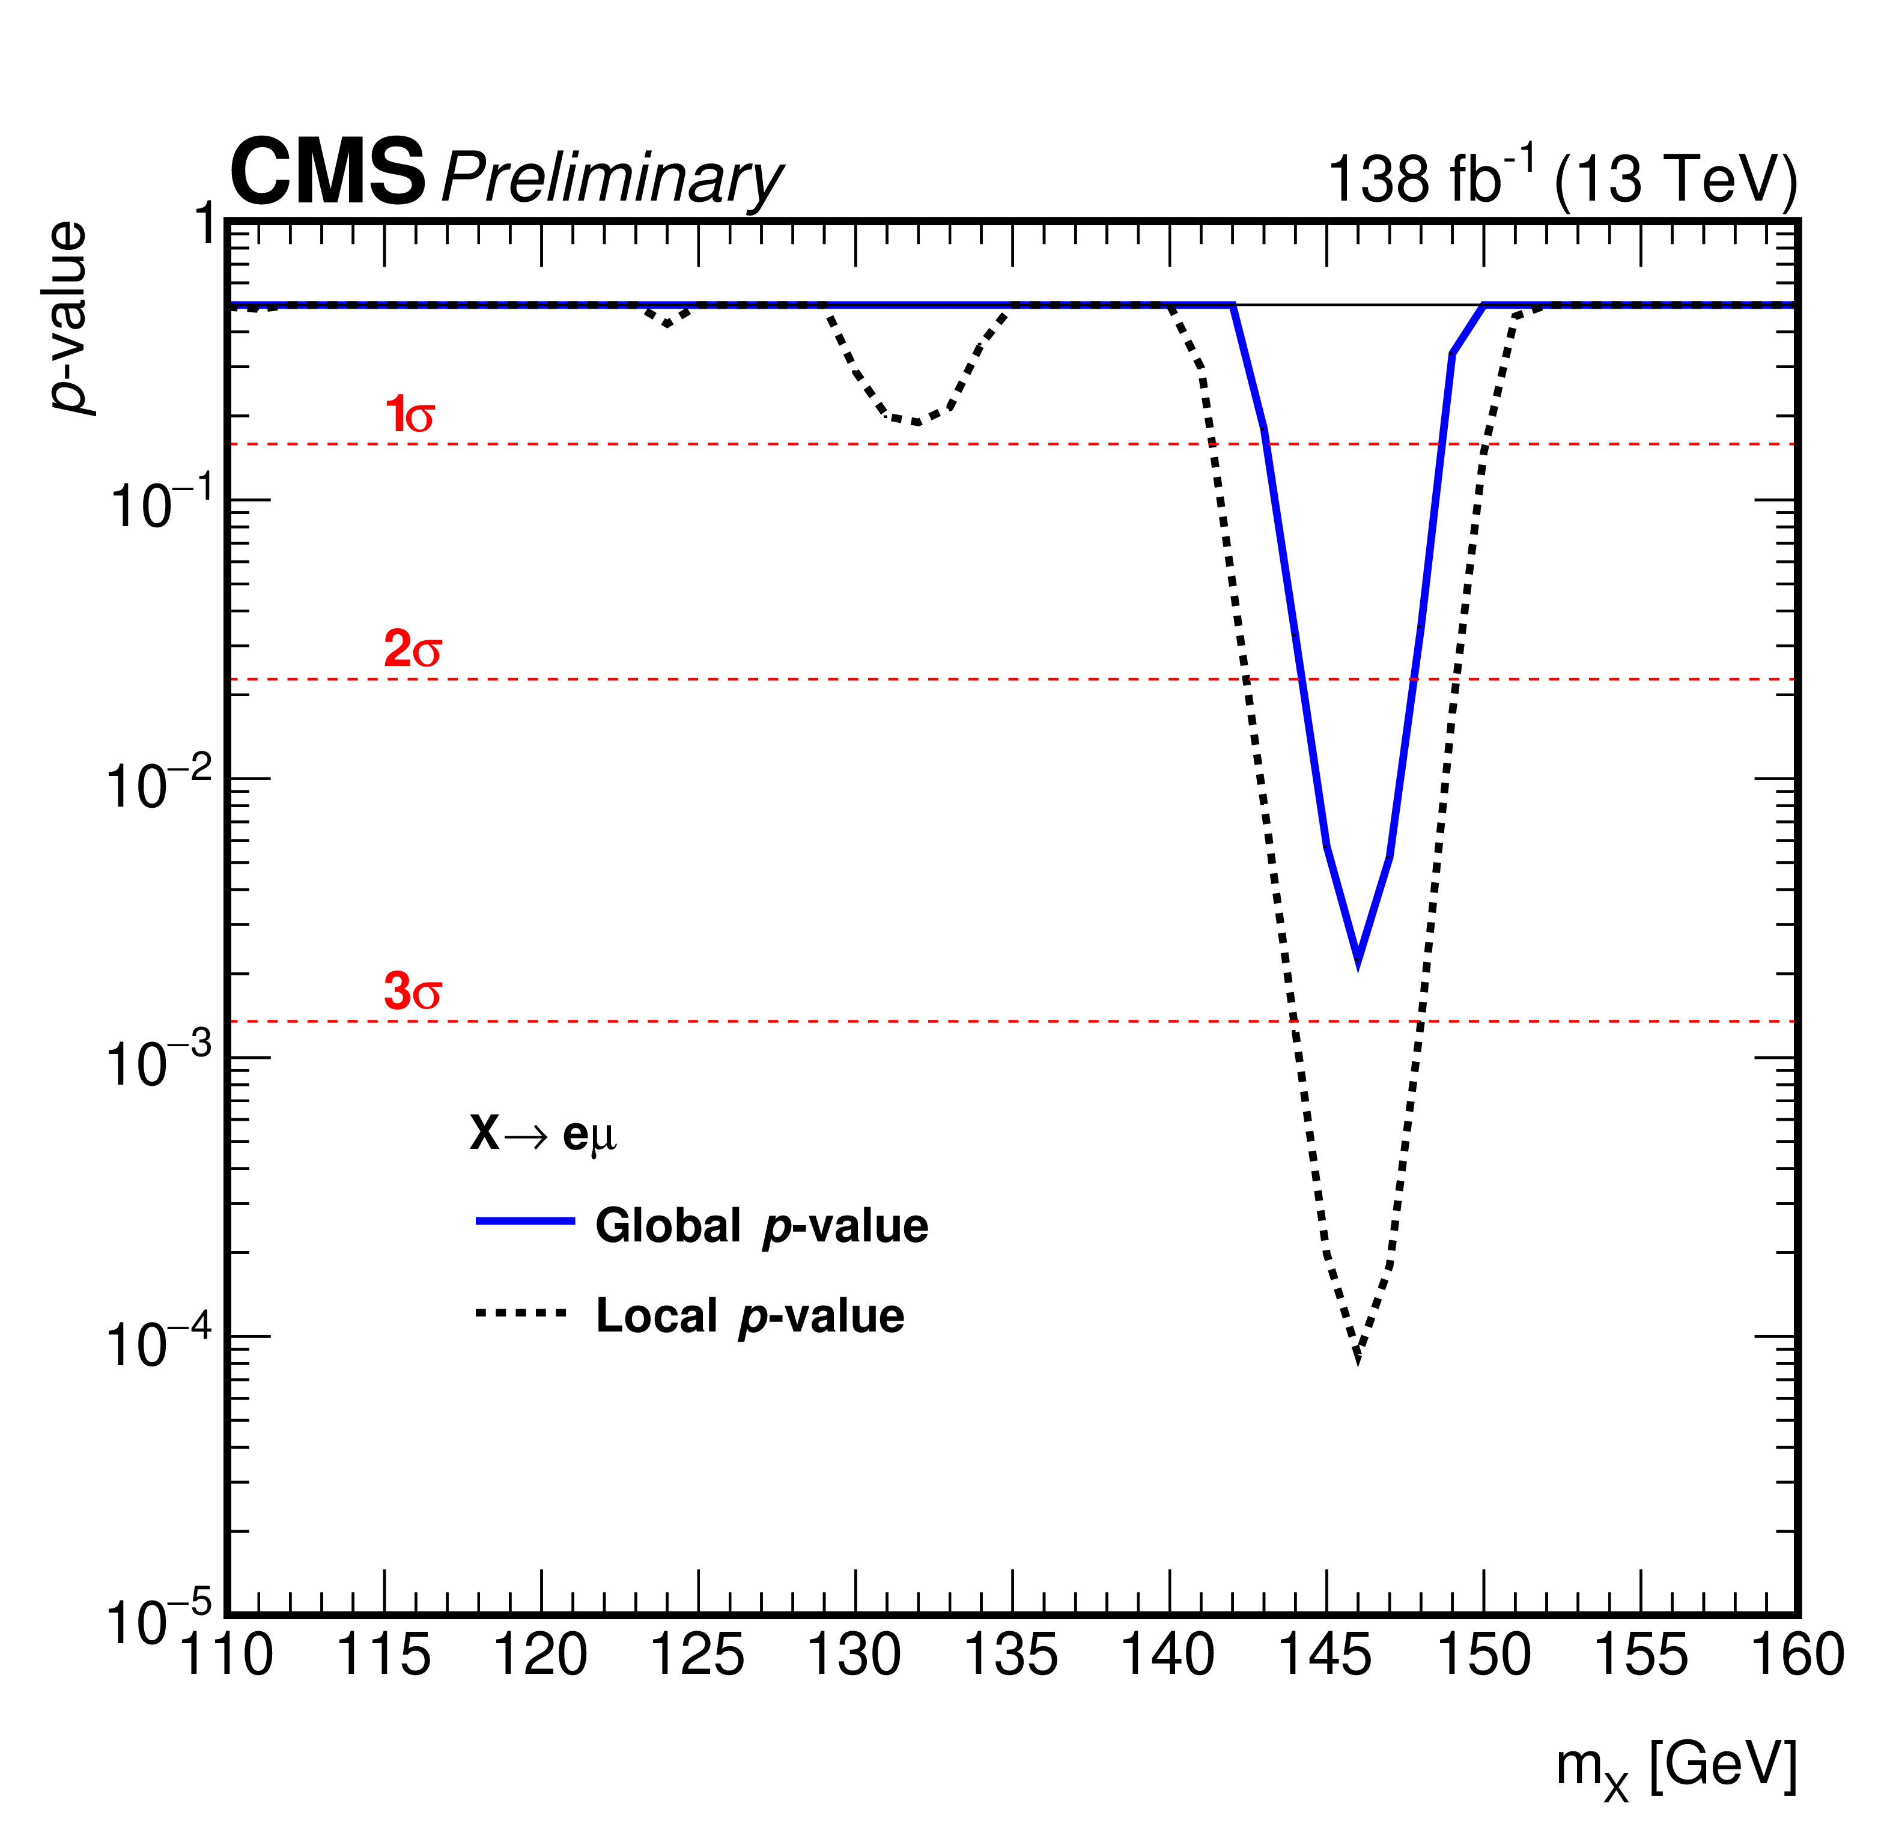
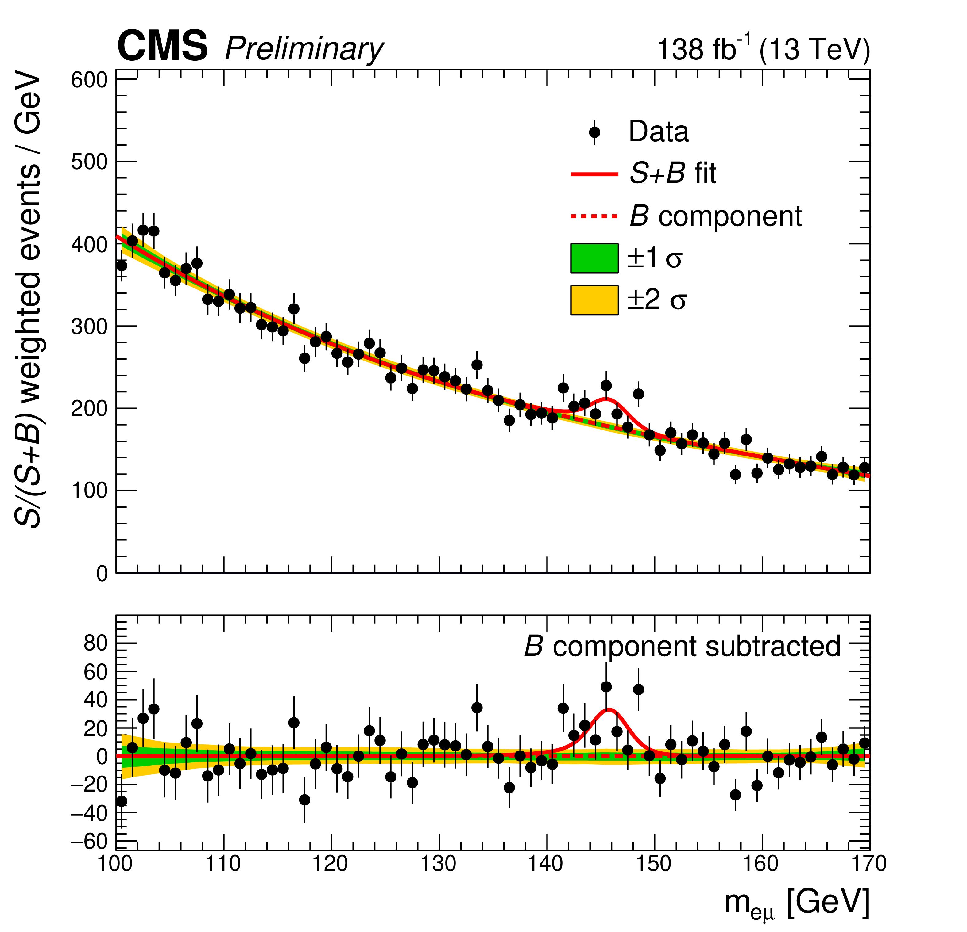
LFV: Well $X→eμ$?
CMS-HIG-22-002
Awaiting more data … Stay-tuned for Run-3

Slide 11
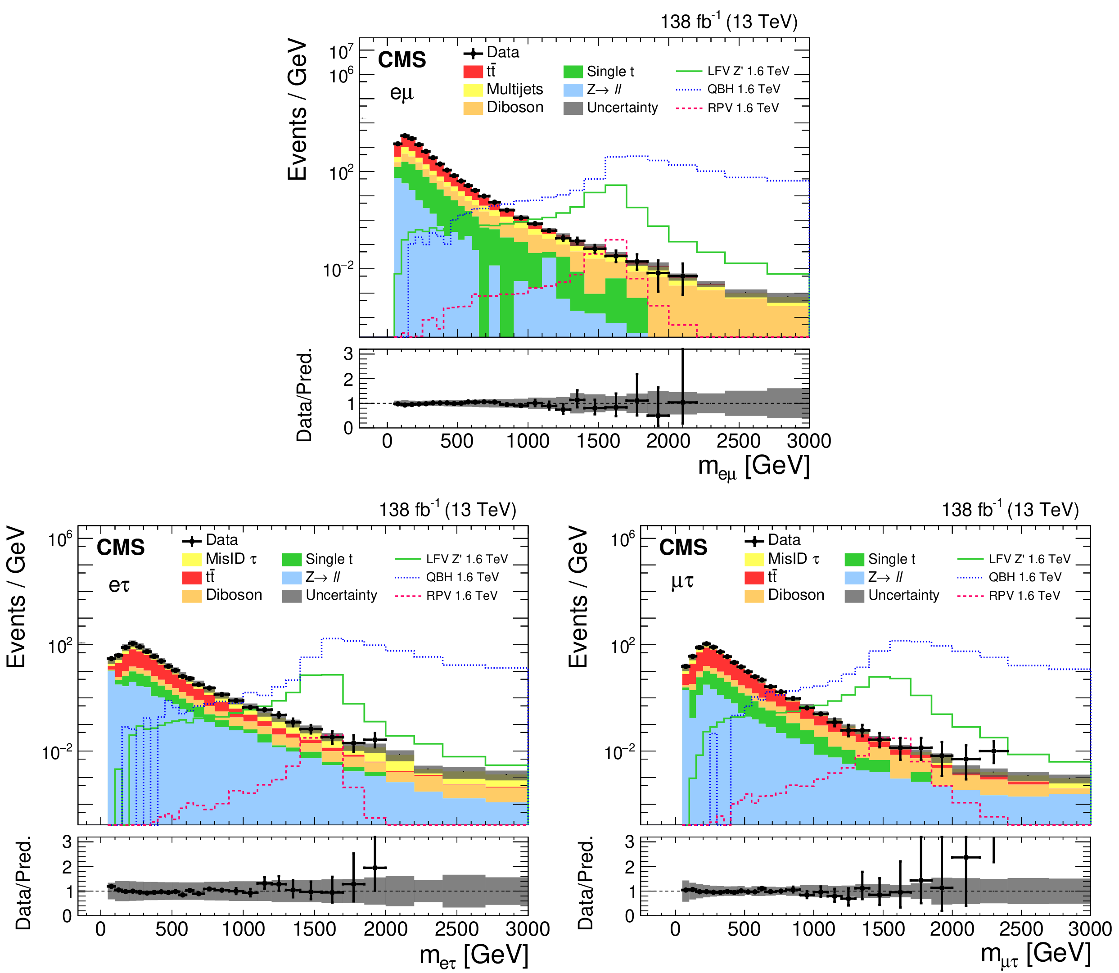
LFV: Very High Mass Objects
arXiv:2205.06709
Push to multi-TeV masses
LHC shines when it comes to measuring very high P_{T} leptons

Slide 12
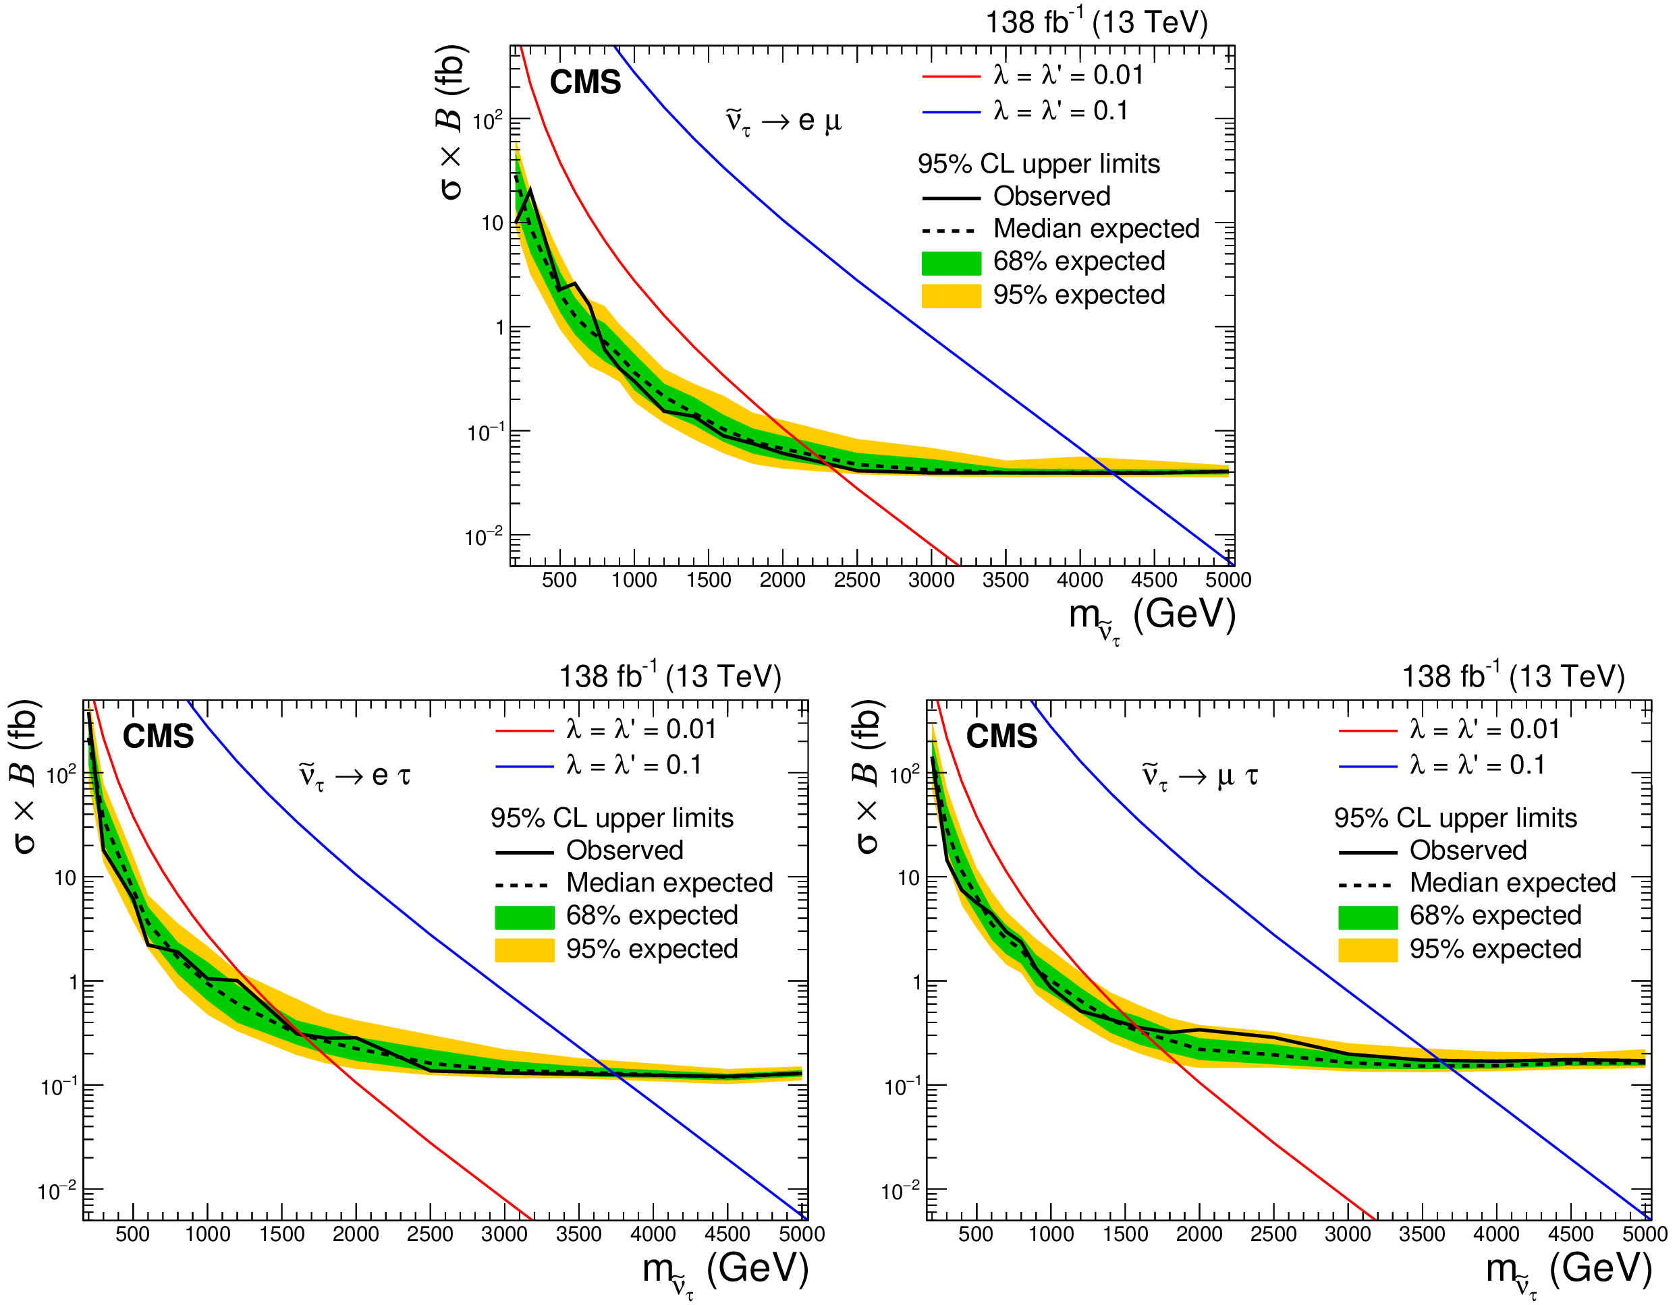
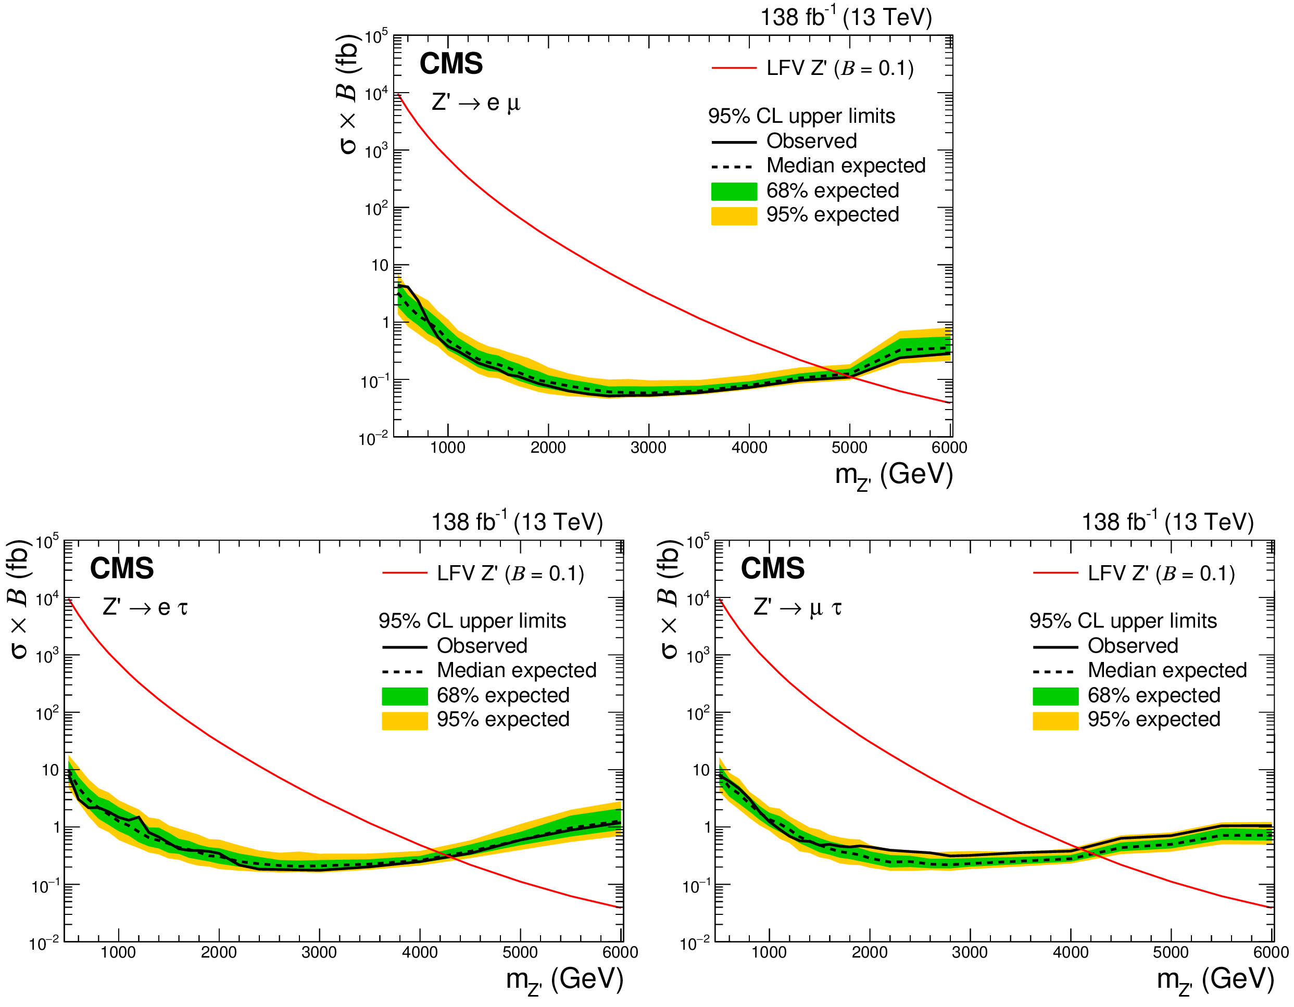
LFV: Sneutrino or Z’ Interpretations
arXiv:2205.06709

Slide 13
Another of Nathaniel’s Seven Questions

Slide 14
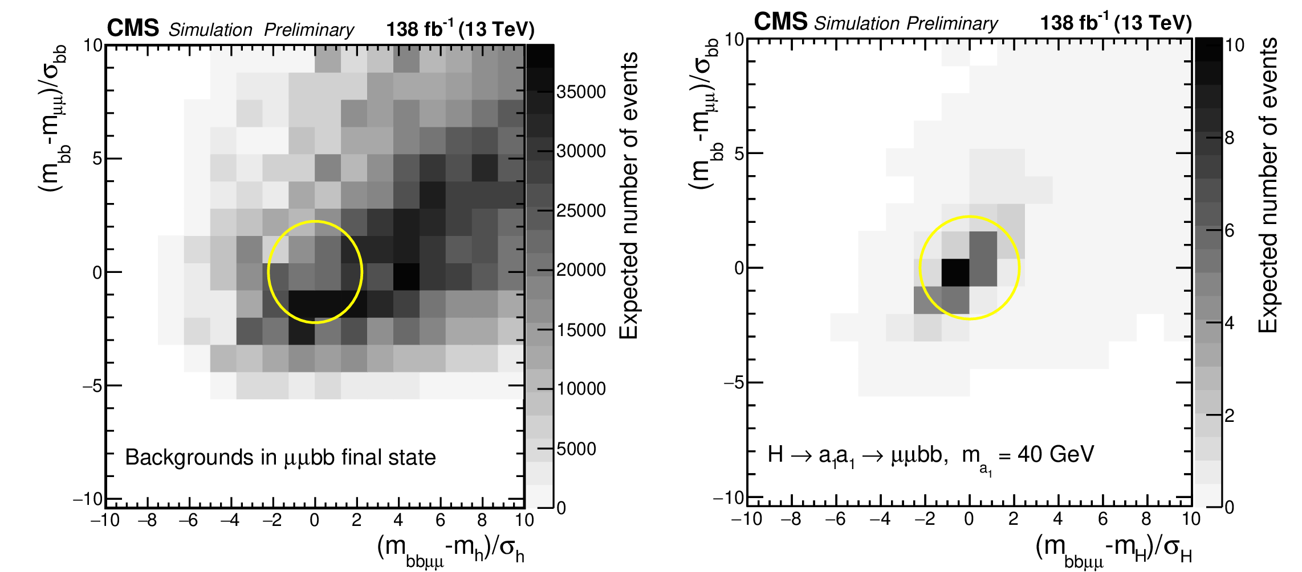
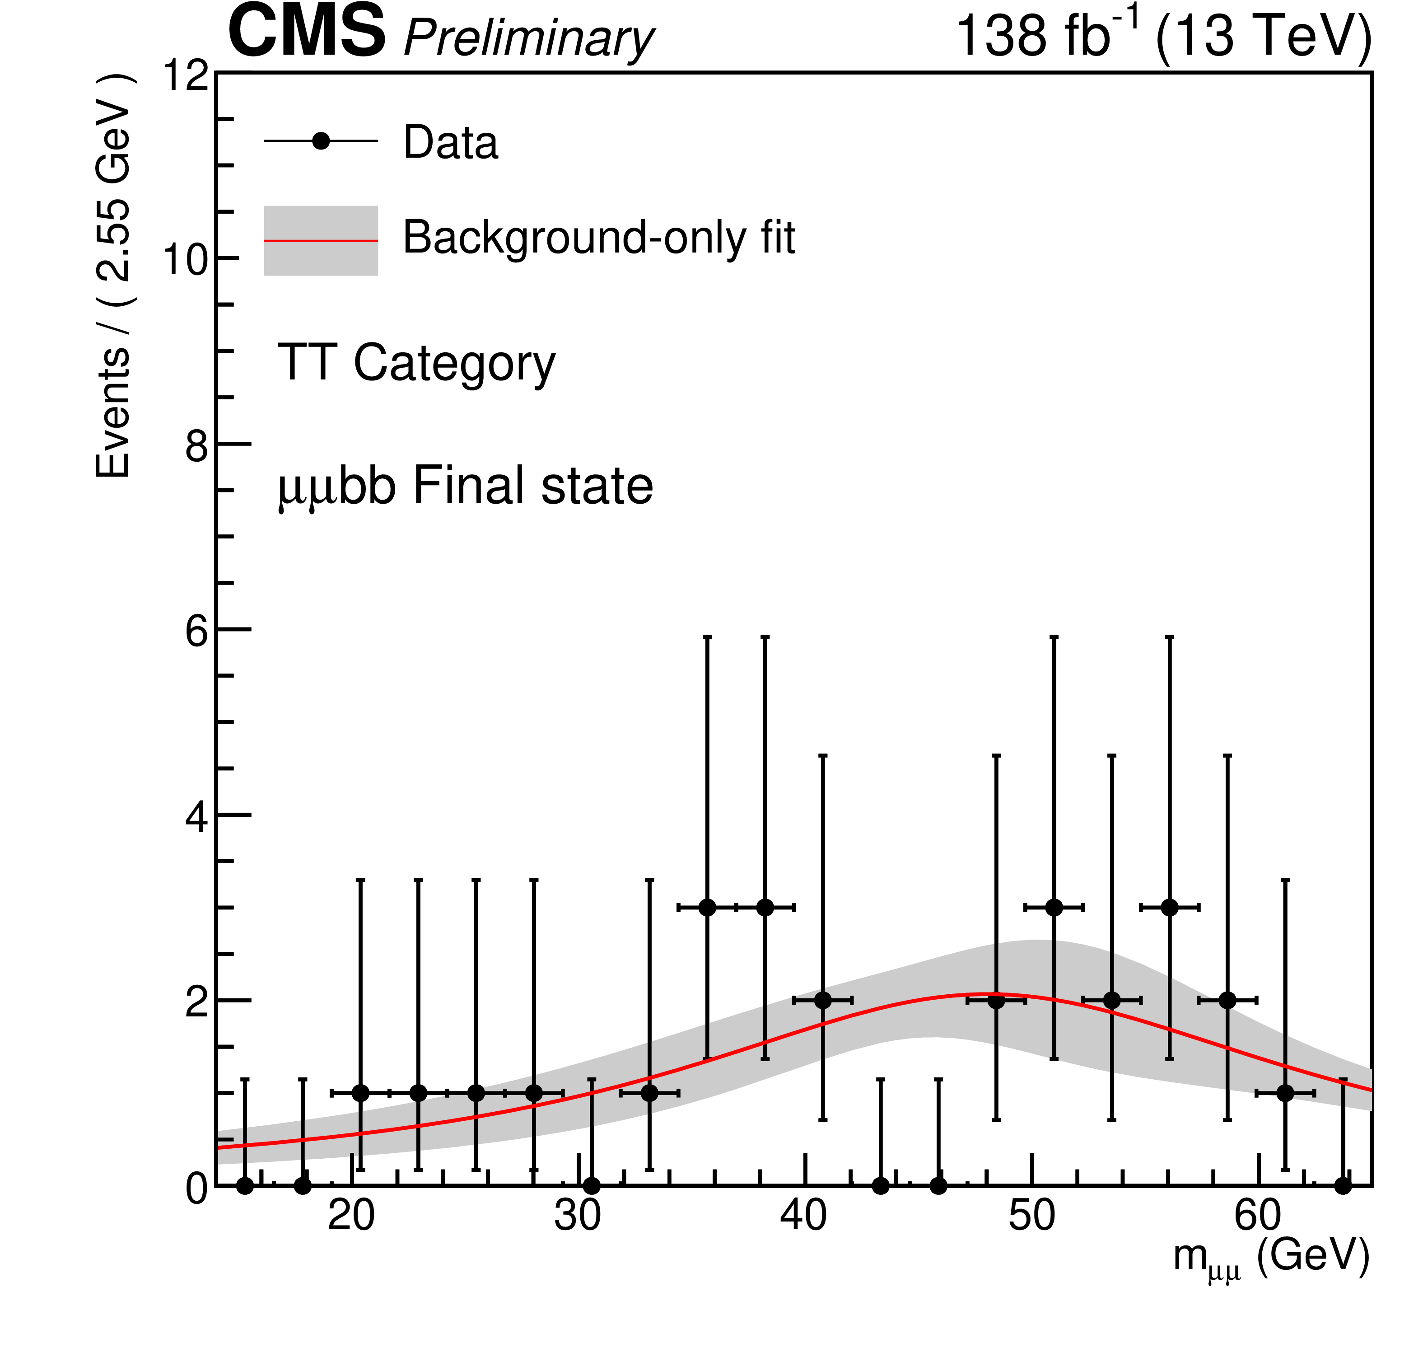
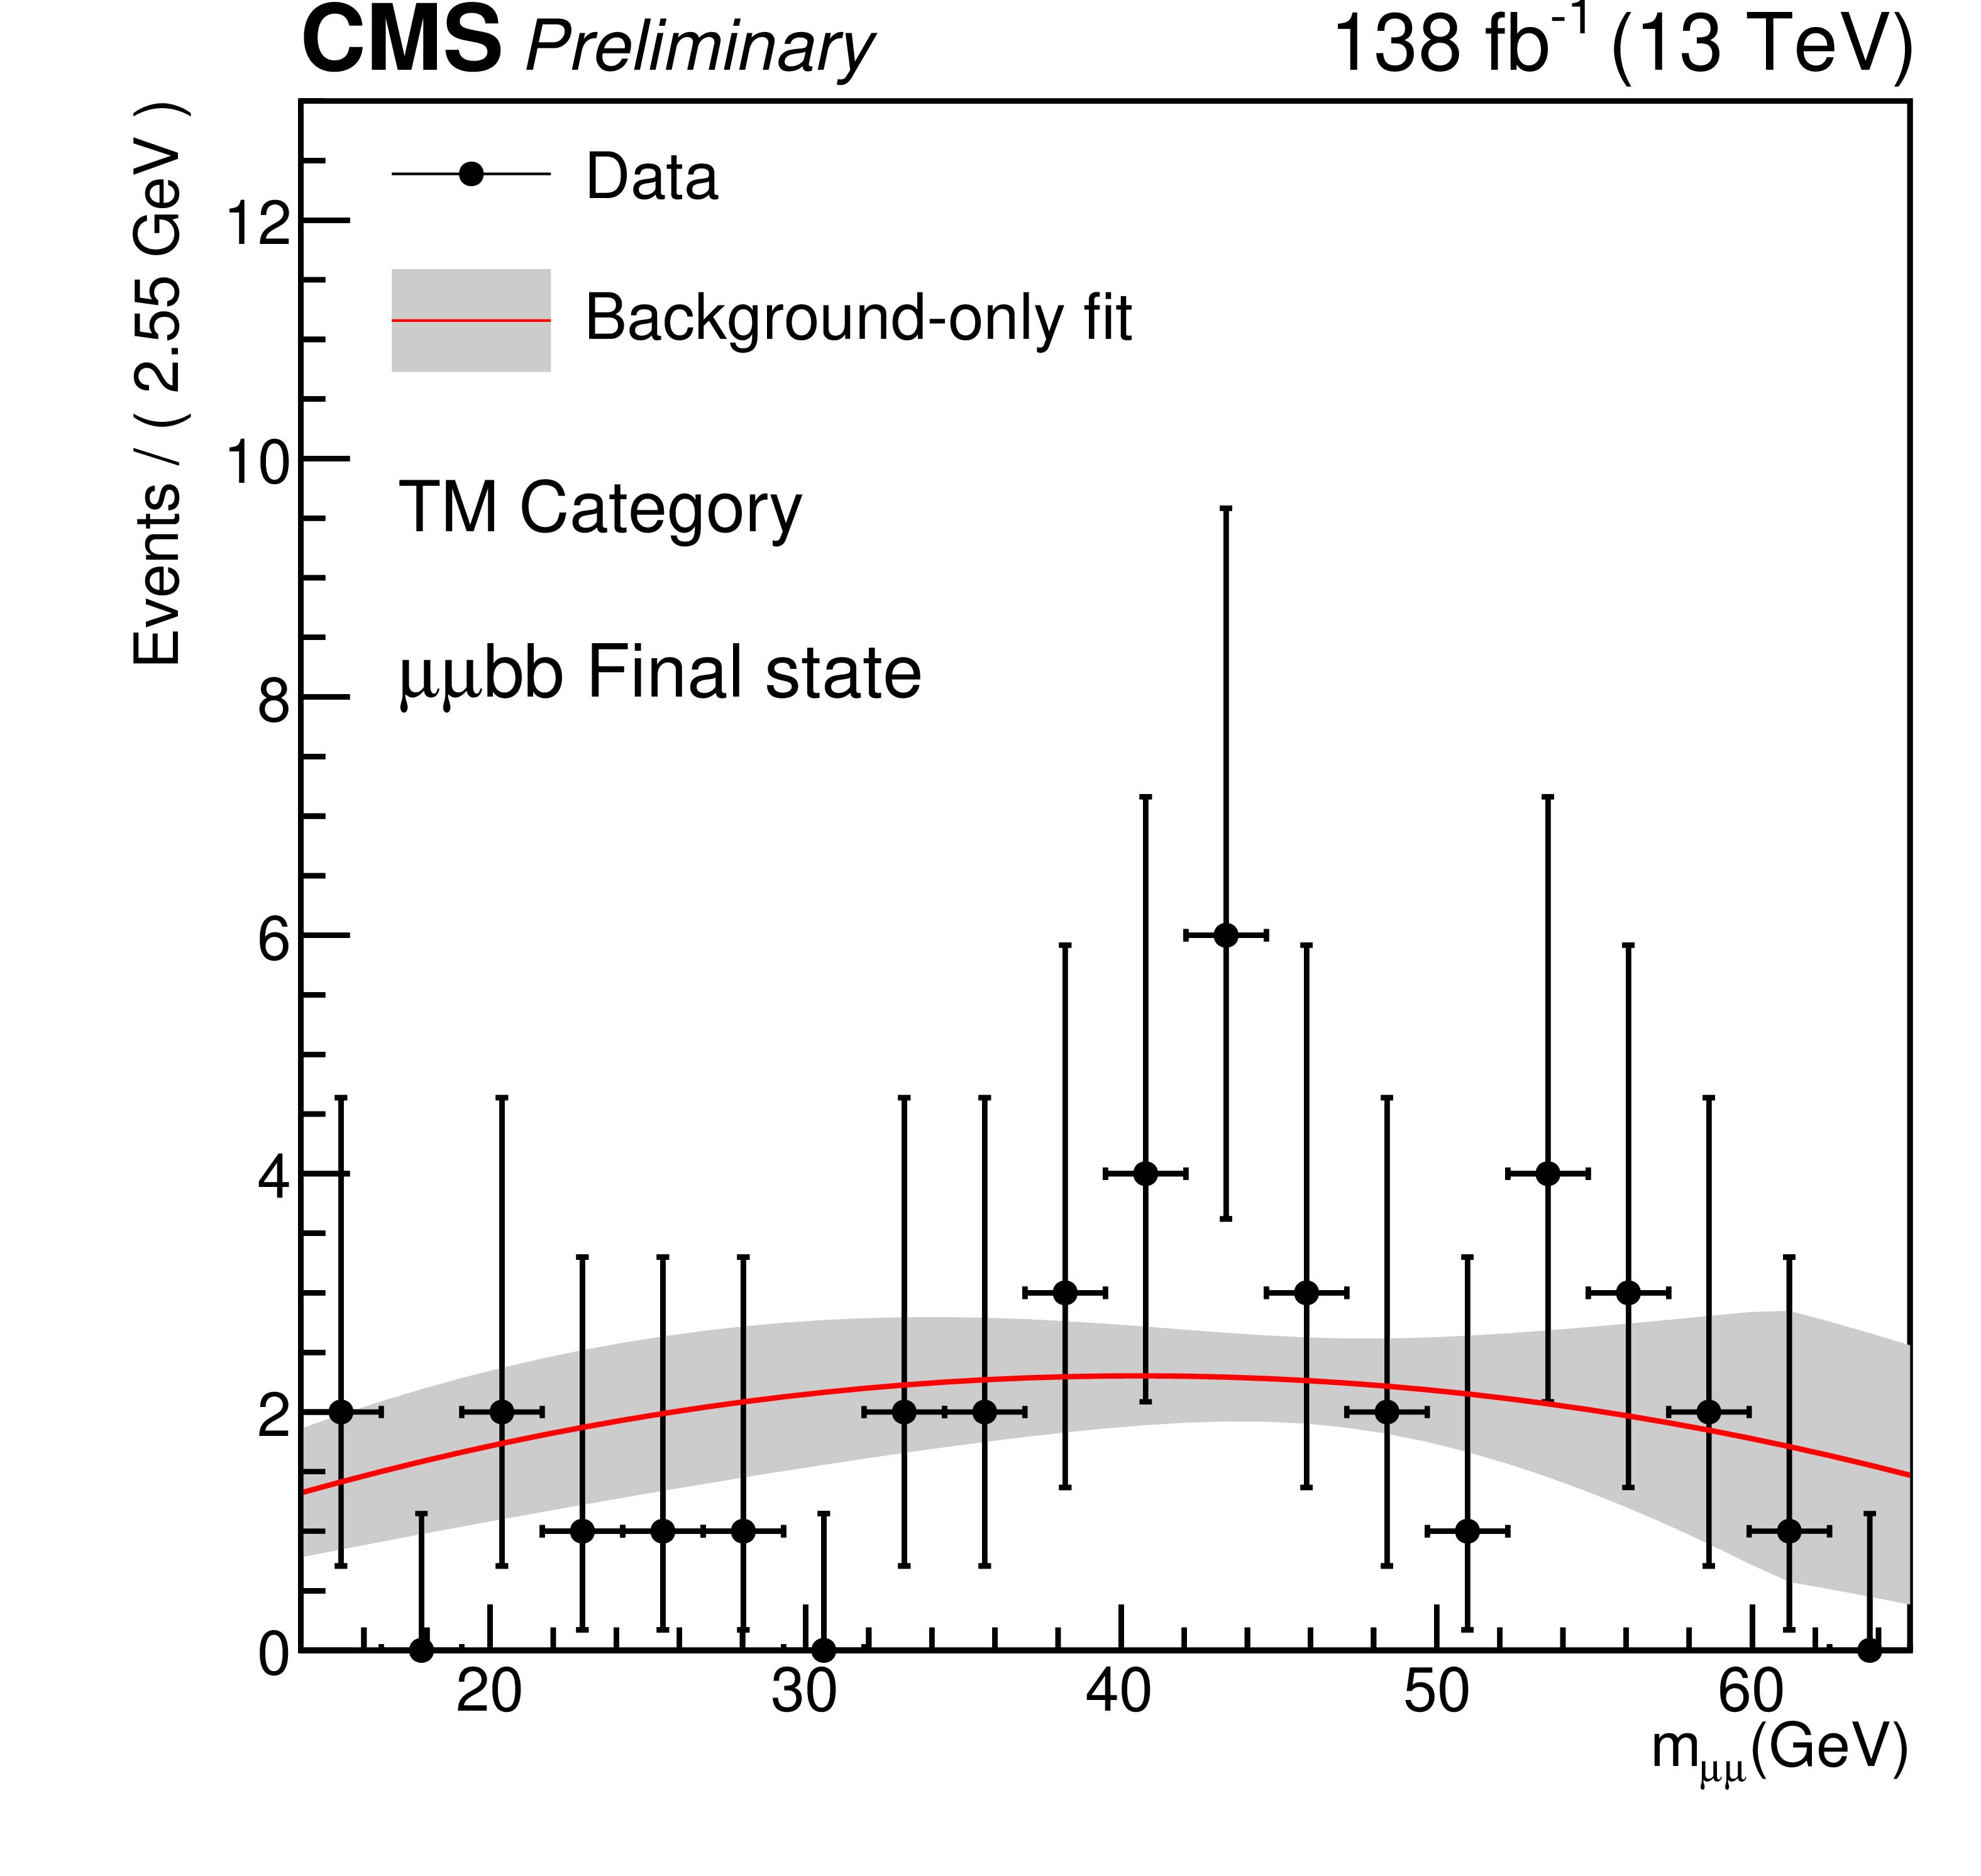
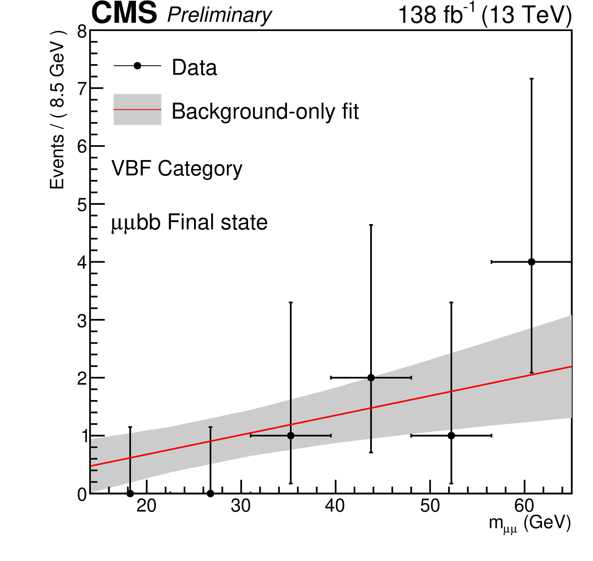
2HDM+S: $H\left(125\right)→aa→μμbb$
CMS-PAS-HIG-22-007
Challenges:
High rate triggers
Leptons from meson decays
Large backgrounds
Plethora of low P_{T} b-jets
Combinatorics …
Mitigation:
Take advantage of topology
Categorize by b-tag quality
Sort by production modes
ML-Based isolation

Slide 15
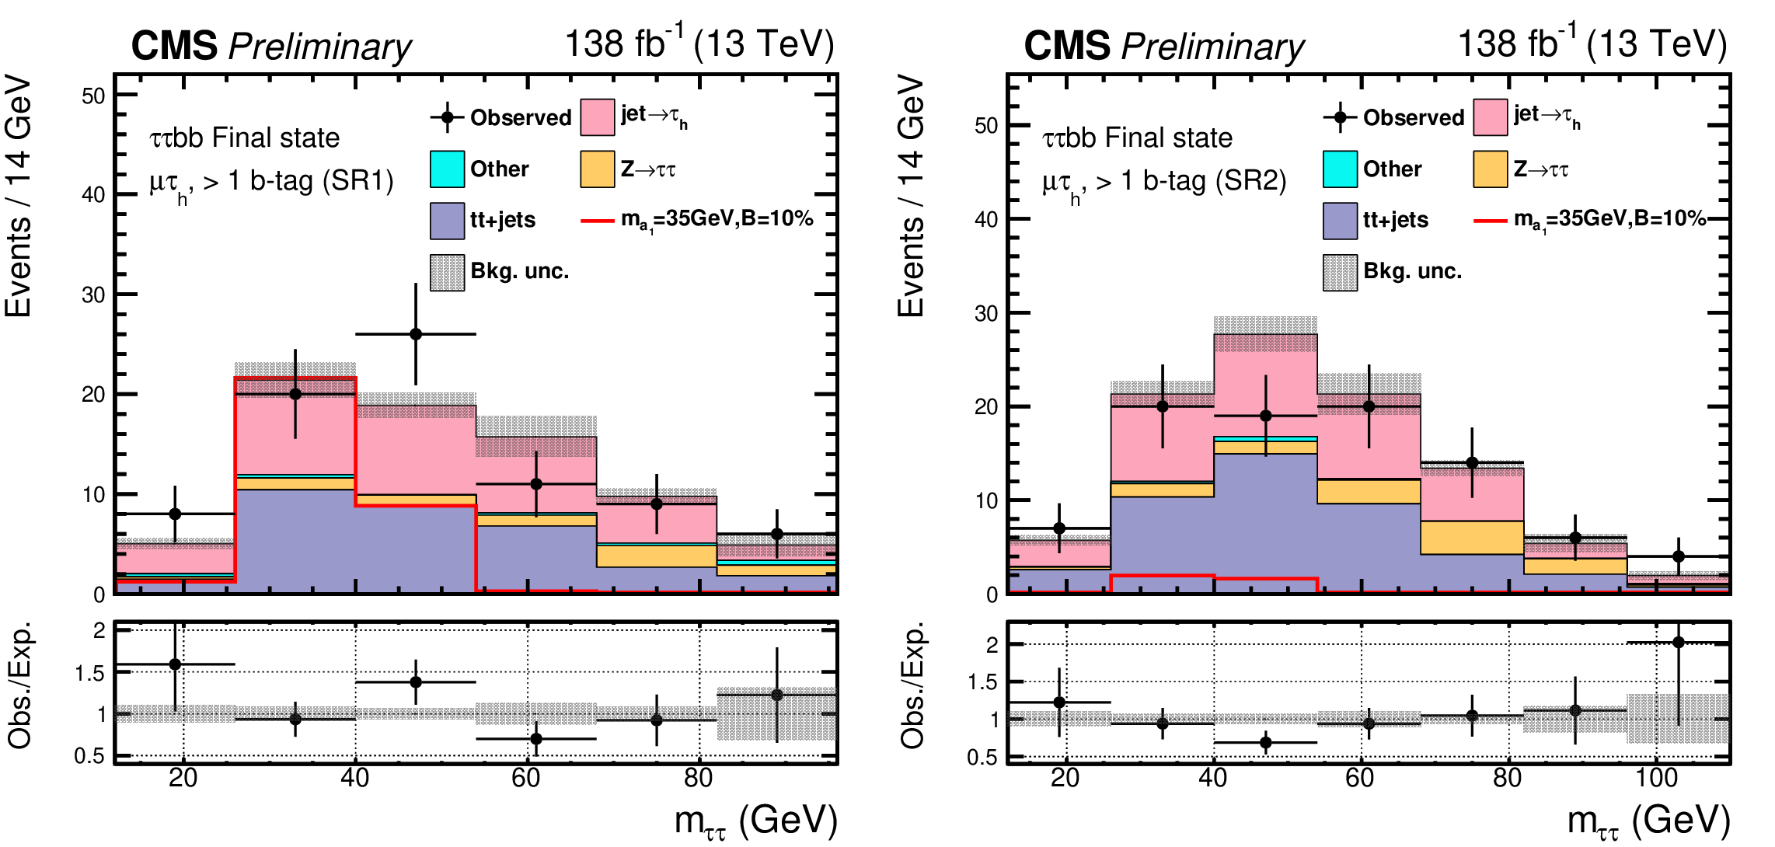
2HDM+S: $H\left(125\right)→aa→ττbb$
CMS-PAS-HIG-22-007
Fake rates estimated using data side bands
Sorted by b-tag counts
Separated by DNN-score thresholds

Slide 16
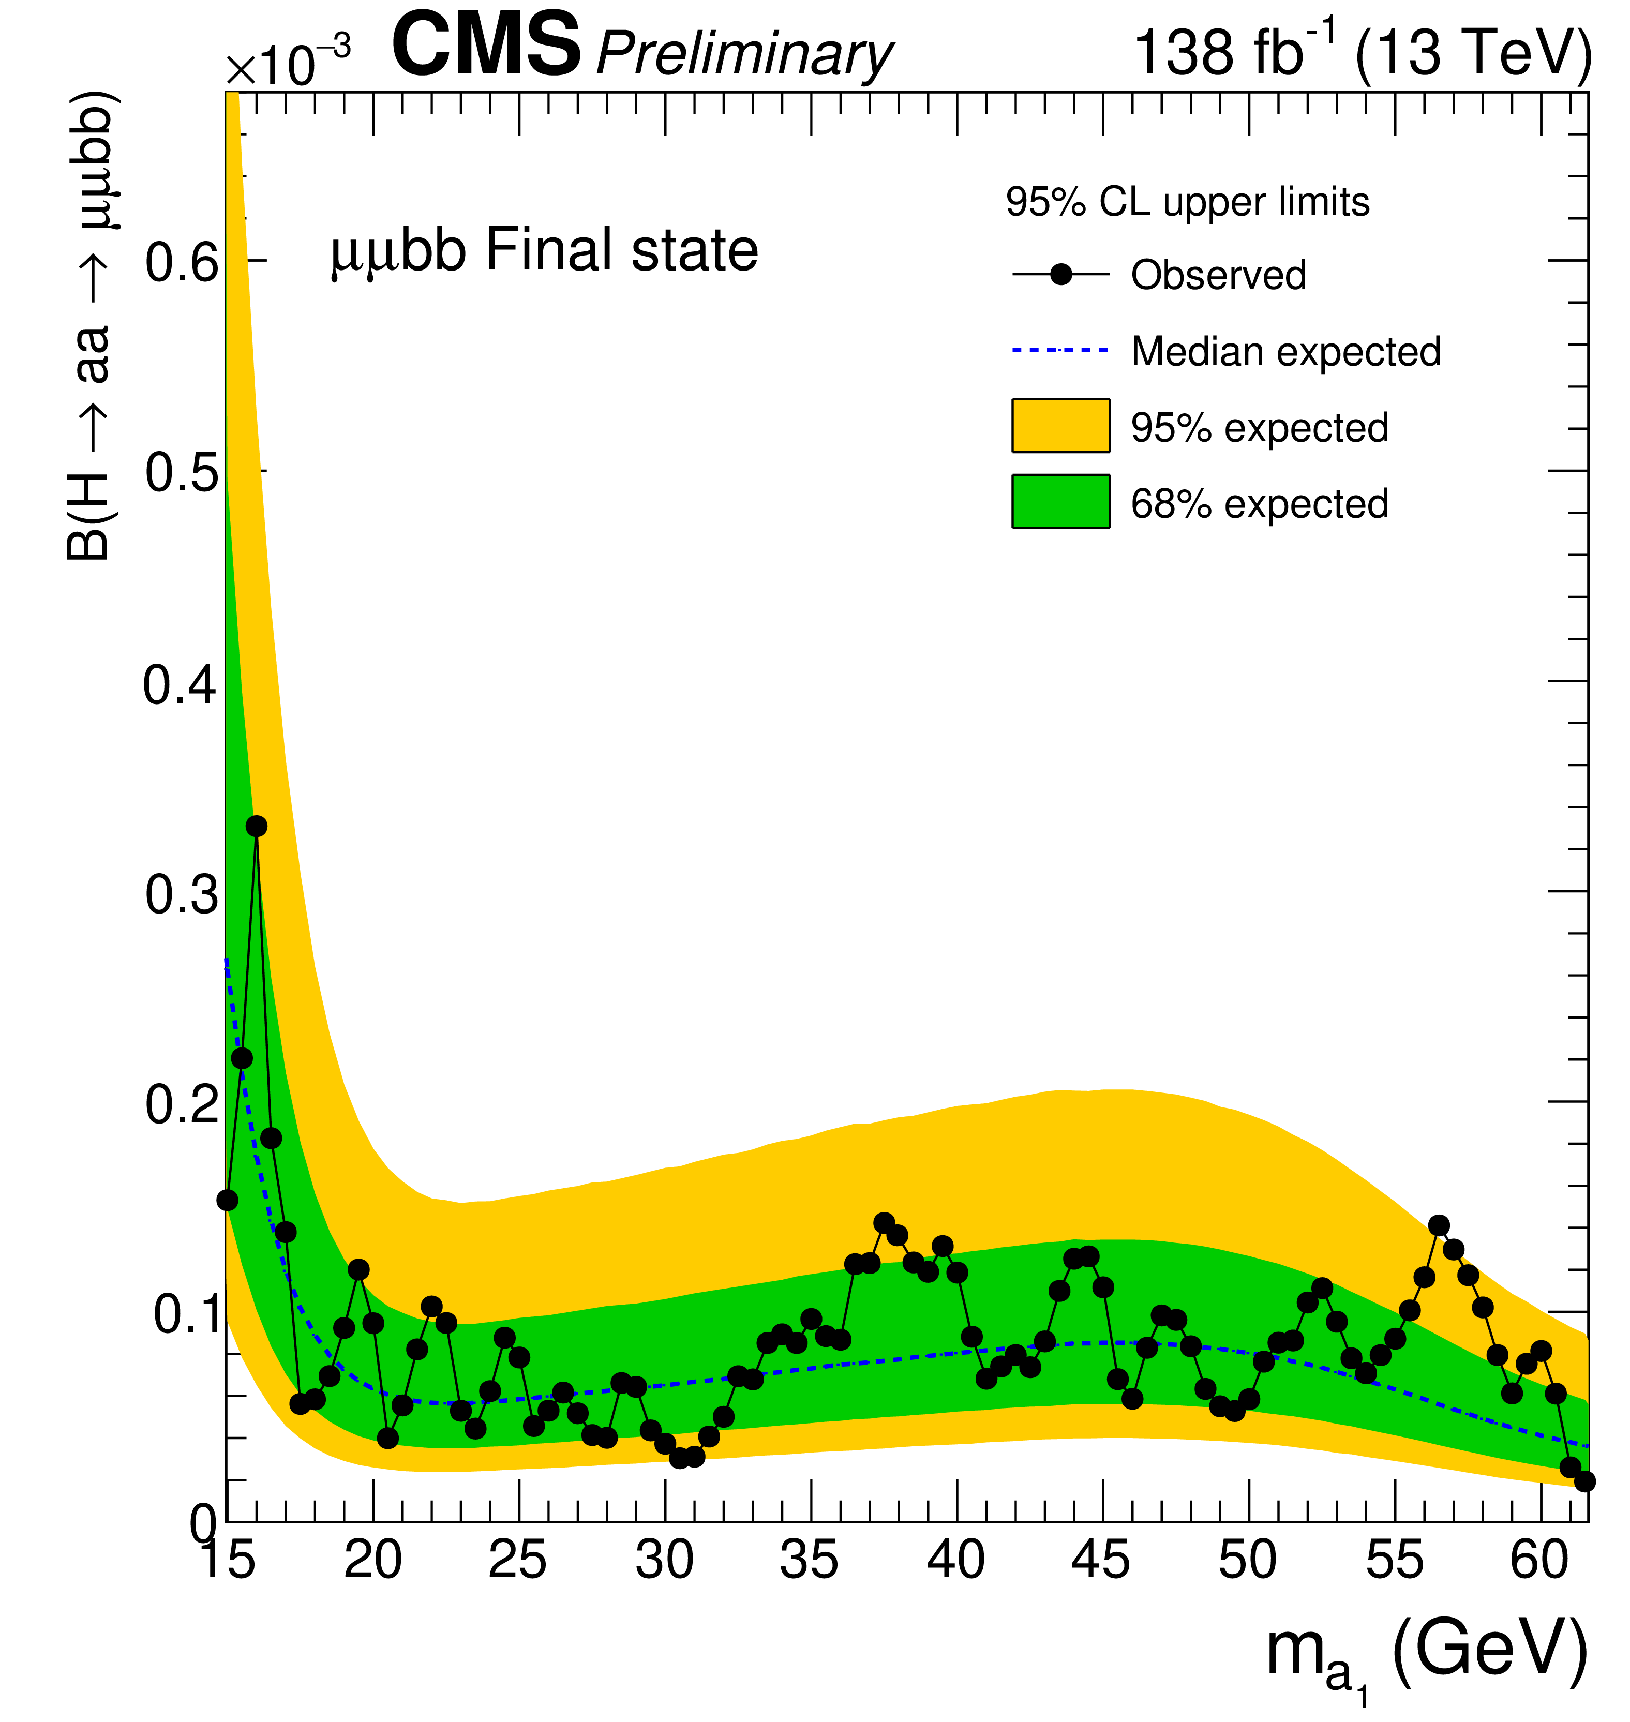
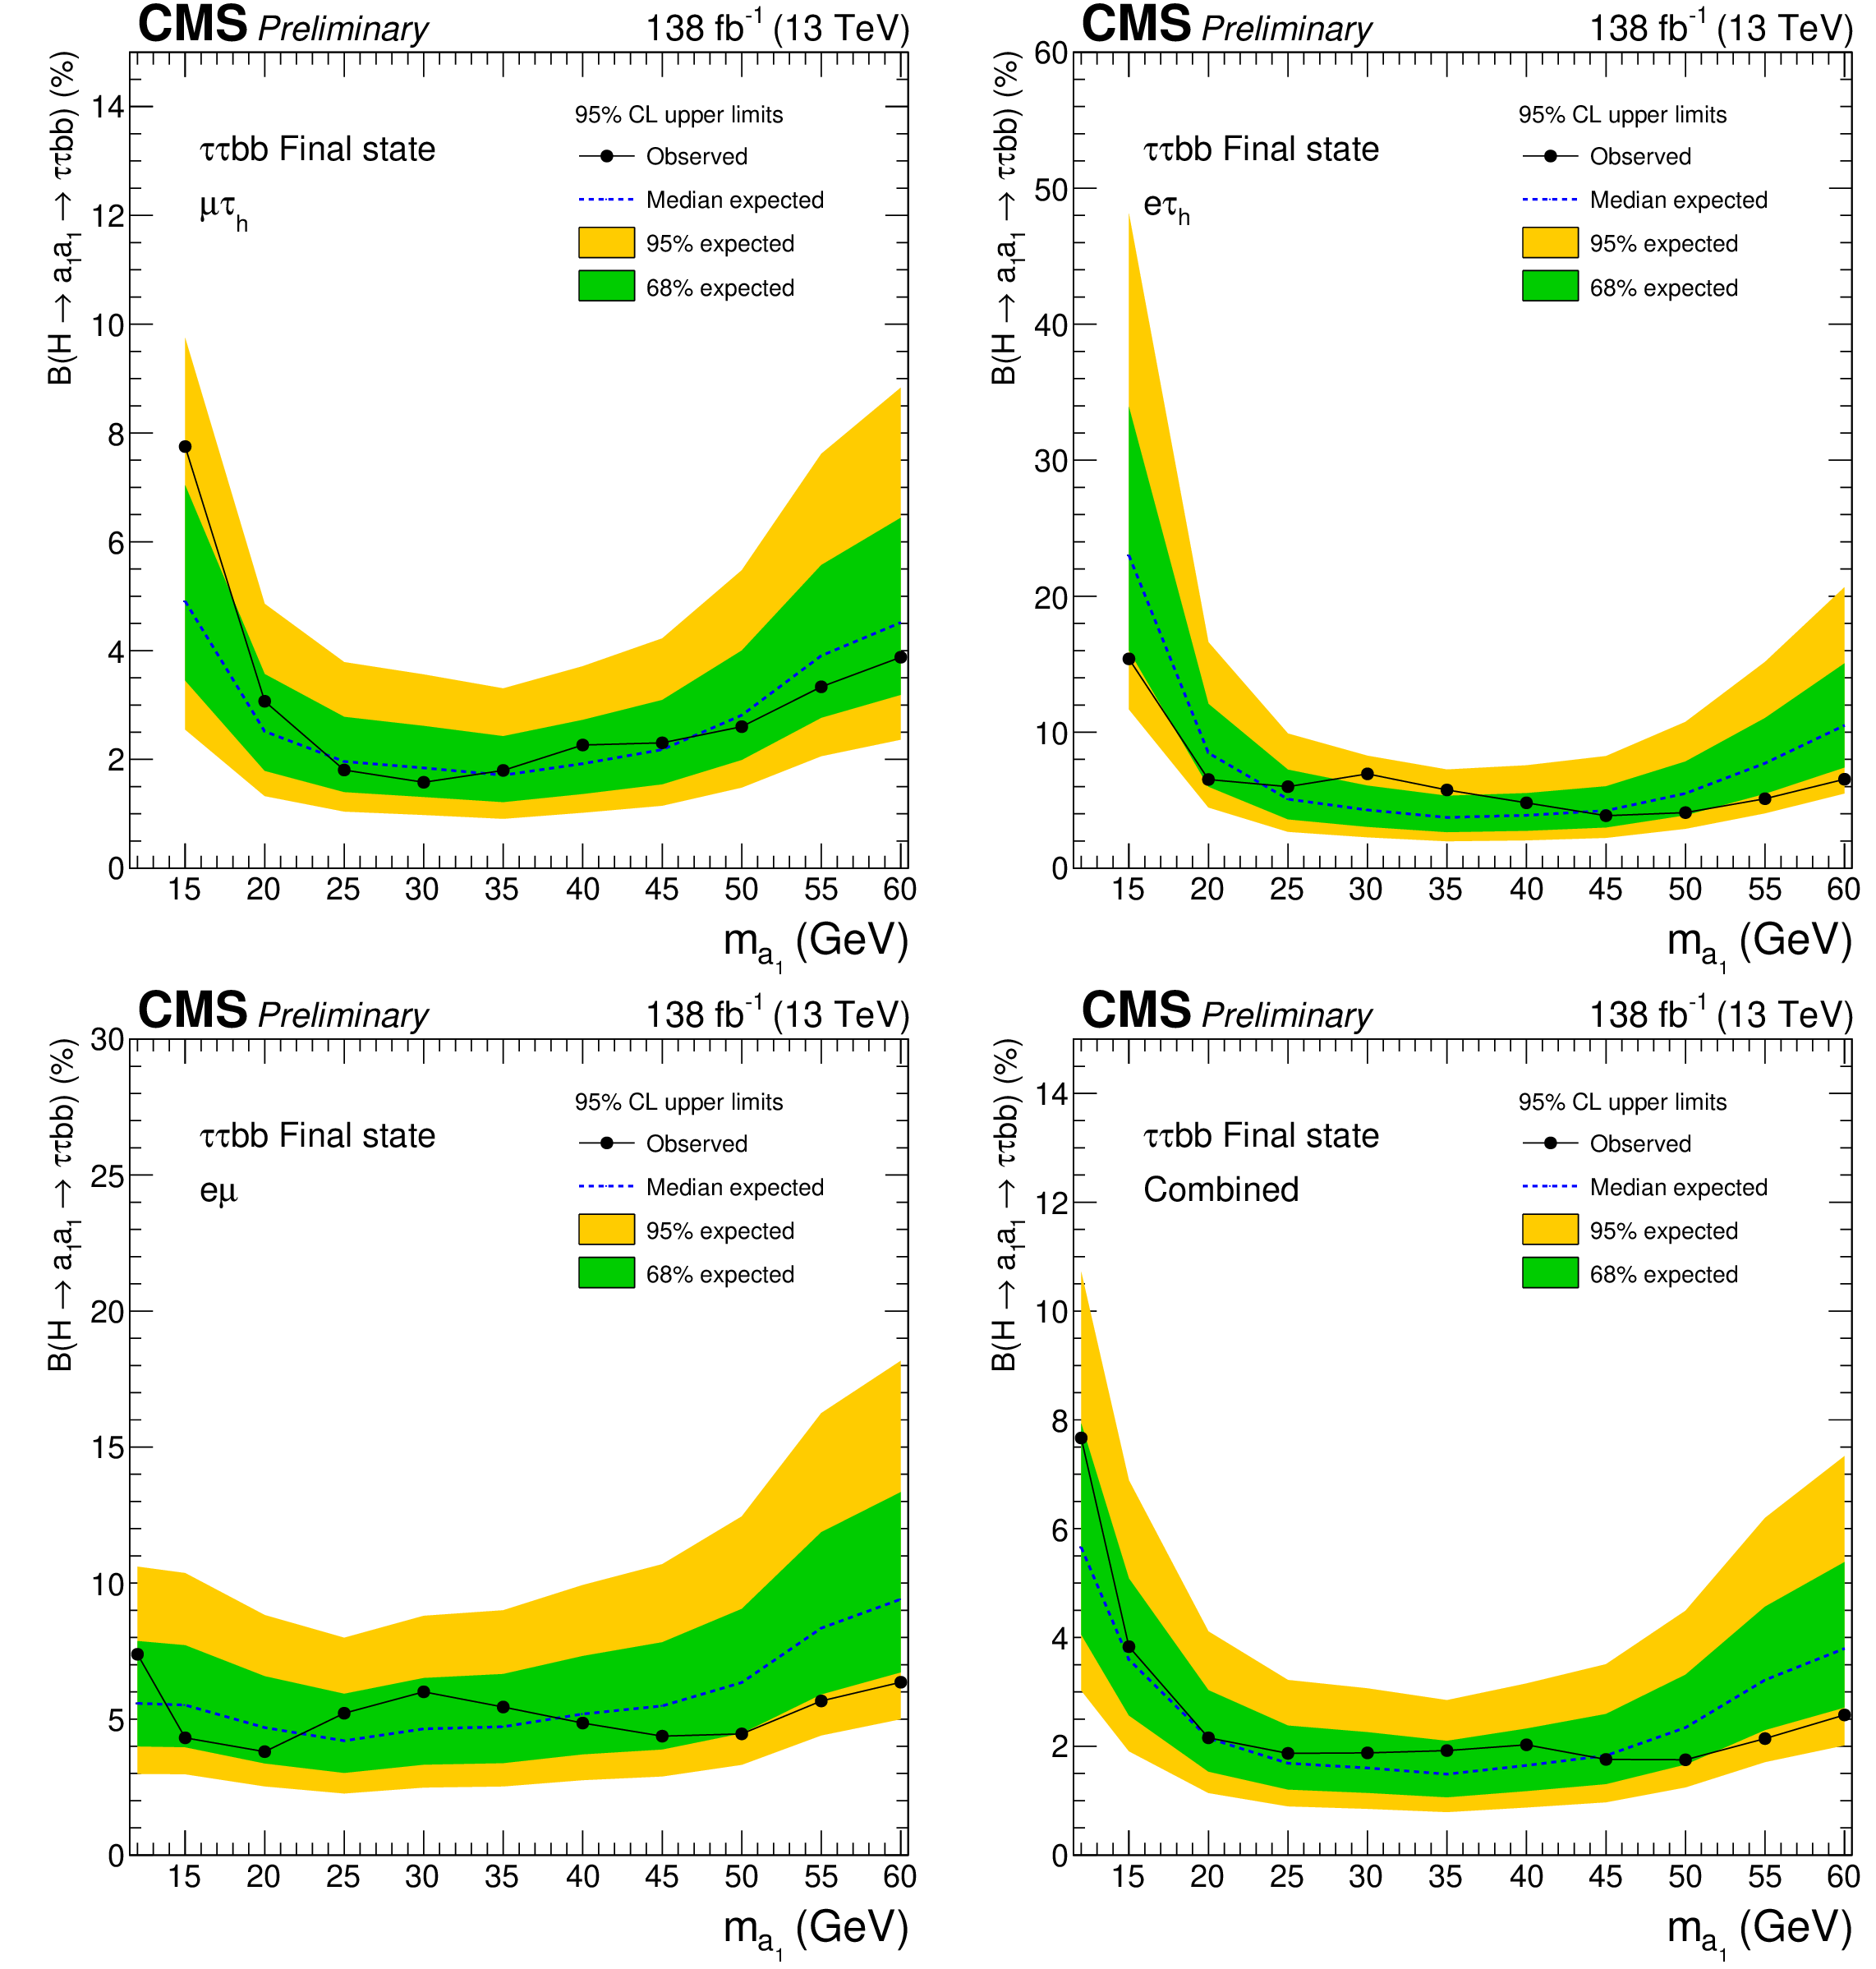
2HDM+S: $H\left(125\right)→aa→μμbb,ττbb$
CMS-PAS-HIG-22-007

Slide 17
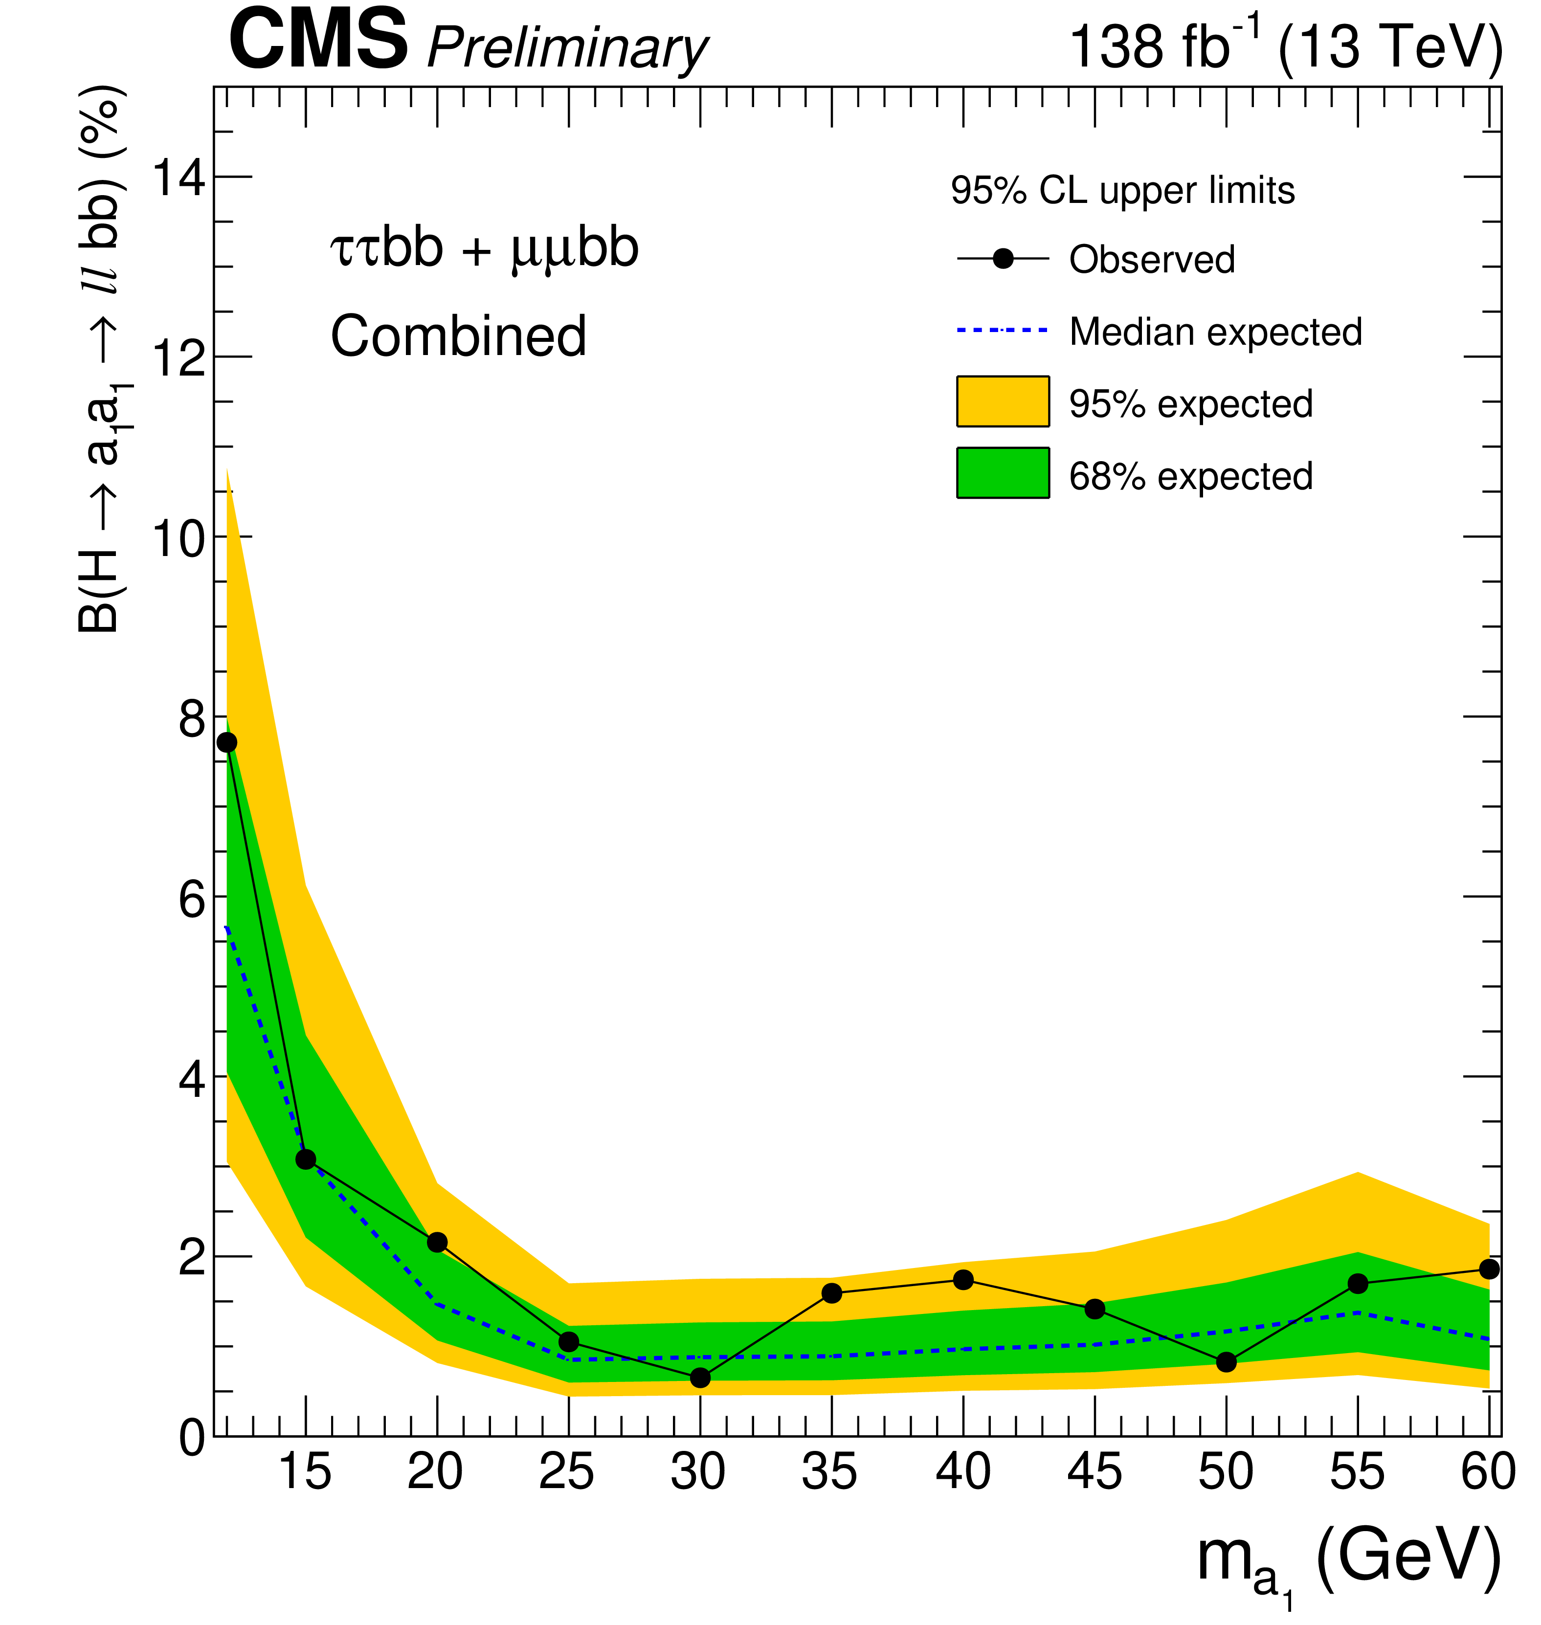
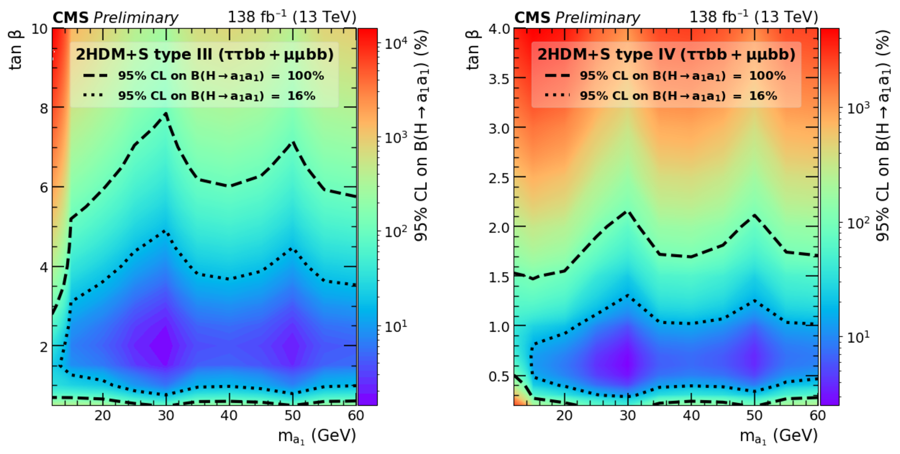
2HDM+S: $H\left(125\right)→aa→μμbb,ττbb$
CMS-PAS-HIG-22-007

Slide 18
Summary / Comments
CMS has explored very many beyond standard model physics signatures
Nothing significant is yet to be seen
Strongly coupled sector is limited
Searches with luminosity increases will provide improved coverage
Weakly coupled new physics will see most improvements
An eclectic collection of BSM Higgs signatures is presented
HL-LHC luminosities will present challenges!
Detector improvements should go far … when going gets tough …
Higher granularity upgrades, Higher trigger rates, Precision timing, … should help mitigate increasing pileup

