Slide 1
Development of a Compact Periodic Permanent Magnet Focused C-Band Klystron
LCWS 2023
Presenter: Brad Shirley
Gonzalez, Haase, Herbst, Hernandez, Hong, Kemp, Krasnykh,
Le Sage, Li, Liu, Merrick, Nanni, Shumail, Tantawi, Weatherford
Date: May 17th, 2023
Notes:
Key difficulties related to klystrons are much higher current / need to cram strong B-fields into tiny tunnel for high efficiency interaction

Slide 2
This research was developed with funding from the Defense Advanced Research Projects Agency (DARPA). The views, opinions and/or findings expressed are those of the author and should not be interpreted as representing the official views or policies of the Department of Defense or the U.S. Government.

Slide 3
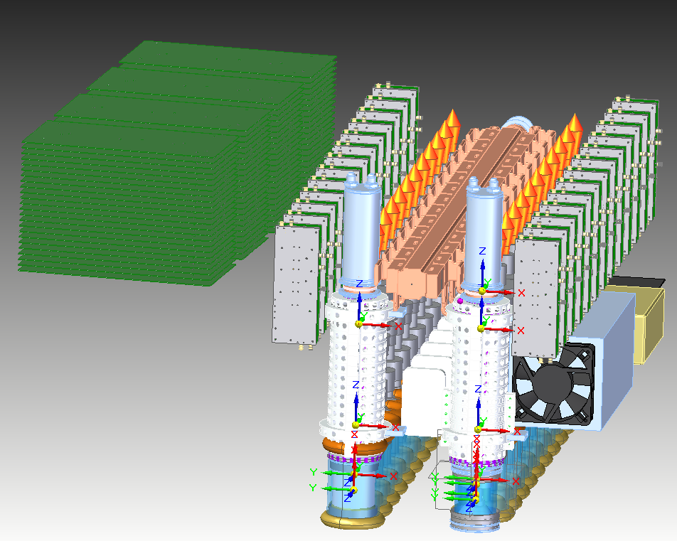
High Level System
Develop a compact, light weight, and portable accelerator system for a variety applications
Array of 26 klystrons that are pulsed by a 35 MW modulator to deliver ~550 kW per klystron of power to two cells of a linac
Linac will accelerate beam to a maximum energy of 20 MeV with 0.5 A of current
High Level System Mockup
Ideally want to fit inside of a 40 cm radius cylinder 1 m long

Slide 4
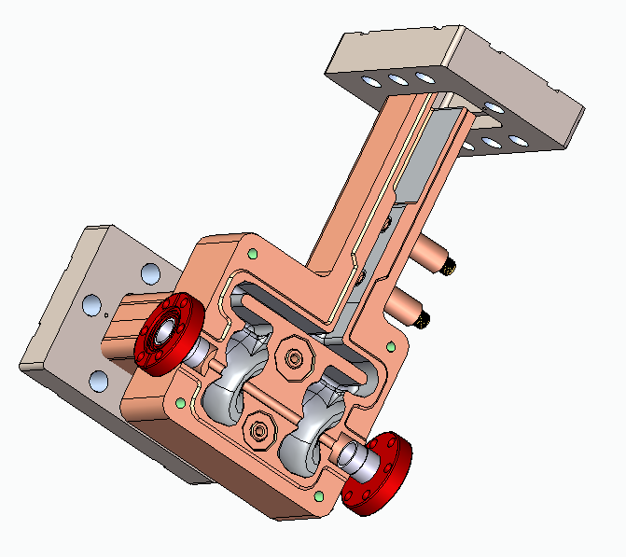
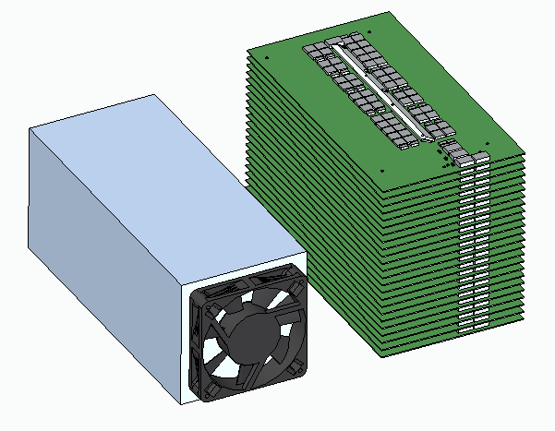
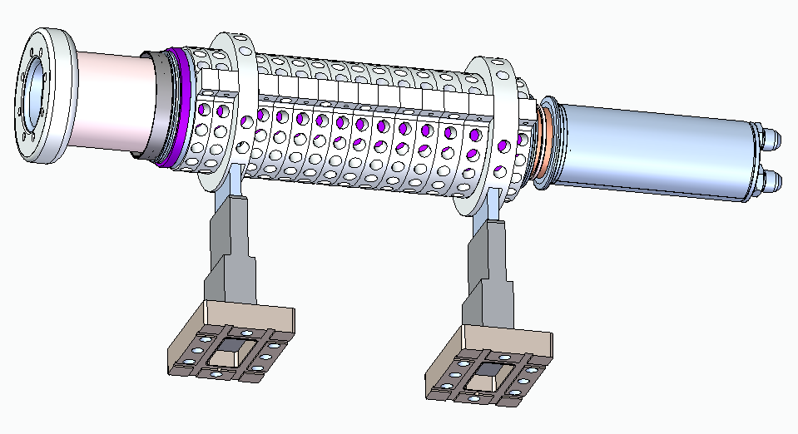
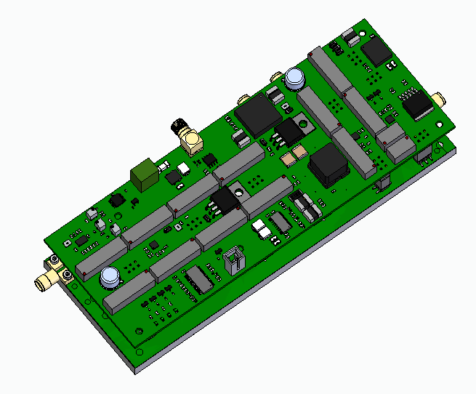
Two Cell System Block Diagram
Accelerator Cavities
Pulsed Power System
RF Source
60kV,1.5us
550kW
5.712GHz
Phase 2: “Beam”
Feedback
200W
5.712GHz
Reflected Power
LLRF
SSA
RF Load

Slide 5
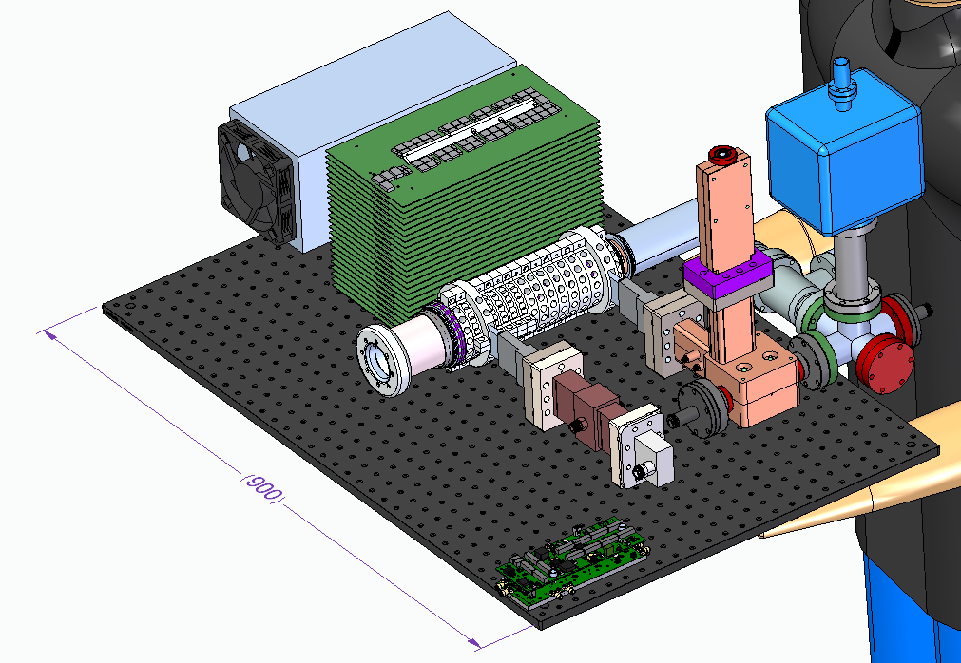
Two Cell Test High Level Mockup
HV Power Supply
RF Load
Modulator
Pump Out and Instrumentation
RF Source
Linac
‘Two Cell Section’
mm
Solid State Amplifier
RF Window

Slide 6
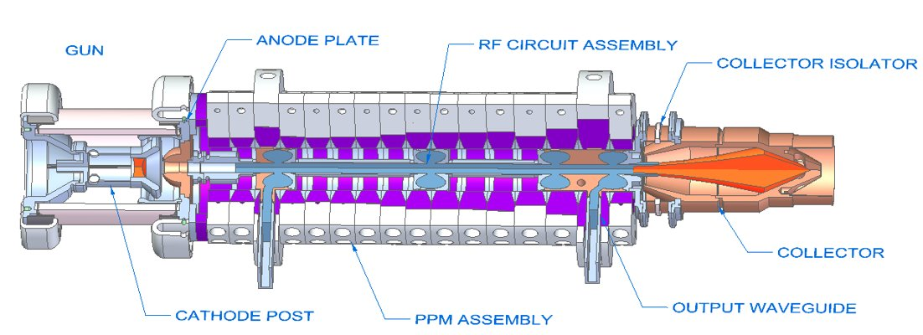
Klystron Design

Slide 7
Top Level Requirement
Metric | Threshold
Output Power | 540 kW (peak)
Frequency | 5.712 GHz
Efficiency | 50%
Beam Voltage | 60 kV
Beam Current | 17.2 A
Repetition Rate | 60 Hz
Pulse Length | 1 µs
Perveance | 1 µK
Beam Tunnel Radius | 3.8 mm
Brillouin Field | 1.3 kG
Circuit Length | 300 mm (as short as possible)
Mass | 1.5 kg

Slide 8
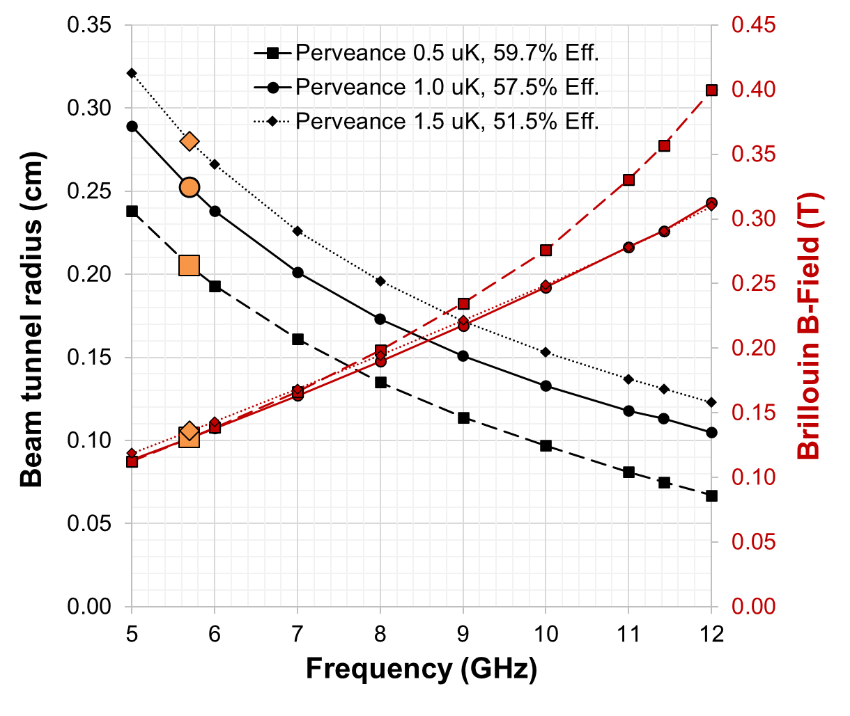
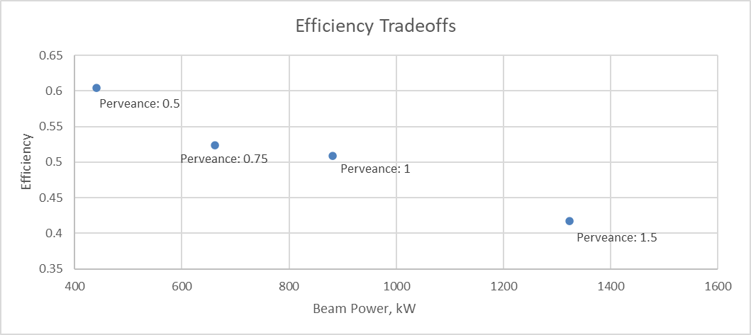
Initial Design Tradeoffs
Tradeoffs were conducted to understand what operating parameters were needed to achieve efficiencies and output power
Lower frequencies allow for smaller magnetic field strengths, but larger beam tunnels
Advantageous for weight constraints
5.712 GHz was used
Higher perveance allows for higher beam power, but less efficient
1 micro-perveance was used
Setting the perveance and the voltage sets the current

Slide 9
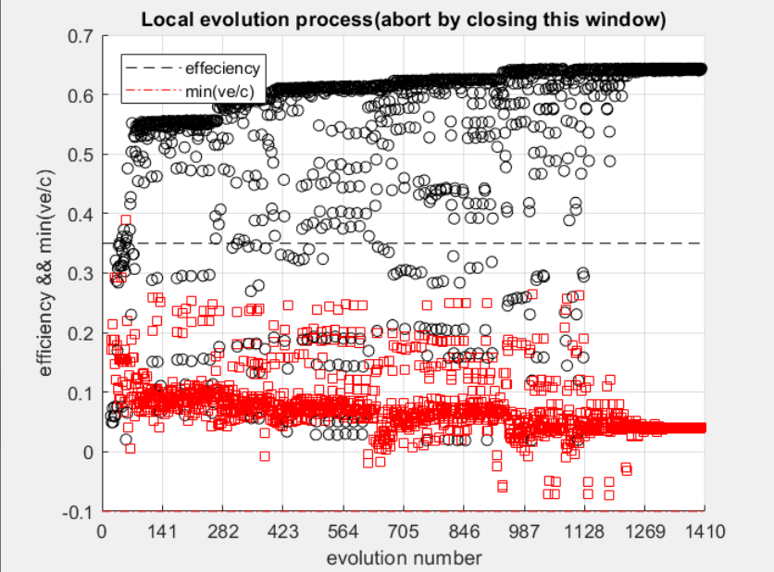
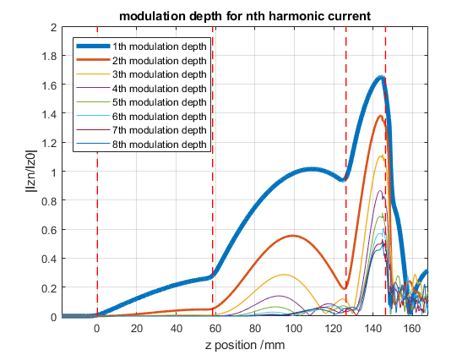
Preliminary Simulations
Preliminary simulations in KlyC, a 1.5-D large signal klystron code developed by CERN
Optimize a variety of cases to analyze performance
3 cavities vs. 4 cavities
Varying perveance
Varying drive power
Cavity frequencies and external Q factors
Four cavity geometry allows for higher efficiencies
This dictates an upper bound for further simulations
Optimization Process with > 1000 runs
Bunching Current vs. Position

Slide 10
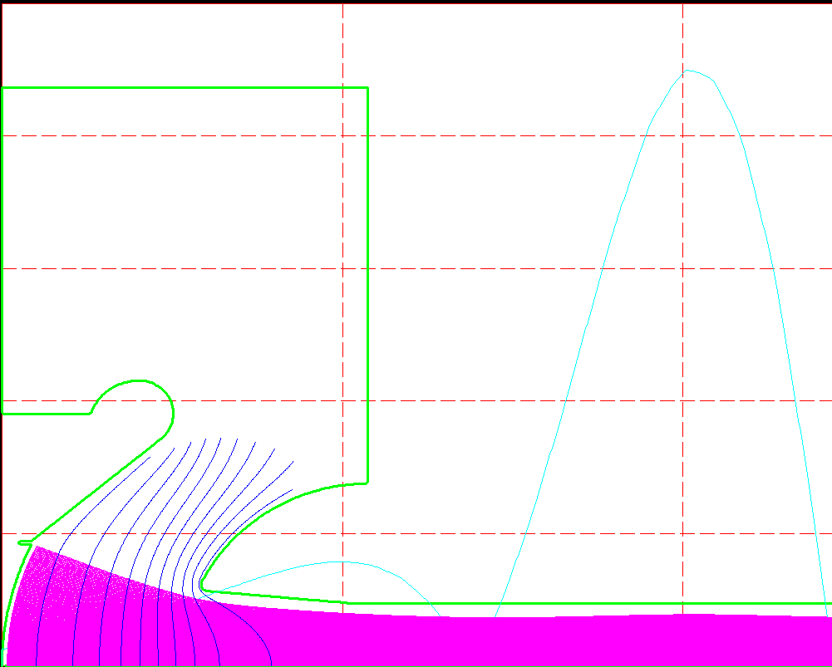
Electron Gun
EGUN was used to design electron gun and electrostatic focusing
Knowing the target power, operating voltage, and perveance sets the gun current
Cathode, heater, and focus electrode is currently on order
High voltage gun insulator and weld flange assembly on hand
Electrostatic Potentials
Focus Electrode
Parameter | Value
Current | 17.2 A
Perveance | 1.178 uK
Beam Waist | 2.8 mm
Throw Distance | 29.6 mm
Fill Factor | 73%
Anode
Beam Waist
Cathode
Electron Beam
Notes:
The beam fill factor of 73% is very high (mitigation = very low duty operation. As long as beam losses don't impact efficiency, it should be OK)

Slide 11
High Voltage Standoff for Electron Gun
High voltage electrostatic simulations completed to allow for sufficient standoff in and around the gun
Gun is biased to -60 kV
Utilizes existing ceramic design
Reduces lead time and tooling development
Remaining assemblies ready for further mechanical design
Reduction in peak E-field is possible with an increase in size
Location | Peak E-Field
Air | 2.2 MV/m
Ceramic | 1.8 MV/m
Vacuum | 22.8 MV/m

Slide 12
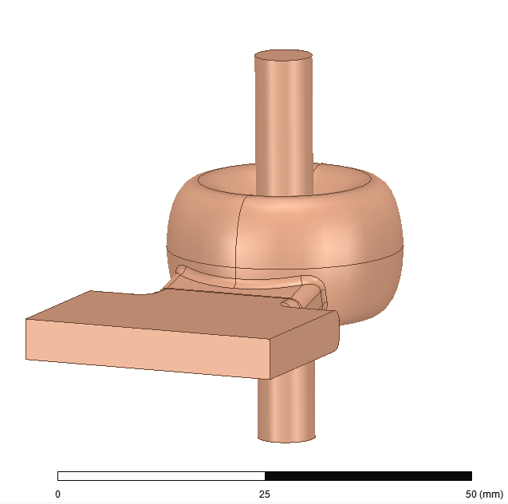
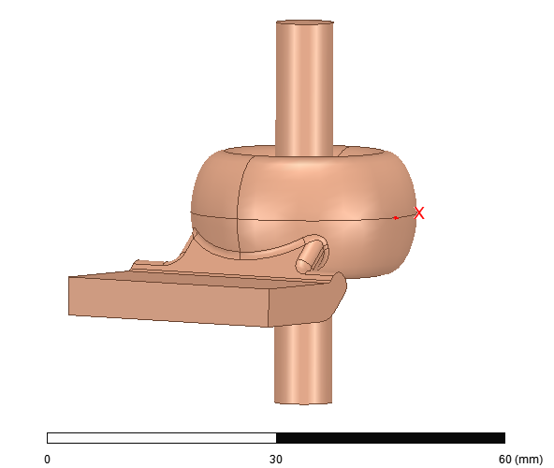
Cavity Design
Klystron cavities were designed in HFSS
Optimized for gap coupling factor (M) and shunt impedance (R/Q)
M: 0.747
R/Q: 117
Q_{ext} Input – 250 , Q_{ext} Output – 45
Same geometry used for all four cavities with slight changes in outer radius for final RF design
Design of IP and OP coupled cavities complete
Side coupling compensates for location of inlet on magnet stack
Input and Output Coupled Cavities
Full RF Circuit
Notes:
Did you check ohmic losses and field strength in penultimate and output cavities? I originally designed with pretty small nose radii with the expectation that I would check and increase rounding if needed

Slide 13
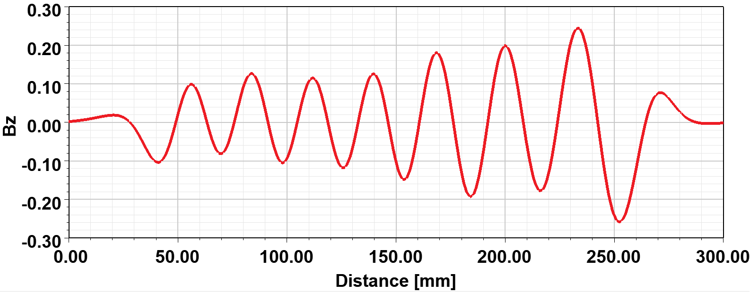
Magnetic Focusing Circuit
NdFeB periodic permanent magnets are used to focus the beam
Allows for lighter weight magnetic focusing than electromagnets
Full nominal design complete which includes:
Gaps in magnets for waveguide routing
Correct field strength and period to focus beam

Slide 14
Magnetic Focusing Circuit
Initial prototype klystron will use larger magnets
Preliminary designs show reduction in weight is possible with more complex magnet design
Weight reduction from 3.25 kg to 1.35 kg -> ~60% weight decrease
Magnets hug beam pipe, reducing the inner diameter

Slide 15
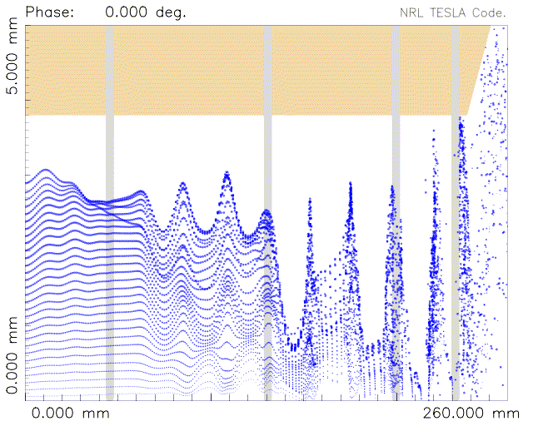
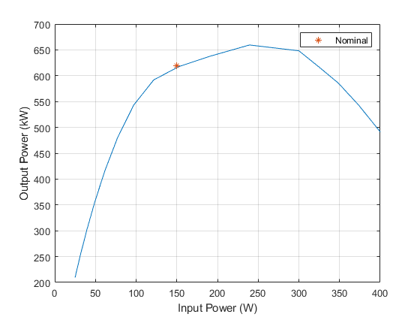
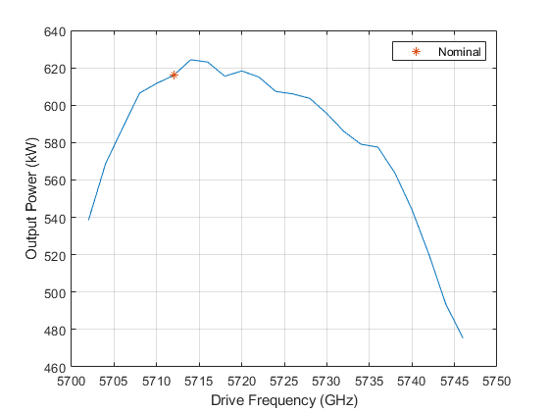
TESLA Simulations
TESLA, a 2.5D large-signal code, is used in the optimization process of the klystron
Optimization of cavity positions, frequencies, and external Q factors
Current optimized design produces 619 kW at 57% efficiency -- gain of 36 dB
R vs. Z
Transfer curve at 5.712 GHz
RF Bandwidth at Fixed Drive
Maintain output power goal over ~ 40 MHz
Input SSA can be nominally operated at 350 W
Nominal klystron design was optimized at 150 W

Slide 16
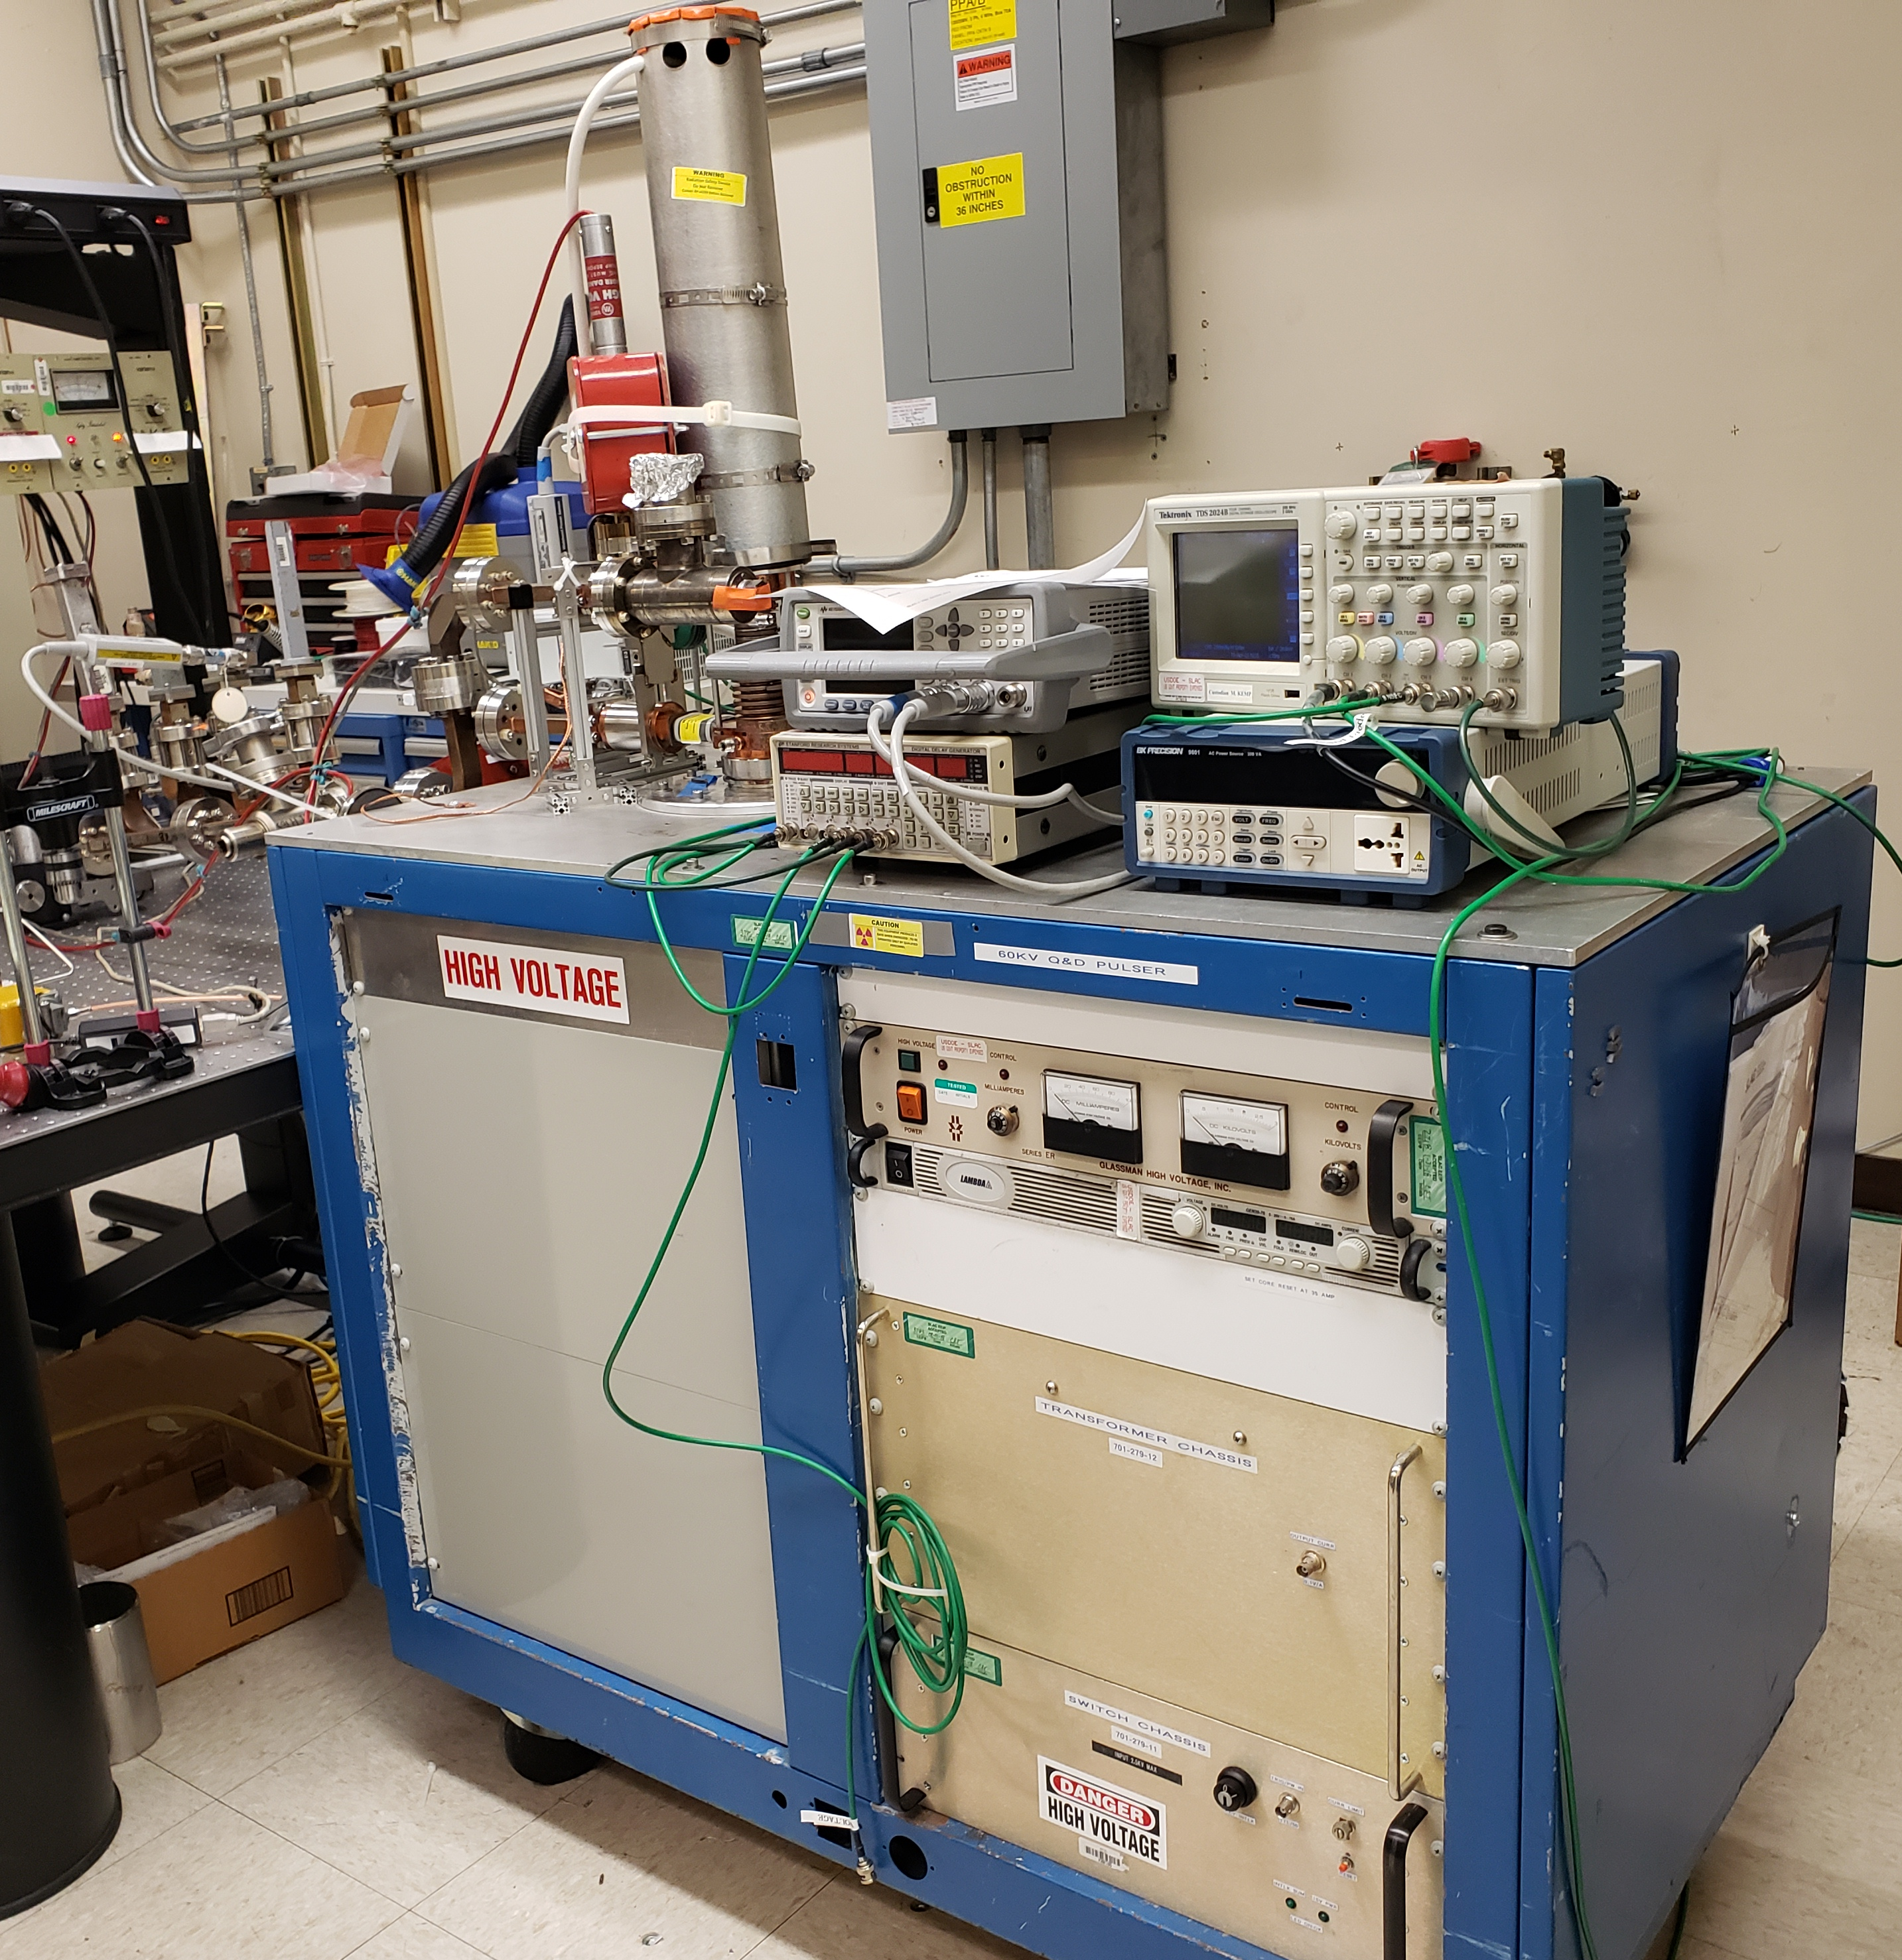
Mechanical Design, Test, and Next Steps
Full mechanical package is nearly finished
Many pieces are being manufactured
Next steps:
Cold test of individual cavities
System is brazed, leaked checked, and baked-out
High power tests using pre-established modulator at SLAC
Modulator to be used in high power testing

Slide 17
Thank you!

Slide 18
Reference slides follow

Slide 19
High-Level Block Diagram Overview
Klystron 1
Mod
Load
LLRF
Klystron 25
Mod
Load
LLRF
SSA
Magic Tee
Magic Tee
C0
C1
C2
C3
C4
C49
C50
C51
C52
Vacuum Pipe
Gun
Power Supply
Magic Tee
Magic Tee
LLRF
Klystron 2
Mod
Load
LLRF
Klystron 26
Mod
Load

Slide 20
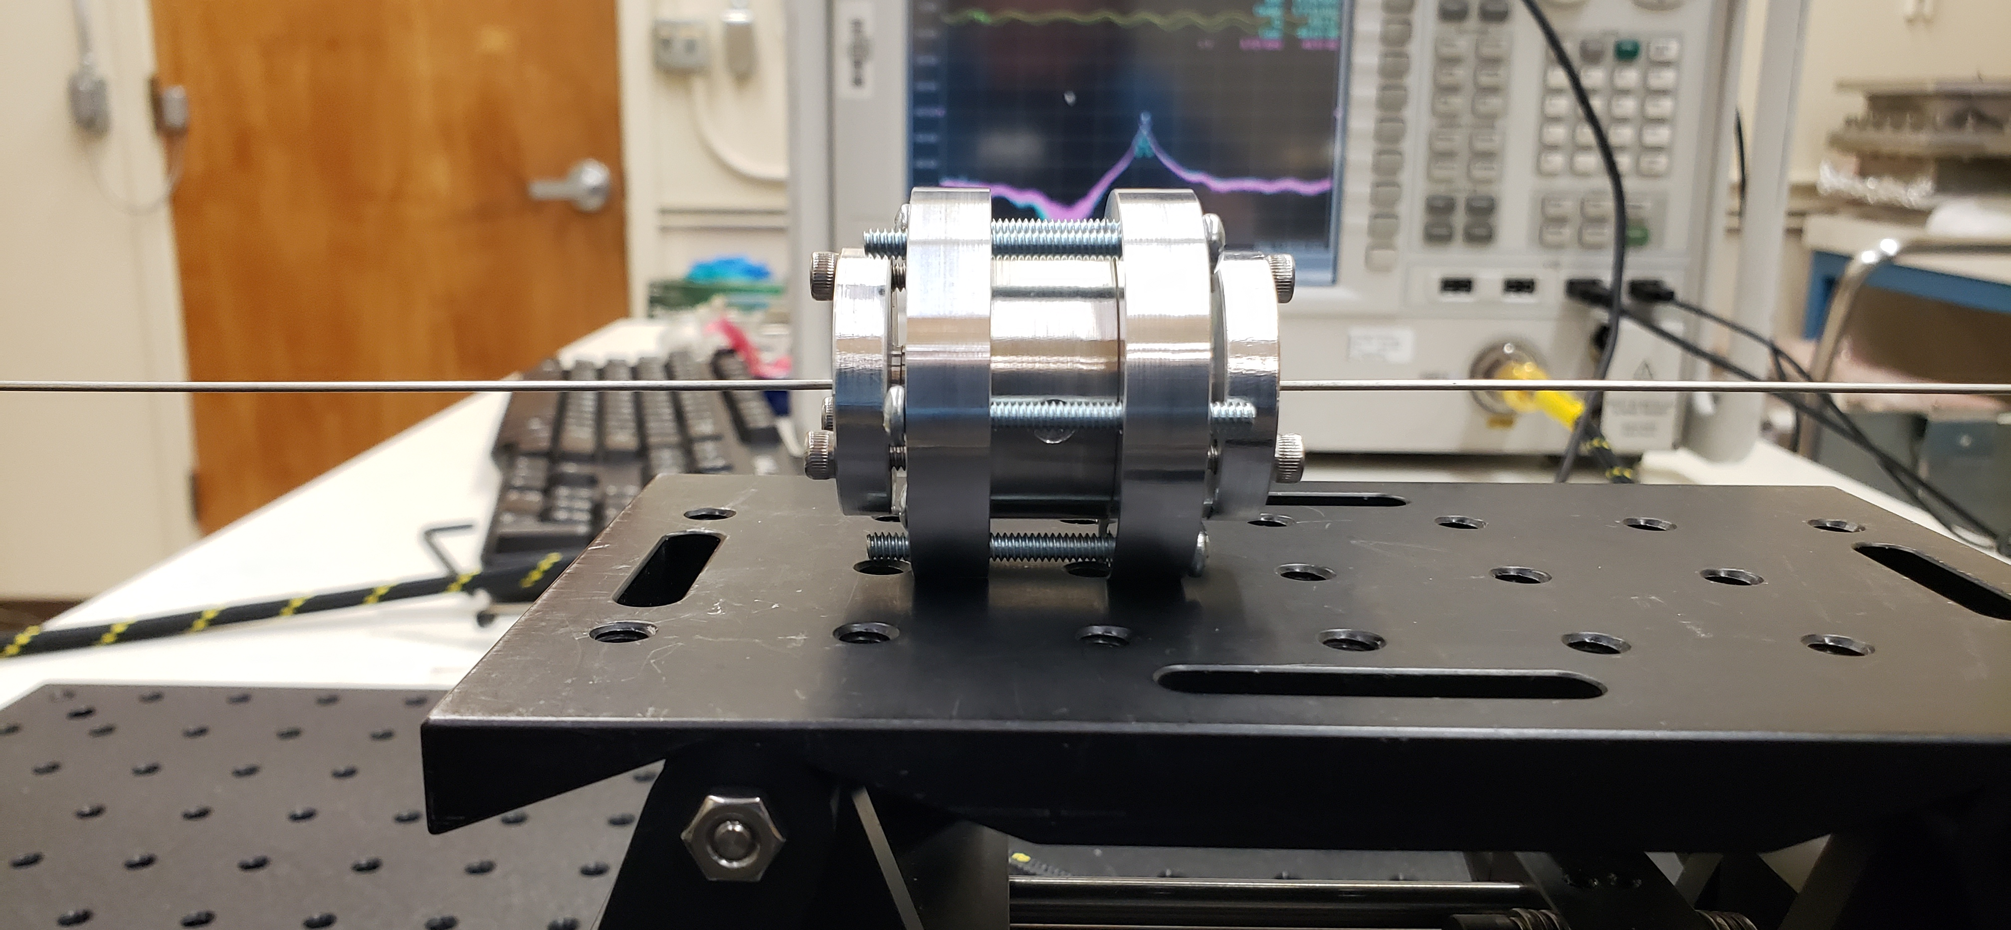
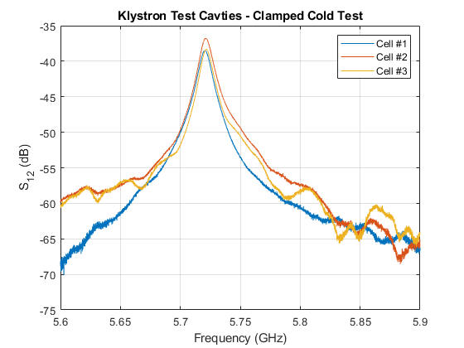
Cold Test – Clamped Test Cells
Preliminary clamped cold test of SST test cells
All cavities within ~1 MHz of each other
Next steps:
Understand tuning behavior
Post-braze cold test
Copper plated test and tune
Test Setup
Cell | Resonant Frequency (GHz)
Design | 5.6740
1 | 5.7206
2 | 5.7213
3 | 5.7218

Slide 21
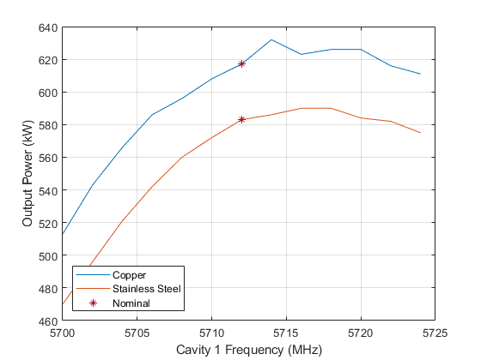
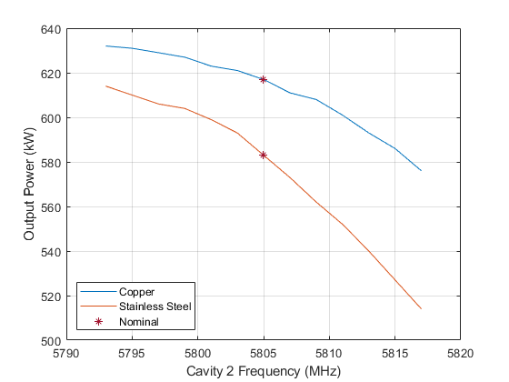
Sensitivity Test Cont.
Perturbation in tuning of first two cavities
Fixed drive power and frequency
All cavities copper (Q ~ 7000)
Can maintain peak power goal over wide bandwidth
Cavity 1 & 2 SST (Q ~ 1000) , cavity 3 & 4 copper
Greater wall losses, less overall gain

