Slide 1
C-Band Distributed Coupling Structure Design and Wakefield Damping
Zenghai Li, Sami Tantawi, Emilio Nani, Muhammad Shumail (SLAC)
Dongsung Kim, Evgenya I. Simakov (LANL)
LCWS2023 May 15-19 SLAC

Slide 2
Outline
Parallel feed scheme for linac structure design
High efficiency cell shapes for parallel feed linac
Parallel feed waveguide system design
Long-range wakefield damping
High efficiency, larger aperture 135 deg/cell parallel feed structure
Outlook

Slide 3
Parallel Feed Scheme Extends Parameter Space for Linc Structure Design
Parallel Feed Structure
Cells fed individually
Feed waveguide distribute power equally to each cell at180 deg phase difference
Scheme also apply to other phase advances to take advantage of higher shunt impedance
Advantages
Iris radius not dictated by cell-to-cell RF coupling
Cell shape can be optimized to achieve higher efficiency
Structure can be machine in two halves or quadrants
Structure tuning straight forward

Slide 4
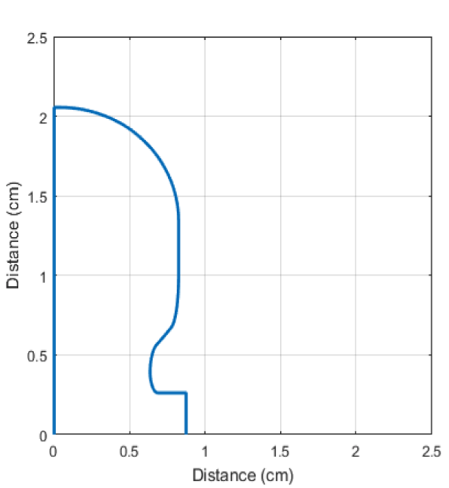
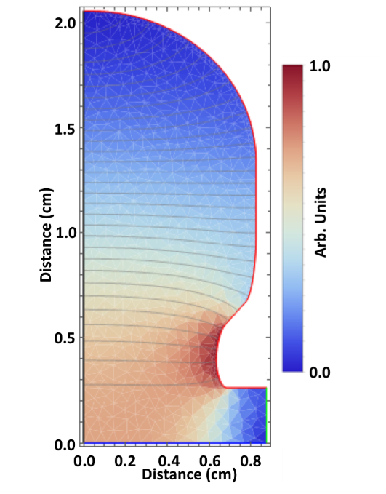
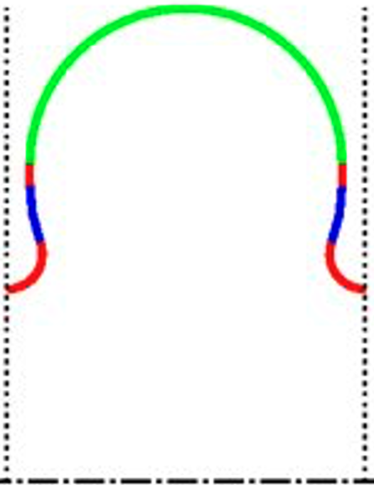
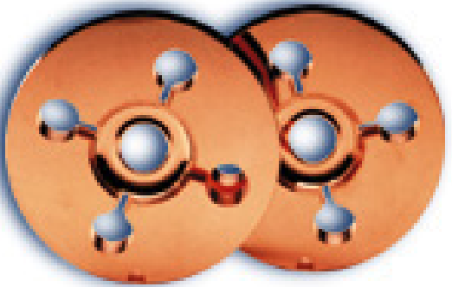
Flexible Cell Optimization to Achieve Higher Shunt Impedance
NLC X-Band structures shunt impedance (300K) : 98 MΩ/m
(iris radius: 4.75 mm)
C-Band Cell at Cryo-T shunt impedance (77K): 298 MΩ/m
180 deg/cell. Iris radius: 2.62 mm

Slide 5
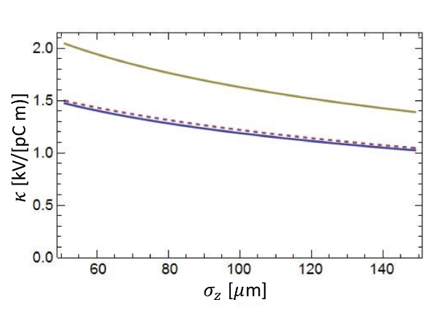
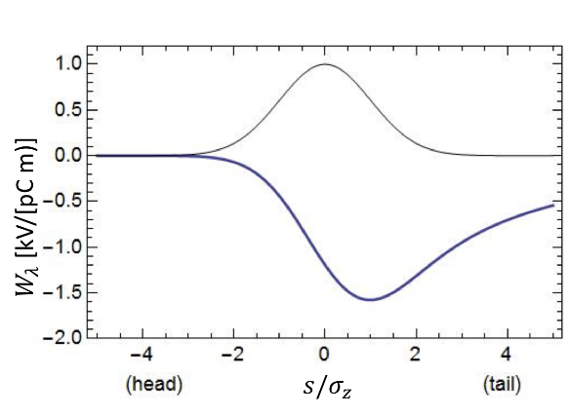
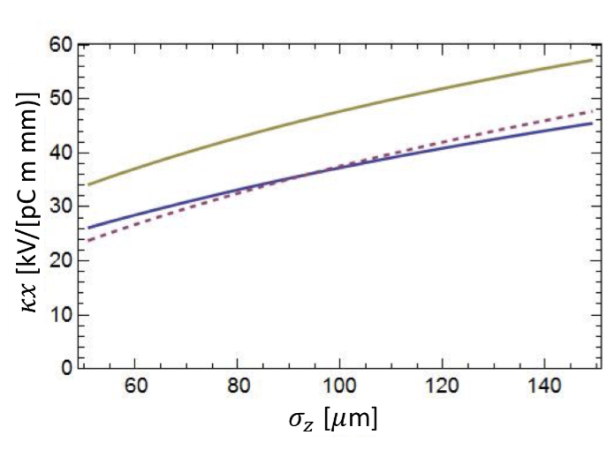
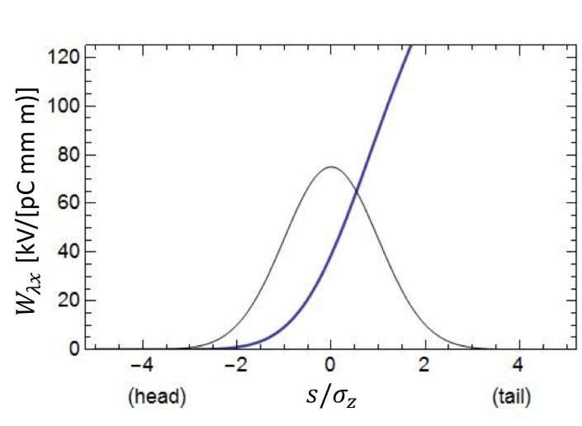
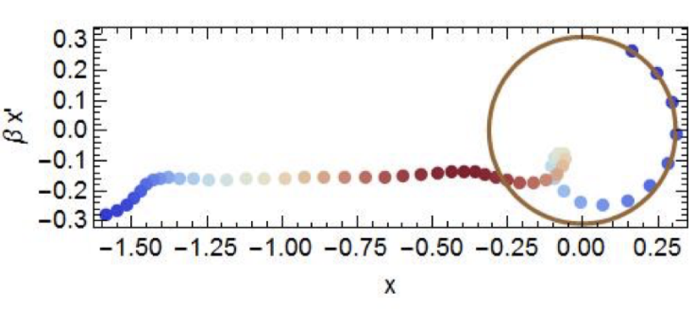
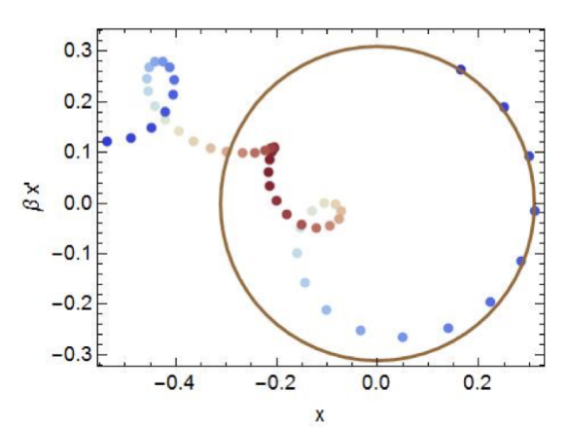
Short-range Wake Field Analysis – iris aperture for LC
Longitudinal Wakes
Transverse Wakes
Karl Bane
C-band, 𝑎⁄𝜆 = 0.05, 2𝜋/3 cavity, 1% BNS correlated energy spread, 𝛽x0 = 4 m: 𝜎z = 150 μm (left) and 𝜎z = 100 μm (right).
The projected emittance growth factors are 4.5 (left) and 0.76 (right).
Preliminary studies on single-bunch short range wakefields indicate that for the nominal charge of 1 nC and an operating gradient at or above 100 MeV/m, an iris aperture radius as small as 2.62 mm is tolerable
Assume an injection energy of 10 GeV with a 𝛽x0 = 4 m, and a final energy of 1 TeV with an increase in 𝛽~E^{1⁄2} , 100 𝜇m bunch length.
Larger iris aperture possible with 135 deg/cell to achieve the same shunt impedance
https://arxiv.org/pdf/1807.10195.pdf
Glen White, “C3 Main Linac Beam Dynamics”, May 17, 2023

Slide 6
Parallel Feed Uniform Power Distribution
A waveguide with equal power tap-offs to feed each individual cell
All input power goes to the feeds, no reflection back to input port
All tap-off junctions identical. Can be designed to power any number of cells
E field at mid-plane
TW
(Chris Nantista)
simulated scattering matrix
Input match better than -60 dB.
Normalized field amplitudes
(ohmic losses not included)
Phases
(180° phase alternation masked by port polarization vector definitions)

Slide 7
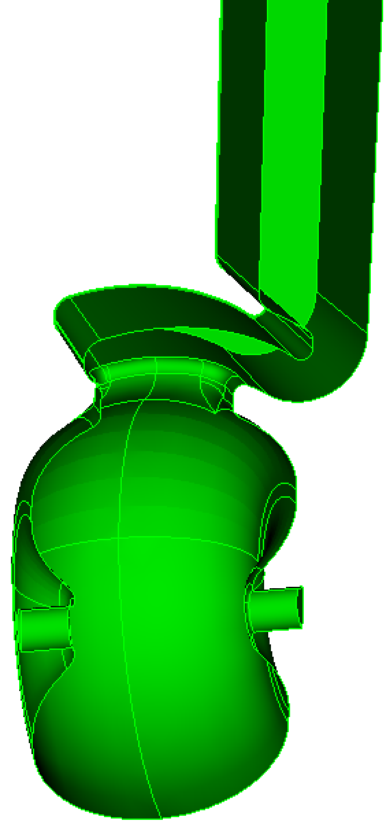
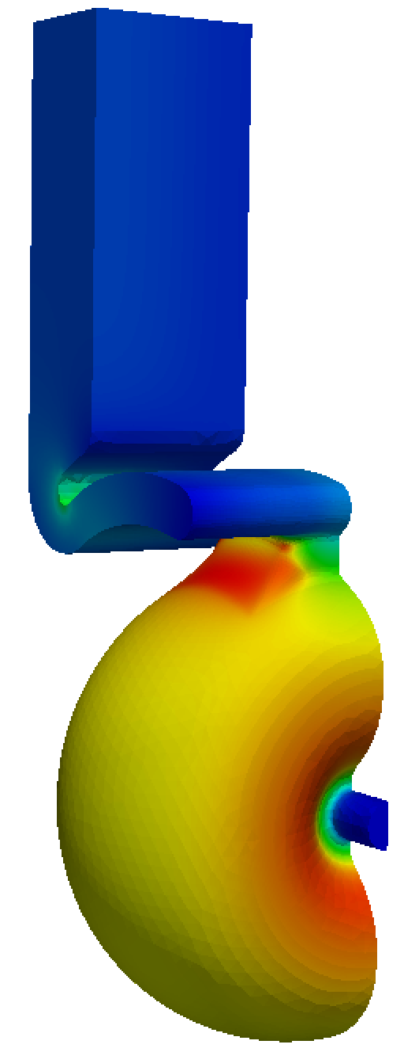
Modular Design Approach of Parallel Feed Structure
Two repeating elements
The T-junction
The cell and coupler

Slide 8
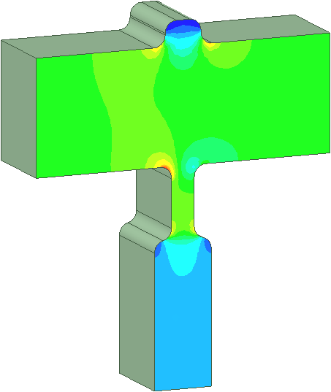
The Manifold Circuit
Each ½ manifold represents a shorted transmission line loaded with periodic ports.
input
3-port
(Chris Nantista)
We need to satisfy the following 3 conditions:
matched at input
power equally divided
π (180°) phase advance/port
The 3-port junction need to satisfy the following scattering matrix
3-port
S-matrix condition:
n=9

Slide 9
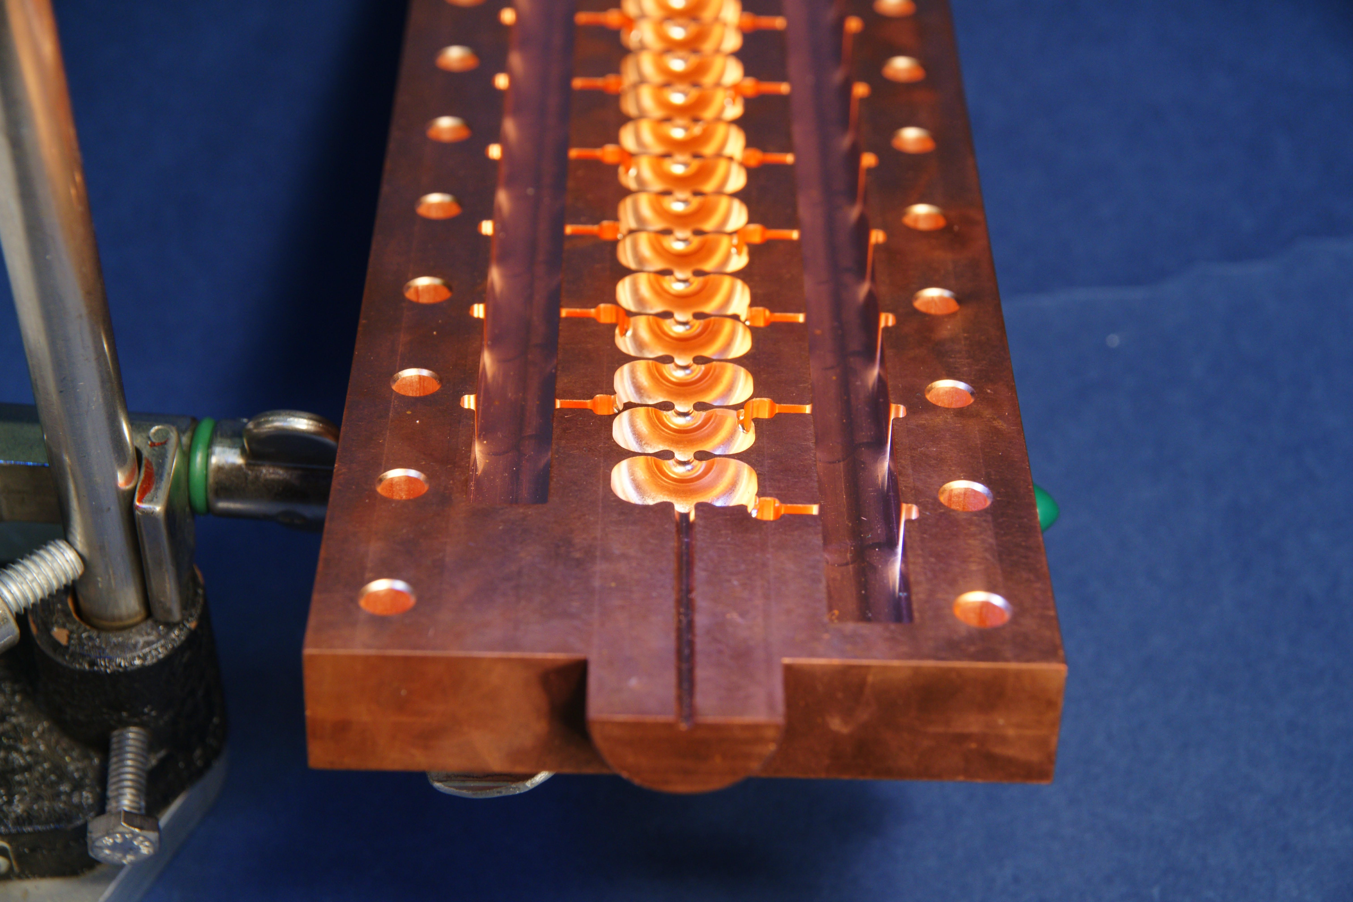
Novel Fabrication Approach with Reduced Cost
Machined in two halves

Slide 10
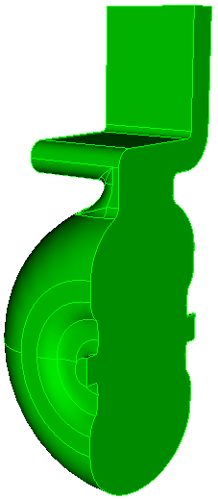
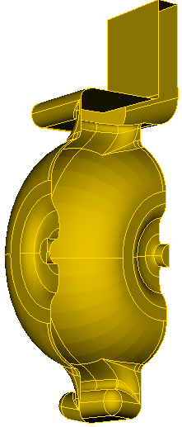
Field Quality - 3D Field Symmetrization to Minimize Coupler Effect
dipole, quad calculated at 50MV/m
Single side coupling induce significant dipole and quad fields
3D coupler symmetrized
Minimizes side effects of 3D acceleration fields
Minimizes electric center offset of HOMs
Dipole
Quad
w/o symmetrization
Dipole
Quad
with symm-stub
with symmetrization

Slide 11
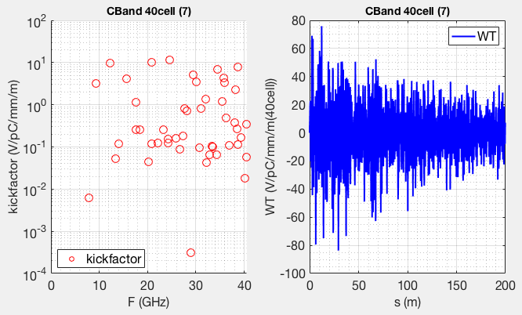
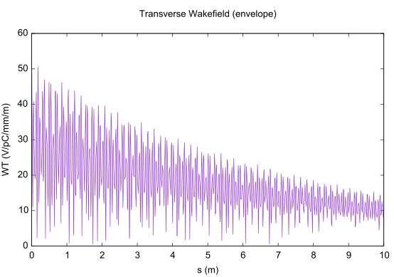
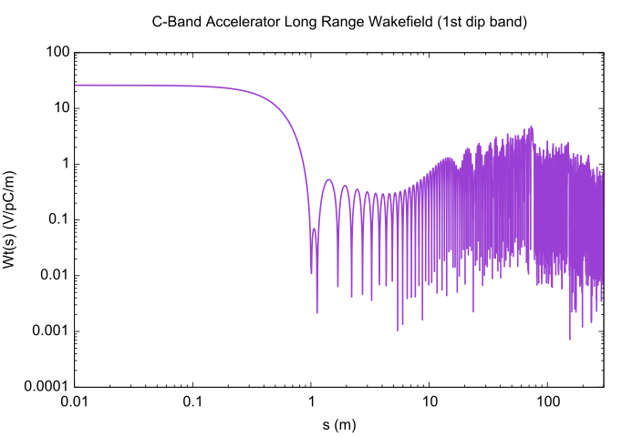
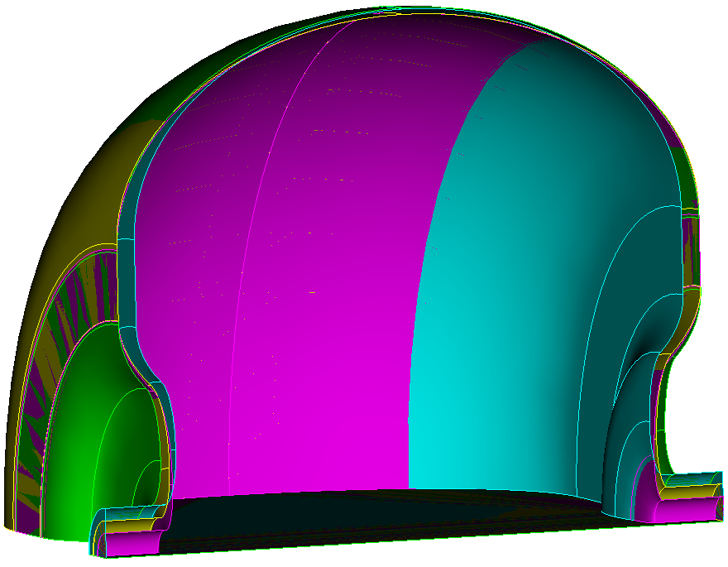
Long-range Wakefield Modeling and Suppression
Due to a smaller aperture, dipole modes up to ~40 GHz need to be included for long-range wakefield modeling
Both damping and detuning needed to suppress long-range wakefield
Dipole kickfactor of the CBand cell
Wakefield of 1-m structure of 40 identical cells
wakefield envelope without detuning
wakefield envelope with detuning

Slide 12
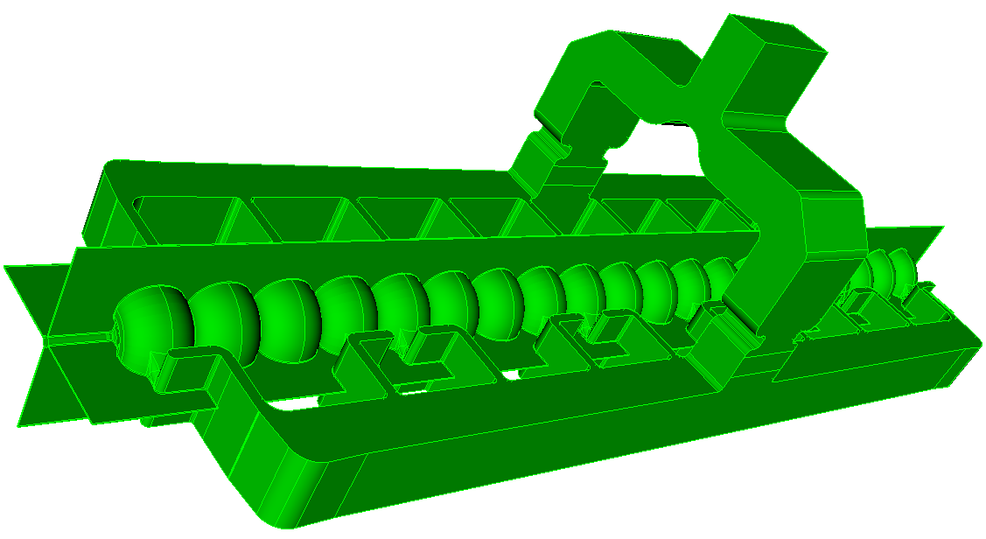
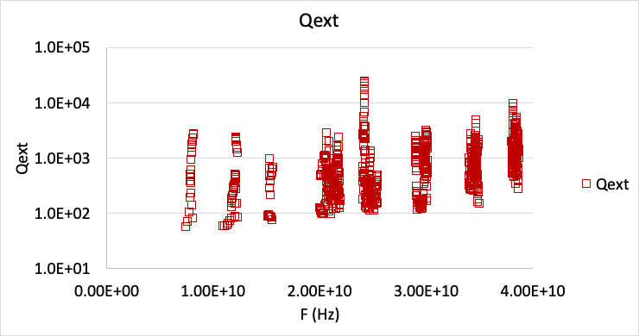
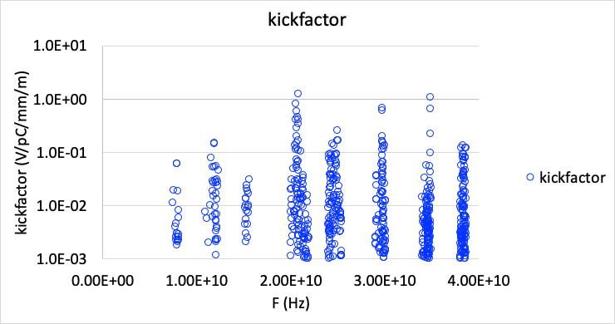
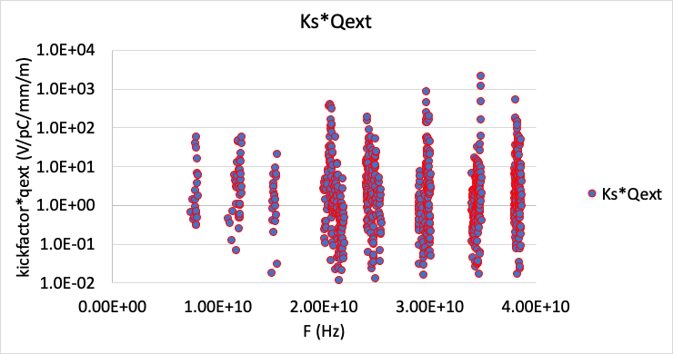
HOM Damping Using Radial Slots Cutting Through Cell Iris
Structure machined in two halves, or in quadrants with other more optimal phase advance
Naturally can use a gap between the two halves to extract HOM power
Additionally, add lossy surface in slot to absorb HOM power (sigma=5.8e4)

Slide 13
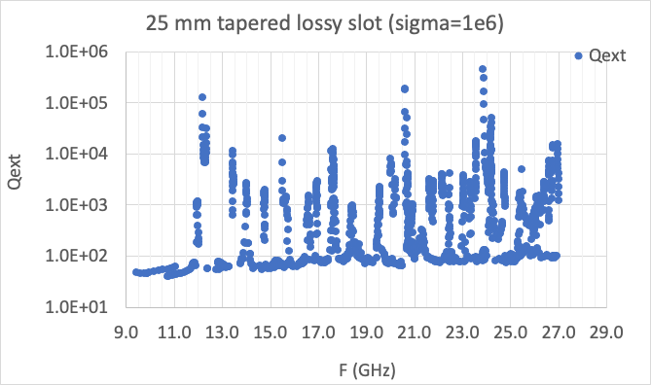
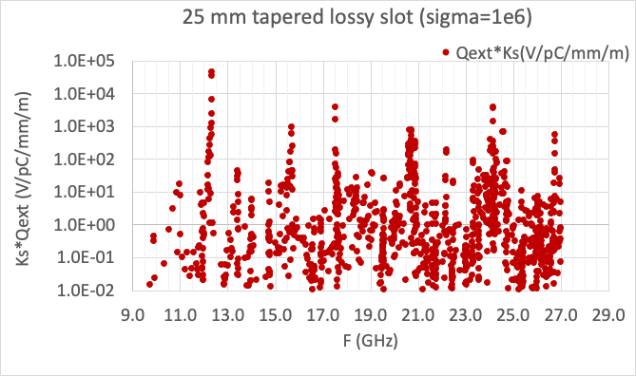
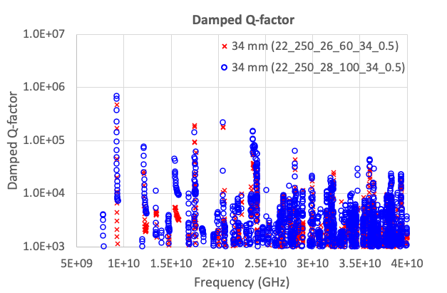
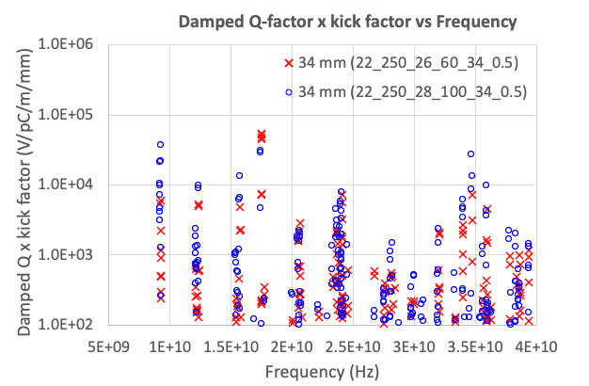
HOM Damping with Tapered Lossy Slot -
Slot surface conductivity (Ni-Cr) 1.0E+6 S/m
Tapered slot
Linear taper: slot height: from 300 micron to 100 micron
Non-linear taper
Optimization in progress
Need more studies in
Lossy materials at cold temperature (77K)
Coating or thin layers brazing on to structure

Slide 14
135 degree/cell design
Higher efficiency
Larger iris opening

Slide 15
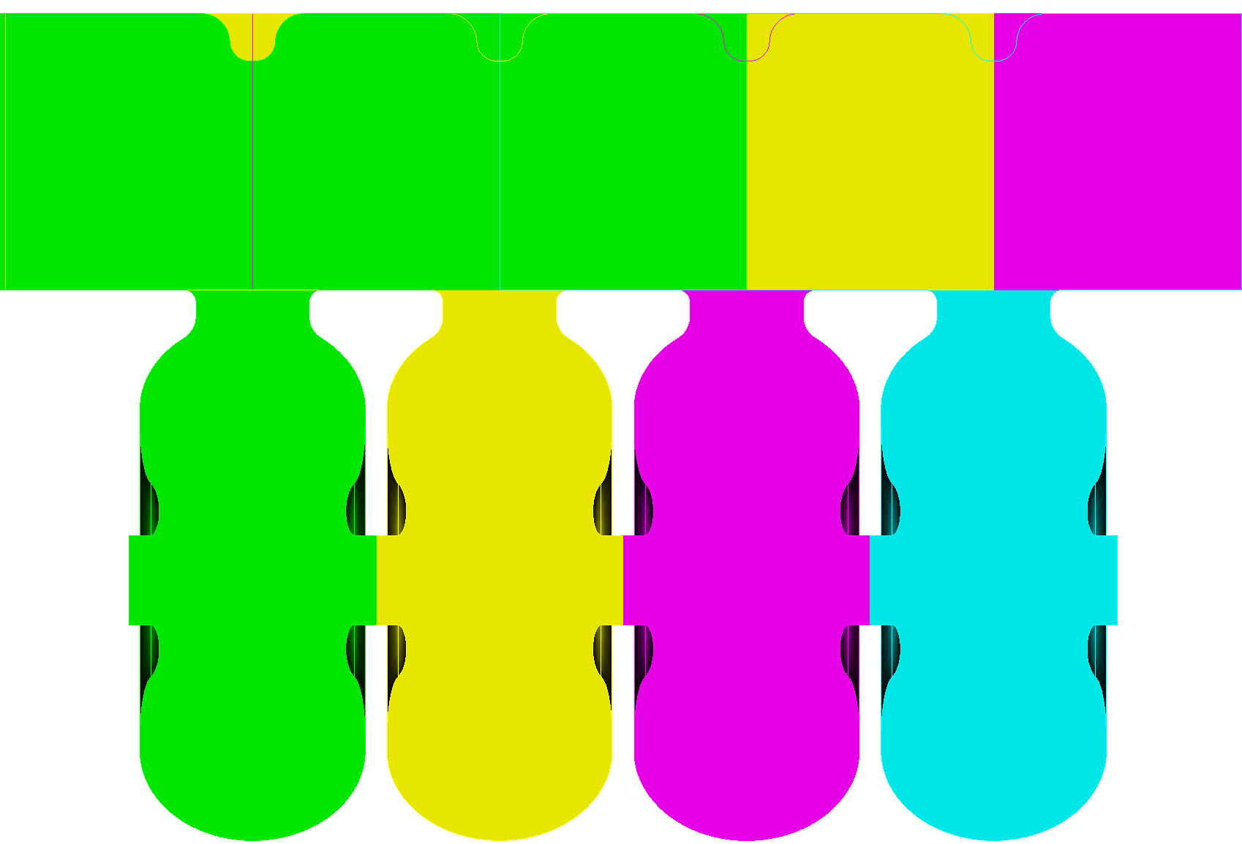
C-Band 135 deg/cell Structure
2m 104 cell Structure
Cell-to-cell phase advance: 135 deg
Cell length: 19.682 mm
Total number of cells: 104
Parallel feed waveguides: 4, feed at middle of structure
4 135-deg cells form a 360+180 deg section
each cell fed by a respective waveguide

Slide 16
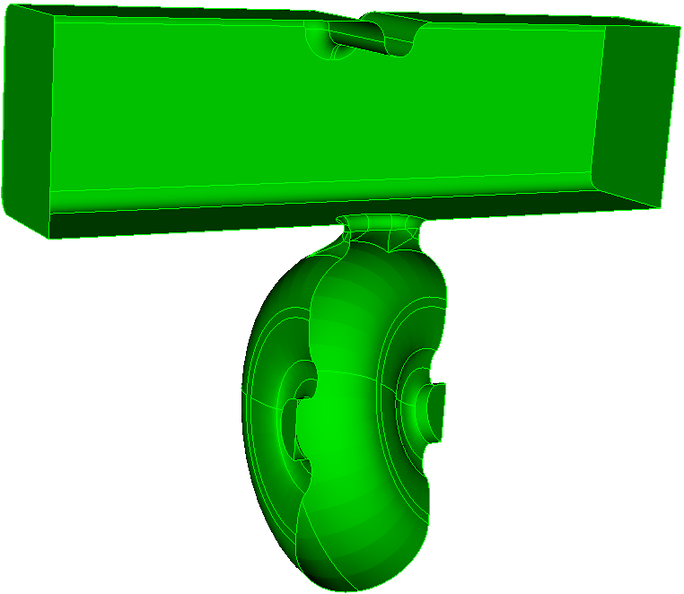
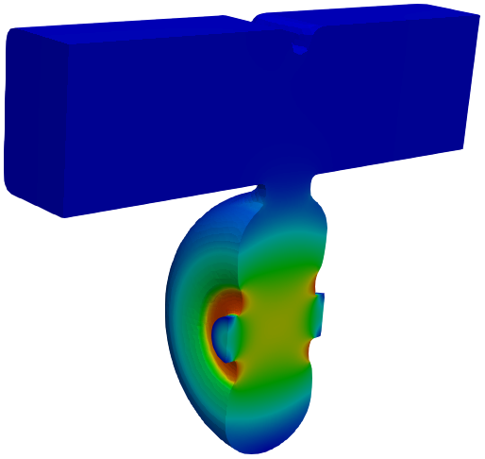
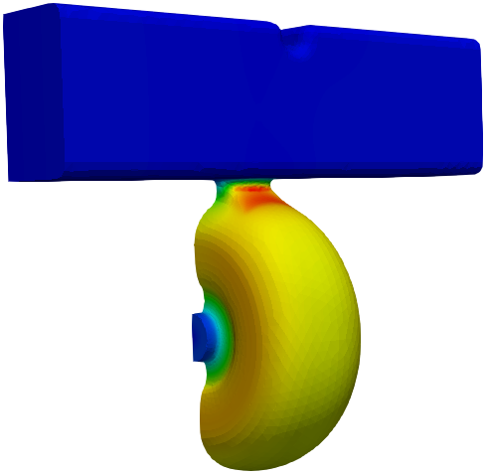
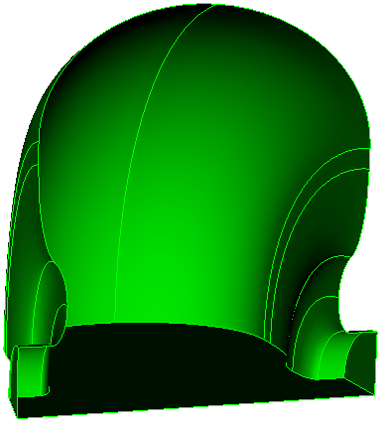
C-Band 135-deg Cell
Optimized to obtain the same shunt impedance as the 180 deg design
Iris aperture can be enlarged to 7.11 mm, as compared with the iris aperture of 5.25 mm for the 180 deg design
Relaxes structure alignment tolerance requirements
135-deg cell shape
single cell with parallel feed waveguide
E field
B field

Slide 17
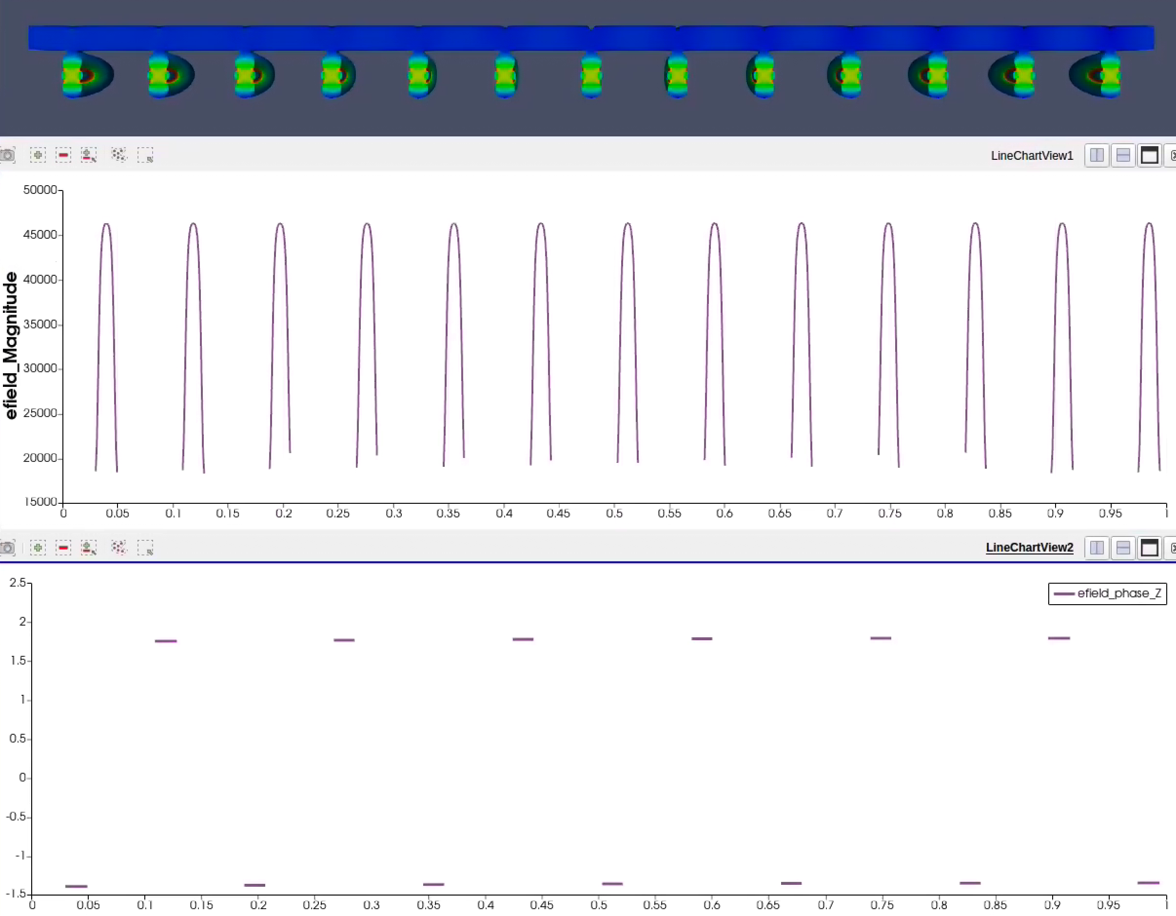
135 deg/cell Parallel Feed
RF power fed at the middle of the structure
RF phase between the cells is 180 degrees
Parallel waveguide feed 13 cells on either side of upstream and down stream
amplitude
RF phase: 180 deg between the cells

Slide 18
180 degree/cell vs 135 degree/cell
180 deg/cell, TWO parallel feeding waveguides, 40cell/meter
135 deg/cell, FOUR parallel feeding waveguides, 52cell/meter

Slide 19
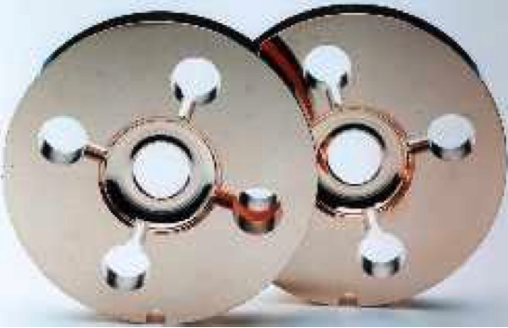
135/cell Structure – Possible Damping Scheme
Parallel feed waveguide acting as damping manifold
similar to NLC DDS structure
Narrow slot cutting through the iris couples the cells to waveguide
HOM calculation in progress
NLC RDDS
(illustration of damping)
HOM power extraction

Slide 20
Outlook
Structure optimization
180 deg/cell parallel feed
135 deg/cell parallel feed
Wakefield damping optimization, in collaboration with LANL (Evgenya I. Simakov, Dongsung Kim)
Damping slot optimization
Damping material studies

