Slide 1
C-band two-cell high-gradient RF cavity for high power HOM absorber testing
Haoran Xu, Dongsung Kim, and Evgenya I. Simakov
05/17/2023
LA-UR-23-25215

Slide 2
Higher-order modes damping
TM₀₁₀ fundamental mode at 5.712 GHz
Accelerator cell profile provided by SLAC and UCLA.
Goal: reduction of quality factor and transverse kick-factor of monopole and dipole modes from 5 to 40 GHz.
TM₁₁₀ first dipole mode at 9.245 GHz

Slide 3
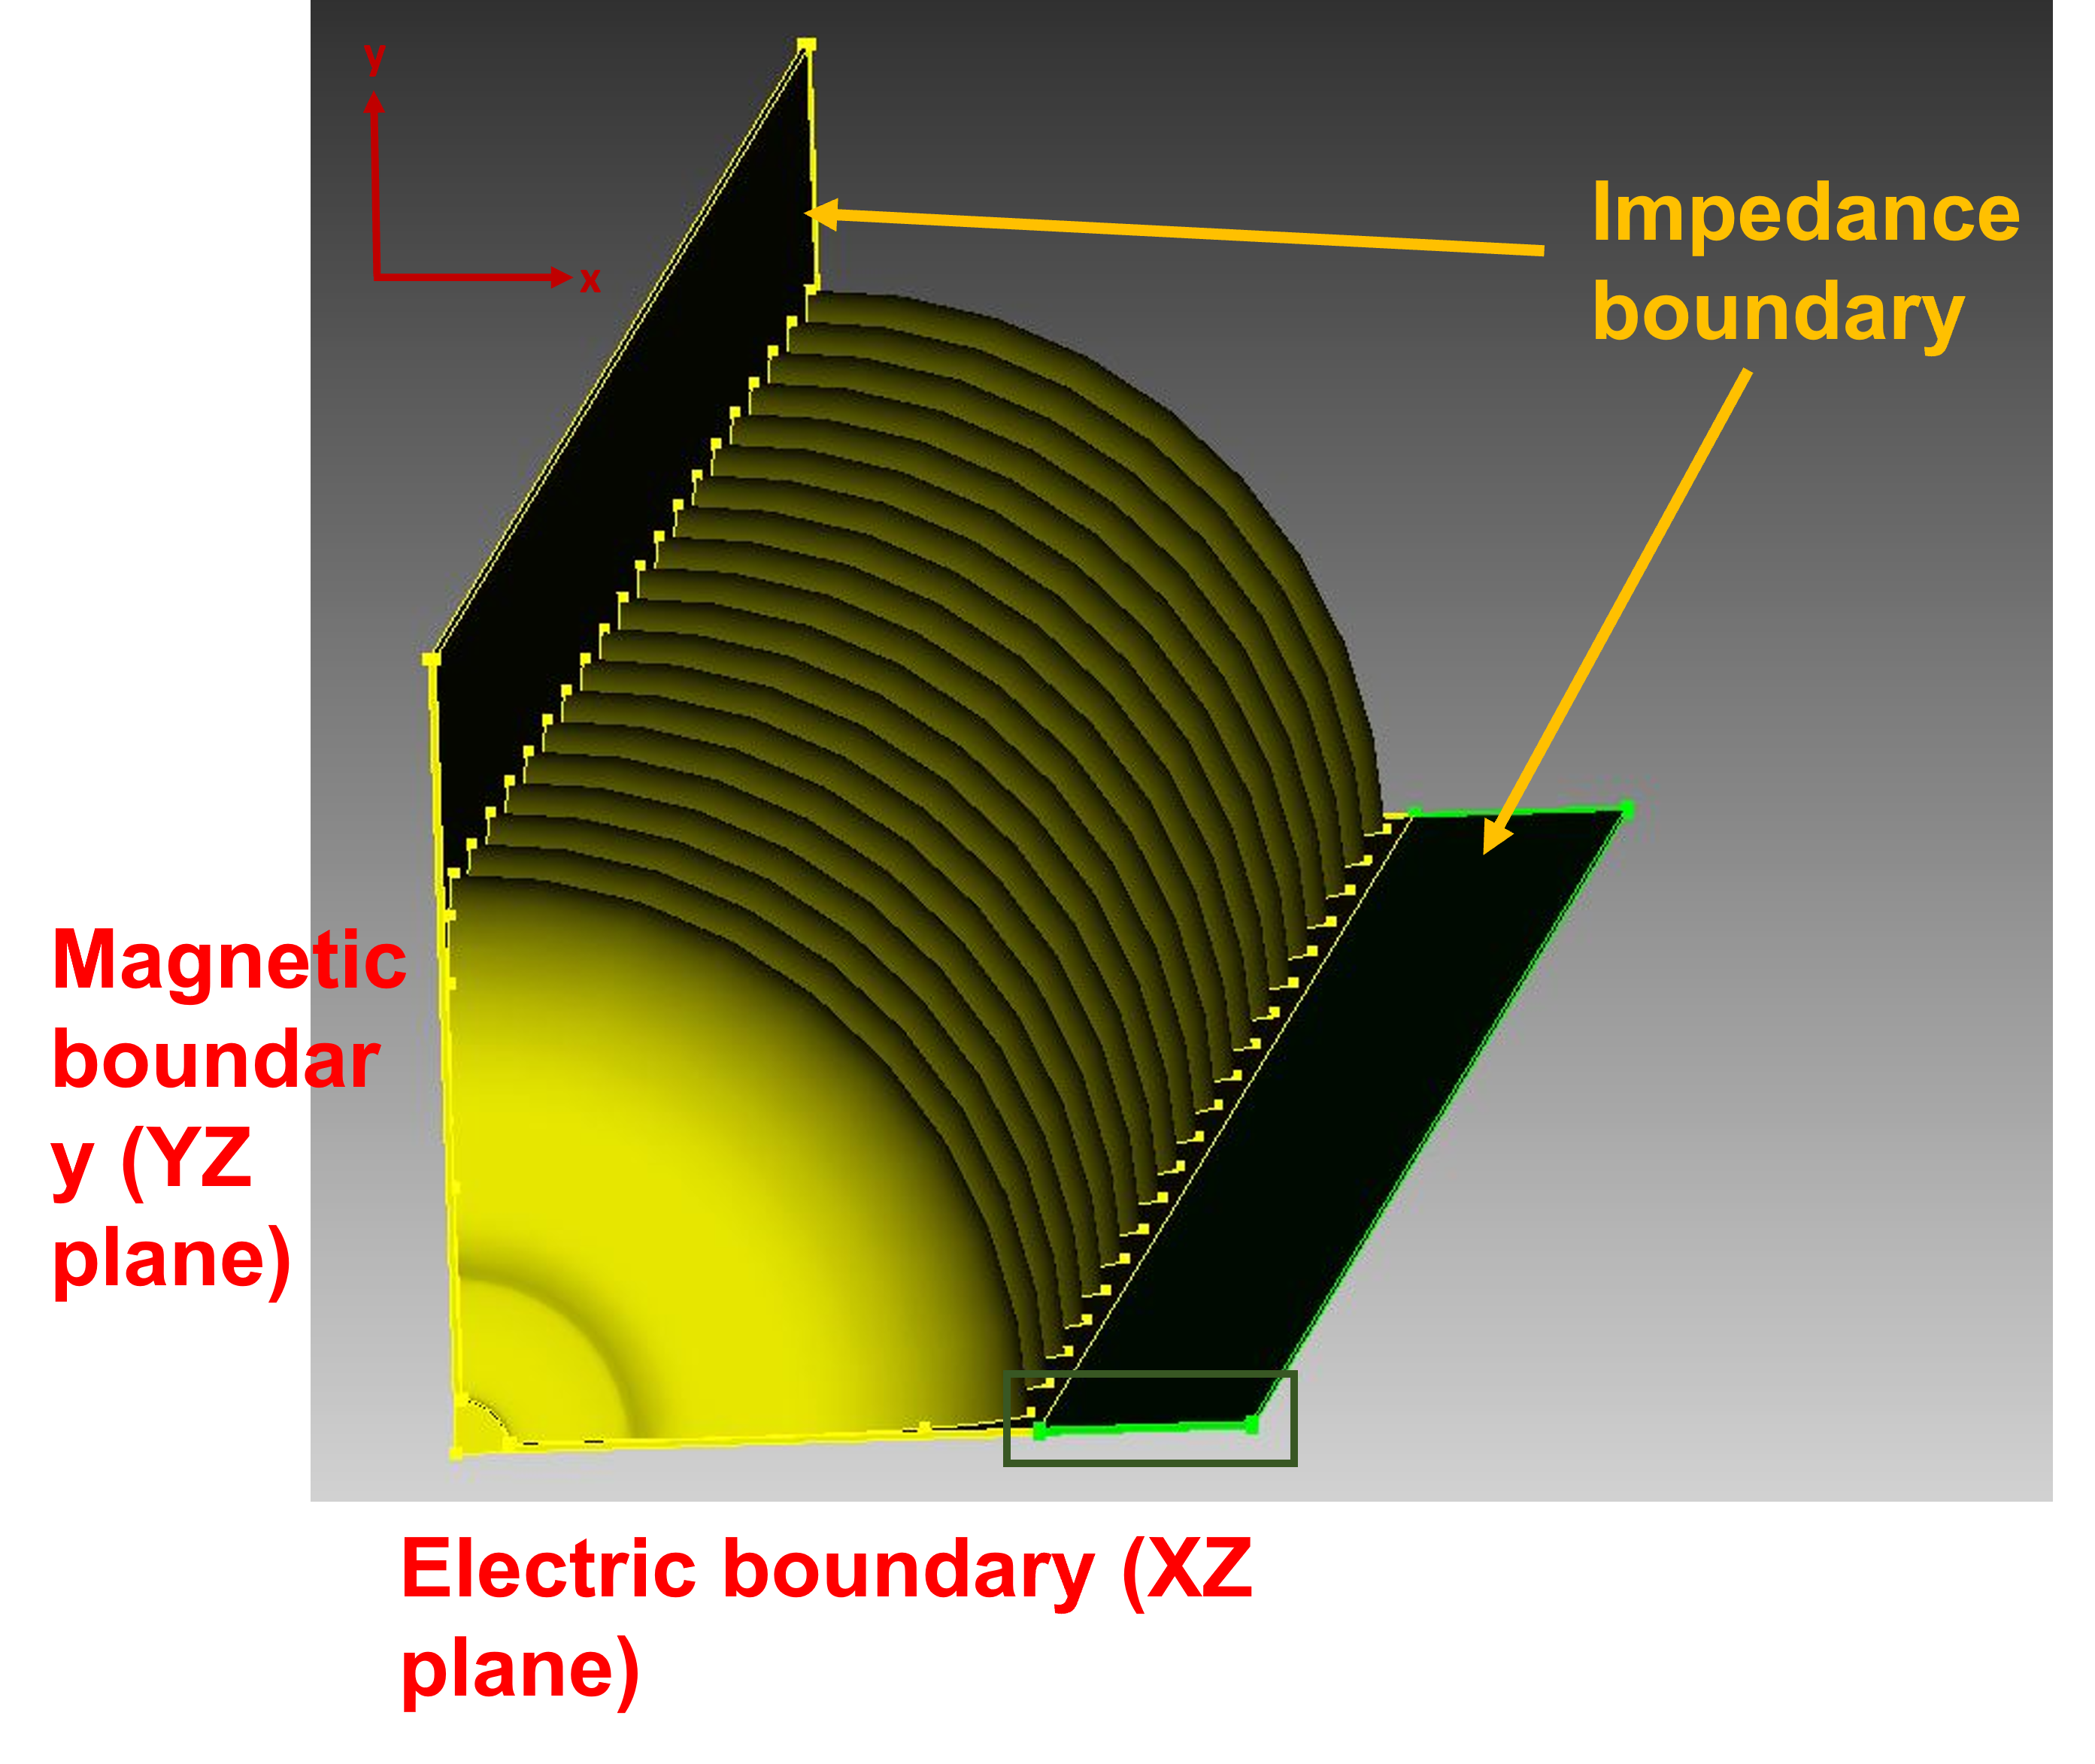
Higher-order modes damping
Design 1 – straight waveguide slot
Approach: HOM damping waveguides.
Damping load: NiCr or SiC coating layer.
20-cell studies in CST and Omega3P.
Length variation: 30-50 mm
Design 2 – one-section taper waveguide slot
copper background
L_wg
t_{in}
t_{out}
Design 3 – two-section taper waveguide slot
L_wg1
L_wg2
t₁
t₂
t₃

Slide 4
Higher-order modes damping study workflow
Single cell with periodic boundary
20-cell structure
STEP 1
CST
STEP 2
CST
STEP 3
CST / Omega3P
Find all monopole and dipole modes over 5 - 40 GHz.
Compute ohmic Q-factor, shunt impedance, kick-factor.
Add waveguide slots with lossy material coating layers.
Compute ohmic Q-factor, shunt impedance, kick-factor, for modes identified in STEP 1.
Compute Q-factor × kick-factor.
Setup waveguide slot with impedance boundary.
Compute ohmic Q-factor with damping, for modes identified in STEP 1.
Compute Q-factor × kick-factor.

Slide 5
Example: TM₁₁₀ mode damping
Undamped TM₁₁₀ mode (9.2 GHz).
Q factor: 18150
Q × transverse kick factor: 5.72×10⁴ V/pC/m/mm
Damped TM₁₁₀ mode in the individual cells of a 20-cell cavity.
With Design 1: straight waveguide slot.
SiC coating (1.0×10² S/m).

Slide 6
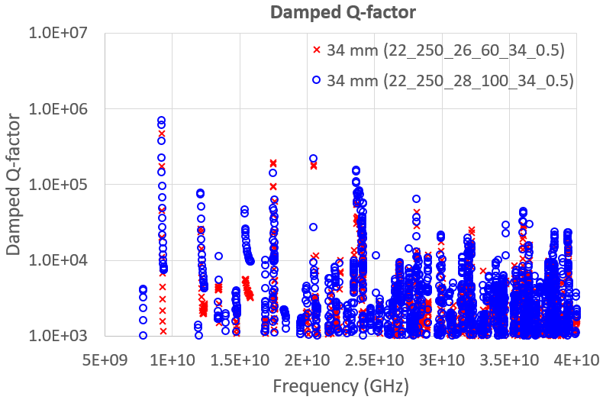
Current best-performing design
x₁ = 22 mm
x₂ = 26 mm
x₃ = 34 mm
L_wg1 = 4 mm
L_wg2 = 8 mm
Design 3 – two-section taper waveguide slot
NiCr coating (1.0×10⁶ S/m).
Optimization setup.
t₁ = 250 μm
t₂ = 60 μm
t₁ = 0.5 μm
Parameter | Value
Length of first w/g slot (L_wg1) | 2 to 8 mm
Length of second w/g slot (L_wg2) | 4 to 10 mm
Thickness of initial w/g (t₁) | 0.25 mm (constant)
Thickness of 1st tapered (t₂) | 20, 40, 60, 80 and 100 μm
Thickness of 2nd tapered (t₃) | 0.5 μm

Slide 7
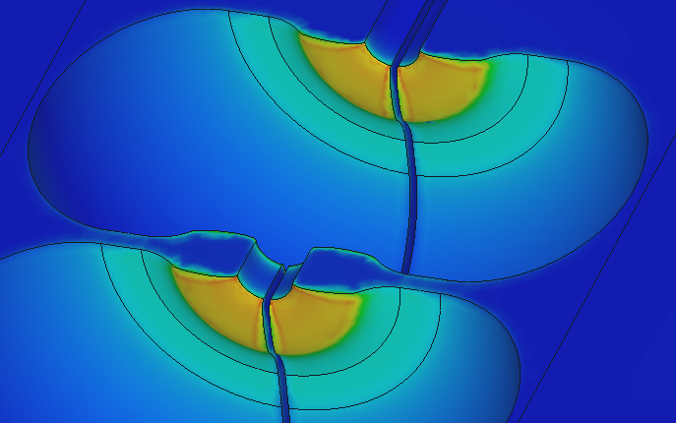
HOM absorber high power test
NiCr (1.0×10⁶ S/m) coating layers.
RF design verification at high accelerating gradient (~100 MV/m)
Breakdown test
Multipactor detection
Absorber performance vs. breakdowns.
Damage examination
|E| plot
peak field
(arb. units)
1
field in gap
0

Slide 8
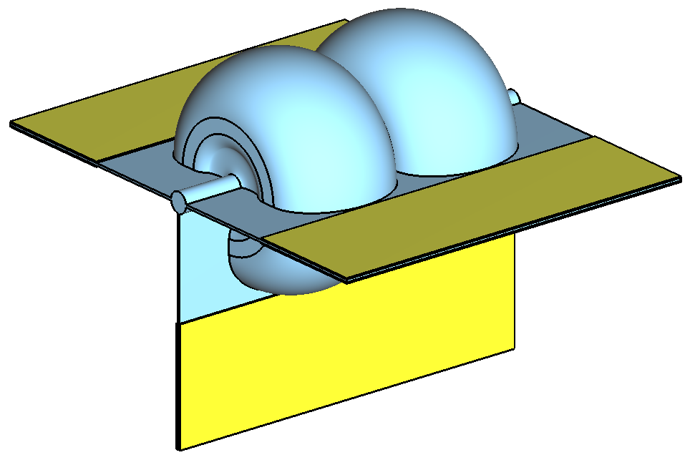
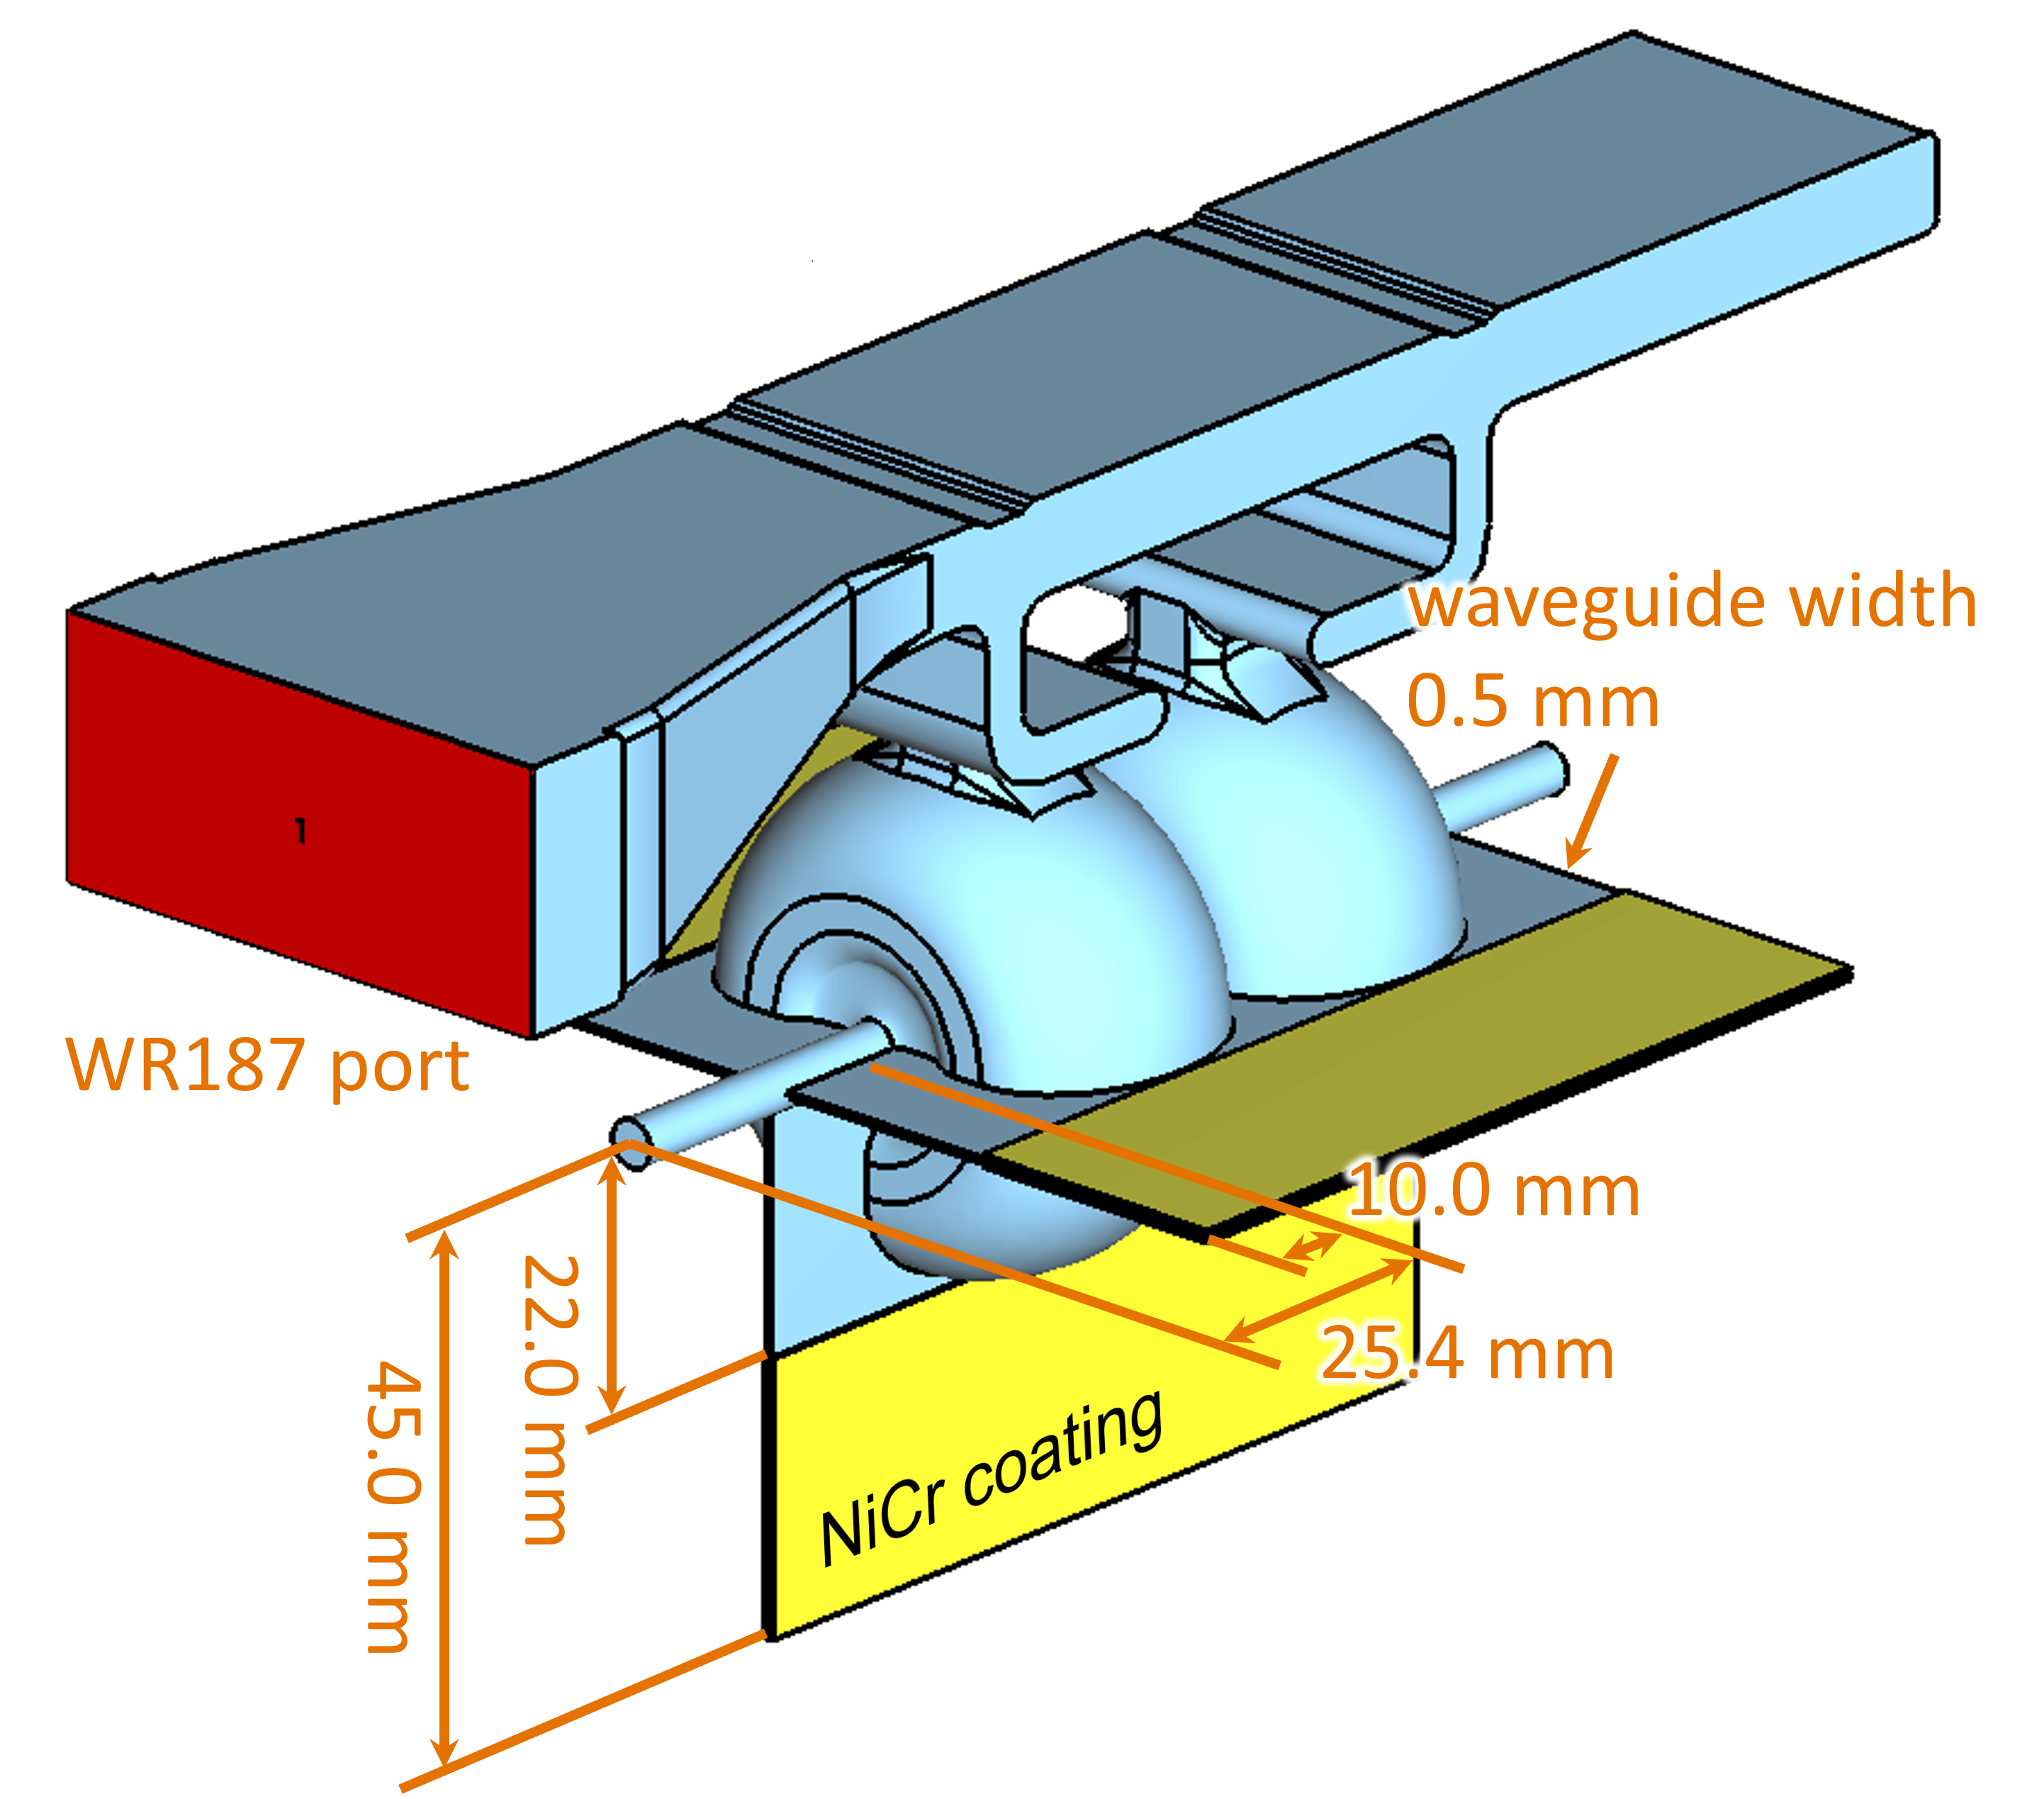
Two-cell cavity design
π-mode operation, critical coupling.
HOM damping: straight waveguide slot.
HOM damping optimization.
Waveguide longitudinal extension length
Waveguide transverse sizes
Eigenmode optimization result: 34 mm & 50 mm
Finalized dimension: 45 mm
NiCr coating

Slide 9
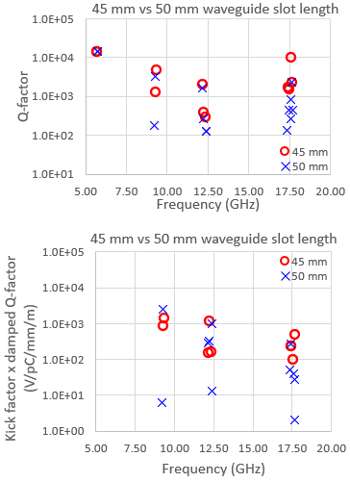
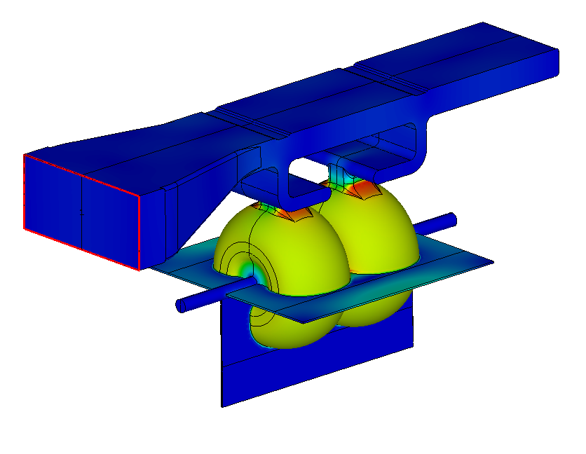
HOM damping waveguide transverse dimension
Two-cell HOM simulation results
Providing maximal damping of HOM.
Rejecting additional parasitic modes introduced by the HOM damping waveguides.
(arb. units)
1
0
unwanted waveguide mode
22.0 mm
34.0 mm
Q_{0, NiCr-coated} = 10721
Q_{0, uncoated} = 13152

Slide 10
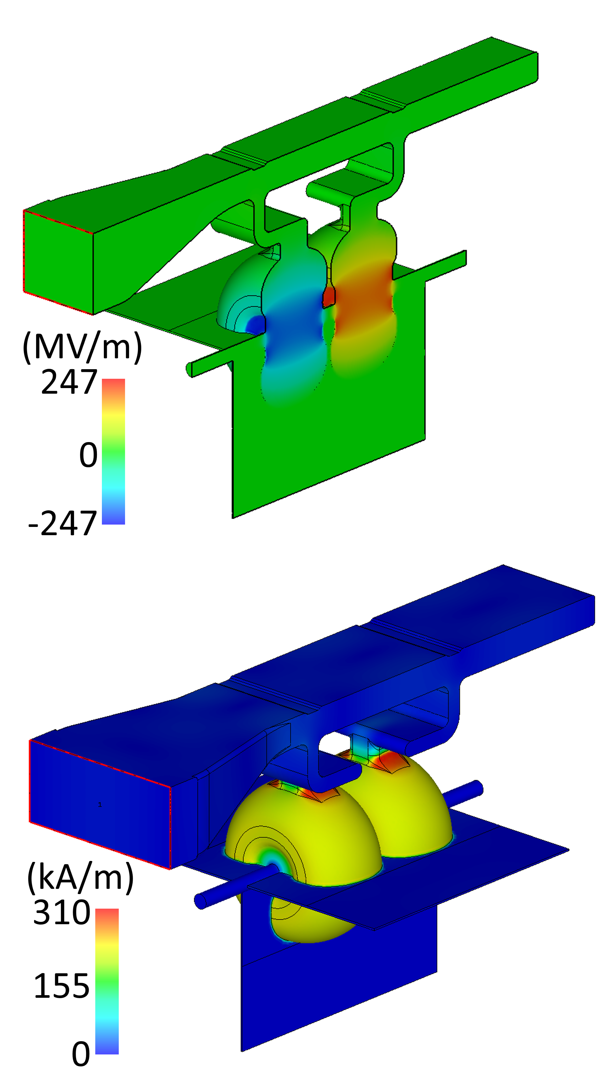
Two-cell cavity RF analysis
100-MV/m accelerating gradient.
Design parameters
Operating frequency f₀ | 5.712 GHz
unit cell shunt impedance r_{sh} | 118 MΩ/m
unloaded quality factor Q₀ | 13500
unloaded quality factor, no absorber Q_{0, uncoated} | 13525
Cavity coupling factor β | 1.00
RF power for 100-MV/m gradient | 4.4 MW
NiCr loss for 100-MV/m gradient | 2.5 kW
NiCr average loss for 100-MV/m gradient, 1-μs pluse length, 100 Hz repetition rate | 0.25 W
NiCr electrical conductivity | 1.0×10⁶ S/m

Slide 11
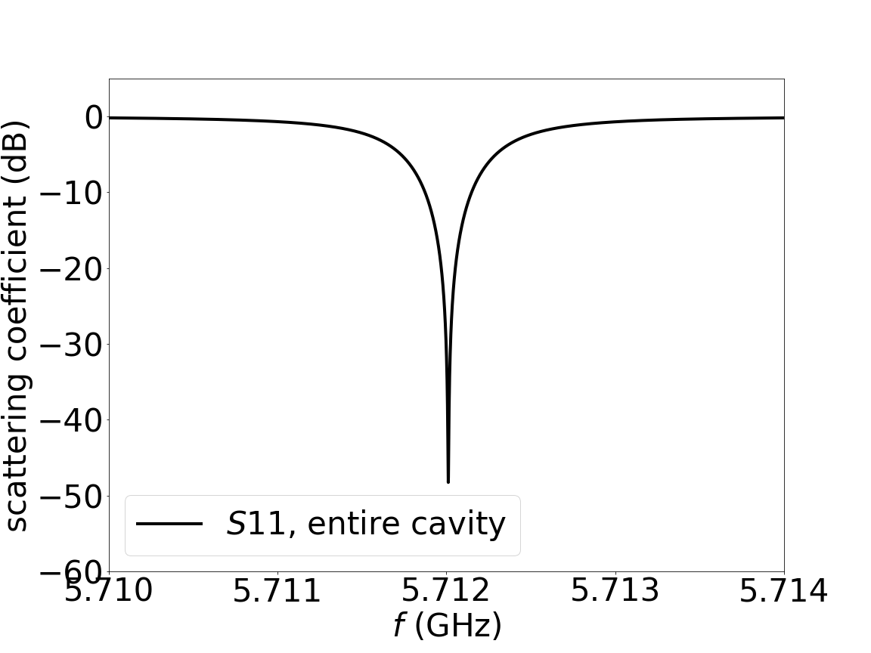
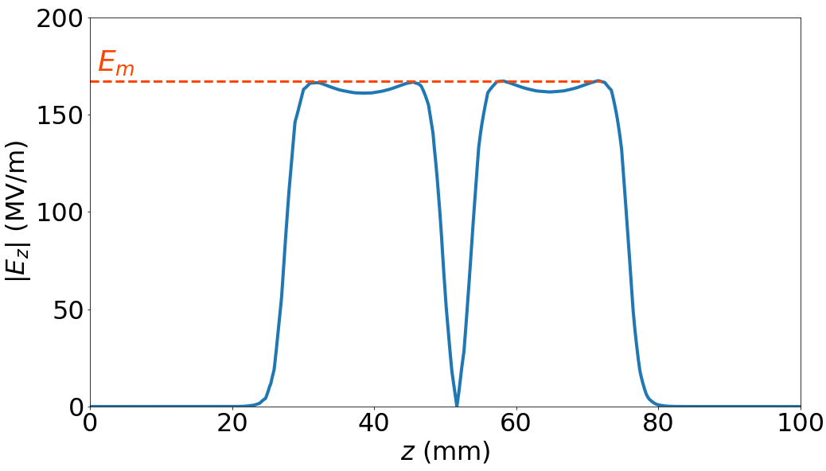
Two-cell cavity RF analysis
Local peak E-field normalized to E_{m}.
Local peak H-field normalized to (E_{m}/Z₀).
Z₀ = 377 Ω.
Electric field local peak values
Cavity overall | 1.48
Coupling slot | 0.28
Waveguide | 0.086
Magnetic field local peak values
Coupling slot | 0.70
Waveguide | 0.075

Slide 12
Two-cell cavity HOM damping
NiCr (1.0×10⁶ S/m) coating layers
HOM E-field magnitude distributions –

Slide 13
Fabrication and challenges
OFHC copper cavity fabricated in quadrants, coated with NiCr layers, and then brazed together.
Tuner design for quadrants.
Machining tolerance sensitivity.
0.001-inch increase of the elliptical cell profile minor radius results in 5-MHz reduction in the cell resonant frequency.

Slide 14
Acknowledgments
Work supported by the U.S. Department of Energy, under Contract No. 89233218CNA000001

