Slide 1

C-band RF photoinjector cavity for testing photocathodes under extreme fields
Haoran Xu, Petr M. Anisimov, and Evgenya I. Simakov
05/17/2023
LA-UR-23-25213

Slide 2
CARIE: CAthodes and Rf Interactions In Extremes
Project funded by the U.S. DOE through the Laboratory Directed Research and Development (LDRD) program at Los Alamos National Laboratory (LANL).
Motivation
  To meet National Security mission needs of compact accelerator facilities, e.g., X-ray sources, for material science studies.
Goal
  To build a C-band cryo-cooled photoinjector study facility
  To study photocathodes that operate at an electric field in excess of 100 MV/m

Slide 3
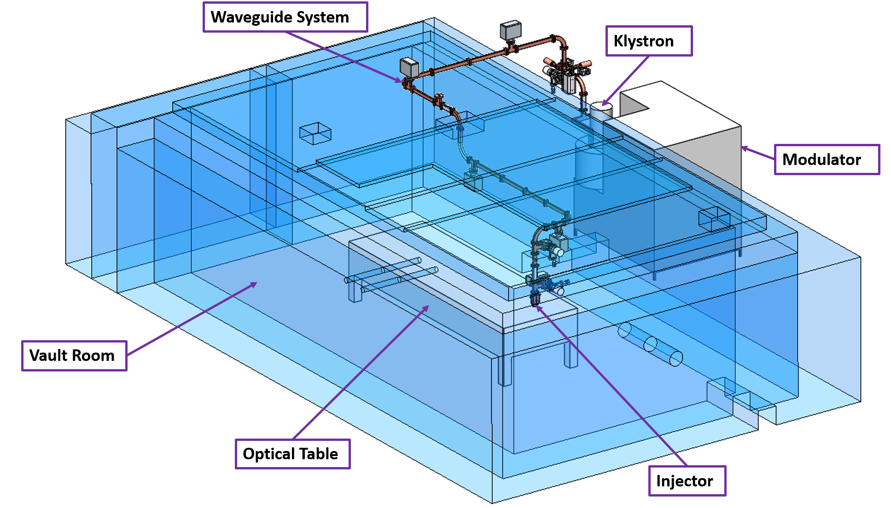
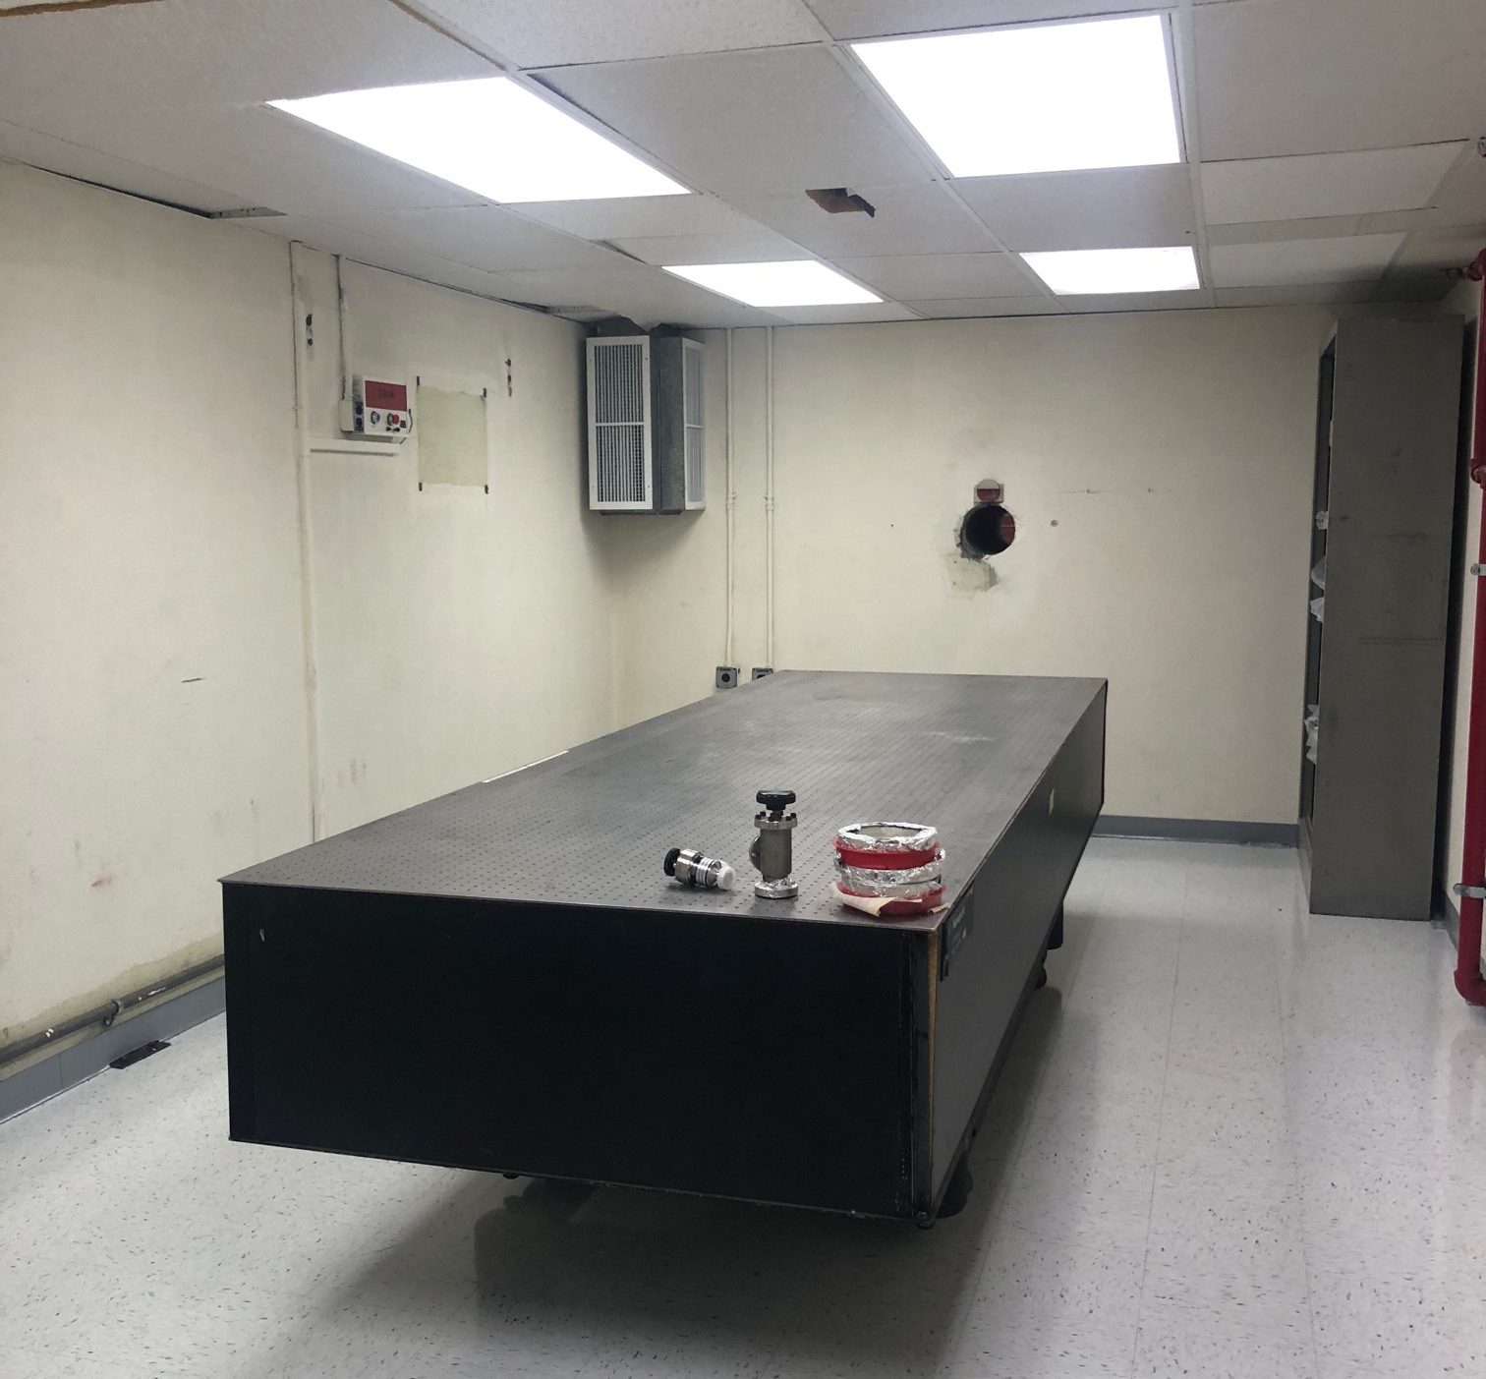
CARIE facility development
50-MW C-band klystron to be installed this year.
Accelerator vault accommodating average electron beam power up to 20 kW.
Co-located with the Applied Cathode Enhancement and Robustness Technologies (ACERT) facility.

Slide 4
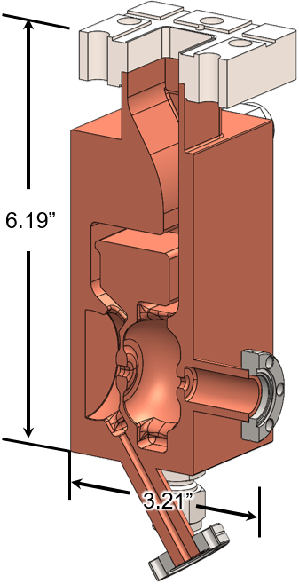
CARIE photoinjector RF cavity
Accelerator cell profile provided by SLAC and UCLA.
First high power test: at room temperature, without the cathode plug.
  Goal: to verify the high-gradient performance of the RF design.
  Fabrication in progress.

Slide 5
CARIE photoinjector RF cavity
Design parameters
Operating frequency f₀ | 5.712 GHz
Cathode cell length l_{cath} / ½λ₀ | 0.6
Full cell length l_{full} / ½λ₀ | 1.0
Full cell shunt impedance R_{sh} (r_{sh}) | 3.09 MΩ (118 MΩ/m)
Cathode cell unloaded quality factor Q_{0,cath} | 14695
Full cell unloaded quality factor Q_{0,full} | 13603
Entire-cavity unloaded quality factor Q_{0,cav} | 14170
Cavity coupling factor β | 1.00
RF power for 100-MV/m cathode field | 1.4 MW
RF power for 240-MV/m cathode field | 8.0 MW

Slide 6
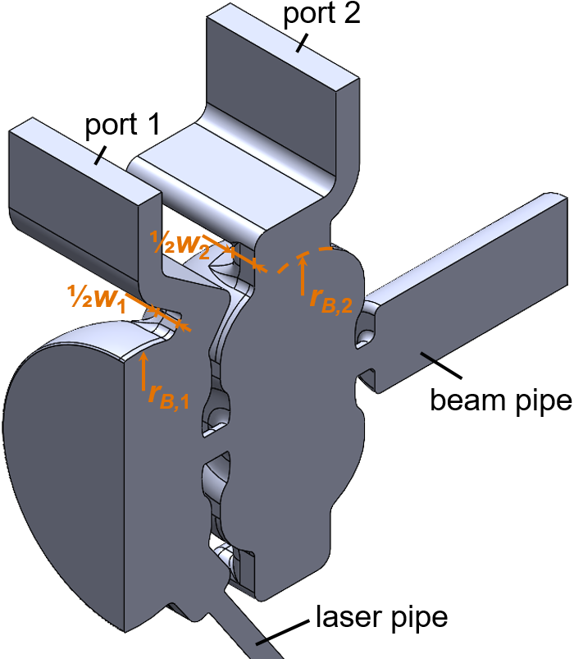
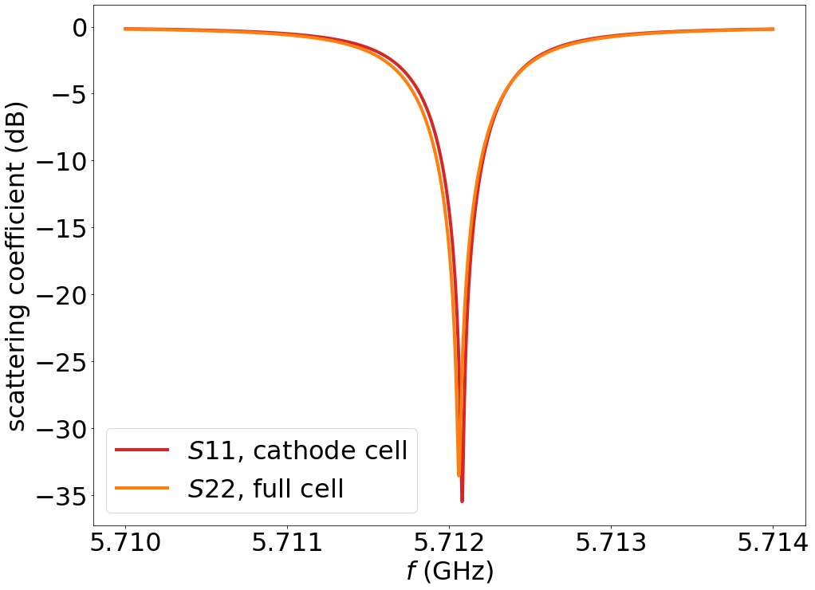
Individual cells
Goal: both cells on critical coupling, at 5.712 GHz.
Resonant frequency tuning by the elliptical cell profile minor radii (r_{B,1} and r_{B,2}).
On-resonance coupling tuning by the slot widths (w₁ and w₂).
Oversized beam pipe: accommodating the beam transverse dimension variation.

Slide 7
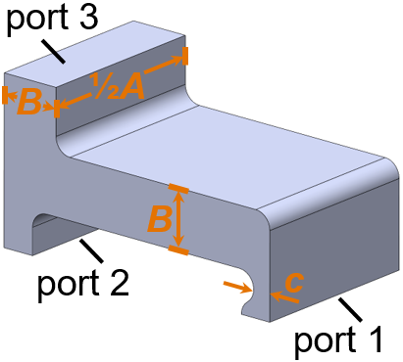
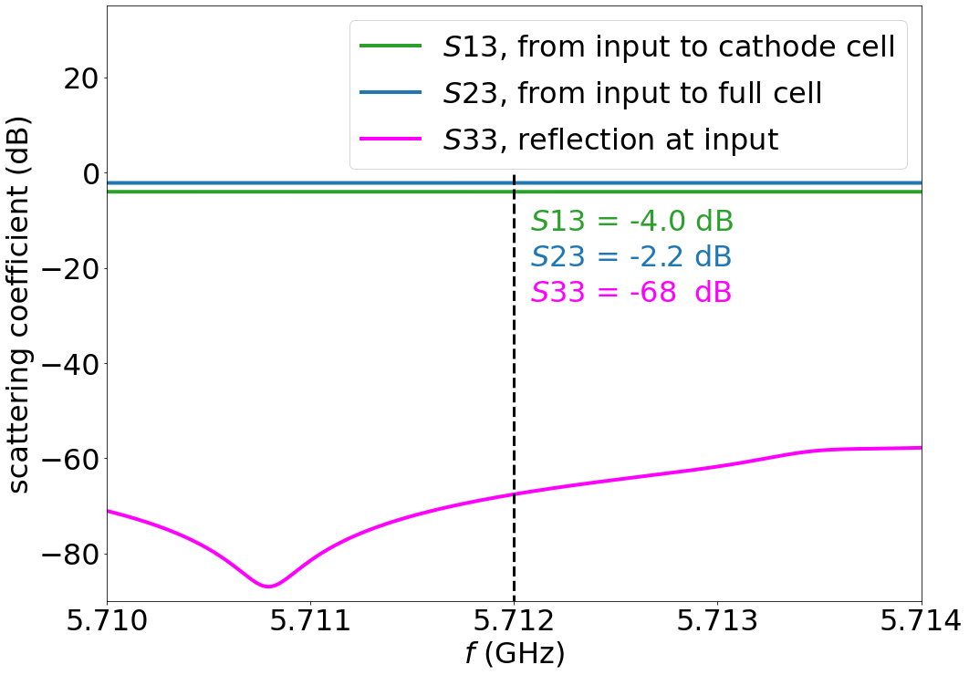
Waveguide splitter
Goals
  To ensure that the peak electric fields in the individual cells are identical.
  To minimize the power reflection at the input.
Power split tuning by the choke size (c).
Phase delay tuning by dimension A.
Reflection tuning by dimension A and B.

Slide 8
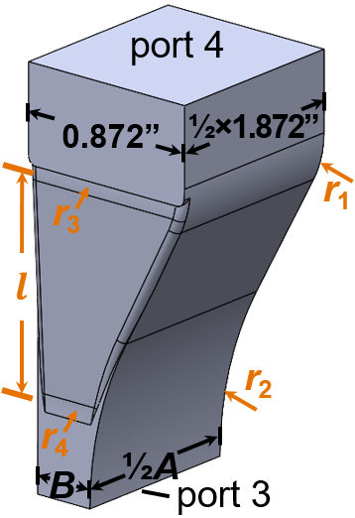
Waveguide horn taper
Goals
  To adapt the waveguide with dimensions A and B to the standard WR187 port.
  To minimize reflection of input power, at 5.712 GHz.
CST Frequency Domain Solver optimizer
  4X fillet radius.
  Taper section length.
  < -60 dB reflection attained.

Slide 9
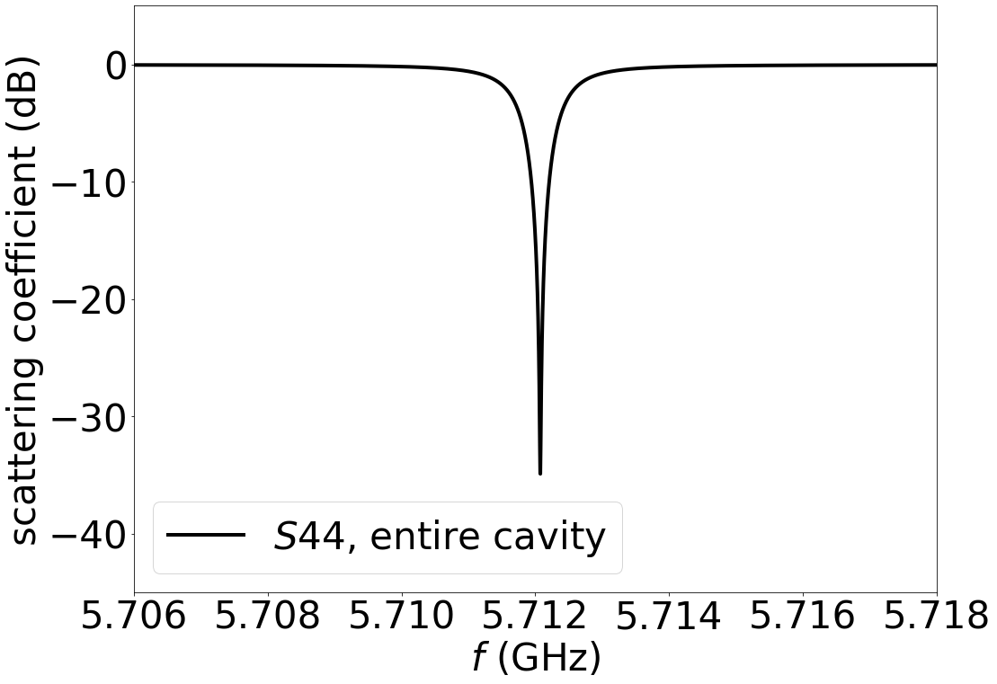
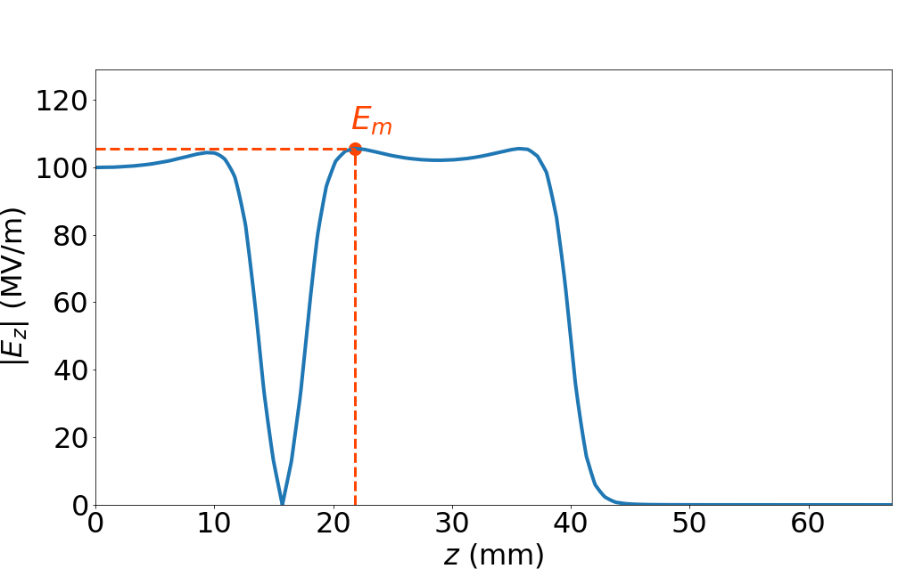
Entire-cavity RF analysis
Critical coupling at 5.712 GHz.
Identical peak electric field magnitude in the individual cells.
Peak accelerating field magnitude E_{m}.

Slide 10
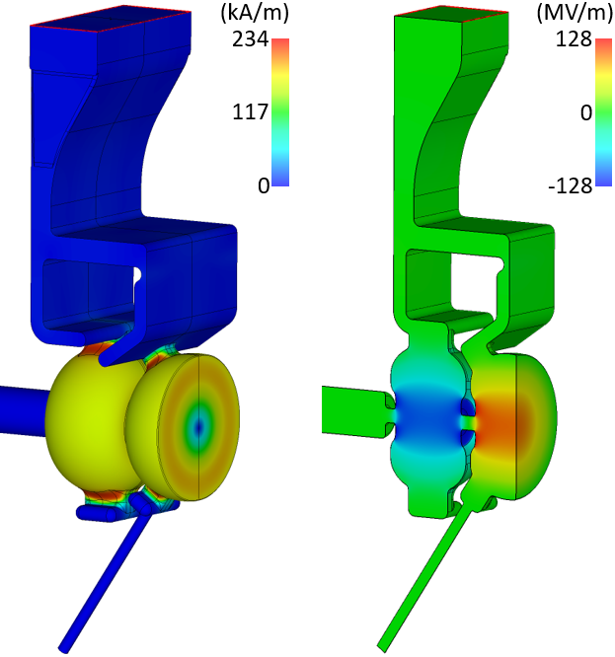
Entire-cavity RF analysis
Local peak E-field normalized to E_{m}.
Local peak H-field normalized to (E_{m}/Z₀).
  Z₀ = 377 Ω.
Electric field local peak values
Cathode cell overall | 1.20
Cathode plane | 0.94
Cathode cell coupling slot | 0.48
Full cell overall | 1.20
Full cell coupling slot | 0.30
Choke | 0.059
Magnetic field local peak values
Cathode plane | 0.55
Cathode cell coupling slot | 0.69
Full cell coupling slot | 0.66
Choke | 0.035
100-MV/m cathode peak field

Slide 11
Fabrication and challenges
OFHC copper cavity fabricated in halves, and then brazed together.
One pair of tuners for each cell.
Machining tolerance sensitivity.
  0.001-inch increase of the elliptical cell profile minor radius results in 5-MHz reduction in the cell resonant frequency.
  0.001-inch increase of the waveguide splitter choke size results in 1% increase in the peak electric field ratio in the cathode cell to that in the full cell.

Slide 12
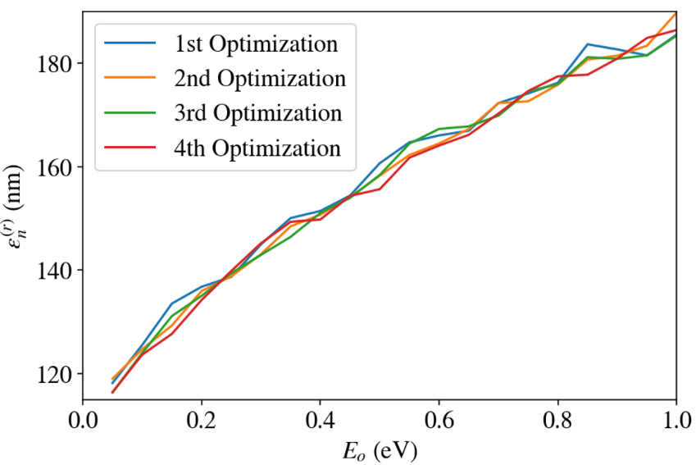
Emittance compensation
Based on the UCLA TOPGUN analysis.
Minimized normalized emittance is a function of the excess energy.
Optimization parameters
Cathode peak electric field | 240 MV/m
Bunch charge | 250 pC
Laser rms sopt size | 220 μm
Launching phase | 125.4 deg
Laser uniform pulse length | 7.34 ps
Solenoid center position (cathode plane at z = 0) | 125 mm
Solenoid field FWHM | 74 mm
Solenoid peak field | 0.5854 T

Slide 13
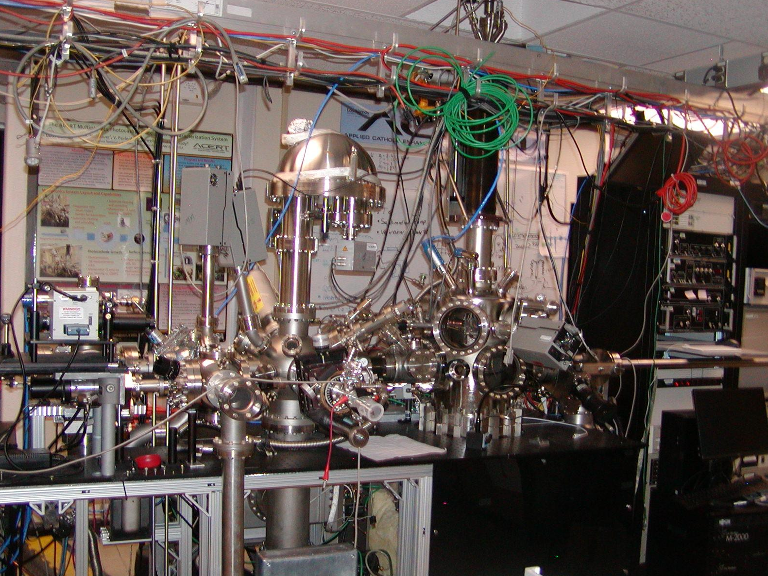
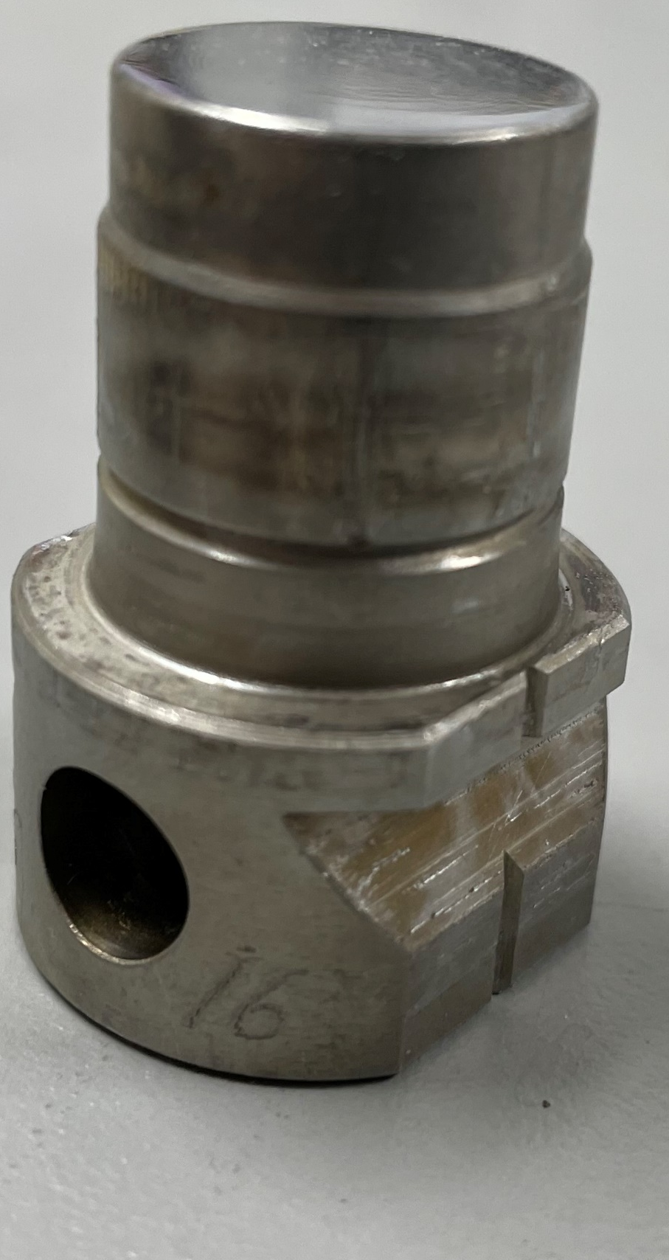
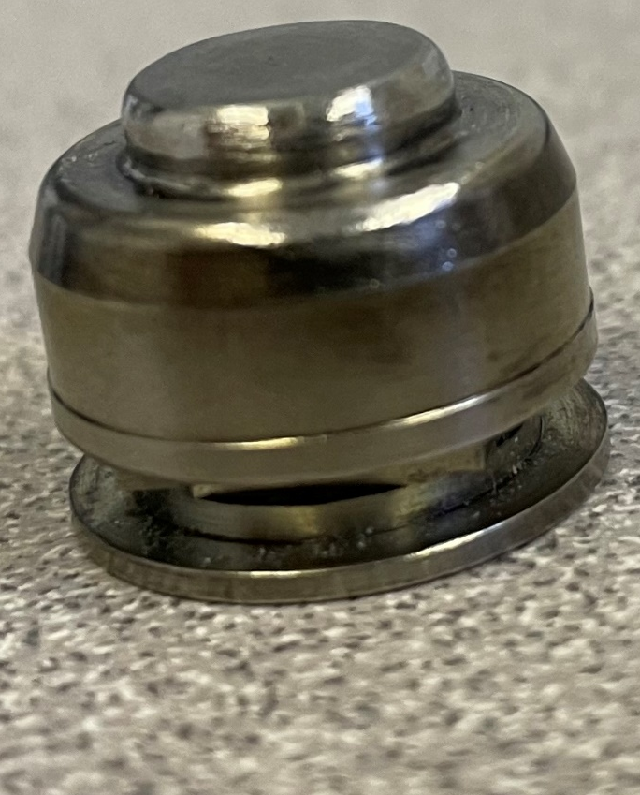
Next steps
High power test of the first photoinjector RF cavity.
Photocathode development (ACERT).
Combined design of photocathode plug and injector cavity.
  Current plug design provided by INFN.
Solenoid magnet at cryo-temperature.
Cryo-cooling design.
ACERT
17 mm
INFN plug
ACERT plug

Slide 14



Acknowledgments
Work supported by the Laboratory Directed Research and Development program of Los Alamos National Laboratory, under project number 20230011DR.

