Slide 1
Distributed Coupling Linac for Efficient Acceleration of High Charge Electron Bunches
Ankur Dhar, Mei Bai, Zenghai Li, Emilio Alessandro Nanni, Mohamed Othman, Sami Tantawi, Glen White
05/17/2023

Slide 2
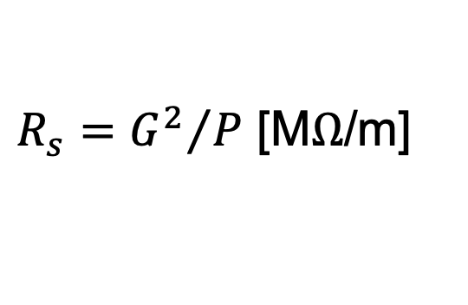
Distributed RF Coupling changes Accelerator Paradigm
RF power coupled to each cell – no on-axis coupling
Full system design requires modern virtual prototyping
Electric field magnitude produced when RF manifold feeds alternating cells equally
Optimization of cell for efficiency (shunt impedance)
Control peak surface electric and magnetic fields
2
S. Tantawi, et al. PRAB 23.9 (2020): 092001.

Slide 3
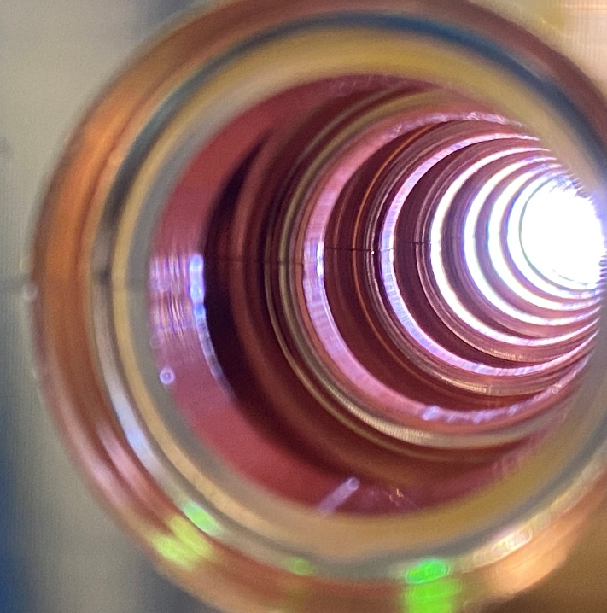
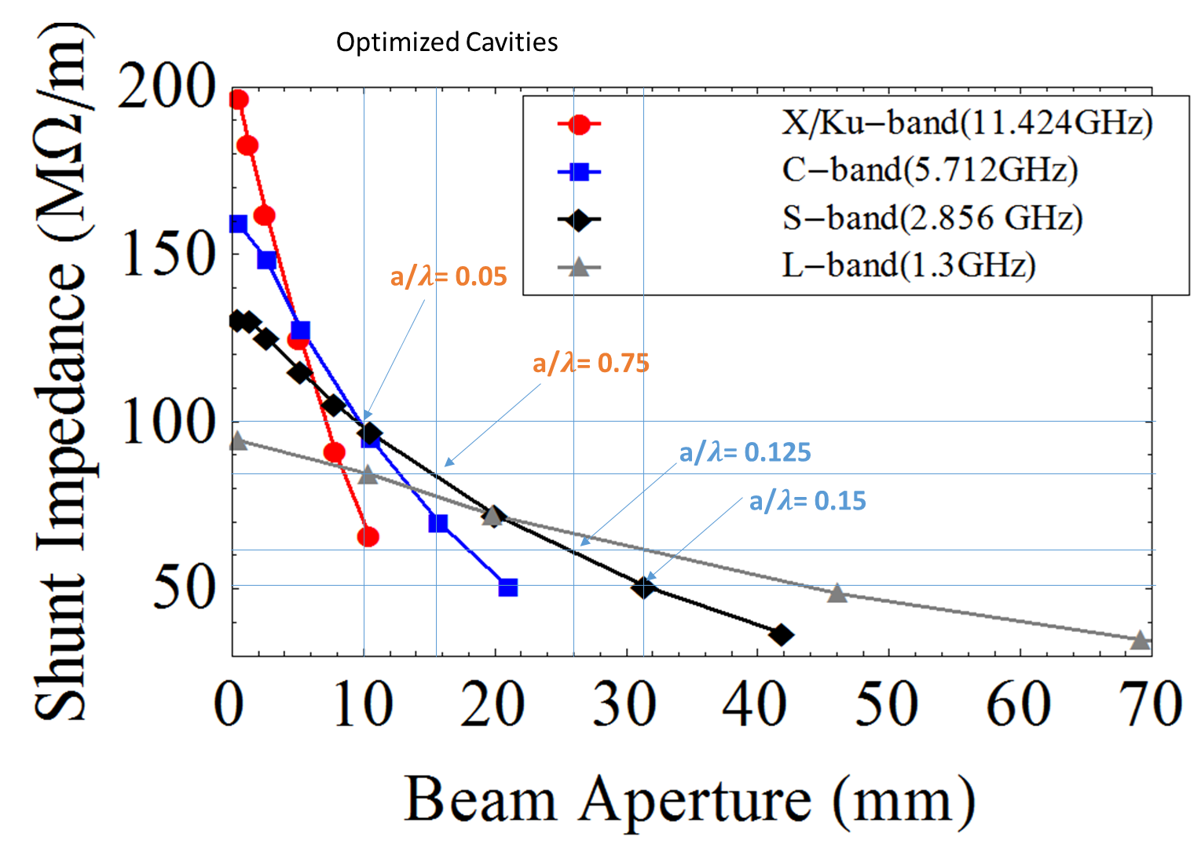
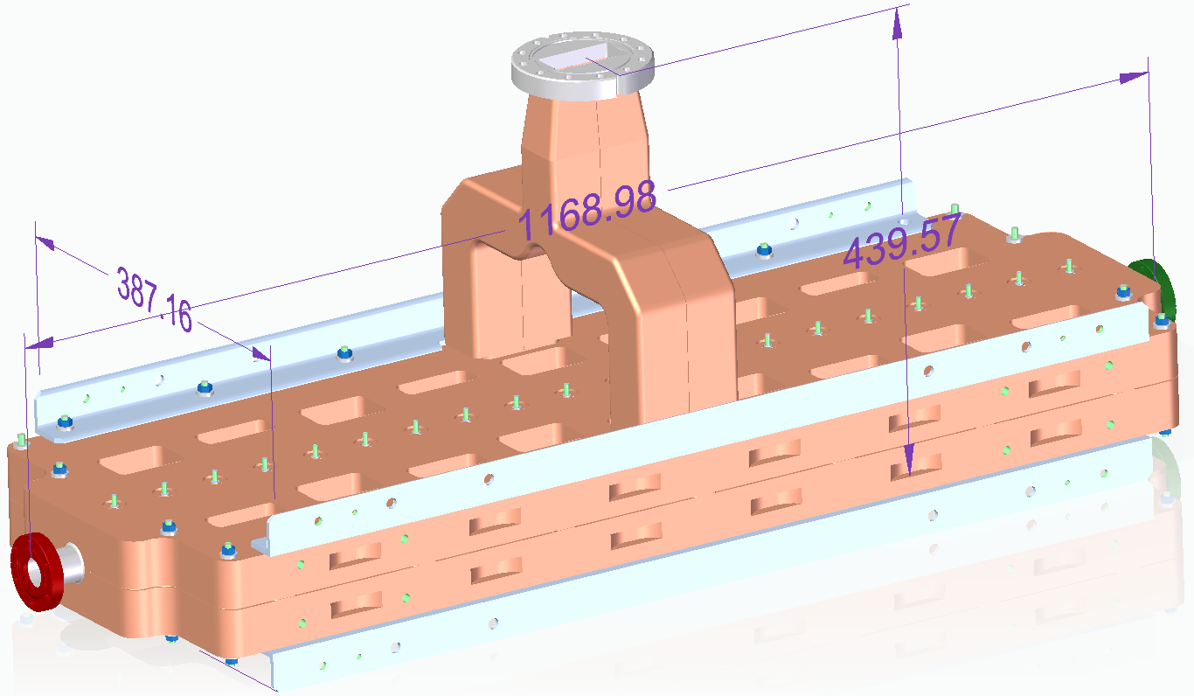
Injector Linac needs to accelerate High Charge Bunches
High charge bunches would require larger apertures to minimize wakefields
S-band provides significant larger aperture compared to C-band for a given shunt impedance
Cool Copper Collider Workshop 2022
3
S. Tantawi, et al. PRAB 23.9 (2020): 092001.

Slide 4
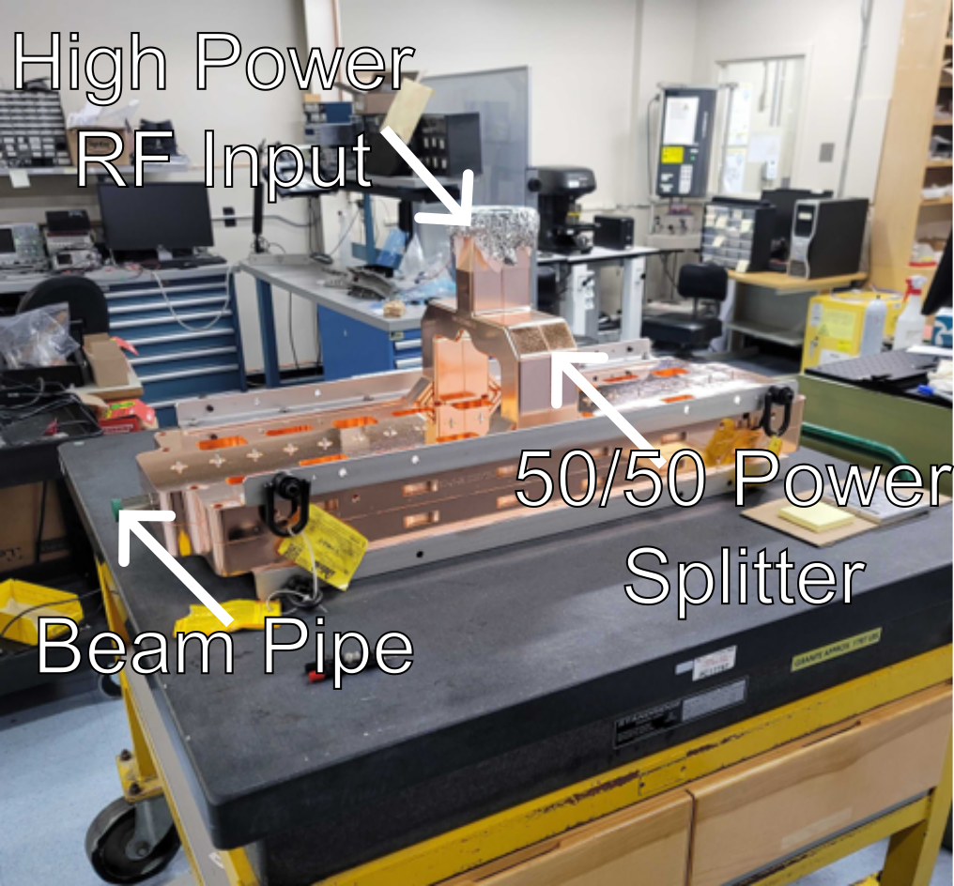
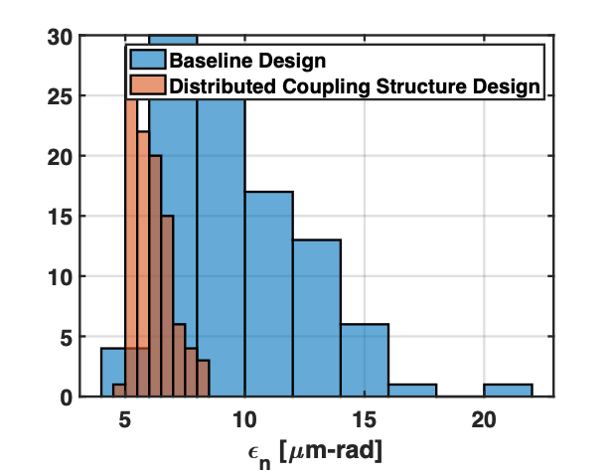
Distributed Coupling as applied to Injector Linac Design
Design balances shunt impedance with aperture size
S-band cavities designed with aperture ratio a/λ=0.135
Better output emittance compared to baseline traveling wave structures with 14 nC bunches
Emittance calculated for a/λ=0.125 cavities
Linac Properties
Freq (GHz) | 2.856 | E_{max}/E_{acc} | 2.63
a (mm) | 14.12 | E_{acc}/Z₀H_{max} | 0.995
a/𝜆 | 0.135 | R_{s} (MΩ/m) | 58
P_{diss} (MW) | 5 | E_{acc} (MV/m) | 18

Slide 5
Comparison of Technologies for pre-injector e⁻ linacs
 | SLAC Linac 3 m structure | PSI Linac 4 m structure | Distributed Coupling 1 m structure | Cryo-Distributed Coupling [77 K] 1 m structure
Shunt Impedance [M/m] a/ [radius/wavelength] | 51* 0.15-0.11 | 45-56 0.135-0.095 | 58 0.135 | 145 0.135
Power / Length @ 16 MeV/m [MW/m] / Power for 400 MeV [MW] in 25 m Min. 65 MW 5045 Klystron | 8.3 / 210 4 klystrons | 6.2 / 156 3 klystrons | 4.4 / 110 2 klystrons | 1.8 / 44 1 klystron
Achievable Gradient [MeV/m] Constant BDR Scaled from Pulsed Heating | 50 | 60 | 74 | 118
Power for 400 MeV in 8 m [MW] Corresponds to 50 MeV/m Min. 65 MW 5045 Klystron | 645 10 klystrons | 488 8 klystrons | 344 6 klystrons | 138 3 klystrons
F. Willeke, “Electron ion collider conceptual design report 2021,” English, Tech. Rep., 2021, doi:10.2172/1765663
5
T. Schietinger, et al., PRAB 19.10 (2016):100702
M. Nasr, et al., PRAB 24.9 (2021):093201

Slide 6
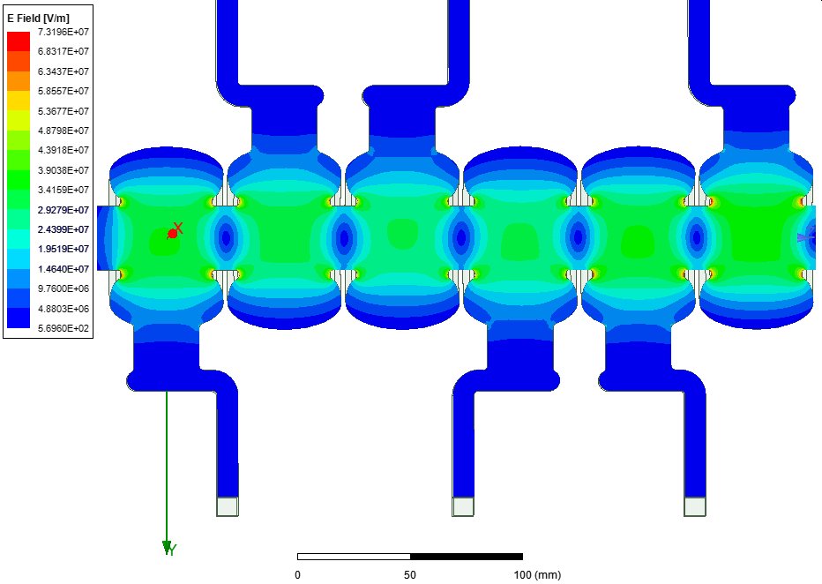
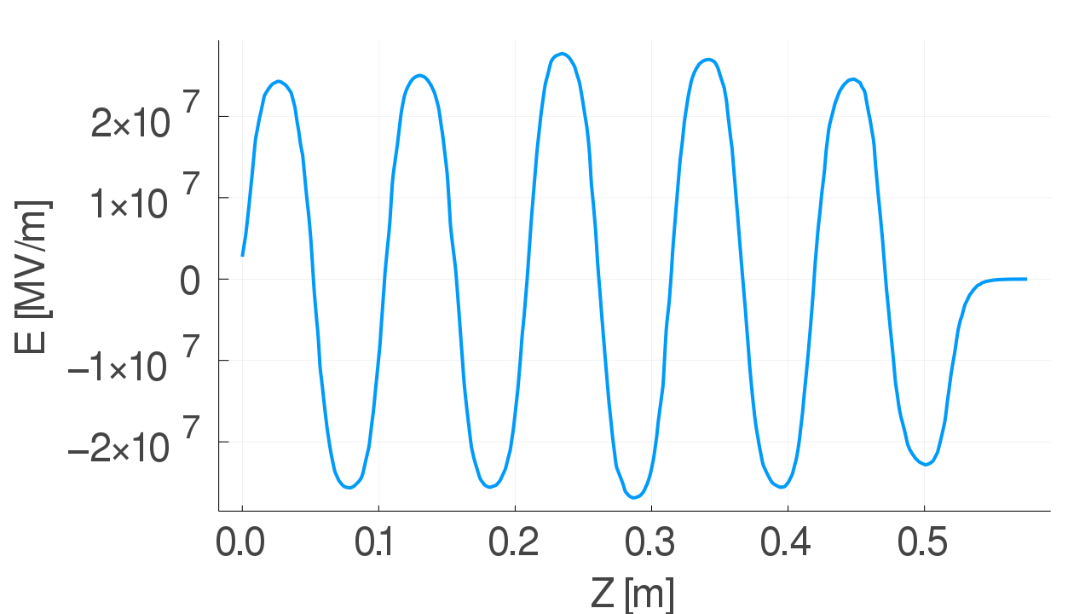
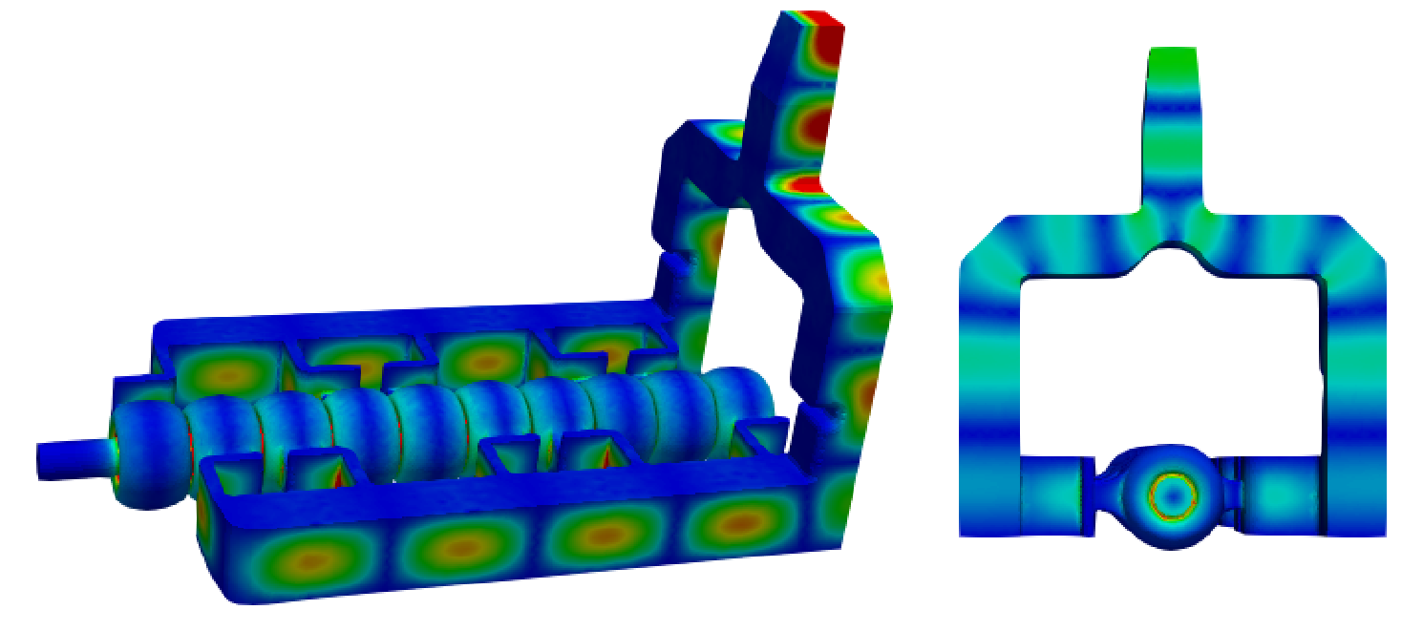
Characterizing a Large Aperture Distributed Coupled Linac
Large apertures introduce coupling between cavities
This cross coupling means adjustment of cavity size at either end is required to ensure field flatness
These adjustments were verified with extensive simulation in HFSS and ACE3P
Bead pulls were conducted to measure field flatness as tuning was conducted
6
Z. Li, et al. AIP Conference Proceedings ,Vol. 1507, No. 1 p. 837-842

Slide 7
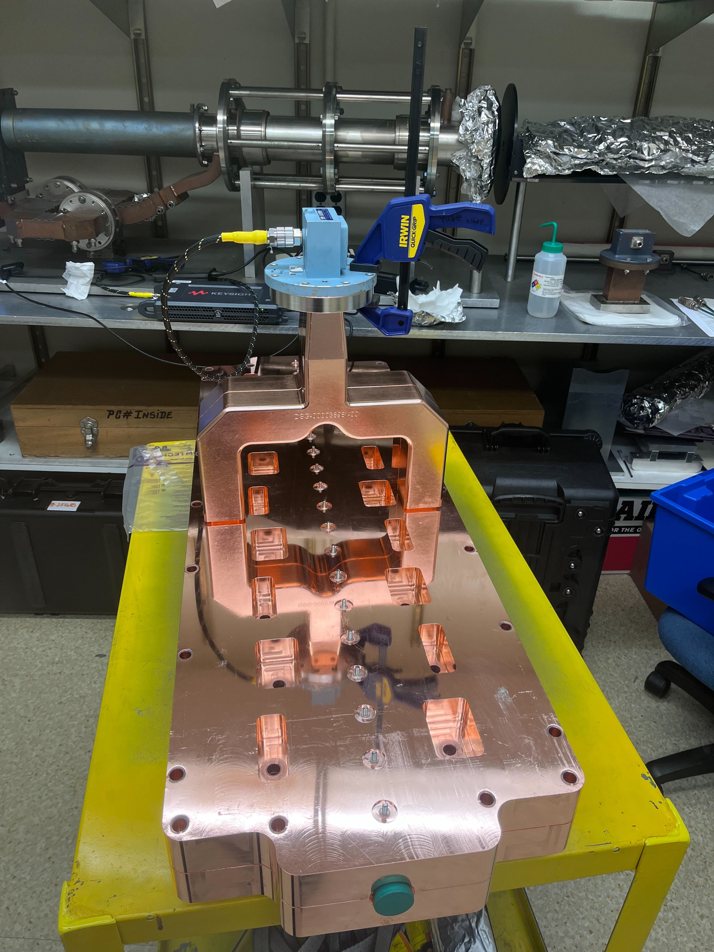
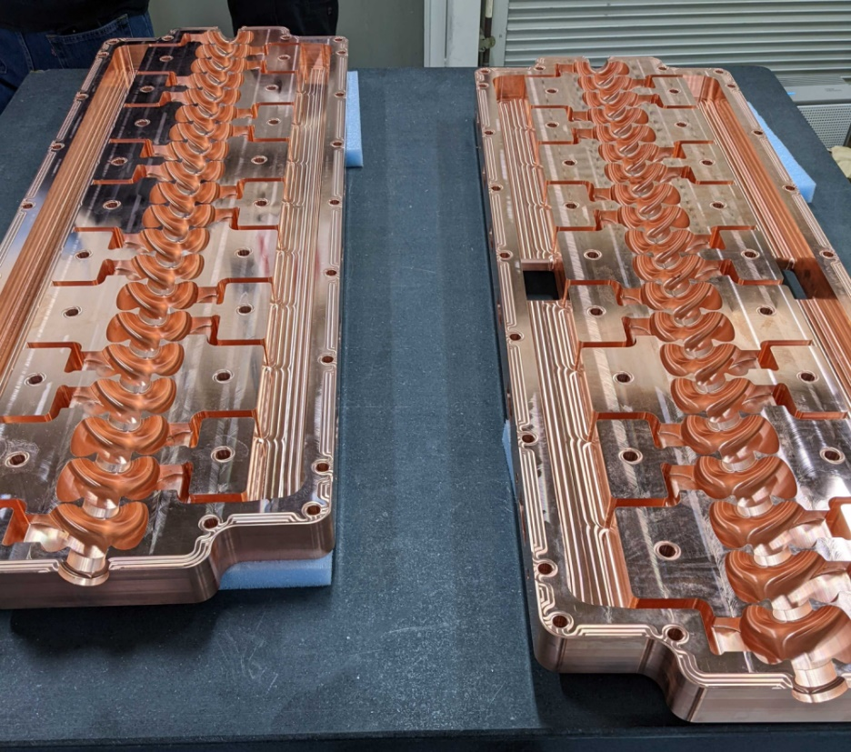
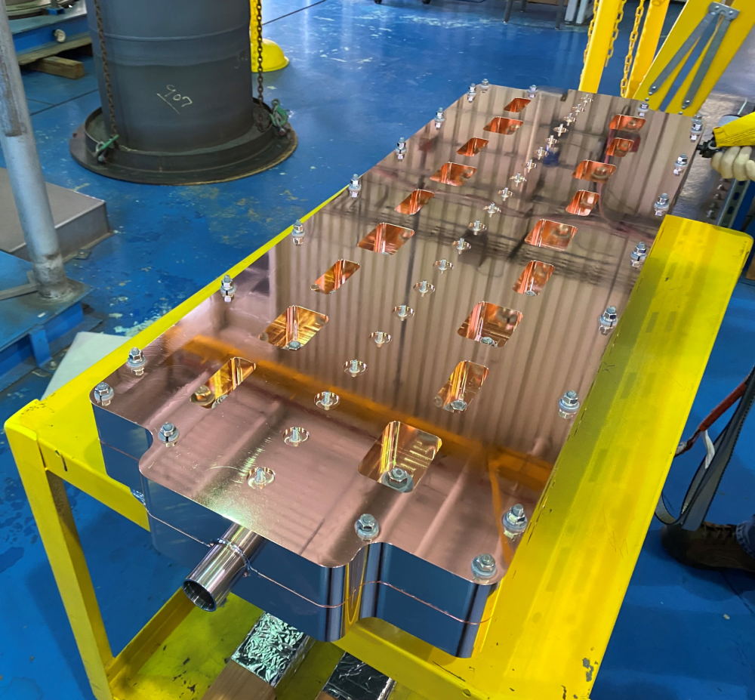
Assembly of Injector Linac
Linac formed from two slabs, which are brazed
Y-Coupler is brazed on afterwards to provide even power splitting between each side
Assembly and brazing was done in house at SLAC

Slide 8
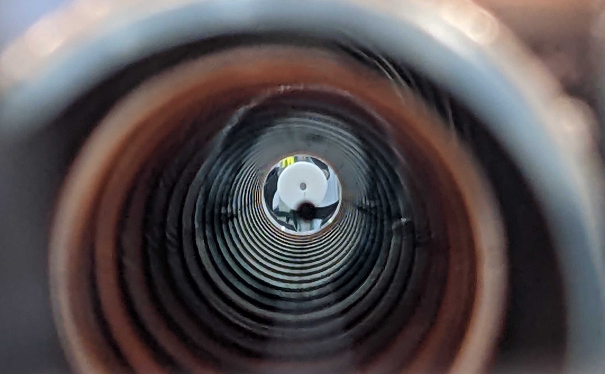
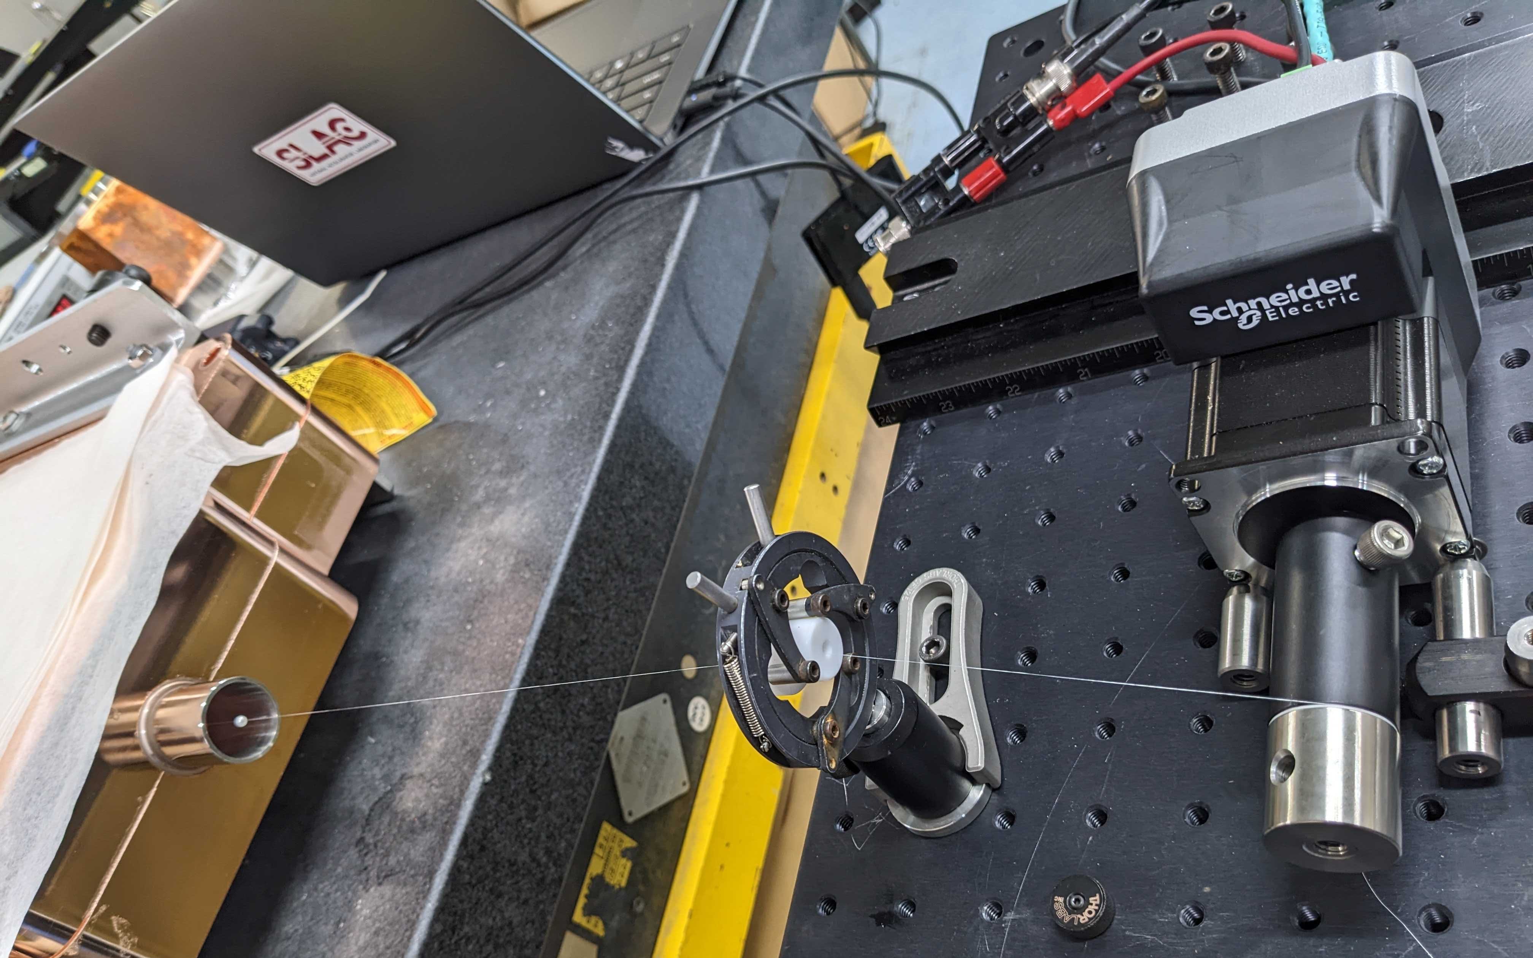
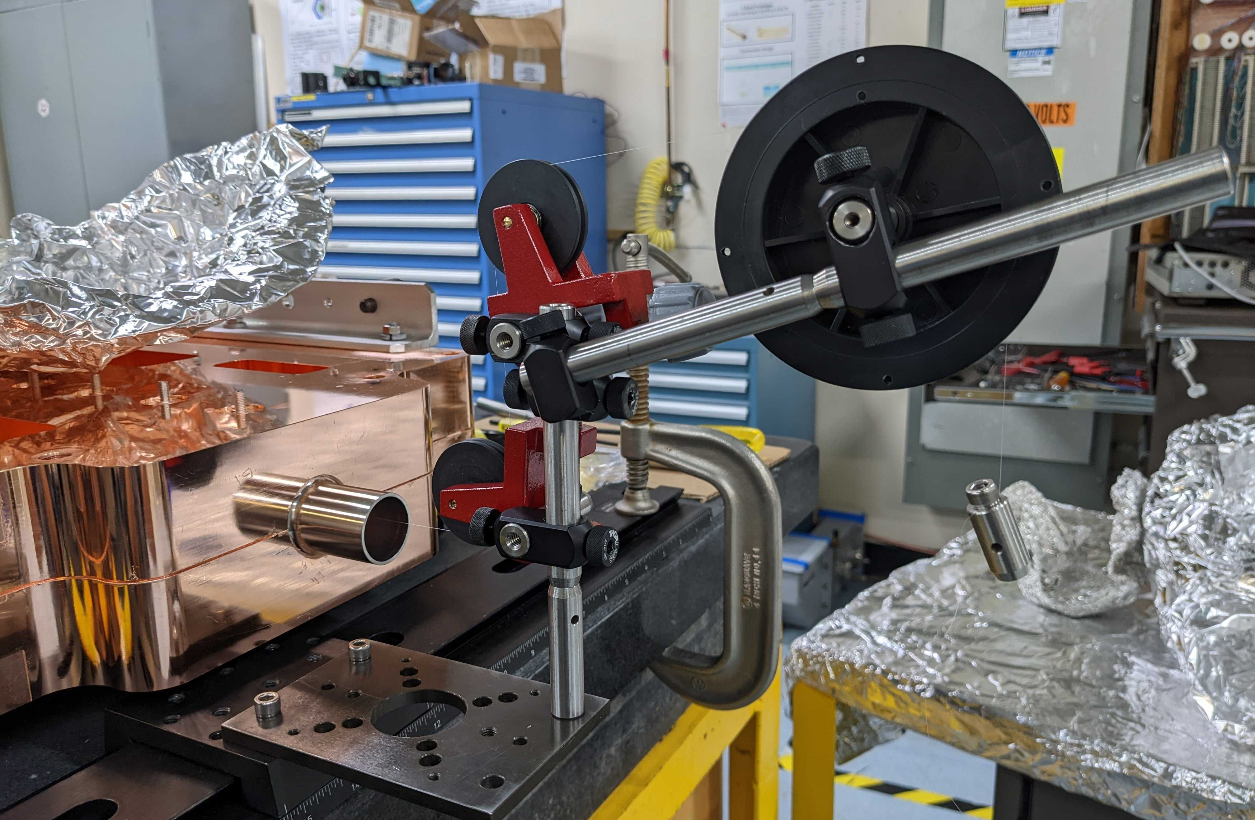
Bead Pull Characterization
Measuring field flatness within structure requires running a dielectric bead along line
Tension is maintained via pulleys
Alignment is handled with optical stages

Slide 9
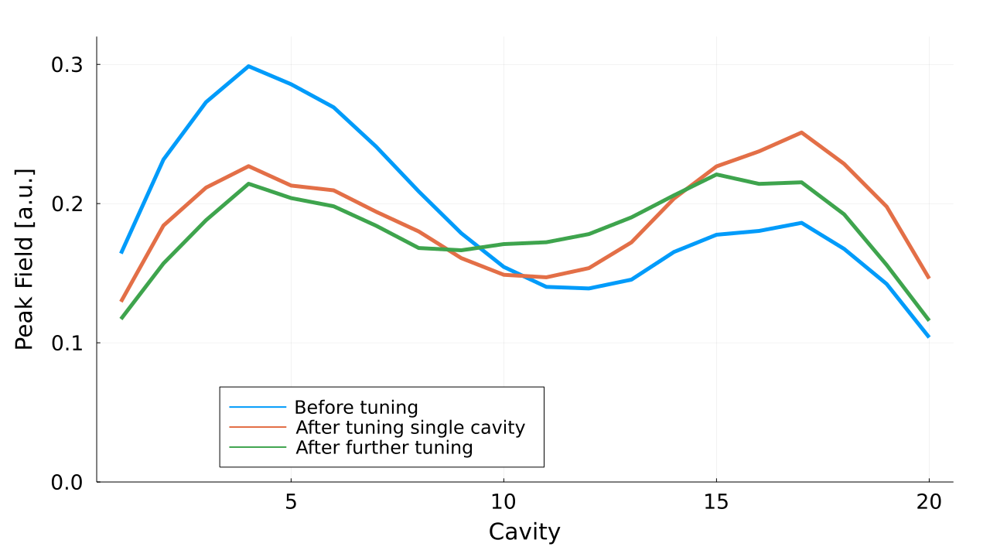
Preliminary Tuning Results
With this information, the first pass of tuning has been successful in improving field flatness
Structure will be brazed one more time to fix leaks before final tuning to 2.856 GHz
9
9

Slide 10
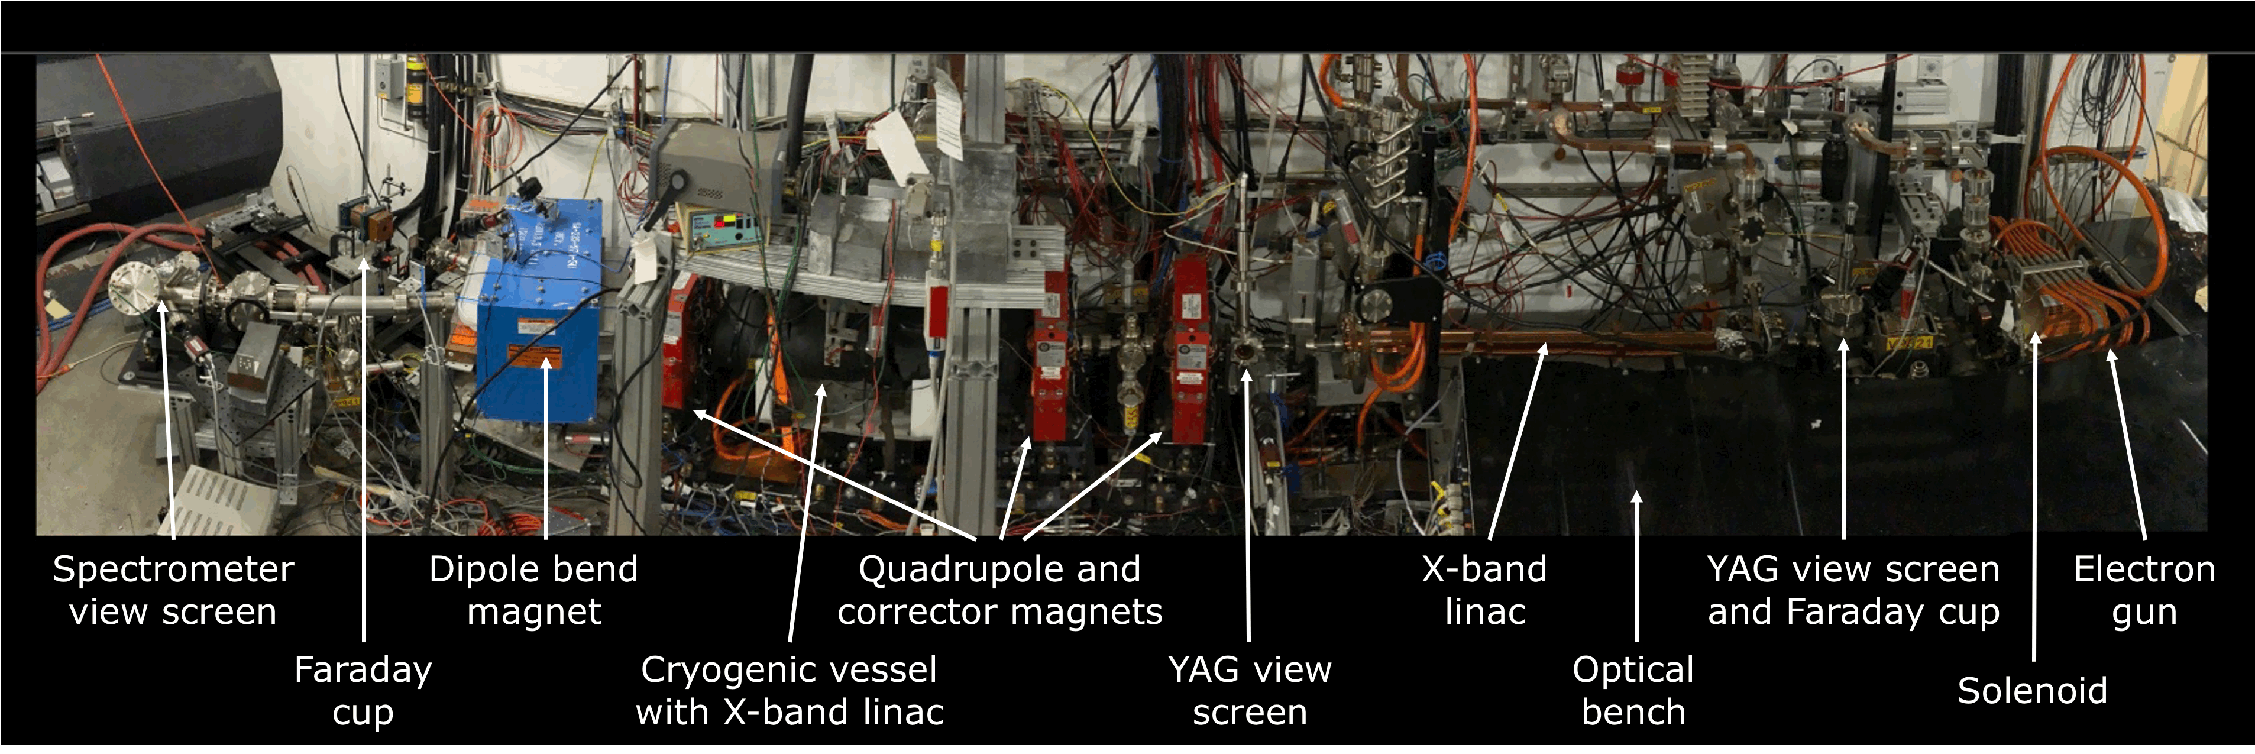
Future Test Plans
Once tuned, various proposals to testing the structure are in preparation:
High power test measuring breakdown rate with 35 MW klystron at Station S-band at NLCTA
ASSET-style wakefield measurement without high power at FACET-II
Also potentially at XTA within NLCTA
Full power + beam tests at CLEAR and/or APS
Open to further suggestions for test sites
10

Slide 11
Potential for collaboration with FCC-ee
C³ approach could reduce length 3.5X OR reduce rf power 3.5X of FCC-ee HE linac
Compared to state-of-the-art RI built linac structure at Swiss FEL
Similar improvements in common linac (up to 6 GeV)
Development timeline compatible with selection of FCC-ee injector
 | RI Swiss FEL S-band | C3 Same RF Power | C3 Same Length
a/$λ$ | 0.135-0.095 | 0.125 | 0.125
Freq. [GHz] | ~2.8
RF Source Power [MW] | 40
Temp. [K] | 300 | 77 | 77
Rs [Mohm/m] | 42 | 145 | 145
Gradient [MeV/m] | 20 | 70 | 20
Number of RF Sources | 168 | 168 | 54
Total Struc. Length [m] | 696 | 201 | 696

Slide 12
Questions?

