Slide 1
What have we learned from E300 experiments so far: part 2
QPAD modeling of wake excitation and acceleration in meter-long beam-ionized plasma at FACET-II
Zan Nie, Chaojie Zhang, Ken A. Marsh, Chan Joshi
UCLA
Oct. 6, 2022
E300 collaboration meeting

Slide 2
Outline
Ionization of hydrogen molecules
Photoionization
Beam ionization
QPAD simulations
Comparison with experimental H2 results
Comparison with experimental He results
Summary

Slide 3
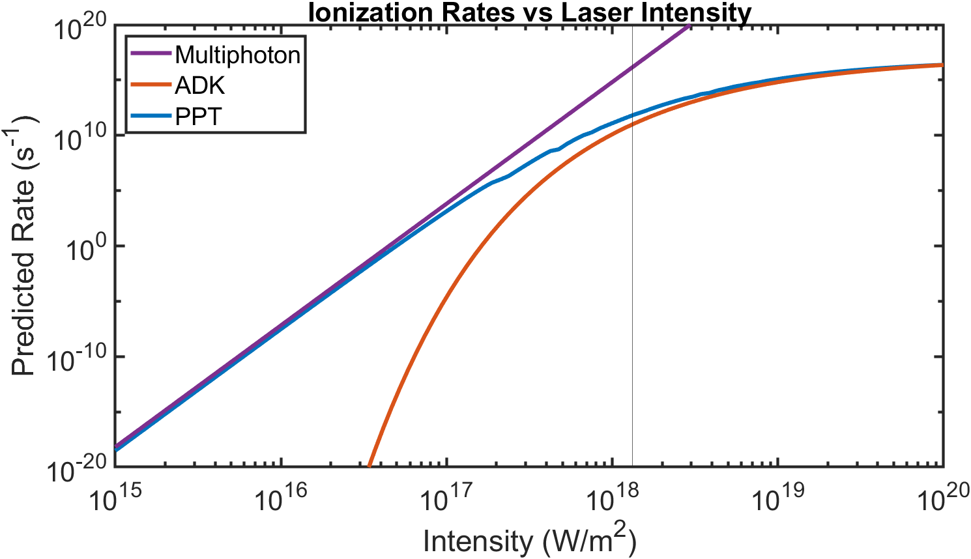
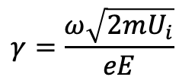
Photoionization regimes
Barrier suppression
Multi-photon
( 𝜸 ≫ 1 )
Tunneling
( 𝜸 ≪ 1 )
Keldysh parameter:
L. V. Keldysh, Sov. Phys. JETP 20, 1307–1314 (1965).
A. M. Perelomov, V. S. Popov, and M. V. Terentev, Sov. Phys. JETP 50, 1393–1409 (1966).
M. V. Ammosov, N. B. Delone, and V. P. Krainov, Sov. Phys. JETP 64, 1191 (1986).
I. Barth, et al., Phys. Rev. A. 87, 013433 (2013)
$$γ=\frac{ω\sqrt{2mU_{i}}}{eE}$$

Slide 4
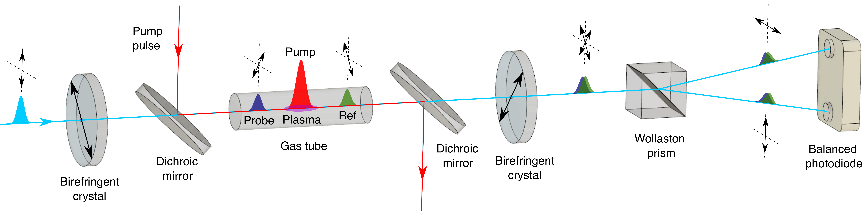
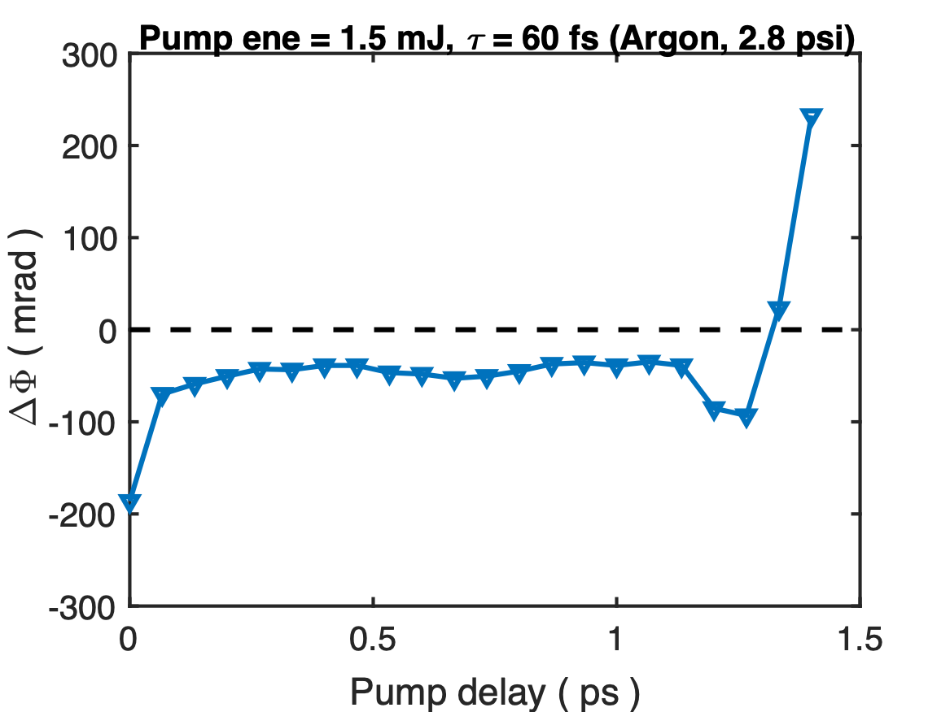



Cross-Polarized Temporal Interferometry
1.6 ps
Ref
$$Δφ=∫\frac{2π}{λ}⋅Δndz=∫\frac{2π}{λ}⋅\frac{n_{p}}{2n_{c}}dz$$
Plasma phase shift:
Plasma signal
$$Δφ_{min}∼0.6mrad$$
$$(n_{p}⋅L)_{min}∼2.6×{10}^{13}cm^{−2}$$
Probe
Z. Nie, et. al., Optics Express 30, 25696 (2022)

Slide 5
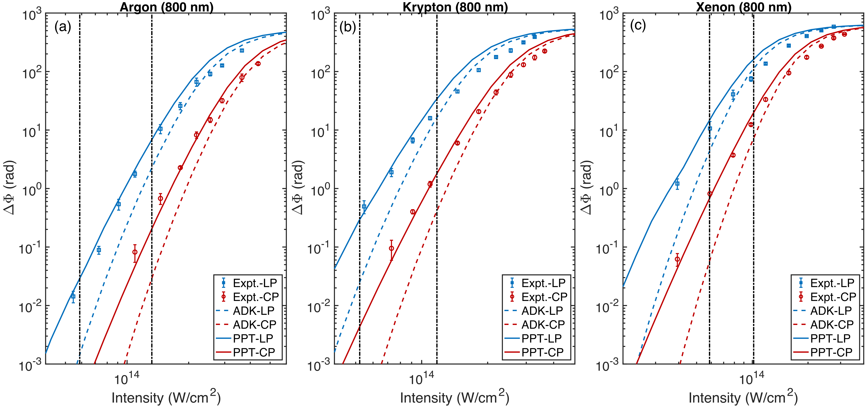
ADK v.s. PPT
𝜸 = 1
𝜸 = 1
𝜸 = 1
Z. Nie, et. al., Optics Express 30, 25696 (2022)

Slide 6
Ionization pathways of H2
Molecular ionization
(MO-PPT, MO-ADK)
15.4 eV
30.0 eV
+
H2
++
H2
H2
Dissociation
4.5 eV
2.8 eV
Coulomb explosion*
Atomic ionization
(PPT, ADK)
H + H
+
H + H
13.6 eV
13.6 eV
+
+
H + H
D. Pavicˇic ́, et. al., Phys. Rev. Lett. 94, 163002 (2005)
J-N. Vigneau, et al, arXiv:2209.10205

Slide 7
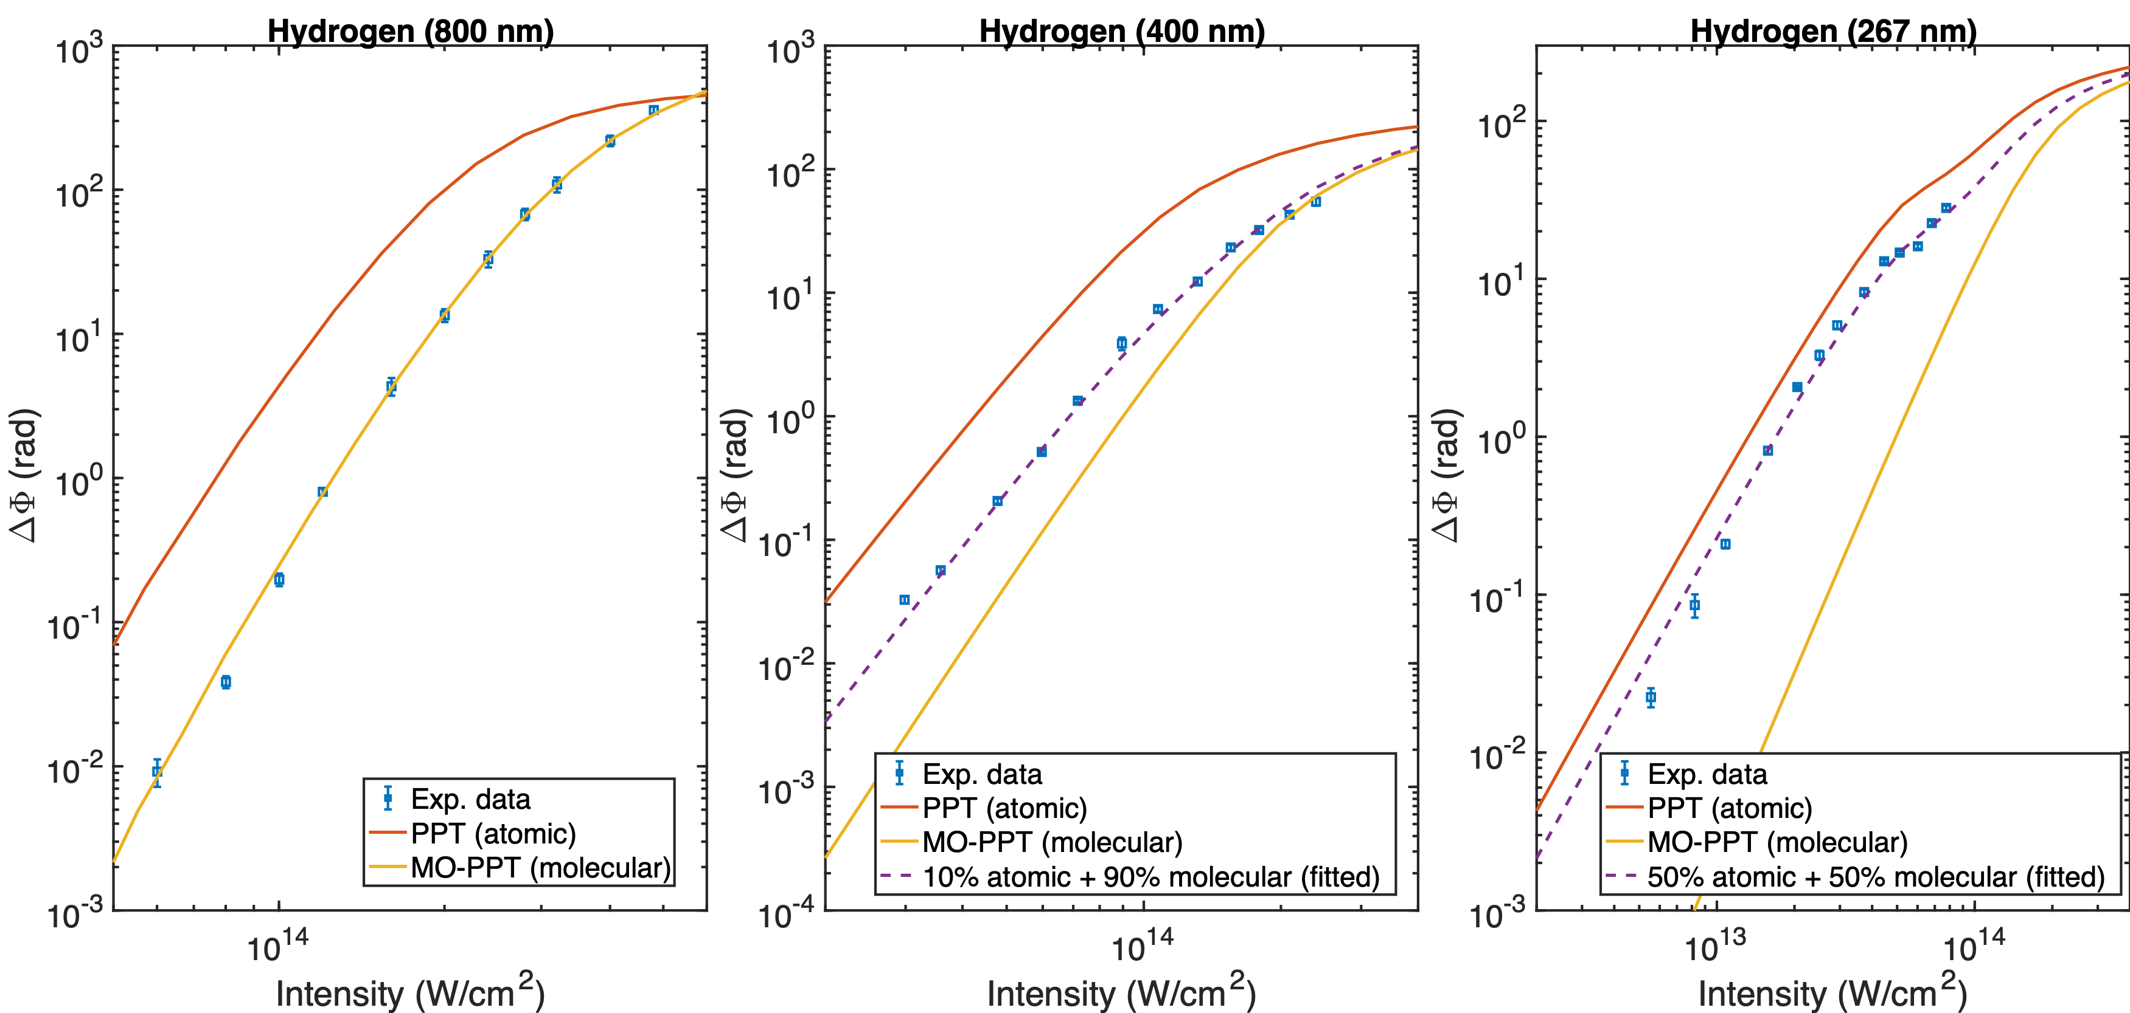
Photoionization of H2 (MO-PPT v.s. PPT)
I = 5⨉10¹⁴ W/cm²
Emax = 61.4 GV/m
Z. Nie, et. al., Optics Express 30, 25696 (2022)

Slide 8
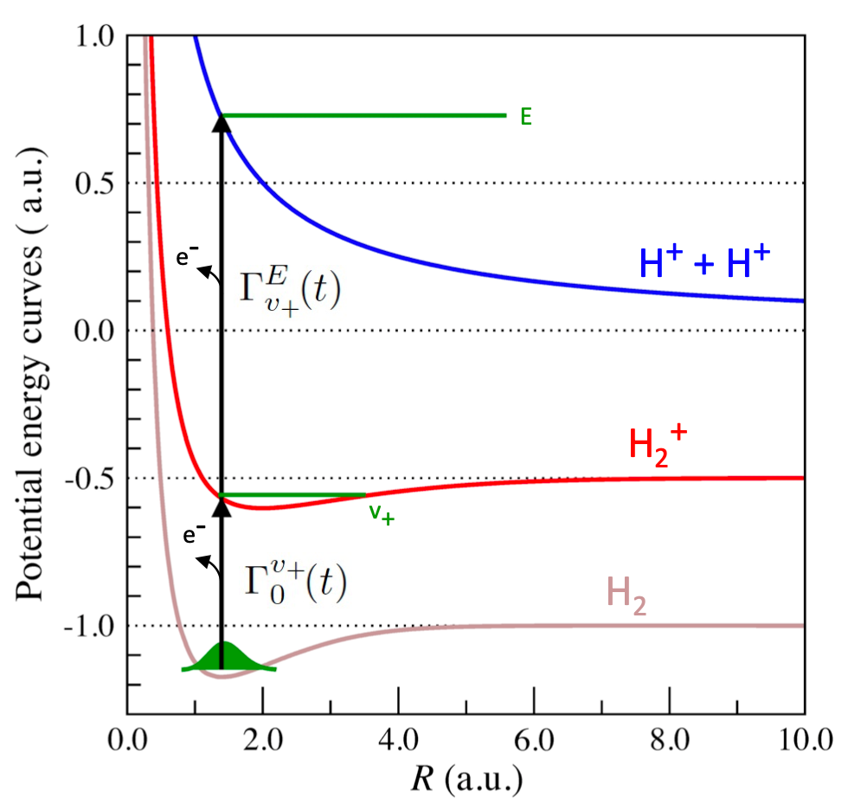
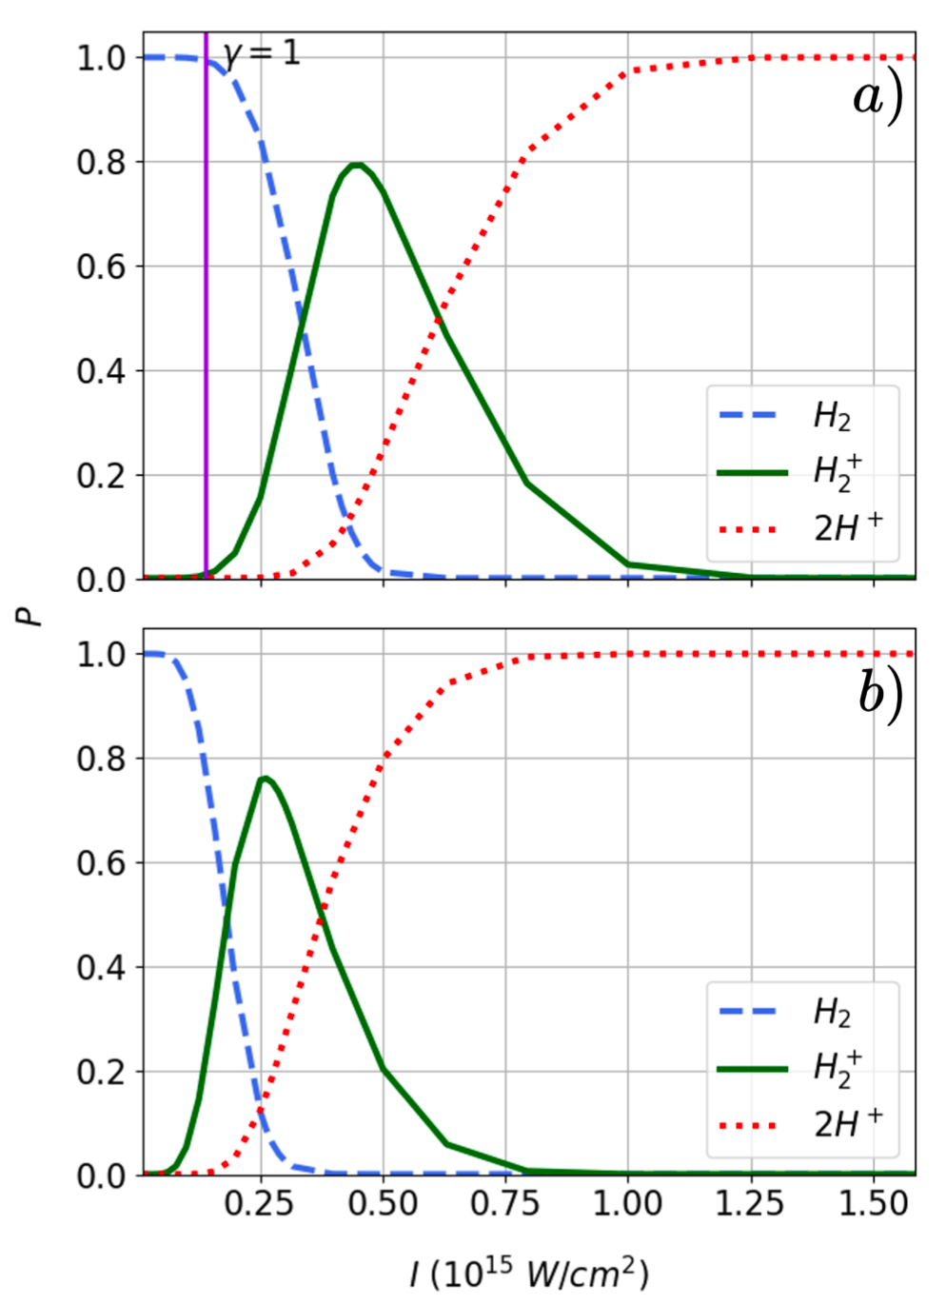
A recent paper on hydrogen ionization
J-N. Vigneau, et al, arXiv:2209.10205

Slide 9
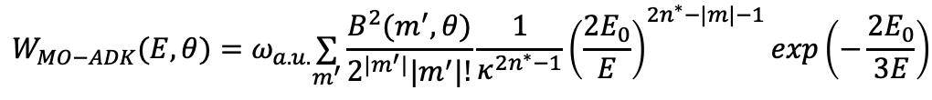
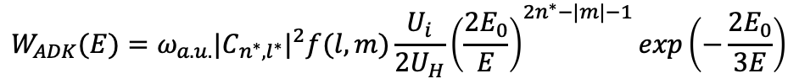
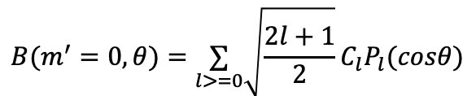

MO-ADK v.s. ADK
$$W_{ADK}(E)=ω_{a.u.}|C_{n^{∗},l^{∗}}|^{2}f(l,m)\frac{U_{i}}{2U_{H}}{\left(\frac{2E_{0}}{E}\right)}^{2n^{∗}−|m|−1}exp\left(−\frac{2E_{0}}{3E}\right)$$
$$W_{MO−ADK}(E,θ)=ω_{a.u.}\underset{m^{′}}{∑}\frac{B^{2}(m^{′},θ)}{2^{|m^{′}|}|m^{′}|!}\frac{1}{κ^{2n^{∗}−1}}{\left(\frac{2E_{0}}{E}\right)}^{2n^{∗}−|m|−1}exp\left(−\frac{2E_{0}}{3E}\right)$$
 | C0 | C2 | C4
H2 | 2.435 | 0.107 | 0.001
H2⁺ | 4.37 | 0.05 | 0.00
$$B(m^{′},θ)=\underset{l>=m}{∑}C_{l}Q(l,m^{′})D_{m^{′},m}^{l}(0,θ,0)$$
$$B(m^{′}=0,θ)=\underset{l>=0}{∑}\sqrt{\frac{2l+1}{2}}C_{l}P_{l}(cosθ)$$
M. V. Ammosov, N. B. Delone, and V. P. Krainov, Sov. Phys. JETP 64, 1191 (1986)
X. M. Tong, Z. X. Zhao, and C. D. Lin, Phys. Rev. A 66, 033402 (2002)
M. Awasthi, et al, Phys. Rev. A 77, 063403 (2008)

Slide 10
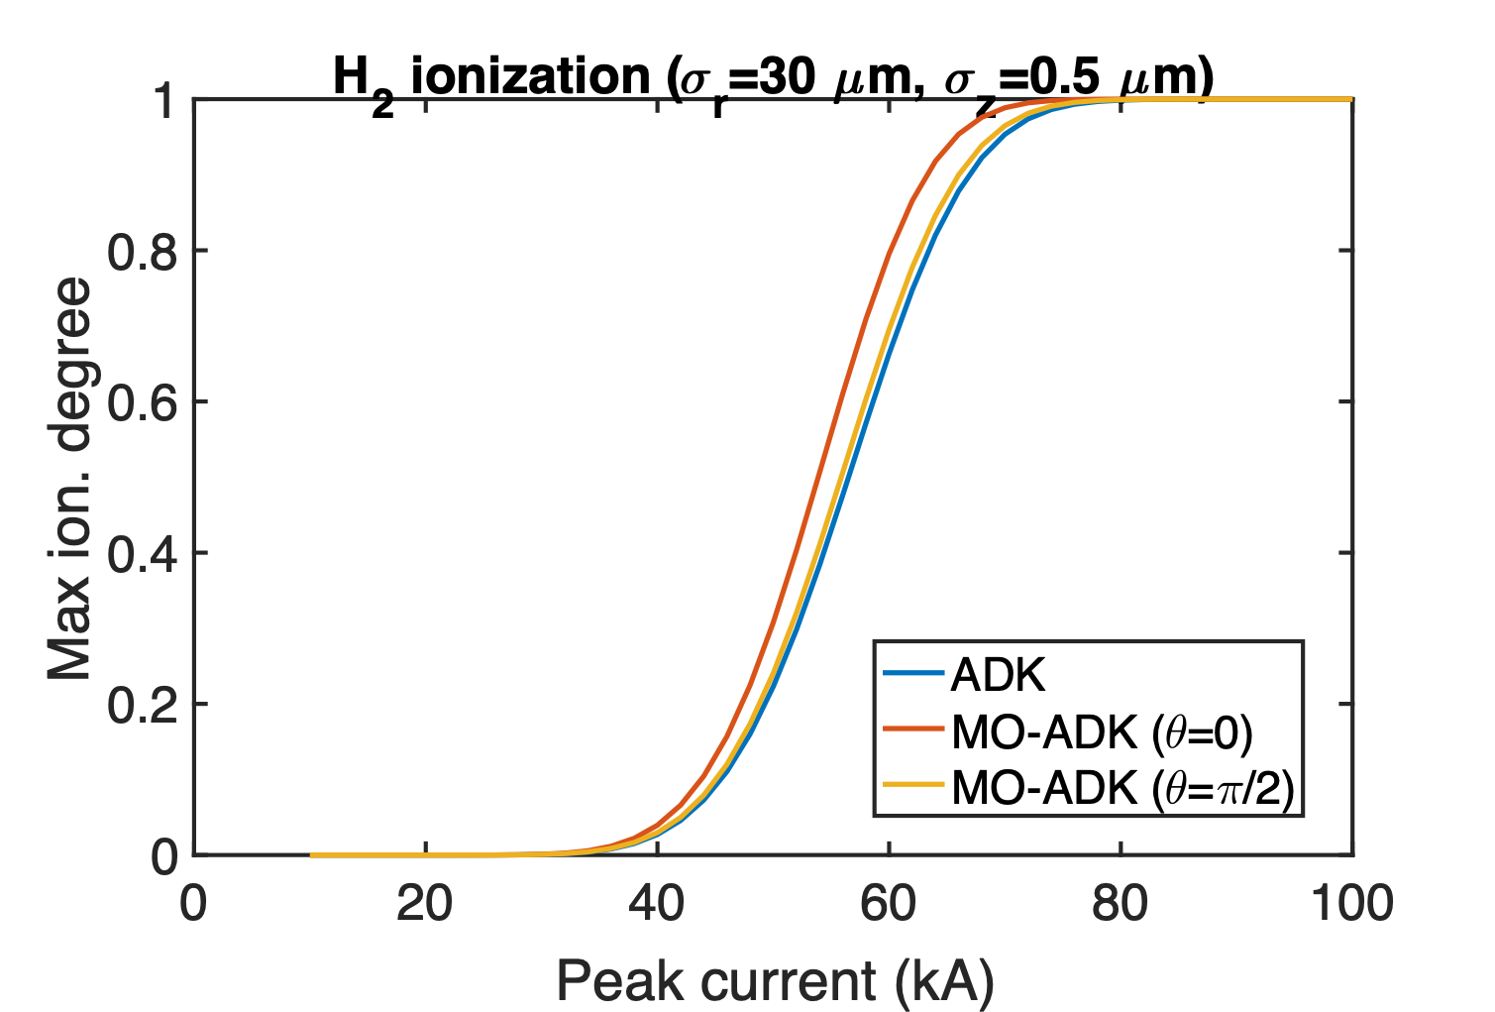
Beam ionization of H2 (MO-ADK v.s. ADK)

Slide 11
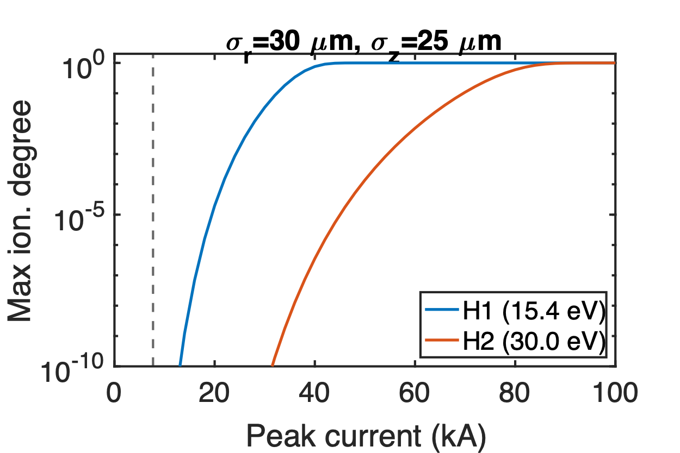
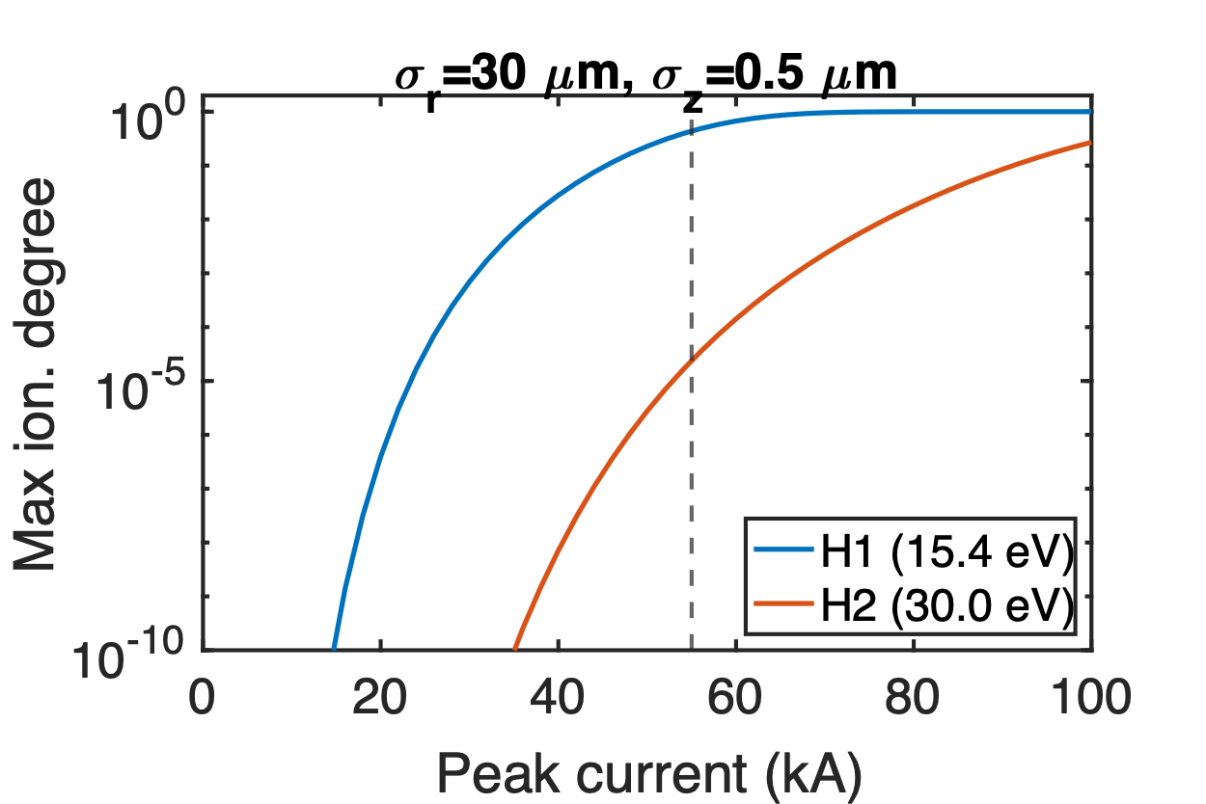
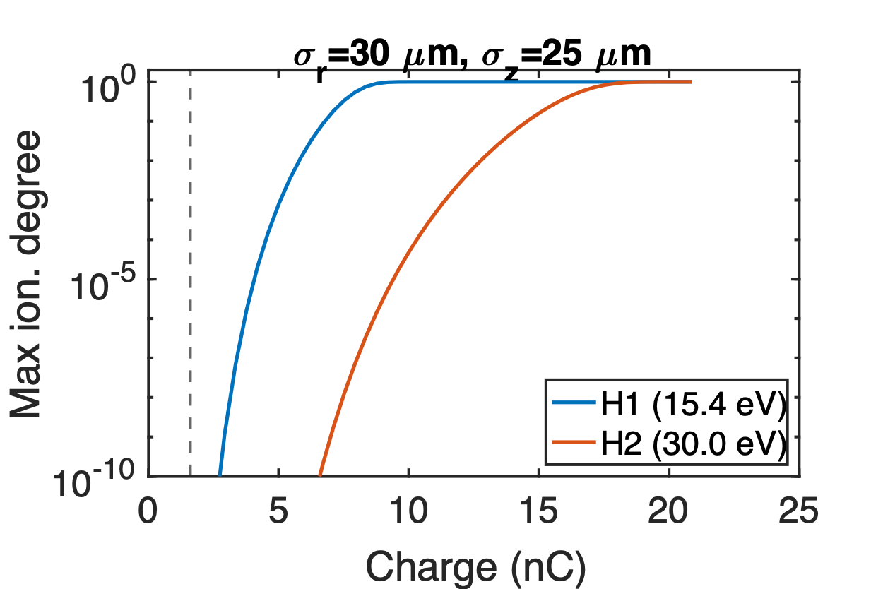
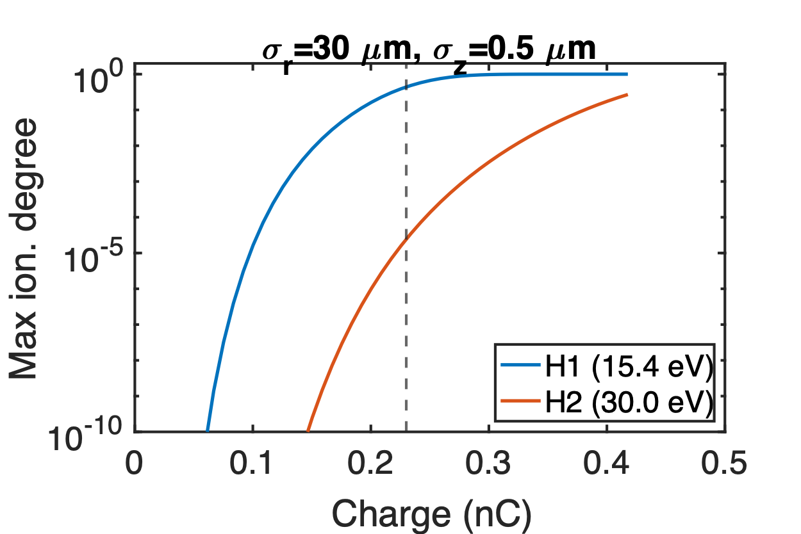
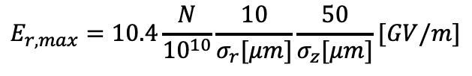
Beam ionization of H2
$$E_{r,max}=10.4\frac{N}{{10}^{10}}\frac{10}{σ_{r}[μm]}\frac{50}{σ_{z}[μm]}[GV/m]$$
Without spike
Spike only
7.7 kA
Emax=6.9 GV/m
Emax=49.6 GV/m
55 kA
1.6 nC
0.23 nC

Slide 12
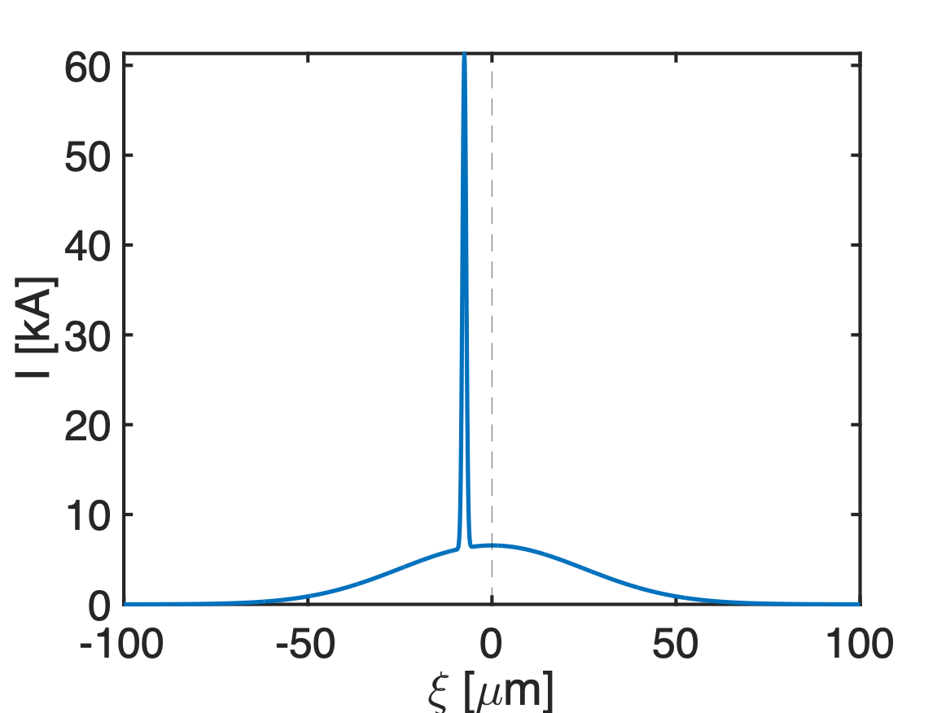
Modeled beam current profile
Main bunch
Spike
Charge | 1.37 nC
Peak current | 6.6 kA
𝝈r | 30 𝜇m
𝝈z1 | 25 𝜇m
εN | 20 𝜇m
𝛽* | 0.88 m
Charge | 0.23 nC
Peak current | 55 kA
𝝈r | 30 𝜇m
𝝈z2 | 0.5 𝜇m
εN | 20 𝜇m
𝛽* | 0.88 m
0.3𝝈z1
~40% unaffected

Slide 13
Latest simulation results from Glen
The spike almost doesn’t loose any energy because it’s too short.
If the spike is at the head and contains ~30% of the charge, then the unaffected electrons all come from the spike.

Slide 14
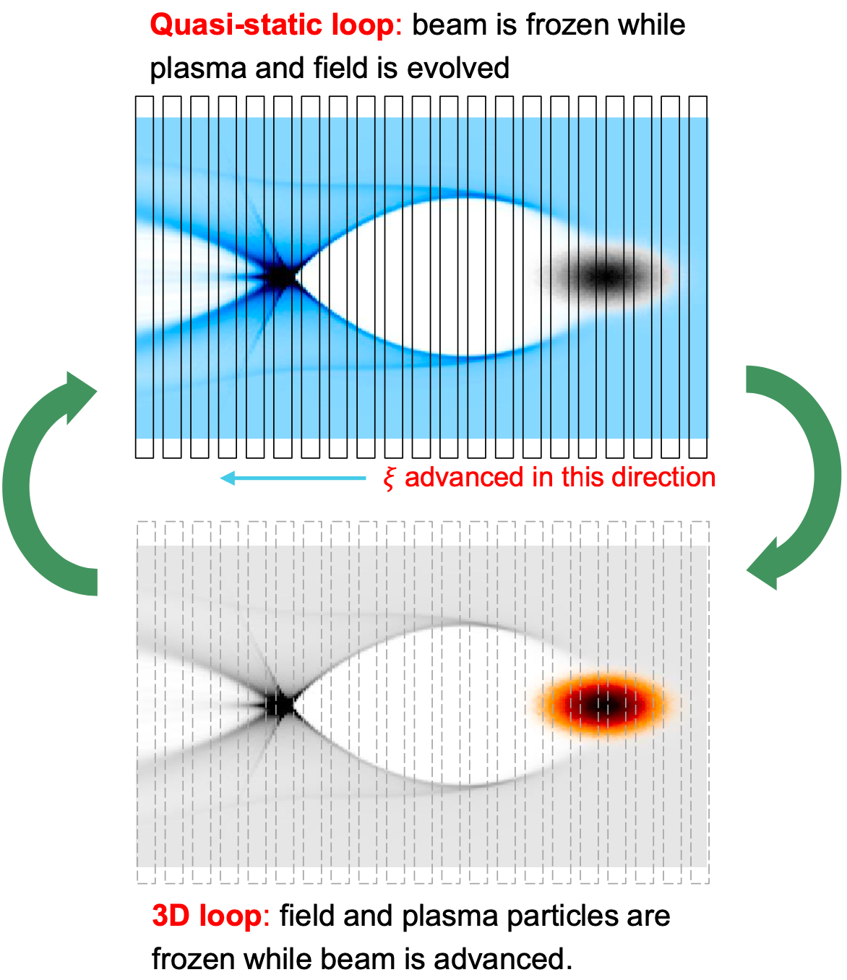
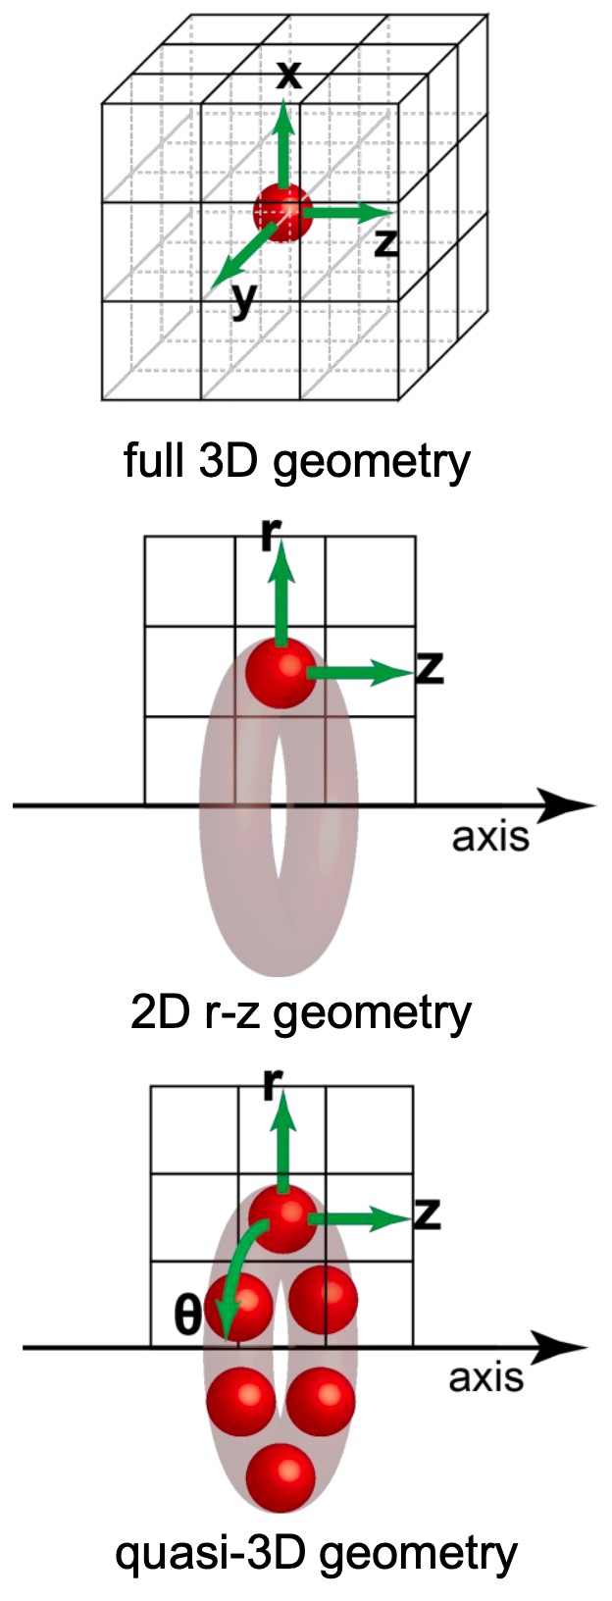
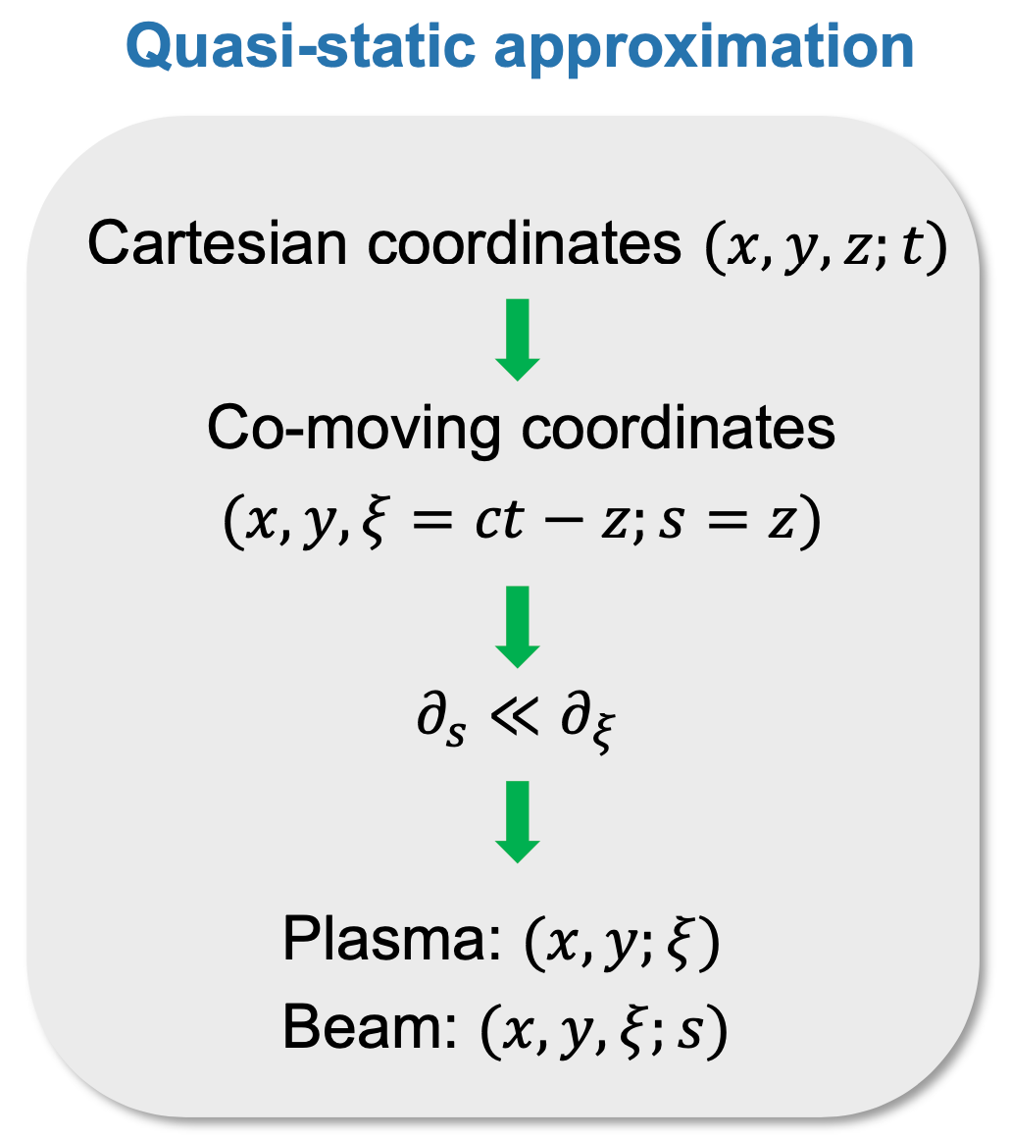
QuickPIC with Azimuthal Decomposition
Quasi-static + Quasi-3D
F. Li, et al., CPC 261, 107784 (2021)

Slide 15
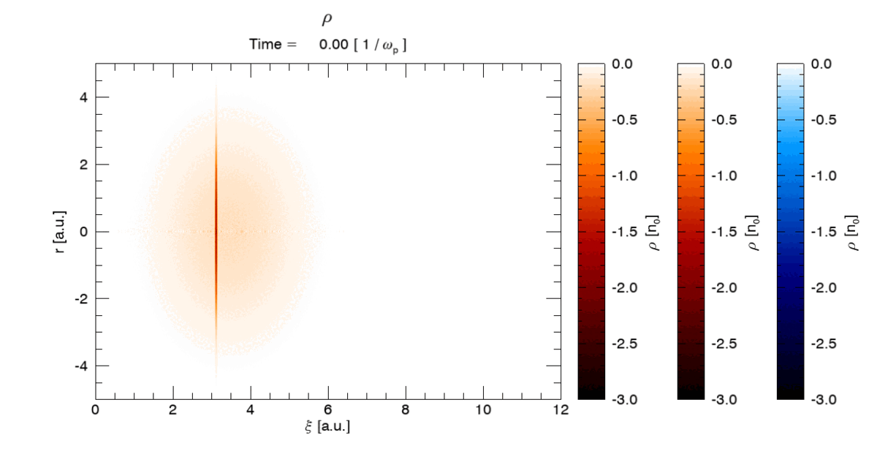
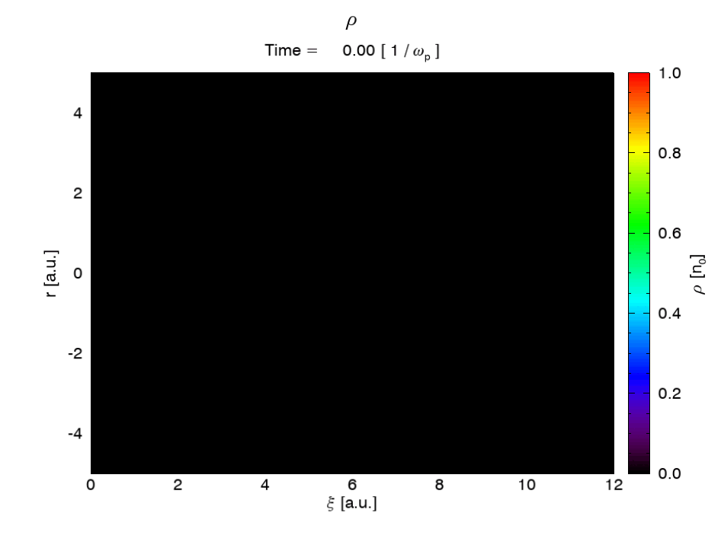
QPAD simulation: beam-ionized H2 case

Slide 16
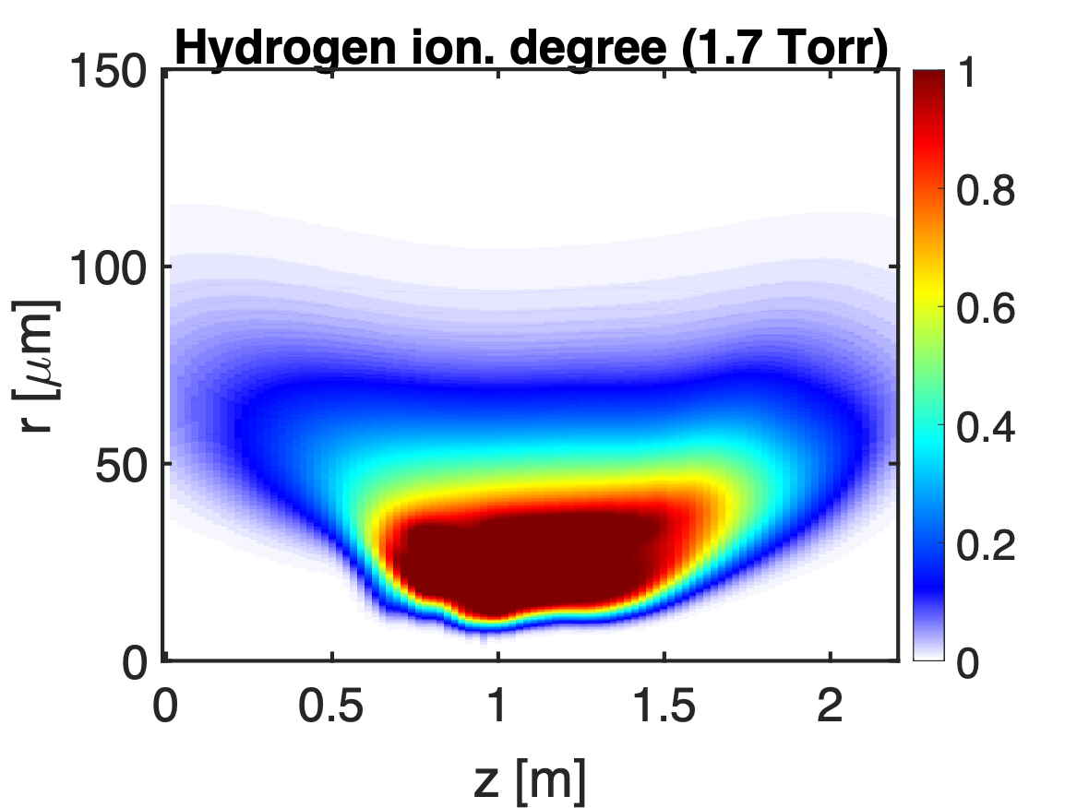
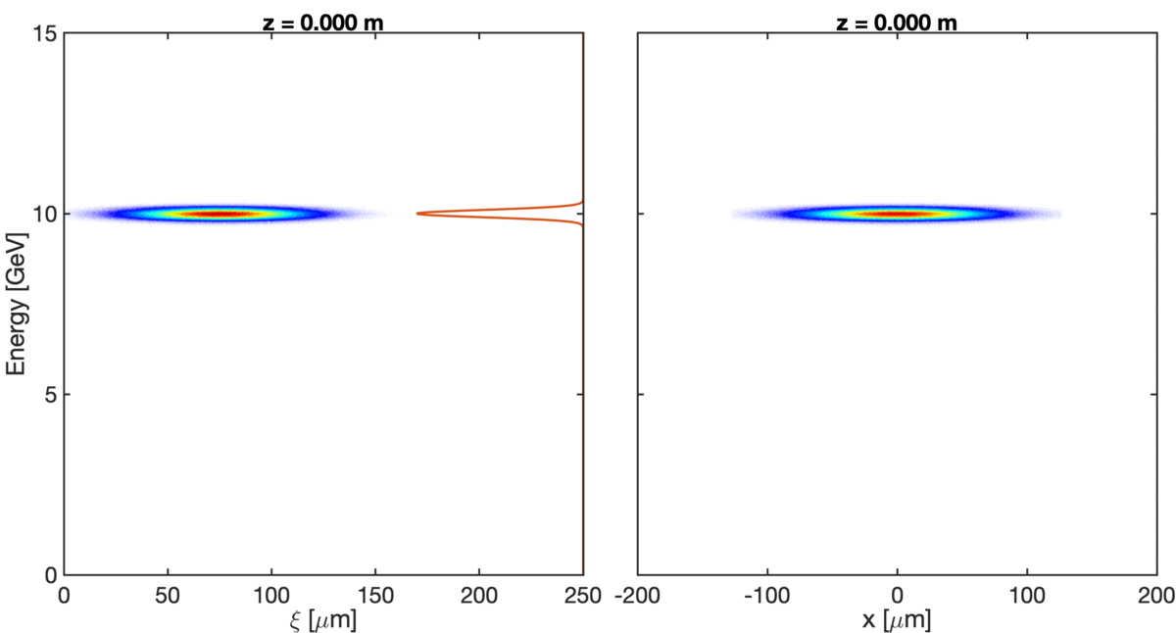
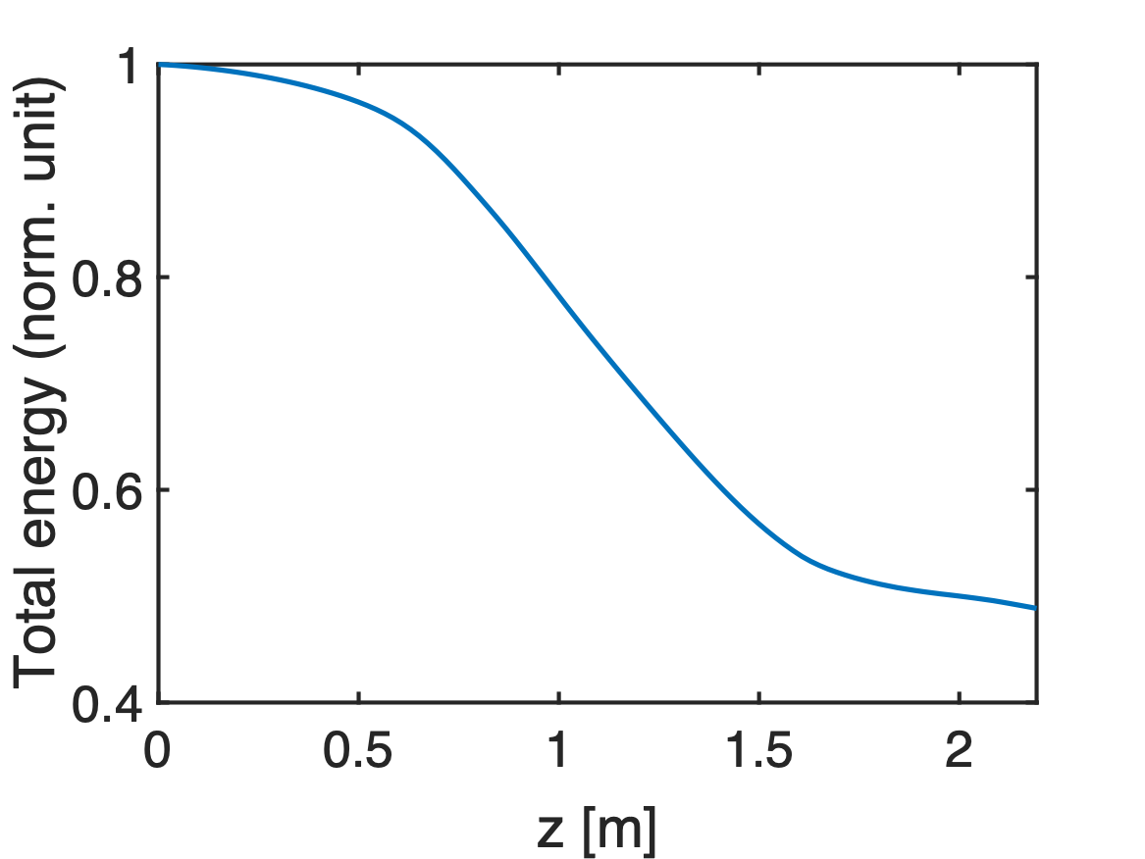
QPAD simulation: beam-ionized H2 case
~50% total energy loss
~80% beam-to-wake

Slide 17
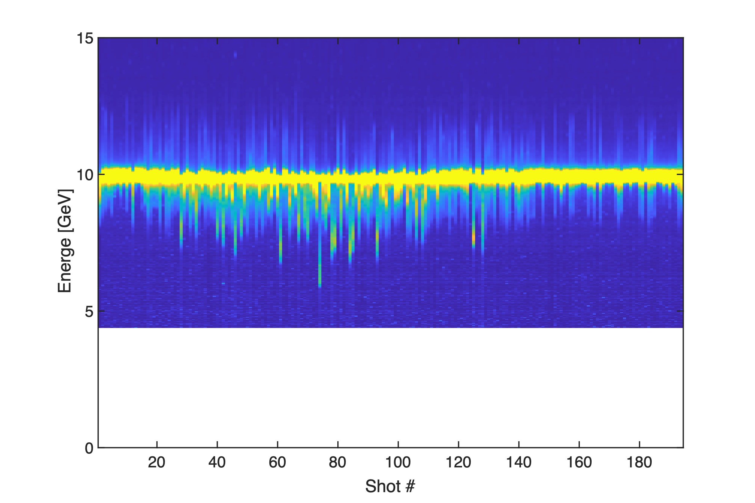
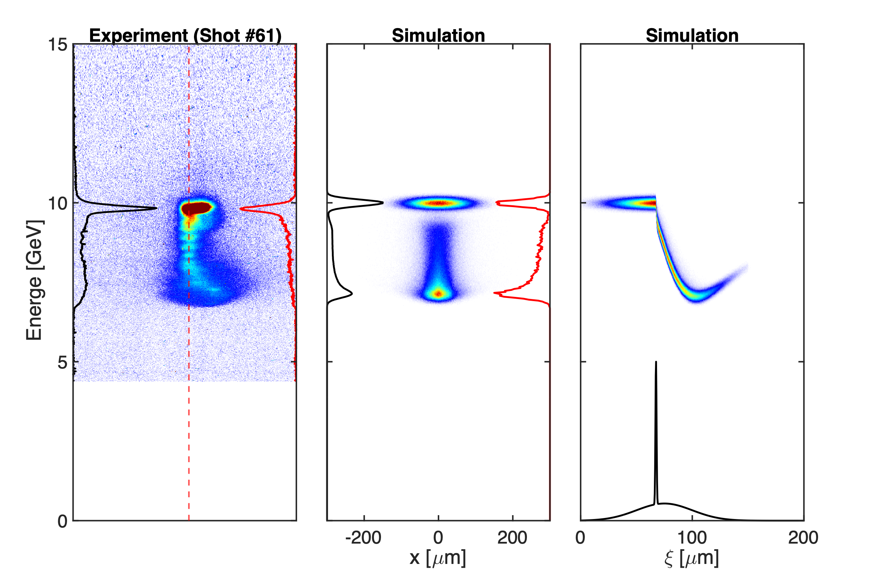
Comparison with experiment (0.3 Torr H2)
E300_02789

Slide 18
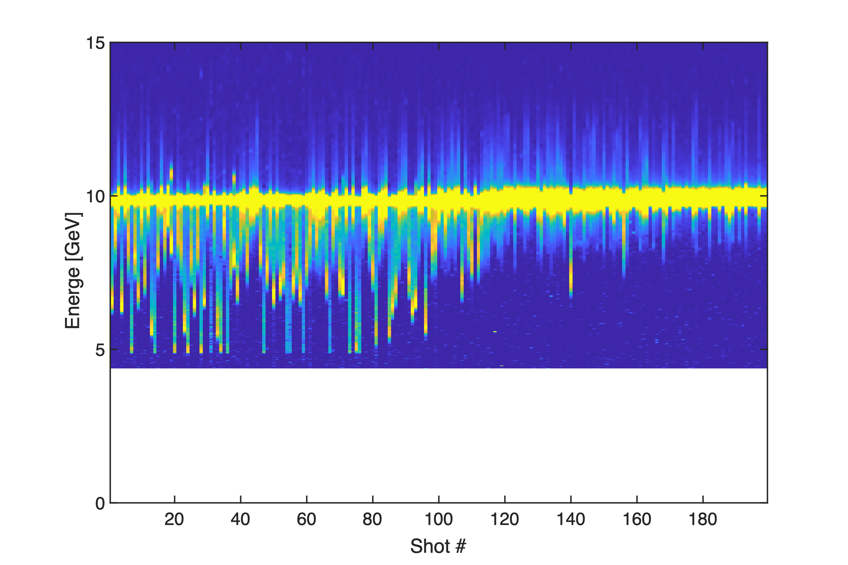
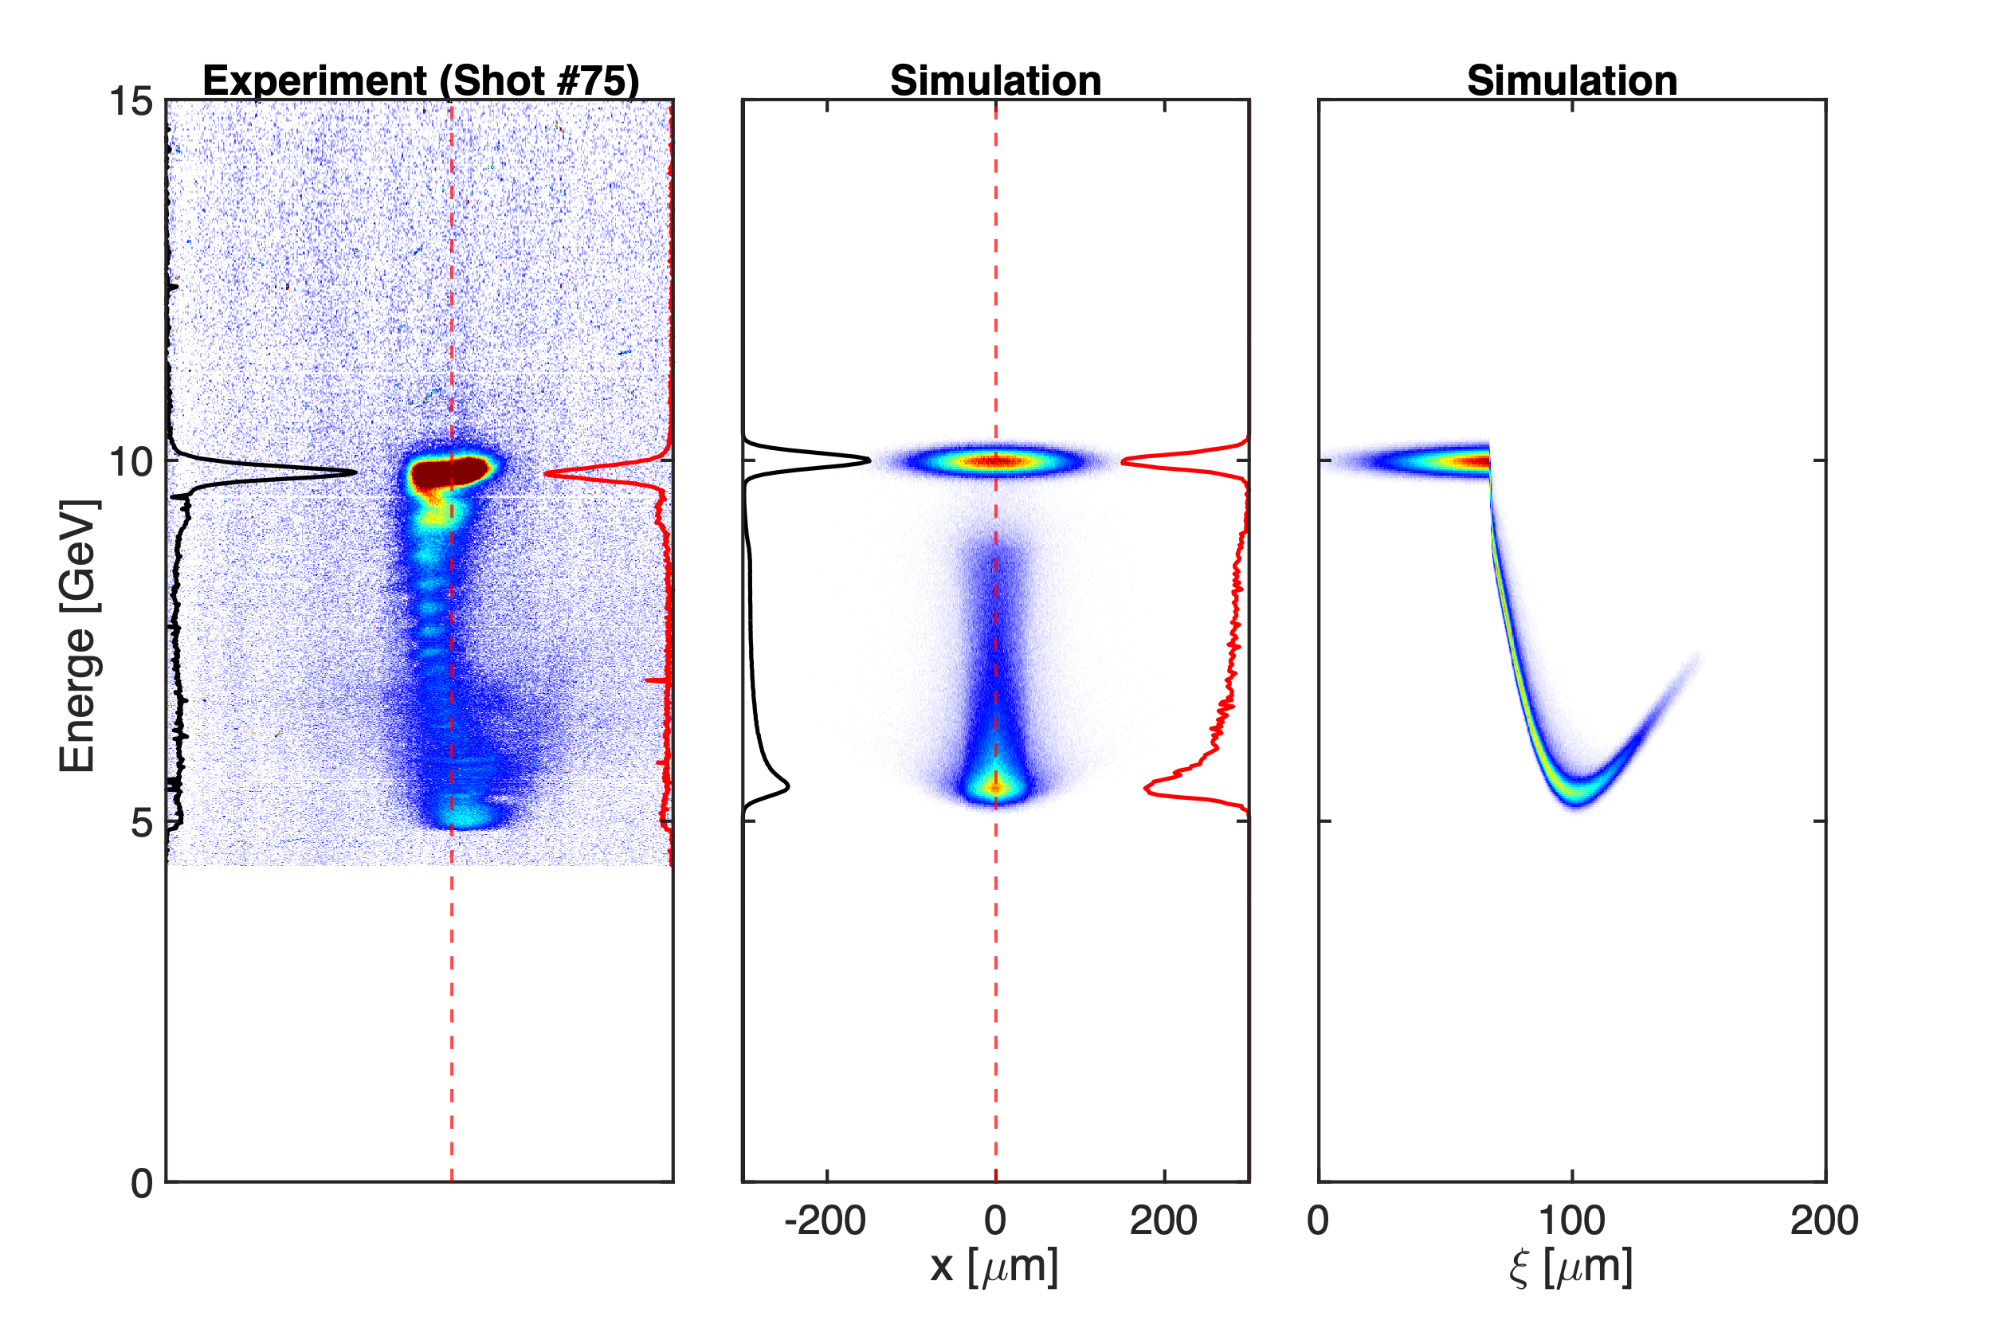
Comparison with experiment (0.5 Torr H2)
E300_02799

Slide 19
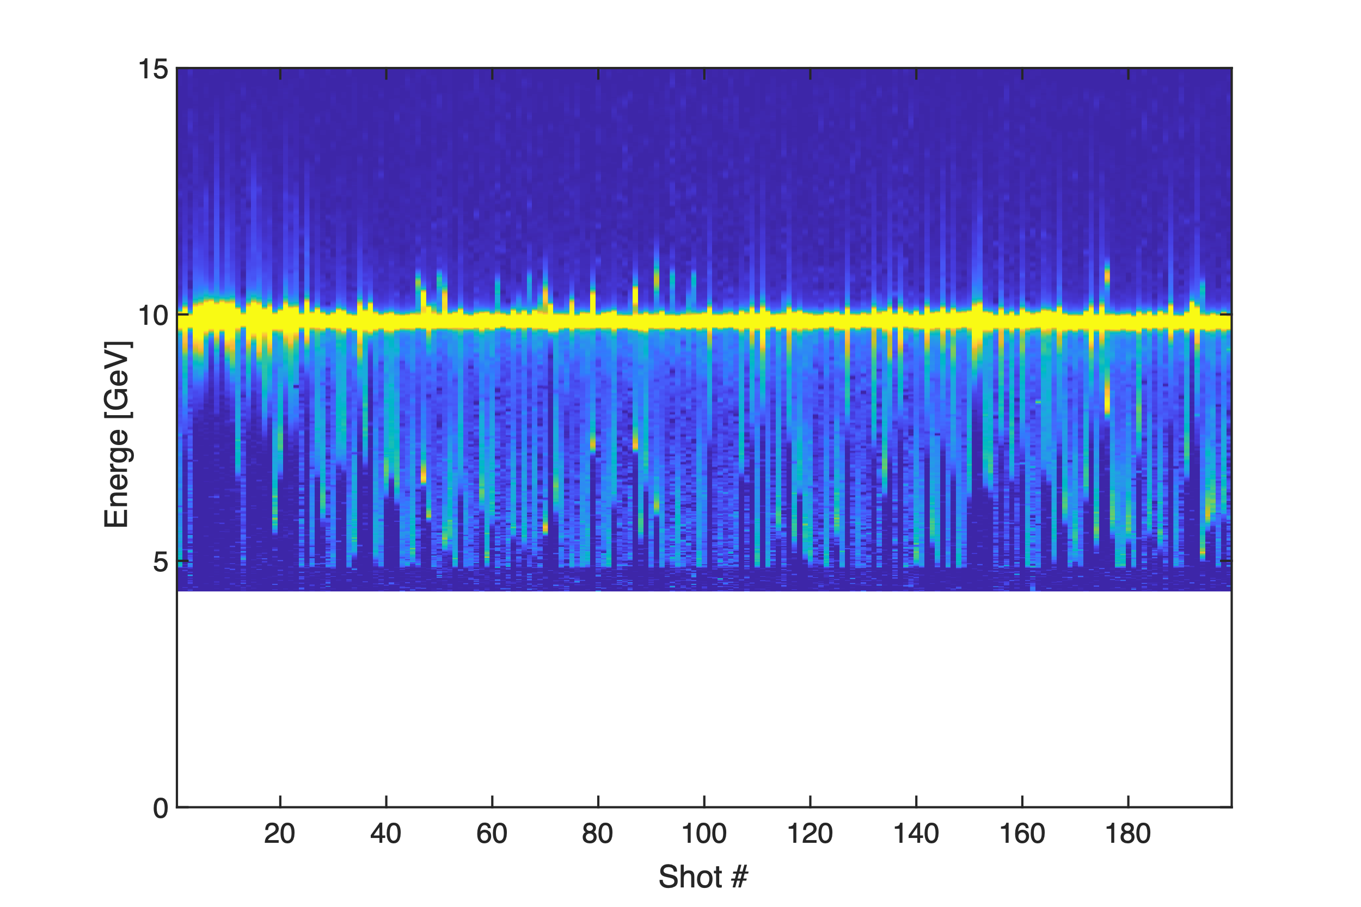
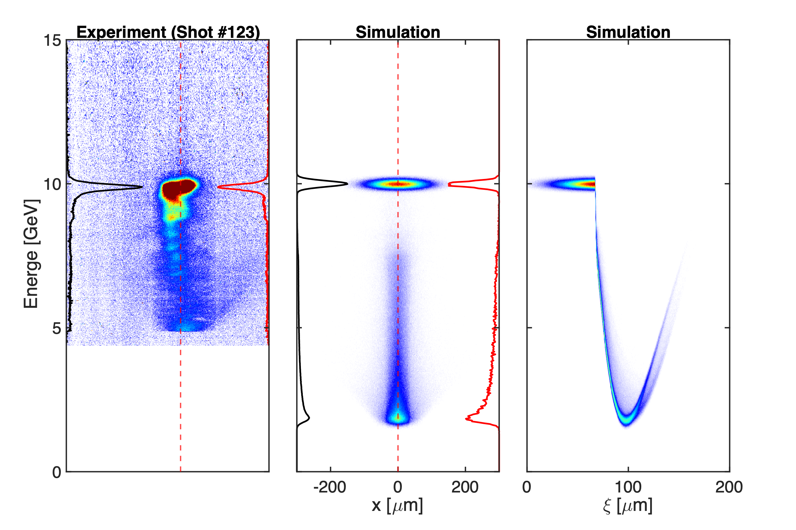
Comparison with experiment (1.0 Torr H2)
E300_02801

Slide 20
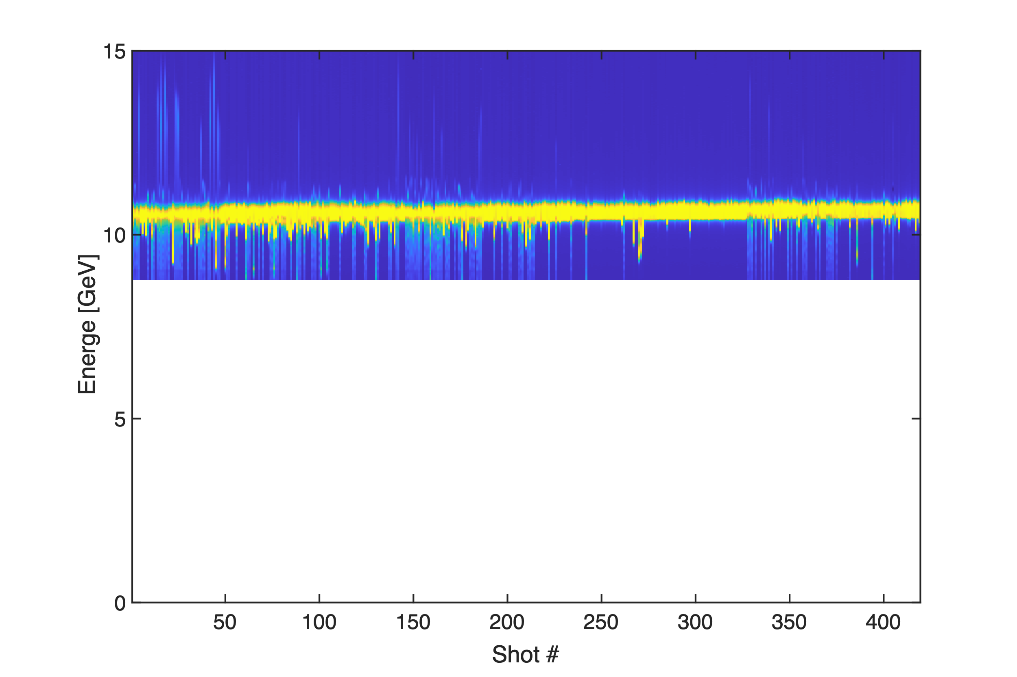
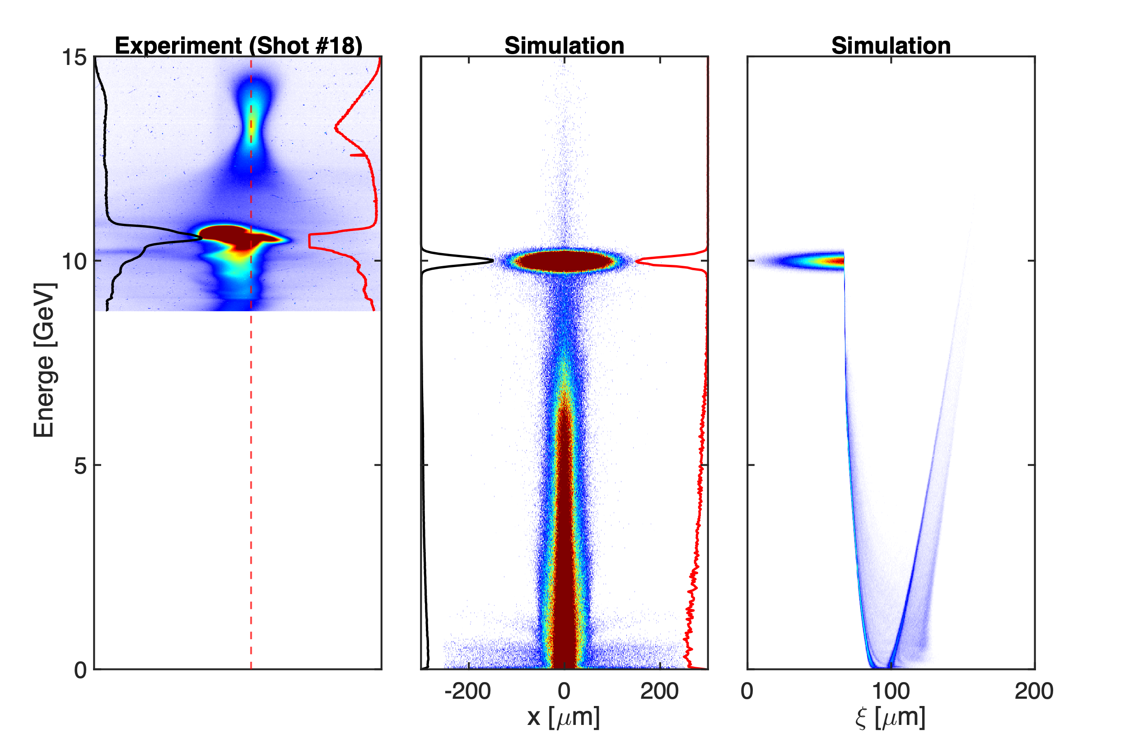
Comparison with experiment (1.5 Torr H2)
E300_02837

Slide 21
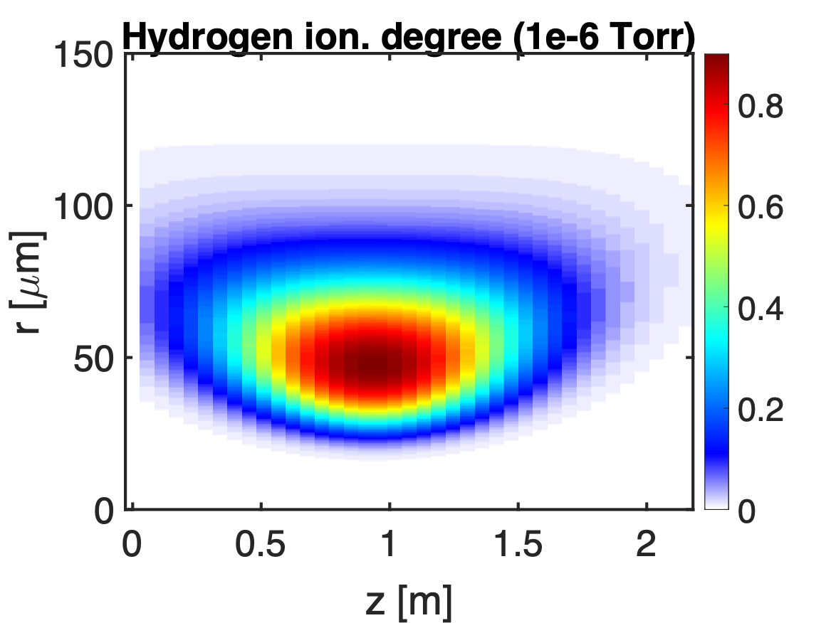
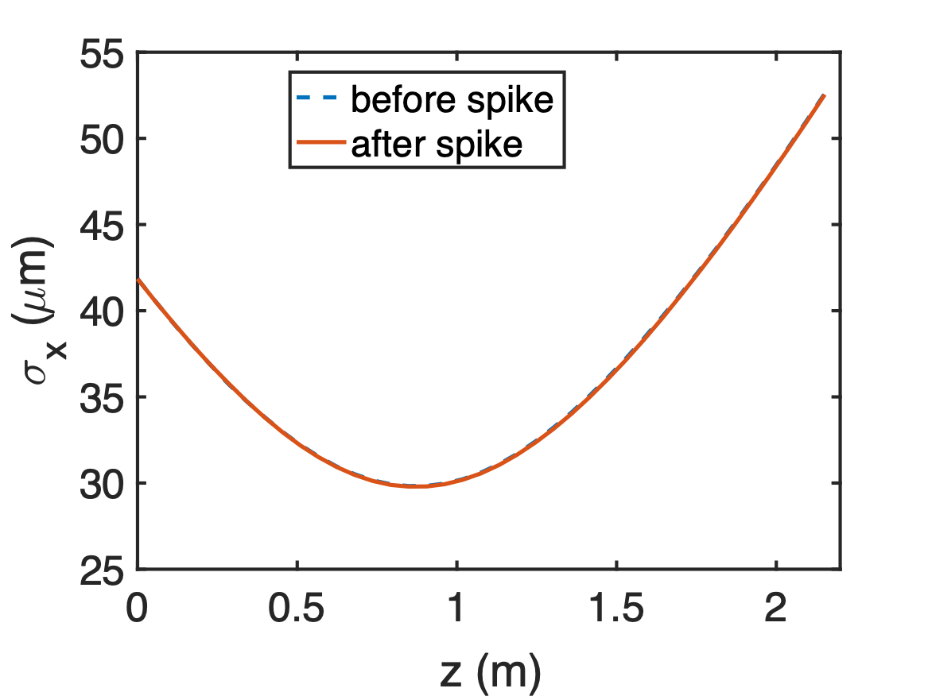
1e-6 Torr H2

Slide 22
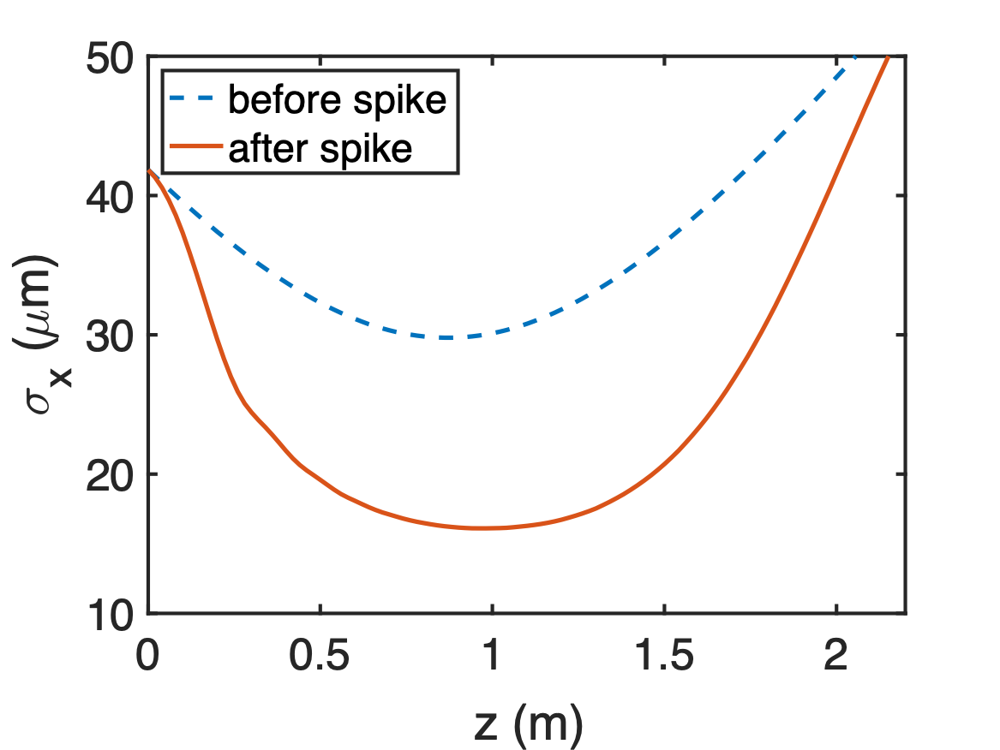
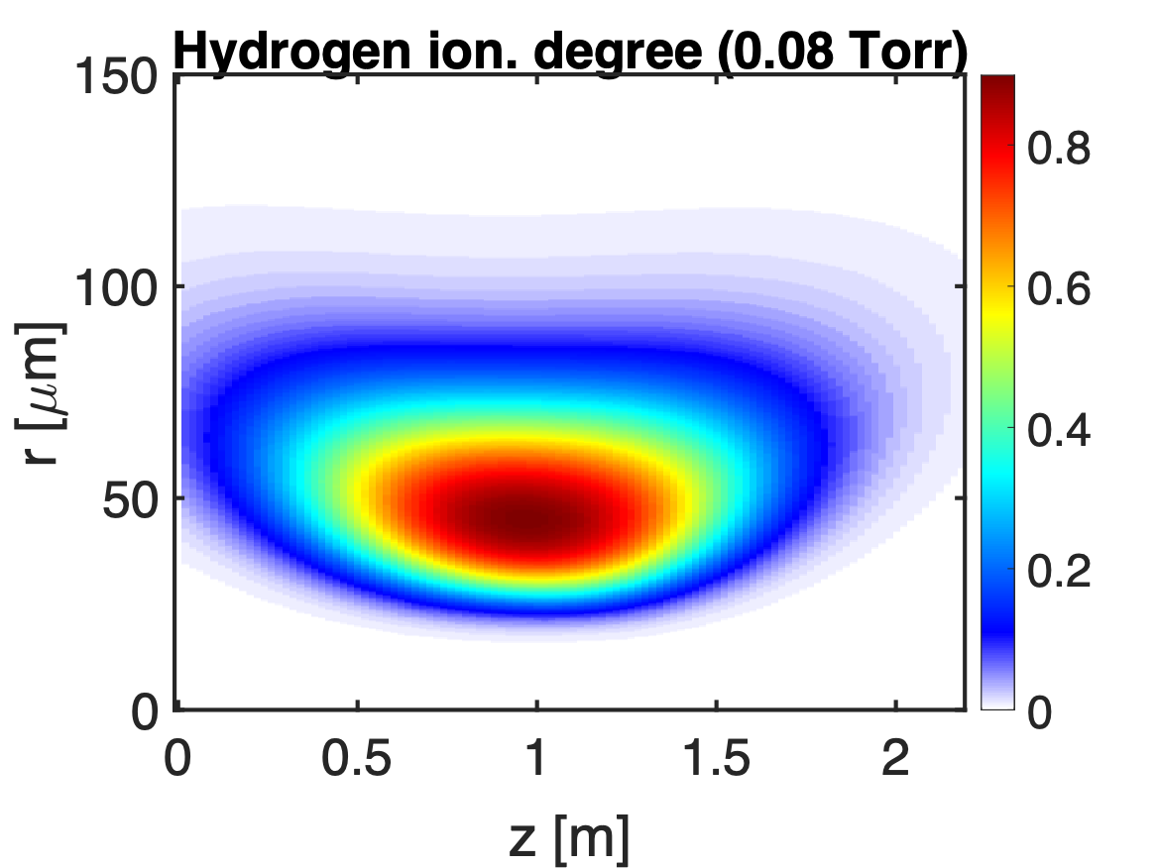
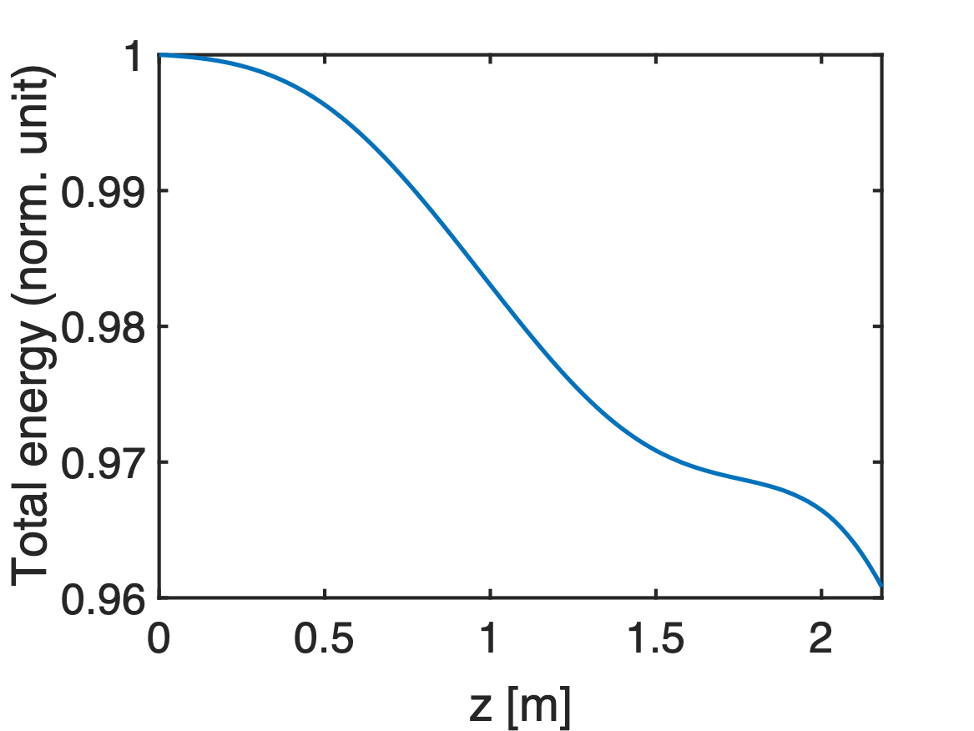
0.08 Torr H2

Slide 23
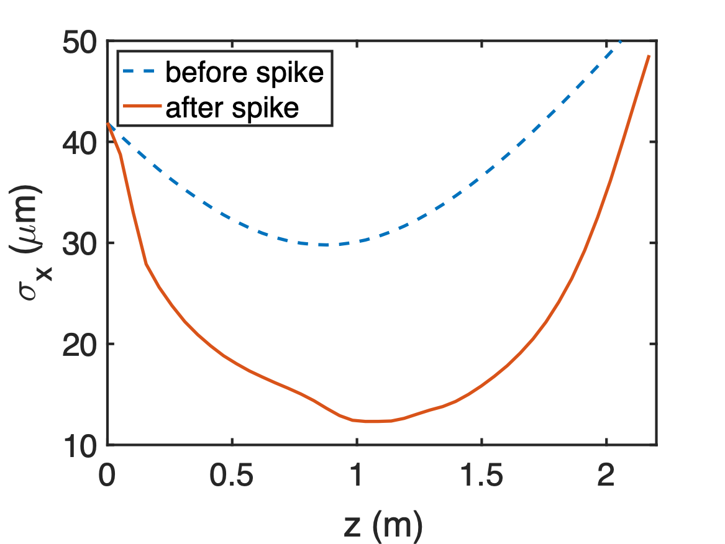
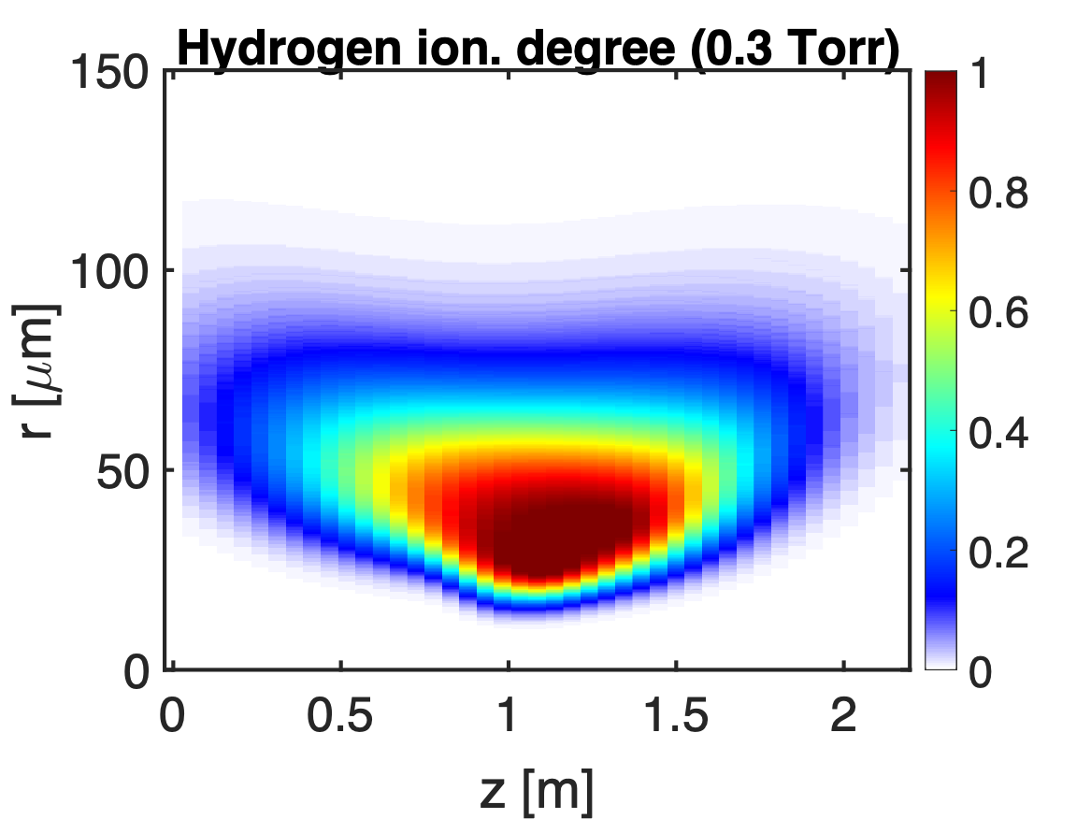
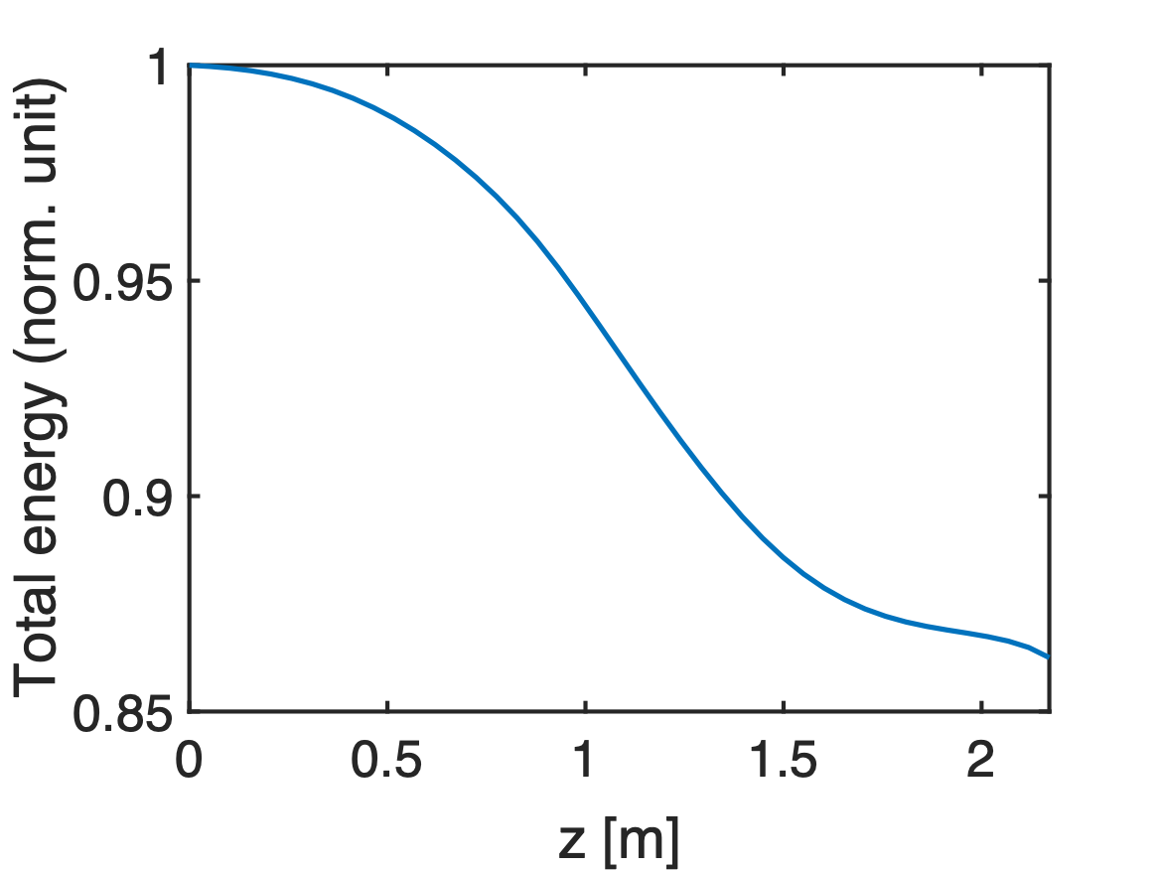
0.3 Torr H2

Slide 24
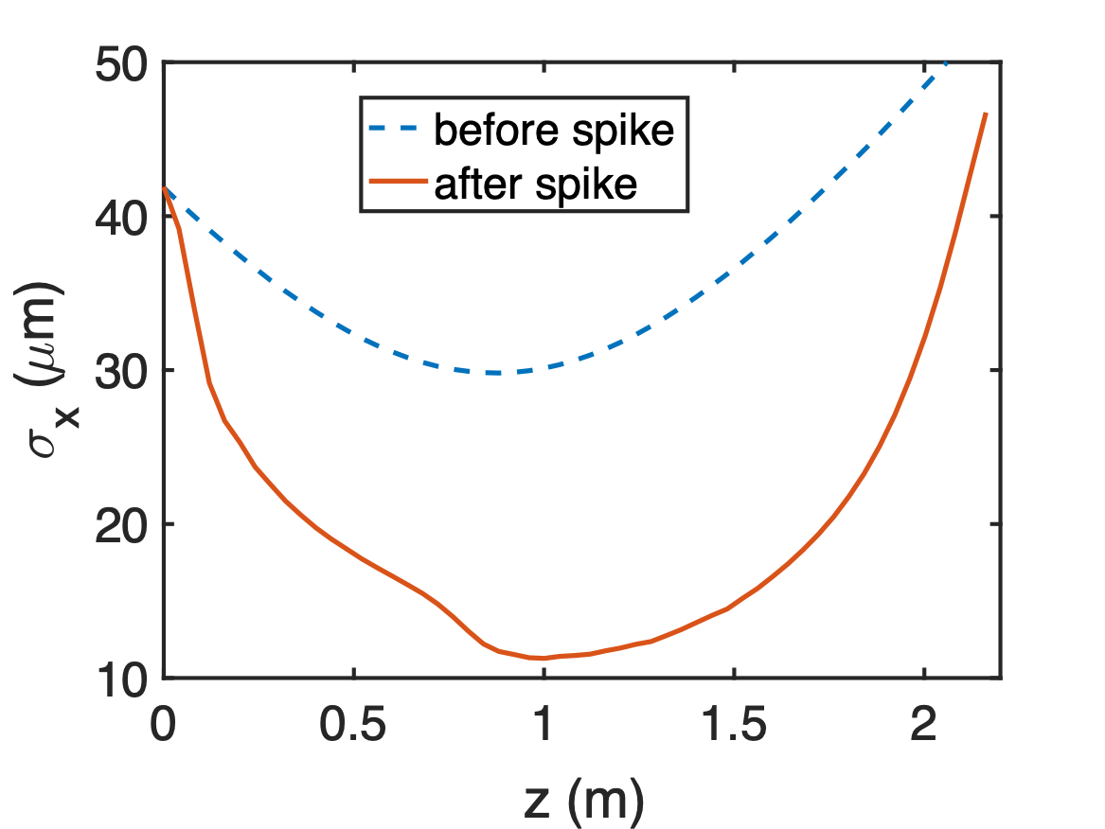
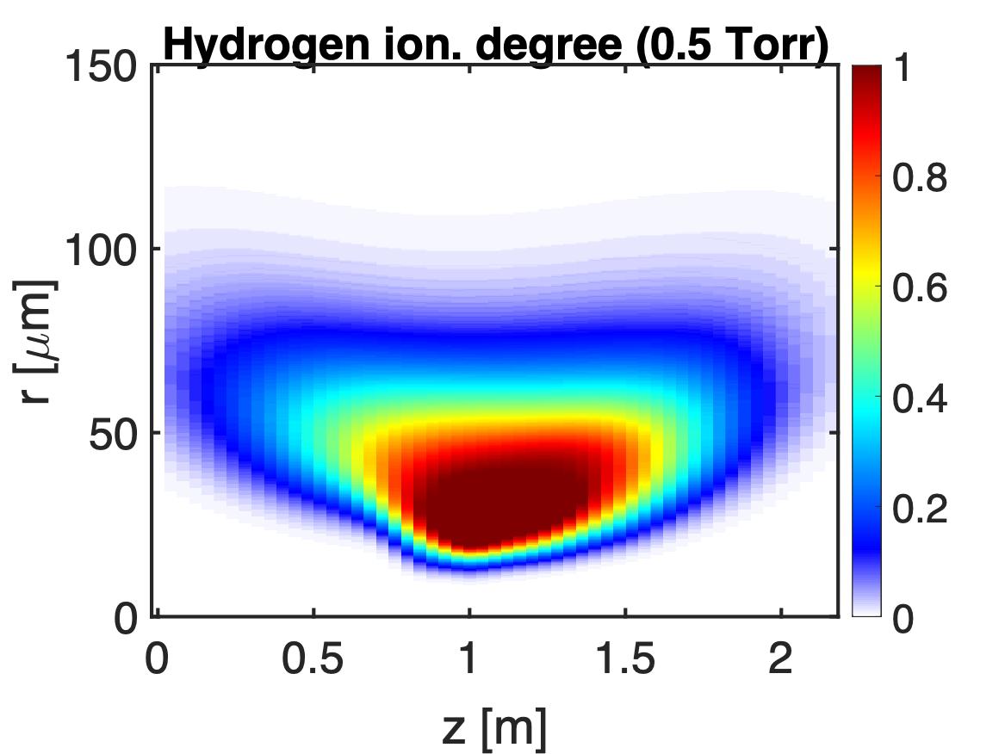

0.5 Torr H2

Slide 25
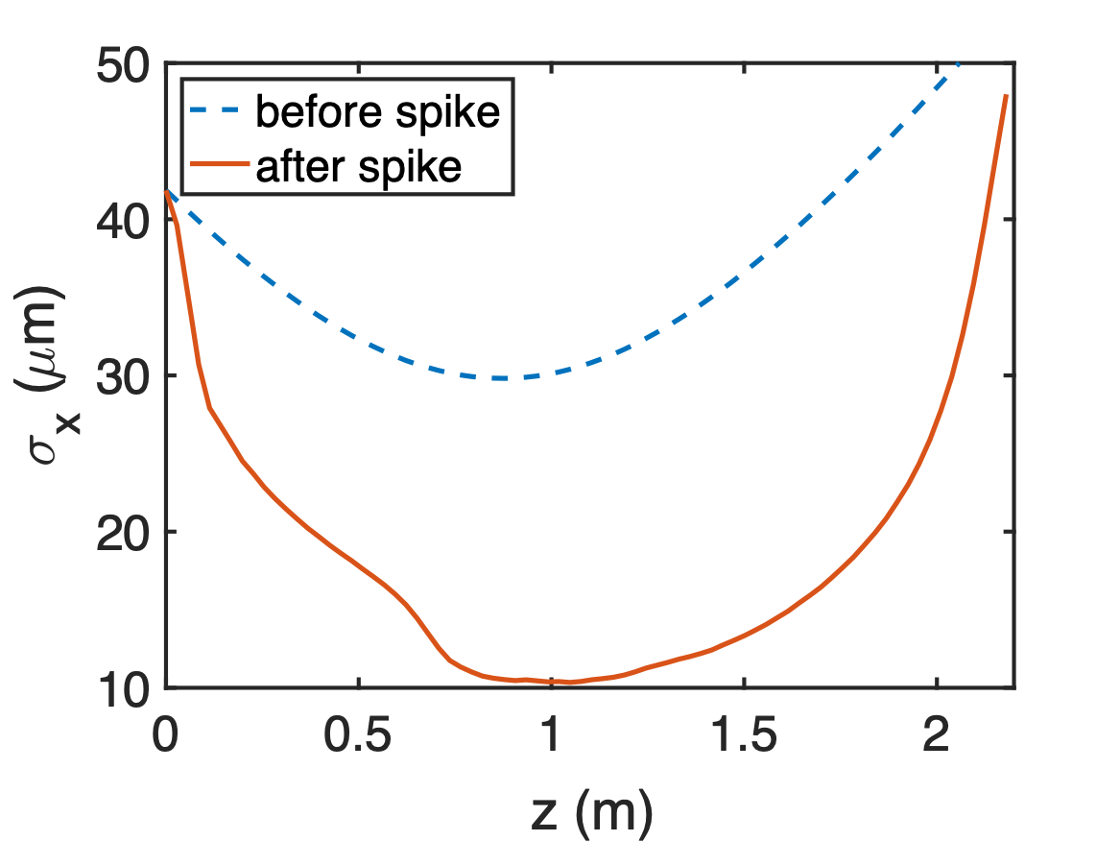
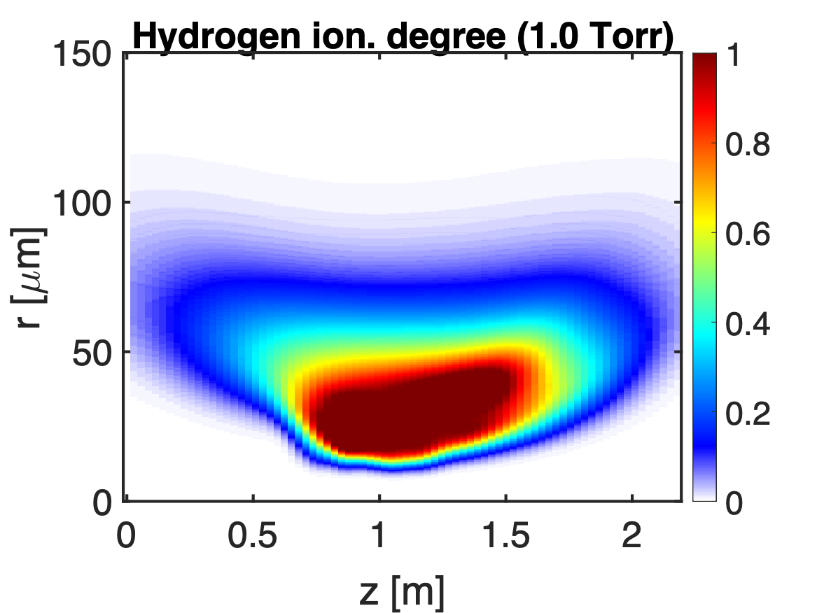

1.0 Torr H2

Slide 26
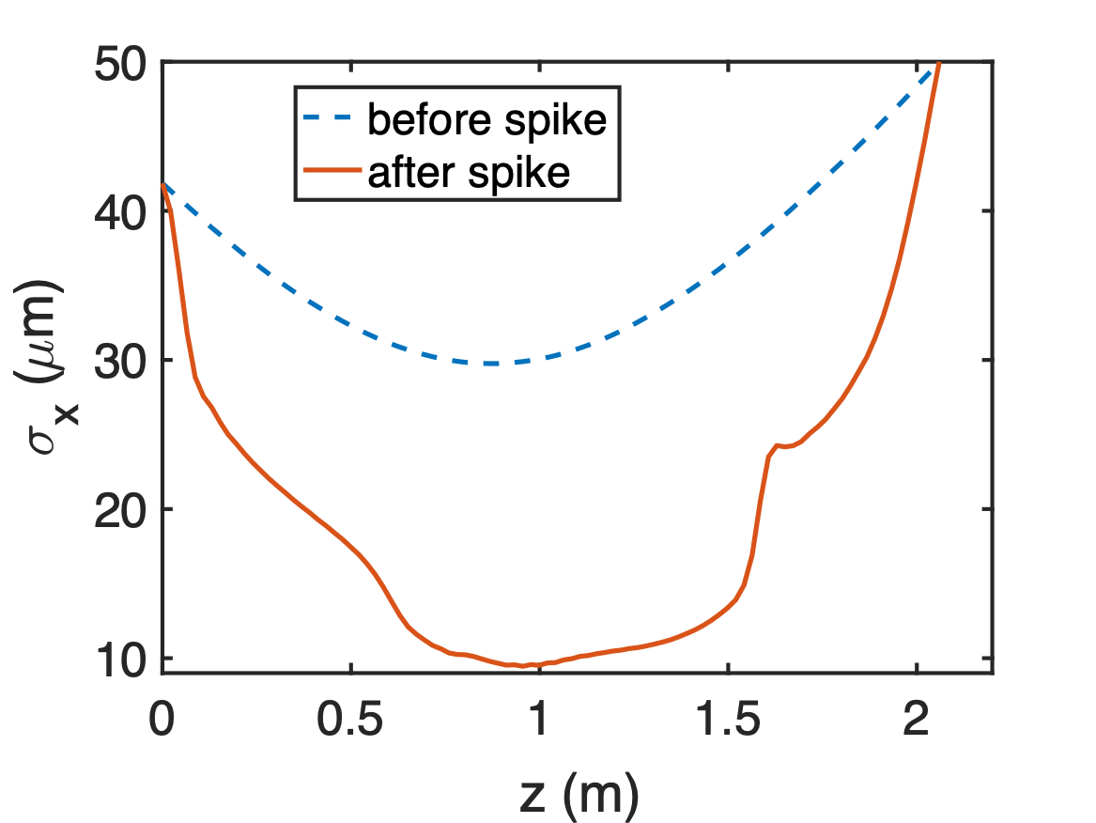
1.7 Torr H2

Slide 27
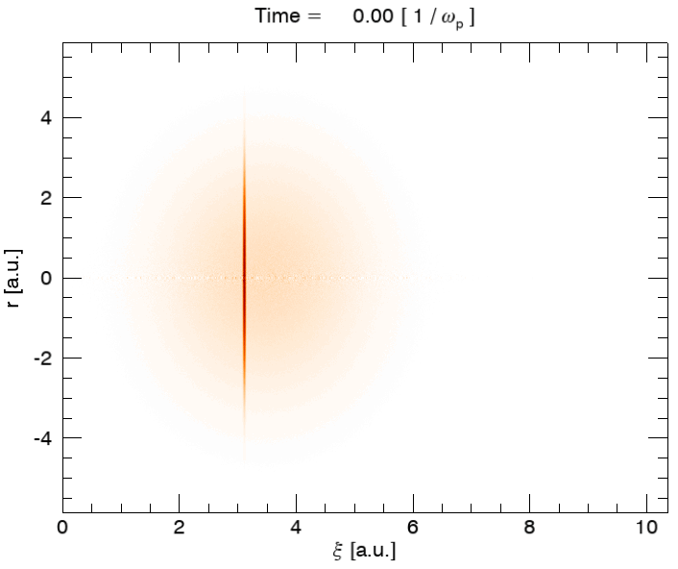
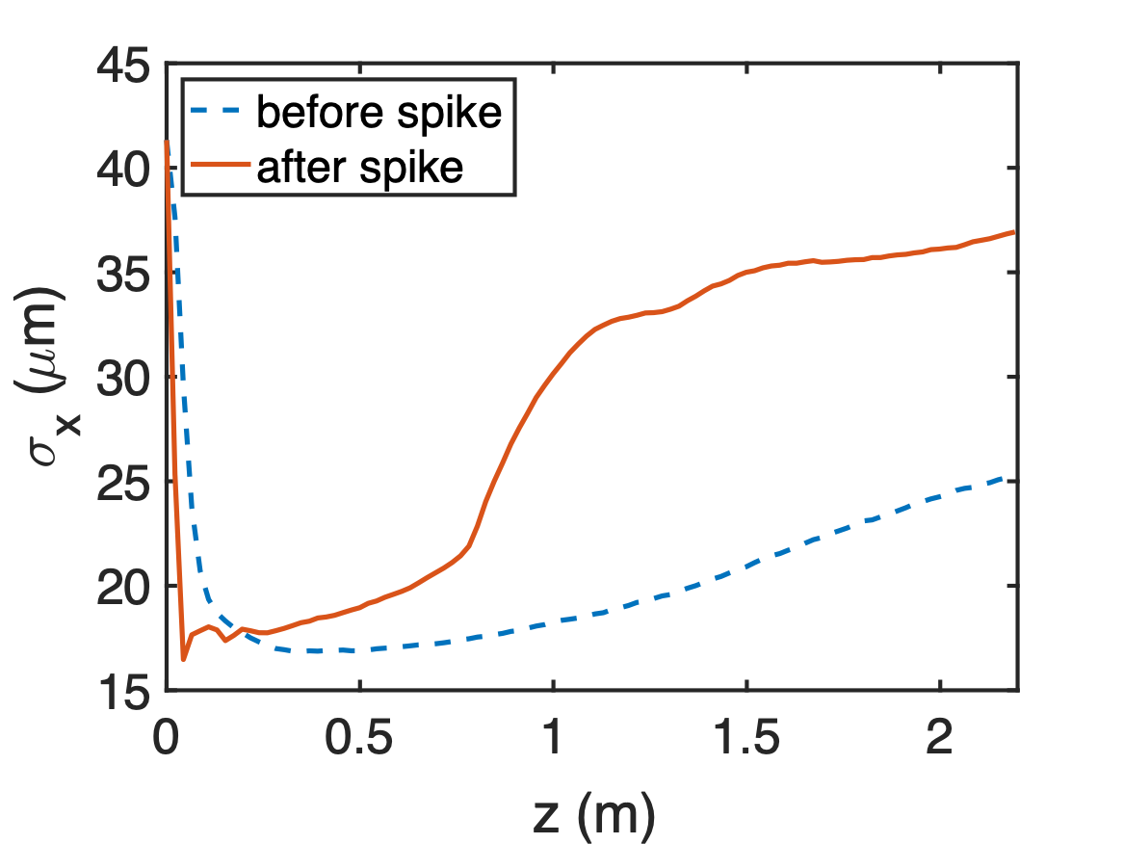
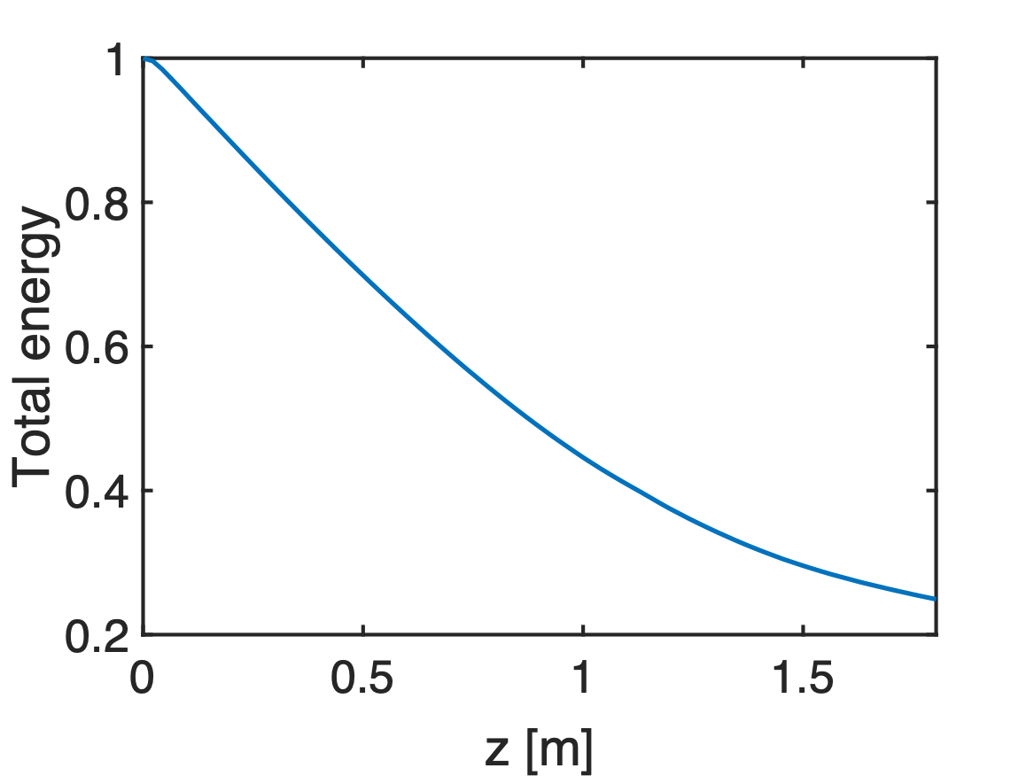
Pre-ionized case (1.7 Torr H2, 6⨉10¹⁶ cm⁻³)
~75% total energy loss

Slide 28

Pre-ionized case (1.7 Torr H2, 6⨉10¹⁶ cm⁻³)

Slide 29
Beam-ionized case (1.7 Torr H2)

Slide 30

Beam-ionized case (1.7 Torr H2)

Slide 31




Beam ionization comparison of H2 and He
Suppose the spike has smaller beam size
5%
Emax=49.6 GV/m
55 kA
55 kA
Emax=82.7 GV/m
0.23 nC
0.23 nC

Slide 32
Modeled beam current profile for He case
Main bunch
Spike
Charge | 1.37 nC
Peak current | 6.6 kA
𝝈r | 30 𝜇m
𝝈z1 | 25 𝜇m
εN | 20 𝜇m
𝛽* | 0.88 m
Charge | 0.23 nC
Peak current | 55 kA
𝝈r | 18 𝜇m
𝝈z2 | 0.5 𝜇m
εN | 7.2 𝜇m
𝛽* | 0.88 m
0.3𝝈z1
~40% unaffected

Slide 33


QPAD simulation: beam-ionized He case (5 Torr)

Slide 34




QPAD simulation: beam-ionized He case (5 Torr)

Slide 35



Comparison with experiment (5.0 Torr He)

Slide 36
What have we learned from E300 experiments and simulations so far?
>50 kA current spike is needed to fully ionize H2.
~30-40% of the beam was not losing any energy, however beam-to-wake energy transfer efficiency can approach ~80%.
The main bunch with a ultrashort spike reproduced the H2 results. To reproduce the He results, a spike with a smaller beam size was used.
Betatron oscillations are expected to be weak in ideal beam-ionized case, but we saw them in experiments which might result from non-ideal beam profile.
Beam ionization induced by spikes fluctuates shot-to-shot since the spike peak current and position might change. Pre-ionization capability will be helpful in the future run.

