Slide 1
Laser Ionized Plasma Sources Using the E300 Optics
October 5-6, 2022
E300 Collaboration Meeting
Robert Ariniello

Slide 2
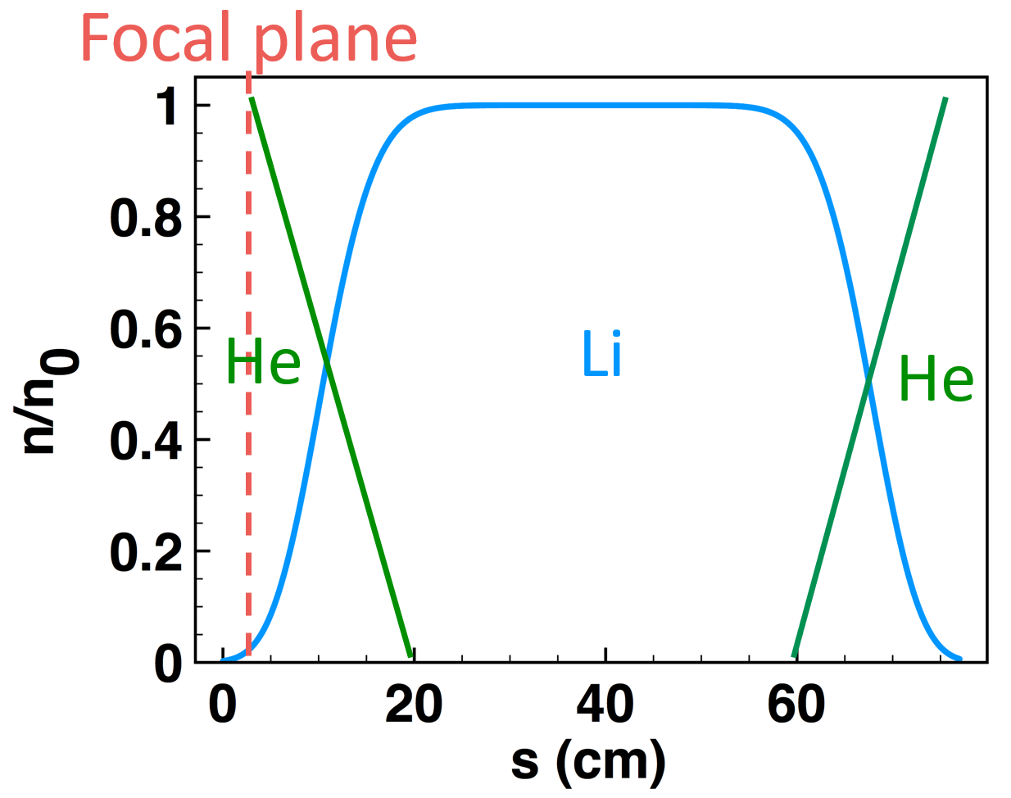
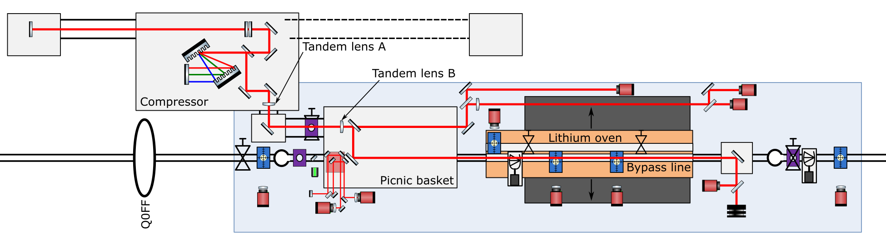
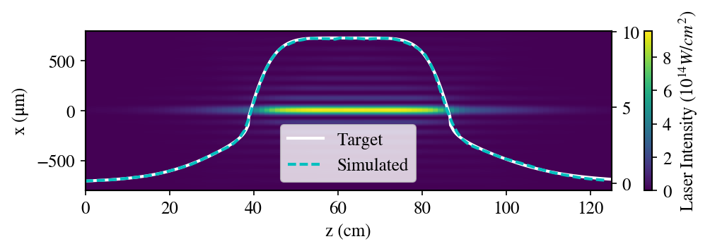
Two alternatives for laser ionized plasma sources
Two options for laser ionizing in the tunnel:
Ionize the lithium in the lithium oven.
Ionize a H2 static fill in the bypass line.

Slide 3
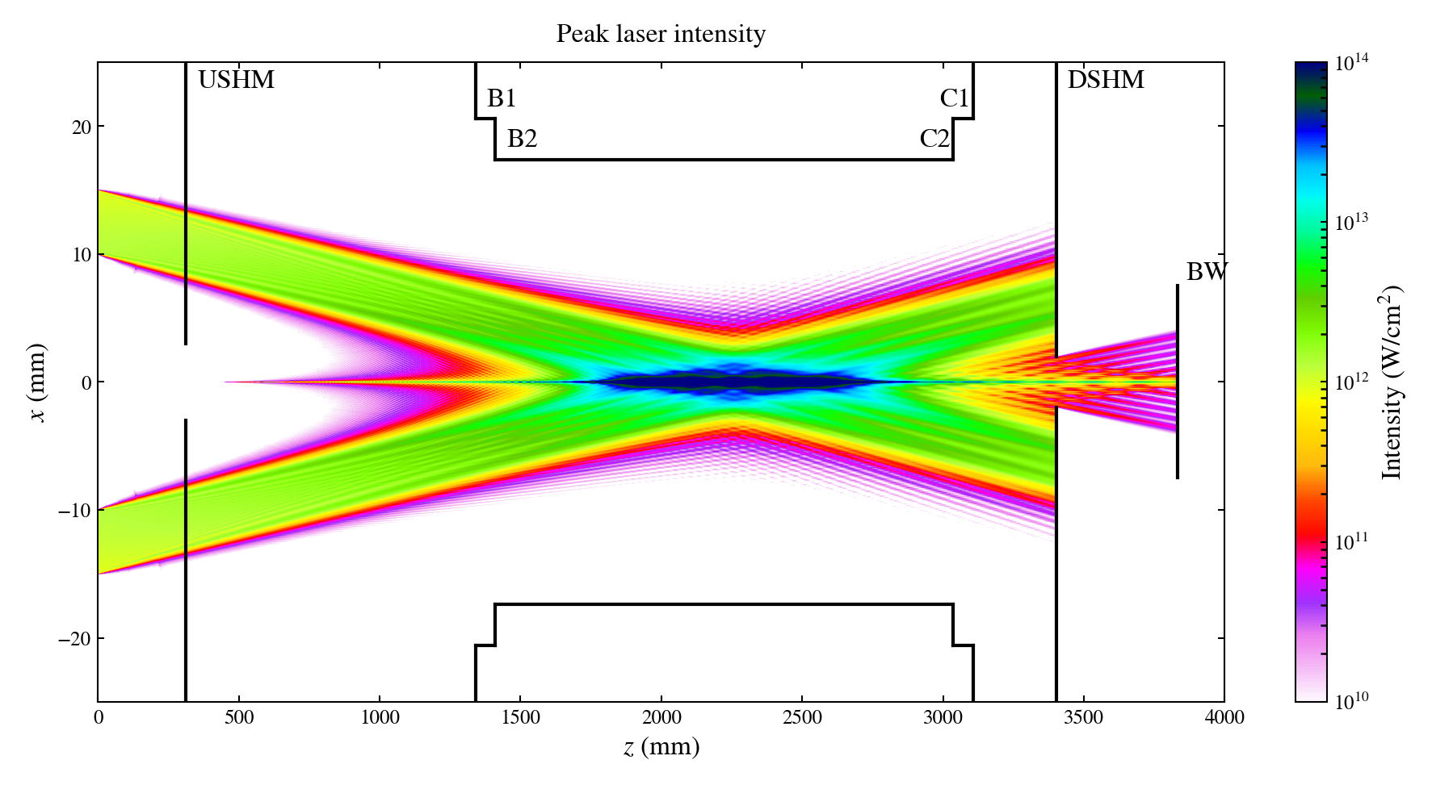
Two optics are currently available for ionization – axicon
Axicon lens:
Loose a lot of laser energy on the mask.

Slide 4
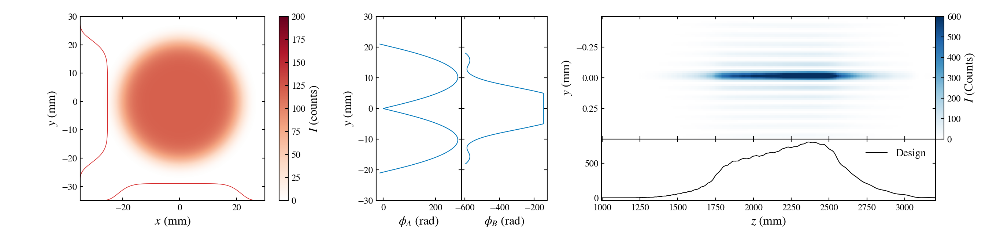
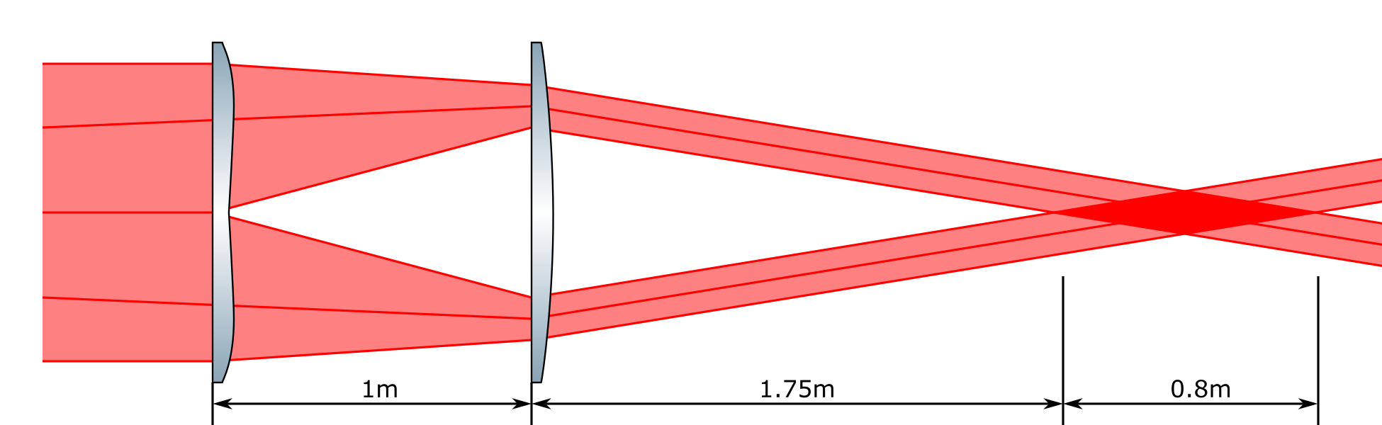
Two optics are currently available for ionization – tandem lens
Tandem lens:
More energy on target, better profile.

Slide 5
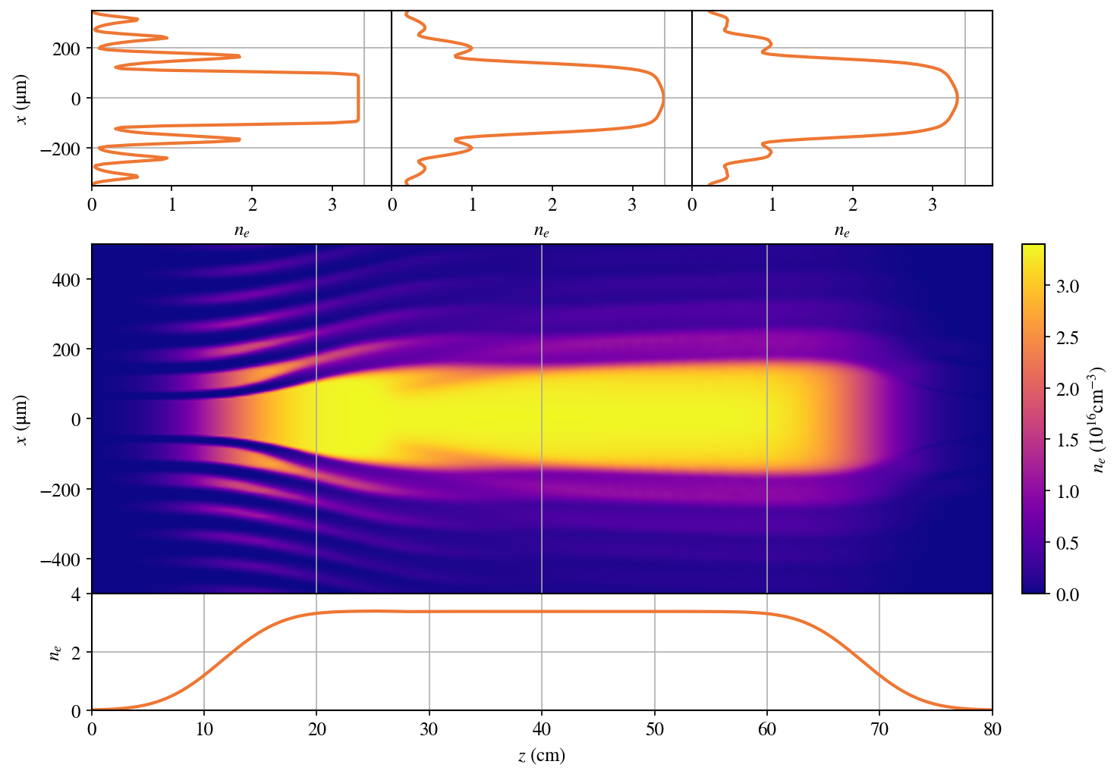
Ionizing the lithium oven
Gas Parameters
Gas species: Li
Gas density: 3.5e16 cm⁻³
Gas profile: Lithium oven
Gas pressure: 2.13 Torr
Laser Parameters
Main-amp output: 20.5mJ
Pulse duration: 70fs FWHM
Wavelength: 800nm
Beam size: 40mm FWHM
Beam profile: Super-Gaussian
Laser Energy
Energy after optics: 7.3mJ
Energy to ionize: 2.86mJ
Laser refraction simulation
Split step Fourier based code.
Energy loss due to ionization.
No dispersion, no self-focusing.

Slide 6
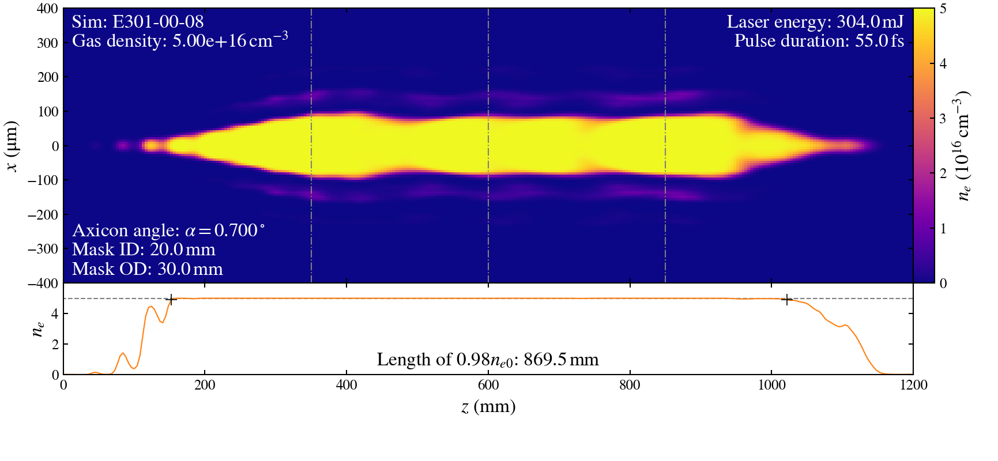
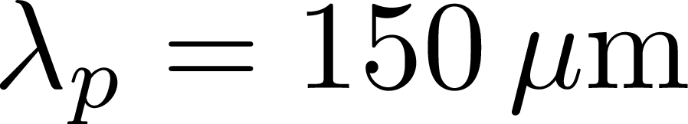

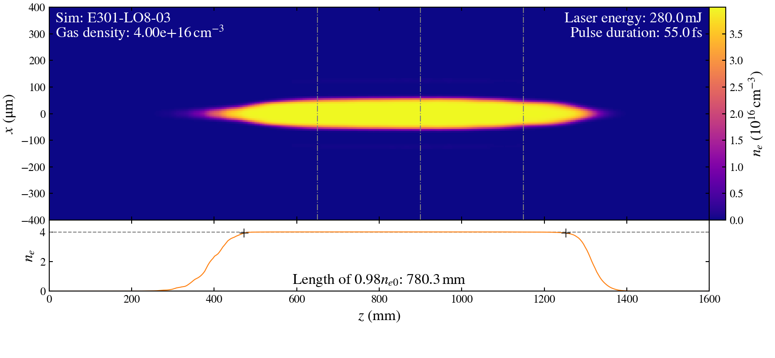
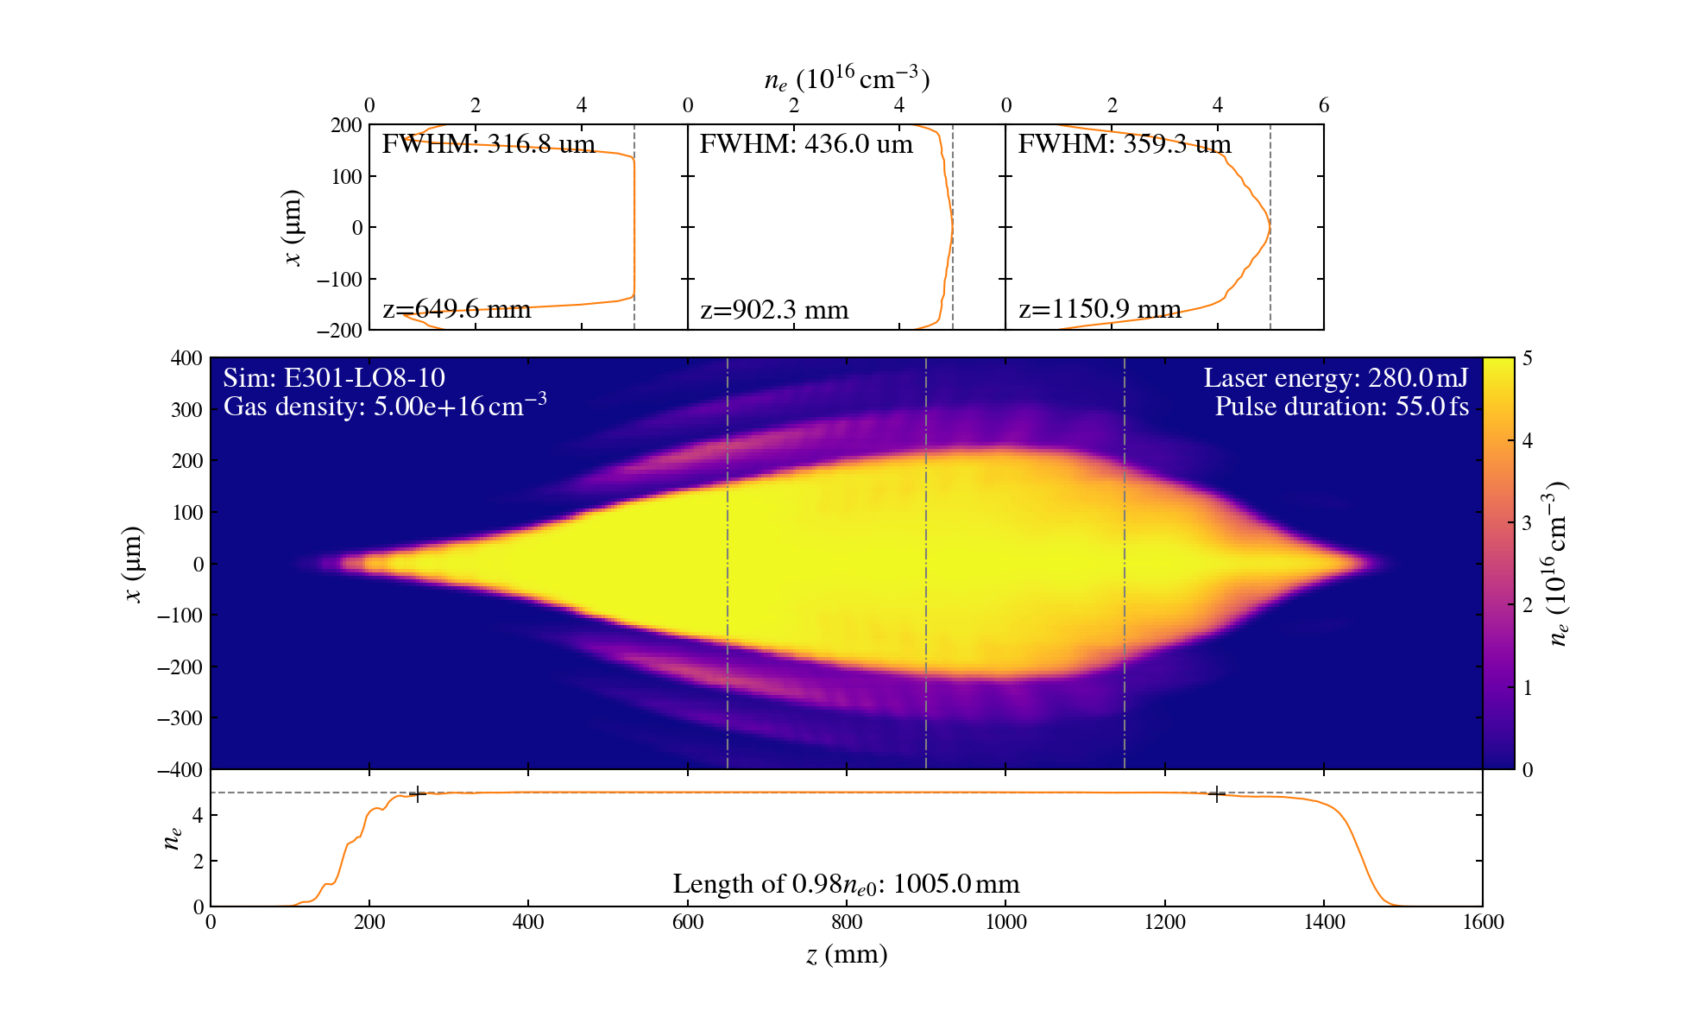
Ionizing fill gas in the bypass line
Goal is a fully ionized plasma, as wide as possible.
Not enough laser energy to get a wide plasma in He.
Either axicon or tandem lens produces a good H2 plasma.
The tandem lens delivers almost three times the energy to the target – leads to a wider plasma.
Bubble size about (target width )
Axicon H2
L=870mm, FWHM=170mm
PWFA is possible with H2 using either lens arrangement.
LO8 He
LO8 H2
L=780mm, FWHM=115mm
L=1005mm, FWHM=436mm

Slide 7

0.7 deg axicon, 20mm ID 20mm OD mask, H2
Gas Parameters
Gas species: H2
Gas density: 2.50e16 cm⁻³
Gas profile: Filled chamber
Gas pressure: 0.76 Torr
Laser Parameters
Main-amp output: 800mJ
Pulse duration: 55fs FWHM
Wavelength: 800nm
Beam size (w0): 20.24mm
Beam profile: Super-Gaussian
Laser Energy
Energy to mask: 304mJ
Energy after mask: 113mJ
Energy to ionize: 2.28mJ
Laser refraction simulation
Split step Fourier based code.
Energy loss due to ionization.
No dispersion, no self-focusing.
LO region starts at z=100mm

Slide 8
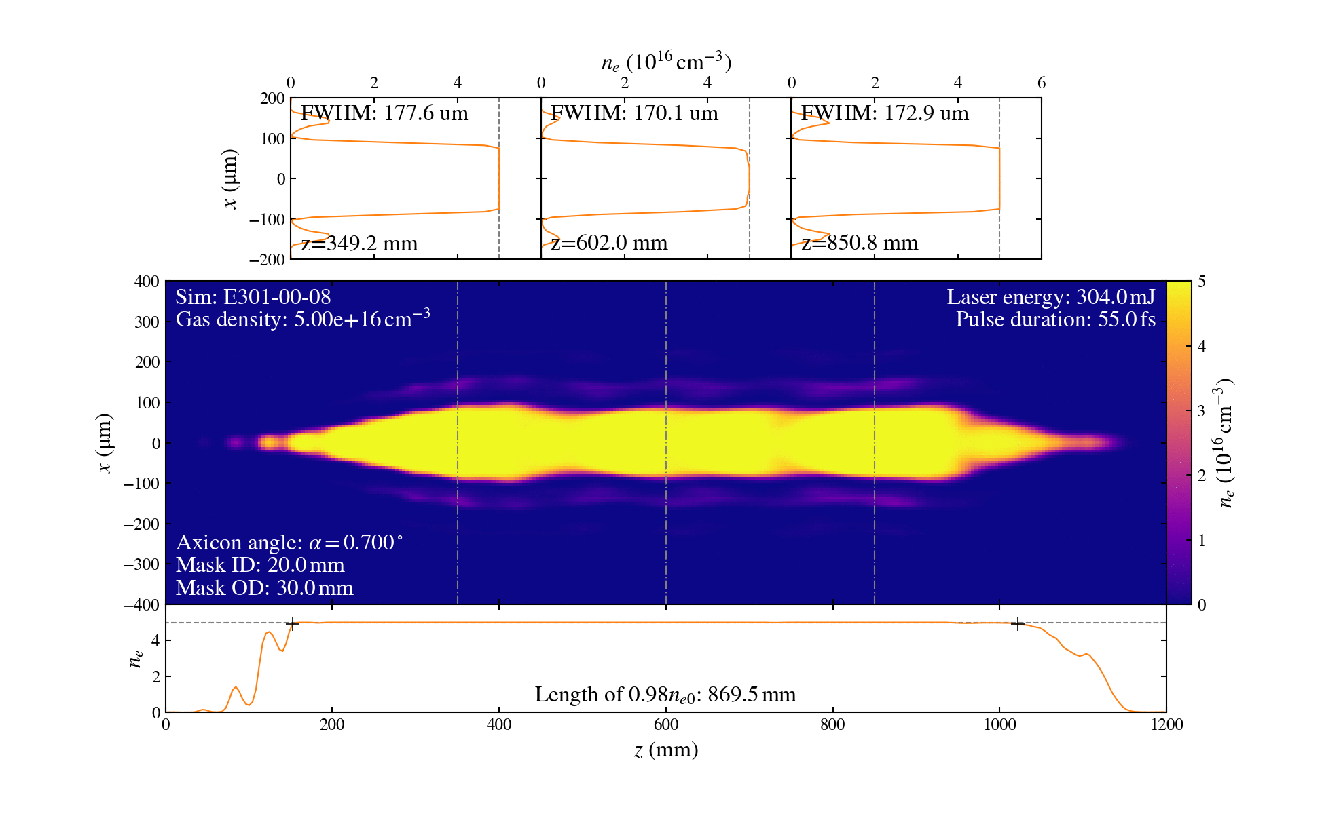
0.7 deg axicon, FACET laser profile, H2
Gas Parameters
Gas species: H2
Gas density: 2.50e16 cm⁻³
Gas profile: Filled chamber
Gas pressure: 0.76 Torr
Laser Parameters
Main-amp output: 800mJ
Pulse duration: 55fs FWHM
Wavelength: 800nm
Beam size (w0): 20.24mm
Beam profile: Actual
Laser Energy
Energy to mask: 304mJ
Energy after mask: 114mJ
Energy to ionize: 2.30mJ
Laser refraction simulation
Split step Fourier based code.
Energy loss due to ionization.
No dispersion, no self-focusing.
FACET beam profile has minimal impact on the plasma formation.
LO region starts at z=100mm

Slide 9

0.7 deg axicon, energy scan, H2
Gas Parameters
Gas species: H2
Gas density: 2.50e16 cm⁻³
Gas profile: Filled chamber
Gas pressure: 0.76 Torr
Laser Parameters
Main-amp output: 800-500mJ
Pulse duration: 55fs FWHM
Wavelength: 800nm
Beam size (w0): 20.24mm
Beam profile: Super-Gaussian
Laser Energy
Energy to mask: 304-190mJ
Energy after mask: 114-71mJ
Energy to ionize: 2.30-1.04mJ
Laser refraction simulation
Split step Fourier based code.
Energy loss due to ionization.
No dispersion, no self-focusing.
H2 is no longer fully ionized for laser energy <500mJ.
LO region starts at z=100mm

Slide 10
LO8 tandem lens, H2
Gas Parameters
Gas species: H2
Gas density: 2.50e16 cm⁻³
Gas profile: Filled chamber
Gas pressure: 0.76 Torr
Laser Parameters
Main-amp output: 800mJ
Pulse duration: 55fs FWHM
Wavelength: 800nm
Beam size (w0): 20.24mm
Beam profile: Super-Gaussian
Laser Energy
Energy after optics: 276mJ
Energy to ionize: 13.70mJ
Laser refraction simulation
Split step Fourier based code.
Energy loss due to ionization.
No dispersion, no self-focusing.
LO region starts at z=100mm

Slide 11

LO8 tandem lens, FACET laser profile, H2
Gas Parameters
Gas species: H2
Gas density: 2.50e16 cm⁻³
Gas profile: Filled chamber
Gas pressure: 0.76 Torr
Laser Parameters
Main-amp output: 800mJ
Pulse duration: 55fs FWHM
Wavelength: 800nm
Beam size (w0): 20.24mm
Beam profile: Actual
Laser Energy
Energy after optics: 274mJ
Energy to ionize: 13.87mJ
Laser refraction simulation
Split step Fourier based code.
Energy loss due to ionization.
No dispersion, no self-focusing.
Plasma is still decent even with the real laser profile.
LO region starts at z=500mm

Slide 12
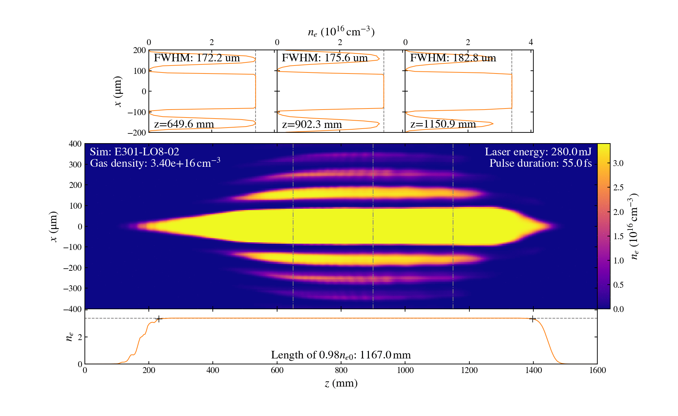
LO8 tandem lens, density scan, H2
Gas Parameters
Gas species: H2
Gas density: 1.70e16-4.50e16 cm⁻³
Gas profile: Filled chamber
Gas pressure: 0.52-1.37 Torr
Laser Parameters
Main-amp output: 800mJ
Pulse duration: 55fs FWHM
Wavelength: 800nm
Beam size (w0): 20.24mm
Beam profile: Super-Gaussian
Laser Energy
Energy after optics: 276mJ
Energy to ionize: 6.96-20.12mJ
Laser refraction simulation
Split step Fourier based code.
Energy loss due to ionization.
No dispersion, no self-focusing.
Narrow range of densities where axicon like focus produces a wide plasma.
LO region starts at z=100mm

Slide 13
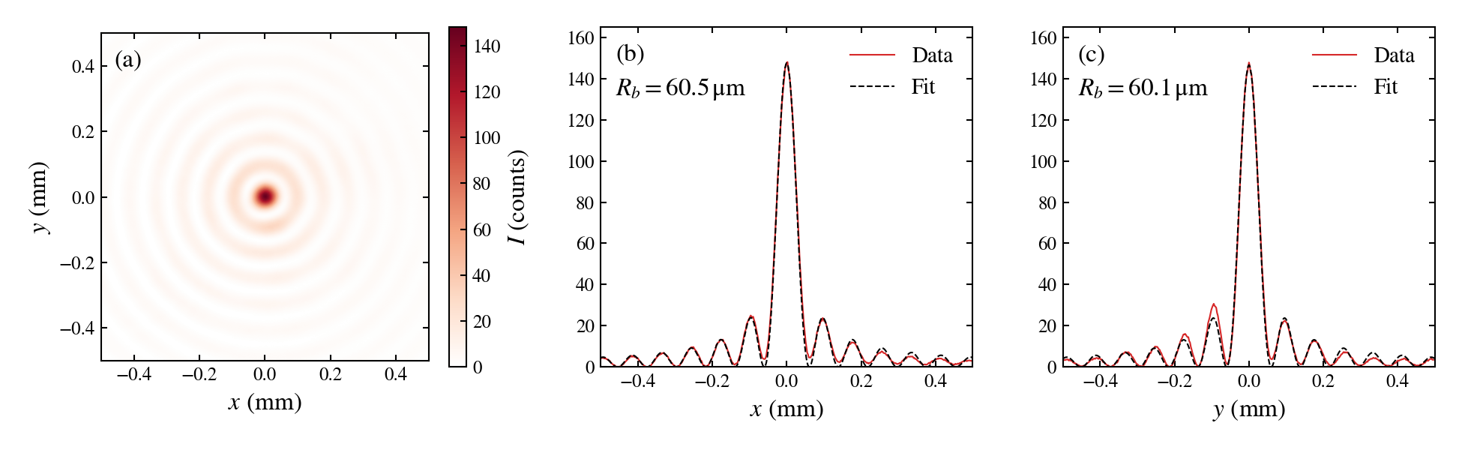
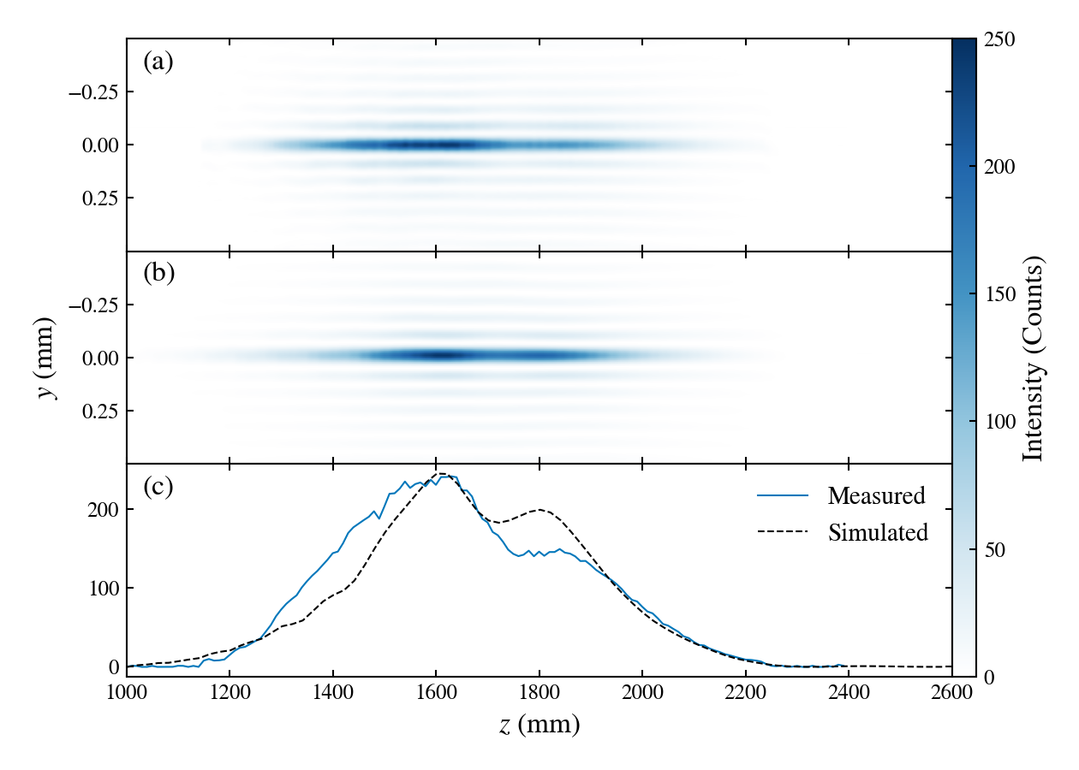
Current progress – tandem lens tests
Bessel focus measured 1.5m after lens B.
Intensity along the focus compared to simulation
Tandem lens focusing performs as expected when tested with a low power laser.

Slide 14
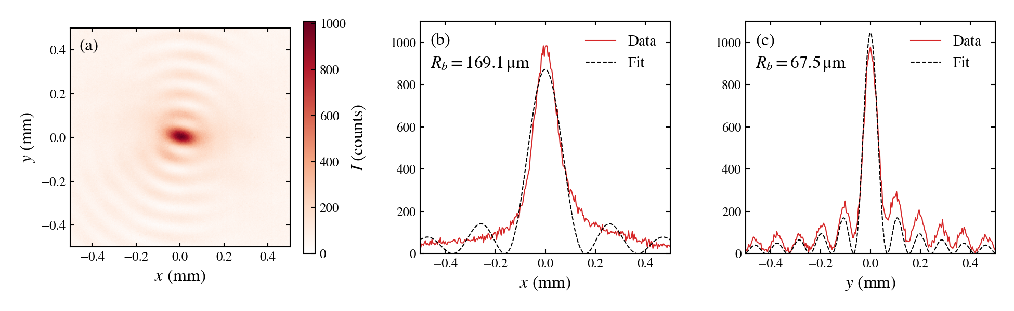
Current progress – ionizing H2 in the bypass line
Bessel focus measured 2.15m after lens B.
Still a lot of work to do in the tunnel!

Slide 15
Summary
Two gas sources and two ionization optics
Lithium oven – either axicon or tandem lens should be able to generate a usable plasma source.
Bypass line – not enough laser power for He, H2 instead
Axicon – near the ionization threshold with the current setup
Tandem lens – should be able to ionize a H2 plasma usable for PWFA
Tandem lens optics tested, focus profile as expected.
One attempt at laser ionization in H2 in the bypass line – no visible plasma.
Next step is to work to understand why and improve the laser.

Slide 16
Thank You!
rariniel@slac.stanford.edu

Slide 17
Laser efficiency on target
Laser energy achieved out of main amp: 800 mJ
Efficiency to transport: 88% 704 mJ
Transport efficiency: 86.5% 609 mJ
Probe beam splitter: 80% 487 mJ
Compressor: 72% 351 mJ
To optic: 94% 330 mJ
Efficiency per optic: 93% 308 mJ (287 mJ)
Final steering mirrors: 99% 305 mJ (284 mJ)
Based off the best measurements I could find in the E-log and confluence.
Pulse duration measured to 55 fs FWHM.
Efficiency to target: 38.1% (35.6%) 305 mJ (284 mJ) for axicon (tandem lens).

Slide 18
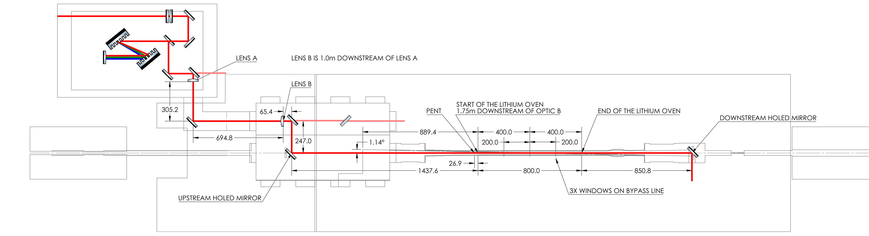
FACET tunnel layout, important dimensions:
Lens A to Lens B: 1.0m
LensB/Axicon to start of LO: 1.75m
LO is 800mm region centered on the physical LO
Axicon to USHM is 312.4mm, LO to DSHM is 850.8mm
DSHM to Beryllium window: 430.6mm
Axicon/LO8 plasmas are longer than the LO. The start of the LO region is noted on each simulation.

Slide 19
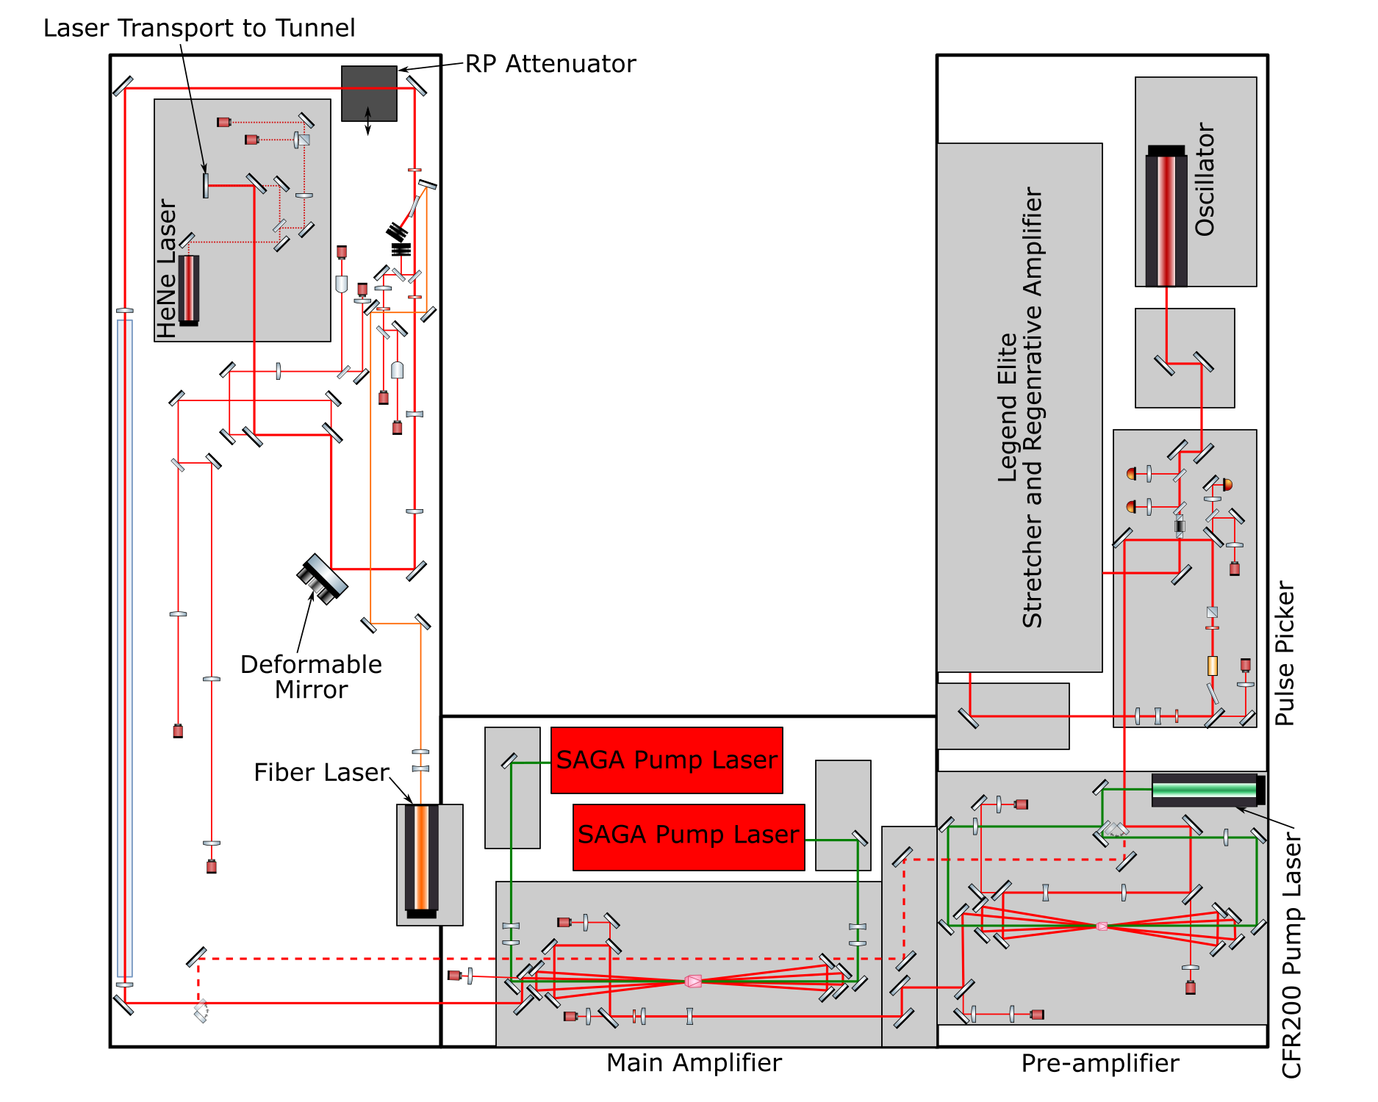
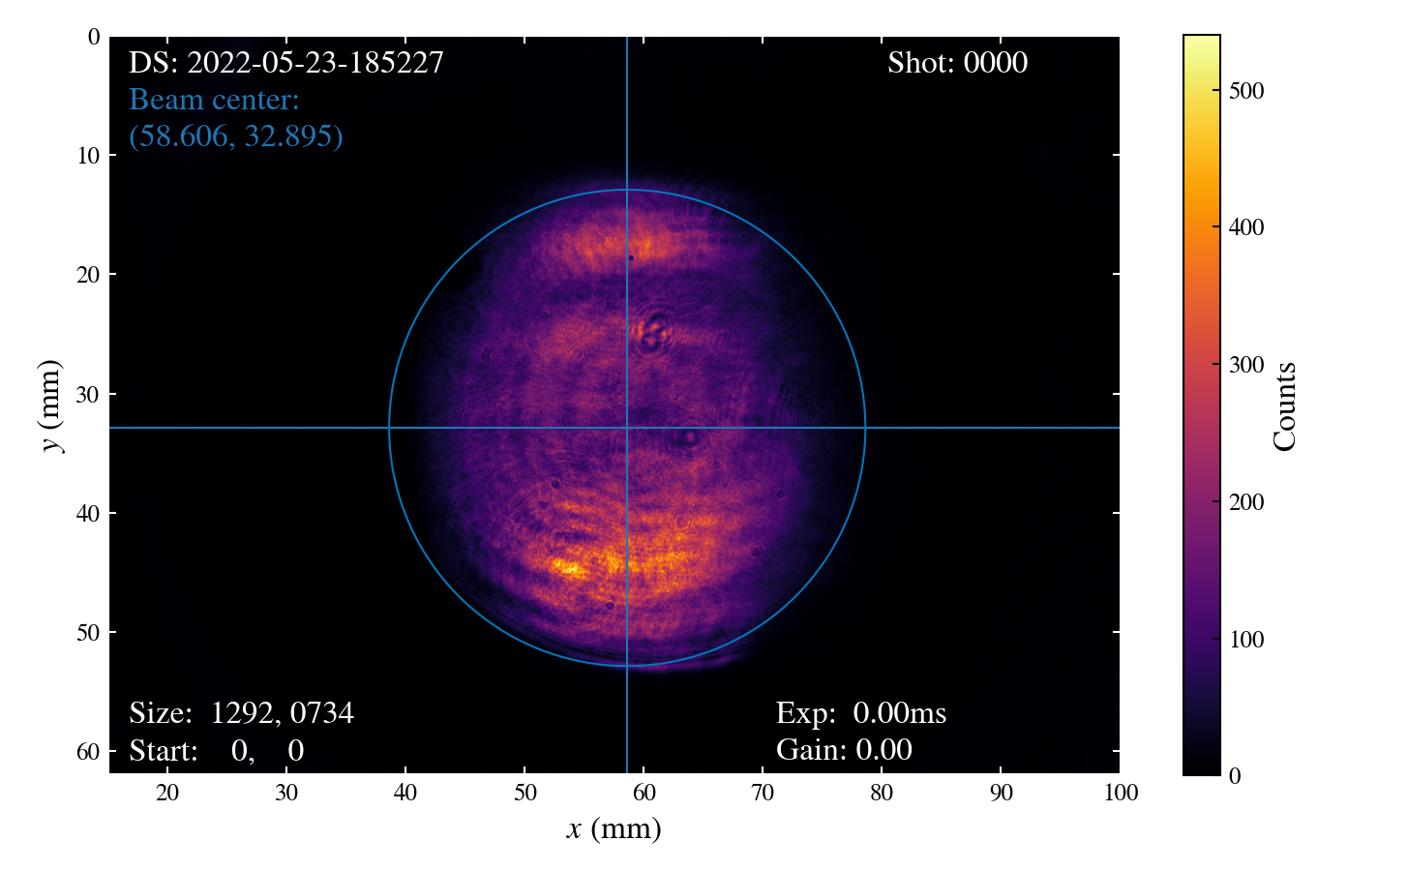
Determine laser beam size for simulation
How big is the laser beam at FACET?
InjNear calibrated and laser images recorded.
Assume beam is imaged 1-1 to tunnel
Measured FACET beam size at InjNear for simulation input.
InjNear

Slide 20
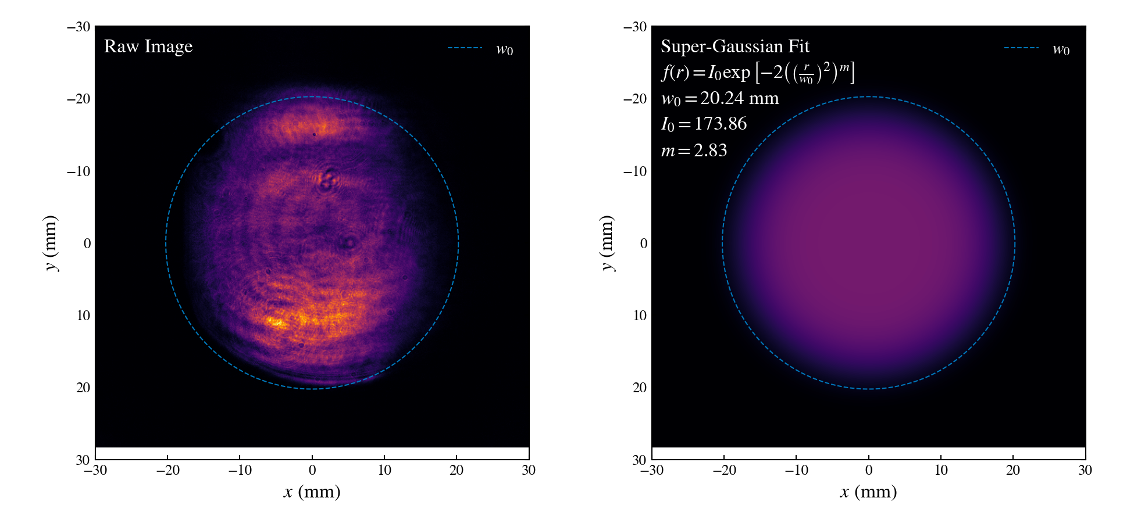
Simulation input beam
Fit a super-Gaussian to the full image.
Fitting a super-Gaussin to the full image was comparable to a simulation of the actual beam.

Slide 21
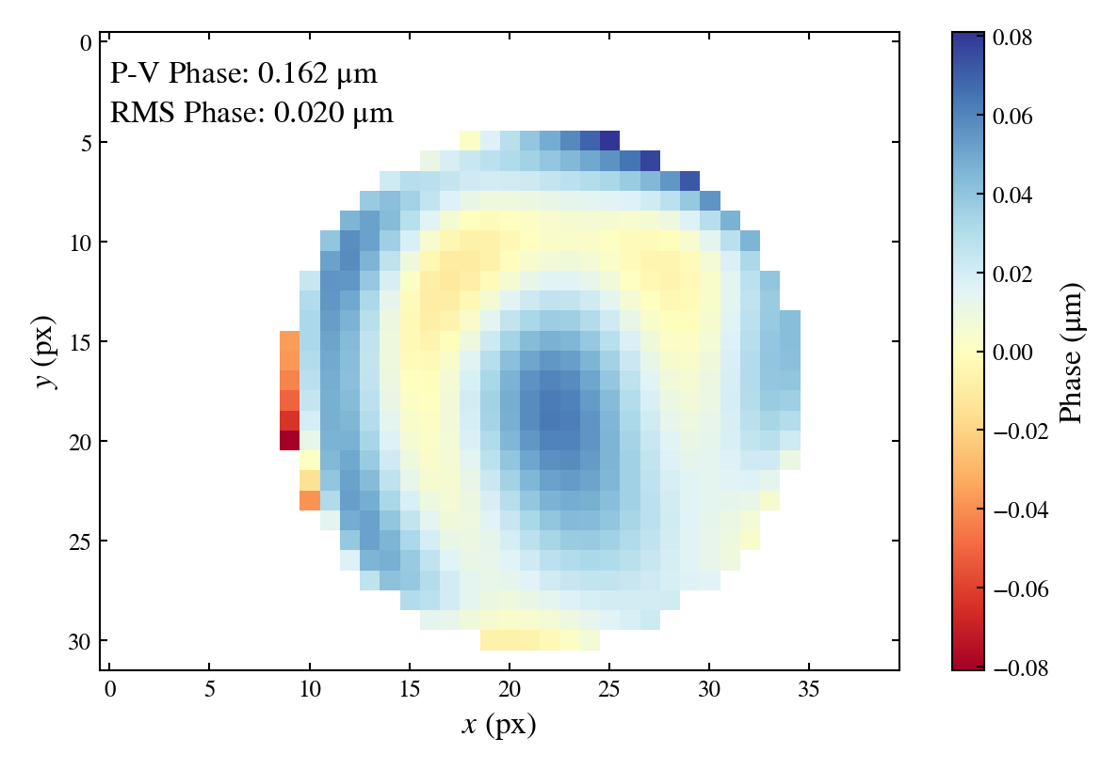
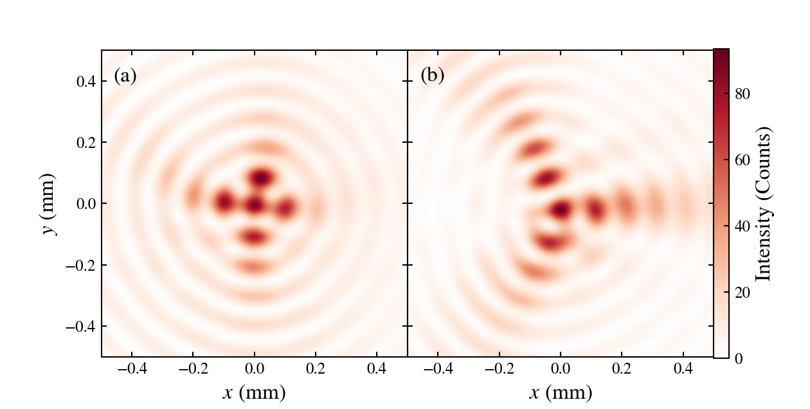
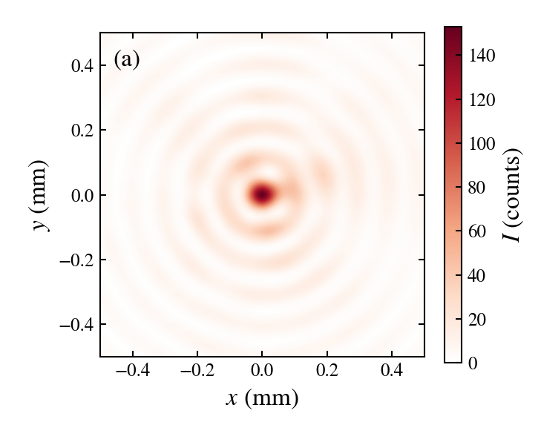
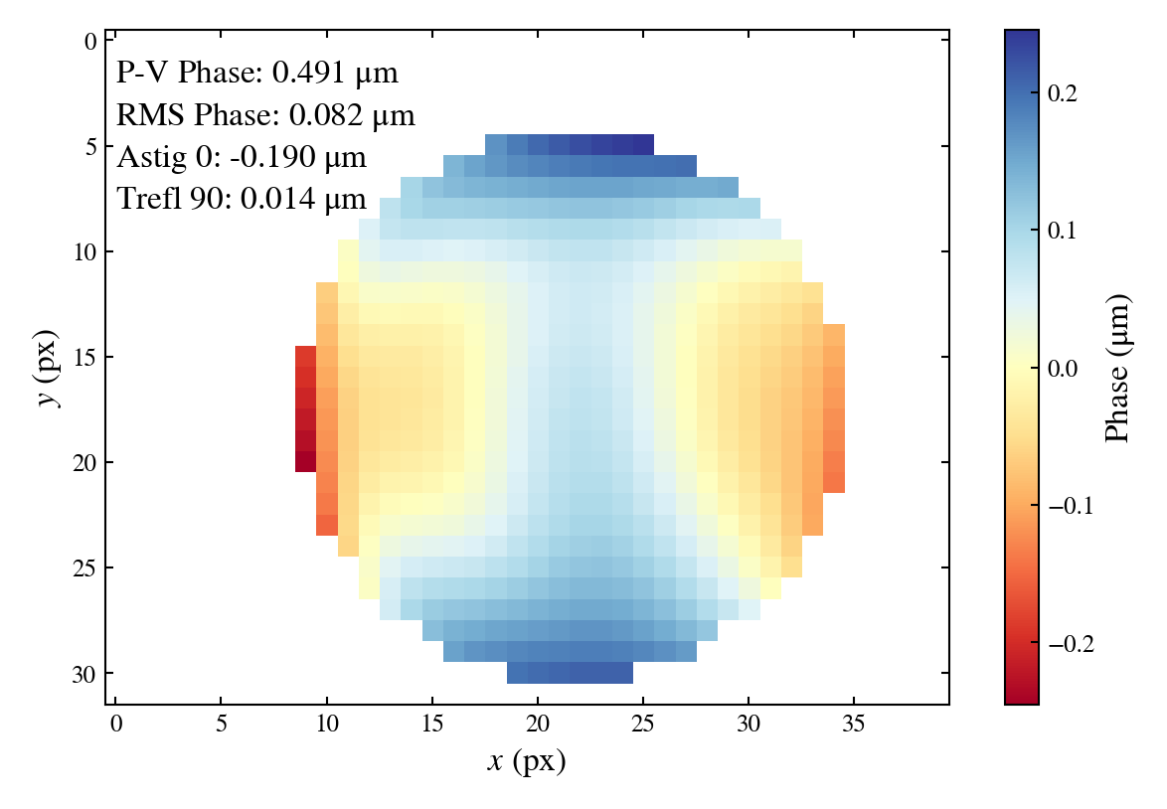
Wavefront sensor says the incoming phase is flat.
Look at the end of the Bessel focus for aberrations.
Astigmatism
Trefoil
Bessel profile at the end of the focus can be used to dial in phase correction.
Add wavefront to correct Bessel

