Slide 1
Differential Pumping Update
Doug Storey
10/6/2022

Slide 2
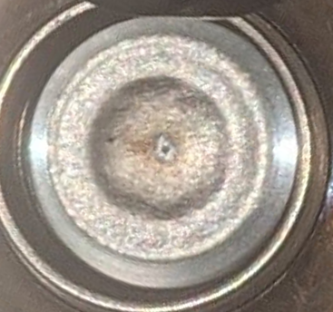
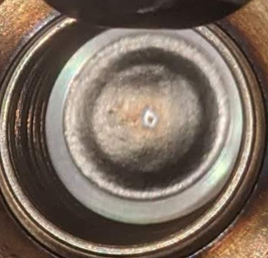
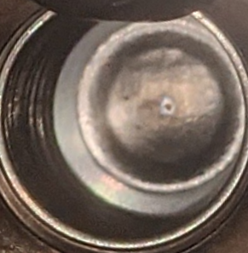
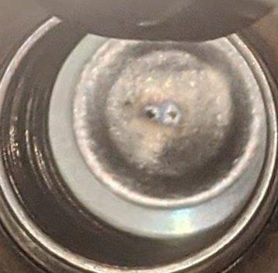
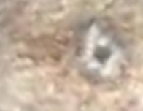


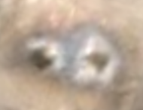
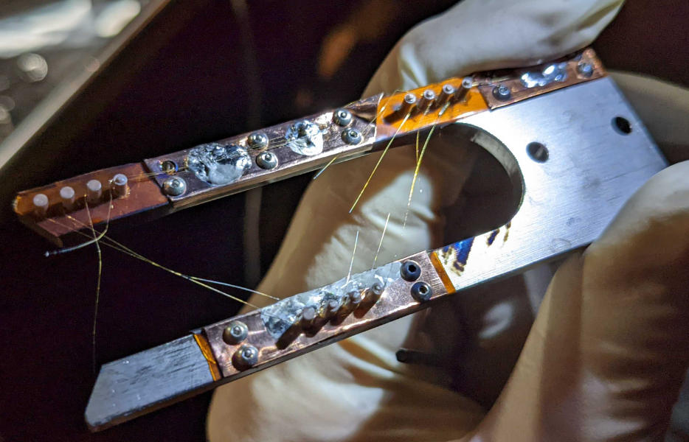
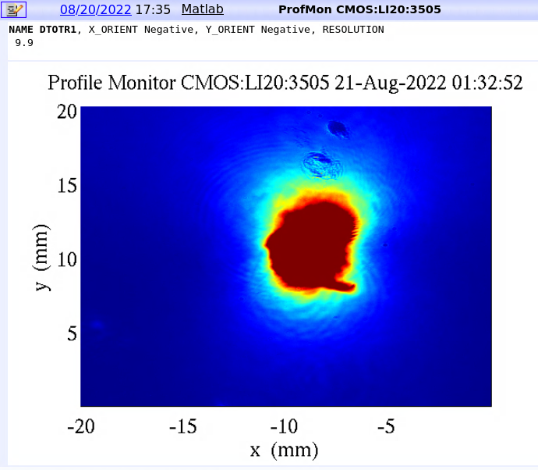
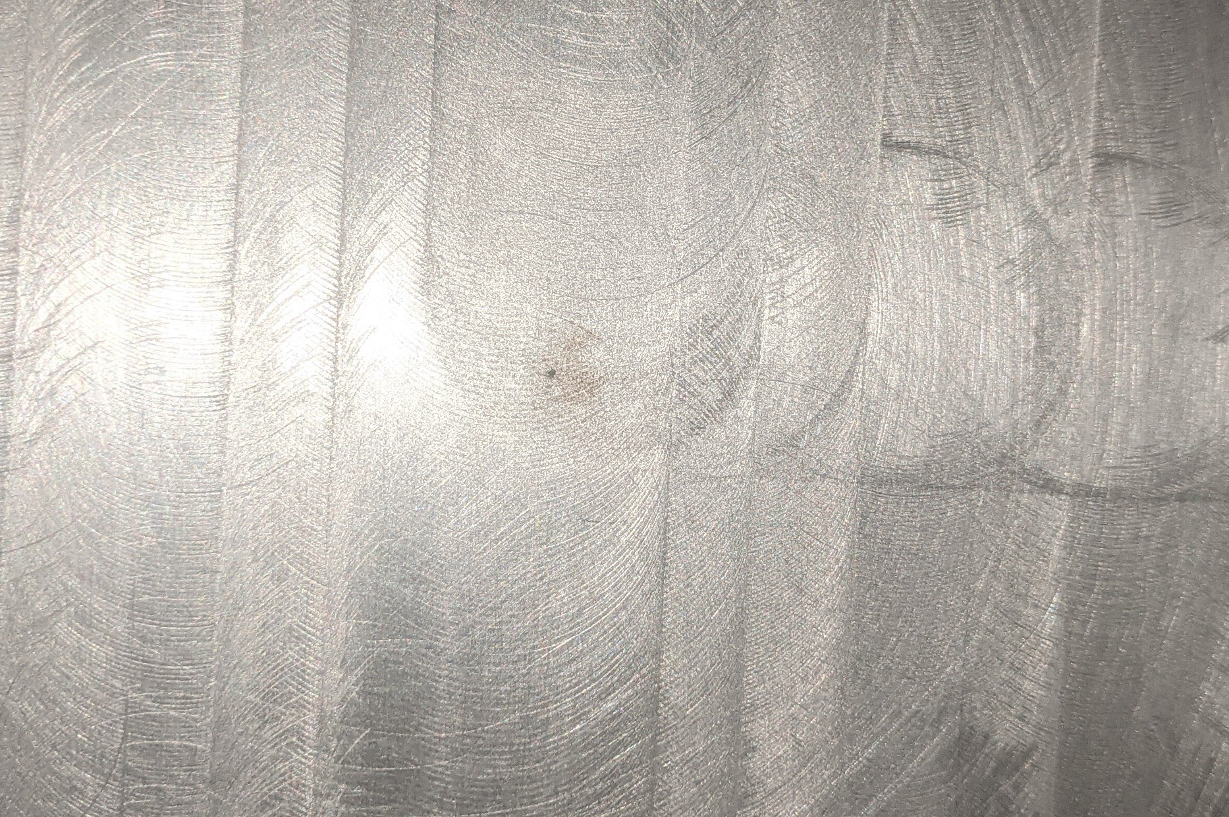
Everything is getting damaged by the beam
Beryllium window:
Wire scanner • DTOTR YAG • Vacuum exit window
May 18
May 26
June 7
July 19
Now?

Slide 3
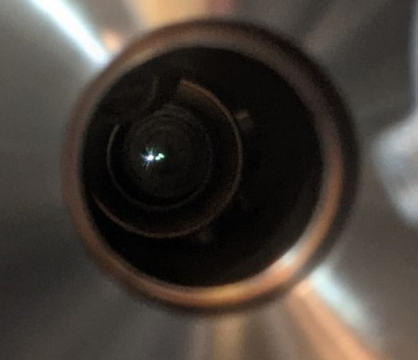
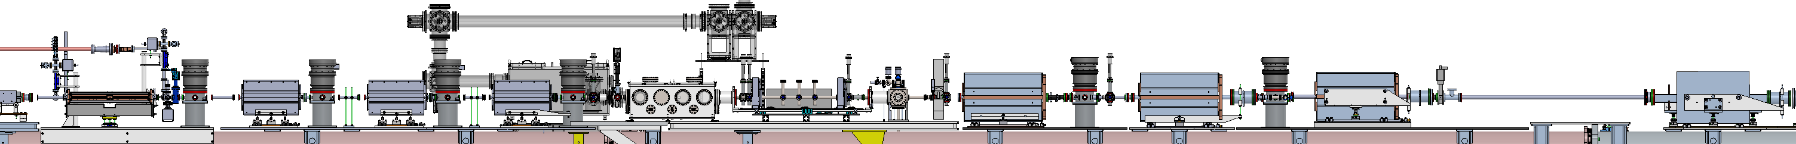
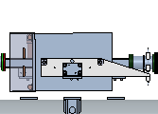
Overview of current installed DPS
Upstream Be window:
January 2022: 2x DS-DPS turbos installed
Late May 2022: Hole burned through US Be window
Early June 2022: US2 turbo installed to allow the experimental
program to continue
July 2022: Remaining 3 US-DPS turbos installed
Note – no 5mm straws and no aperture restrictions have been installed
Picnic Basket
DS Be
window
Upstream DPS and final focus quads
US Be
window
Downstream DPS and reimaging quads
XTCAV
Li Oven
Spectrometer Bend
US4
US3
US2
US1
DS1
DS2
-10m
-5m
0
5m
10m

Slide 4
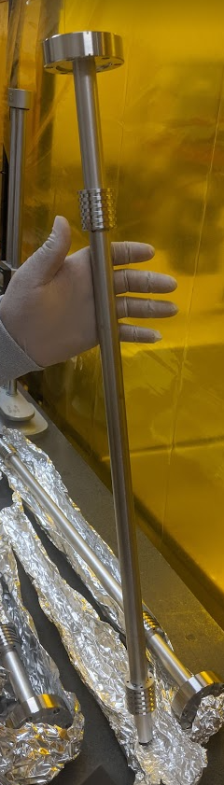
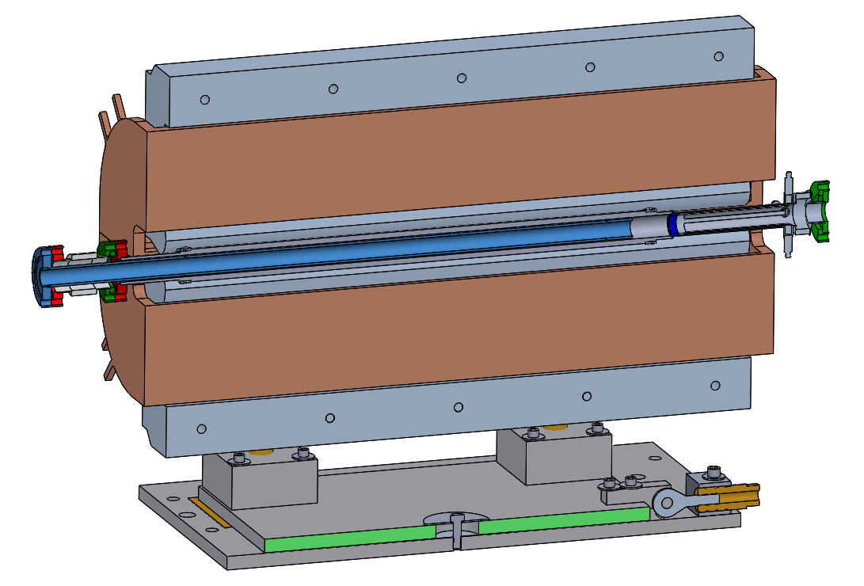
What is left to install to complete the DPS?
The initial 5mm straw apertures
  One goes right before PB, one goes after DSHM
  Currently the beam vector through the IP is not stable, so waiting on this
  More details on next slide
  Or… we keep running with the leaky Be windows for now?
Quad apertures on US-DPS
  These are fabricated and ready to install
  Waiting for BBA of quads and more testing before installing
Updated gas delivery system
Robustness!
  Lead shielding, etc

Slide 5
Static Fill Performance (so far)
Helium /Stage: | US4* | US3 | US2 | US1 | IP | DS1 | DS2
Meas. w. Be window | 1e-9 | 7e-8 | 8e-7 | 2e-4 | 2 | 6e-6 | 1e-7
 | 1.5e-9 | 8e-8 | 2e-6 | 3e-4 | 5.2 | 2e-5 | 2e-7
Meas. w. 5mm straw | - | - | - | - | 5 | 5e-3 | 7e-5
Simulations with 5mm straw | 1e-9 | 2e-7 | 4e-5 | 5e-3 | 5 | 5e-3 | 1e-4
Hydrogen /Stage: | US4* | US3 | US2 | US1 | IP | DS1 | DS2
Meas. w. Be window | 1e-9 | 2e-8 | 4e-7 | 6e-5 | 0.5 | 1e-5 | 2e-7
 | 1e-9 | 4e-8 | 1e-6 | 2e-4 | 1 | 4e-5 | 1e-6
 | 2e-9 | 1e-7 | 1e-5 | 1e-2 | 1.7 | 6e-5 | 4e-6
Simulations with 5mm straw | 1e-9 | 3e-7 | 2e-4 | 7e-2 | 5 | 7e-2 | 1e-3
Can operate the DPS up to 5 Torr with He and ~2 Torr with H2 with current setup
Limit for H2 comes from the US1 and DS1 roughing pumps losing pumping power
Good experimental agreement to simulations with Helium

Slide 6
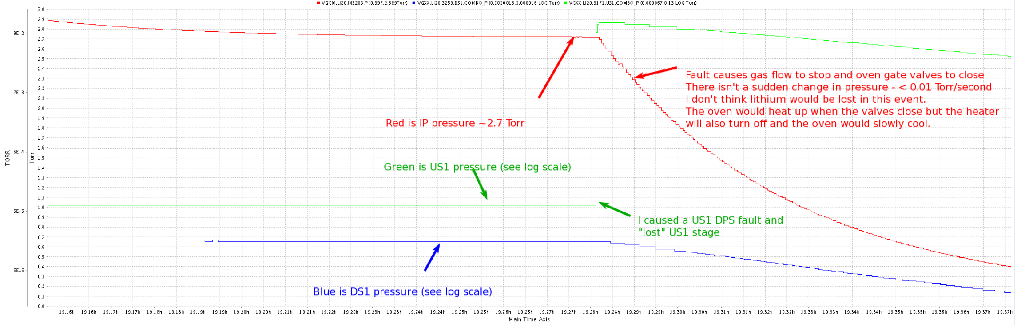
Current behavior with a turbo fault – Christine’s 11th hour test!
TORR
3.0
9e-2
2.5
7e-3
2.0
6e-4
1.5
9 min
5e-5
1.0
5e-6
0.5
0.0
EPS will trip off both gas and oven on a beamline pressure fault
Results in a relatively slow decrease in IP pressure: <0.01 Torr/second
Likely no loss of lithium, but ~1day of oven recovery time

Slide 7
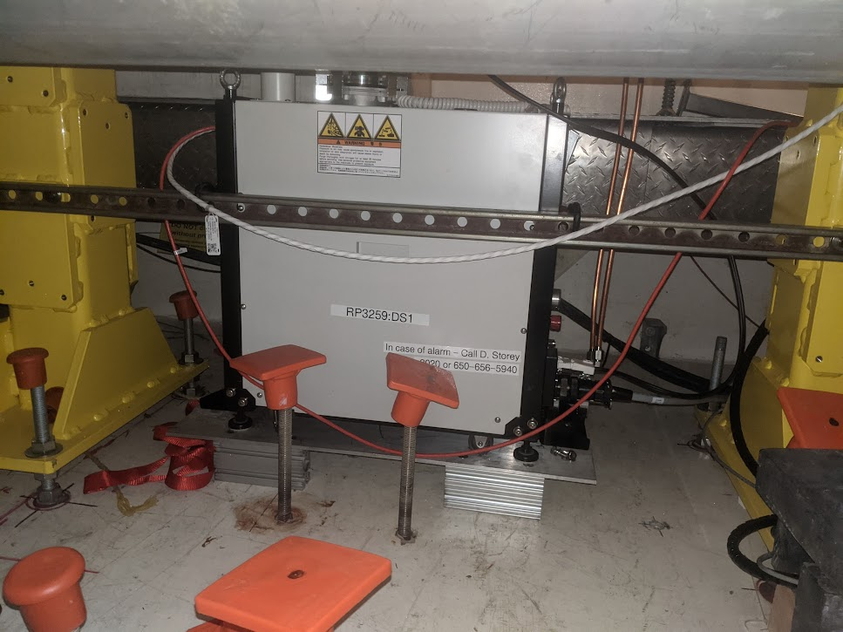
Increasing the radiation robustness
A critical weakness of the DPS is the susceptibility of the roughing pumps to radiation
Foreline valves are now interlocked to foreline pressure.
A watcher process monitors the vacuum pumps statuses and vacuum levels.
Installing lead and polyethylene shielding around the pump electronics.
Investigating removing electronics altogether and relocating to a cooler spot.

Slide 8
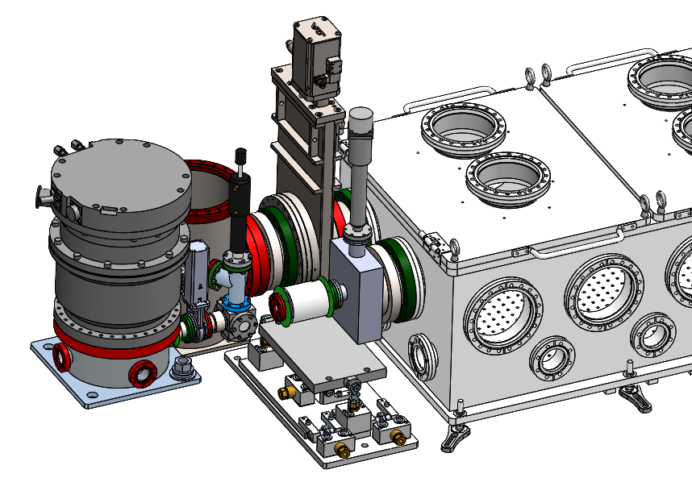
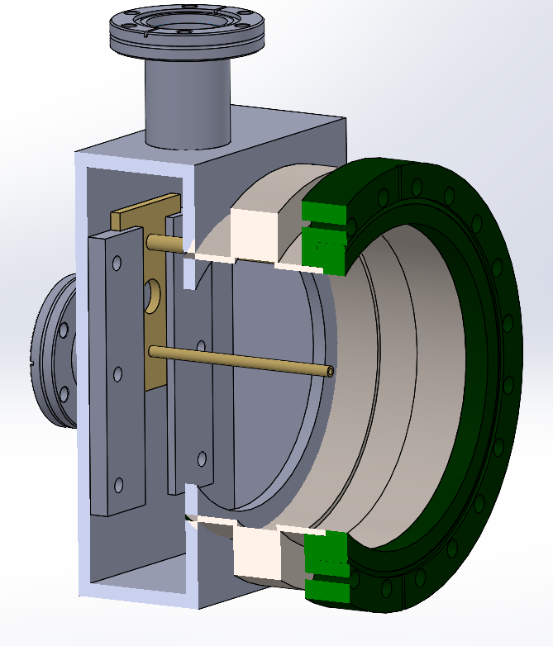
5mm straw
Developing a removable straw aperture to allow for retraction, and even remote alignment if required.
Conceptual design:
Picnic Basket
Alignment laser injection cube
US1 Turbo
Beamline valve

Slide 9
Summary
Operational notes:
The DPS is becoming more familiar, but still requires some experience/knowledge to manage
Robustness has been the biggest challenge, but we have plans to improve this
Performance with Helium is exactly what was expected
Most critical items left to do:
Improve radiation robustness
Design and install straw apertures

Slide 10
Questions?

Slide 12
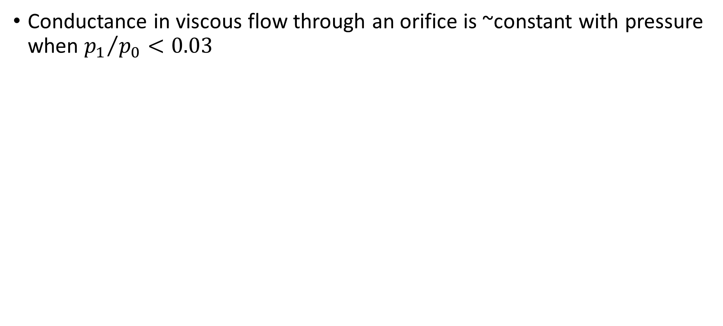
Conductance through an oriface
Conductance in viscous flow through an orifice is ~constant with pressure when ${p_{1}}/{p_{0}<0.03}$

