Slide 1
Emittance and energy spectrum measurements at the dump table, I'll include some discussion of COTR and SYAG/DTOTR/IPOTR correlations
and
Something about plasma generation in more general terms - i.e. how long via IP camera measurements, where the plasma starts vs. waist location, how consistently we formed plasma, radiation signals, ???
Doug Storey
10/5/2022

Slide 2
Emittance Measurements
and
Plasma Generation Studies
Doug Storey
10/5/2022

Slide 3
Outlines
Talks 1&2 - today
Summary of E300 shifts from this year
Diagnostics overview
Some ongoing issues
Emittance measurements of incoming beam and PWFA beams
Plasma generation
Energy lost in the plasma
Energy gain in the plasma
Talk 3 – later today
DPS overview
Performance with He and H2
Upgrade plans
Installation left to do
Movable straw

Slide 4
2022 E300 Shift Quick Summary
05/02 – Laser shift to test alignment procedures
05/07 – Diagnostics commissioning – first attempt at doing quad scans, energy calibrations, etc
05/10 – EOS timing, first attempt to find t0 using EOS
05/13 – Laser shift – align laser to e-beam vector
06/03 - Diagnostics commissioning – quads scans and energy spectra with foils
06/19 – Diagnostics commissioning – quads scans and energy spectra with foils
07/06 – EOS shift - SYAG and DTOTR COTR correlation
07/08 – TCAV shift – DAQs at various phases
07/12 – EOS shift – Acquired EOS and TCAV data
07/14 – Diagnostics commissioning – developed quad scan routines
07/27 – He fill – DPS characterization at 5 Torr, He plasma
07/29 – Diagnostics commissioning– single shot and quad scan emittance datasets
08/04 – H2 fill – Tested L2 phase optimization - energy loss data, e and gamma data
08/13 – H2 fill but beam was not great
08/17 – H2 static fill – Pressure scan and object plan scans - PWFA acceleration recorded!

Slide 5
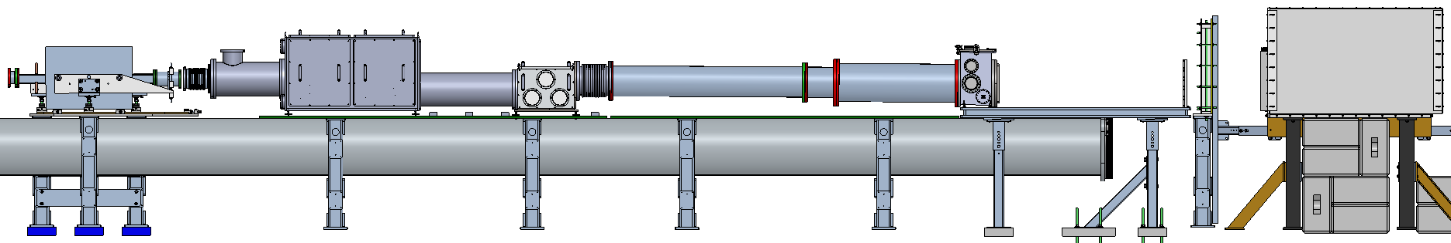
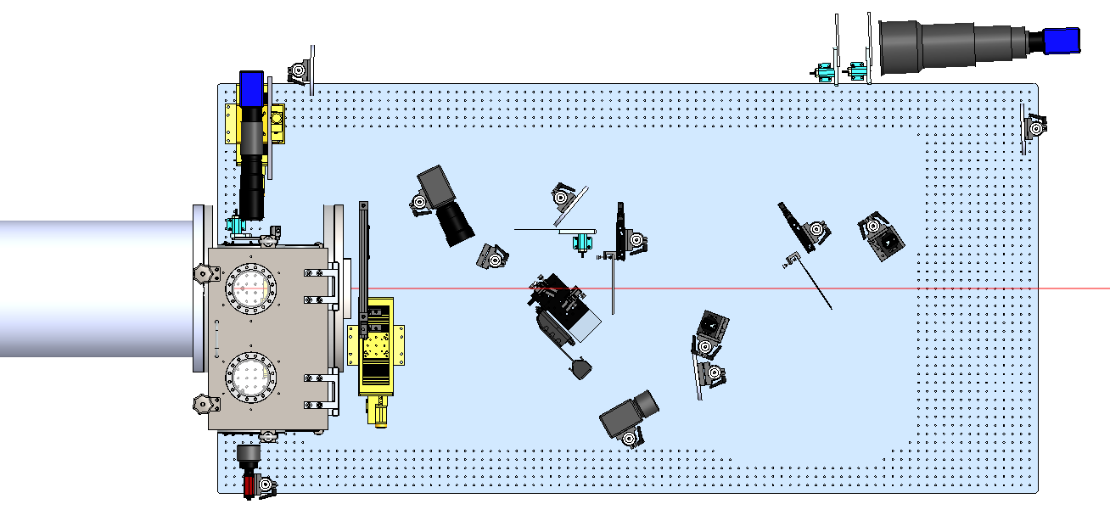
Spectrometer Diagnostics Overview
Dipole
PDC
EDC
Dump Table
Butterfly
Beam Dump
gammas
e-
Dump table contains main electron and gamma diagnostics
DTOTR1/2 – in vacuum OTR+YAG
LFOV and CHER – DRZ and Cherenkov spectrometers
Gamma1/2/3 -> photon diagnostics
PDC/EDC added for low energy electron and positron diagnostics
CHER
DTOTR1
Gamma1
Beam Direction
Gamma3
Gamma2
LFOV
DTOTR2

Slide 6
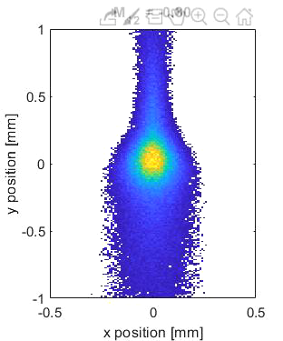

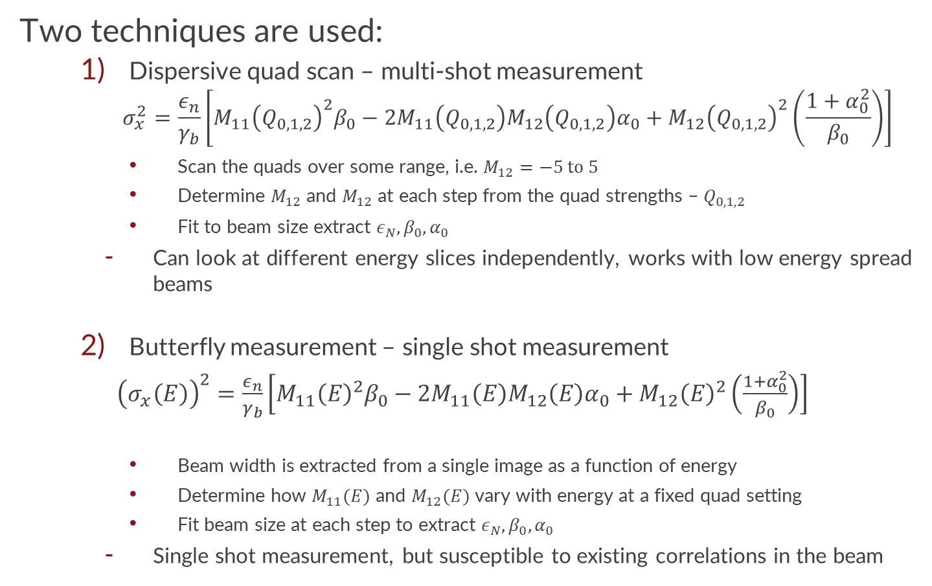
Emittance measurements
Dispersive Quad Scan
Two techniques are used:
Dispersive quad scan – multi-shot measurement
$$σ_{x}^{2}=\frac{ε_{n}}{γ_{b}}\left[M_{11}{\left(Q_{0,1,2}\right)}^{2}β_{0}−{2M}_{11}{\left(Q_{0,1,2}\right)M}_{12}\left(Q_{0,1,2}\right)α_{0}+M_{12}{\left(Q_{0,1,2}\right)}^{2}\left(\frac{1+α_{0}^{2}}{β_{0}}\right)\right]$$
Scan the quads over some range, i.e. $M_{12}=−5 to 5$
Determine $M_{12}$and $M_{12}$ at each step from the quad strengths – $Q_{0,1,2}$
Fit to beam size extract $ε_{N}, β_{0}, α_{0}$
Can look at different energy slices independently, works with low energy spread beams
Butterfly measurement – single shot measurement
${\left(σ_{x}\left(E\right)\right)}^{2}=\frac{ε_{n}}{γ_{b}}\left[M_{11}{\left(E\right)}^{2}β_{0}−{2M}_{11}{\left(E\right)M}_{12}\left(E\right)α_{0}+M_{12}{\left(E\right)}^{2}\left(\frac{1+α_{0}^{2}}{β_{0}}\right)\right]$
Beam width is extracted from a single image as a function of energy
Determine how $M_{11}(E)$ and $M_{12}(E)$ vary with energy at a fixed quad setting
Fit beam size at each step to extract $ε_{N}, β_{0}, α_{0}$
Single shot measurement, but susceptible to existing correlations in the beam
Butterfly Emittance Measurement
DTOTR1: $ε_{N}=3$µm, $β_{0}=5$cm

Slide 7
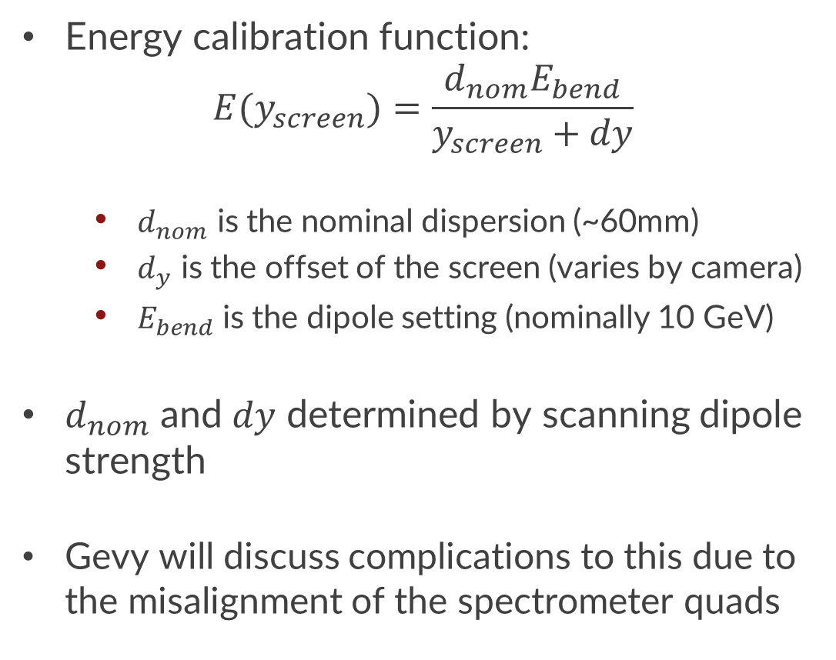
Electron Energy Measurements
Energy calibration function:
$$E(y_{screen})=\frac{d_{nom}E_{bend}}{y_{screen}+dy}$$
$d_{nom}$ is the nominal dispersion (~60mm)
$d_{y}$ is the offset of the screen (varies by camera)
$E_{bend}$ is the dipole setting (nominally 10 GeV)
$d_{nom}$ and $dy$ determined by scanning dipole strength
Gevy will discuss complications to this due to the misalignment of the spectrometer quads

Slide 8
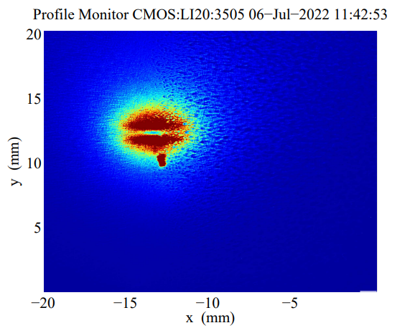
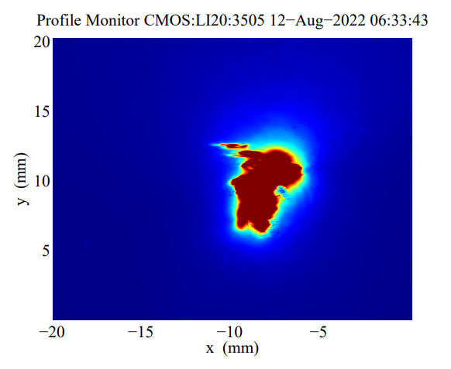
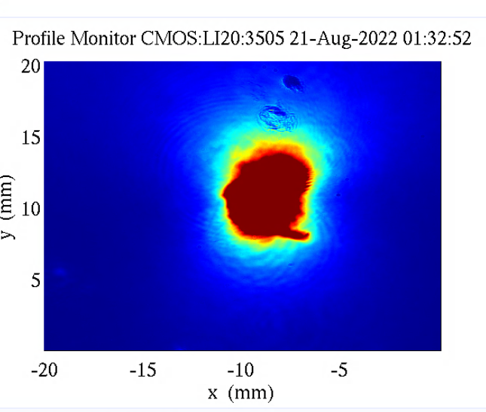
Coherent OTR issues
DTOTR1
DTOTR1 is often afflicted by COTR:
Sometimes it blows out the whole image
Other times it is just parts of the beam that are brighter
We see some sign of microbunching on SYAG, but I have not attempted to correlate them yet
DTOTR2 YAG does not see COTR because we look at the back side of the YAG screen
DTOTR1

Slide 9
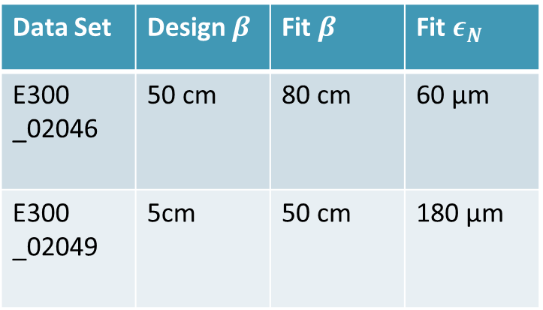
Dispersive Quad Scans of main beam – using DTOTR2
Quad scans with 50 and 5 cm waist at PEXT. S19 emittance measurement = ~45µm
Data Set | Design $β$ | Fit $β$ | Fit $ε_{N}$
E300 _02046 | 50 cm | 80 cm | 60 µm
E300 _02049 | 5cm | 50 cm | 180 µm
Changing the waist without retuning S20 messes up the projected emittance
This matches what we see – the spot size/wires do not decrease with beta function at IP without significant tuning

Slide 10
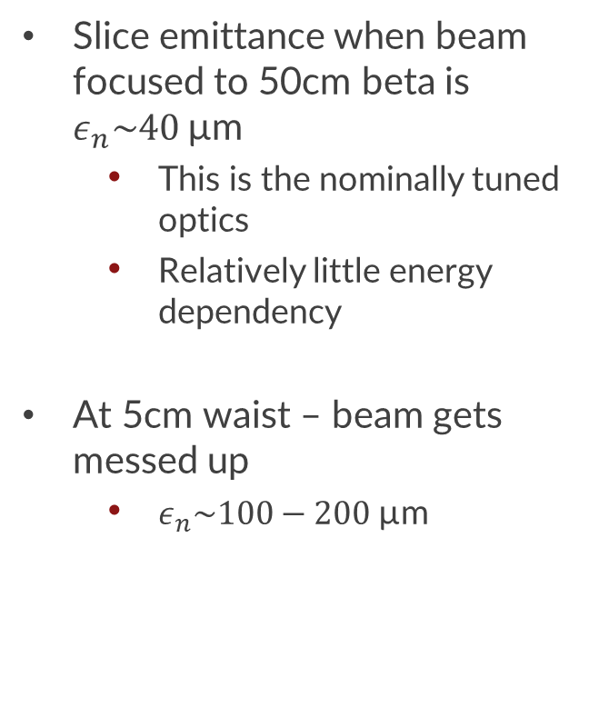
Dispersive quad scan – Energy dependency
Slice emittance when beam focused to 50cm beta is $ε_{n}\sim 40$µm
This is the nominally tuned optics
Relatively little energy dependency
At 5cm waist – beam gets messed up
$ε_{n}\sim 100−200$µm

Slide 11
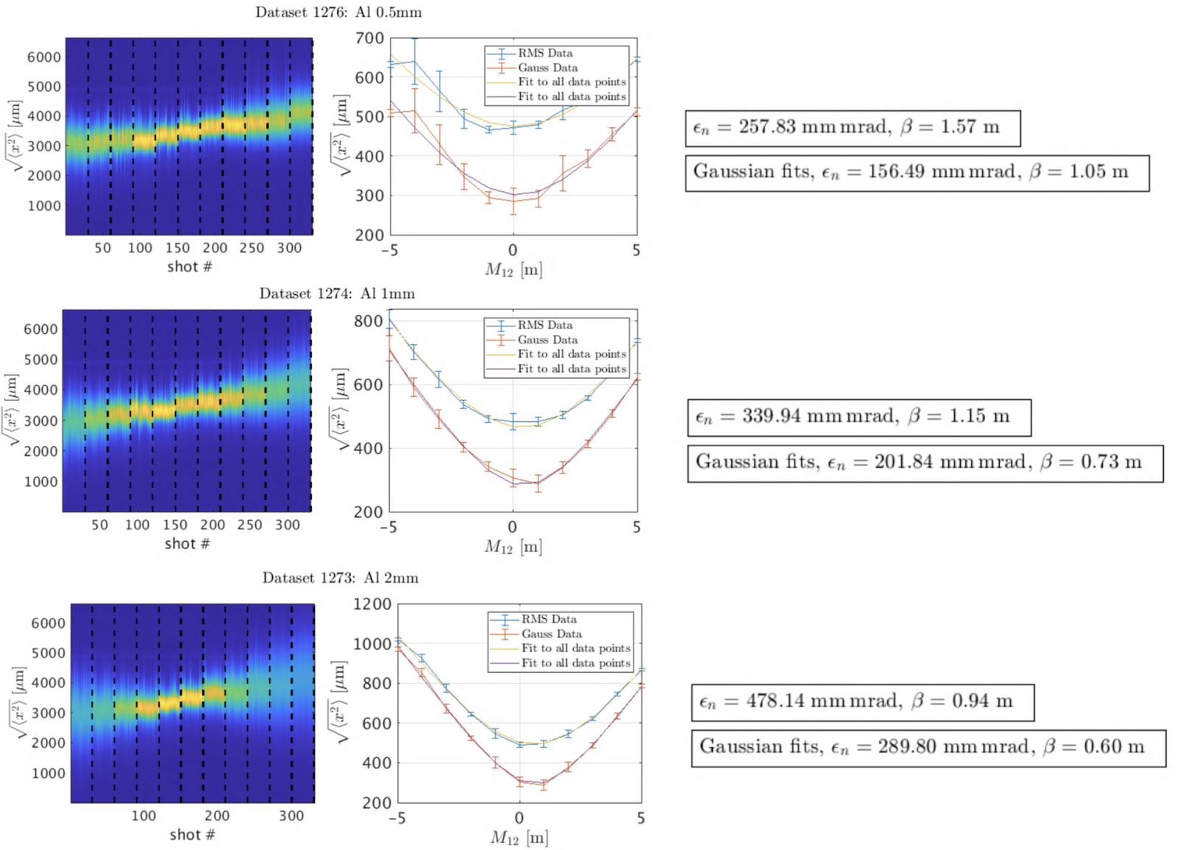
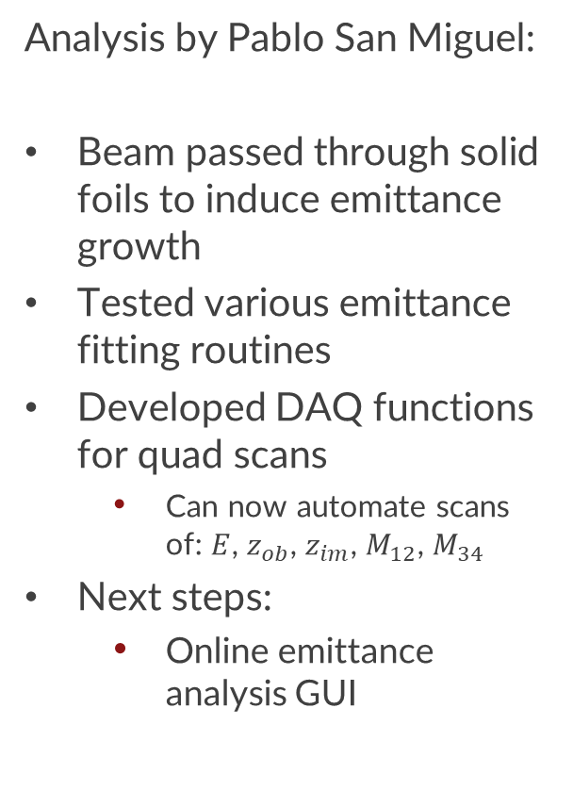
Dispersive quad scan commissioning from early summer
Analysis by Pablo San Miguel:
Beam passed through solid foils to induce emittance growth
Tested various emittance fitting routines
Developed DAQ functions for quad scans
Can now automate scans of: $E$, $z_{ob}$, $z_{im}$, $M_{12}$, $M_{34}$
Next steps:
Online emittance analysis GUI

Slide 12
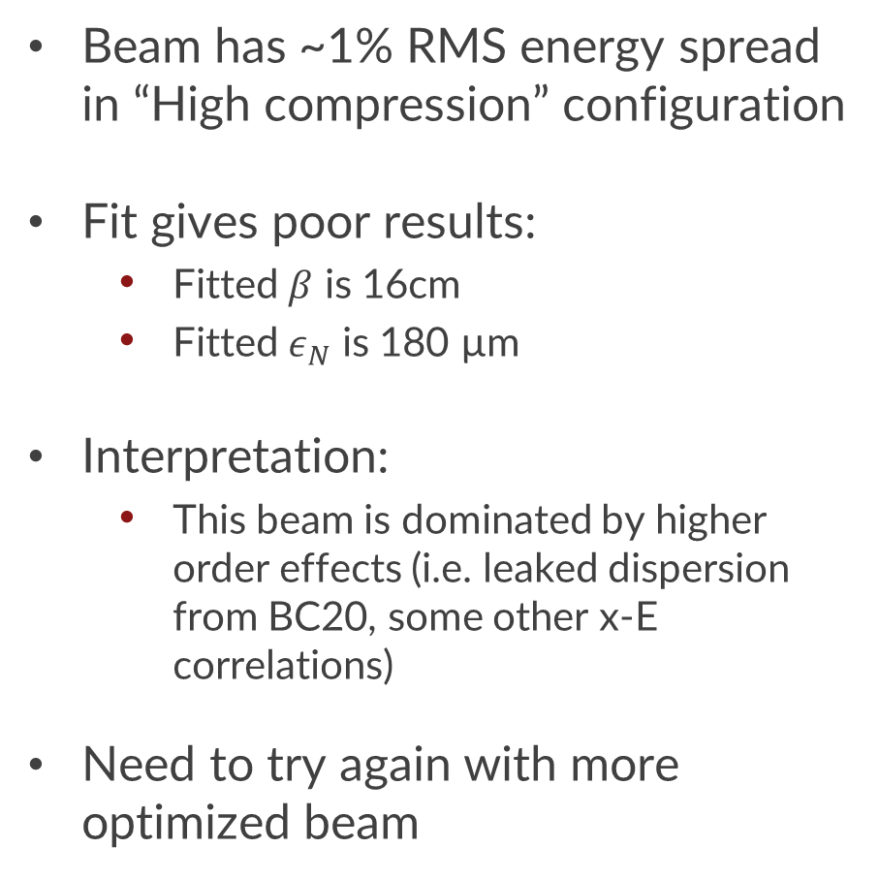
Butterfly measurement of main beam
Beam has ~1% RMS energy spread in “High compression” configuration
Fit gives poor results:
Fitted $β$ is 16cm
Fitted $ε_{N}$ is 180 µm
Interpretation:
This beam is dominated by higher order effects (i.e. leaked dispersion from BC20, some other x-E correlations)
Need to try again with more optimized beam

Slide 13
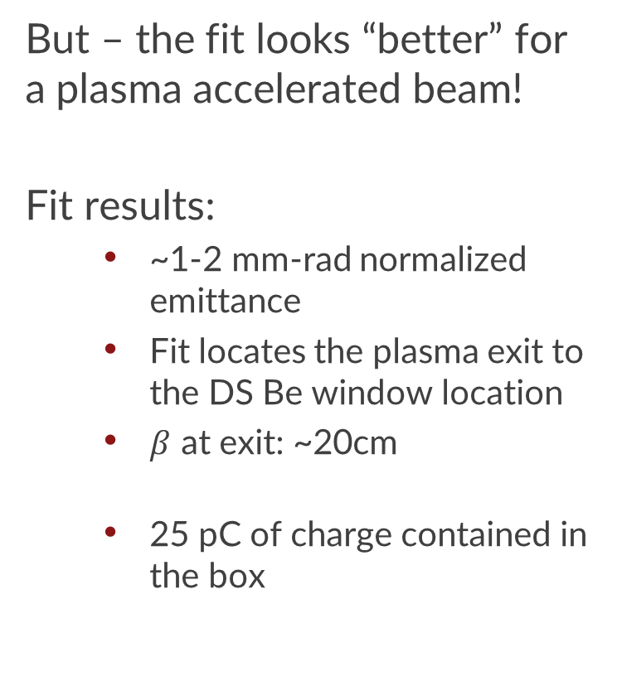
Butterfly of accelerated beam – (will come back to acceleration later)
But – the fit looks “better” for a plasma accelerated beam!
Fit results:
~1-2 mm-rad normalized emittance
Fit locates the plasma exit to the DS Be window location
$β$ at exit: ~20cm
25 pC of charge contained in the box

Slide 14
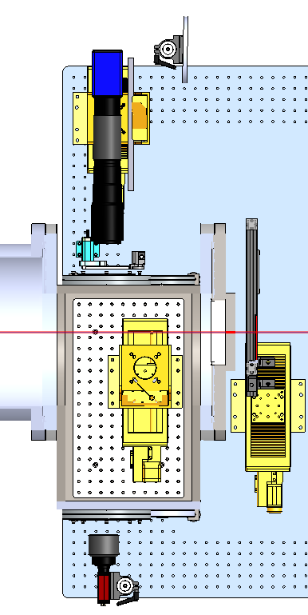
What do we need to do to improve on this:
Start using DTOTR1
COTR is currently limiting us
Maybe the laser heater saves us from spurious current spikes?
Short term: Install another YAG screen that faces the opposite way → look at back
Need a better tuned beam
Currently there is lot of uncorrected dispersion/correlations that limit the single shot usefulness of the diagnostic with low energy spread
More GUIs!
Dispersive quad scan analysis
Butterfly scan analysis
DTOTR1
DTOTR2

Slide 15
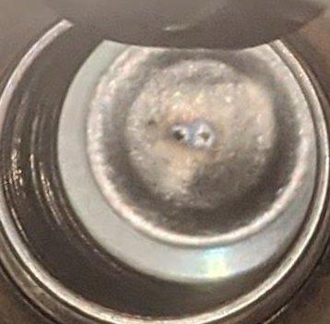
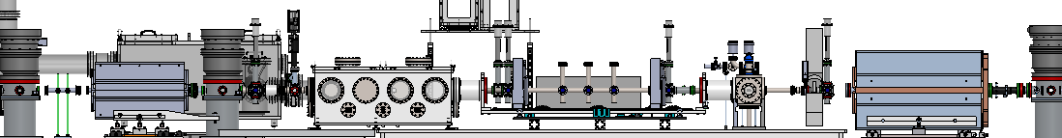
Plasma Generation
US Be Window
3 shifts with plasma:
He plasma at 5 Torr
H2 plasma up to ~2 Torr max
H2 plasma – density scans from 0.07 to 2 Torr
These were static fills using the partially installed differential pumping system
All 4 US-DPS and 2 DS-DPS stages
But no straw aperture
First aperture is the US and DS Beryllium windows with holes of ~100’s of µm diameter
July 19
US Be window
DS Be window: Z=1996

Slide 16
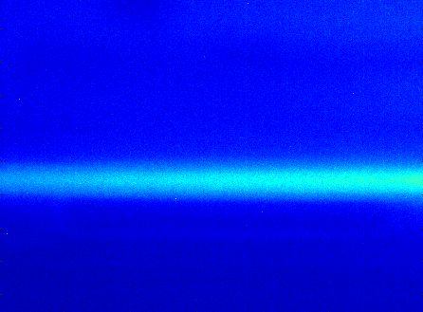
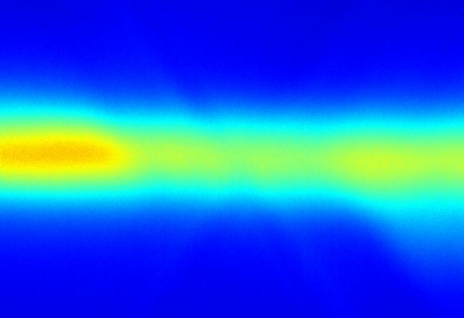
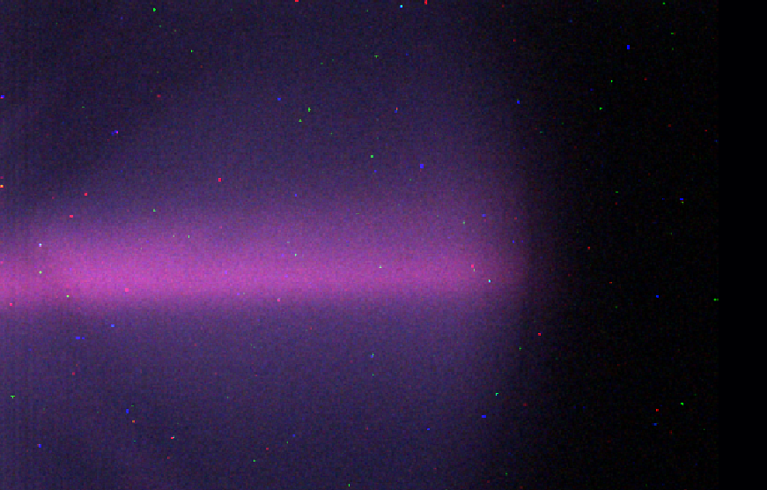
Plasma Generation
Plasma is simultaneously visible on each of Topview, IPOTR1, and IPOTR2
Note that IPOTR2 shows a true colour image of the plasma
Waist is at FILS (Z=1993.3), Butterfly puts exit waist at Be window (Z=1996m)
Length of plasma channel is ~3 meters
US Be window
TopView: Z=1993.3
IPOTR1: Z=1993.8
IPOTR2: Z=1995.1
DS Be window: Z=1996

Slide 17
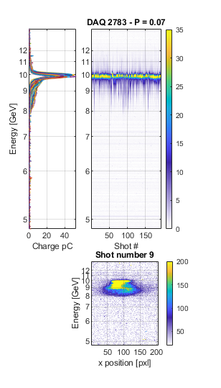
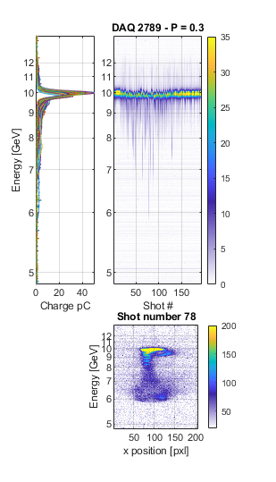
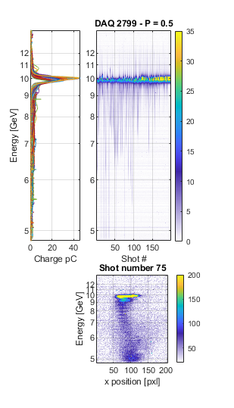
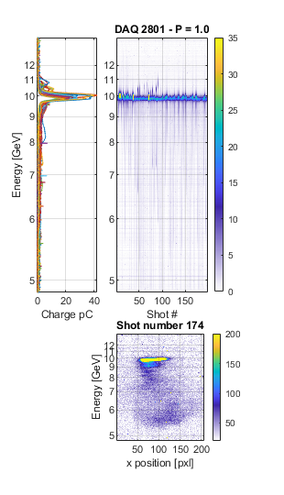
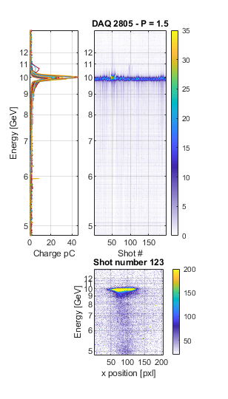
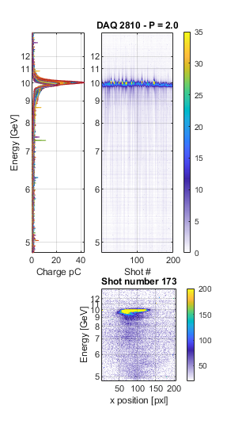
H2 fill – Charge depletion
Amount of charge that loses energy in the plasma increases with pressure
Error bars indicate the max and min value in each pressure dataset
Example LFOV image shown for each pressure

Slide 18
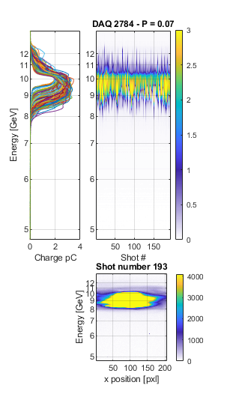
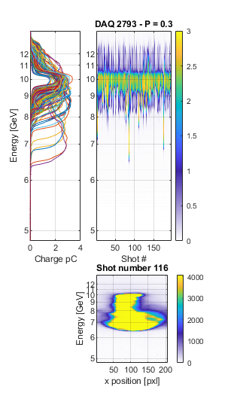
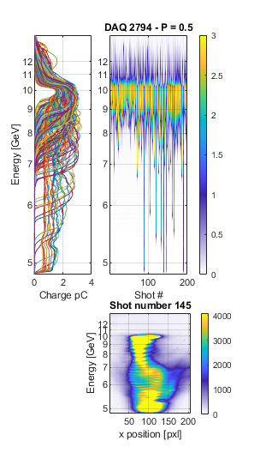
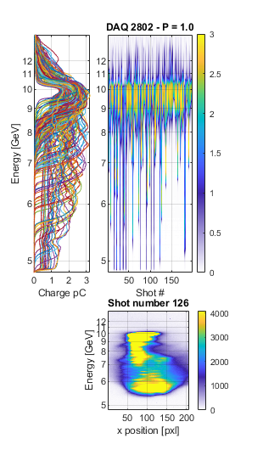
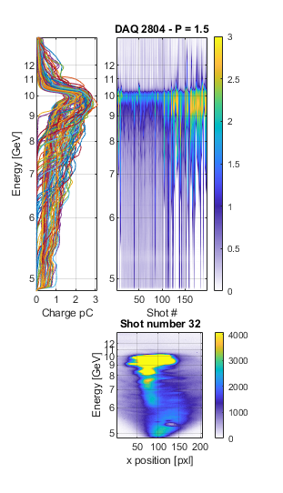
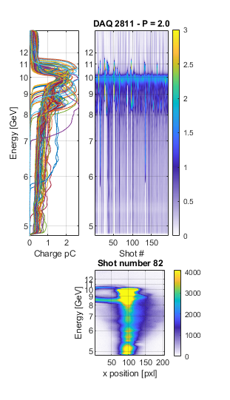
H2 fill – Charge depletion (2)
Datasets with ND2 filter removed to make low energy particles visible
Some shots show acceleration
Notes:
Still seeing saturation in some cases (sCMOS will be better at this)
Not measuring charge below 5 GeV here

Slide 19
H2 static fill – Some electrons ~fully depleted of energy
Turning the dipole low shows energy depletion to <2 GeV
Spectrometer quads focused at 2 GeV
Note – saw <1 GeV in He fill data with the dipole set to an even lower level
Sample images:
Most shots look like this – smooth energy profile down to <2GeV
Some shots show a charge accumulation at low energy
300pC in box 2 at 2 GeV vs box 1.
Some shots show a lot of structure
Scalloping due to betatron oscillations
A few discrete charge bunches
1.
2.
3.

Slide 20
Ring structure viewed on LFOV – Scanning spectrometer object plane
50cm vacuum waist at 1993.3m (FILS)
Object plane scan traces the origin of the “ring” to be near the start of the plasma
Possible explanation:
Main beam electrons being blown out of plasma bubble
Can simulations back this up?
US Be Window
Vacuum Waist
DS Be Window

Slide 21
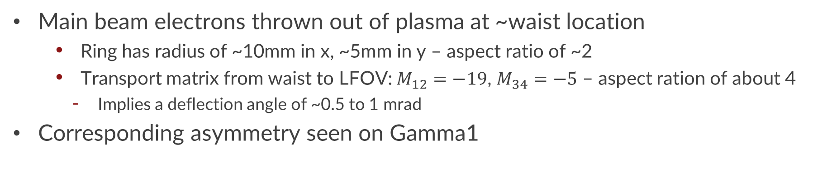
LFOV ring hypothesis:
Main beam electrons thrown out of plasma at ~waist location
Ring has radius of ~10mm in x, ~5mm in y – aspect ratio of ~2
Transport matrix from waist to LFOV: $M_{12}=−19$, $M_{34}=−5$ – aspect ration of about 4
Implies a deflection angle of ~0.5 to 1 mrad
Corresponding asymmetry seen on Gamma1

Slide 22
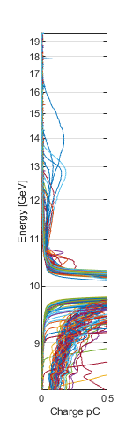
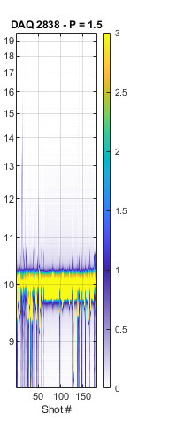
PWFA Acceleration - Almost energy doubled a few pC’s charge
Charge imaged up to ~17 GeV with 1.5 Torr H2 fill
Dipole at 20 GeV
Spectrometer quads focused at ~16 GeV
Shot #15 has order pC of charge >16 GeV
Butterfly measurements:
Waist of the accelerated charge at Be Window
~1 mm-rad emittance
Acceleration very unstable by this point in the shift

Slide 23
Acceleration vs Plasma Length
DAQ E300 2837 - shot # 5, 1.5 Torr H2
Acceleration is roughly correlated with amount of light on IPOTR1/2
So correlated with plasma length since we see light on all 3 cameras

Slide 24
Summary
We had 3 shifts with plasma - both H2 and He
Lots of data on beam ionized plasma, but very unstable beam properties make it difficult to characterize
Beam was unexpectedly good at self ionizing – possibly due to longitudinal current spikes?
Many commissioning shifts
Dump table diagnostics are now well characterized – more work on CHER and DTOTR1
DAQ and analysis tools developed – i.e. quads scans, energy calibration,
Work and issues moving forward:
Need to deal with COTR issue to make better profile and emittance measurements
Would be great to repeat some of these measurements with better beams
Many more data acquisition and analysis tools to be developed!

Slide 25
Questions?

Slide 26
Working material

Slide 27
7/30 – no foil data sets
E300_02046 = 50cm waist at PEXT
E300_02048/9 = 5cm waist at PEXT
1) Dispersive quad scan data using DTOTR2:
2049 – 5cm

Slide 28
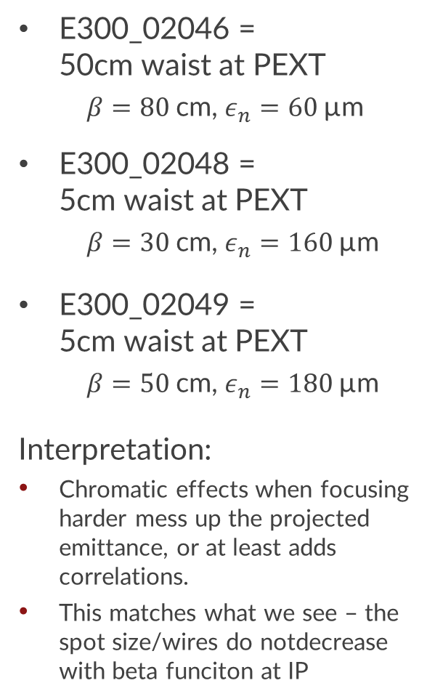
Dispersive Quad Scans
E300_02046 = 50cm waist at PEXT
$β=80$cm, $ε_{n}=60$µm
E300_02048 = 5cm waist at PEXT
$β=30$cm, $ε_{n}=160$µm
E300_02049 = 5cm waist at PEXT
$β=50$cm, $ε_{n}=180$µm
Interpretation:
Chromatic effects when focusing harder mess up the projected emittance, or at least adds correlations.
This matches what we see – the spot size/wires do notdecrease with beta funciton at IP

Slide 29
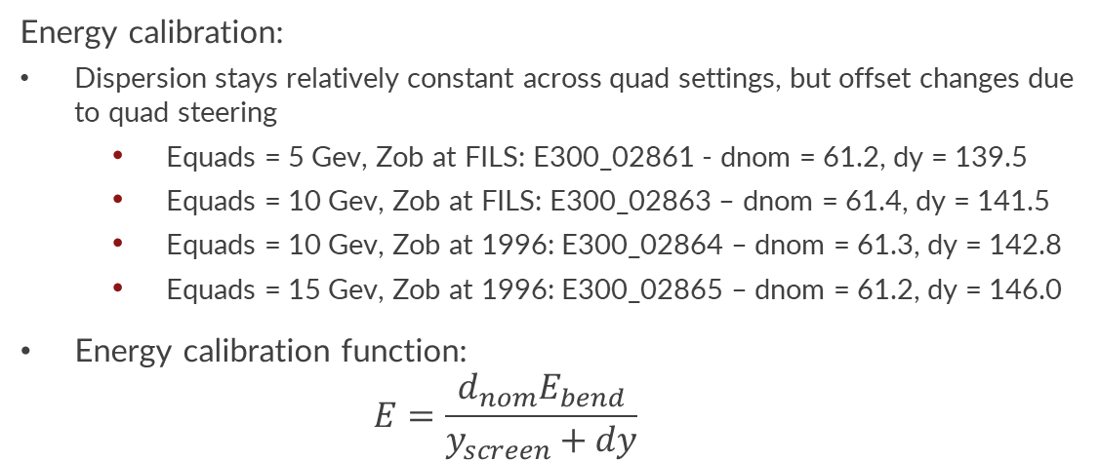
Calibrations - LFOV
Energy calibration:
Dispersion stays relatively constant across quad settings, but offset changes due to quad steering
Equads = 5 Gev, Zob at FILS: E300_02861 - dnom = 61.2, dy = 139.5
Equads = 10 Gev, Zob at FILS: E300_02863 – dnom = 61.4, dy = 141.5
Equads = 10 Gev, Zob at 1996: E300_02864 – dnom = 61.3, dy = 142.8
Equads = 15 Gev, Zob at 1996: E300_02865 – dnom = 61.2, dy = 146.0
Energy calibration function:
$$E=\frac{d_{nom}E_{bend}}{y_{screen}+dy}$$
Charge calibration:
Two datasets with different quad settings have minimally different calibrations
Mostly likely due significantly different beam sizes → larger error from background
Charge calibration:
With ND2 filter in: 4.2e-4 pC/unit
With ND2 filter out: 4.2e-6 pC/unit

