Slide 1
Accelerator Configurations and Upgrades
Glen White / Lead Scientist / AD-ARD Beam Physics

Slide 2
Outline
Accelerator configurations designed to meet science needs of user programs
Start-to-end tracking simulations with current machine configuration
Minimum # of configurations for ease of accelerator operations:
“Clean” single bunch: low energy-spread,
low peak-current
  e.g. E320 -> requires high energy for γ-boost of photons & low-backgrounds for sensitive measurements of low-energy tails of detected signals
Highly compressed single bunch: high
energy-spread, high peak-current (<300kA)
  e.g. E305 -> require v. high fields from bunch to drive instabilities in high-density plasmas, solid targets etc.
2-bunch for PWFA experiments
  e.g. E300 -> High peak-current drive + high-quality witness bunch tailored for optimal beam loading
Considered modifications to electron accelerator baseline design
Can we get a notch collimator simulation that looks good to tease while we wait for two-bunch mode from gun?
Upgrade of final stage BC20 compression chicane?
Injector laser heater for increased longitudinal stability, bunch length control & μ-bunching suppression
Some operational experience:
Injector
Linac emittances
Sector 20 transverse bunch size & length

Slide 3
Electron Injector Parameters
6 MeV
(E₀=120 MV/m)
60 MeV
125 MeV
Vault shield wall
OTR screens
To L1 →
YAG screen
BPMs
Laser heater
Gun
L0-A
L0-B
TCAV
Phase cavity
Toroid
Diagnostics section
Dump screen/FC
Parameter | Single Bunch | 2 Bunch |  | Operation
 |  | Driver Pulse | Witness Pulse
Gun rf Phase (deg) | 10 | 15 |  | 30
Laser spot Gaussian rms width pre-cut [mm] | 5.0 | 4.5
Cut radius on transverse laser spot [mm] (initial dist. X2 rms) | 2.68 | 2.68 |  | 2.75
Laser pulse length (FWHM) [ps] | 7.0 | 7.0 | 4.0 | 3.8
L0-B phase w.r.t. δ_{E,min} (deg) | 0 | -9
Gun Solenoid Int. Field Strength [kG.m] | 0.38 | 0.48 |  | 0.39

Slide 4
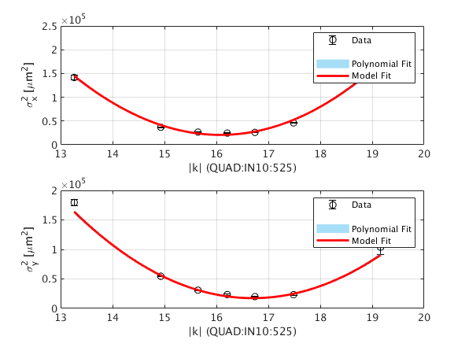
Beam Parameters into L1
GPT Tracking Simulations →
Challenges operating at φ_{s}=10⁰
Excessive energy spread seen (6X nominal @ 10⁰)
  Require TCAV0 to diagnose bunch length
No overhead in uv laser power
Expected bunch too short for optimal emittance & compression, need 7ps
Parameter | FACET-II TDR | Double-Pulse Option |  | Operation (typical) | Operation 8/21/2022
 |  | Driver Pulse | Witness Pulse | φ_{s}=30⁰ | φ_{s}=10⁰
Bunch Charge [nC] | 2.0 | 1.6 | 0.5 | 1.6 | 2.0
Transverse Emittance (90%) [μm-rad] | 3.0 | 3.1 | 2.3 | 4.5-5.5 | 4.9 x 5.2
Peak Current [A] | 290 | 270 | 180 | ? | ?
Bunch Length (rms) [μm] | 736 | 608 | 277 | ? | ?
Bunch separation [mm] | -- | 2.18

Slide 5
1) Single Bunch “Clean” (Low E-Spread) Design Configuration
E=6 MeV
E=125 MeV
E=335 MeV
E=4.5 GeV
E=10.0 GeV
Q = 0.6 – 2.0 nC
β∗ = <10 m
σ_{z} = 100 μm
δ_{E} < 0.1 %
I_{pk} = 2 kA
γε_{x} = 5 mm-mrad
RF Gun (φ_{s}=30º)
DL10
BC11
BC14
BC20
L0
Future Laser Heater
L1
L2
L3
R₅₆ = +7mm
S20 Exp. Region
φ = −16.5 deg
R₅₆ = -4.6mm
φ = −31.7 deg
R₅₆ = -3.6mm
φ = 0 deg
[-ve z = HEAD OF BUNCH]
Low-compression, low final E-spread, good emittance preservation configuration

Slide 6
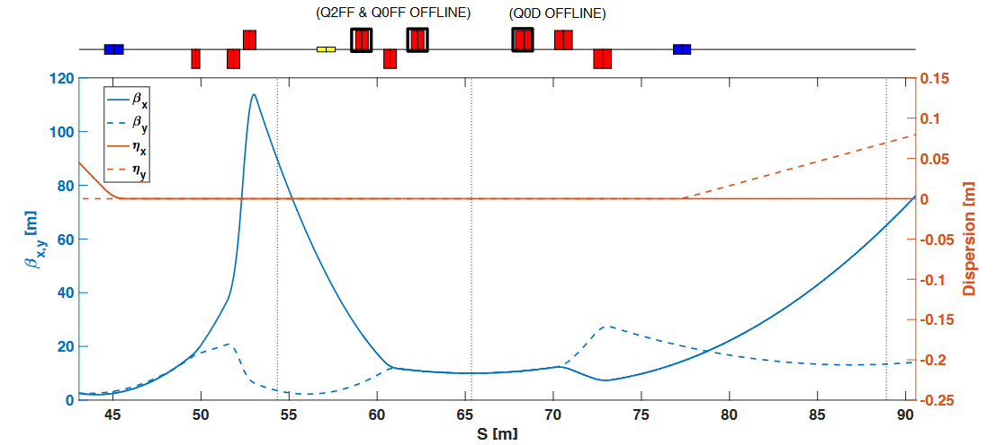
1) Sector 20 & Transverse Particle Tracking Results
BC20
FFS
SPECTROMETER
IP
Current FACET-II Sector 20 layout, matched for R56=+7mm, β*=50cm
3 families of sextupoles matched to minimize T566, & ε_{x}
FFS quads (5 families of magnet) matched for round beams at IP
R56 matching range = [-10:+10] mm
β* matching range > 5 cm
E320 Configuration with β*=10m
Sector 20 contains existing “W” chicane from FACET, new FFS & spectrometer magnets to handle round-beams

Slide 7
2) Single-Bunch Max-Compression Design Configuration
E=6 MeV
E=125 MeV
E=335 MeV
E=4.5 GeV
E=10.0 GeV
Q = 0.6 – 2.0 nC
β∗ > 5 cm
σ_{z} > 0.25 - 100 μm
δ_{E} = 0.1 – 1.4 %
I_{pk} = 10 – 300 kA
γε_{x} = 5−40 mm-mrad
RF Gun (φ_{s}=10º)
DL10
BC11
BC14
BC20
L0
L2 φ sets final compression
Future Laser Heater
L1
L2
L3
R₅₆ = +7mm
S20 Exp. Region
φ = −20.5 deg
R₅₆ = -4.6mm
φ = −39 deg
R₅₆ = -3.6mm
φ = 0 deg
[-ve z = HEAD OF BUNCH]
Over-compress bunch in BC14 for high-energy-spread, high-peak current requirements in S20

Slide 8
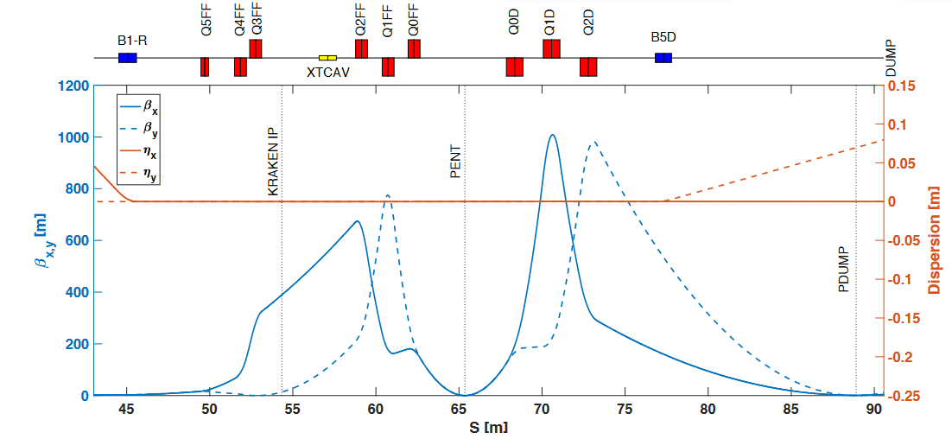
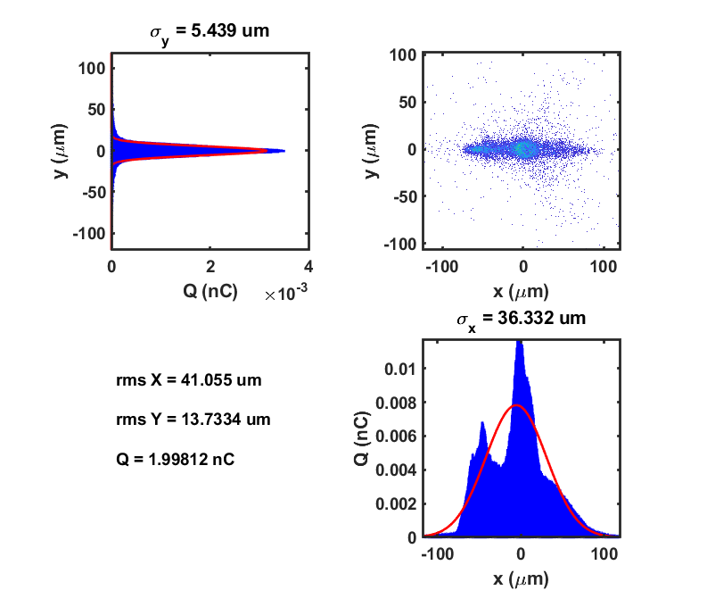
2) Transverse Particle Distribution @ IP (Max Compression)
β∗ = 5 cm
Horizontal emittance varies ~5-40 mm-mrad for bunch lengths 100 -> 0.25 um due to CSR effects in BC20
CSR generates longitudinal position-dependent kicks according to charge as beam traverses BC20
Bunch compression : bend-plane emittance growth tradeoff due to CSR effects
Communication with experimental groups to understand optimal configuration in each case

Slide 9
3) Two-Bunch Design Configuration
Drive bunch
Witness bunch
E=6 MeV
E=125 MeV
E=335 MeV
E=4.5 GeV
E=10.0 GeV
Q = 1.4 nC
β∗ = 5 cm
σ_{z} = 11 μm
δ_{E} = 0.8 %
I_{pk} = 16 kA
γε_{x} = 75 mm-mrad
Q = 0.5 nC
β∗ =5 cm
σ_{z} = 7 μm
δ_{E} = 0.2 %
I_{pk} = 8 kA
γε_{x} = 5 mm-mrad
RF Gun (φ_{s}=10º)
DL10
BC11
BC14
BC20
L0
Future Laser Heater
L1
L2
L3
R₅₆ = +7mm
S20 Exp. Region
φ = −19 deg
R₅₆ = -4.6mm
φ = −37 deg
R₅₆ = -3.6mm
φ = −45 deg
[-ve z = HEAD OF BUNCH]
Double-pulsed laser on RF Gun generates drive+witness pulse with 3:1 charge ratio, 2:1 I_{pk}

Slide 10
3) Two-Bunch Particle Distributions @ IP
Drive
Bunch
γε = 73 x 35 μm-rad
Δt = 600 fs
β∗ longitudinal waist offset
due to energy difference
ΔW_{x,y} = 22.8, 17.3 cm
Can make use of BC20 “notch” collimator to help separate bunches
150 MeV energy difference between drive & witness generates different beam dynamics
Trade-offs exist e.g. bunch spacing vs. transverse quality: iterating with experimental groups to optimize
Witness
Bunch
γε = 4.5 x 2.6 μm-rad
High-quality witness bunch generated, driven by higher charge drive beam at requisite longitudinal spacing

Slide 11
Alternate 2-Bunch Setup using BC20 Notch & Jaw Collimators
BC20
FFS
SPECTROMETER
σ_{δ} / σ_{β} ~ 30 / % (γε=10μm-rad)
IP
CN2069 & CX2085
Whilst we commission double-bunch injector setup, use tested notched 2-bunch setup from FACET-I experience
Compared with FACET-I, smaller head-tail energy spread: re-configure for larger R56 in BC20
  Optics re-matched for R56=+10 mm
  Adjust L1 & L2 rf phases to fine-tune 2-bunch results
Use notch & jaw collimators as indicated to generate 2-bunch profile
Option to use FACET-I mechanism for 2-bunch operations with modifications to BC20 optics

Slide 12
Alternate 2-bunch Configuration Particle Tracking
Δx=0.65mm
Δx=1.1mm
Δx @ CN2069
Δx=1.1mm
Drive
Bunch
Witness
Bunch
Δt = 500 fs , I_{pk} ~5/15 kA, Q ~330/820 pC
Φ(L1) = -19.8 deg ; Φ(L2) = -39.8 deg
Can trade: >I_{pk} for < Δt by adjusting Φ (L1&L2)
Notched configuration enables quick start of PWFA 2–bunch experiments ahead of double-pulsed injector configuration which will bring improved beam quality at a later date

Slide 13
Laser Heater
Laser heater used to increase incoherent energy spread in injector
Consider 0->500 keV heating
Enables orthogonal control of final energy spread
  Minimizes accelerator tuning for different final bunch lengths
Provides trade-off between final peak current and horizontal emittance
Final beam profiles become more Gaussian
Suppresses micro-bunching and coherent emission by putting a cap on max peak current possible
Injector laser heater can be used for bunch length control and μ-bunching suppression

Slide 14
BC20 Chicane Upgrade
New BC20E layout, re-using subset of existing magnets
  uses reduced magnet count => easier operations
  lower chromatic aberrations, better beam quality / lower losses @ high energy spread
  compression range R56 = 0 -> 5mm
  OK for FACET-II parameters
  NB: no 2-bunch notch operation option
  3.5m shorter z length -> more FFS space
 | W-Chicane | New BC20E
R56 | -10 - +10 mm | 0 - +5 mm
Magnet count | 18 quads 6 bends 6 sextupoles | 9 quads 4 bends 4 sextupoles
z length | 49.1 m | 45.6 m
β(max) @ R56=5mm | 190 m | 100 m
ε_{x} @ δ_{E} = 1.2 % Sextupoles OFF Sextupoles Opt. | 400 um-rad 15 um-rad | 60 um-rad 15 um-rad
New BC20 expected to ease operational complexity and provide more space for upstream S20 experiments

Slide 15
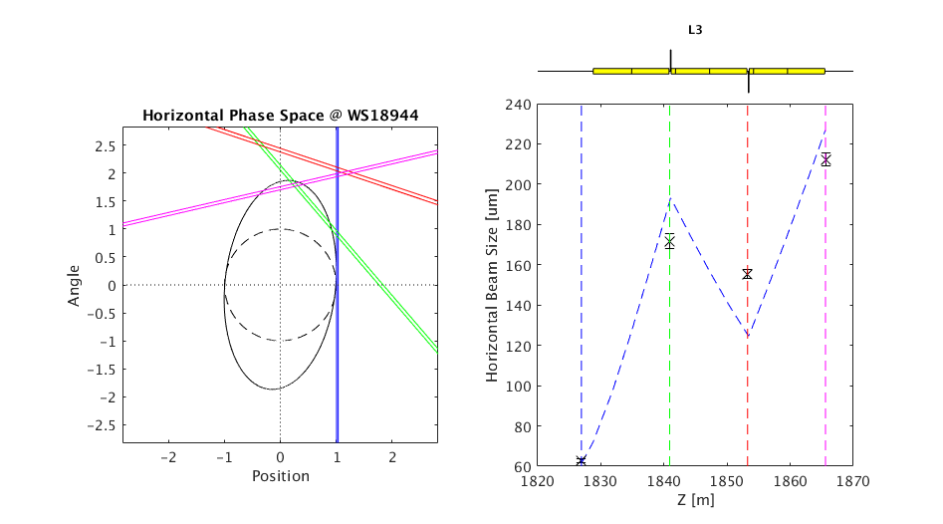
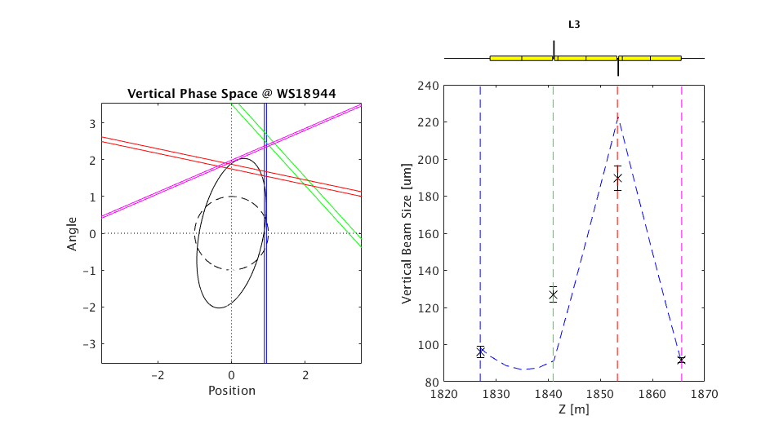
Linac Operational Measurements
Measurements taken 8/7/2022
  Multi-wire (4 wirescanners)
L2 (LI11/12)
  γε_{x} = 8.2 μm-rad, BMAG = 1.1
  γε_{x} = 4.5 μm-rad, BMAG = 1.9
L3 (LI18/19)
  γε_{x} = 12.6 μm-rad, BMAG = 1.2
  γε_{x} = 8.8 μm-rad, BMAG = 1.4
Operational issues affecting emittance & stability
  Fast orbit excursions during wirescans
    Improvements to control system links to SCP over downtime
    to enable jitter-subtraction
  Extreme sensitivity to orbit in L1 / beginning of L2
    MD studies scheduled to further investigate
  Diurnal variation in klystron phases (see next slide)

Slide 16
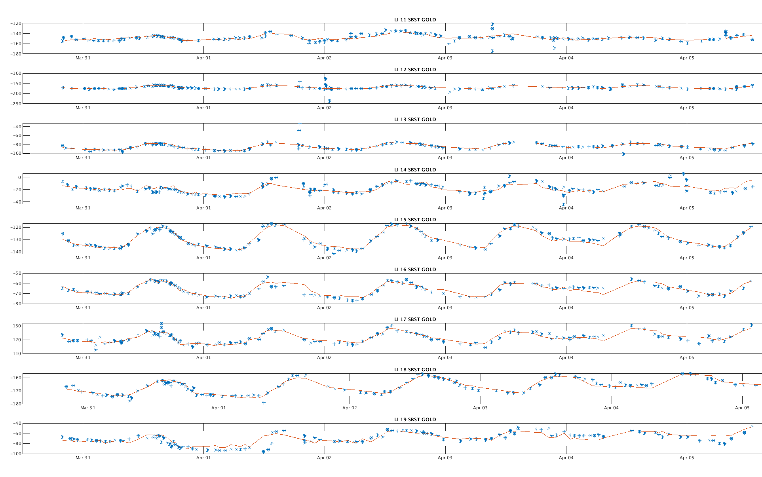
Klystron Sub-Booster Phase feedback (MDL compensation)
Compensate for temp & pressure changes affecting main drive line RF distribution
Blue= phase scan measurements
Red= NN feedforward model
Operationally, still see 10’s degree phase jumps
  Investigations ongoing…
Feedback OFF
Feedback ON
r.m.s. 14°
r.m.s. 5°

Slide 17
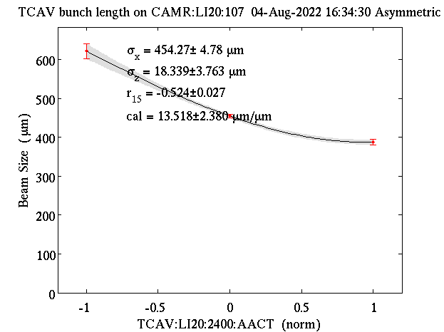
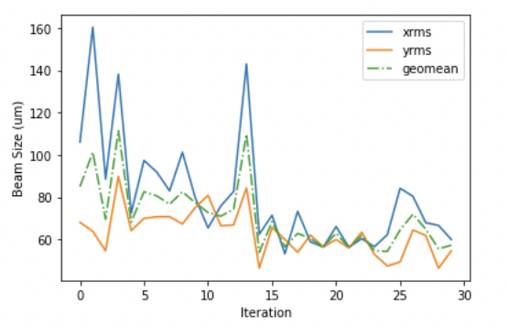
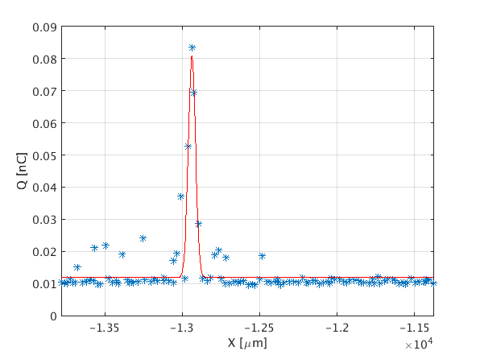
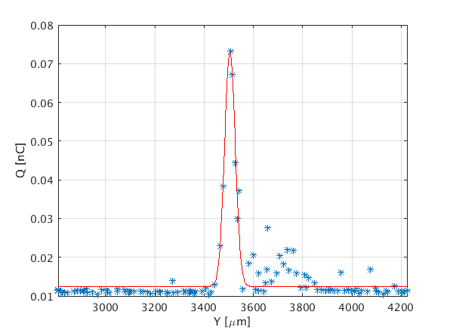
Sector 20 Operational Measurements
Measurements taken 8/7/2022 (wirescanner), 8/4/2022 (XTCAV)
Wire-scanner measurements (IPWS1)
with β*= 0.5 m
  σ_{x}* = 23.2 μm
  σ_{y}* = 21.5 μm
  σ_{z} = 18.3 μm
wires started breaking after this date
  ongoing problem
  due to high charge density
Similar sensitivity to dispersion leakage
seen in FACET & controllability issues
First checkout of “ML tuning”
  Bayesian optimization tool applied to
  Sextupole mover system for S1 & S2
  sextupoles (L & R)

Slide 18
Summary
3 primary accelerator configurations
  3-stage Linac compression with variable 3rd stage compression & real-time configurable FFS
    Low Espread, high beam quality
    Single pulse, high-compression (tunable)
    Double-pulse for drive-witness bunch configuration used by plasma acceleration programs
      Either double-pulsed from RF gun or “notched” using BC20 collimators
  Performance assessed using start-to-end tracking simulations
Operational measurements in first run
  Delivered normalized emittance into S20 < 20 μm-rad @ 1.6 nC
  Transverse bunch size ~20 x 20 μm in S20 with σ_{z}<20 μm
  Work required on stability and repeatability
Upgrades considered for improved performance
  Laser heater chicane in injector for bunch length control and μ-bunching suppression
  BC20 upgrade using fewer quadrupole and bending magnets for easier operational management

Slide 19
Questions?

